Slide 1
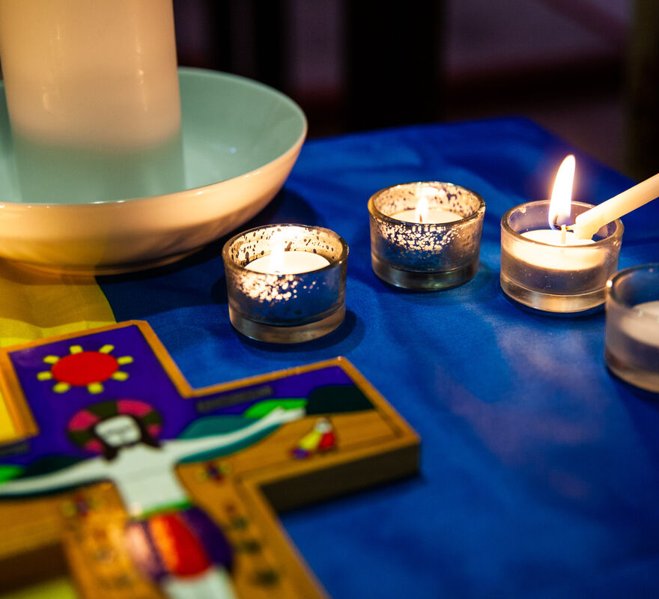
What will you do to share the light of God's love for us all?
Gospel Celebration of the Word
Notes:
Children’s liturgy: Third Sunday in Ordinary Time (Year A)
Preparation of the worship space
Colour: green
Props: white and yellow paper for making paper candles
Song suggestions
Christ be our light (883, Laudate) Walk in the light (771, Laudate)
Welcome
Today we are going to be talking about light. We are going to think about how we can share light with others.
All Saints school, Sheffield
Photo credit: Thom Flint

Slide 2
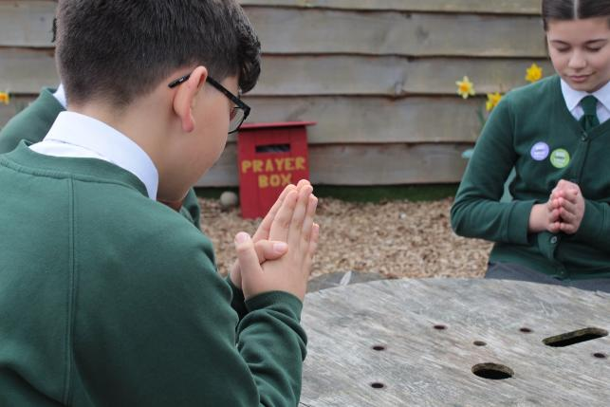

God of light,
Shine in our hearts so that we can share joy and hope with other people, especially those who are frightened, sick, lonely or hungry.
Amen.
  Gather
Notes:
St Francis Xavier's RC Primary School, Herefordshire
Photo credit: Vicky Ahmed

Slide 3

Gospel: Matthew 4: 12-17
When Jesus heard that John had been put in prison, he went away to Galilee. He did not stay in Nazareth, but went to live in Capernaum, a town by Lake Galilee, in the territory of Zebulun and Naphtali. This was done to make what the prophet Isaiah had said come true:
“Land of Zebulun and land of Naphtali,
on the road to the sea; on the other side of the Jordan,
Galilee, land of the Gentiles!
The people who live in darkness will see a great light.
On those who live in the dark land of death
the light will shine.”
From that time Jesus began to preach his message: “Turn away
from your sins, because the Kingdom of heaven is near.”
Word

Slide 4


What do you remember from the Gospel reading?
It talks about people who lived in darkness seeing a great light.
Who do you think the people living in darkness were?
Where do you think the light came from?
Respond
Notes:
Light in the darkness
Photo credit: RD Smith on Unsplash

Slide 5
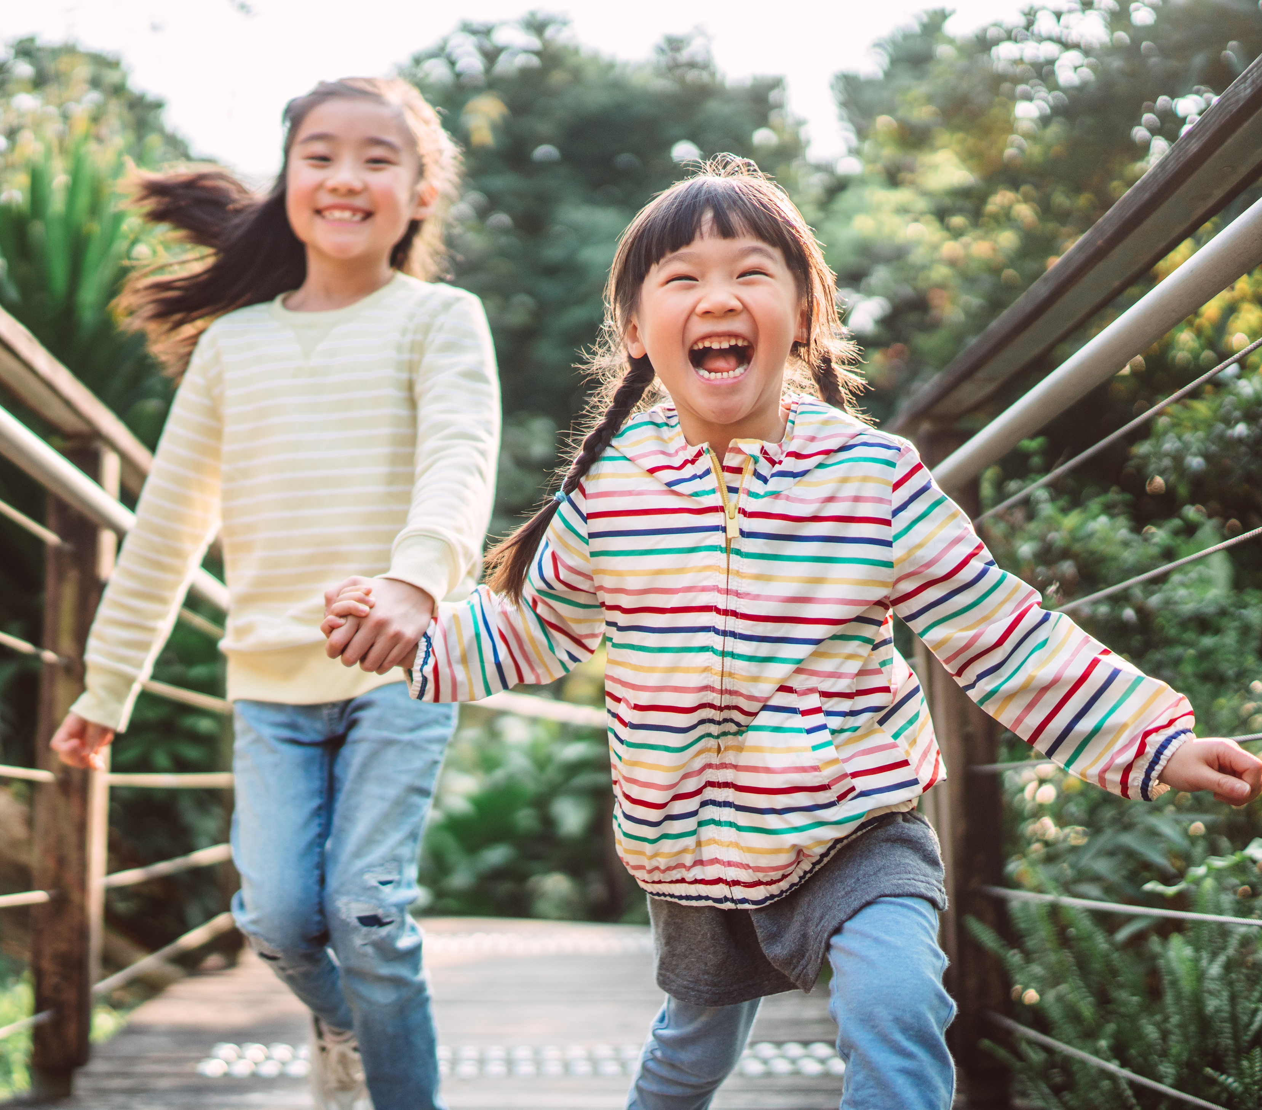
One way of thinking about this is that when we are sad or lonely, everything feels dark and gloomy. This is the dark.
But then when someone does something nice for us, like including us in their game, or making us laugh, everything seems brighter again. This is the light.
This is the light that Jesus brings into the world. It is the light of God’s love for each one of us.
Notes:
Playing together
Photo credit: Stock image

Slide 6
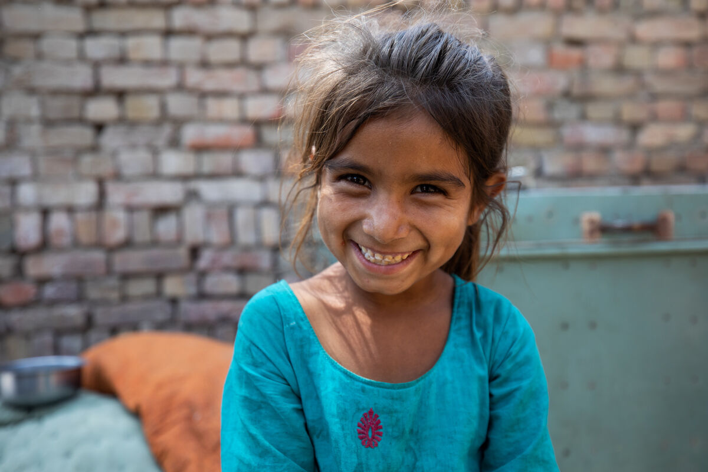
Can you think of a time when someone did something that helped to light up your world and make you smile?
What did they do?
Ayra in Pakistan with a smile of welcome
Notes:
Ayra, Pakistan
Photo credit: Khaula Jamil/ CWSA

Slide 7
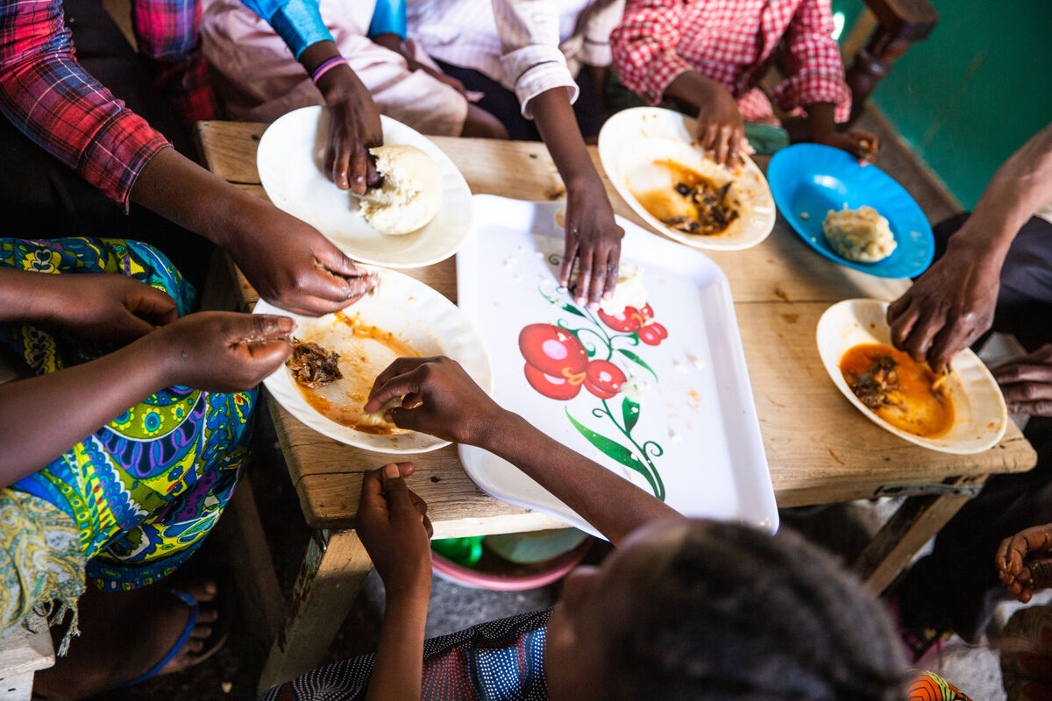
We can try to share this light by loving our neighbours, near and far.
We can do this by helping to make the world a fairer place so that every person has what they need to live a healthy and happy life.
Because we know that at the moment some people in our world do not have enough food to eat, safe houses to live in or enough water to drink.
Marie-Claire and her family share a meal, DRC
Notes:
Marie-Claire and her family share a meal, DRC
Photo credit: Thom Flint

Slide 8

And we know that this is not what God wants for his children.
We all live in one world, with the same sun shining down on us.
We are all God’s children and belong to one global family.
Jesus asks us to care for one another. By doing this we can help the light of Jesus to shine in the world.
Notes:
The sun in the sky
Photo credit: Rajiv Bajaj on Unsplash

Slide 9
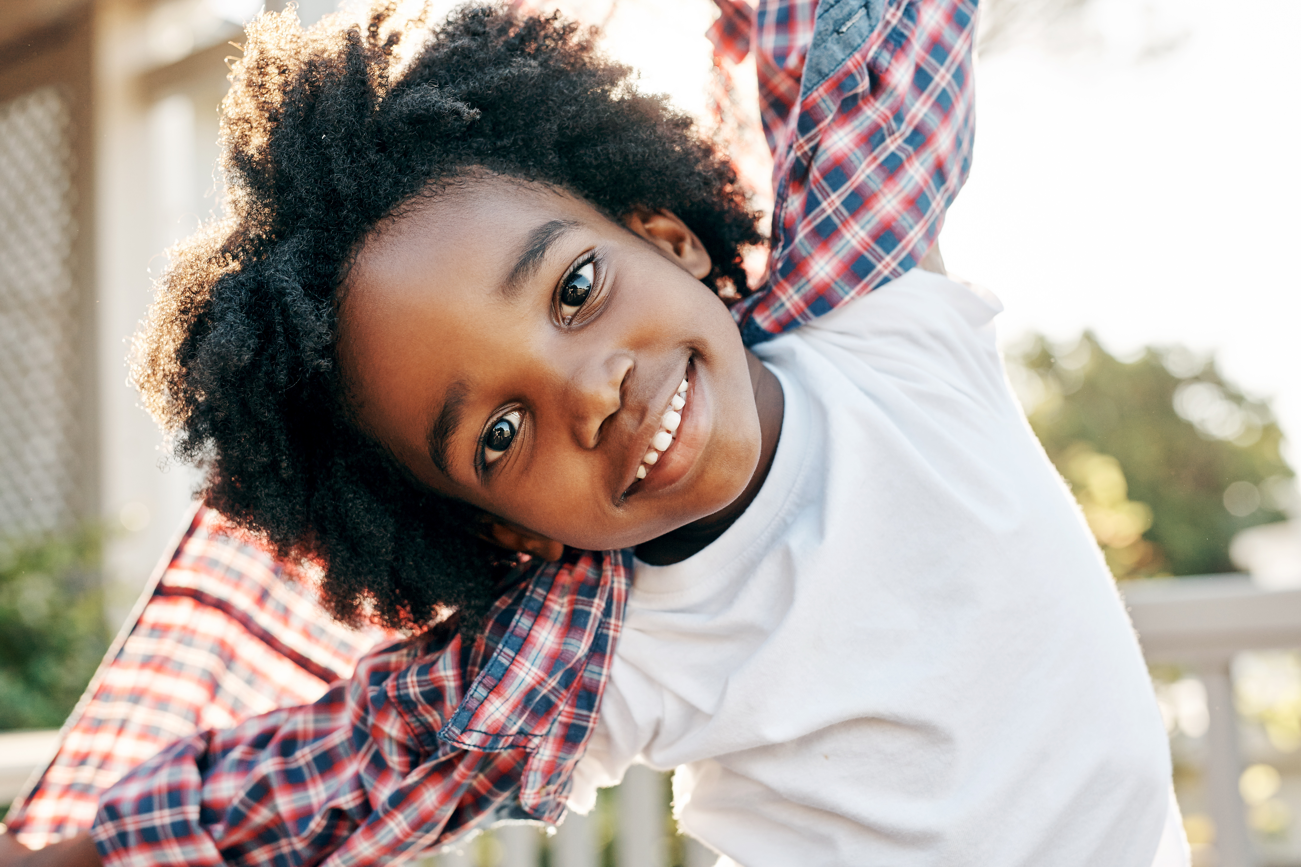
There are many things we can do to share light all around us. There are many ways we can try to make the world a better place.
We can be kind to others. We can look out for others who may be feeling sad or lonely. We can help with jobs at home.
And we all know that a smile costs nothing and can make anyone's day!
Notes:
Smiling child
Photo credit: Stock images

Slide 10
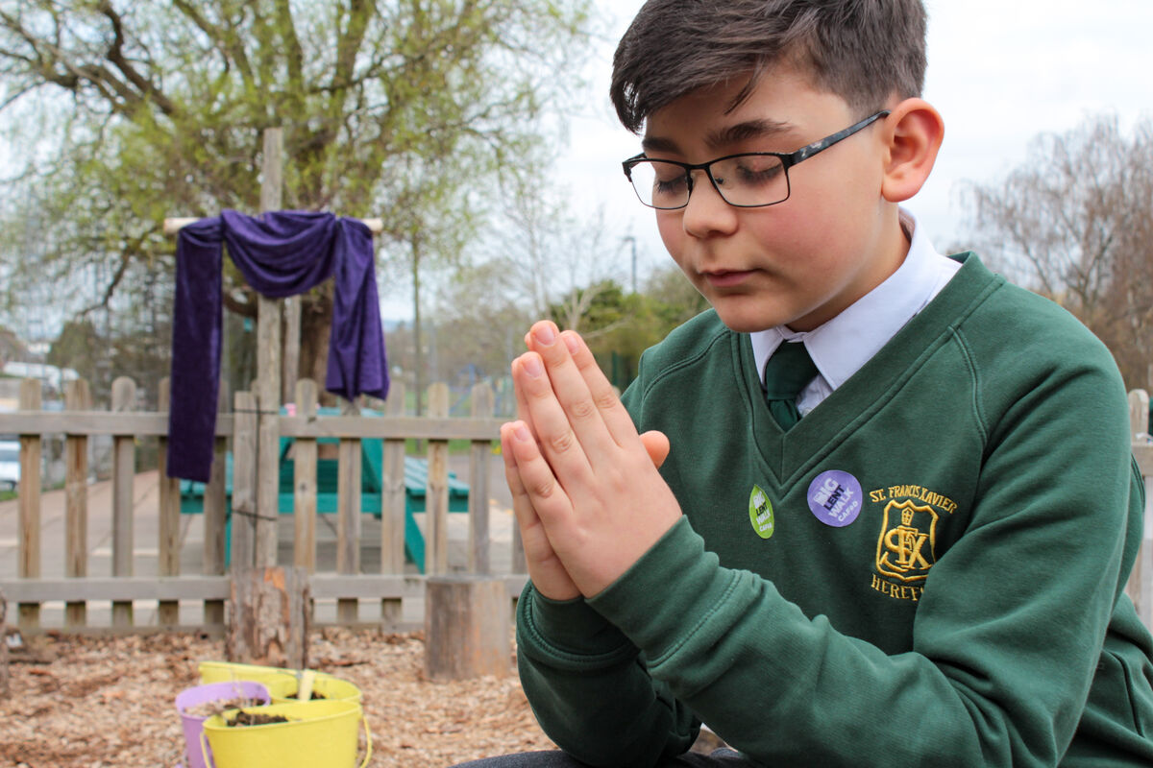
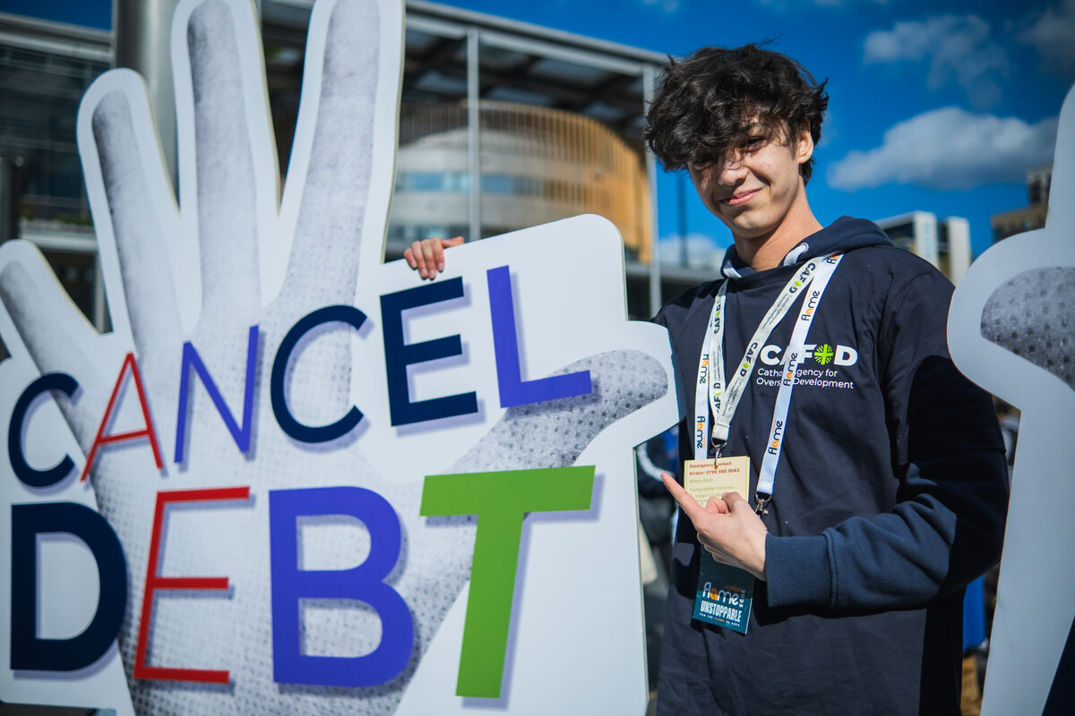
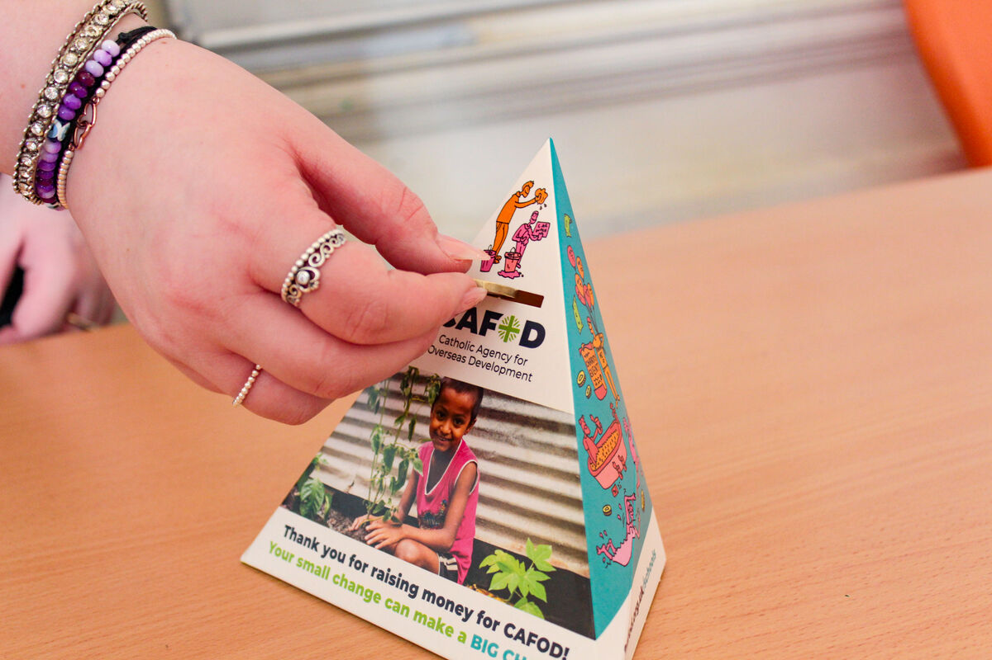
We can remember our brothers and sisters living in poverty around the world in our prayers.
We can stand in solidarity with them by speaking out against unfair situations.
We can raise money for CAFOD to help our global family in need have enough food to eat, clean water to drink and the things they need for a happy life.
And that would bring a smile to all of our faces!
Notes:
Praying, St Mary's RC school, Herefordshire
Photo credit: Victoria Ahmed
Kieran at Flame 2025
Photo credit: Amit Rudro
Cake sale, St Mary's RC school, Herefordshire
Photo credit: Victoria Ahmed

Slide 11
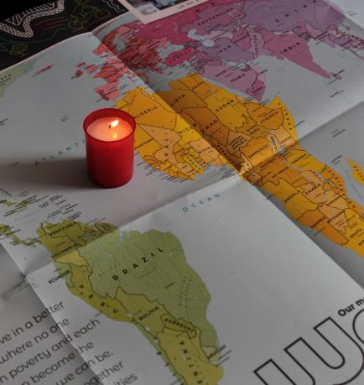
Let us pray
We pray for all people who are poor:
that they may hold onto the hope for a better future and find the support they need from others, as they work to build a better world.
Lord in your mercy…
We pray for our parish, families and friends:
that we may know the light of Christ and share that light with all we meet.
Lord in your mercy...

Slide 12
Let us pray
We pray for the church in the world:
that as it spreads the message of Jesus, Light of the World, it may work to share comfort and hope with those in need.
Lord in your mercy…
God of hope, share your light with all your children: help us to work together to help those among us who are in need.
Amen.

Slide 13
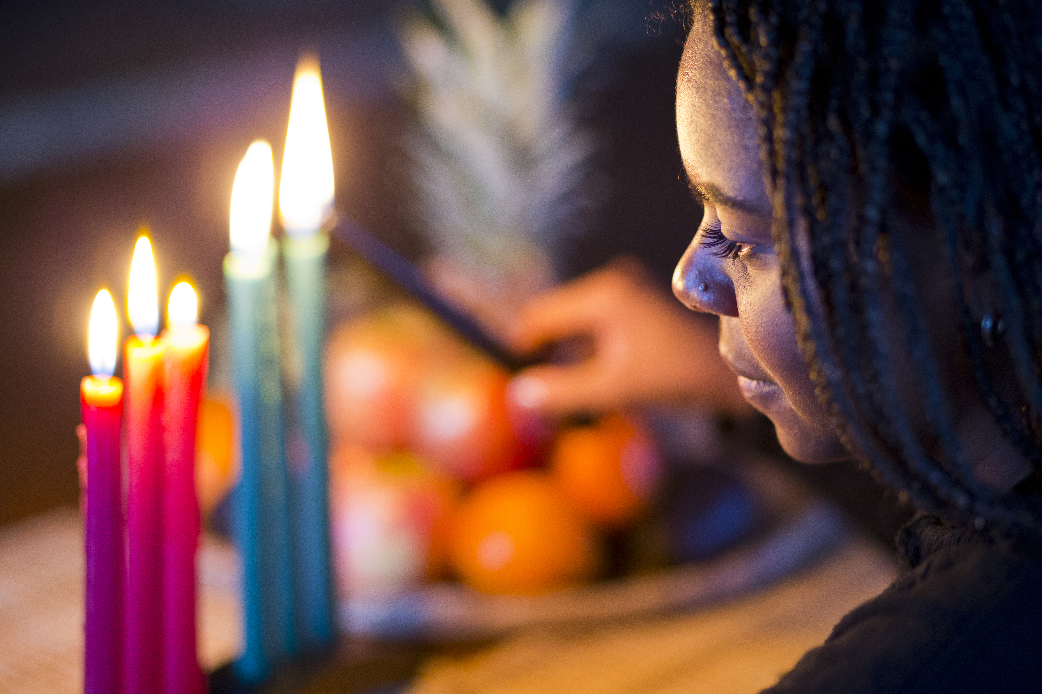

What will you do this week to share the light of God's love for us all?
Send
Notes:
Lighting candles
Photo credit: Stock image

Slide 14
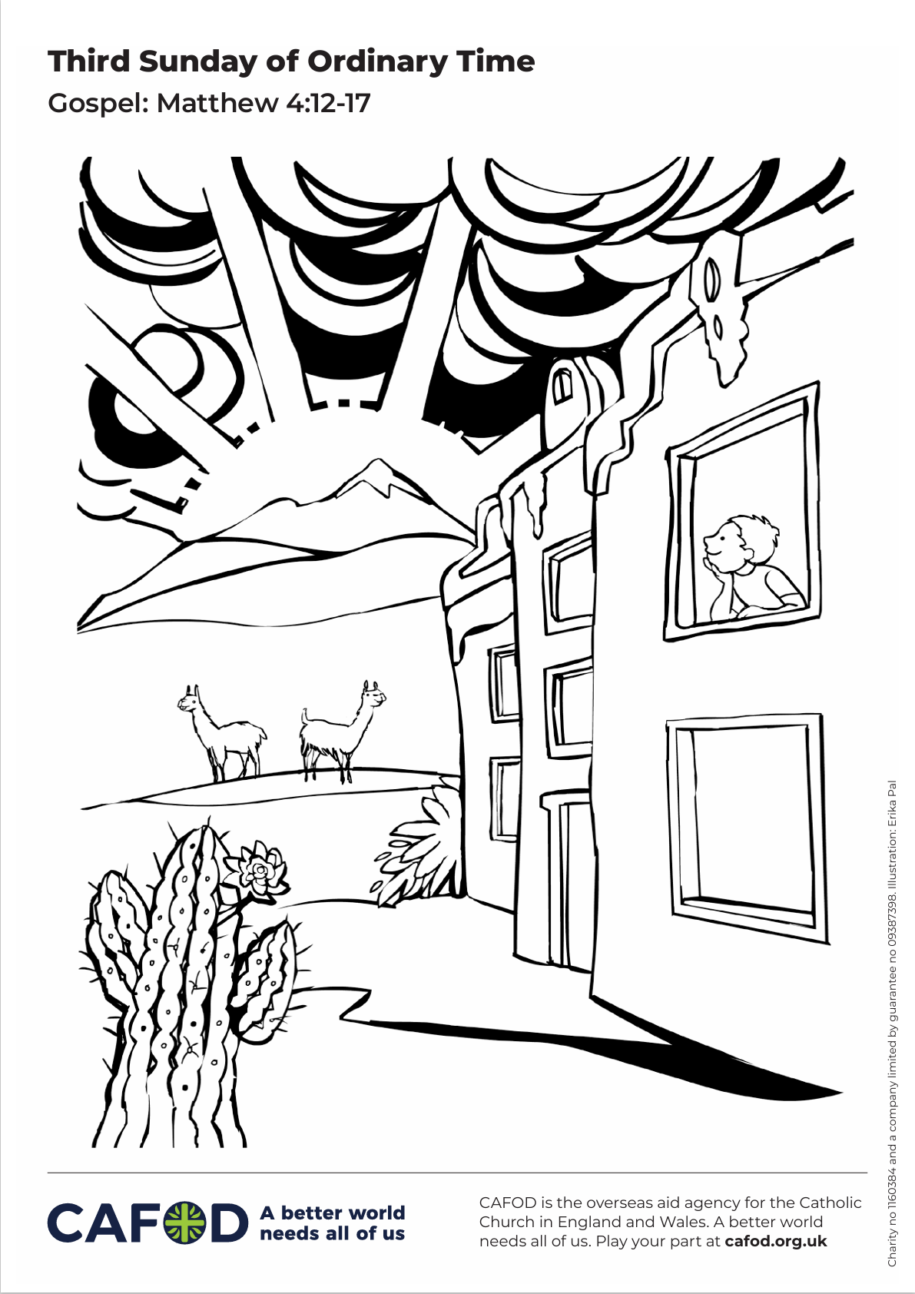
Activity suggestions
Download the illustration
Discuss the accompanying illustration with the children. The boy in the picture lives in South America. The houses are a little bit different from those in England and Wales, the plants and animals are a bit different too. It is the same sun that he is watching rise though. Invite the children to colour in the picture and to write in the sun what they will do this week to share the light of Jesus with others.
Encourage the children to write a short prayer for their brothers and sisters around the world on a piece of paper (landscape A4). Roll the paper up, tape it, and stick a yellow flame-shaped piece of paper to the top to make a candle. They could carry the paper candle out into Mass to show the light of Christ that they are going to spread in the world this week.
Notes:
Illustration: Erika Pal

Slide 15
Remind the children to share all that they have heard and thought about today with the people at home. If they have written a prayer, encourage them to say it together at home during the week.
Remind them to love their neighbours during the week, to care for others and by doing so, to share the light of God’s love for us all with one another.

Slide 16
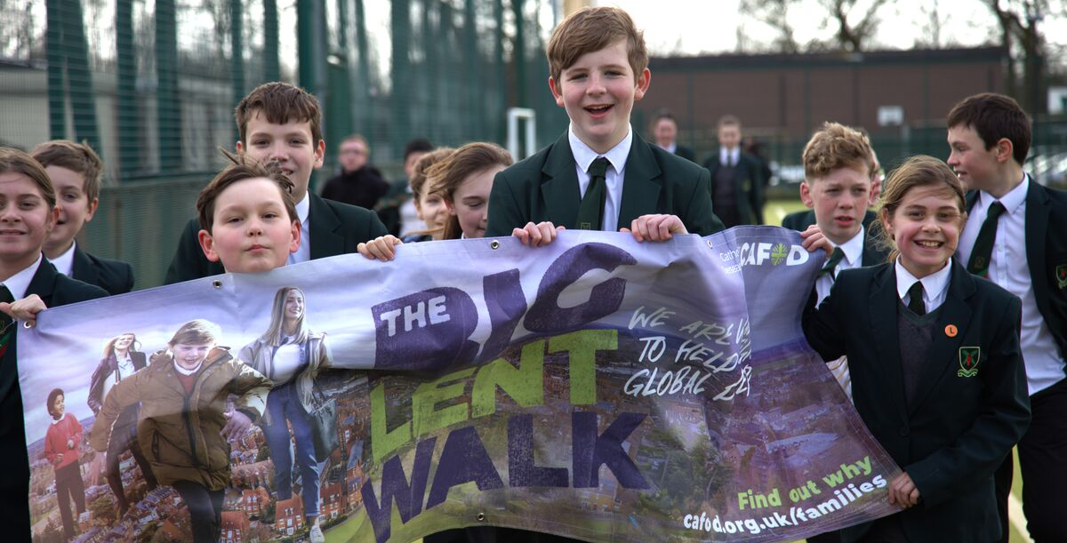
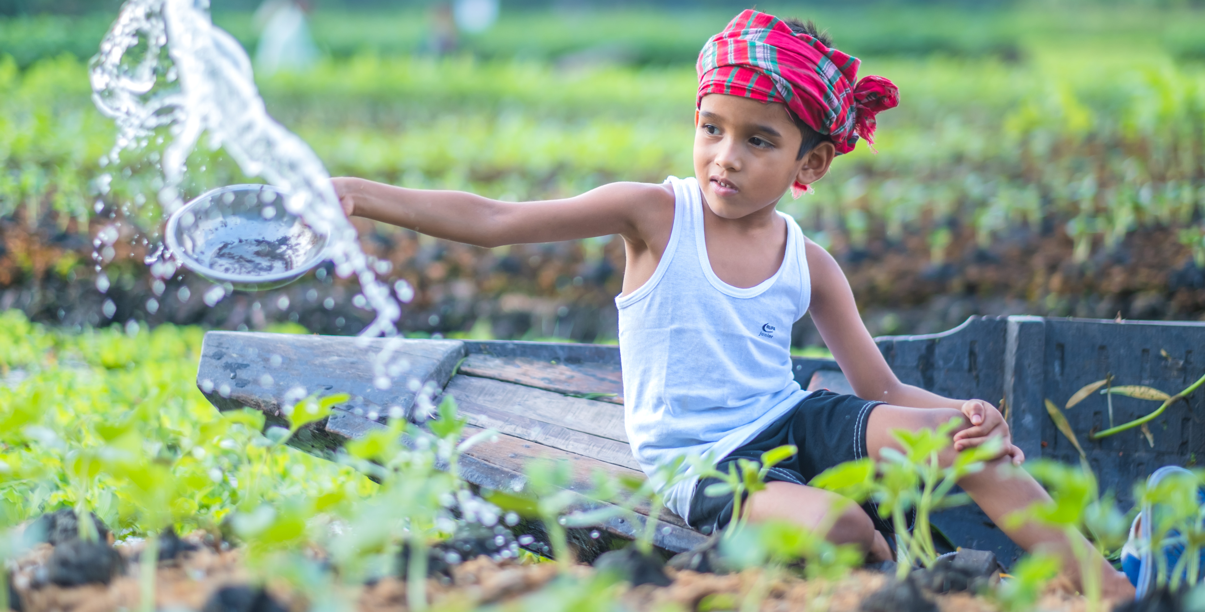
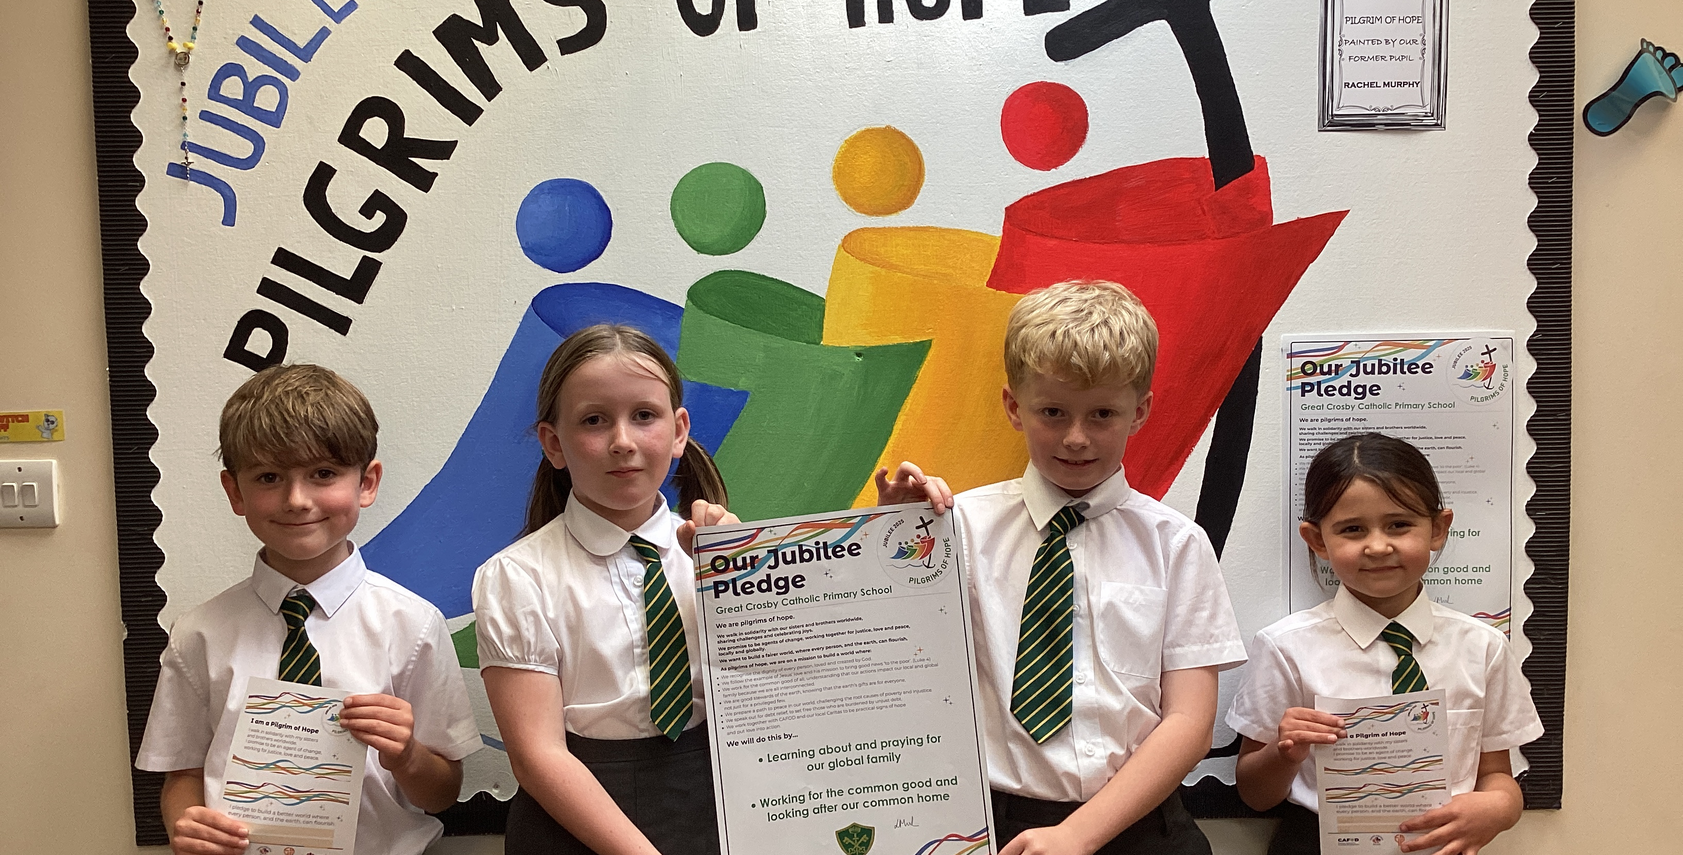
Get involved with CAFOD this term
Big Lent Walk resources
Save the date!
Jubilee Pledge resources
Join us on the Big Lent Walk!
Join our national assembly
It's not too late to make a Jubilee Pledge!

Slide 17


