Slide 1
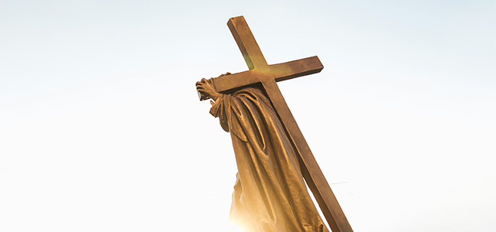

Stations
of the
Cross
A prayerful journey of transformation
Notes:
Photo credit: Алексей Вечерин from Pexels

Slide 2
Let us pray together
for God to transform our lives
and the lives of others.
Notes:
Opening reflection
Leader: In the Name of the Father, and of the Son, and of the Holy Spirit.
All: Amen.
Leader: As we reflect on the final journey of Jesus, leading to his death on the cross, we do so in solidarity with all those, here at home and across the world, who are suffering today.
Let us pray together for God to transform our lives and the lives of others:
God of mercy,
we gather as disciples,
seeking to follow Christ,
on the costly path to Calvary.
As we walk the Way of the Cross,
open our eyes to see the face of Jesus
in the faces of people in every kind of need
and sustain in us the commitment
to build a better world where all can flourish.
Amen.

Slide 3
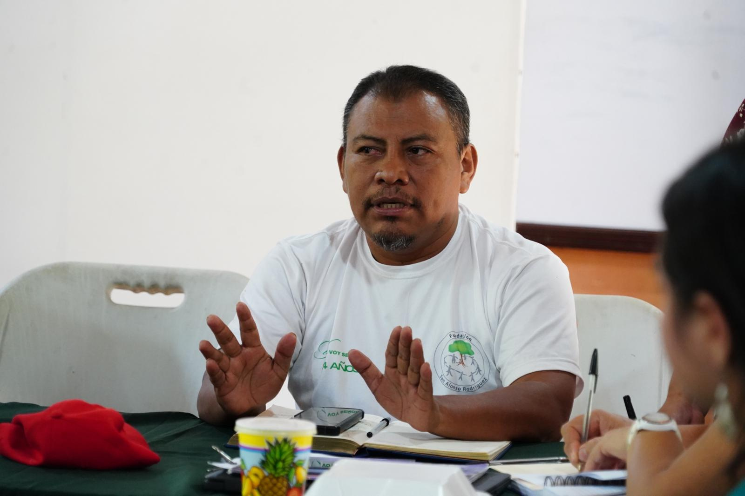
The first station:
Jesus is condemned to death
“he delivered him to be crucified.”
Mark 15:15
Notes:
The first Station: Jesus is condemned to death
Reader: “And Pilate said to them, “Why? What evil has he done?” But they shouted all the more, “Crucify him.” So Pilate, wishing to satisfy the crowd, released for them Barabbas, and having scourged Jesus, he delivered him to be crucified.” Mark 15:14-15
Leader: We adore you, O Christ, and we praise you,
All: because by your Holy Cross you have redeemed the world.
Challenging injustice can be costly today, just as it was for Jesus.
On 14 September 2024, Honduran community leader and activist Juan Lopez was shot dead by several men as he travelled home from church. For over a decade he had been working to protect the Guapinol river from further contamination by a giant mining project.
The gospel is a disruptive force; it points toward a kingdom of justice and peace that necessarily unsettles the status quo. While Jesus’ message is hope for the vulnerable and marginalised, it is a provocation to those who hold onto oppressive systems.
As followers of Christ, we are entrusted with continuing his mission of liberation and healing. We pray for the strength to live the radical way of the gospel and to speak courageously for what is right, even when it is difficult,
Prayer:
Christ Jesus,
you remained faithful,
in the face of injustice and violence.
Give us the courage and commitment
to live with generosity and justice,
to speak out for peace and love

Slide 4
The first station:
Jesus is condemned to death
We adore you, O Christ, and we praise you,
R/ because by your Holy Cross you have redeemed the world.
Prayer:
Christ Jesus,
you remained faithful,
in the face of injustice and violence.
Give us the courage and commitment
to live with generosity and justice,
to speak out for peace and love
and stand in solidarity with our neighbours.
Amen.
Notes:
Image: Juan Lopez, an anti-mining activist in Honduras.
Photo credit: Radio Progreso

Slide 5
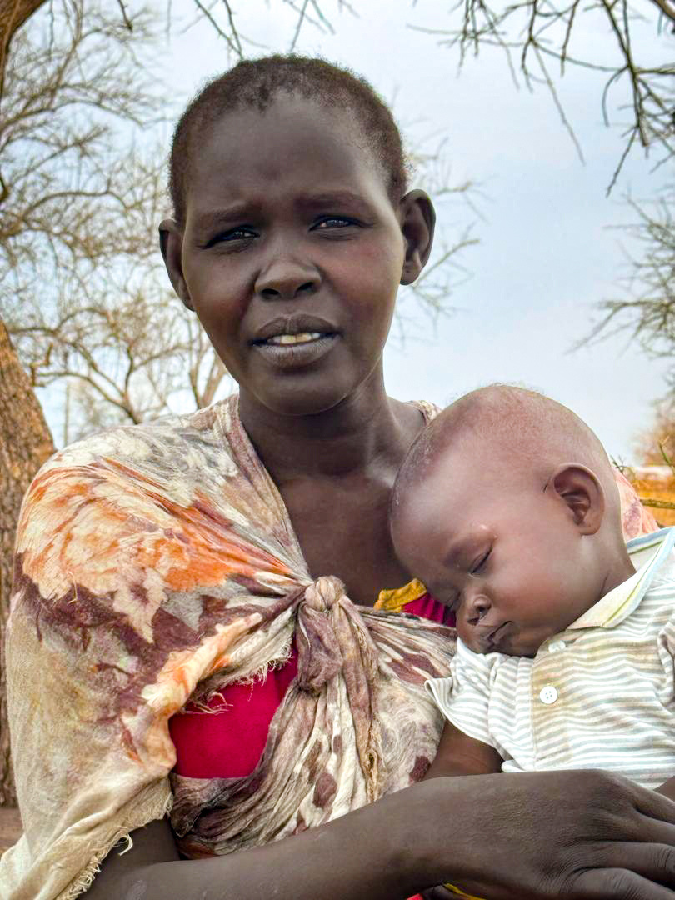
The second station:
Jesus carries his cross
“So they took Jesus, and he went out,
bearing his own cross.”
John 19: 16b-17
Notes:
The second Station: Jesus carries his cross
Reader: “So they took Jesus, and he went out, bearing his own cross, to the place called The Place of a Skull, which in Aramaic is called Golgotha.” John 19:16b-17
Leader: We adore you, O Christ, and we praise you,
All: because by your Holy Cross you have redeemed the world.
Jesus begins his walk, forced to carry the heavy wooden cross, on the road that leads to the hill where he will be crucified.
Across the world, many of our sisters and brothers are on difficult journeys. More than 100 million people are displaced due to conflict, persecution and disasters.
Sarah is one of 15 million people who have been displaced due to the civil war in Sudan. When fighting broke out in her hometown she and her child were forced to flee to another part of Sudan. Sarah left behind her neighbours, her business, her home – everything she knew.
Refugee camps in the area are past capacity, with many families vulnerable to the spread of diseases and unable to feed their children dinner every night
We pray for the grace to walk alongside refugees, migrants and all those making challenging journeys.
Prayer:
Faithful Jesus,
you carried the wood of the cross
with courage and love.
May we walk alongside
our neighbours seeking sanctuary
seeking to build a world where all people
are loved, welcomed and safe.
Amen.

Slide 6
The second station:
Jesus carries his cross
We adore you, O Christ, and we praise you,
R/ because by your Holy Cross you have redeemed the world.
Prayer:
Faithful Jesus,
you carried the wood of the cross
with courage and love.
May we walk alongside
our neighbours seeking sanctuary
seeking to build a world where all people
are loved, welcomed and safe.
Amen.
Notes:
Image: Sarah
Credit: Africa Development Aid

Slide 7
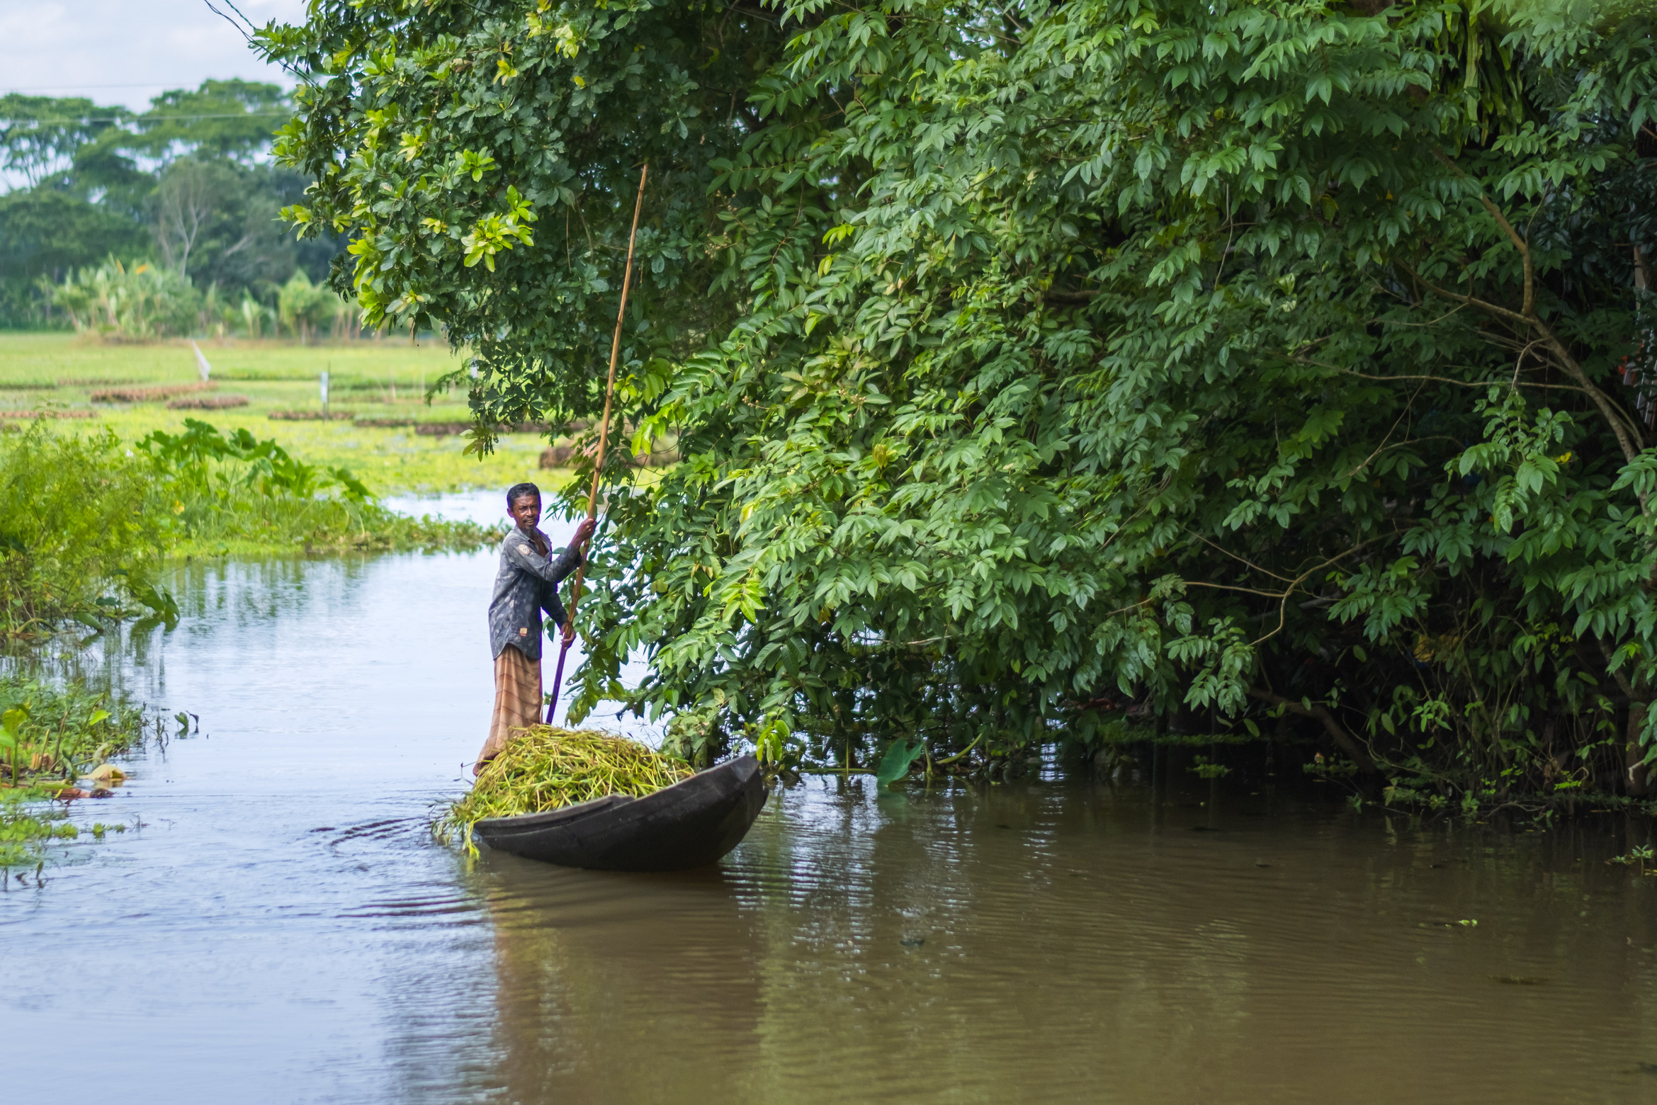
The third station:
Jesus falls for the first time
“Blessed is the man who remains steadfast under trial…”
James 1:12
Notes:
The third Station: Jesus falls for the first time
Reader: “Blessed is the man who remains steadfast under trial, for when he has stood the test he will receive the crown of life, which God has promised to those who love him.” James 1:12
Leader: We adore you, O Christ, and we praise you,
All: because by your Holy Cross you have redeemed the world.
Burdened by his heavy cross, worn down by fatigue and pain, Jesus falls. Yet he pushes himself up and continues on.
Obayedul, a farmer in Bangladesh, recalls how difficult things were after particularly severe flooding. The water rose so high that he had to climb on the tin roof of the house and for some time the family had no food at all. Even when the waters subsided, the waterlogged land made it hard for him to grow anything for them to eat.
Now, things look very different. Obayedul has received training in floating plant beds, in which food can be cultivated regardless of rising water levels. His crops are thriving, and he shares the skills he has learned with others in the village, helping the whole community.
We pray for all those in the front line of the climate crisis who continue to persevere in the face of adversity. We pray for strength and determination when we face challenges.
Prayer:
Resolute Jesus,
you fell under the weight of the wood
yet did not abandon the journey.
Be with us when we are struggling,
and help us persevere in love.
Amen.

Slide 8
The third station:
Jesus falls for the first time
We adore you, O Christ, and we praise you,
R/ because by your Holy Cross you have redeemed the world.
Prayer:
Resolute Jesus,
you fell under the weight of the wood
yet did not abandon the journey.
Be with us when we are struggling,
and help us persevere in love.
Amen
Notes:
Obayedul Molla on his boat
Credit: Amit Rudro

Slide 9
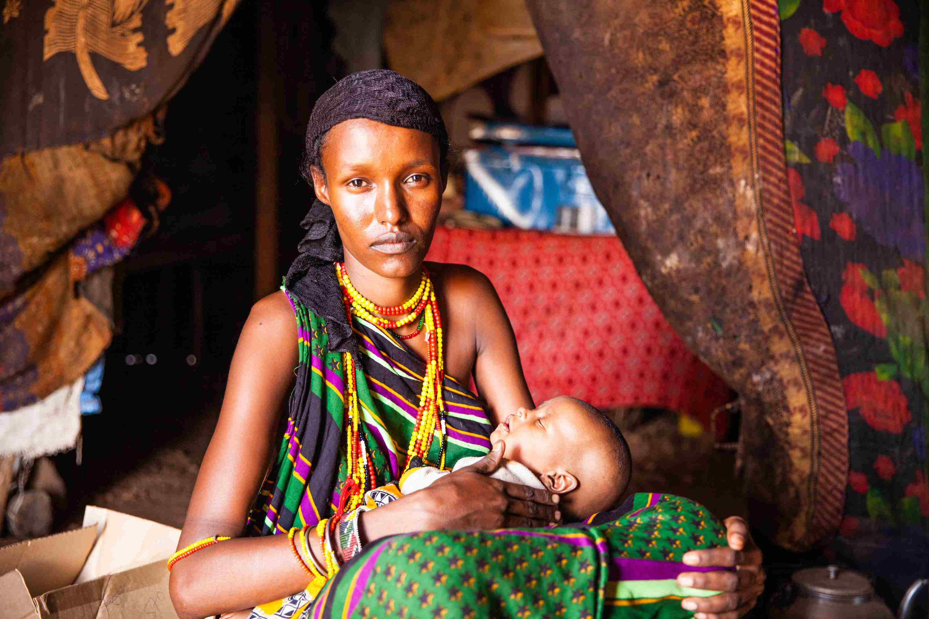
The fourth station:
Jesus meets his mother
“And a sword will pierce your own soul too…”
Luke 2:35
Notes:
The fourth Station: Jesus meets his mother
Reader: “Then Simeon blessed them and said to Mary his mother, “Behold, this child is appointed for the fall and rising of many in Israel, and for a sign that is opposed (and a sword will pierce through your own soul also), so that thoughts from many hearts may be revealed.” Luke 2:33-35
Leader: We adore you, O Christ, and we praise you,
All: because by your Holy Cross you have redeemed the world.
This was the fulfilment of Simeon’s prophecy, the sword that ran through Mary’s soul. She who nurtured Jesus as a baby, witnessed his first steps and words, now meets her son on this final journey. What pain Mary must have felt, unable to reach out to help or comfort Jesus. Yet she remains present and steadfast.
So many mothers throughout the world grieve, as they struggle to feed their hungry children or access vital medicines and healthcare.
“It’s very distressing to be unable to feed your children,” says Talaso from drought-stricken Marsabit in Keyna. “As a mother, that’s the most distressing thing of all.”
Let us look to the example of Mary and not turn our faces away from those who are suffering.
Prayer:
Compassionate Jesus,
you gave us your mother
and entrusted us to her care.
May we stand with those who suffer
offering comfort and assistance.
Amen.

Slide 10
The fourth station:
Jesus meets his mother
We adore you, O Christ, and we praise you,
R/ because by your Holy Cross you have redeemed the world.
Prayer:
Compassionate Jesus,
you gave us your mother
and entrusted us to her care.
May we stand with those who suffer
offering comfort and assistance.
Amen.
Notes:
Image: Talaso in Marsabit, Kenya
Credit: Thom Flint

Slide 11
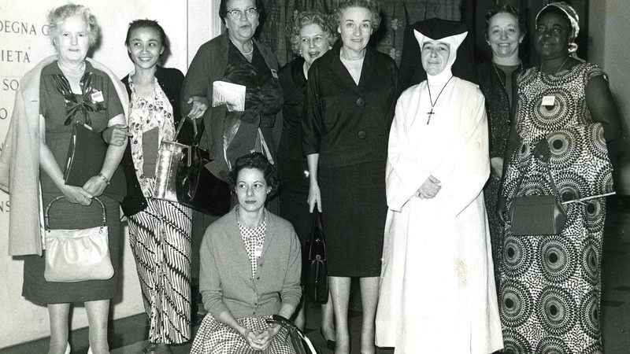
The fifth station: Simon of Cyrene carries the cross
“They compelled a passerby... to carry his cross”
Mark 15: 21
Notes:
The fifth Station: Simon of Cyrene carries the cross
Reader: “And they compelled a passerby, Simon of Cyrene, who was coming in from the country, the father of Alexander and Rufus, to carry his cross.” Mark 15:21
Leader: We adore you, O Christ, and we praise you,
All: because by your Holy Cross you have redeemed the world.
Simon of Cyrene comes into the city of Jerusalem on the day of Jesus’ death. He finds himself in the crowds along Jesus’ pathway to Golgotha and is enlisted to help carry his cross. He does not know Jesus but lends his strength to carrying the heavy weight of the wood.
Some sixty years ago, a small group of women from Catholic Women’s organisations got together to support a mother and child clinic in Dominica. The women thought they might raise about £500 but their idea was so enthusiastically received by Catholic parishes it raised £6,000; much more than they ever hoped for. So, as well as funding the new clinic, the project also improved water supplies and enabled local people to develop their vegetable gardens. Two years later the Catholic Bishops’ Conference of England and Wales formally recognised their initiative. And CAFOD was born.
Although Simon did not have a choice but to help carry Jesus’ cross, we do. We pray that we will look for opportunities to help one another and to build a better world.
Prayer:
Jesus, our brother,
you call us to bear each other’s burdens.
Bless all who give of themselves
in the service of others;
and make us always ready
to offer and to receive help.
Amen.

Slide 12
The fifth station: Simon of Cyrene carries the cross
We adore you, O Christ, and we praise you,
R/ because by your Holy Cross you have redeemed the world.
Prayer:
Jesus, our brother,
you call us to bear each other’s burdens.
Bless all who give of themselves
in the service of others;
and make us always ready
to offer and to receive help.
Amen.
Notes:
Image: The Catholic women who organised the first Family Fast Day in 1960 with Sister Alicia who ran the mother-and-baby clinic in Dominica.

Slide 13
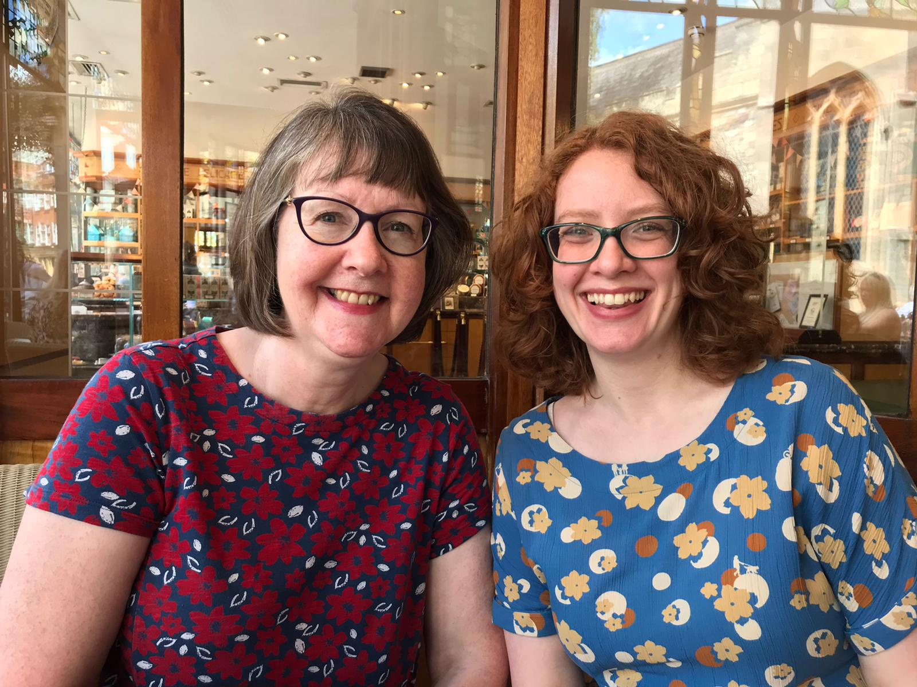
The sixth station:
Veronica wipes the face of Jesus
”It is like a grain of mustard seed”
Mark 4:30
Notes:
The sixth Station: Veronica wipes the face of Jesus
Reader: “With what can we compare the kingdom of God, or what parable shall we use for it? It is like a grain of mustard seed, which, when sown on the ground, is the smallest of all the seeds on earth, yet when it is sown it grows up and becomes larger than all the garden plants and puts out large branches, so that the birds of the air can make nests in its shade.” Mark 4:30-32
Leader: We adore you, O Christ, and we praise you,
All: because by your Holy Cross you have redeemed the world.
Moved by Jesus’ pain, Veronica’s love overcomes her fear and she courageously steps forward to wipe the blood and sweat from Jesus’ face. She cannot change his fate, but recognising his dignity, she faithfully performs her small act of compassion. As the guards force Jesus onward, the image of his face is left on Veronica’s veil.
“There are a lot of problems in our world – inequality, poverty, climate change, to name a few – and it can feel overwhelming and like nothing really changes.” reflect mother and daughter Kate and Hannah who are CAFOD parish volunteers in West Yorkshire. “But we are motivated by our faith. The parable of the mustard seed helps us to remember that even small actions can make a lifesaving difference.”
At this station, we pray for the grace to look for opportunities to do small acts of kindness and generosity. In so doing, we recognise the face of Jesus in our neighbours, and he imprints his face on each of us.
Prayer:
Jesus, our teacher,
as you journey to the Cross,
you show us the way of your kingdom.
May we not grow discouraged
but be always ready to act
with compassion and hope.
Amen.

Slide 14
The sixth station:
Veronica wipes the face of Jesus
We adore you, O Christ, and we praise you,
R/ because by your Holy Cross you have redeemed the world.
Prayer:
Jesus, our teacher,
as you journey to the Cross,
you show us the way of your kingdom.
May we not grow discouraged
but be always ready to act
with compassion and hope.
Amen.
Notes:
Image: Mum and daughter Kate and Hannah are parish volunteers from West Yorkshire.

Slide 15
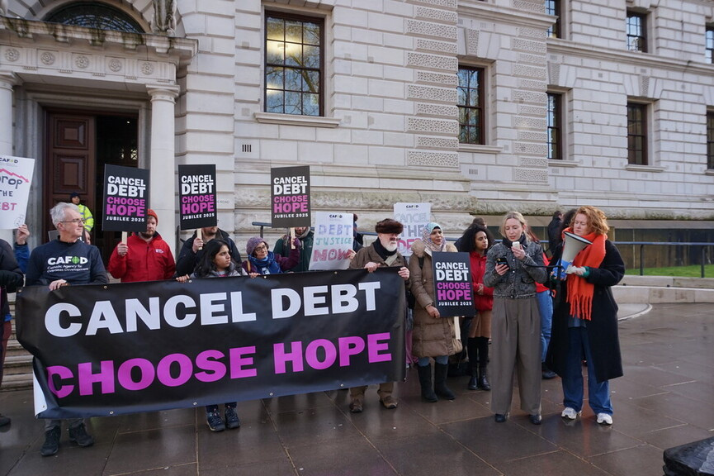
The seventh station:
Jesus falls for a second time
“For you load people with burdens hard to bear.”
Luke 11:47
Notes:
The seventh Station: Jesus falls for the second time
Reader: “For you load people with burdens hard to bear, and you yourselves do not touch the burdens with one of your fingers.” Luke 11:47
Leader: We adore you, O Christ, and we praise you,
All: because by your Holy Cross you have redeemed the world.
Under the weight of the cross, Jesus is once again brought to his knees. After this second fall, Jesus’ struggle to rise up again is much harder.
Many people around the world are falling under the heavy weight of the most acute debt crisis in history: 54 countries – from Kenya to Sri Lanka – are facing debt distress. It’s the world’s poorest countries who are the worst affected, with many forced to spend more on payments to big banks, wealthy nations and global institutions than they spend on health, education or tackling the climate crisis.
In Dilexi Te. Pope Leo XIV reminds us of our call, as the People of God, to speak out against structural injustice. He writes “Unjust structures need to be recognized and eradicated by the force of good.” #97
As we reflect on nations trapped in a cycle of debt, we pray that God will help us to build a global family where the dignity of the person is always placed before the demands of profit.
Prayer:
Jesus, our redeemer,
you were willing to die
that we might live.
Help us stand against injustice
so all people can flourish
and fulfil their potential.
Amen.

Slide 16
The seventh station:
Jesus falls for a second time
We adore you, O Christ, and we praise you,
R/ because by your Holy Cross you have redeemed the world.
Prayer:
Jesus, our redeemer,
you were willing to die
that we might live.
Help us stand against injustice
so all people can flourish
and fulfil their potential.
Amen.
Notes:
Image: Launch of the Cancel Debt Choose Hope campaign in the Jubilee Year.
Picture credit: Phoebe Worthington

Slide 17
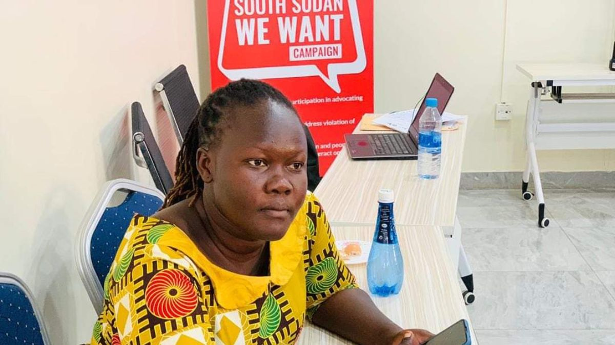
The eighth station:
Jesus meets the women of Jerusalem
“...a great multitude of women…were mourning and lamenting for him.”
Luke 23:28
Notes:
The eighth Station: Jesus meets the women of Jerusalem
Reader: “And there followed him a great multitude of the people and of women who were mourning and lamenting for him. But turning to them Jesus said, “Daughters of Jerusalem, do not weep for me, but weep for yourselves and for your children.” Luke 23:27-28
Leader: We adore you, O Christ, and we praise you,
All: because by your Holy Cross you have redeemed the world.
As Jesus draws closer to the place of execution, he encounters the women of Jerusalem weeping for him. There is a shared empathy here as Jesus recognises their difficulties and tells them not to weep for him, but for themselves and their children.
As we recall this exchange, we remember the many societies where women face huge challenges. Today, women represent the majority of the world’s poor. Globally, they are less likely than men to be involved in decision making, to own land or property, or to have access to education, technology and employment
In South Sudan, up to 65 per cent of women have experienced either sexual or physical violence in their lifetime – double the global average and among the highest levels in the world. CAFOD supports the work of Women for Change, an organisation dedicated to working on women’s and children’s rights in the areas of protection, education, health and livelihoods as well as peace building and advocacy.
We pray for the work of Women for Change and for a world where the distinctive contributions of women and girls are valued and all can live free from violence, fear and discrimination.
Prayer:
Lord Jesus,
despite your own pain
you notice the suffering of others.
Give us hearts that grieve
for all that is wrong in our world
and embolden us to work for change.
Amen.

Slide 18
The eighth station:
Jesus meets the women of Jerusalem
We adore you, O Christ, and we praise you,
R/ because by your Holy Cross you have redeemed the world.
Prayer:
Lord Jesus,
despite your own pain
you notice the suffering of others.
Give us hearts that grieve
for all that is wrong in our world
and embolden us to work for change.
Amen.
Notes:
Image: Anna Tazita Samuel, Executive Director of Women for Change

Slide 19
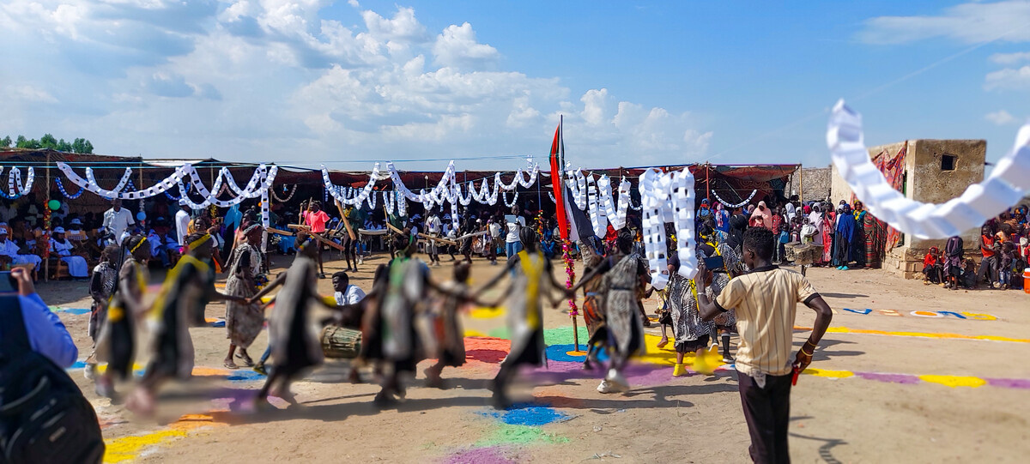
The ninth station:
Jesus falls the third time
“Surely he has borne our griefs and carried our sorrows.”
Isaiah 53:4
Notes:
The ninth Station: Jesus falls the third time
Reader: “Surely he has borne our griefs and carried our sorrows.” Isaiah 53:4
Leader: We adore you, O Christ, and we praise you,
All: because by your Holy Cross you have redeemed the world.
Jesus falls a third time. In this final fall, he shares the exhaustion of those who feel overwhelmed by difficulties.
Even before the war erupted in April 2023, Sudan was already experiencing a severe humanitarian crisis. Now, more than 1000 days of fighting have plunged the country into one of the worst humanitarian crises the world has ever seen. It is estimated over 150,000 people have already lost their lives and almost 12 million people have been forced to flee their homes. Over 33 million people - more than half of Sudan's population – desperately need emergency aid.
After a visit to the country, Kayode Akintola, CAFOD’s Head of Region for Africa, said, “What I heard left me speechless. Atrocities, mass displacement, and a humanitarian crisis that continues to unfold in silence. The scale of suffering is staggering, and the muted global response has been profoundly disheartening.”
Love gave Jesus the strength to stand again and continue onwards. We pray for all those who need strength and courage, that in the face of so many struggles, they will know Christ’s love and comfort.
Prayer:
Jesus, suffering servant,
you know the crushing weight
of violence and hate.
Be with the people of Sudan
and all who suffer because of conflict
and inspire all people to work
for reconciliation and peace.
Amen.

Slide 20
The ninth station:
Jesus falls the third time
We adore you, O Christ, and we praise you,
R/ because by your Holy Cross you have redeemed the world.
Prayer:
Jesus, suffering servant,
you know the crushing weight
of violence and hate.
Be with the people of Sudan
and all who suffer because of conflict
and inspire all people to work
for reconciliation and peace.
Amen.
Notes:
Image: Sudan refugee camp
Credit: HOPE Sudan (Friendship for Development Organisation)

Slide 21
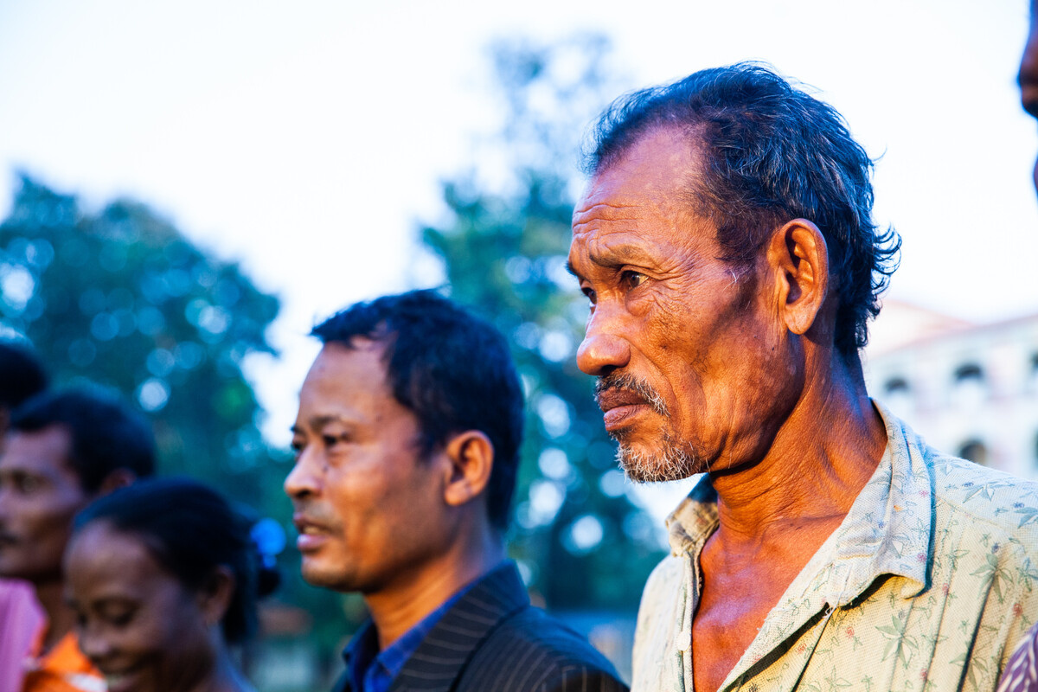
The tenth station:
Jesus is stripped of his garments
“The soldiers took his garments.”
John 19:23
Notes:
The tenth Station: Jesus is stripped of his garments
Reader: “When the soldiers had crucified Jesus, they took his garments and divided them into four parts, one part for each soldier; also his tunic.” John 19:23
Leader: We adore you, O Christ, and we praise you,
All: because by your Holy Cross you have redeemed the world.
Jesus has nothing left. Arriving at his place of execution, even his clothes are taken from him. He holds nothing back.
In some parts of the world, indigenous communities are being stripped of their ancestral land. Monu is a member of the indigenous Garo community in Bangladesh and a proud father and grandfather. He has faced false accusations and violent threats in attempts to evict him from his land.
However, with legal advice, workshops, training and financial support, the Garo community are standing up for their rights and speaking out against injustice. “When someone is having a problem, we go to help him or stand beside him,” Monu reflects.
​
Let’s pray that we will also stand in solidarity with our sisters and brothers whose rights are being unjustly challenged.
Prayer:
Jesus,
you sacrificed everything
and endured mockery for our sake.
Strip away our indifference
and clothe us with your love
May we advocate for justice
for all our global family.
Amen.

Slide 22
The tenth station:
Jesus s stripped of his garments
We adore you, O Christ, and we praise you,
R/ because by your Holy Cross you have redeemed the world.
Prayer:
Jesus,
you sacrificed everything
and endured mockery for our sake.
Strip away our indifference
and clothe us with your love
May we advocate for justice
for all our global family.
Amen.
Notes:
Image: Monu takes part in a land rights legal clinic
Credit: Thom Flint

Slide 23
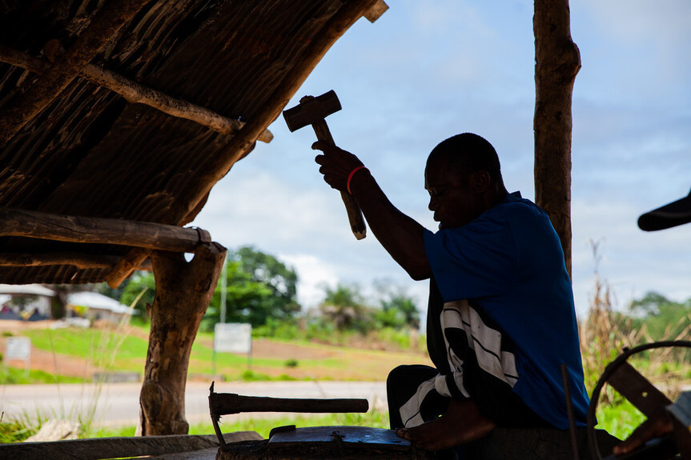
The eleventh station:
Jesus is nailed to the cross
“He was pierced for our transgressions”
Isaiah 53:5
Notes:
The eleventh Station: Jesus is nailed to the cross
Reader: “But he was pierced for our transgressions; he was crushed for our iniquities; upon him was the chastisement that brought us peace, and with his wounds we are healed.” Isaiah 53:5
Leader: We adore you, O Christ, and we praise you,
All: because by your Holy Cross you have redeemed the world.
The soldiers drive the nails into Jesus’ hands and feet. Yet even in this moment he shows his compassion, praying for those who crucify him.
Jesus continues to be crucified in all who suffer in our world. He is present in those whom society marginalises: people who are hungry or homeless, refugees or asylum seekers. He is crucified in the exploitation of our common home, the earth and its resources.
As followers of Jesus, may we show his compassion and so be a source of hope for all our brothers and sisters, our global family, and our common home, the earth.
Prayer:
Lord Jesus,
you stretched out your arms on the cross,
to embrace all creation.
Bless all those who
reach out in love to their neighbours
speak out for justice,
care for creation
and work to build your peace.
Amen.

Slide 24
The eleventh station:
Jesus is nailed to the cross
We adore you, O Christ, and we praise you,
R/ because by your Holy Cross you have redeemed the world.
Prayer:
Lord Jesus,
you stretched out your arms on the cross,
to embrace all creation.
Bless all those who
reach out in love to their neighbours
speak out for justice,
care for creation
and work to build your peace.
Amen.
Notes:
Image: Ishmael is a blacksmith in Sierra Leone.
Picture credit: Thom Flint

Slide 25
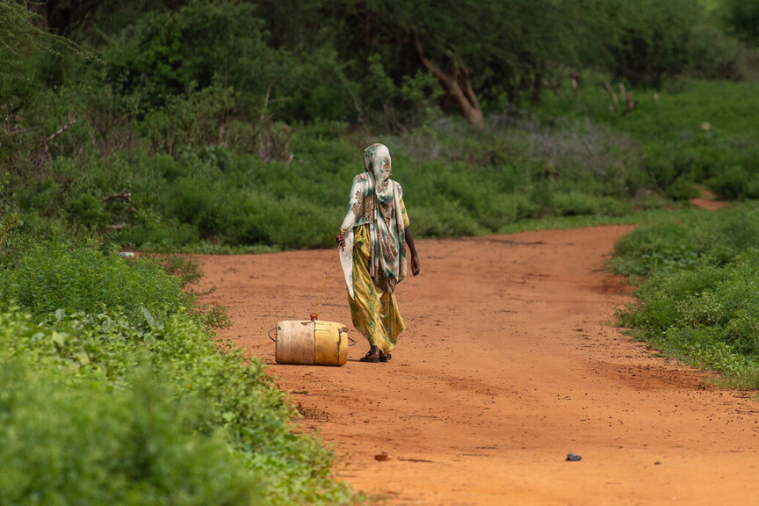
The twelfth station:
Jesus dies on the cross
“I thirst”
John 19:28
Notes:
The twelfth Station: Jesus dies on the cross
Reader: “After this, Jesus, knowing that all was now finished, said (to fulfil the Scripture), ‘I thirst.’ A jar full of sour wine stood there, so they put a sponge full of the sour wine on a hyssop branch and held it to his mouth. When Jesus had received the sour wine, he said, ‘It is finished,’ and he bowed his head and gave up his spirit.” John 19:28-30
Leader: We adore you, O Christ, and we praise you,
All: because by your Holy Cross you have redeemed the world.
Just before he dies on the cross Jesus cries out that he is thirsty. We can hear him continue to say these words to us, through our brothers and sisters who each day must strive for enough water to live.
During the long drought in Kenya, Kerra walked for many hours to find water to get water for her family.
"I trekked for almost seven hours carrying a carton on my back." she recalls "I could only afford to go there once a week… I carried from 20 to 120 litres… It was very hard. I felt so exhausted, I started to get sick. The sun was scorching, burning. I had pain in my legs and my back. But in the drought season, that is what we had to do.”
These last words of Jesus challenge us. They call us to see his face in all those who thirst for justice and to stand alongside them raising our own voices for change. May we thirst for a better world, where all our neighbours have safe water.
Prayer:
Jesus, the living water,
you know what it is to thirst.
Let your love well up within us.
Together may we reshape the world,
so that the thirst for water,
and for justice, is satisfied.
Amen.

Slide 26
The twelfth station:
Jesus dies on the cross
We adore you, O Christ, and we praise you,
R/ because by your Holy Cross you have redeemed the world.
Prayer:
Jesus, the living water,
you know what it is to thirst.
Let your love well up within us.
Together may we reshape the world,
so that the thirst for water,
and for justice, is satisfied.
Amen.
Notes:
Image: A woman in Kenya walking to collect water
Picture credit: Joe Newman

Slide 27
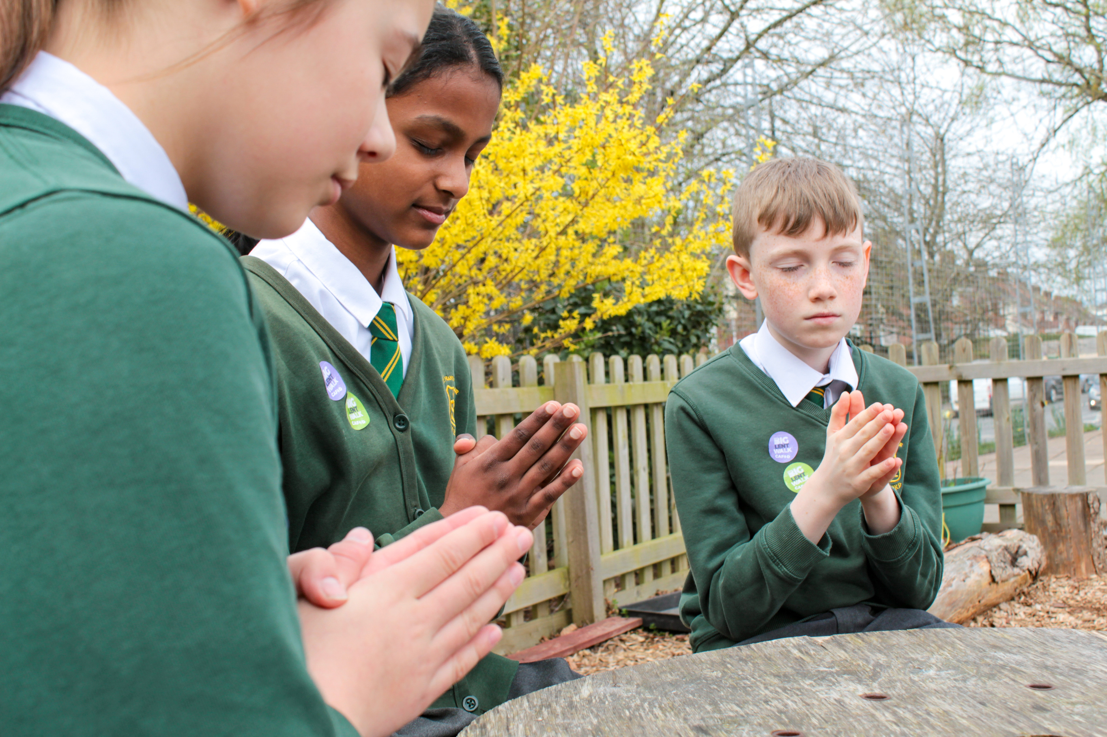
The thirteenth station:
Jesus’ body is taken down from the cross
"Joseph...took courage and went to Pilate and asked for the body of Jesus."
Mark 15:43
Notes:
The thirteenth Station: Jesus’ body is taken down from the cross
Reader: “Joseph of Arimathea, a respected member of the council, who was also himself looking for the kingdom of God, took courage and went to Pilate and asked for the body of Jesus.” Mark 15: 43
Leader: We adore you, O Christ, and we praise you.
All: because by your Holy Cross you have redeemed the world.
The bodies of those crucified were usually left on the cross to decay. Joseph of Arimathea has been a secret follower of Jesus, but now he finds the courage to go to Pilate and ask for Jesus’ body. He acts despite the fear he must have felt, to ensure the lifeless body of his teacher is, at least now, treated with dignity and gentleness.
As we gaze on the Lord’s lifeless body, we see too the bodies of refugees washed ashore from the sea, the bloodied victims of conflict and war, and those consumed by the slow violence of poverty.
May we join Joseph in seeking the kingdom of God, where the dignity of all is respected.
Prayer:
Jesus, Lord of life,
you descended into death.
May we, the Body of Christ,
cherish the gift of life
and promote the dignity of all people.
Amen.

Slide 28
The thirteenth station:
Jesus’ body is taken down from the cross
We adore you, O Christ, and we praise you,
R/ because by your Holy Cross you have redeemed the world.
Prayer:
Jesus, Lord of life,
you descended into death.
May we, the Body of Christ,
cherish the gift of life
and promote the dignity of all people.
Amen.
Notes:
Pupils praying outside
Credit: Victoria Ahmed

Slide 29
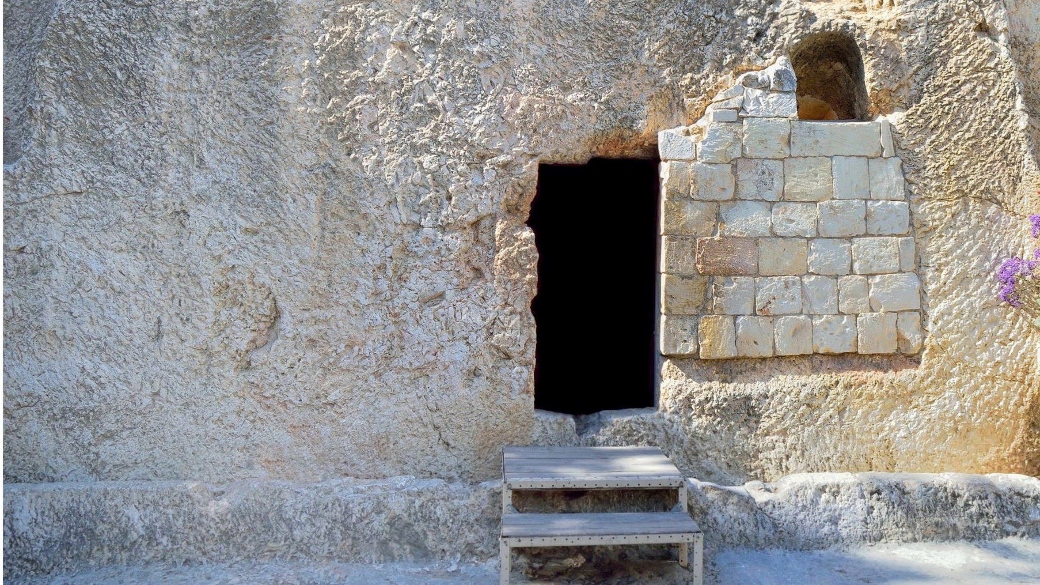
The fourteenth station:
Jesus’ body is laid in the tomb
“And he rolled a stone against the entrance of the tomb.”
Mark 15:46
Notes:
The fourteenth Station: Jesus’ body is laid in the tomb
Reader: “Joseph bought a linen shroud, and taking him down, wrapped him in the linen shroud and laid him in a tomb that had been cut out of the rock. And he rolled a stone against the entrance of the tomb.” Mark 15: 46
Leader: We adore you, O Christ, and we praise you,
All: because by your Holy Cross you have redeemed the world.
There has been little time to prepare Jesus’ body for burial. Joseph has to move quickly to place it in the tomb before the Sabbath begins. He wraps it in a simple linen cloth and rolls the stone over the door. The disciples have scattered in fear and grief and it seems like the end.
We too must act quickly if we are to protect our common home, the earth, for future generations. As Pope Francis warned in his final apostolic exhortation Laudate Deum: “Our responses have not been adequate, while the world in which we live is collapsing and may be nearing the breaking point.” (#2)
We pray that we may have a sense of urgency and hope, even in dark times, as we seek to make a difference.
Prayer:
Jesus, rock of our salvation,
your body was sealed in a tomb,
May our hearts be broken open
by the cry of the earth
and the cry of the poor.
Amen.

Slide 30
The fourteenth station:
Jesus’ body is laid in the tomb
We adore you, O Christ, and we praise you,
R/ because by your Holy Cross you have redeemed the world.
Prayer:
Jesus, rock of our salvation,
your body was sealed in a tomb,
May our hearts be broken open
by the cry of the earth
and the cry of the poor.
Amen.
Notes:
Image: Garden Tomb in Jerusalem, one of two sites proposed as the place of Jesus’ burial.
Picture credit: Manuel F-O/ istock

Slide 31
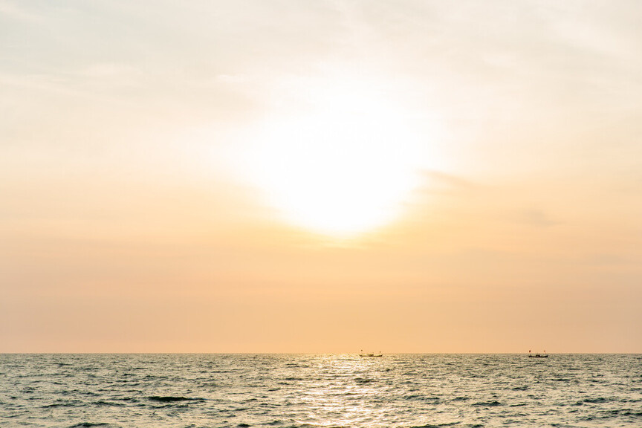
The fifteenth station:
Jesus rises from the dead
“Why do you seek the living among the dead? He is not here but has risen.”
Luke 24:5
Notes:
The fifteenth Station: Jesus rises from the dead
Reader: “Why do you seek the living among the dead? He is not here but has risen.” Luke 24:5-6
Leader: We adore you, O Christ, and we praise you,
All: because by your Holy Cross you have redeemed the world.
Jesus is alive. He has conquered death and is here among us.
His resurrection opens the way of hope and assures us that injustice, pain and death can be overcome.
As we reflect on Jesus’ final journey, we pray for the strength to live each day as people transformed through God’s love. May we radiate God’s love to all our sisters and brothers throughout the world.
Prayer:
Risen Jesus,
you make all things new,
Renew us with your risen life,
to carry your loving presence
into our broken world.
Amen.

Slide 32
The fifteenth station:
Jesus rises from the dead
We adore you, O Christ, and we praise you,
R/ because by your Holy Cross you have redeemed the world.
Prayer:
Risen Jesus,
you make all things new,
Renew us with your risen life,
to carry your loving presence
into our broken world.
Amen.
Notes:
Image: The sun shines over the Atlantic at West Point on the coast of Liberia. May we radiate God’s love to all our sisters and brothers throughout the world.
Picture credit: Thom Flint

