Slide 1


Slide 2

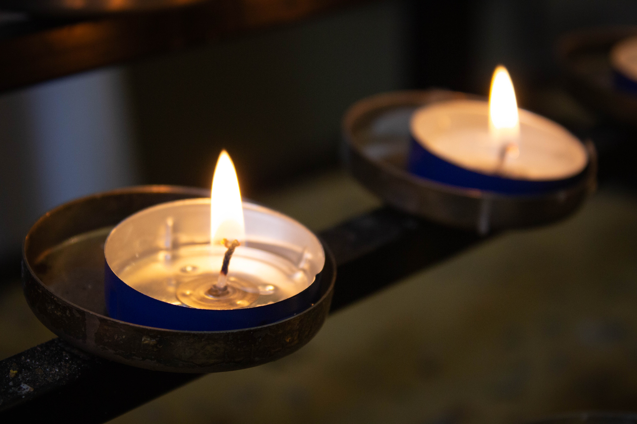

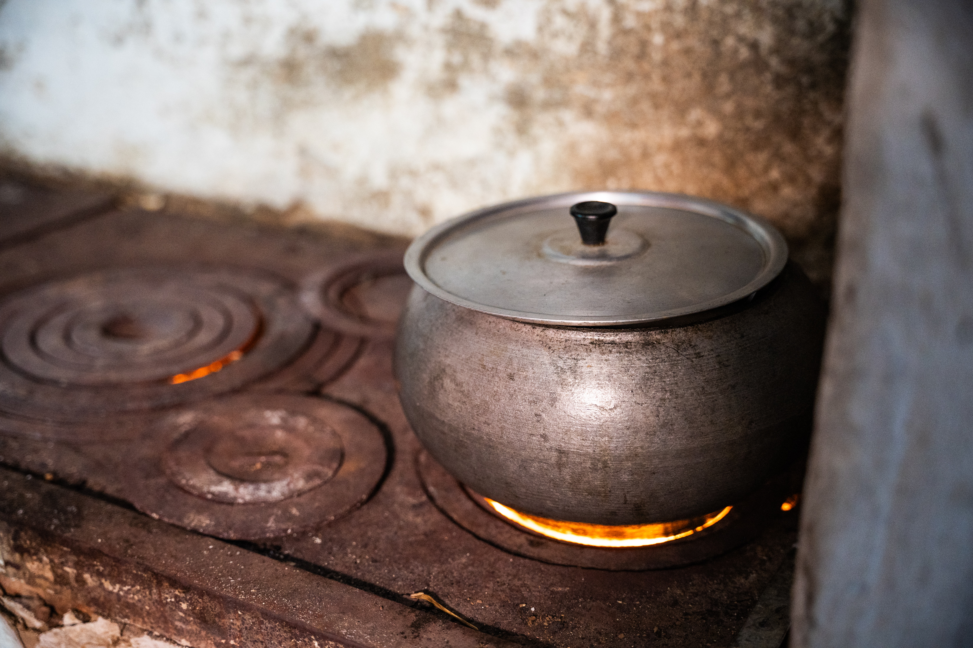
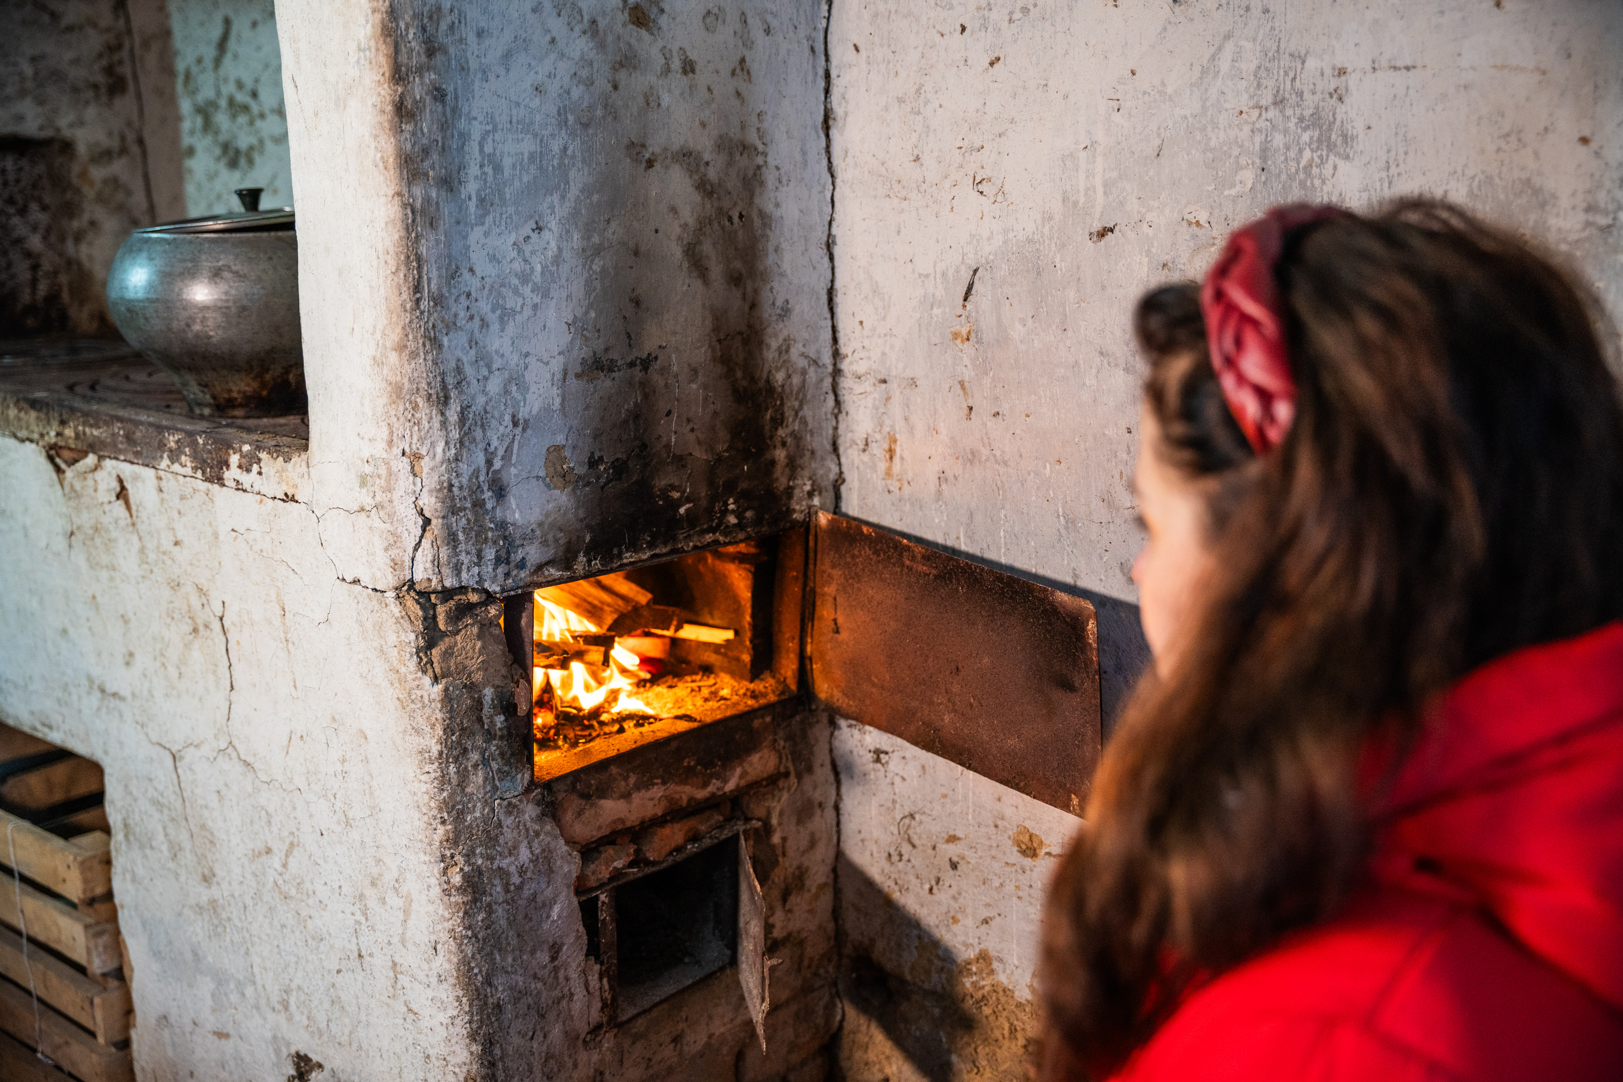
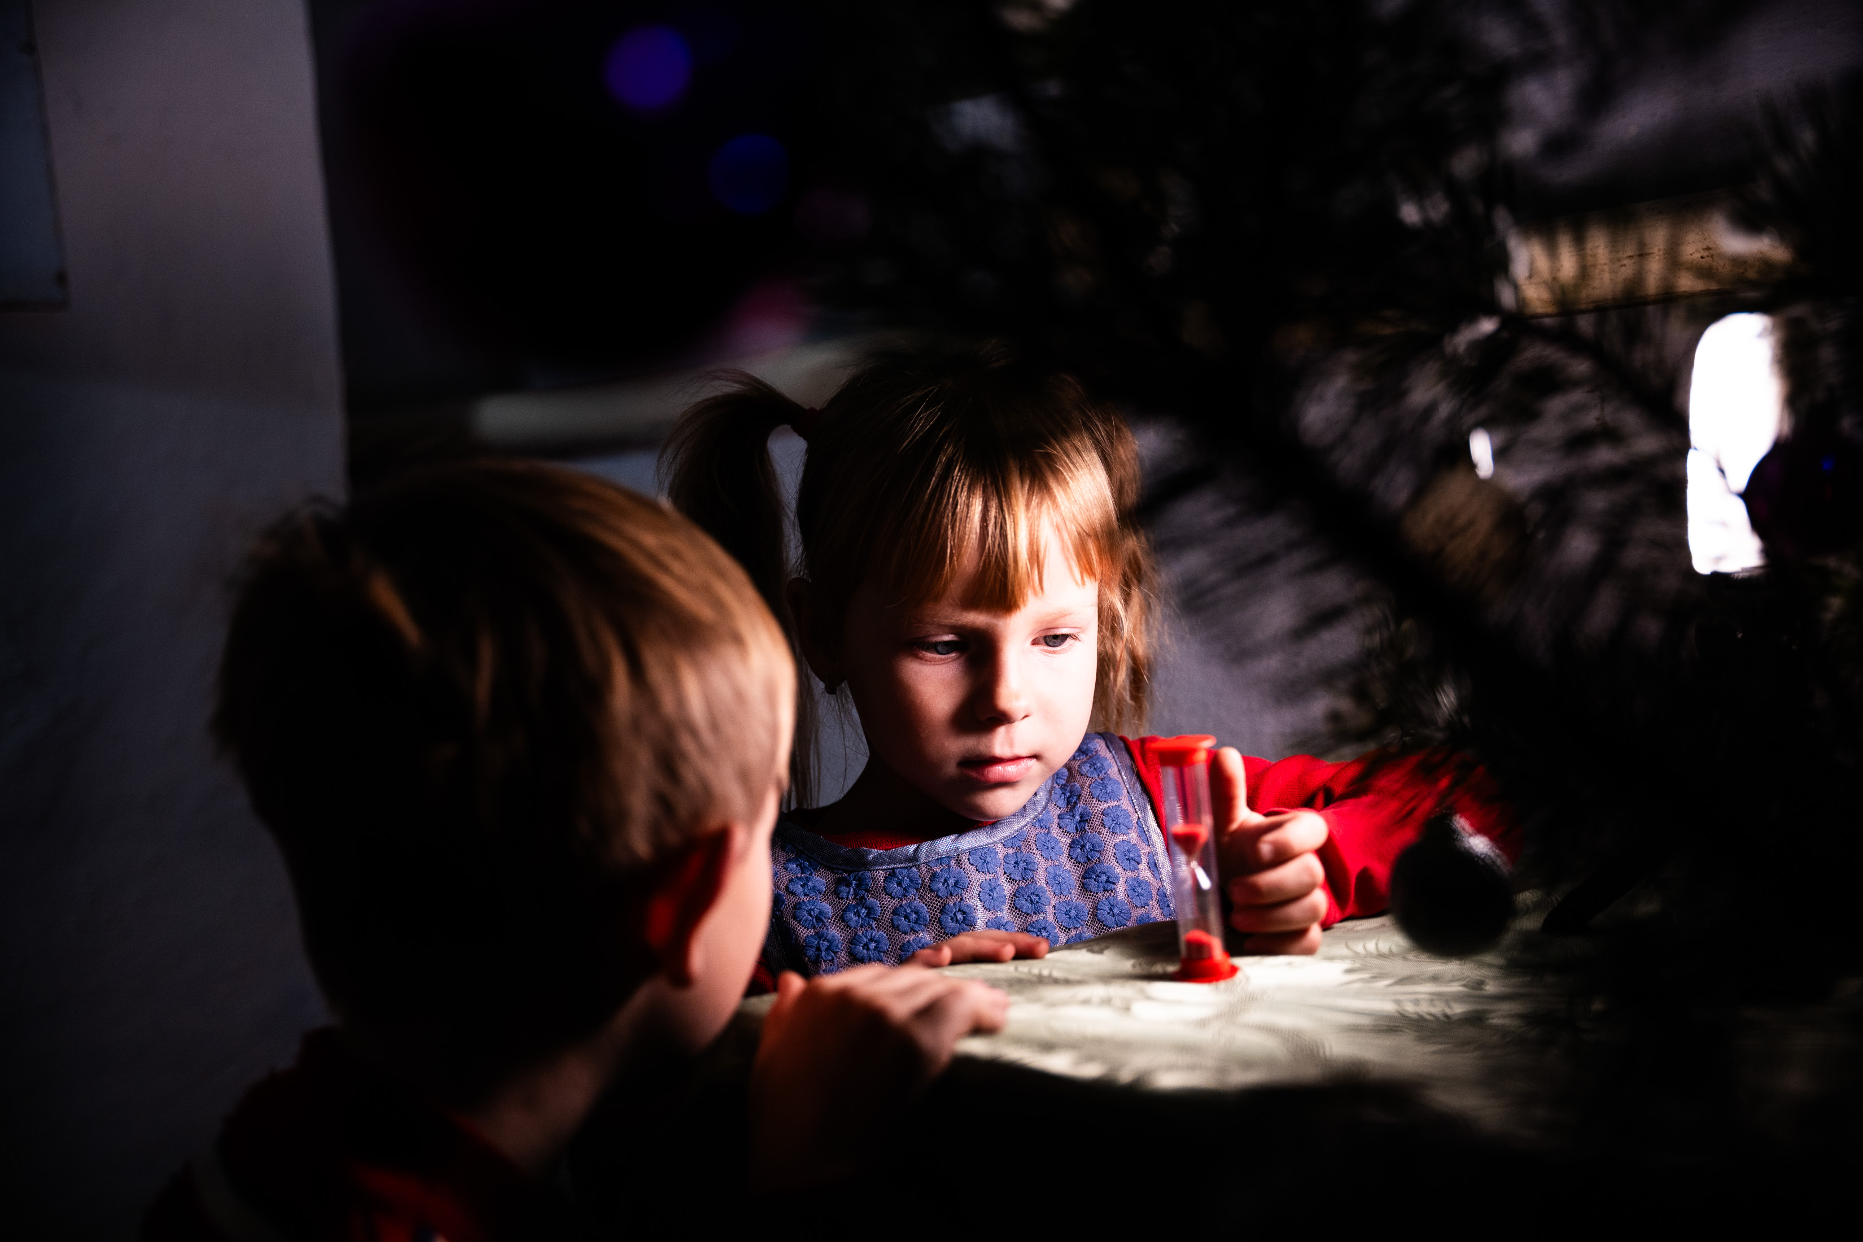
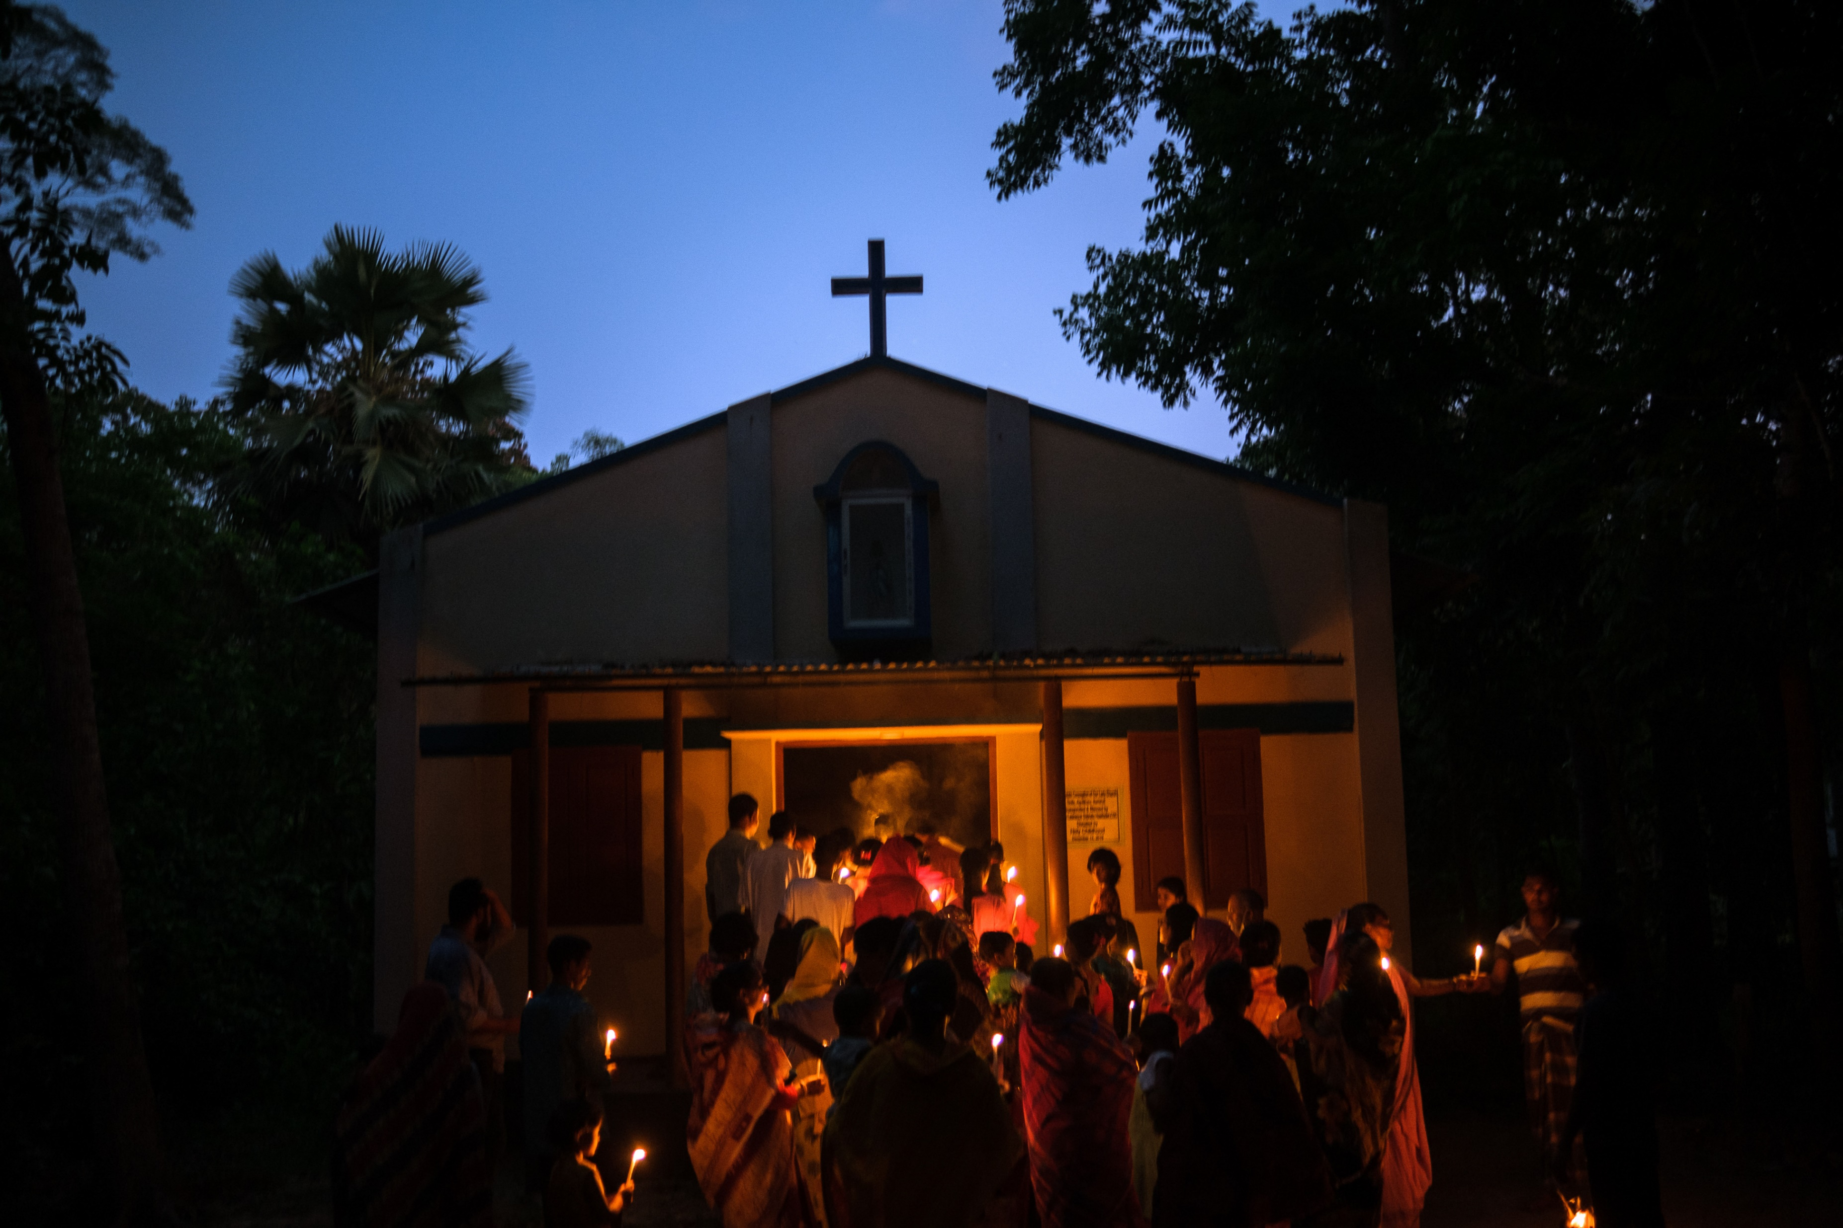
Light appears in so many places and for different uses.
We light tealights to represent prayers
We light stoves to cook food
LED lights illuminate games
Candle processions light the path to church
Firewood project, Ukraine
Easter mass, Bangladesh

Slide 3
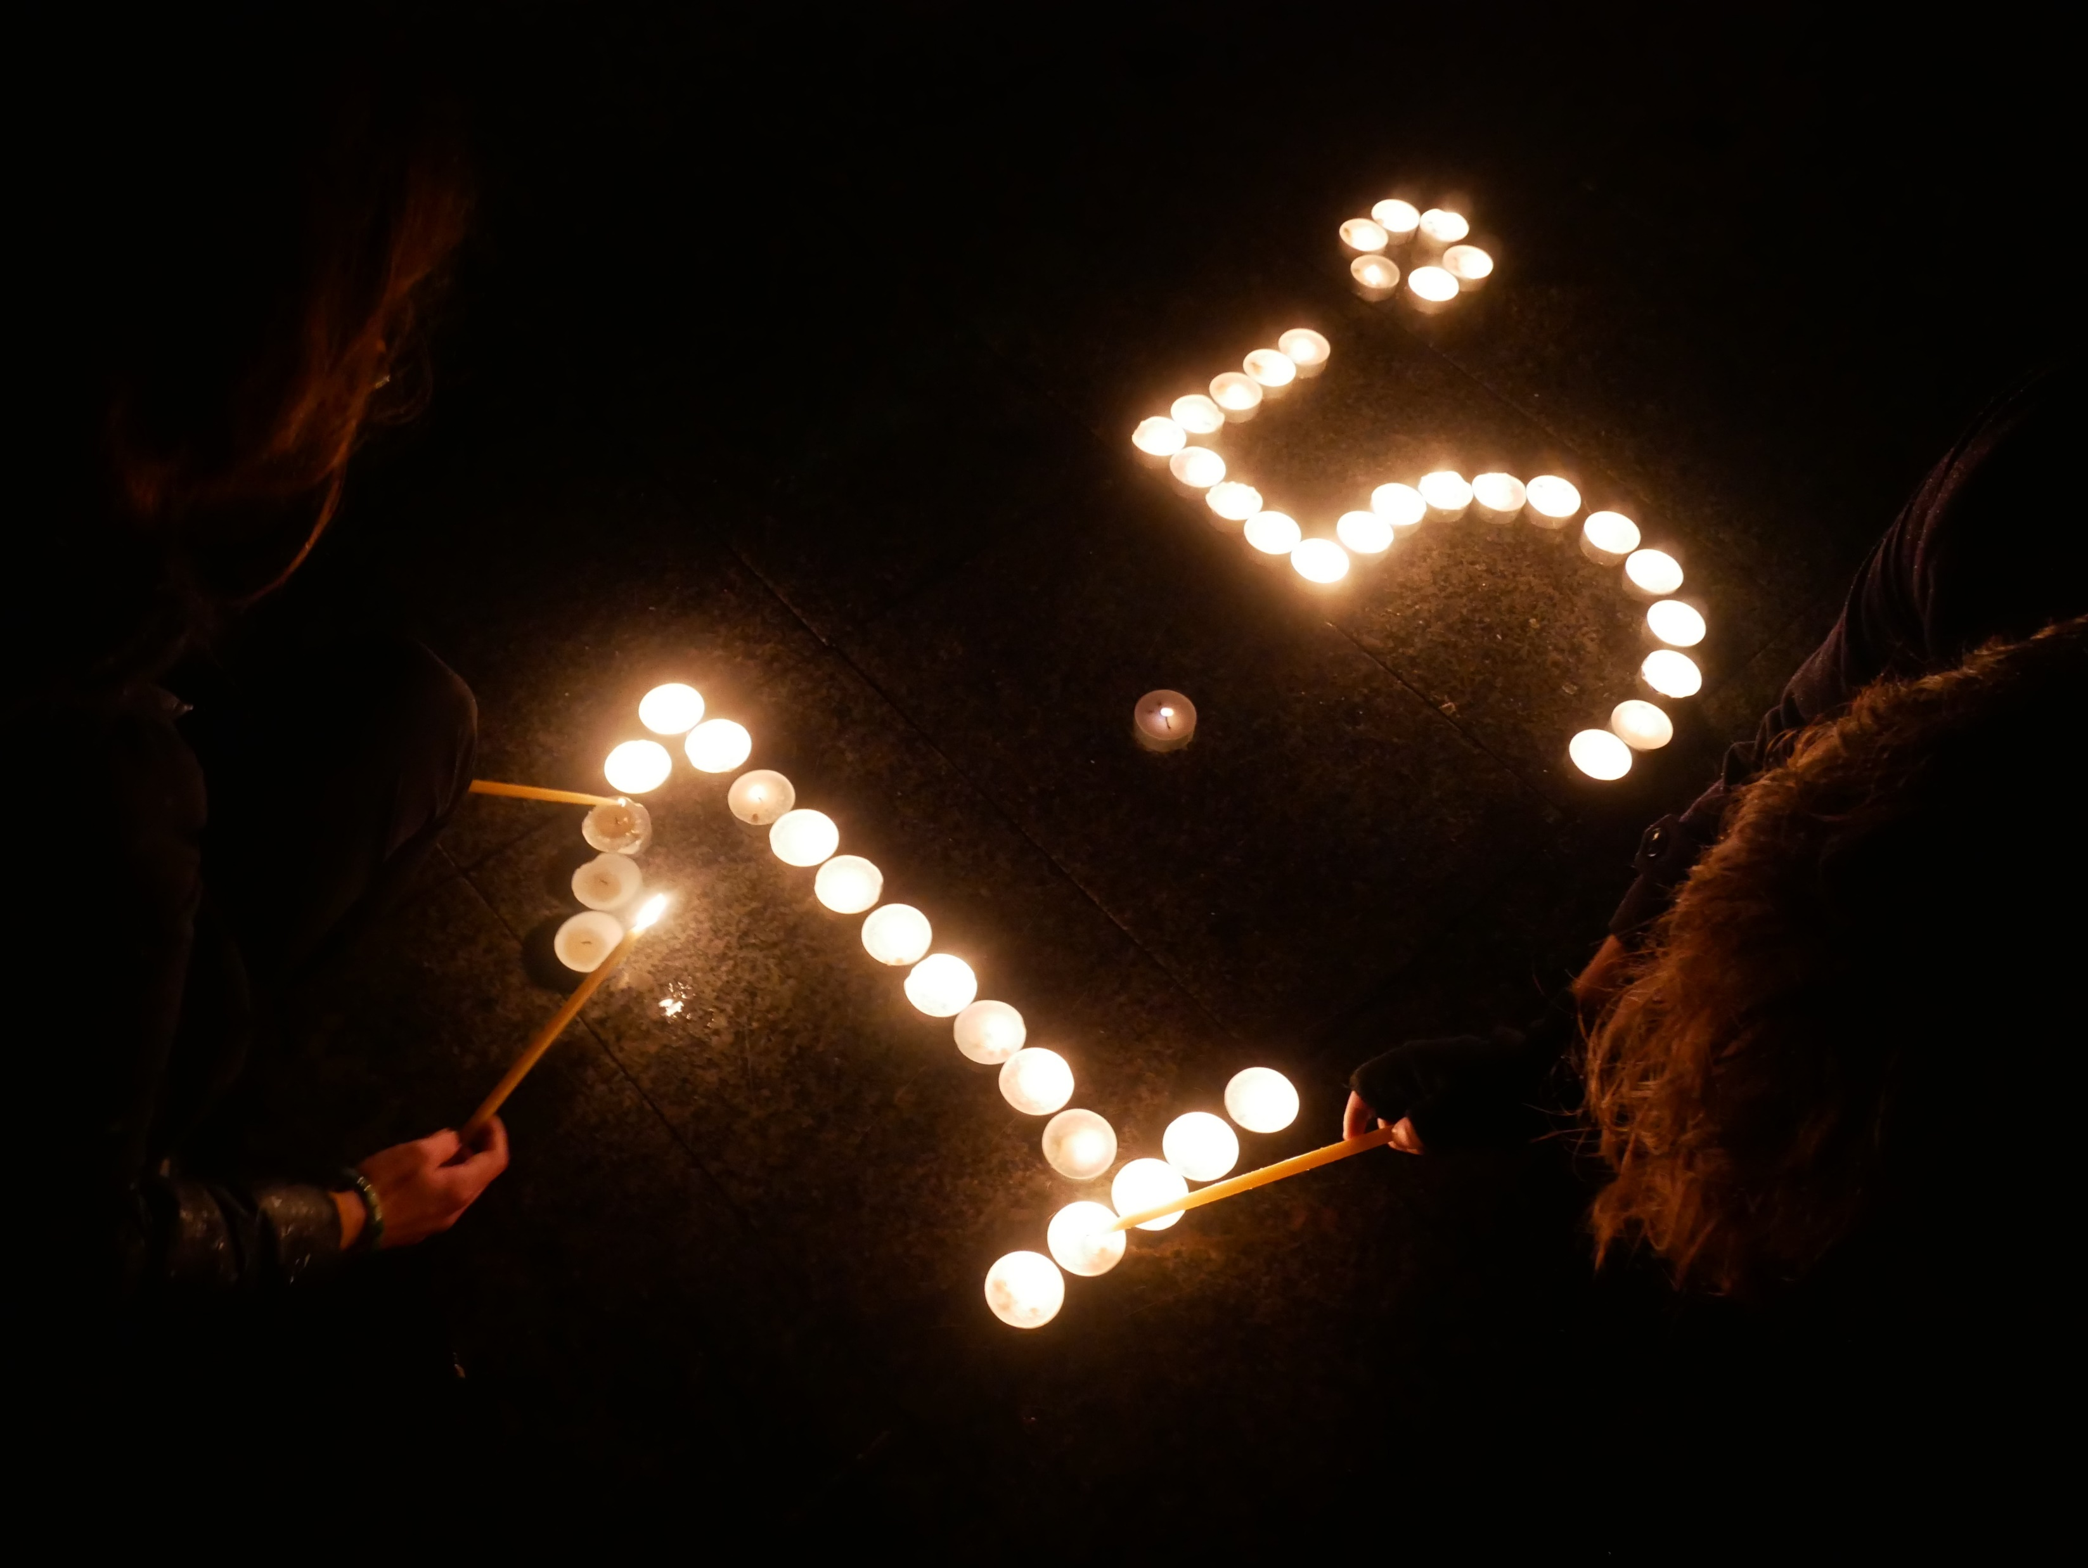
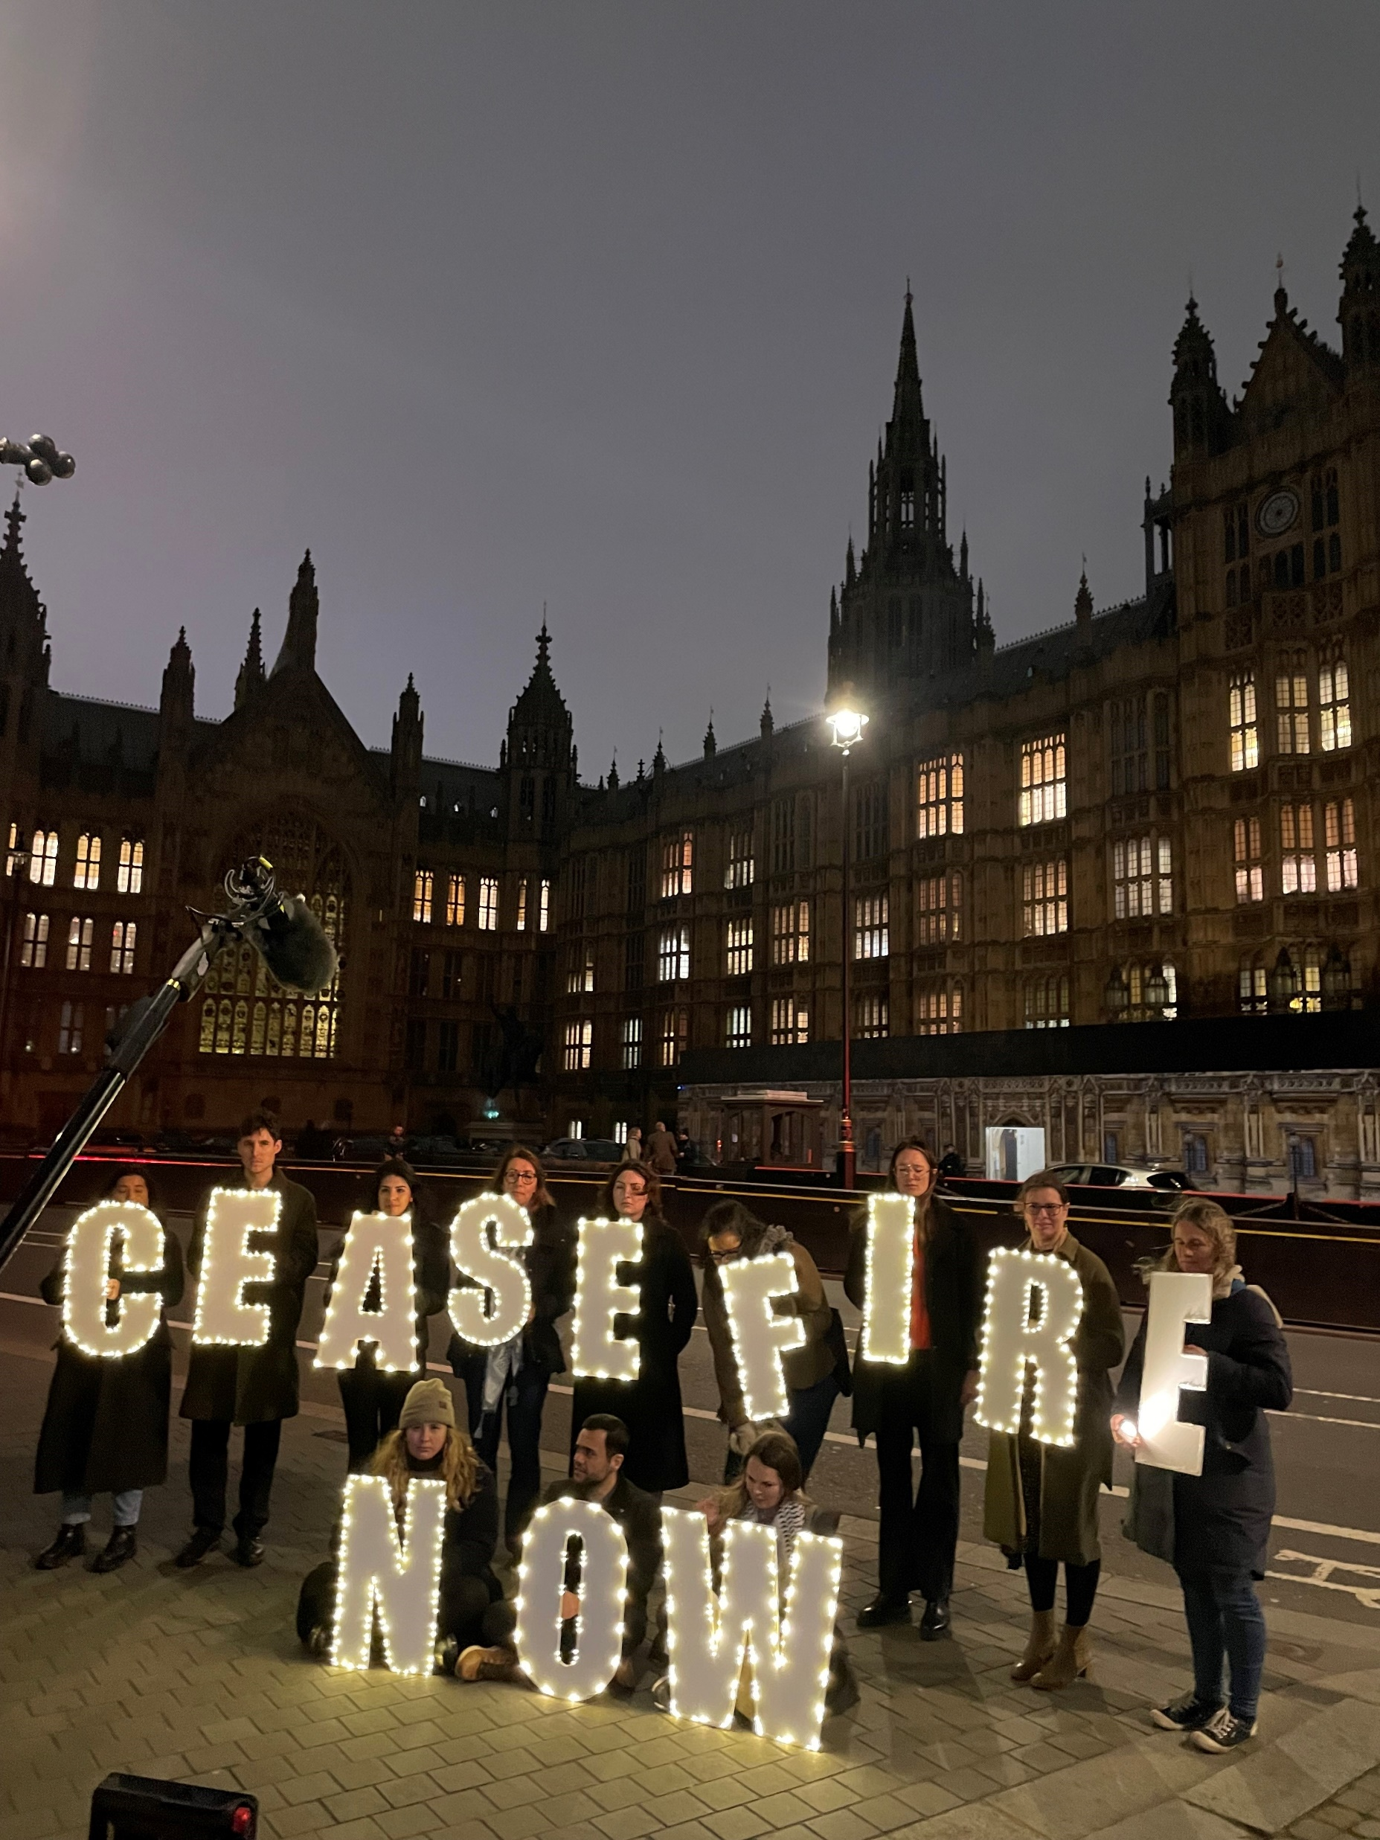

CAFOD have even used lights to draw attention to our campaigns on climate change and the war in the Middle East.
We do this because we believe that:
"The light shines in the darkness, and the darkness has not overcome it’’
1 John 5 (ESV)
We use light to make a statement about a future hope.

Slide 4

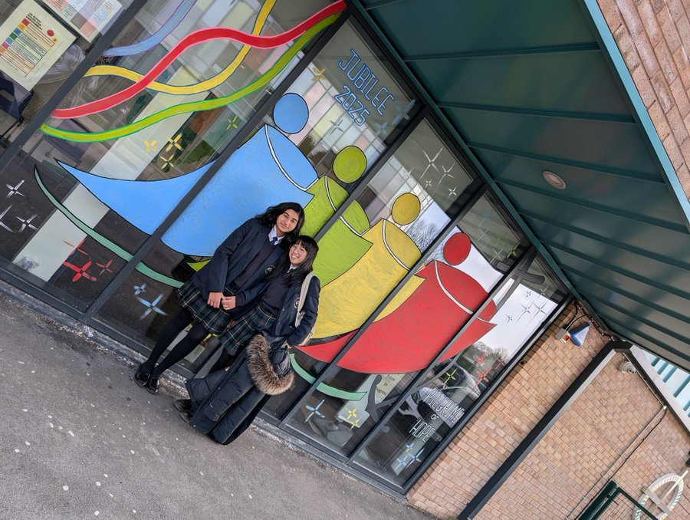



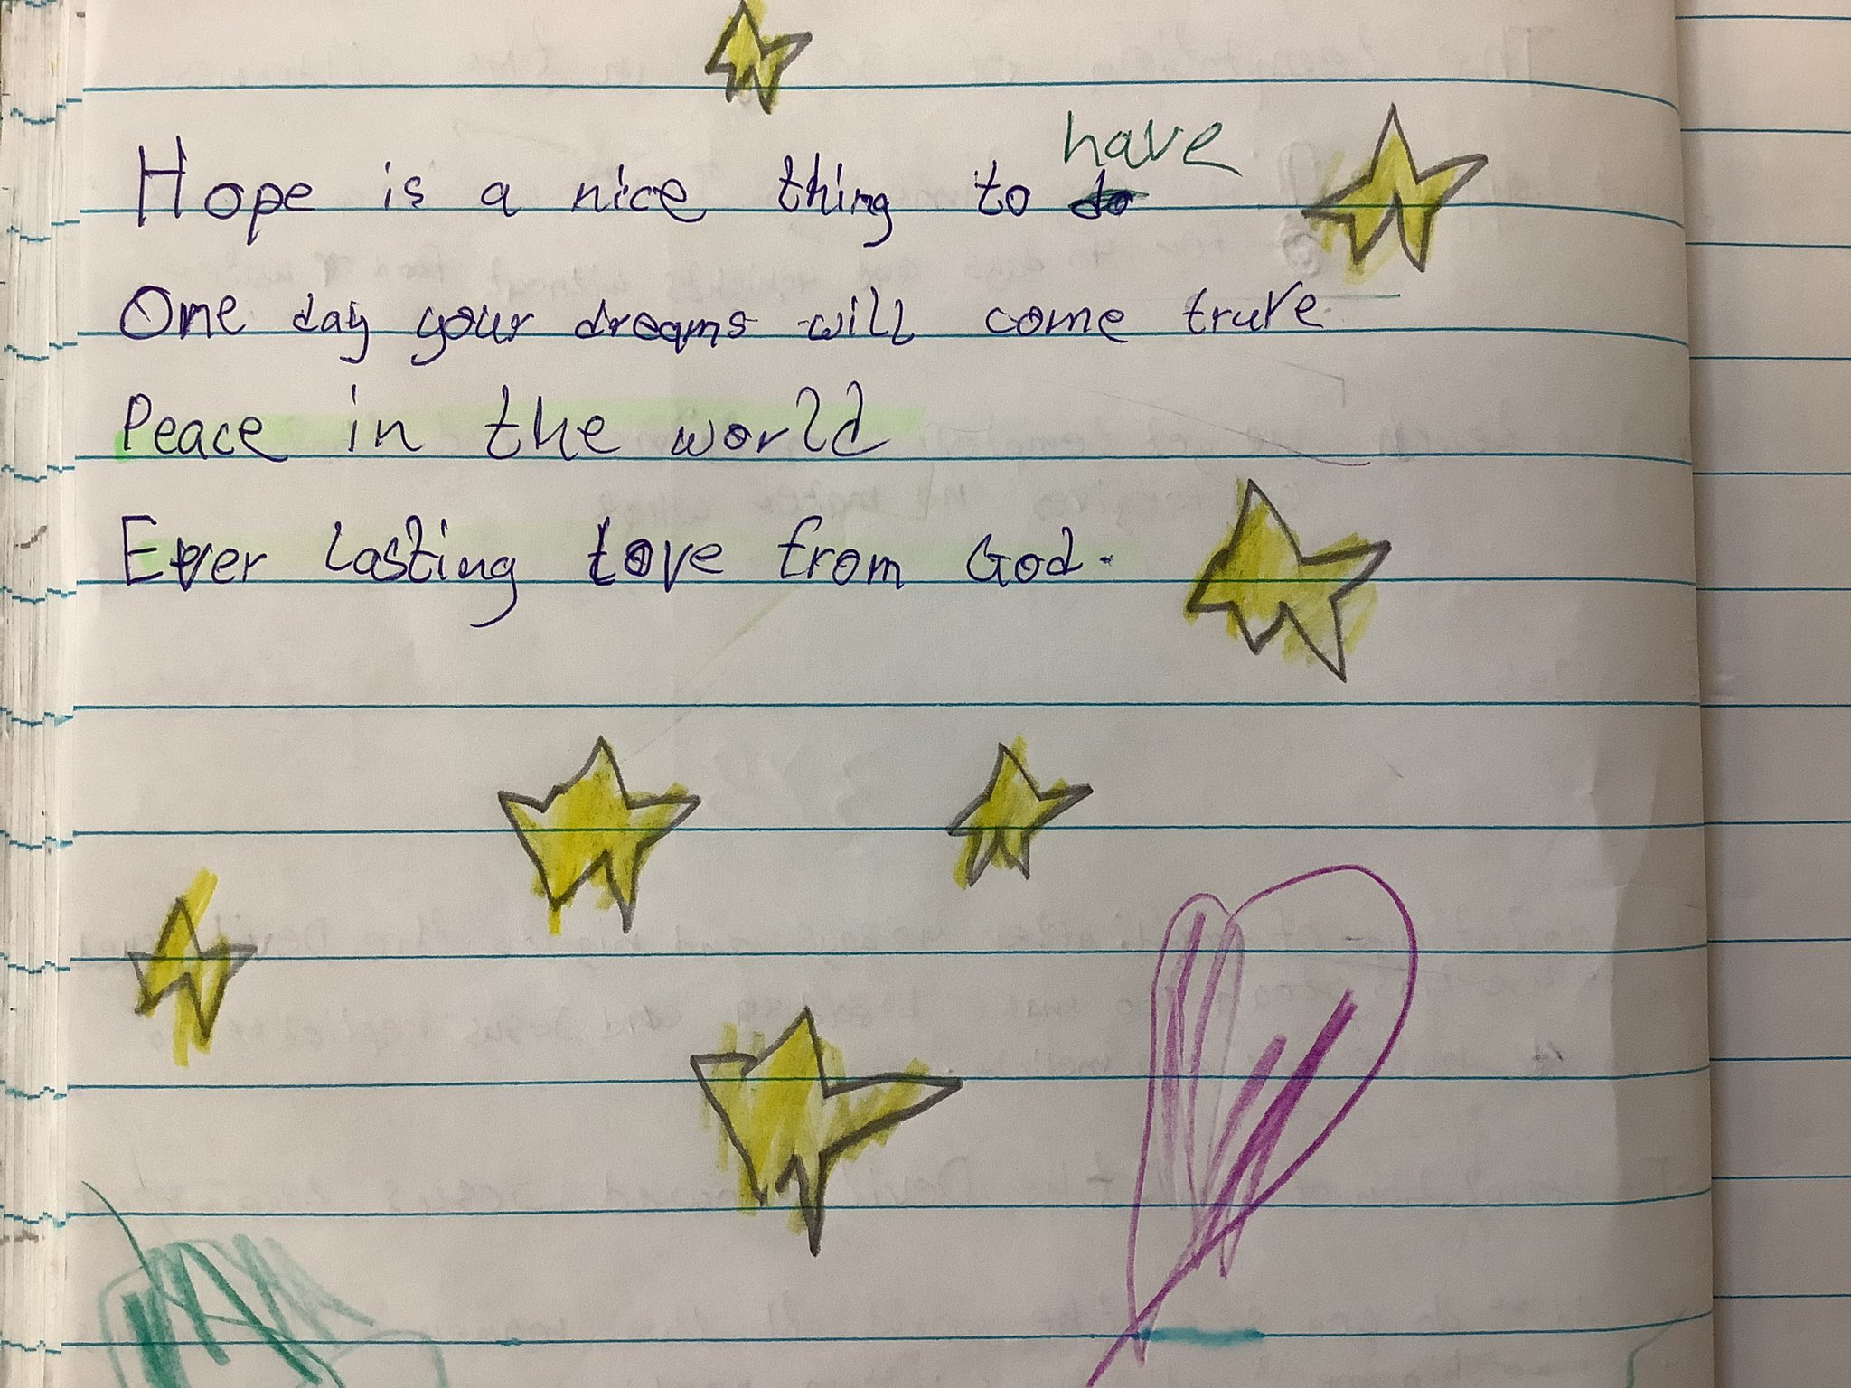



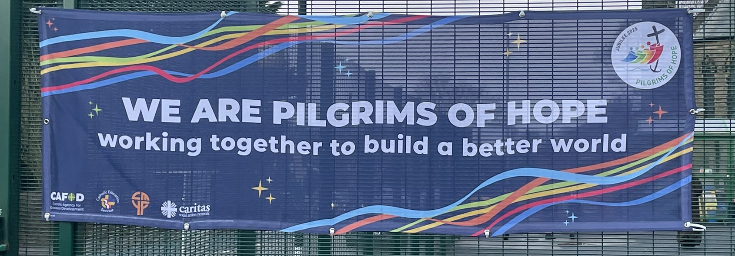

Throughout this Jubilee year, we have been walking as ‘Pilgrims of Hope’.
As we walk through life, our prayer is to bring light and hope to all our brothers and sisters.
You might have noticed sparkles on banners, assemblies, worksheets and resources.

Slide 5

We saw hope sparkling through the water tank project in Ethiopia.
Adi, Abbiott and Abadhalee said the water tank brought much hope to the community.

Slide 6

We saw hope sparkling through Yuliia’s story.
CAFOD supported her family with firewood during a very cold winter when they were refugees, forced to flee their home as a result of the war in Ukraine.
While they long to return home, they are finding glimmers of hope in Bulgaria.

Slide 7

In the midst of a devastating war in the Middle East, CAFOD’s partner, Caritas Jerusalem, has been steadfast in providing small moments of hope to children and young people in Gaza.

Slide 8

And in 2026 we will be sharing stories about how CAFOD’s support in the floating garden project in Bangladesh provided hope to a community combatting the devastating effects of the climate crisis.
Hope keeps sparkling but it needs all of us.

Slide 9
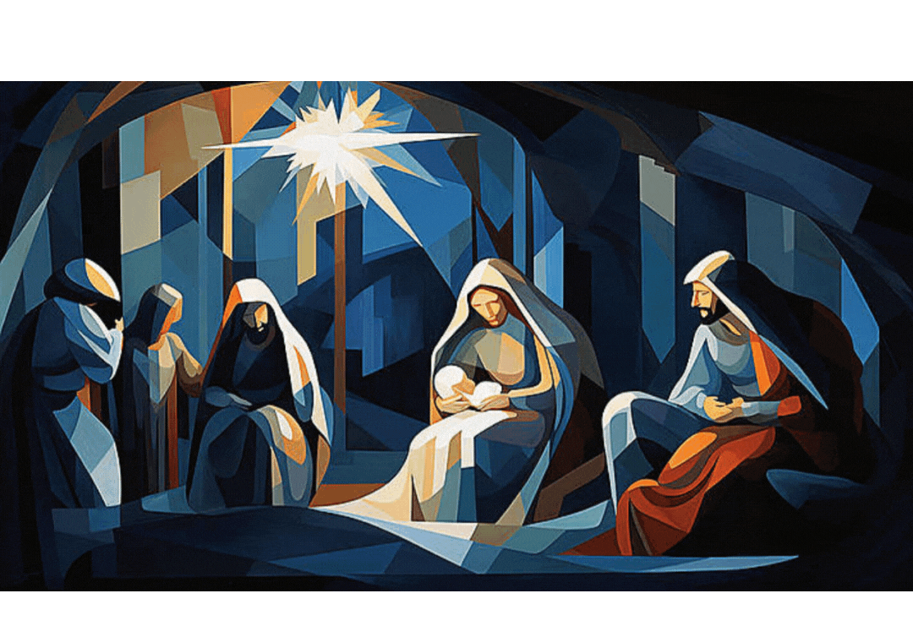
Blink and you might miss it! Advent is about waiting expectantly. We slow down. We look all around us.
We start to count down the days to the greatest hope of all. Emmanuel, God with Us.

Slide 10
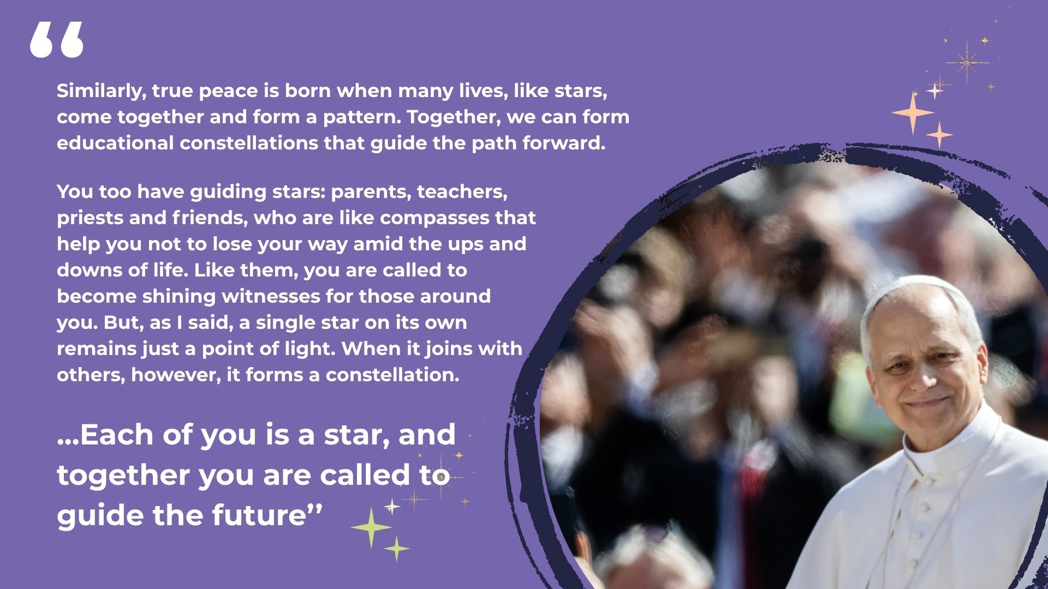
Notes:
You can find this letter to young people on the Vatican website.
Audience with Students participating in the Jubilee of the World of Education

Slide 11
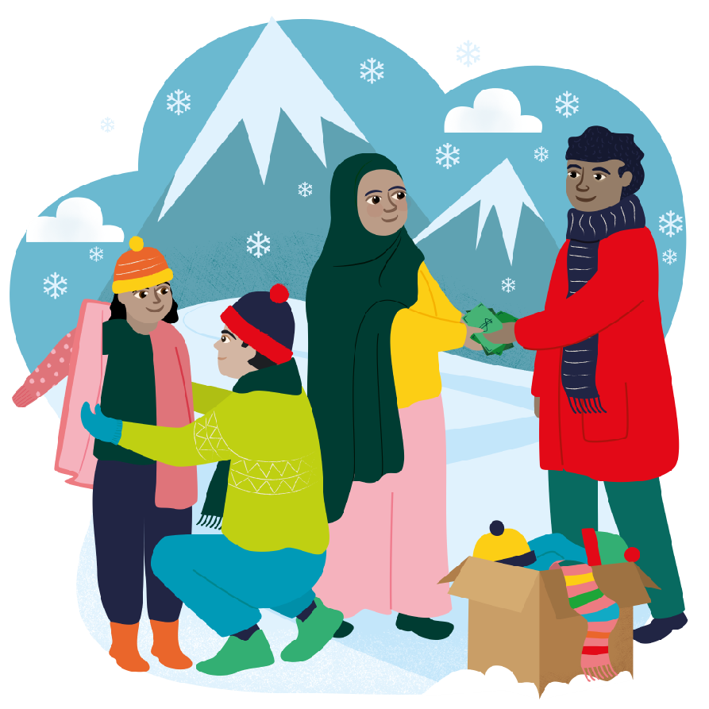


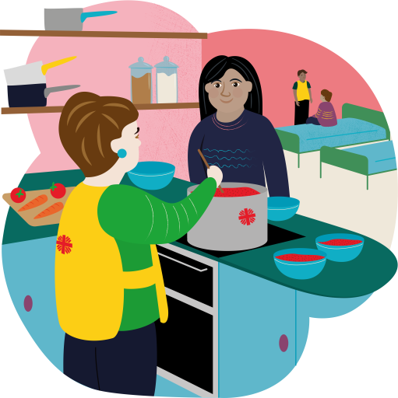

You can give a sparkle of hope this year through World Gifts!
Your school can celebrate Christmas together and help transform the lives of families and communities living in poverty.
This year we have a special school stocking….!
It includes 5 World Gifts Promoting peace
Super soup kitchen
Winter survival kit
Therapy through play
Firewood for winter
£100 Stocking

Slide 12

Prayer
We stay awake, watch and wait,
for we do not know the hour or the day of your arrival.
Come, Lord, bringer of hope.
Create in us a desire for a world transformed
to reflect your glory.
Come, Lord, bringer of hope.
Lead us in your ways, as together we make a change, to dispel the darkness of poverty.
Come, Lord, bringer of hope.
Notes:
Prayer credit: Sue Cooper, CAFOD

Slide 13
