Slide 1
assembly
2024
Notes:
Good morning/afternoon everyone and welcome to our World Gifts CAFOD assembly. World Gifts are a great chance to learn about our global neighbours, and also how we can help them by working together to build a brighter world.

Slide 2
Notes:
Who can remind me what CAFOD stands for?
[Invite responses from the children.]
At CAFOD, we believe in a better world, where no one lives in poverty and each of us can become the best person we can be.

Slide 3
Clean water
Enough food
Safe home
School
Doctor or nurse
Live in peace
Notes:
This means a world where people have clean, safe water to drink. They have enough food to eat every day. Everyone has a safe home, children can go to school, anyone who is sick can visit a doctor or nurse and everyone can live in peace.

Slide 4
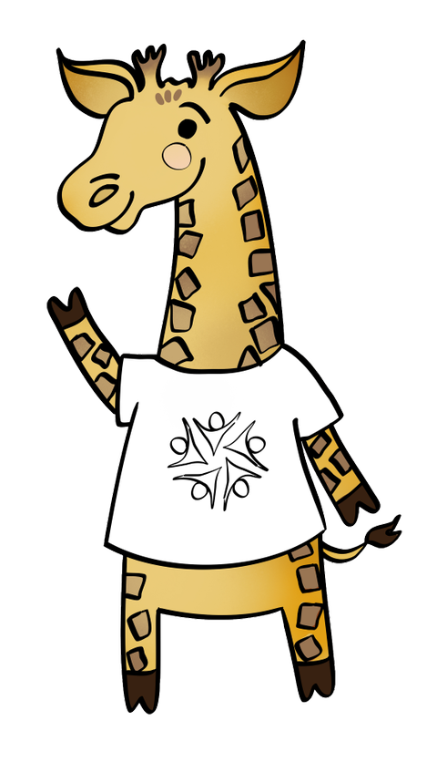
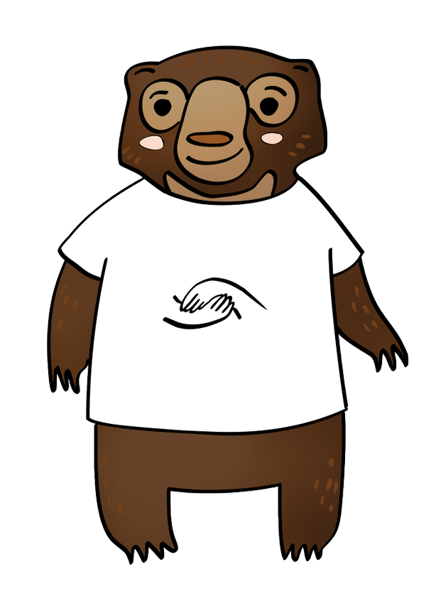
Common Good
Solidarity
Thinking of everyone
Showing we care
Notes:
Catholic Social Teaching, or CST, is at the heart of what we do and who we are. Today we will be thinking about two of the principles in particular: the Common Good (or thinking of everyone, as Chikondi the Giraffe says) and Solidarity (or showing we care, as Shristi the Sun Bear says).

Slide 5
What’s the best gift you ever received?
What’s the best gift you ever gave?
Notes:
Today we are going to think about gifts. Can anyone tell me what a gift or a present is?
I’d like you to think about the best gift you ever received. How did you feel?
Now, how about the best gift you ever gave to someone. How did that make you feel? Was it the same? Or better? (Tell the person next to you/the other person on your table).

Slide 6
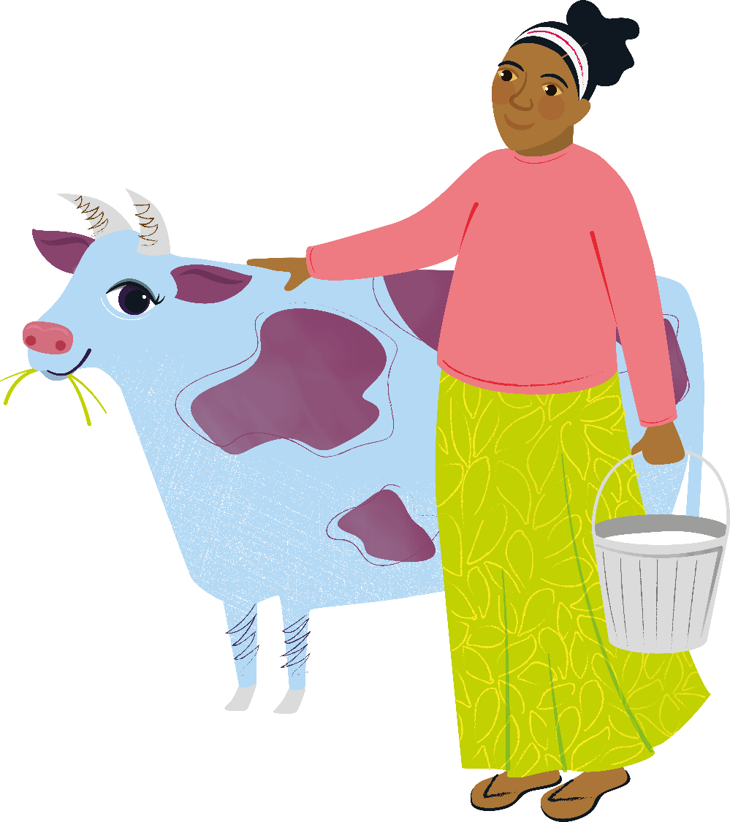
Notes:
Has anyone ever given or received a cow?! This marvellous moo cow is one of CAFOD’s World Gifts, that you can give to someone in another part of the world.

Slide 7
“For God loved the world so much that he gave his only Son.”
John 3:16
Notes:
World Gifts help to support our global neighbours.
As we know ‘God so loved the world so much that he gave his only Son’.
God gave us the most precious gift of his son Jesus. We make a difference too, by having fun together and raising money for a world gift.

Slide 8
2.2 billion people (nearly a third of the world’s population) are not able to wash their hands at home
Notes:
Let’s find out about some of the challenges our global neighbours face around the world, and how World Gifts can help.
2.2 billion people (nearly a third of the world’s population) are not able to wash their hands at home

Slide 9
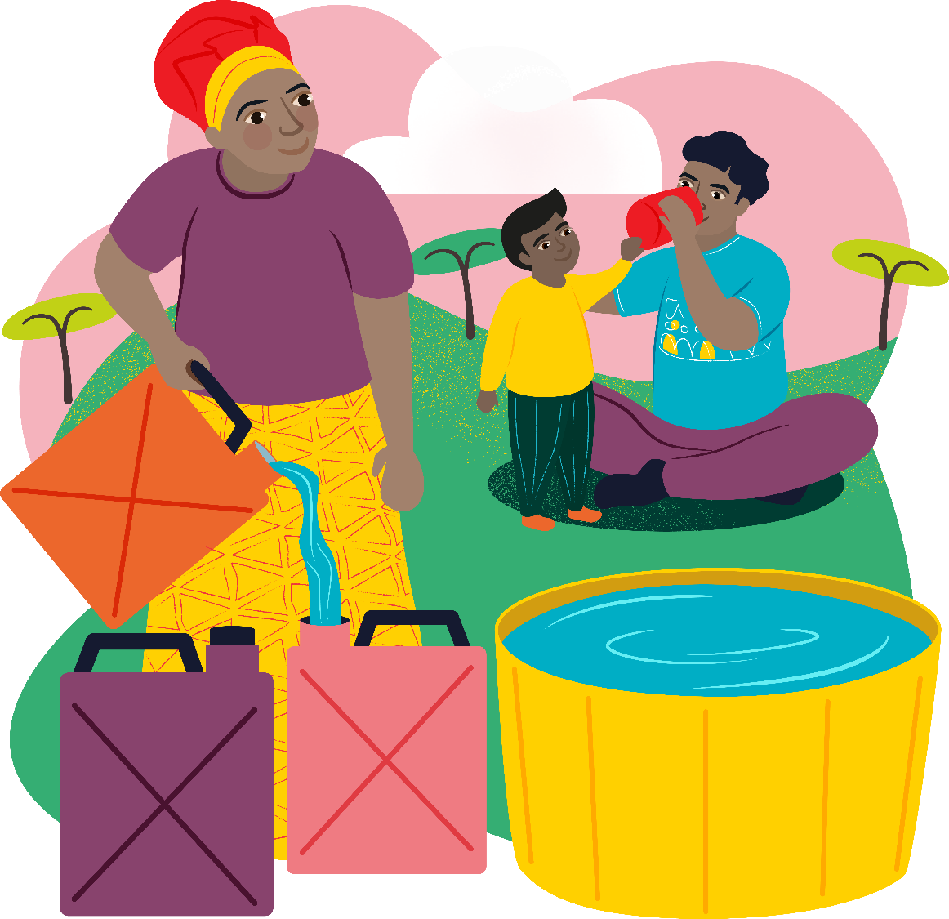
Emergency water
£5

Slide 10
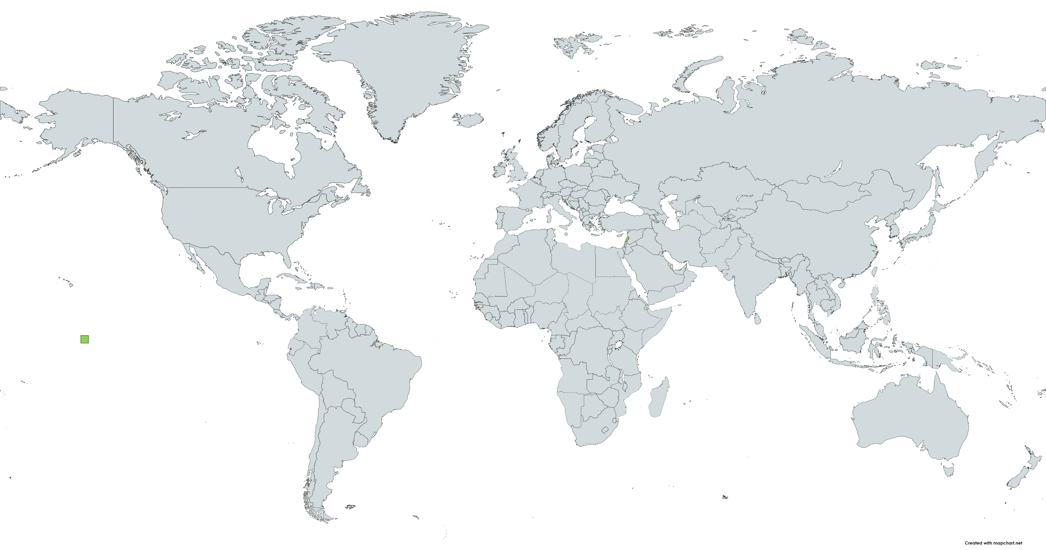
Lebanon
Notes:
Beirut is the capital of Lebanon. In 2020 there was an explosion in the city. This caused an emergency and a need for safe and clean water to get to people quickly.

Slide 11
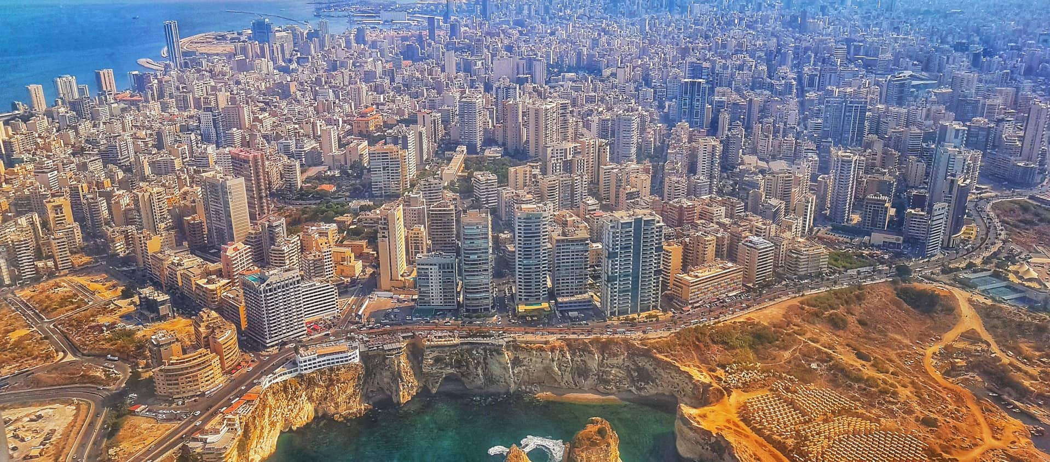
Beirut
Notes:
Beirut is the capital of Lebanon. In 2020 there was an explosion in the city. This caused an emergency and a need for food to get to people quickly.

Slide 12
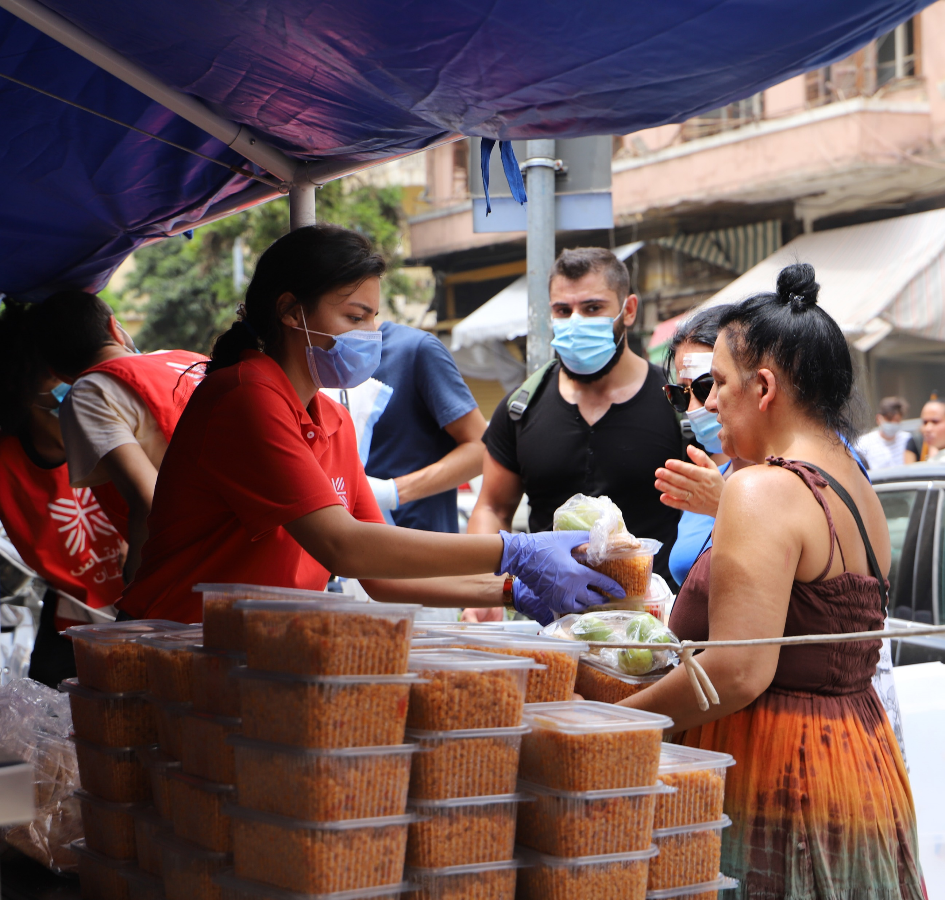
Emergency
water
Notes:
The explosion damaged half the city. Thousands of people were left homeless and unable to access even the basic things they needed, like water and food.

Slide 13
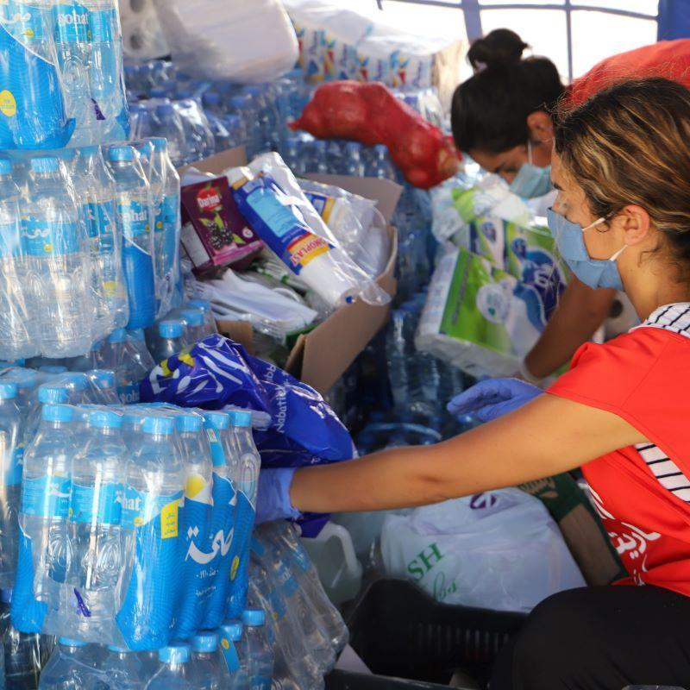
Notes:
But thanks to CAFOD’s work with local experts – who were already there as part of the Caritas family – we were able to instantly help people by distributing life saving water.

Slide 14
Emergency water
£5

Slide 15
Deforestation and damaged land keeps growing.
Notes:
In the past 20 years, more than 100 million hectares of forest has been chopped down – similar to the size of 100 million football pitches. This, and other types of pollution, damage the land and make it hard to grow crops.

Slide 16
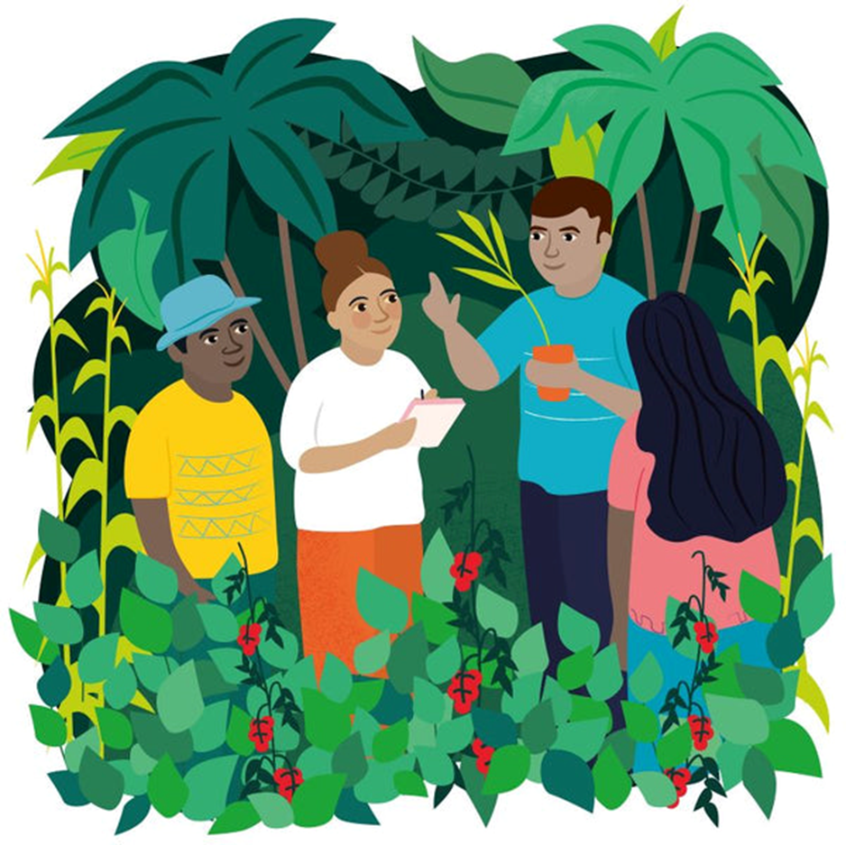
Forest school
£40

Slide 17
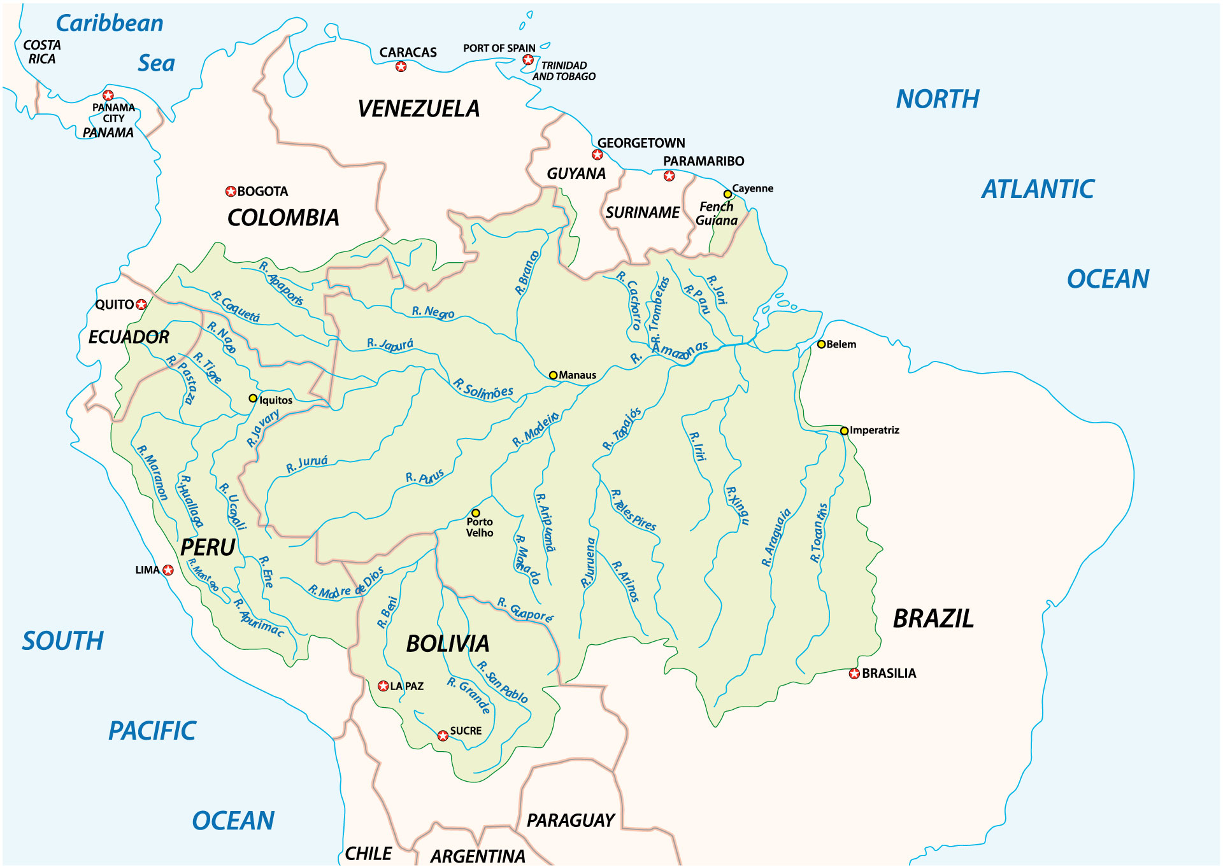
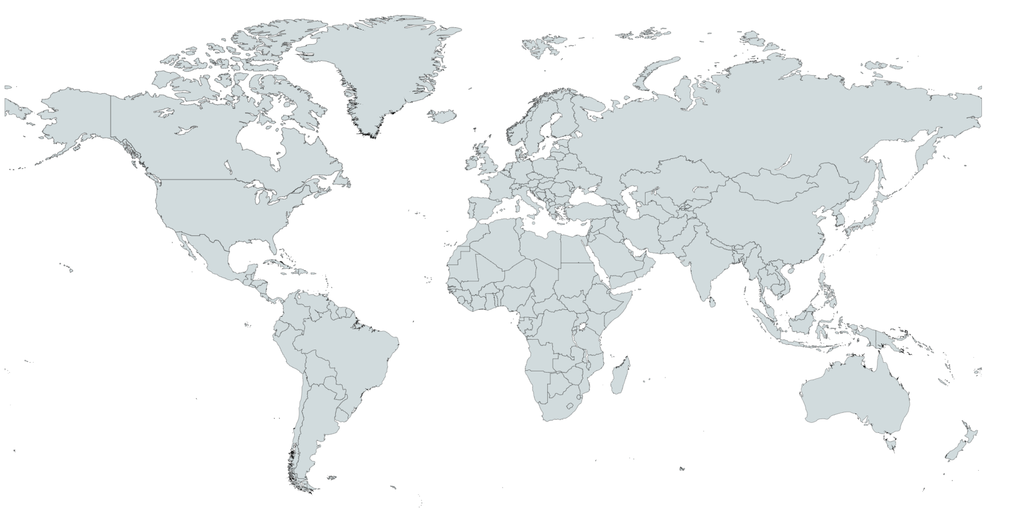
The Amazon Rainforest
Notes:
One of the worst areas of deforestation is in the Amazon rainforest. The rainforest covers 9 countries, the largest of which is Brazil.

Slide 18
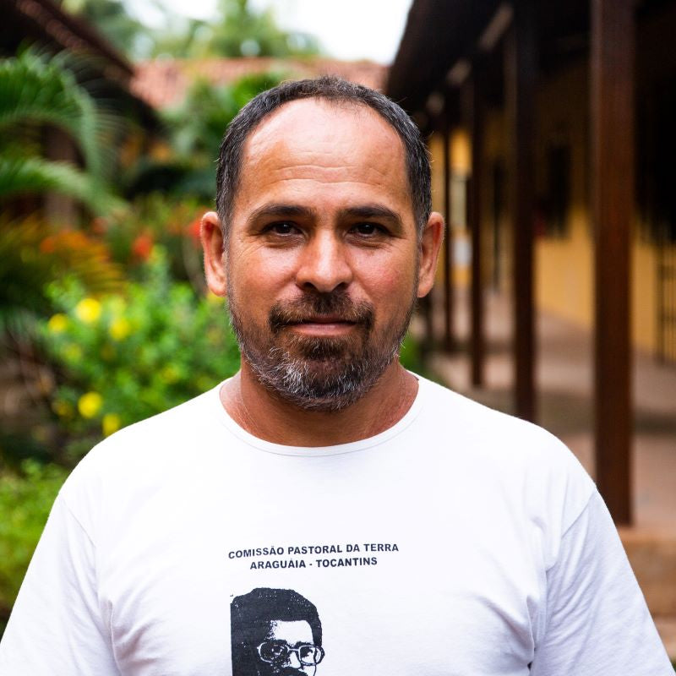
Chiquinho
Notes:
Chiquinho lives in Brazil.
He is an expert in eco-friendly forest farming that helps with the health of the Amazon rainforest and helps families grow enough food to eat.
With so much deforestation and even smaller farms damaging the forest around them, it’s very important for people to continue to learn and use these farming techniques.

Slide 19
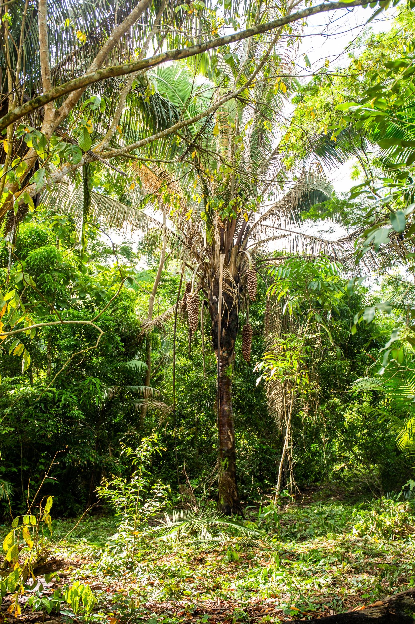
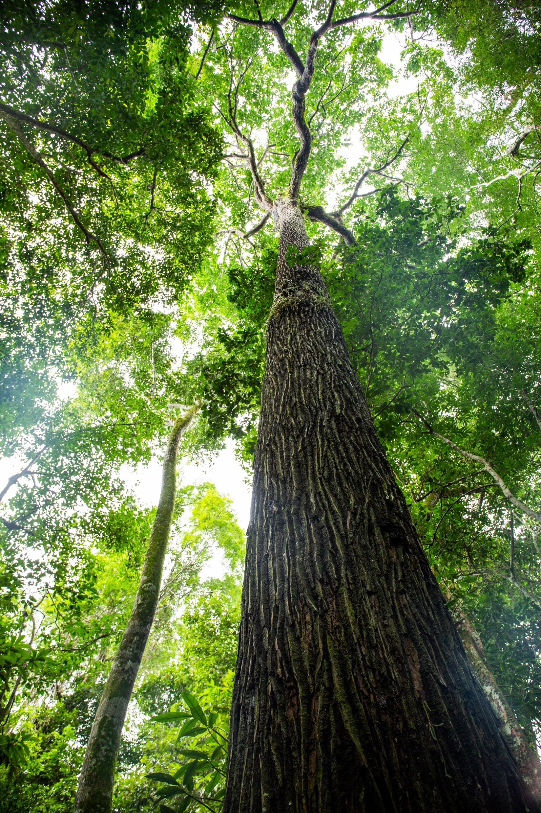
Notes:
Chiquinho works with local communities to encourage and teach them how to grow fruits and vegetables without using chemicals.
This way of farming produces a more varied and bigger harvest. It also enables the soil, water, plants and animals of the Amazon to recover and flourish.

Slide 20
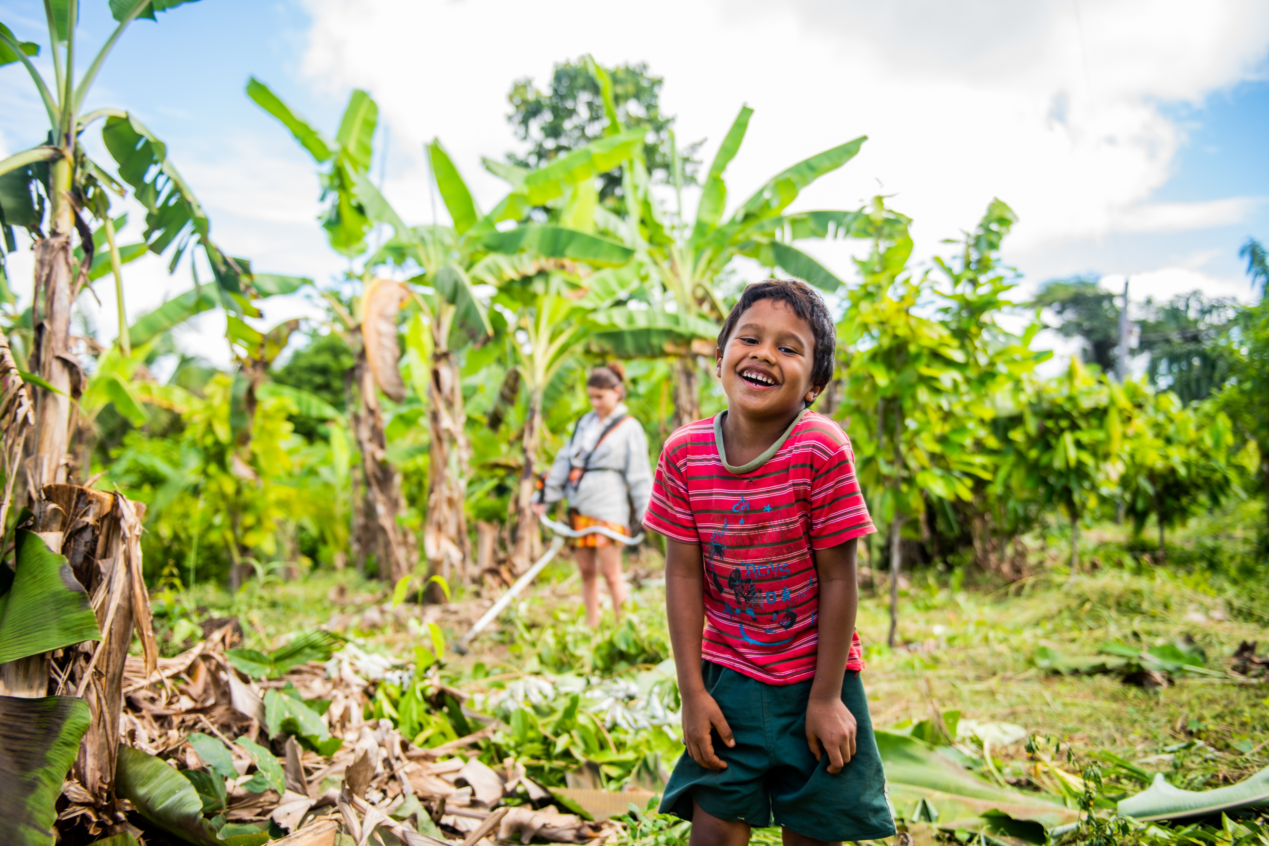
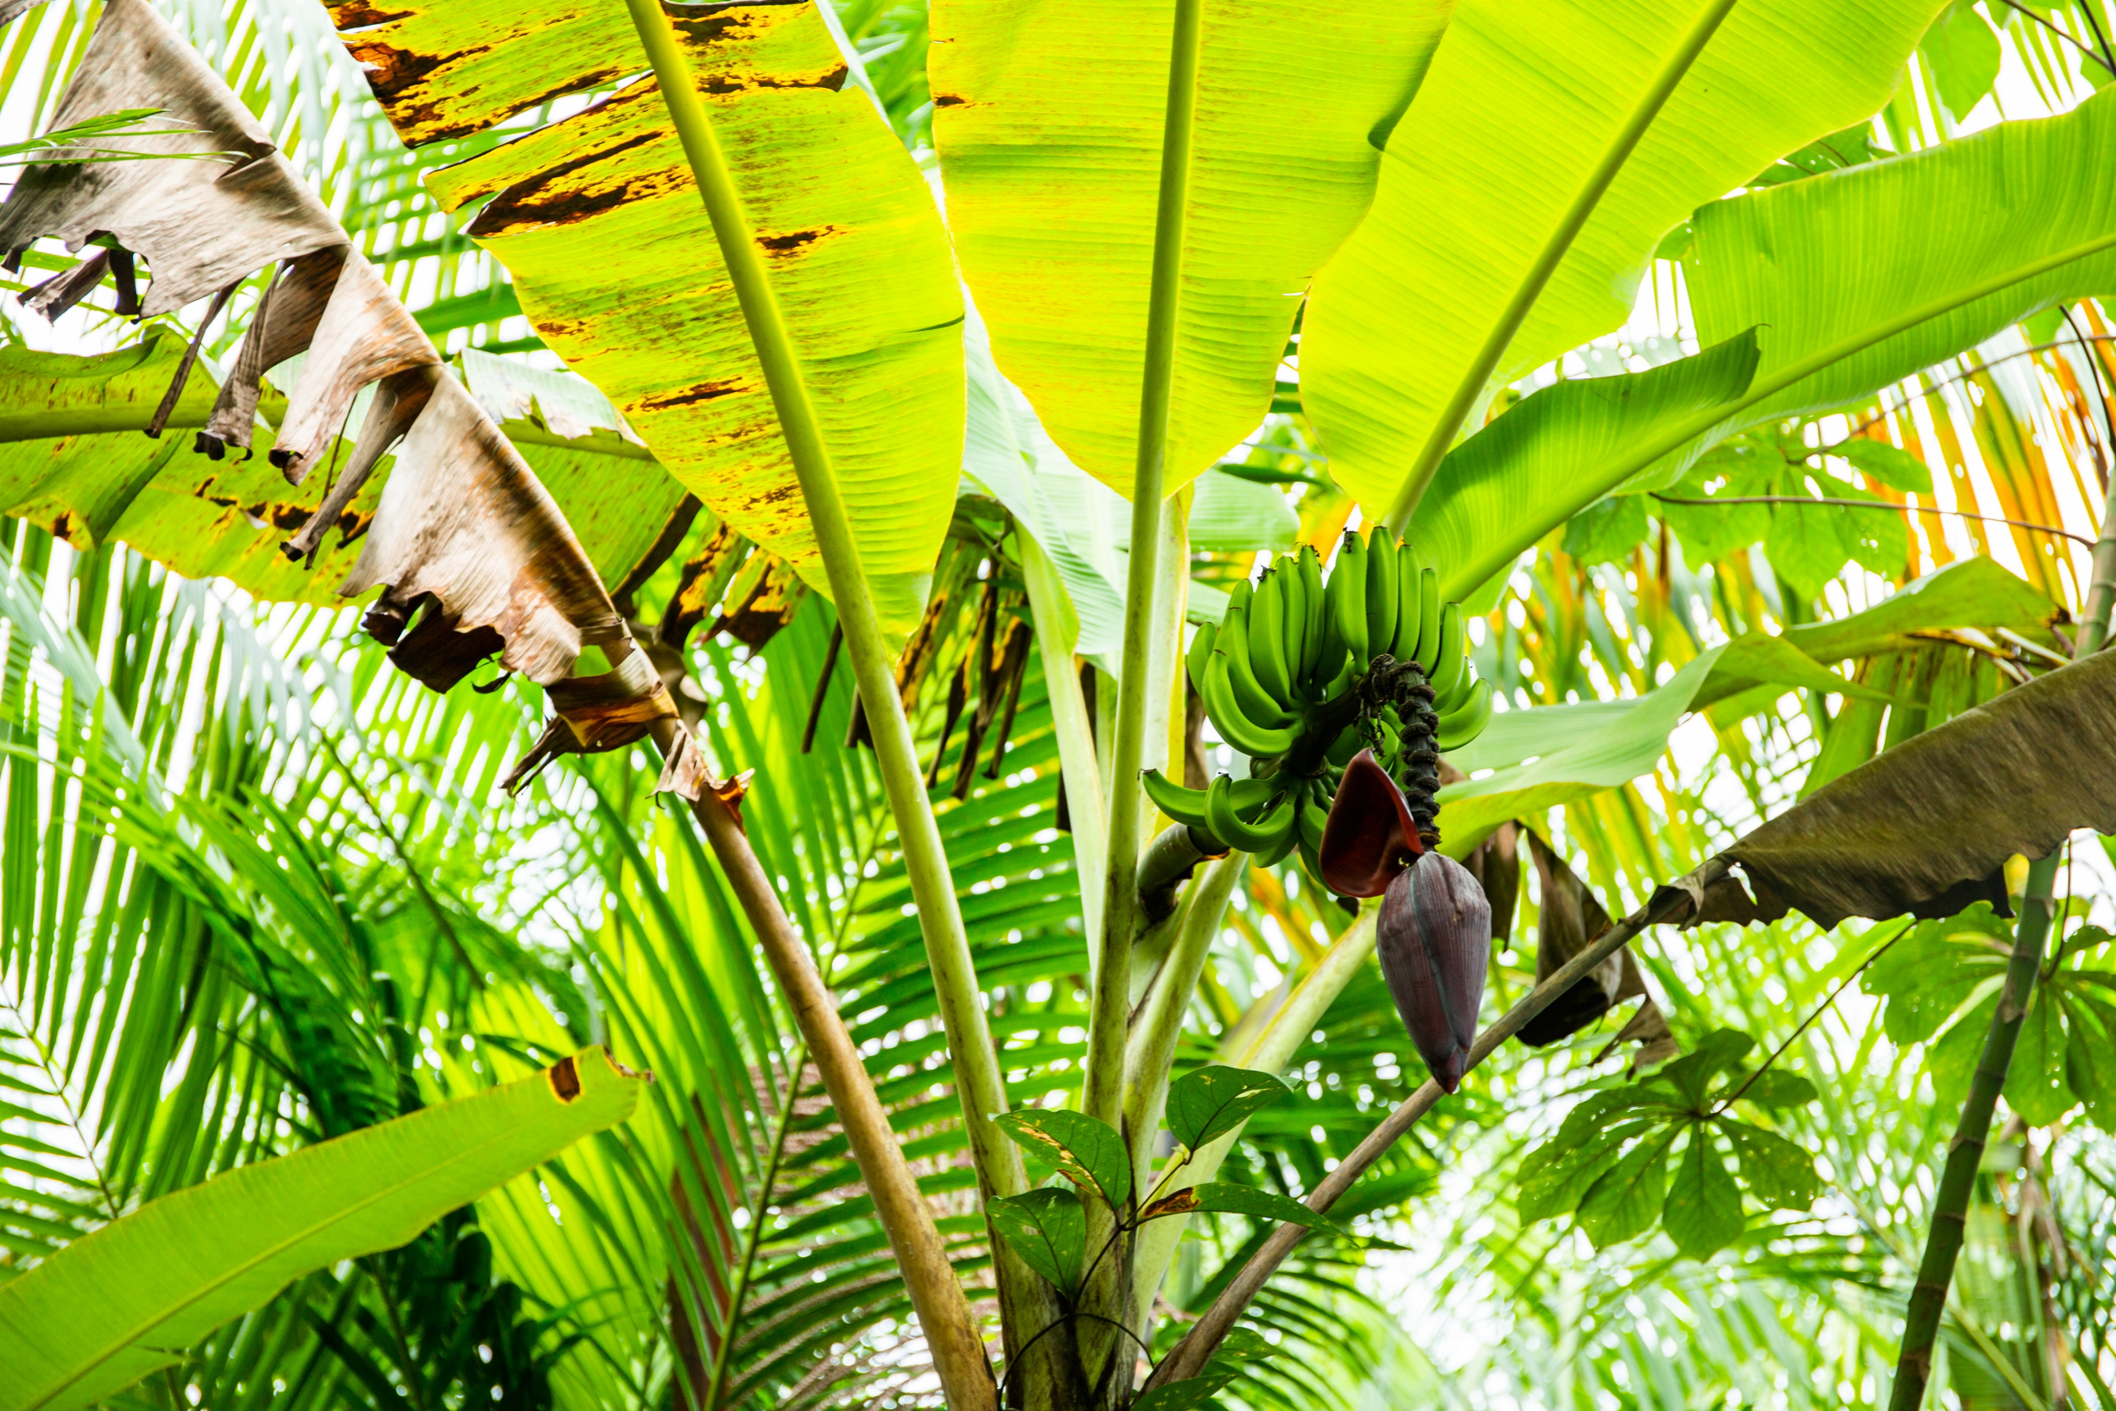
Notes:
The communities he works with are often living under threat of powerful groups who use violence and fraud to grab the land away.
Chiquinho says,“The forest can be used by humans in a way that humans don’t dominate nature and nature doesn’t dominate humans. We work together. Neither one excludes the other.”

Slide 21
Forest school
£40
Notes:
£40 can provide a year of help showing people how to grow fruit and vegetables, while also helping the rainforest to recover and flourish.

Slide 22
3 people in every one thousand are refugees, those who have had to leave their homes.
Notes:
Around the world, and average of 3 people in every one thousand are refugees, those who have had to leave their homes.

Slide 23
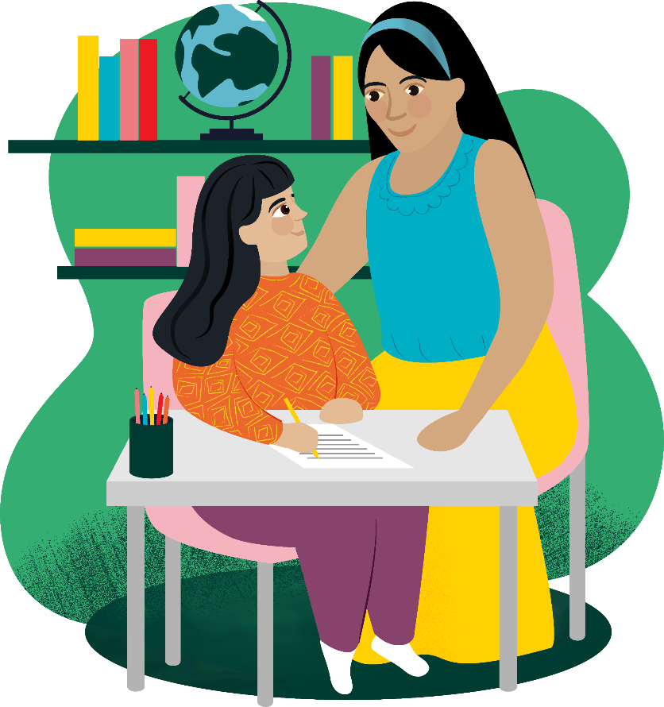
Help a refugee child
£46

Slide 24
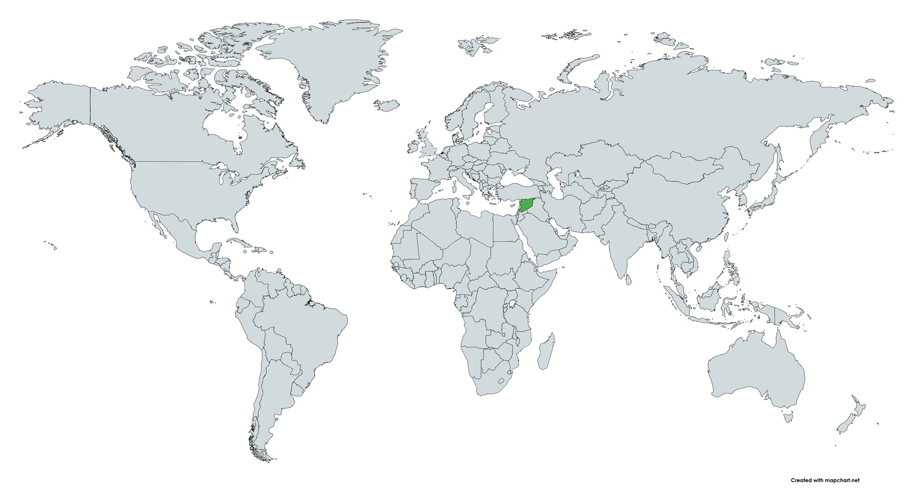
Syria

Slide 25
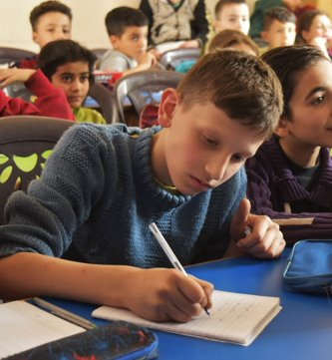
Sami
Notes:
Sami is nine years old and lives in Syria. He has been through so much with the conflict in his country. He was scared to go to school.
Sami has worked closely with his teachers to overcome his fears. With this support and with CAFOD-funded classes, Sami has been able to return to school. He is doing well, and when he is older, Sami wants to help rebuild Aleppo and create a better future for himself and his country.

Slide 26
Help a refugee child
£46

Slide 27
2.4 billion people are without food or unable to eat a healthy balanced diet on a regular basis
Notes:
2.4 billion people are without food or unable to eat a healthy balanced diet on a regular basis – that’s about 3 people out of every 10 around the world. We’ve already talked about how emergencies affect people’s access to food, but we can support our global neighbours for the longer term as well.

Slide 28
Marvellous moo cow
£150

Slide 29
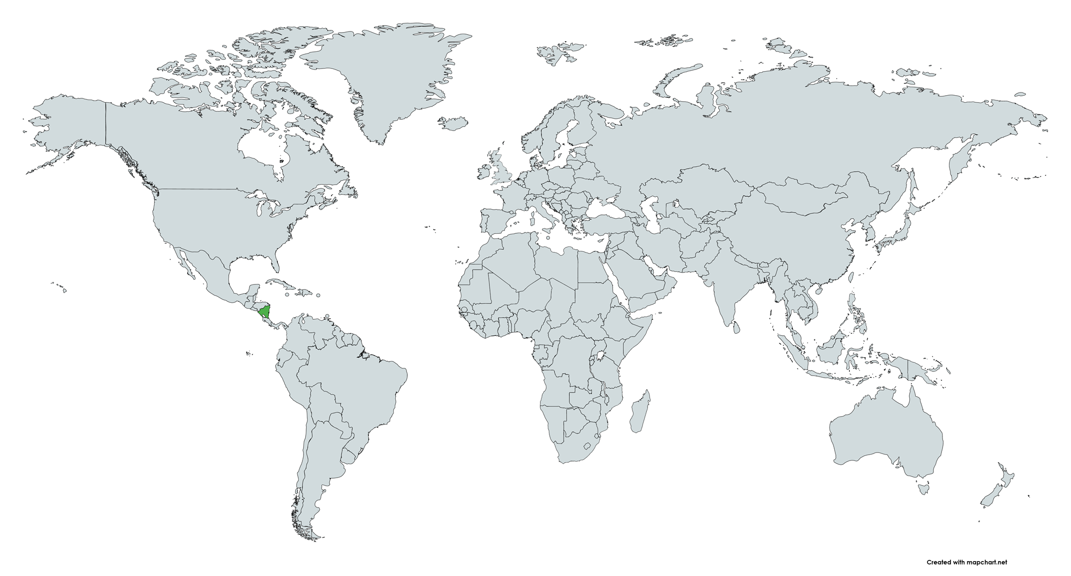
Nicaragua
Notes:
Finally we are going to Central America, to Nicaragua. Nicaragua is a country with coast on both the Pacific Ocean and the Caribbean sea.

Slide 30
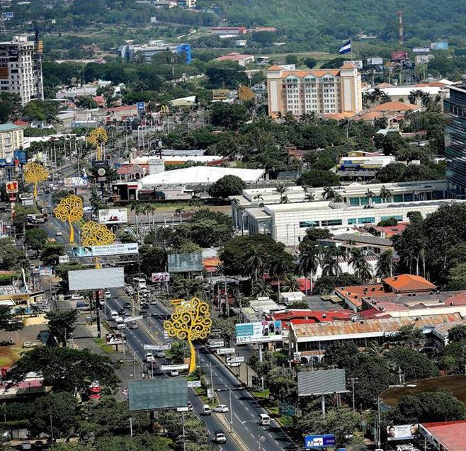
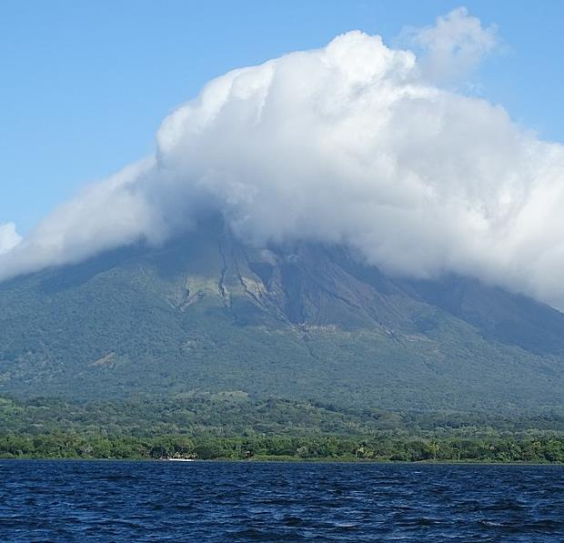
Notes:
It has high mountains and the two biggest lakes in Central America. There are cities and there is countryside.

Slide 31
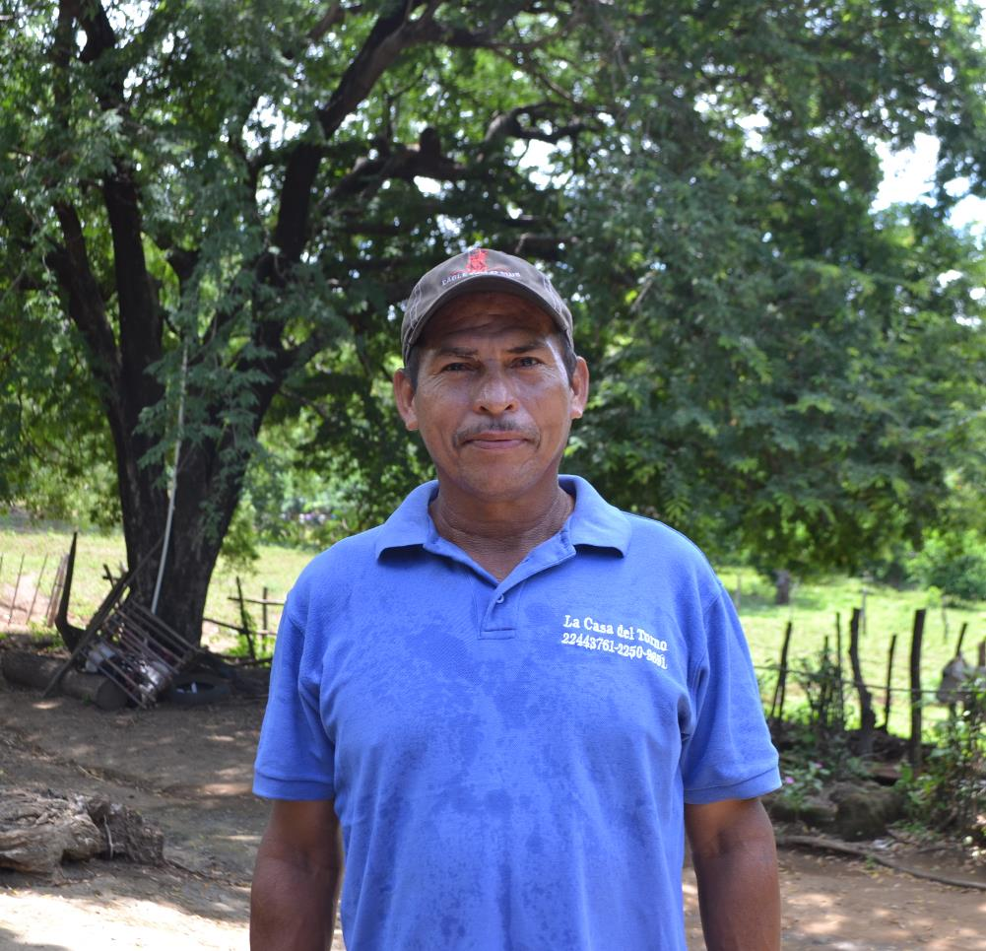
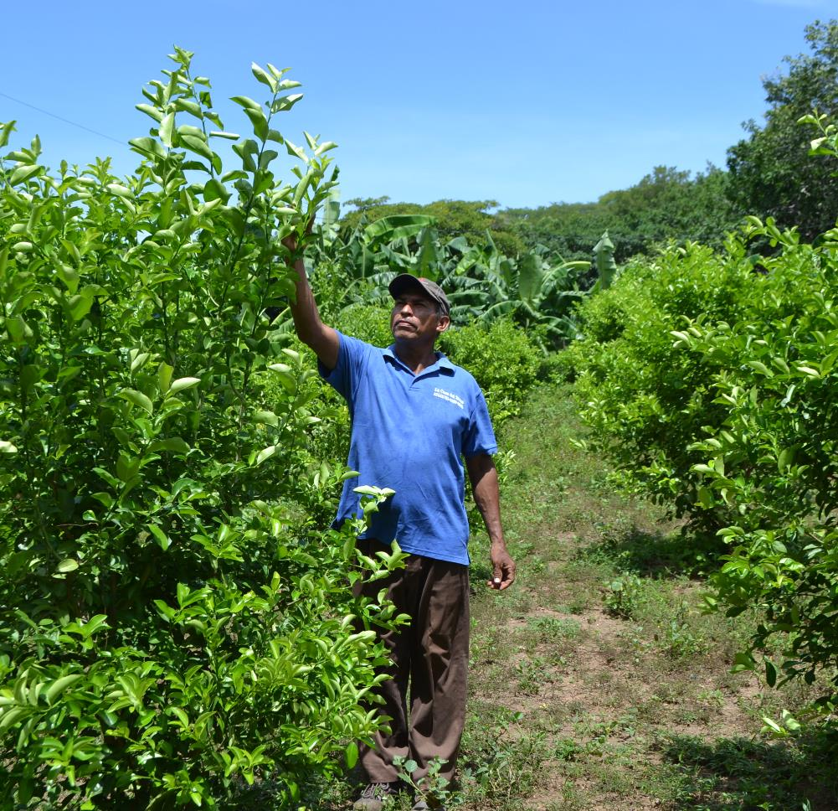
Wilmer
Notes:
Wilmer lives with his wife and two children in the countryside in Nicaragua. Climate change is making life hard where they live. With ever increasing extreme weather, local farmers like Wilmer struggle to produce enough food to feed their families or make savings.
Wilmer has received training on how to look after cattle, as well as how to keep cows healthy so they produce more milk.

Slide 32
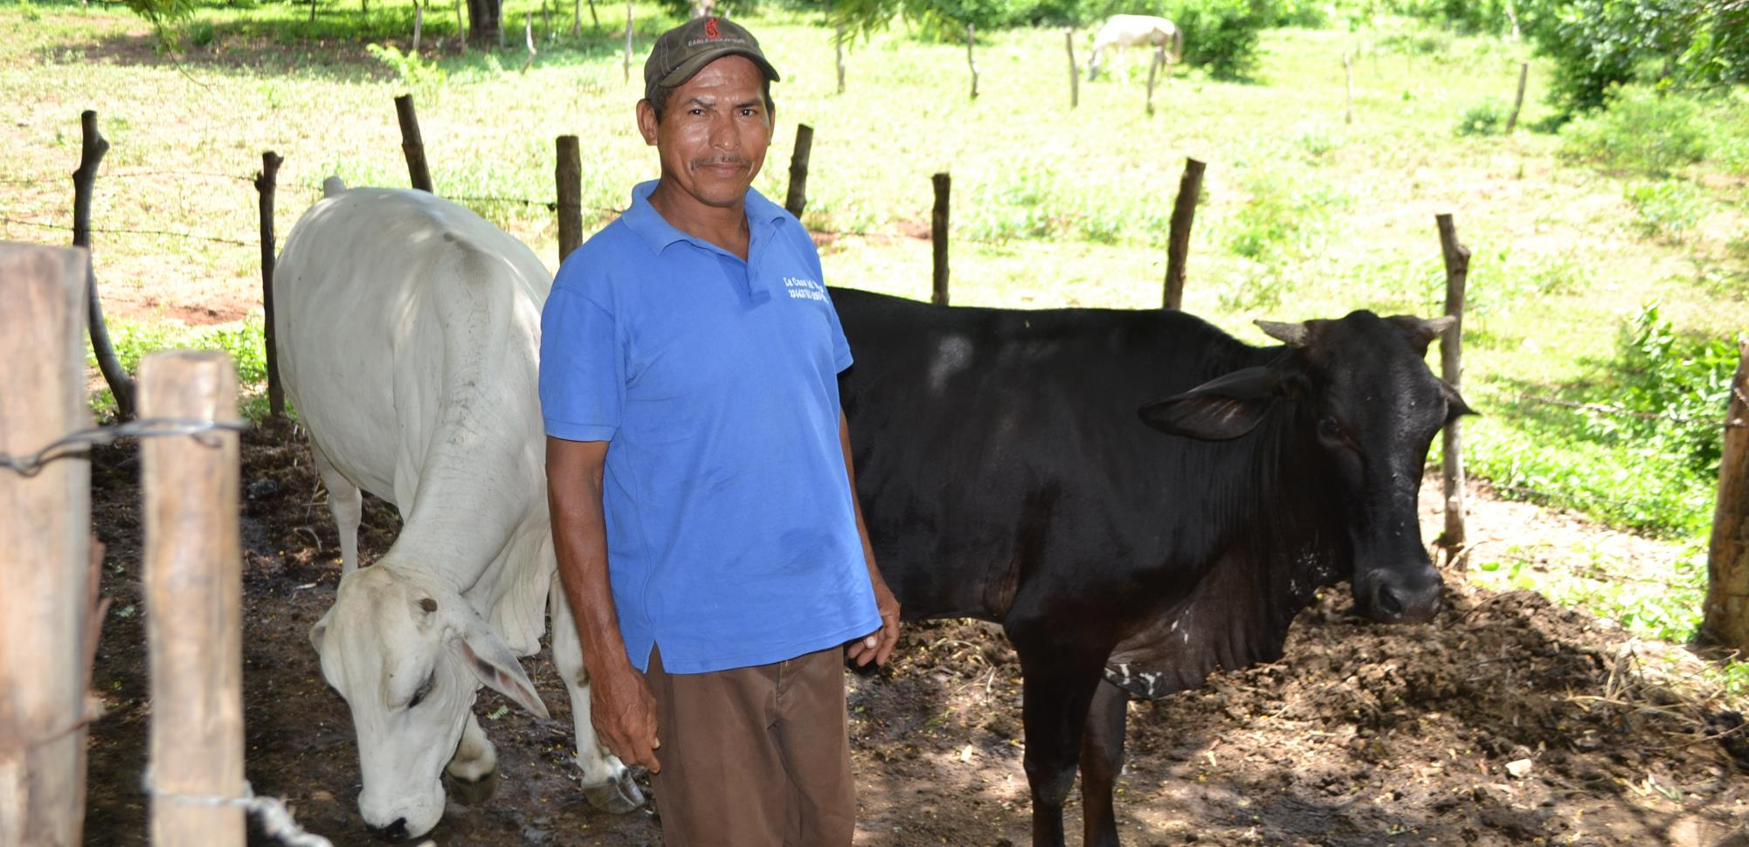
Notes:
For now, the one cow produces enough milk for Wilmer and his family, but he hopes to be able to raise more cows in future so he can sell extra milk and cheese for a profit. “For the moment the cow’s milk is just for our own family but if the farm grows, we can also sell milk to others”.

Slide 33
Marvellous moo cow
£150

Slide 34
Make a
of difference!
Notes:
So you can see how much difference you can make to our global neighbours. There are even more available at worldgifts.cafod.org.uk
These gifts can change lives.
There are lots of ways you can work together to raise money for a World Gift. You could do a Brighten Up fundraiser. You could do sponsored events. Or you could collect money over the weeks, or the even the whole term to save up for a big gift.
Grid posters to track progress available at cafod.org.uk/primary or cafod.org.uk/schoolfundraising

Slide 35
Notes:
However much you raise will make a difference and as Pope Francis says:
“My dear young people, a better world can be built as a result of your efforts, your desire to change and your generosity!”

Slide 36
Loving God,
Your Son was the greatest gift ever for the world.
Help us to remember all that He taught us
About loving our brothers and sisters,
Wherever they live in your world.
Amen.

