Slide 1
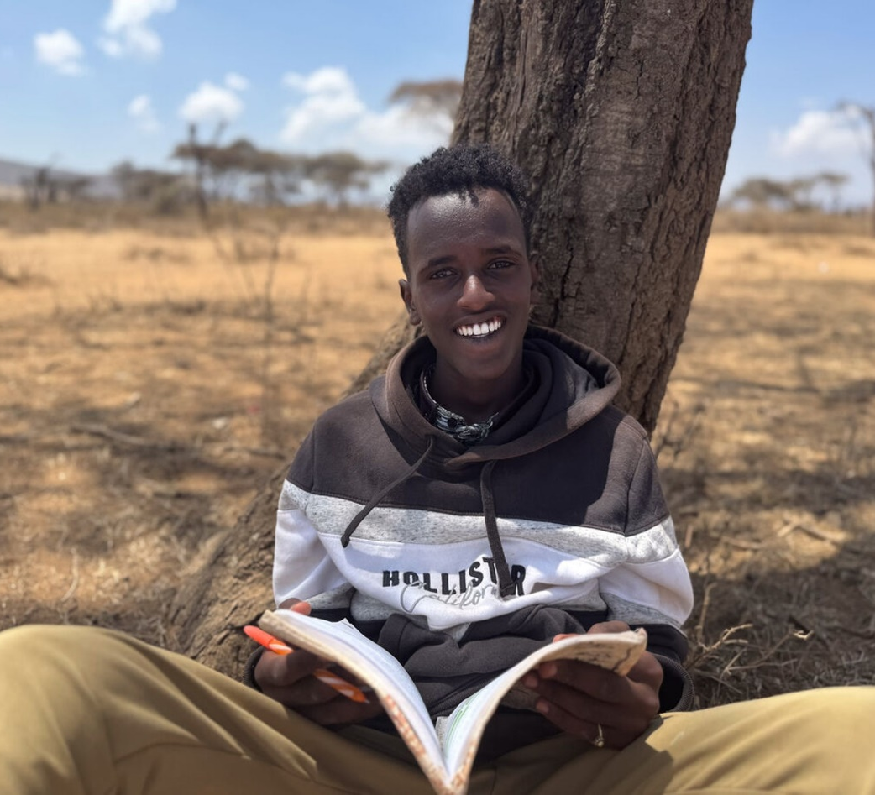
What gifts will you thank God for?
Gospel Celebration of the Word
Notes:
Children’s liturgy: Twenty-eighth Sunday in Ordinary Time (Year C)
Preparation of the worship space
Colour: green
Props: coloured pens and pencils
Song suggestions
In the Lord I’ll be ever thankful (944, Laudate)
Welcome
Today we hear about how ten people were healed by Jesus, but only one of them said ‘thank you’. Let’s think about the importance of saying thank you to each other and to God.
Abadhalee, Southern Ethiopia
Photo credit: Louise Norton

Slide 2
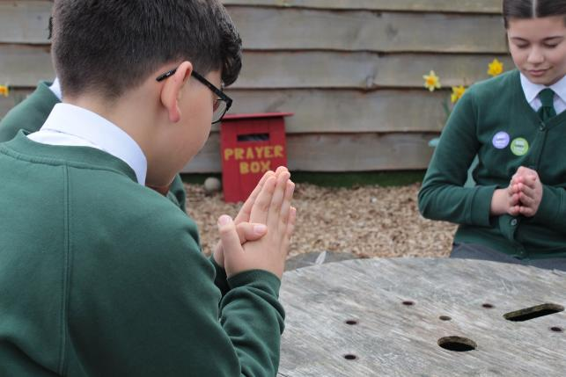

God of grace and mercy, we give you thanks for all the wonderful things you have done for us. May we turn to you with thanks and praise. Amen.
Gather
Notes:
St Francis Xavier's RC Primary School, Herefordshire
Photo credit: Vicky Ahmed

Slide 3

Gospel: Luke 17: 11-19
As Jesus made his way to Jerusalem, he went along the border between Samaria and Galilee. He was going into a village when he was met by ten men suffering from a skin disease. They stood at a distance and shouted, “Jesus! Master! Take pity on us!”
Jesus saw them and said to them, “Go and let the priests examine you.”
On the way they were made clean. When one of them saw that he was healed, he came back, praising God in a loud voice. He threw himself to the ground at Jesus’ feet and thanked him. The man was a Samaritan.
Jesus said, “There were ten men who were healed; where are the other nine? Why is this foreigner the only one who cam back to give thanks to God?” And Jesus said to him, “Get up and go; your faith has made you well.”
Word

Slide 4
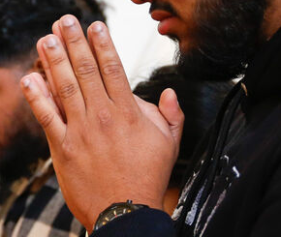

What do you remember from the Gospel reading?
Today we heard that Jesus gave the amazing gift of good health to ten men who all had an illness called leprosy. But what happened afterwards? Did all the men say thank you for the gift they had been given?
While all ten men were happy to receive the gift, only one of them gave thanks to Jesus and praised God.
Respond
Notes:
Hounslow parish event
Photo credit: Ben White

Slide 5
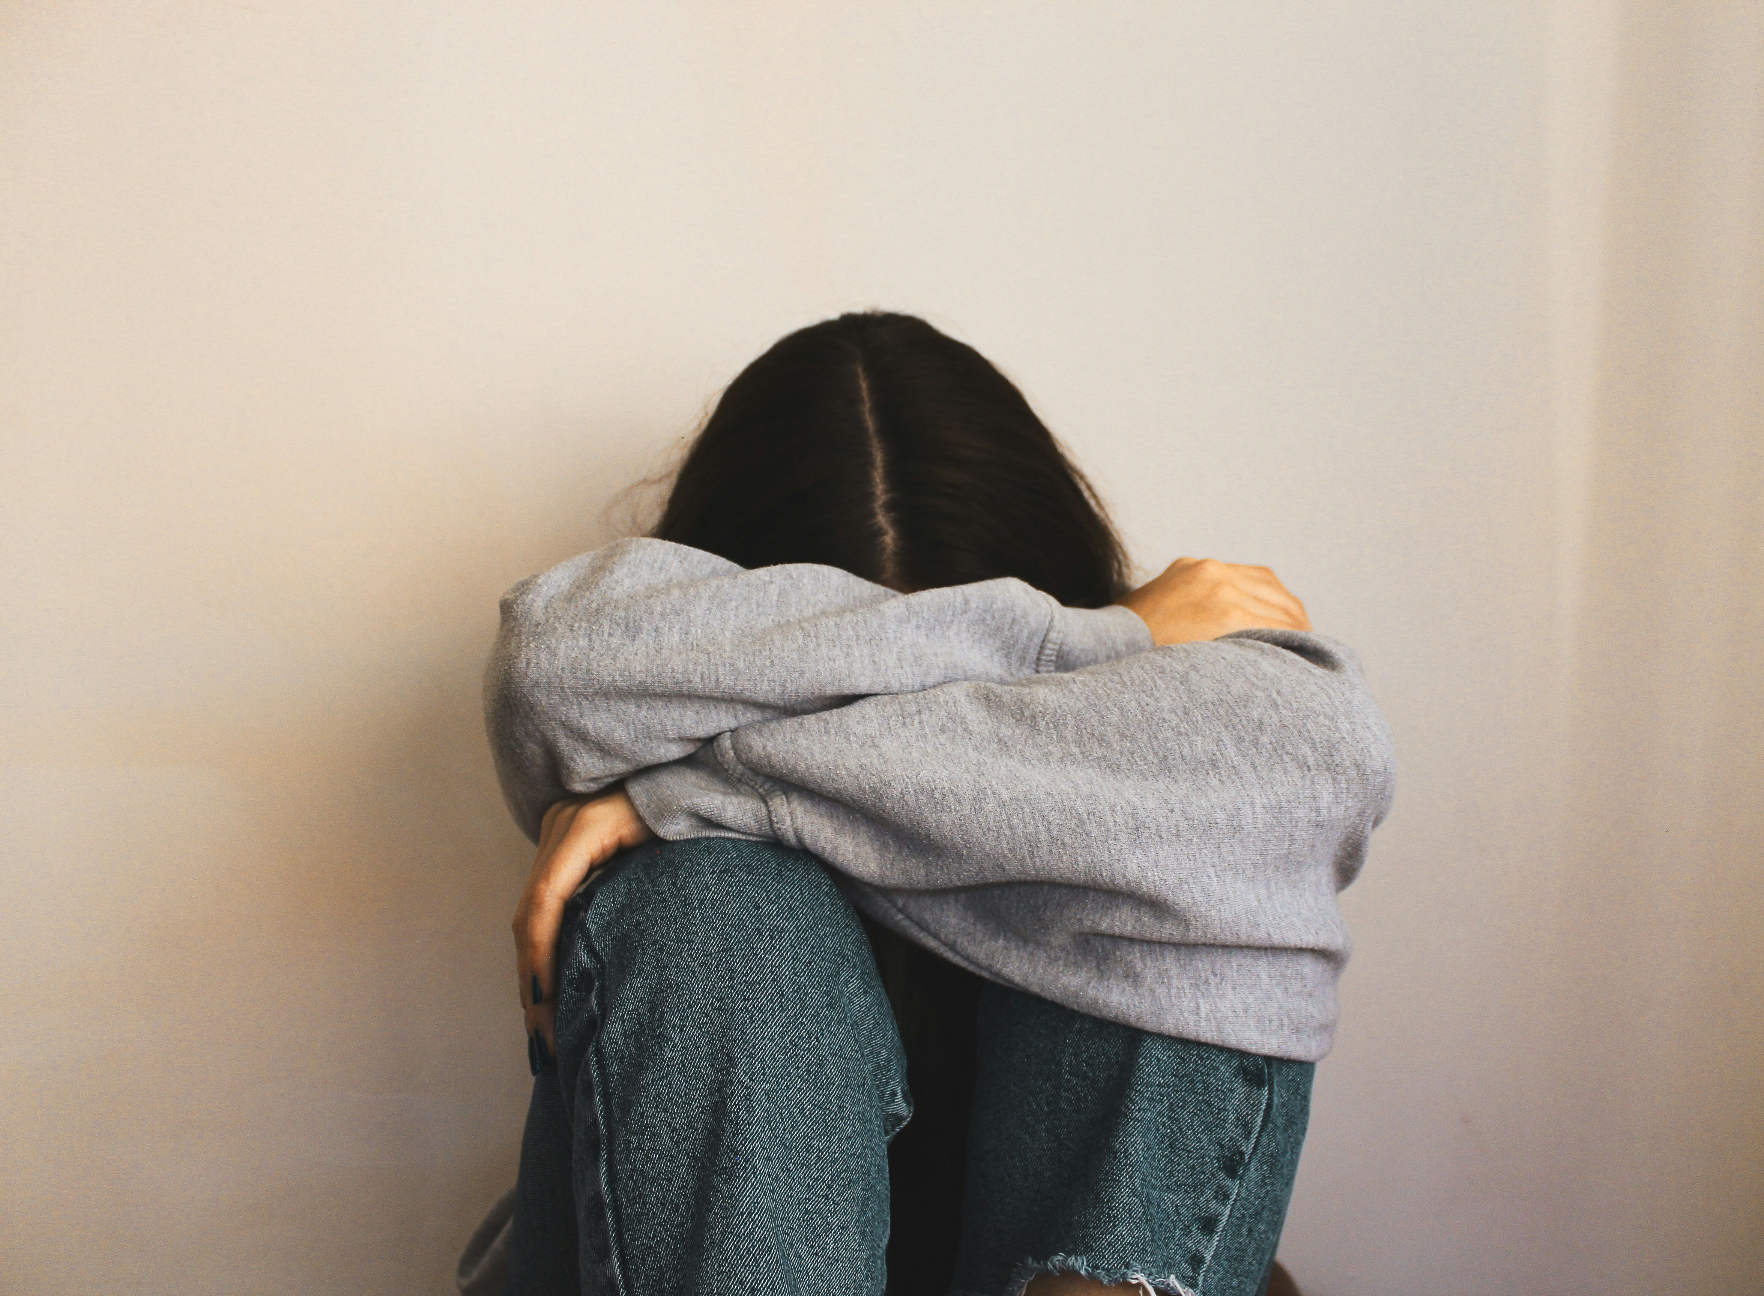
This illness can be very painful.
People with leprosy couldn’t get too close to others for fear of making them sick too. They couldn’t even hug their families or friends anymore.
They had to live separately to everyone else.
Imagine if you weren’t able to hug or be near the people you love. How would you feel?
Notes:
Sitting alone
Photo credit: Carolina on Unsplash

Slide 6
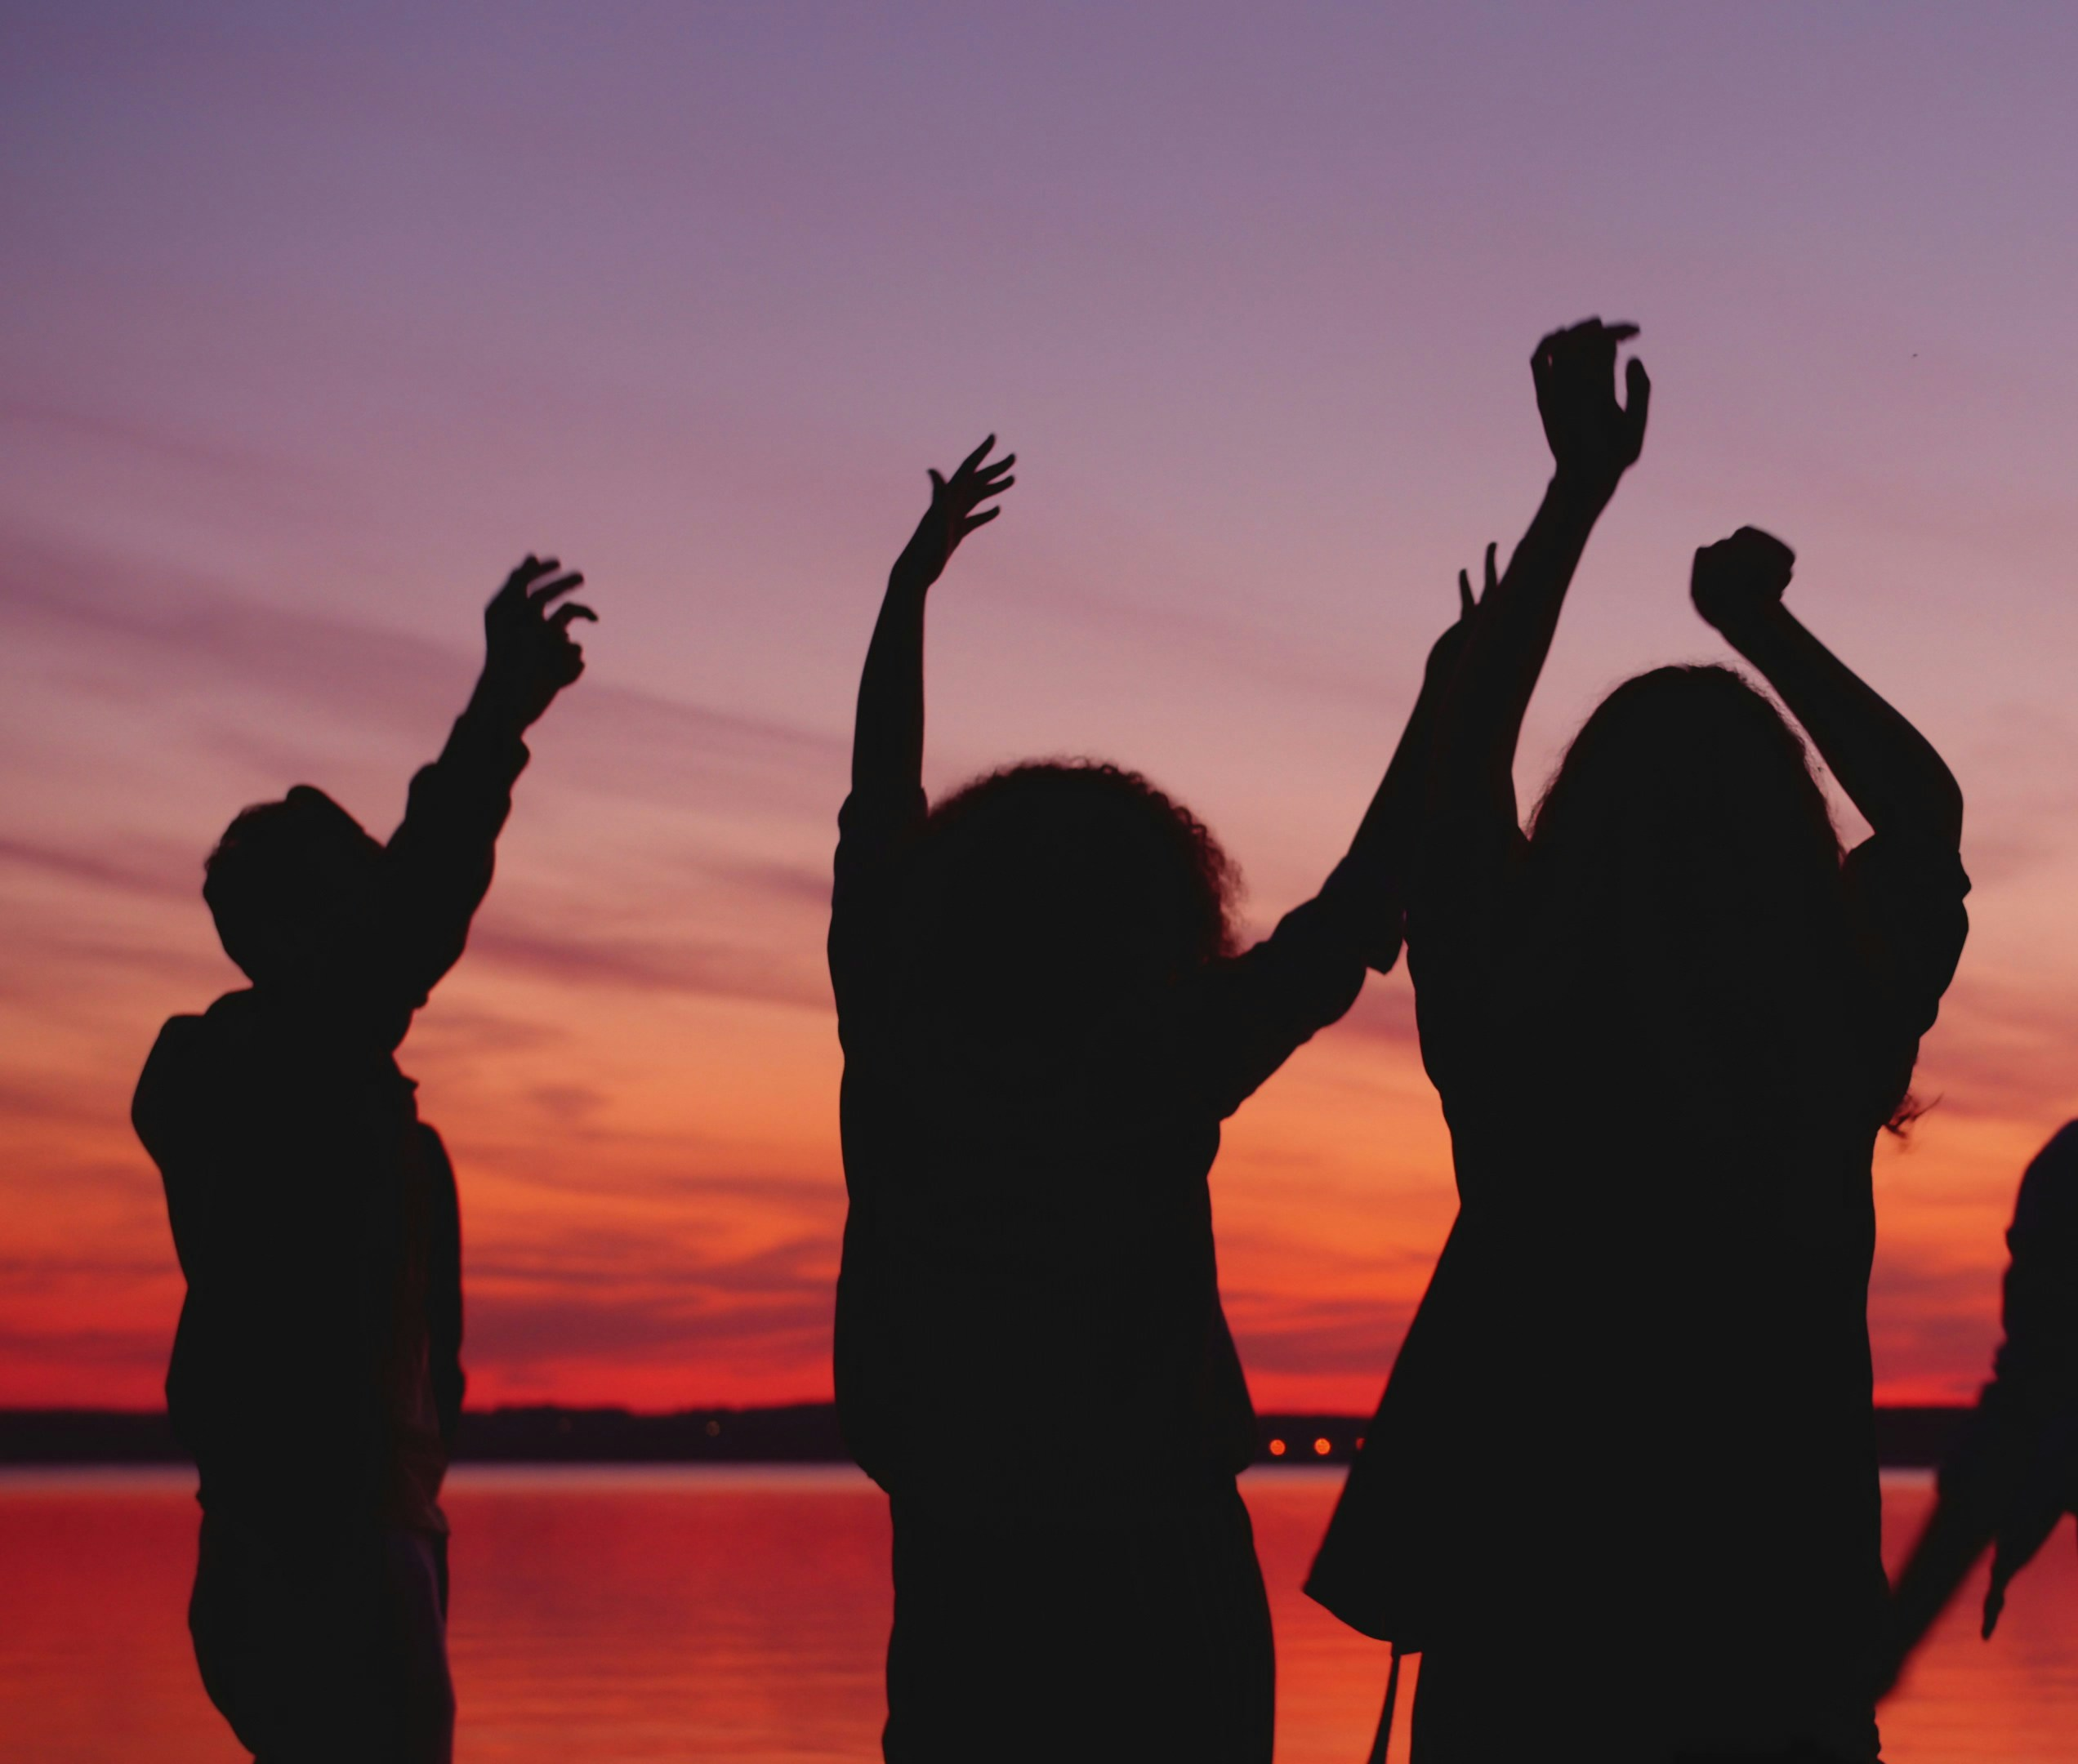
How do you think the men felt when they realised that they were well again?
What do you think the nine men who didn’t return to Jesus did instead?
Perhaps they ran home to their families and friends? After all, they’d been living away from them for ages.
Can you imagine how excited they were and how happy their families must have been to see them again?
Notes:
Feeling happy
Photo credit: Vitaly Gariev on Unsplash

Slide 7
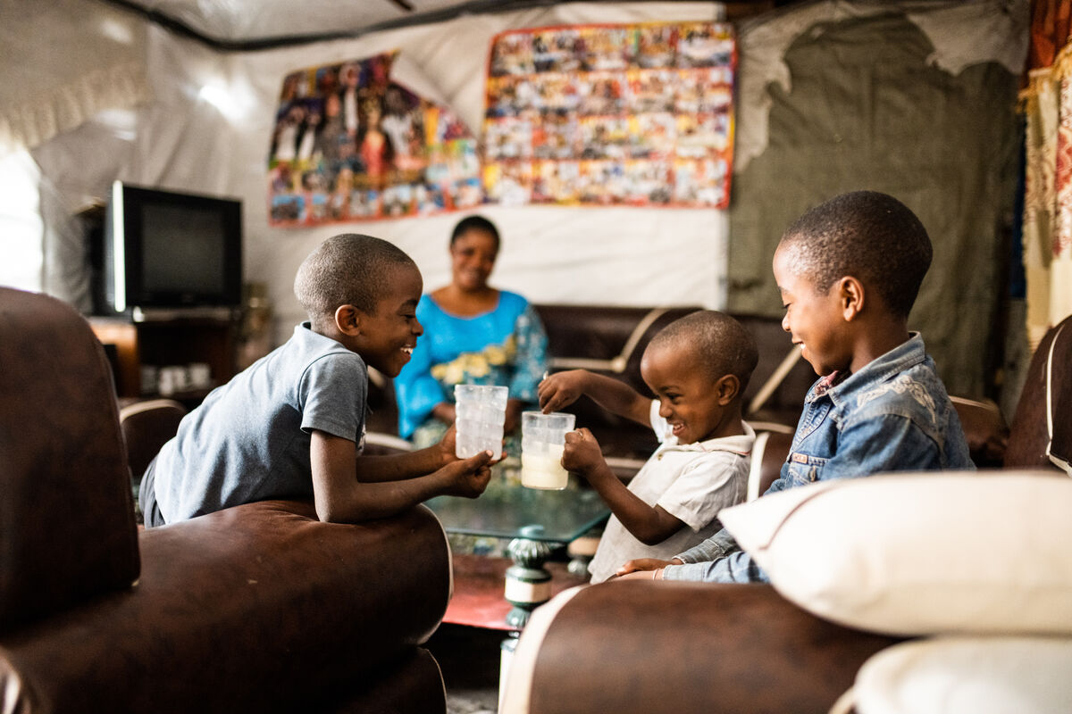
Though the nine other men were really happy to be healed, they didn’t return to Jesus to give thanks for what he had done.
Only one man went back to show how grateful he was for the gift of health and a new life with his family.
What has God given to you?
Notes:
What has God given to you? (Give some examples to help the children if you think you need to e.g. a family, friends, all the animals and plants in the world, love, talents, food etc.)
Anuarite Kahindo sharing milk with her children
Photo credit: Arlette Bashizi

Slide 8
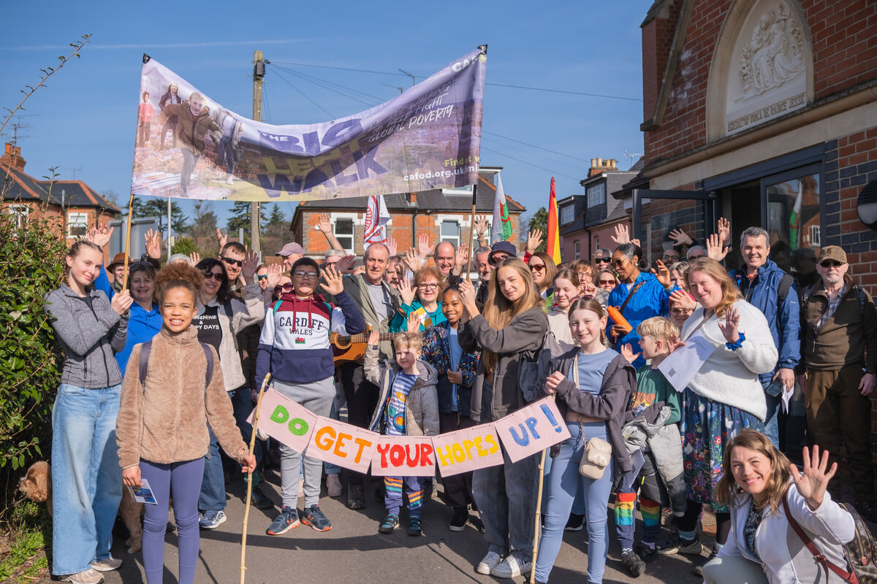
Like the man who returned to Jesus, we should praise and thank God for all the amazing things that we have been given.
When we see all that we have as a gift from God, it is easier to share what we have. It makes us want to care for the earth and make it a fairer place for all people to live – a place where all people have enough food to eat, safe water to drink, a home to live in.
Notes:
Community Big Lent Walk, Reading
Photo credit: Amit Rudro

Slide 9
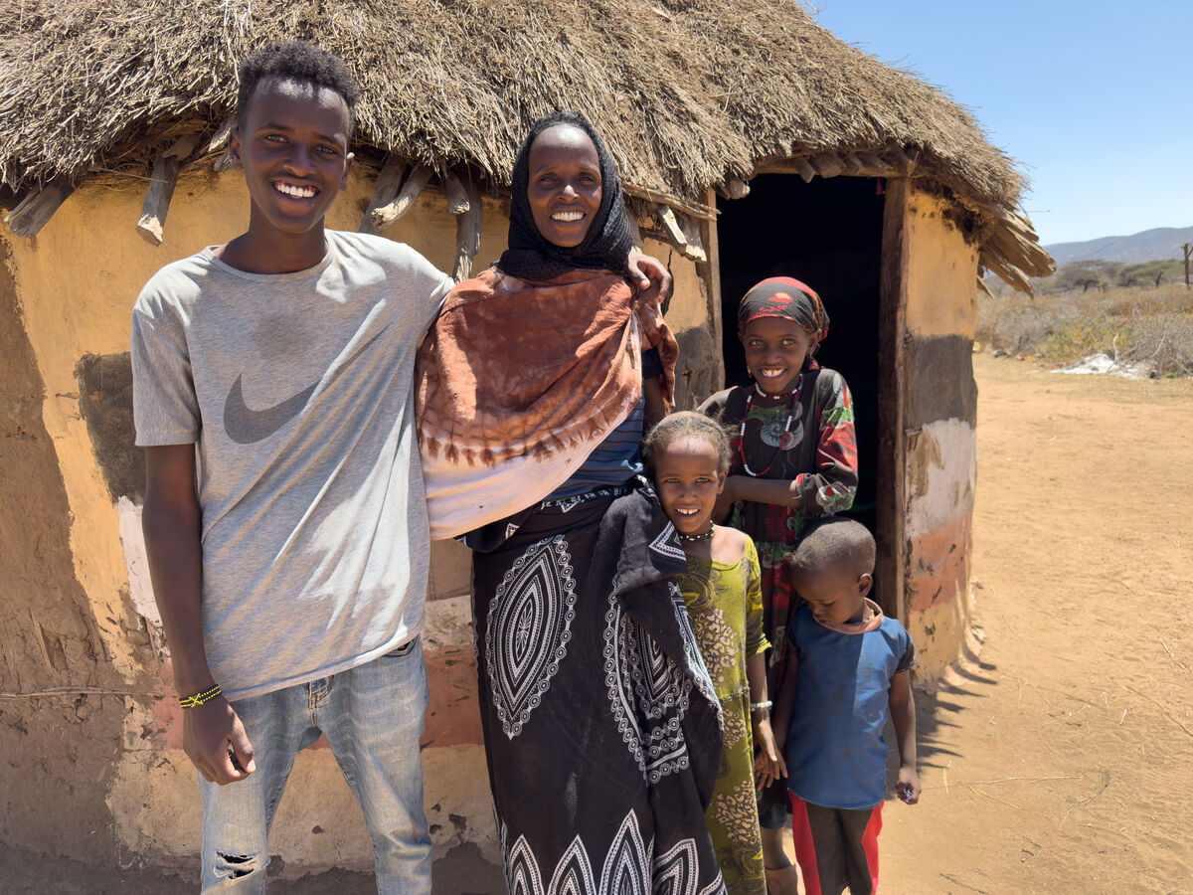
This is Adi with her children. Adi is thankful a water tank has been built close to where she lives. Before, she had to walk five hours to fetch clean water for her family, leaving her children alone.
"This water tank is a blessing for us," says Adi. "Instead of walking five hours for water, we can now spend time with our children."
Notes:
Adi and her children, Southern Ethiopia
Photo credit: Louise Norton

Slide 10
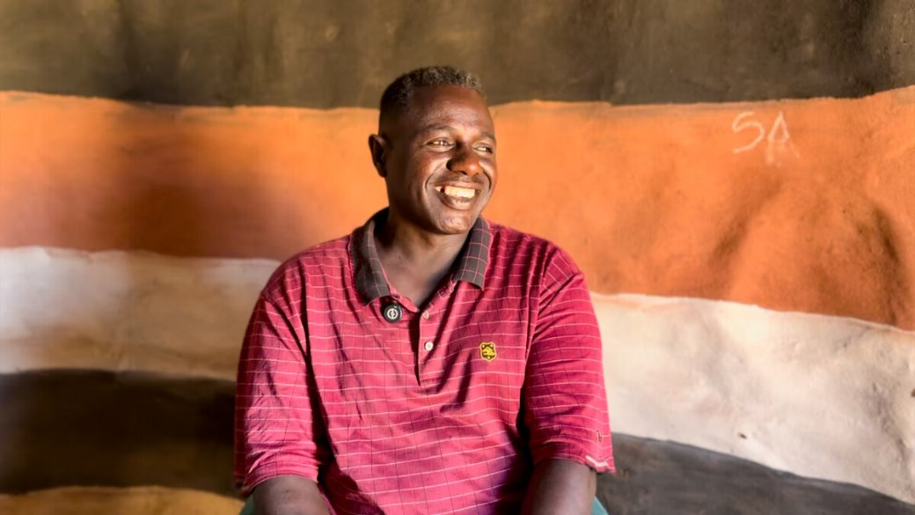
Abbiott grew up in the same community as Adi and saw how the change in the weather he had been used to as a child had affected his people.
Less rainfall meant there was not enough clean water to drink, or enough for crops and animals to survive.
Notes:
Abbiott, Southern Ethiopia
Photo credit: Louise Norton

Slide 11
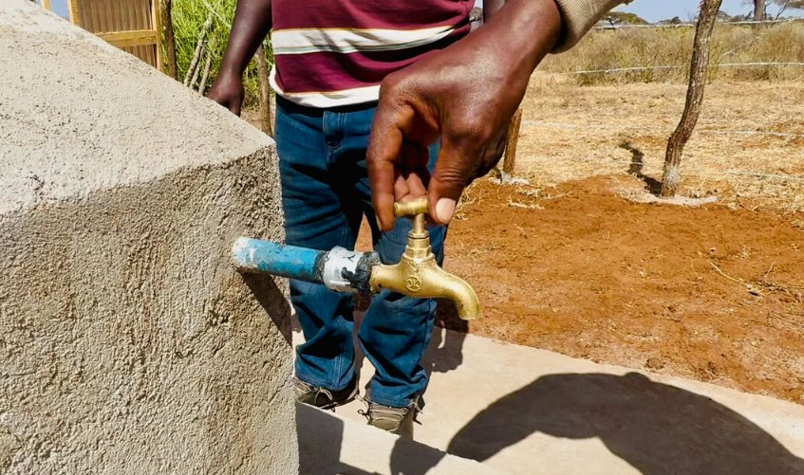
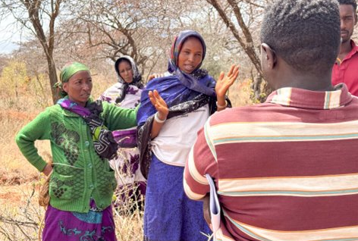
Abbiott went to university to study climate change so that he could help his community and work to build a better world.
With CAFOD's help, Abbiott has developed a tank that catches water when rain does fall. It can store enough water for around 300 families.
Abbiott is thankful that all the community came together to help build the tank. "Working together is good," he says.
Notes:
CIFA (Community Initiatives Facilitations and Assistance) water tank project
Photo credit: Louise Norton

Slide 12
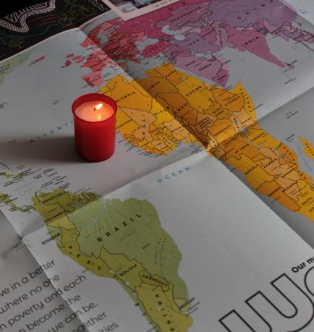
Let us pray
We pray for the church:
that it may always be a place of healing love which welcomes all people.
Lord in your mercy…
We pray for our brothers and sisters especially those that are ill or are struggling to get enough food: that they may find comfort and support from those around them.
Lord in your mercy…

Slide 13
Let us pray
We pray for our parish, family and friends:
that they may be moved to care for all people with tenderness and compassion.
Lord in your mercy…
Loving Lord,
Help us to remember all the good things we have which come from you. Fill our hearts with thanks and praise. Help us to make sure all your people have their fair share of the gifts you give for us all. Amen.

Slide 14
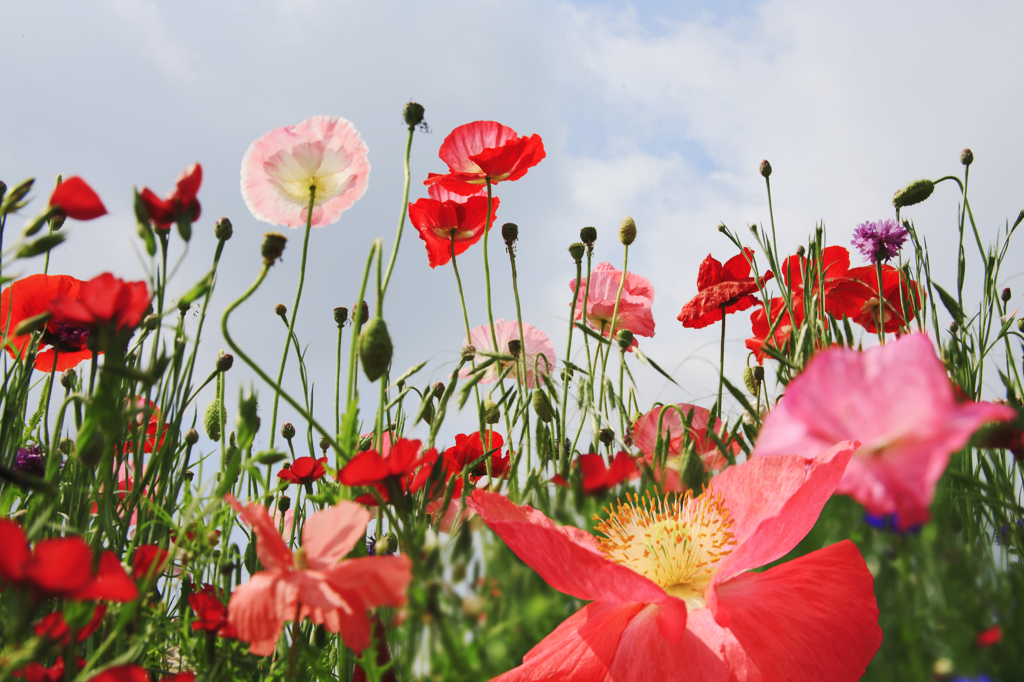

What gifts will you thank God for this week?
Send
Notes:
Nature
Photo credit: Stock image

Slide 15
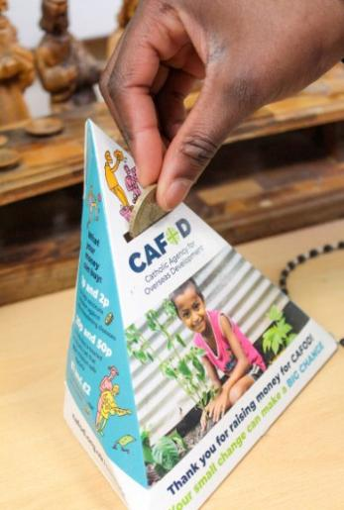
CAFOD Family Fast Day
Hundreds of schools and parishes across England and Wales raised money for CAFOD's recent Family Fast Day.
Explore our fundraising resources and find out how your school can support people like Abadhalee and his family.
Notes:
St Francis Xavier's RC Primary School, Herefordshire
Photo credit: Vicky Ahmed

Slide 16
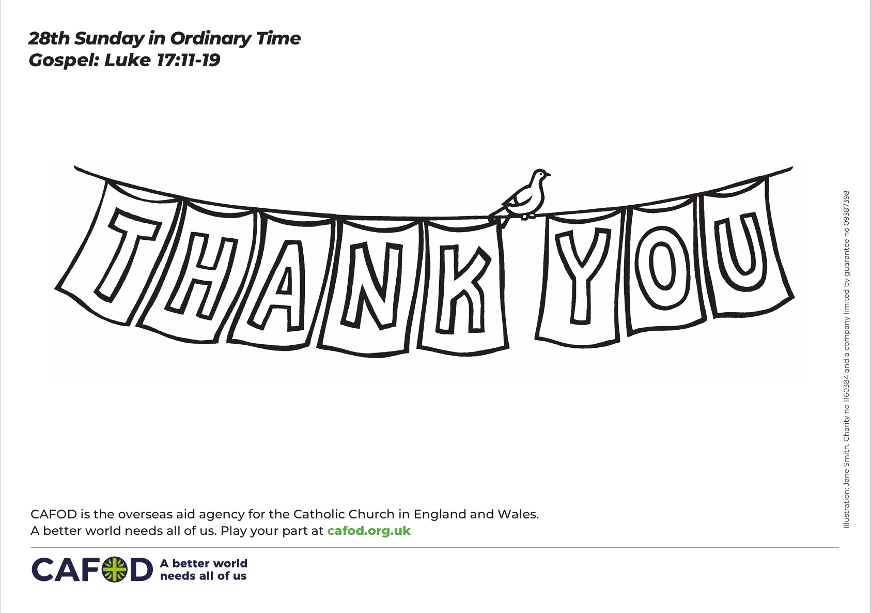
Activity suggestions
Download the illustration
Invite the children to colour in the accompanying illustration and to write or draw what they are thankful for under the banner. Remind the children to think about the importance of saying ‘thank you’ each day. Perhaps they could make a thank you card for someone during the week.
Encourage the children to get into pairs and pray for each other by saying – God bless [name of child] always. Amen. Or they can make up their own words. When they have finished, encourage them to thank each other for their prayers.
Invite the children to thank God this week in the home, at school and with friends. They could write a thank you prayer for all the things God has done for and given to them.
Remind the children to share all that they have heard and thought about in the liturgy today with the people at home. Remind them to thank God in their prayers and to say thank you to others in the coming week.
Notes:
Illustration: Jane Smith

Slide 17
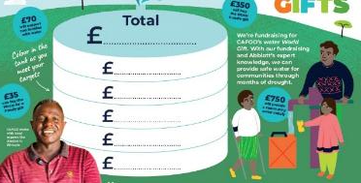

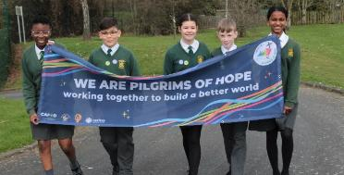
Get involved with CAFOD this term
Season of Creation
Fundraise this term
Jubilee activities
Watch our national assembly
Order an Autumn fundraising pack
Watch our new animation on water
Make the Jubilee Pledge
Tell us about your Jubilee Debt action!

Slide 18
