Slide 1

Welcome
Advent Calendar
2026
“Be on guard, keep awake.
For you do not know when the time will come.”
Mark 13:33
Hope
Peace
Joy
Love
Notes:
Bethlehem Illustration: Sam Obsorne, CAFOD.
Advent candle graphics: M. Wallflower, Trendify, via Canva.
Green foliage: Sketchify, via Canva.

Slide 2
Celebrating the season of Advent
Welcome to CAFOD's secondary school’s Advent calendar 2026!
The word “Advent” comes from the Latin word adventus, meaning “coming” or “arrival”.
Advent is a season of waiting, hope and preparation.
During this season, Christians prepare to celebrate the birth of Jesus at Christmas and look forward in hope to the day when Christ will come again.
Advent also marks the beginning of a new liturgical year, giving us the opportunity for a fresh start.
During these weeks, we are invited to make room for Jesus, notice God at work and put our faith into action.
How will you prepare your heart for Jesus this Advent?
Joy
Hope
Peace
Love
Notes:
Advent candle graphics: M. Wallflower, Trendify, via Canva.
Green foliage: Sketchify from sketchify, via Canva.
Star graphic: WC Studio from WC Studio, via Canva.

Slide 3
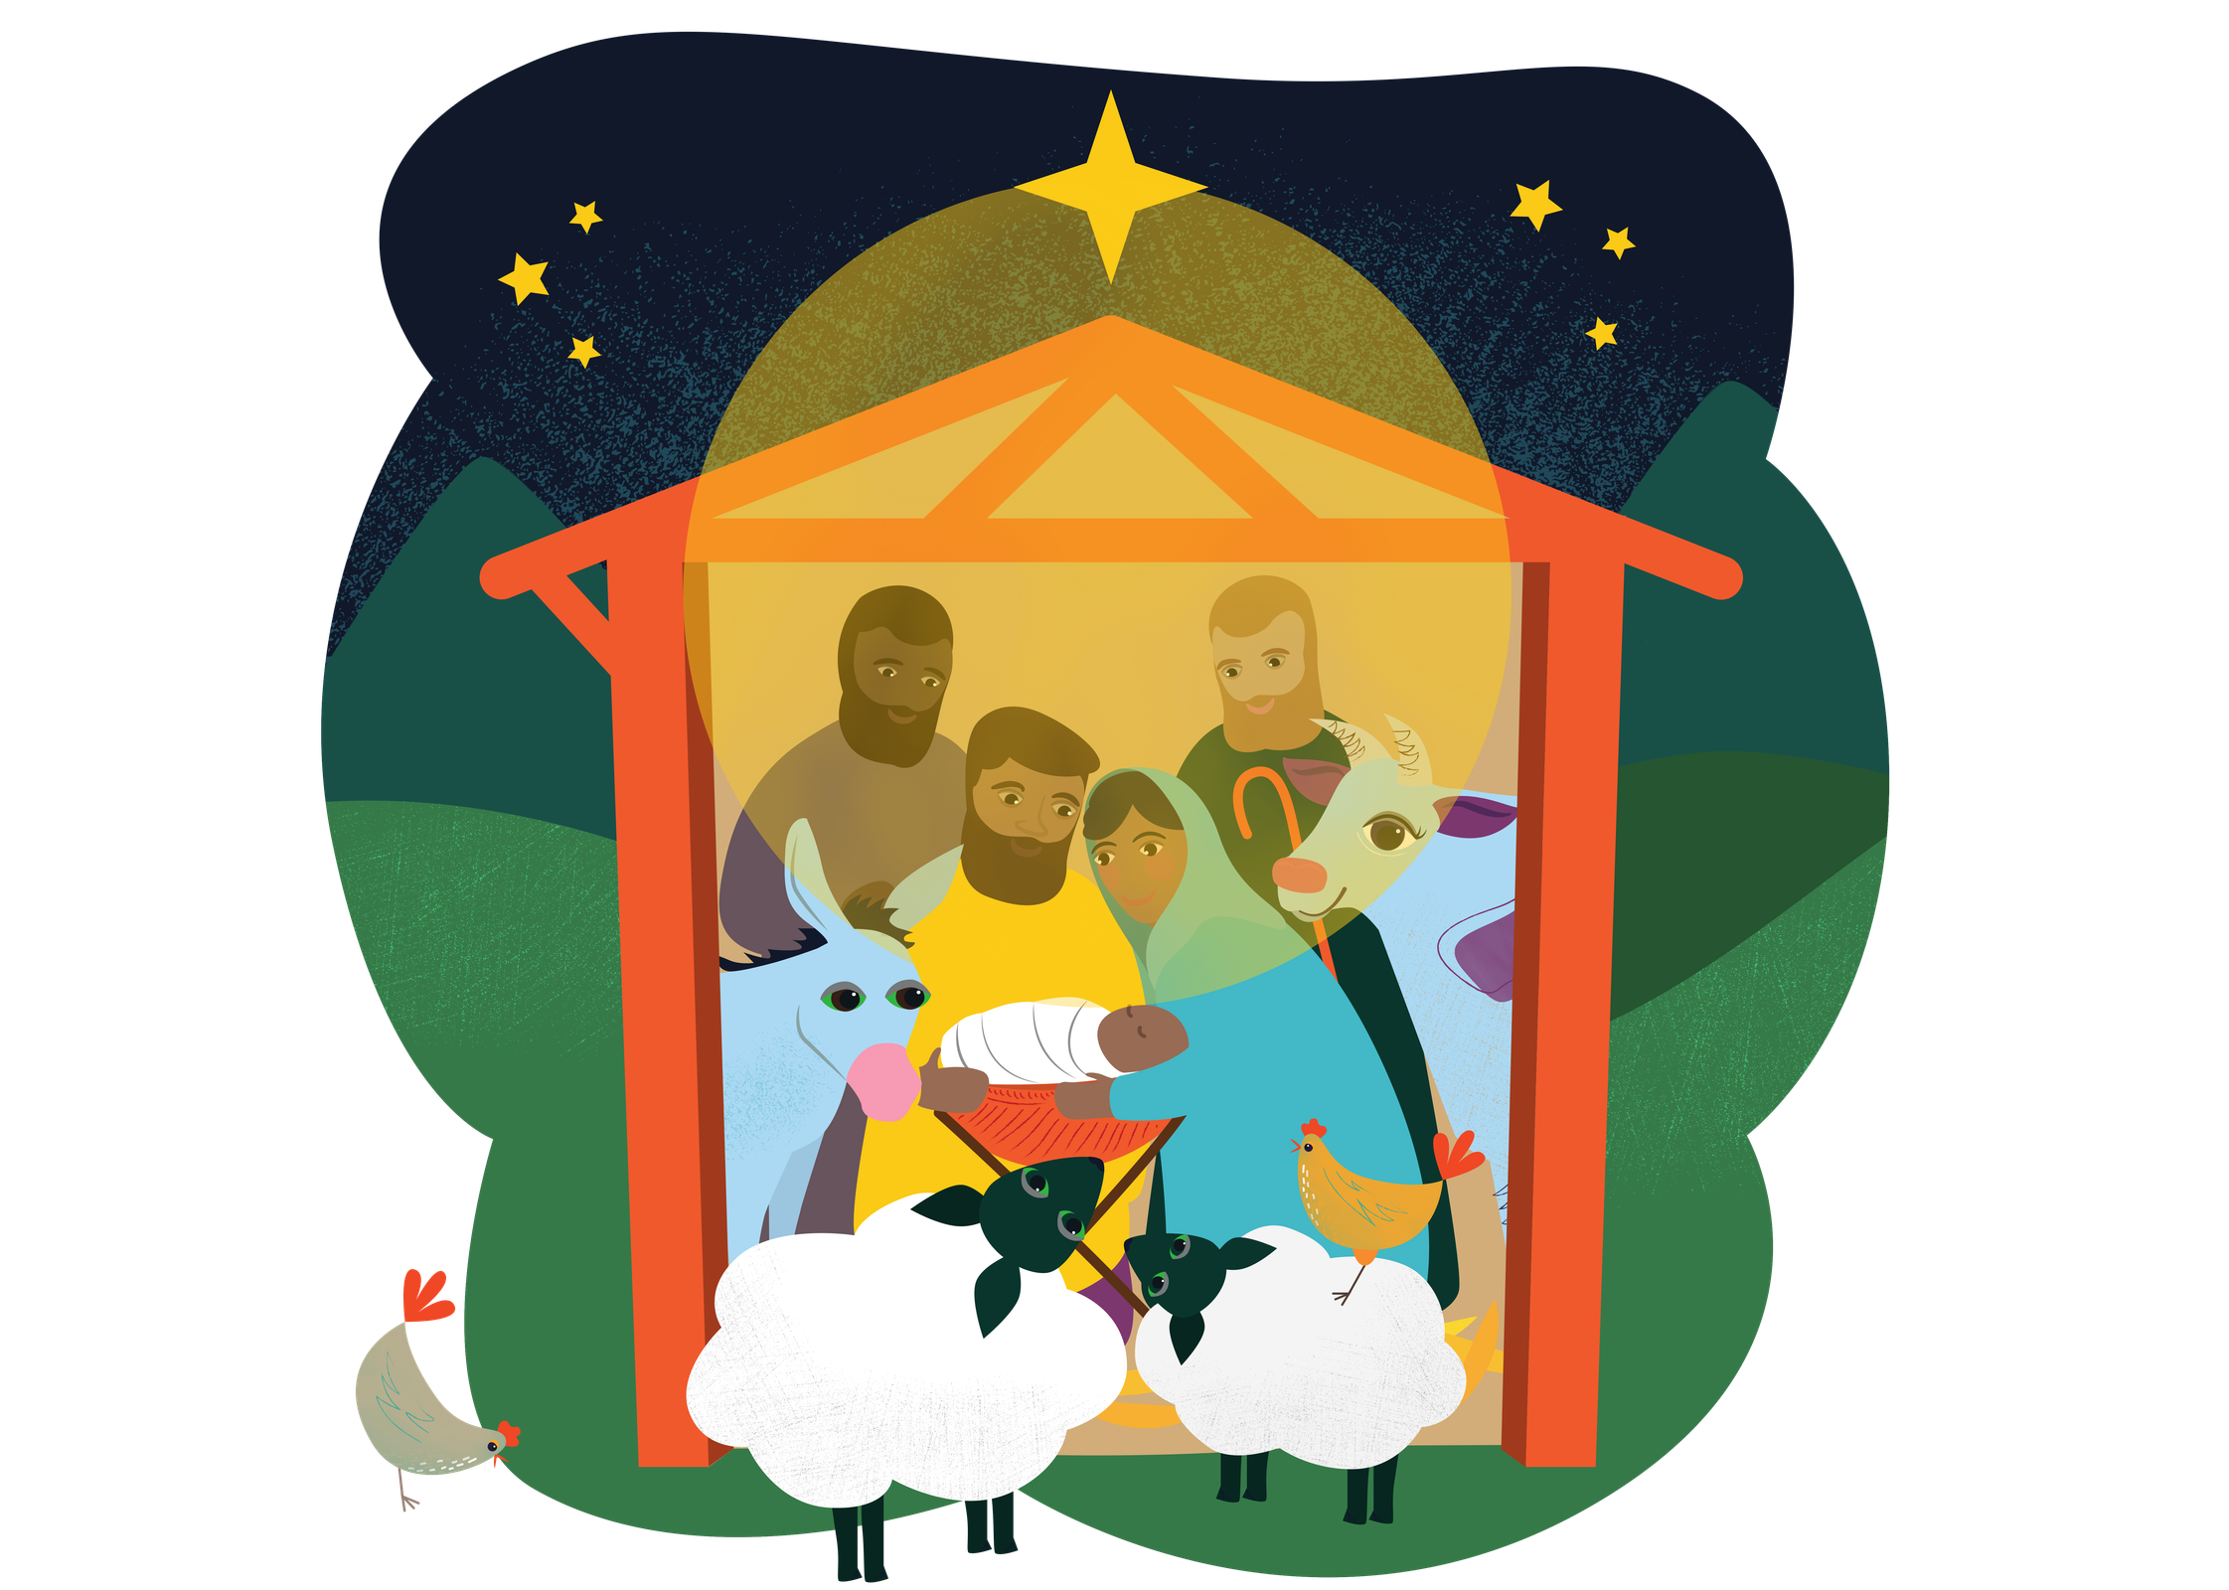
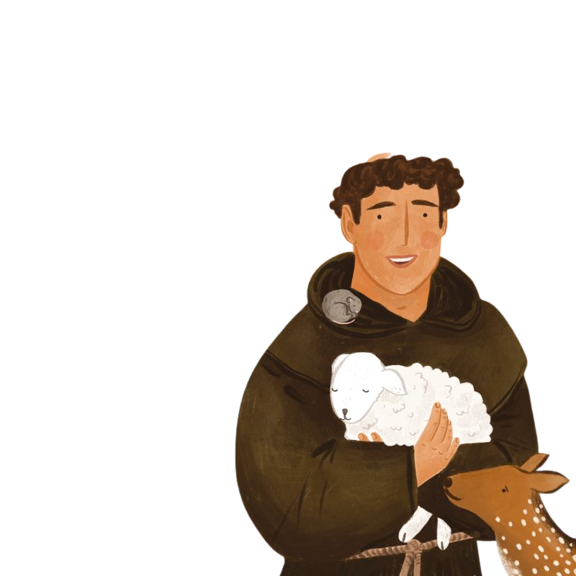
The Jubilee Year of Saint Francis of Assisi
Throughout 2026, we have been celebrating the Jubilee Year of Saint Francis of Assisi, marking 800 years since his death.
Francis believed everything was made by God and he recognised God's presence in everyone and all of God’s creation. He loved caring for people, especially those who were poor or sick and he had a special devotion to caring for creation.
Francis also had a special
love for Christmas.
In 1223, Francis created the first living Nativity scene at
Greccio, Italy, to help people
reflect on the simplicity and humility of Jesus' birth and encounter the Christmas
story in a new way.
Today, Francis can inspire us to encounter Christ in simple ways too:
in prayer, in creation and in our sisters and brothers around the world.
Who will you encounter this Advent and what might you learn from them?
Notes:
Nativity Illustration: Sam Obsorne, CAFOD.
Saint Francis of Assisi Illustration: Emma Hartley Walton, CAFOD.
Star graphic: WC Studio from WC Studio, via Canva.

Slide 4
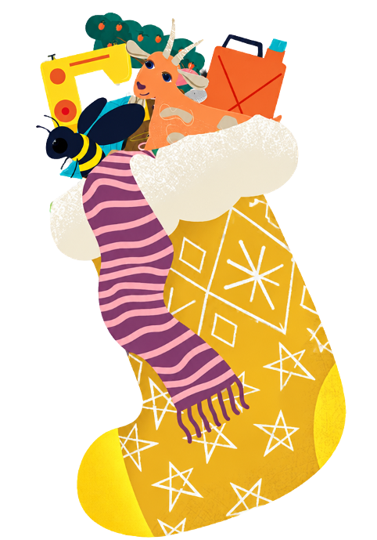
CAFOD’S World Gifts
Each day, CAFOD's Advent Calendar invites you to:
Listen to scripture from the readings of the day.
Respond to what you have heard.
Pray together.
Encounter people from our global family.
Act through a simple Advent mission.
Throughout the calendar, you will also discover some of our wonderful CAFOD World Gifts for schools - virtual charity gifts that support CAFOD's work with communities around the world.
Could your class, school or family choose one or more to fundraise for this Advent to help our global brothers and sisters?
Let's begin our Advent journey together…
Notes:
World Gift Illustration: Sam Obsorne, CAFOD.
Star graphic: WC Studio from WC Studio, via Canva.

Slide 5
Start here...
29
24
12
6
2
10
30
23
19
4
1
15
8
14
7
16
20
3
11
21
5
13
9
17
25
18
22
Notes:
Bethlehem Illustration: Sam Obsorne, CAFOD.
Star graphic: WC Studio from WC Studio, via Canva.

Slide 6

Sunday 29 November - First Sunday of Advent
It’s the weekend and the start of our Advent journey!
Sunday’s Gospel
“Be on guard, keep awake. For you do not know when the time will come.”
Mark 13:33
Reflection
Advent is a special time of waiting and preparation. As Christmas gets closer, there can be lots of practical things to prepare, but Christians are called to prepare in another way too.
In today's Gospel, Jesus tells his followers to “keep awake”. During these first weeks of Advent, we look forward in hope to Christ's second coming.
Christians are called to be active while we wait: to notice God at work and pay attention to the people and situations around us that need our care.
Where in our world do we need to pay attention this Advent?
Hope
Notes:
Photo: Kara Gebhardt, Light Stock.
Advent candle graphics: M. Wallflower, Trendify, via Canva.
Green foliage: Sketchify from sketchify, via Canva.
Star graphic: WC Studio from WC Studio, via Canva.

Slide 7
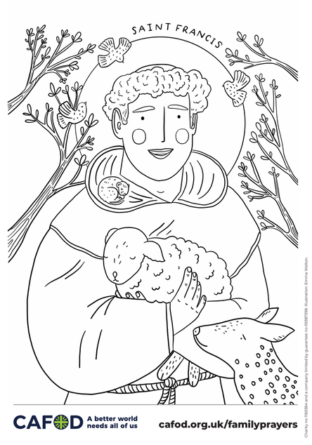
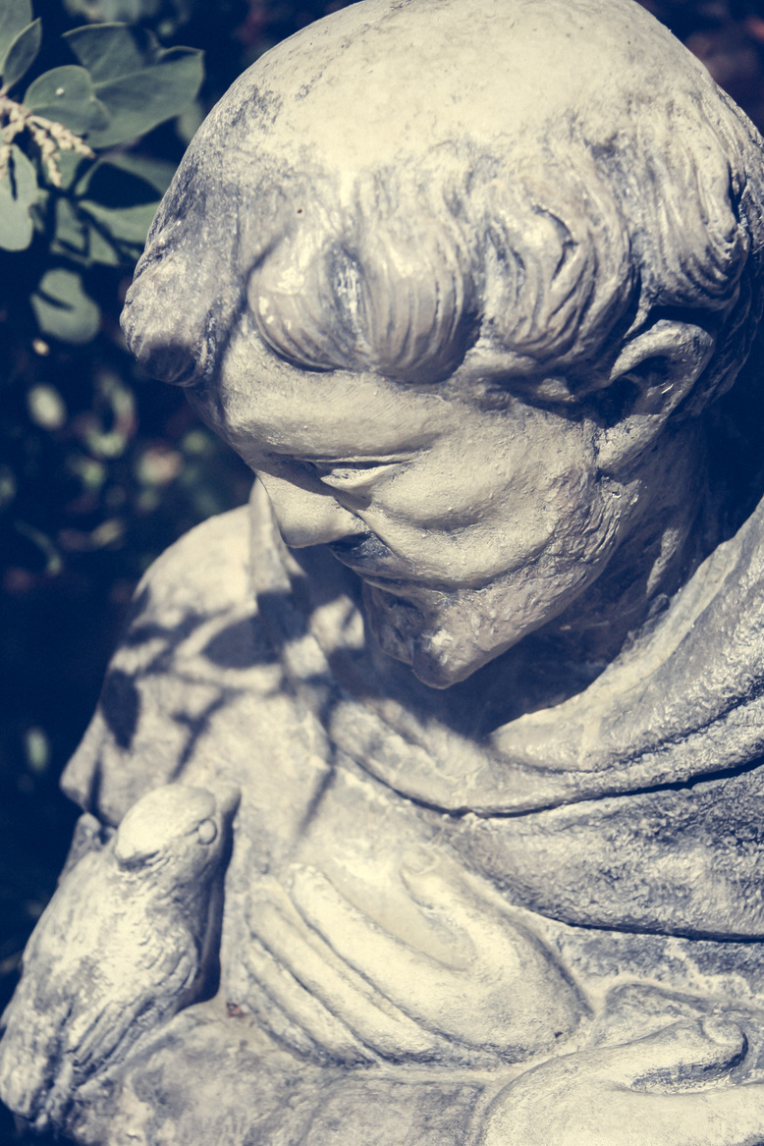
Sunday 29 November - First Sunday of Advent
Respond
Saint Francis of Assisi reminds us that paying attention to God can lead us to act.
While praying in front of a crucifix in the church of San Damiano, near Assisi, Francis heard Christ calling him to “repair my church”.
Over time, Francis realised this meant much more than repairing a building with stone: he was being called to serve others and care for creation.
Reflect and discuss with the people around you:
how could you help repair and renew Christ's
Church today?
Mission
Let us pray
“Keep awake.”
If you missed our Saint Francis of Assisi content for World Youth Sunday - make sure to catch up here!
God of hope,
help us to slow down and pay attention.
Open our eyes to our neighbours
and give us courage to turn hope into action.
Amen.
Hope
Notes:
Saint Francis of Assisi Colouring Illustration: Emma Hartley Walton, CAFOD.
Photo: Heath, Light Stock.
Advent candle graphics: M. Wallflower, Trendify, via Canva.
Green foliage: Sketchify from sketchify, via Canva.
Star graphic: WC Studio from WC Studio, via Canva.

Slide 8
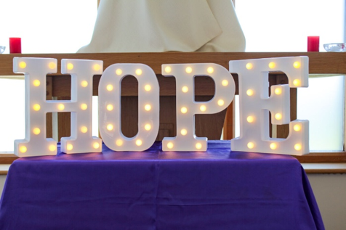
Monday 30 November - First week of Advent
The Word
“Lord, I am not worthy to have you come under my roof, but only say the word, and my servant
will be healed.”
Matthew 8:8
Reflection
In today's Gospel, a Roman centurion comes to Jesus because someone in his care is suffering.
The centurion is a Roman military officer, known as having authority, but he recognises that he cannot fix everything himself. He trusts Jesus enough to ask for help.
Jesus is amazed by his faith. Although the centurion comes from a different background, Jesus looks beyond these differences and recognises his faith.
God's love is for everyone. What is also striking is that the centurion's hope is for someone else.
Advent invites us to look beyond ourselves too.
Hope
Notes:
Photo: Vicky Ahmed, CAFOD.
Advent candle graphics: M. Wallflower, Trendify, via Canva.
Green foliage: Sketchify from sketchify, via Canva.
Star graphic: WC Studio from WC Studio, via Canva.

Slide 9
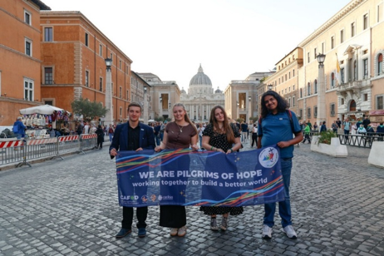
Monday 30 November - First week of Advent
Respond
Who or what are you hopeful for this Advent?
Share your hope, write it on the board or create a hope-inspired decoration for your classroom.
Watch CAFOD’s Hope reflection for young people for inspiration!
Let us pray
God of hope,
open our eyes to the needs of our neighbours.
Help us recognise everyone's dignity
and be ambassadors of hope,
so that all people may flourish.
Amen.
Mission
The 2025 Jubilee Year called us to be Pilgrims of Hope, working for a better world where everyone and creation can flourish.
Keep that hope alive by revisiting your school's Jubilee Pledge.
What small action can you take today to help live it out?
Explore CAFOD’s Ways to live out your Jubilee Pledge
for more inspiration!
Hope
Notes:
Photo: Giuseppe Chiantera, CAFOD.
Advent candle graphics: M. Wallflower, Trendify, via Canva.
Green foliage: Sketchify from sketchify, via Canva.
Star graphic: WC Studio from WC Studio, via Canva.

Slide 10
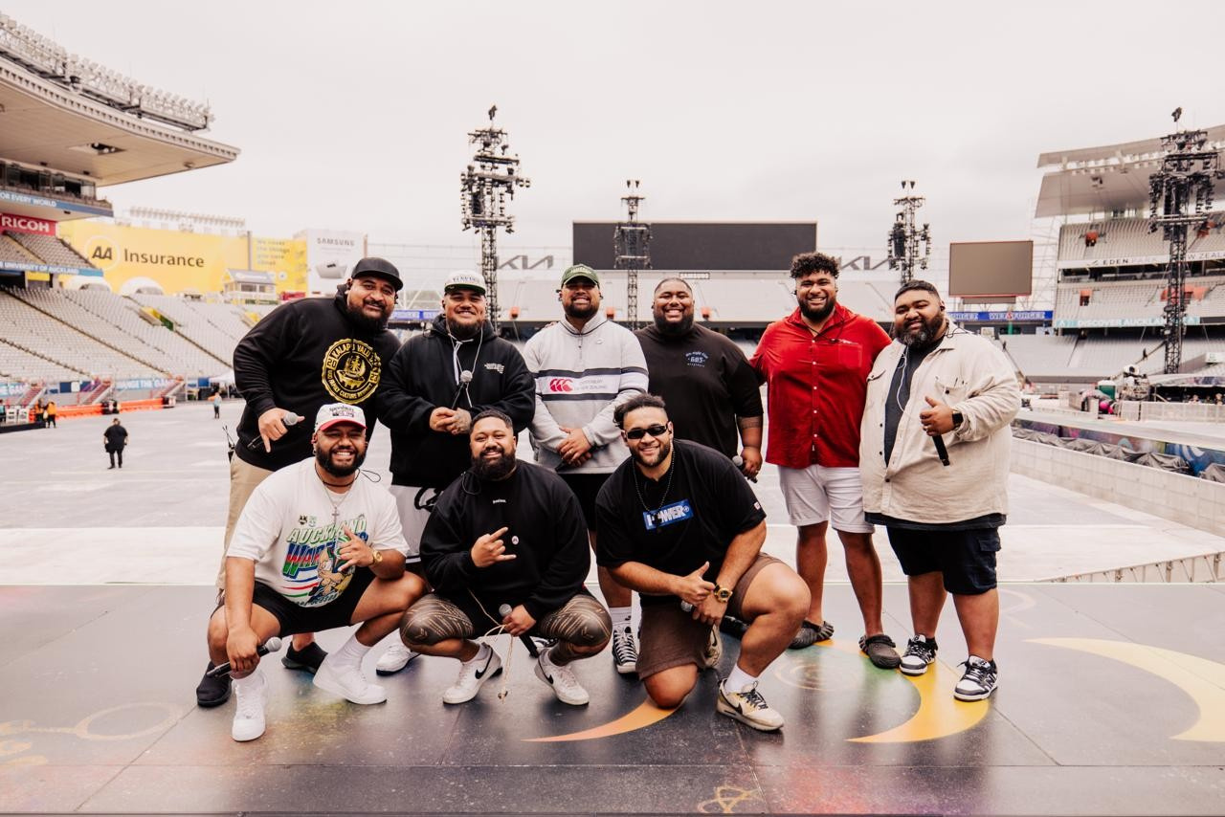
Tuesday 1 December - First week of Advent
The Word
“In his days justice shall flourish and
peace till the moon fails.”
Psalm 71:7
Reflection
Today's Psalm gives us a hopeful vision of a world where justice and peace flourish.
Advent hope is not simply wishing for a better world. It is believing that change is possible and choosing to play our part in building it.
Last month, on World Youth Sunday, we heard voices from the Pacific Islands, where communities are already experiencing the effects of the climate crisis.
The Pacific Artists for Climate Justice use music and creativity to share their experiences and their hopes for the future. Their voices remind us that hope is not passive. Hope inspires people to speak up,
work together and care for our common home.
Hope
Notes:
Photo: Pacific Artists for Climate Justice.
Advent candle graphics: M. Wallflower, Trendify, via Canva.
Green foliage: Sketchify from sketchify, via Canva.
Star graphic: WC Studio from WC Studio, via Canva.

Slide 11
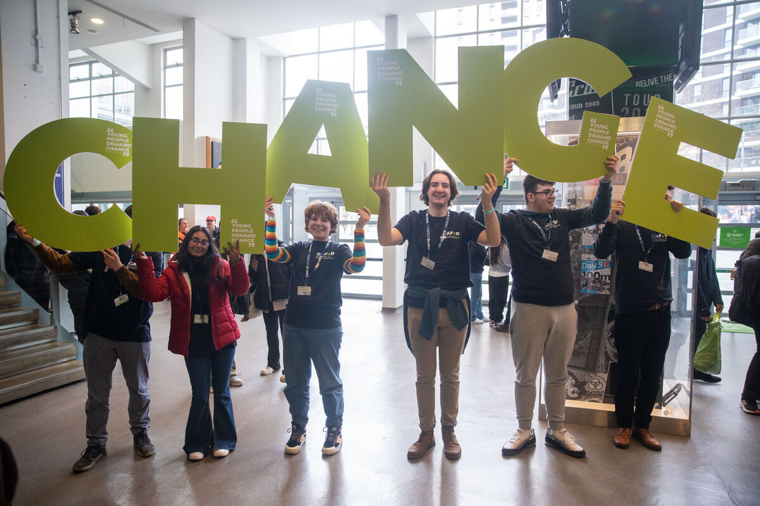
Tuesday 1 December - First week of Advent
Respond
Meet the Pacific Artists for Climate Justice and listen to their song called 'This Is Our Home' - a powerful anthem capturing the urgency of the climate crisis and the beauty of the Pacific Islands.
What can we learn by listening to people experiencing the climate crisis first hand?
Let us pray
God of hope,
help justice and peace to flourish.
May we listen to those affected by the climate crisis
and use our own gifts to bring hope and change.
Amen.
Mission
Use your gifts for our common home!
Listen to This Is Our Home and sing along with the lyrics. Could your school record yourselves singing the song and share the video with CAFOD as part of our collection of voices?
Hope
Notes:
Photo: Joe Newman, CAFOD. Flame 2023.
Advent candle graphics: M. Wallflower, Trendify, via Canva.
Green foliage: Sketchify from sketchify, via Canva.
Star graphic: WC Studio from WC Studio, via Canva.

Slide 12
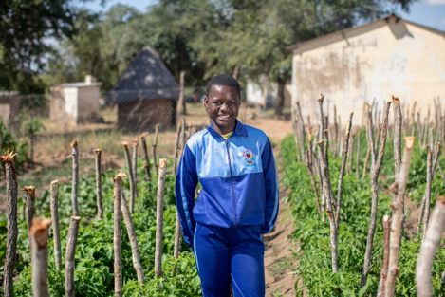
Wednesday 2 December - First week of Advent
The Word
“Where are we to get enough bread in such a desolate place to feed so great a crowd?”
Matthew 15:33
Tayla, Zimbabwe.
Reflection
In today's Gospel, Jesus sees that the crowd is hungry.
He notices their need, shows compassion and acts.
Food and water are things every person needs to live and flourish.
Tayla is 12 and lives in Zimbabwe.
Tayla loves maths and dreams of becoming a doctor, but collecting water and having little food sometimes left Tayla too exhausted to concentrate at school.
CAFOD's local partners worked alongside Tayla's community to build a solar-powered water system.
The school can now access safe water and grow vegetables for nutritious meals. Food and water are helping young people like Tayla stay in school, develop their God-given talents and hold onto their hopes for
the future.
Hope
Notes:
Photo: Cynthia Matonhodze, CAFOD.
Zimbabwe 2025 - Solar-powered water and community gardens
Advent candle graphics: M. Wallflower, Trendify, via Canva.
Green foliage: Sketchify from sketchify, via Canva.
Star graphic: WC Studio from WC Studio, via Canva.

Slide 13
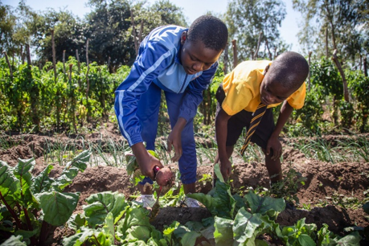

Wednesday 2 December - First week of Advent
Respond
Think about all the people and parts of creation involved in bringing food to your plate or lunchbox today and write a list.
Give thanks for them and remember those who do not have enough to eat.
Let us pray
God of hope,
thank you for the gifts of food and water and for all those who help provide them.
Help us to care for creation, share what we have
and build a world where everyone can flourish.
Amen.
Mission
Create an Advent grace for your class to pray before meals during Advent.
Could your class fundraise for a food and farming World Gift to support farmers and communities with tools and techniques to farm sustainably?
What about some Chirpy chickens (£20)?
Hope
Notes:
Photo: Cynthia Matonhodze, CAFOD.
Zimbabwe 2025 - Solar-powered water and community gardens
World Gift Illustration: Sam Obsorne, CAFOD.
Advent candle graphics: M. Wallflower, Trendify, via Canva.
Green foliage: Sketchify from sketchify, via Canva.
Star graphic: WC Studio from WC Studio, via Canva.

Slide 14
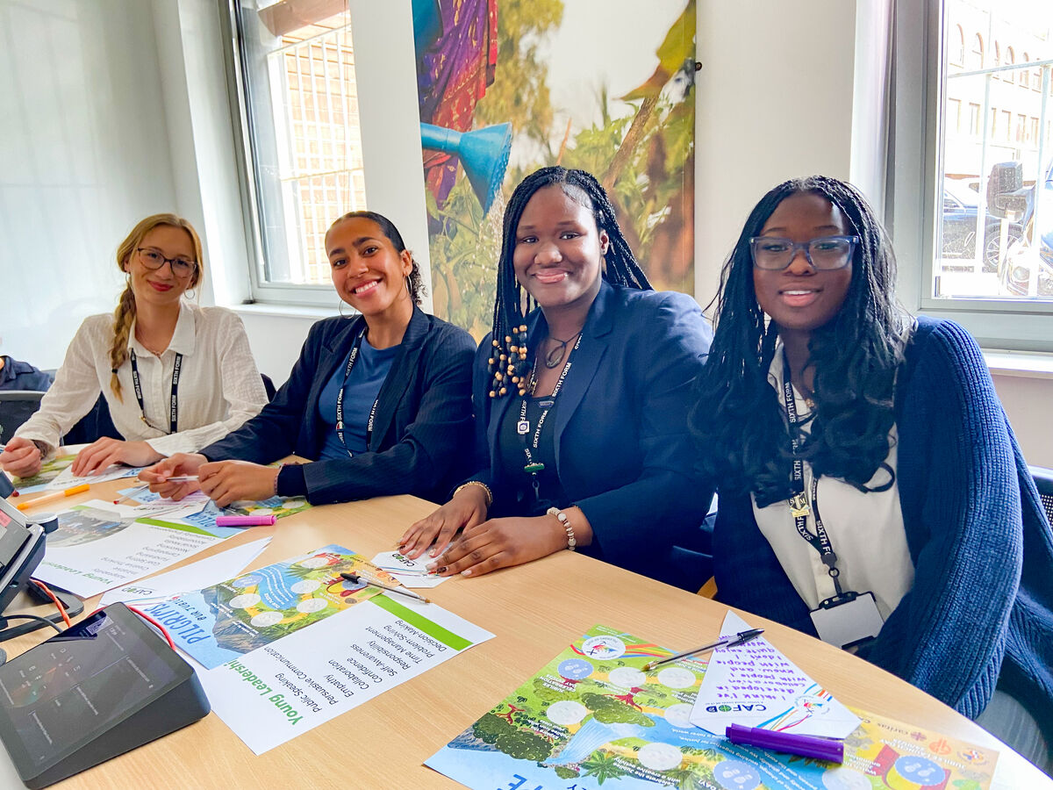
Thursday 3 December - First week of Advent
International Day of Persons with Disabilities
The Word
“Everyone then who hears these words of mine and
does them will be like a wise man who
built his house on the rock.”
Matthew 7:24
Reflection
In today's Gospel, Jesus tells the story of a wise person who builds a house on strong foundations. Jesus reminds us that simply listening to his words is not enough. We are called to put our faith into action.
Today is the International Day of Persons with Disabilities.
A hopeful and inclusive community is one where everyone is valued, can participate and has the opportunity
to flourish.
Catholic Social Teaching calls us to work for the common good and the participation of all people: this means respecting everyone's dignity and removing barriers that prevent people from taking part.
Hope
Notes:
Photo: CAFOD. Jubilee Year 2025: Pilgrims of Hope - Schools make the Jubilee Pledge
Advent candle graphics: M. Wallflower, Trendify, via Canva.
Green foliage: Sketchify from sketchify, via Canva.
Star graphic: WC Studio from WC Studio, via Canva.

Slide 15
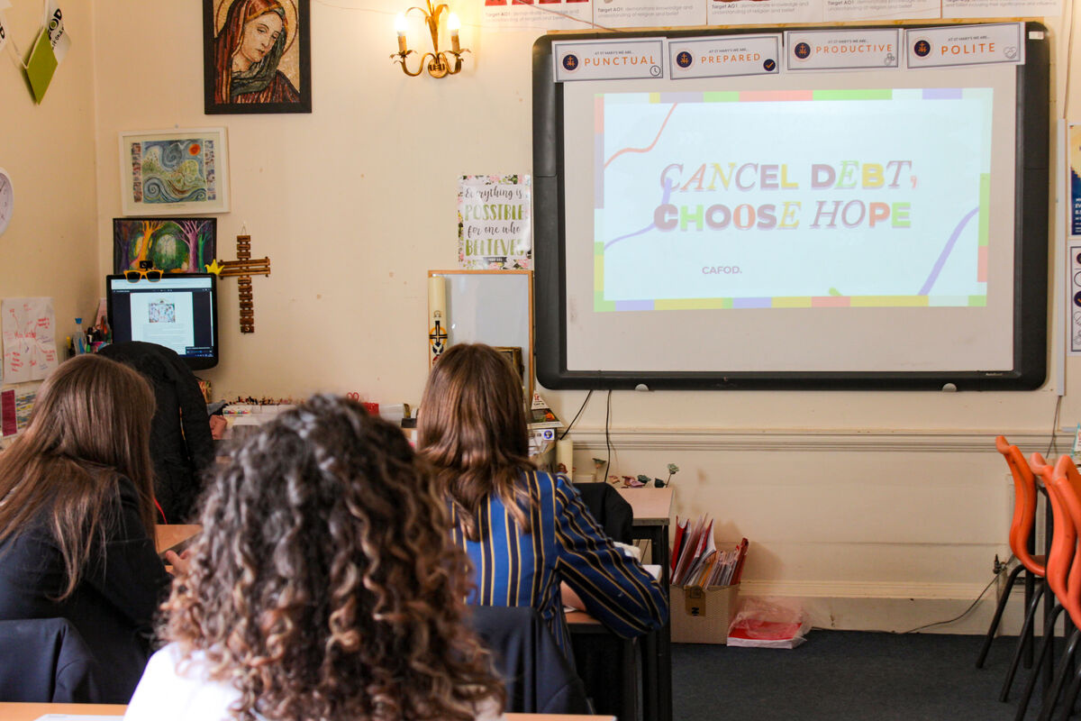
Thursday 3 December - First week of Advent
Respond
Think about your school. What helps people feel welcome and able to participate?
How can we help build communities where everyone belongs?
Share one thing your school does well and one thing that could make it even more accessible and inclusive to help everyone flourish.
Let us pray
God of hope,
help us build communities where everyone is valued and included.
Guide us to notice and remove barriers
so that everyone can flourish.
Amen.
Hope
Mission
Notice one way you can help someone participate, feel included or have their voice heard today.
Notes:
Photo: Vicky Ahmed, CAFOD.
Jubilee Pilgrims of Hope - St Mary's RC High School, Herefordshire
Advent candle graphics: M. Wallflower, Trendify, via Canva.
Green foliage: Sketchify from sketchify, via Canva.
Star graphic: WC Studio from WC Studio, via Canva.

Slide 16
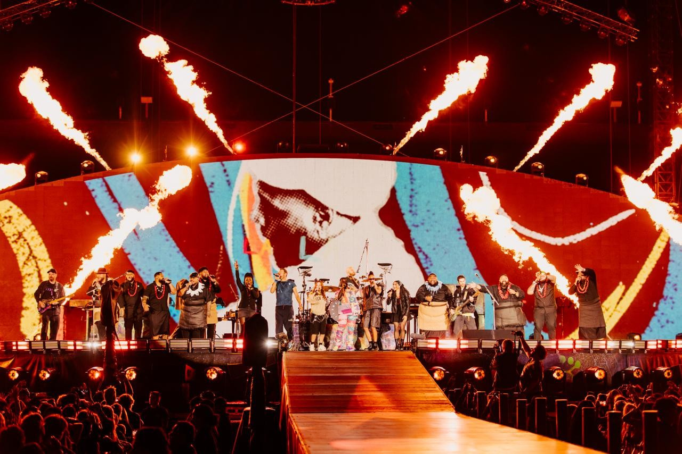
Friday 4 December - First week of Advent
The Word
“The Lord is my light and my salvation.”
Psalm 27:1
Reflection
Light is one of the great symbols of Advent. As the light of the Advent wreath grows each week, we are reminded that we are drawing closer to Christmas and looking forward in hope to Christ's coming again.
Earlier this week, we met the Pacific Artists for Climate Justice, who use music and creativity to share their experiences of the climate crisis and their hope for the future.
Like John the Baptist, who pointed people towards Christ, the Pacific Artists for Climate Justice use their gifts to shine a light on the challenges their communities are facing and the hope they have for the future.
How can you use your gifts to bring hope to others this Advent?
Hope
Notes:
Photo: Pacific Artists for Climate Justice
Advent candle graphics: M. Wallflower, Trendify, via Canva.
Green foliage: Sketchify from sketchify, via Canva.
Star graphic: WC Studio from WC Studio, via Canva.

Slide 17
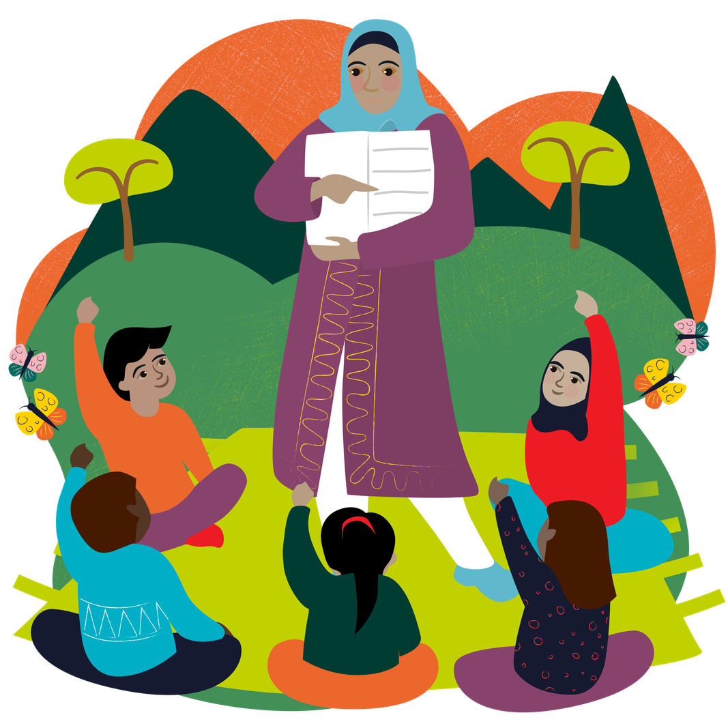
Friday 4 December - First week of Advent
Respond
Today, let's raise our voices alongside the Pacific Artists for Climate Justice. Listen to This Is Our Home and sing along with the lyrics.
Could your school record yourselves singing the song and share the video with CAFOD as part of our collection of voices?
Which lyrics stand out to you?
Let us pray
God of hope,
thank you for being our light.
Help us use our gifts and talents
to reflect your light and bring hope to others.
Amen.
Mission
Share This Is Our Home with someone else and explain why caring for our common home matters.
World Gift: Share hope for a brighter future with a Teach someone to read World Gift (£12).
Hope
Notes:
Photo: Pacific Artists for Climate Justice
World Gift Illustration: Sam Obsorne, CAFOD.
Advent candle graphics: M. Wallflower, Trendify, via Canva.
Green foliage: Sketchify from sketchify, via Canva.
Star graphic: WC Studio from WC Studio, via Canva.

Slide 18

Sunday 6 December - Second Sunday of Advent
It’s the weekend!
Sunday’s Gospel
“The voice of one crying in the wilderness:
‘Prepare the way of the Lord,
make his paths straight.’”
Mark 1:3
Reflection
In Sunday’s Gospel, John the Baptist fulfils Isaiah's prophecy, calling people to “prepare the way of the Lord”. He asks them to repent, change the way they live and prepare for the one who is to come.
This week, our Advent theme is peace. Preparing the way means thinking about what gets in the way of peace, such as unkindness, selfishness and injustice, and reflecting on how we can become peacemakers.
How can you “prepare the way” and welcome peace into your life?
Peace
Notes:
Photo: Neely Wang, Light Stock.
Advent candle graphics: M. Wallflower, Trendify, via Canva.
Green foliage: Sketchify from sketchify, via Canva.
Star graphic: WC Studio from WC Studio, via Canva.

Slide 19
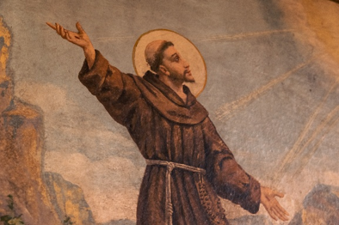
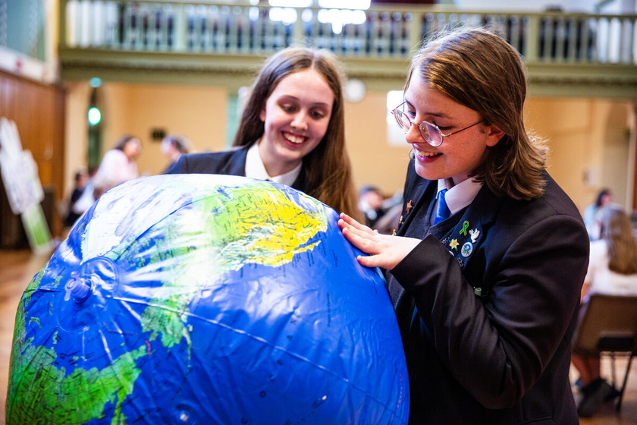
Sunday 6 December - Second Sunday of Advent
Respond
Saint Francis of Assisi dedicated his life to following Jesus and living humbly and peacefully with God, other people and creation.
Reflect: Where is peace most needed today: in your life, your relationships or our world?
Explore CAFOD's Prayers for peace and choose a community to pray for today.
Let us pray
An extract from a prayer often attributed to Saint Francis of Assisi:
Lord, make me an instrument of your peace.
Where there is hatred, let me sow love;
where there is doubt, the faith;
where there is despair, hope;
where there is darkness, light;
and where there is sadness, joy.
Amen.
Saint Francis of Assisi, pray for us.
Mission
Choose one small action today to help you prepare the way for peace: say sorry, forgive,
listen carefully, include someone, or care for creation.
Peace
Notes:
Saint Francis Photo: BlueIncDrone, Light Stock.
Globe photo: Thom Flint, CAFOD. Mass lobby 2025.
Advent candle graphics: M. Wallflower, Trendify, via Canva.
Green foliage: Sketchify from sketchify, via Canva.
Star graphic: WC Studio from WC Studio, via Canva.

Slide 20
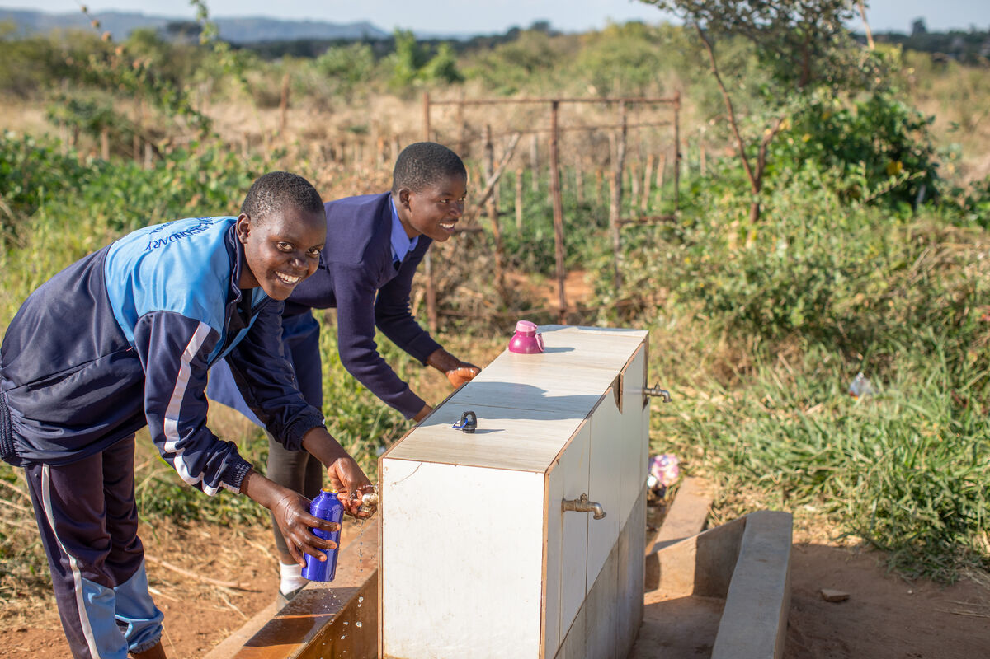
Monday 7 December - Second week of Advent
The Word
“For waters break forth in the wilderness,
and streams in the desert;
the burning sand shall become a pool,
and the thirsty ground springs of water.”
Isaiah 35:6-7
Maggie, Zimbabwe.
Reflection
In today's reading, Isaiah shares a joyful vision of transformation: water flows in the desert, dry land comes to life and there is hope for a better future.
Yet for many communities around the world, accessing enough safe water can be a daily challenge. In parts of Zimbabwe, unpredictable weather and poor rainfall can lead to severe water shortages.
Earlier this year, CAFOD shared Maggie's story. A lack of water and suitable facilities at Maggie's school made it difficult for students to manage their periods safely and privately. Some girls missed lessons or school as a result.
CAFOD's local partners worked alongside Maggie's community to improve access to water. New facilities mean students can manage their periods with greater privacy and dignity whilst continuing their education.
Peace
Notes:
Photo: Cynthia Matonhodze, CAFOD.
Zimbabwe 2025 - Solar-powered water and community gardens
Advent candle graphics: M. Wallflower, Trendify, via Canva.
Green foliage: Sketchify from sketchify, via Canva.
Star graphic: WC Studio from WC Studio, via Canva.

Slide 21
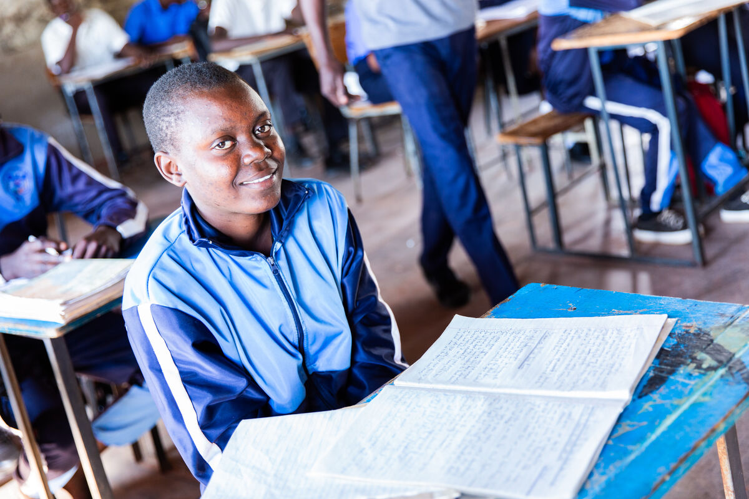
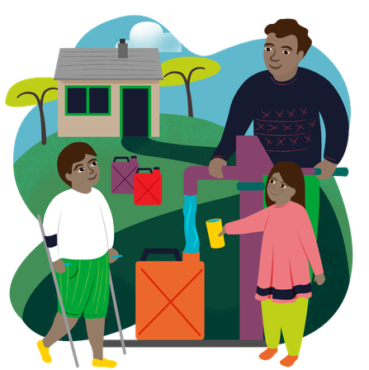
Monday 7 December - Second week of Advent
Respond
Watch CAFOD's film about how water projects are helping communities in Zimbabwe.
Then explore the Zimbabwe photopack and discuss the photos and reflective questions together.
How are water and clean facilities helping children stay healthy, flourish and learn?
Let us pray
Loving God,
thank you for the things we often take for granted, especially safe water and facilities.
We pray that everyone may have what they need
to live and learn with dignity.
Amen.
Mission
Value every drop. Think about how you use water today and avoid wasting it.
World Gift: Help families access safe water with a Water for a family World Gift (£35)!
Peace
Notes:
Photo: Cynthia Matonhodze, CAFOD.
Maggie in Zimbabwe 2025 - Solar-powered water and community gardens
World Gift Illustration: Sam Obsorne, CAFOD.
Advent candle graphics: M. Wallflower, Trendify, via Canva.
Green foliage: Sketchify from sketchify, via Canva.
Star graphic: WC Studio from WC Studio, via Canva.

Slide 22
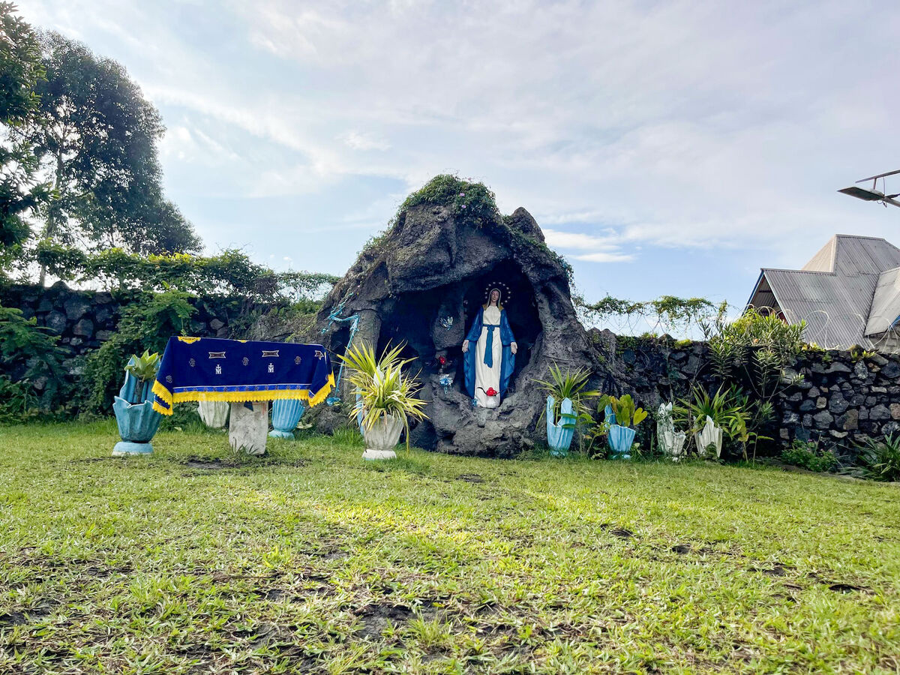
Tuesday 8 December - Second week of Advent
The Immaculate Conception of the Blessed Virgin Mary
The Word
Mary said: “Behold, I am the servant of the Lord; let it be to me according to your word.”
Luke 1:38
Reflection
Today we celebrate the Immaculate Conception of the Blessed Virgin Mary.
From the beginning of her life, Mary was preserved from original sin by God's grace and chosen for her unique calling to become the mother of Jesus.
In today's Gospel, the angel Gabriel brings Mary unexpected news. Mary does not know exactly what lies ahead, but she trusts God and has the courage to say yes.
Mary reminds us that following God can take courage and trust, especially when we don't know where our yes might lead.
A statue of Mary in the Paroisse Saint Paul parish community, Goma, Democratic Republic of the Congo.
Peace
Notes:
Photo: CAFOD Democratic Republic of the Congo.
A statue of Mary with the Paroisse Saint Paul parish community, Goma.
Advent candle graphics: M. Wallflower, Trendify, via Canva.
Green foliage: Sketchify from sketchify, via Canva.
Star graphic: WC Studio from WC Studio, via Canva.

Slide 23

Tuesday 8 December - Second week of Advent
Respond
Being a follower of Jesus calls us to be courageous too: to choose kindness, make peace, care for creation, stand up for others or do what is right, even when others aren't doing the same.
What would you like the courage to say yes to this Advent?
Share or write down one thing.
Let us pray
Mission
Hail, Mary, full of grace,
the Lord is with thee.
Blessed art thou amongst women
and blessed is the fruit of thy womb, Jesus.
Holy Mary, Mother of God,
pray for us sinners,
now and at the hour of our death.
Amen.
Say yes to CAFOD's Big Lent Walk 2027!
Make sure you are signed up before Christmas and start thinking creatively about how you could take part during Lent 2027: walk, run, skip or even
dribble a football as you fundraise together for CAFOD!
Sign up here!
Peace
Notes:
Photo: Amit Rudro Bepari, CAFOD. Big Lent Walk - CAFOD staff from London.
Advent candle graphics: M. Wallflower, Trendify, via Canva.
Green foliage: Sketchify from sketchify, via Canva.
Star graphic: WC Studio from WC Studio, via Canva.

Slide 24
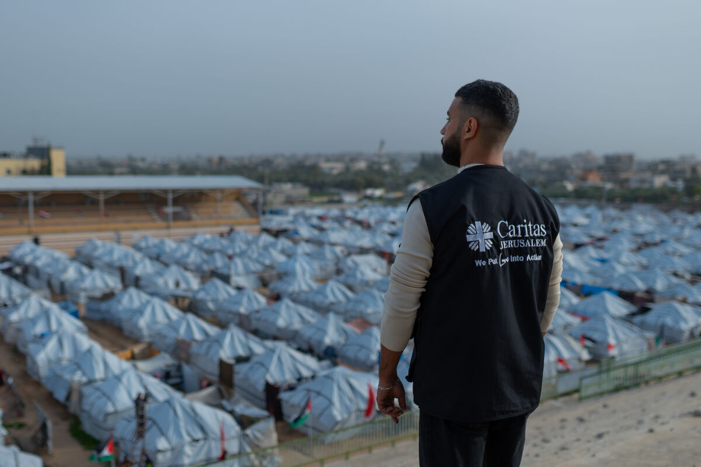
Wednesday 9 December - Second week of Advent
The Word
“Come to me, all who labour and are heavy laden,
and I will give you rest.”
Matthew 11:28
Reflection
In today's Gospel, Jesus speaks to people carrying heavy burdens and promises them rest.
Peace and rest can feel far away in a world affected by conflict and division. But in Magnifica Humanitas,
Pope Leo XIV reminds us that peace is always possible:
“Peace is neither a naïve hope nor merely the absence of war; instead, it is always possible as the fruit of justice and charity.”
This Advent, we remember our neighbours in Gaza.
Many families have been displaced and are living in temporary shelters, where the winter weather and shortages of food, water and medicine make life even harder.
CAFOD partners are continuing to work alongside communities to provide practical and medical support.
Jesus invites us to bring the burdens of our lives and our world to him.
A member of Caritas Jerusalem staff overlooking the Al Masri (Egyptian) camp, Gaza.
Peace
Notes:
Photo: Trocaire | Raw Media, CAFOD.
Displaced families in Gaza.
Advent candle graphics: M. Wallflower, Trendify, via Canva.
Green foliage: Sketchify from sketchify, via Canva.
Star graphic: WC Studio from WC Studio, via Canva.

Slide 25
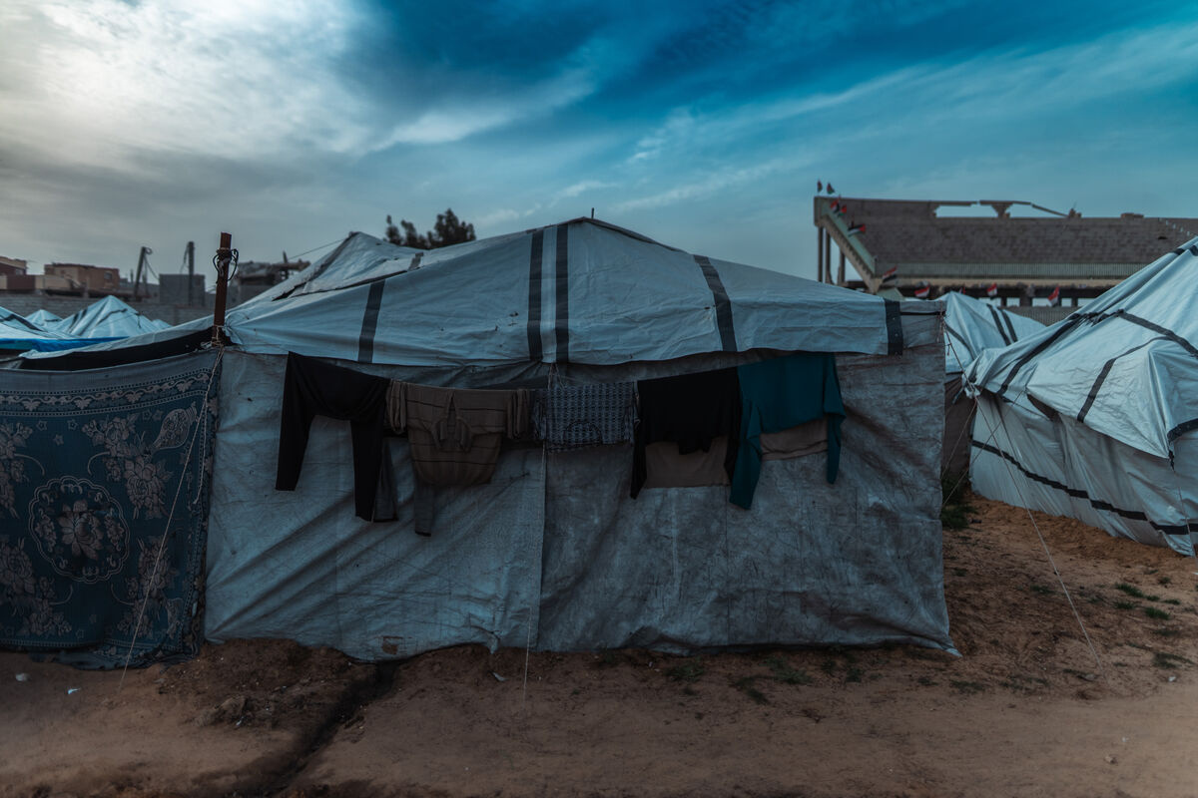
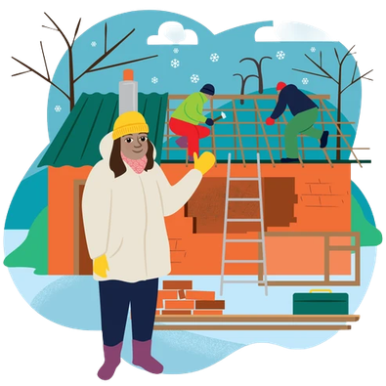
Wednesday 9 December - Second week of Advent
Respond
Where is Christ's peace especially needed today?
Take one minute of silence.
Bring to God anything that is worrying or weighing on you. Then remember one person, community or place in our world that needs peace and pray for them.
Let us pray
God of peace,
be close to all who are tired, afraid
or without a safe home this winter.
Give them strength, comfort and hope,
and guide our world in the way of peace.
Amen.
Tents in the Al Masri (Egyptian) camp, Gaza.
Mission
Be a peacemaker. Listen, pray for peace or check in with someone who may be carrying a burden.
Could your school work together to help fundraise a Rebuild a home World Gift (£370) this Advent?
Peace
Notes:
Photo: Trocaire | Raw Media, CAFOD.
Displaced families in Gaza. Tents in the Al Masri (Egyptian) camp, Gaza.
World Gift Illustration: Sam Obsorne, CAFOD.
Advent candle graphics: M. Wallflower, Trendify, via Canva.
Green foliage: Sketchify from sketchify, via Canva.
Star graphic: WC Studio from WC Studio, via Canva.

Slide 26
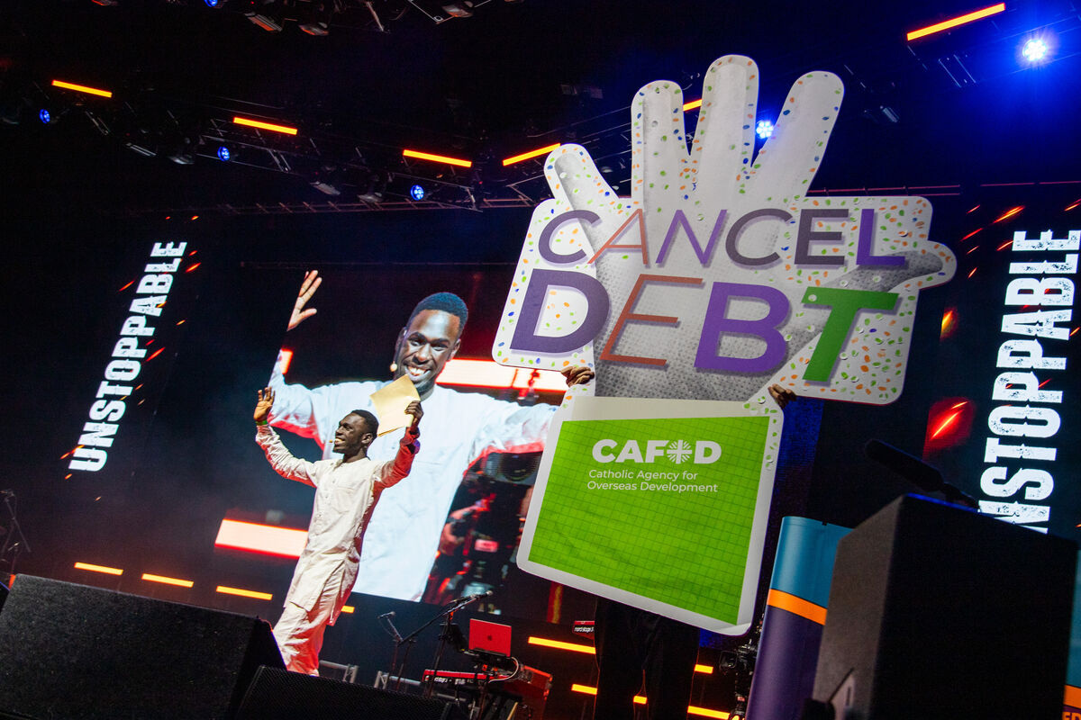
Thursday 10 December - Second week of Advent
Human Rights Day
The Word
“The Lord is kind and full of compassion, slow to anger, abounding in love.”
Psalm 144:8
Reflection
Today's Psalm reminds us that God is kind, compassionate and full of love.
We are called to show that same compassion to others.
Today is Human Rights Day. Every person is special and deserves to be treated with dignity and respect.
Yet around the world, many people are denied their rights or do not have the basic things they need to flourish.
Catholic Social Teaching teaches us that every person is made in the image and likeness of God and has equal dignity. Our faith calls us to notice injustice, stand alongside others and work for change.
How can we help build a world where everyone's dignity and rights are respected?
Peace
Notes:
Photo: © Mazur/catholicnews.org.uk
Flame 2025 - 'Unstoppable' and CAFOD's 'Cancel Debt, Choose Hope' campaign with Brian Maeba and Adeniké Adewale
Advent candle graphics: M. Wallflower, Trendify, via Canva.
Green foliage: Sketchify from sketchify, via Canva.
Star graphic: WC Studio from WC Studio, via Canva.

Slide 27
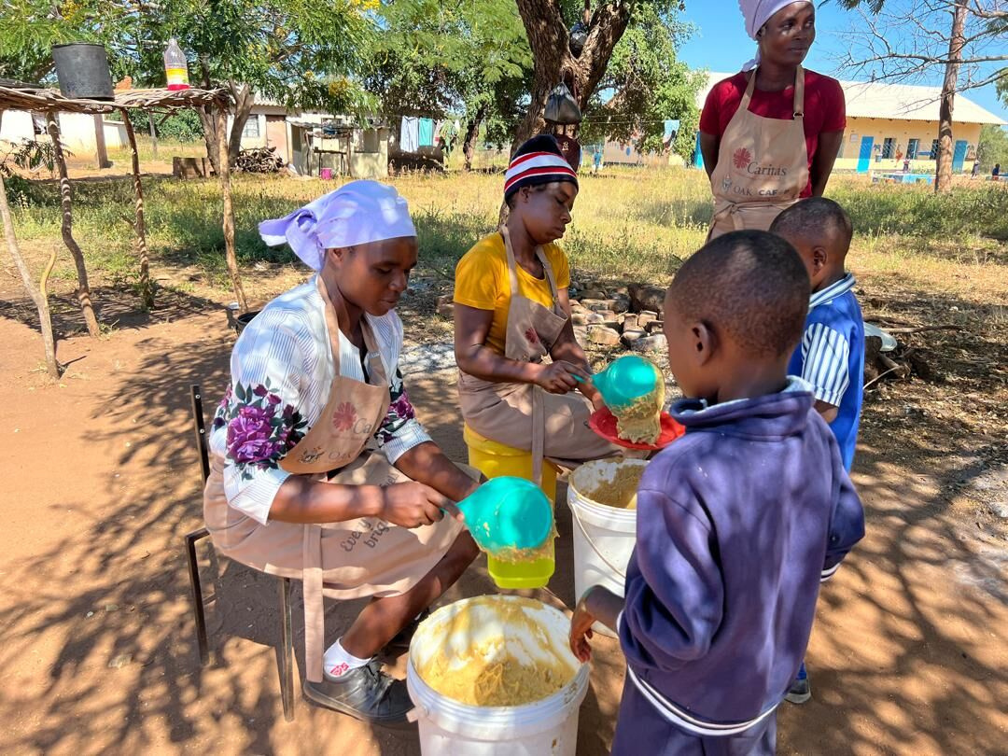
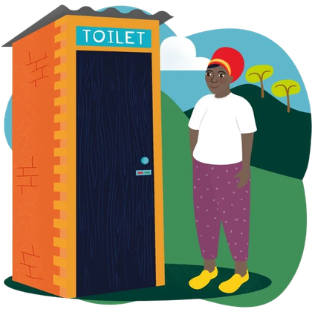
Thursday 10 December - Second week of Advent
Respond
Think about some of the rights included in the Universal Declaration of Human Rights:
· Education · Food and an adequate standard of living
· Freedom of thought and religion · Family life
· Rest and leisure
Choose one and reflect on whether you sometimes take it for granted. How would your life be different without it?
Let us pray
God of compassion,
help us recognise the dignity of every person.
Give us courage to stand alongside others
and work together for a better world.
Amen.
Zimbabwe schools' food programme.
CAFOD implemented livelihoods and women empowerment projects to uplift the standard of living and support schools.
Mission
Put human dignity into action. Listen, include, speak respectfully or stand up for someone whose voice isn't being heard.
World Gift: Help communities stay clean and healthy
with a Terrific Toilet (£89)!
Peace
Notes:
Photo: CAFOD Zimbabwe. Zimbabwe schools food programme
World Gift Illustration: Sam Obsorne, CAFOD.
Advent candle graphics: M. Wallflower, Trendify, via Canva.
Green foliage: Sketchify from sketchify, via Canva.
Star graphic: WC Studio from WC Studio, via Canva.

Slide 28
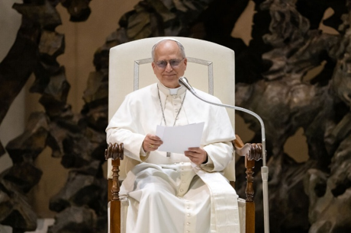
Friday 11 December - Second week of Advent
The Word
“The Son of Man came eating and drinking, and they say, ‘Look at him! A glutton and a drunkard, a friend of tax collectors and sinners!’ Yet wisdom is justified by her deeds.”
Matthew 11:19
Reflection
In today's Gospel, Jesus is criticised for spending time with people whom others judge or avoid. Jesus was a peacemaker. He looks beyond labels and recognises the dignity of every person.
In Magnifica Humanitas, Pope Leo XIV reminds us that genuine encounters with people who are different from us can help build peace:
“For if we experience authentic encounters with others, with those who are different, strangers and migrants, it becomes much more difficult even to imagine war.”
Magnifica Humanitas #220
How can making time to really listen to someone help build peace?
Peace
Notes:
Photo: © Mazur/cbcew.org.uk
Pope Leo XIV - Audience for Journalists
Advent candle graphics: M. Wallflower, Trendify, via Canva.
Green foliage: Sketchify from sketchify, via Canva.
Star graphic: WC Studio from WC Studio, via Canva.

Slide 29
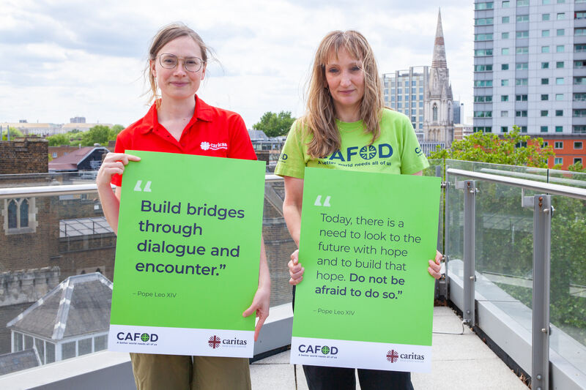

Friday 11 December - Second week of Advent
Respond
Pope Leo XIV's first words as Pope were “Peace be with you.”
Peace grows when we welcome others, listen carefully and make sure everyone feels included.
Jesus reminds us that being a peacemaker starts with our encounters and the way we treat people each day.
Today, we invite you to share the sign of peace! Learn how to sign “peace be with you” in sign language, or place your hands together and gently bow to the people around you as you say: “Peace be with you.”
Mission
Make time to talk to someone
you wouldn't usually speak to
and really listen.
World Gift: Help bring young people together through sport
and peace building with a Fabulous football World Gift (£15)!
Let us pray
Lord Jesus,
open our hearts to authentic encounters.
Help us to see your presence in our neighbours,
to listen, welcome others
and build relationships of peace.
Amen.
Peace
Notes:
Photo: Louise Norton, CAFOD. Million acts of hope with CAFOD and Caritas Social Action Network.
World Gift Illustration: Sam Obsorne, CAFOD.
Advent candle graphics: M. Wallflower, Trendify, via Canva.
Green foliage: Sketchify from sketchify, via Canva.
Star graphic: WC Studio from WC Studio, via Canva.

Slide 30
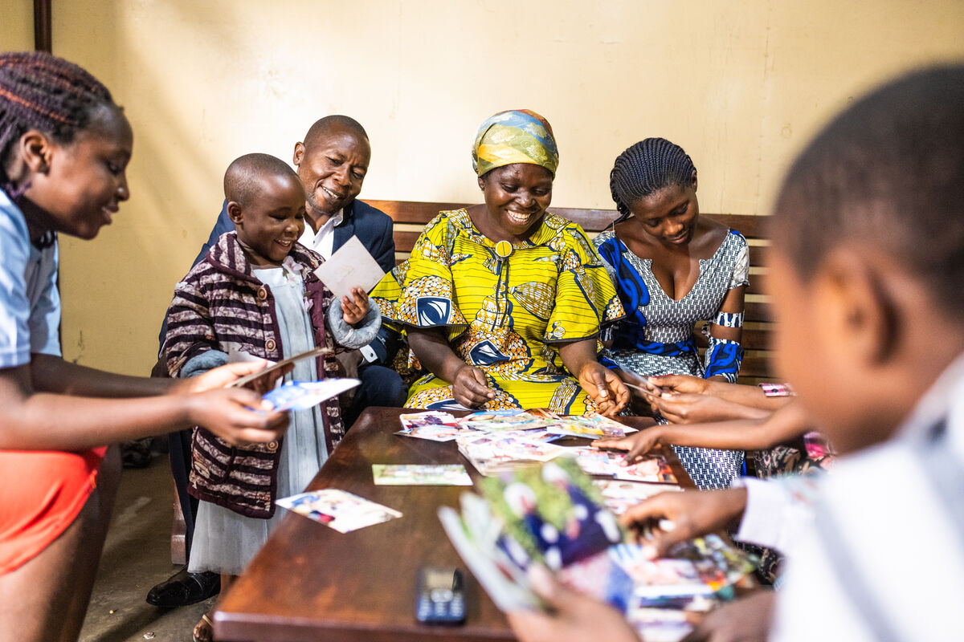
Sunday 13 December - Third Sunday of Advent
It’s the weekend!
Sunday’s Gospel
“He came as a witness, to bear witness about the light, that all might believe through him.”
John 1:7
Reflection
Today we celebrate Gaudete Sunday!
Gaudete means “rejoice” in Latin.
On this third Sunday of Advent, we light the rose candle and rejoice because Christmas is drawing closer!
The liturgical colour changes from purple to rose, reminding us that we wait in joyful anticipation.
In today's Gospel, John the Baptist bears witness to the light. John is not the light himself, but points others towards Christ.
We can do the same. When we share hope, kindness, justice and joy, our actions can reflect Christ's light.
Where have you noticed signs of light and joy
this Advent?
Francoise Kanyere (yellow dress) looking at old photos with her family.
Democratic Republic of the Congo, CAFOD.
Joy
Notes:
Photo: Arlette Bashizi, CAFOD. Savings and Internal Lending Communities (SILC) and Solidarity Groups in Goma, DRC
Advent candle graphics: M. Wallflower, Trendify, via Canva.
Green foliage: Sketchify from sketchify, via Canva.
Star graphic: WC Studio from WC Studio, via Canva.

Slide 31
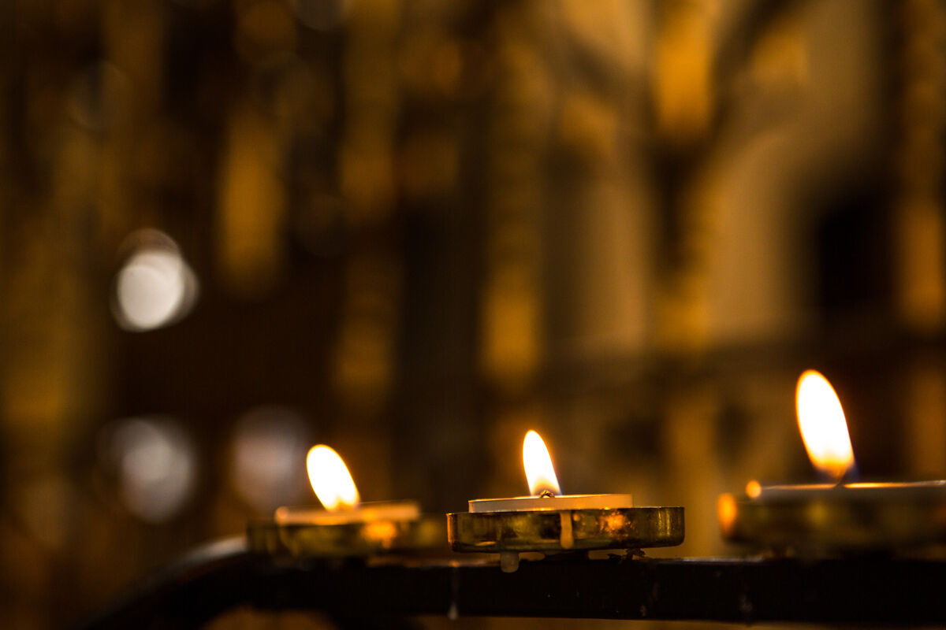

Sunday 13 December - Third Sunday of Advent
Respond
We invite you to light a virtual candle with CAFOD for a personal or class intention.
Add a short prayer and join others praying for our global family this Advent.
CAFOD - Light a Candle
Let us pray
Jesus, light of the world,
fill us with your joy.
Help us to share your light
and bring hope to others this Advent.
Amen.
Mission
Share the joy on this Gaudete Sunday and tell someone one thing you appreciate about them today. World gift: Share more joy and help communities have honey to eat and sell with the gift of Happy queen bees (£5)!
Joy
Notes:
Photo: Thom Flint, CAFOD. Candles in St George's Cathedral, Southwark.
World Gift Illustration: Sam Obsorne, CAFOD.
Advent candle graphics: M. Wallflower, Trendify, via Canva.
Green foliage: Sketchify from sketchify, via Canva.
Star graphic: WC Studio from WC Studio, via Canva.

Slide 32
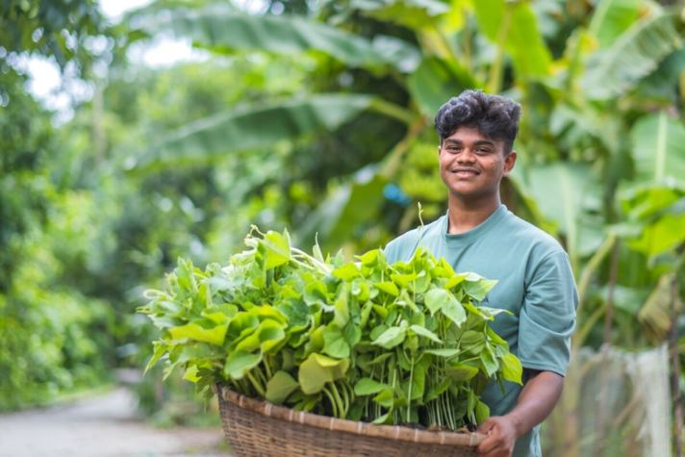
Monday 14 December - Third week of Advent
The Word
“Lord, make me know your ways.
Lord, teach me your paths.” Psalm 24:4
Bayezid, Bangladesh.
Reflection
Today's Psalm reminds us to seek God's guidance and be open to learning from others.
Earlier this year, CAFOD shared the story of Bayezid, a young farmer in Bangladesh. Where Bayezid lives, flooding can leave farmland underwater and make it difficult to grow food.
With support from CAFOD's local partners, communities are using an ingenious solution: floating gardens, where they can grow food even when the land is flooded.
Bayezid's story reminds us to listen to and learn from local communities. Our global neighbours experiencing the climate crisis have knowledge, skills and ideas that can help bring about positive change.
Catholic Social Teaching calls this subsidiarity: listening to people closest to an issue and making sure they can participate in decisions that affect them.
Why is it important to listen to and learn from people who are closest to the challenges they face?
“To build a beautiful world is everyone's responsibility...
We have to prevent pollution and save the environment together.”
Bayezid
Joy
Notes:
Photo: Amit Rudro, CAFOD. Floating gardens in Bangladesh.
Advent candle graphics: M. Wallflower, Trendify, via Canva.
Green foliage: Sketchify from sketchify, via Canva.
Star graphic: WC Studio from WC Studio, via Canva.

Slide 33
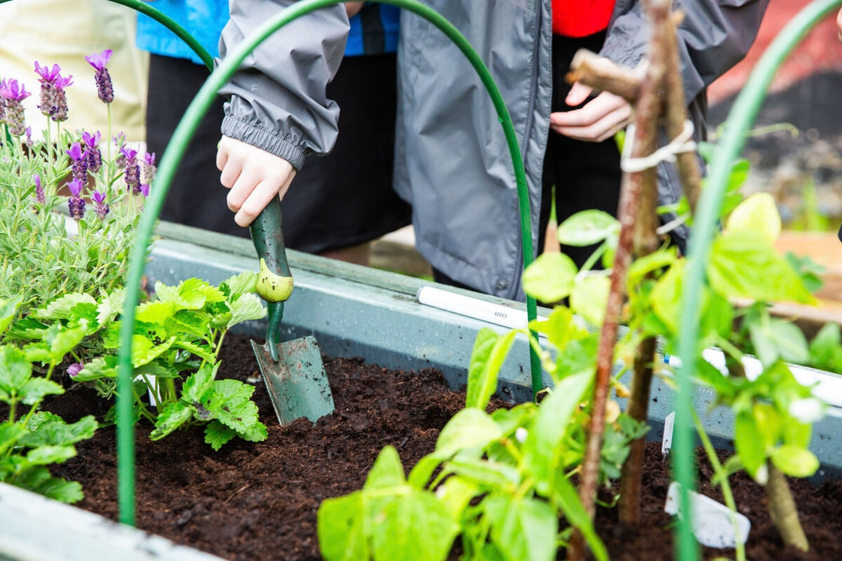
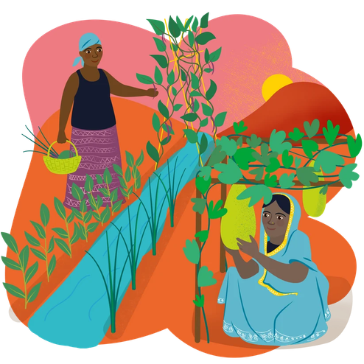
Monday 14 December - Third week of Advent
Respond
Think about your school: What are you already doing to care for creation? What could you do even better?
Does your school take part in CAFOD's LiveSimply award?
Learn more here: LiveSimply award
Let us pray
God of creation,
help us to listen and learn from others.
We thank you for the work of CAFOD who support and empower local partners to share their gifts and skills with their community.
Amen.
Mission
Think creatively for creation. Choose one new thing your class or school could do to care for our common home.
World Gift: Help communities in Bangladesh build Floating gardens to grow food and earn a living!
Joy
Notes:
Photo: Thom Flint, CAFOD. St Gregory’s Primary School, Chorley, demonstrating LiveSimply.
World Gift Illustration: Sam Obsorne, CAFOD.
Advent candle graphics: M. Wallflower, Trendify, via Canva.
Green foliage: Sketchify from sketchify, via Canva.
Star graphic: WC Studio from WC Studio, via Canva.

Slide 34
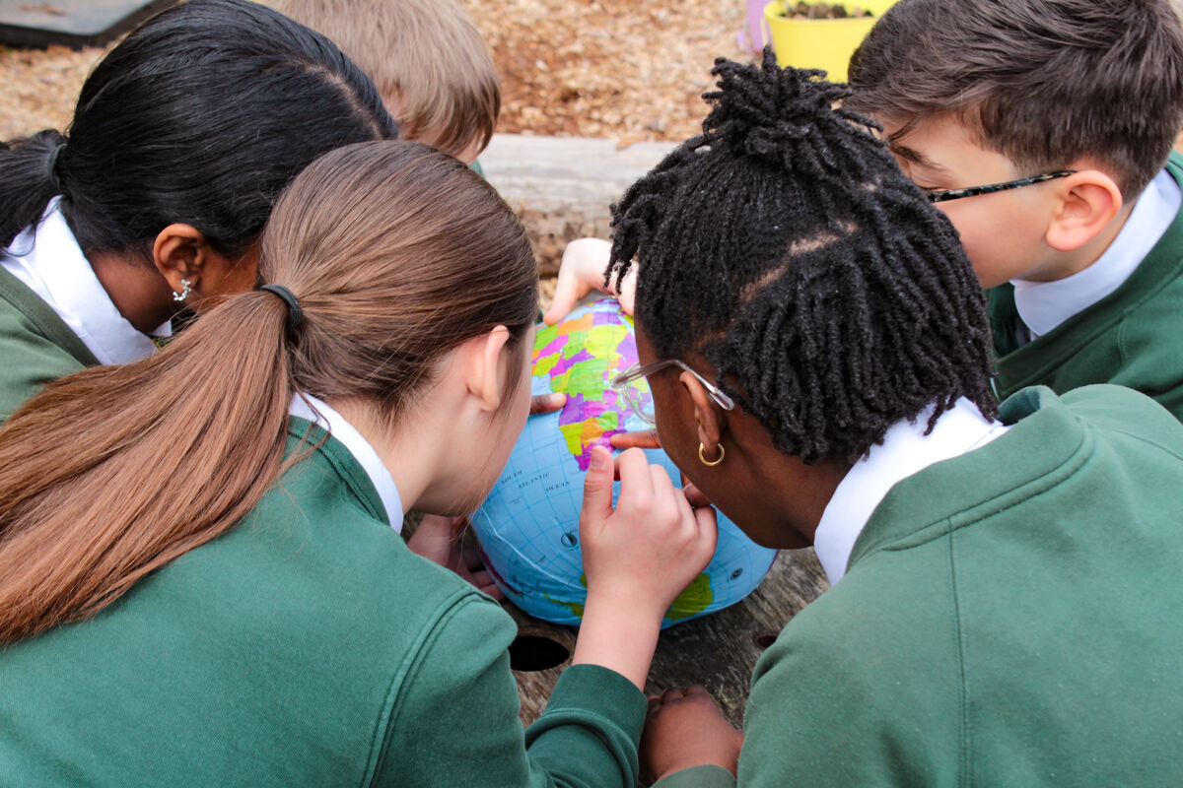
Tuesday 15 December - Third week of Advent
The Word
“The Lord is close to the broken-hearted.”
Psalm 33:18
Reflection
Today's Psalm reminds us that God is close to us, especially when life is difficult or we face challenges.
Christian joy does not mean pretending everything is perfect. It means trusting that God is with us and that His love can bring hope even in difficult times.
Around the world, many people are facing challenges such as conflict, poverty, hunger and the effects of the climate crisis. As Christians, we are called to remember them in our prayers and stand in solidarity with them.
God's love reaches across every border and connects us as one global family.
Who in our world needs God's hope, comfort and peace today?
Joy
Notes:
Photo: Vicky Ahmed, CAFOD. Jubilee Pilgrims of Hope - St Francis Xavier's RC Primary School, Herefordshire.
Advent candle graphics: M. Wallflower, Trendify, via Canva.
Green foliage: Sketchify from sketchify, via Canva.
Star graphic: WC Studio from WC Studio, via Canva.

Slide 35
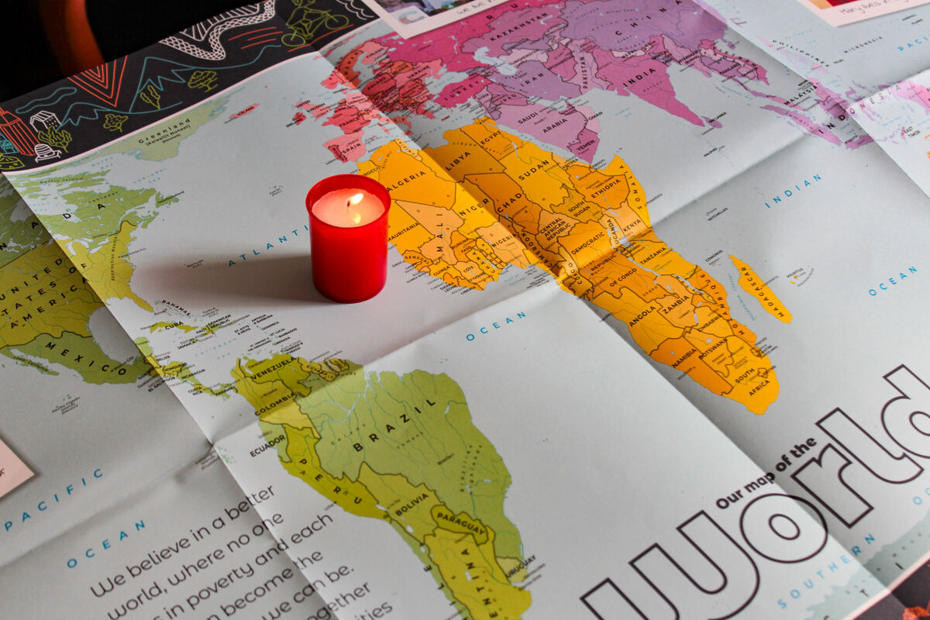
Tuesday 15 December - Third week of Advent
Respond
Use CAFOD's World Prayer Map to explore the different countries and communities CAFOD are working in.
Click on a country to find a prayer for or from that place.
Let us pray
God of hope,
you are close to the broken-hearted.
Be with all those who are suffering,
and help us to remember them in our prayers.
May your love bring hope, peace and comfort
to our global family in need.
Amen.
Mission
World Gift: Share some festive cheer with your global neighbours...could you fundraise for CAFOD’s special Christmas stocking this Advent (£100)? Check out the amazing five gifts included in this year's stocking.
Joy
Notes:
Photo: Vicky Ahmed, CAFOD.
Advent candle graphics: M. Wallflower, Trendify, via Canva.
Green foliage: Sketchify from sketchify, via Canva.
Star graphic: WC Studio from WC Studio, via Canva.

Slide 36
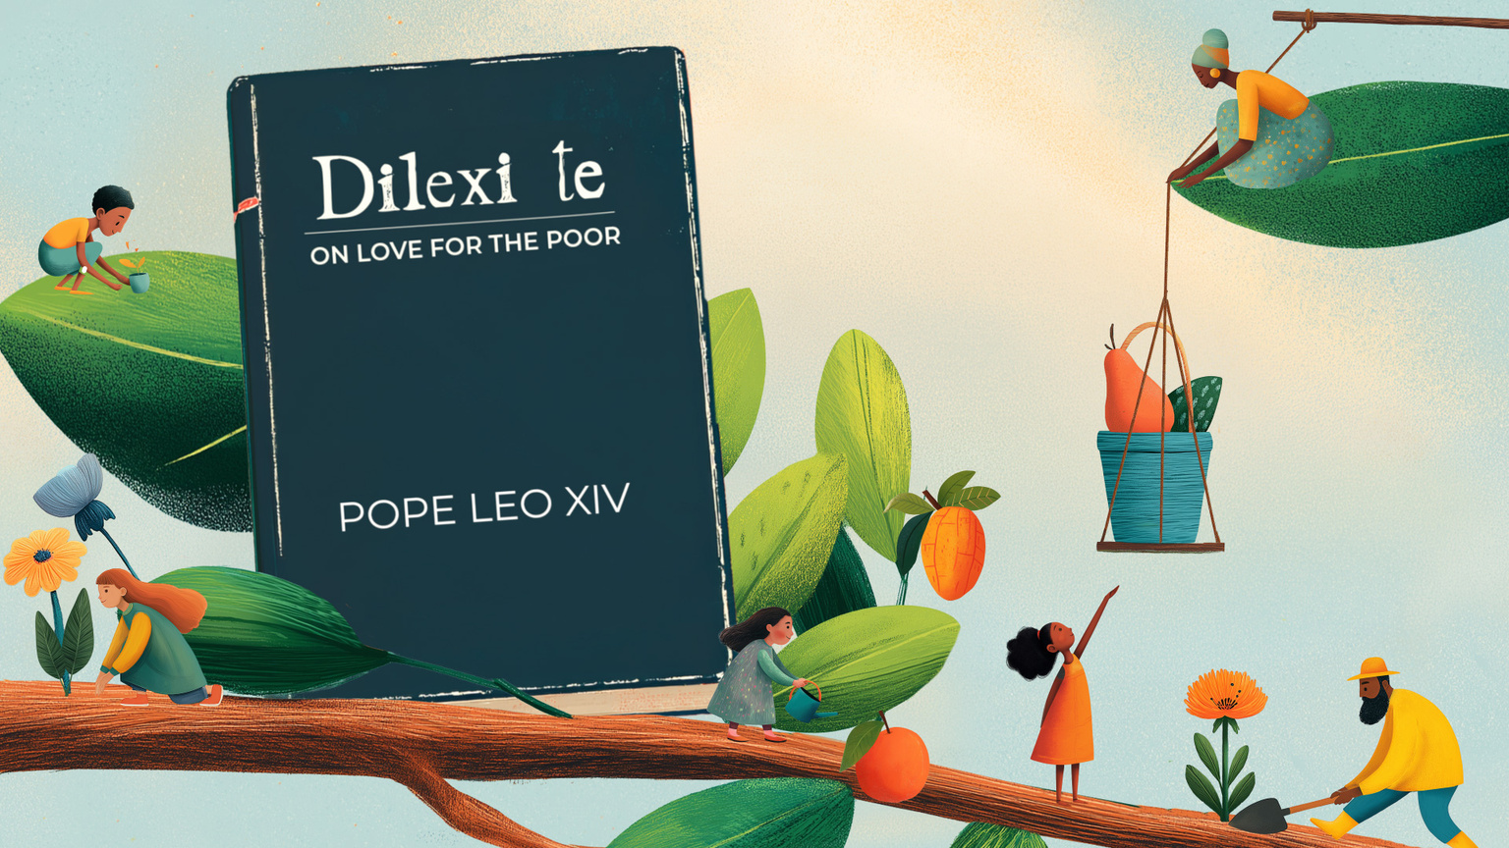
Wednesday 16 December - Third week of Advent
The Word
Jesus said: “Go and tell John what you have seen and heard: the blind receive their sight, the lame walk,
lepers are cleansed, and the deaf hear, the dead are raised up, the poor have good news preached to them.”
Luke 7:22
Reflection
In today's Gospel, John the Baptist sends messengers to ask Jesus if he really is the one they have been waiting for. Jesus doesn't simply say yes. He points to what is happening: people are being healed, lives are changing and people experiencing poverty are hearing Good News.
In Dilexi te, Pope Leo XIV calls Christians to hear the
“cry of the poor” and reminds us of God's special love for people experiencing poverty and exclusion.
Catholic Social Teaching calls us to put their needs first: the Preferential Option for the Poor.
We can share Christ's joy by helping his Good News become visible through our actions.
Joy
Notes:
Dilexi Te Illustration: V Srodi/M Nino/Ministory, CAFOD.
Advent candle graphics: M. Wallflower, Trendify, via Canva.
Green foliage: Sketchify from sketchify, via Canva.
Star graphic: WC Studio from WC Studio, via Canva.

Slide 37
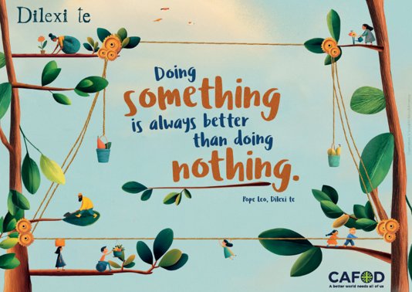
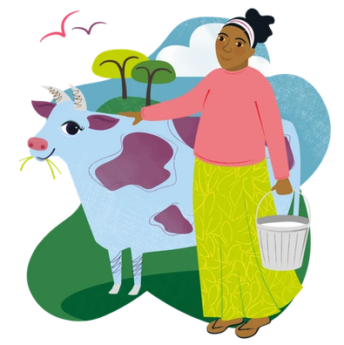
Wednesday 16 December - Third week of Advent
Respond
At CAFOD, we believe a better world needs all of us.
Watch CAFOD’s Dilexi te animation for young people and explore Pope Leo XIV's call to put love into action.
How can we help people who need extra support? What might “Good News” look like for someone experiencing poverty today?
Let us pray
Lord Jesus,
open our eyes to people who are overlooked and put the needs of the vulnerable first.
Help us to share your Good News through our words and actions.
Amen.
Mission
Joy
Like we hear Jesus do in the scripture, share a piece of Good News today! Could your school make an enormoooooos difference to a vulnerable family with an udderly wonderful Marvellous moo cow gift (£155)?
Notes:
Dilexi Te Illustration: V Srodi/M Nino/Ministory, CAFOD.
World Gift Illustration: Sam Obsorne, CAFOD.
Advent candle graphics: M. Wallflower, Trendify, via Canva.
Green foliage: Sketchify from sketchify, via Canva.
Star graphic: WC Studio from WC Studio, via Canva.

Slide 38
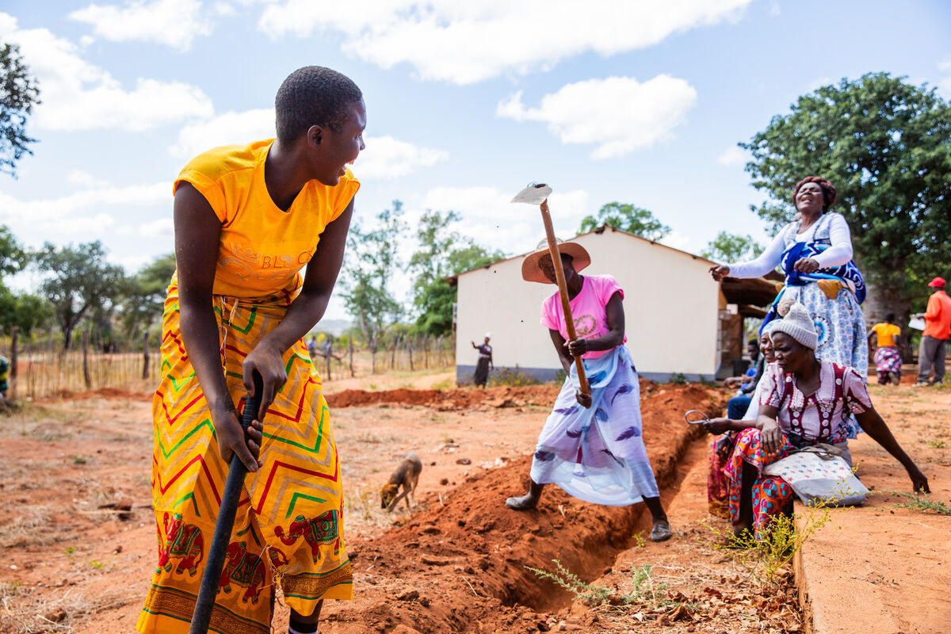
Thursday 17 December - Third week of Advent
The Word
“And Jacob the father of Joseph the husband of Mary, of whom Jesus was born, who is called Christ.”
Matthew 1:16
Reflection
In today’s Gospel, we hear about Jesus’ ancestors, from Abraham and David to Joseph. Each person is part of the story that leads us to Jesus today.
The people in our families, friendships, schools, parishes and communities help us to learn, grow and become who we are.
Joseph was Jesus' earthly father and his trade was that of a carpenter. He used his skills and work to care for his family. Like Joseph, each of us has different gifts and talents that we can use to care for others and help our communities to flourish.
Jesus’ family tree reminds us that everyone has a place in God’s family. There is joy in knowing that we belong and that each of us has something valuable to share.
Trench digging for solar water pumps at Nyamuzeya Primary School, Rushinga, north of Zimbabwe.
Joy
Notes:
Photo: Thom Flint, CAFOD. Zimbabwe 2025 - Solar-powered water and community gardens.
Advent candle graphics: M. Wallflower, Trendify, via Canva.
Green foliage: Sketchify from sketchify, via Canva.
Star graphic: WC Studio from WC Studio, via Canva.

Slide 39
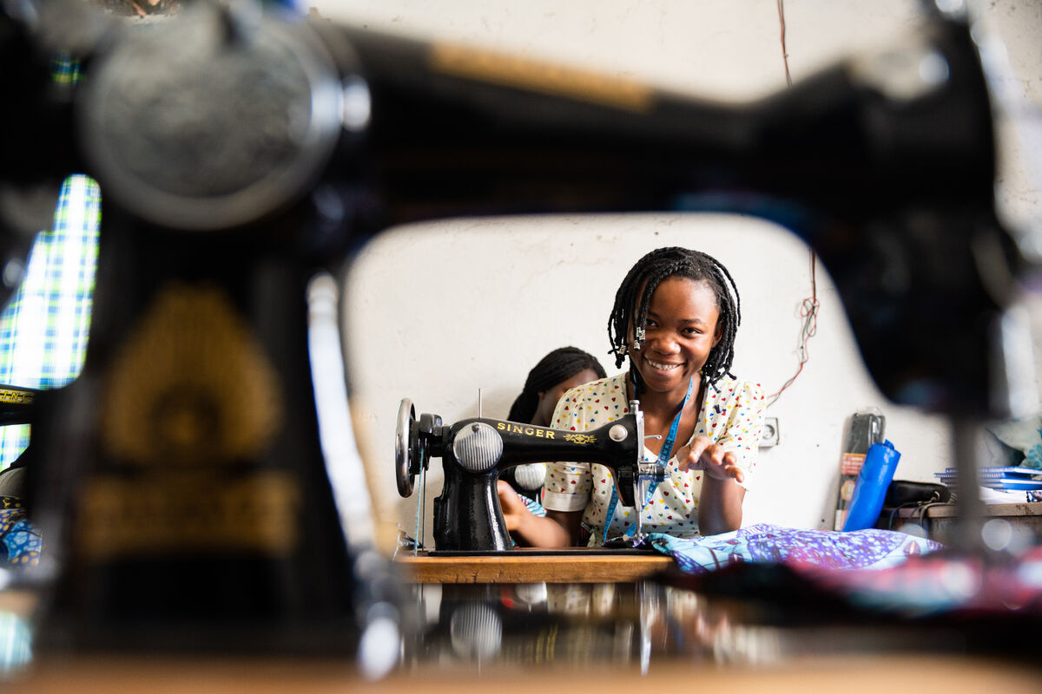
Thursday 17 December - Third week of Advent
Respond
What gift, skill or talent do you have that you could use to help someone else? Share it with someone nearby and thank God for it.
Let us pray
God of joy,
thank you for the people who care for us
and help us to know that we belong.
Thank you for the different gifts and skills
you have given each of us.
Help us to use them generously
to care for others and build a better world.
Amen.
Mission
CAFOD partner CAJED lead a tailoring training session in the Democratic Republic of the Congo (DRC).
Share one of your gifts today. You could use a skill to help someone, teach somebody something you know, or notice and encourage a gift that you see in
another person.
Joy
Notes:
Photo: Arlette Bashizi.
CAFOD partner CAJED lead a tailoring training session in the Democratic Republic of the Congo (DRC).
Advent candle graphics: M. Wallflower, Trendify, via Canva.
Green foliage: Sketchify from sketchify, via Canva.
Star graphic: WC Studio from WC Studio, via Canva.

Slide 40
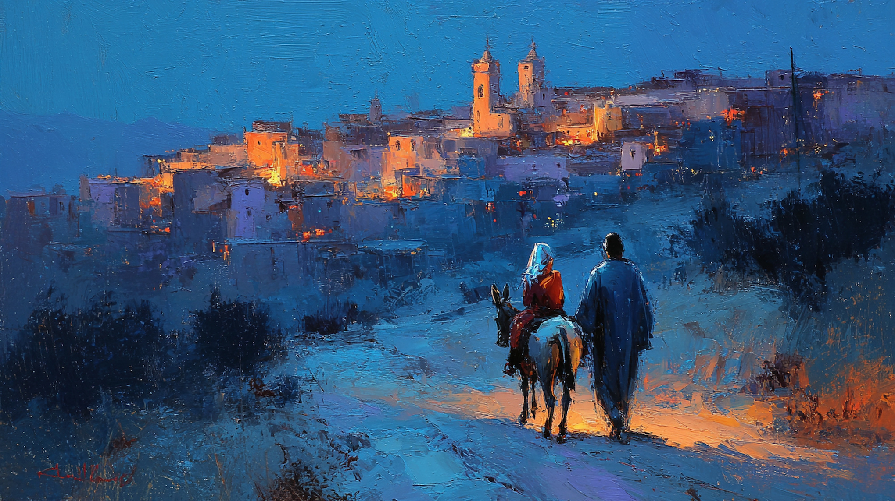
Friday 18 December - Third week of Advent
International Migrants Day
The Word
“They will call him Immanuel,
a name which means ‘God-is-with-us’.”
Matthew 1:23
Reflection
When Joseph discovers that Mary is expecting a baby, he is unsure what to do. In a dream, an angel from God tells him not to be afraid to take Mary into his home and to trust in God’s plan.
The name ‘Immanuel’ means ‘God-is-with-us’. During difficult or uncertain times, Christians can remember that God stays close to us, bringing hope and courage.
Today is International Migrants Day, a time to remember and pray for people who have left their homes to live somewhere new. Some people choose to move in search of new opportunities, while others are forced to leave because their homes are no longer safe.
Later in Matthew’s Gospel, Mary and Joseph have to flee with the baby Jesus to Egypt to escape danger. Their story reminds us to welcome people who are far from home, especially those seeking safety and a new beginning.
Joy
Notes:
Painterly illustration of Mary and Joseph traveling to Bethlehem on their journey: Prixel Creative, Lightstock.
Advent candle graphics: M. Wallflower, Trendify, via Canva.
Green foliage: Sketchify from sketchify, via Canva.
Star graphic: WC Studio from WC Studio, via Canva.

Slide 41
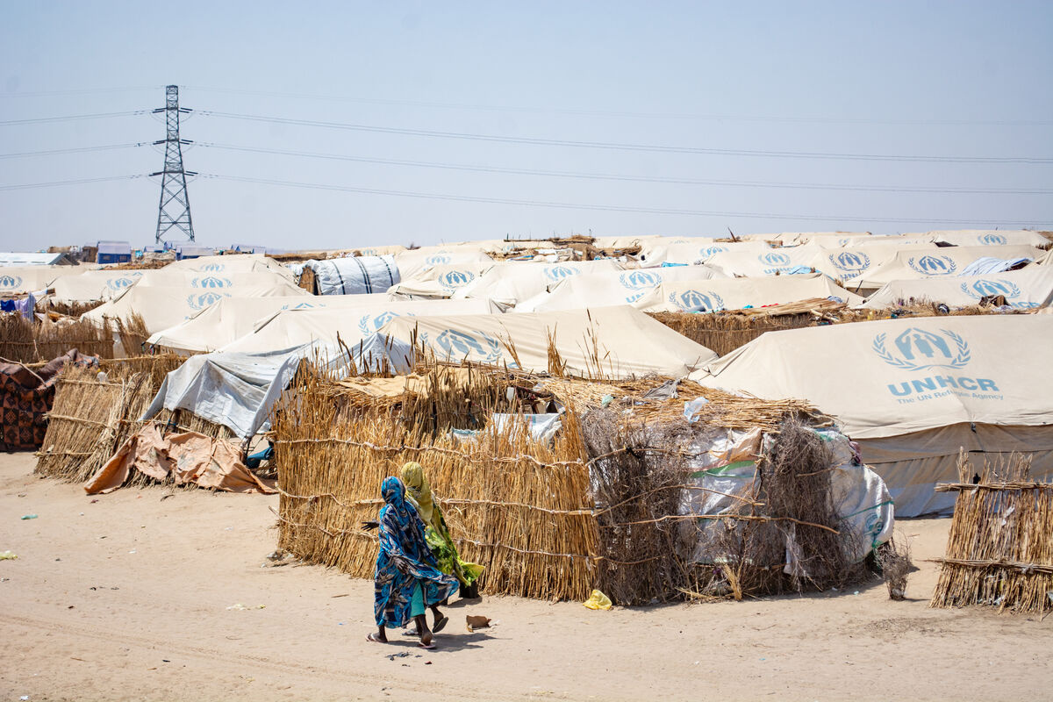
Friday 18 December - Third week of Advent
Respond
Think about children and families who have had to leave their homes. Discuss and share: what might help someone feel safe and welcomed in a new place?
Let us pray
God of joy,
you are with us wherever we go.
Be close to people forced to leave their homes.
Keep them safe on their journeys
and help them find welcome, peace and hope.
Amen.
Mission
Sudan crisis: refugee camp.
CAFOD has helped provide emergency water and toilets in the camp.
Be a welcoming presence today. Look out for someone who might feel left out and help them
feel included.
Joy
Notes:
Photo: George Wambugu, CAFOD. Sudan crisis: refugee camp - March 2025.
Advent candle graphics: M. Wallflower, Trendify, via Canva.
Green foliage: Sketchify from sketchify, via Canva.
Star graphic: WC Studio from WC Studio, via Canva.

Slide 42
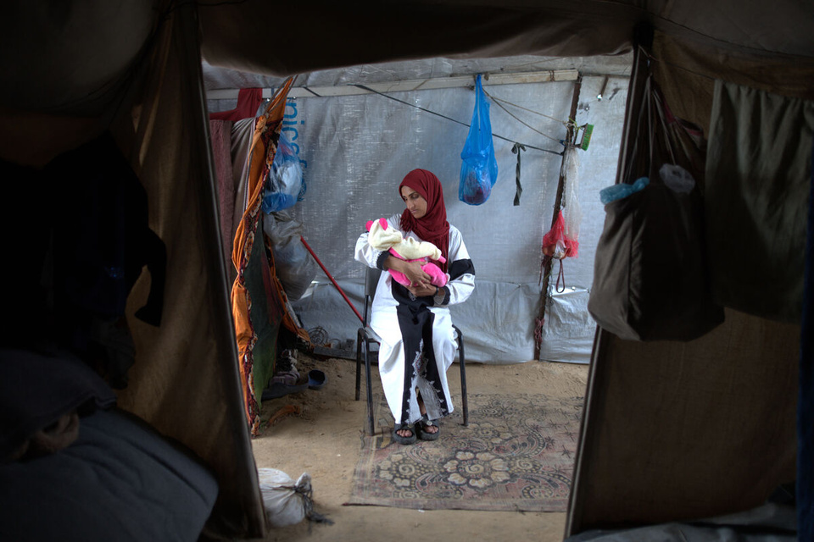
Sunday 20 December - Fourth Sunday of Advent
It’s the weekend!
Special day of prayer for expectant mothers
Yasmine, mother in Gaza
Sunday’s Gospel
“For nothing will be impossible with God.”
Luke 1:37
Reflection
In Sunday’s Gospel, the angel Gabriel tells Mary that she will become the mother of Jesus. Mary doesn't know everything that lies ahead, but she puts her trust in God.
Today, the Church asks us to pray especially for expectant mothers.
Advent is a time of joyful waiting. But in Gaza, winter weather and shortages of food and medicine make life especially difficult for families with young children and babies.
Yasmine is a young mum living with her family in a camp in Gaza. CAFOD's partners are working alongside families like Yasmine's, providing medical care and practical support.
“The Caritas team gave us a lot of support, including psychological care and medical treatment...
I even felt special among the people around me.” - Yasmine
Love
Notes:
Photo: Trocaire | Raw Media, CAFOD.
Displaced families in Gaza - Yasmine.
Advent candle graphics: M. Wallflower, Trendify, via Canva.
Green foliage: Sketchify from sketchify, via Canva.
Star graphic: WC Studio from WC Studio, via Canva.

Slide 43
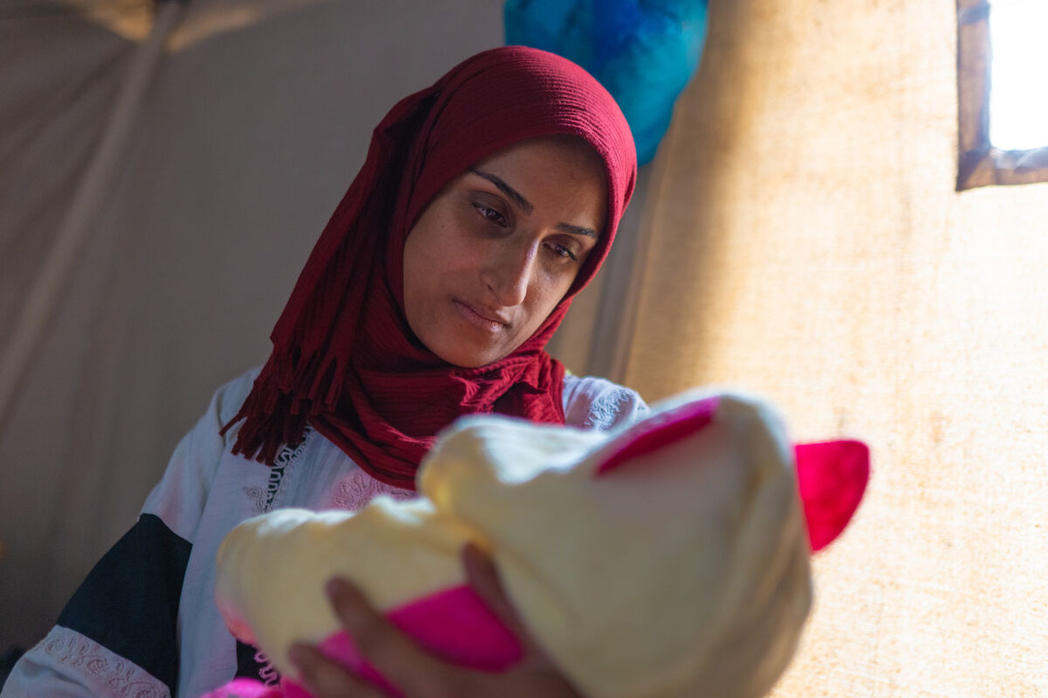
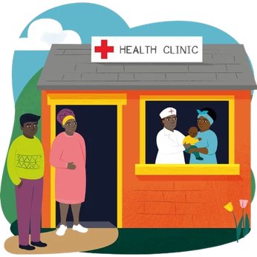
Sunday 20 December - Fourth Sunday of Advent
Respond
Pray a decade of the Rosary for expectant mothers and babies. Pray one Our Father, Ten Hail Marys and the Glory Be prayer.
You can use rosary beads, a piece of string and tie your own prayer knots or simply use your fingers to help you keep count the Hail Marys.
Let us pray
God of love,
we pray for expectant mothers
and families around the world.
Give them hope, strength and courage,
and surround them with your love and care.
Amen.
This gift can make an enormous difference to communities with important medicines, medical equipment and helps keep the clinic ambulance running!
Mission
Continue to pray for expectant mothers and babies around the world, especially from families facing difficult circumstances.
Could your school or family of schools work together to fundraise for a Health Clinic World Gift (£4000)?
Love
Notes:
Photo: Trocaire | Raw Media, CAFOD.
Displaced families in Gaza - Yasmine.
World Gift Illustration: Sam Obsorne, CAFOD.
Advent candle graphics: M. Wallflower, Trendify, via Canva.
Green foliage: Sketchify from sketchify, via Canva.
Star graphic: WC Studio from WC Studio, via Canva.

Slide 44
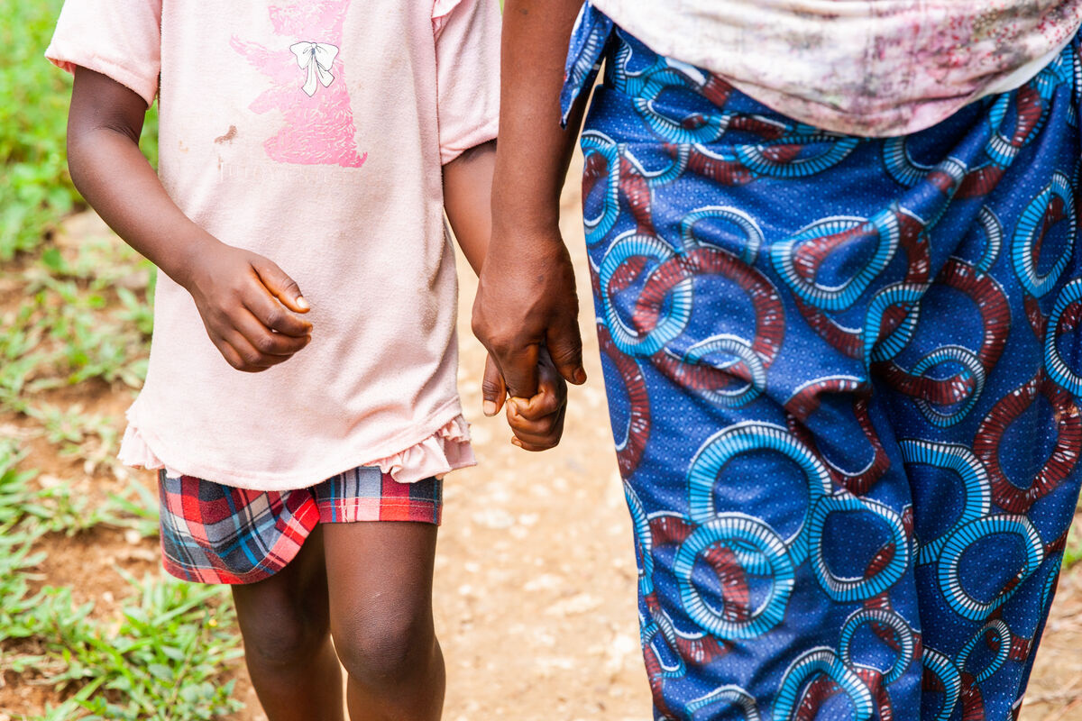
Monday 21 December - Fourth week of Advent
The Word
“Blessed are you among women, and blessed is the fruit of your womb!”
Luke 1:42
Reflection
In today's Gospel, Mary visits her cousin Elizabeth and their encounter is full of welcome, joy and love.
During Advent, we prepare to encounter Christ and we recognise His presence in others. These encounters can open us to new experiences and remind us that we are one global family.
Through CAFOD, we can encounter people from around the world whose lives and experiences help us see God's presence in new ways. Their stories remind us that we are connected to one another and called to stand alongside our neighbours.
Like Mary, we are invited not only to listen, but also to respond with love.
How can encountering another person's experience help us build a better world?
Love
Notes:
Photo: Thom Flint, CAFOD. Hunger, nutrition and livelihoods in Sierra Leone.
Advent candle graphics: M. Wallflower, Trendify, via Canva.
Green foliage: Sketchify from sketchify, via Canva.
Star graphic: WC Studio from WC Studio, via Canva.

Slide 45
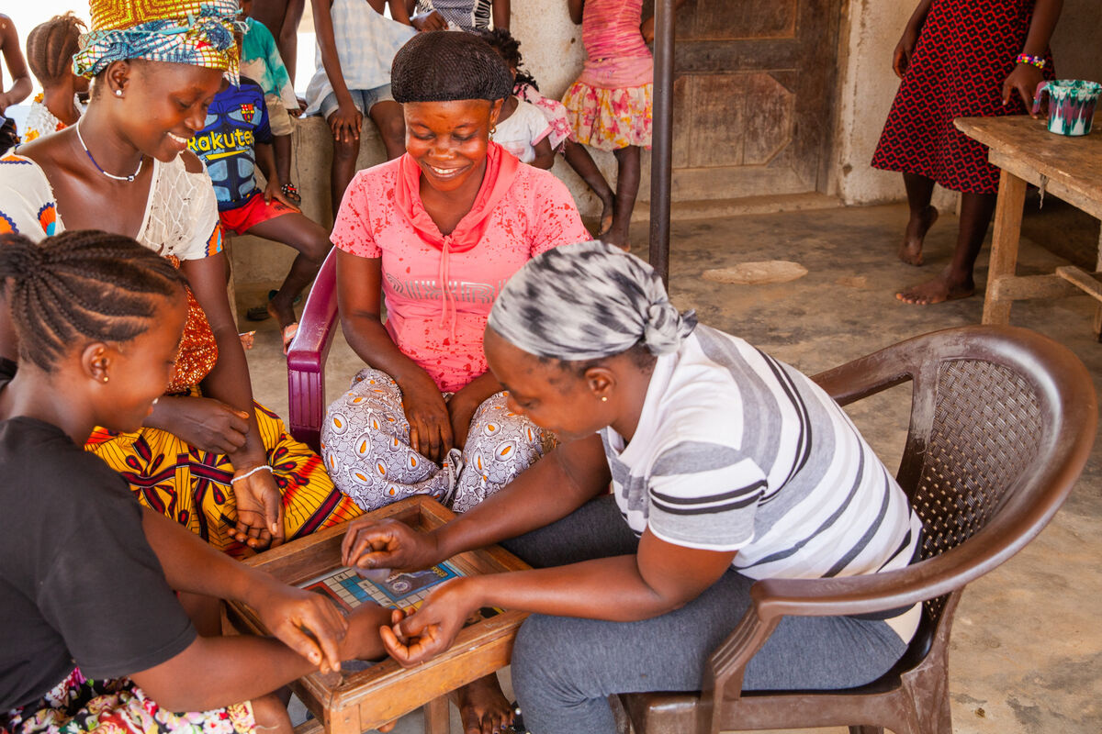
Monday 21 December - Fourth week of Advent
Respond
When Jesus taught us the Our Father, He used words like "our," "we" and "us." These are words that remind us we belong together and that we pray not just for ourselves, but for everyone in God's family.
We invite you to pray the Our Father Prayer together.
As you pray, listen carefully for the words "our," "we" and "us." Count how many times you hear them.
Why do you think Jesus taught us to pray in this way?
Let us pray
CAFOD partner - the Handmaid Sisters (Sisters of the Congregation of the Handmaids of the Holy Child Jesus) run a clinic in Sierra Leone for pregnant mothers.
God of love,
help us to recognise Your presence in the people we meet.
Open our hearts to others
and give us the courage to respond with love.
Amen.
Take your mission further: Learn more about the people and communities CAFOD works alongside and how their experiences can inspire us to build a better world.
Mission
Love
Follow Mary's example and make time for someone today. Listen carefully, give someone your full attention and learn something from their experience.
Notes:
Photo: Thom Flint, CAFOD. Hunger, nutrition and livelihoods in Sierra Leone.
Advent candle graphics: M. Wallflower, Trendify, via Canva.
Green foliage: Sketchify from sketchify, via Canva.
Star graphic: WC Studio from WC Studio, via Canva.

Slide 46
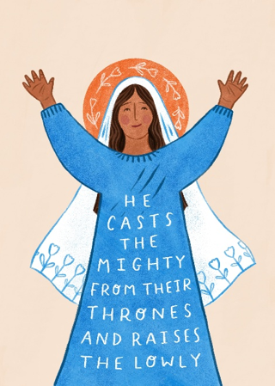
Tuesday 22 December - Fourth week of Advent
The Word
“He has shown strength with his arm;
he has scattered the proud in the thoughts of their hearts...he has filled the hungry with good things,
and the rich he has sent away empty.”
Luke 1:51-53
Reflection
When Mary visited Elizabeth, Mary proclaimed a joyful song of praise and thanksgiving to God called the Magnificat.
In her song, Mary gives thanks for God's goodness and celebrates a God who lifts the lowly, fills the hungry and remembers those who are overlooked.
Mary looks back and recognises God at work. Her prayer invites us to do the same: to notice God's love and mercy in our lives and consider how we can help build a world that is more loving, fair and just.
Where can you see God's goodness and mercy at work today?
Love
Notes:
Magnificat Illustration: Emma Hartley Walton, CAFOD.
Advent candle graphics: M. Wallflower, Trendify, via Canva.
Green foliage: Sketchify from sketchify, via Canva.
Star graphic: WC Studio from WC Studio, via Canva.

Slide 47
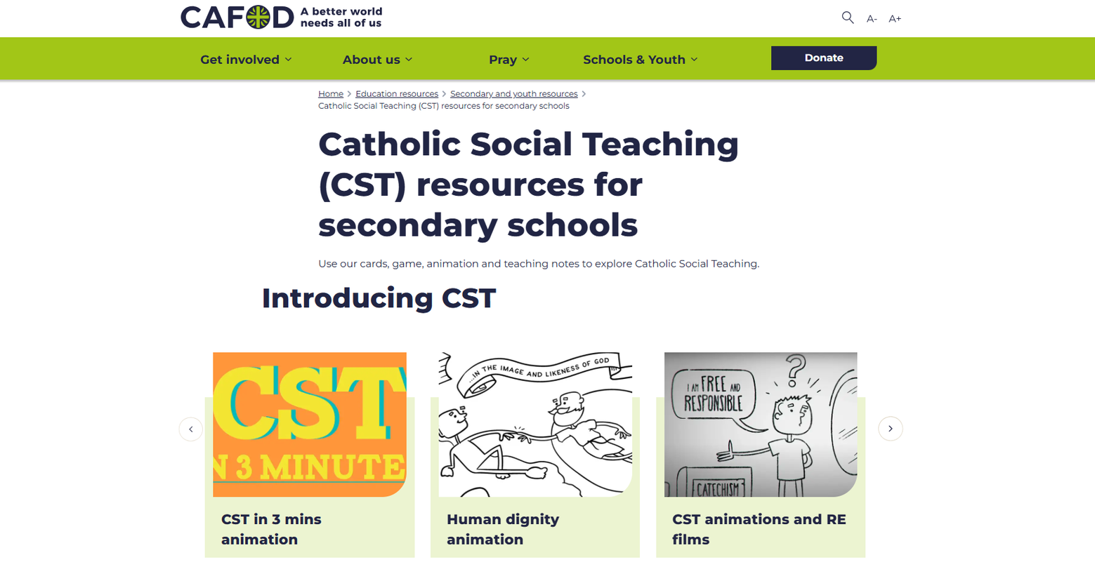
Tuesday 22 December - Fourth week of Advent
Respond
Read or listen to the Magnificat (Luke 1:46-55).
Which words stand out to you? Which principles of Catholic Social Teaching can you find throughout her song?
Explore CAFOD's Catholic Social Teaching resources for secondary schools for more ideas.
Let us pray
God of love,
like Mary, help us to say yes to you
and give thanks for all you have done.
As we prepare our hearts for Jesus,
help us to lift up those who are overlooked.
Amen.
Mission
Love
Like Mary did in the Magnificat, take time to give thanks.
Say a prayer of thanks to God or thank someone who has shown you love or kindness this year.
Notes:
https://cafod.org.uk/education/secondary-and-youth-resources/cst-resources-young-people
Advent candle graphics: M. Wallflower, Trendify, via Canva.
Green foliage: Sketchify from sketchify, via Canva.
Star graphic: WC Studio from WC Studio, via Canva.

Slide 48

Wednesday 23 December - Fourth week of Advent
The Word
“The time came for Elizabeth to give birth,
and she bore a son. And her neighbours and relatives heard that the Lord had shown great mercy to her,
and they rejoiced with her.”
Luke 1:57-58
Reflection
Today's Gospel is full of joy. Elizabeth's neighbours and relatives hear her good news and rejoice with her.
Love means celebrating the good things that happen to other people, not just ourselves.
As Christmas draws near, we have so much to give thanks for.
At CAFOD, we are especially grateful for the incredible ways schools and young people have put their faith into action this year through praying, giving, campaigning and working for a better world.
THANK YOU!
CAFOD supporting and empowering female farmers to improve their food production and economic opportunities in Kailahun District, Sierra Leone.
Love
Notes:
Photo: CAFOD Staff. Supporting female farmers to improve their food production and economic opportunities in Kailahun District, Sierra Leone.
Advent candle graphics: M. Wallflower, Trendify, via Canva.
Green foliage: Sketchify from sketchify, via Canva.
Star graphic: WC Studio from WC Studio, via Canva.

Slide 49

Wednesday 23 December - Fourth week of Advent
Respond
Think back over this year. What good news or achievement could you celebrate and give thanks for today? Share your achievements with your peers!
Let us pray
God of love,
thank you for all we have to celebrate.
As we prepare to welcome Jesus,
help us to rejoice with others, recognise our blessings
and share your hope and joy.
Amen.
Mission
Celebrate and say thank you.
Thank someone who has helped your class, school or community make a difference this year.
Love
Notes:
Photo: Thom Flint, CAFOD. Mass Lobby 2025.
Advent candle graphics: M. Wallflower, Trendify, via Canva.
Green foliage: Sketchify from sketchify, via Canva.
Star graphic: WC Studio from WC Studio, via Canva.

Slide 50

Thursday 24 December - Christmas Eve
The Word
“I will sing forever of your love, O Lord.”
Psalm 88:2
Reflection
It's Christmas Eve! Today’s Psalm invites us to sing of God's love: a love for every person, in every place and for all time.
Tomorrow, we celebrate the birth of Jesus and the extraordinary gift of God coming to live among us.
In the excitement and preparations of Christmas Eve, take time to remember why we celebrate and make room in your heart for Jesus.
How can you share God's love with others throughout this festive period?
Anna and Orest playing with a sand timer preparing for Christmas in Ukraine.
Caritas Khmelnytskyi – the organisation CAFOD works with in Ukraine – helped the family with fuel so that they would have heat during the worst months.
Love
Notes:
Photo: Svitlana Dmytrenko, CAFOD. Ukraine winterisation support.
Anna and Orest playing with a sand timer preparing for Christmas in Ukraine.
Caritas Khmelnytskyi – the organisation CAFOD works with in Ukraine – helped the family with fuel so that they would have heat during the worst months.
Advent candle graphics: M. Wallflower, Trendify, via Canva.
Green foliage: Sketchify from sketchify, via Canva.
Star graphic: WC Studio from WC Studio, via Canva.

Slide 51


Thursday 24 December - Christmas Eve
Respond
Listen to or sing a favourite Christmas hymn or carol and reflect on the true meaning of Christmas.
Let us pray
God of love,
as we prepare to celebrate the birth of Jesus,
help us remember the true meaning of Christmas.
Bless our families and our global family,
and help us share your love with others.
Amen.
Mission
Still looking for a Christmas gift?
Choose a CAFOD World Gift and
share the joy of Christmas with our global family!
Saint Francis of Assisi created the first living Nativity scene to bring people together and help them to reflect on the simplicity and humility of Jesus' birth.
Spend a few moments with your crib or looking at a Nativity scene today and remember what Christmas is really about.
Love
Notes:
Photo: Elisa Schulz, Lightstock.
World Gift Illustration: Sam Obsorne, CAFOD.
Advent candle graphics: M. Wallflower, Trendify, via Canva.
Green foliage: Sketchify from sketchify, via Canva.
Star graphic: WC Studio from WC Studio, via Canva.

Slide 52

Friday 25 December - Christmas Day
The Word
“And she gave birth to her firstborn son and wrapped him in swaddling cloths and
laid him in a manger.”
Luke 2:7
Reflection
Happy Christmas! After our Advent journey of waiting and preparation, today we celebrate the birth of Jesus.
God chose to live among us as a small and humble baby. The birth of Jesus reminds us that every person is precious to God and we are all part of one global family.
Notes:
Photo: Blue Wave Creative, Lightstock.
Advent candle graphics: M. Wallflower, Trendify, via Canva.
Green foliage: Sketchify from sketchify, via Canva.
Star graphic: WC Studio from WC Studio, via Canva.

Slide 53

Friday 25 December - Christmas Day
Respond
Today we celebrate God's love made visible in Jesus, fully human and fully God.
Think of the people you love and give thanks to God for them. How can you share some extra love with them today?
Let us pray
God of love,
thank you for the gift of Jesus.
Fill us with hope, peace, joy and love this festive season.
Help us to share your light with our neighbours and our global family.
Amen.
Mission
Now the season of Christmastide begins!
Keep celebrating the joy of Christmas with CAFOD's Christmas family prayer ideas, with short prayers and activities from Christmas Day through to Epiphany.
Notes:
Photo: Kara Gebhardt, Lightstock.
Advent candle graphics: M. Wallflower, Trendify, via Canva.
Green foliage: Sketchify from sketchify, via Canva.
Star graphic: WC Studio from WC Studio, via Canva.

