Slide 1
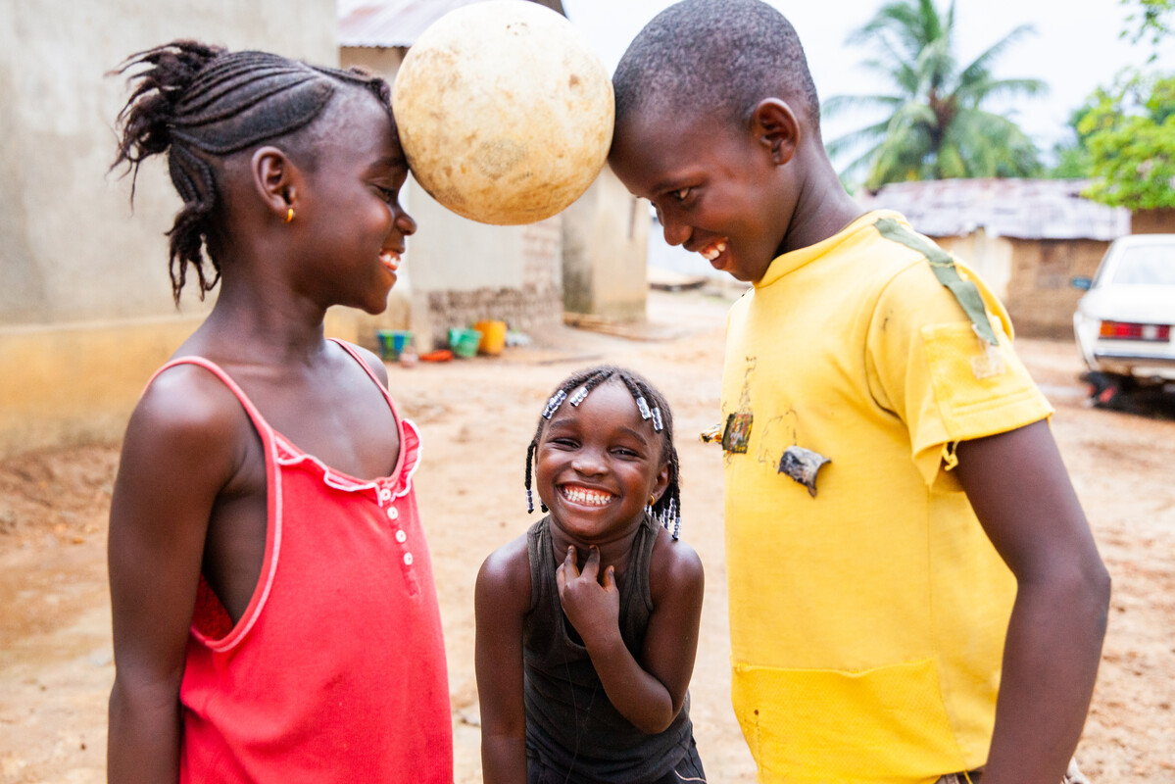
Preferential Option for
the Poor
Exploring CST principles in CAFOD’s work
Notes:
Photo credit: Thom Flint

Slide 2
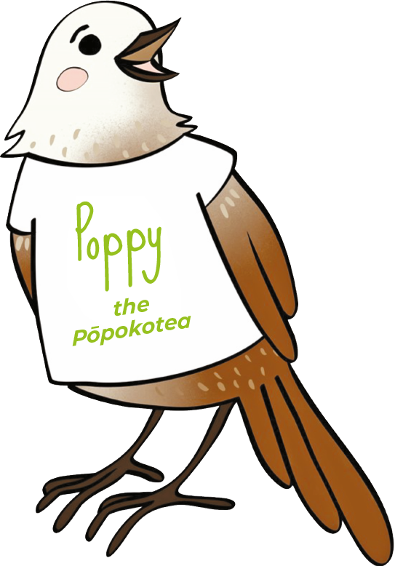
Preferential option for the poor means we believe in
putting people living in poverty first.

Slide 3
"Learn to do good; seek justice, rescue the oppressed, defend the orphan, plead for the widow."
Isaiah 1:17

Slide 4
Preferential Option for the Poor
We should help our brothers and sisters around
the world living in poverty, putting their needs first.
Notes:
Photo credit: St Edmund Arrowsmith Catholic High School

Slide 5
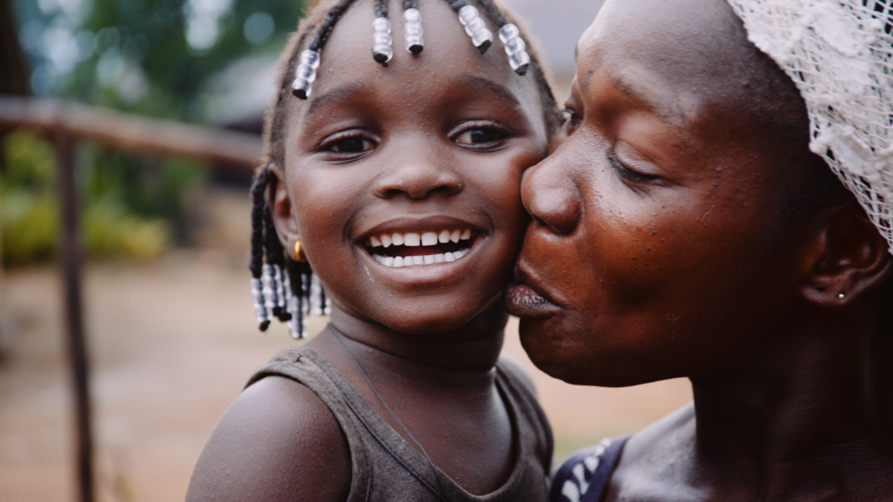
This is Lombeh.
She lives in a village with her family in Sierra Leone.
When Lombeh was a baby, she did not have enough of the right foods to eat and was very sick.
Notes:
Photo credit: Thom Flint

Slide 6
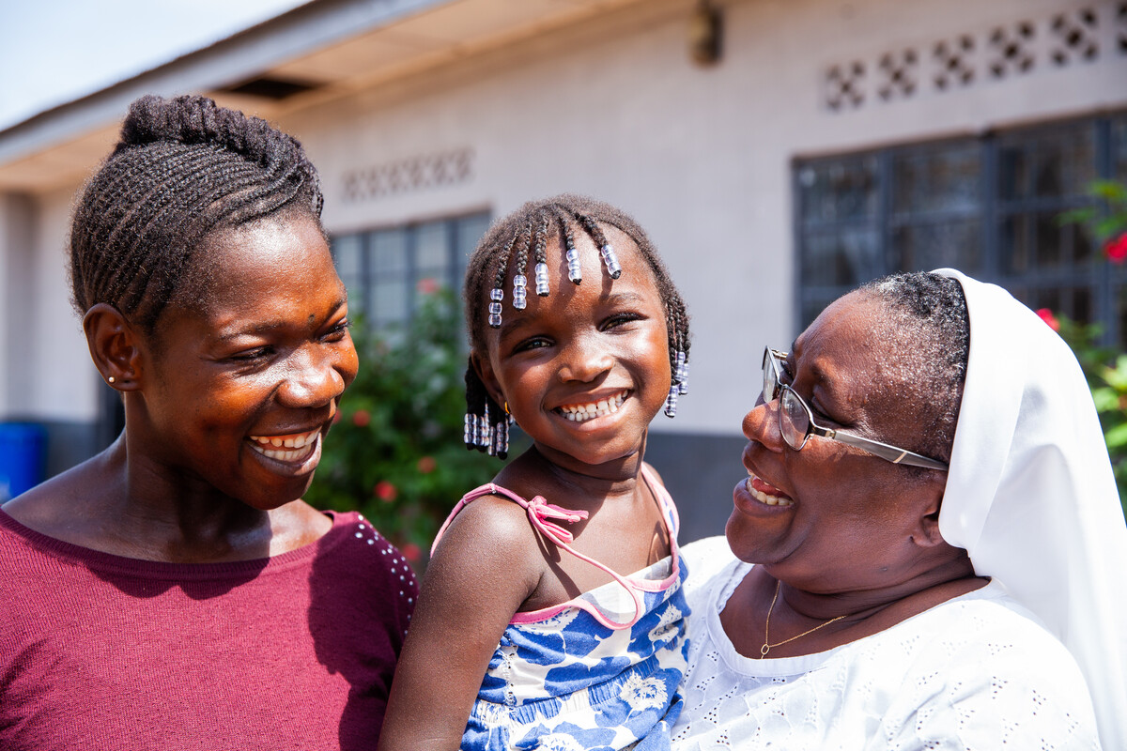
With CAFOD's help, Lombeh's mum began to feed her a special mix that included rice and sesame seeds to give her strength.
Now Lombeh is strong and healthy. "She is very lively!" says her mum.
Notes:
Photo credit: Thom Flint

Slide 7
Jesus taught that when we feed the hungry, welcome the stranger, clothe the naked, look after the sick and visit those imprisoned, we are looking after Him.
Notes:
Photo credit: St Eizabeth’s Primary School

Slide 8
"The measure of the greatness of a society is found in the way it treats those most in need."
Pope Francis,
26 July 2013
Notes:
Photo credit: Thom Flint

Slide 9
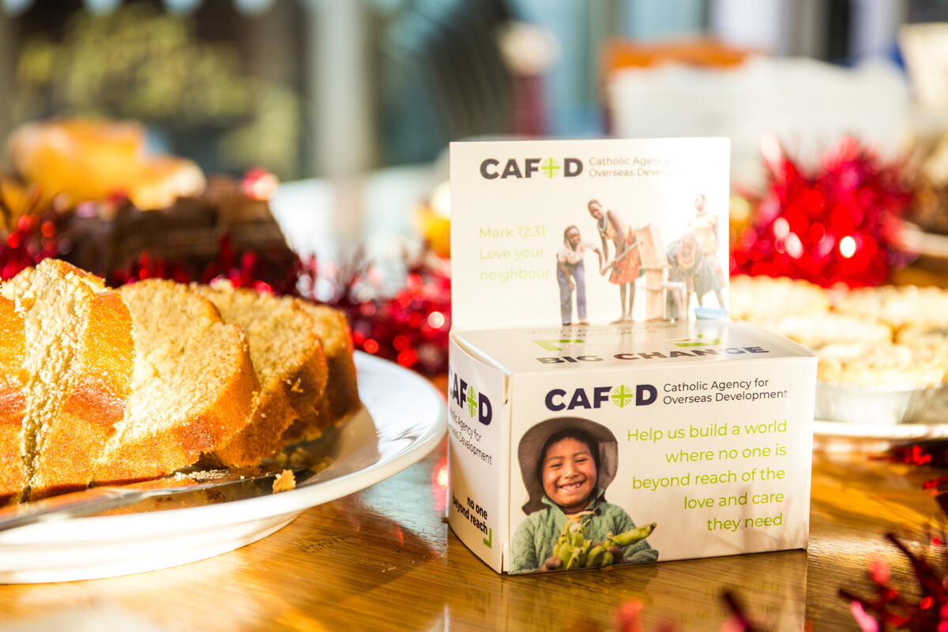
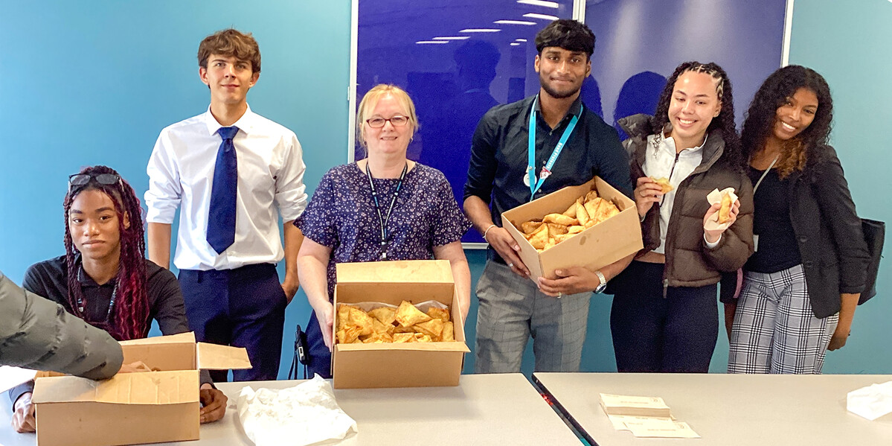
Putting the needs of people in poverty first
Lots of schools have CAFOD cake sales to raise money for our brothers and sisters living in poverty around the world.
St Edmund’s Catholic Academy even had a ‘Samosa Friday’ for CAFOD!
Notes:
Photo credit: Thom Flint
Photo credit: St Edmund's Catholic Academy

Slide 10
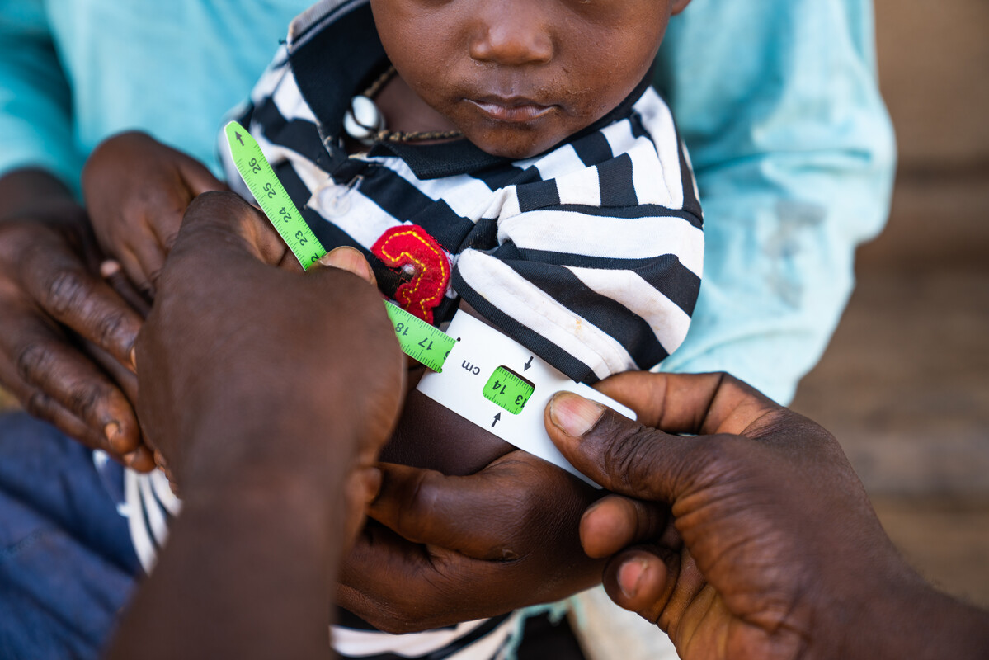
Let us pray
Loving God,
We believe that when we serve people living in poverty, we serve you.
Help us to take special care of those people most in need.
Lord in your mercy
Hear our prayer
Putting people living in poverty first
Preferential Option for the Poor
Notes:
Photo credit: Michael Duff

Slide 11
Putting people living in poverty first
Poppy the Popokotea reminds us that a preferential option for the poor is putting people living in poverty first.
How can we put people in most need first?

