Slide 1
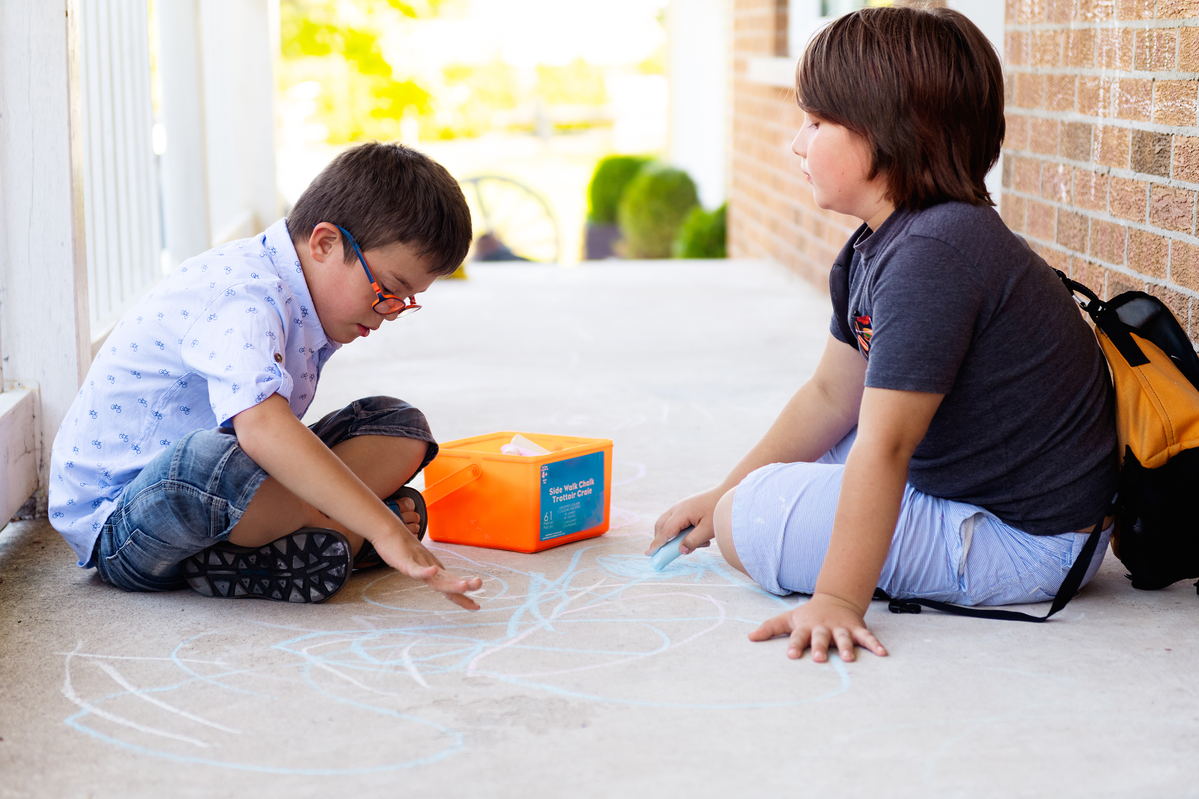
How should we treat each other so that we can be signs of hope?
Gather
Notes:
Children’s liturgy: Fourth Sunday of Easter (Year C)
Preparation of the worship space
Colour: white
Props: paper or card, pens and pencils
Song suggestions
Love is his word, love is his way (803, Laudate)
Welcome
Today Jesus talks about how important it is to listen to him. And how he knows and cares about every one of us, no matter who we are. Let’s think some more about this today.
Drawing with chalk
Photo credit: Stock image

Slide 2
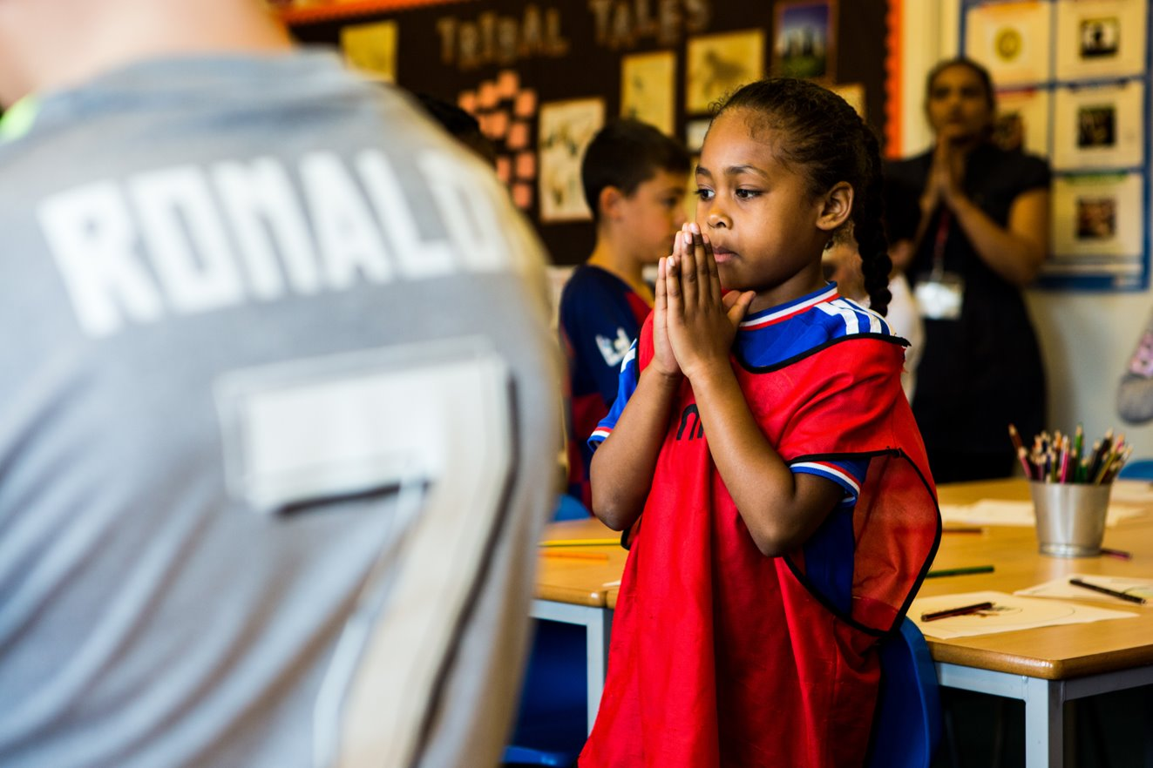
God of all,
Help us to listen to your voice and to care for one another as you care for all people. We ask this through Christ our Lord, Amen.
Notes:
Children at Our Lady Queen of Heaven Primary School
Photo credit: Thom Flint

Slide 3
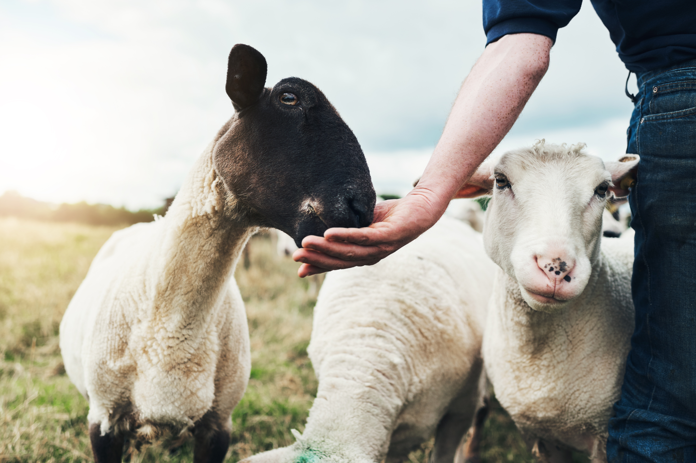
Gospel: John 10: 27-30
"My sheep listen to my voice; I know them, and they follow me. I give them eternal life, and they shall never die. No one can snatch them away from me.
What my Father has given me is greater than everything, and no one can snatch them away from the Father’s care. The Father and I are one."
Word
Notes:
Shepherd and sheep
Photo credit: Stock image

Slide 4
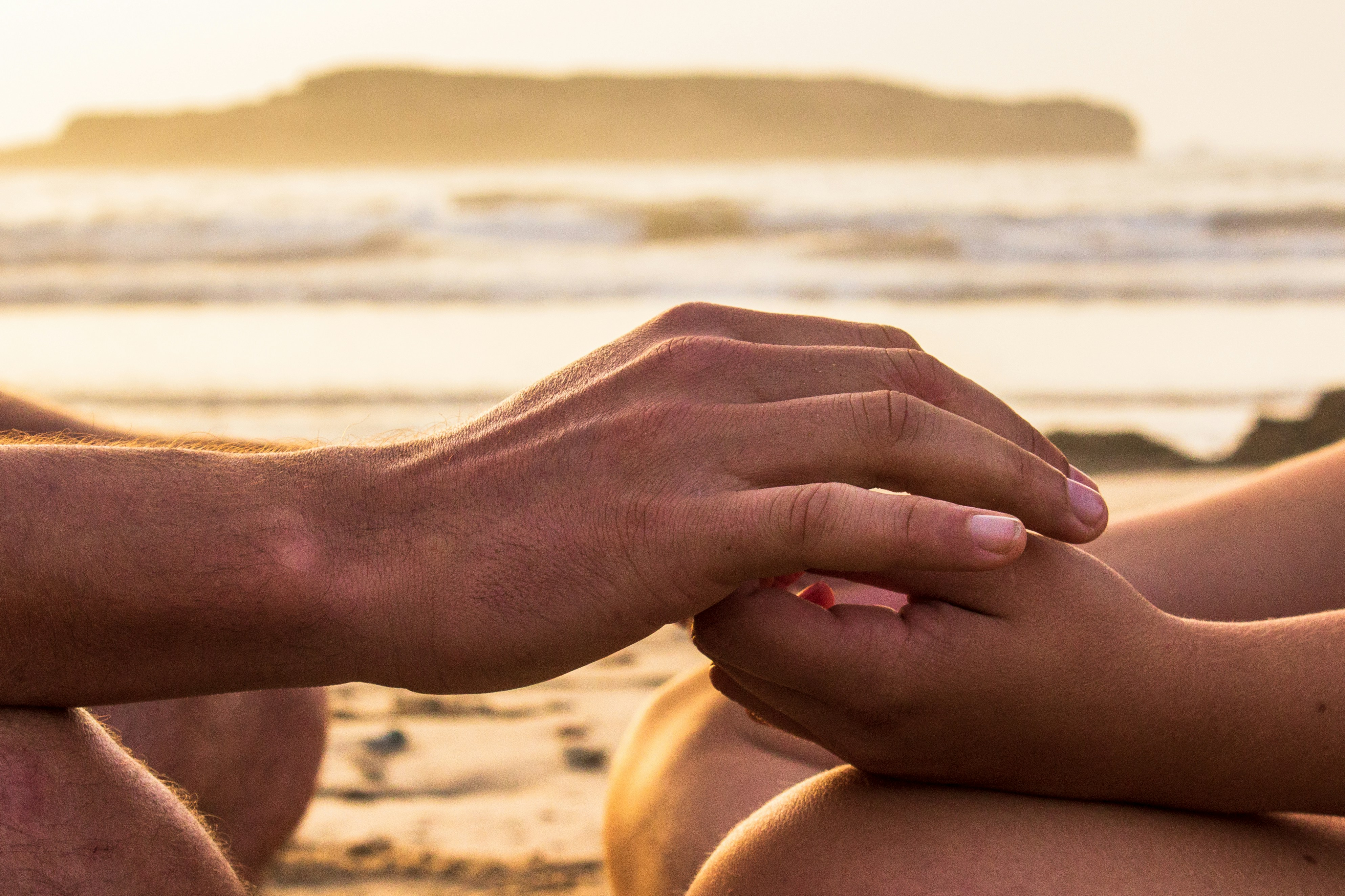
What do you remember from the Gospel reading?
Today Jesus talks about sheep. Jesus didn’t spend his time looking after sheep out in the fields, so who do you think Jesus’ sheep are? Who is he talking about?
Jesus is a shepherd of people. He shows us the way to live our lives. He looks after us and cares for us, just like a shepherd looking after their sheep.
Respond
Notes:
Comfort
Photo credit: Louis Hansel on Unsplash

Slide 5
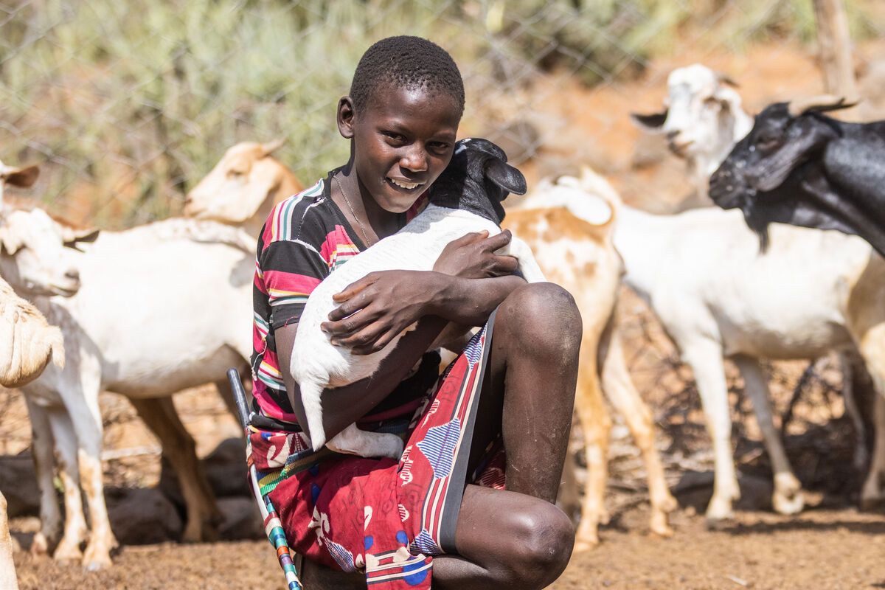
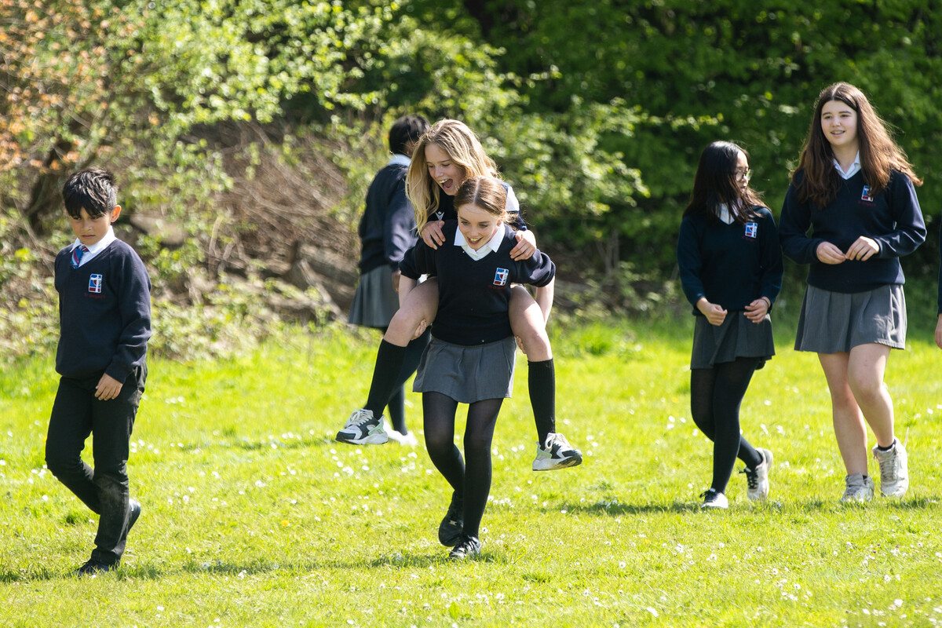
What does Jesus say about his sheep?
Jesus says that his sheep listen to his voice.
How do we listen to Jesus in our lives? (Through hearing his word in the readings, through prayer, what else?)
Jesus also says that he knows his sheep and that they will never be lost. What do you think this means?
Jesus cares for every one of us. No matter who we are or from where we come.
Notes:
Saidimu, Kenya
Photo credit: Mwangi Kirubi
St Gregory's school pupils, UK
Photo credit: Joe Newman

Slide 6
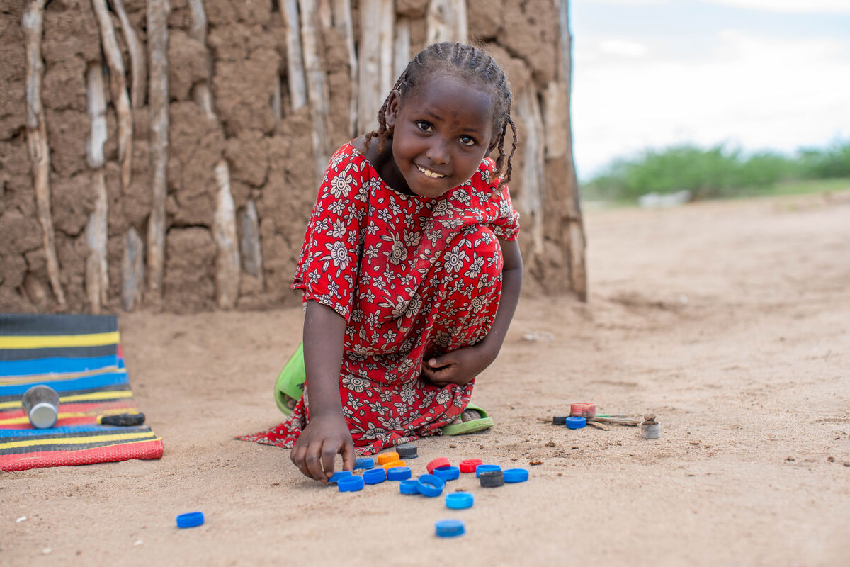
Worqi lives in Kenya with her mum, her brother and two younger sisters.
Worqi enjoys playing shops, using old bottle tops as counters. With CAFOD's help, her mum has a shop where she sells the vegetables her community grows in their garden.
Worqi’s favourite food is the vegetables that her mum grows. She says, “I like rice with onions and tomatoes and potatoes.”
Notes:
Worqi, Kenya
Photo credit: Joe Newman

Slide 7
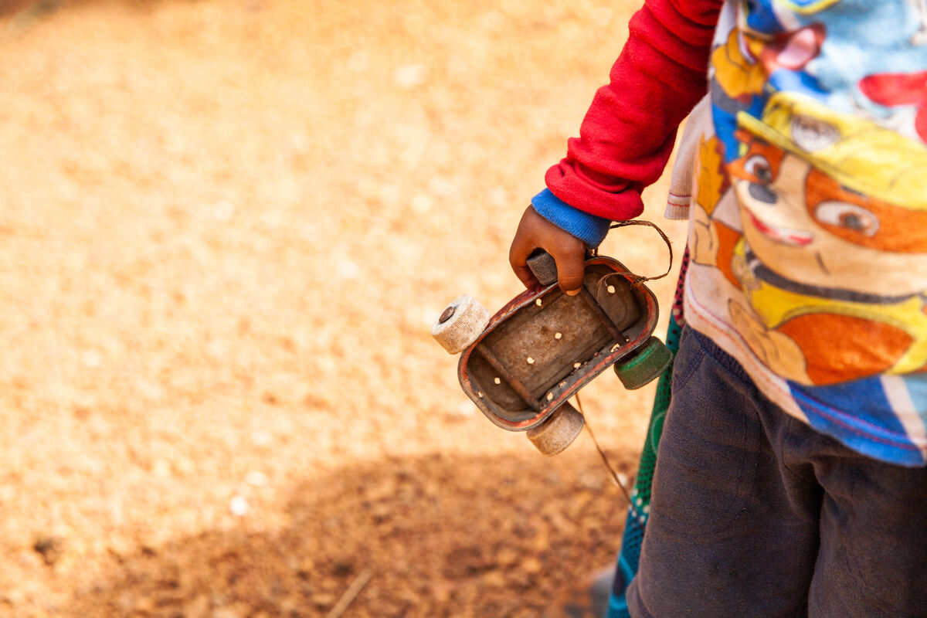
Usman likes to play with a toy car made from a used sardine can. Many children in Sierra Leone enjoy playing games with homemade toys like this.
Usman wasn't very well when he was born. With CAFOD's help, his grandmother, who looks after him, has been able to feed him a special paste called Plumpynut.
This has helped Usman become much stronger.
Notes:
Usman, Sierra Leone
Photo credit: Thom Flint

Slide 8
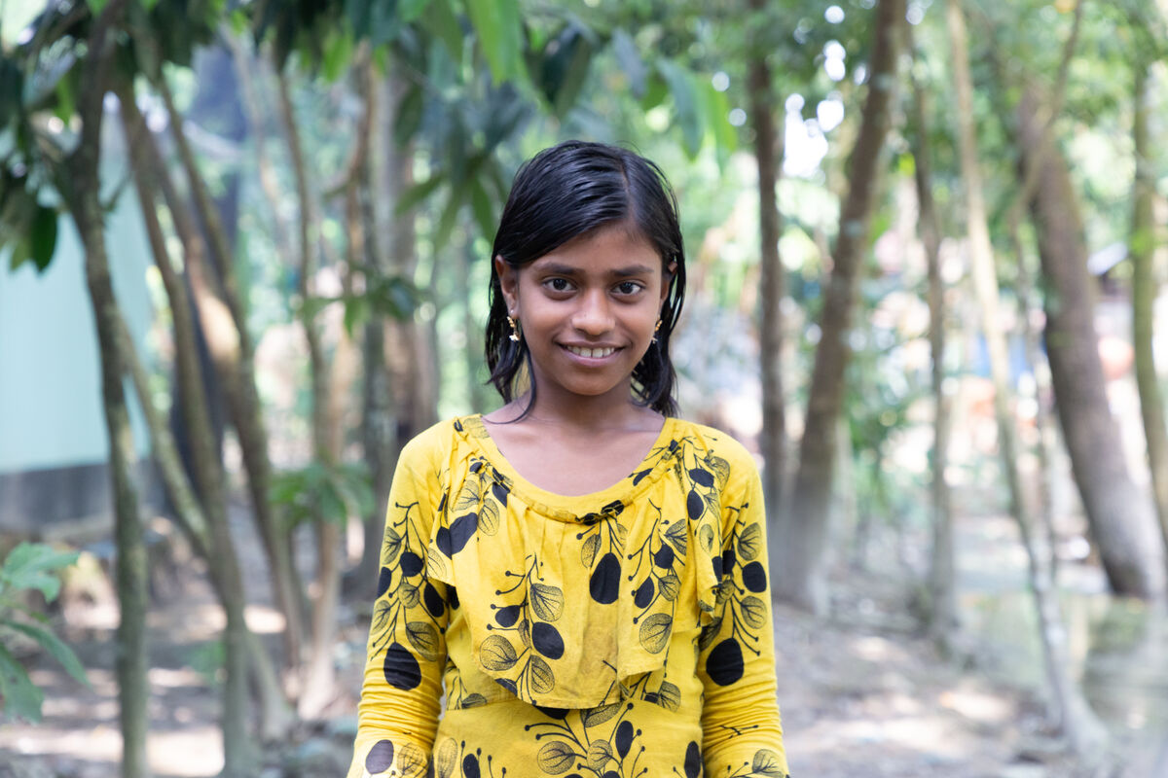
“I like skipping, jumping and running,” says Maria, who lives with her family in Bangladesh.
“I go to school after cleaning my room. I come from school and help my mother with domestic work. I sit down to study in the evening. “I want to become a teacher and spread the light of education to everyone,” says Maria.
Notes:
Maria, Bangladesh
Photo credit: Nazmul Shanji

Slide 9
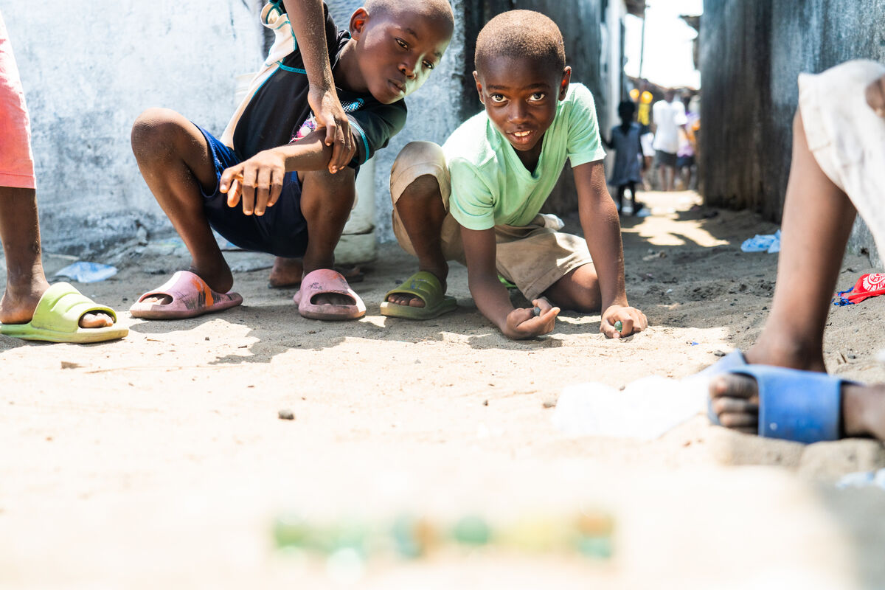
Worqi, Usman, Maria and Aaron and his friends in this photo live in different places around the world.
Can you tell us some things that are different about each child?
And can you tell us something that is the same? Are these children the same as, or different from, you? How?
We are all different from each other, but we are also very alike. We all need enough food and water to live. We all like to have fun with our friends.
Notes:
Aaron and friends play marbles, Liberia
Photo credits: Carielle Doe

Slide 10
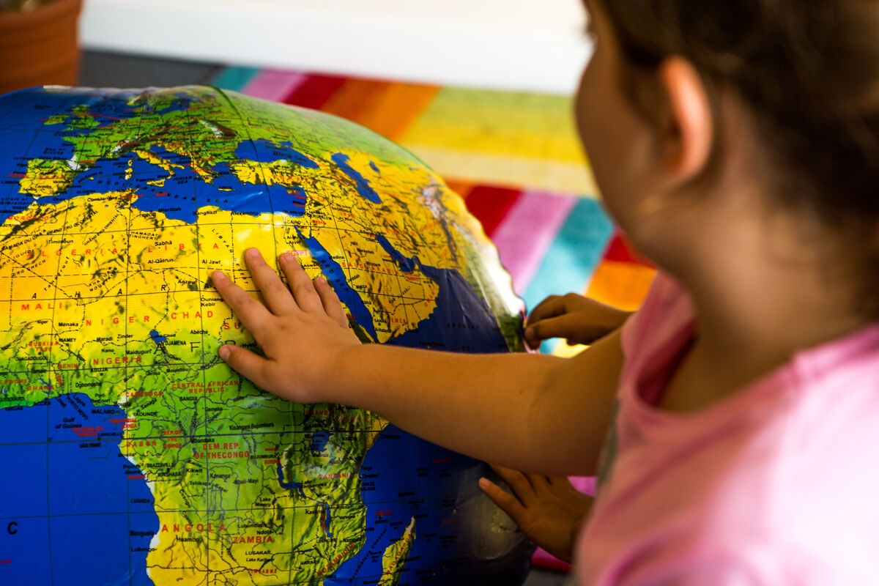
We are all part of the same global family and so we are all very special and important. Jesus loves and cares for us all.
How does it make you feel to know that Jesus loves and cares for all of us, no matter who or where we are? What do you think this means for how we should treat each other?
Jesus asks us to treat other people as we would wish to be treated. This week, let’s listen to what Jesus is saying to us, and share the love he has for us all with others.
Notes:
School child with globe
Photo credit: Thom Flint

Slide 11
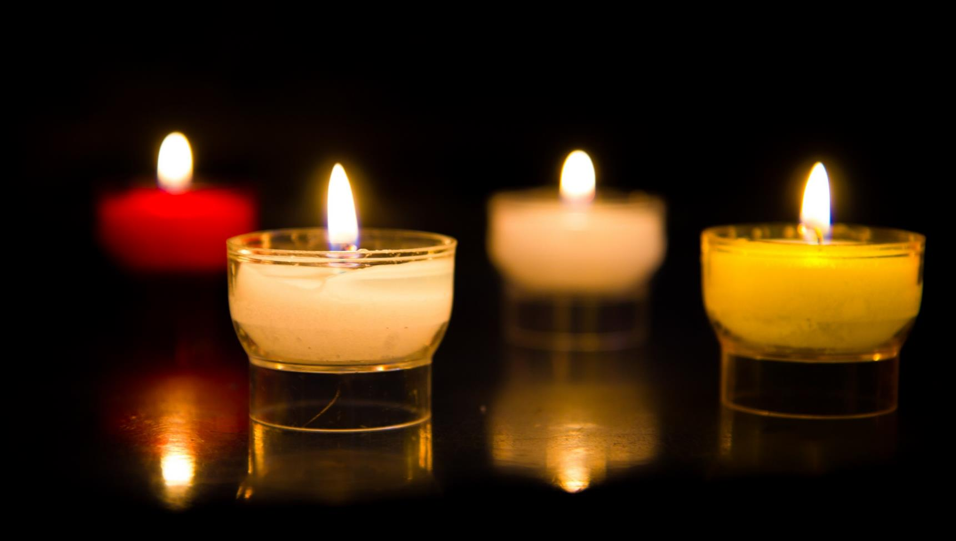
Let us pray…

Slide 12
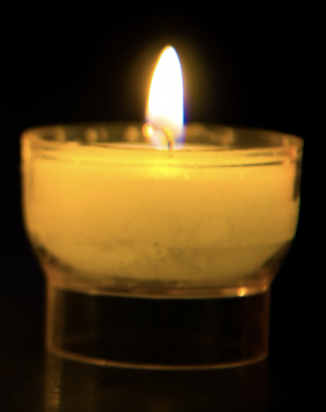
We pray for the Church throughout the world: that it may welcome and care for everyone as Jesus did – like a shepherd cares for their sheep. Lord, in your mercy…
We pray for our parish, family and friends: that we may listen to Jesus in our lives and treat all people as brothers and sisters.
Lord, in your mercy…

Slide 13
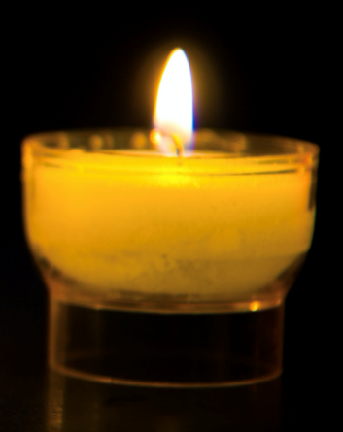
In this Jubilee Year, we pray that we may be signs of hope
in our world through all that we do and how we treat one another. Lord, in your mercy…
Lord Jesus,
Help us to listen to and follow you and to care for each other, so that all members of our global family may live together in peace. Amen.

Slide 14
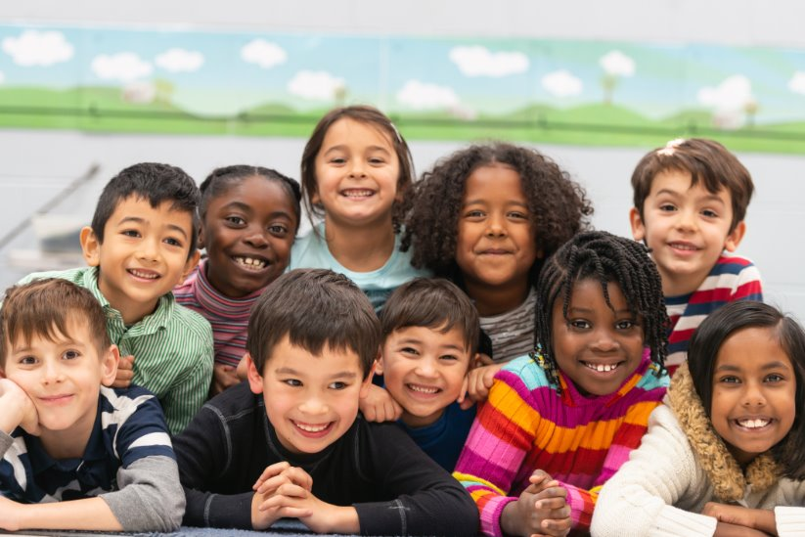
How should we treat each other so that we can be signs of hope this week?
Send
Notes:
Children
Photo credit: Stock image

Slide 15
Activity suggestions
Invite the children to colour in the accompanying illustration and to write their name and the names of some of their friends, family members and the children they’ve heard about today on the sheep. On the back they could write or draw either how they will show that they are listening to Jesus this week, or how they will care for their brothers and sisters around the world.
Give the children a cut-out of a sheep. Encourage them to write their name on it and to decorate it. You could also invite them to decorate a sheep for some of the children that they have heard about from around the world. When they have finished, display all the sheep on a large board, saying, “I know my sheep”.
Remind the children to tell the people that they live with all that they have heard and thought about in the liturgy today. Encourage them to remember that all people are loved by God, and to try to care for others as Jesus cares for us, his sheep, during the week.
Notes:
Illustration: Jane Smith

Slide 16
Notes:
Illustration: Jane Smith

Slide 17
Jubilee activities!
It will soon be time to make your Jubilee Pledge!
In June or July, all Catholic schools are invited to make a Jubilee Pledge to live out Catholic Social Teaching.
A better world needs all of us, and the Pledge will be a whole school, long-term commitment to building a fairer world.
Watch our film and download our resources to help you write your Pledge and plan your Pledge Day:
Jubilee pledge for schools
The Jubilee Year is a landmark moment in the life of the global church. School communities are invited to join together as pilgrims of hope, pledging to work together for God’s kingdom of justice, peace and love. Find resources at:
Jubilee for schools 2025 – Pilgrims of Hope

