Slide 1
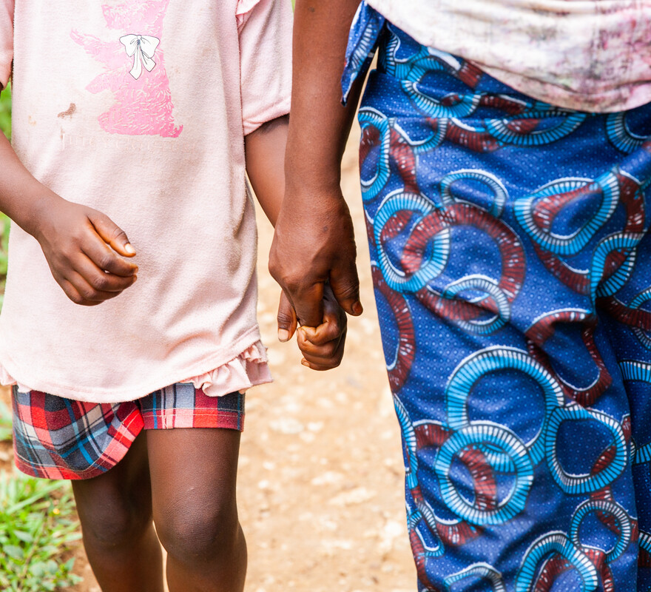
What will you do to help someone who is finding life difficult, who is tired or struggling?
Gospel Celebration of the Word
Notes:
Children’s liturgy: Fourteenth Sunday in Ordinary Time (Year A)
Preparation of the worship space
Colour: green
Song suggestions
O the love of my Lord (967, Laudate)
Welcome
Today we hear how Jesus has a special care for all who are working too hard, who are tired, and who are struggling. Let’s think a bit more about this today.
Miatta Juana and her child, Sierra Leone
Photo credit: Thom Flint

Slide 2
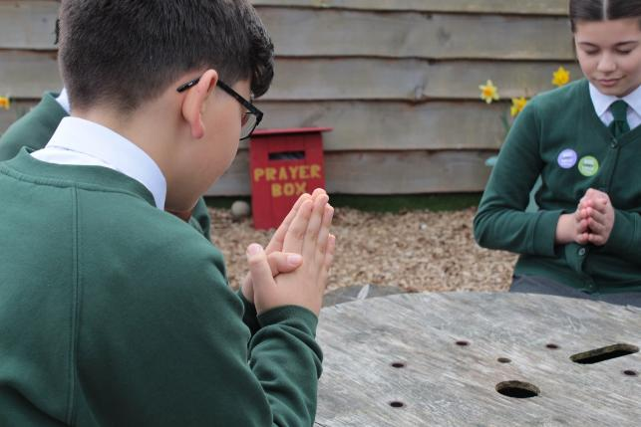
Caring God, you are there with us in the most difficult times. Help us when we find things hard. Help us to be there for others when they struggle. We ask this through Christ our Lord, Amen.
  Gather
Notes:
St Francis Xavier's RC Primary School, Herefordshire
Photo credit: Vicky Ahmed

Slide 3
Gospel: Matthew 11:25-30
At that time Jesus said, “Father, Lord of heaven and earth! I thank you because you have shown to the unlearned what you have hidden from the wise and learned. Yes, Father, this was how you wanted it to happen.
“My Father has given me all things. No one knows the Son except the Father, and no one knows the Father except the Son and those to whom the Son chooses to reveal him.
“Come to me, all of you who are tired from carrying heavy loads, and I will give you rest. Take my yoke and put it on you, and learn from me, because I am gentle and humble in spirit; and you will find rest. For the yoke I will give you is easy, and the load I will put on you is light.”
Word

Slide 4

What do you remember from the Gospel reading?
Today we hear Jesus calling all people who are working hard, who are tired and struggling to come to him. Why do you think he does this?
Jesus knows that we all have times when we find life difficult.
We all have times when even though we try hard, we can’t do something.
We all have times when we are tired, fed up and would like to give up.
Respond
Notes:
Sad child
Photo credit: Stock image

Slide 5
Can you think of a time when you felt like this?
Did anyone help you or comfort you during this time?
Who helped you?
What did they do?
Notes:
Comfort
Photo credit: Annie Spratt on Unsplash

Slide 6
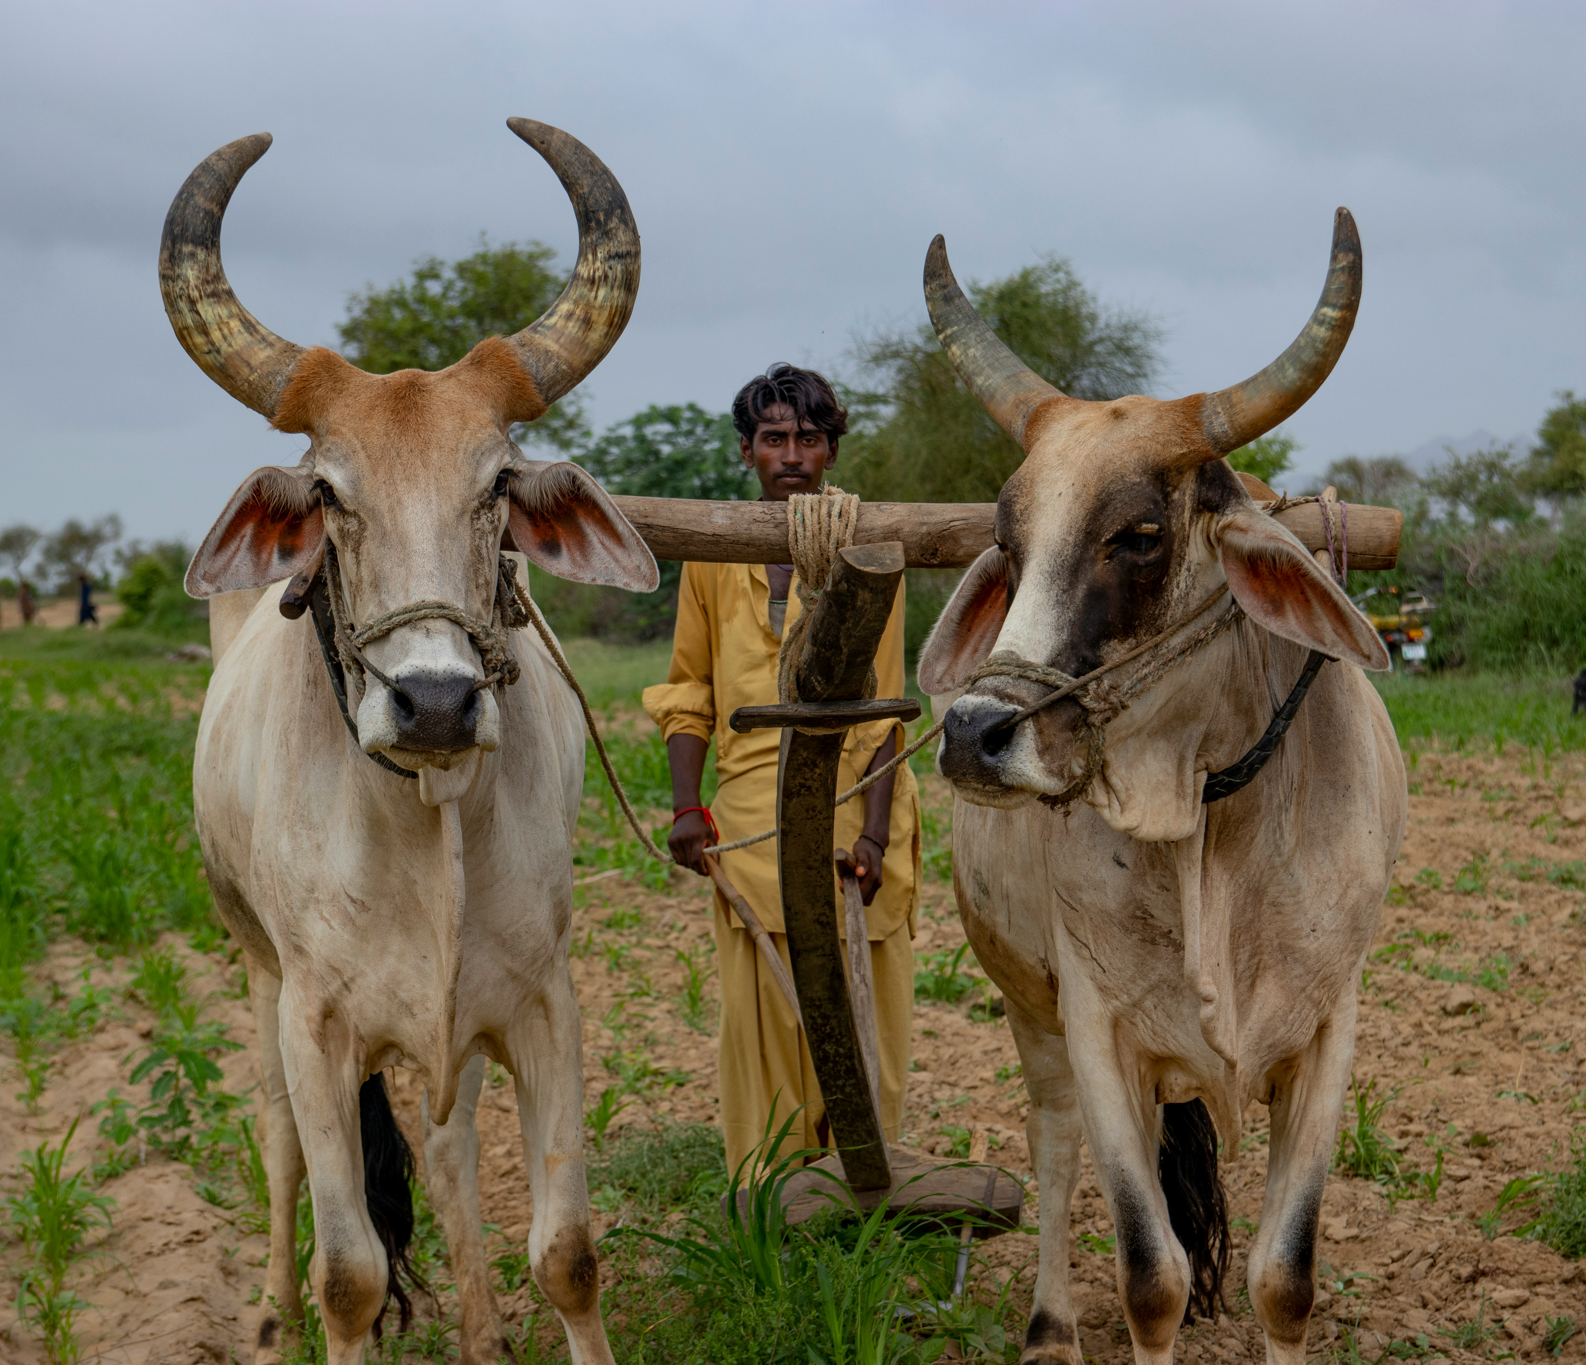
Jesus says his yoke is easy. He does not mean an egg yolk!
This yoke is spelled differently. It is a wooden bar farmers around the world use to make it easier to pull heavy ploughs. So Jesus is saying he will help us.
Jesus says in today’s reading that he is always there to comfort and support us. That when we are tired or finding things difficult, we can turn to him and find rest.
Notes:
A farmer pulls his cows with a yoke
Photo credit: Paul Jai on Unsplash

Slide 7
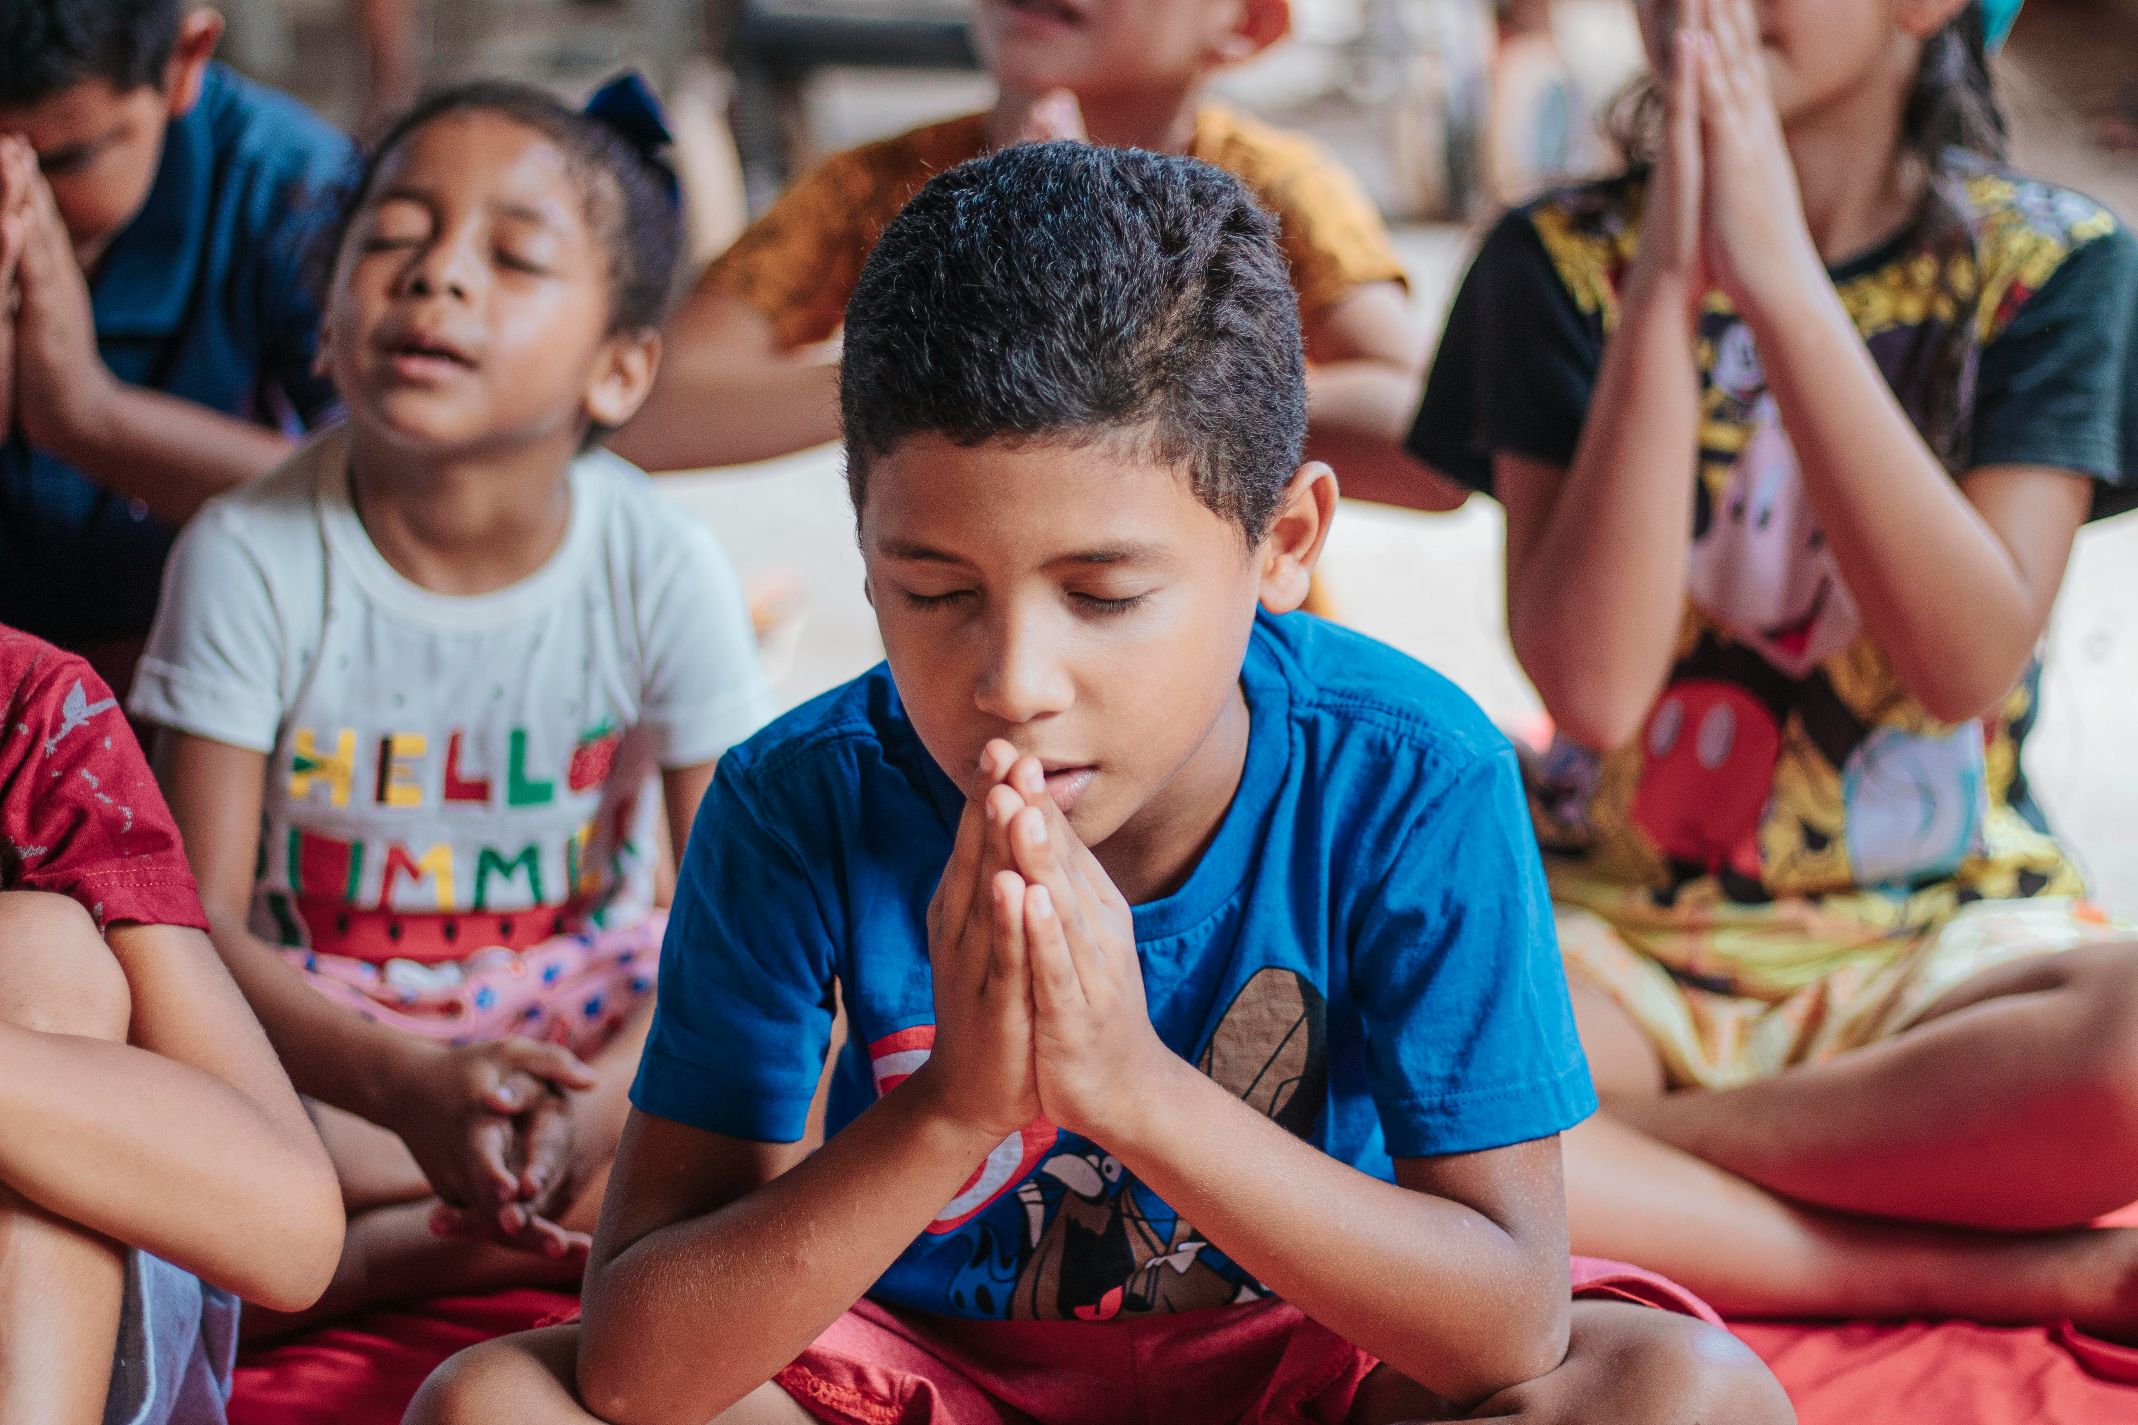
What do you think this means? If we take our worries and the things we find difficult to Jesus, he will be there for us.
How do you think we can share our worries, or the things we find hard, with Jesus?
We can share our worries in prayer. And we can pray for help during the most difficult times.
Notes:
Praying
Photo credit: Carlos Magno on Unsplash

Slide 8
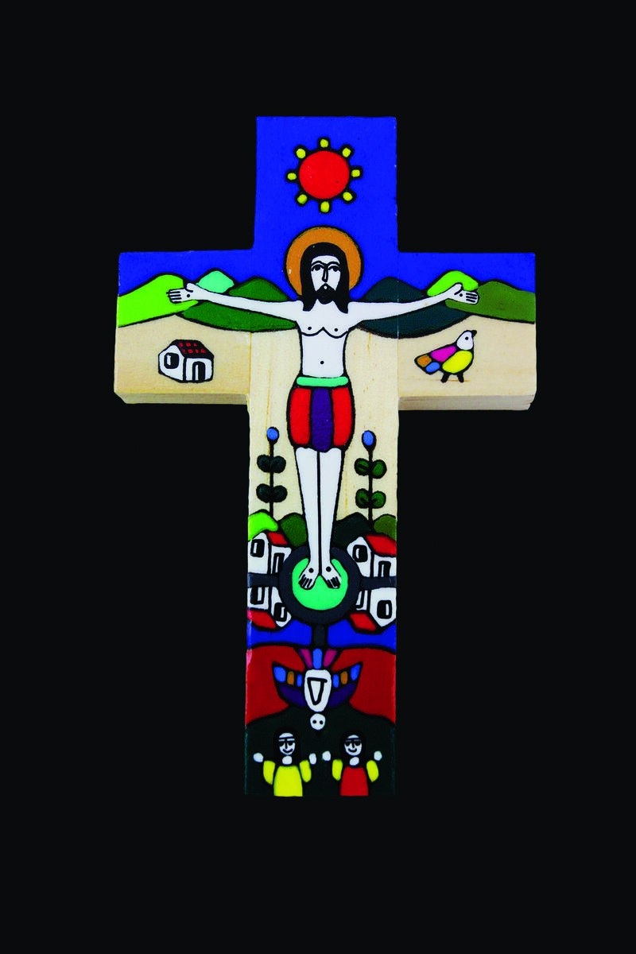
How does it make you feel to know that Jesus is there with us when things are hard?
Just knowing that we are not alone can make a big difference when we are finding life hard.
God is with us always, when we are alone, but also in the people who help and support us.
Notes:
Romero Cross
Photo credit: CAFOD

Slide 9

So, this week, let’s remember we can turn to God when things are hard.
But also, let’s look after others who are finding things difficult and do our best to help them.
We can show them that they are not alone by the way we treat them.
Notes:
Hug
Photo credit: Stock image

Slide 10
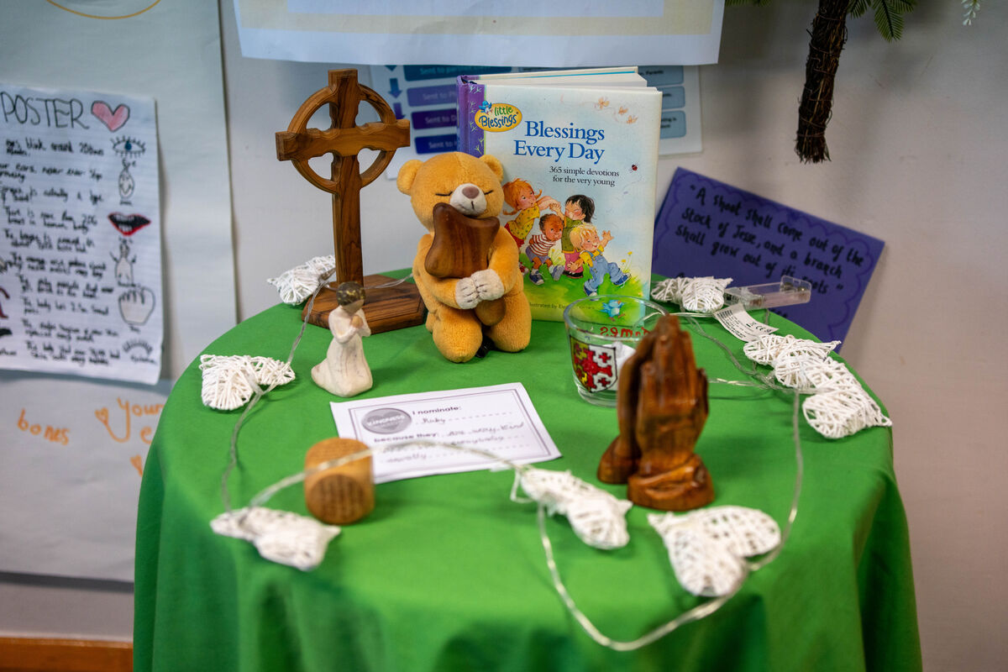
There are many ways we can do this. Here are some that we’ve thought of:
Perhaps you could pray for people who are poor, sick, lonely or sad.
You could fundraise for or donate some money to CAFOD. This will support people living in poverty around the world as they work to build a better future.
Notes:
St Chad's primary school, UK
Photo credit​: Joe Newman

Slide 11
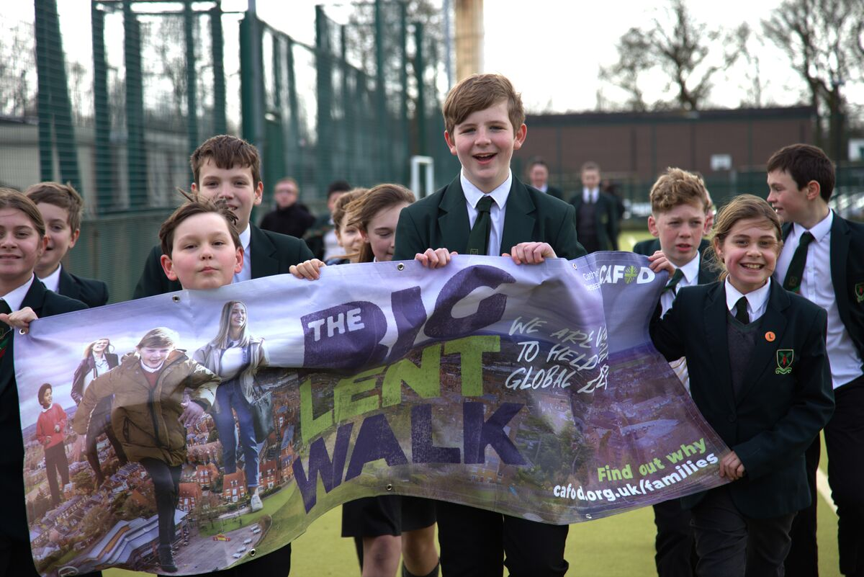
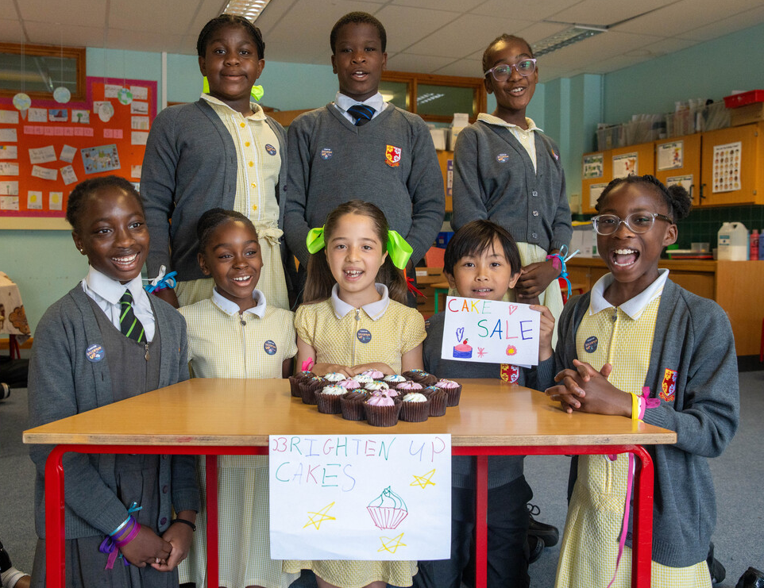
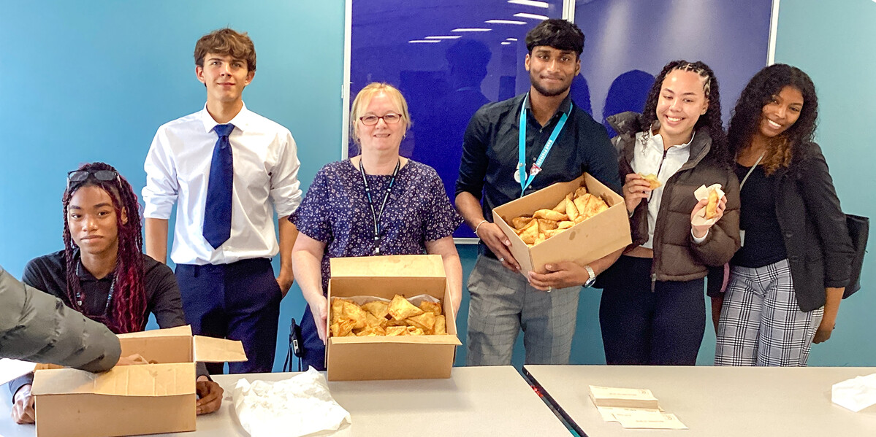
Lots of schools across England and Wales have raised money for CAFOD.
Pupils at St Edumund Arrowsmith walked, ran and jumped their way round the Big Lent Walk; St Chad's baked some delicious-looking treats for their cake sale; And another St Edmund's set up a tasty take-away with their Samosa Friday! What could you do?
Notes:
Children from St Edmund Arrowsmith Catholic High School, Wigan
Photo credit: HOPE Friendship for Development Organisation​
St Chad's pupils, London
Photo credit: Joe Newman
St Edmund's students, Wolverhampton
Photo credit: St Edmund's, Wolverhampton

Slide 12

You could take food to your local food bank to help those in your area who are struggling to get enough to eat.
You could help your grown ups with jobs around the house if they are tired.
You could send a postcard to someone you know who is sad to cheer them up.
What other ways of helping can you think of? And what will you do when you are finding things hard?
Notes:
Writing a letter
Photo credit: Stock images

Slide 13
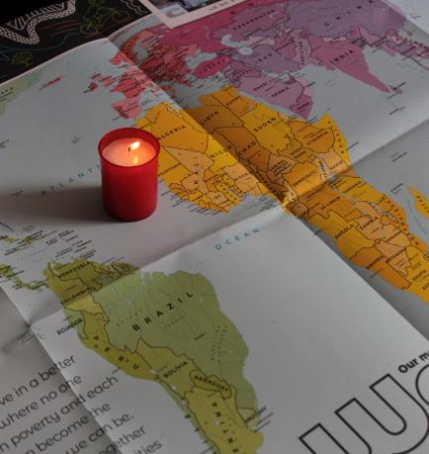
Let us pray
We pray for all members of our global family who are poor or finding life difficult:
may they know that they are not alone and that they find the practical support they need.
Lord in your mercy…
We pray for our parish, families and friends:
that we may love one another and be there to help and comfort one another in difficult times.
Lord in your mercy...

Slide 14
Let us pray
We pray for the Church throughout the world:
that it may follow Christ's example of loving care for all those who are in need.
Lord in your mercy…
God of all: be there for us when we find things hard. Strengthen us as we help each other, so that all people may have hope for the future. Amen.

Slide 15
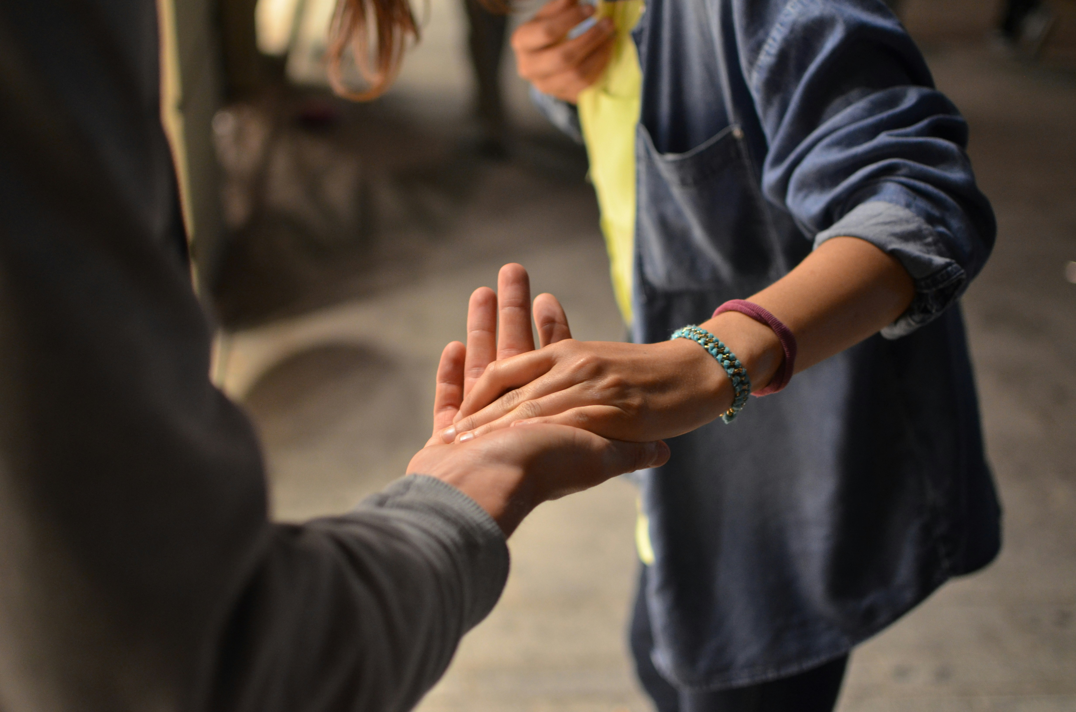
What will you do this week to help someone who is finding life difficult, who is tired or struggling?
Send
Notes:
Lending a hand
Photo credit: Remi Walle on Unsplash

Slide 16
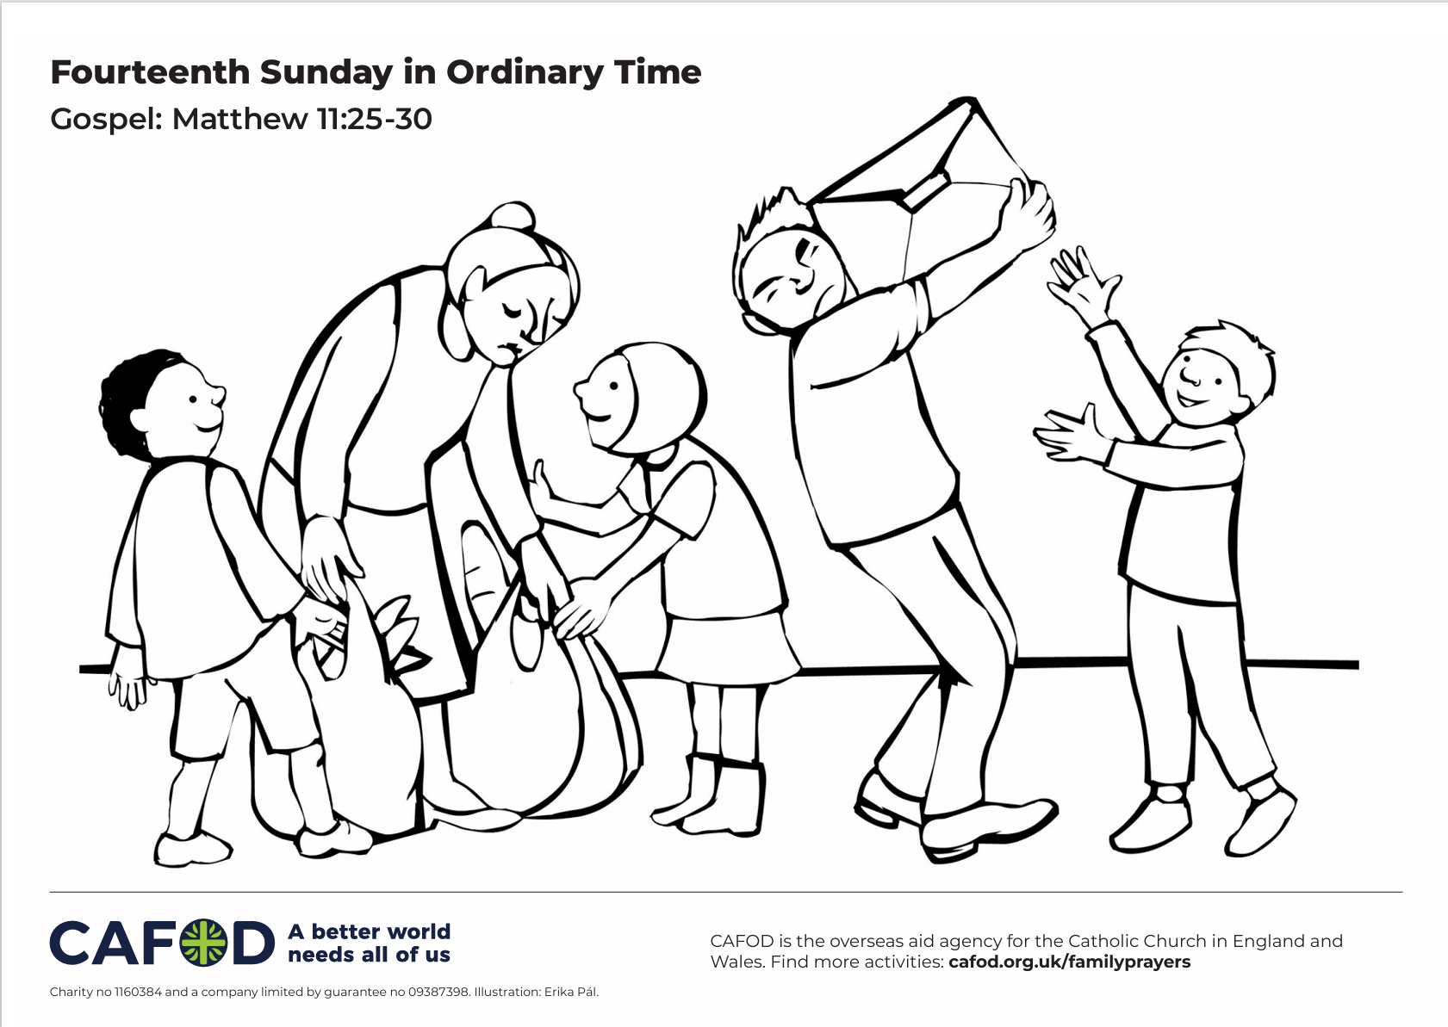
Activity suggestions
Download the illustration
Encourage the children to colour in the accompanying optional illustration and to write or draw on the back how they will help someone in the week who is struggling.
Invite the children to do a role play in pairs, ask one of them to pretend to be working really hard, to be tired, or to be struggling in some way. Ask the other child to act out what they would do to help and support that person.
Invite the children to write a prayer for the times when they are finding life hard and for all those members of our global family who need some help.
Remind the children to share all that they have heard and thought about today with the people at home. Encourage them to look out for people who are finding life difficult in the next week, and to do all that they can to help and support them.
For more CAFOD ideas and activities, please go to Primary teaching resources
Notes:
Illustration: Erika Pal

Slide 17
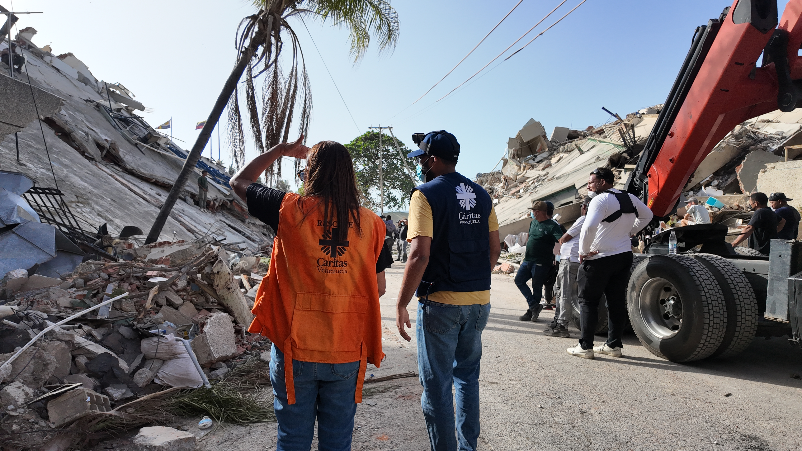
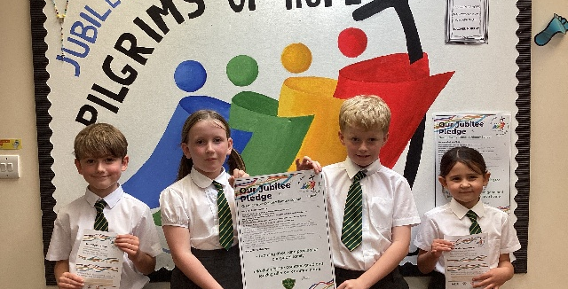

Get involved with CAFOD this term
Fundraise for the Venezuela Earthquake Appeal
Ways to live out your Jubilee Pledge
Fundraise for a World Gift

Slide 18


