Slide 1
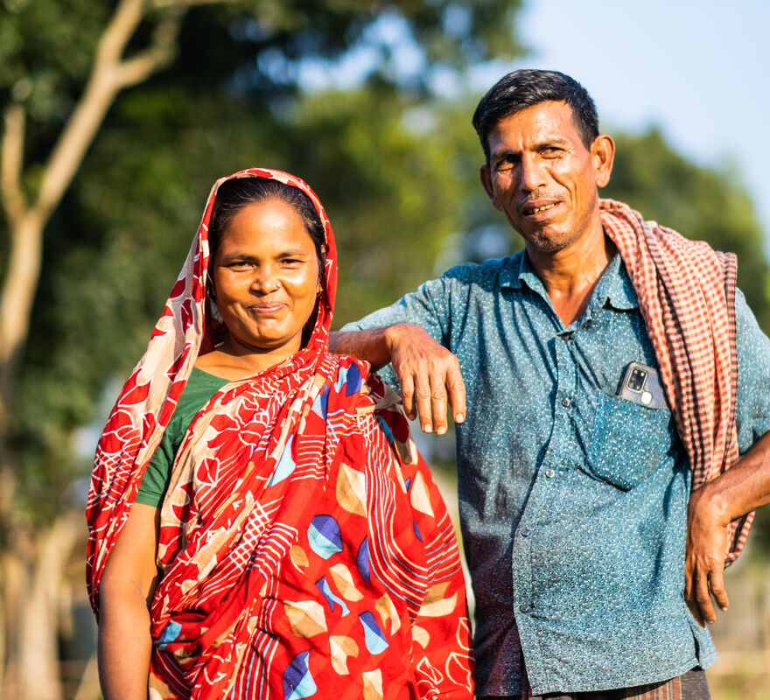
How will you listen to what Jesus asks of you and live your life as God calls you to?
Gospel Celebration of the Word
Notes:
Children’s liturgy: Fifteenth Sunday in Ordinary Time (Year A)
Preparation of the worship space
Colour: green
Props: coloured paper, coloured pencils and pens
Song suggestions
O the word of my Lord (979, Laudate)
In the earth (306, Celebration Hymnal for Everyone)
Welcome
Today Jesus tells us a parable about planting seeds. It shows us how important it is that the seeds land on the right kind of ground to grow, but it also tells us something about ourselves and how we should behave. Let’s listen and find out more...
Salina and Mogibor, Bangladesh
Photo credit: Amit Rudro

Slide 2
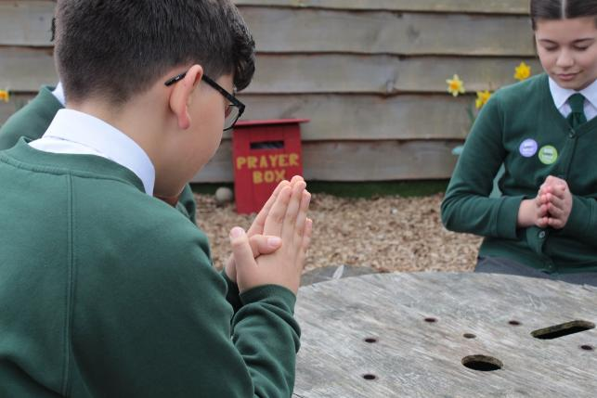
God of life,
Help us to hear your word. Guide us to understand it so that we may grow to live our lives the way you want us to. We ask this through Christ our Lord.
Amen.
  Gather
Notes:
St Francis Xavier's RC Primary School, Herefordshire
Photo credit: Vicky Ahmed

Slide 3
Gospel: Matthew 13:1-9
That same day Jesus left the house and went to the lakeside, where he sat down to teach. The crowd that gathered round him was so large that he got into a boat and sat in it, while the crowd stood on the shore. He used parables to tell them many things.
“Once there was a man who went out to sow corn. As he scattered the seed in the field, some of it fell along the path, and the birds came and ate it up.
"Some of it fell on rocky ground, where there was little soil. The seeds soon sprouted, because the soil wasn’t deep. But when the sun came up, it burned the young plants; and because the roots had not grown deep enough, the plants soon dried up.
Word

Slide 4
Gospel: Matthew 13:1-9
"Some of the seed fell among thorn bushes, which grew up and choked the plants. But some seeds fell in good soil, and the plants produced corn; some produced 100 grains, others sixty, and others thirty.”
And Jesus concluded, “Listen, then, if you have ears!”
Word

Slide 5
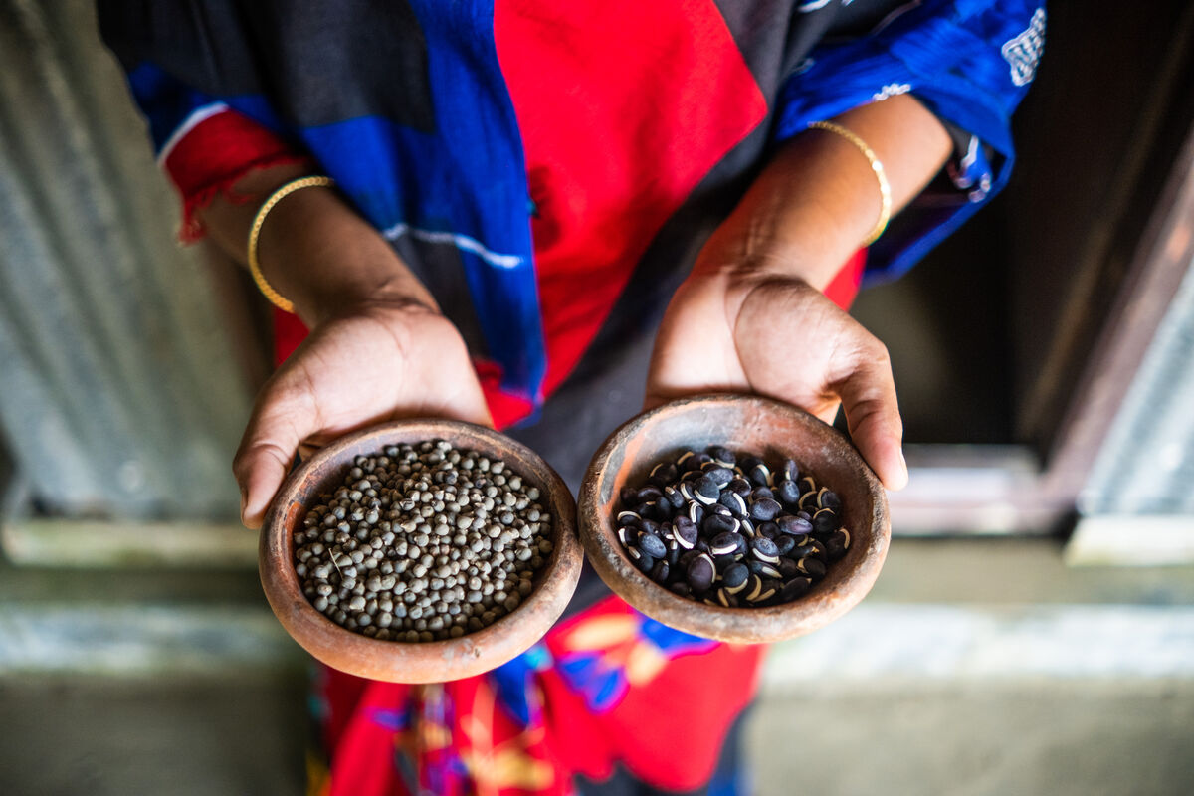
What do you remember from the Gospel reading?
Jesus tells a story or parable about someone planting seeds in a field. He does not carefully place the seeds in
the ground but scatters them around.
The seeds all land in different places, some in good soil and some not.
Can you remember all the places the seed lands and what happens to it?
Respond
Notes:
Seeds, Bangladesh
Photo credit: Amit Rudro

Slide 6
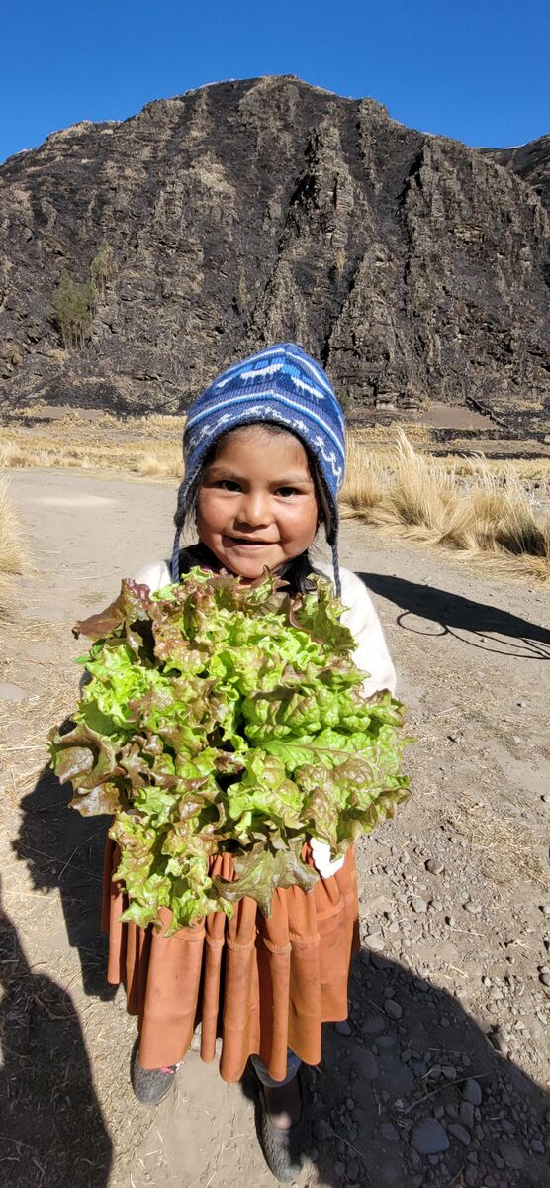
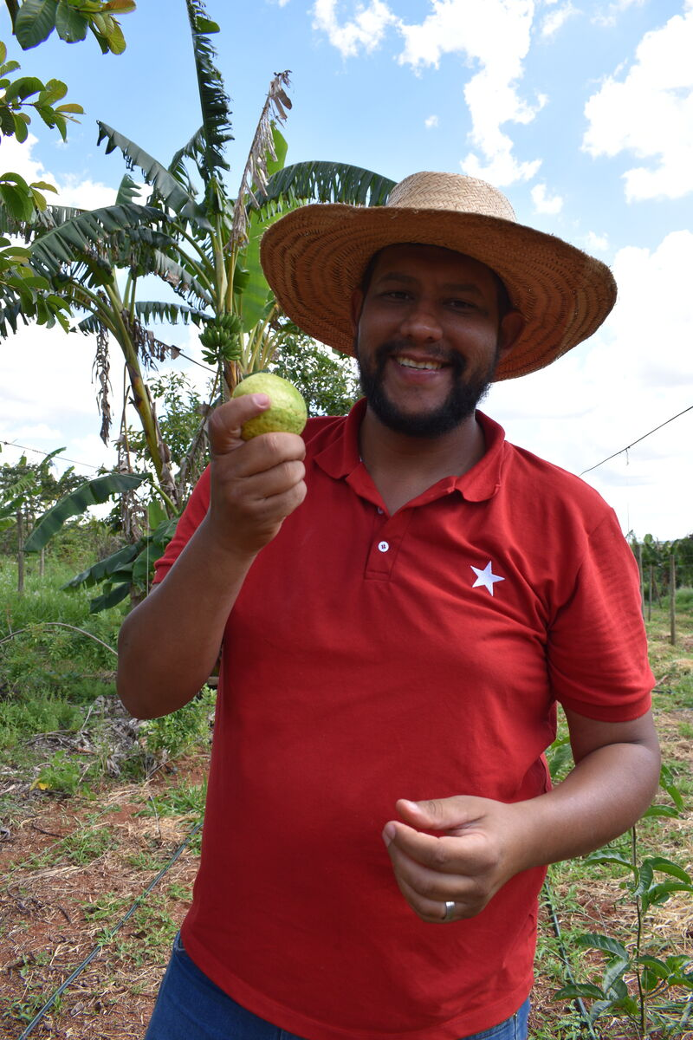
All around the world, people plant seeds to grow.
It is really important to make the ground ready, to make sure that the seeds have all that they need to grow.
What do seeds need to grow?
Seeds are very important. They are life. They are a gift from God. And they make growing food possible.
Crops in Bolivia and Brazil
Notes:
What do seeds need to grow? (Earth, water, light, food)
Vagner and his guava, Brazil
Photo credit: Kezia Lavan
Helping grow food in Bolivia
Photo credit: Diana Trimino

Slide 7

But laws are forcing farmers around the world to buy seeds from big companies who make lots of money, rather than being able to choose which seeds they want to use.
These laws make it even harder for small farmers and their families to grow enough food.
Notes:
Cash
Photo credit: John McArthur on Unsplash

Slide 8
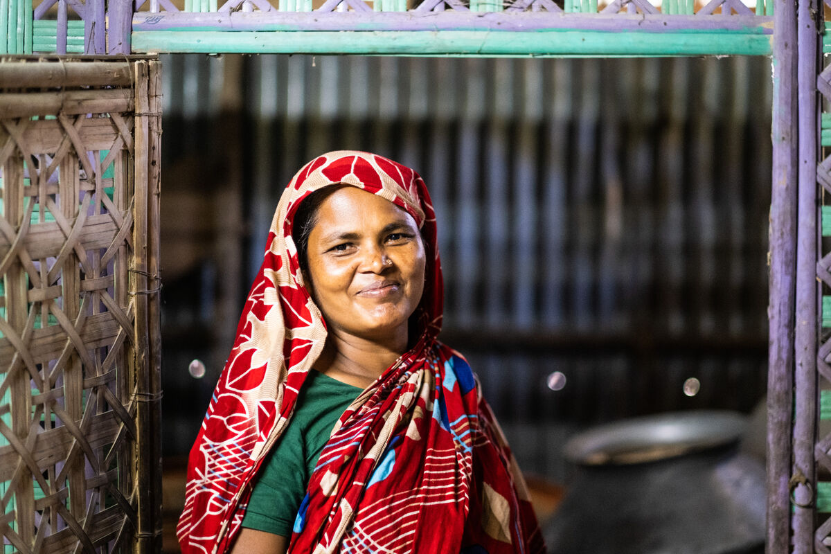
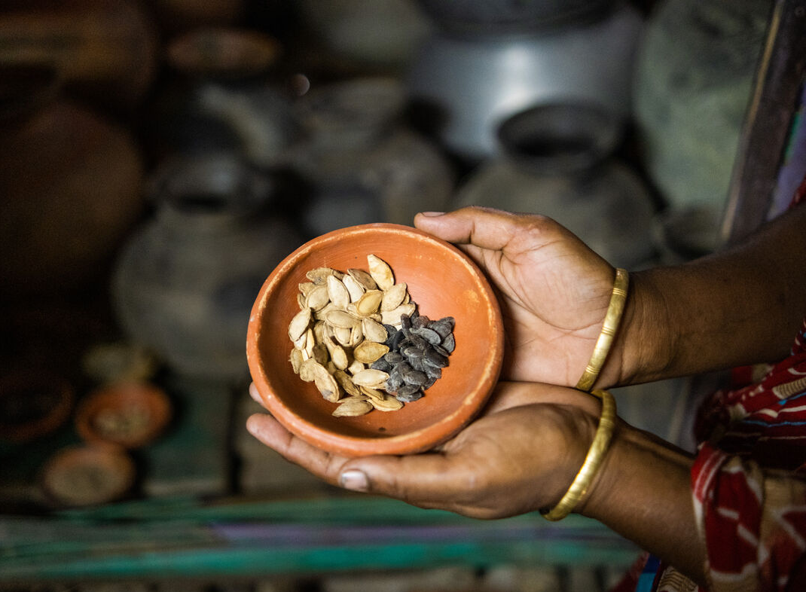
Salina and her husband are farmers in Bangladesh. With CAFOD's help, they have learned how to look after seeds.
Together, they grow bananas, rice, okra, sweet pumpkin, onions, radishes, cauliflower and chilli.
“To keep seeds in our own hands is the main thing," explains Salina. "Without seeds, being a farmer is not possible."
Notes:
Salina, Bangladesh
Photo credit: Amit Rudro

Slide 9
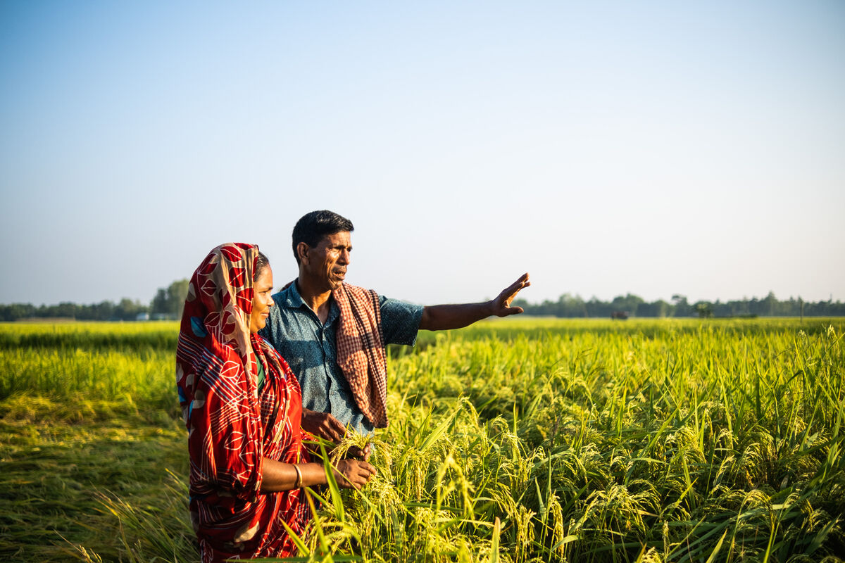
The idea of sharing within the community is crucial.
"If you have good seeds, then there is a good harvest," says Salina, with her husband Mogibor.
"And because we have had a good harvest, I have shared the vegetables among the people here. That has strengthened our relationships and our community."
Notes:
Salina and Mogibor, Bangladesh
Photo credit: Amit Rudro

Slide 10
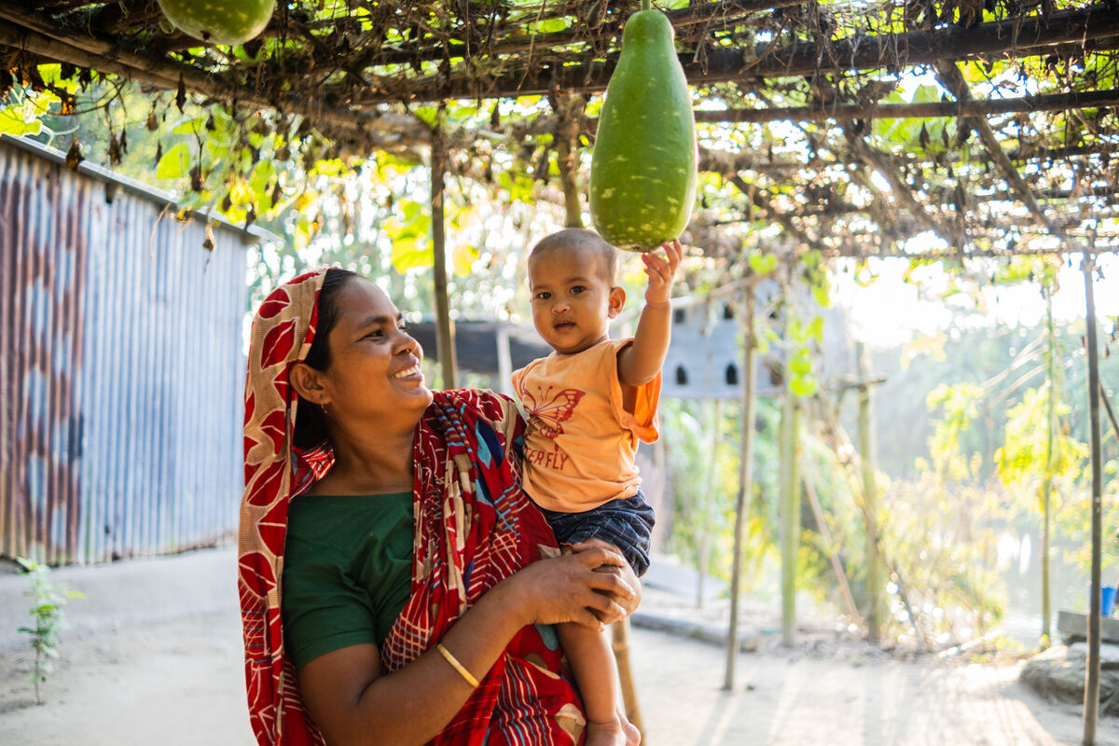
Salina and Mogibor hope that their children and grandchildren will look after seeds too so that they will have enough to eat to live a happy life.
Notes:
Salina, Bangladesh
Photo credit: Amit Rudro

Slide 11
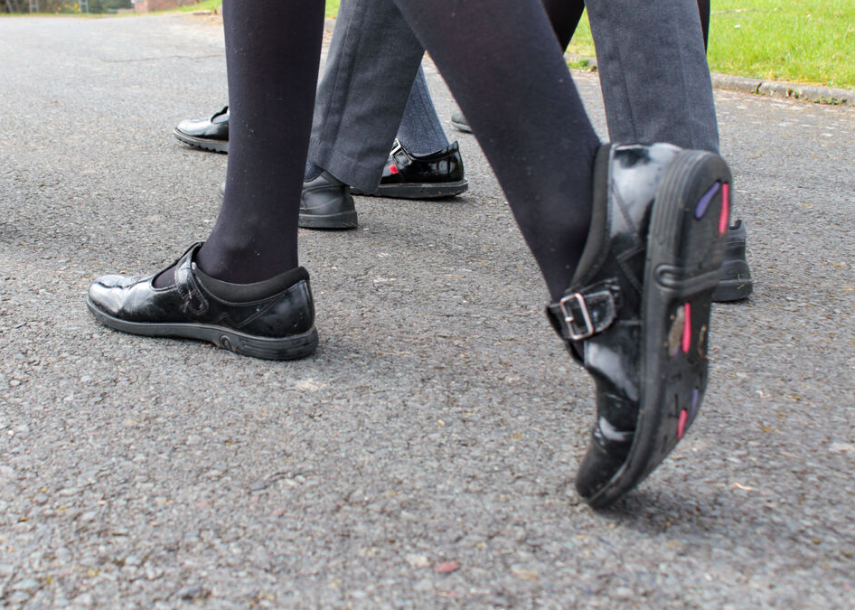
In today’s gospel reading which is all about planting seeds, Jesus goes on to explain his parable and exactly what it means.
The seed that falls on the path is like those people who hear what Jesus is saying but don’t really understand it, or they don't listen to it properly.
Notes:
St Francis Xavier's RC Primary School, Herefordshire
Photo credit: Vicky Ahmed

Slide 12
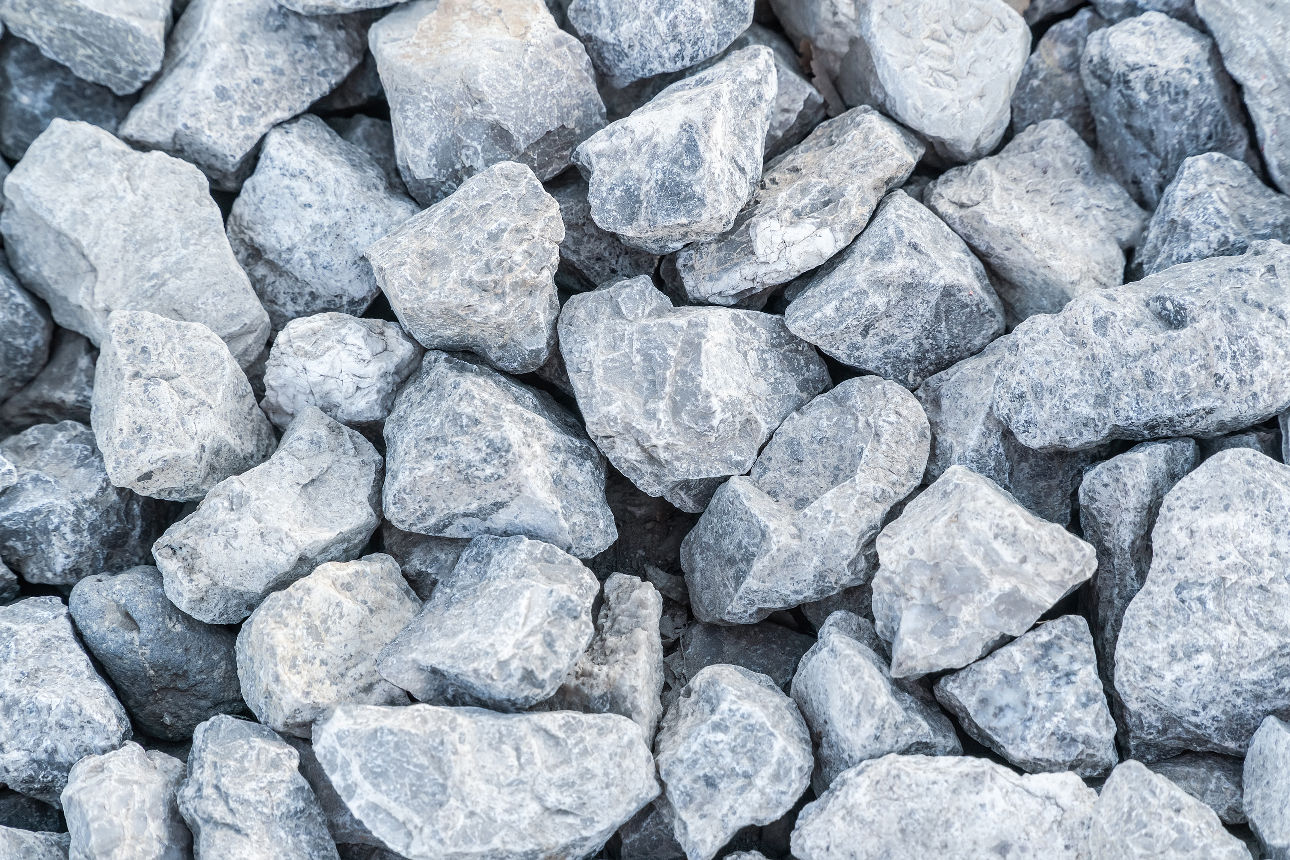
The seed that falls on the rocks is like the person who hears what Jesus asks of us.
They start off really excited about what they have heard, but they give up following him as soon as it is difficult.
Notes:
Stones
Photo credit​: Stock image

Slide 13
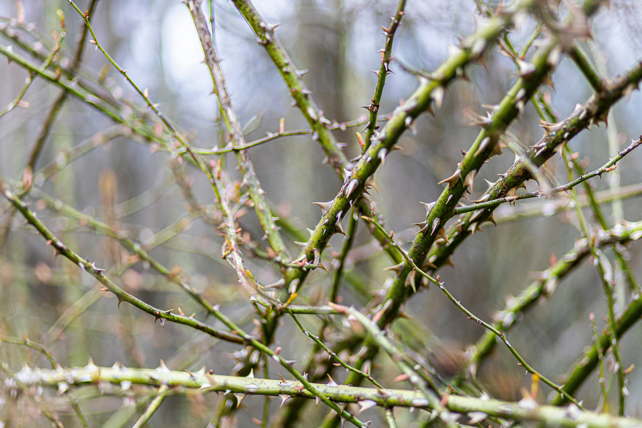
The seed that falls in the thorns is like someone who hears what Jesus is saying, but who concentrates too much on having the best things or the most money.
They focus on these things rather than on being the person Jesus wants them to be.
Notes:
Thorns
Photo credit​: Glen Michaelsen on Unsplash

Slide 14
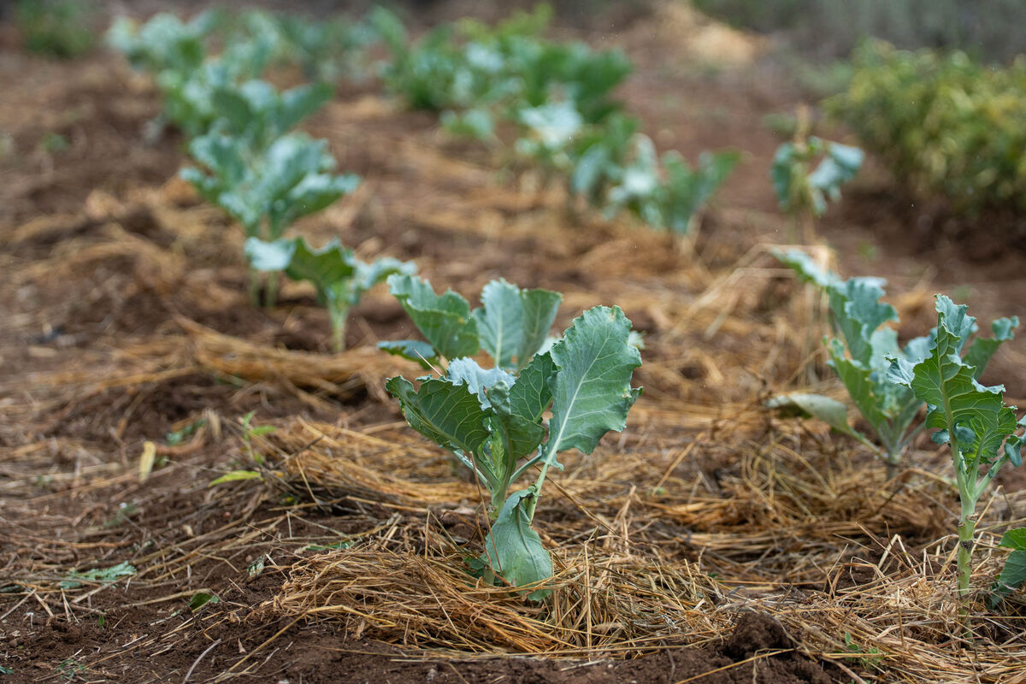
The seed that falls on the rich soil is like someone who hears what Jesus is asking, understands it, and lives their life as he asks them to.
So which one of the seeds do you think we should try to be?
Notes:
Crops, Kenya
Photo credit: Joe Newman

Slide 15
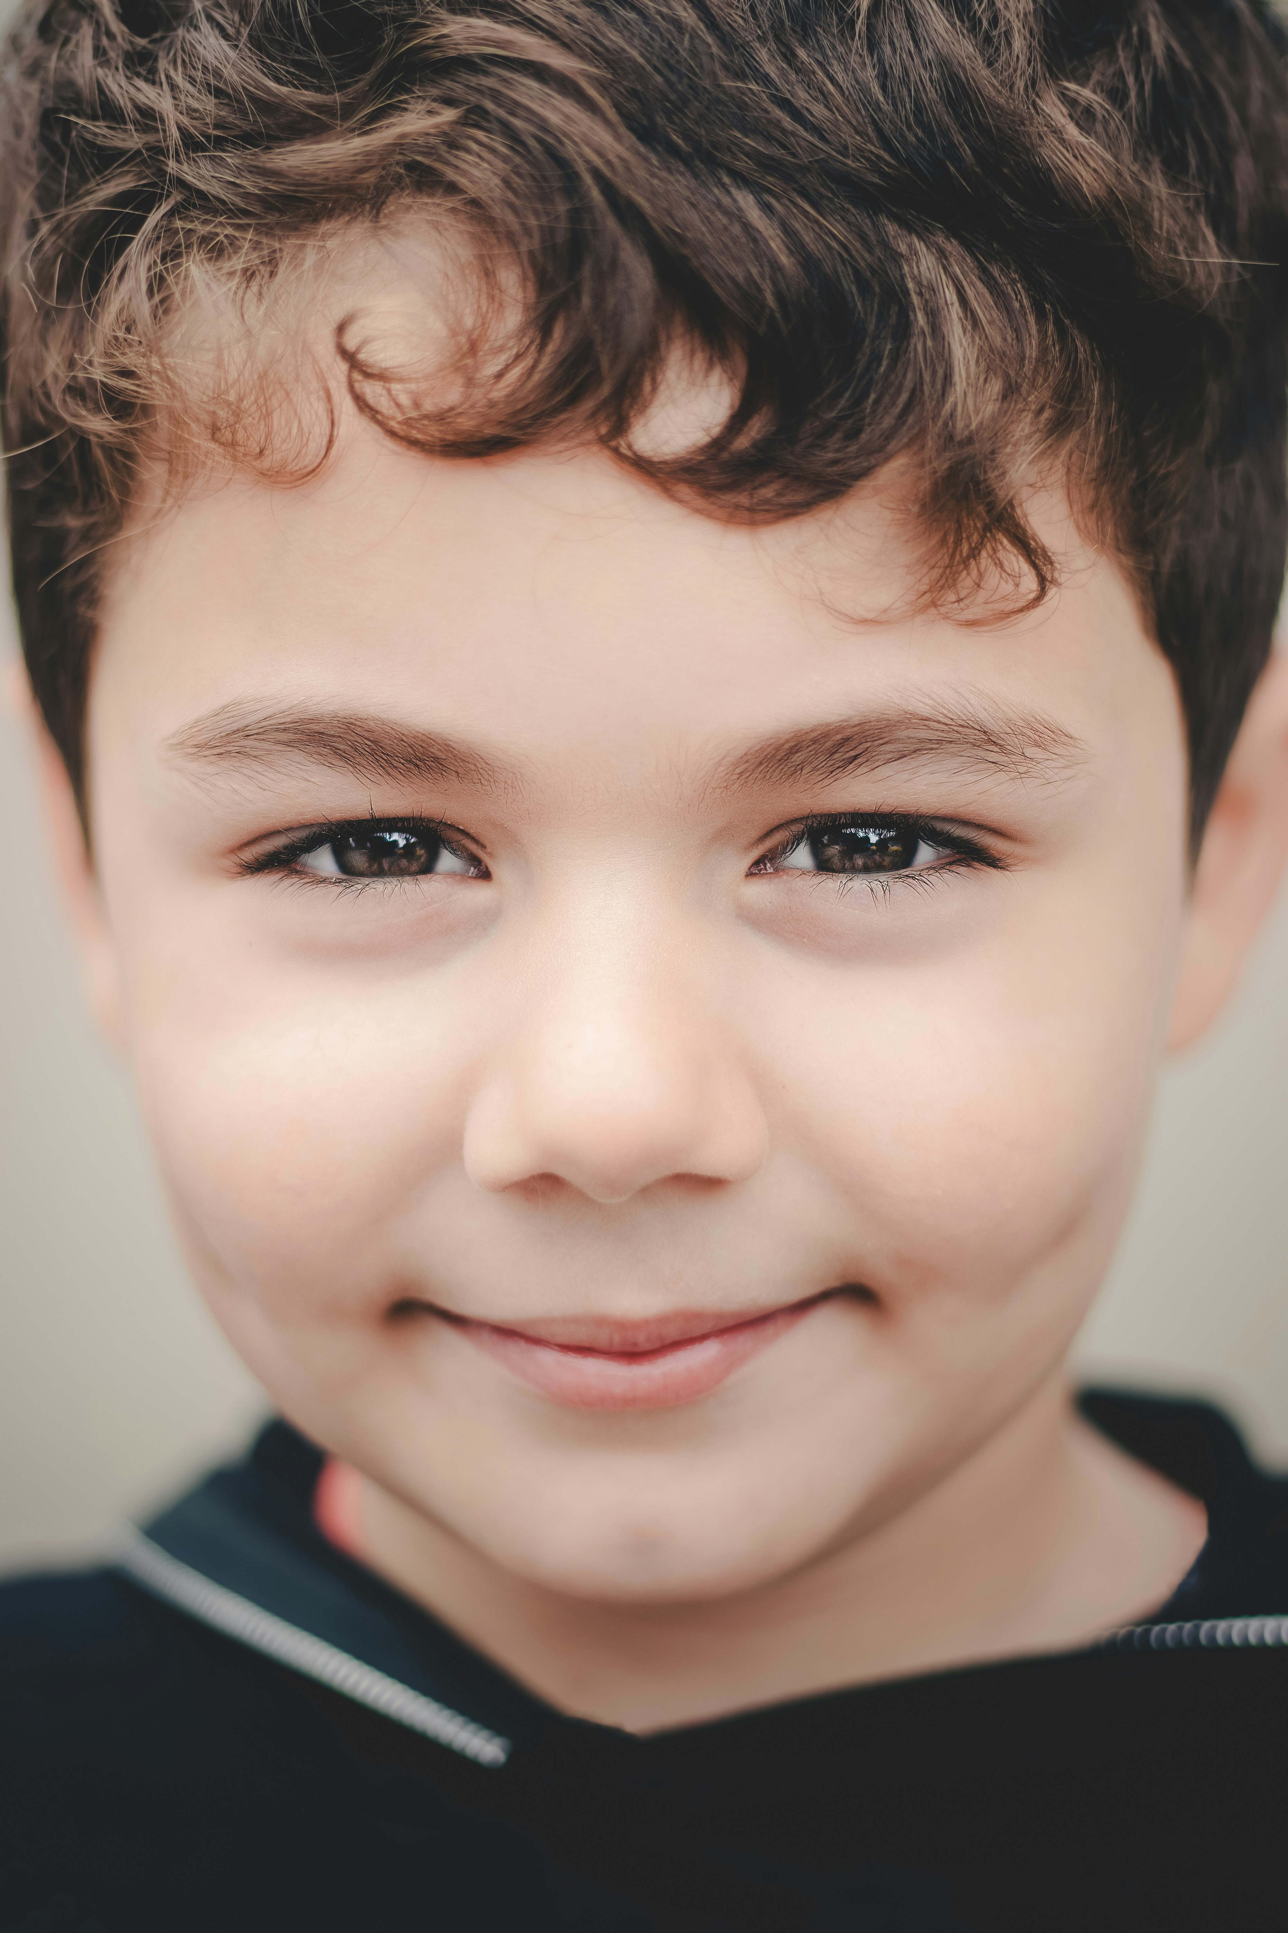
How do you think you can be like the seed that falls on the rich soil?
How do you listen to what Jesus is saying to you?
How does Jesus ask us to live our lives and treat one another?
What can you do to follow him?
Notes:
Child
Mahdi Bafande on Unsplash

Slide 16
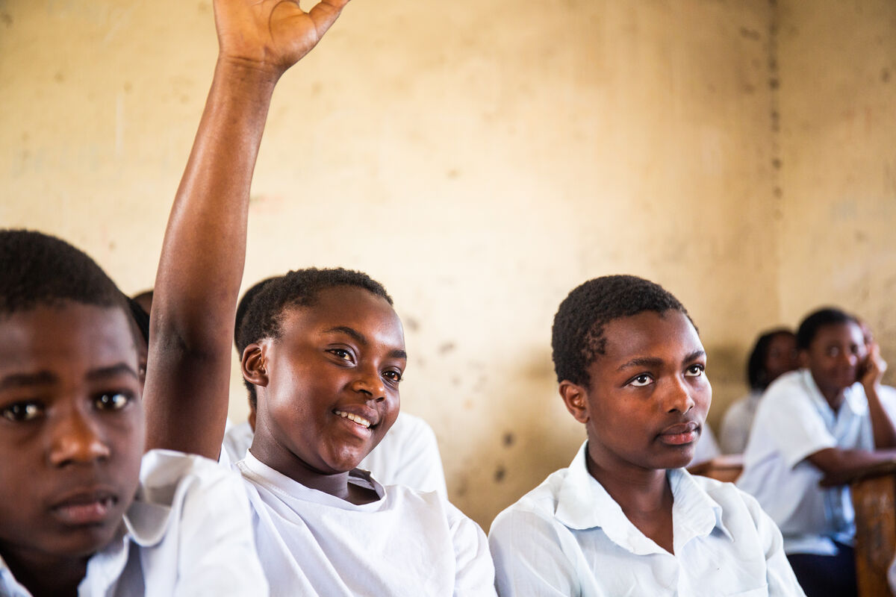
This week see if you can be like the seed that falls on the rich soil.
Try to listen to what Jesus asks of you, try your best to understand it and live your life as God calls you to.
Sagesse listening, DRC
Notes:
Sagesse, DRC
Photo credit: Thom Flint

Slide 17
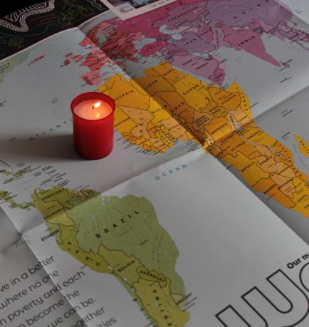
Let us pray
We pray for world leaders and all people with power: that they may do what is best for all their people, especially those who are poor.
Lord in your mercy…
We pray for our parish, families and friends:
that we may be like the seed in the rich soil, listening to Jesus and caring for one another.
Lord in your mercy...

Slide 18
Let us pray
We pray for people who grow crops to feed themselves and to feed others:
that they may keep hold of the seeds that they need and have a good harvest.
Lord in your mercy…
God of all: guide as us we listen to you, so that we may grow in faith and love. May we share that love with all people throughout the world. Amen.

Slide 19
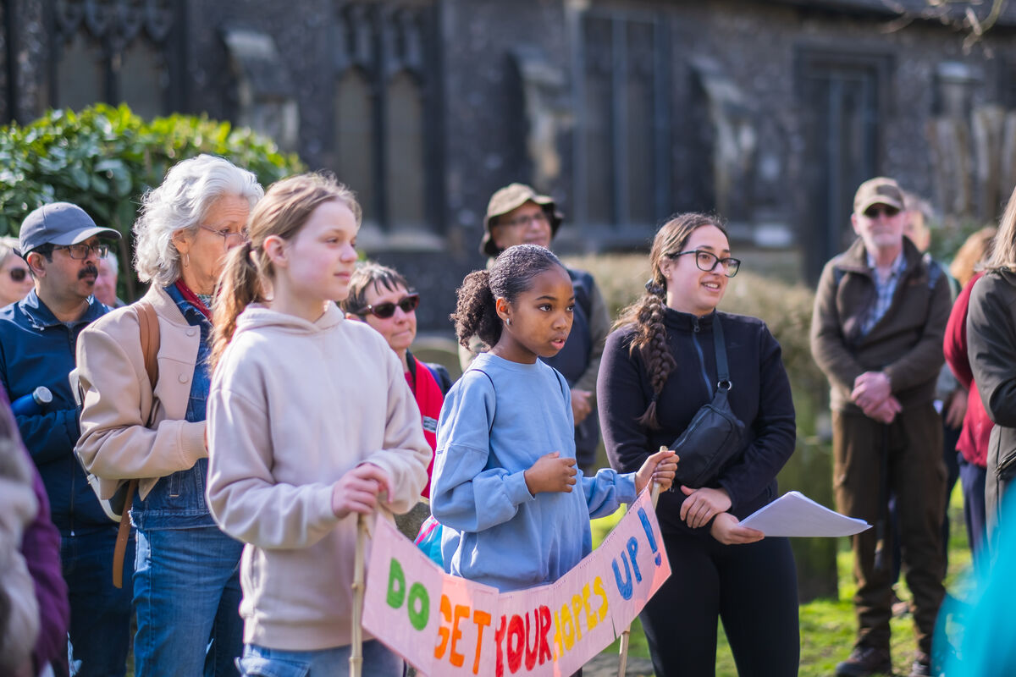
How will you listen this week to what Jesus asks of you and live your life as God calls you to?
Send
Notes:
Community Big Lent Walk, Reading
Photo credit: Amit Rudro

Slide 20
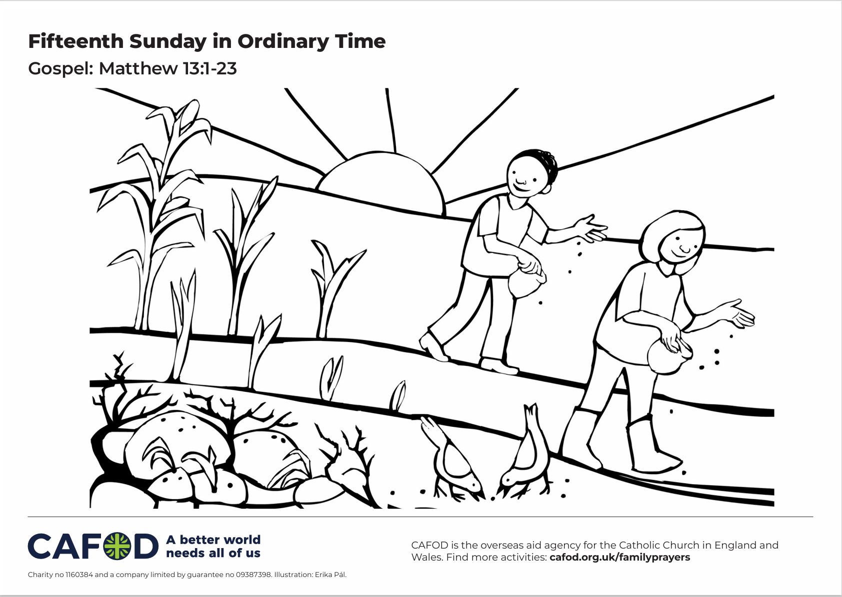
Activity suggestions
Download the illustration
Encourage the children to colour in the accompanying illustration and to write or draw on the back what they will do this week to make sure that they are like the seed that falls in the rich soil – listening to God’s word and living their lives as God wants them to.
Make a display with the children – draw a seed under the earth and invite the children to add all the things that a plant needs to grow: sunshine, water, rich soil, weeding. Then also invite them to add in what they can do to listen to Jesus and to live as he asks them to – so that they grow like the seed in the rich soil.
Find out about CAFOD’s work on seeds and the food system at Fix the Food System
Remind the children to share all they've done today with people at home. Encourage them to be like the seed in rich soil – listening to the word of God and living the way God wants us to. Could they plant some seeds and take care of them to see what grows?
See Family prayer ideas for more child-friendly activities.
Notes:
Illustration: Erika Pal

Slide 21
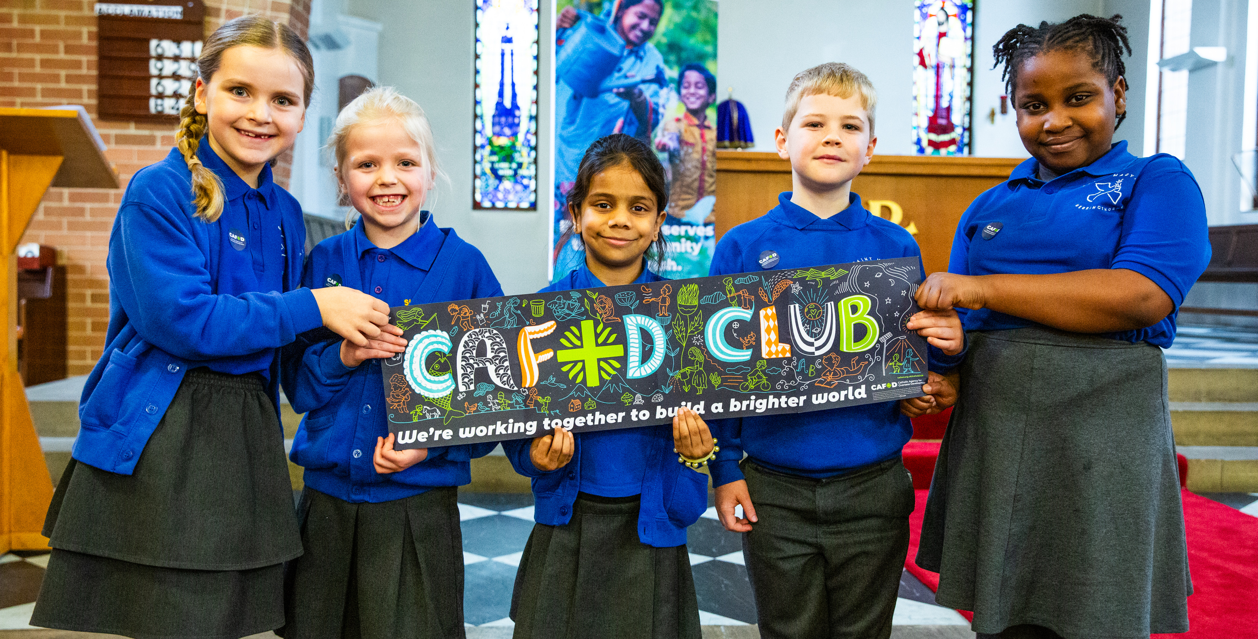
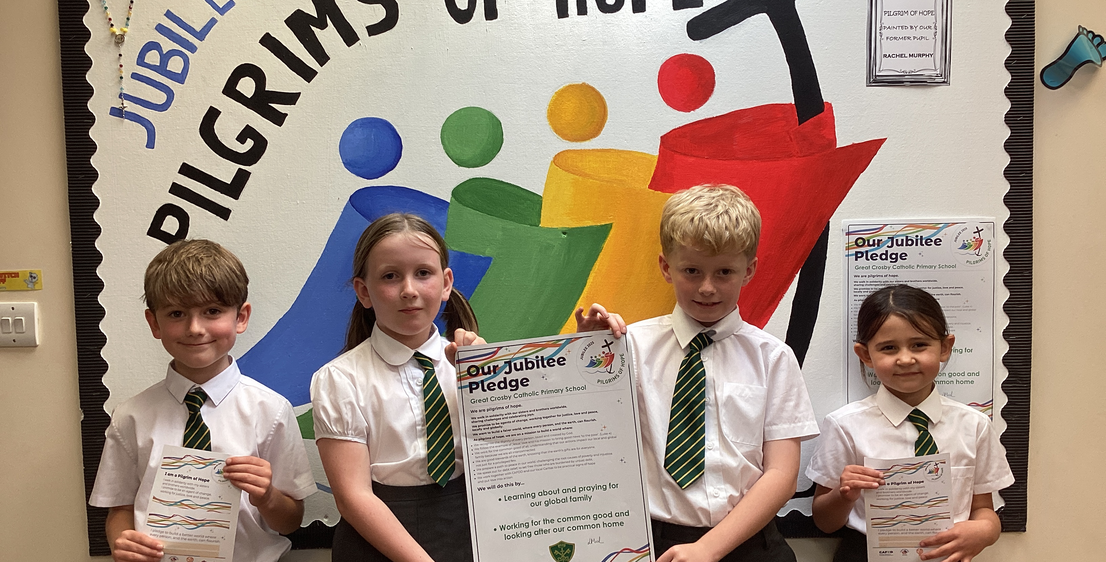

Get involved with CAFOD this term
Explore our summer term resources
Ways to live out your Jubilee Pledge
Fundraise for a World Gift

Slide 22


