Slide 1
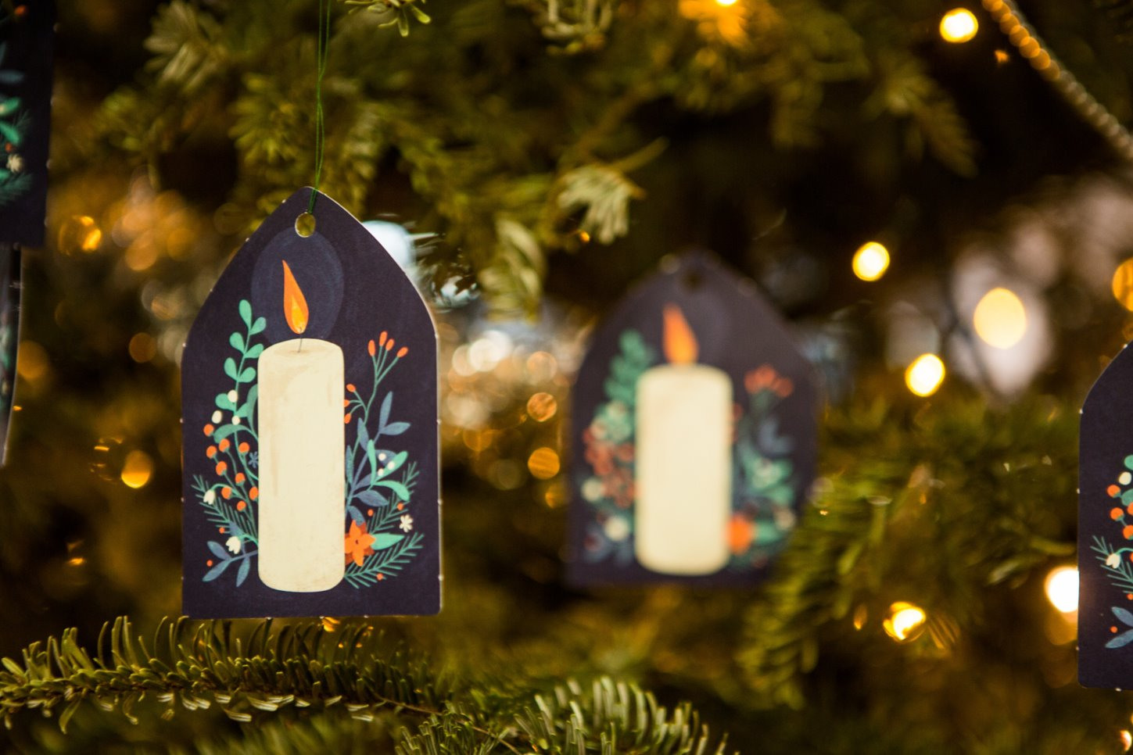

What can I do this week to share and spread some joy in our world?
We gather

Slide 2
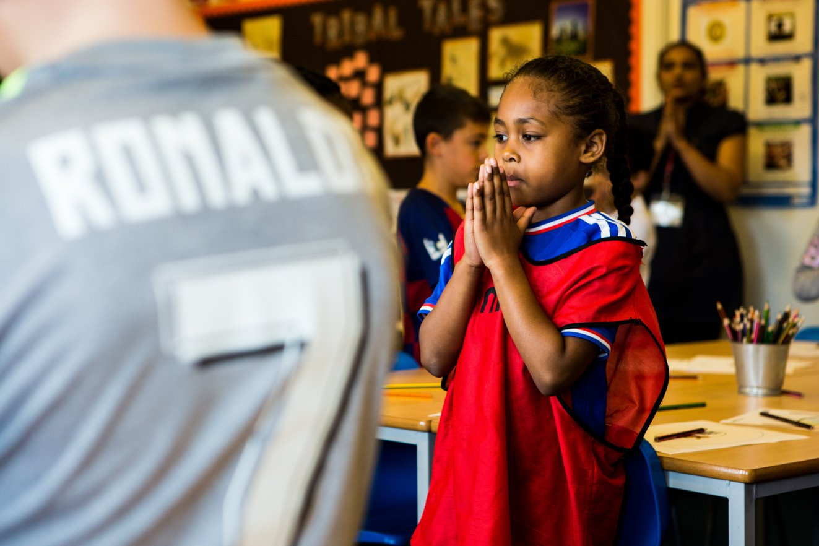
Generous God, we give you thanks for all the good things that you have given us. Inspire us to share what we have so all people may live a full and happy life. Amen.
Notes:
Children at Our Lady Queen of Heaven Primary School
Photo credit: Thom Flint

Slide 3

Gospel: Luke 3:10-18
The people asked [John the Baptist], “What are we to do, then?”
He answered, “Whoever has two shirts must give one to the man who has none, and whoever has food must share it.”
Some tax collectors came to be baptised, and they asked him, “Teacher, what are we to do?”
“Don't collect more than is legal,” he told them.
Some soldiers also asked him, “What about us? What are we to do?”
He said to them, “Don't take money from anyone by force or accuse anyone falsely. Be content with your pay.”
Word

Slide 4
People's hopes began to rise, and they began to wonder whether John perhaps might be the Messiah.
So John said to all of them, “I baptise you with water, but someone is coming who is much greater than I am. I am not good enough even to untie his sandals. He will baptise you with the Holy Spirit and fire. He has his winnowing shovel with him, to thresh out all the grain and gather the wheat into his barn; but he will burn the chaff in a fire that never goes out.”
In many different ways John preached the Good News to the people and urged them to change their ways.

Slide 5
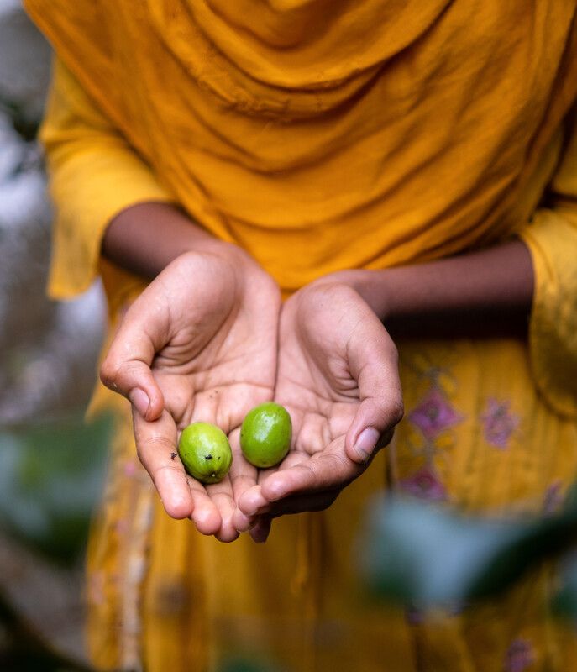

What do you remember from the Gospel reading?
The people ask John the Baptist what they should be doing to prepare for the coming of Christ. What did John say to them?
John says anyone who has two shirts should share with the person who has none. He says that anyone who has something to eat must do the same.
Are you always good at sharing? Can you tell me about a time when you didn’t have something you needed or wanted and someone else shared with you? How did you feel when they shared with you?
Respond
Notes:
Dristy, Bangladesh
Photo credit: Amit Rudro

Slide 6
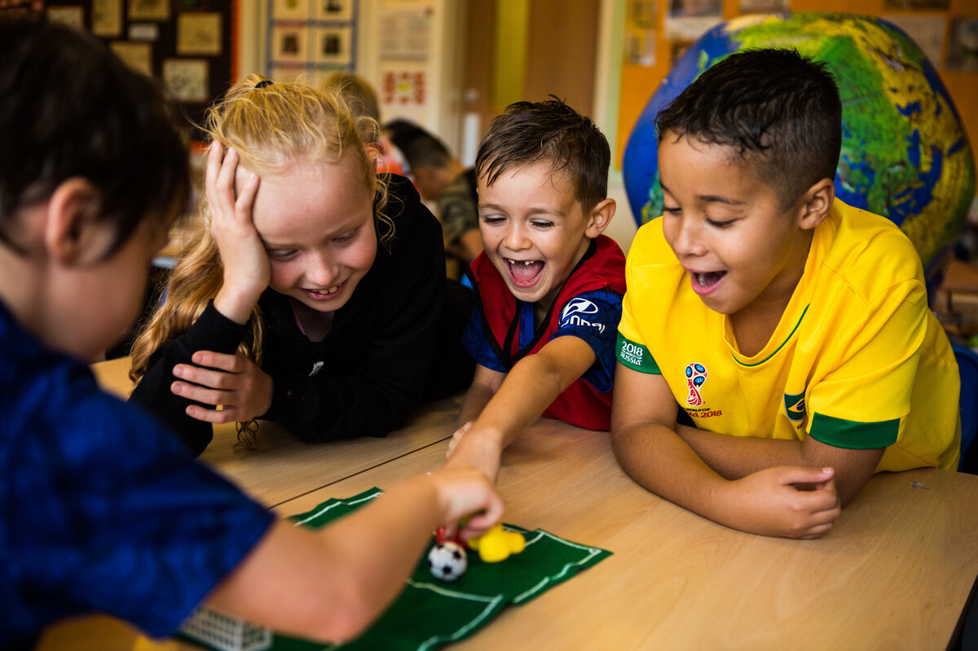
When you share your toys or sweets with someone how does it make you feel?
Does it make you feel happy? Today is Gaudete Sunday. Gaudete means joy. So let’s think today a bit about what makes us happy and joyful.
Can you all tell me one thing that makes you happy?
Notes:
Primary football fundraisers
Photo credit: Thom Flint

Slide 7
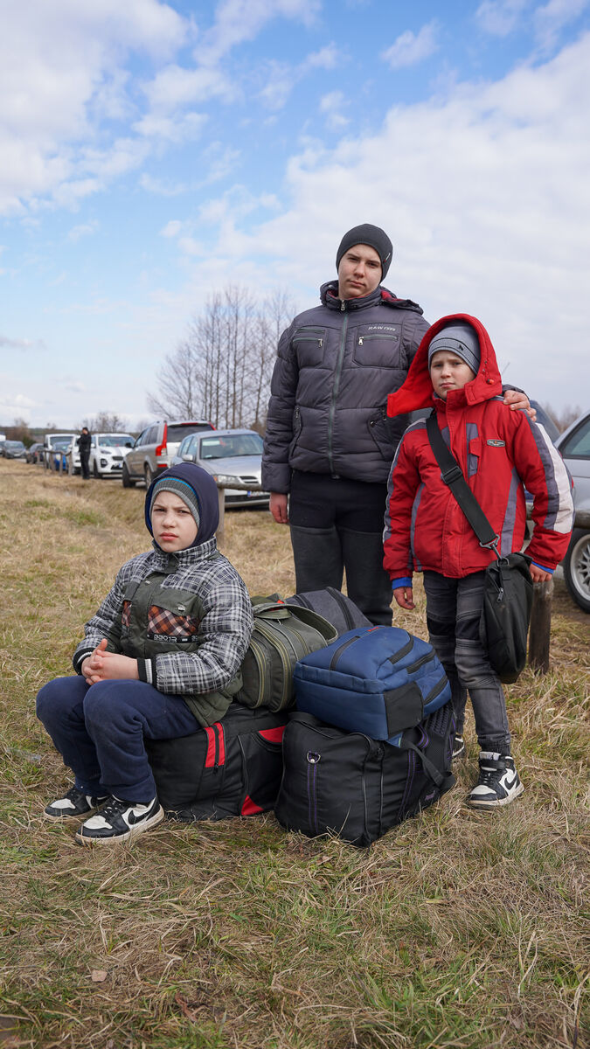
There are some things in the world that all people need to live happy and healthy lives. Can you think of what some of these things are?
We all need food, water and somewhere safe to live. But some of us in this country and in countries around the world struggle to get enough food, to get clean water to drink, to go to school, to get medicine or to have a safe place to live.
Notes:
A refugee family, fleeing from Ukraine
Photo credit: Caritas Poland

Slide 8
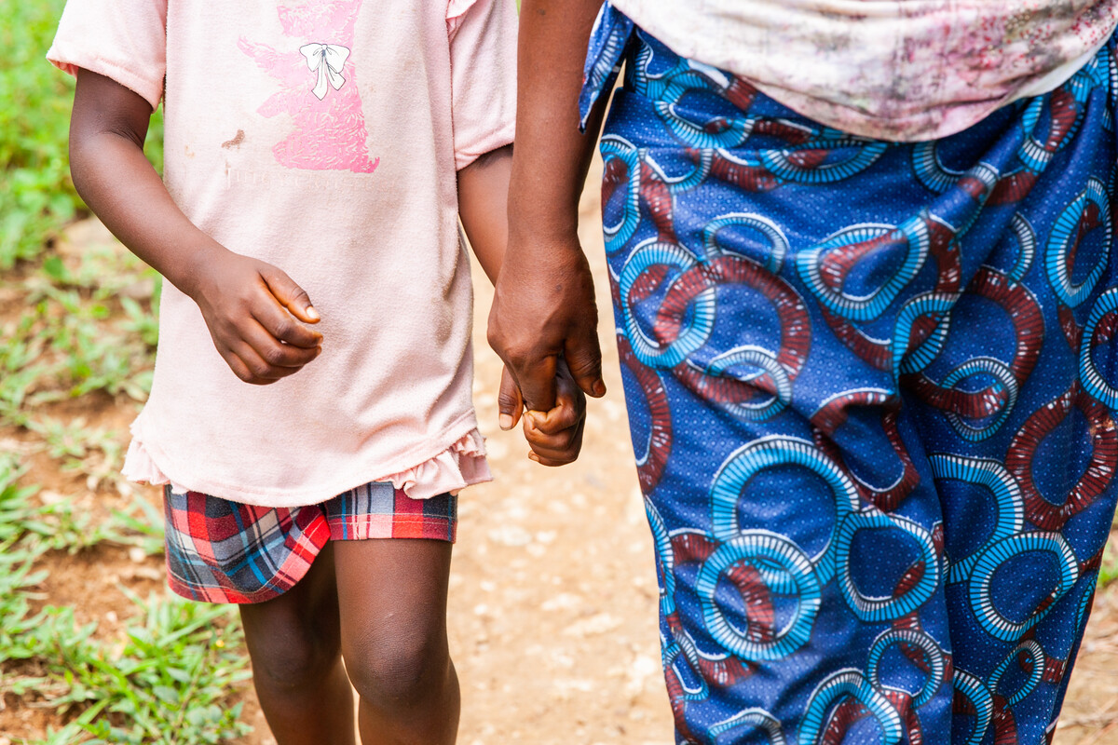
We also all need people to share our worries with, and who are willing to share their time with us to help us. We all need people who love us and care for us.
What could you do this week to share and spread some joy in our world? How could you share joy with someone who is lonely, poor or who needs some help either locally or around the world?
Notes:
Miatta Juana Tombolu, Sierra Leone
Photo credit: Thom Flint

Slide 9

Let us pray…

Slide 10

We pray for the Church throughout the world: that it may be a shining example of joy and God’s love, welcoming everyone and spreading the message of sharing to all people. Lord, in your mercy…
We pray for all members of our global family: that we may all recognise the importance of our brothers and sisters and share what we can for the good of all people. Lord, in your mercy…

Slide 11

We pray for our communities, families and friends: that we may be moved to care for one another and share what we have so all people can live full and happy lives. Lord, in your mercy…
Christ Jesus, as Christmas approaches, we look forward joyfully to your coming. Help us to share what we can so all people may have what they need. Amen.

Slide 12
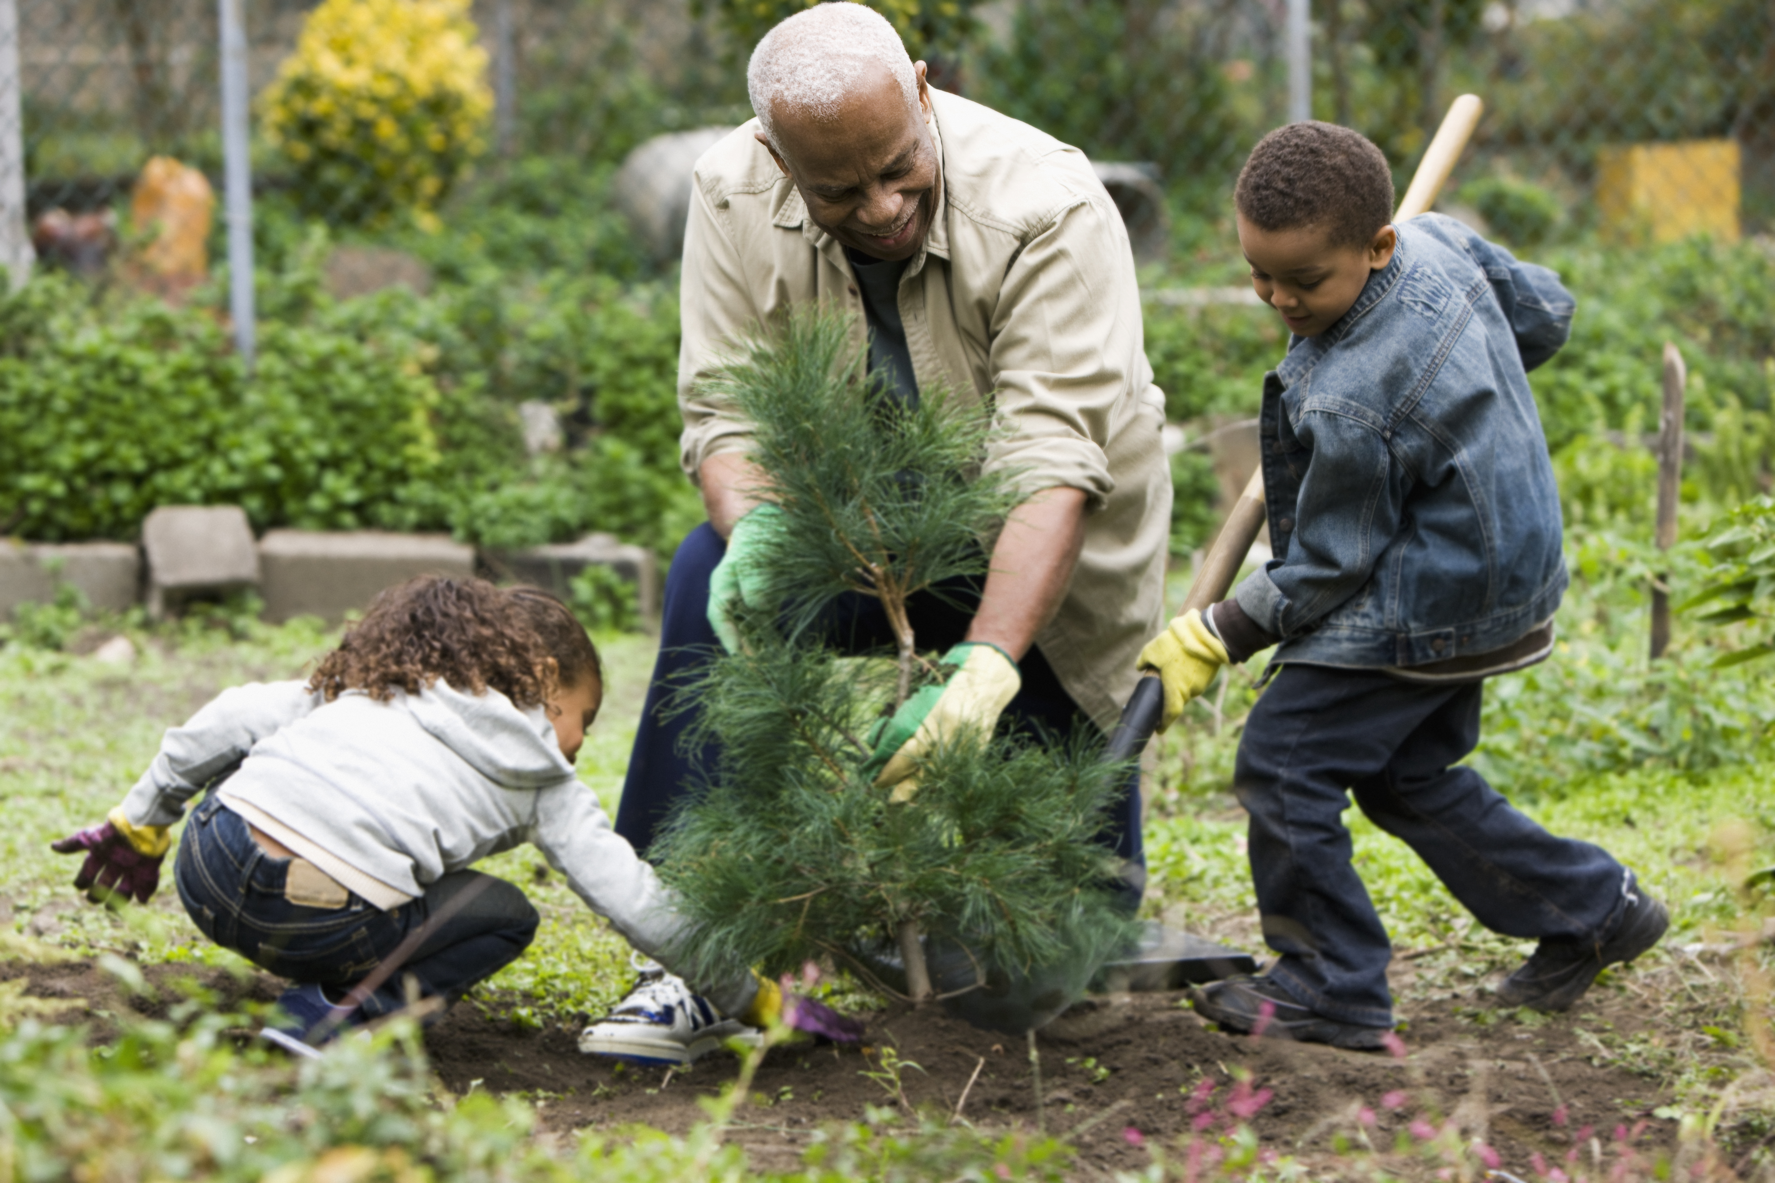

What could you do this week to share and spread some joy in our world? Especially how could you share joy with someone who is lonely or who needs some help either locally or around the world?
Send
Notes:
Photo credit: Stock image

Slide 13
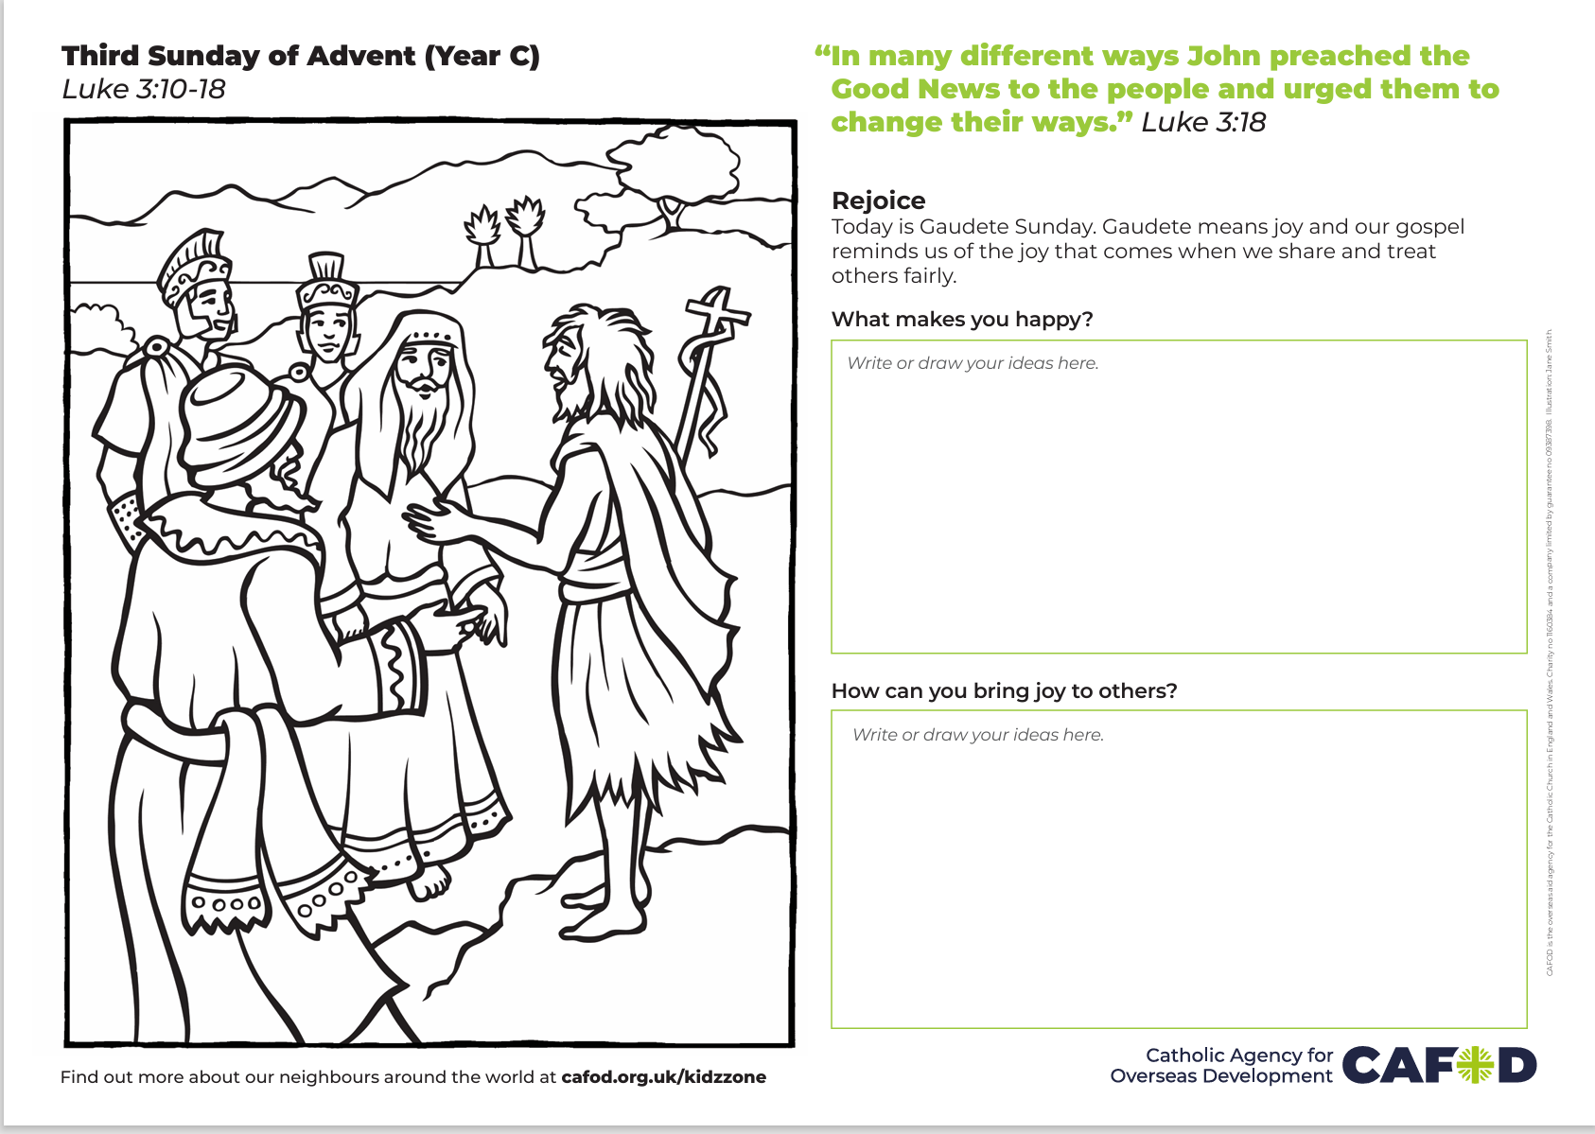
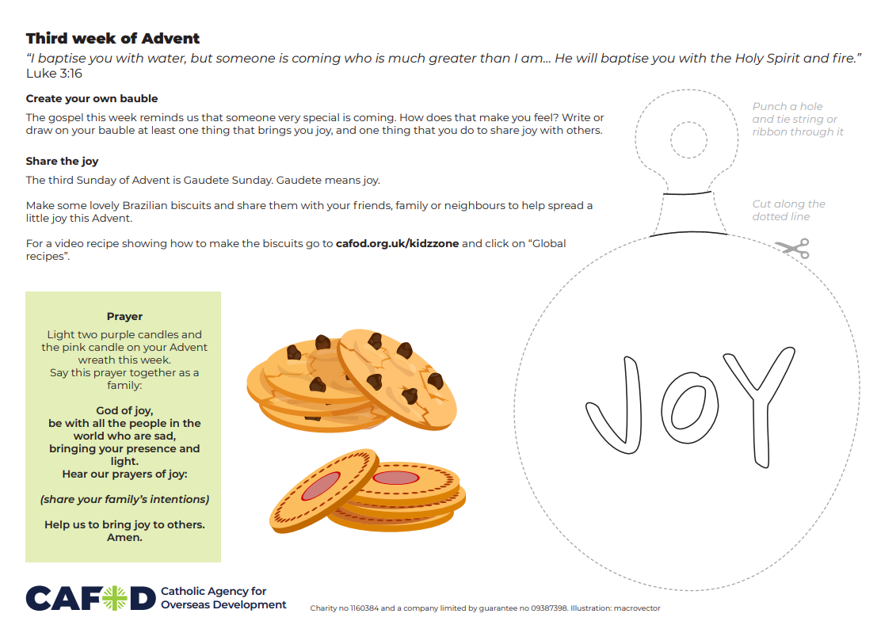
Activity suggestions
Colour and complete the Gaudete sheet. Spread the joy!
Share the other activity sheet with the children. Invite them to decorate the bauble by writing or drawing something that brings them joy and how they can share joy this Advent. Encourage them to cut it out and hang it on their tree once it is up. You could also encourage them to stick the paper template to card to make it stiffer.
Light three candles on your Advent Wreath if you have one. Use the prayer on the accompanying activity sheet to pray for your group’s intentions at this time and encourage the children to take it home to pray during the week.
Encourage the children to discuss all that they have heard and thought about today with the people at home. Remind them to try their best to share and to spread joy throughout the world in the coming week.

Slide 14

Buy your World Gifts!
Did you fundraise for World Gifts this term? Don’t forget to buy your gifts – a goat, cow or a Christmas stocking filled with life changing gifts?
Buy World Gifts with your fundraising money
Thank you.

Slide 16


