Slide 1
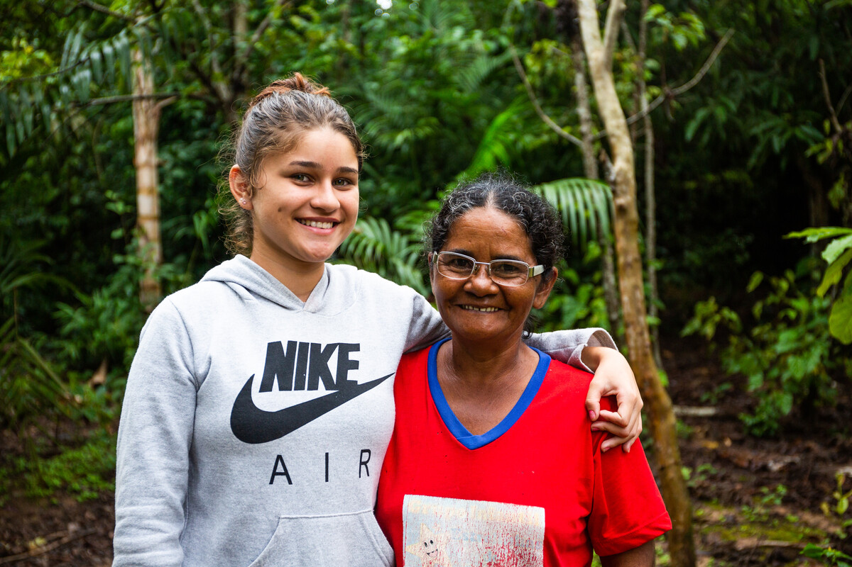
Subsidiarity
Exploring CST principles
in CAFOD’s work
Notes:
Photo credit: Thom Flint

Slide 2
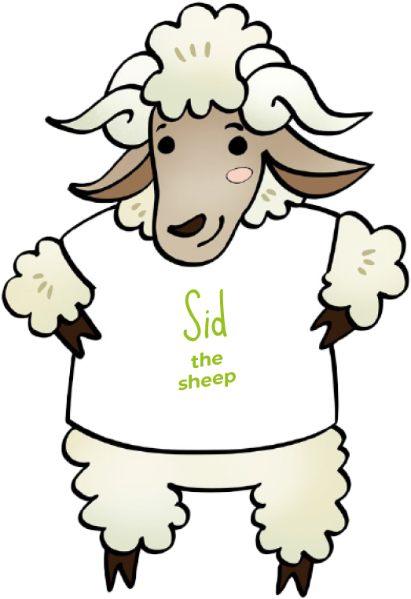
Subsidiarity means we believe that
everyone should have a say.

Slide 3
Jethro said to Moses, “Let them bring every important case to you, but decide every minor case themselves.”
Exodus 18:22

Slide 4
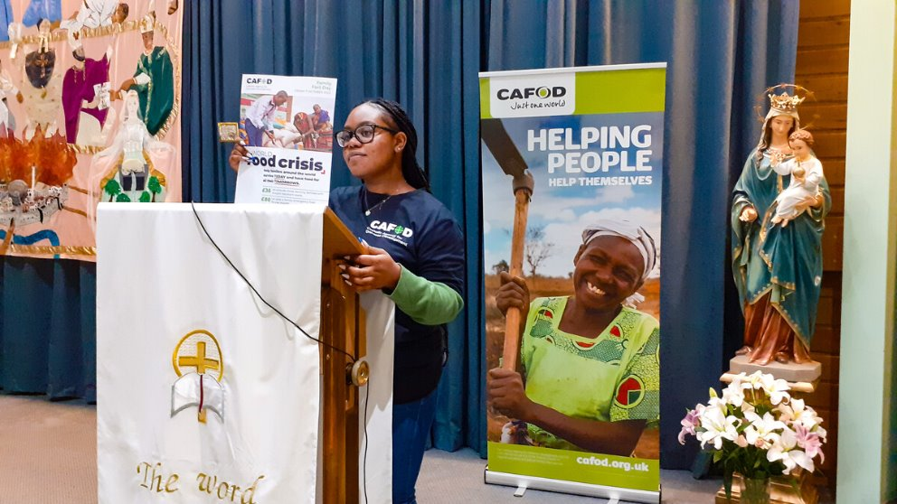
Subsidiarity
We believe everyone should have a say about what affects them.
Notes:
Photo credit: CAFOD Northampton

Slide 5
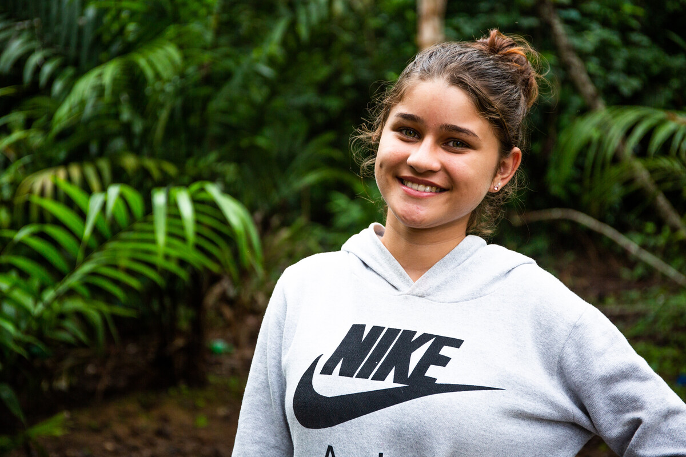
This is Luana. She loves living in her village in Brazil. "It’s quiet and peaceful and I am near to nature here," she says.
Luana is inspired by her hard-working grandmother called Dona Sonia.
Notes:
Photo credit: Thom Flint

Slide 6
Every day, Dona Sonia goes out to work on the land. "Each year, nearby farmers burn fields to stop the forest growing back. Sometimes, the fires spread," says Dona Sonia.
"They destroy crops and precious trees that grow fruit and nuts that our community relies on to eat and sell."
Notes:
Photo credit: Thom Flint

Slide 7
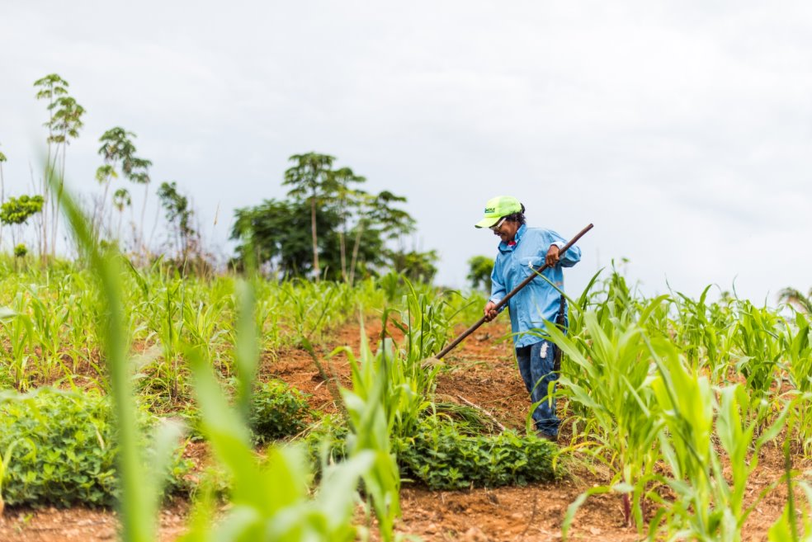
Many people have lost their homes and were forced to leave because they did not have a say about the land they lived on.
With CAFOD's help, the community has won the right to stay.
Notes:
Photo credit: Thom Flint

Slide 8
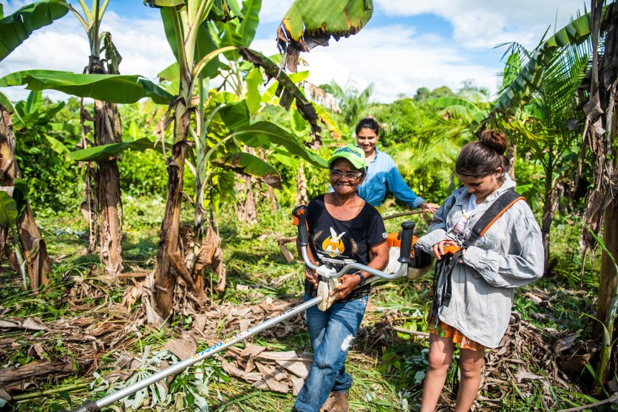
CAFOD has also helped Dona Sonia to learn to grow bananas, lemons, coconuts and Brazil nuts on the land that is now theirs.
"The trees provide us with food, but they also help to reforest the Amazon and protect our environment," says Dona Sonia.
Notes:
Photo credit: Ana Caroline De Lima

Slide 9
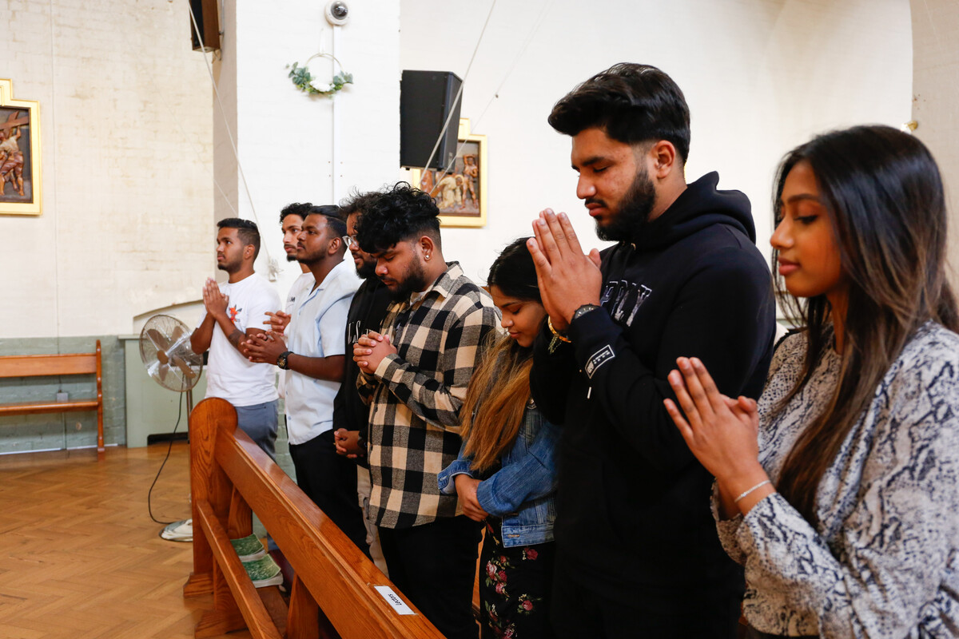
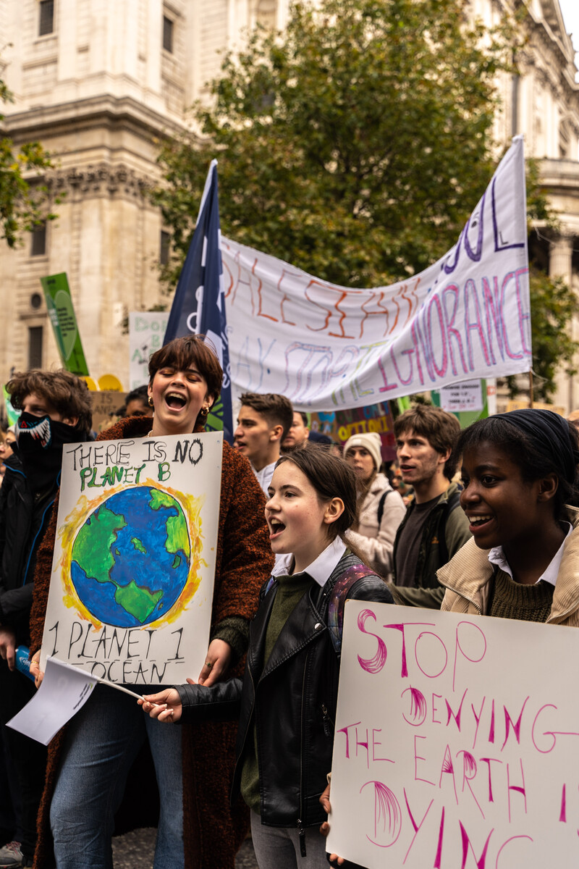
“...together we want to give voice to all those who suffer, to all those who have no voice and are not heard.”
Pope Francis, 20 September 2016
Notes:
Photo credit: Ben White
Photo credit: David Gallardo

Slide 10
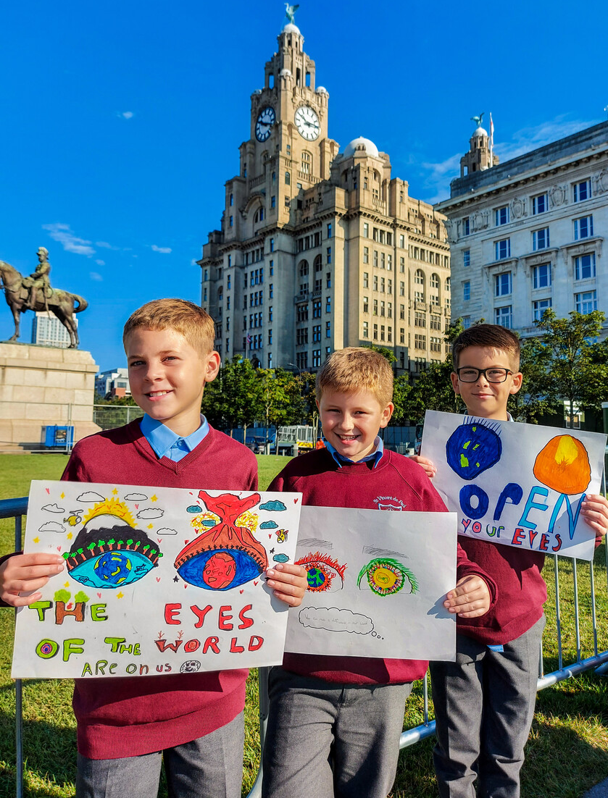
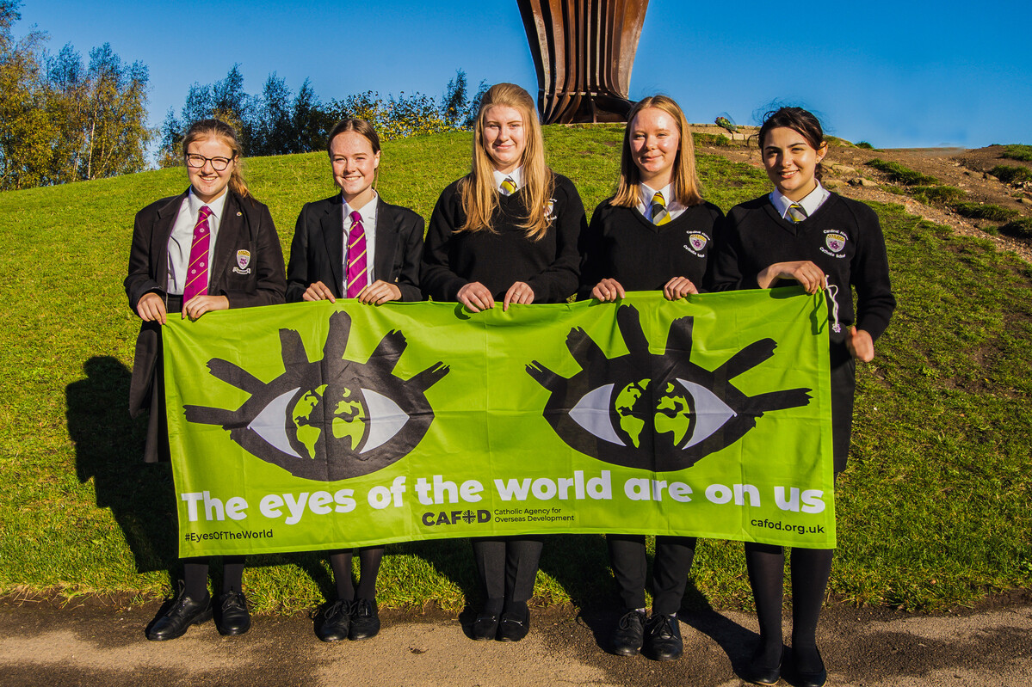
Everyone should have a say
Everyone has important ideas and knows what is best for their families and communities. They need to have a chance to be heard.
The climate is in crisis and people living in poverty suffer most and are often not listened to.
During the 'Eyes of the World' campaign, children in England and Wales spoke up so their global brothers and sisters could have their voices heard too.
Notes:
Photo credit: Tamala Ceasar

Slide 11
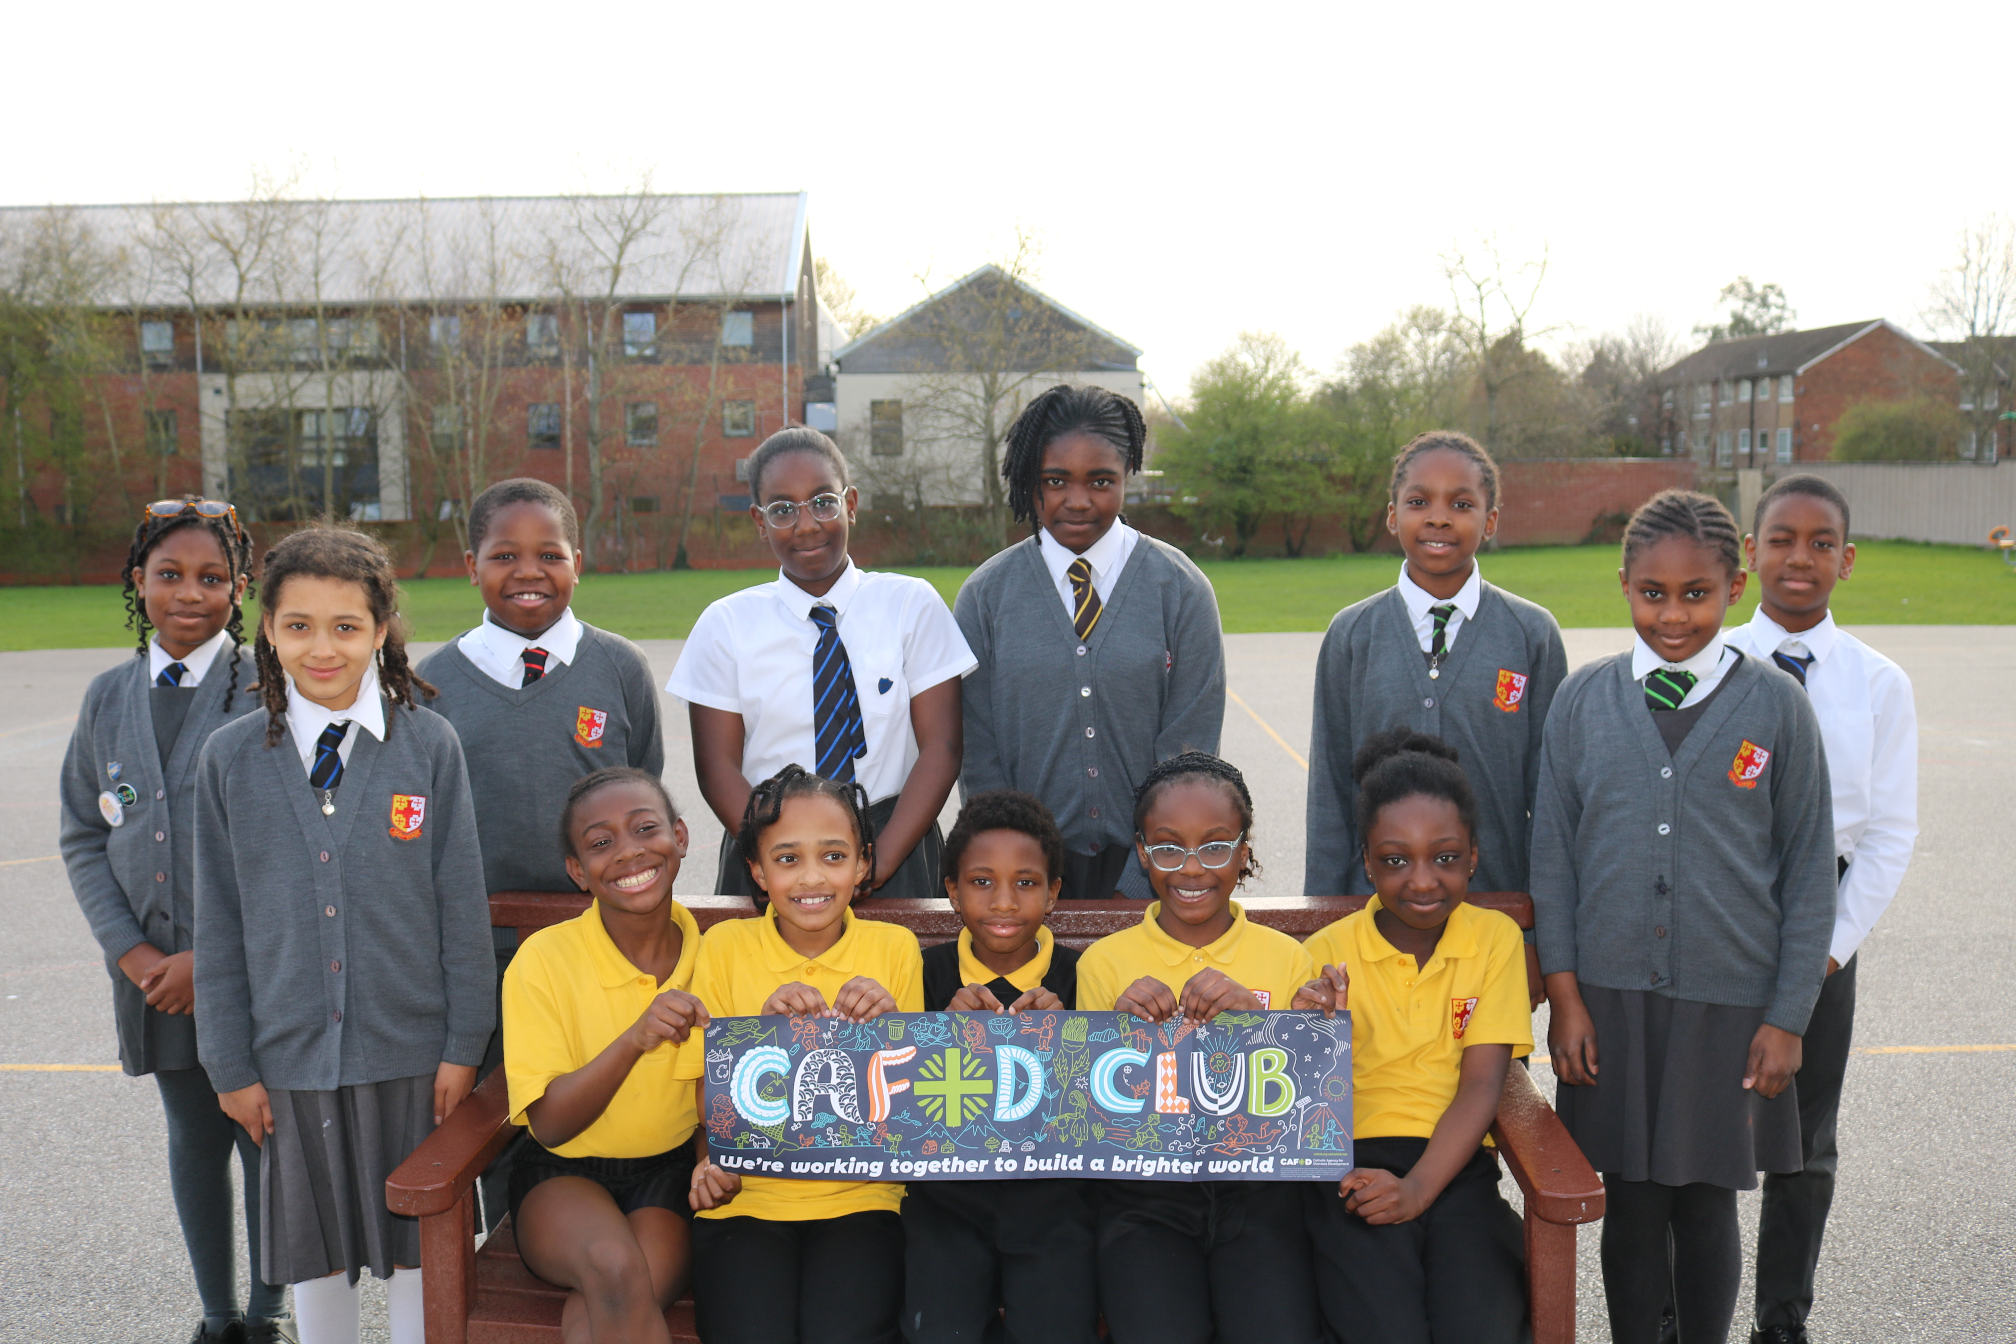
CAFOD Clubs work to help our brothers and sisters around the world have their say. ​
Faith is part of CAFOD Club.
"We discuss ideas, design posters, plan assemblies and end with a prayer. We also take part in CAFOD campaigns," she says.
"I love our CAFOD club! It helps us understand the needs of others."
Notes:
Photo credit: St Chad's

Slide 12
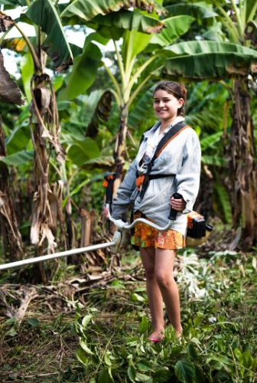
Let us pray
Loving God,
We believe that people who make decisions should listen to everyone.
Help us make sure everyone is treated fairly and can have a say.
Lord in your mercy
Hear our prayer
Everyone should have a say​
Subsidiarity
Notes:
Photo credit: Ana Caroline De Lima

Slide 13
Everyone should have a say
Sid the sheep reminds us that everyone should have a say.
How can we make sure that everyone around us is able to have their say?

