Slide 1
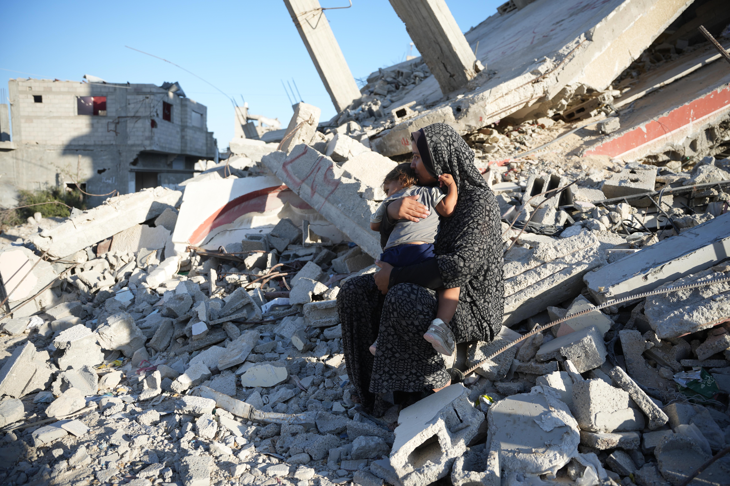
DEC
Middle East Humanitarian Appeal
School fundraising assembly

Slide 2
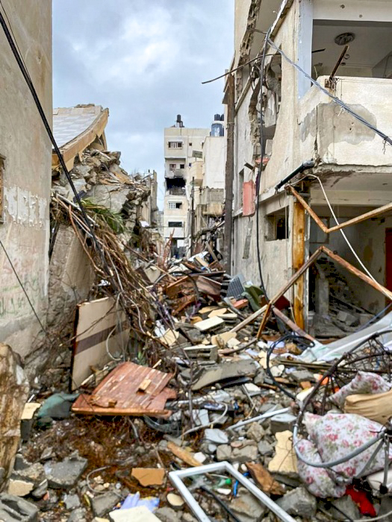
What has happened?
You may have seen pictures on the news and on the internet of the conflict in the Middle East region. ​
Communities in Gaza, the West Bank, Lebanon, Syria and Israel are being caught up in the violence.
A street in Gaza

Slide 3
In Gaza
In Gaza, people are dying of hunger and disease, as well as injuries caused by the conflict.
People are in need of food and clean water.
Here is Aaliyah* sitting on the remains of a damaged building with her daughter, in October 2024.
Aaliyah said
“I had a house that was destroyed in February.
We live in a tent near the rubble of our home.”
Notes:
*Aaliyah is not her real name.

Slide 4
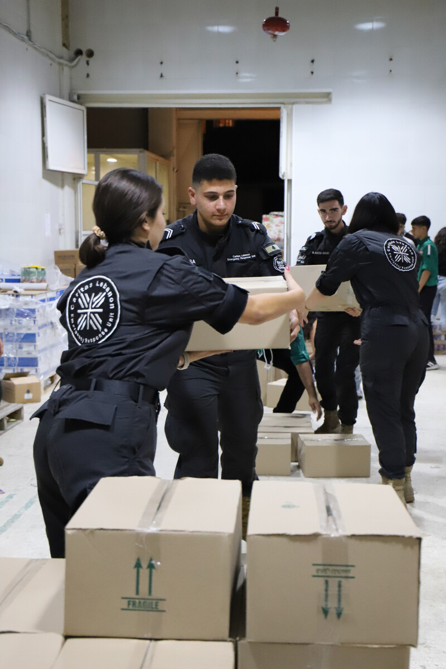
In Lebanon
In Lebanon, over 1 million people have had to leave their homes due to the conflict.
Shelters are full, and hospitals are struggling to treat the thousands of people injured.
Caritas Lebanon providing emergency supplies
Notes:
*Aaliyah is not her real name.

Slide 5
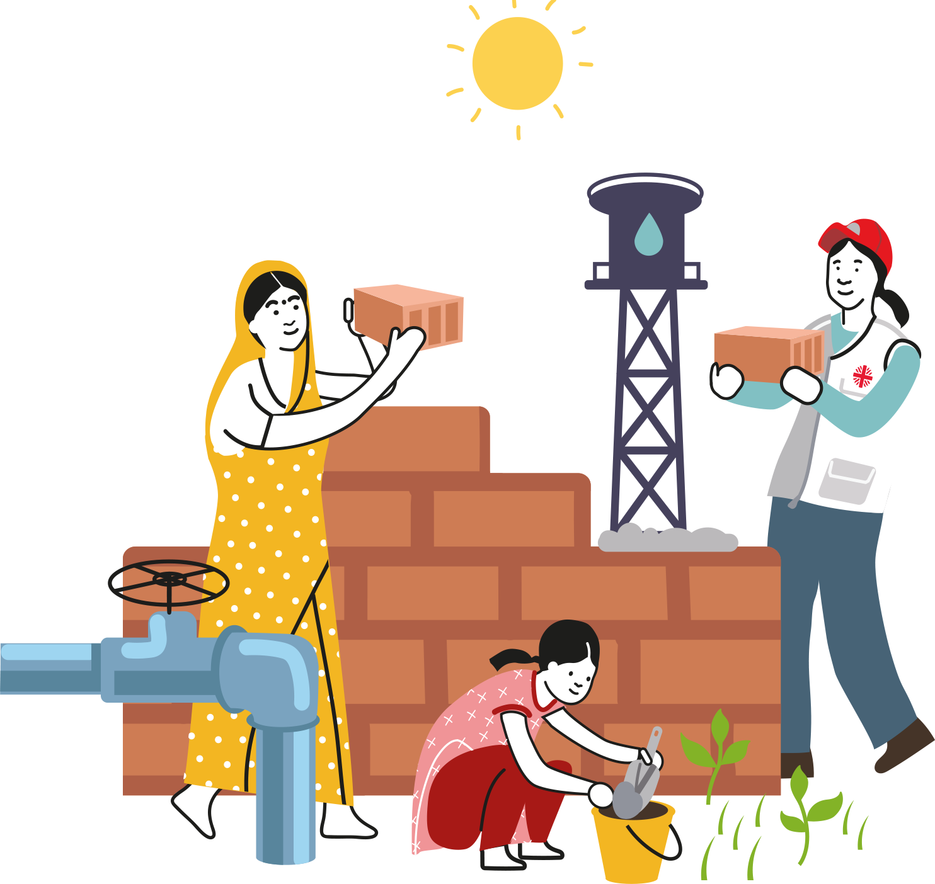
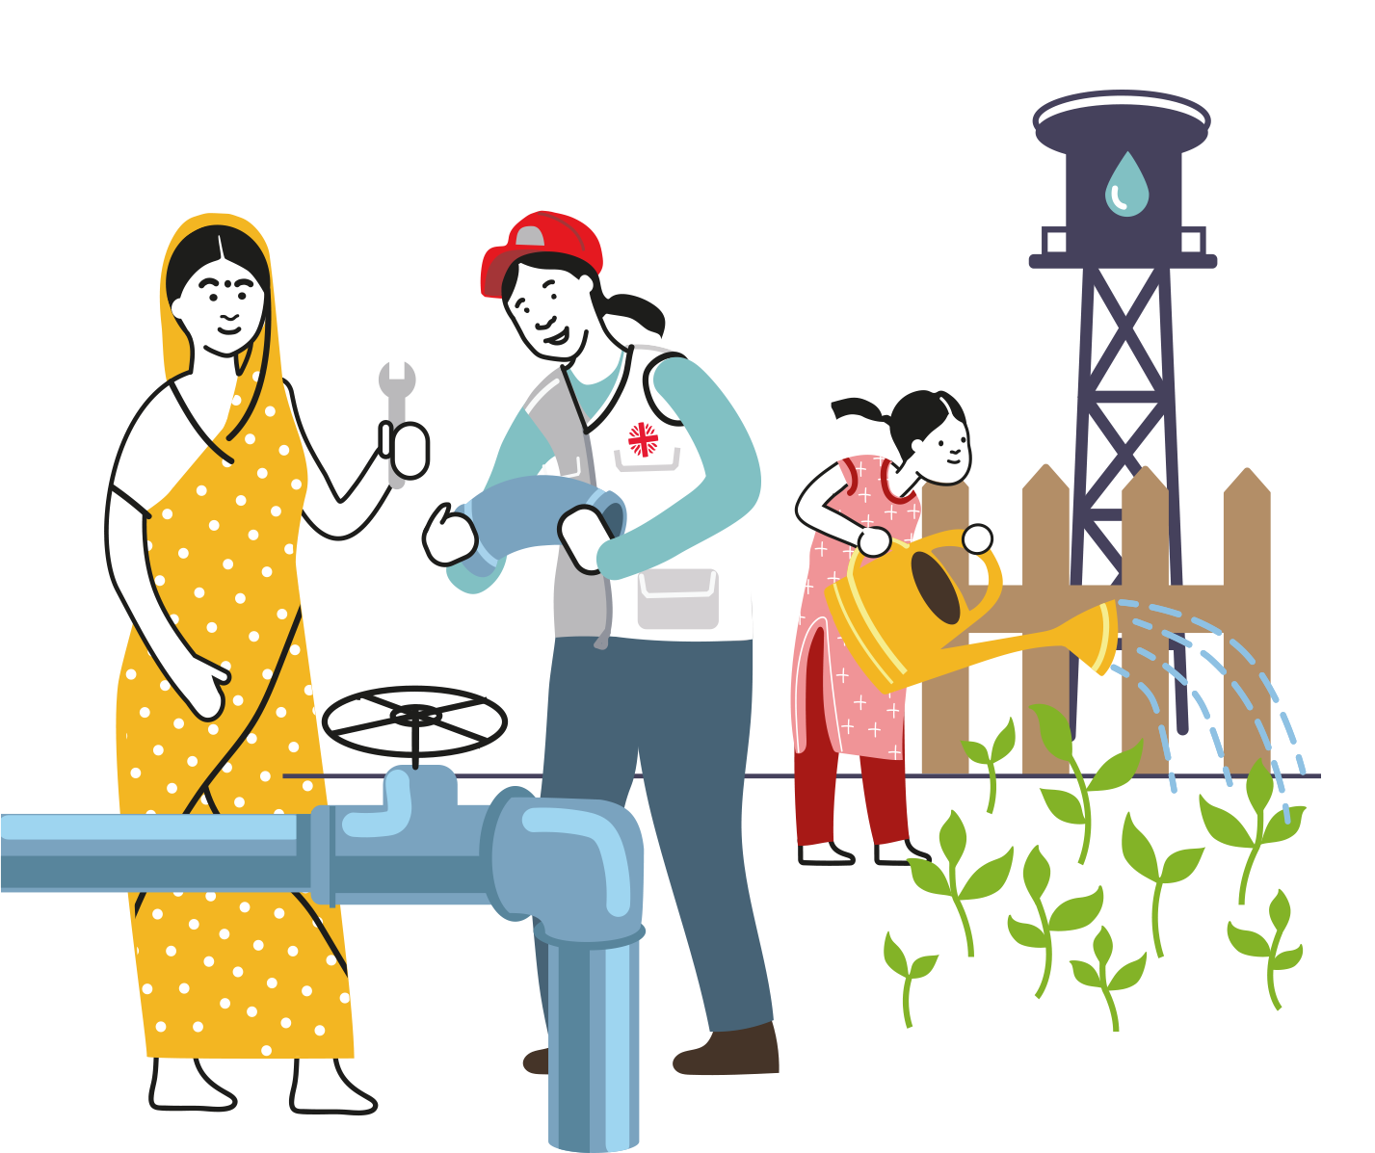
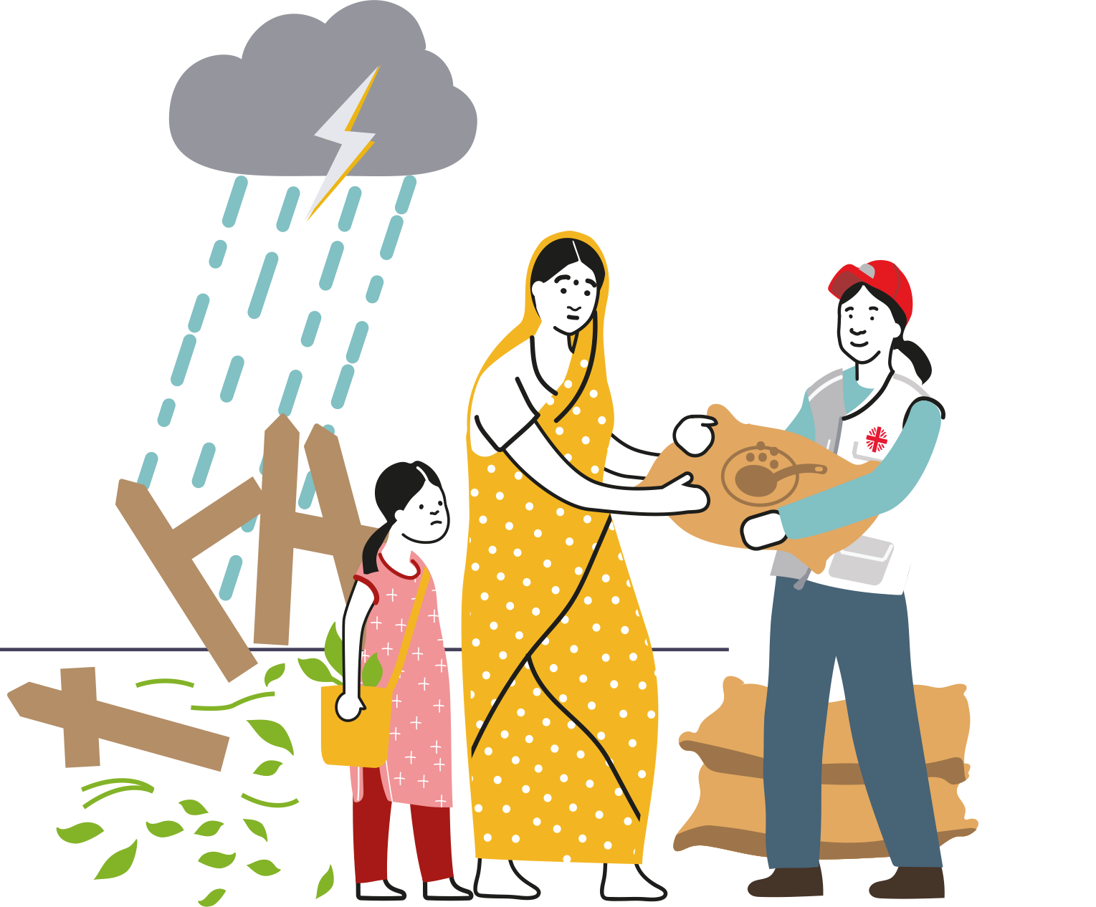
CAFOD is there…
BEFORE
>
DURING
>
AFTER
…any emergency

Slide 6
CAFOD’s work in the Middle East
CAFOD has been working in the Middle East for 40 years and works with Christian, Jewish, Muslim and secular partner organisations.
CAFOD is part of one of the largest aid agencies in the world, Caritas Internationalis. Can you see the Caritas flame in the CAFOD logo?
Through Caritas, CAFOD can reach more people.

Slide 7
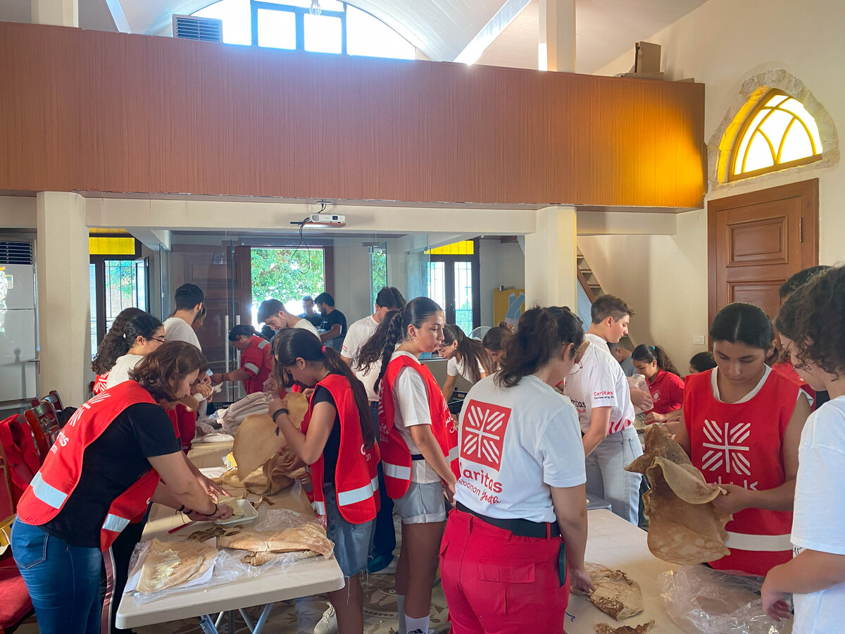
How CAFOD is helping
CAFOD is helping local aid workers to give urgent help such as food, water and shelter to families in Lebanon and Gaza, the West Bank and Israel.
Caritas Lebanon providing food parcels

Slide 8
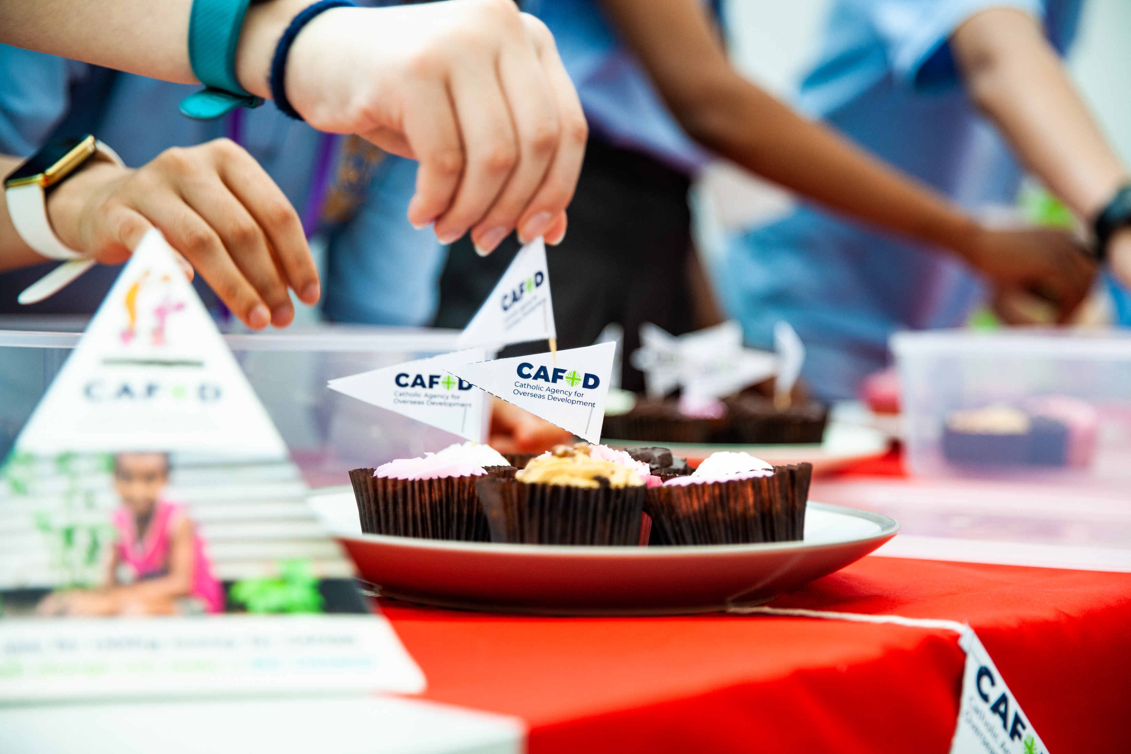
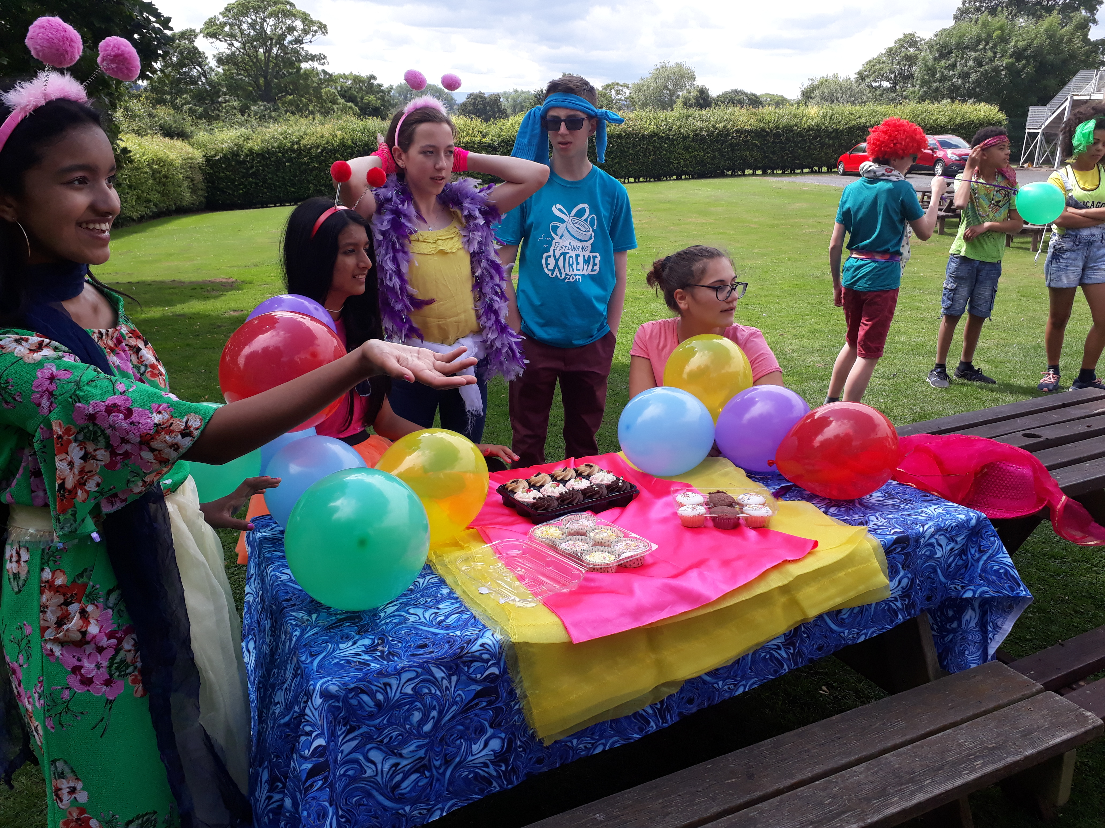
What can we do to help?
We can raise money to help support this emergency.

Slide 9
How our fundraising can help
£10
gives displaced families emergency water
£120
gets emergency shelter to three households

Slide 10
Let us pray together:
God of love
We pray for peace in our world, and an end to war.
Instead of hatred, let there be love.
Shelter your children and protect us.
Guide us and keep us from harm,
So we can build a world of love and live our lives in peace.
Amen.

