Slide 1


Slide 2

CAFOD’s experts provide long-term aid
Part of one of the largest aid networks in the world, Caritas Internationalis.
CAFOD are there in the months and years that follow an emergency
CAFOD’s global reach is present in the lived experience of local community experts.
CAFOD help anyone regardless of faith, gender and ethnicity.
Official aid agency for the Catholic Church in England and Wales

Slide 3

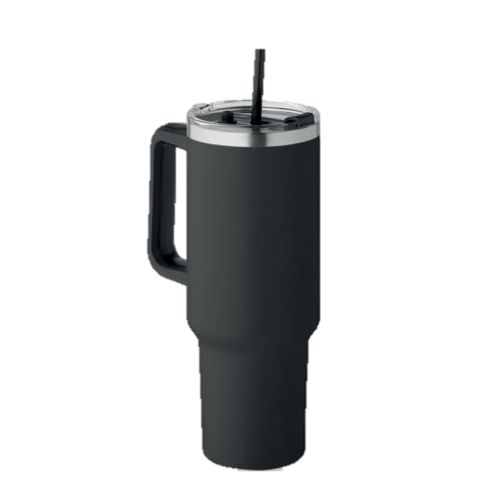
Water storage
Top Trumps
Practicality: 30
Storage capacity: 0.5
Evaporation resistance: 80
Overall CAFOD score: 29
Practicality: 10
Storage capacity: 1.25
Evaporation resistance: 95
Overall CAFOD score: 73

Slide 4

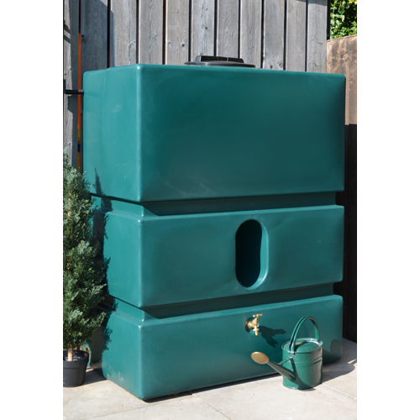
Water storage
Top Trumps
Practicality: 70
Storage capacity: 113
Evaporation resistance: 100
Overall CAFOD score: 78
Practicality: 20
Storage capacity: 30
Evaporation resistance: 30
Overall CAFOD score: 23

Slide 5

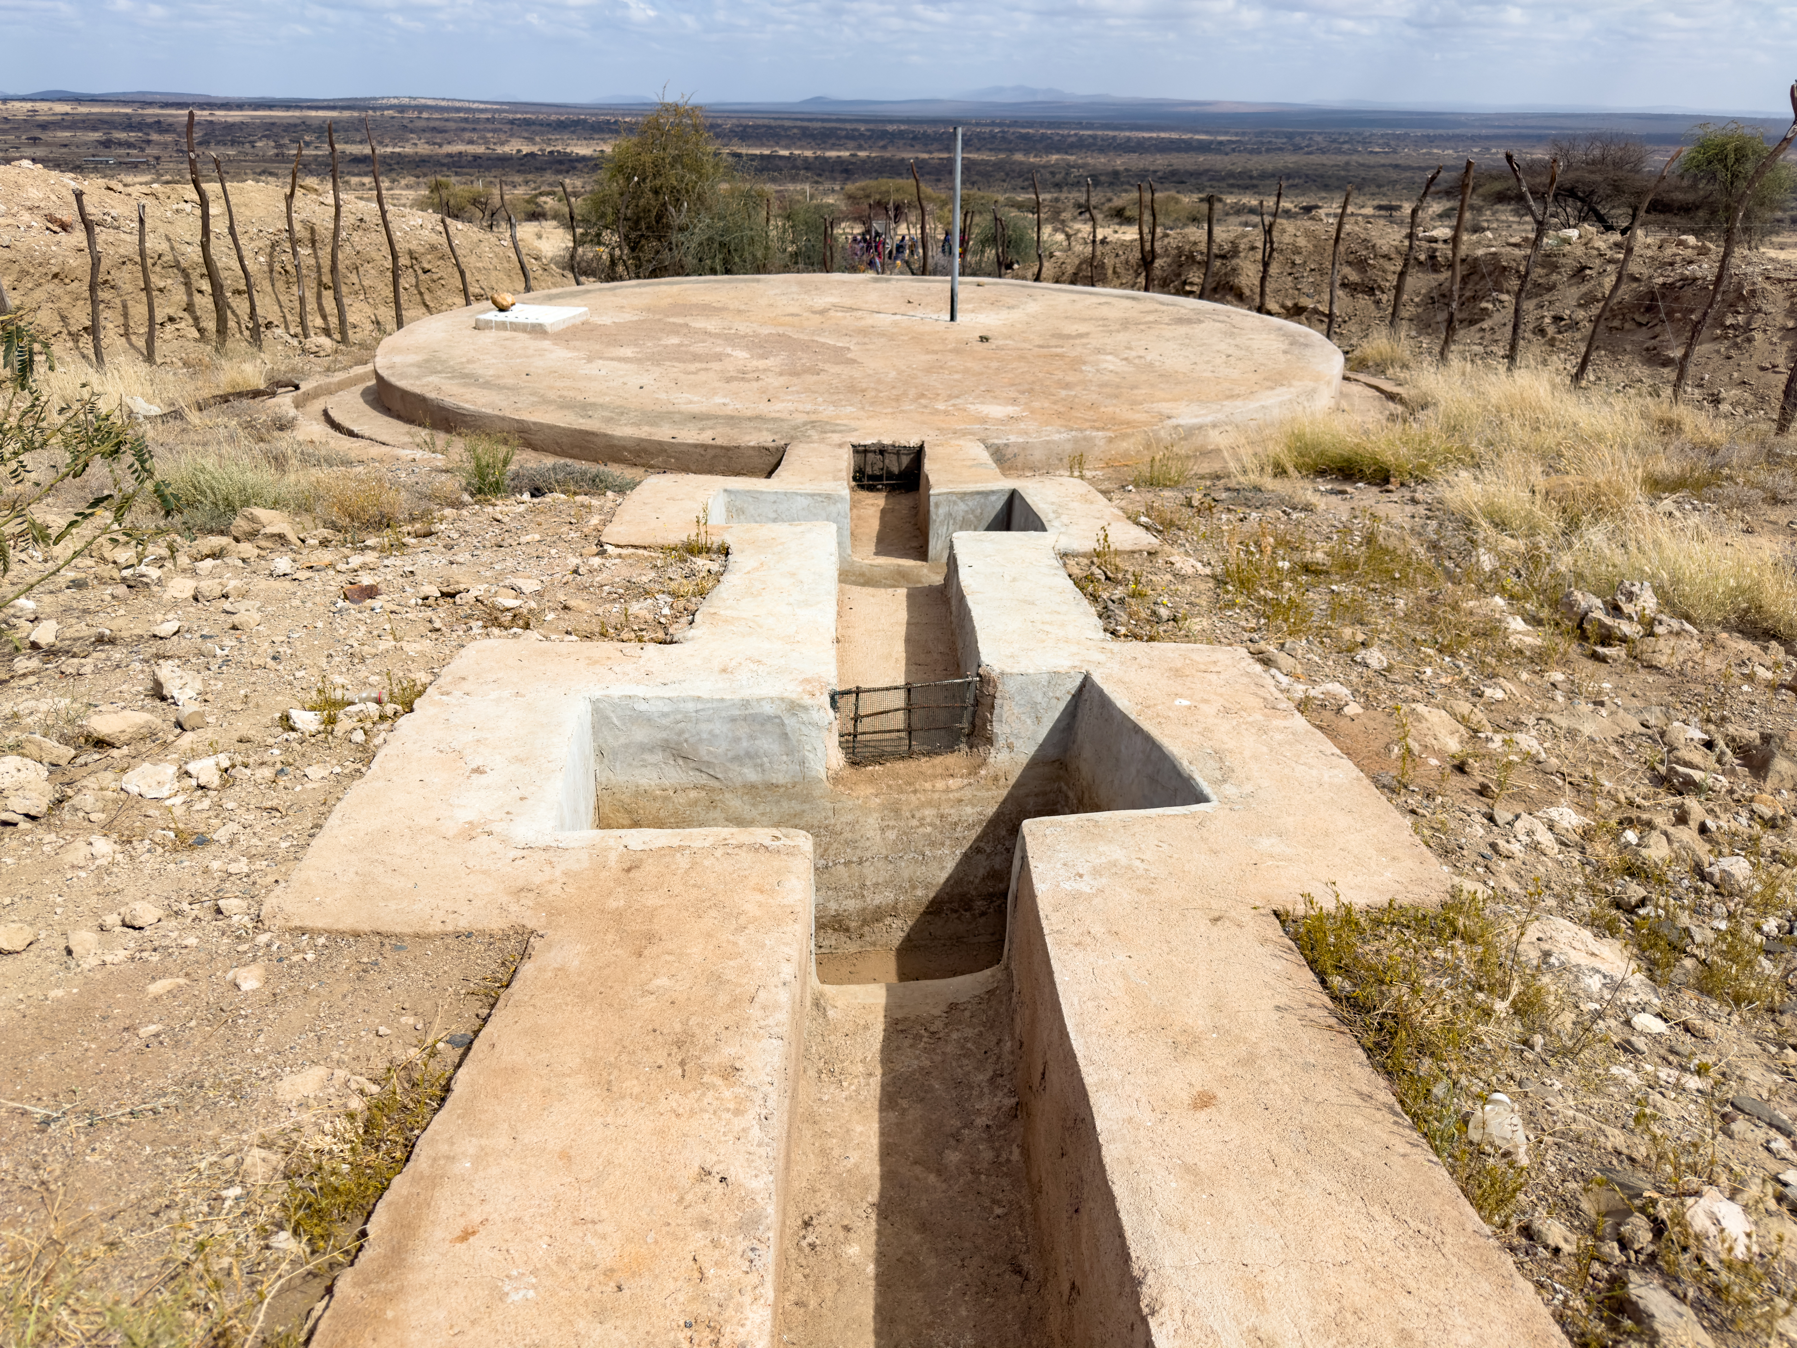
CAFOD project
Water tank Ethiopia
Practicality: 100
Storage capacity: 150, 000
Evaporation resistance: 98
Overall rating: HYDRATION HERO!

Slide 6
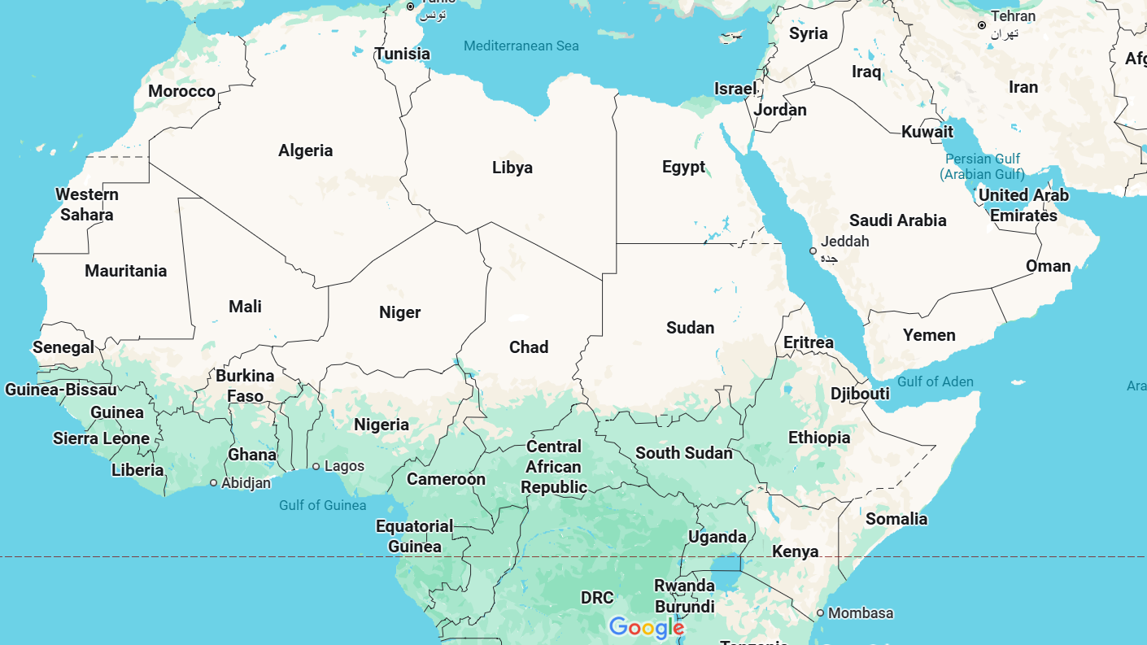

Slide 7

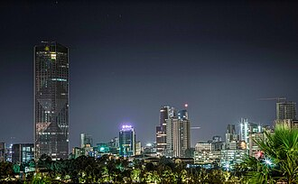


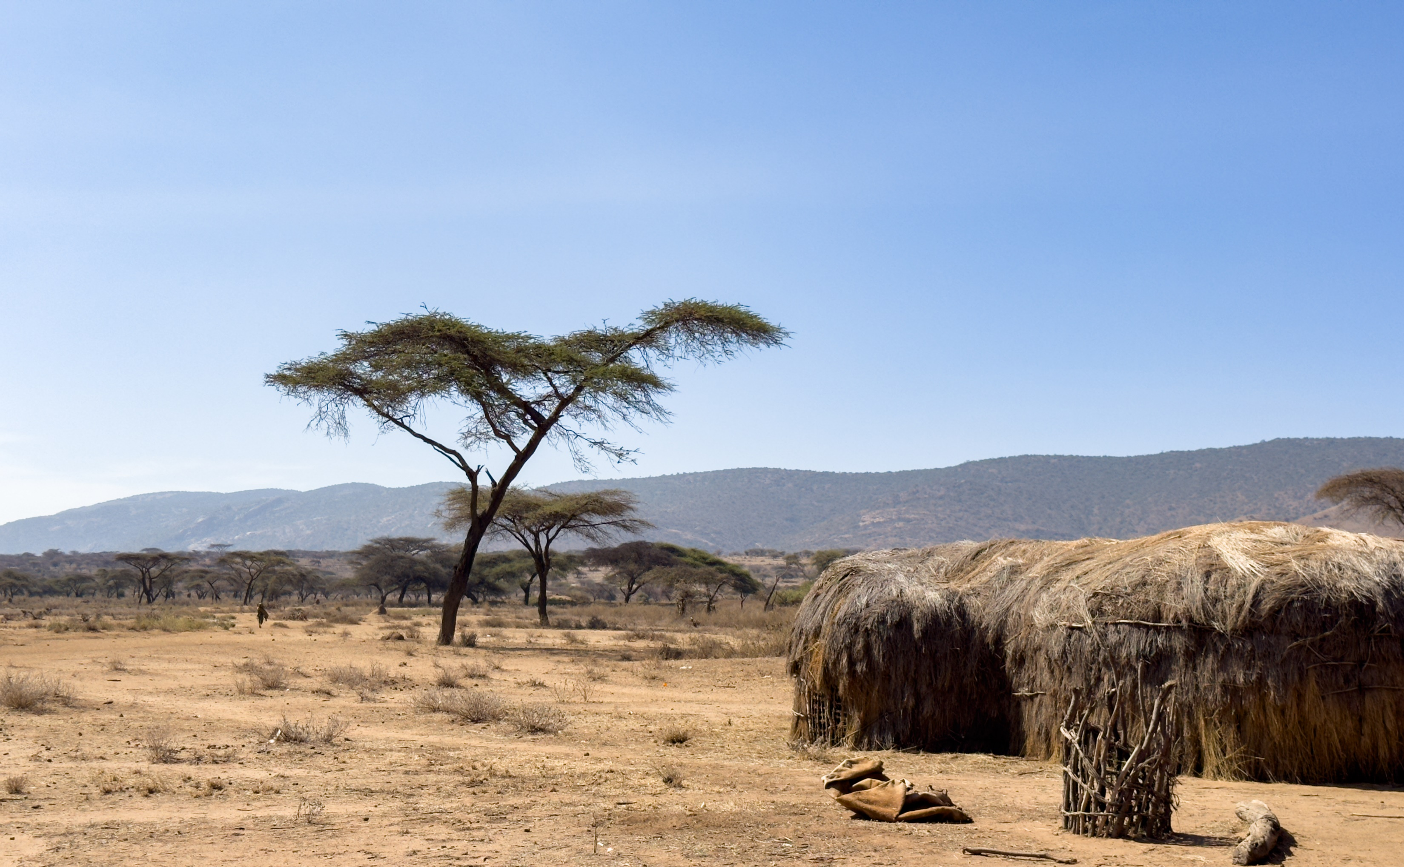

Ethiopia: Country Profile
Ethiopia has the second largest population in Africa with 113.6 million people living in the country.
Ethiopia’s President is called Taye Atske Selassie, he replaced the first female President in 2024.
Capital city: Addis Adaba
According to the World Bank 70% of the population work in agriculture.
The unpredictable weather in Ethiopia means food security is a challenge. The World Bank estimated this affected 20 million people in 2023.
Borana, southern Ethiopia

Slide 8


Slide 9
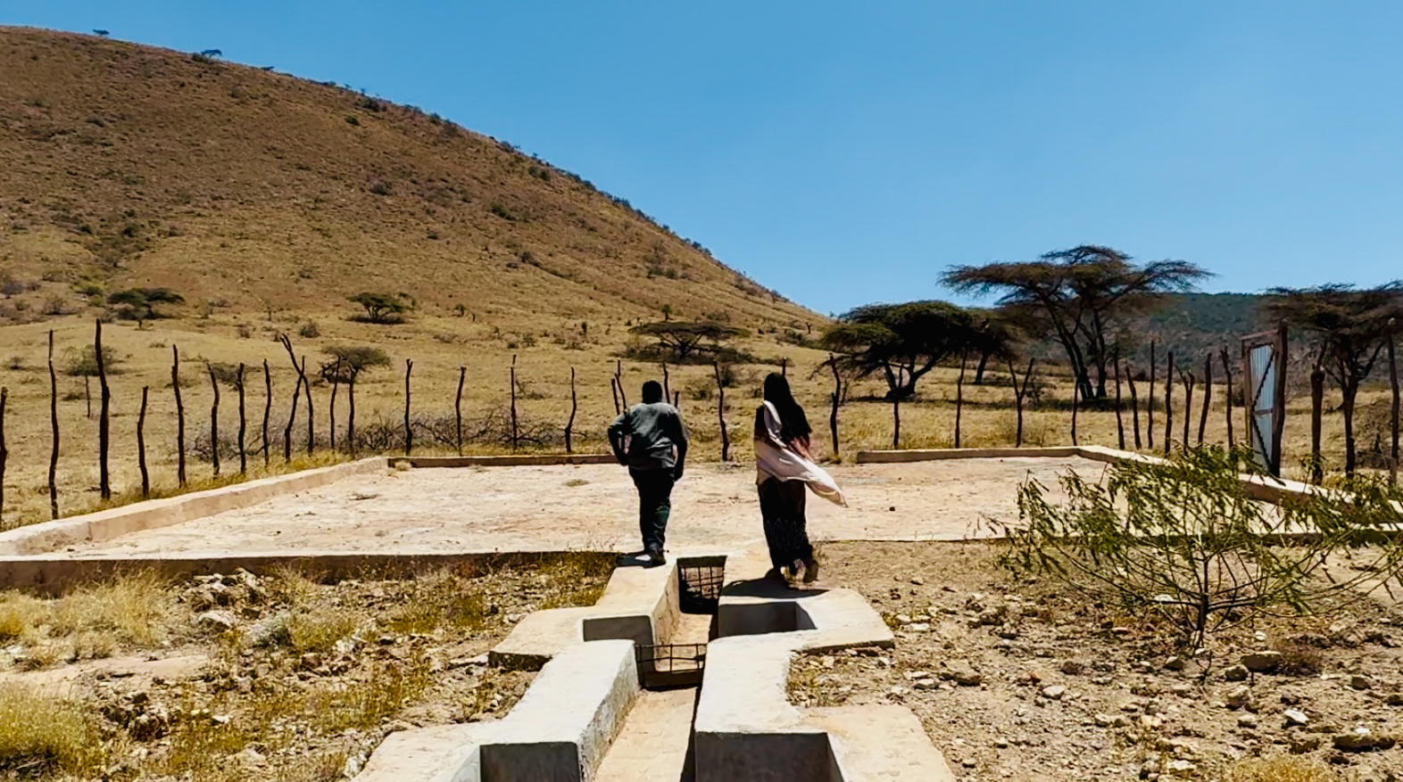
Abbiott shows Adi the water catchment pan.
Notes:
Photo credit: Louise Norton

Slide 10
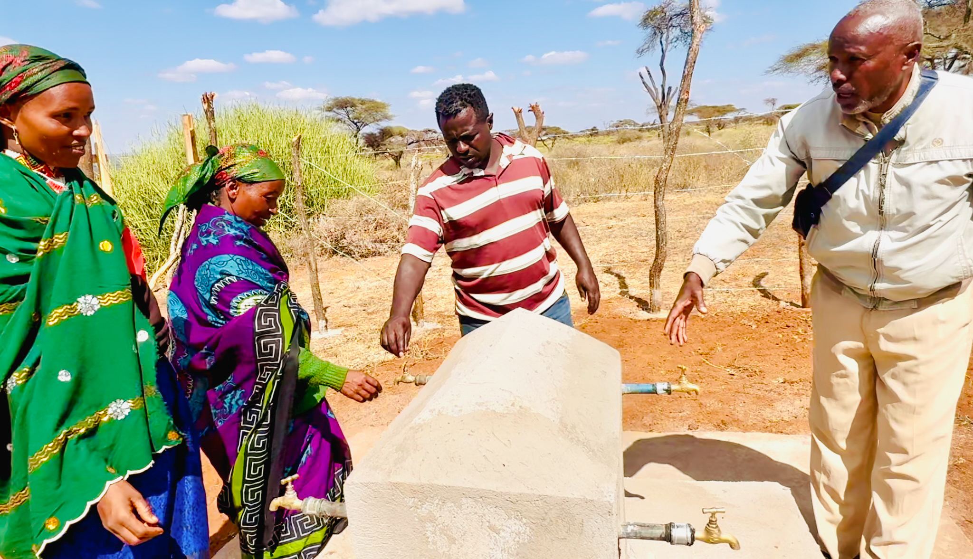
Abbiott with the community learning how care for the taps.
Notes:
Photo credit: Louise Norton

Slide 11
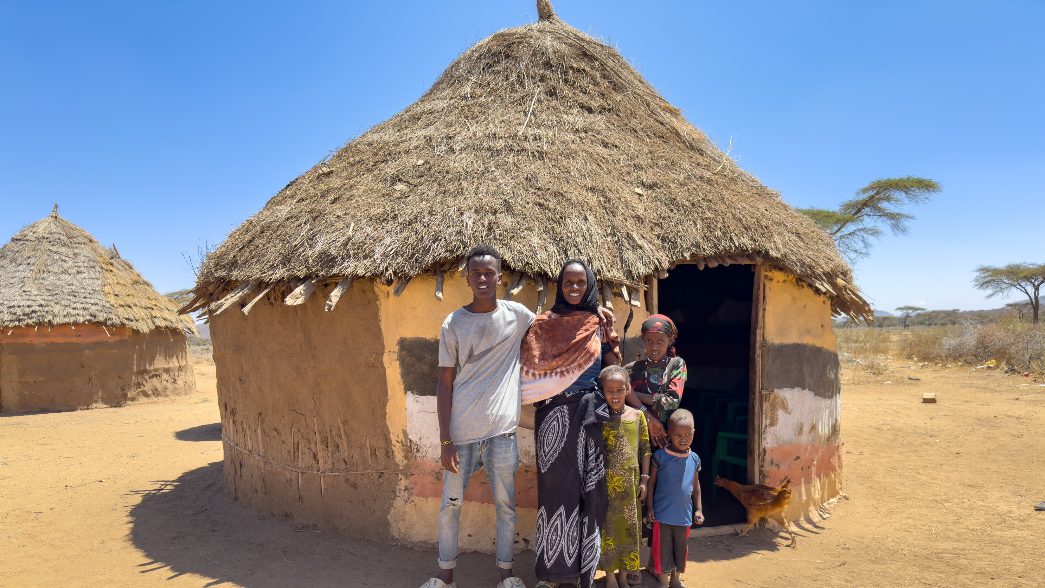
Adi and her family, including her son Abadhalee (16).
Notes:
Photo credit: Louise Norton

Slide 12
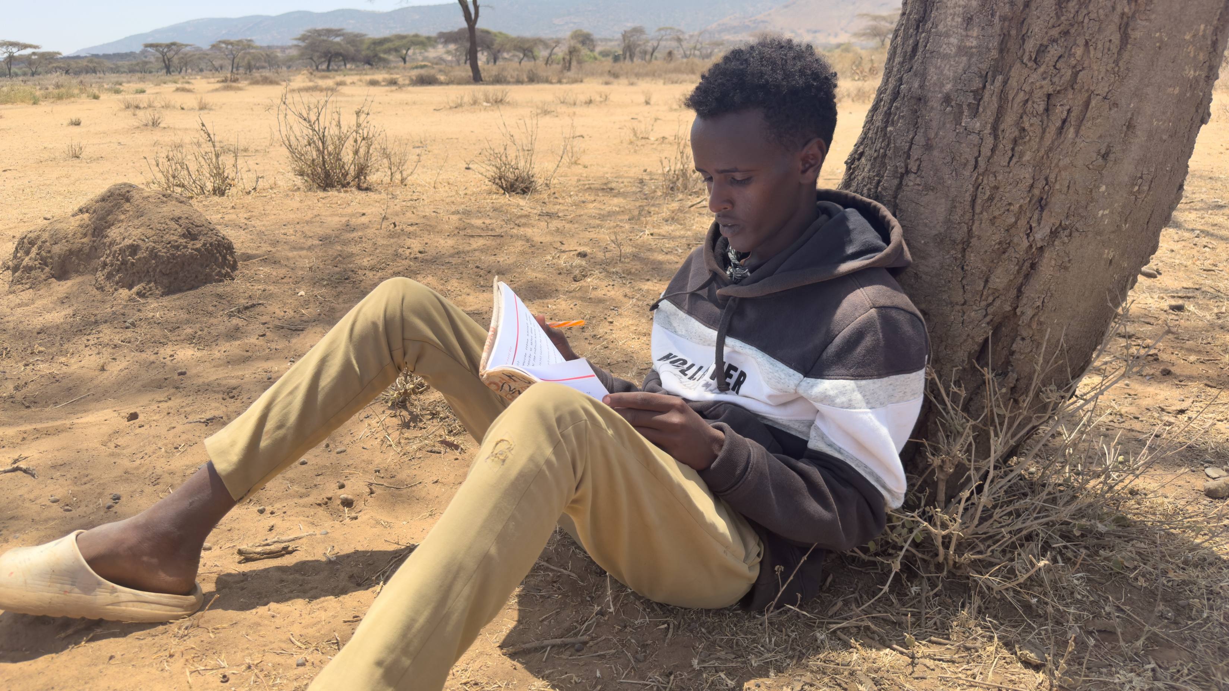
Abadhalee is studying at high school.
Notes:
Photo credit: Louise Norton

Slide 13
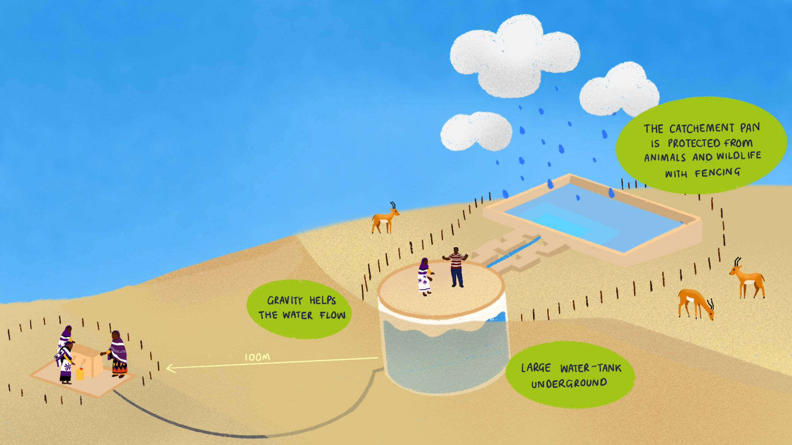
“But let justice roll down like waters, and righteousness like an ever-flowing stream.”
Amos 5:24 (ESV)
Notes:
Animation and illustration: Inez Padiachy Design

Slide 14

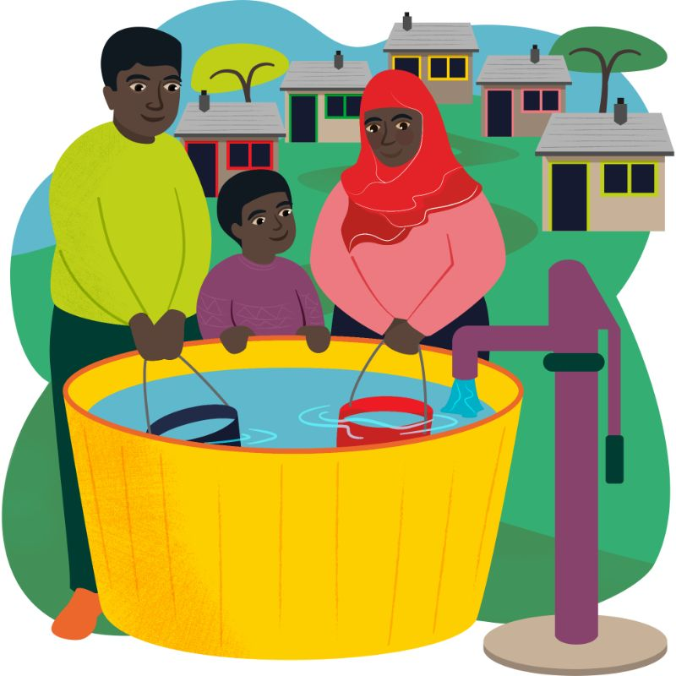

£35 Water for a family
£750 Community water
supply

Slide 15
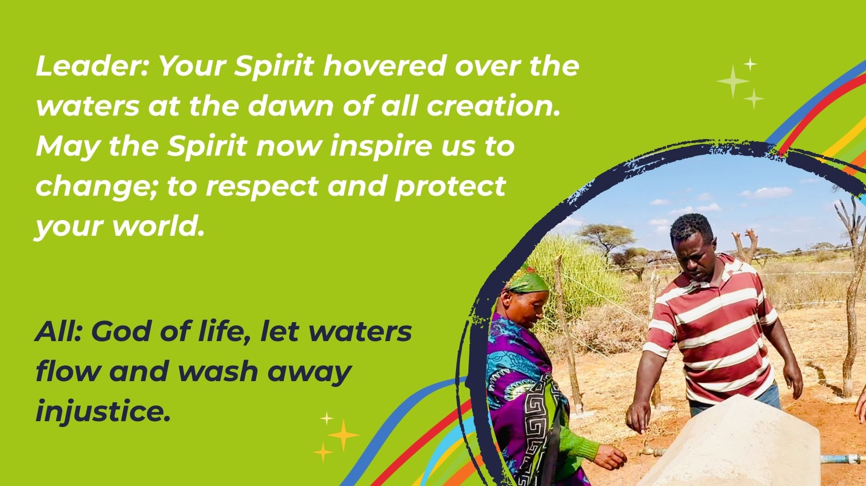
Notes:
Photo credit: Louise Norton, CAFOD
Features Abbiott with the water tank project community members

Slide 16

Notes:
Photo credit: James Cave, SCIAF
Features Ware in Ethiopia at the water tank project

Slide 17
