Slide 1
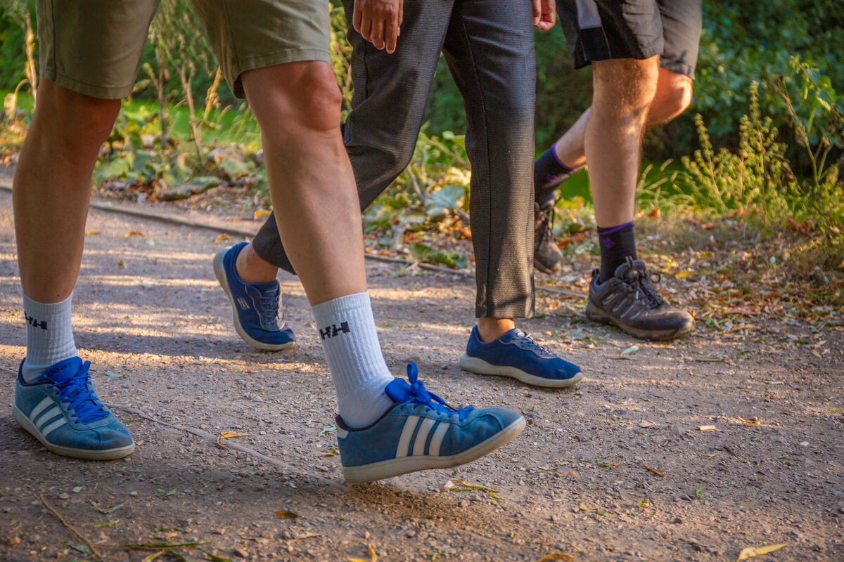

How will you follow Jesus this week?
Gather
Notes:
Children’s liturgy: Twenty-third Sunday in Ordinary Time (Year C)
Preparation of the worship space
Colour: green
Props: coloured pens and pencils
Song suggestions:
Here I am, Lord (865, Laudate)
Welcome
Today Jesus tells the crowds that if they want to follow him and be his disciples then they need to give up everything. Let’s find out more...
Sunset over West Point, Monrovia, Liberia
Photo credit: Thom Flint

Slide 2
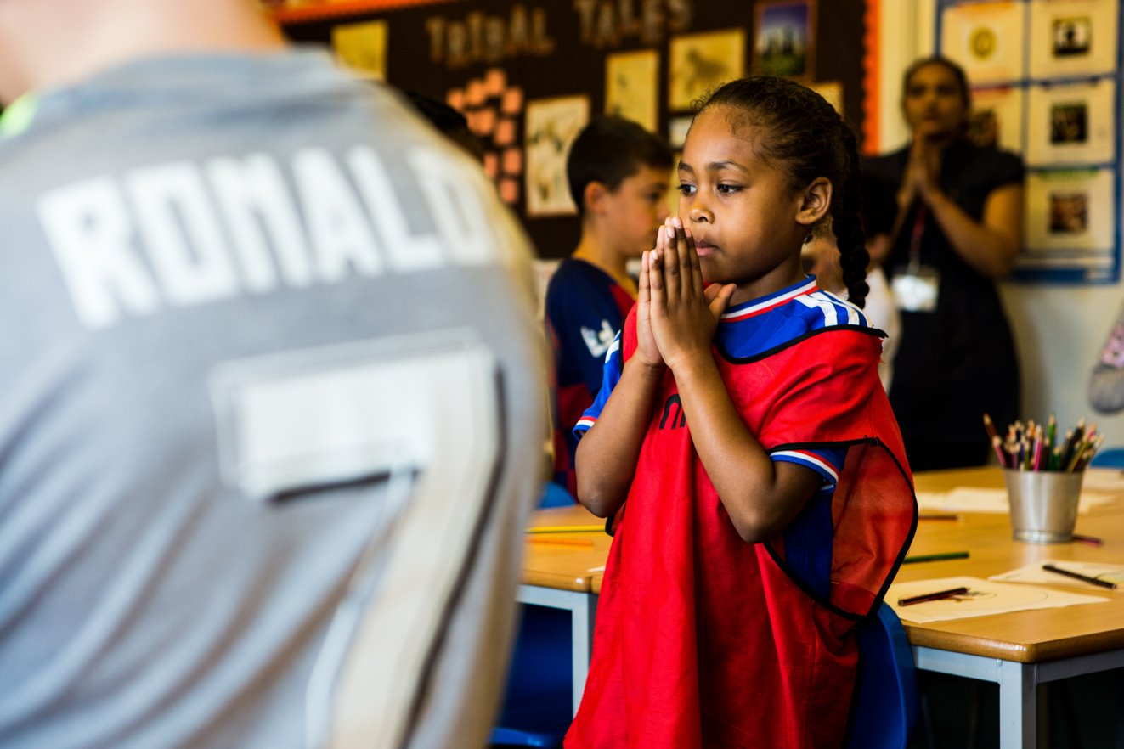
Guiding Lord,
May we love you and follow you all the days of our lives.
Amen.
Notes:
Children at Our Lady Queen of Heaven Primary School
Photo credit: Thom Flint

Slide 3

Gospel: Luke 14: 25-33
Once when large crowds of people were going along with Jesus, he turned and said to them, “Those who come to me cannot be my disciples unless they love me more than they love father and mother, wife and children, brothers and sisters, and themselves as well. Those who do not carry their own cross and come after me cannot be my disciples.
“If one of you is planning to build a tower, you sit down first and work out what it will cost, to see if you have enough money to finish the job. If you don’t, you will not be able to finish the tower after laying the foundation; and all who see what happened will laugh at you. ‘This man began to build but can’t finish the job!’ they will say.
“If a king goes out with 10,000 men to fight another king who comes against him with 20,000 men, he will sit down first and decide if he is strong enough to face that other king.
If he isn’t, he will send messengers to meet the other king, to ask for terms of peace while he is still a long way off. In the same way,” concluded Jesus, “none of you can be my disciple unless you give up everything you have.”
Word

Slide 4
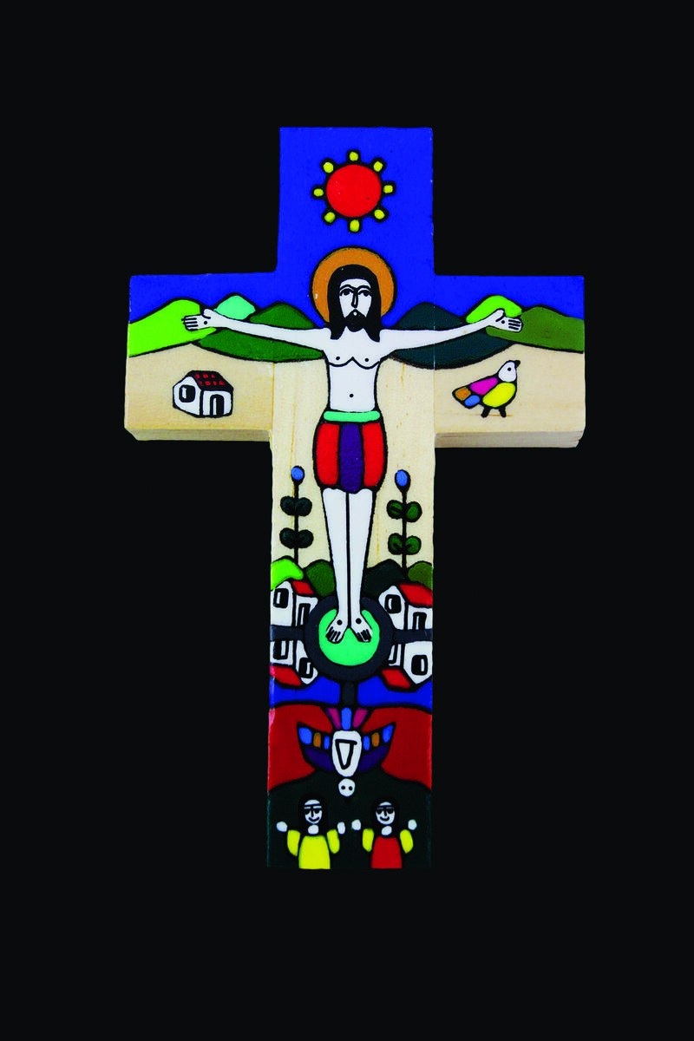

What do you remember from the Gospel reading?
Jesus tells the crowds two short stories to explain what being a disciple means, and to show us that if we want to follow him, we must give up everything.
What do you think “giving up everything” means? I think it means that we need to try to see that Jesus is the most important person in our lives.
Respond
Notes:
A Romero cross
Photo credit: CAFOD

Slide 5
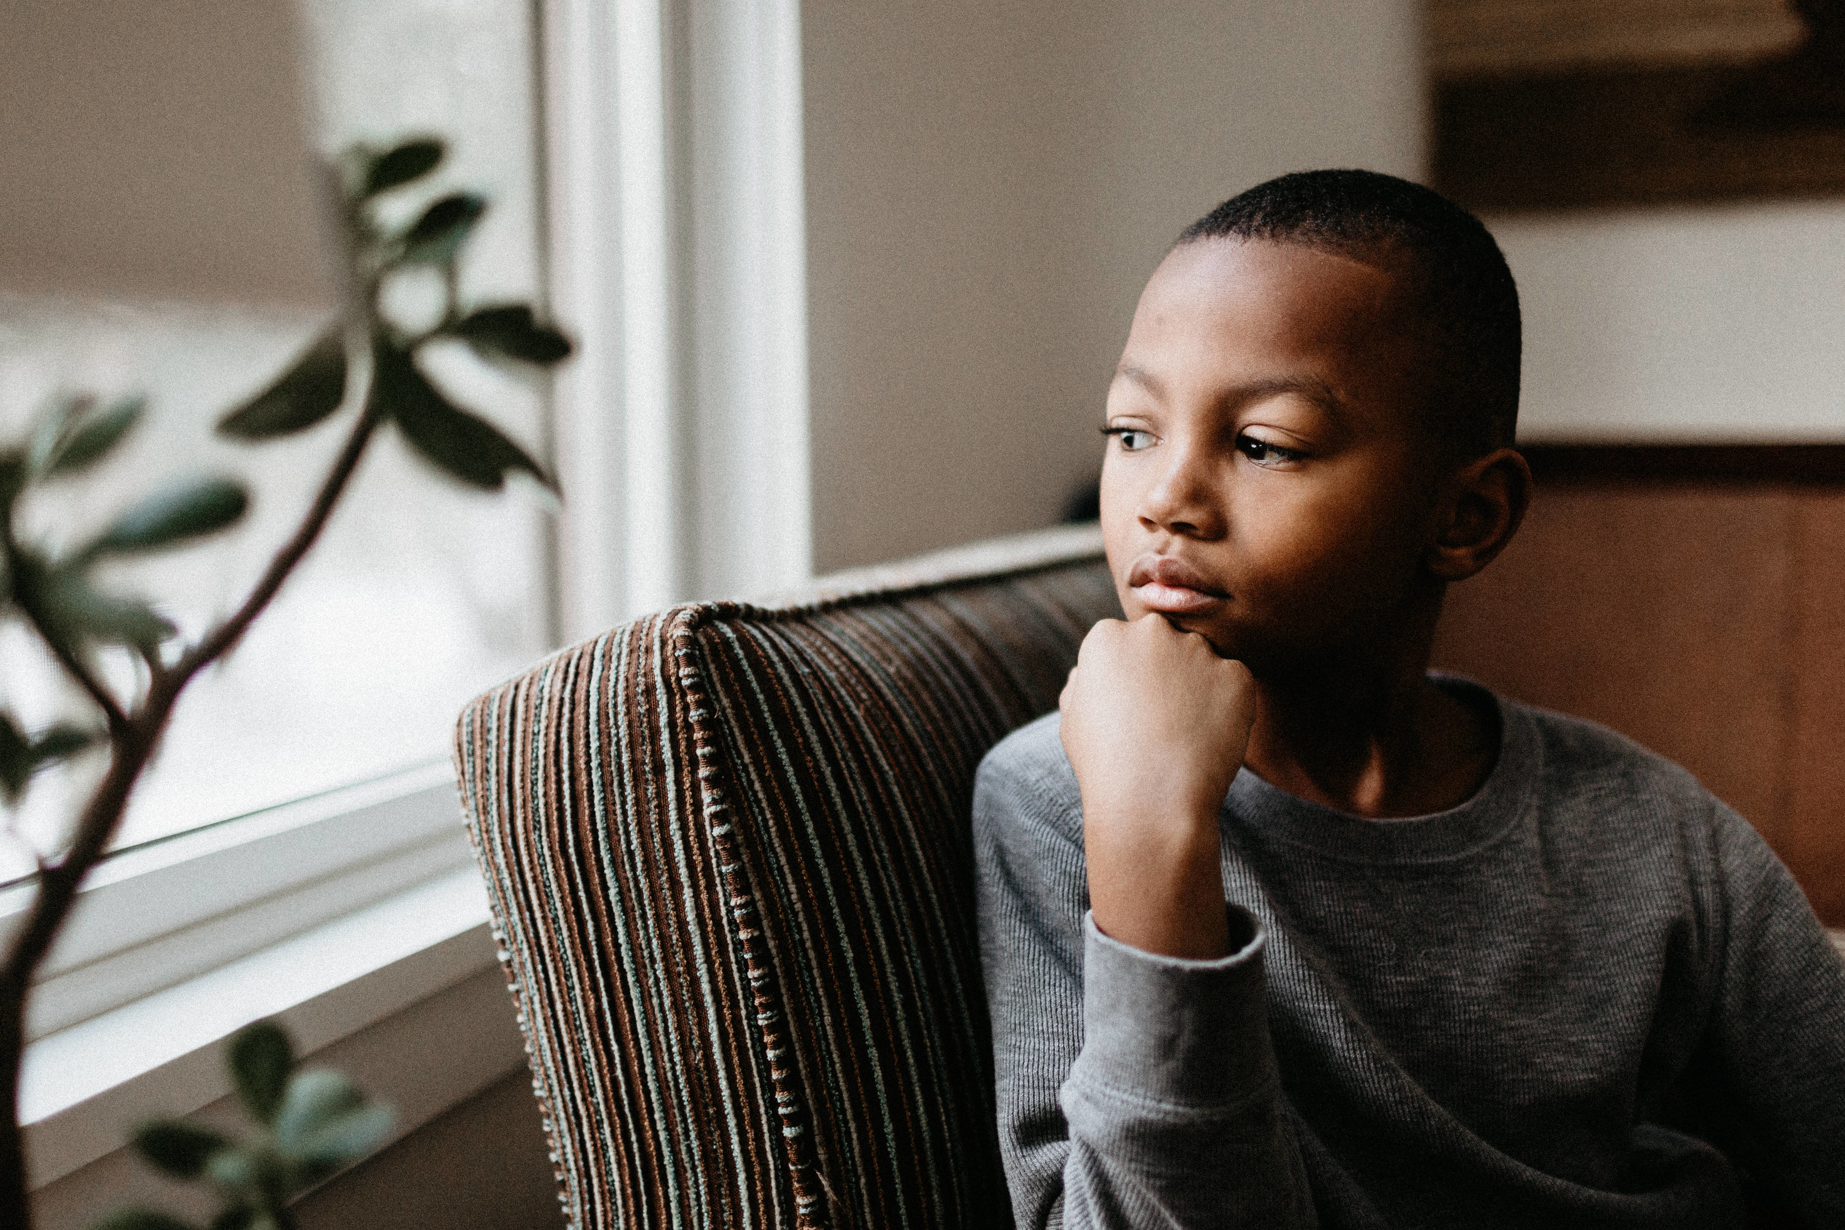
We must also “carry our cross” which means accepting the things we find difficult in our lives and asking for God’s help in these difficult things.
These difficult things might be people we find it hard to get on with, lessons in school that we find boring, or wanting something we can’t have.
It might be not having enough to eat or even living somewhere where there is violence.
Notes:
Thoughtful child
Photo credit: Stock images

Slide 6
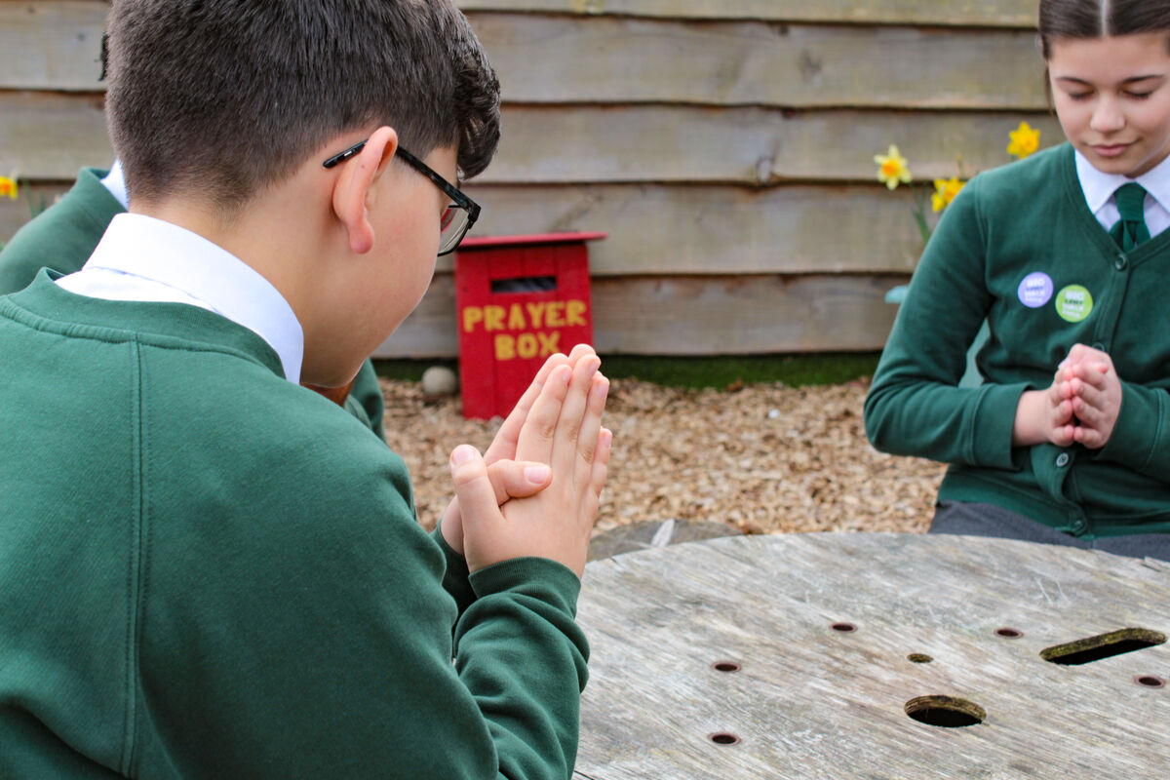
For a few moments in silence, think about what you find difficult and ask for God’s help now.
Then, still in silence, pray for each other – that God will be with all of us. While we do this, we know that we are all supported in prayer.
Notes:
After a few minutes of silent prayer with the children, draw their prayers together with an “Amen.”
Pupils at St Francis Xavier's RC Primary School, Herefordshire
Photo credit: Victoria Ahmed

Slide 7
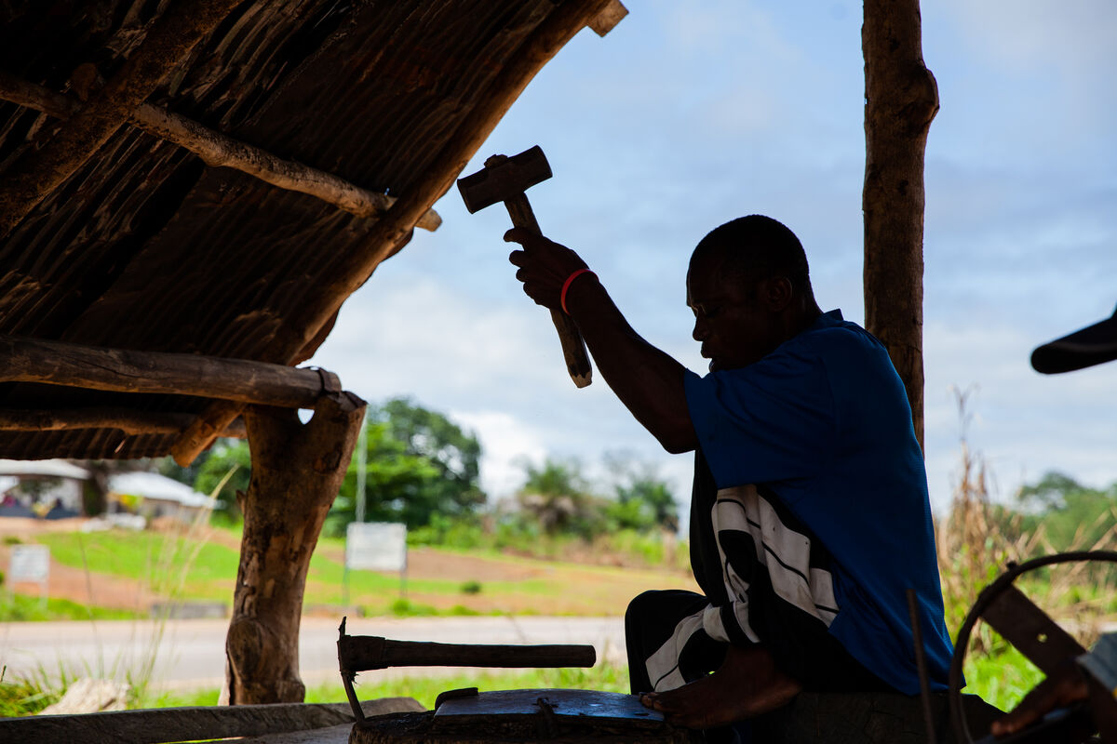
Let’s look at the two stories Jesus tells now…
The first story is about a man who wants to build a tower. He must work out the cost to make sure he has enough money and resources to finish the job.
The second story is about a king going to war. He must first count his soldiers and resources to make sure he can win the battle.
Notes:
Ishmael Sesay at work, Sierra Leone
Photo credit: Thom Flint

Slide 8

What do you think these stories are telling us?
Both stories tell us how important it is not to rush straight into something without thinking about it first.
We need to prepare so that we can see our project through to the finish. It needs to be done properly.
Notes:
Writing a list
Photo credit: Stock image

Slide 9
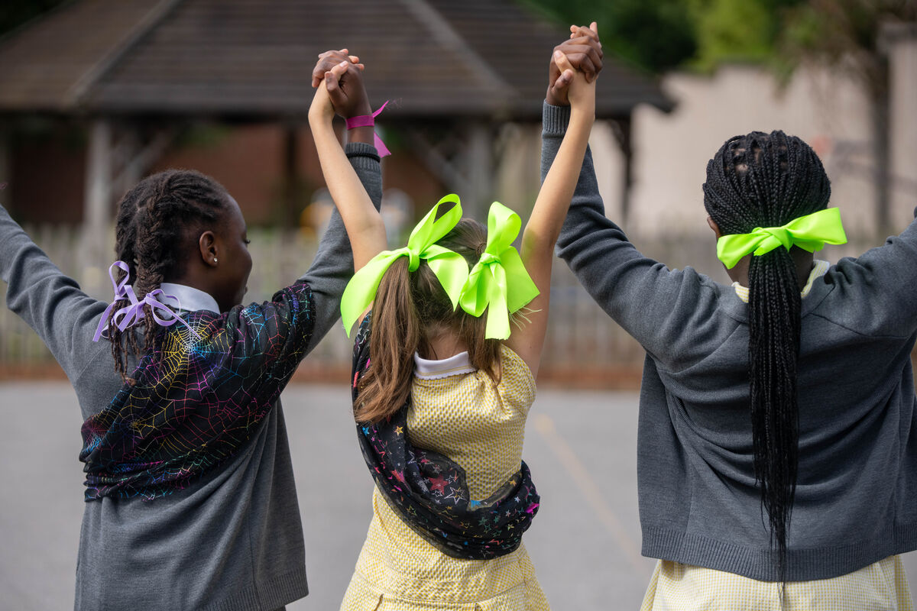
Perhaps you can think of something big that you were asked to do.
Maybe you thought it was too hard and that you’d never manage it, but it turned out you could do it!
How did you feel when you had finished?
Notes:
Children at St Chad's Primary School
Photo credit: Joe Newman

Slide 10
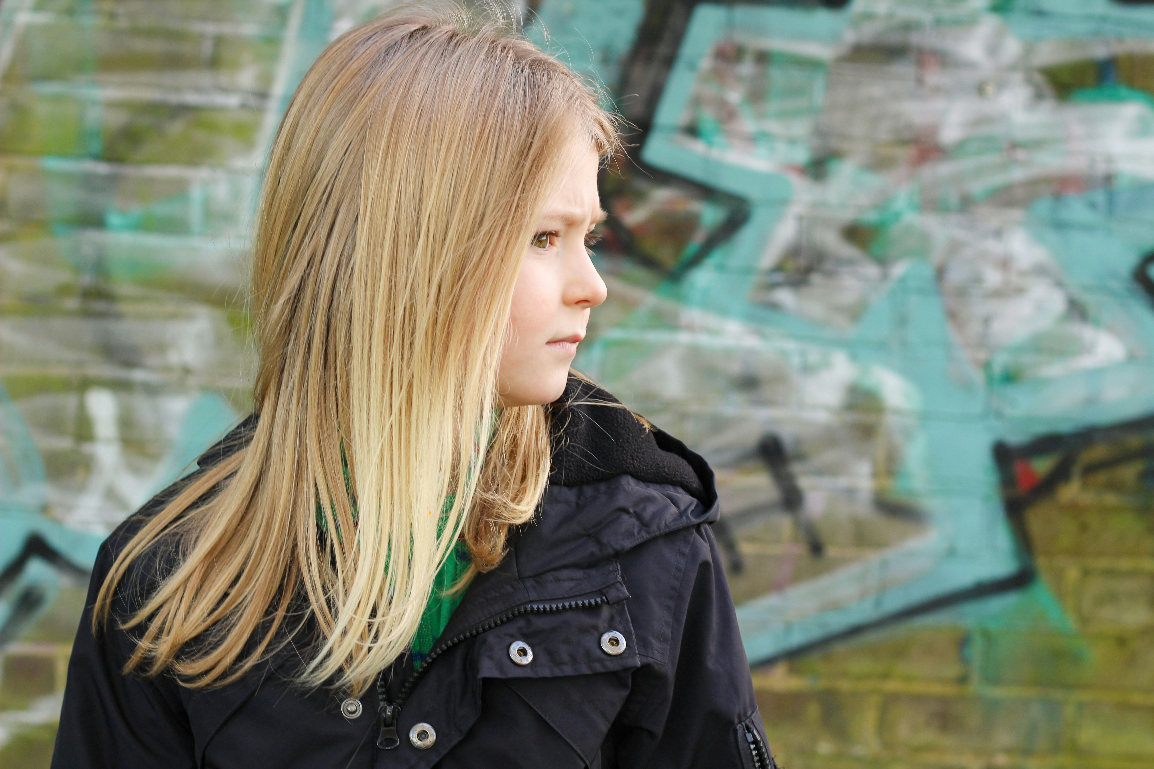
And is there anything that you’ve ever rushed into without thinking about it and then you weren’t able to finish or it went wrong?
Perhaps you were asked to help your friends at school or to help around the house and you didn’t do as much as you could?
How did you feel about that? And how do you think the person who asked you to help in the first place felt?
Notes:
Thinking
Photo credit: Katie Gerrard on Unsplash

Slide 11

Jesus is telling us that following him and being a disciple is something that we have to see through to the finish. We need to follow Jesus always and this isn’t always easy.
Often, we can be distracted by other people or by thinking about what we want rather than about what Jesus wants for us.
Throughout our lives as followers of Jesus we might have to choose to do what Jesus wants even if it means not always being popular. It is hard but God is with us all the way to help and guide us.

Slide 12
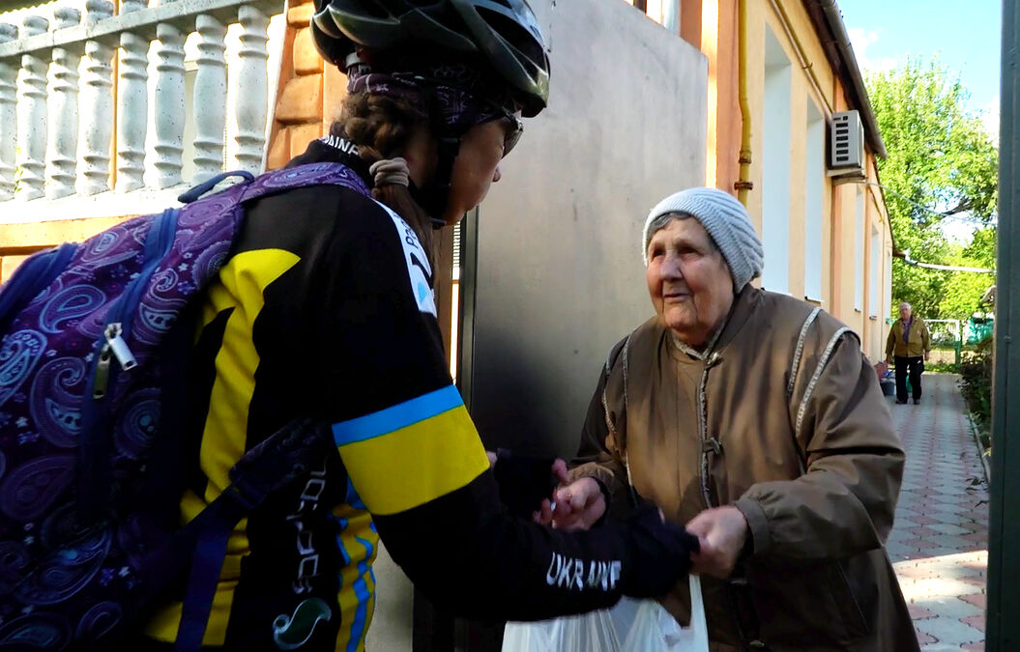
With CAFOD's help, Viktoria, a cycle volunteer, delivers food to Larysa, an older resident of Kharkiv in Ukraine.
“I could easily get a job abroad, but I have many relatives here and I do not want to leave them without support,” says Viktoria.
Notes:
Viktoria and Larysa in Kharkiv, Ukraine
Photo credit: Dmytro Minyailo / DEC

Slide 13
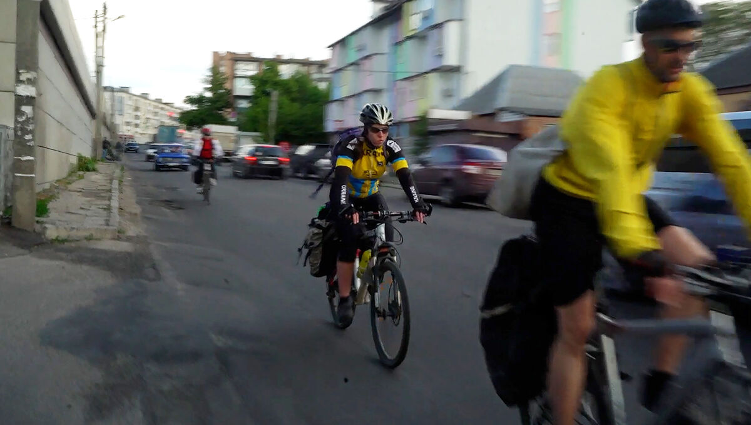
Before the war in Ukraine, Viktoria would regularly go to cycling races around Europe.
Now, she cycles delivering food to older people and those with disabilities who cannot leave their homes.
This volunteering can be difficult, but Viktoria and her friends believe it is the right thing to do.
Notes:
Cycle volunteers deliver food baskets in Kharkiv, Ukraine
Photo credit: Dmytro Minyailo / DEC

Slide 14
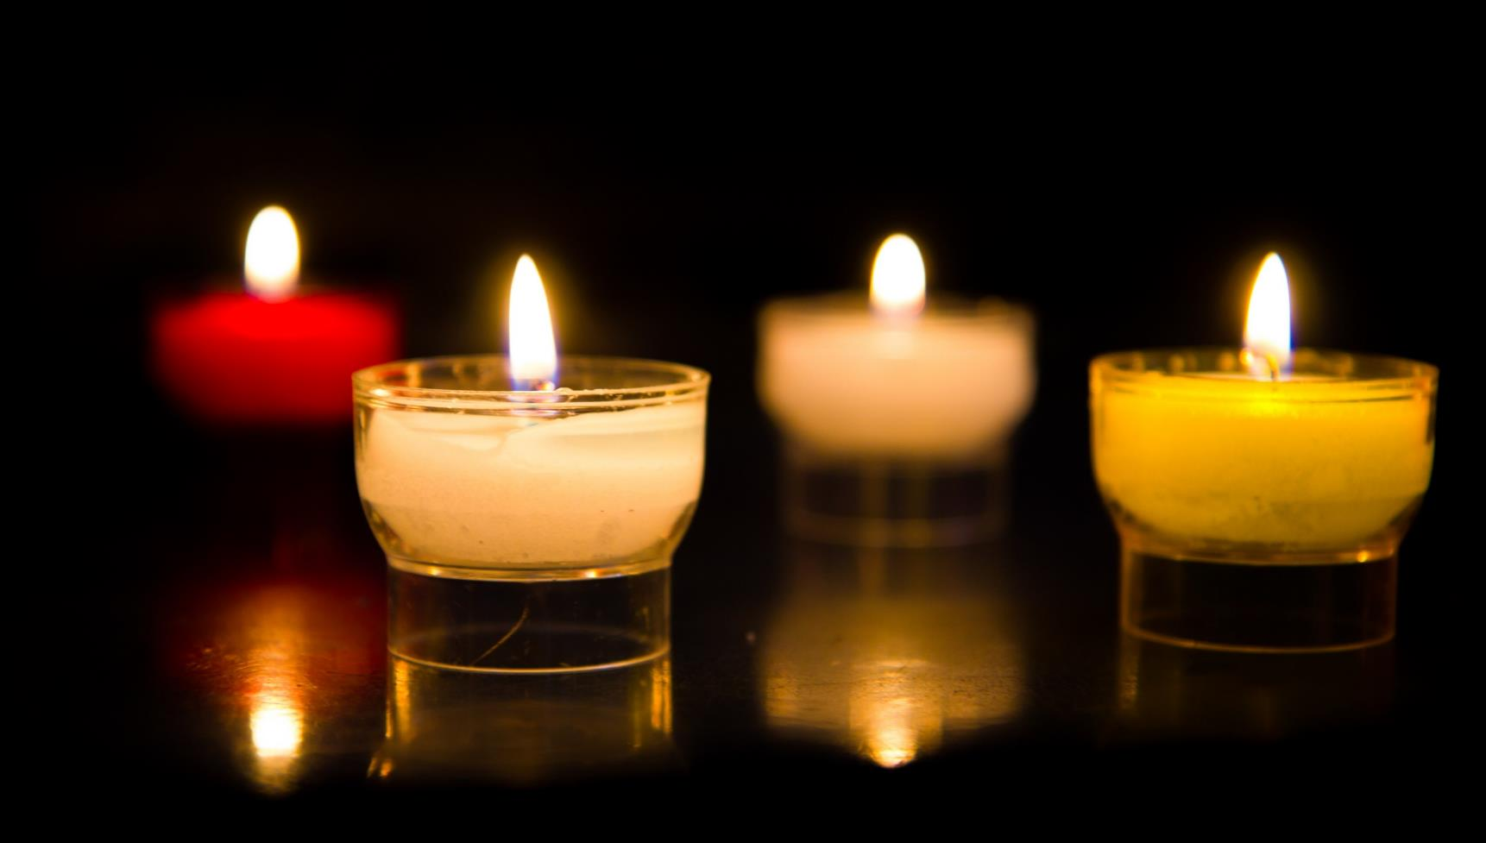
Let us pray…

Slide 15

We pray for the Church: that it may always work to share God’s love with all people, especially those who are poor, sick or ignored.
Lord in your mercy…
We pray for leaders in our communities: that they may do their best to serve everyone that they meet, even when it is difficult or makes them unpopular. Lord, in your mercy…
We pray for our parish, family and friends: that we may be disciples together and support each other in all the challenges and difficulties we face.
Lord, in your mercy…

Slide 16

In this Jubilee Year, we pray that we may be signs of hope in our world through all that we do and how we treat one another.
Lord, in your mercy…
Guiding Lord,
Give us courage to know you, to love you, to follow you always in how we treat others and care for our world. Amen.

Slide 17
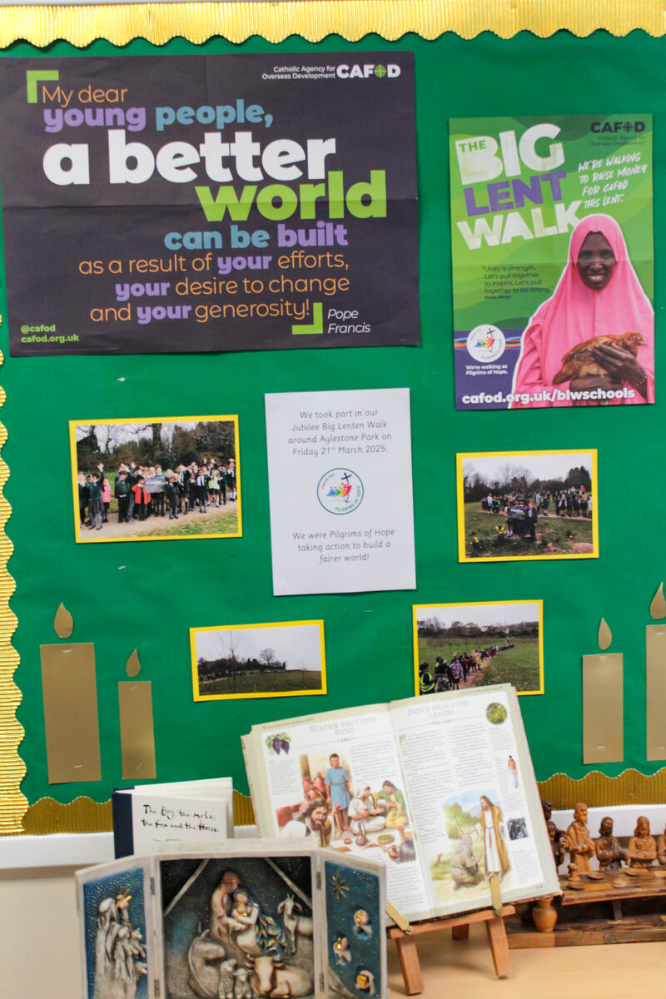

How will you follow Jesus this week at home or in school?
Even if it is difficult, what one thing could you do that shows you follow him?
Send
Notes:
St Francis Xavier's RC primary school, Herefordshire
Photo credit: Vicky Ahmed

Slide 18
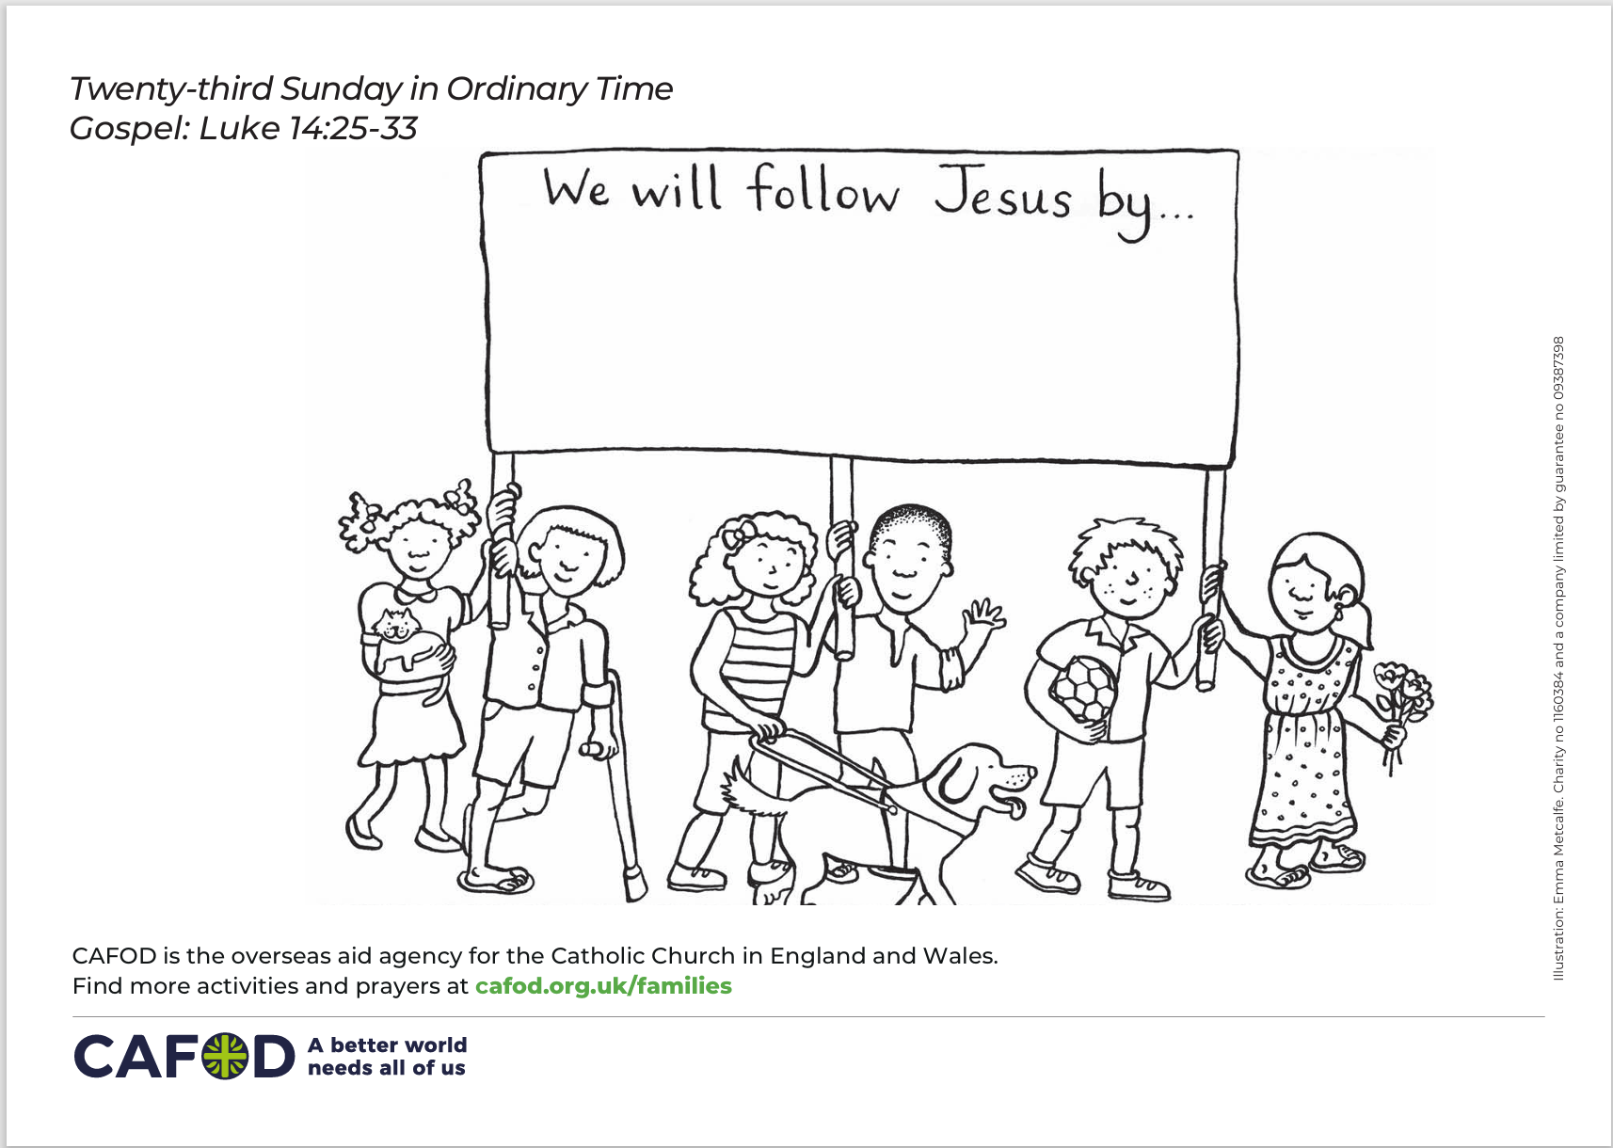

Activity suggestions
Invite the children to colour in the accompanying illustration and to write or draw what they will do in the coming week to show that they are followers of Jesus.
Join the primary national assembly on Thursday 11 September at 9.30 to find out how to live out your Jubilee Pledge in this Season of Creation.
Explore our autumn fundraising resources and take action this term.
Notes:
Illustration: Emma Metcalfe

Slide 19
Notes:
Illustration: Emma Metcalfe

Slide 20
Autumn fundraising resources
Jo

Slide 21

It's not too late to make your Jubilee Pledge!
There's still time to make your Jubilee Pledge!
Many schools have made their Jubilee Pledge to live out Catholic Social Teaching. If you haven't made yours yet, it's not too late!
A better world needs all of us, and the Pledge will be a whole school, long-term commitment to building a fairer world.
Watch our films and download our resources to help you write your Pledge and plan your Pledge Day:
Jubilee pledge for schools
The Jubilee Year is a landmark moment in the life of the global church. School communities are invited to join together as pilgrims of hope, pledging to work together for God’s kingdom of justice, peace and love. Find resources at:
Jubilee for schools 2025 – Pilgrims of Hope

Slide 22


