Slide 1
Lent calendar 2024
Week: One Two Three Four Five Six
M
T
W
T
F
19 February
26 February
4 March
11 March
18 March
25 March
20 February
27 February
5 March
12 March
19 March
26 March
Ash
Weds
21 February
28 February
6 March
13 March
20 March
27 March
15 February
22 February
29 February
7 March
14 March
21 March
Maundy
Thursday
16 February
CAFOD
Fast Day
1 March
8 March
15 March
22 March
Good
Friday
“God saw everything that he made and it was indeed very good.”
Easter
Sunday
Genesis 1
Notes:
Each date on this slide is hyperlinked within the presentation. In Slide Show mode, click each date to go to that day’s content.

Slide 2
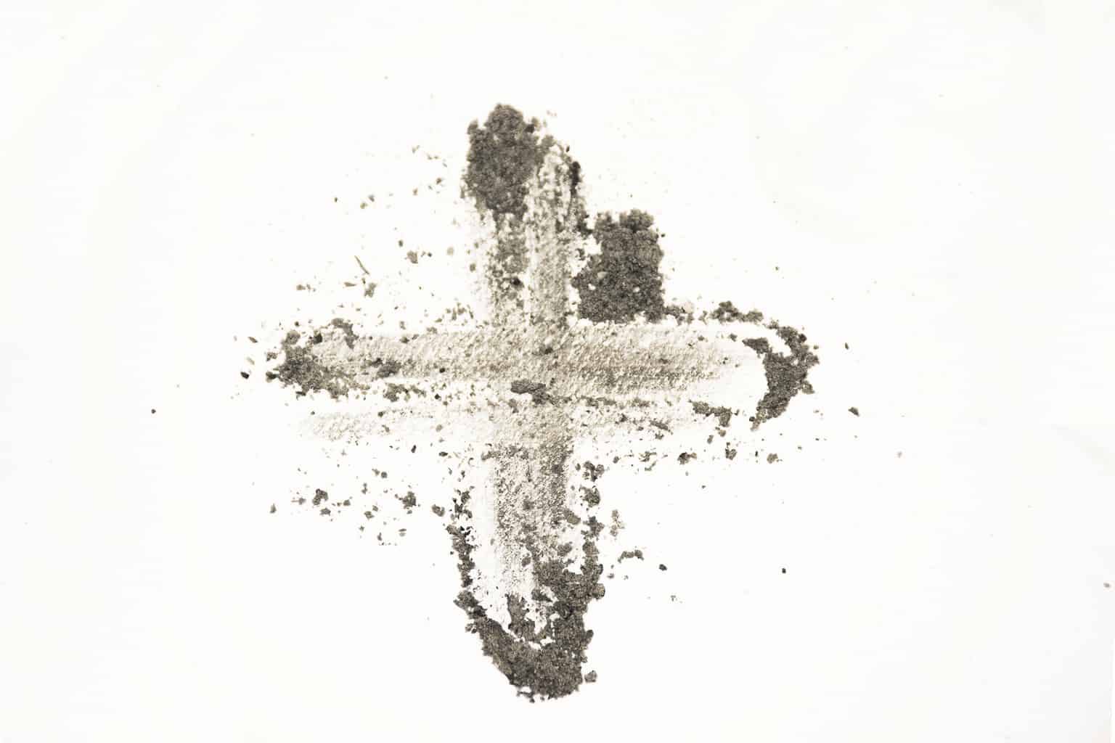
Wednesday 14 February
Think about…
As Lent begins, we remember how Jesus spent 40 days in the desert.
While Jesus was in the desert he had very little to eat or drink.
There are many people around the world who do not have the rights to basic things like enough food or clean water.
Throughout Lent we will think about our neighbours around the world.
Click here for a Lent liturgy (perfect for Ash Wednesday)

Slide 3
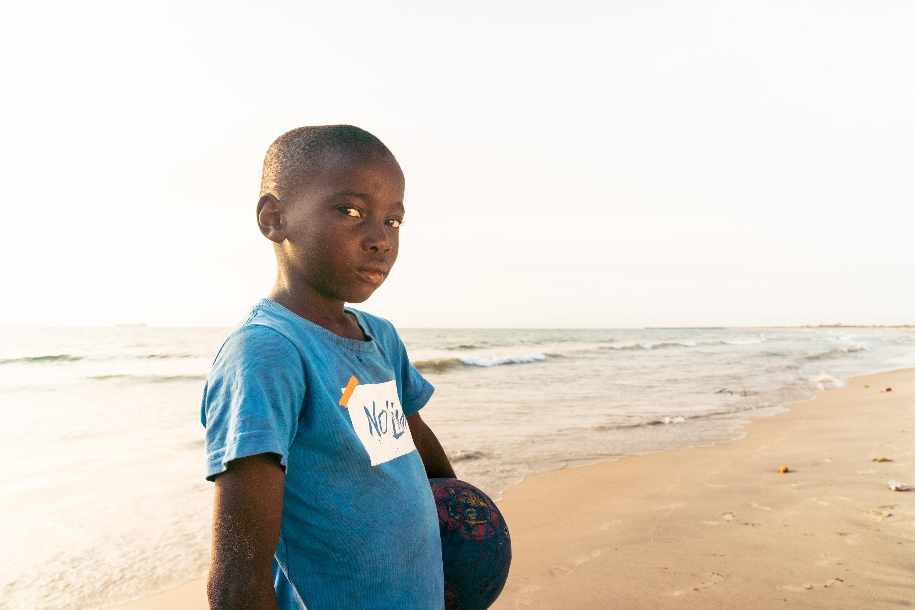
Thursday 15 February
Act
“My name is Aaron and I am 7 years old.”
This Lent, we are thinking about our global neighbours who don’t have enough food to eat.
Meet Aaron who lives in West Point, in Monrovia, the capital of Liberia. Monrovia is by the sea and many families rely on fish to eat. But being a fisherman here is dangerous.
Find out more in our Lent film

Slide 4
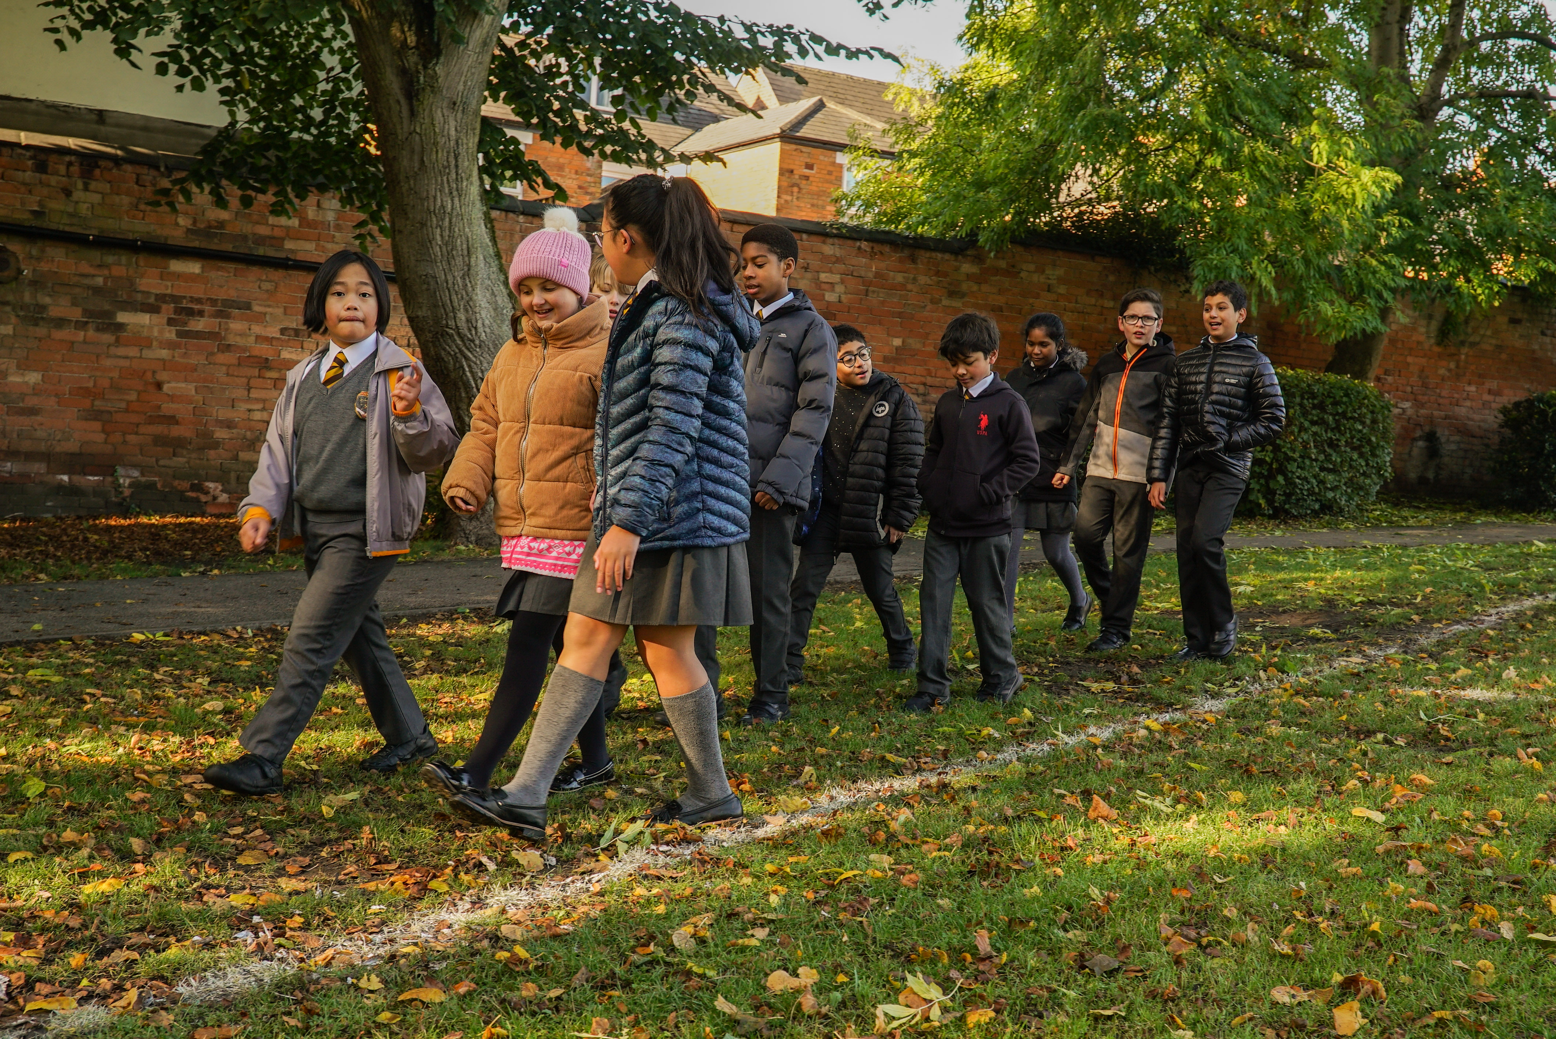
Friday 16 February
Pray
Give
This Lent, schools in England and Wales are walking to help communities like Aaron’s have safe access to enough food to eat.
Lord,
may my support bring hope to people who are in difficulty around the world.
May they know that you are with them and that they have sisters and brothers who care for them.
Amen
Find out more

Slide 5
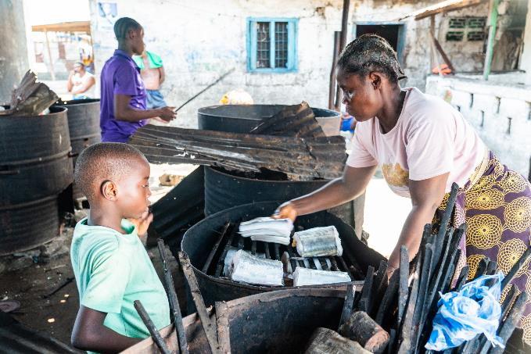
Monday 19 February
Pray
Aaron lives with his grandparents, Felicia and Augustine. His grandfather is a fisherman, he goes to sea to catch fish to eat and to sell in the market.
When the catch is brought back to shore, Aaron helps with cleaning and drying the fish.
His family have taken part in a project to help the fishermen catch more fish and stay safe at sea. They can then have more food to eat, and money to spend on other important things.
Loving God,
fill our hearts with compassion for the earth and all its peoples.
Lead us to be good neighbours to all who are in need.
Amen

Slide 6
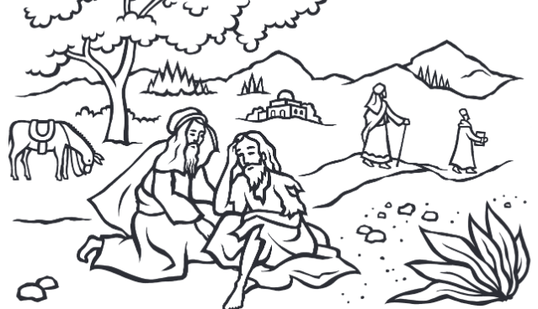
Tuesday 20 February
Think about…
What do you notice in this picture?
This is one of the stories that Jesus told.
Can anyone think which one?
Read Luke 10: 25-31 together.
What is Jesus teaching us in this parable?
Explore an illustrated version of this parable

Slide 7
Wednesday 21 February
Act
Fairtrade is about giving a fair share to all the people who produce food around the world.
Find out whether your local shop sells Fairtrade Easter eggs. If not, ask them why not and if they will stock them next year.
Find our Fairtrade resources here

Slide 8
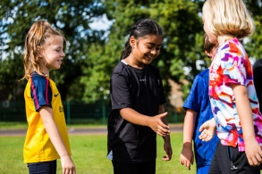
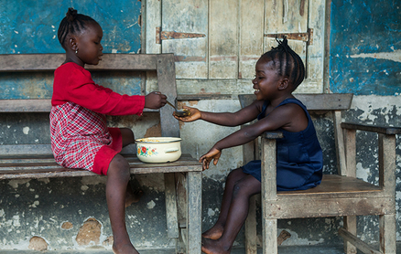
Thursday 22 February
Act
What action will you take to show kindness to others today?
Think of at least three things you can do today and during the next week of Lent.
You could think of three different people to show kindness to, maybe someone you don’t always get on with or someone you wouldn’t normally talk to.

Slide 9
Friday 23 February
Pray
Today is Lent Family Fast Day!
Watch our online Lent liturgy to learn more about Aaron in Liberia and hear how his community are working together to catch more fish more safely, so that there is enough food for everyone to eat.
“It [the GPS] really has changed our lives. By the grace of God, we can go further and so we can catch better fish.”
James, fisherman
Watch the assembly

Slide 10
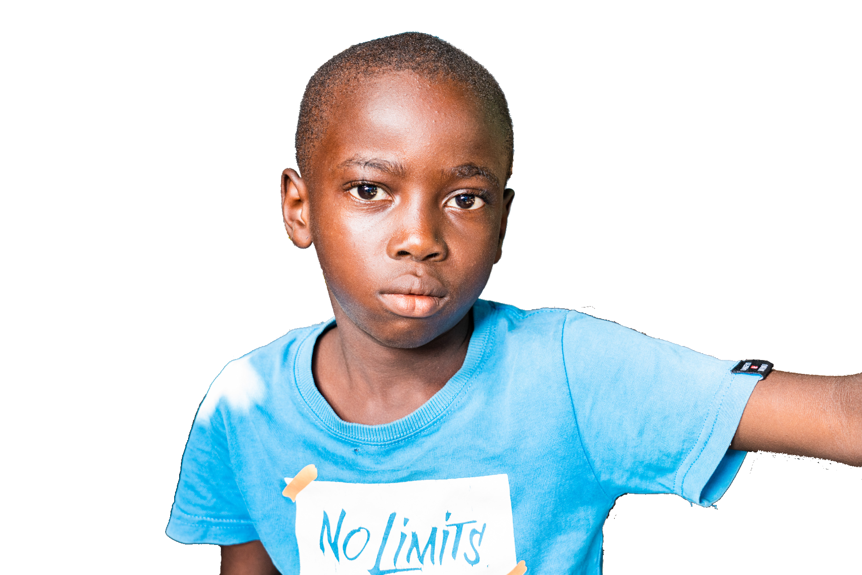
Monday 26 February
Pray
This Lent we have been learning about Aaron who lives in Liberia. Aaron is 7 years old. He likes to help his family with the fish they catch.
“I will dry the fish, carry them and sell them in the market.”
Loving God,
fill our hearts with compassion for the earth and all its people.
Lead us to be good neighbours to all who are in need.
Amen

Slide 11
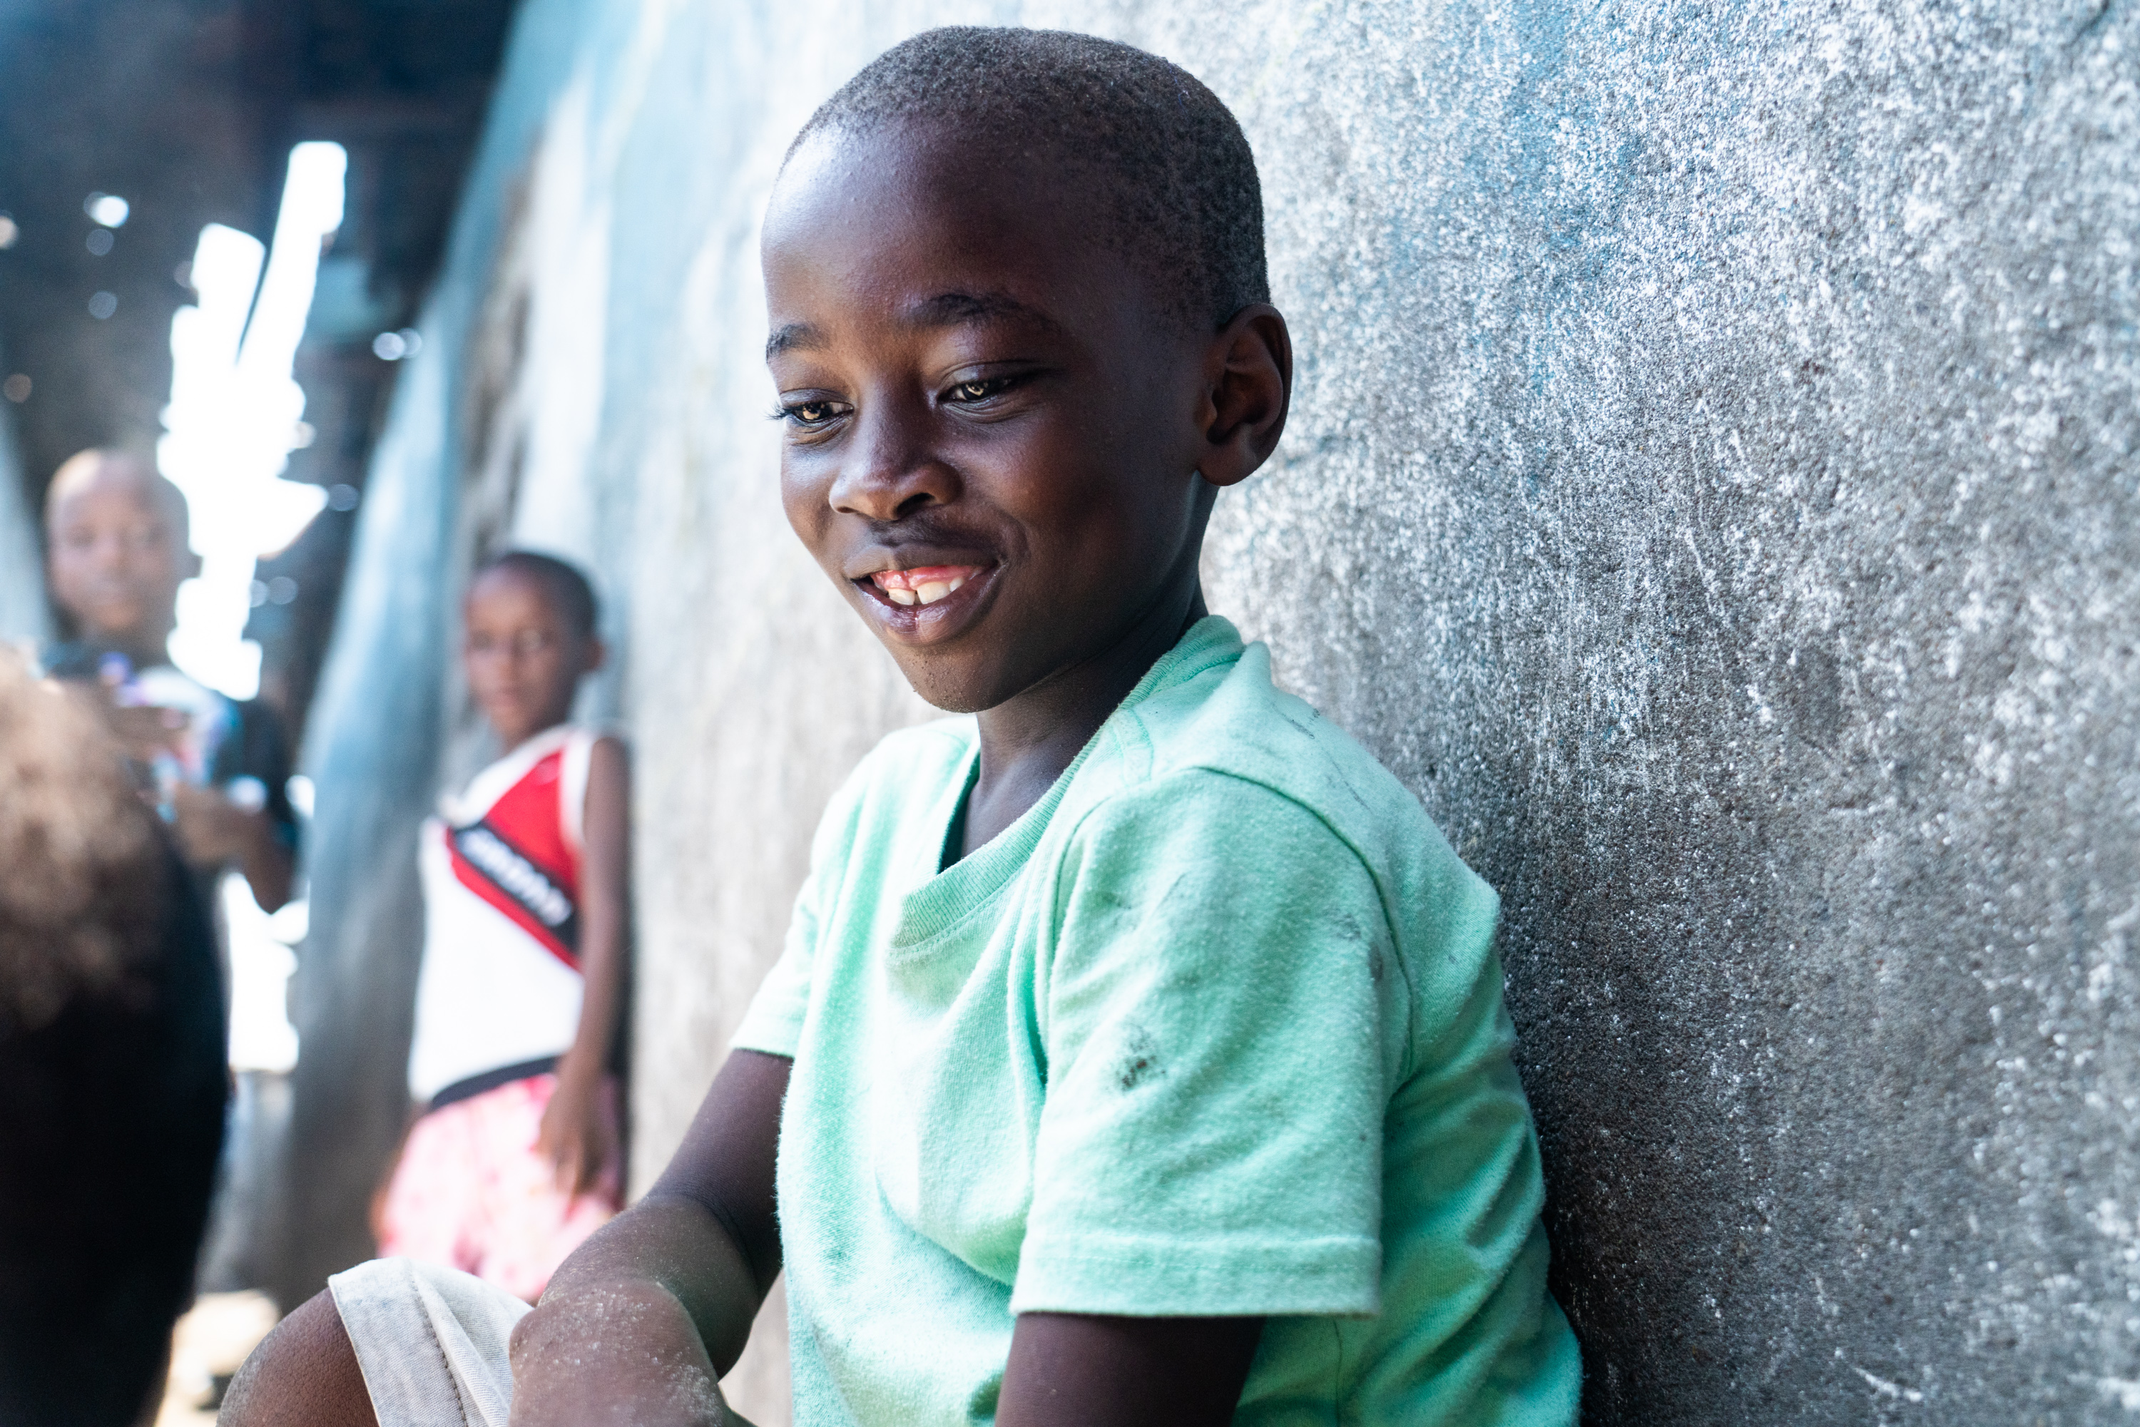
Tuesday 27 February
Think about…
“I have come so that they may have life, and have it to the full”
John 10:10
Say these words together and spend some time today thinking about them.
Where do these words come from?
What do they mean?
How can we live by these words and put our faith into action?
Aaron in Liberia

Slide 12
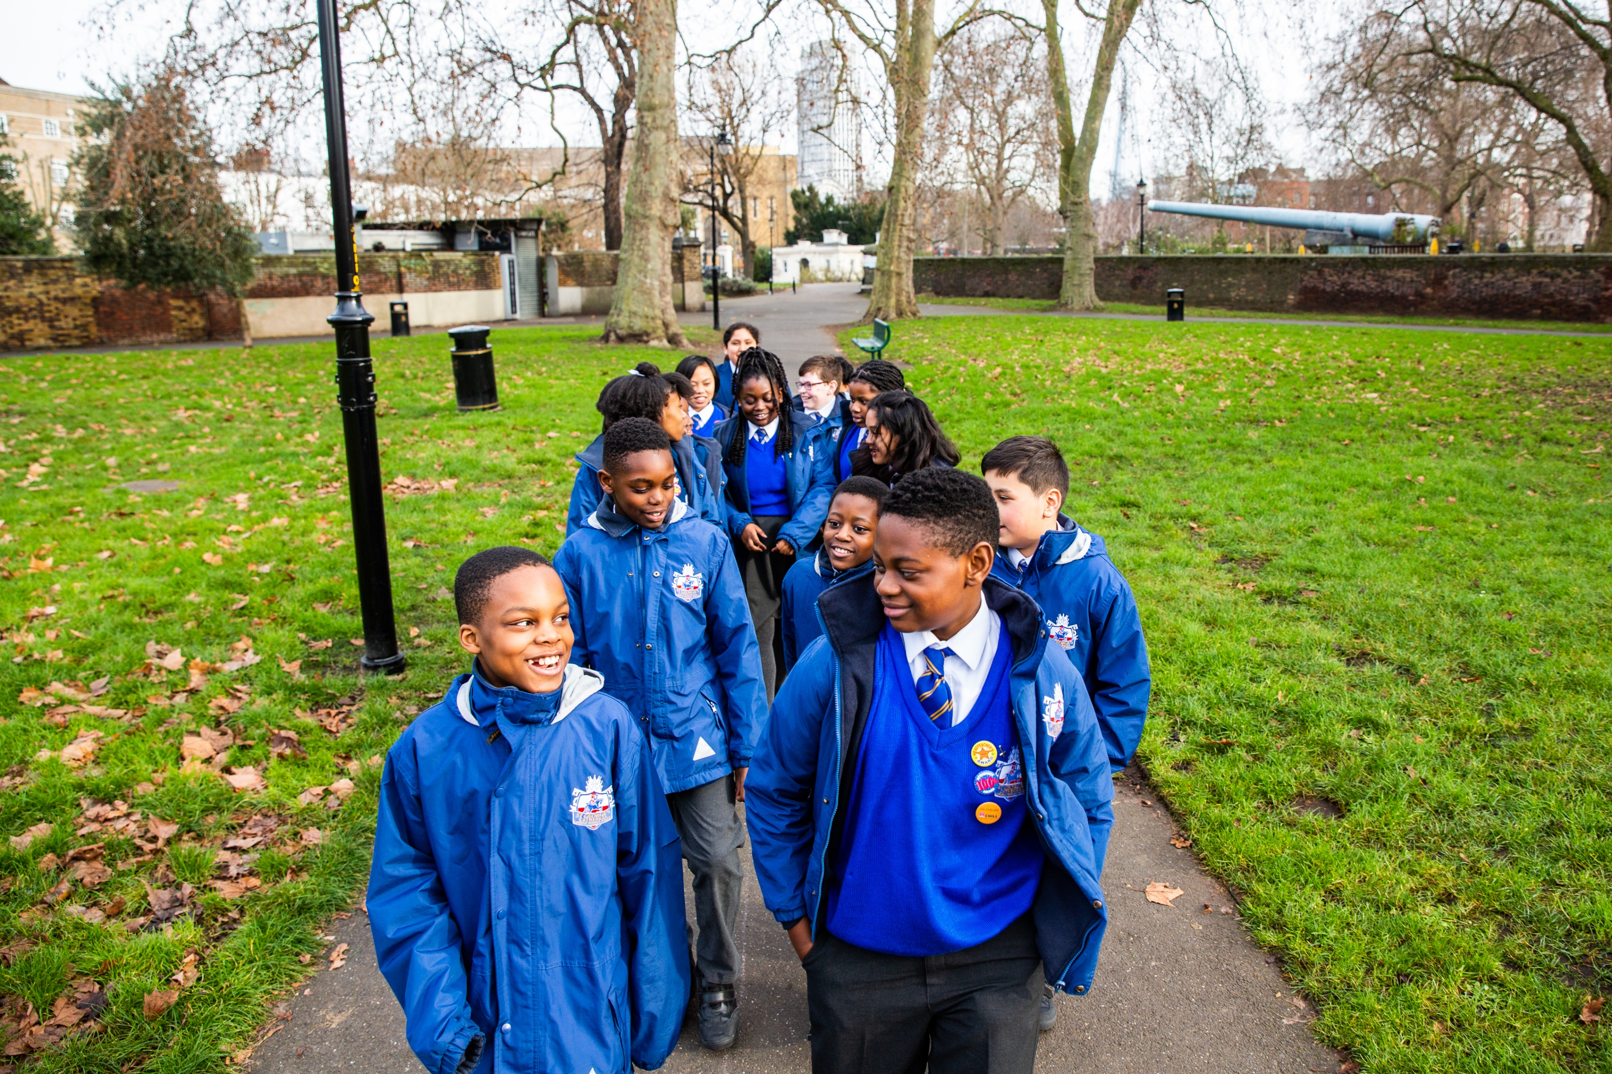
Wednesday 28 February
Pray
Give
This Lent, schools in England and Wales are raising money to support our global neighbours.
Lord,
may my support bring hope to people who are in difficulty around the world.
May they know that you are with them and that they have sisters and brothers who care for them.
Amen
There are lots of ways you can do this!
Find out more

Slide 13
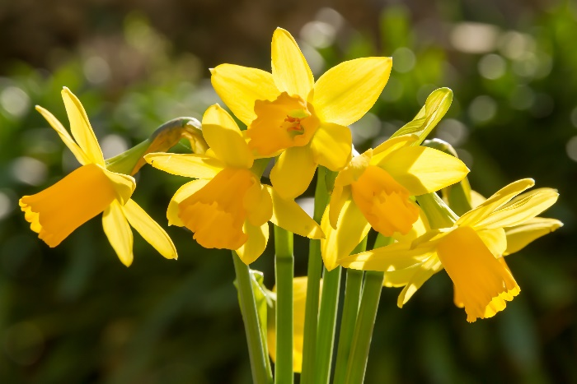
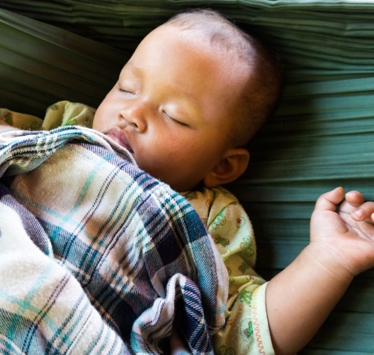
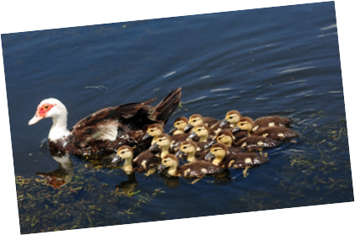
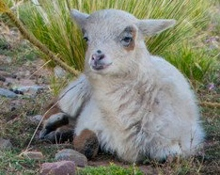
Thursday 29 February
Act
Jesus came to bring us new life.
Take time today to look for and celebrate signs of new life in the world around you.

Slide 14
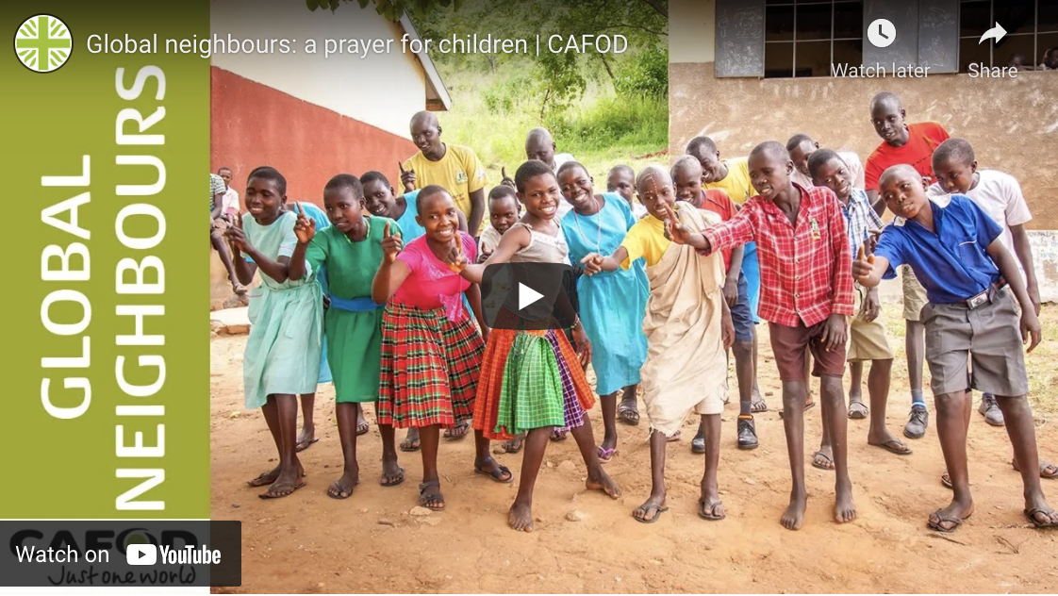
Friday 1 March
Pray
Light a candle and pray with and for our global neighbours using this film.

Slide 15
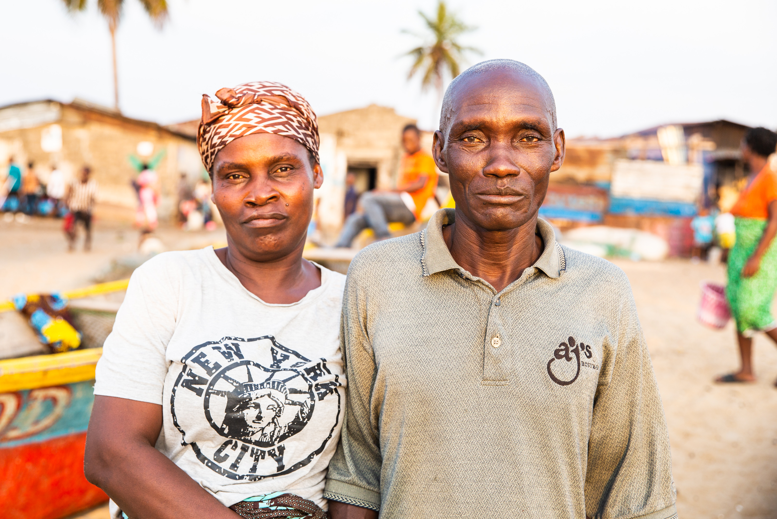
Monday 4 March
Pray
This Lent we have been learning about Aaron and the fishermen in Liberia.
Aaron’s grandfather, Augustine, is a fisherman. By working with CAFOD’s local experts, he can now sail further out to sea and stay safe when there are storms.
This means he can bring more fish back to shore for the family to eat and sell in the market.
Aaron lives with his grandparents,
Felicia and Augustine.
Loving God,
fill our hearts with compassion for the earth and all its people. Lead us to be good neighbours to all who are in need.
Amen

Slide 16
Tuesday 5 March
Pray
Light a candle and pray for our Earth, using this film.

Slide 17
Wednesday 6 March
Pray
Give
Whatever way you choose to raise money this Lent, you can help our global neighbours like Aaron and his community.
Lord,
may my support bring hope to people who are in difficulty around the world.
May they know that you are with them and that they have sisters and brothers who care for them.
Amen
What creative ways can you think of to fundraise for our brothers and sisters around the world?
Find out more

Slide 18
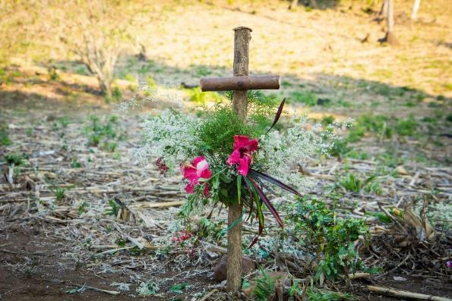
Thursday 7 March
Pray
Reflect on one of the Stations of the Cross today.
Find our Stations of the Cross resource here

Slide 19
Friday 8 March
Pray
Give
This Lent, schools in England and Wales have been raising money to help our global neighbours.
There is still time to organise a walk or another fundraiser!
Find out more
Notes:
Photo credit: Zinyange Autony

Slide 20
Monday 11 March
Think about…
This Lent we have been thinking about communities in Liberia who have been learning ways to stay safe while fishing.
They work together when the weather turns stormy to make sure they return safe to shore.
Today let’s think about looking after other people.
How can you care for others today?
GPS fish finders help the fisherman find the fish.

Slide 21
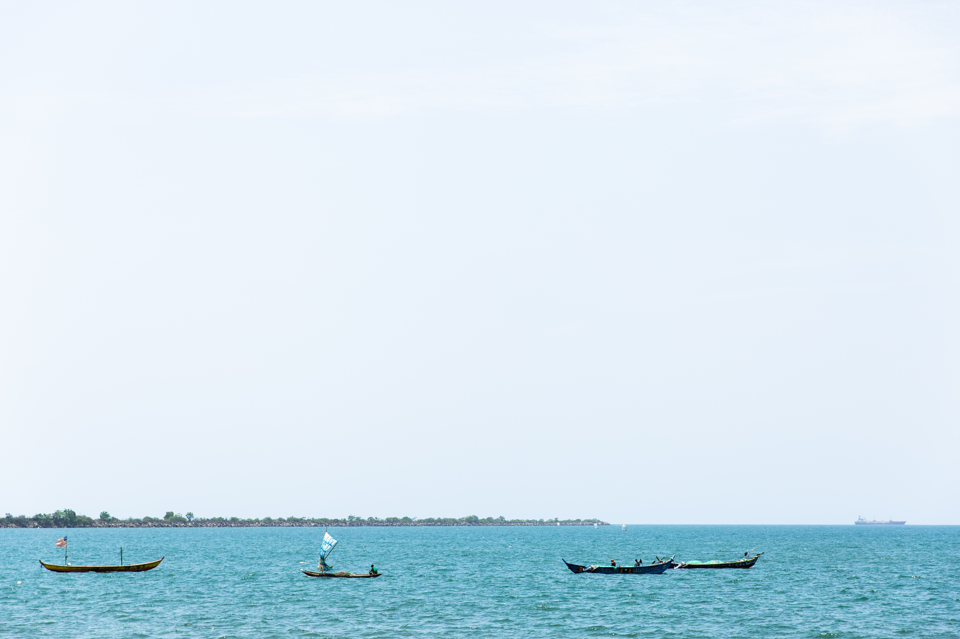
Tuesday 12 March
Act
The fishermen in Liberia have to sail further out to sea than they used to to find fish. This is caused by the changing climate.
We all need to care for the Earth and help our global neighbours who are affected by the climate crisis.
How can you care for the Earth, our common home, today?
Find out about Pope Francis’ letter to everyone about caring for creation.

Slide 22
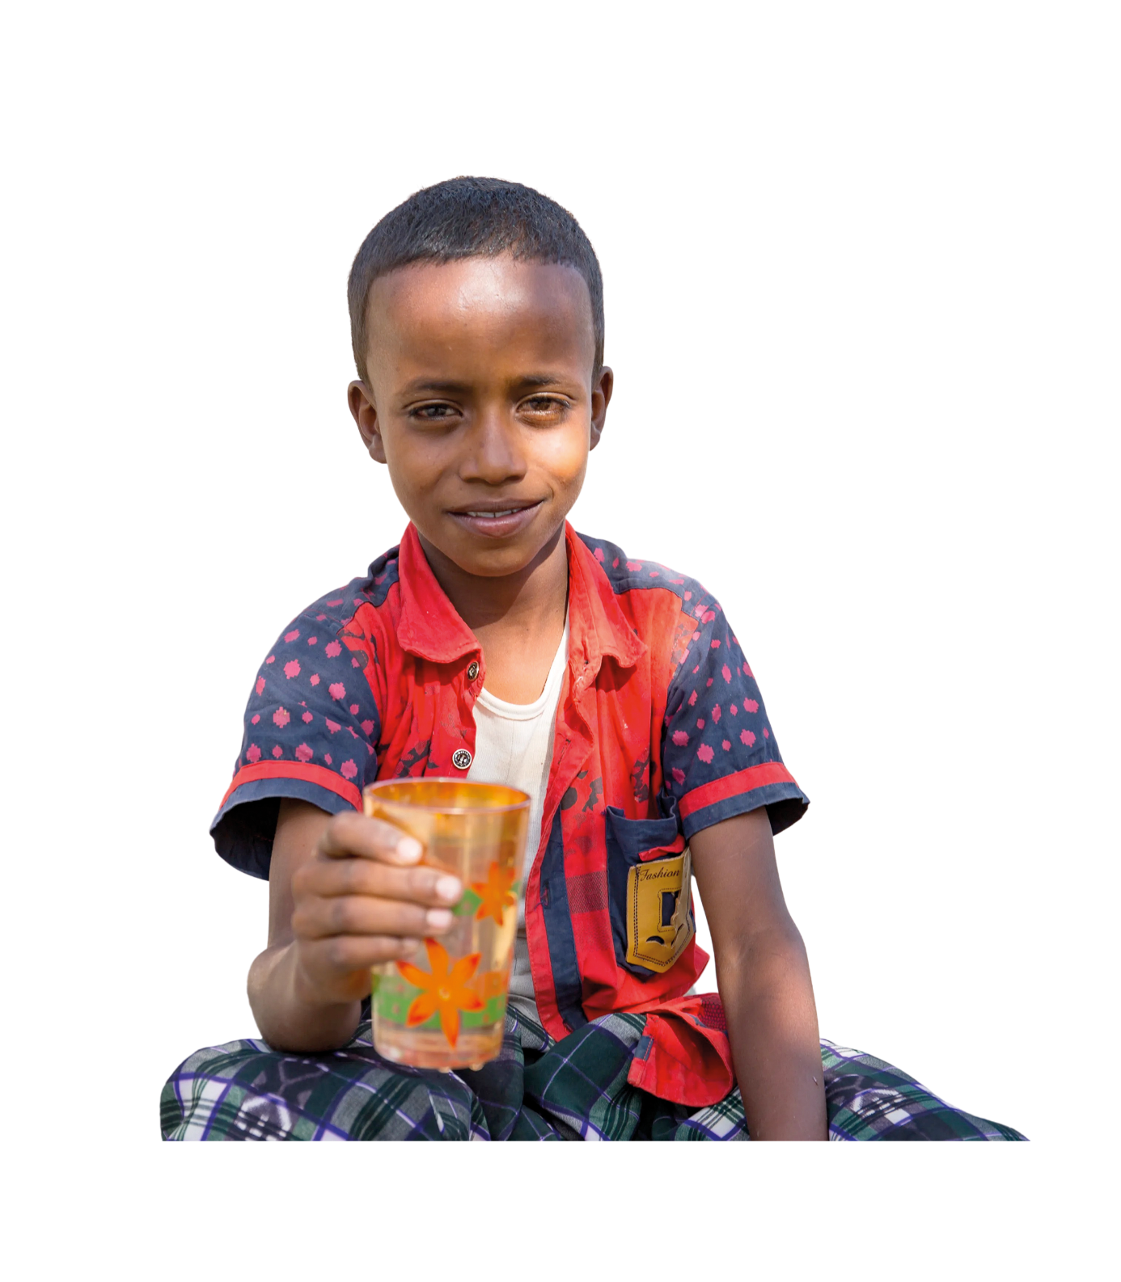
Wednesday 13 March
Think about…
Pray
Today is World Water Day.
How many different ways do you use water in a day?
How many can you think of as a class?
Today try to notice each time you use water.
When you do, thank God for his gift of water and pray for people throughout the world who don’t have access to clean, safe water for their families.

Slide 23
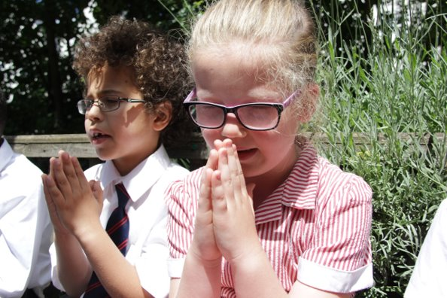
Thursday 14 March
Pray
Creator God,
open our eyes to see your love throughout creation.
Inspire us to treat creation and each other as you would, with respect.
Amen

Slide 24
Friday 15 March
Pray
Reflect on one of the Stations of the Cross today.
Find our Stations of the Cross resource here

Slide 25
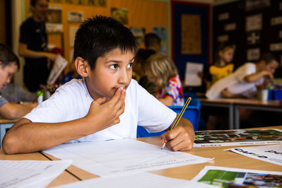
Monday 18 March
Act
Easter is nearly here.
Start getting ready by making Easter cards for your family and friends.
Generous God,
you show us how to love and share with everyone.
Be with us this week as we learn and help each other.
Amen
Find our Easter card templates here

Slide 26
Tuesday 19 March
Think about…
Pope Francis has written a letter to everyone, asking us to reach out to our sisters and brothers in need, whoever they are, wherever they may come from.
Spend some time thinking about what this means today.

Slide 27
Wednesday 20 March
Give
There is still time to hold your fundraiser this Lent.
Find out more

Slide 28
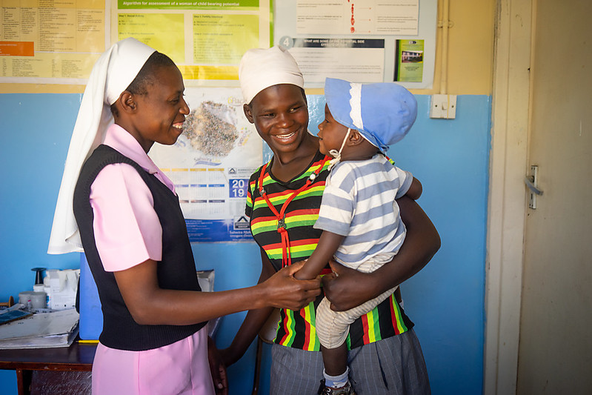
Thursday 21 March
Pray
Today we pray for all those who care for the sick.
Healing God,
we pray for those who are sick
and those who care for them.
Be close to them with your strength, comfort and peace.
Amen.

Slide 29
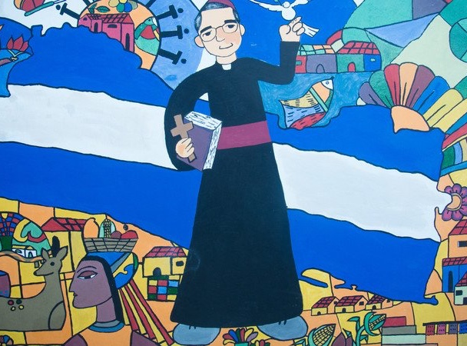
Friday 22 March
Think about…
Sunday is the Feast of St Oscar Romero. He said:
“Aspire not to have more but to be more”
Spend some time today thinking about what this might mean and how we can live it out.
Explore our St Oscar Romero resources

Slide 30
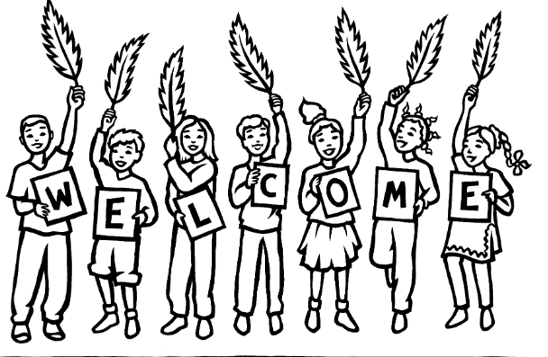
Monday 25 March
Think about…
We are in Holy Week.
Yesterday was Palm Sunday and we remembered the story of Jesus entering into Jerusalem on a donkey, greeted by joyful crowds waving palms.
How can we make Jesus welcome as we get ready to celebrate Easter?
How can we be welcoming to others?

Slide 31
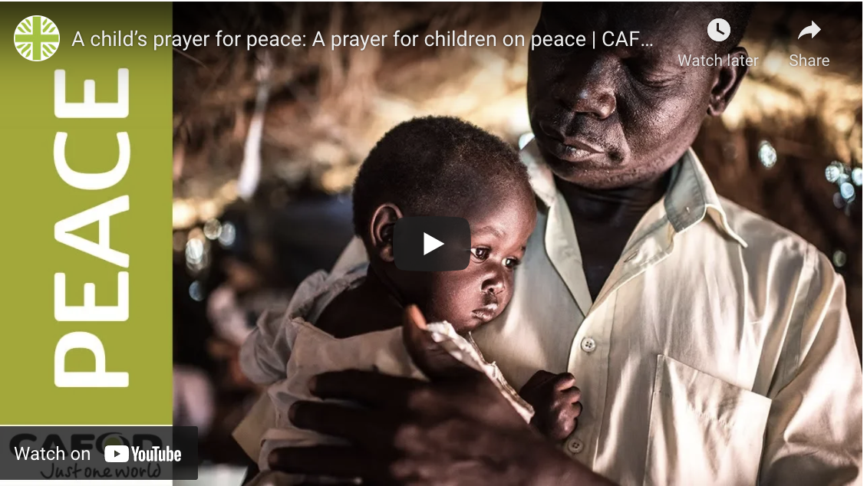
Tuesday 26 March
Pray
God of love,
we pray for peace in our world, and an end to war.
Instead of hatred, let there be love.
Shelter your children and protect us.
Guide us and keep us from harm,
so we can build a world of love and live our lives in peace.
Amen.

Slide 32
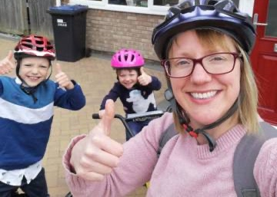
Wednesday 27 March
Act
This time of Lent invites us to be generous.
Think about what you can share:
Your time (perhaps visiting someone who may be lonely)
Your talents (sports, painting, singing, baking, storytelling….)
Your toys (you could share with family and friends and perhaps there are some toys you’d like to donate to charity)

Slide 33
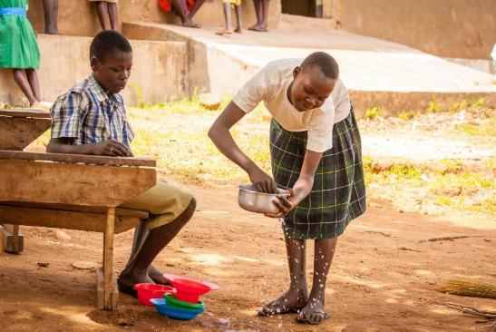
Thursday 28 March
Think about…
Holy Thursday
Today Jesus washed his disciples feet at the Last Supper.
Think about how you can serve others.
Find our Holy Week liturgical prayer here

Slide 34
Friday 29 March
Pray
Good Friday
Today Jesus died on the Cross.
We pray together, the Light in the darkest times prayer, remembering especially all those who are affected by the climate crisis today.

Slide 35
Easter Sunday 31 March
Alleluia!
He is risen!
Notes:
Picture credit: Laura Ouseley/CAFOD

