Slide 1
Lent calendar 2025
Week: One Two Three Four Five Six
M
T
W
T
F
10 March
17 March
24 March
31 March
7 April
14 April
11 March
18 March
25 March
1 April
8 April
15 April
Ash
Weds
12 March
19 March
26 March
2 April
9 April
16 April
6 March
13 March
20 March
27 March
3 April
10 April
Maundy
Thursday
7 March
CAFOD
Fast Day
21 March
28 March
4 April
11 April
Good
Friday
Easter
Sunday
Notes:
Each date on this slide is hyperlinked within the presentation. In Slide Show mode, click each date to go to that day’s content.

Slide 2
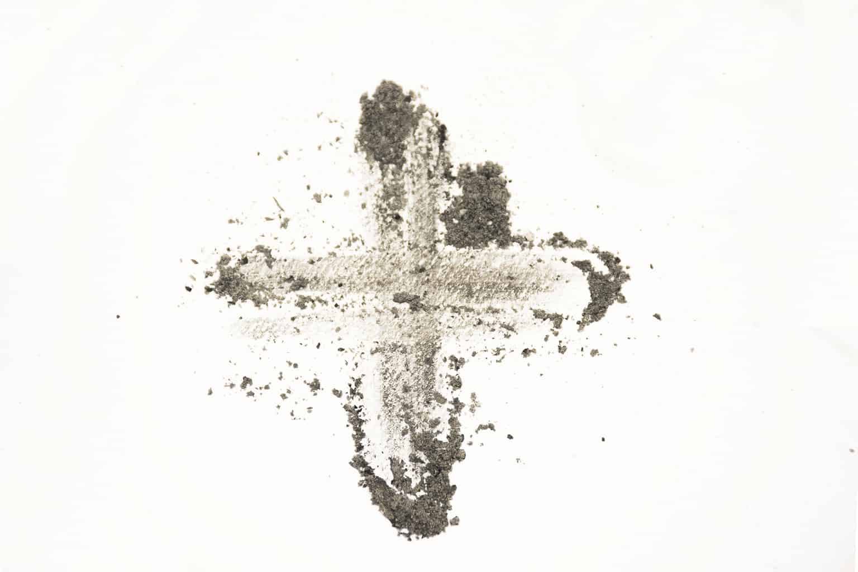
Wednesday 5 March
Think about…
On Ash Wednesday, as Lent begins, we remember how Jesus spent 40 days in the desert.
While Jesus was in the desert, he had very little to eat or drink.
There are many people around the world who do not have the right things to live a happy life like enough food to eat or clean water to drink.
Throughout Lent we will think about our neighbours experiencing poverty all around the world.
Use our Lent liturgy (perfect for Ash Wednesday)

Slide 3
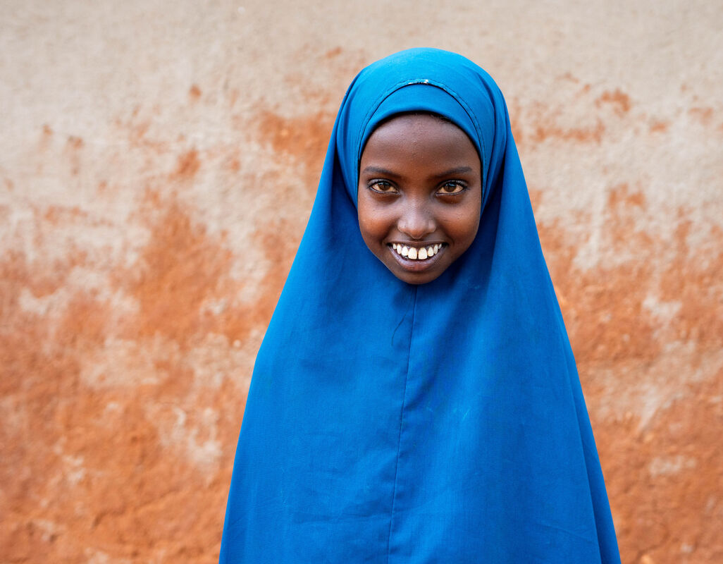
Thursday 6 March
“My name is Chirri and I am 12 years old.”
Act
Today is our Lent national assembly. Join us!
Meet Chirri in our national assembly today. She lives in Marsabit, northern Kenya, Africa, with her mother, father and four brothers and sisters.
Chirri’s mother, Khera, belongs to the Glitter Group, a club of woman from the local community. They help each other with lots of things, but particularly when times are tough – and times have been very tough for this community in Kenya.
Join our national assembly
Notes:
Chirri, Marsabit, Kenya
Photo credit: Joe Newman

Slide 4
Friday 7 March
Think about…
The year 2025 is a special Jubilee Year.
Pope Francis invites us all to be Pilgrims of Hope to build a better world.
Learn more about the Jubilee Year by watching our animation.
Watch our Jubilee animation
Notes:
Photo credit: Children in St Anthony’s Catholic Primary School

Slide 5
Monday 10 March
Give
This Lent, schools in England and Wales are taking part in the Big Lent Walk, raising money to help communities like Chirri's through tough times.
During Jubilee Year, we are called to make a Pledge to build a better world. Fundraise for the Big Lent Walk as part of your Jubilee Pledge!
Sign up for the Big Lent Walk

Slide 6
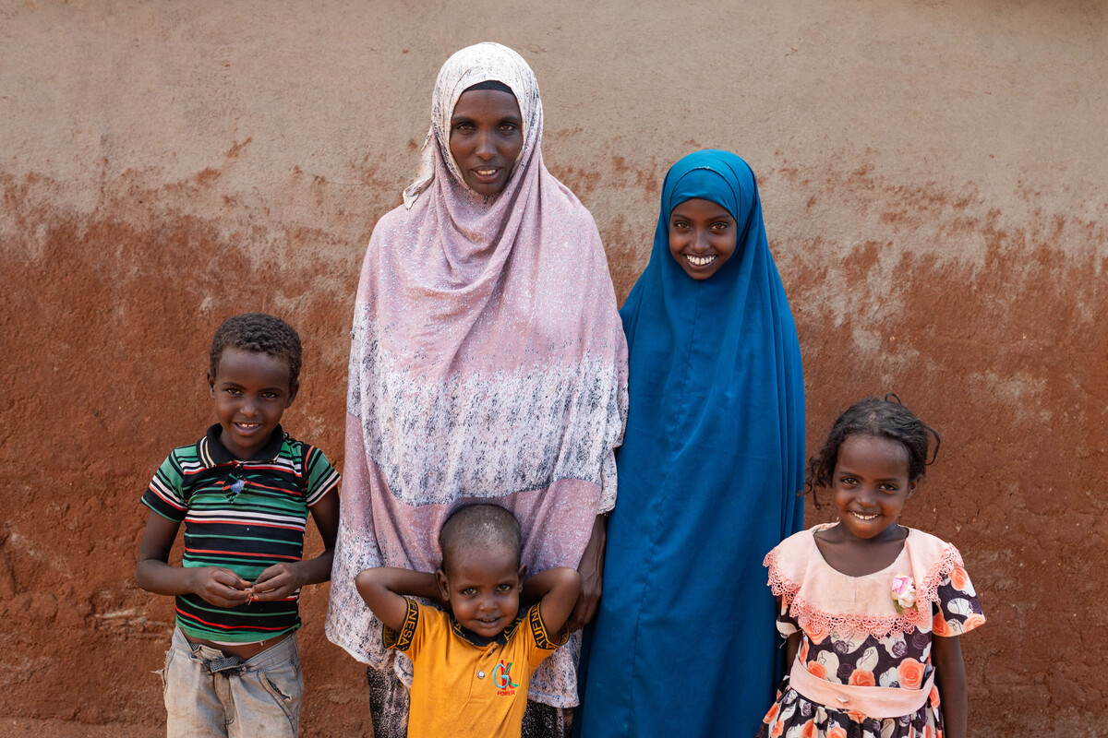
Tuesday 11 March
Pray
Severe drought in Kenya, where Khera and Chirri live, has meant water is scarce. There is not enough for people to drink or for crops to grow. Animals used to help people make their living were dying.
“Before the drought, we had camels, cows and goats that we used for food for our family. Anything left over I sold for money for anything else we needed. I enjoyed life then,” explains Khera. “We had no worries.”
Loving God,
Fill our hearts with compassion for the earth and all its peoples. Lead us to be good neighbours to all.
Amen.
Notes:
Khera, Marsabit, Kenya
Photo credit: Joe Newman

Slide 7
Wednesday 12 March
Think about…
Jubilee Pledge
As you journey towards making your special school Jubilee Pledge in the summer, think about what it means to be pilgrims of hope.
What does ‘agents of change’ mean?
How can you walk in solidarity this Lent?

Slide 8
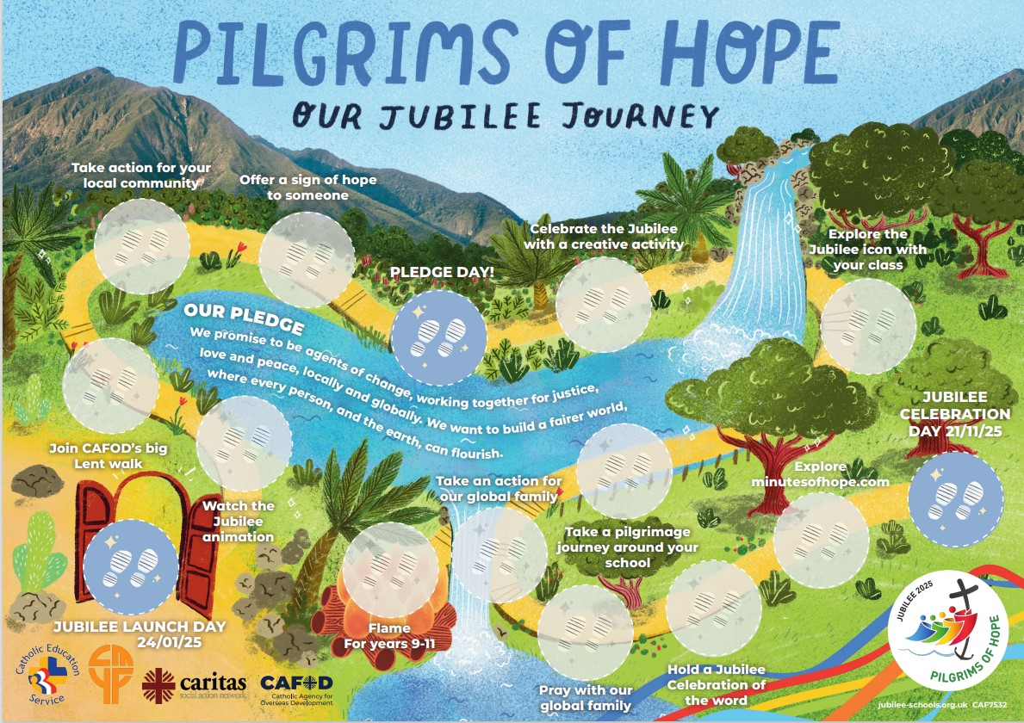
Thursday 13 March
Think about…
Pilgrims of Hope map
Do you have a Pilgrims of Hope map in your classroom?
What are you doing this year to help build a better world?
As you work towards our Jubilee school Pledge this summer, think about all the ways you can reach out in love this Lent.
Order a free Pilgrims of Hope map

Slide 9
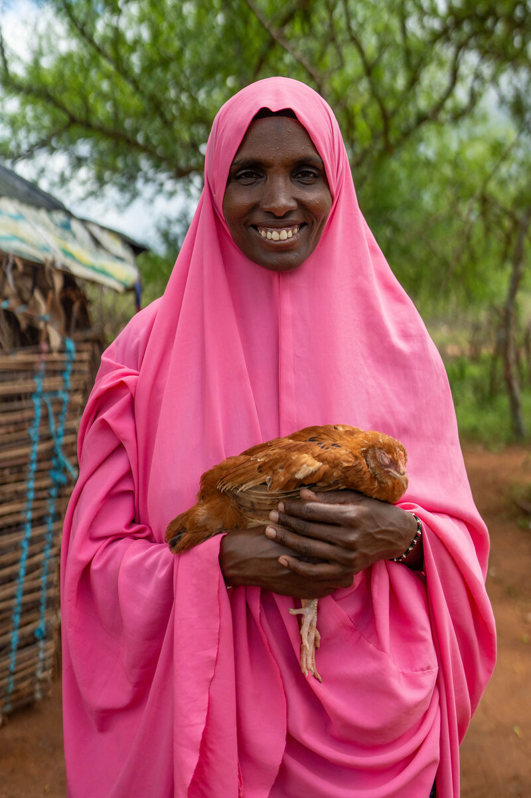
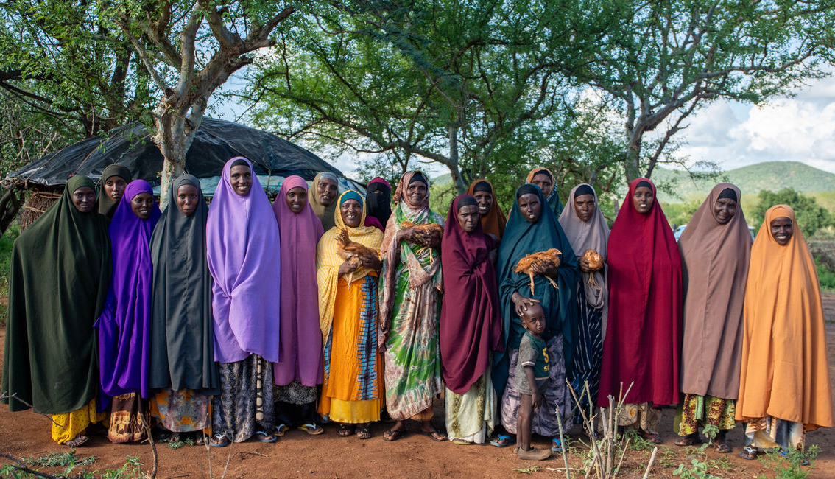
Friday 14 March
Pray
Today is Lent Family Fast Day!
Learn more about Chirri and her mother, Khera, in Kenya.
Hear how the women in the Glitter Group are working together to raise chickens so the community can make a living.
“We have a slogan which says: Unity is strength. Let’s pull together to inspire; let’s pull together to be strong.”
Khera, the Glitter Group
Watch our Lent film

Slide 10
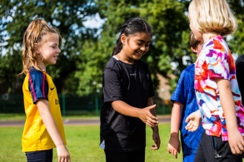
Monday 17 March
Act
What action will you take to show kindness to others today? What can you do to be the Pilgrims of Hope that Pope Francis calls us to be in this Jubilee year?
Think of at least three things you can do today and during the next week of Lent.
You could think of three different people to show kindness to, perhaps try with someone you wouldn’t normally talk to?

Slide 11
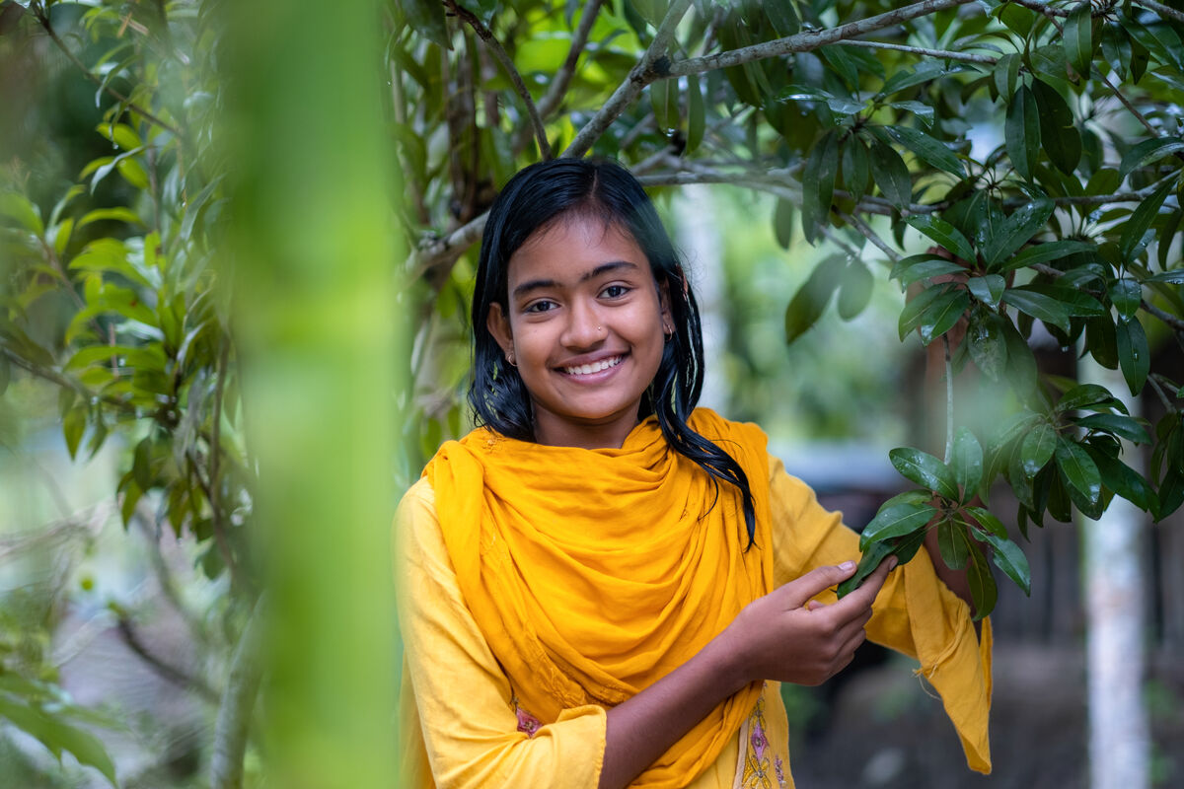
Tuesday 18 March
Pray
Pope Francis wrote a prayer for our Earth.
Light a candle and watch this film of the prayer.
Watch the prayer film
Notes:
Dristy in Bangladesh

Slide 12
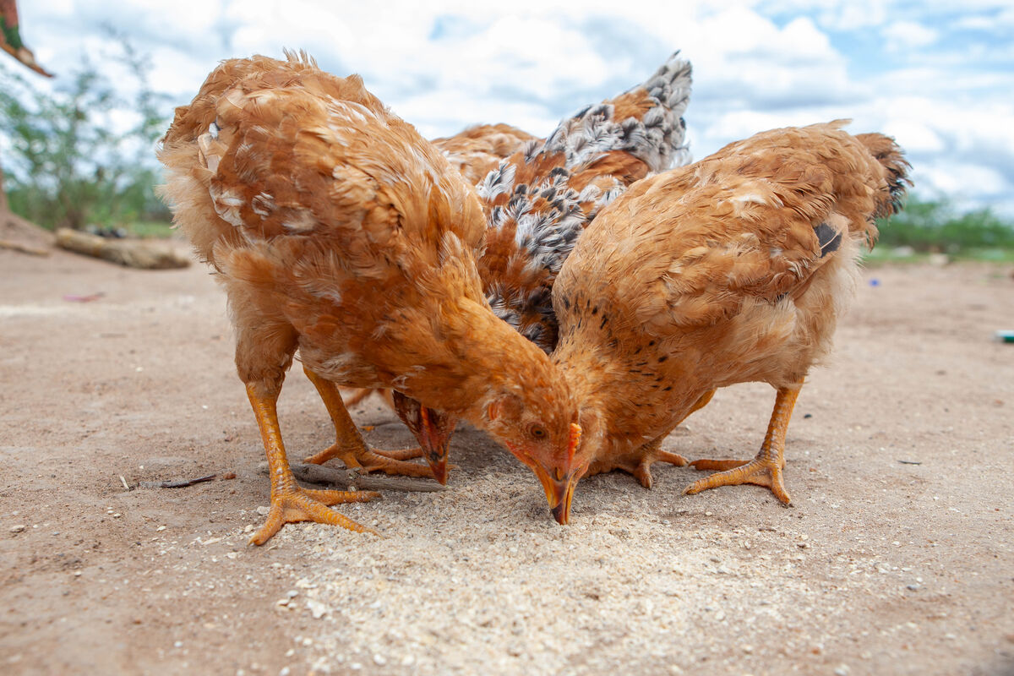
Wednesday 19 March
Think about…
Let’s think about the super chickens in the CAFOD Lent story today!
The whole community in Marsabit, northern Kenya, struggled because of the drought.
With CAFOD's help, Khera and the Glitter Group were given some chickens and learned how to look after them as a business.
These chickens do not depend on so much water. Khera can sell their eggs, or a chicken, for money to buy food, soap, clothes and things for school.
Chirri helps with the chickens aswell. She said: "I like when they jump about and seeing them lay eggs. I like eating the eggs too – fried for breakfast!"

Slide 13
Thursday 20 March
Pray
Act
Give
How can we be a neighbour to our brothers and sisters who are living in poverty so far away from us?
Sometimes it may feel difficult. The Big Lent Walk gives us the opportunity to stand in solidarity with our brothers and sisters around the world living in poverty.
Loving God,
Fill our hearts with compassion for the earth and all its people. Lead us to be good neighbours to all who are in need.
Amen.

Slide 14
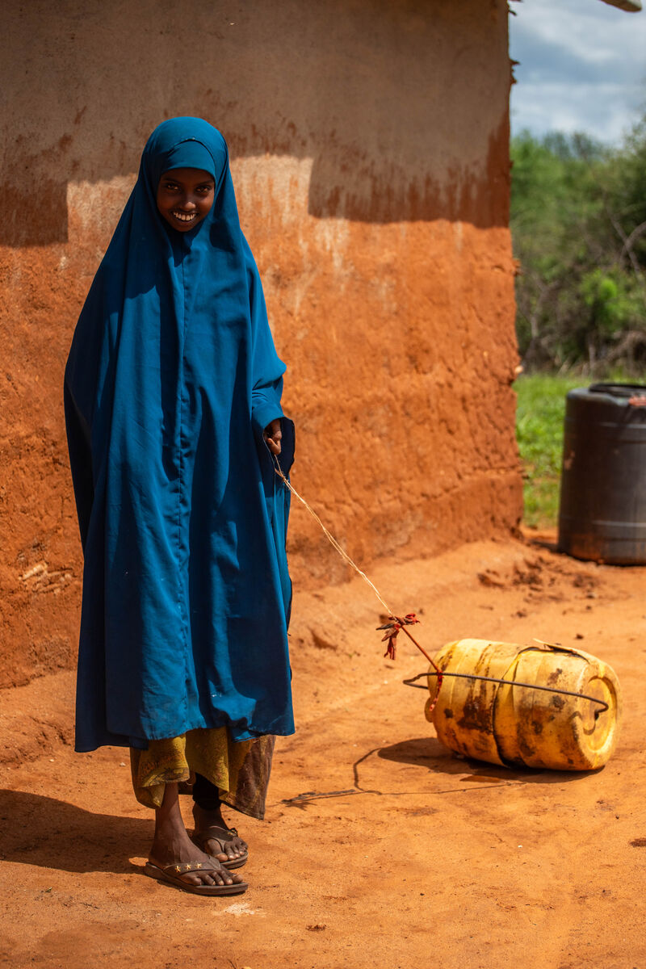
Friday 21 March
Think about…
Tomorrow is World Water Day.
Severe drought in Kenya has meant water is scarce, with not enough for people, crops or animals.
"There was no rain for years,” says Chirri. “We had to get water from far away. I walked with my neighbour. We started our journey at seven and came back at ten. I got tired and thirsty. The sun was way too hot.”
How many different ways do you use water in a day?
Today try to notice each time you use water.
When you do, thank God for his gift of water and pray for people throughout the world who don’t have clean, safe water for their families.

Slide 15
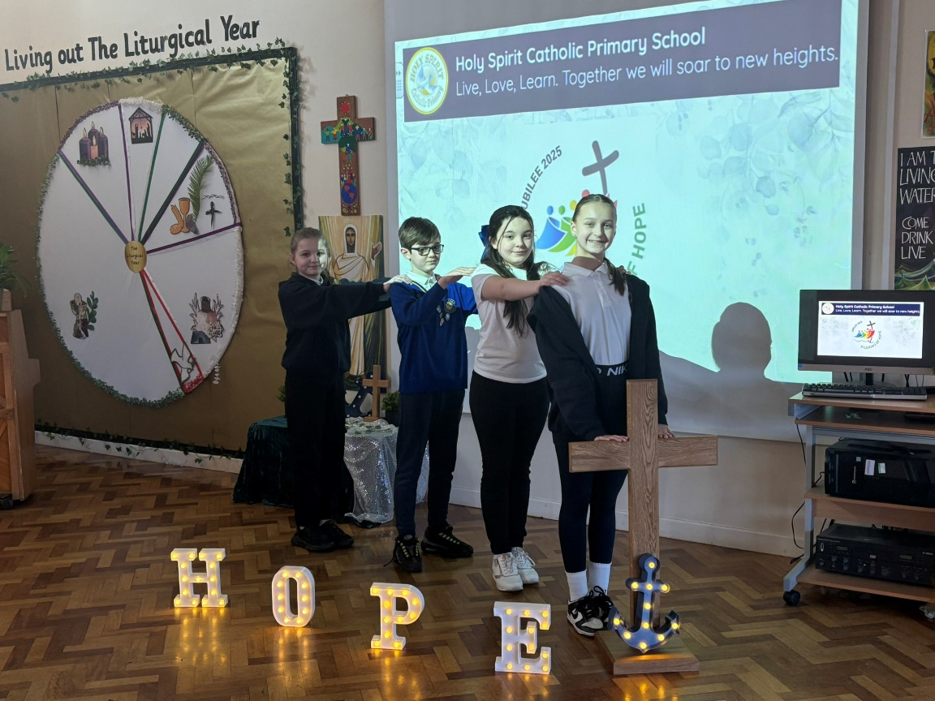
Monday 24 March
Think about…
“I have come so that they may have life, and have it to the full”
John 10:10
Say these words together and spend some time today thinking about them.
Where do these words come from?
What do they mean?
How can we live by these words and put our faith into action in this Jubilee Year?
Say the Jubilee prayer together
Notes:
Children at Holy Spirit Catholic Primary School

Slide 16
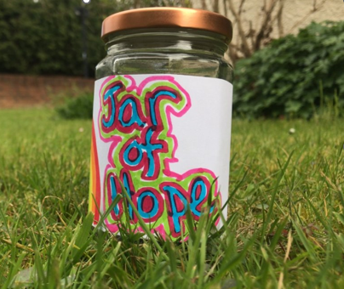
Tuesday 25 March
Act
Jar of Hope activity
Find an empty jar and decorate it as your class Jar of Hope!
Keep the jar on the prayer focus table and write or draw things that make you feel hopeful on paper, and drop them into the
jar. Share your hopes during prayer times.
Notes:
Photo credit: Zinyange Autony

Slide 17
Wednesday 26 March
Think about…
Hope worksheet
In this Jubilee Year think about all the things that bring you hope.
Draw or write them on the worksheet.
Hope worksheet

Slide 18
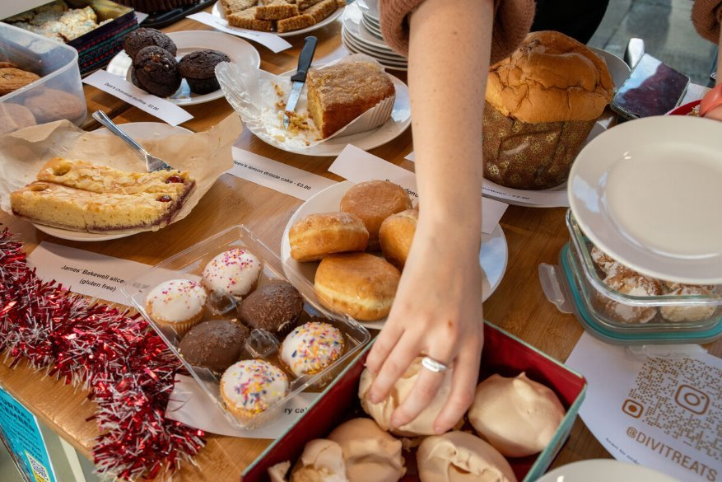
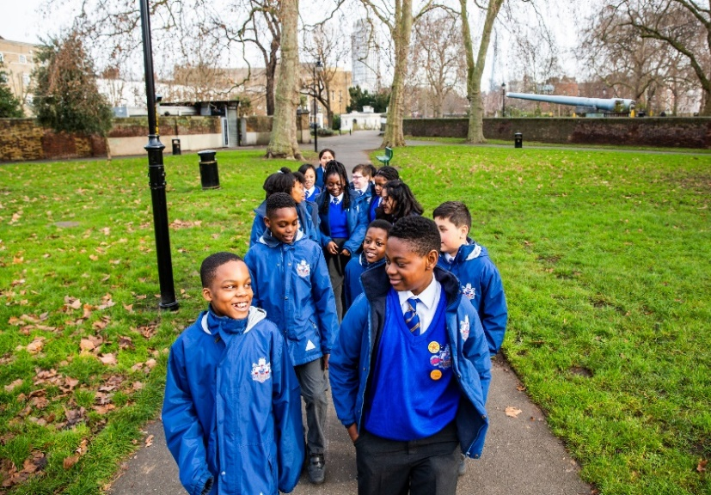
Thursday 27 March
Pray
Give
This Lent, hundreds of schools in England and Wales are raising money to support our global neighbours.
Lord,
may my support bring hope to people in difficulty around the world.
May they know that you are with them and that they have sisters and brothers who care for them.
Amen
There are so many easy ways you can do this! Try the Big Lent Walk, a cake sale or a sponsored silence!
Find out more

Slide 19
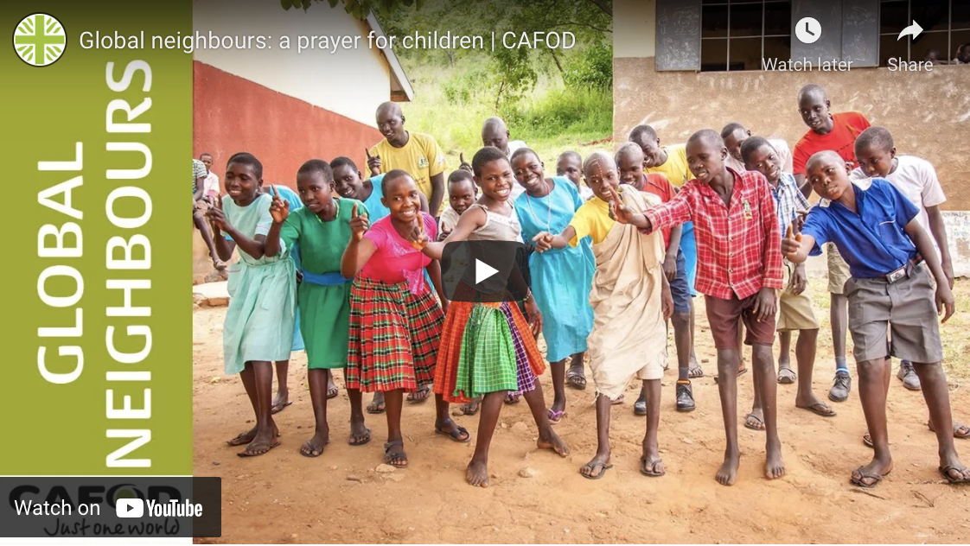
Friday 28 March
Pray
Light a candle and pray with and for our global neighbours using this film.
Watch the prayer film

Slide 20
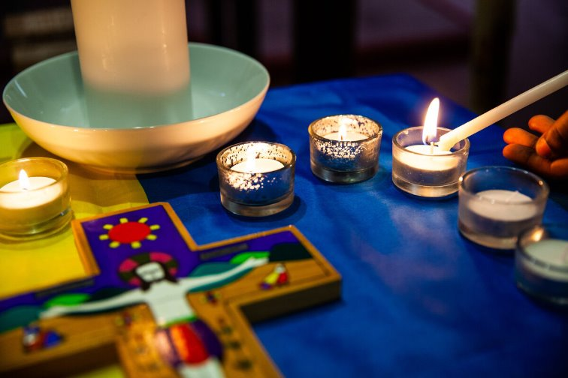
Monday 31 March
Pray
Jubilee Celebration of the word
Pope Francis asks us to celebrate this Jubilee Year with a deep faith, lively hope and active charity.
Hold a Celebration of the word to think about how to do this.
Celebration of the word

Slide 21
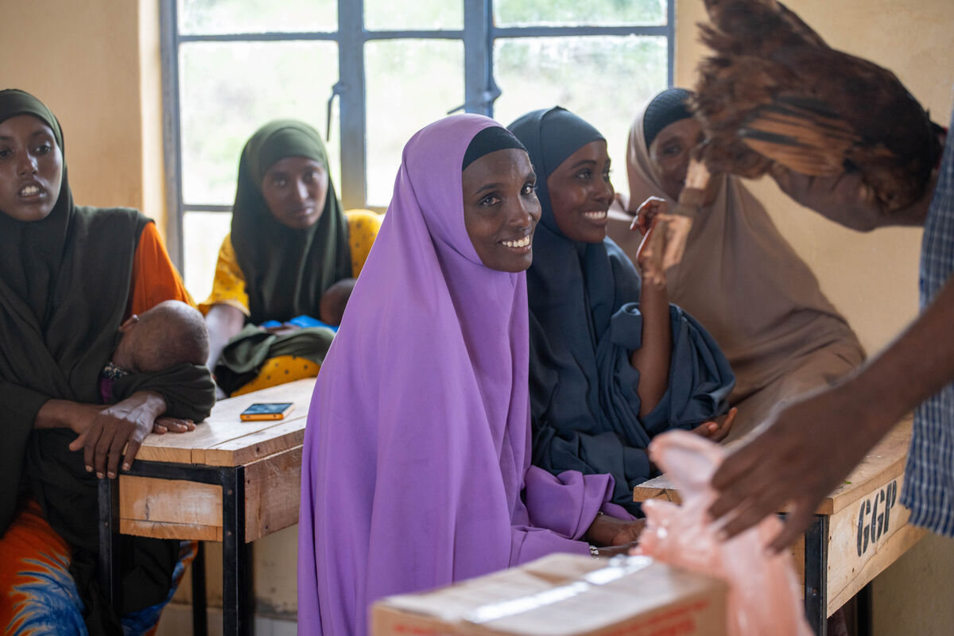
Tuesday 1 April
Think about…
This Lent we have been thinking about the Glitter Group in Kenya who have been raising chickens to help make a living.
The Glitter Group help each other with lots of things, but particularly when times have been tough because of the droughts.
Today let’s think about looking after other people, particularly in this special Jubilee Year.
How can you care for others today?

Slide 22
Wednesday 2 April
Act
Sing the Jubilee song!
Sing the Jubilee Song about being pilgrims of hope together!
Find the lyrics and the music
Why not take part in the Big Lent Walk with other children across England and Wales? You could help raise money for our global neighbours like Chirri, Khera and the Glitter Group community.
What other creative ways can you think of to fundraise for our brothers and sisters around the world?

Slide 23
Thursday 3 April
Act
Fairtrade is about giving a fair share to all the people who produce food around the world.
Find out whether your local shop sells Fairtrade Easter eggs. If not, ask them why not and if they will stock them next year.
Find our Fairtrade resources
Could you mark this special Jubilee Year by becoming a Fairtrade school?

Slide 24
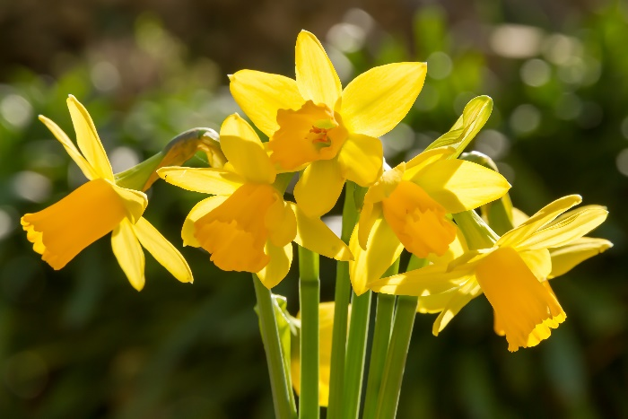
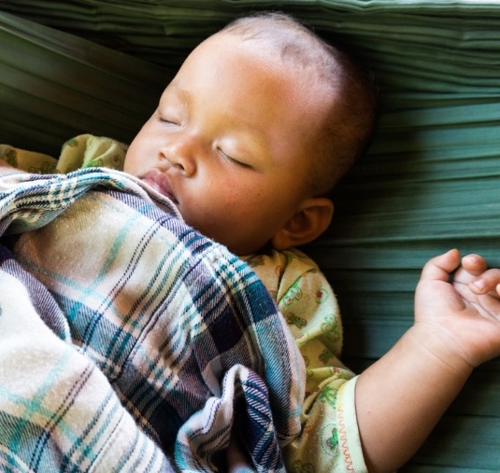
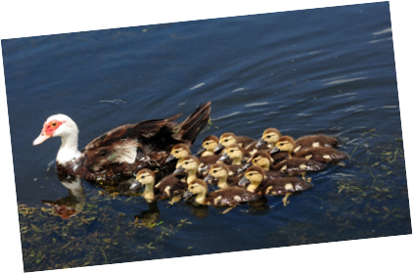
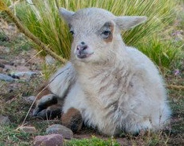
Friday 4 April
Act
Jesus came to bring us new life. The Jubilee Year is a time of renewal and celebration.
Take time today to look for and celebrate signs of new life in the world around you.

Slide 25
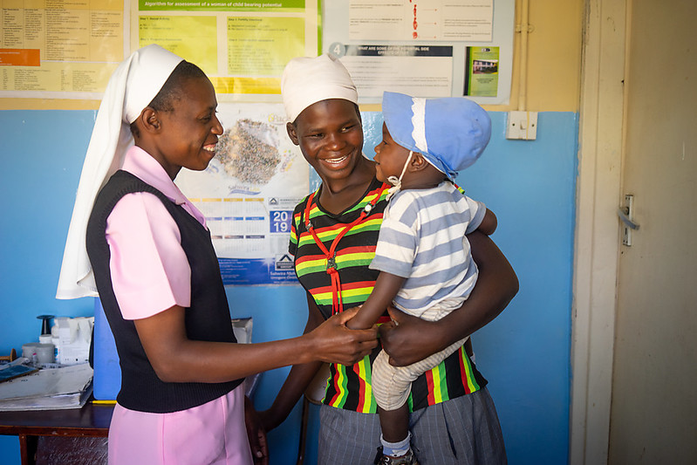
Monday 7 April
This Lent, children in England and Wales have been raising money to help our global neighbours.
Pray
Today is World Health Day
Let us pray together.
Healing God,
we pray for those who are sick
and those who care for them.
Be close to them with your strength, comfort and peace.
Amen.

Slide 26
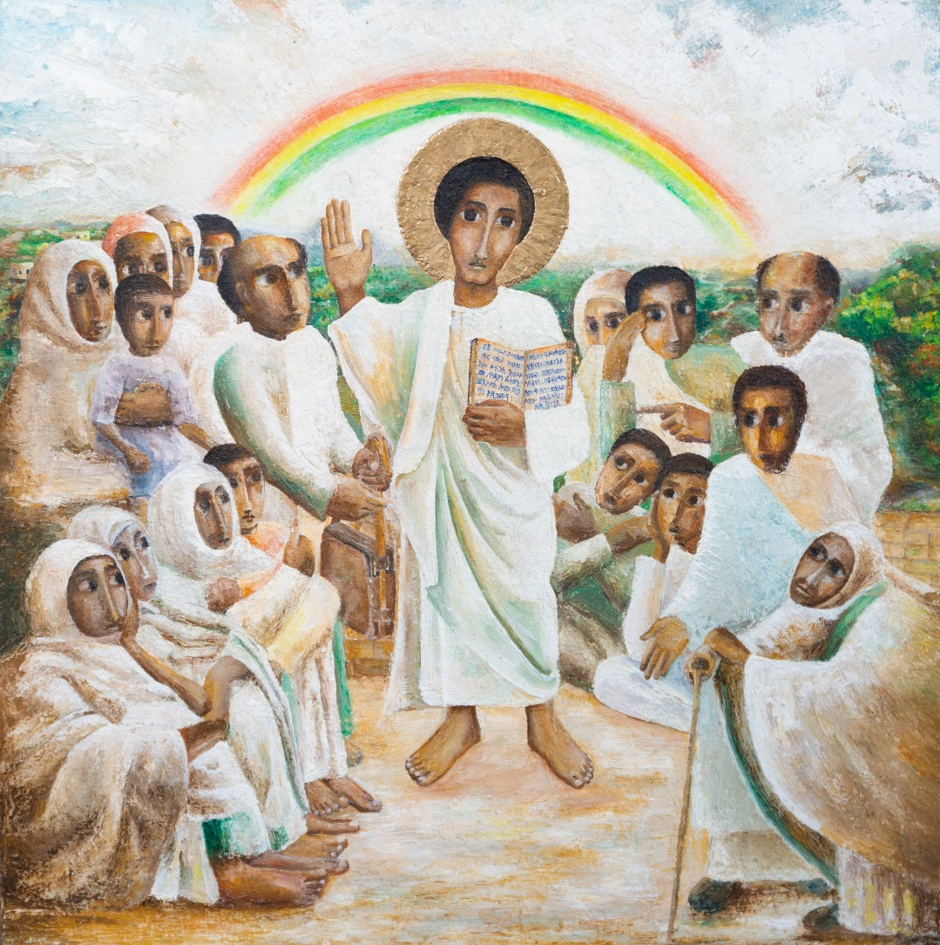
Tuesday 8 April
Think about…
The Jubilee icon
Mulugeta Araya from Ethiopia created a special piece of artwork for the Jubilee Year.
Find out more about it.
Jubilee Icon reflection

Slide 27
Wednesday 9 April
Think about…
Pope Francis wrote a letter to everyone, asking us to reach out to our sisters and brothers in need, whoever they are, wherever they may come from. This letter is especially important in this special Jubilee Year.
Spend some time thinking about what this means.
Watch the animation

Slide 28
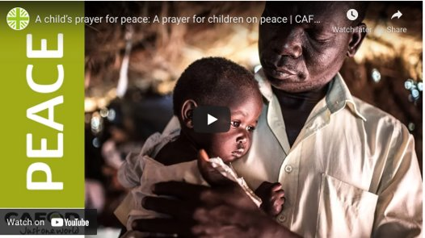
Thursday 10 April
Pray
A prayer for peace
Let us say a prayer for peace this Lent.
Watch the peace prayer film

Slide 29
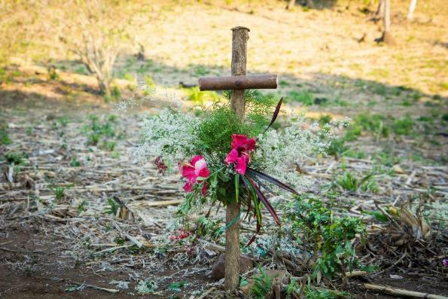
Friday 11 April
Pray
Reflect on one of the Stations of the Cross today.
Stations of the Cross resource

Slide 30
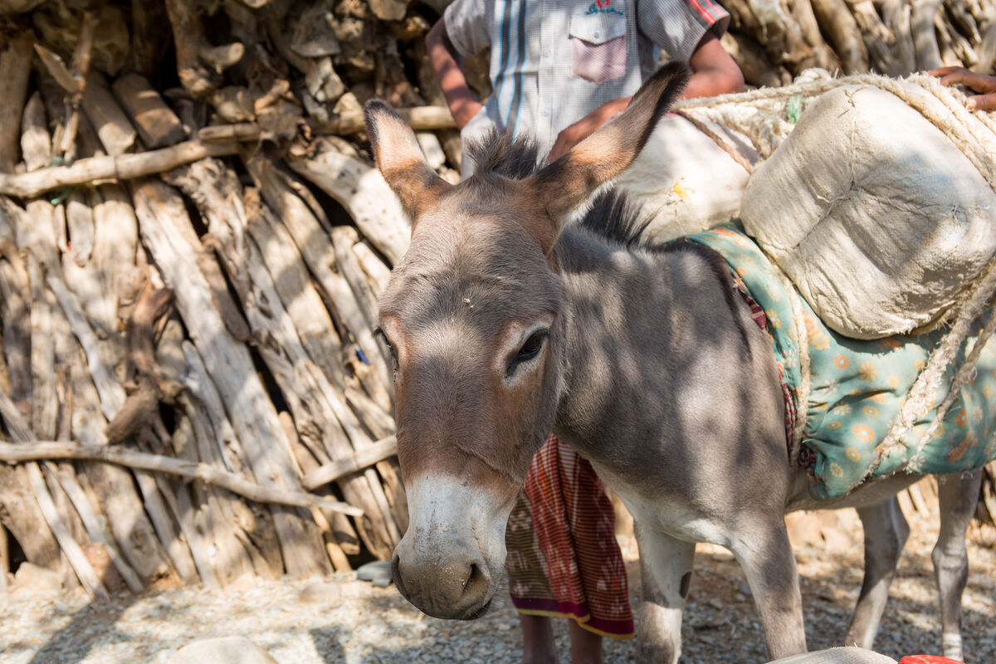
Monday 14 April
Think about…
We are in Holy Week.
Yesterday was Palm Sunday and we remembered the story of Jesus entering into Jerusalem on a donkey, greeted by joyful crowds waving palms.
How can we make Jesus welcome as we get ready to celebrate Easter?
How can we be welcoming to others?

Slide 31
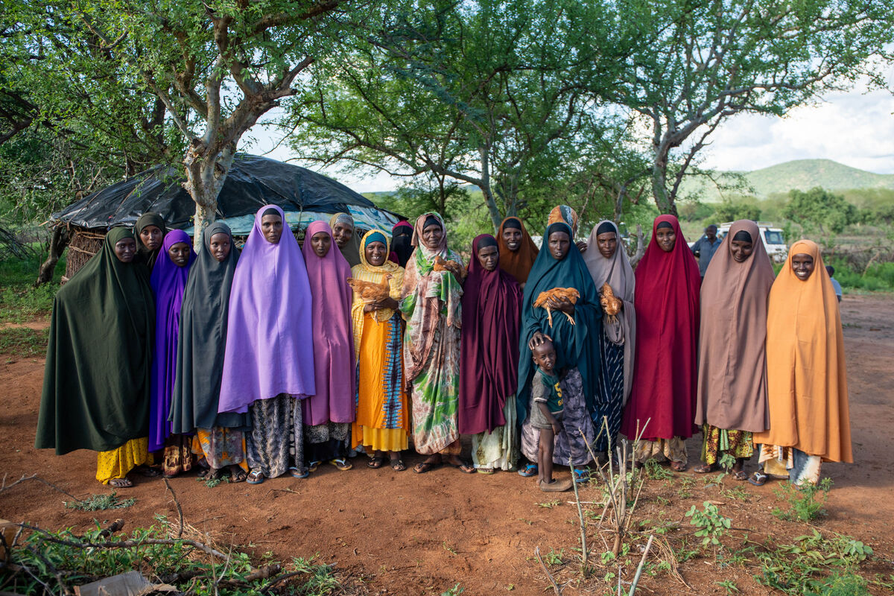
Tuesday 15 April
Think about…
Your Big Lent Walk
Your fundraising during Lent will help more communities like Khera’s to survive in times of drought.
What do you think Khera meant when she said
“Unity is strength. Let’s pull together to inspire. Let’s pull together to be strong”?

Slide 32
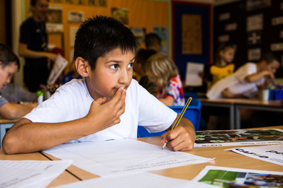
Wednesday 16 April
Act
Easter is nearly here.
Start getting ready by making Easter cards for your family and friends.
Use our Easter card templates

Slide 33
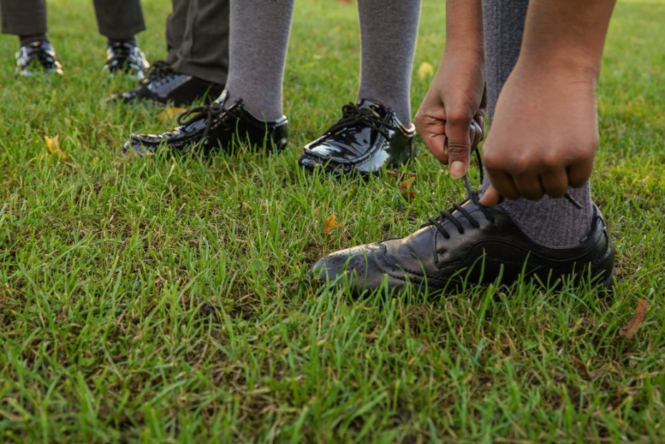
Thursday 17 April
Think about…
Holy Thursday
Today Jesus washed his disciples’ feet at the Last Supper.
Think about how you can serve others.
Find our Holy Week Celebration of the word

Slide 34
Friday 18 April
Pray
Good Friday
Today Jesus died on the Cross.
We pray together, the Light in the darkest times prayer, remembering especially all those who are affected by the climate crisis today.
Watch the prayer film

Slide 35
Easter Sunday
Alleluia!
He is risen!
Notes:
Picture credit: Laura Ouseley/CAFOD

