Slide 1
How many pieces of technology have you used this morning?

Slide 2
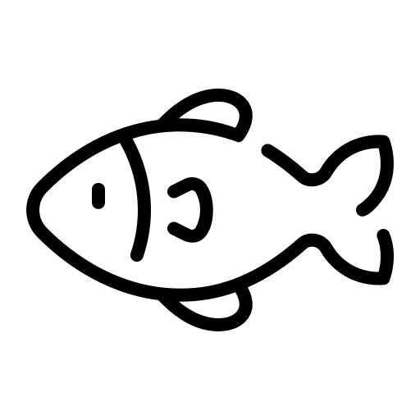
Lent assembly
2024
Notes:
Image by xadartstudio on Freepik

Slide 3
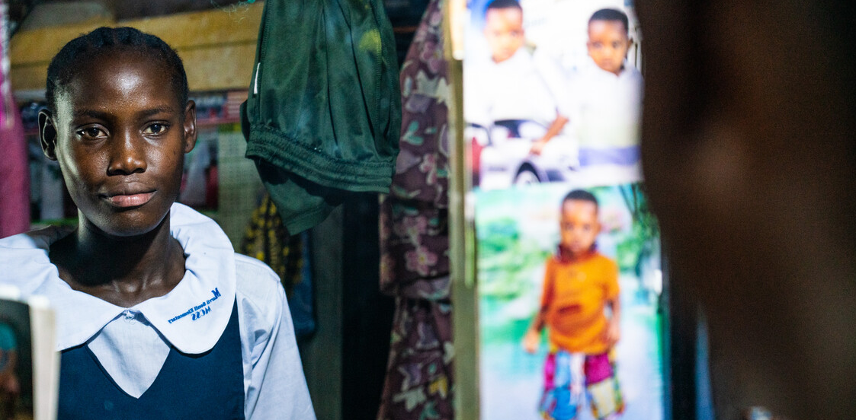
This year we’ll be sharing the story of Mary, who lives in West Point, Monrovia in Liberia.
West Point is by the sea, so the largest industry is trading fish.

Slide 4
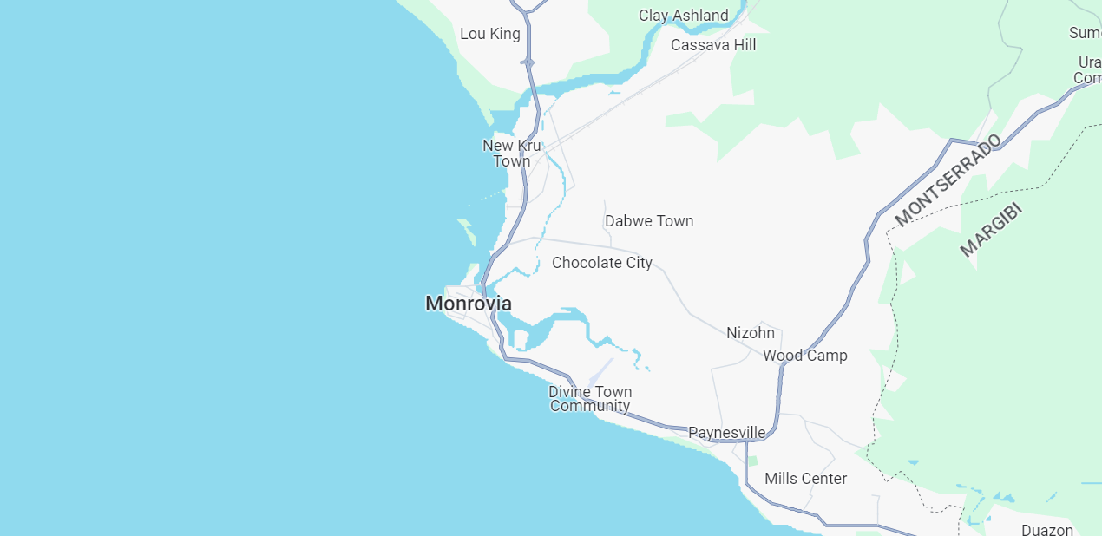
LIBERIA
WEST POINT

Slide 5
Country Profile: Liberia
Liberia’s population = 5 million people (2020)
Agriculture, fisheries and forestry are key to economic growth and poverty reduction goals.
Climate change = heavy rains, storm surges, sea level rise and increased erosion.
CAFOD is the only NGO working in the fishing sector in Liberia.

Slide 7
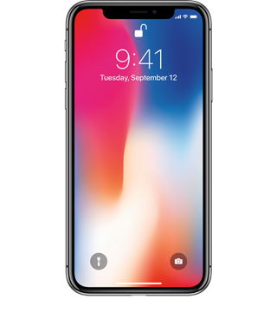
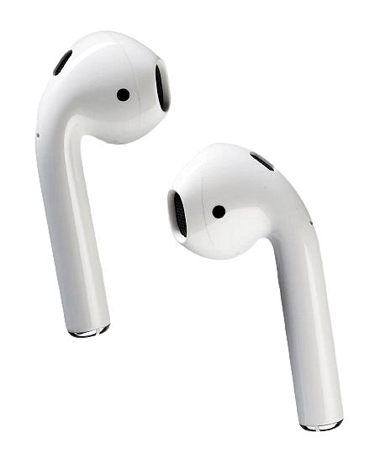
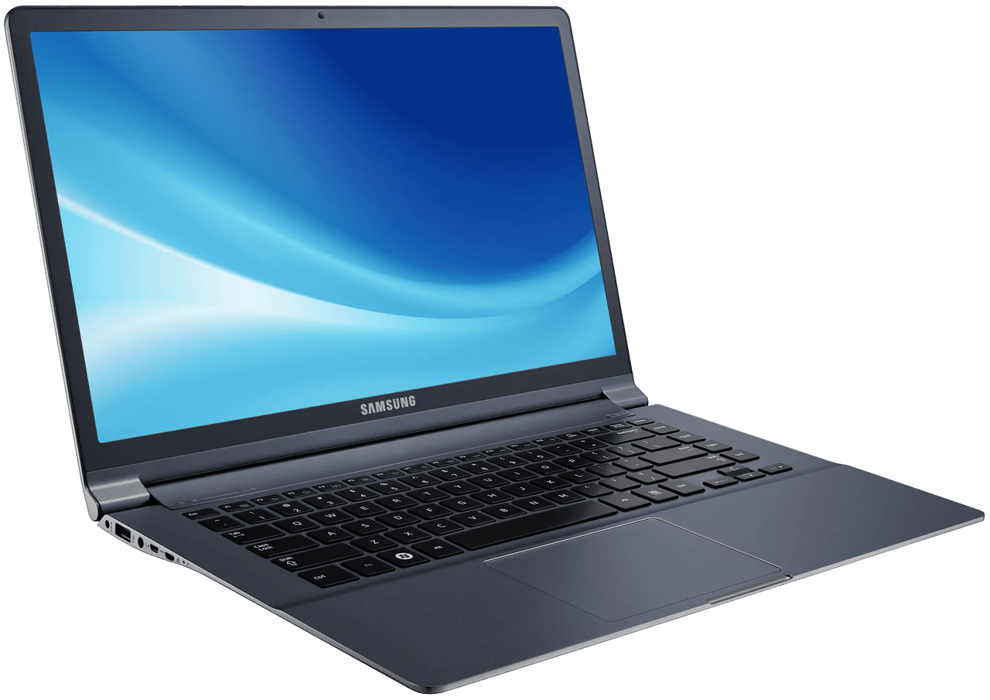
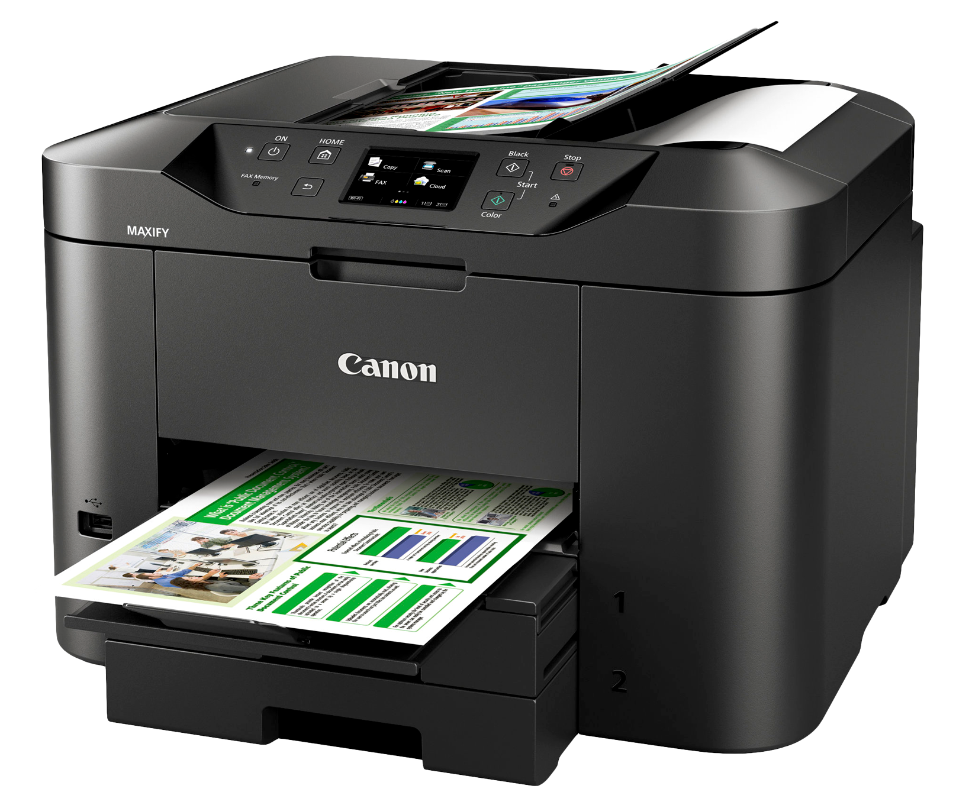
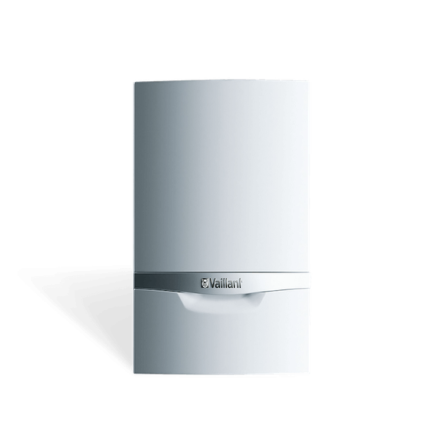
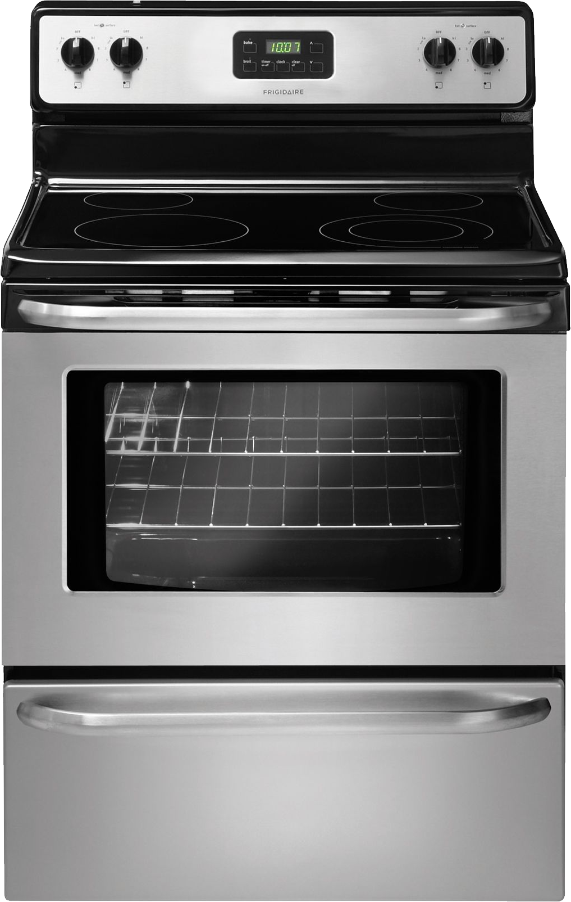

Slide 8
"In whose hands does all this power lie, or will it eventually end up? It is extremely risky for a small part of humanity to have it."
Pope Francis, Laudato Si’

Slide 9
Internet usage around the world
Dark blue = Young people (15-24)
Light Blue = Rest of the population

Slide 10
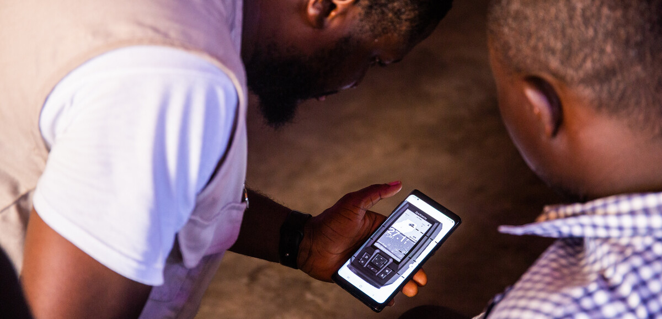

Slide 11
GPS WEATHER TRACKING & TRAINING
CLIMATE CHANGE
STORMS
SAFETY
FAMILY INCOME
DANGEROUS CONDITIONS
EDUCATION
POVERTY
CLIMATE CHANGE RESILIENCE

Slide 12
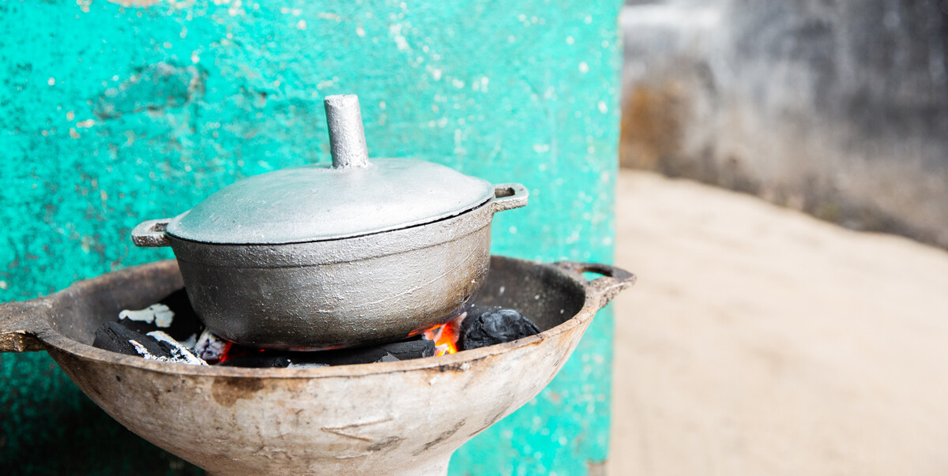
With a better family income Mary’s family can buy more food.
‘‘In the morning, I drink tea and eat bread. In the afternoon, I eat rice. In the evening, I fry an egg.’’
‘‘I eat delay, marcray, poarp fish , blood fish, cassava fish, soul fish and crab. Things like that. I like rice and beans.’’

Slide 13
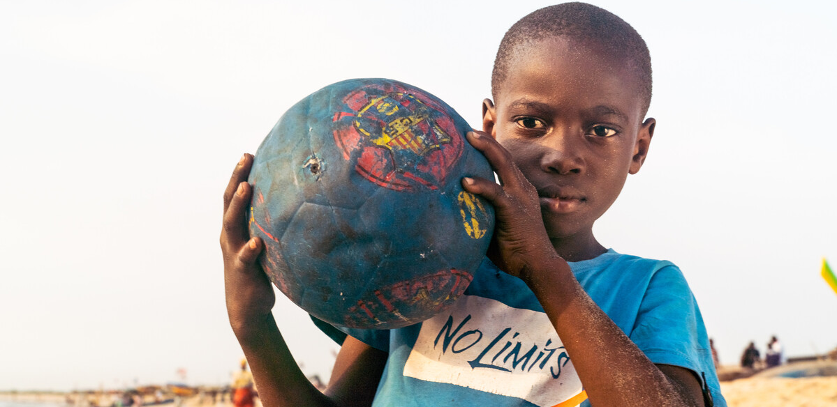
With good nutrition then families can thrive and communities can build up. This is Aaron, Mary’s nephew. The community in West Point like playing football on the beach.
Mary said ‘‘I like football because when I play, some people see me and come over to tell me, you can play! I say, yeah, I can play well. So I went to play for their team and I won games. I scored two goals.’’

Slide 14
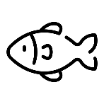
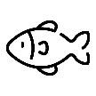

Slide 16
Lord Jesus,
We think of the privileges we have in the 21st century, but we know that these are not accessible to everyone across the world because things are not being shared fairly.

Slide 17
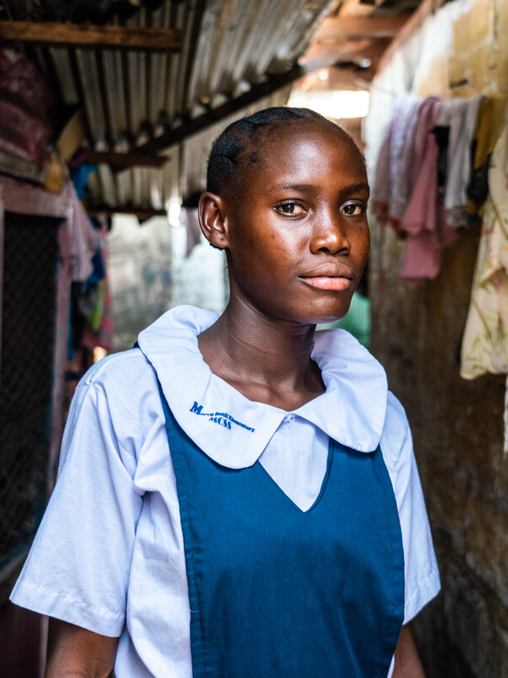
We stand in solidarity with Mary and her community and pray you will bless those taking part in the CAFOD fish tracking project. Help us to take the next right step to tackle global injustice.
Amen.

