Slide 1
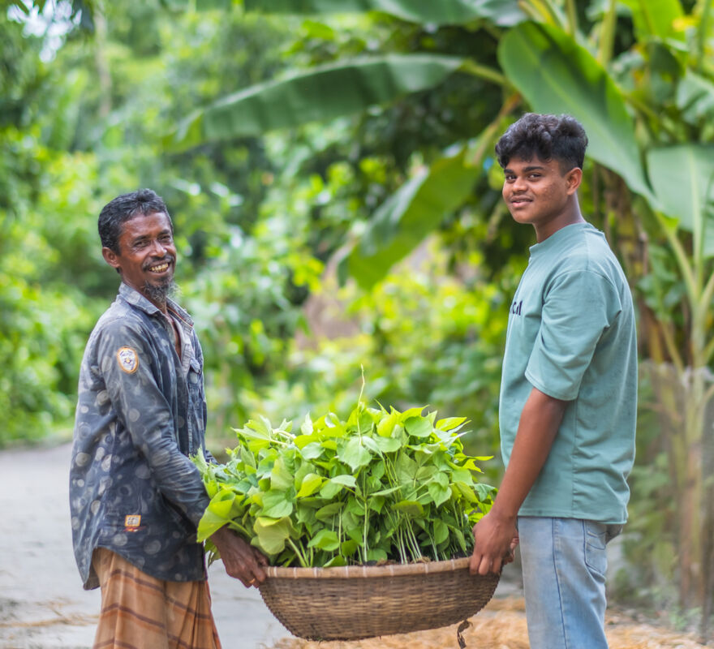
What could you do to become more united – or ‘at one’ –
with other people?
Gospel Celebration of the Word
Notes:
Children’s liturgy: Seventh Sunday of Easter (Year A)
Preparation of the worship space
Colour: white
Song suggestions
Alleluia, alleluia, give thanks to the risen Lord (268, Laudate)
Welcome
Today we hear Jesus praying for his friends and for us. He wanted us to be one, to be united in love, as closely as Jesus and God the Father are united in love. So let’s think about how we can be more like that.
Bayezid and his father, Bangladesh
Photo credit: Amit Rudro

Slide 2
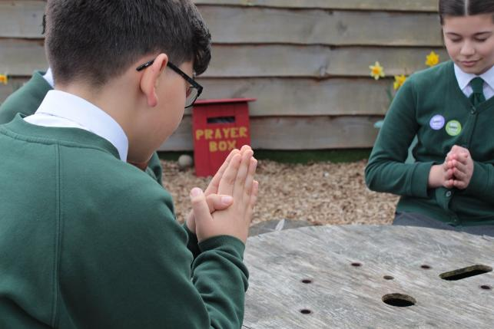
God our Father, You sent your Son Jesus to show us how to love. Help us to learn to work together in love, and to make the world a better place for everyone. Amen.
Gather
Notes:
St Francis Xavier's RC Primary School, Herefordshire
Photo credit: Vicky Ahmed

Slide 3
Gospel: John 17: 1-11
After Jesus finished saying this, he looked up to heaven and said, “Father, the hour has come. Give glory to your Son, so that the Son may give glory to you.
"For you gave him authority over all humanity, so that he might give eternal life to all those you gave him. And eternal life means knowing you, the only true God, and knowing Jesus Christ, whom you sent.
"I have shown your glory on earth; I have finished the work you gave me to do. Father! Give me glory in your presence now, the same glory I had with you before the world was made.
“I have made you known to those you gave me out of the world. They belonged to you, and you gave them to me."
Word

Slide 4
Gospel: John 17: 1-11
"They have obeyed your word, and now they know everything you gave me comes from you. I gave them the message you gave me and they received it; they know that it is true that I came from you, and they believe that you sent me.
“I pray for them. I do not pray for the world but for those you gave me, for they belong to you. All I have is yours, and all you have is mine; and my glory is shown through them.
"And now I am coming to you; I am no longer in the world, but they are in the world. Holy Father! Keep them safe by the power of your name, the name you gave me, so that they may be one just as you and I are one.”
Word

Slide 5
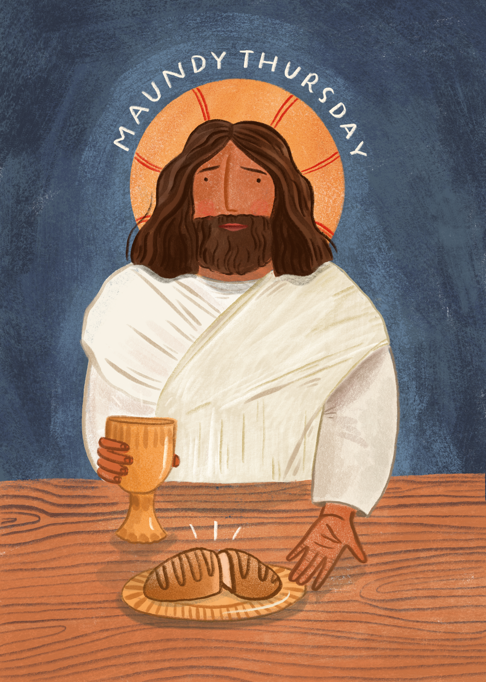
What do you remember from the Gospel reading?
In today’s reading Jesus is praying for his friends during
his Last Supper with them, on the night before he died.
Jesus prayed to his Father, that his friends “may be one just as you and I are one".
What do you think he meant?
Respond
Notes:
Illustration: Emma Walton

Slide 6
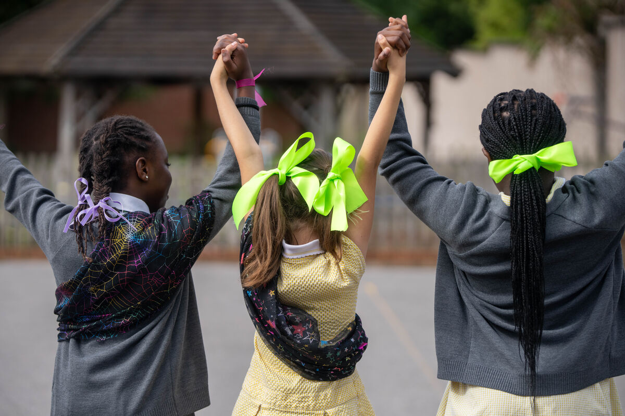
Jesus wanted his disciples to love one another, to be united with each other, to be together – just
as closely as Jesus and God the Father are together.
Jesus prayed for us too. He wants us to be united, together, loving one another.
What sort of things might we do if we are united?
Notes:
Pupils at St Chad's primary school, London
Photo credit: Joe Newman

Slide 7
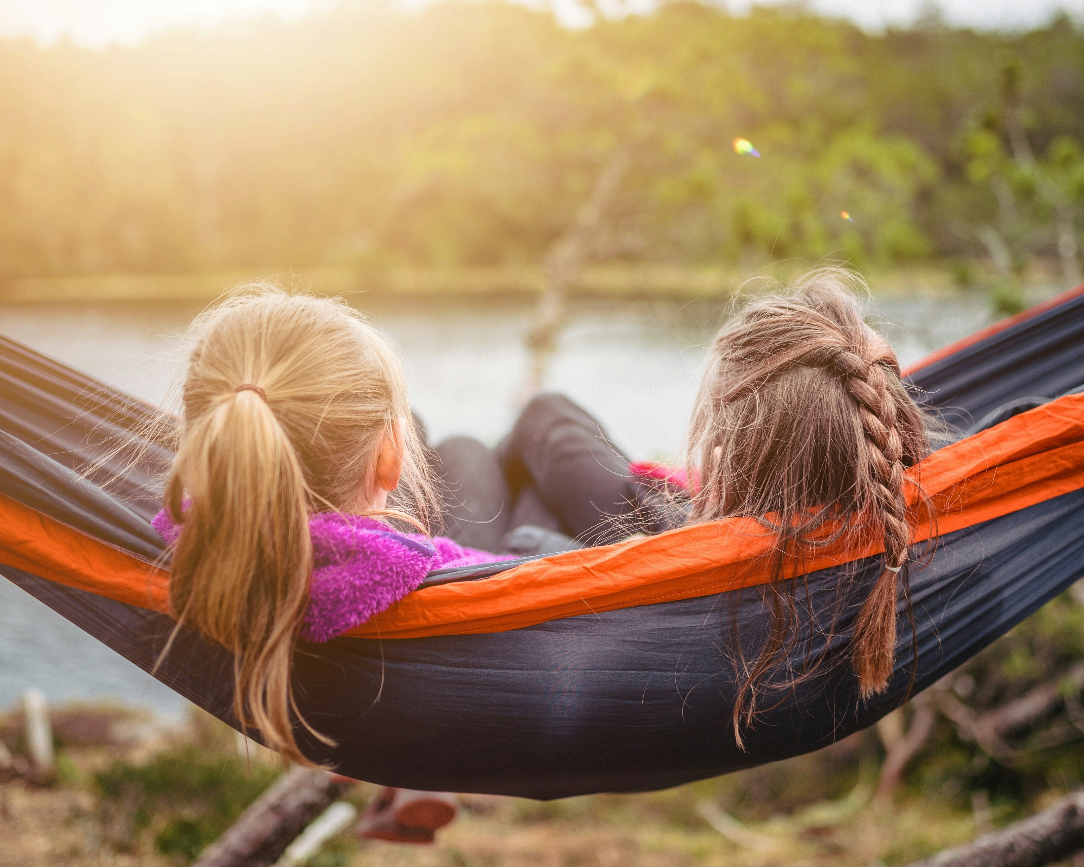
We might spend time together, be at peace with each other, listening to each other and doing what we can to help each other.
We would want what is best for the other person – loving one another
as much as we love ourselves.
Notes:
Together
Photo credit: Janko Ferlic on Unsplash

Slide 8
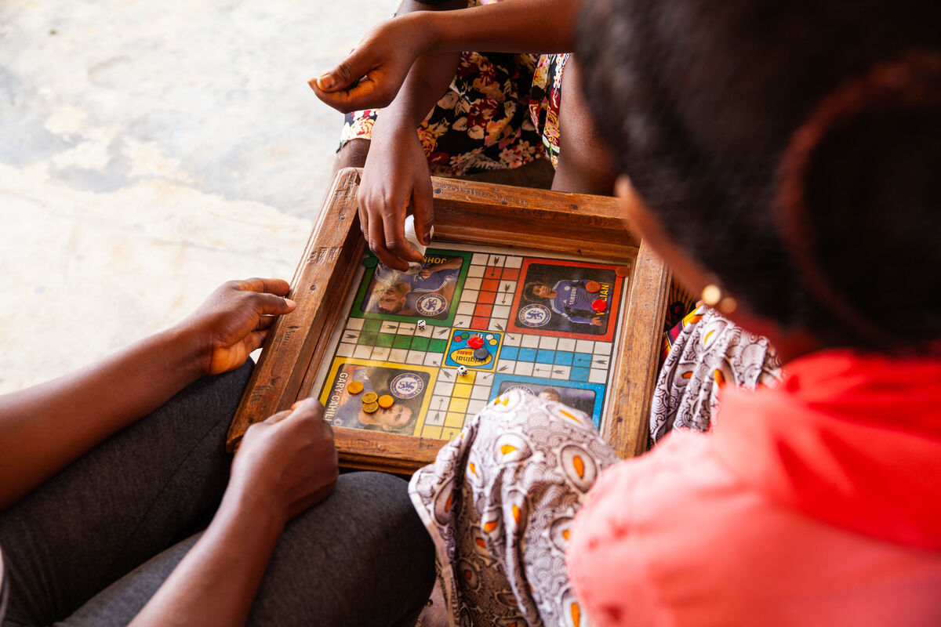
What do you love to have or love to do?
Can you help someone else enjoy the same?
Perhaps you have a favourite book you could read to a little brother or sister.
Perhaps you enjoy music and could invite a friend or family member to join you singing or playing an instrument.
Perhaps you like a particular game which you could teach to a friend.
Notes:
Playing games, Sierra Leone
Photo credit: Thom Flint

Slide 9
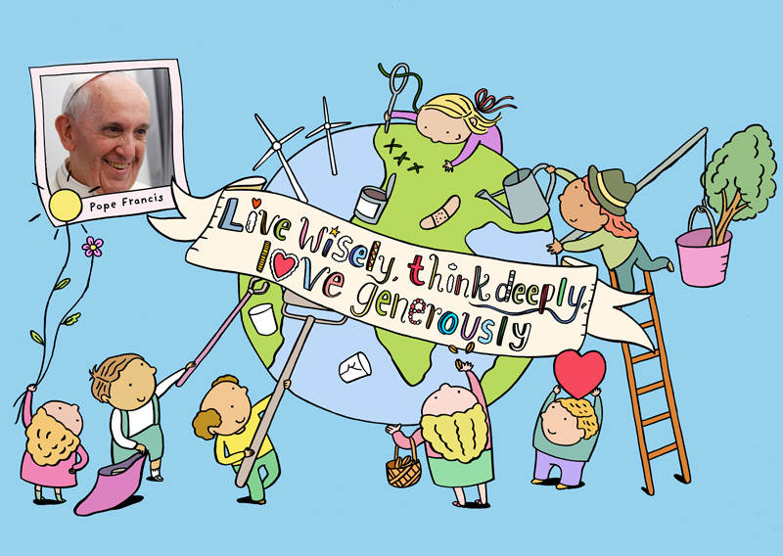
Do you have any other ideas?
How else could we come together with others?
In a special letter called Laudato Si’, Pope Francis asked us all to join together to care for our earth and each other.
Find out how we can do that in our Laudato Si' animation!
Notes:
In a special letter called Laudato Si’, Pope Francis asked us all to join together to care for our earth and each other.
Watch and share our animation to find out more about Laudato Si’: https://cafod.org.uk/education/primary-teaching-resources/laudato-si-for-children
Hands around the world
Photo credit: Stock image

Slide 10

Earlier this year, schools from across England and Wales joined together to take part in the Big Lent Walk.
They helped raise money for our global family around the world who are struggling due to climate change.
During Lent, we met Bayezid from Bangladesh who knows the importance of caring for the planet.

Slide 11
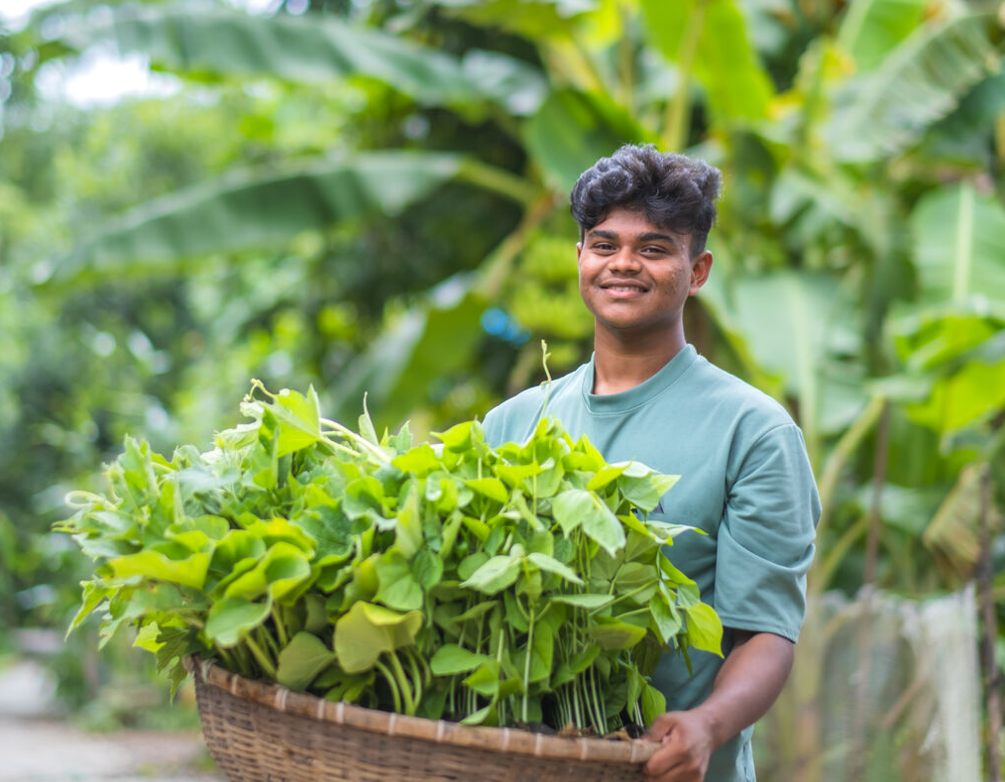
“To build a beautiful world is everyone’s responsibility," Bayezid says.
“We have to try to prevent pollution and to save the environment together,” he adds.
With CAFOD's help, Bayezid and his friends are helping their families to grow floating gardens.
Notes:
Bayezid, Bangladesh
Photo credit: Amit Rudro

Slide 12
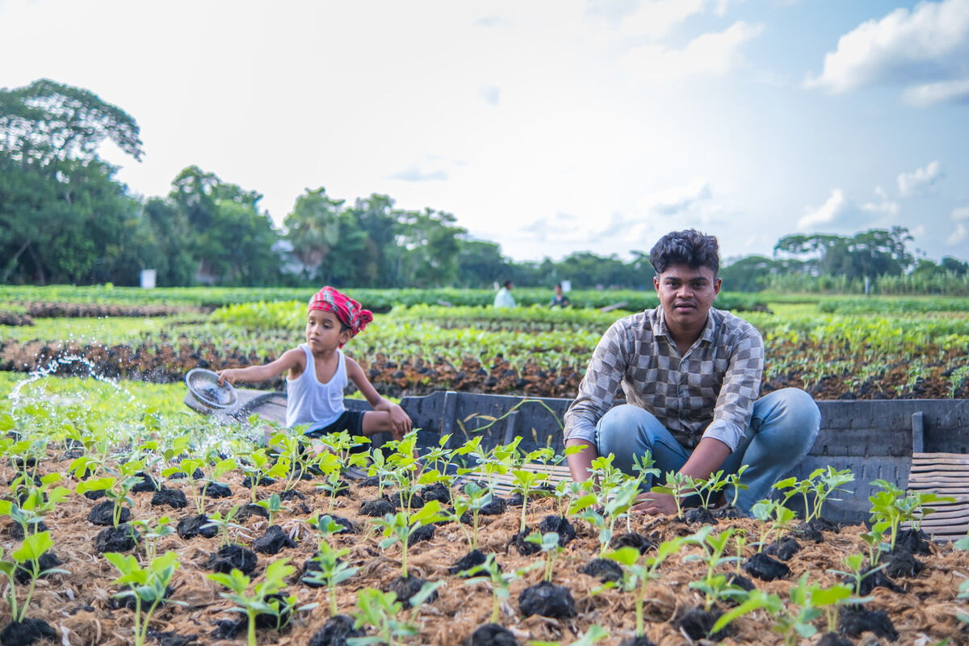
These floating gardens are resistant to extreme rain. Flooding doesn't harm the crops that grow in them.
This means that Bayezid and his family will still have enough food to eat and sell to make their living, despite challenges caused by climate change.
Notes:
Zunayed and Bayezid, Bangladesh
Photo credit: Amit Rudro

Slide 13
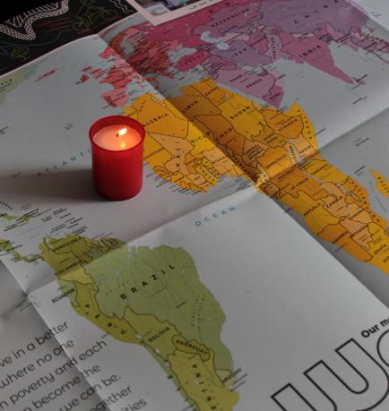
Let us pray
We pray for people who are poor around the world:
that they may feel supported by us as they work to improve life in their communities.
Lord in your mercy…
We pray for our parish, families and friends:
that we may love one another and work together for the good of the earth and everyone who lives here.
Lord in your mercy...

Slide 14
Let us pray
We pray for world leaders:
that they may learn to work together and make decisions that will make the world a more peaceful place.
Lord in your mercy…
God of love: help us to be like Jesus and work together with others to build a better future for all people.
Amen.

Slide 15
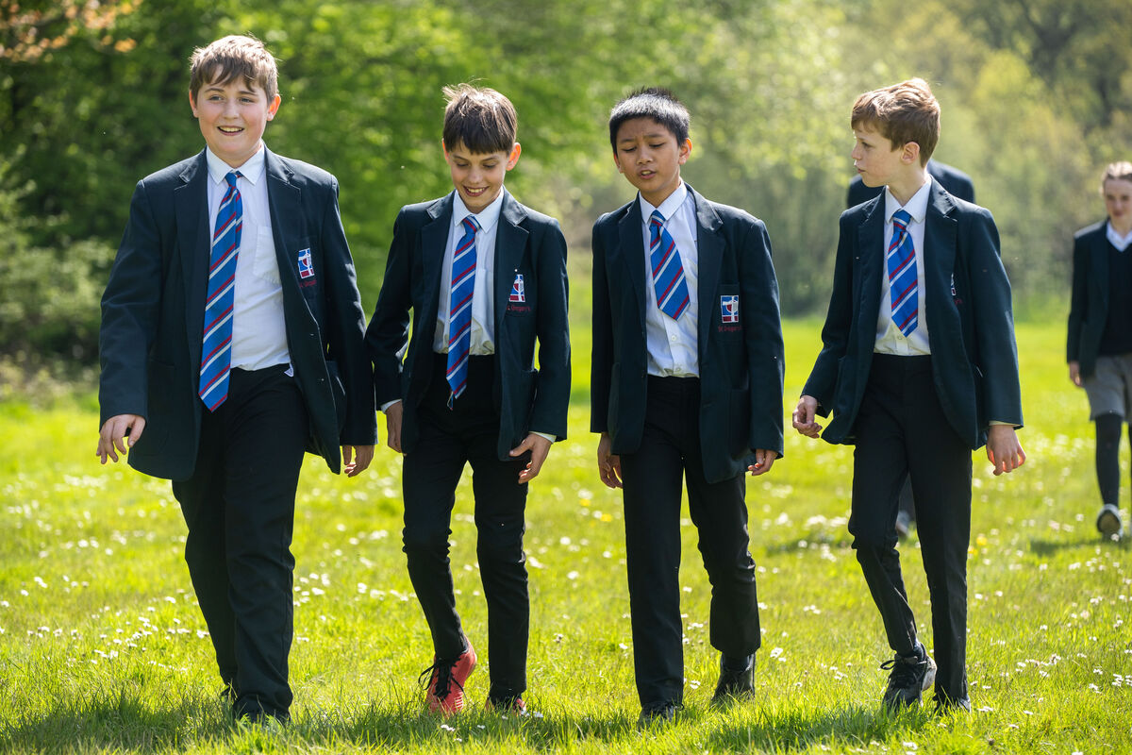
What could you do this week to become more united – or ‘at one’ – with other people?
Send
Notes:
St Gregory's Catholic School, UK
Photo credit: Joe Newman

Slide 16
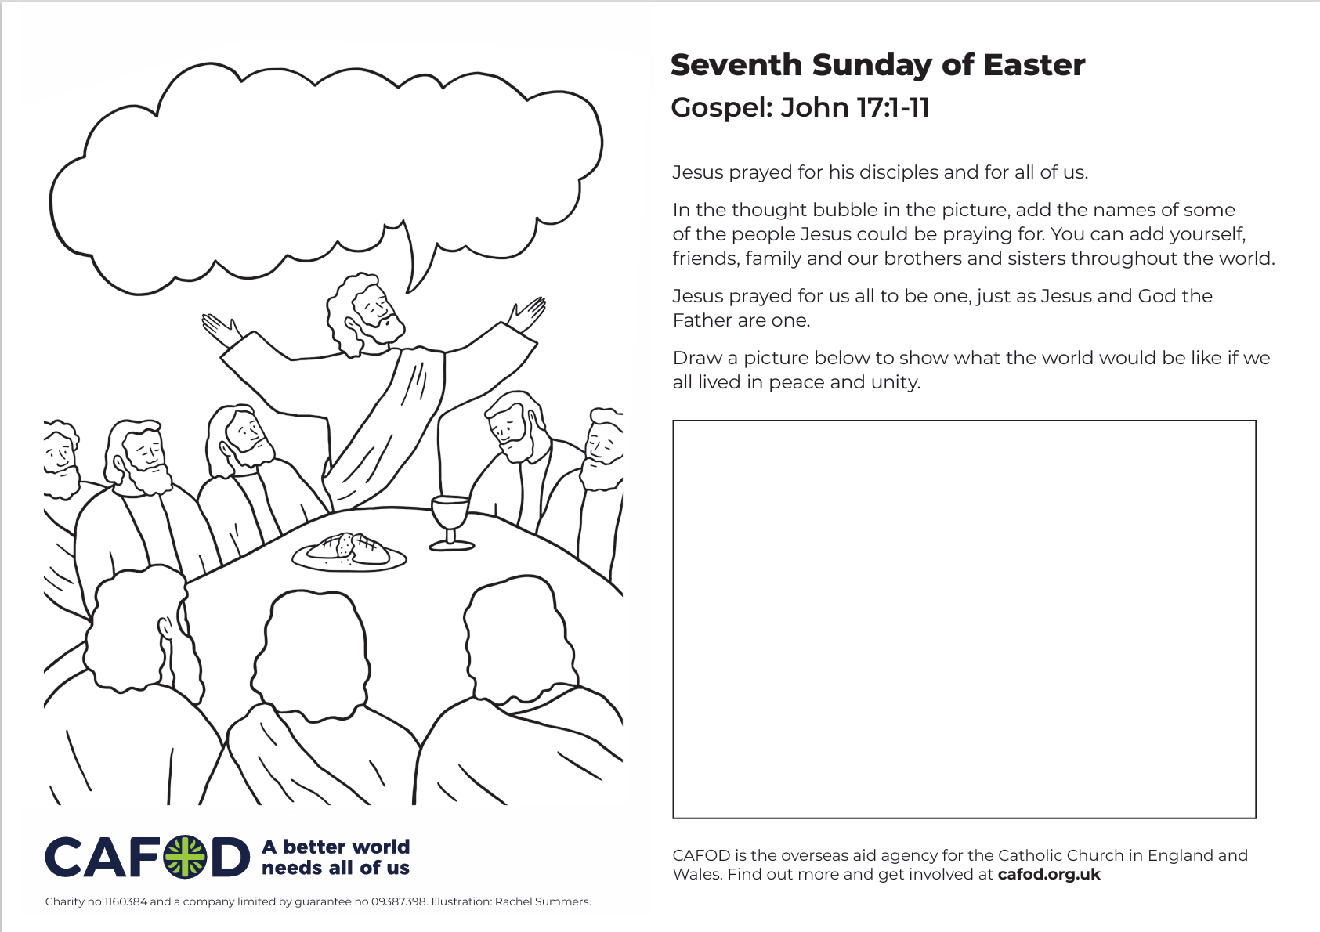
Activity suggestions
Download the illustration
Share the accompanying activity sheet with the children and encourage them to complete it, either in the liturgy or at home.
Remind the children to share all that they have heard and thought about today with the people at home.
Encourage the children to spend time this week doing something they really enjoy together with a family member or friend, either in person or online.
Notes:
Illustration: Rachel Summers

Slide 17
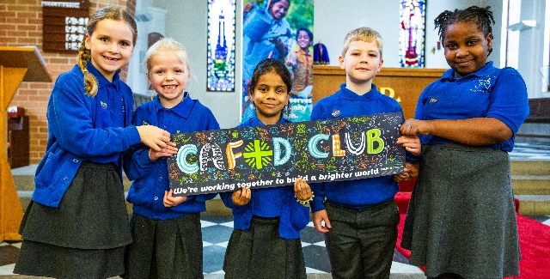
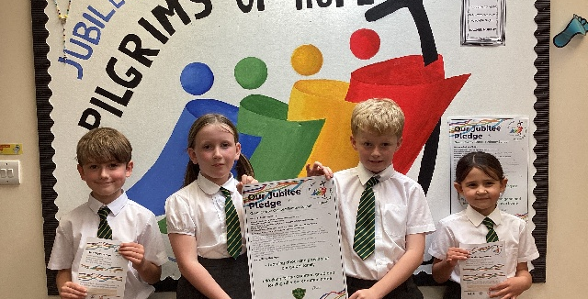

Get involved with CAFOD this term
Explore our summer term resources
Ways to live out your Jubilee Pledge
Fundraise for a World Gift

Slide 18


