Slide 1
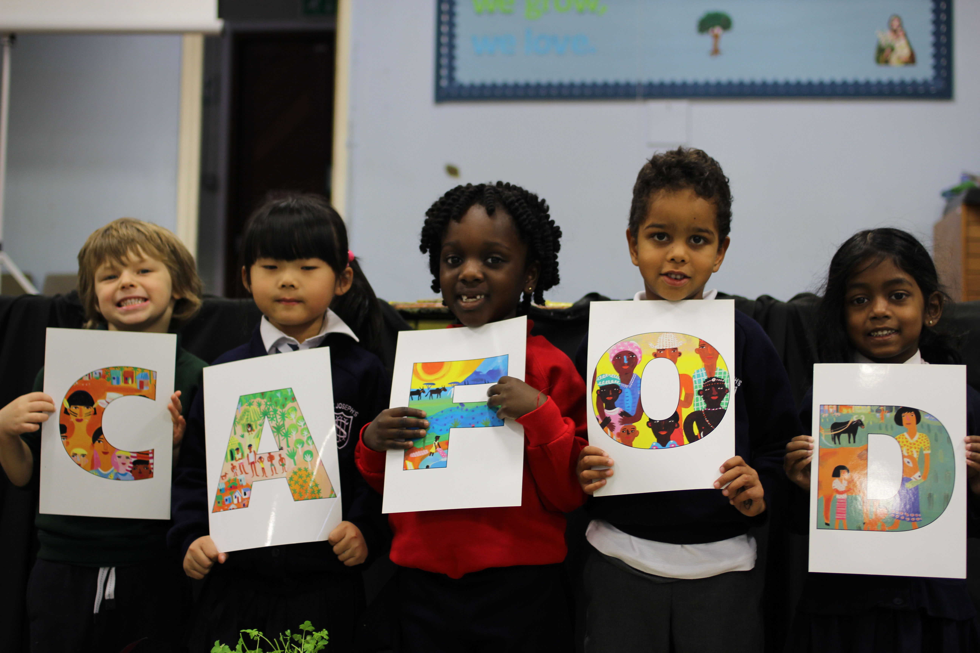
How can we show love for children who live far away this week?
We gather
Notes:
Sixth Sunday of Easter (Year B)
Preparing for worship Download and print the illustration
Colour: White Props: Pencil, paper, scissors, crayons.
Song suggestions: A new commandment I give unto you (4, Celebration Hymnal for Everyone) Give me joy in my heart (190, Celebration Hymnal for Everyone.)

Slide 2
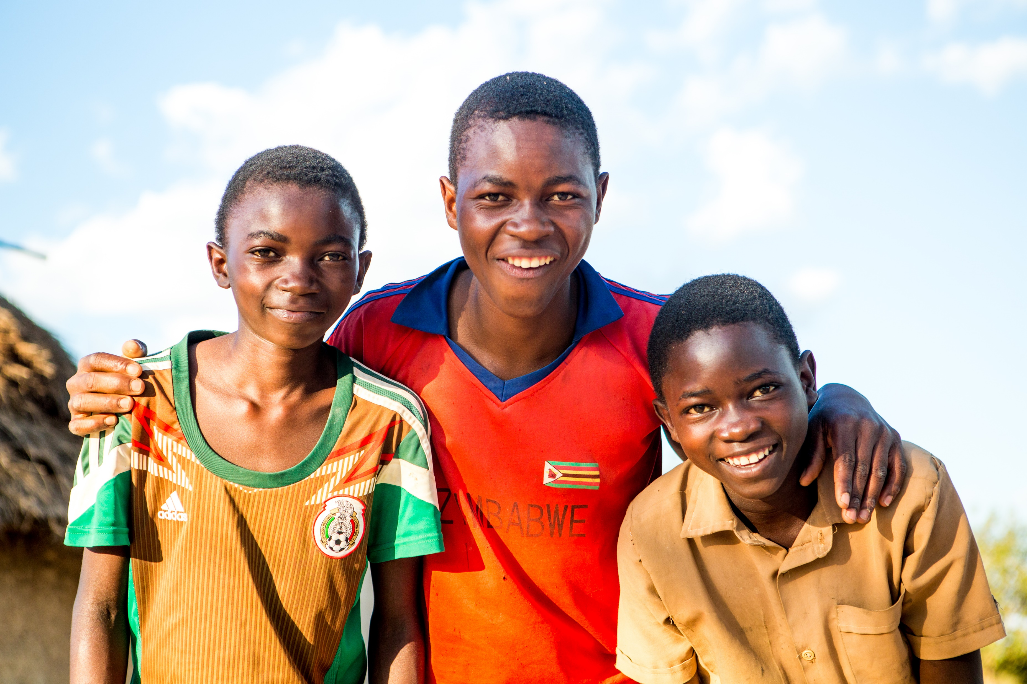
God of joy, you loved us so much you sent your Son to us.
Help us to love each other as you love us.
Amen.
Notes:
Welcome: Today Jesus asks us to love one another as he loves us. He talks about the importance of looking out for our friends, and how we can all be friends of Jesus. Let’s think a bit more about our friends today.

Slide 3
Jesus said: 'If anyone loves me he will keep my word, and my Father will love him, and we shall come to him.’

Slide 4
Gospel: John 15:9-17
I love you just as the Father loves me; remain in my love. If you obey my commands, you will remain in my love, just as I have obeyed my Father's commands and remain in his love.
“I have told you this so that my joy may be in you and that your joy may be complete. My commandment is this: love one another, just as I love you. The greatest love you can have for your friends is to give your life for them. And you are my friends if you do what I command you.
We listen

Slide 5
I do not call you servants any longer, because servants do not know what their master is doing. Instead, I call you friends, because I have told you everything I heard from my Father.
You did not choose me; I chose you and appointed you to go and bear much fruit, the kind of fruit that endures. And so the Father will give you whatever you ask of him in my name. This, then, is what I command you: love one another.

Slide 6
Gospel reflection – What do you remember?
Jesus is telling us he loves us very much. How does it feel to know that Jesus loves each of us so much?
Jesus says he chose us all to be his friends, and we should love others in the same way as he loves us. He says that we should all do as much as we can to help our friends, and that if we follow his teaching, we will be friends of Jesus.
Who are your friends? Can you tell me the name of two of your friends? What do you like about your friends?
We respond

Slide 7
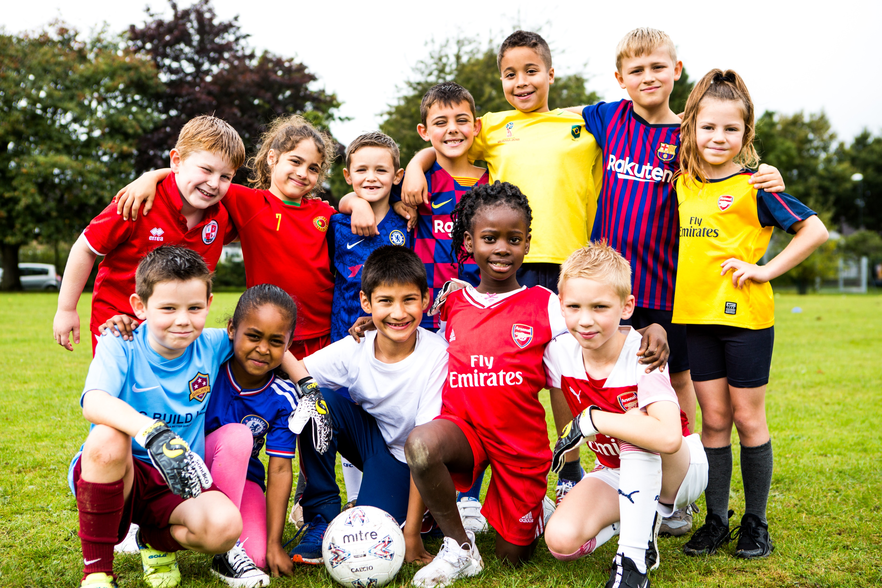
Friends can make us happy and laugh. They help us when we find things difficult.
They are kind and share with us.
Can you tell me something one of your friends has done to make you happy?
What do you do to help your friends up when they are sad or finding something difficult?

Slide 8
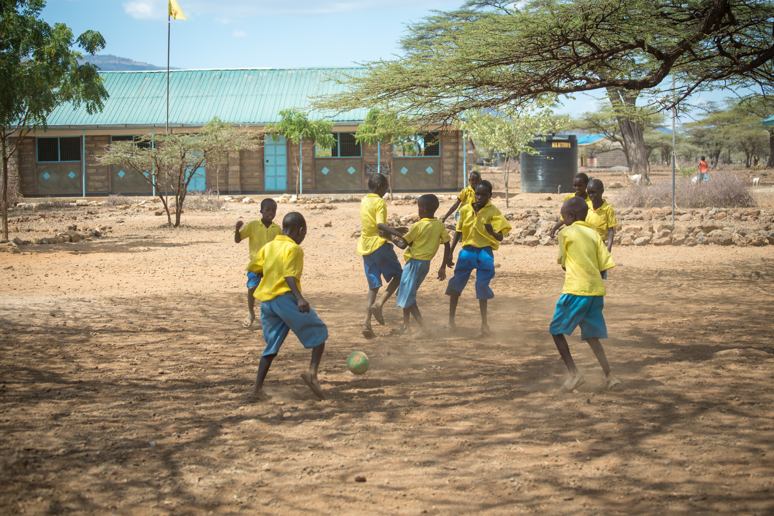
Children in other parts of the world are the same as us, they also like to have friends that they play games with, friends who make them happy when they are sad and help them when they are in trouble.

Slide 9
My commandment is this:
love one another, just as I love you.
Jesus asks us today to love others as he has loved us. How do you think we can do this? How can we show love for children who live far away on the other side of the world?

Slide 10
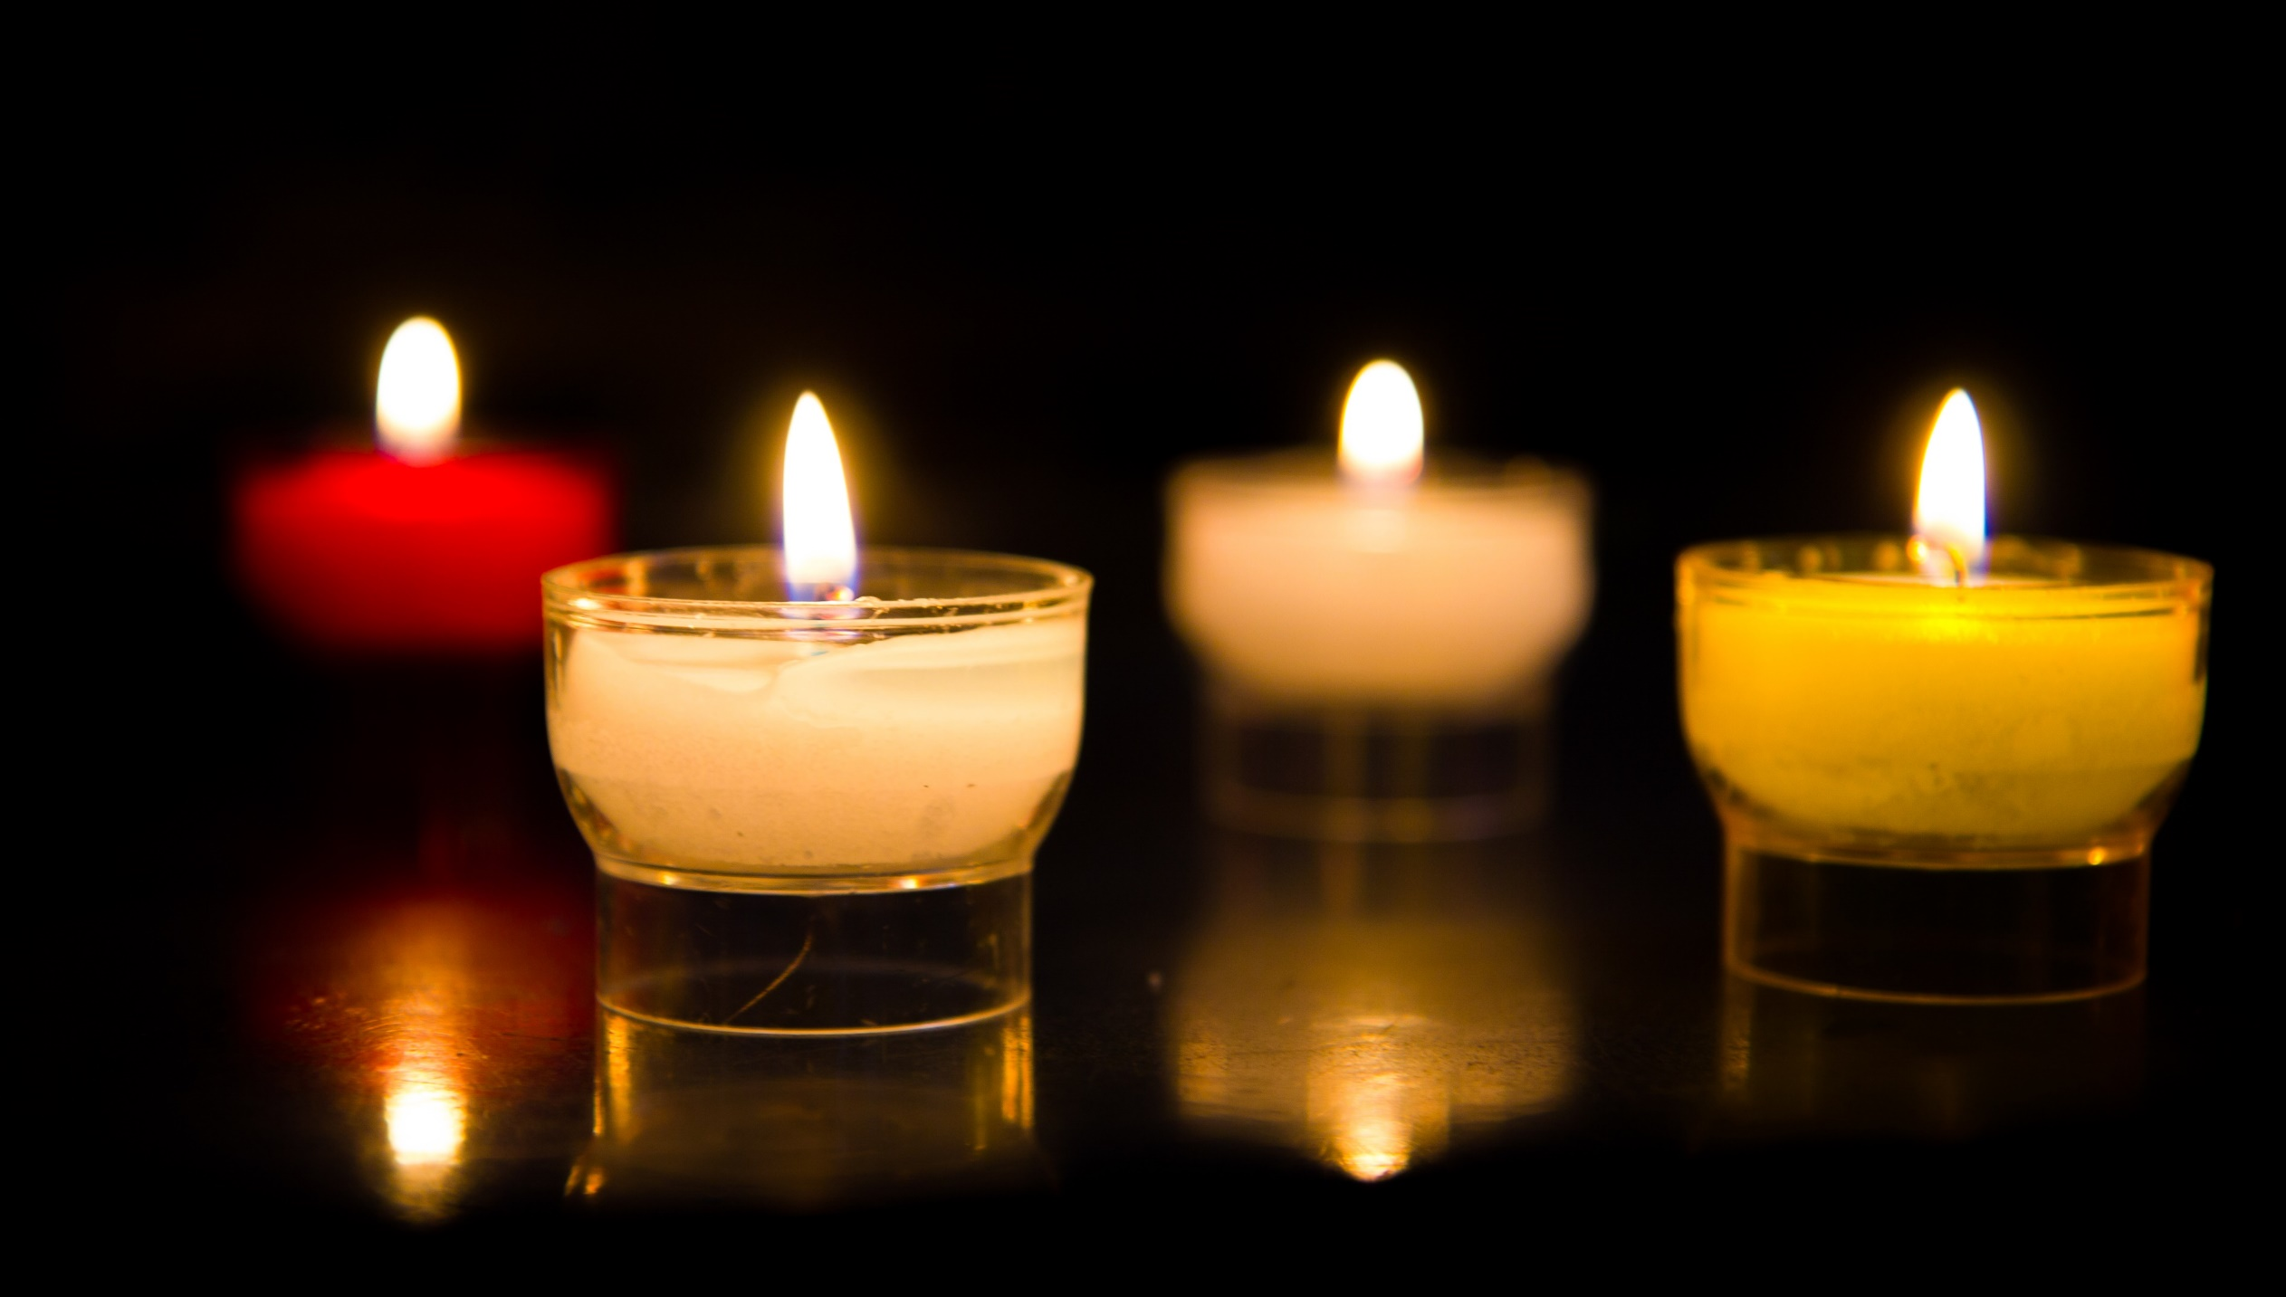
Let us pray…

Slide 11
We pray for world leaders: that they may be inspired by Jesus’ example of love, to do what is best for all people. Lord, hear us…
We pray for all children around the world: that they may have the chance to play and learn with their friends. Lord, hear us…

Slide 12
We pray for our school, family and friends: that we may be good friends to each other, helping and caring for others especially people who are poor around the world. Lord, hear us…
Generous God, we give thanks for our friends and the joy they bring us. Help us to be generous, loving and kind to all people around the world, so that they may know that we are their friends. Amen.

Slide 13
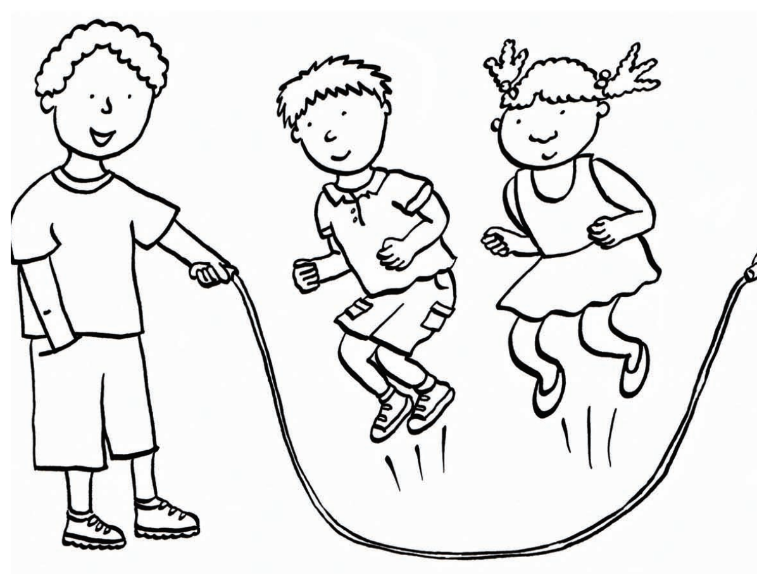
How will you be a good friend this week to children here and in other countries around the world? And how will you follow Jesus’ example of love for all people, no matter where they are in the world?
Going forth

Slide 14
Activity suggestions
Ask the children to colour in the accompanying illustration, and to draw in themselves and their friends into the group of children – one of the children in the illustration is just an outline which they can add their own features on to. On the back ask them to write a prayer giving thanks for their friends, or to write or draw how they will be good friends to others around the world this week.
Make a paper chain of friends with the children:
•Fold a sheet of paper, accordion-fashion, (like you would to make a paper fan) in three-inch strips so that all sections are equal. The number of folds in the paper determines the number of people in the chain.
•On the top piece of the folded paper, draw a person whose hands extend to touch the folds of the paper on each side.
•Carefully cut around the person, making sure NOT to cut where the hands meet the folds.
•Open up the paper and you will have a chain of several people holding hands.
•Get the children to colour them in with crayons. They can also name the paper people as different people in their friendship group – including some of the children from around the world featured in CAFOD’s website and resources at cafod.org.uk/primary
Ask the children to go home and share all that they have heard and thought about today and to ask the people they live with who their friends are! If the children have written a prayer giving thanks for their friends encourage them to say this at home during the week. Ask them to show their love for others both here and around the world over the coming week as Jesus asks us to.

Slide 15
Notes:
Illustration: Emma Metcalfe

