Slide 1

Notes:
Zunayed in his floating garden, Bangladesh
Photo credit: Amit Rudro

Slide 2
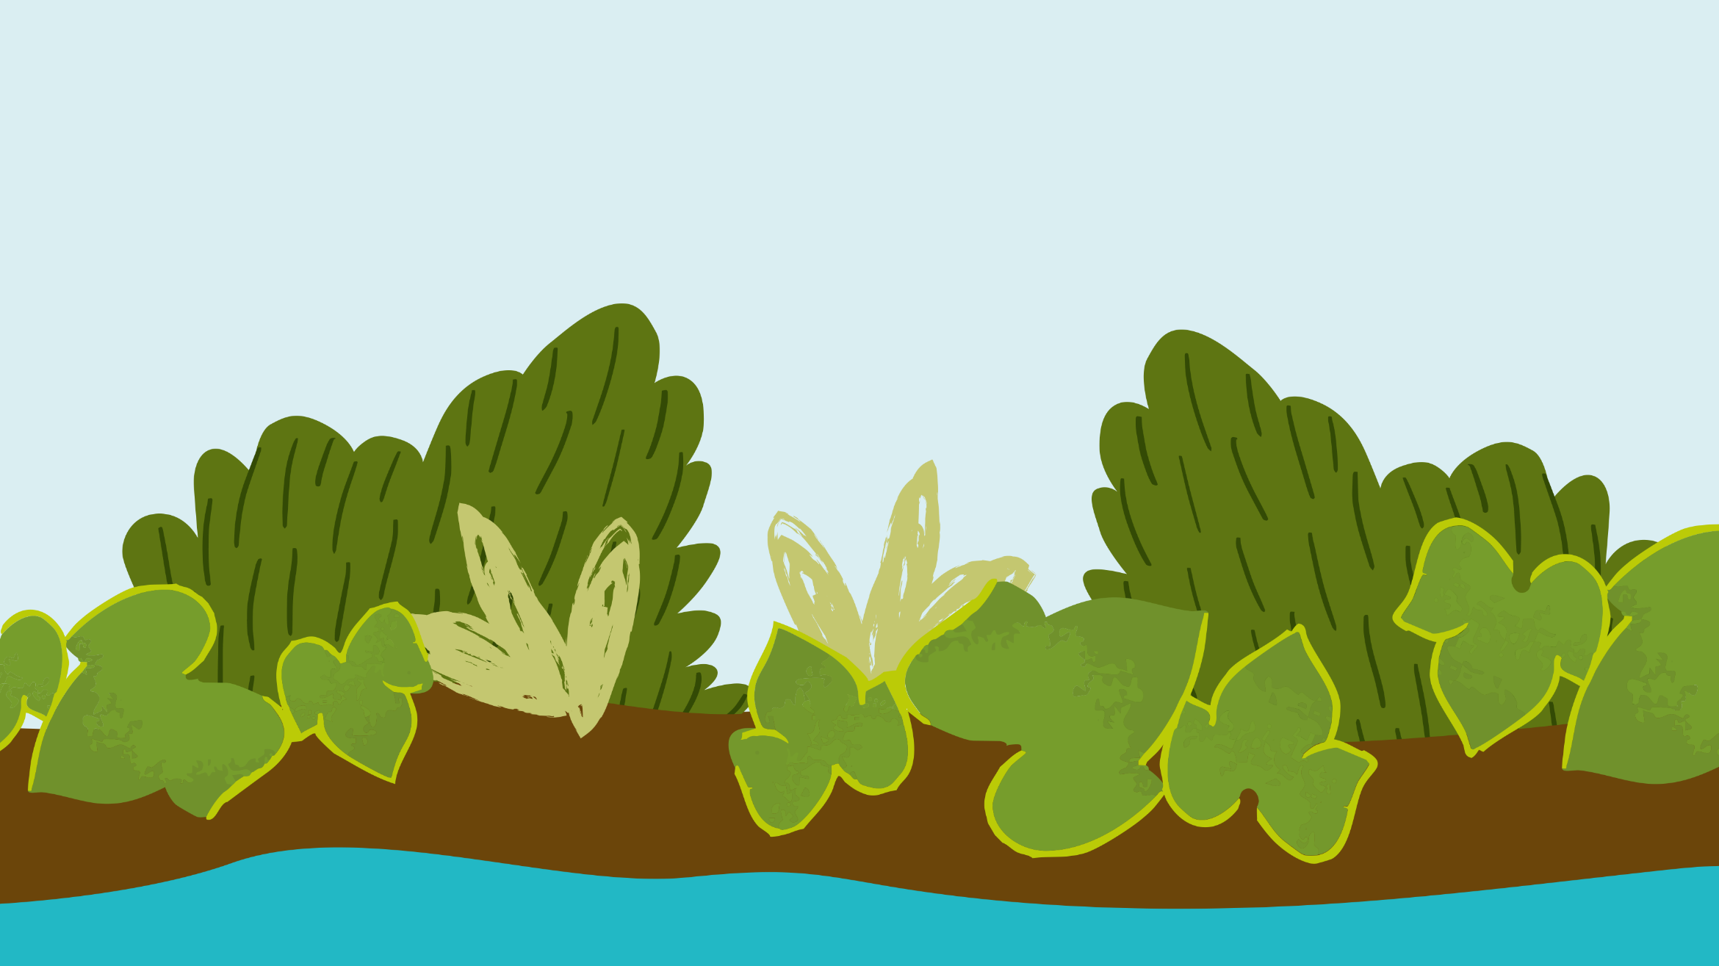

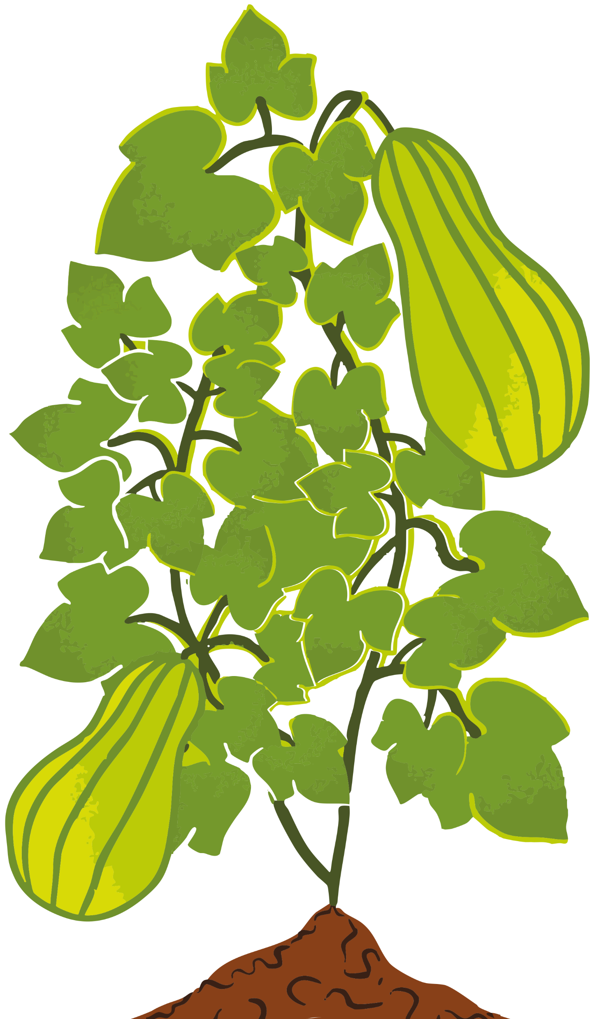


Lent calendar 2026
Week: One Two Three Four Five Six
M
T
W
T
F
23 February
2 March
9 March
16 March
23 March
30 March
24 February
3 March
10 March
17 March
24 March
31 March
Ash
Wednesday
25 February
4 March
11 March
18 March
25 March
1 April
19 February
26 February
5 March
12 March
19 March
26 March
Maundy
Thursday
20 February
CAFOD
Fast Day
6 March
13 March
20 March
27 March
Good
Friday
Easter
Saturday
Easter
Sunday

Slide 3
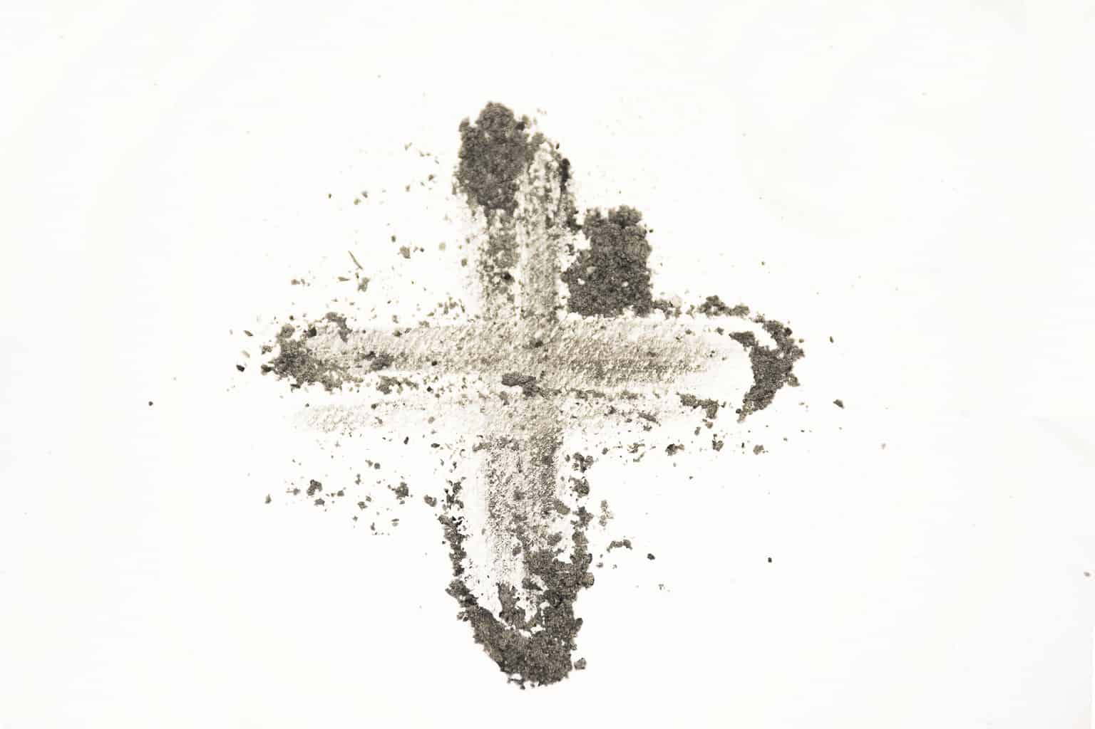



Wednesday 18 February
Think about...
As Lent begins, we remember how Jesus spent 40 days in the desert.
While Jesus was in the desert he had very little to eat or drink.
There are many people around the world today who do not have the right things to live a happy life like enough food to eat or clean water to drink.
Throughout this Lent, we will think about our neighbours living in poverty around the world.
Download our Lent liturgy - perfect for Ash Wednesday

Slide 4

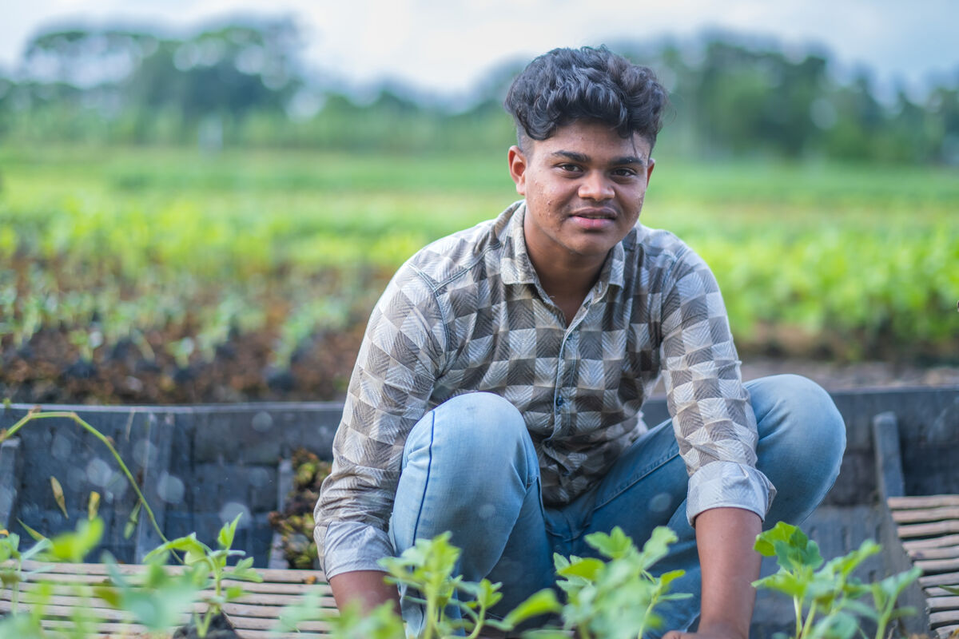
Thursday 19 February
Think about...
Act
This Lent, we are thinking particularly about our global neighbours who struggle to grow food because of climate change.
Meet 16-year-old Bayezid who lives in a village called Choto Bashail in Bangladesh.
Since he was little, Bayezid has helped his
family grow vegetables on a floating garden plot. But in recent years, growing
crops has become very tough because
of climate change.
Make a Bangladesh Lent display with our resources!
Notes:
Bayezid, Bangladesh
Photo credit: Amit Rudro

Slide 5
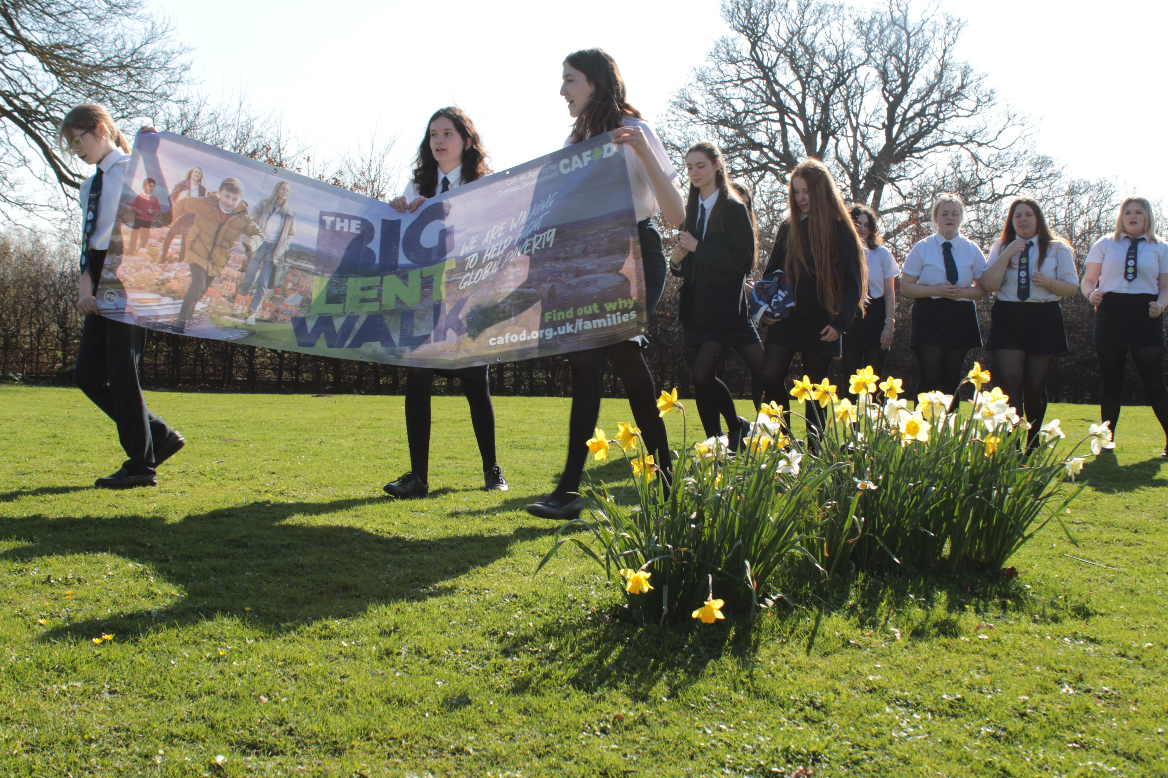
Friday 20 February
Think about...
Lent is a time when we pray, do kind things for other people, give up things and give to others, as we prepare to celebrate the great feast of Easter.
When we fundraise for others, or give up fast food, snacks or some other treat, we stand in solidarity with people who are living in poverty.
What can you do this Lent to stand
with our brothers and sisters living in poverty?
Colour and pray each day with prayer leaves
Notes:
Girl thinking
Photo credit: Stock image

Slide 6


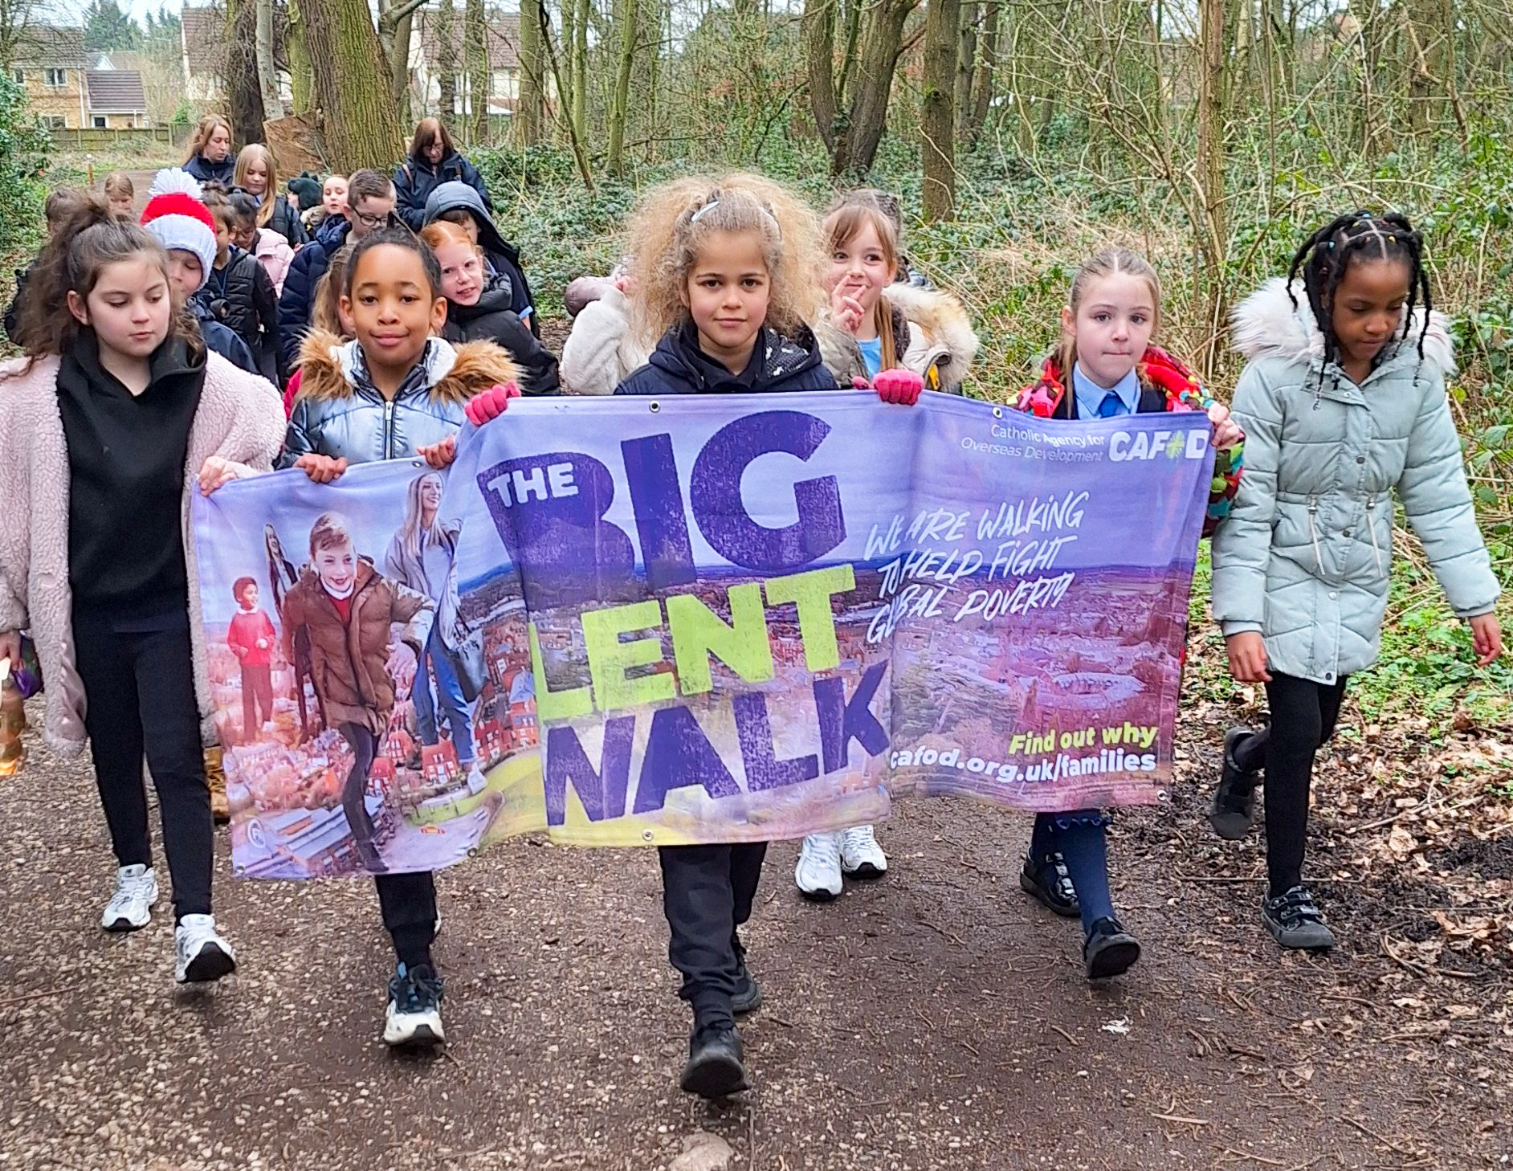

Monday 23 February
Pray
Act
Give
This Lent, schools in England and Wales are taking part in the Big Lent Walk, raising money to help communities like Bayezid's through tough times.
Could you join other school children in making a difference this Lent?
Lord, may my support bring hope to people in difficulty around the world.
May they know you are with them, with a family who care for them. Amen.
Watch this film about the Big Lent Walk!
Notes:
School children doing the Big Lent Walk
Photo credit: CAFOD Liverpool

Slide 7
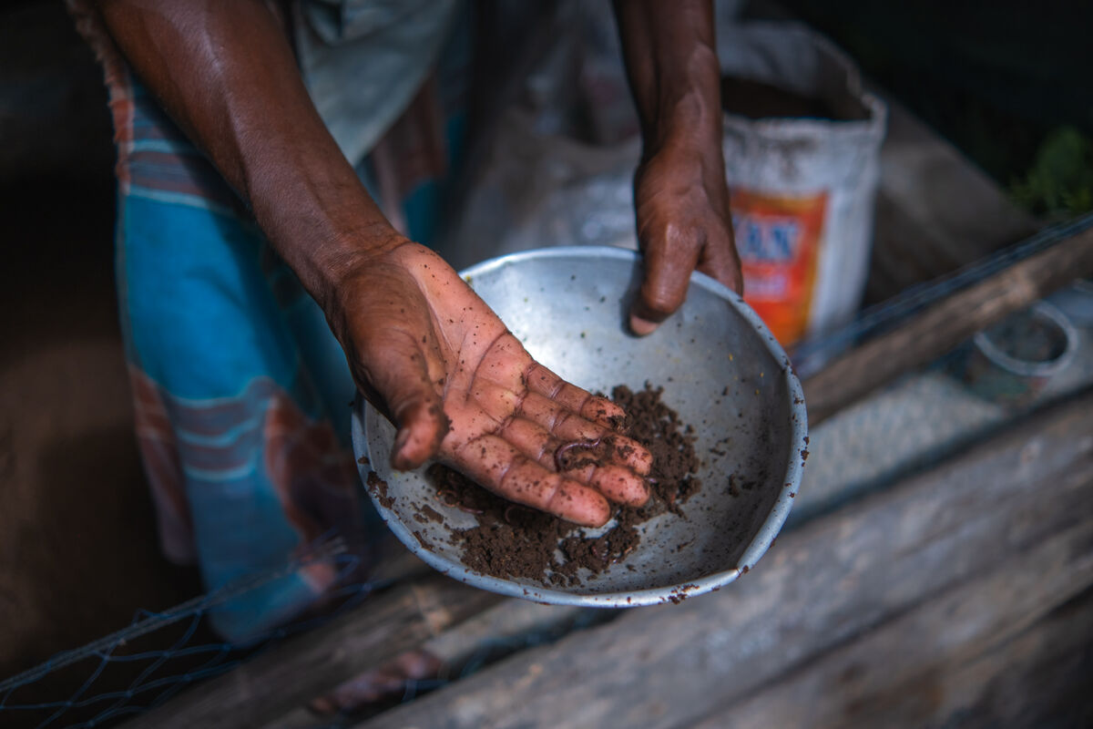
Tuesday 24 February
Pray
Climate change can make growing crops very difficult.
In some parts of the world, there is too little rain. In places like Bangladesh, where Bayezid lives, there is too much. The result is the same – seeds fail to grow, plants die and families will go hungry.
"It's a big loss for us in Choto Bashail," says Bayezid.
Lord, fill our hearts with compassion for all our brothers and sisters around the world. Lead us to be good neighbours to all in need. Amen.
Notes:
Farmer Moksed Biswas, Bangladesh
Photo credit: Amit Rudro

Slide 8

Wednesday 25 February
Act
Fairtrade is about giving a fair share to all the people who produce food around the world.
Find out if your local shop sells Fairtrade Easter eggs. If not, ask them why not?! Ask if they'll consider stocking them next year.
Could you become a Fairtrade school? This is a great way to live out your school’s Jubilee Pledge!
Find Fairtrade resources

Slide 9
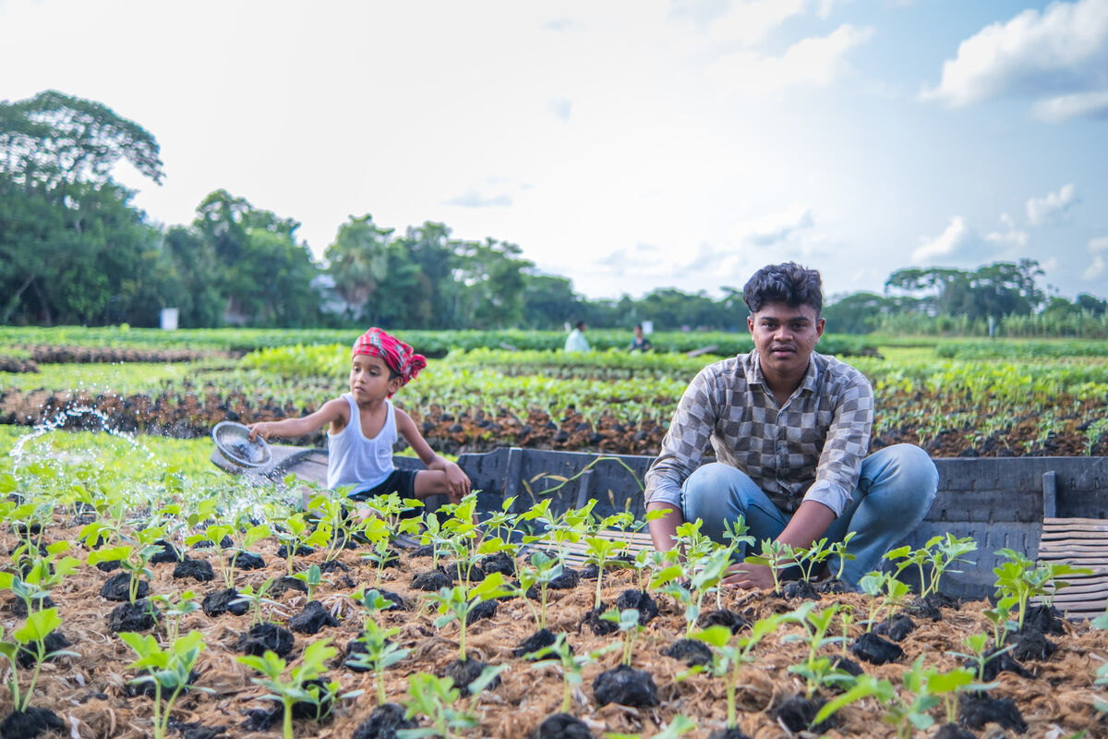
Thursday 26 February
Think about...
Join our national assembly today.
Join schools from across England and Wales to watch it!
Meet communities in Bangladesh and find out how Bayezid and his neighbour Zunayed are helping their families to grow floating gardens.
Join our Lent national assembly
Join our national assembly
Notes:
Bayezid and Zunayed among the floating gardens, Bangladesh
Photo credit: Amit Rudro

Slide 10
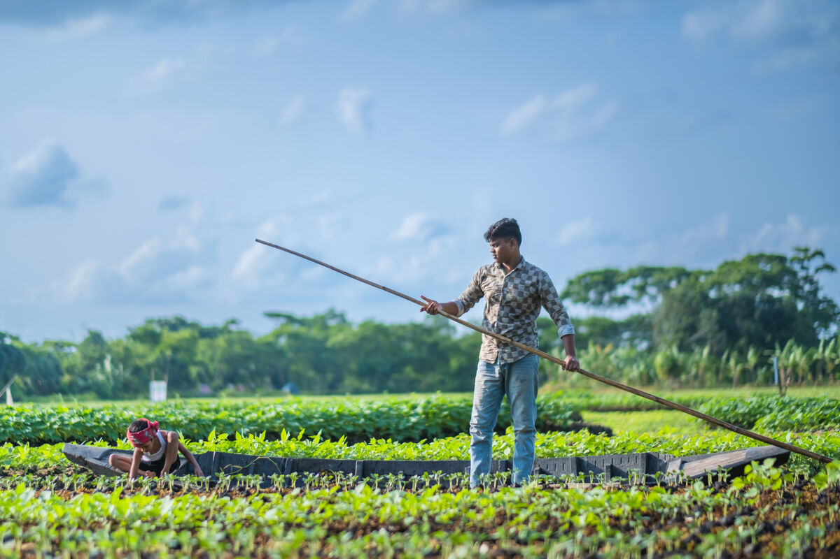
Friday 27 February
Pray
Act
Today is CAFOD’s Lent Fast Day!
Watch our Lent film to learn more about Bayezid and his neighbours in Choto Bashail.
See how, with CAFOD's help, they are working together, and with the environment, to grow crops that won't be destroyed by flooding.
Lord,
Lord, on this CAFOD Fast Day, we pray for those around the world who do not have enough food to eat. May we do what we can to help them. Amen.
Watch and share this Lent film
Notes:
Bayezid, Bangladesh
Photo credit: Amit Rudro

Slide 11
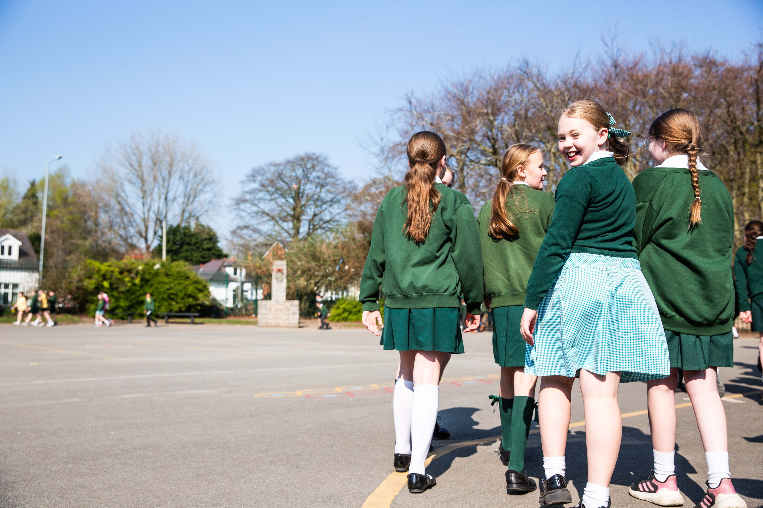
Monday 2 March
Act
What action will you take to show kindness to others today?
How will you carry on as the Pilgrims of Hope we were called to be in the Jubilee Year?
Think of at least three things you can do today and in the next week of Lent.
Notes:
Pupils on the Big Lent Walk
Photo credits: CAFOD

Slide 12
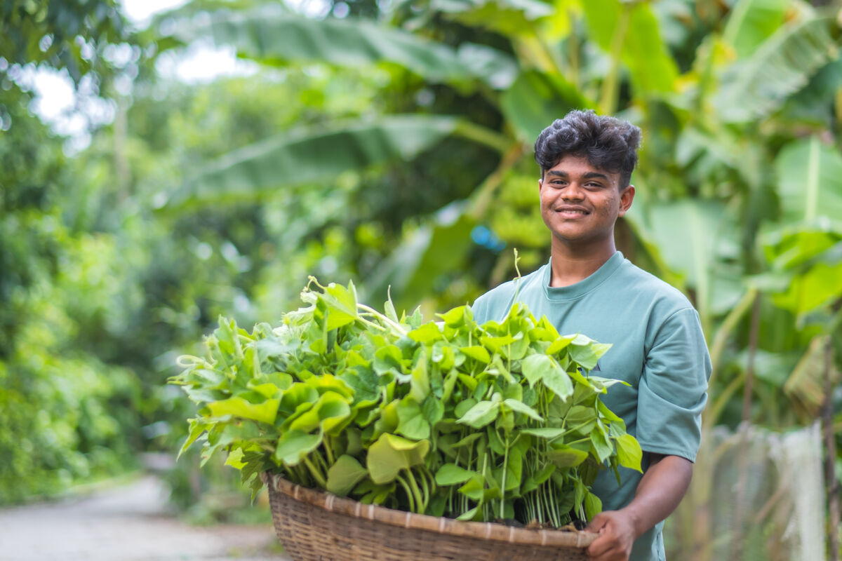
Tuesday 3 March
Pray
Act
Everyone likes to receive a letter!
Pope Francis wrote a special letter called Laudato Si' to everyone on earth asking us to take care of the world - our common home.
Bayezid knows how important it is to care for creation. “To build a beautiful world is everyone’s responsibility,” he says. “We have to prevent pollution and save the environment together.”
Watch our Laudato Si' animation
Lord,
Notes:
Bayezid, Bangladesh
Photo credit: Amit Rudro

Slide 13
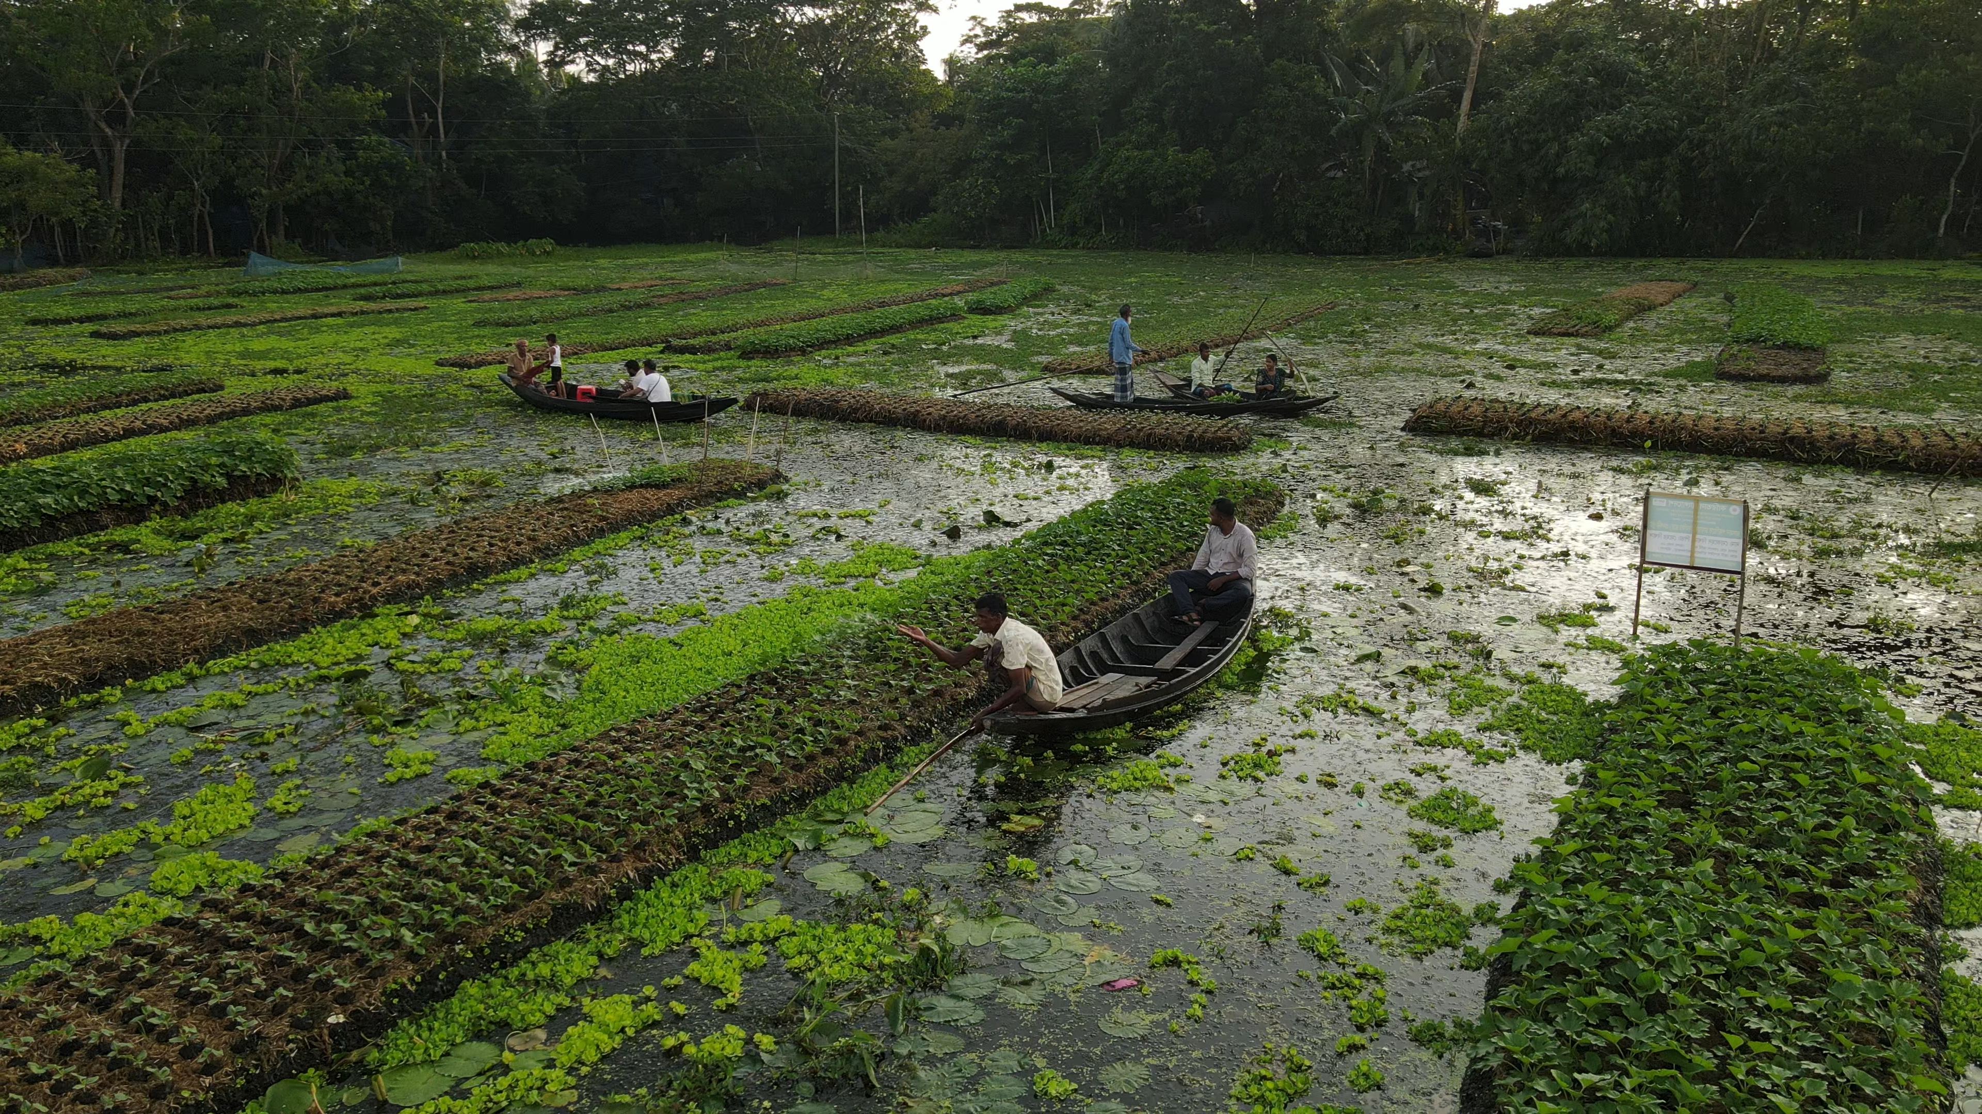
Wednesday 4 March
Think about...
Climate change has caused devastating floods in Bangladesh.
Bayezid's community has struggled to make a living because the increase in rain has ruined their crops.
With CAFOD’s help, local experts work with families to build floating gardens. Because they are buoyant, the gardens rise with growing water levels, they are not flooded and the crops stay safe. How amazing!
Play Our Wonderful World game!
Notes:
Floating gardens, Bangladesh
Photo credit: Amit Rudro

Slide 14

Thursday 5 March
Pray
Act
Give
How can we be a neighbour to our brothers and sisters who are living in poverty so far away from us?
Sometimes it may feel difficult. The Big Lent Walk gives us the opportunity to stand in solidarity and to raise money to help communities to help themselves out of poverty.
Lord, fill our hearts with compassion for the earth and all its people. Lead us to be good
neighbours to all who are in need.
Amen.
Join the Big Lent Walk!

Slide 15
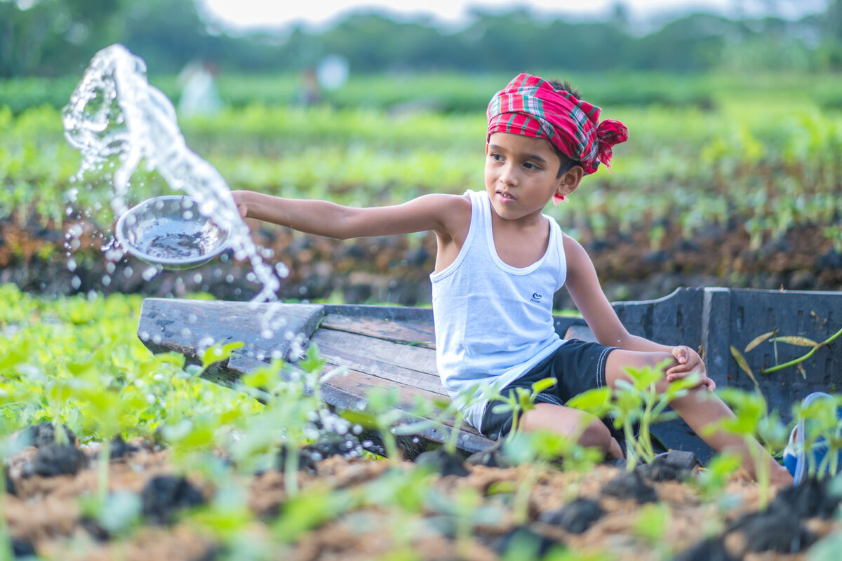
Friday 6 March
Think about...
Zunayed likes visiting the floating gardens with his father, who had watched his neighbours plant beds. He became curious, went to training sessions and learnt how to build them himself.
Zunayed is keen to keep an eye on things – checking that the plants on the floating beds are growing well.
Learn more in the floating gardens photopack
Notes:
Zunayed at the gardens, Bangladesh
Photo credit: Amit Rudro

Slide 16
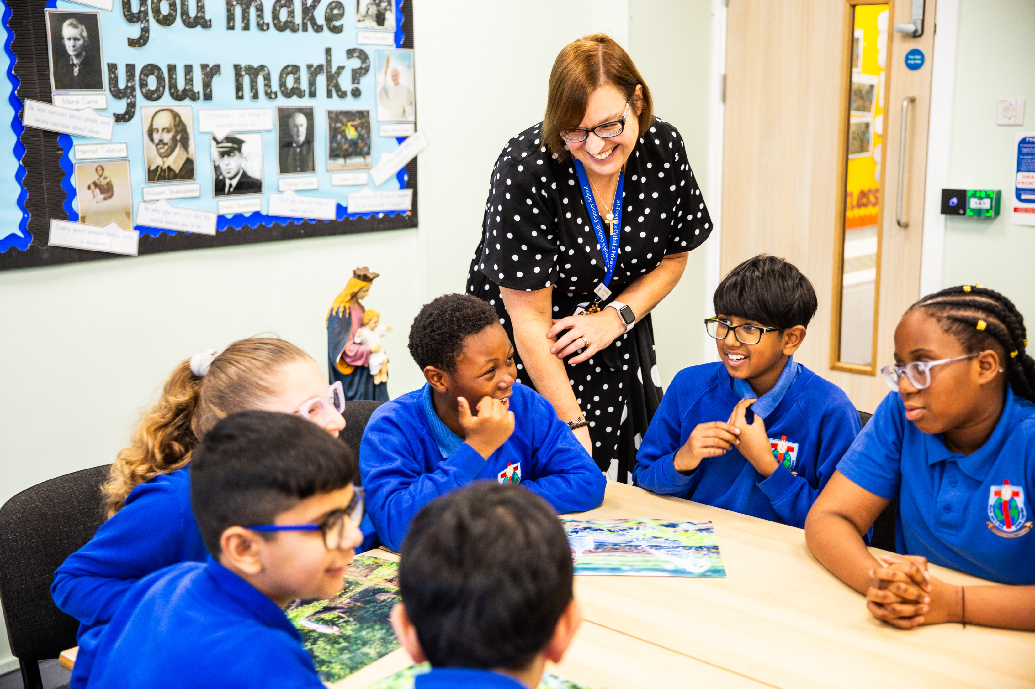
Monday 9 March
Think about...
Pray
“I have come so that they may have life, and have it to the full.” John 10:10
Say these words together and spend time today thinking about them.
Where do these words come from?
What do they mean?
How can we live by these words and put our faith into action?
Lord, help us use our talents and make the most of opportunities so that we live our best lives! Help us to put our faith into action so that we can help others live life to the full too. Amen.
Notes:
Children in Dudley exploring the Lent Bangladesh photopack
Photo credit: Amit Rudro

Slide 17
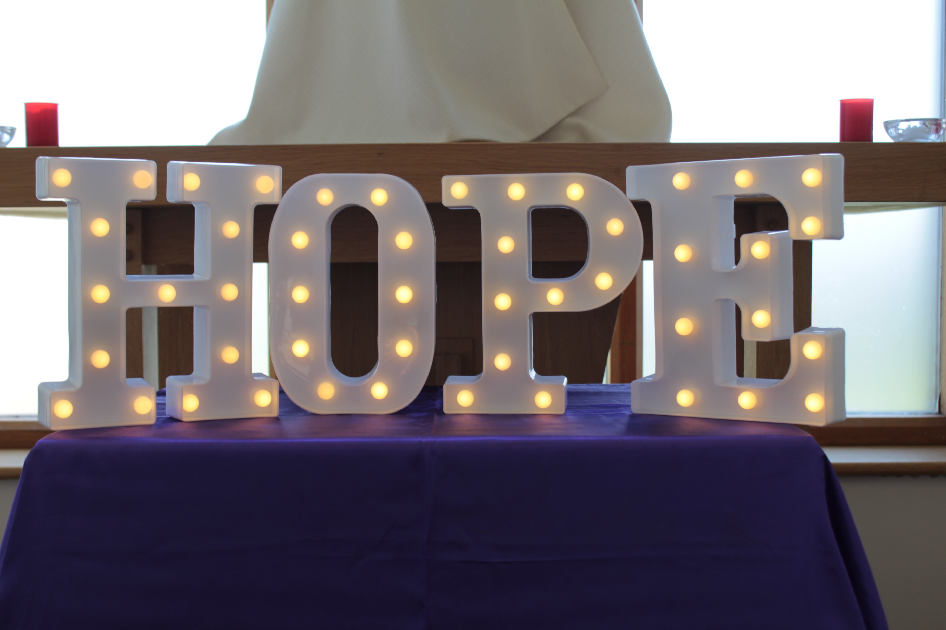
Tuesday 10 March
Think about...
Last year, we were called to be Pilgrims of Hope in the Jubilee Year, and we continue to look forward with renewed hope.
Find a glass jar and decorate it as your class Jar of Hope.
Keep the jar on the prayer focus table. Write or draw things that make you feel hopeful on a piece of paper and pop it into the jar. Share your hopes during prayer times!
You can still make a Jubilee Pledge
Notes:
A hope display in a school chapel.
Photo credit: Victoria Ahmed

Slide 18
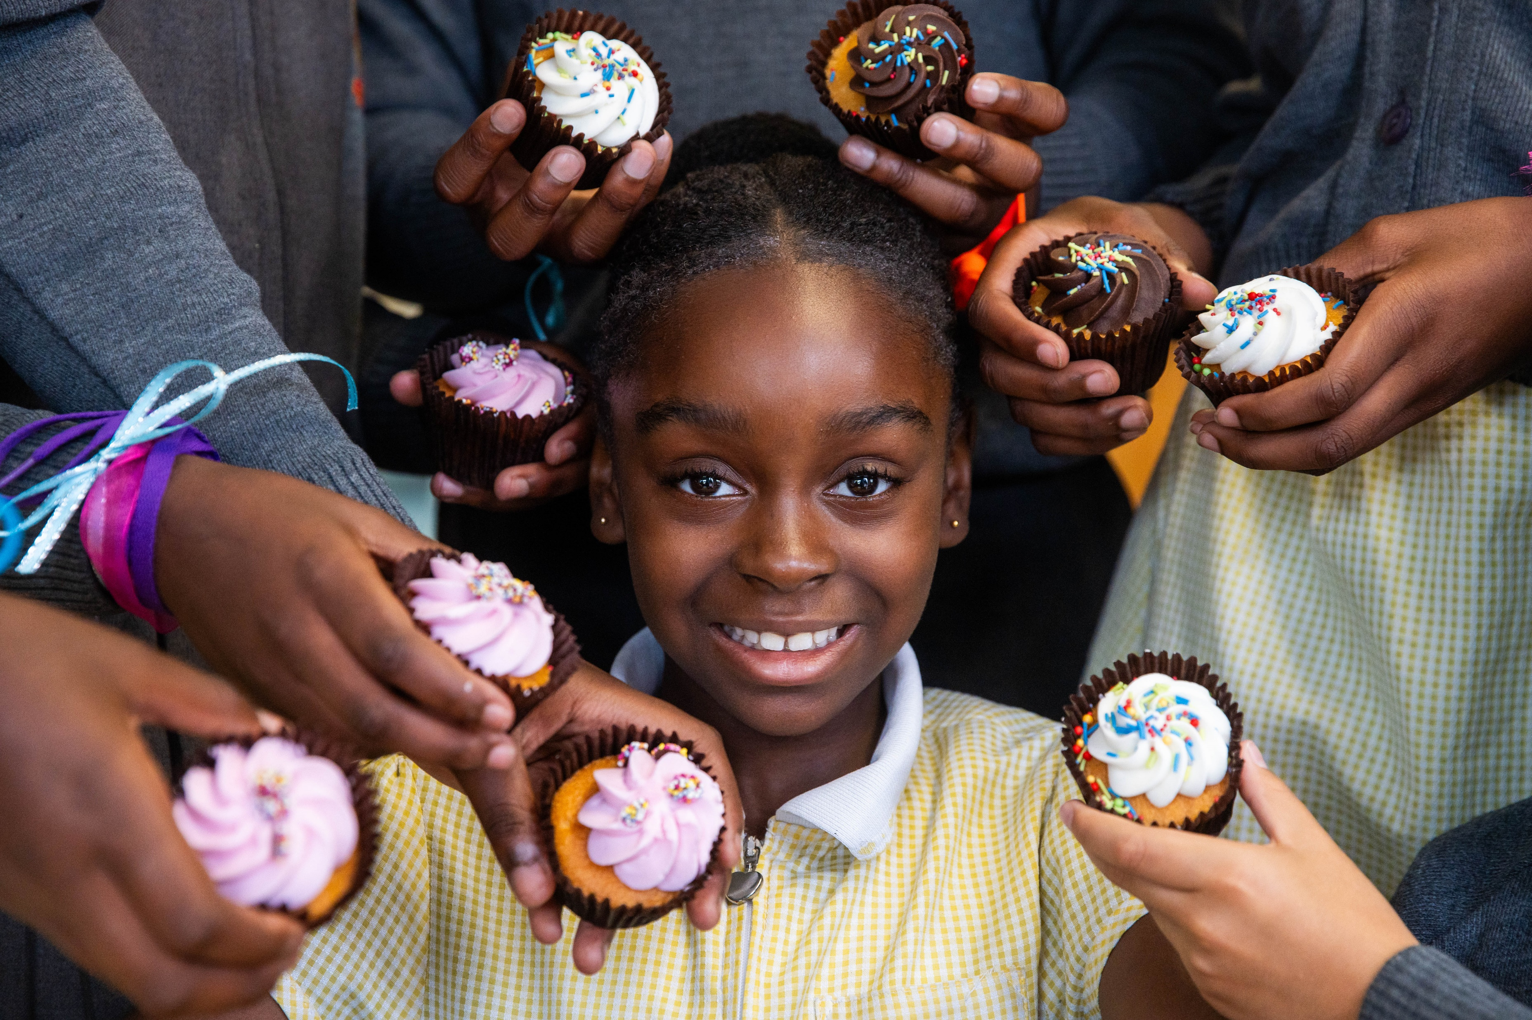
Wednesday 11 March
Act
Give
This Lent, hundreds of schools in England and Wales are raising money to support our brothers and sisters living in poverty around the world.
There are so many easy ways you can do this! How about fundraising for the Big Lent Walk, organising a cake sale or a sponsored silence?
Check out our CAFOD clubs Lent activity ideas
Notes:
CAFOD cake sale, London
Photo credit: Joe Newman

Slide 19
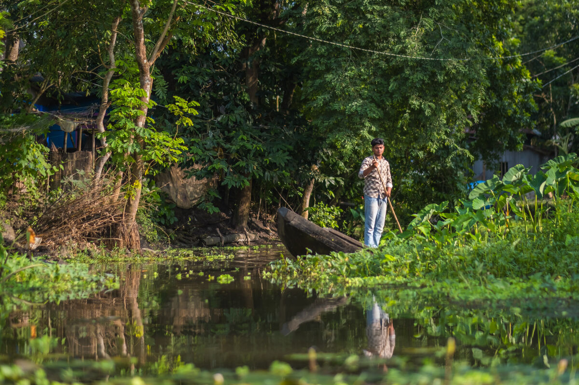
Thursday 12 March
Pray
The Choto Bashail community create floating gardens by planting saplings into layers of woven hyacinth plants which grow locally.
"I help with the seedlings at the beginning and then when we bring in the beds," says Bayezid. He enjoys working on the floating gardens because "it has to be done in harmony with nature", he says.
Bayezid warns that we should look after our environment because he has seen the harm climate change can do.
Watch and pray together:
A prayer for our earth
Notes:
Bayezid in the floating gardens, Bangladesh
Photo credit: Amit Rudro

Slide 20

Friday 13 March
Think about...
Pope Francis wrote a letter to everyone in the world called Fratelli Tutti.
In it, he asks us to reach out to our sisters and brothers in need, whoever they are, wherever they may come from.
What does that mean? It sounds like a big job. How can we do it?
Watch the animation!

Slide 21

Monday 16 March
Act
Football legend and England Lioness Sue Smith is taking part in the Big Lent Walk again this year!
Sue says:
“By joining the walk you can put Catholic Social Teaching into action – the money your school raises by walking will help fight poverty around the world!”
Watch the animation on Catholic Social Teaching
Notes:
Sue Smith
Photo credit: Thom Flint

Slide 22
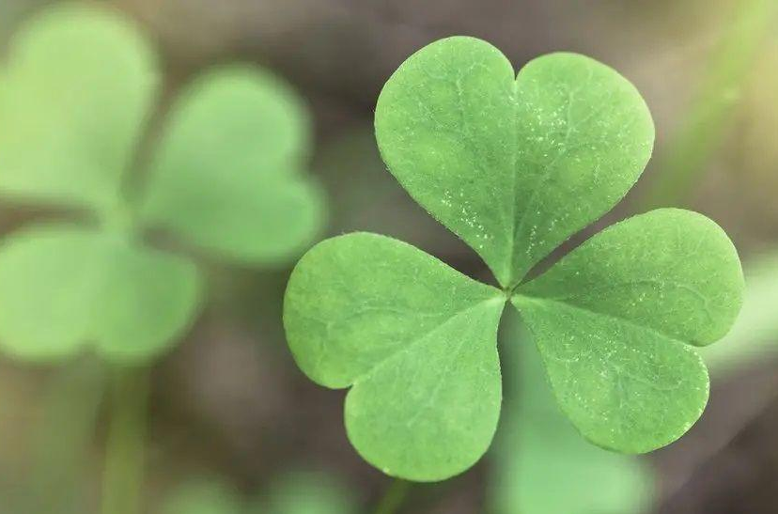
Tuesday 17 March
Think about...
Dia dhuit! That's 'hello' in Irish and today we celebrate St Patrick, the patron saint of Ireland.
One of his symbols is a shamrock. Its three leaves are said to represent the Holy Trinity of Father, Son and Holy Spirit and to stand for faith, hope and love.
How can we put our faith into action, give hope to others and show love to our global neighbours in need?
Notes:
Shamrock
Photo credit: Getty images

Slide 23
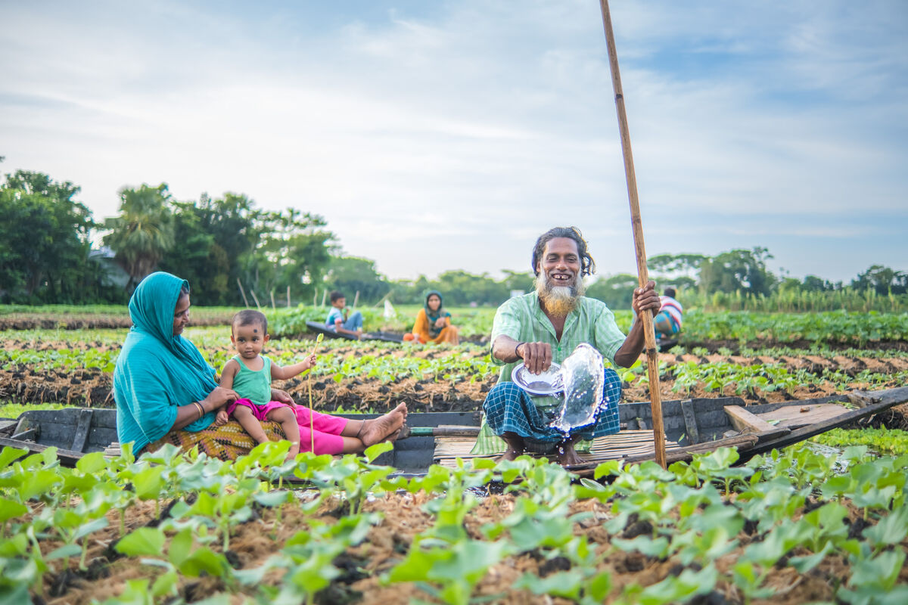
Wednesday 18 March
Act
Floating gardens aren't new – they've bobbed along in Bangladesh for hundreds of years!
But as changing weather means more rain, other ways of farming have become difficult.
So, with CAFOD's help, more families are turning to the old way of farming floating beds which isn't as affected by flooding.
Write a message about caring for our world
Notes:
Salam Molla and his family at work
Photo credit: Amit Rudro

Slide 24
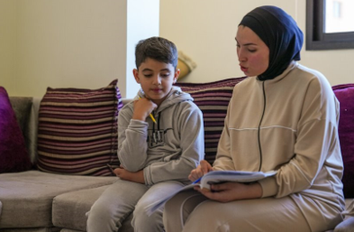
Thursday 19 March
Pray
Today is the feast of St Joseph – he's the patron saint of workers, fathers and families.
Joseph protected Mary when pregnant with Jesus on the difficult journey to Bethlehem.
Many children make difficult journeys fleeing poverty or war – like eight-year-old Zein.
He escaped from southern Lebanon to a refugee camp. With CAFOD's help, his family receive food and bedding. "But what I want most is to go home," says Zein.
Lord, we think of those who have had to flee their homes because of war, and we pray for peace around the world. Amen.
Watch Zein’s film
Notes:
Zein with his sister, Jinane
Photo credit: Elisa Oddone/Arete/DEC

Slide 25
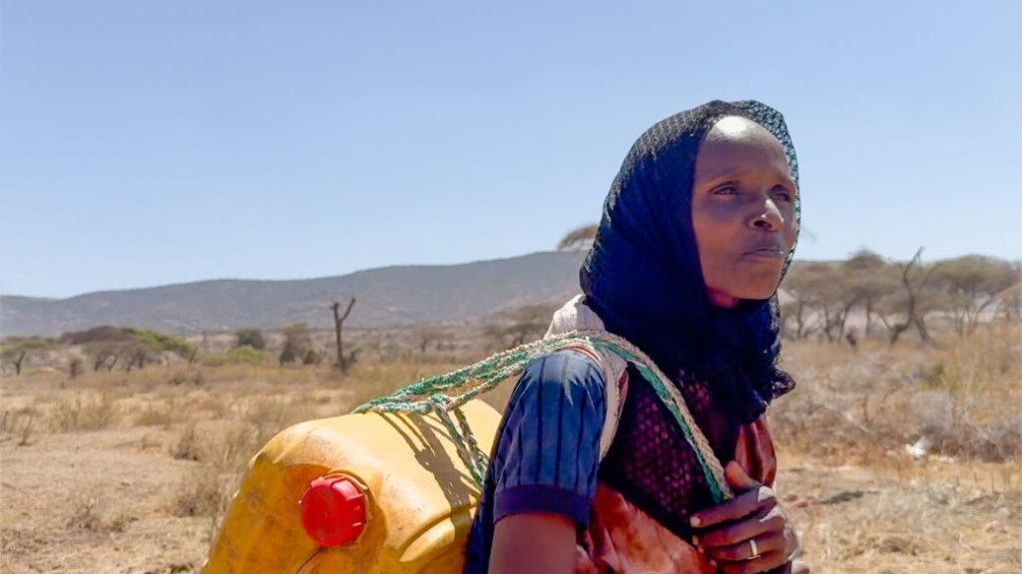
Friday 20 March
Think about...
This Sunday is World Water Day.
Bayezid and Zunayed are affected by too much rain, but we know in some areas of the world there is not enough.
Severe drought in Ethiopia meant Adi had to walk for hours to fetch water.
With CAFOD's help, a water tank was built in the community. She knows a better world needs all of us and helped with the project. "This tank is a blessing," says Adi.
Watch Adi’s film about water in Ethiopia
Notes:
Adi, Southern Ethiopia
Photo credit: Louise Norton

Slide 26
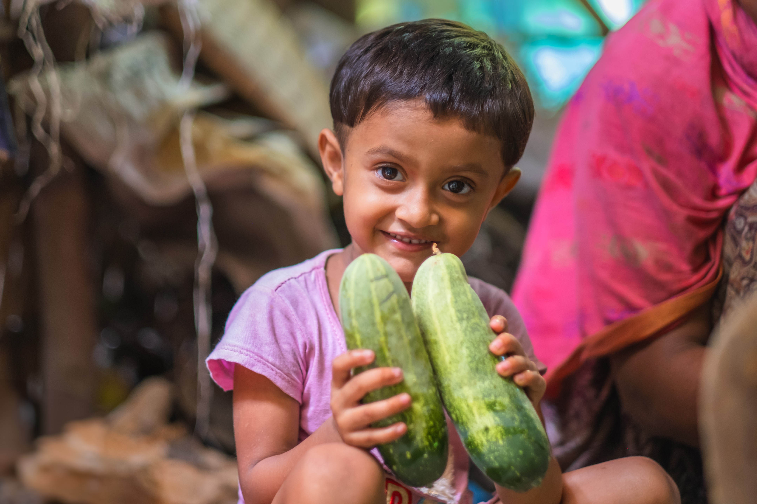
Monday 23 March
Think about...
Muslima is five and is Bayezid’s niece. Her grandfather was able to buy ducks and cows from money he made selling what he'd grown on the floating beds.
Muslima enjoys being in the kitchen with her grandmother, watching her cook the vegetables harvested from the floating gardens.
Check out these gardening tips from children!
Notes:
Muslima and her grandmother, Bangladesh
Photo credit: Amit Rudro

Slide 27
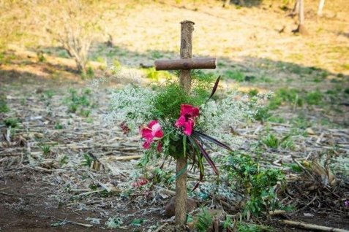
Tuesday 24 March
Think about...
Act
The Stations of the Cross show Jesus' journey to his crucifixion on Good Friday.
It is a difficult journey. We see Jesus stumbling with his cross and meeting his mother, Mary.
Inspired by Jesus, can we journey alongside our brothers and sisters around the world? Can we stand by our global family facing difficulties every day because of lack of food, clean water or peace?
Reflect on the Stations of the Cross
Notes:
Cross adorned with flowers
Photo credit: CAFOD

Slide 28
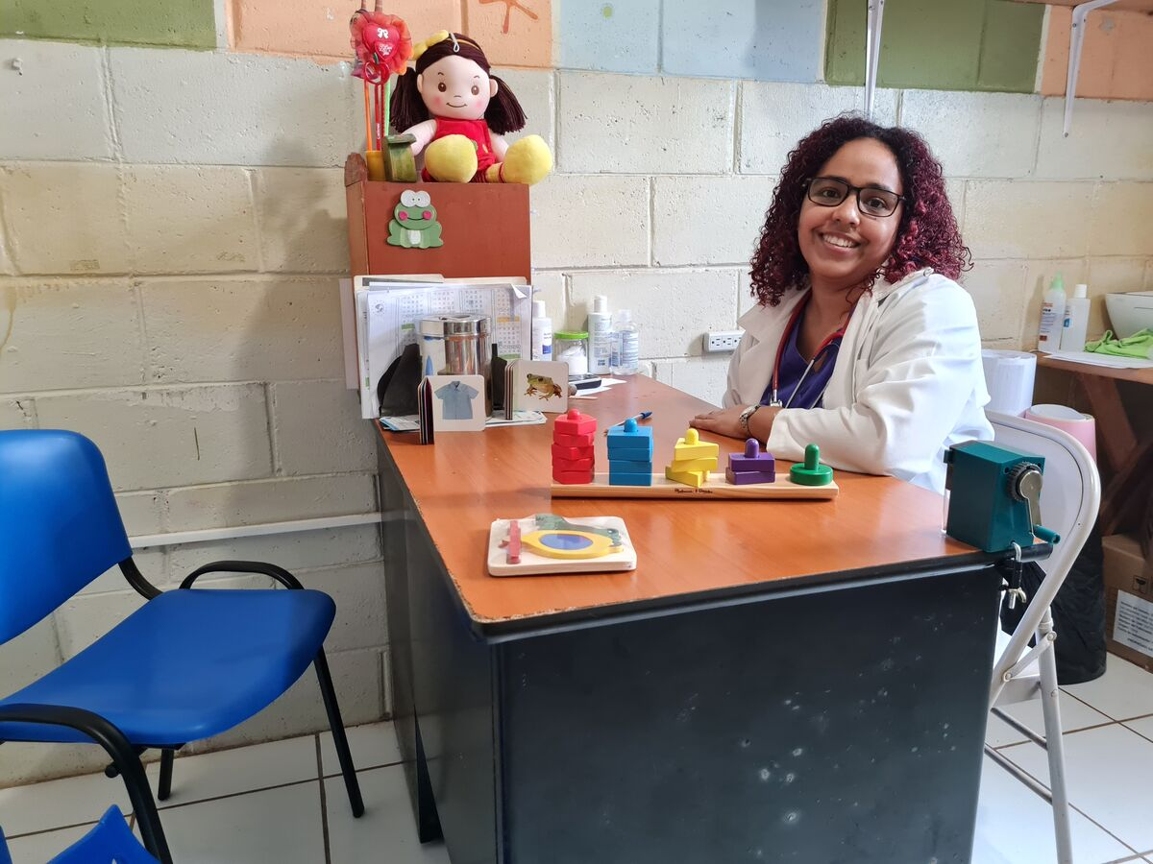
Wednesday 25 March
Pray
Tuesday 7 April is World Health Day – but as that's in the Easter holidays, we'll mark it today!
Monica is a children's doctor. She works with families who live in poverty in El Salvador.
Lord, we pray for people who are sick and all the nurses, doctors and others who look after them. Be close to them with your strength, comfort and peace. Amen.
Notes:
Monica, Clínica Ana Manganaro, El Salvador
Photo credit: Clínica Ana Manganaro

Slide 29
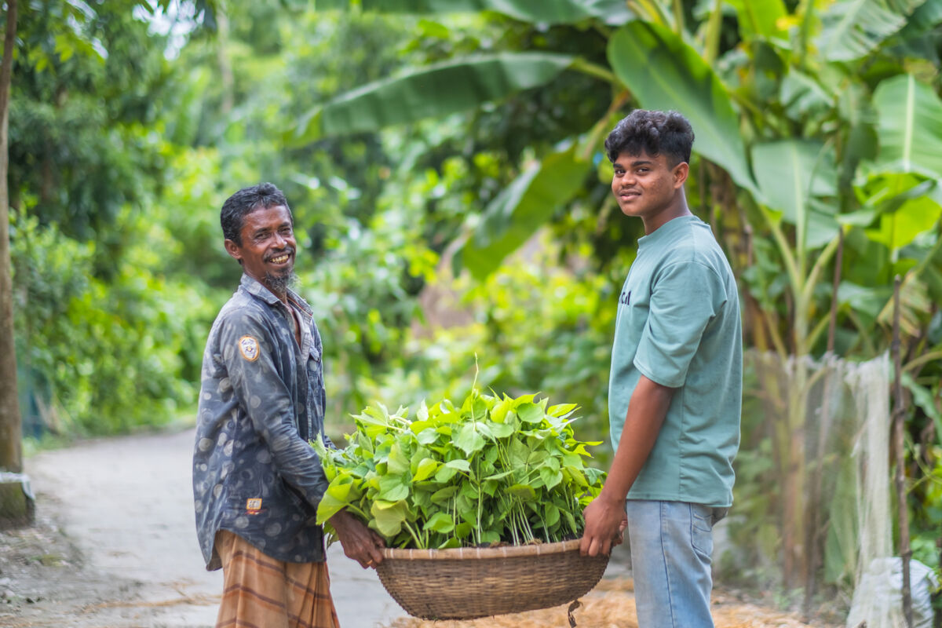
Thursday 26 March
Think about...
Harvest time brings satisfaction for Bayezid, here in the photo with his father.
"After many days' hard work and dedication, I feel at peace when harvest comes," he says.
Because of the floating beds, the family have enough food to eat and sell, with money left over for the things to live a happy life.
“The floating garden is very important for us," explains Bayezid.
Download Easter colouring sheets for Holy Week
Notes:
Bayezid and his father, Bangladesh
Photo credit: Amit Rudro

Slide 30
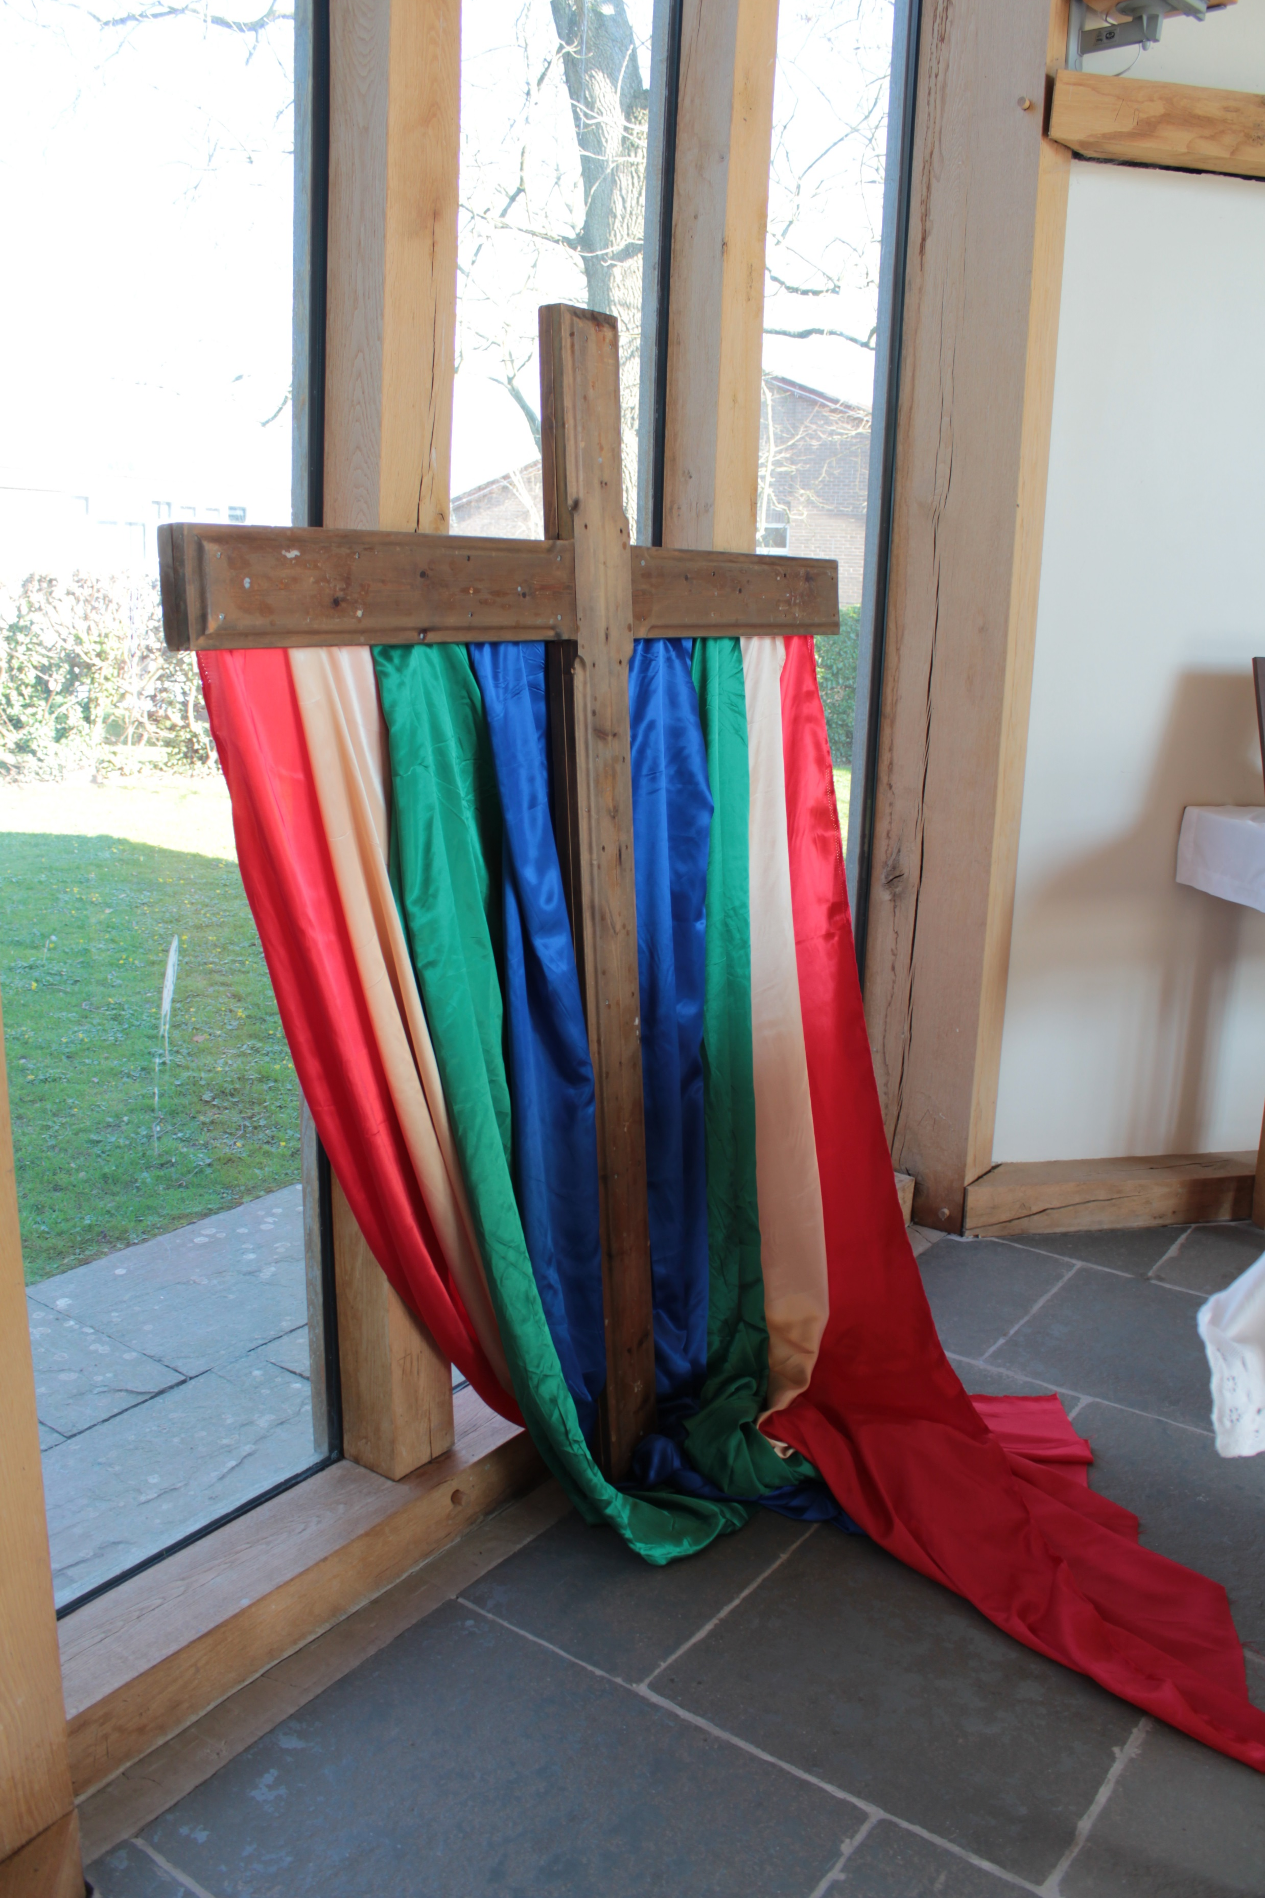
Friday 27 March
Think about
Are you excited about the Easter holidays?
We might share a special meal with family or friends, enjoy Easter eggs or nice treats.
But what is Easter really about? God loved us so much, he sent his son to live and die for us; to help us be the kindest we can be, to be hopeful and thoughtful.
Think about this question today:
How has your journey over Lent helped you follow Jesus more closely?
Notes:
A cross at St Mary’s Catholic High School in Herefordshire
Photo credit: Victoria Ahmed

Slide 31

Monday 30 March
Think about
Pray
Yesterday was Palm Sunday and now we are in Holy Week.
On Palm Sunday, we hear the story of Jesus entering into Jerusalem on a donkey, greeted by joyful crowds waving palms.
How can we make Jesus welcome as we get ready to celebrate Easter?
How can we be welcoming to others?
Lord, help us to be welcoming to all, not just to our friends, but to the stranger who may be struggling. Amen.
Notes:
Palms
Photo credit: Stock image

Slide 32
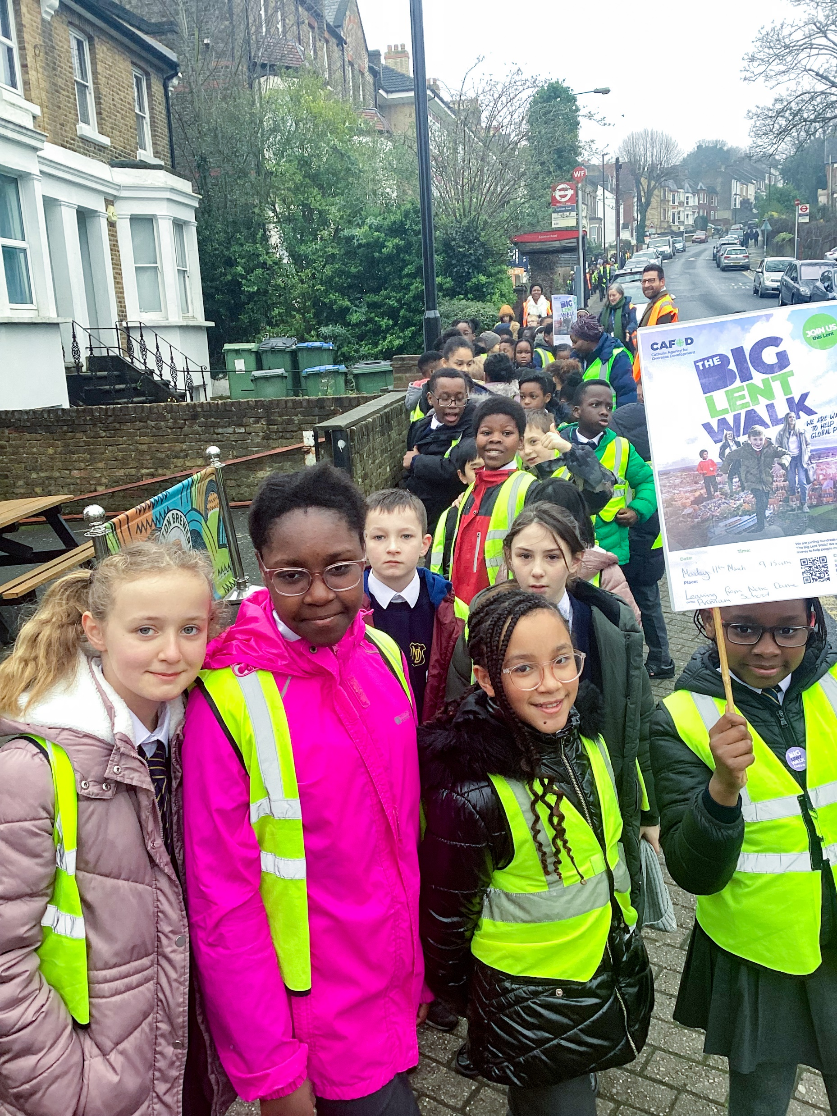
Tuesday 31 March
Think about
Act
It's not too late to do a Big Lent Walk!
You may have finished school for the holidays, but how about finding a friend or family member to do the Big Lent Walk with?
You could walk around your garden if you have one, a nearby park or up and down the road! Make sure you check with an adult first and bring one with you!
Notes:
Children on the Big Lent Walk
Photo credit: CAFOD Liverpool

Slide 33
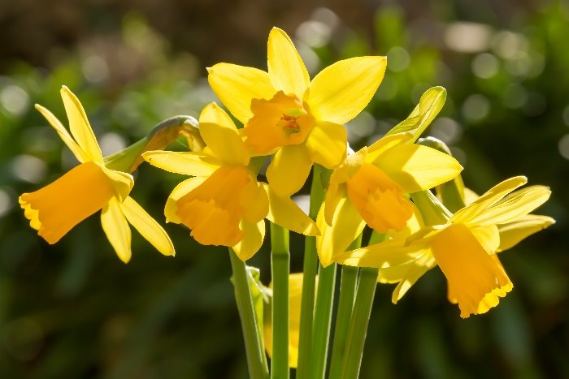
Wednesday 1 April
Act
Easter is nearly here.
Why not make some Easter cards for your family and friends?
You could use our Easter flower templates for decoration.
Look around and be inspired by the signs of new life which are all around us too!
Easter flower template
Notes:
Daffodils
Photo credit: Stock images

Slide 34

Thursday 2 April
Think about
Pray
Maundy Thursday
Today Jesus washed his disciples' feet at the Last Supper. This may seem a strange thing for the son of God to do!
Why do you think he did this?
Jesus was showing the apostles how important it is to be humble and to serve others.
How can we follow in Jesus' own footsteps and serve others?
Lord, help us to be humble, knowing we are all equal in God's eyes, so we serve others in the way you have shown us. Amen.
Notes:
Splashing in water
Photo credit: Klara Kulikova on Unsplash

Slide 35
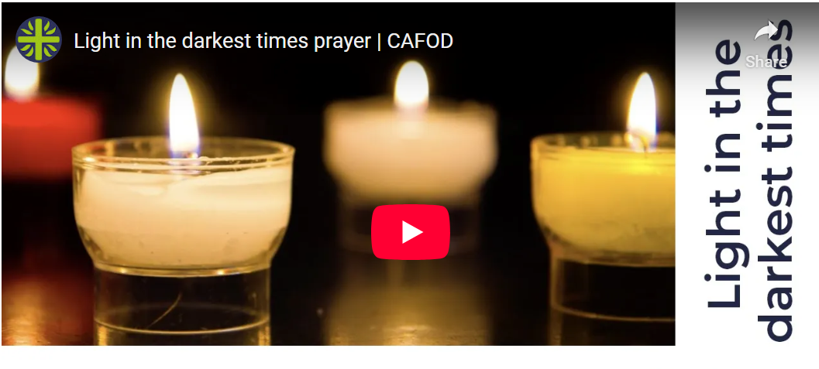
Friday 3 April
Think about
Pray
Good Friday
Today, Jesus died on the Cross.
We pray together, the Light in the darkest times prayer.
Let us remember all our global family who are struggling due to war, climate change, not having enough food to eat or clean water to drink.
Prayer for light in the darkest times

Slide 36
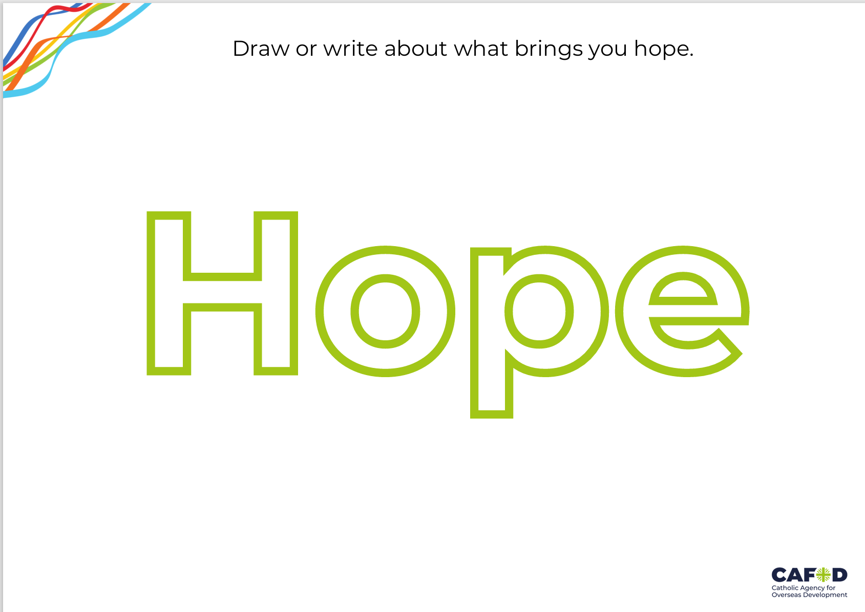
Saturday 4 April
Think about
Act
Easter Saturday
Tomorrow is Easter Sunday and as the season of Lent comes to a close, we can look forward to celebrating Jesus rising from the dead.
Easter Sunday gives us hope that we can walk from darkness into the light, that even when things are difficult, we can always be optimistic.
What gives you hope? Draw or write your thoughts on our worksheet.
What brings you hope?
Notes:
Shamrock
Photo credit: Getty images

Slide 37
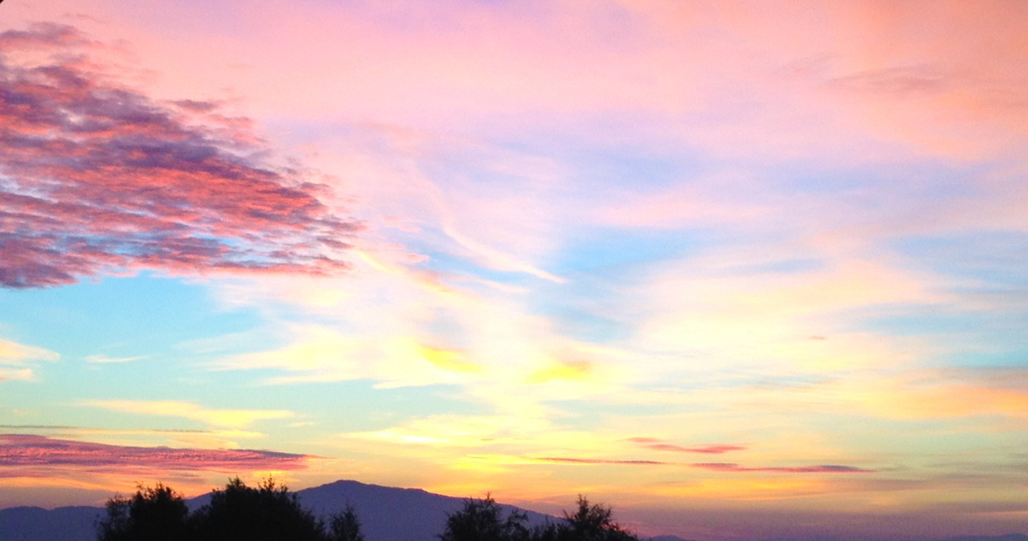
Easter Sunday
Alleluia!
He is risen!

