Slide 1
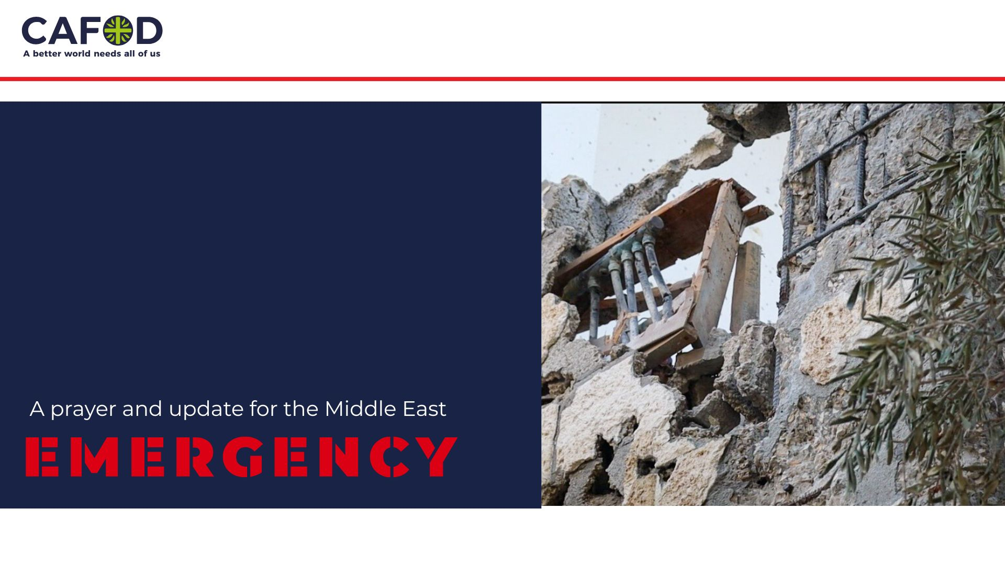
Notes:
Please find the most current updates about the situation, and the link to make any donations to our appeal, at: https://cafod.org.uk/News/Emergencies-news
Thank you for your prayerful and generous support. As part of the CAFOD and Caritas family, you are already there in this emergency.
Image credit: Withheld for security reasons

Slide 2
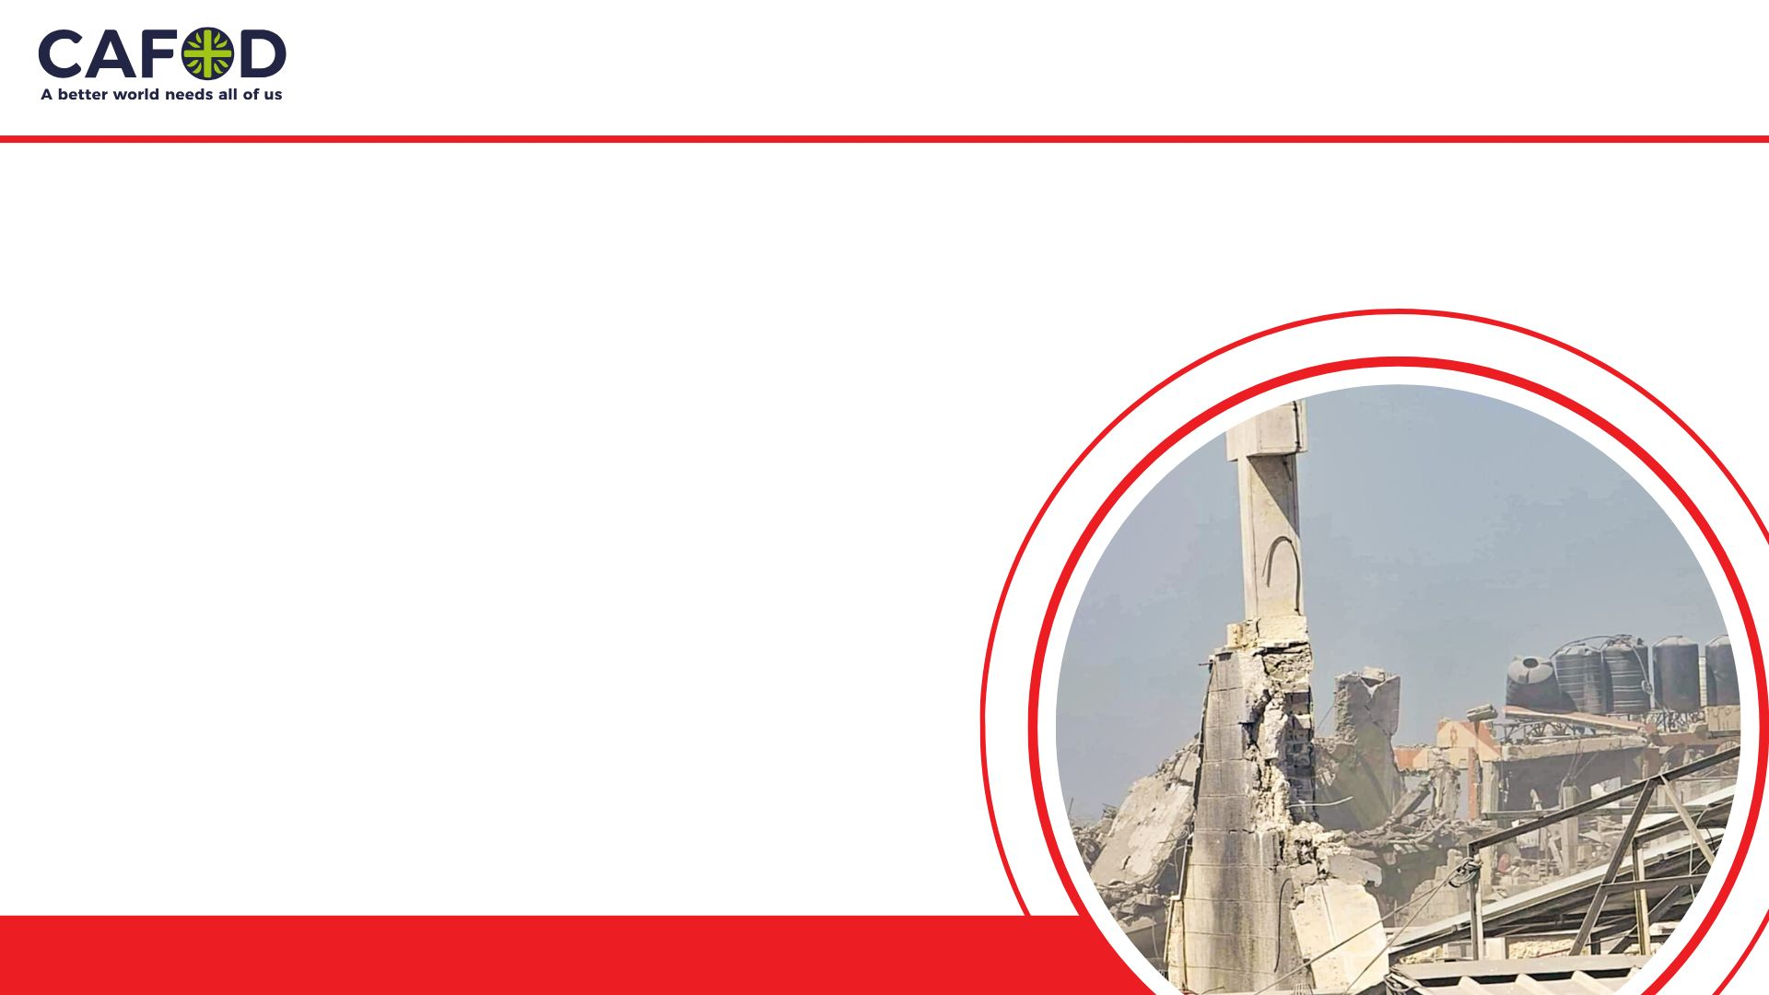
15 October 2025
Note to teachers: This PowerPoint is intended to update schools and colleges on recent developments in the Middle East and the work of CAFOD. We invite you to pray with us.
It has been made for a secondary school audience with the aim of helping students pray about the suffering, death and starvation they have seen on the news, and in the context of CAFOD’s work.
The Holy Family Church in Gaza, a sanctuary for displaced civilians, was struck by a shell causing injuries and widespread panic. (Photo taken 17 July 2025)

Slide 3
Learn about the situation from multiple, reliable sources. CAFOD listens carefully to our partners in the Middle East, and to reputable organisations working on the ground..
Pray for all the people involved in this situation.
Respond sensitively as this is a fast-changing situation. Make sure you think carefully before you speak or act.

Slide 4
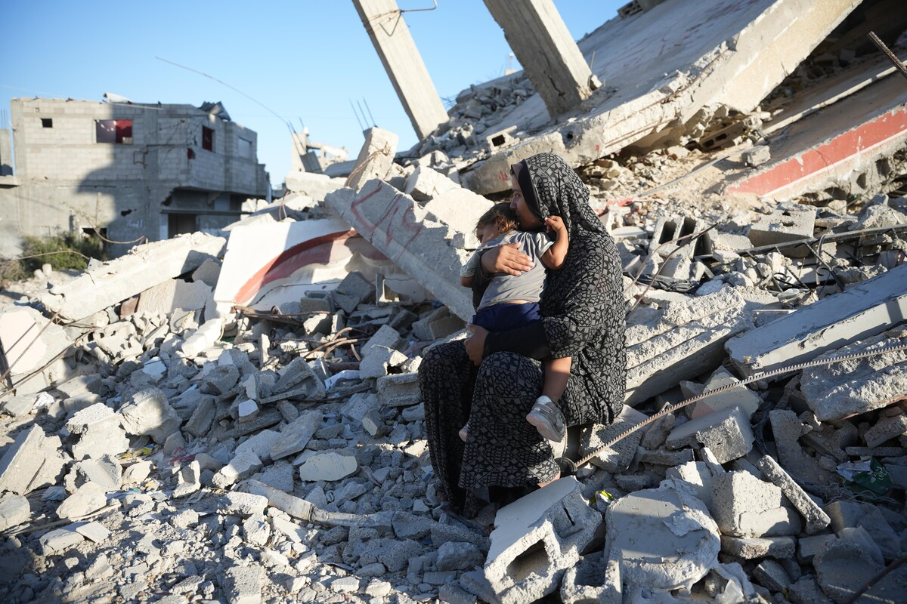
On 22 July, Cardinal Pierbattista Pizzaballa, the Latin Patriarch of Jerusalem, offered a powerful reflection on the suffering in Gaza:
“Christ is not absent from Gaza. He is there — crucified in the wounded, buried beneath the rubble, and yet present in every act of mercy, every candle in the darkness, every hand extended to the suffering.”
We ask you join us in prayer as we share updates from our partners.
Aaliyah* and her daughter sits on the remains of a damaged building.
Notes:
Image credit: DEC

Slide 5
The ceasefire
After a two-year war in this region, the ceasefire has brought a glimmer of hope.
The US-led 20-point plan outlines initial steps to bring an end to the fighting.
However, the ceasefire is just the first step. Aid has not yet been permitted to enter at the scale that is needed and the humanitarian situation is catastrophic.
Aaliyah* and her daughter sits on the remains of a damaged building.
Notes:
Image credit: DEC

Slide 6
What our partners are saying
Partners in Gaza reacted to the news of the ceasefire:
“It is good news. A first step, we have to rejoice about this.”
Elizabeth Funnel, CAFOD’s Country Programme Representative in the Middle East said:
“There needs to be a massive increase in aid now into Gaza with unimpeded access to food, water and healthcare to reverse the spread of famine and malnutrition.”
Notes:
Image credit: Caritas Jerusalem

Slide 7
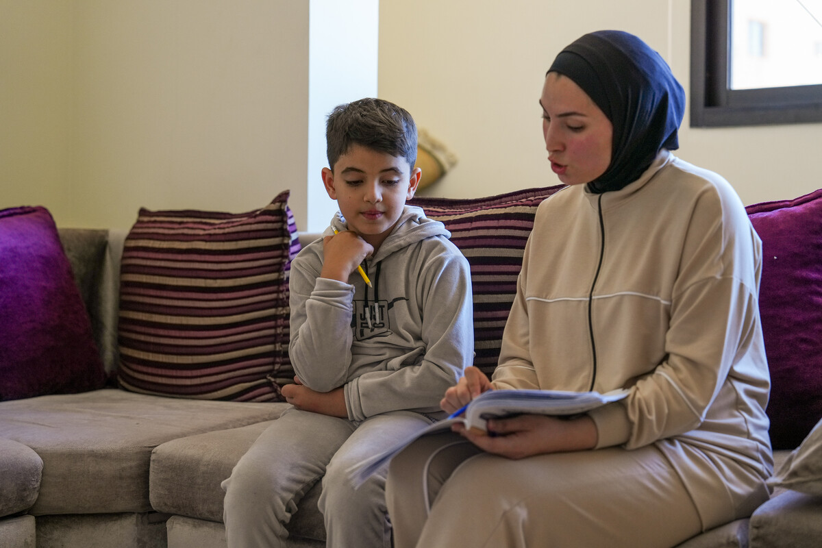
What our partners are saying
Zein’s story (Lebanon)
As the war in the Middle East escalated and involved other countries, Zein* (8) was displaced from his home in southern Lebanon and is currently staying at a camp for displaced people in North Lebanon.
Zein is feeling homesick and as his family only brought essential items with them, he’s also missing his toys and being able to draw.
‘‘What I want most is to go back home and for the war to stop. I love my home, and I just want to return, sleep there, and feel safe and comfortable. No one understands the value of home until they leave it’’
Zein (8), Lebanon
Zein* and his sister Jinane* doing school work together.
Notes:
Image credit: DEC. CAFOD use psuedonyms for the security of our partners.

Slide 8
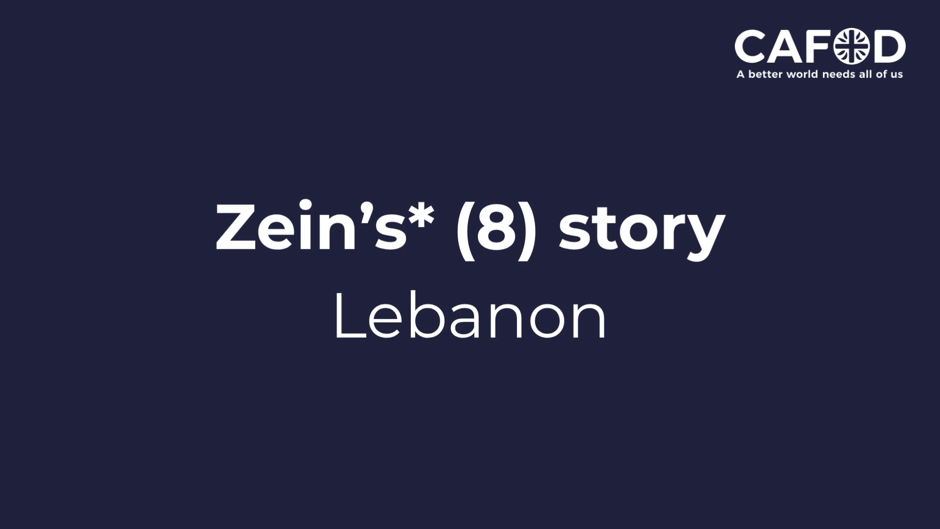

Slide 9
What is CAFOD calling for?
Supporting the people of Gaza after the ceasefire
Following the ceasefire in Gaza, our support and prayers are needed more than ever.
CAFOD’s Church partners, working with great courage, continue to bring food, shelter, medical care and comfort to families in need.
Cardinal Pizzaballa, the Latin Patriarch of Jerusalem, has urged us to “stand beside the people of Gaza as they begin the journey of healing, recovery and rebuilding”.
Let us respond with love and generosity – please fundraise today and pray for lasting peace in the Holy Land.
cafod.org.uk/middle-east
Notes:
Image credit: Caritas Jerusalem

Slide 10
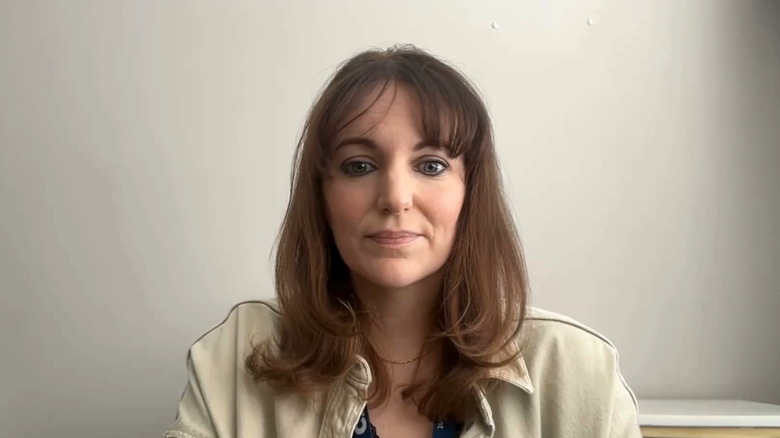
Video

Slide 11
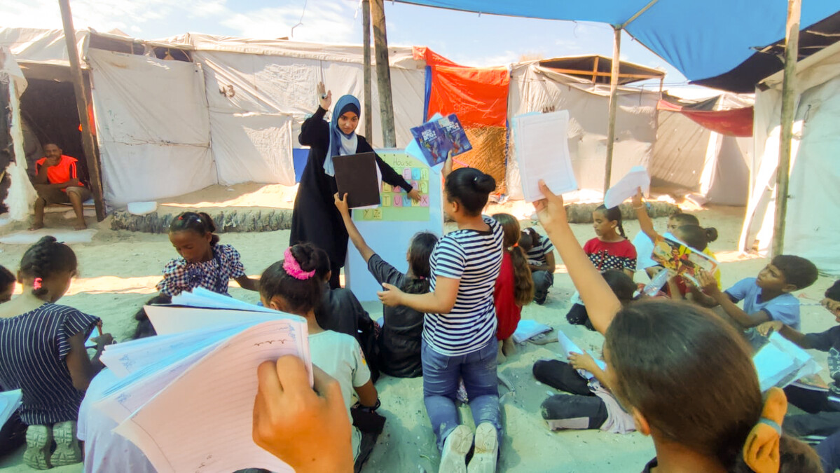
Let us pray
God of peace, bearer of hope, we seek your help for the peoples of the Middle East.
Quiet the clamour of war and guide us towards peace.
Where there is hatred and division sow seeds of calm and openness.
Children’s groups in Gaza
Notes:
Image credit: Caritas Jerusalem

Slide 12
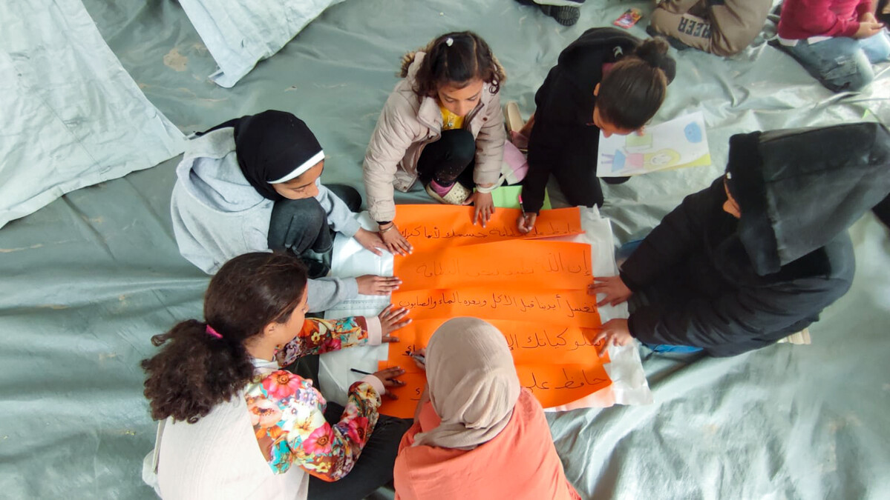
Where there is destruction help us to rebuild.
Where children are crying bring an end to tears.
Shelter your peoples and protect them Guide them and keep them from harm.
Show us how to break down the barriers of history and fear and breathe whispers of hope.
Children’s groups in Gaza
Notes:
Image credit: Caritas Jerusalem

