Slide 1
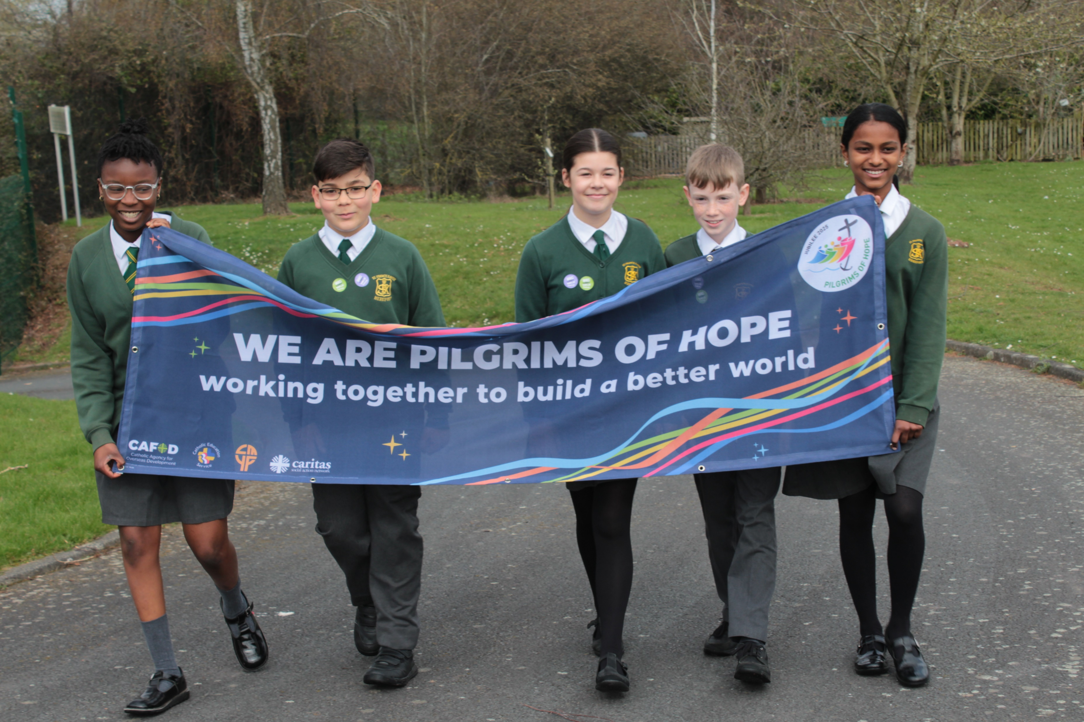
Can you be strong in your faith and show others what you believe?
Gather
Notes:
Children’s liturgy: Saints Peter and Paul (Year C)
Preparation of the worship space
Colour: red
Props: Coloured pens and pencils. A small bag of rocks or pebbles – one for each child.
Song suggestions
Here in this place (475, Laudate)
Welcome
Today we hear how the disciple Simon recognises Jesus as the Son of God and how Jesus gives Simon a new name – Peter. Jesus tells Peter that he will build his church on him.
Girl thinking
Photo credit: Stock image

Slide 2
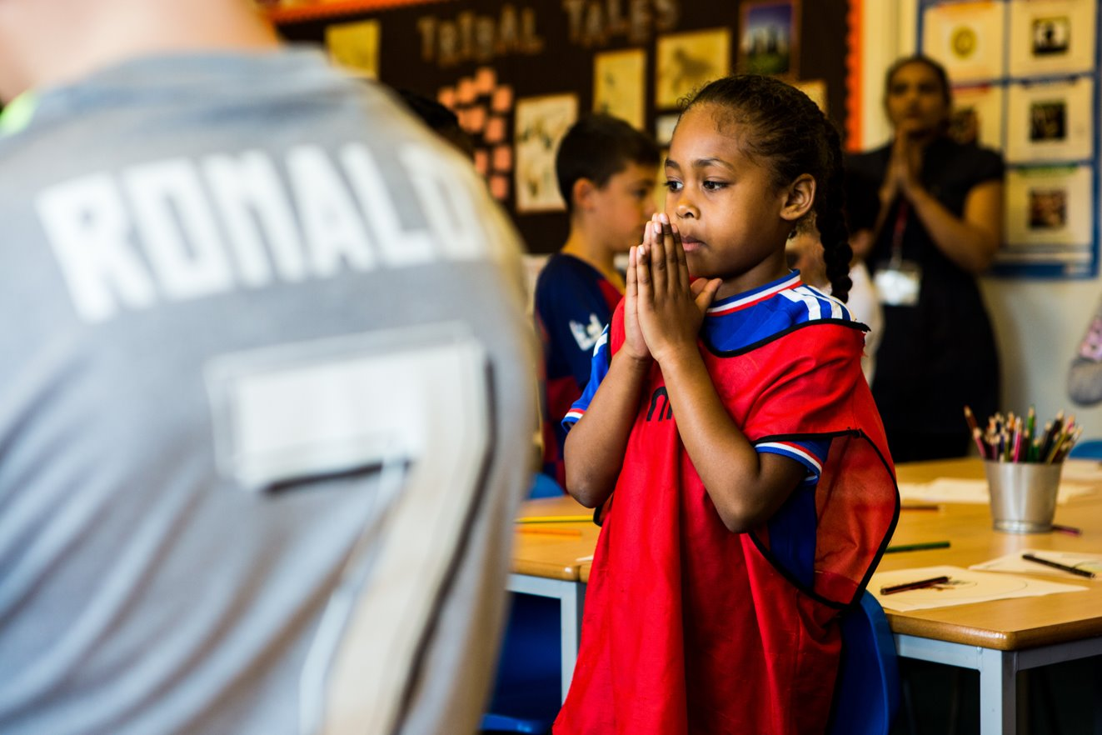
God of all,
Just as Simon Peter built the Church, may we be rocks of faith and stand firm in your name. Amen.
Notes:
Children at Our Lady Queen of Heaven Primary School
Photo credit: Thom Flint

Slide 3
Gospel: Matthew 16: 13-19
Jesus went to the territory near the town of Caesarea Philippi, where he asked his disciples, “Who do people say the Son of Man is?”
“Some say John the Baptist,” they answered. “Others say Elijah, while others say Jeremiah or some other prophet.”
“What about you?” he asked them. “Who do you say I am?” Simon Peter answered, “You are the Messiah, the Son of the living God.”
“Good for you, Simon son of John!” answered Jesus. “For this truth did not come to you from any human being, but it was given to you directly by my Father in heaven. And so I tell you, Peter: you are a rock, and on this rock foundation I will build my church, and not even death will ever be able to overcome it. I will give you the keys of the Kingdom of heaven; what you prohibit on earth will be prohibited in heaven, and what you permit on earth, will be permitted in heaven.”
Word

Slide 4
What do you remember from the Gospel reading?
In our gospel, Jesus asks the disciples who people say that he is.
The disciples say that people think Jesus might be John the Baptist, Elijah, Jeremiah or one of the prophets.
Then Jesus asks the disciples who they believe he is. What does Simon say?
Respond
Notes:
Question mark
Photo credit: Stock image

Slide 5
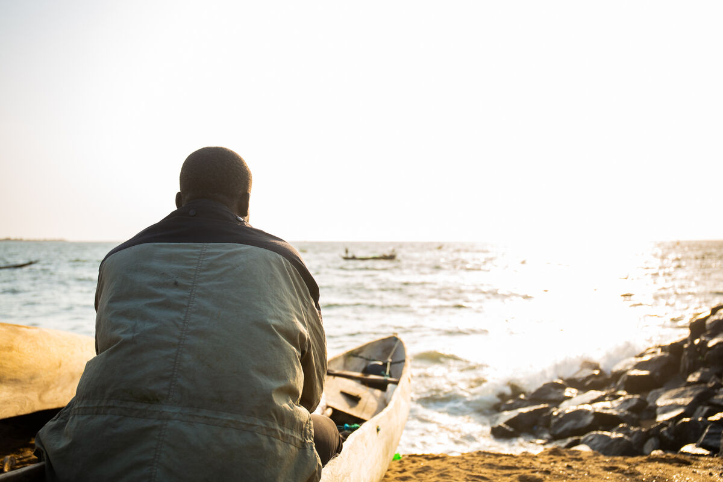
Simon says that Jesus is the Son of God. Simon believes in Jesus and he is not afraid to say so.
What does Jesus say and do next to Simon? Jesus gives Simon a new name – Peter. And Jesus tells Simon Peter that he will have the keys to the kingdom of heaven.
Simon Peter was just an ordinary fisherman with his brother Andrew. But he was one of the first disciples of Jesus.
Notes:
Fisherman James Pyne, Monrovia, Liberia
Photo credit: Thom Flint

Slide 6
Jesus gave Simon the name Peter which means ‘rock’ in Greek. Jesus wanted to build his Church on strong ground and rock is a strong material.
Simon Peter’s faith was strong in this story, like a rock, so Peter was a good name for him!
Notes:
Rock
Photo credit: Stock image

Slide 7
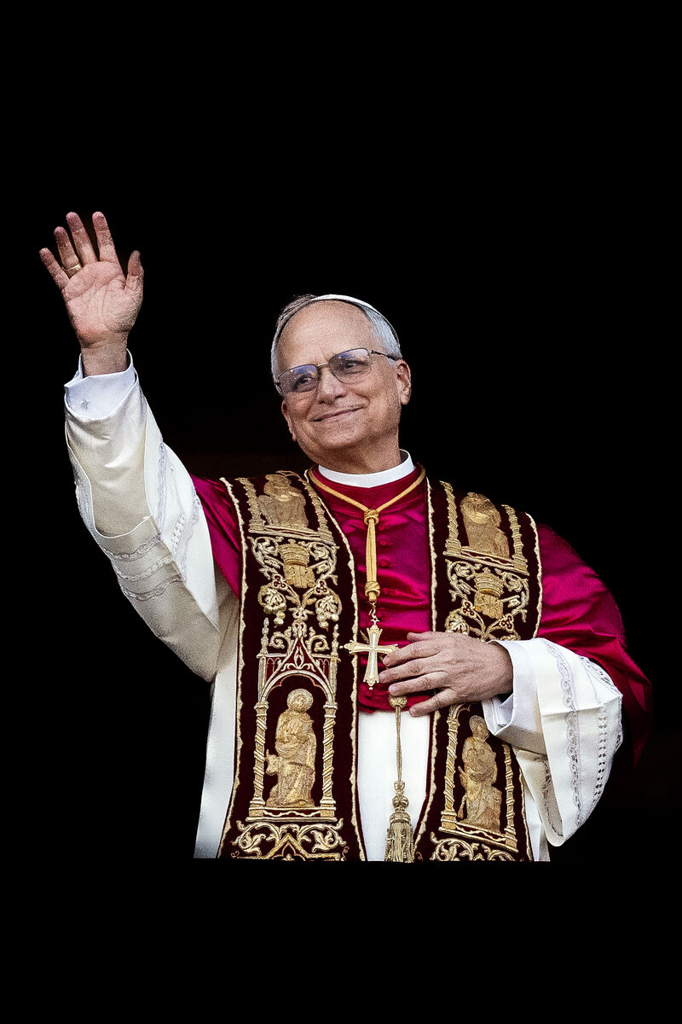
Peter is one of the greatest leaders of the early Church. He believed in Jesus and wanted to follow him and serve him. And in this story Peter also spoke up about what he believed.
What does Simon Peter teach us about knowing Jesus? What does he teach us about serving Jesus?
Simon Peter is considered to be the first pope. All the popes since then have followed on from Peter.
Notes:
Pope Leo XIV
Photo credit: © Mazur/cbcew.org.uk

Slide 8
Pope Francis called us to be ‘Pilgrims of hope’ in this Jubilee Year and our new pope, Pope Leo XIV reminds us that the Church wants always to seek peace and to be “close above all to those who are suffering.”
How do you think you might do that?
Notes:
Local market, Marsabit, Kenya
Photo credit: Louise Norton

Slide 9
Pupils at St Mary's Roman Catholic school are enjoying being Pilgrims of Hope!
Notes:
Jubilee Pilgrims of Hope - St Mary's RC High School
Photo credit: Vicky Ahmed

Slide 10
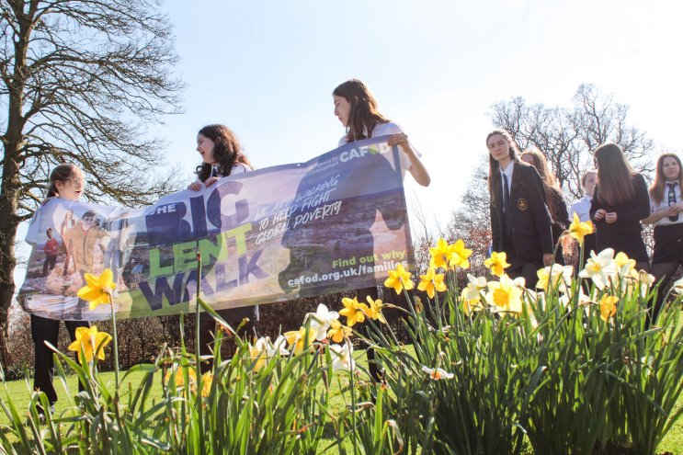
In the sunshine, they took part in the Big Lent Walk, raising money for CAFOD to help their brothers and sisters in need around the world.
Proudly holding their banners, the pupils celebrated their faith and showed their community they believe in helping others.
Notes:
Jubilee Pilgrims of Hope - St Mary's RC High School
Photo credit: Vicky Ahmed

Slide 11
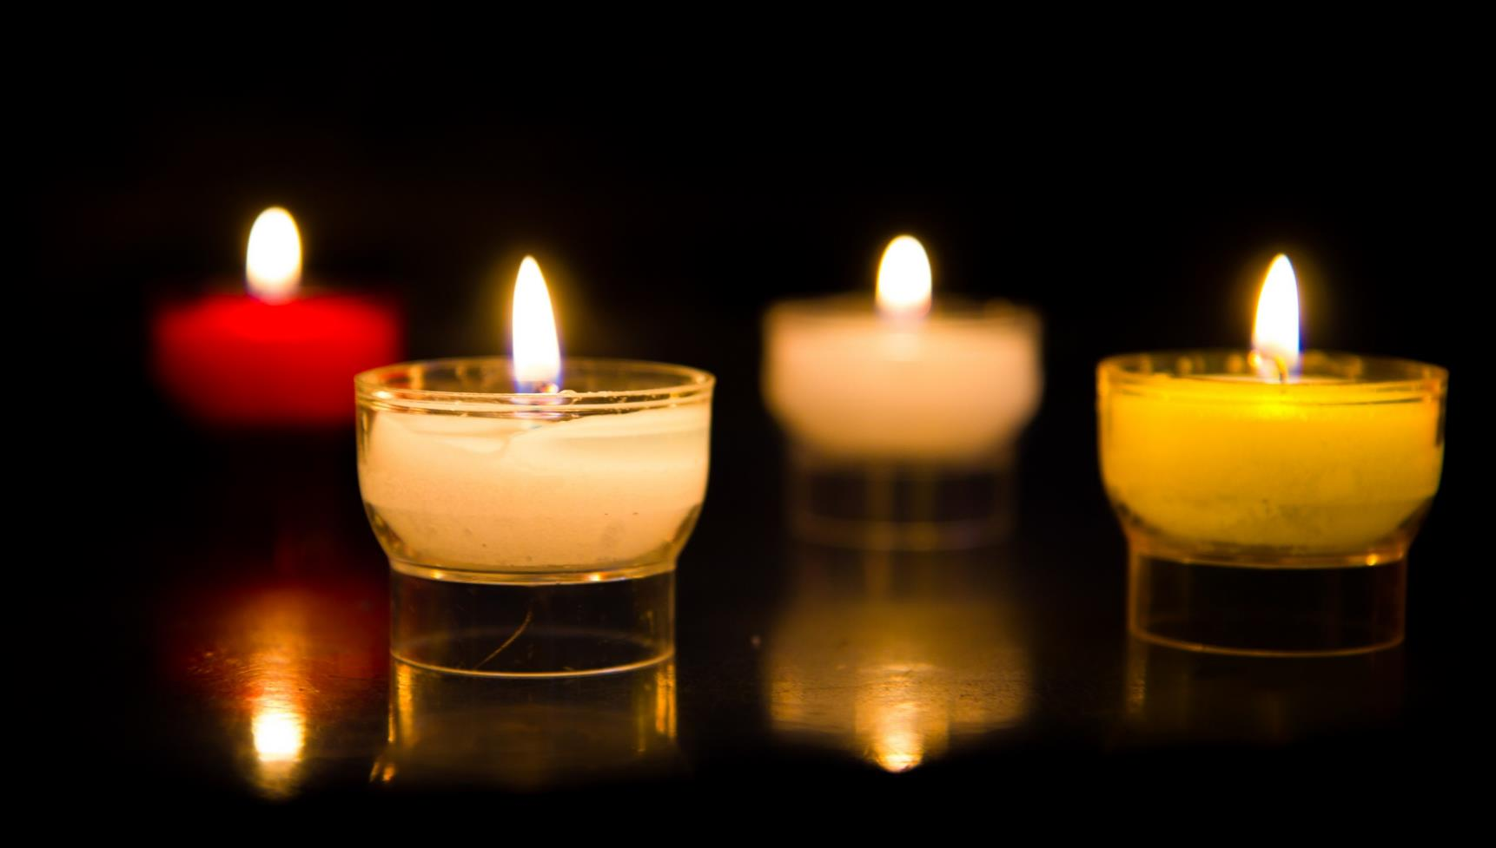
Let us pray…

Slide 12
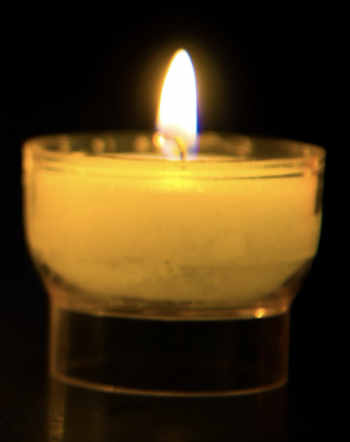
We pray for our new pope, Leo XIV. May he and all who serve the Church find strength in God to continue their work.
Lord in your mercy…
We pray for our parish, family and friends: that we may be inspired by Simon Peter’s example of faith and service to speak up for what we believe and share our faith by our actions. Lord in your mercy…

Slide 13
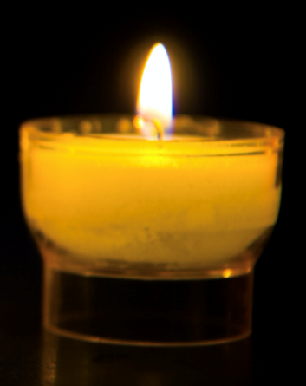
In this Jubilee Year, we pray that we may be signs of hope in our world through all that we do and how we treat one another. Lord, in your mercy…
Christ Jesus, may our hearts be filled with joy as we honour Simon Peter, our leader and rock in the faith. May we be inspired to be like him, serving others both here and around the world and speaking up for what we believe. Amen.

Slide 14
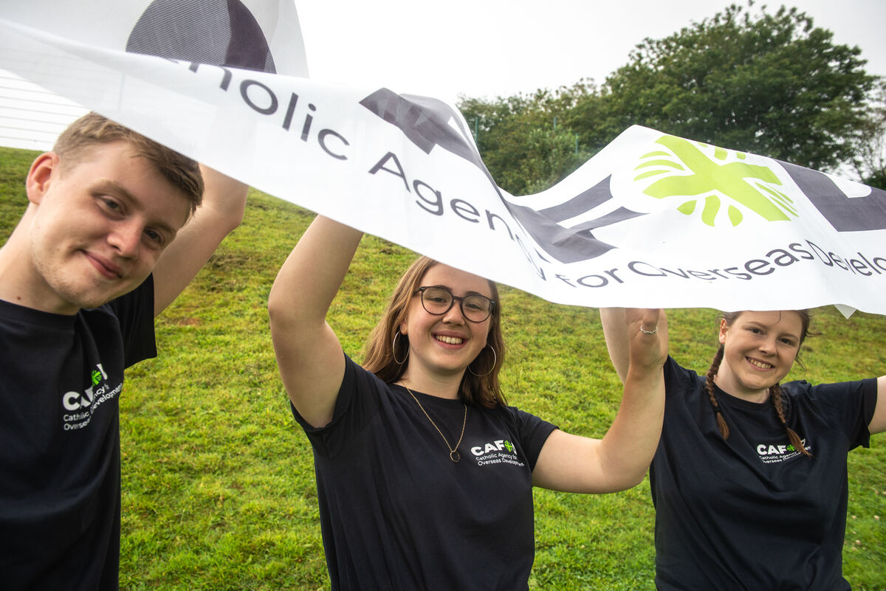
Can you be strong in your faith, speaking up for what you believe in, like Simon Peter,
this week?
Send
Notes:
Young campaigners
Photo credit: Annie Bungeroth

Slide 15
Activity suggestions
Invite the children to colour in the accompanying illustration of a rock and to write or draw on it how they will live out their faith this week.
Invite the children to choose a rock or pebble from the bag and to use it as a prayer tool when they are at home during the week. Encourage them to hold it as they pray and to think about all they have heard and thought about today, and how they can follow Simon Peter’s example of faith and service to others.
Encourage the children to speak up for something they believe in. For example, in the Jubilee Year, people across the world are uniting in solidarity to demand action on the global debt crisis. This is because around the world many countries are spending more on debt repayments than on health, education and tackling the climate crisis. Find out more and discover resources to help the children get involved at: cafod.org.uk/jubilee-schools and click on “Ways to take action.”
The name Peter means “rock”. Spend some time with the children exploring what their names mean. Does it reflect how they live their lives?
Remind the children to tell the people that they live with all that they have heard and thought about in the liturgy today. Encourage them to speak out for what they believe in and to show their faith through their actions.
Notes:
Illustration: Jane Smith

Slide 16
Notes:
Illustration: Jane Smith

Slide 17
Planning your Jubilee Pledge?
It's time to make your Jubilee Pledge!
In June or July, all Catholic schools are invited to make a Jubilee Pledge to live out Catholic Social Teaching.
A better world needs all of us, and the Pledge will be a whole school, long-term commitment to building a fairer world.
Watch our films and download our resources to help you write your Pledge and plan your Pledge Day:
Jubilee pledge for schools
The Jubilee Year is a landmark moment in the life of the global church. School communities are invited to join together as pilgrims of hope, pledging to work together for God’s kingdom of justice, peace and love. Find resources at:
Jubilee for schools 2025 – Pilgrims of Hope

