Slide 1

Venezuela Earthquake Appeal

Slide 2
Learn about the situation from multiple, reliable sources. CAFOD listens carefully to our partners in Venezuela, and to reputable organisations working on the ground.
Pray for all the people involved in this situation.
Look out for people in our communities who might be affected by this disaster.
Venezuela

Slide 3
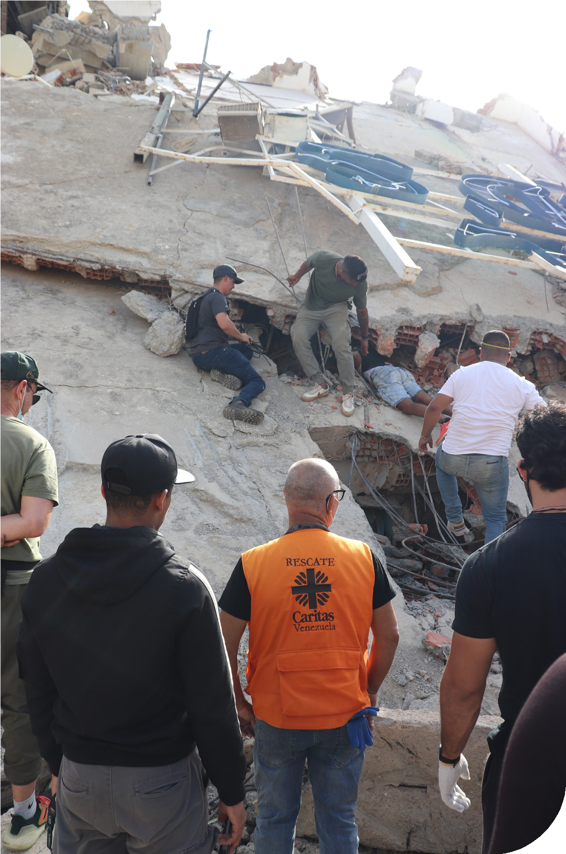
What has happened?
On Thursday 25 June two powerful earthquakes struck northern Venezuela within minutes of each other.
As of Monday 29 June, up to 50,000 people are still reported missing, buildings have been destroyed and 1,500 people are known to have died.
Venezuela

Slide 4
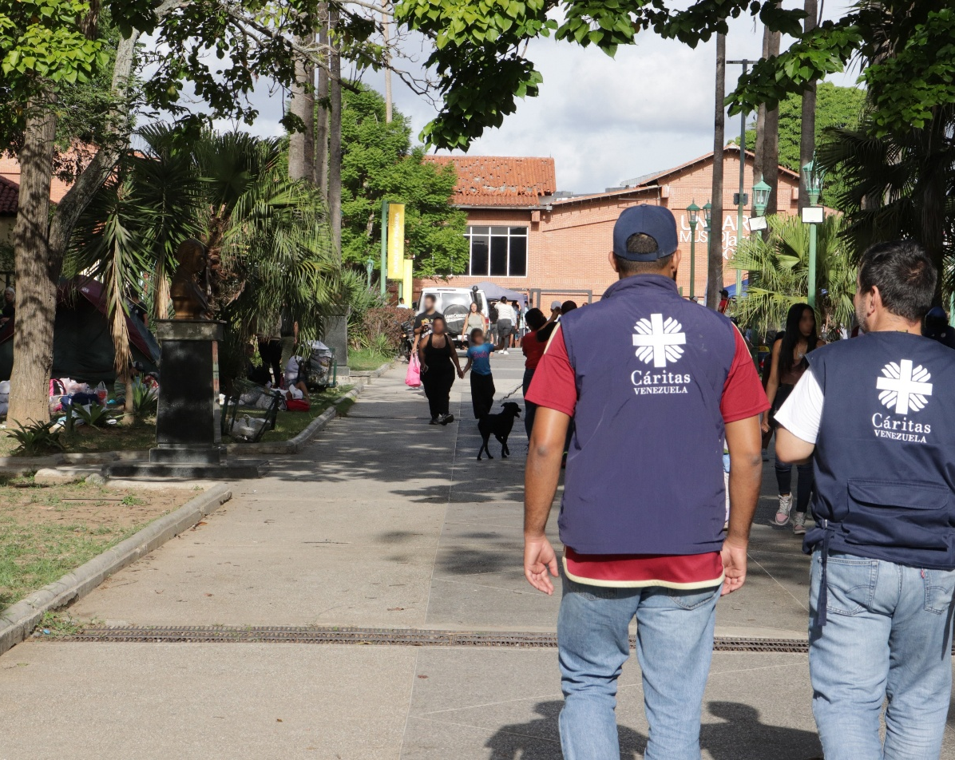

Who are CAFOD working with?
CAFOD are part of Caritas Internationalis. This means we work with all organisations and church partners to ensure that they can scale up and adapt their work effectively.
Our partner in Venezuela is called Caritas Venezuela.
Venezuela

Slide 5
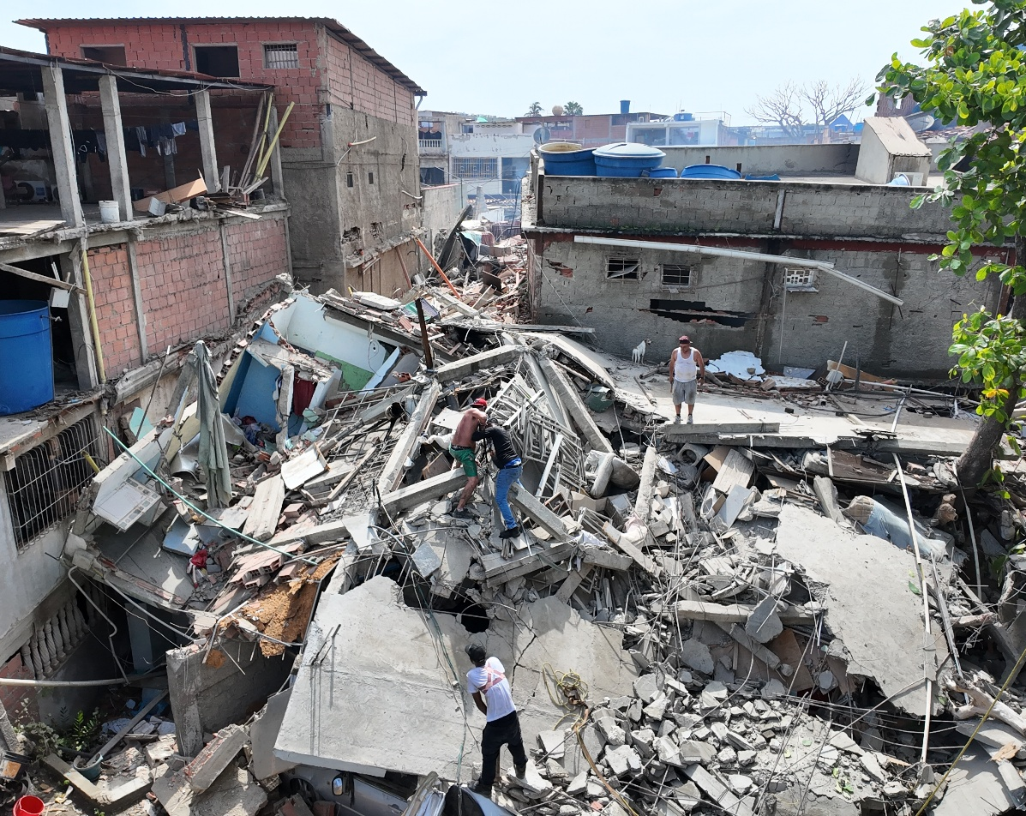
What has CAFOD done so far?
We’ve allocated £100,000 from CAFOD funds to our trusted Church partners who are already providing emergency food, water and shelter.
We also launched our DEC appeal with 15 other major charities in the UK.
Your fundraising will support this vital work.
Venezuela

Slide 6


What is Pope Leo saying?
‘‘As we pray to the Lord for the eternal repose of the deceased, I renew my spiritual closeness to their families, the injured, and those struck by this tragedy. At the same time, I express my gratitude and support to those who are generously carrying out search and rescue efforts.”
Notes:
Image credit: Caritas Jerusalem

Slide 7
What can you do to support?
PRAY – pray for our brothers and sisters in Venezuela
Fundraise for the appeal
Venezuela

Slide 8
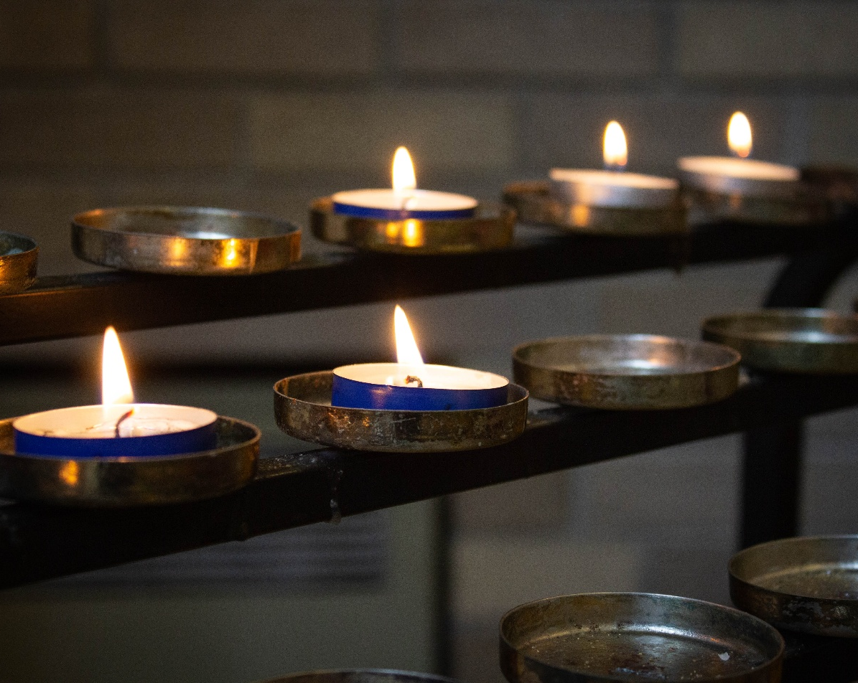
Let us pray
Faithful God,
even when the earth shakes,
your love remains firm.
You are our refuge and help.
Be near the people of Venezuela,
in this time of grief and fear.
Venezuela

Slide 9
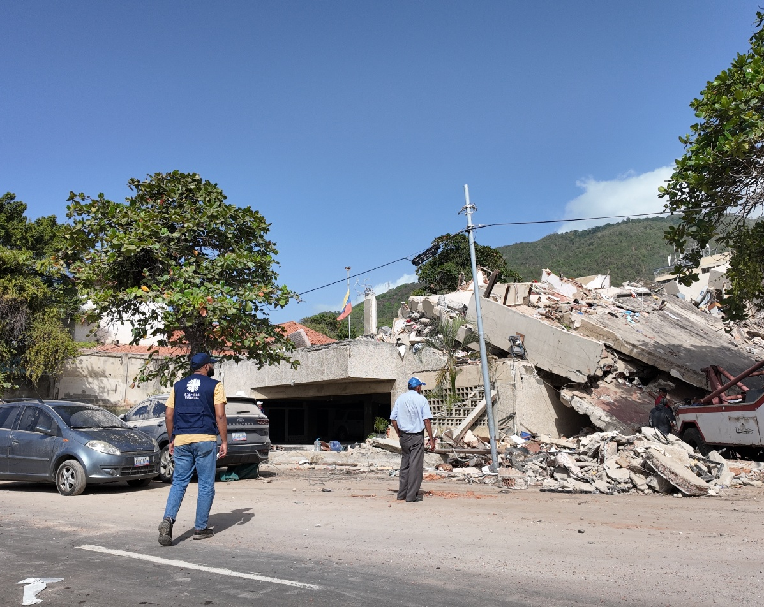
Welcome into your light
those who have died,
comfort those who mourn,
be close to those who are injured
and bring renewed hope
to those who have lost all that they built.
Venezuela

Slide 10
Move us, and the world,
to respond urgently and generously,
in this time of crisis
and keep us united in solidarity,
walking with the people of Venezuela,
in the long journey of recovery ahead.
Our Lady of Coromoto,
Patroness of Venezuela,
pray for us.
Amen.
Venezuela

Slide 11
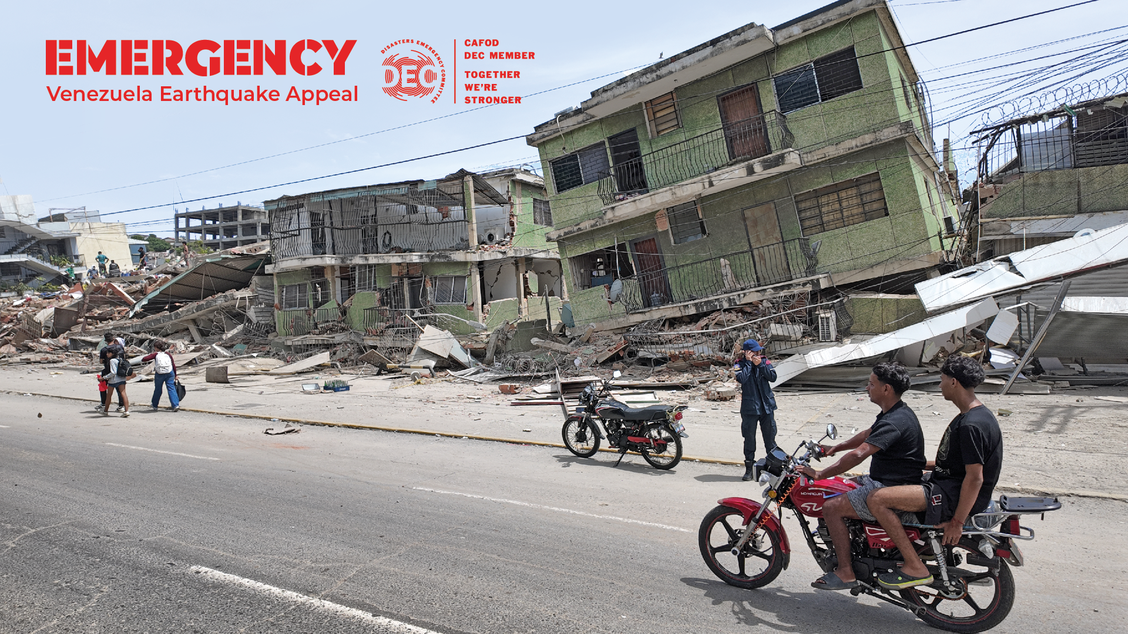

Please fundraise today

