Slide 1


Slide 2

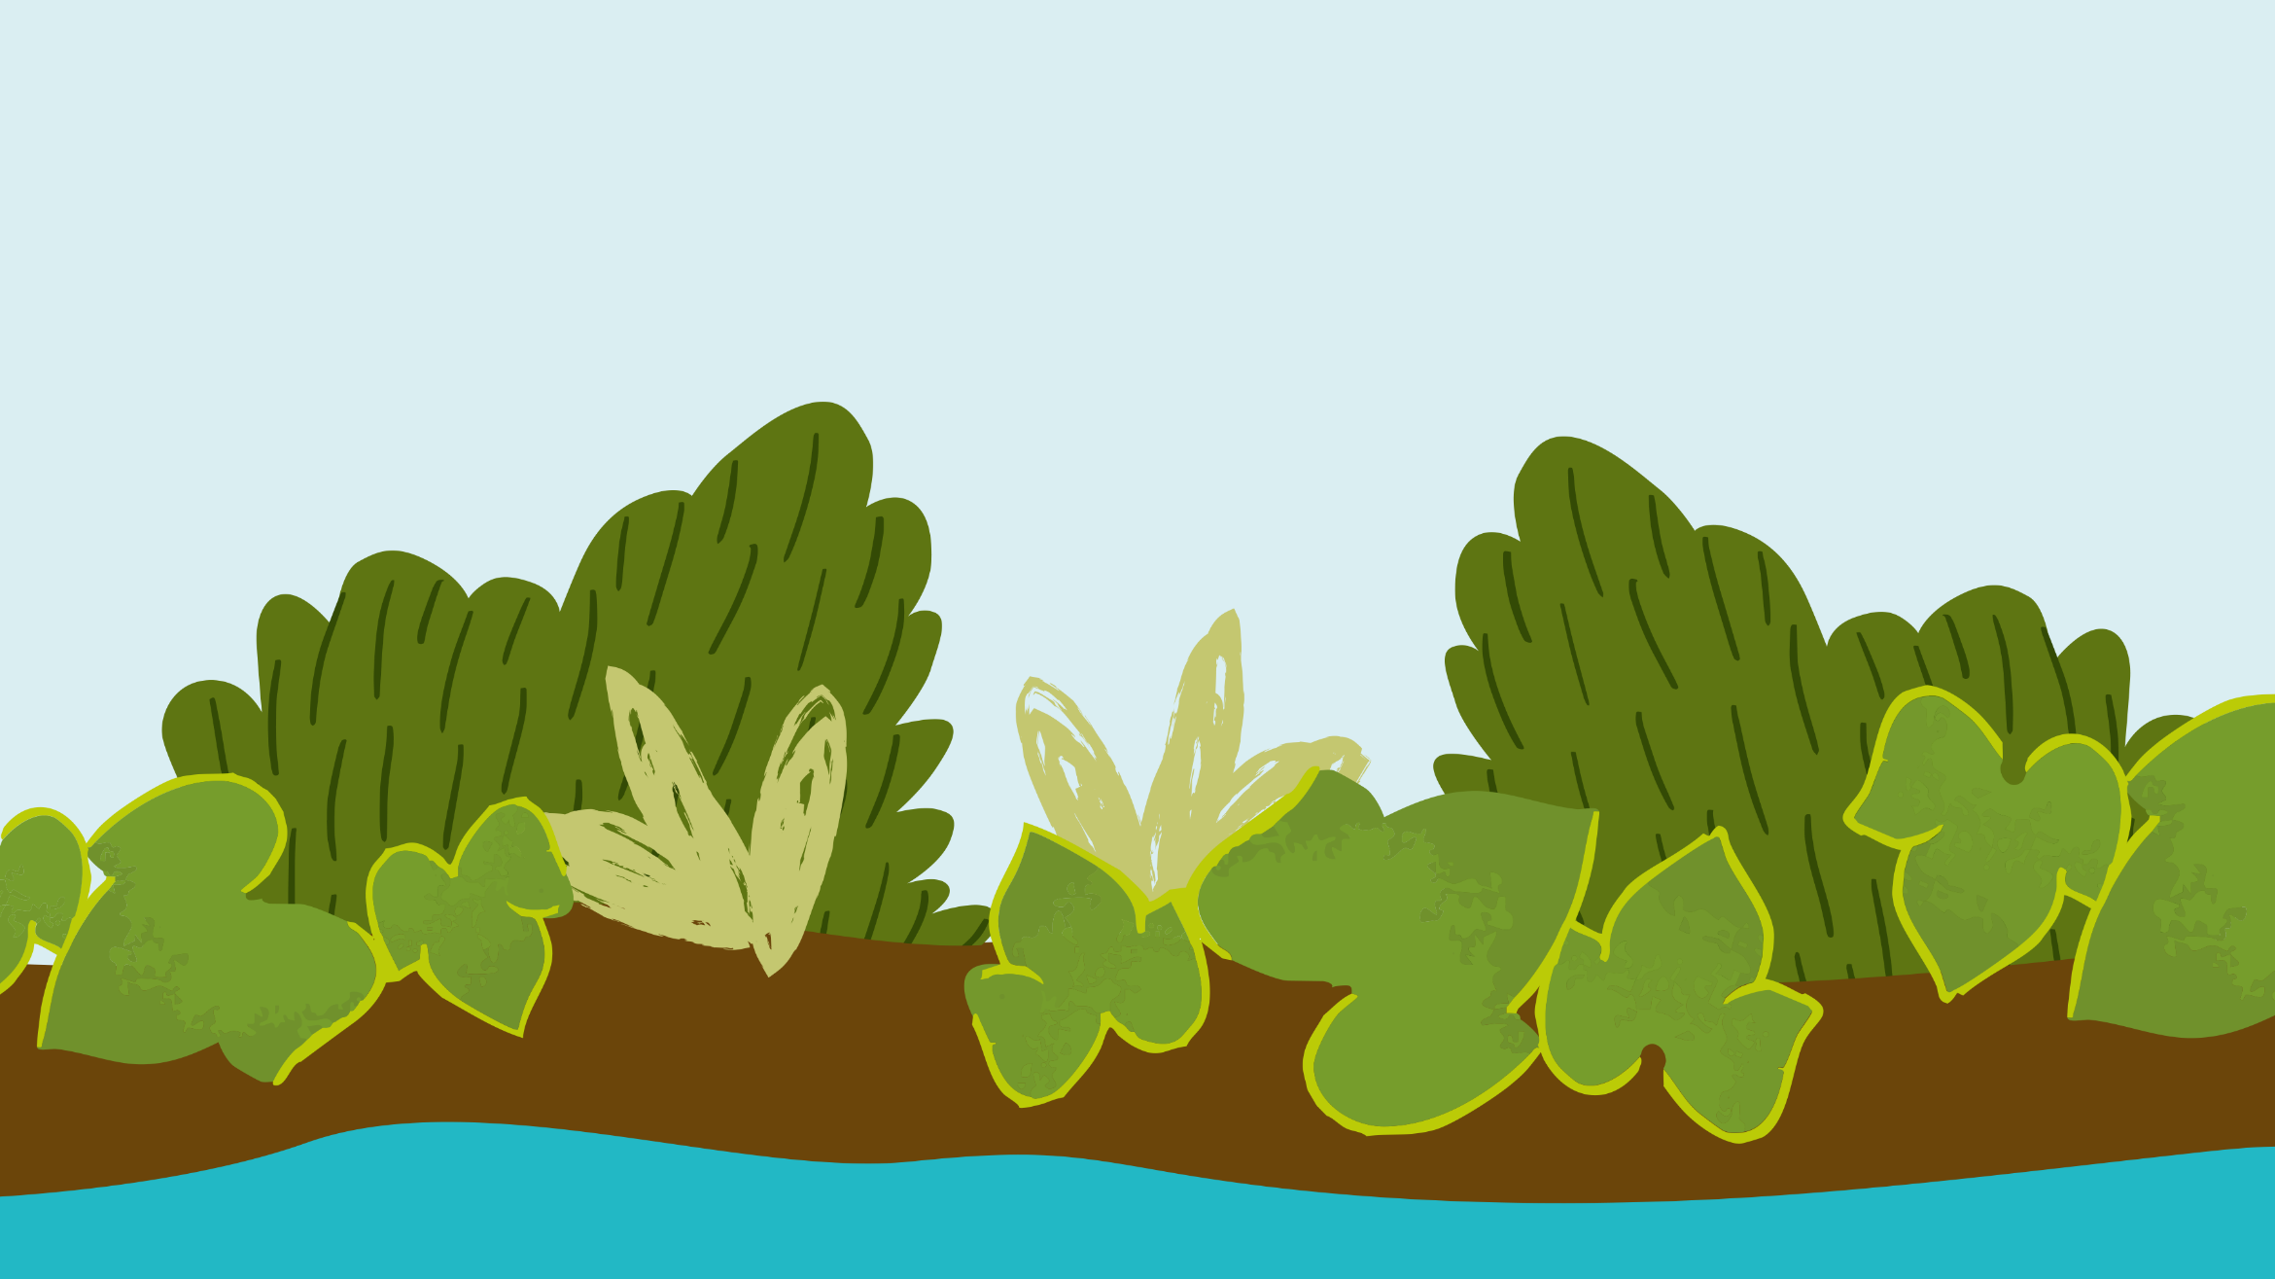
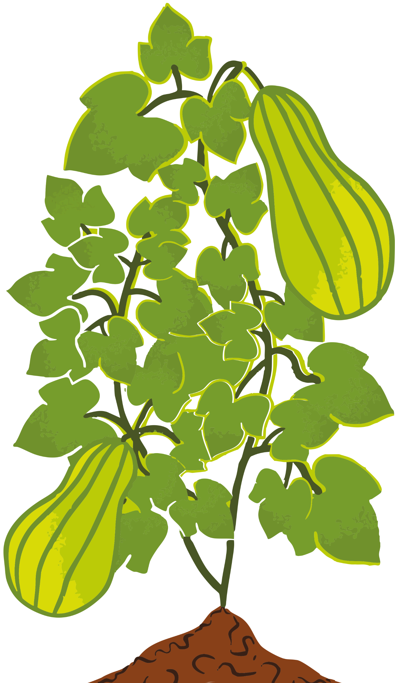


Lent calendar 2026
Week: One Two Three Four Five Six
M
T
W
T
F
23 February
2 March
9 March
16 March
23 March
30 March
24 February
3 March
10 March
17 March
24 March
31 March
Ash
Wednesday
25 February
4 March
11 March
18 March
25 March
1 April
19 February
26 February
5 March
12 March
19 March
26 March
Maundy
Thursday
20 February
CAFOD
Fast Day
6 March
13 March
20 March
27 March
Good
Friday
Easter
Sunday

Slide 3
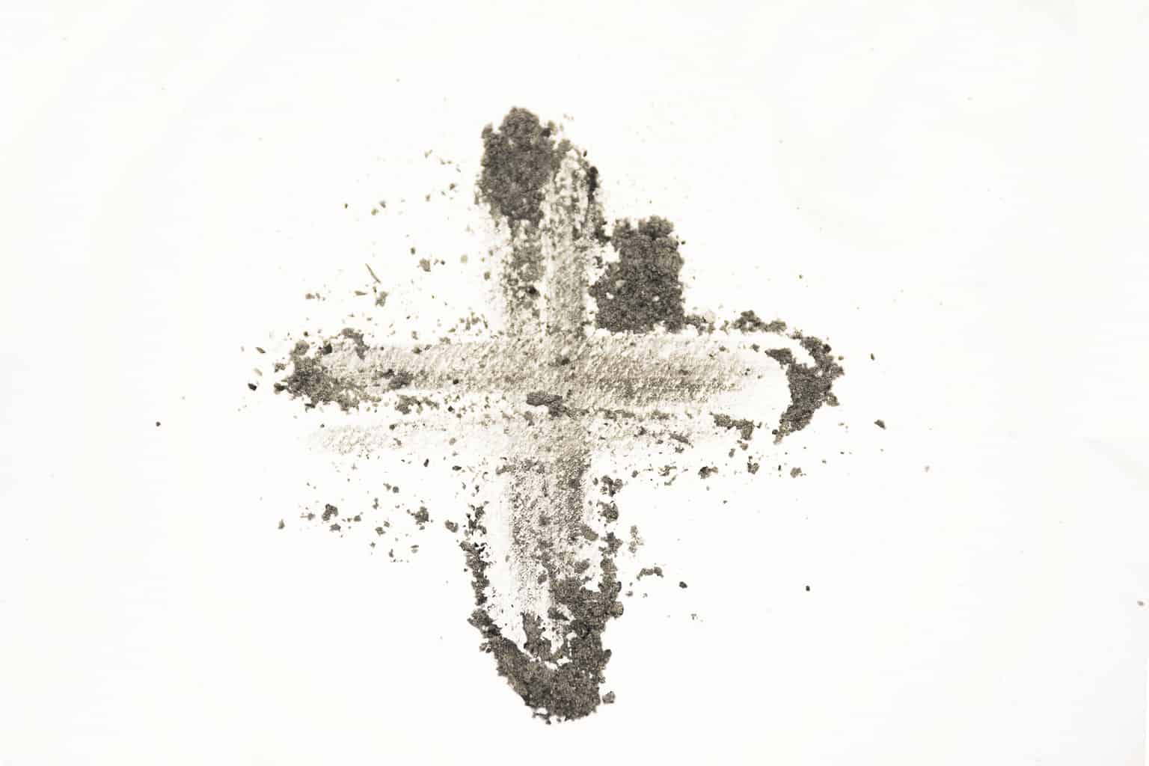
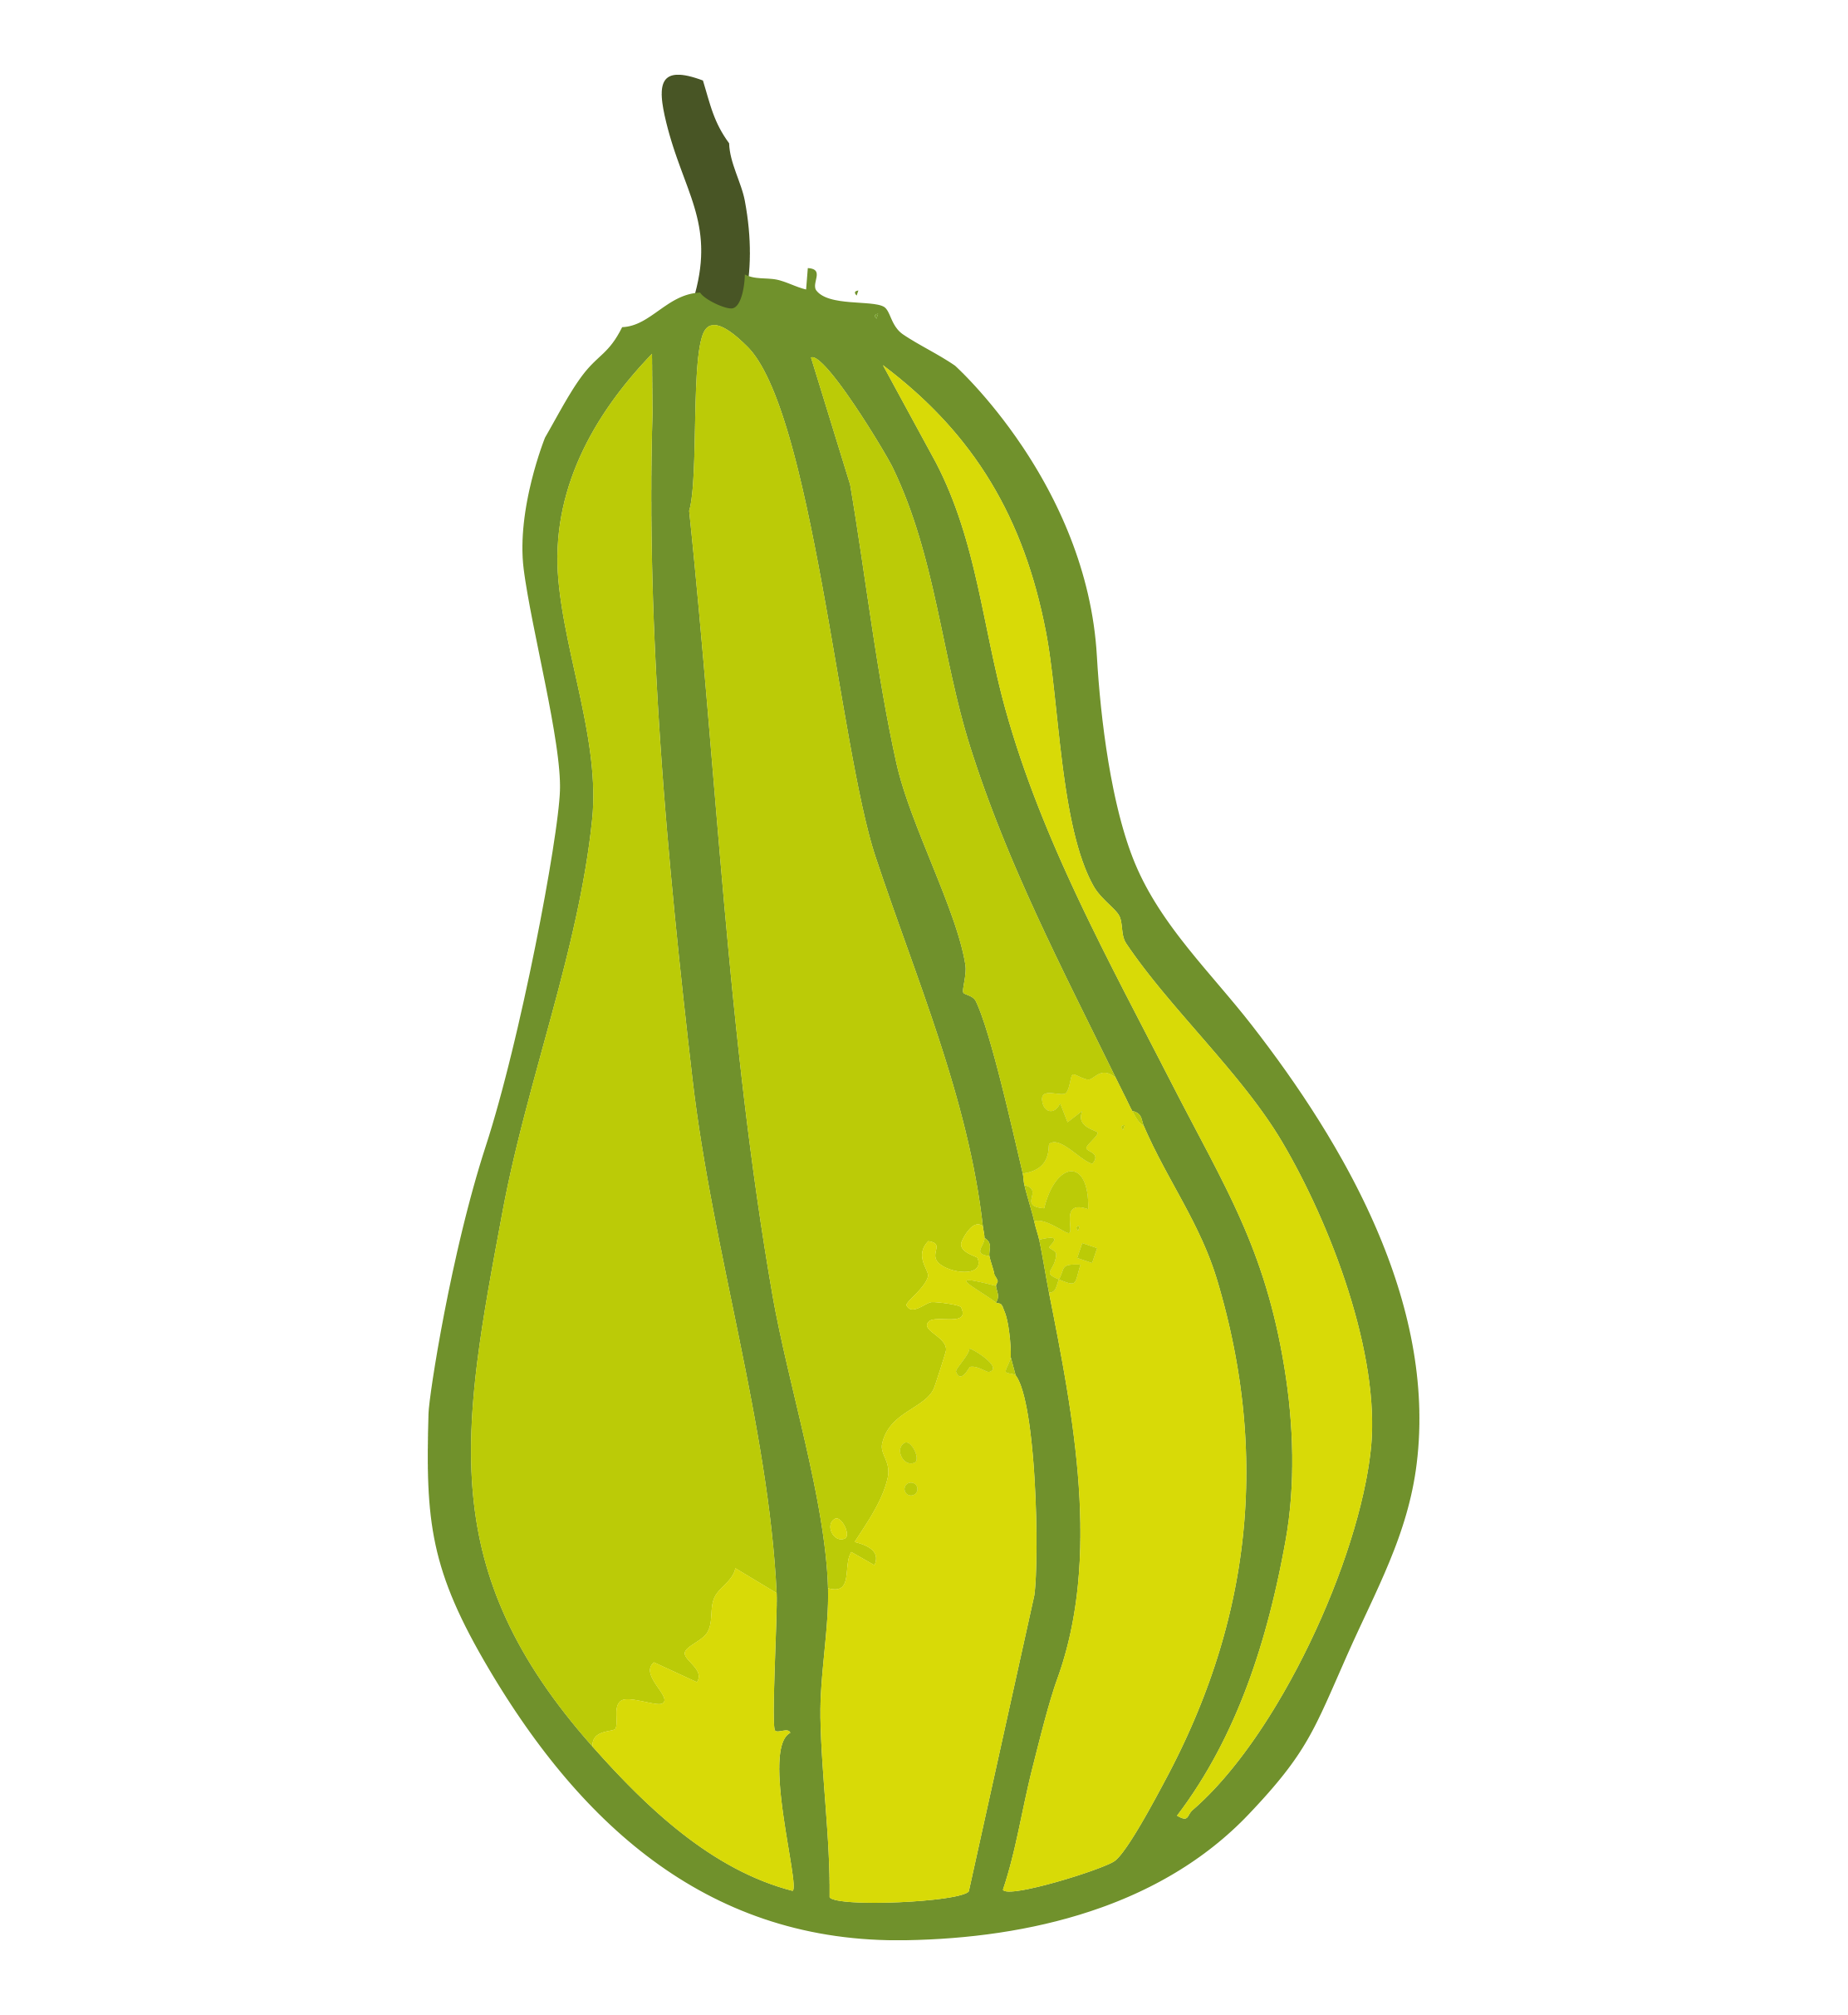

Wednesday 18 February
"Today, if you hear his voice, harden not your heart. " Psalm 95:8
As Lent begins, we remember how Jesus spent 40 days in the desert, preparing for his ministry.
Alone and fasting, he spent time in prayer and reflection. If we take time to consider that, it must have been very challenging.
Many people around the world today face the challenge of lacking basic necessities like enough food to eat, clean water to drink or a safe place to live.
Throughout Lent, we will reflect on how we open our hearts to our neighbours in need around the world; how we can do what's right to help our global brothers and sisters live with dignity and hope.
Download our Lent liturgy - perfect for Ash Wednesday

Slide 4
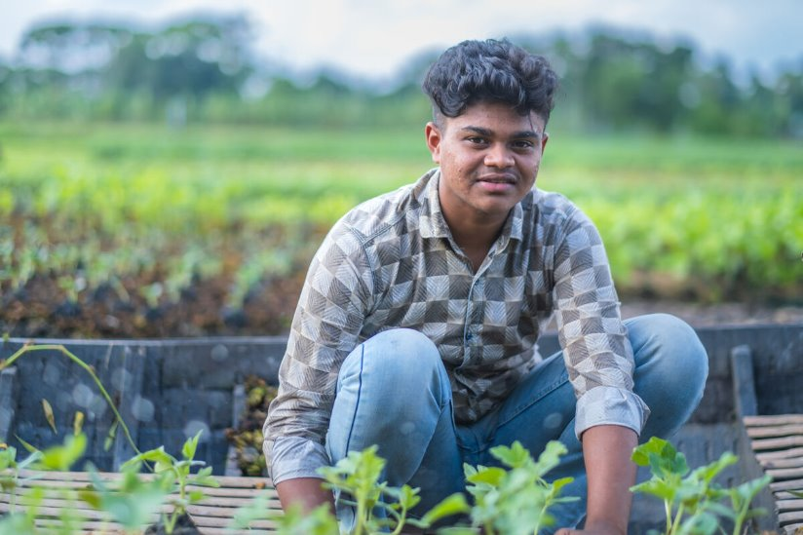
Thursday 19 February
This Lent, we are thinking about our global neighbours who struggle to grow food because of the impact of climate change.
Meet 16-year-old Bayezid who lives in a village called Choto Bashail in Bangladesh.
Bayezid has always helped his family grow vegetables on a floating garden plot, which is how his family and others in the community make their living.
But in recent years, growing crops has become very tough due to climate change.
Watch our Lent film
Notes:
Bayezid, Bangladesh
Photo credit: Amit Rudro

Slide 5
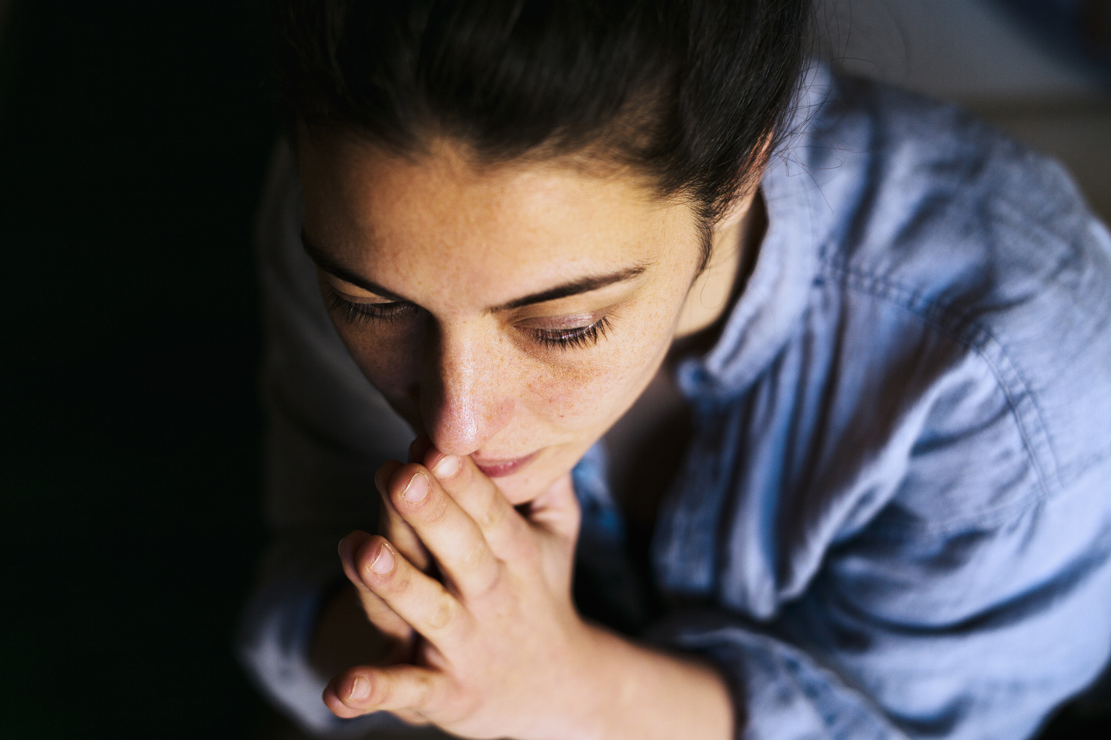

Friday 20 February
"Is this not the fast that I choose... to share your bread with the hungry and bring the poor into your house?" Isaiah 58: 6-7
During Lent, we try to spend a little more time in prayer, be a little more considerate of those around us and give a little more of what we have to others, as we prepare to celebrate the feast of Easter.
When we fundraise, or give up fast food, snacks or other treats, we stand in solidarity with people who are living in poverty.
What can you do this Lent to stand with our brothers and sisters in need? Could you do the Big Lent Walk?
Join the Big Lent Walk!
Notes:
Reflecting
Photo credit: Stock image

Slide 6
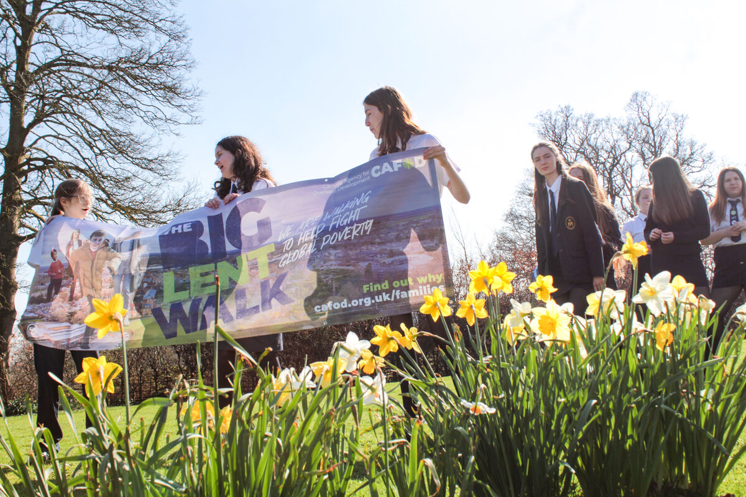
Monday 23 February
"For I was hungry and you gave me food, I was thirsty and you gave me drink." Matthew 25:35
This Lent, schools in England and Wales are taking part in the Big Lent Walk, raising money to help communities like Bayezid's help themselves.
Could you join other young people in making a difference to our brothers and sisters in need around the world? Could you do the Big Lent Walk to help fundraise for those who are hungry and thirsty?
Lord, may my support bring hope to people in difficulty around the world. May they know you are with them, with a global family that cares for them. Amen.
Join the Big Lent Walk!
Come together at our Lent Assembly

Slide 7
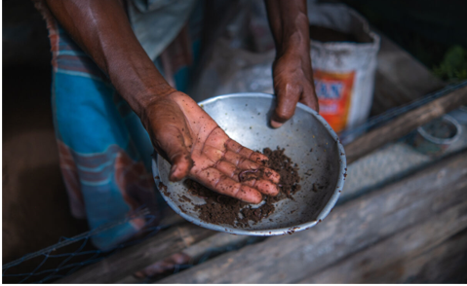
Tuesday 24 February
Climate change can make growing crops very difficult.
In some parts of the world, there is too little rain. In places like Bangladesh, where Bayezid lives, there is too much. The result is the same – seeds fail to grow, plants die and families go hungry.
"It's a big loss for us in Choto Bashail," says Bayezid.
Many communities across the world are affected by changing weather that affects livelihoods.
Lord, fill our hearts with compassion for all our brothers and sisters around the world affected by a changing climate. Lead us to be good neighbours to all in need. Amen.
Our reflection on climate change

Slide 8
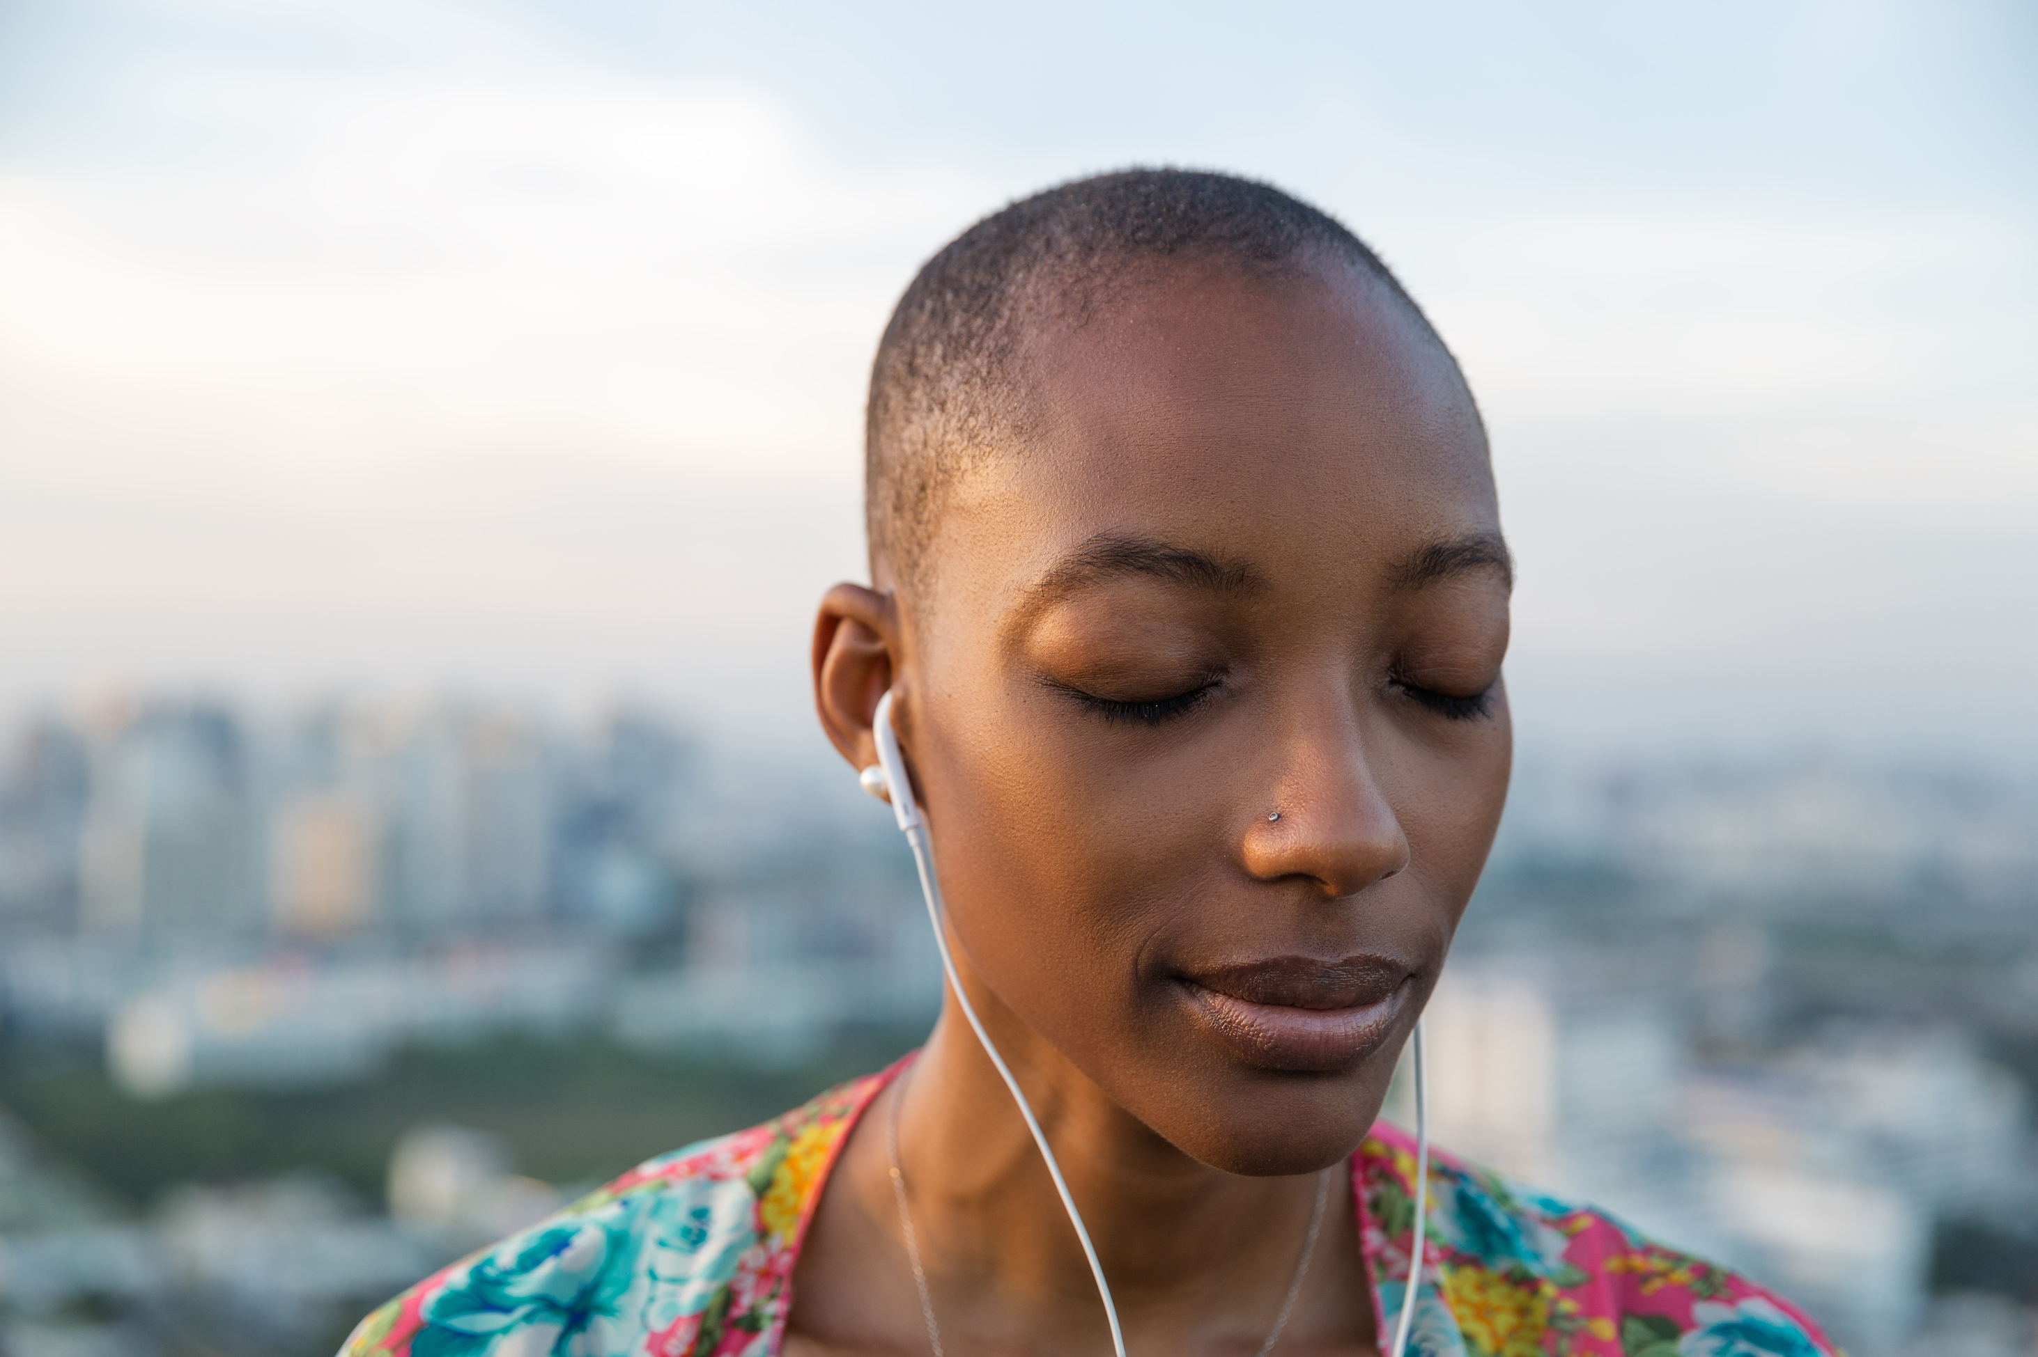
Wednesday 25 February
"Return to the Lord your God, for he is gracious and merciful, slow to anger and abounding in steadfast love." Joel 2:13
Lent is a time for us to turn back to God. It's a time to reflect on the choices we make and the way we live our lives and to seek forgiveness for where we've gone wrong.
It's a time to draw closer to God, knowing he loves us very much and that we can do all things with him.
We all have busy lives, but how, during our day, could we make a bit more space for God? How about a few minutes while having breakfast? On your journey to school or college? Or on your way home? Between homework tasks?
All Things reflection

Slide 9
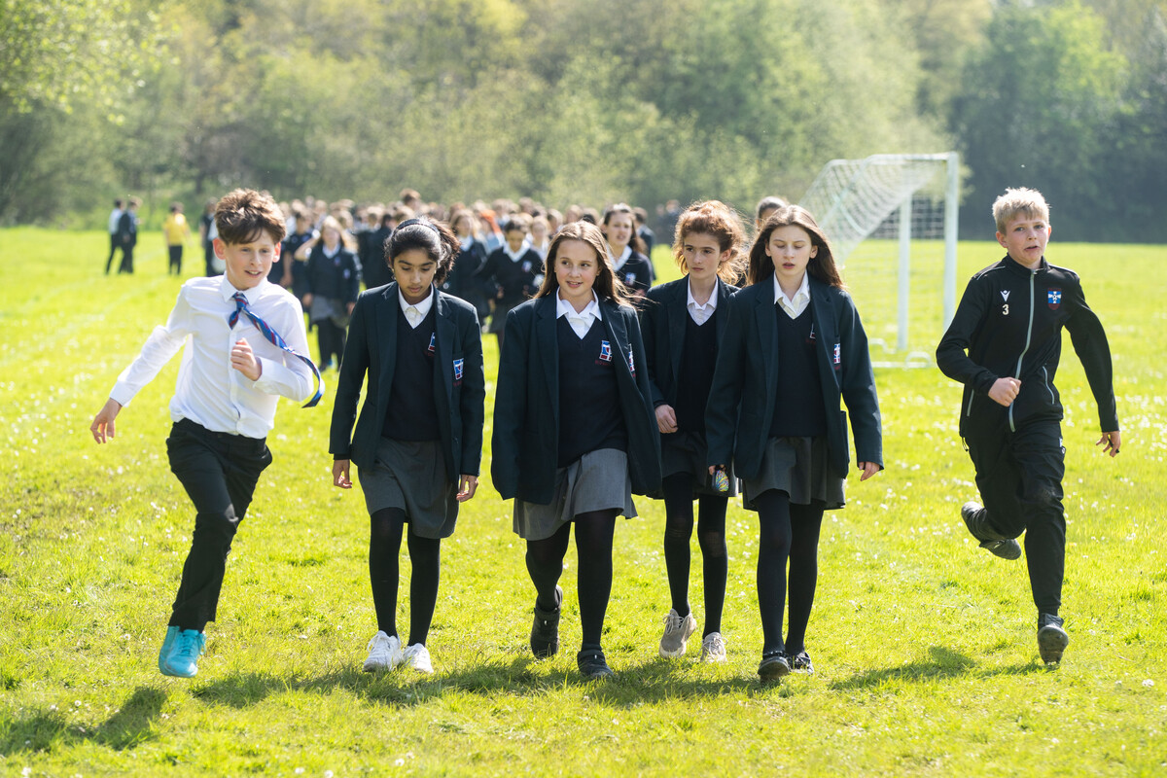
Thursday 26 February
"Ask and it will be given to you; seek and you will find; knock and it will be opened to you." Matthew 7:7
We know God wants us to pray regularly, to ask him for the things that help us lead our best lives.
But praying may feel difficult - worrying about saying the right words or doing the right things.
We are reminded God always listens and wants us to come closer. And he just wants us to be us - no special language required!
CAFOD is asking you to do the Big Lent Walk this Lent – and so is Harry...
Harry's message
Former Traitors winner Harry Clark has signed up to do the Big Lent Walk. We promise he's not lying!
Notes:
Big Lent Walk at St Gregory's Catholic School
Photo credit: Joe Newman

Slide 10
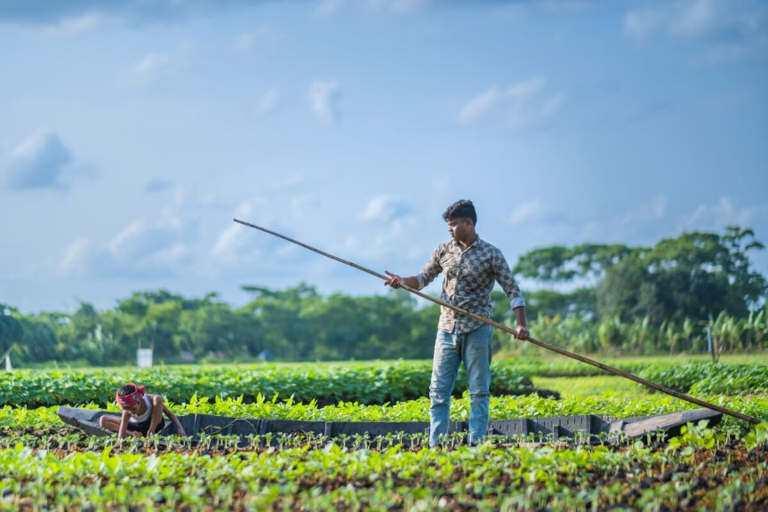
Friday 27 February
Today is Lent Family Fast Day!
Watch our Lent film to learn more about Bayezid and his neighbours in Choto Bashail.
See how, with CAFOD's help, they are working together, and with the environment, to build floating gardens.
On these beds, they can grow crops that won't be destroyed by flooding, allowing them to grow enough food to eat and to sell to make a good living. .
Lord, as we eat simply today on Family Fast Day, in solidarity with our sisters
and brothers, let us pray we will grow a closer relationship with the earth, our global family and with God. Amen.
Watch our Lent film

Slide 11
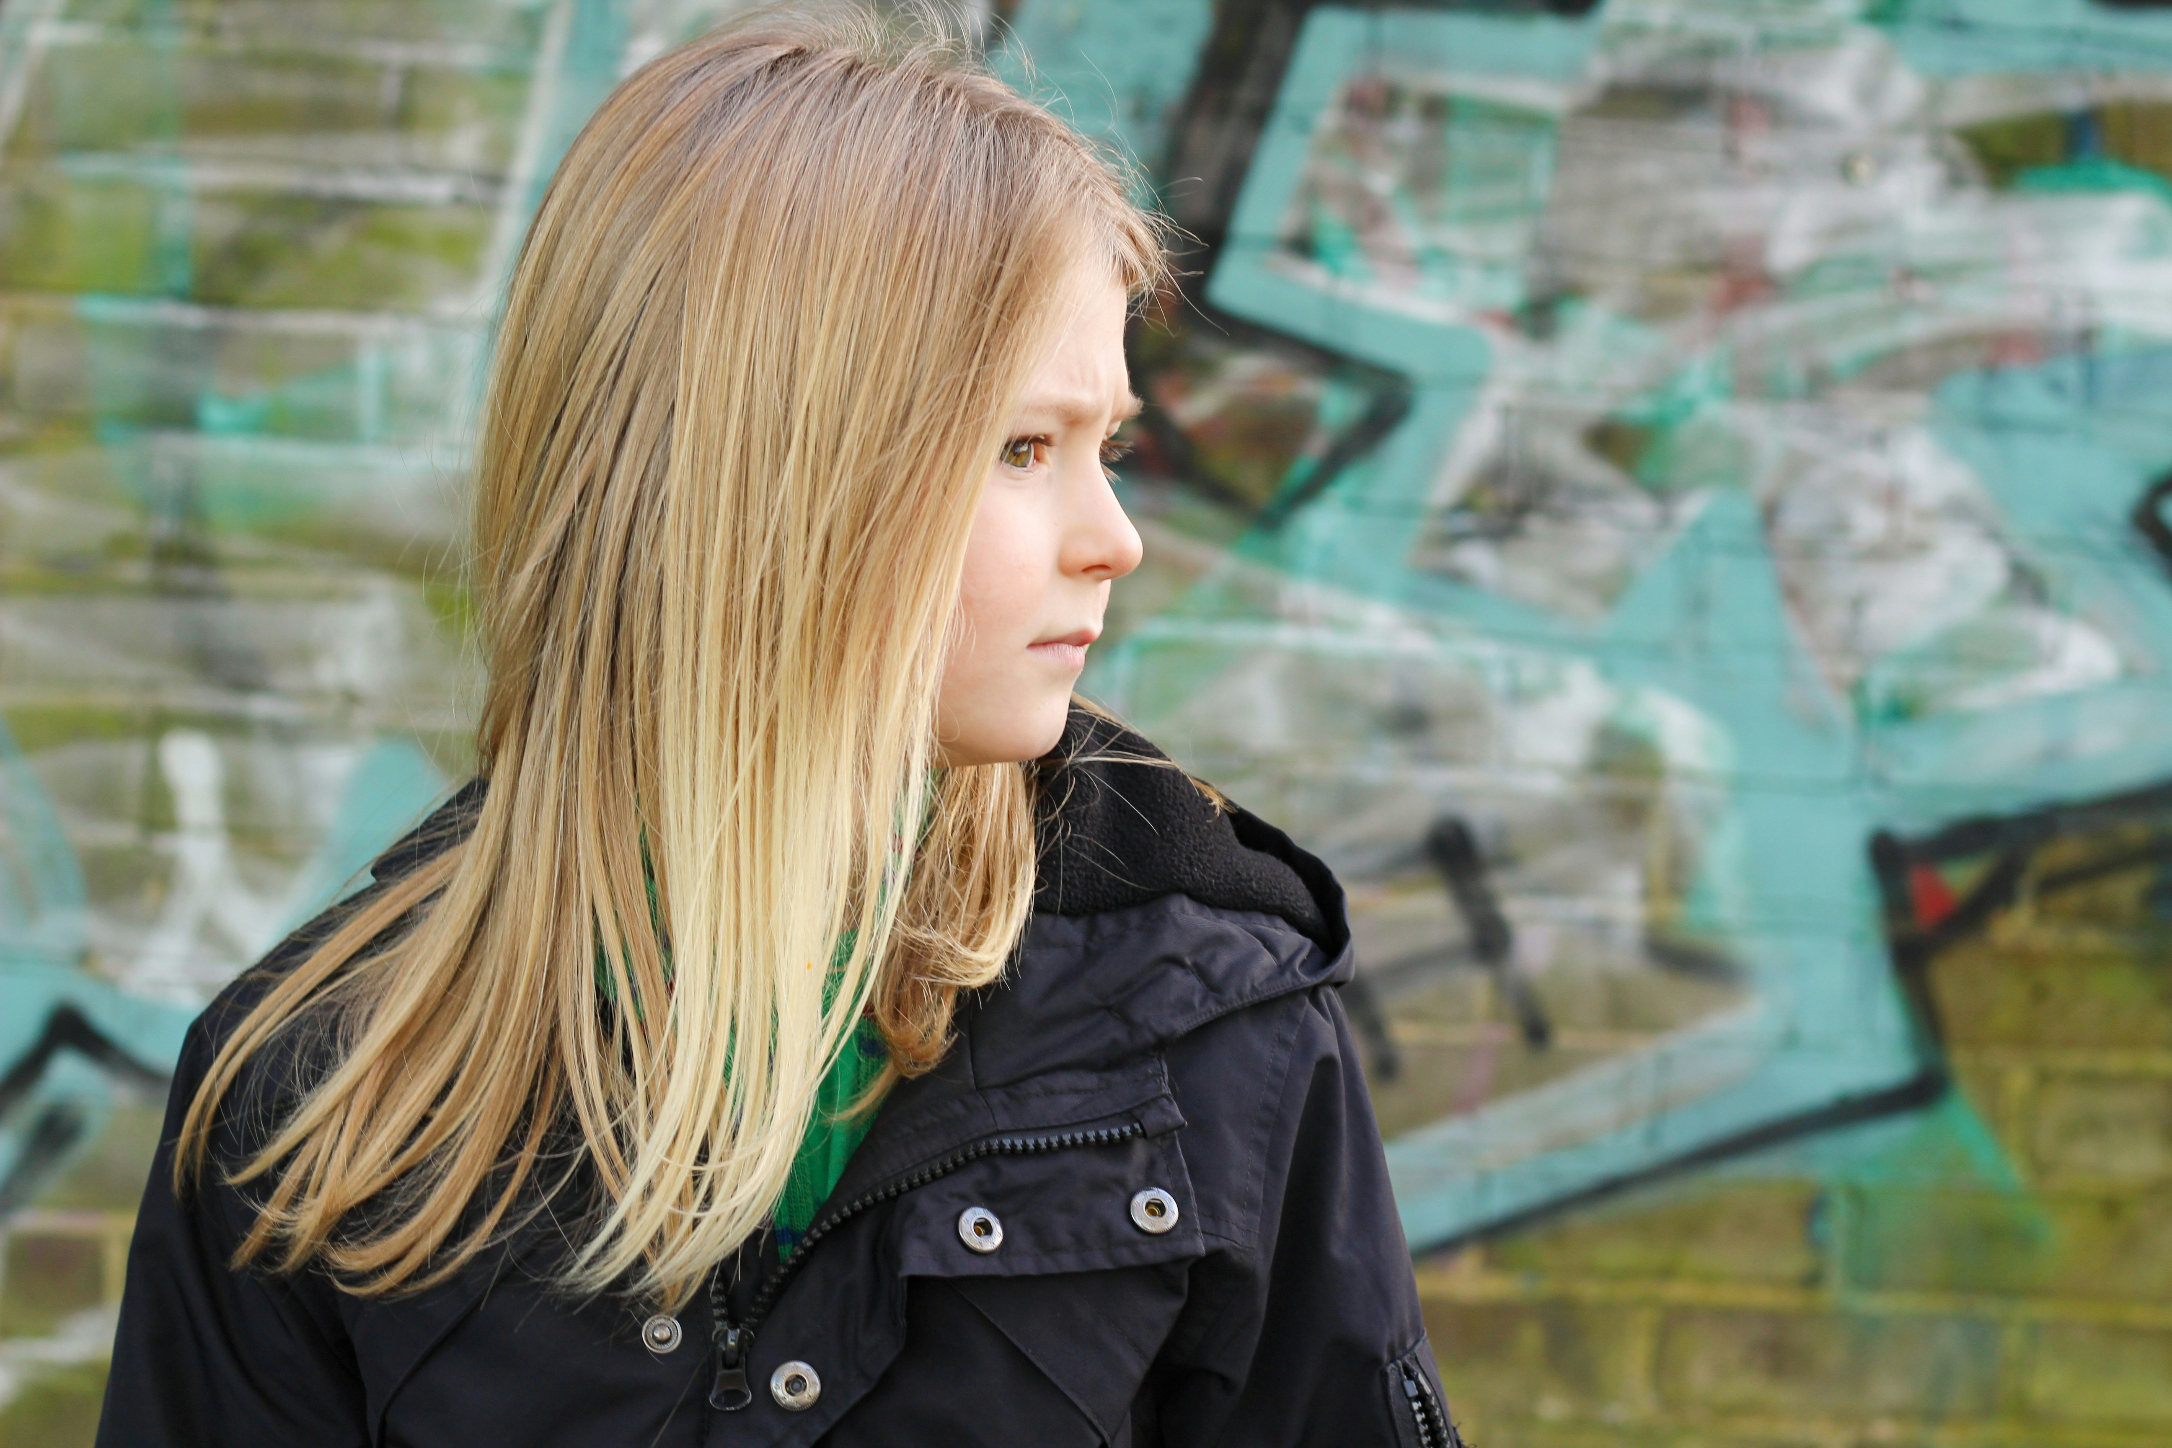
Monday 2 March
Jesus said: "Be merciful, as your Father is merciful. Stop judging and you will not be judged. Stop condemning and you will not be condemned. Forgive and you will be forgiven." Luke 36-37
What encapsulates all this is kindness. Be kind.
Although we've been told from a young age to be kind, it's not always easy, is it? If you're feeling stressed, annoyed or upset, kindness may feel a long way off.
But we know it's important to treat others the way we would like to be treated. If we spend a little time with God, asking for help, he can guide us in that – even when the situation seems challenging. Give it a try!
Lord, help us to be merciful, not to judge, not to condemn and to be ready to forgive. Help us be kind. Amen.
Notes:
World Kindness Day 2025: 5 ways kindness can help your wellbeing - BBC Bitesize

Slide 12
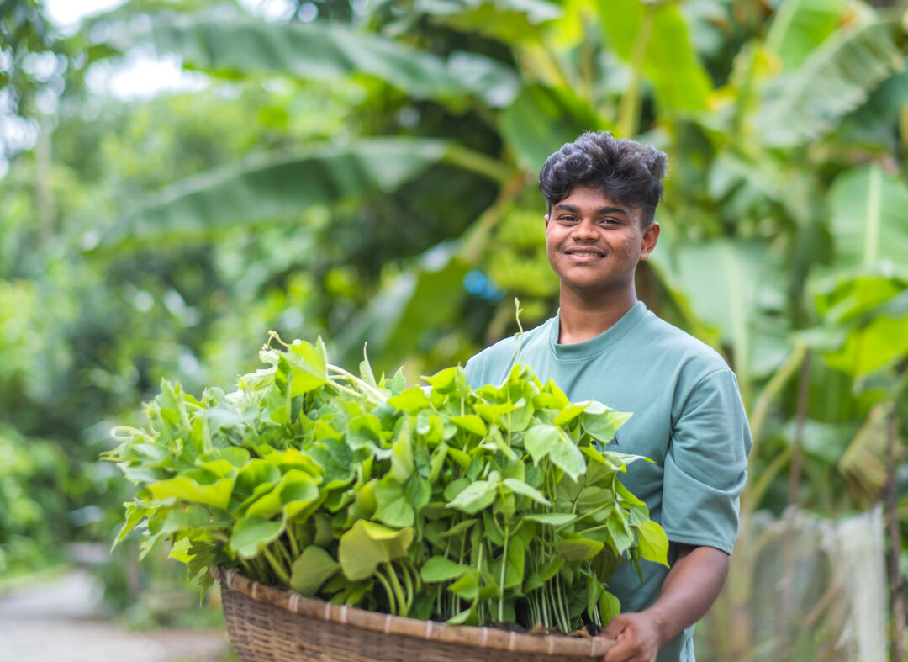
Tuesday 3 March
Not many letters come through the front door these days – but we still like to get one, don't we?
Pope Francis wrote a special letter called Laudato Si' to everyone on earth asking us to take care of the world - our common home.
Bayezid knows how important it is to care for creation. He knows climate change has had a big effect on his area.
“To build a beautiful world is everyone’s responsibility,” he says. “We have to prevent pollution, saving the environment together."
Watch our Laudato Si animation
Notes:
Bayezid, Bangladesh
Photo credit: Amit Rudro

Slide 13
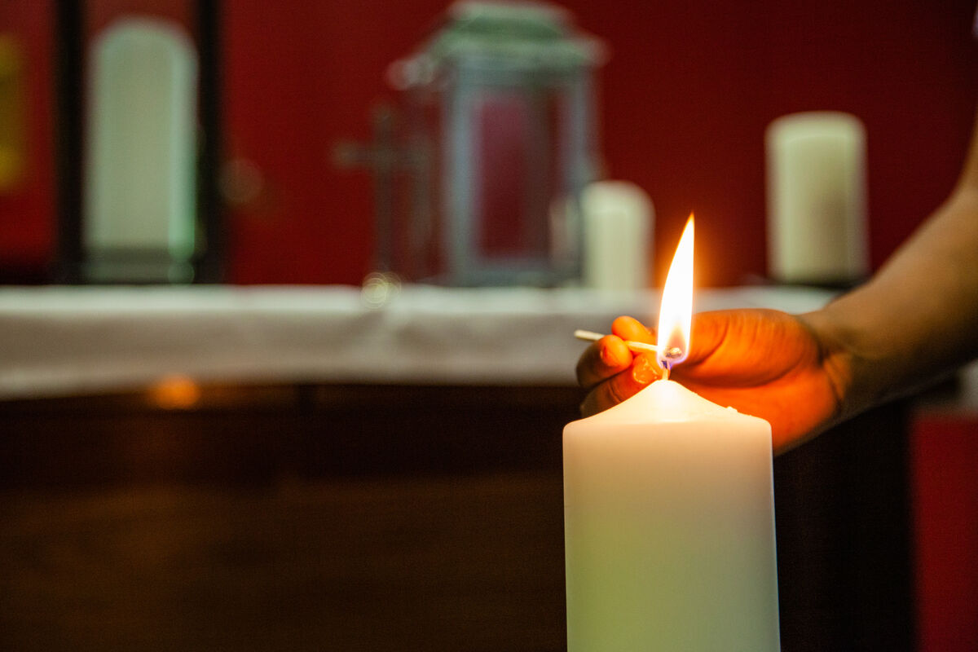
Wednesday 4 March
"I am the light of the world, whoever follows me will not walk in darkness, but will have the light of life."
John 8:12
Being afraid of the dark is a fear we often associate with children.
But actually, not many of us like being in the sort of darkness where you can't see anything at all, particularly in unfamiliar surroundings. How does it make us feel?
In these moments, any amount of light brings comfort.
How can we be lights in the darkness, bringing comfort to others?
Shining a light on success: Three stories of how you’ve helped
Notes:
All Saints School, Sheffield
Photo credit: Thom Flint

Slide 14
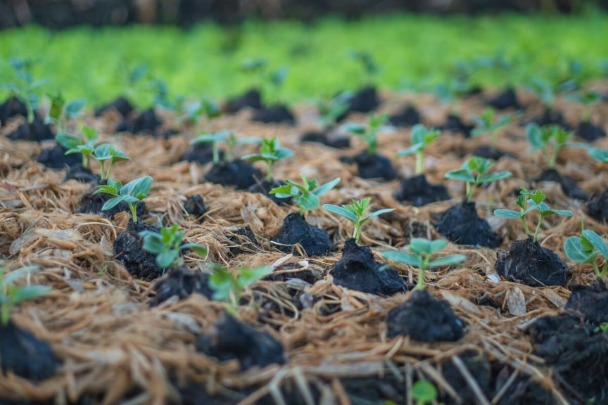
Thursday 5 March
"Blessed is the man... whose trust is the LORD. He is like a tree planted by water, that sends out its roots by the stream..." Jeremiah 17:7-8
Climate change has caused devastating floods in Bangladesh.
Bayezid's community has struggled to make a living because the increase in rain has ruined their crops.
With CAFOD’s help, local experts work with families to build floating gardens. Because they are buoyant, these gardens rise with growing water levels, they are not flooded and the crops stay safe and continue to thrive.
Watch our Caring for our Earth prayer
Notes:
Floating gardens, Bangladesh
Photo credit: Amit Rudro

Slide 15
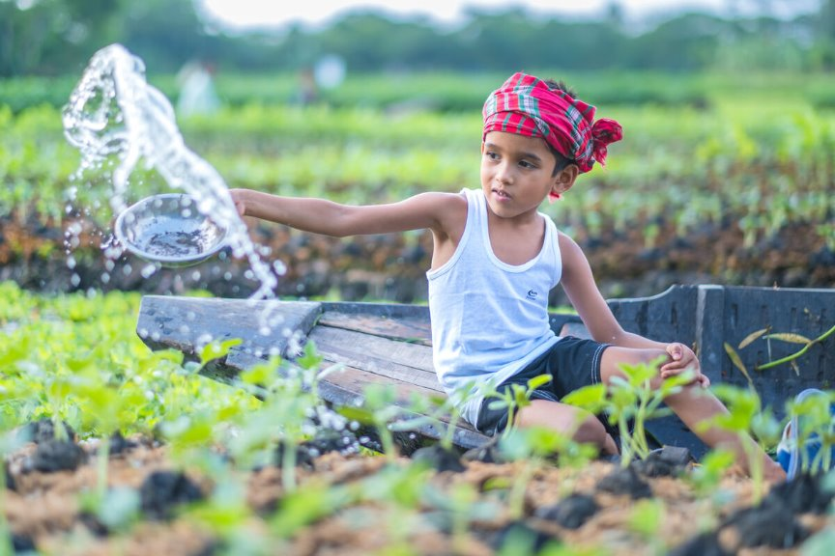
Friday 6 March
Zunayed likes visiting the floating gardens with his father, Zahidul.
Having watched his neighbours plant floating beds, Zahidul was curious about the process. He went to the community training sessions, asked questions and learnt how to construct them himself.
Zunayed is keen to keep an eye on things – checking that the plants on the floating beds are growing well.
Lord, in the way that Zahidul learnt by the example of his neighbours, let us learn to live by your example of loving one another. Amen.
Learn more in the floating gardens photopack
Notes:
Zunayed at the gardens, Bangladesh
Photo credit: Amit Rudro

Slide 16
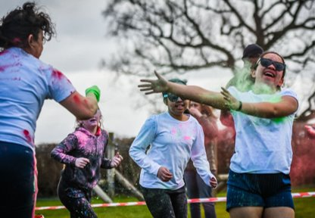
Monday 9 March
“I have come so that they may have life, and have it to the full”
John 10:10
Say these words together and take some time to think about them.
Where do these words come from?
What do you think they mean?
How can we live by these words and put our faith into action?
How can we live our lives to the full?
Lord, help us use our talents and make the most of opportunities so that we live our best lives! Help us to put our faith into action so that we can help others live life to the full too. Amen.
Notes:
St. George's Catholic Voluntary Academy do a Colour Run for CAFOD
Photo credit: St. George's Catholic Voluntary Academy

Slide 17
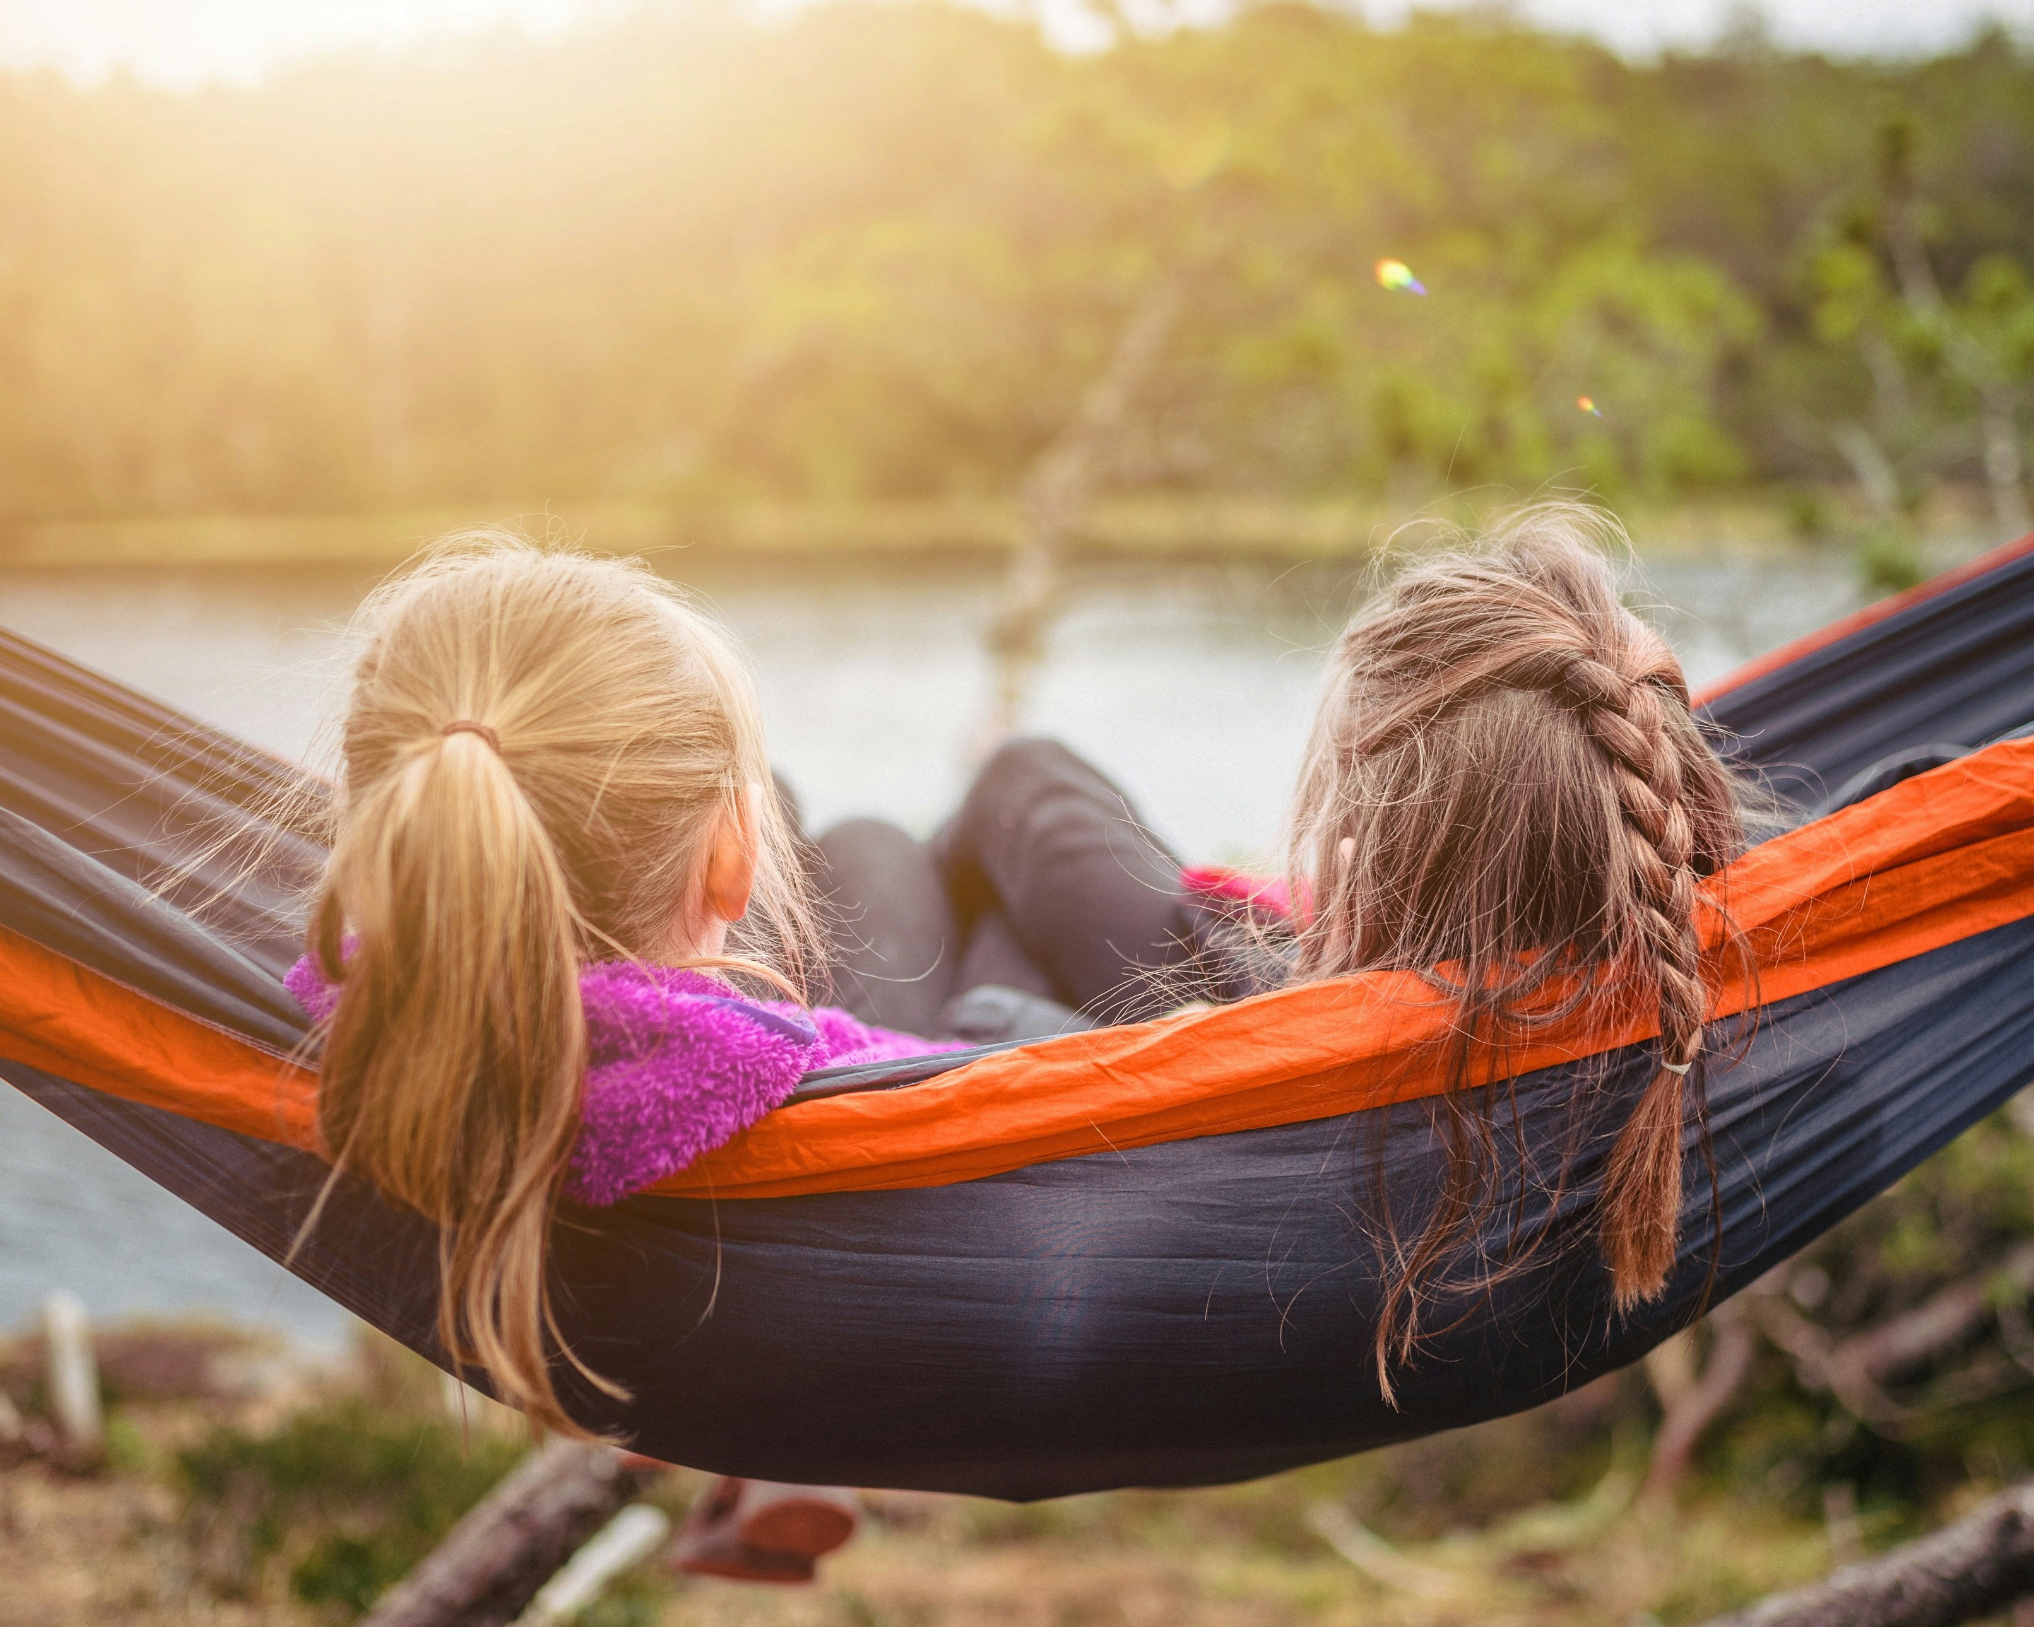
Tuesday 10 March
"Return to the Lord with all your heart... Return to the Lord, your God, for he is gracious and merciful." Joel 2:12-13
It can be challenging doing the right thing all the time. We get things wrong sometimes. But if we are truly sorry, God is merciful, God is forgiving.
And we in turn should do our best to "forgive those who trespass against us". But this can be very hard, particularly if we are angry or upset.
An African proverb states: ‘He who forgives ends the quarrel.’ Forgiveness might require patience but we can ask God to help us; whereas revenge only creates bitterness. Forgiving helps us to heal wounds.
Reflection on forgiveness
Reflection on forgiveness
Notes:
Together
Photo credit: Janko Ferlic

Slide 18
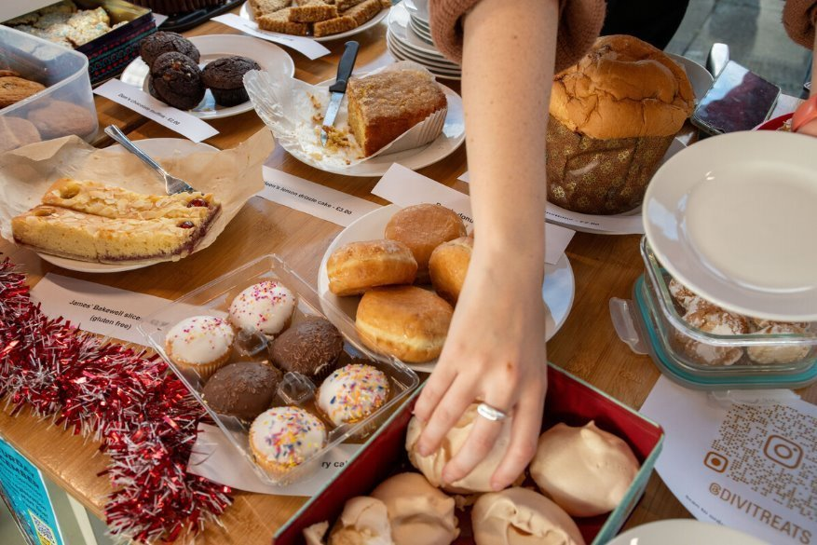
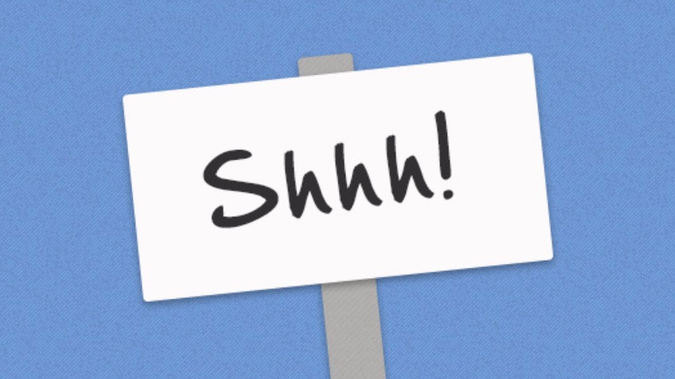
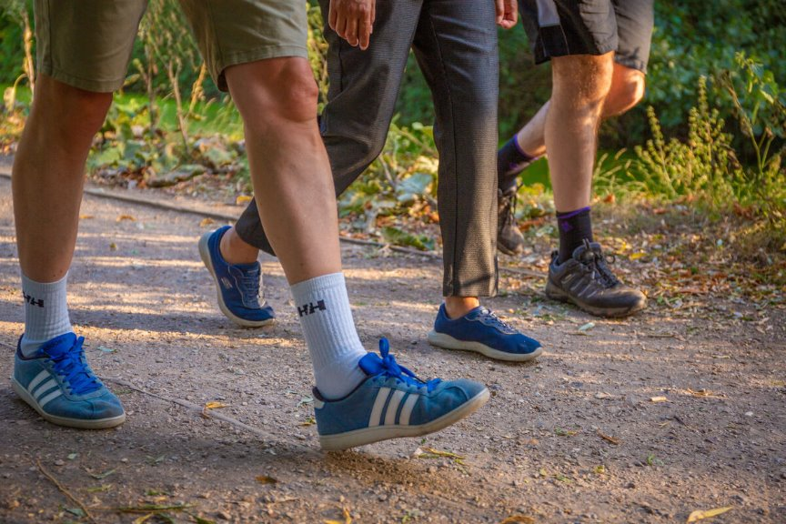
Wednesday 11 March
This Lent, hundreds of schools in England and Wales are raising money to support our brothers and sisters living in poverty around the world.
There are so many easy ways you can do this! How about trying the Big Lent Walk, raising money and walking in solidarity with our global family in need?
Or showing off your baking and organisational skills by having a cake sale?
Or by saying absolutely nothing in a sponsored silence?
Lord, may my support bring hope to people in difficulty around the world.
May they know they have sisters and brothers who care for them. Amen.
Find out more here!
Notes:
CAFOD cake sale, London
Photo credit: Joe Newman
St Francis Xavier's RC Primary School, Herefordshire
Photo credit: Victoria Ahmed
Shh!
Photo credit: Stock image

Slide 19
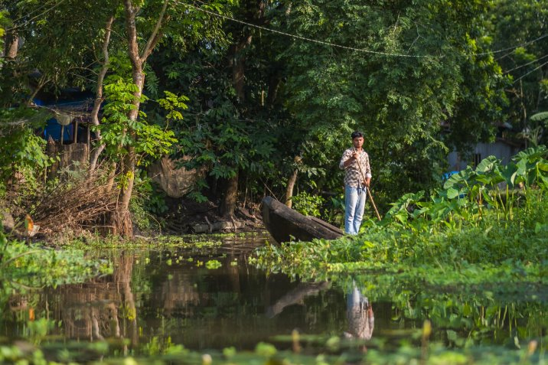
Thursday 12 March
The Choto Bashail community create floating gardens by planting saplings into layers of woven hyacinth plants which grow locally.
"I help with the seedlings at the beginning and then when we bring in the beds," says Bayezid. He enjoys working on the floating gardens because "it has to be done inharmony with nature", he says.
Bayezid warns that we should look after our environment because he has seen the harm climate change can do.
Climate change and creation

Slide 20
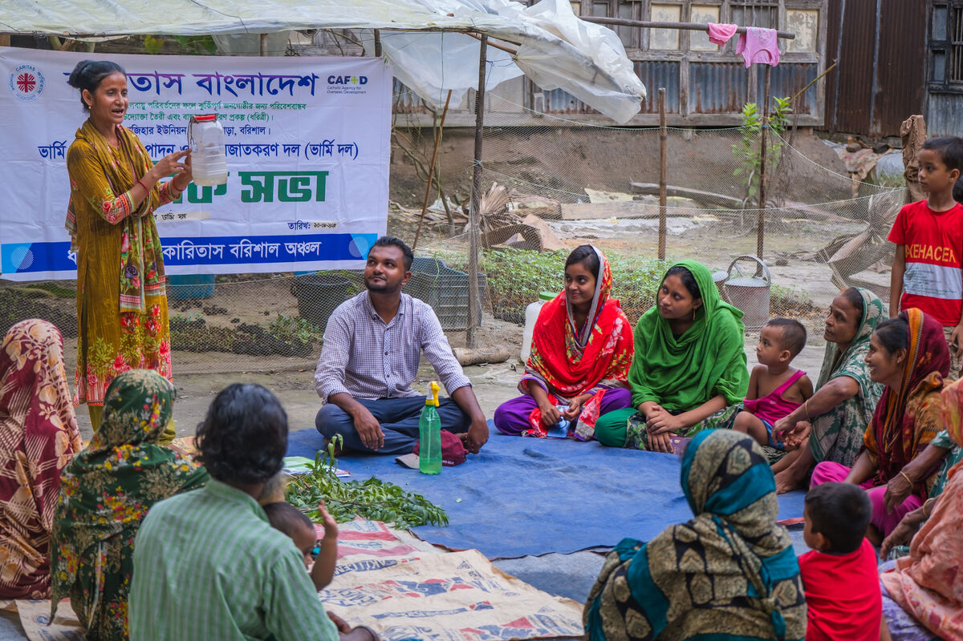
Friday 13 March
"'...You shall love your neighbour as yourself.' There is no other commandment greater than these." Mark 12:31
Zunayed's father, Zahidul, learnt how to construct a floating garden from his neighbours.
With help from CAFOD and the support of neighbours, the families in the community in Choto Bashail have come together, learning how to make a living and becoming self-sufficient.
Can you think of examples of where neighbours or communities have worked together, supporting one another, showing love for one another to make a difference to each other's lives?
Lord of all people, help us to live life faithfully, growing in love for you and our neighbours, both near and far. Amen.
Notes:
Learning about floating gardens, Bangladesh
Photo credit: Amit Rudro

Slide 21
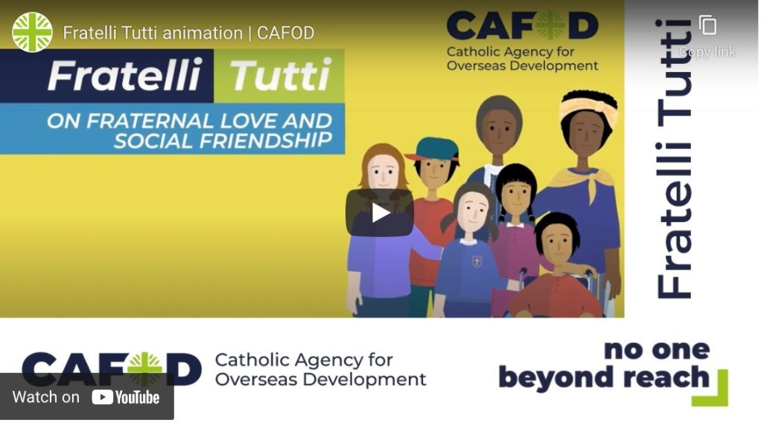
Monday 16 March
Pope Francis liked writing letters!
This one is called Fratelli Tutti. In it, he asks us to reach out to our sisters and brothers in need, whoever they are, wherever they may come from.
We are challenged to think of ourselves as a single global family living in a common home, and neighbours to all.
At CAFOD, we believe this means moving towards a world where everyone can be the best person they can be. How do we all play our part in achieving that?
Watch the animation!

Slide 22
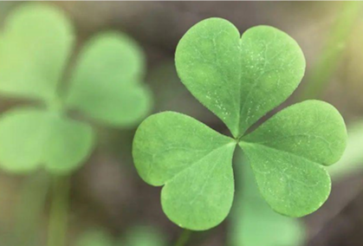
Tuesday 17 March
'God is our refuge and strength, a very present help in trouble.' Psalm 46:1
Dia dhuit! That's 'hello' in Irish and today we celebrate St Patrick, the patron saint of Ireland.
This psalm may have sustained Patrick, sad and afraid when forced into slavery in Ireland.
Conflict, poverty and hunger force millions of people from their homes, however they do not always find a warm welcome elsewhere. But Pope Leo XIV says: "In every rejected migrant, it is Christ himself who knocks on the door."
St Patrick's symbol is a shamrock. Its three leaves represent the Holy Trinity of Father, Son and Holy Spirit, standing for faith, hope and love.
Lord, help us to put our faith into action, give hope to others and show love to our global neighbours in need. Amen.
Notes:
Shamrock
Photo credit: Stock image

Slide 23
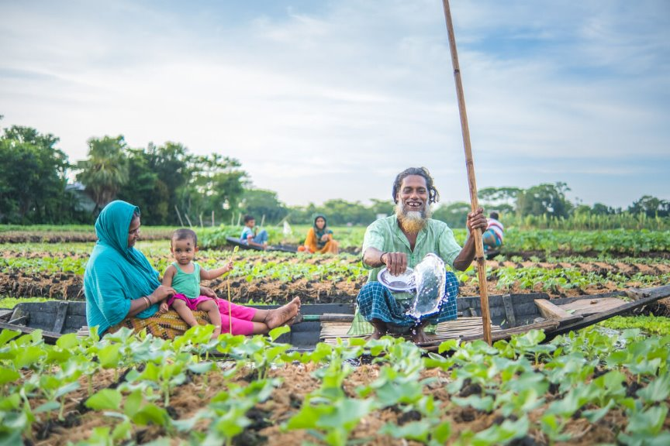
Wednesday 18 March
So Jesus said to them, "Truly, I say to you... whatever the Father does, that the Son does likewise." John 5:19
In Jesus’ day, it was usual for sons to take up their fathers’ work – eg carpentry or fishing - by watching and imitating their father. And Jesus, the Son, does the work of his Father.
Bayezid learned about beds from his father. Floating gardens aren't new – they've bobbed along in Bangladesh for hundreds of years!
But as changing weather means more rain, other ways of farming have become difficult.
So, with CAFOD's help, more families are turning to the old way of farming floating beds which isn't as affected by flooding.
Join the Big Lent Walk!
Notes:
Salam Molla and his family at work, Bangladesh
Photo credit: Amit Rudro

Slide 24
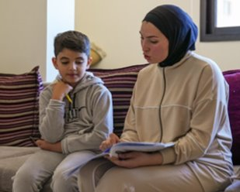
Thursday 19 March
Today is the feast of St Joseph – patron saint of workers, fathers and families.
Joseph protected Mary when pregnant with Jesus on the difficult journey to Bethlehem.
Many children make difficult journeys fleeing poverty or war – like eight-year-old Zein. He escaped from southern Lebanon to a refugee camp. With CAFOD's help, his family receive food and bedding. "But what I want most is to go home," says Zein.
Jinane, his sister, says: “There are no schools here, so I’m teaching my brother [but] he no longer likes studying, saying he doesn’t feel comfortable because of the war."
Watch Zein’s film
Notes:
Zein with his sister, Jinane
Photo credit: Elisa Oddone/Arete/DEC

Slide 25
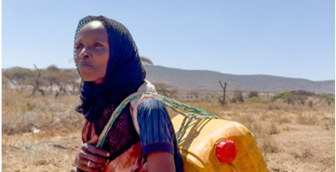
Friday 20 March
This Sunday is World Water Day.
Bayezid and Zunayed are affected by too much rain, but we know in some areas of the world there is not enough.
Severe drought in Ethiopia meant Adi had to walk for hours to fetch water.
With CAFOD's help, a water tank was built in the community. She knows a better world needs all of us and helped with the project.
"This tank is a blessing," says Adi.
How many ways do you use water in one day?
Today, when you have a drink, wash your hands, or flush the toilet, try to remember to thank God for this gift!
Notes:
Adi, Southern Ethiopia
Photo credit: Louise Norton

Slide 26
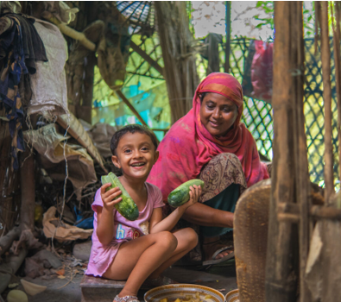
Monday 23 March
"The LORD is my shepherd; I shall not want..." Psalm 23
Muslima is five and is Bayezid’s niece. Her grandfather was able to buy ducks and cows from money he made selling what he'd grown on the floating beds.
Muslima enjoys being in the kitchen with her grandmother, watching her cook vegetables harvested from the floating gardens.
How do you feel knowing that the money you raise for CAFOD gives families real hope? That the money you raise helps communities help themselves so they "shall not want"?
Share your hopes with our Jar of Hope activity
Notes:
Muslima and her grandmother, Bangladesh
Photo credit: Amit Rudro

Slide 27
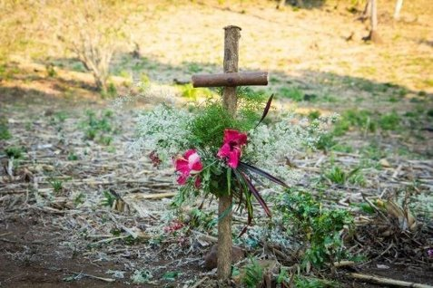
Tuesday 24 March
The Stations of the Cross show Jesus' journey to his crucifixion on Good Friday.
It is a difficult journey. We see Jesus being condemned to death, stumbling with his cross and meeting his mother, Mary.
Inspired by Jesus, can we journey alongside our brothers and sisters in need?
Can we stand by our global family facing difficulties every day because of lack of food, clean water or peace?
Can we do the Big Lent Walk?
Reflect on the Stations of the Cross
Notes:
Cross adorned with flowers
Photo credit: CAFOD

Slide 28
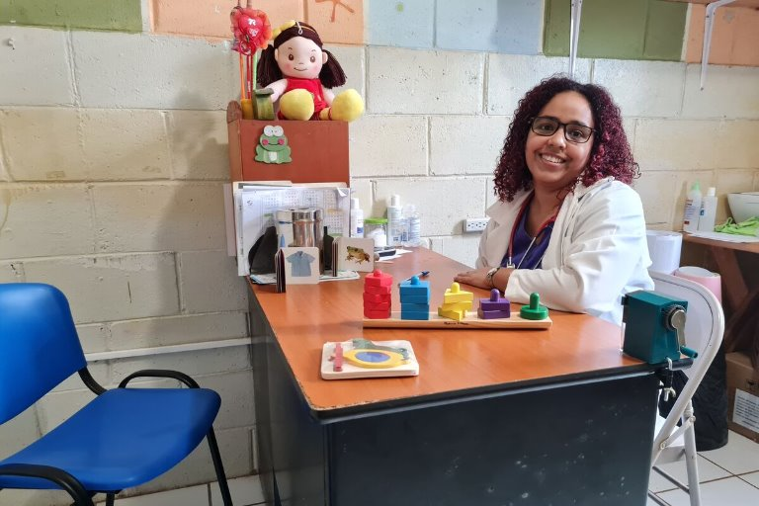
Wednesday 25 March
"I am the servant of the Lord, let it be to me according to your word." Luke 1:38
Today is the feast of the Annunciation of the Lord. Although Mary must have been scared and overwhelmed, she said she would do as God asked her and be the mother of our Lord.
Tuesday 7 April is World Health Day – but as that's in the Easter holidays, we'll mark it today, keeping in mind Mary's words.
Monica is a doctor, working with families who live in poverty in El Salvador.
Around the world, there are nurses and doctors answering God's call – giving care and hope to people, often in challenging situations.
Lord, we pray for those who are sick and the nurses, doctors and others who look after them. Be close to them with your strength, comfort and peace. Amen.
Notes:
Monica, Clínica Ana Manganaro, El Salvador
Photo credit: Clínica Ana Manganaro

Slide 29
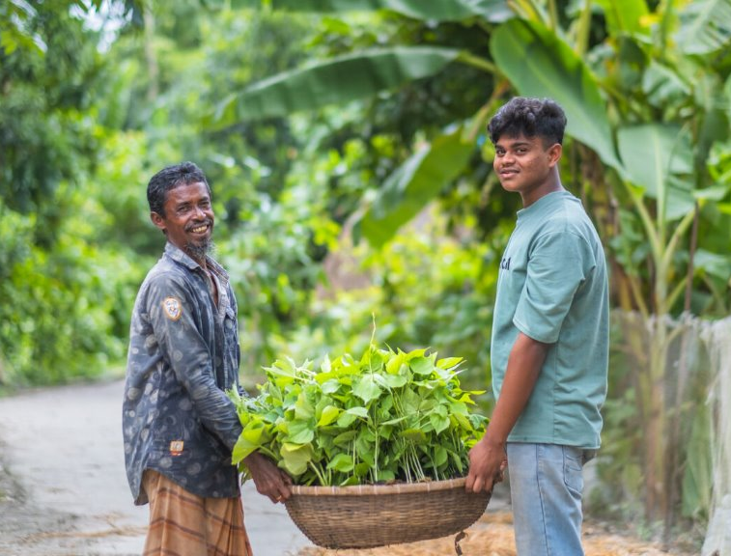
Thursday 26 March
Harvest time brings satisfaction for Bayezid, here in the photo with his father.
"After many days' hard work and dedication, I feel at peace when harvest comes," he says.
Because of the floating beds, the family have enough food to eat and sell, with money left over for the things to live a happy life.
“The floating garden is very important for us," explains Bayezid.
What is important to you? What are the things that make you feel blessed?
The new Beatitudes reflection
Notes:
Bayezid and his father, Bangladesh
Photo credit: Amit Rudro

Slide 30
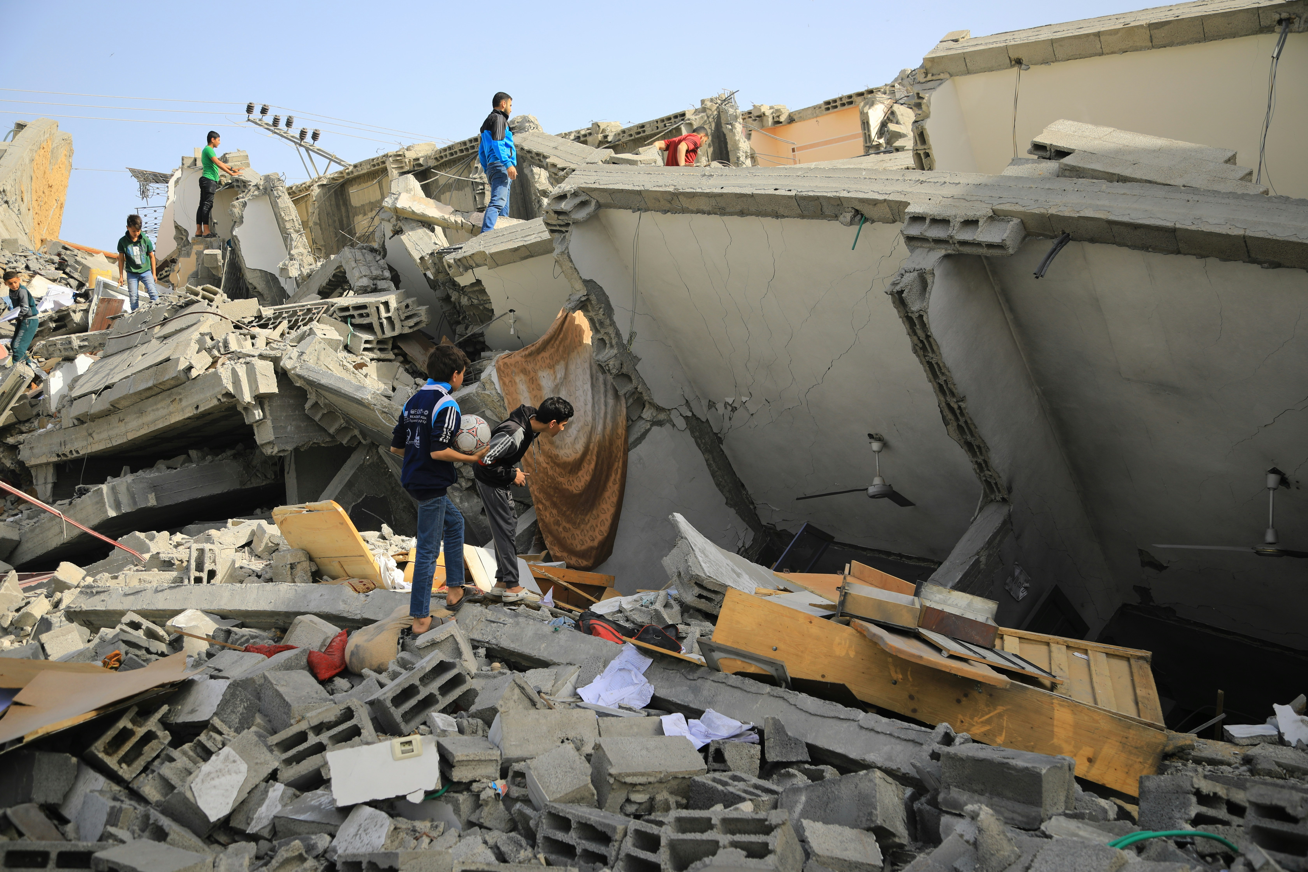
Friday 27 March
"The LORD is my rock and my fortress and my deliverer, my God, my rock in whom I take refuge... my stronghold." Psalm 18:2
Most of us look forward to the Easter break – there might be time for a refresh and reset, possibly some nice meals and special treats.
But what is Easter really about? God loved us so much, he sent his son to be our 'fortress, deliverer, rock, refuge, shield and stronghold'. Jesus came to live and, actually, die for us. Let's consider that for a moment...
While we look forward to time off, some of our global family just look forward to a life lived in peace. Let's think of them today.
Prayer for peace
Notes:
Devastation
Photo credit: Mohammed al Bardawil on Unsplash

Slide 31
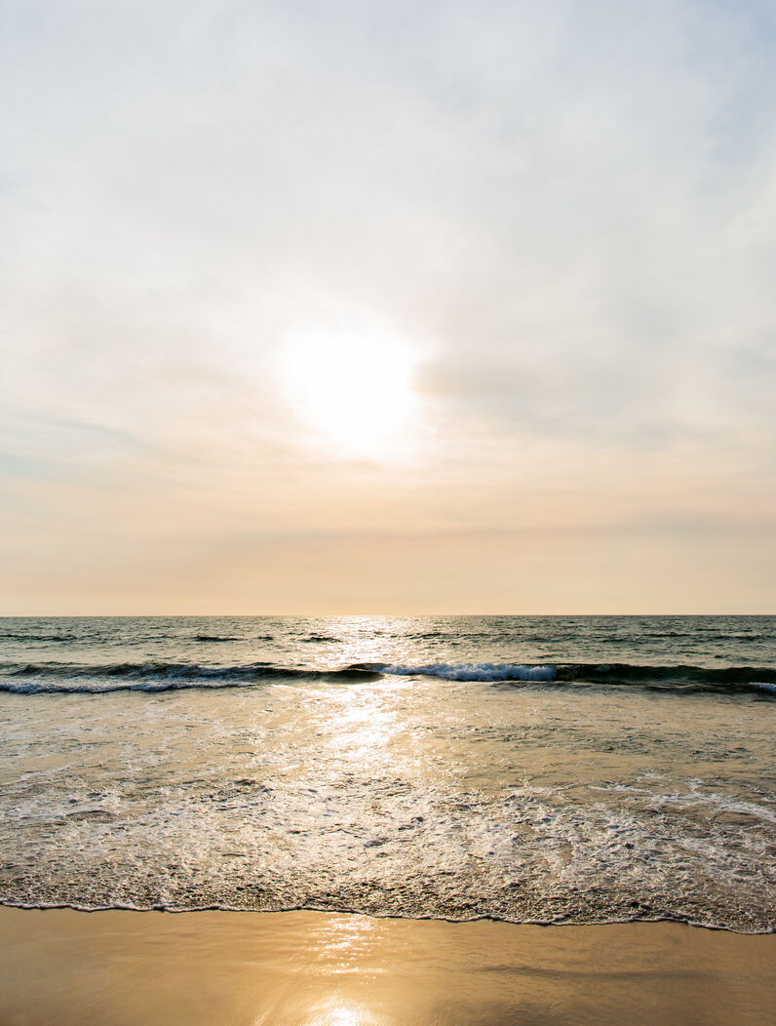
Monday 30 March
"The Lord is my light and my salvation; whom shall I fear?" Psalm 27:1
Yesterday was Palm Sunday and we hear how Jesus entered Jerusalem on a donkey, greeted by joyful crowds waving palms.
It's a very different story less than one week later - the same crowds call for Jesus to be crucified.
If we've ever had experience of friends being disloyal to us, we know how much it hurts. What are the emotions we experience?
But even when we might feel there is no-one we can turn to, let's remember that 'the Lord is my light' - we can always turn to him.
Notes:
The sun, Liberia
Photo credit: Thom Flint

Slide 32
Tuesday 31 March
It's not too late to do a Big Lent Walk!
You may have finished school for the holidays, but how about finding a friend or family member to do the Big Lent Walk with?
You could walk around your garden if you have one, a nearby park or up and down the road! You can walk anywhere, just make sure it's a safe space.
Click on the link to find out how to get sponsorship and how you can raise money for CAFOD. Make a difference to our global family around the world!
The Big Lent Walk 2026

Slide 33
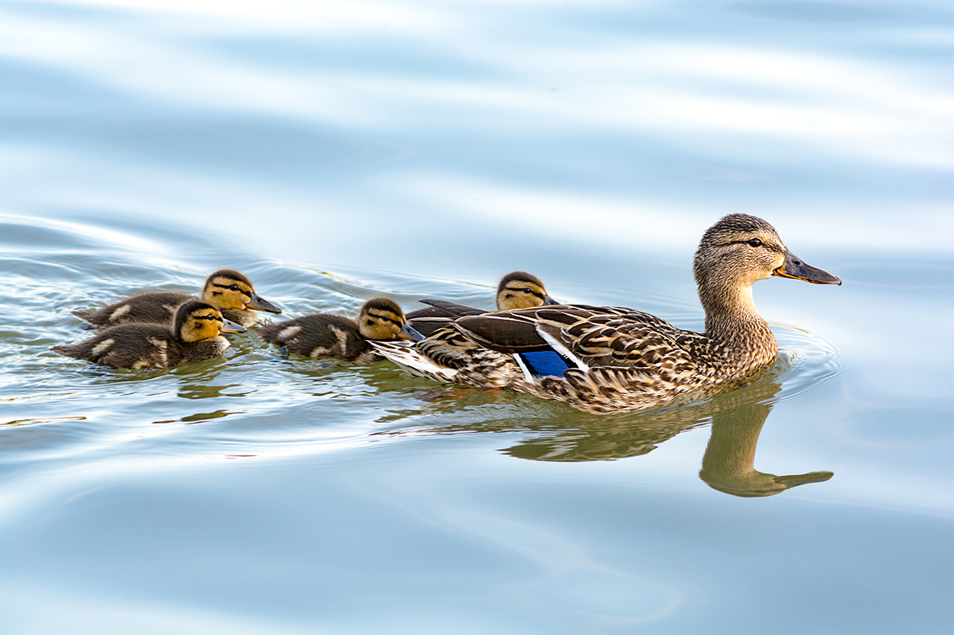
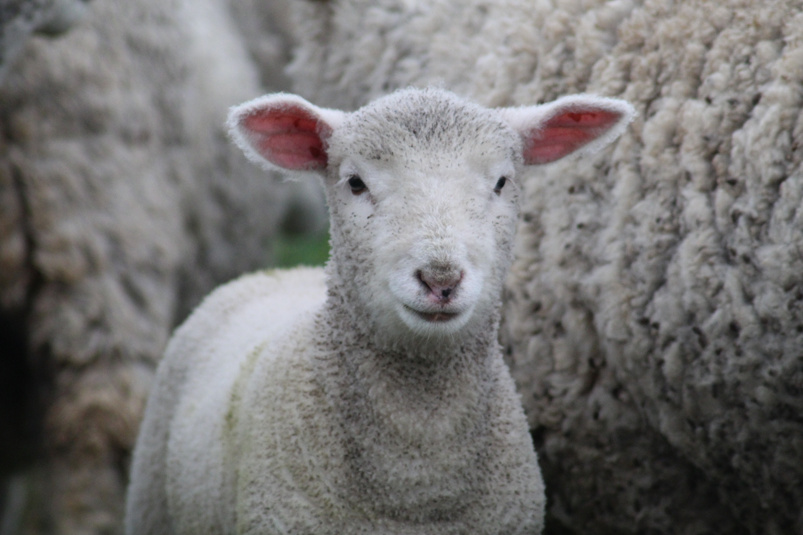
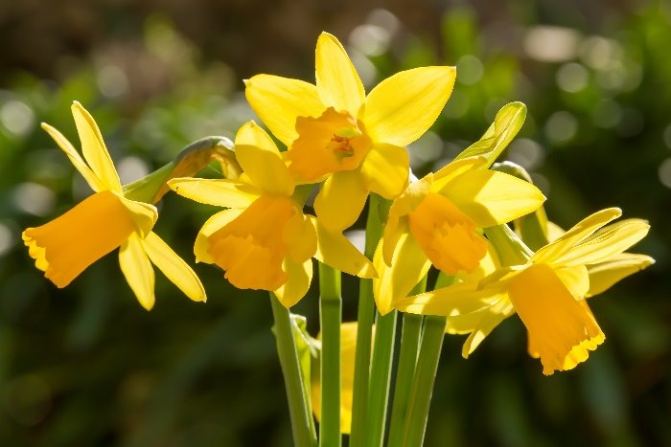
Wednesday 1 April
"The Lord God has given me the tongue... that I may know how to sustain a word with him who is weary." Isaiah 50:4
There are times when we all feel weary – perhaps worn out by illness, difficult relationships or simply the daily stress of life.
Sometimes it might seem the whole world is weary - the climate crisis, conflict, racism and poverty can make us feel anxious.
How can we lift our spirits? Look around and be inspired by creation and the signs of new life which are all about us, particularly at this time of year!
Notes:
Ducklings, lamb and daffodils
Photo credit: Stock images

Slide 34
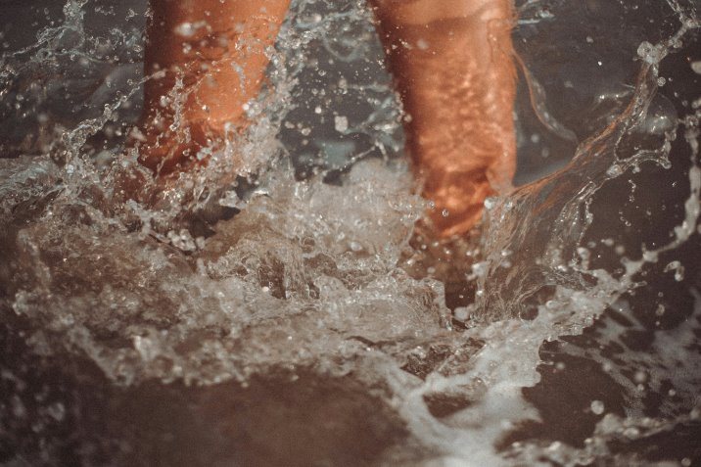
Thursday 2 April
Today Jesus washed his disciples' feet at the Last Supper. This may seem a strange thing for the Son of God to do!
Why do you think Jesus did this?
Jesus was showing the apostles how important it is to be humble and to serve others.
Today, social media often promotes being the 'best' at this, the 'most impressive' of that. While it is important to be proud of our achievements, it's important too to be humble.
How can we follow in Jesus' own footsteps and serve others?
Lord, help us to be humble, knowing we are all equal in God's eyes, so we serve others in the way you have shown us. Amen.
Notes:
Splashing in water
Photo credit: Klara Kulikova on Unsplash

Slide 35
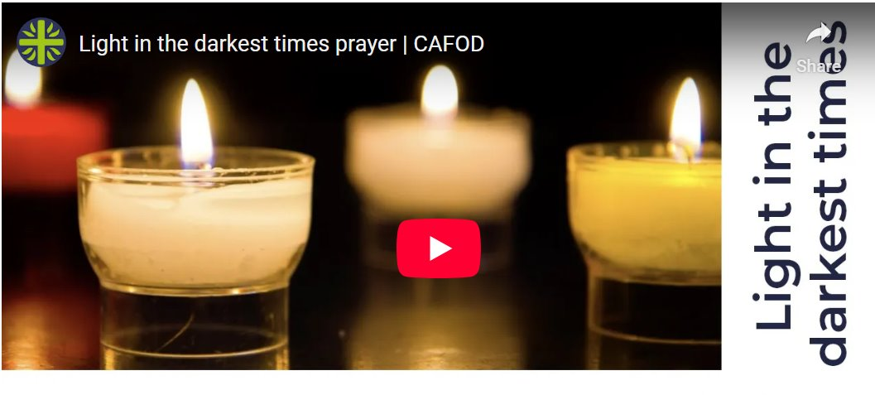
Friday 3 April
Jesus said, "It is finished," and he bowed his head and gave up his spirit. John 19:30
Today, Jesus died on the Cross.
We pray together, the Light in the darkest times prayer.
Let us remember all our global family who are struggling due to all the challenges that are facing the world at present - war, persecution of minorities, climate change, not having enough food to eat or clean water to drink.
Prayer for light in the darkest times

Slide 36
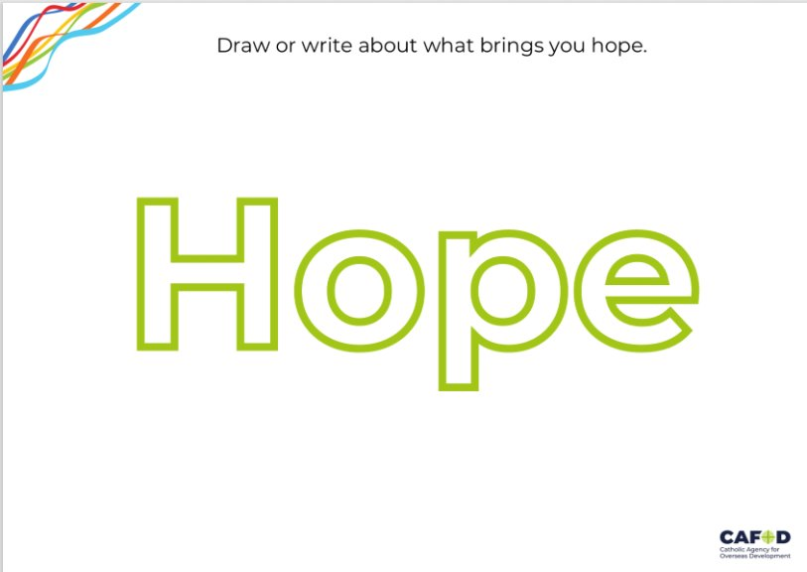
Saturday 4 April
Tomorrow is Easter Sunday and as the season of Lent comes to a close, we can look forward to celebrating Jesus rising from the dead.
Easter Sunday gives us hope that we can walk from the darkness into the light, that even when things are difficult for us, we can always be optimistic.
What gives you hope? Draw or write your thoughts on our worksheet.
What brings you hope?

Slide 37
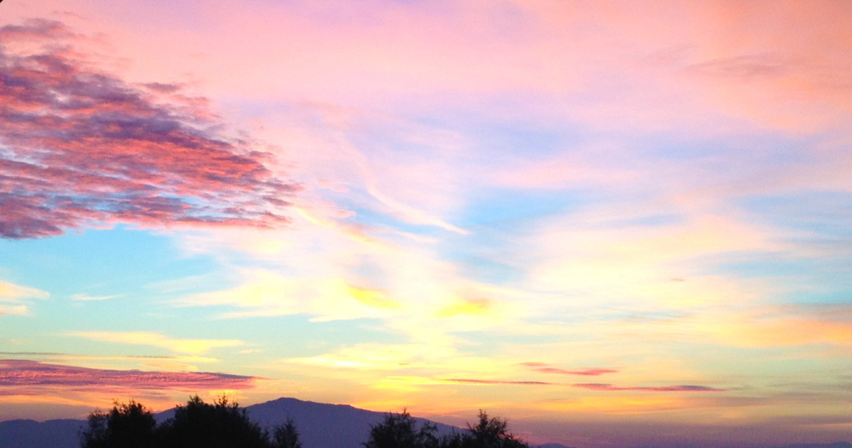
Easter Sunday
Alleluia!
He is risen!
Notes:
Shamrock
Photo credit: Getty images

