Slide 1
Jubilee 2025:
Pilgrims of Hope:
An overview for school staff

Slide 2
OUTCOMES
By the end of this session, you should:
understand why a Jubilee year is a landmark time for Catholic schools, which will support the Catholic life and mission of our school;
understand ways in which, during this Jubilee Year, our school can be outward looking and can commit to challenging injustice as pilgrims of hope;
be able to start planning the Jubilee journey for our school throughout 2025.

Slide 3
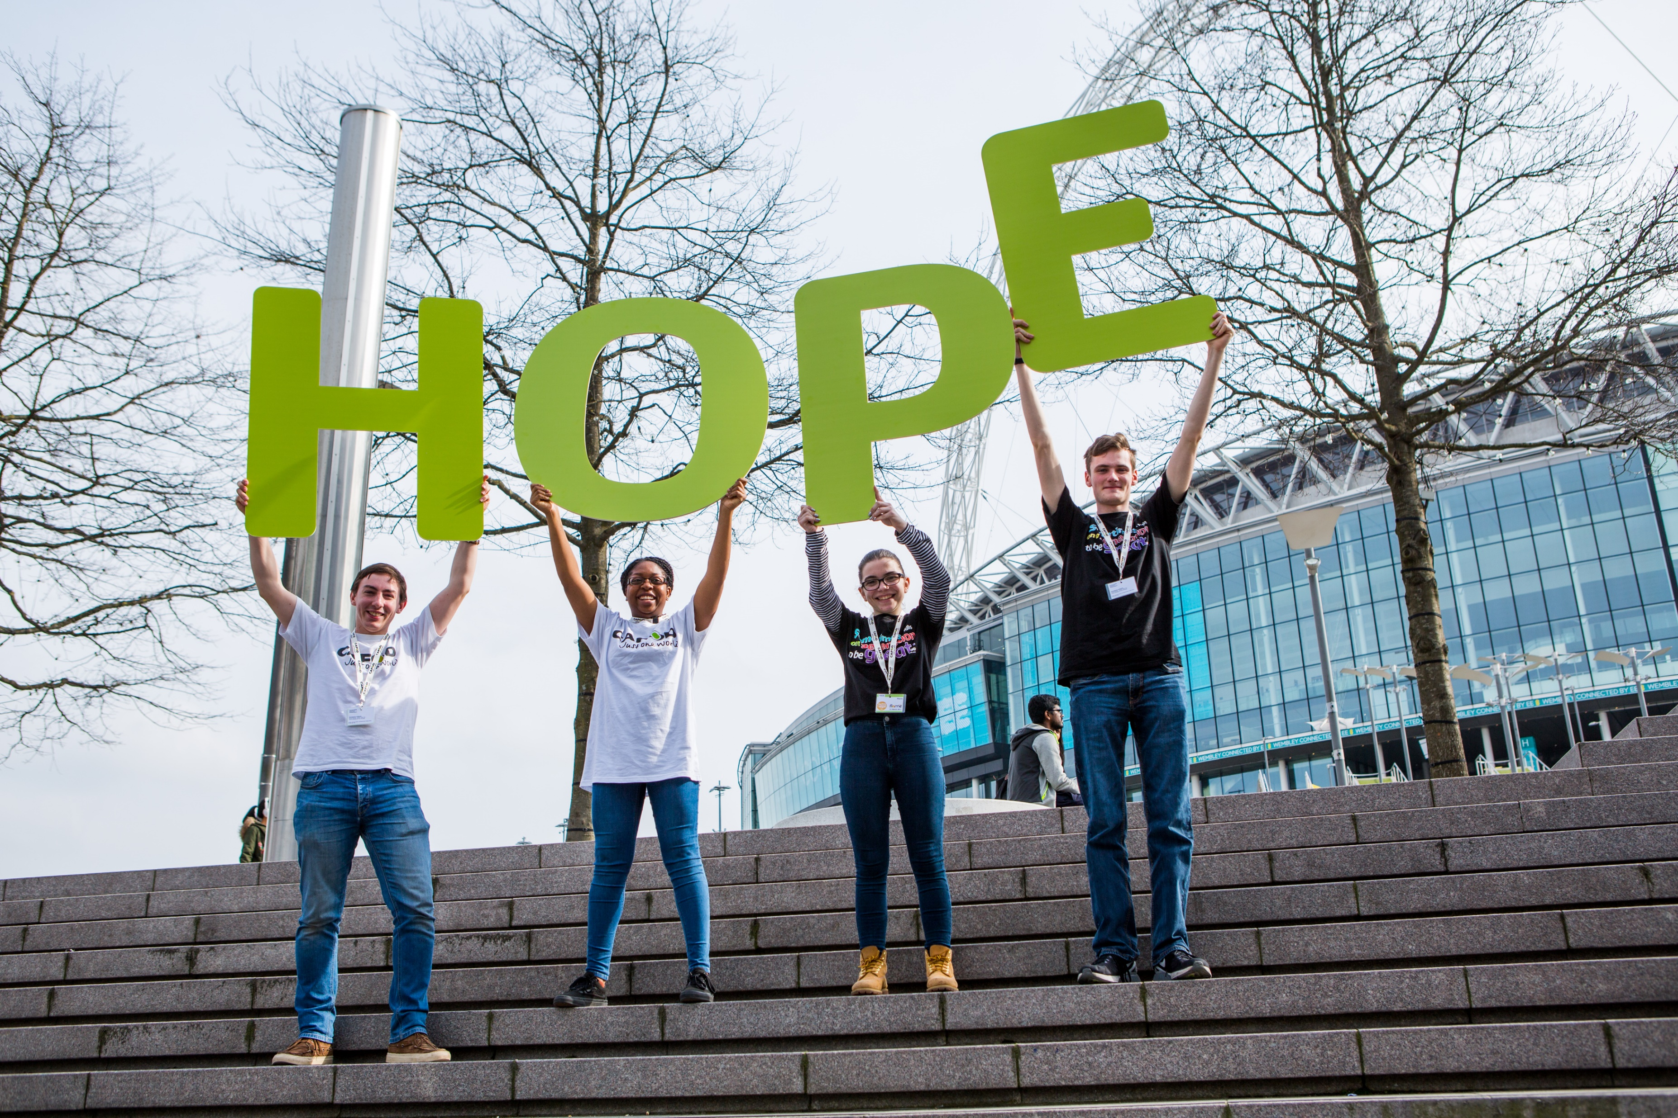
All it takes is one good person to restore hope!
Laudato Si’ 71
We must fan the flame of hope that has been given us…
Letter for the
Jubilee
Notes:
Credit: CAFOD/Joe Newman

Slide 4
1
10
24
43
75
half
two thirds
530 million
735 million
998 million
one billion three billion four billion
We live in an unequal world. The world’s richest __% own ___% of all global financial assets and emit as much carbon pollution as the poorest __________ of humanity.
Despite there being enough food in the world to feed everyone, approximately ___________ people worldwide face hunger daily.
Over ____________ people are living in countries where governments are spending more money on debts than on health or education.
Notes:
Can you fill in the gaps with the correct number?
Choices: 1, 10, 24, 43, 75, half, two thirds, 530 million, 735 million, 998 million, 1 billion, three billion, four billion
We live in an unequal world. The world’s richest 1% own 43% of all global financial assets and emit as much carbon pollution as the poorest two-thirds of humanity.
Despite there being enough food in the world to feed everyone, approximately 735 million people worldwide face hunger daily.
Over three billion people are living in countries where governments are spending more money on debts than on health or education.
Show the correct answers.
How does this make you feel? [Share thoughts – you might even want to set up a Mentimeter to gather these via phones.]

Slide 5
We live in an unequal world. The world’s richest 1% own 43% of all global financial assets and emit as much carbon pollution as the poorest two-thirds of humanity.
Despite there being enough food in the world to feed everyone, approximately 735 million people worldwide face hunger daily.
Over three billion people are living in countries where governments are spending more money on debts than on health or education.
How do we feel about this?
Notes:
Can you fill in the gaps with the correct number?
Choices: 1, 10, 24, 43, 75, half, two thirds, 530 million, 735 million, 998 million, 1 billion, three billion, four billion
We live in an unequal world. The world’s richest 1% own 43% of all global financial assets and emit as much carbon pollution as the poorest two-thirds of humanity.
Despite there being enough food in the world to feed everyone, approximately 735 million people worldwide face hunger daily.
Over three billion people are living in countries where governments are spending more money on debts than on health or education.
Show the correct answers.
How does this make you feel? [Share thoughts – you might even want to set up a Mentimeter to gather these via phones.]

Slide 6
Who said this, and in what context? What is the missing word?
Everyone knows what it is to hope. In the heart of each person, hope dwells as the desire and expectation of good things to come, despite our not knowing what the future may bring… For all of us, may the ______ be an opportunity to be renewed in hope. God’s word helps us find reasons for that hope.
Notes:
Who said this, and in what context? Can anyone guess the missing word?
Everyone knows what it is to hope. In the heart of each person, hope dwells as the desire and expectation of good things to come, despite our not knowing what the future may bring… For all of us, may the __________ be an opportunity to be renewed in hope. God’s word helps us find reasons for that hope.

Slide 7
Everyone knows what it is to hope. In the heart of each person, hope dwells as the desire and expectation of good things to come, despite our not knowing what the future may bring… For all of us, may the Jubilee be an opportunity to be renewed in hope. God’s word helps us find reasons for that hope.
Spes non confundit #1
Pope Francis said this is in the opening paragraph of the decree that announced the purpose and spirit of the next Holy Year – the Jubilee.
Notes:
Photo credit: Catholic Church of England and Wales Flickr
Who said this, and in what context? Can anyone guess the missing word?
Everyone knows what it is to hope. In the heart of each person, hope dwells as the desire and expectation of good things to come, despite our not knowing what the future may bring… For all of us, may the Jubilee be an opportunity to be renewed in hope. God’s word helps us find reasons for that hope.
It was Pope Francis. This is in the opening paragraph of the decree that announced the purpose and spirit of the next Holy Year – the Jubilee.
What do you think links this reflection to the statistics we looked at earlier?

Slide 8
Everyone knows what it is to hope. In the heart of each person, hope dwells as the desire and expectation of good things to come, despite our not knowing what the future may bring… For all of us, may the Jubilee be an opportunity to be renewed in hope. God’s word helps us find reasons for that hope.
Spes non confundit #1
What do you think links this reflection to the statistics we looked at earlier?
Notes:
Photo credit: Catholic Church of England and Wales Flickr
Who said this, and in what context? Can anyone guess the missing word?
Everyone knows what it is to hope. In the heart of each person, hope dwells as the desire and expectation of good things to come, despite our not knowing what the future may bring… For all of us, may the Jubilee be an opportunity to be renewed in hope. God’s word helps us find reasons for that hope.
It was Pope Francis. This is in the opening paragraph of the decree that announced the purpose and spirit of the next Holy Year – the Jubilee.
What do you think links this reflection to the statistics we looked at earlier?

Slide 9
Watch this animation:
Notes:
As we watch this animation, think about why we as a Catholic school are invited by Pope Francis, and the bishops of England and Wales, to take part in this Jubilee year.
What’s this got to do with us? Why is it such a great opportunity for our school?

Slide 10
What is the Jubilee?
A Jubilee is a significant moment in the life of the Church that happens every 25 years.
Biblically, the Jubilee is a time of renewal, celebration, rest and freedom.
In Old Testament times, debts were cancelled, prisoners and enslaved people were freed, and even the land was able to rest.
Pope Francis has called this Jubilee Year ‘Pilgrims of Hope’. It’s an invitation to renew our hope, a hope which comes from knowing that God loves each one of us, whoever we are.
He has asked us to be signs of hope for others, by putting Catholic Social Teaching into action through caring for our common home, and supporting our sisters and brothers who are experiencing war, hunger or poverty.
Notes:
As we watch this animation, think about why we as a Catholic school are invited by Pope Francis, and the bishops of England and Wales, to take part in this Jubilee year.
(If the animation is not available):
A Jubilee is a significant moment in the life of the Church that happens every 25 years.
Biblically, the Jubilee is a time of renewal, celebration, rest and freedom.
In Old Testament times, debts were cancelled, prisoners and enslaved people were freed, and even the land was able to rest.
Pope Francis has called this Jubilee Year ‘Pilgrims of Hope’. It’s an invitation to renew our hope, a hope which comes from knowing that God loves each one of us, whoever we are.
He has asked us to be signs of hope for others, by putting Catholic Social Teaching into action through caring for our common home, and supporting our sisters and brothers who are experiencing war, hunger or poverty.
What’s this got to do with us? Why is it such a great opportunity for our school?

Slide 11
What’s this got to do with us? Why is it such a great opportunity for our school?
Notes:
What’s this got to do with us? Why is it such a great opportunity for our school?
Discuss briefly and share ideas.

Slide 12
Why is this such a great opportunity for our school?
Here are some suggestions. What else can we come up with?
Rather than feeling powerless when they watch the news, and feel anxious when they hear statistics like the ones we started with, our pupils can explore the vital role they have in making change and bringing hope in an unfair world.
There will be many clear ways for our pupils to get involved with putting their faith into action, locally, nationally and globally.
We will have an opportunity to renew our mission as Catholic school.
It’s a time for us to experience and renew our hope and put Catholic Social Teaching into action.
We can be part of something big as part of the Catholic community, not only in England and Wales, but globally.
Notes:
Here are some suggestions. What else can we come up with?
Rather than feeling powerless when they watch the news, and feel anxious when they hear statistics like the ones we started with, our pupils can explore the vital role they have in making change and bringing hope in an unfair world.
There will be many clear ways for our pupils to get involved with putting their faith into action, locally, nationally and globally.
We will have an opportunity to renew our mission as Catholic school.
It’s a time for us to experience and renew our hope and put Catholic Social Teaching into action.
We can be part of something big as part of the Catholic community, not only in England and Wales, but globally.

Slide 13
When is this taking place?
The Jubilee year begins on 24 December 2024 and will close on 6 January 2026. In England and Wales, there will be key dates for schools:
Friday 24 Jan 2025: Jubilee Launch Day for Schools​
The gospel reading on Sunday 26 January is Luke 4:16-21, a key text for the Jubilee year. (See the text on slide 20)
Take time to reflect on the Jubilee journey ahead using the prayers and resources that will be provided
June or July 2025: Jubilee Pledge Day
Schools are invited to reflect on their mission and choose a date to commit to stand in solidarity with the poorest communities, sharing hope and challenging injustice by pledging to take concrete actions to make their community, country and world a better place.​
Friday 21 November 2025: Jubilee Finale
Celebrating the end of the Jubilee year and looking ahead with hope. ​
Notes:
The Jubilee year begins on 24 December 2024 and will close on 6 January 2026. In England and Wales, there will be a launch on 24 January 2025. Here are some key dates for schools:
Friday 24 January 2025: Jubilee Launch Day for Schools
The gospel reading on Sunday 26 January is Luke 4:16-21, a key text for the Jubilee year.
Take time to reflect on the Jubilee journey ahead using the prayers and resources that will be provided.​
June or July 2025: Jubilee Pledge Day
Schools are invited to reflect on their mission and choose a date to commit to stand in solidarity with the poorest communities, sharing hope and challenging injustice by pledging to take concrete actions to make their community, country and world a better place.​
Friday 21 November 2025: Jubilee Finale
Celebrating the end of the Jubilee year and looking ahead with hope.

Slide 14
This Jubilee Pilgrims of Hope journey map will be available, to help us journey through the year together.
Mark key moments on your Pilgrims of Hope journey maps.
Can you complete all the pilgrim points by the end of the Jubilee year?
Notes:
Visit jubilee-schools.org.uk to find resources. Order copies of the pilgrims of hope journey map.

Slide 15
How can we get involved?
During the Jubilee year schools are invited to revisit and renew their mission statement. Part of our mission is to put our faith into action as we commit to stand with the poorest communities locally and globally, sharing hope and challenging injustice.
In the summer, schools are invited to take part in a whole school Jubilee pledge day to take concrete actions to make the world a better place.
CAFOD, CSAN and the CES are working together with CYMFed to provide schools with resources to support you on this day – visit our Jubilee Schools website for more details.
We are pilgrims of hope. We walk in solidarity with our sisters and brothers worldwide, sharing challenges and celebrating joys. We promise to be agents of change, working together for justice, love and peace, locally and globally. We want to build a fairer world, where every person, and the earth, can flourish.
Jubilee schools pledge
Notes:
During the Jubilee year schools are invited to revisit and renew their mission statement. Part of our mission is to put our faith into action as we commit to stand with the poorest communities locally and globally, sharing hope and challenging injustice.
In the summer, schools are invited to take part in a joint pledge to take concrete actions to make the world a better place, for example taking part in raising our voices against the injustice of international debt.
This is the text of the Jubilee pledge. There will be more resources to support you coming soon.

Slide 16
How can we get involved?
Biblically, the Jubilee was a time for cancelling debts. This year, CAFOD will focus on asking our government to take action on the international debt crisis, and as part of our pledge to challenge injustice, we can join CAFOD in asking our government to act:
Over three billion people are living in countries where governments are spending more money on debts than on health or education.
Pope Francis says, “If we really wish to prepare a path to peace in our world, let us commit ourselves to remedying the remote causes of injustice, settling unjust and unpayable debts, and feeding the hungry.” (Spes non confundit, #16)
Notes:
Biblically, the Jubilee was a time for cancelling debts. This year, CAFOD will focus on asking our government to take action on the international debt crisis, and as part of our pledge to challenge injustice, we can join CAFOD in asking our government to act:
Over three billion people are living in countries where governments are spending more money on debts than on health or education.
Pope Francis says, “If we really wish to prepare a path to peace in our world, let us commit ourselves to remedying the remote causes of injustice, settling unjust and unpayable debts, and feeding the hungry.” (Spes non confundit, #16)

Slide 17
jubilee-schools.org.uk
Visit the Jubilee Schools website for more information and resources
Notes:
jubilee-schools.org.uk

Slide 18
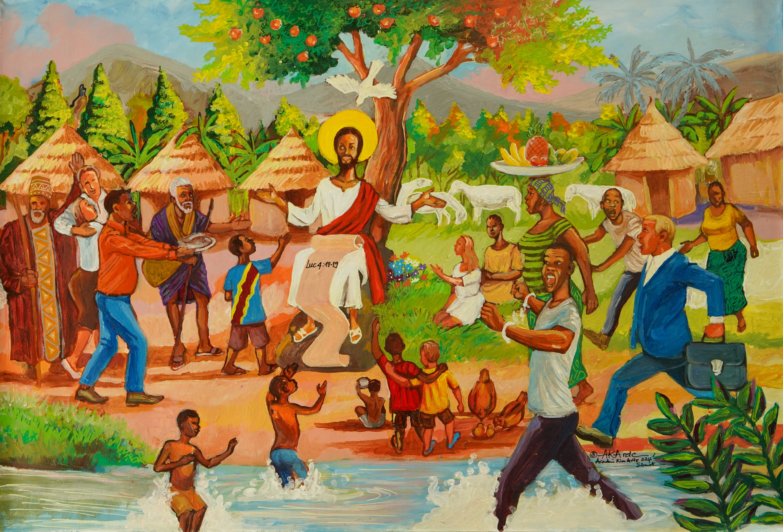
“Christ the Liberator”, an artwork commissioned for the Jubilee Year 2025 from Académie Kivu Arts "AKA" in Goma, Democratic Republic of Congo.
Notes:
If you have time, read Luke 4:16-21, which will be a key scripture as we launch the Jubilee in schools. You might want to spend time reflecting on the artwork.
"Christ the Liberator", an artwork commissioned for the Jubilee Year 2025 from Académie Kivu Arts "AKA" in Goma, DRC.
Credit: CAFOD/Joe Newman

Slide 19
Luke 4:16-21
And he came up to Nazareth, where he had been brought up. And as was his custom, he went to the synagogue on the Sabbath day, and he stood up to read. And the scroll of the prophet Isaiah was given to him. He unrolled the scroll and found the place where it was written:
“The Spirit of the Lord is upon me,
because he has anointed me
to proclaim good news to the poor.
He has sent me to proclaim liberty to the captives
and recovering of sight to the blind,
to set at liberty those who are oppressed free,
to proclaim the year of the Lord’s favour.”
And he rolled up the scroll and gave it back to the attendant and sat down. And the eyes of all in the synagogue were fixed on him. And he began to say to them, “Today this scripture has been fulfilled in your hearing.”
Notes:
If you have time, read Luke 4:16-21, which will be a key scripture as we launch the Jubilee in schools. You might want to spend time reflecting on the artwork and the scripture.
¹⁶ And he came to Nazareth, where he had been brought up. And as was his custom, he went to the synagogue on the Sabbath day, and he stood up to read. ¹⁷ And the scroll of the prophet Isaiah was given to him. He unrolled the scroll and found the place where it was written,
¹⁸ “The Spirit of the Lord is upon me, because he has anointed me to proclaim good news to the poor. He has sent me to proclaim liberty to the captives and recovering of sight to the blind, to set at liberty those who are oppressed, ¹⁹ to proclaim the year of the Lord's favor.”
²⁰ And he rolled up the scroll and gave it back to the attendant and sat down. And the eyes of all in the synagogue were fixed on him. ²¹ And he began to say to them, “Today this Scripture has been fulfilled in your hearing.”
"Christ the Liberator", an artwork commissioned for the Jubilee Year 2025 from Académie Kivu Arts "AKA" in Goma, DRC.
Credit: CAFOD/Joe Newman
Bible translation: English Standard Version (Anglicised version)

Slide 20
God of blessings,
in this year ahead
help us to listen and be open to your word,
as we look towards your kingdom.
As we journey towards the Jubilee,
a time of new beginnings,
we pray for help and strength
to take better care for each other and the earth.
Notes:
This is the prayer for the Year of Prayer.
Let’s finish by saying this prayer together.

Slide 21
Sing your song of love over us,
giving us faith and courage
so that we can join our voices together
in songs of hope and peace.
Help us to listen to the Spirit,
and the needs of the world,
as we join as one global family
in a great song of prayer and praise.
Amen

