Slide 1
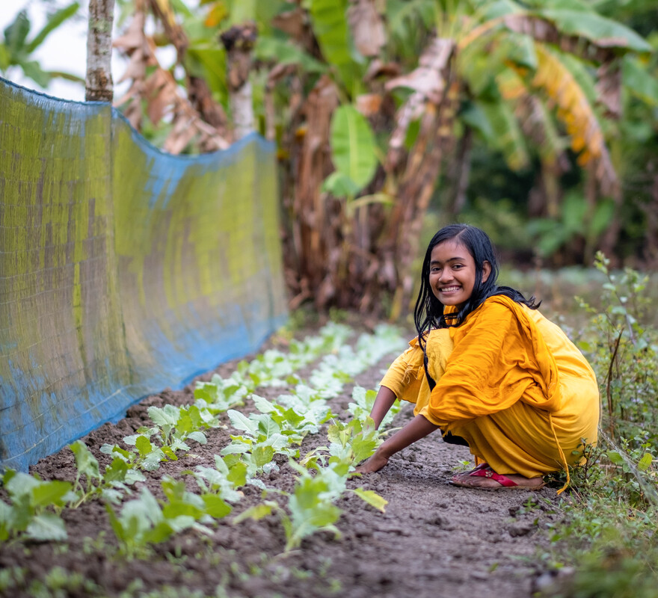
How will you show your love for others, both here and around the world?
Gospel Celebration of the Word
Notes:
Children’s liturgy: Sixth Sunday of Easter (Year A)
Preparation of the worship space
Colour: white Props: heart-shaped paper or card, pens and pencils
Song suggestions
Love is his word, love is his way (803, Laudate)
A new commandment (920, Laudate)
Welcome
Today Jesus tells us that if we love him, we must keep his commandments. God loves those who listen to and love his Son. Let’s think a bit more about love today.

Slide 2
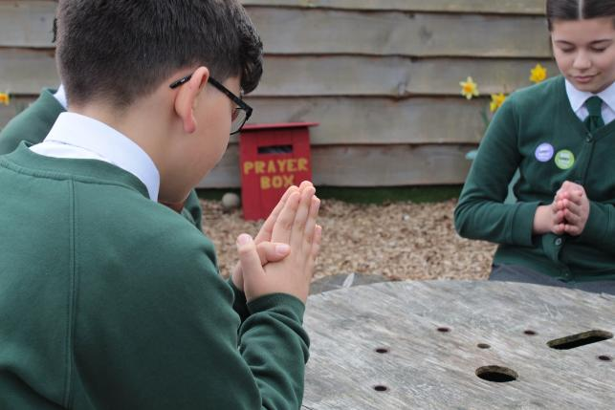
God of love,
You sent your only Son into the world to show us how to live.
Help us to love you and one another in our words and all that we do.
Amen.
  Gather
Notes:
St Francis Xavier's RC Primary School, Herefordshire
Photo credit: Vicky Ahmed

Slide 3
Gospel: John 14: 15-21
“If you love me, you will obey my commandments. I will ask the Father, and he will give you another Helper, who will stay with you forever. He is the Spirit, who reveals the truth about God. The world cannot receive him, because it cannot see him or know him. But you know him, because he remains with you and is in you.
“When I go, you will not be left all alone; I will come back to you. In a little while, the world will see me no more, but you will see me; and because I live, you also will live. When that day comes, you will know that I am in my Father and that you are in me, just as I am in you.
“Those who accept my commandments, and obey them, are the ones who love me. My Father will love those who love me; I too will love them and reveal myself to them.”
Word

Slide 4
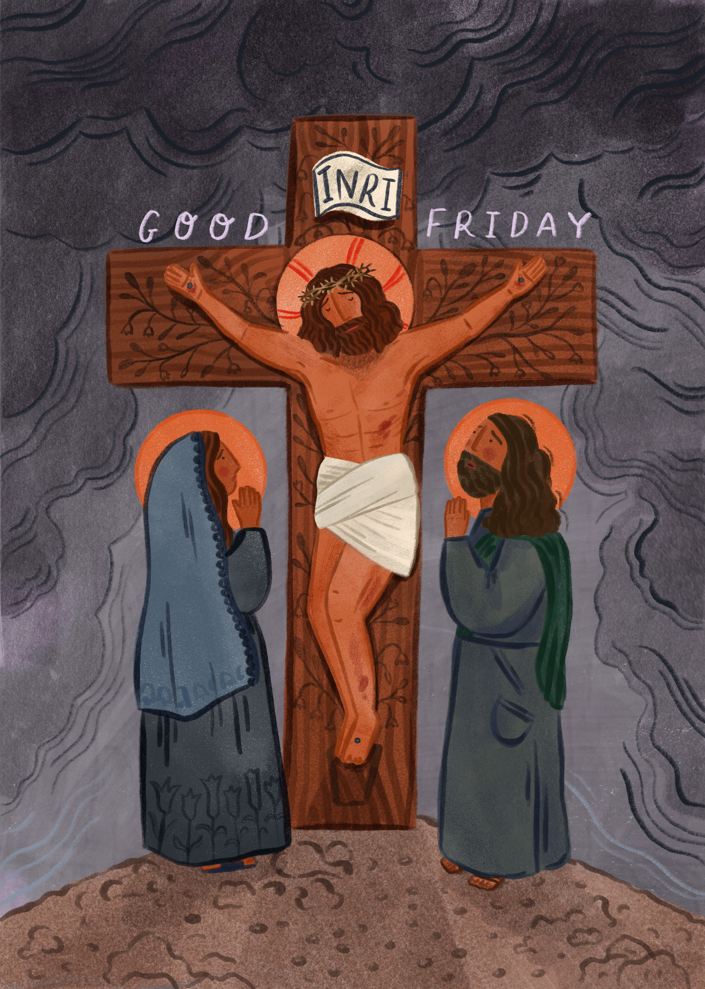
What do you remember from the Gospel reading?
In today’s reading, Jesus is trying to prepare his disciples for what is coming next – his death on the cross and his rising again.
Can you remember some of what he tells the disciples?
He tells them that if they love him, they must keep his commandments.
Respond
Notes:
Photo credit:

Slide 5
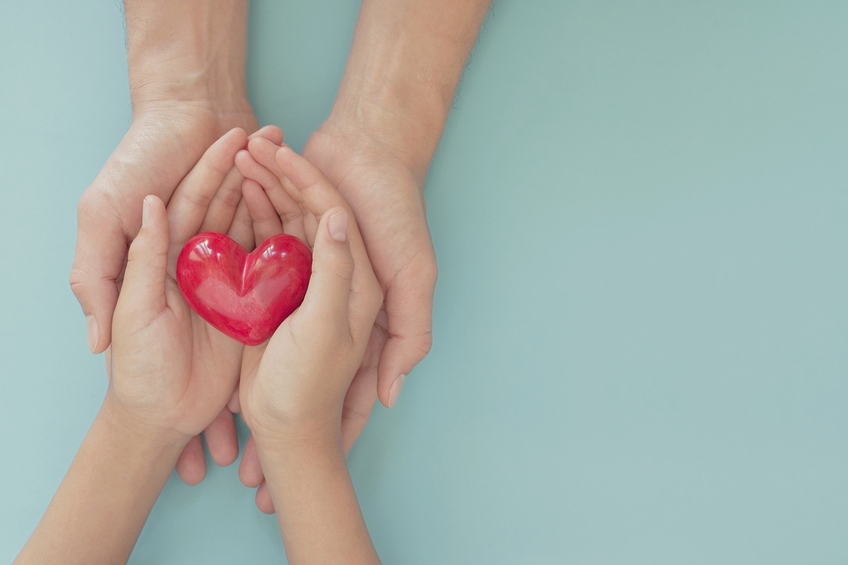
Can you remember the commandments that Jesus has given us?
Jesus asked us to love God and to love one another.
How do you show your love for others? How do others show their love for you?
Notes:
Heart
Photo credit: Stock images

Slide 6
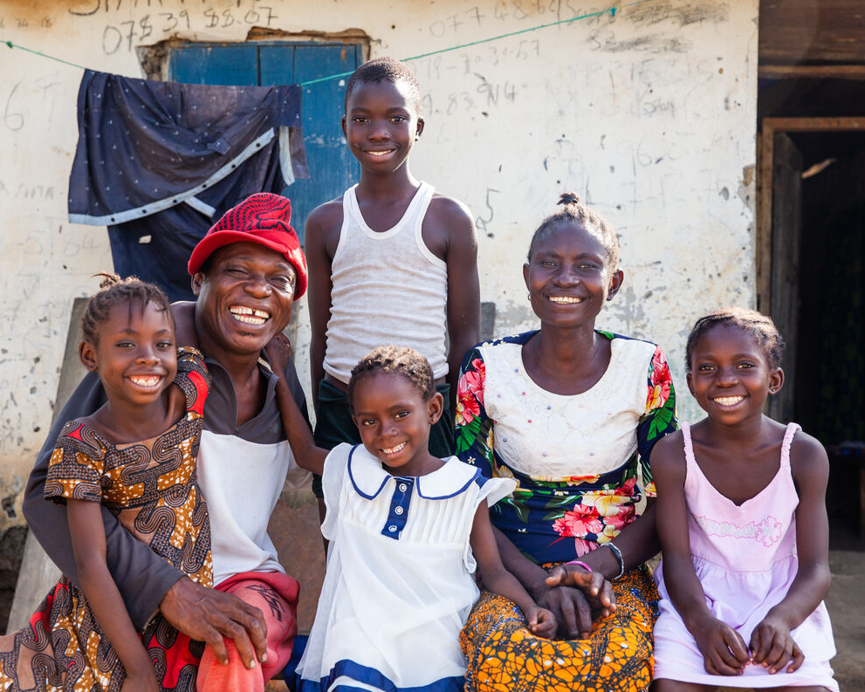
It is often easy to show our love for those people who are close to us.
We can be kind and generous to our friends, we can listen to our parents, carers and teachers. We can share with our brother or sister.
And they show their love for us by comforting us when we are upset, by looking after us, and by sharing their things with us too.
Ishmael and Lucia Sesay's family, Sierra Leone
Notes:
Ishmael and Lucia Sesay and their family, Sierra Leone
Photo credit: Thom Flint

Slide 7
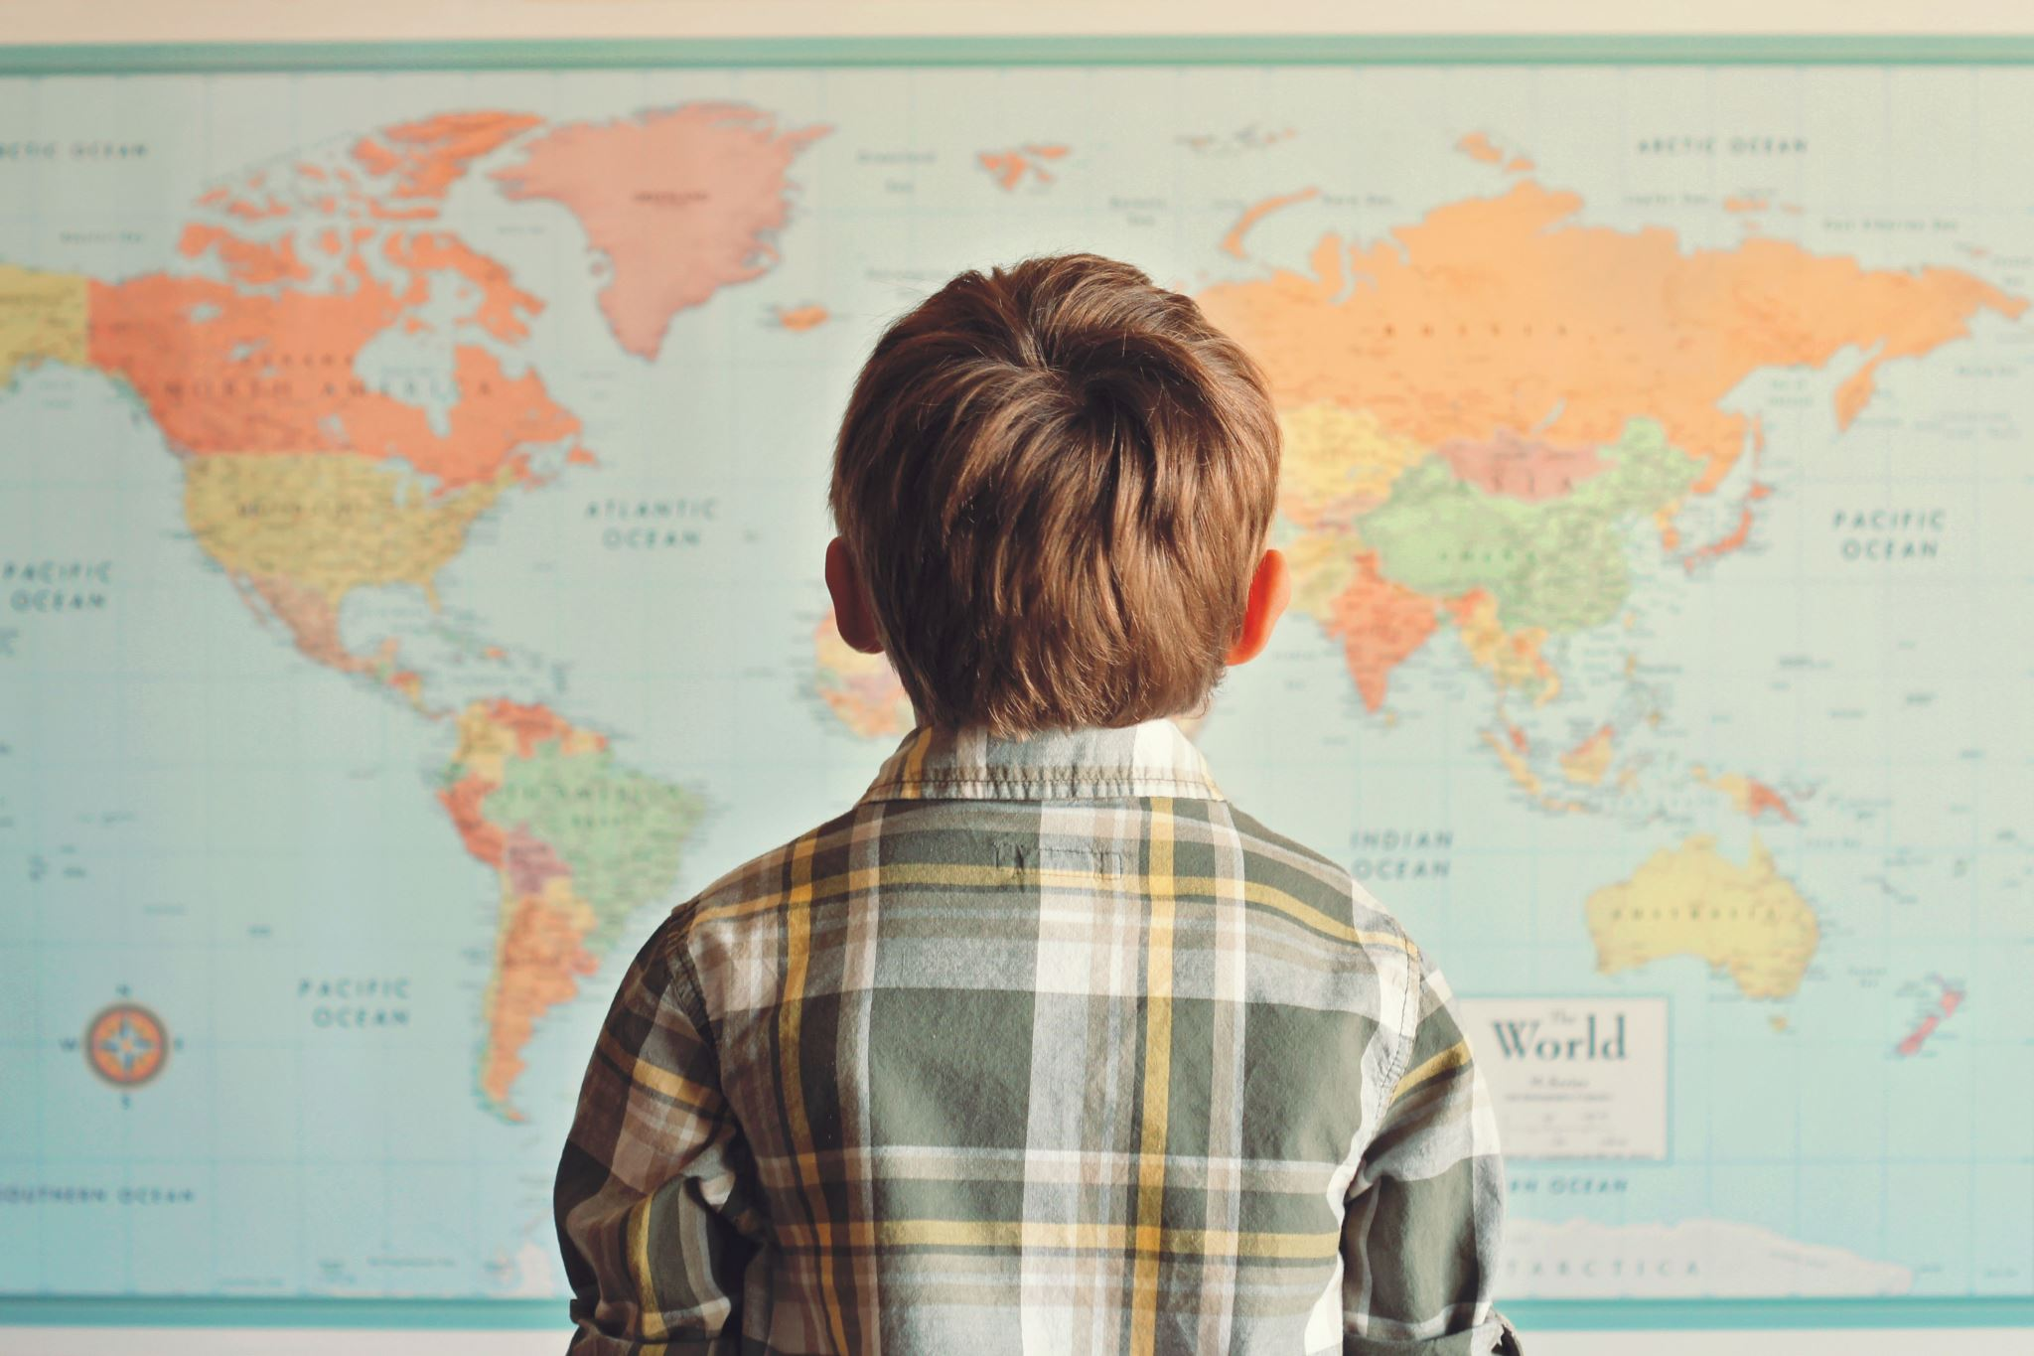
But we are all God’s children. God loves each and every one of us because we are all special.
And so we need to do our best to show our love for all people, not just those who are close by. We are all part of one big global family.
How do you think we can show our love for all the members of our global family?
Notes:
Child looking at a world map
Photo credit: Stock images

Slide 8
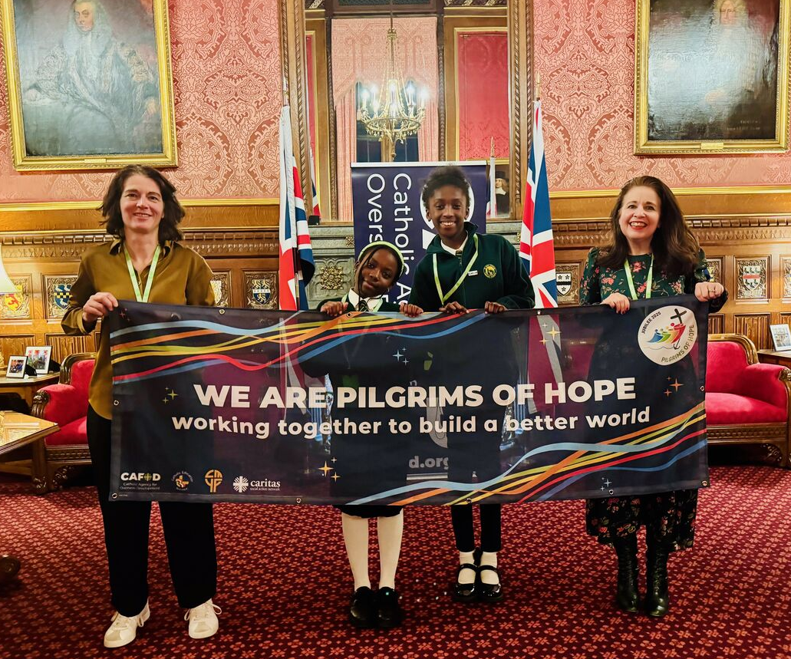
We can show our love by caring for our world, which is the home that all people share.
We can try to make the world a fairer place, by making sure world leaders and others who have power know that we want them to make a difference.
Pupils at the Houses of Parliament to support their global family in need around the world
Notes:
Pupils from St John Vianney at the House of Parliament, London
Photo credit: Louise Norton

Slide 9
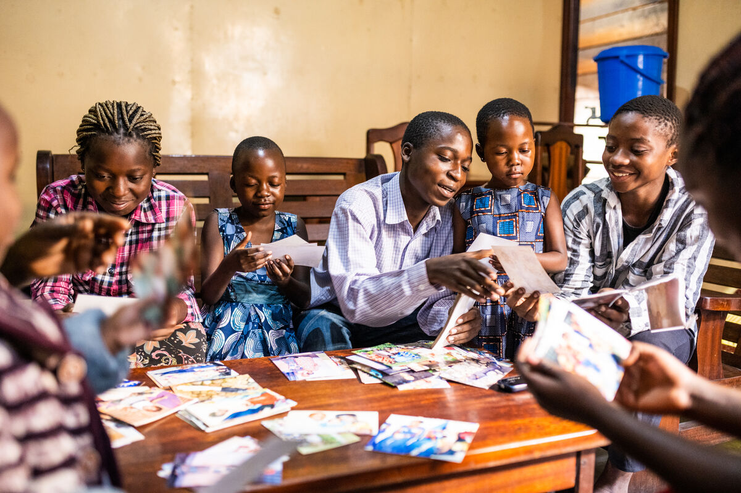
We can give money to charities who work with people who are poor or sick around the world.
We can stand up for what we believe in and try to make a change so that all people feel loved, respected and supported to build the life that they want for themselves and their family.
With CAFOD's help, Francoise built a business making pots and pans and can now provide for her family
Notes:
The Kanyere family, DRC
Photo credit: Arlette Bashizi

Slide 10
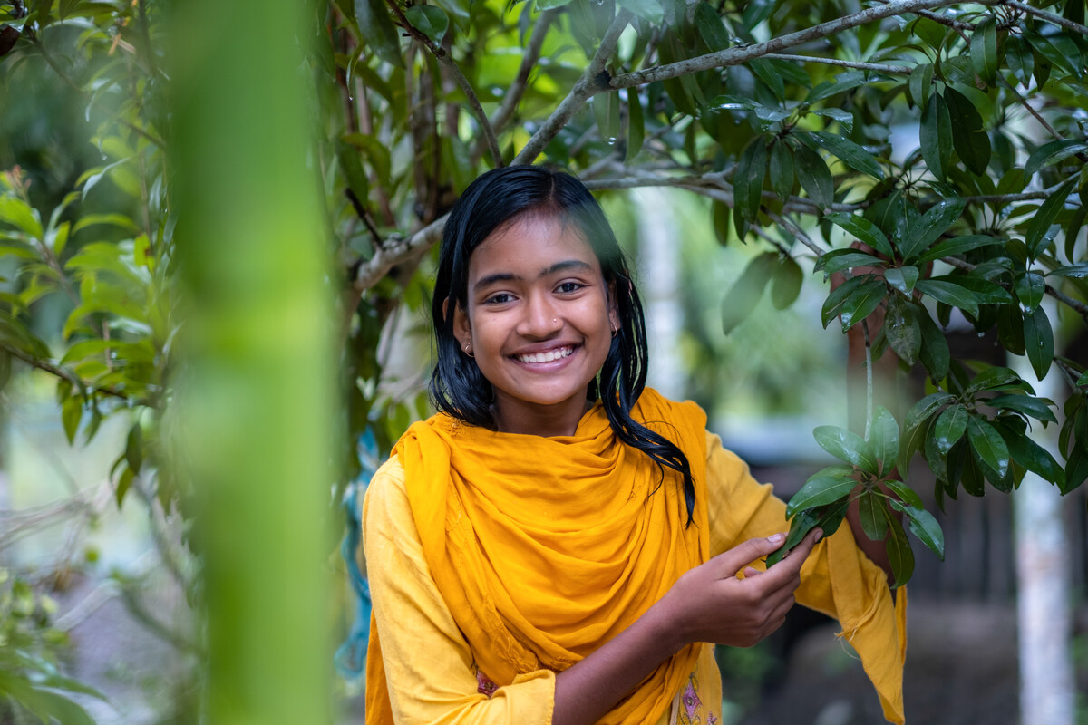
This is Dristy. She lives in a village in Bangladesh.
Dristy loves being in her garden.
"My favourite thing is lychee fruit," she explains. "I like bananas too.
"I am used to eating food from my garden. I love it!"
Notes:
Dristy in her garden, Bangladesh
Photo credit: Amit Rudro

Slide 11
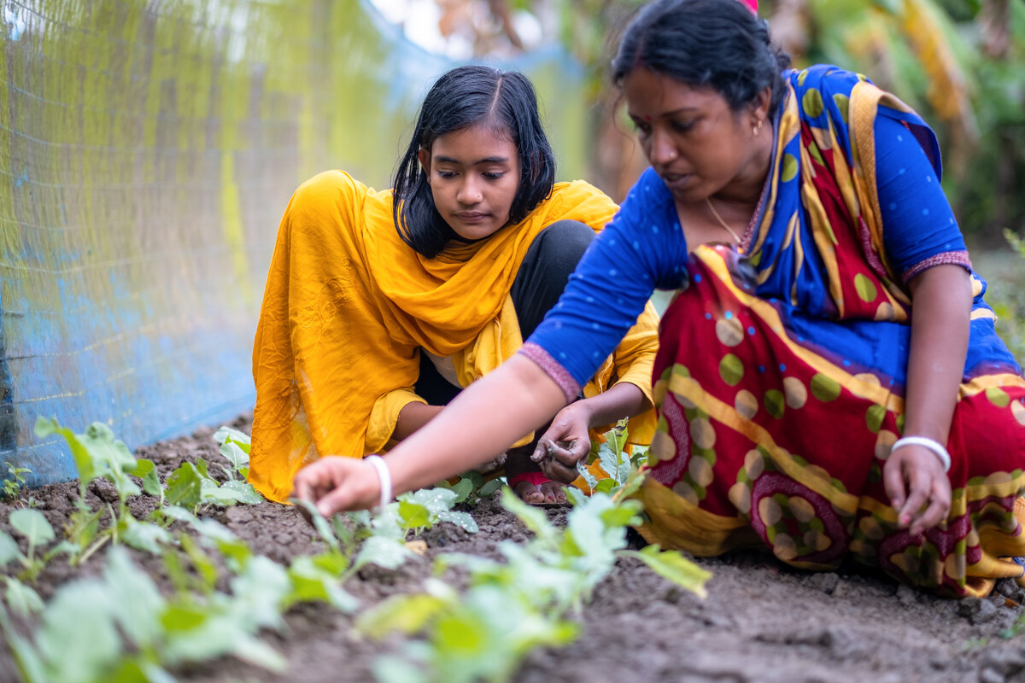
But heavy rains have destroyed crops in Dristy's community. This left people worried about how to grow food to eat and sell to make a living.
With CAFOD's help, Dristy's mum, Rupali, learnt how to plant different crops which were stronger against the cyclones caused by climate change.
Rupali taught Dristy and now they both show their neighbours and friends who can now feed themselves and sell their produce.
Notes:
Dristy and Rupali, Bangladesh
Photo credit: Amit Rudro

Slide 12
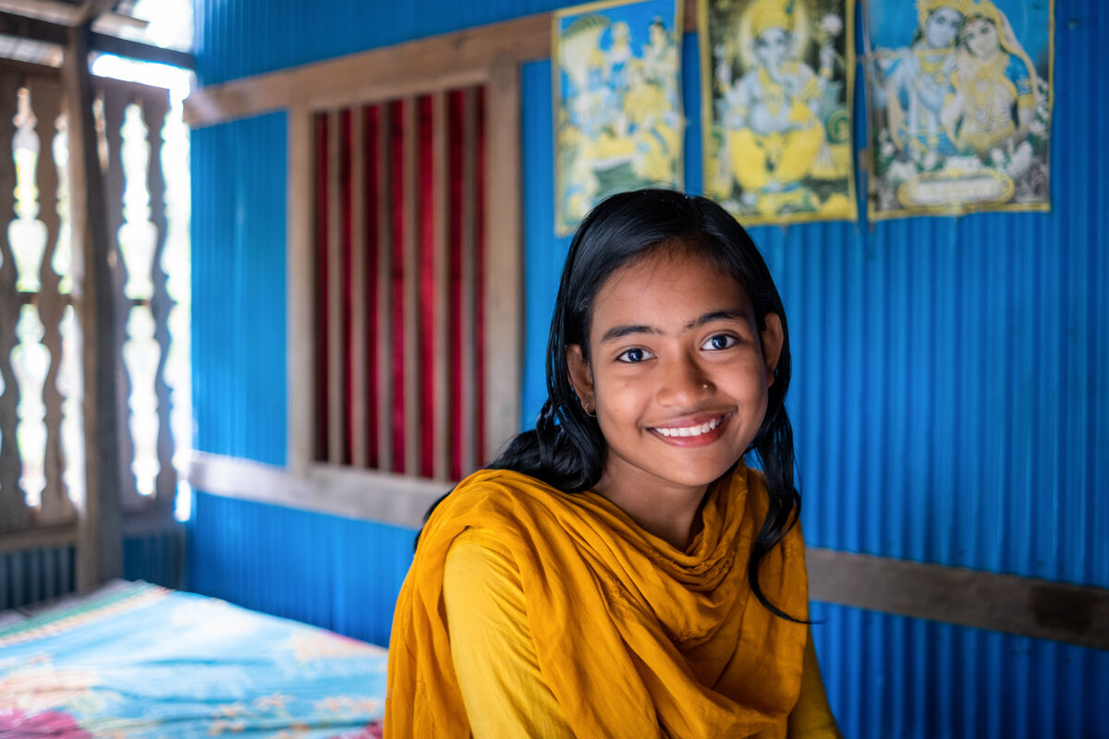
Dristy's community has been able to thrive because of the help that schools across England and Wales give to CAFOD.
By praying, speaking out and raising money for our global brothers and sisters in need, we can help them make better lives for themselves – the kind of lives we all deserve.
Notes:
Dristy, Bangladesh
Photo credit: Amit Rudro

Slide 13
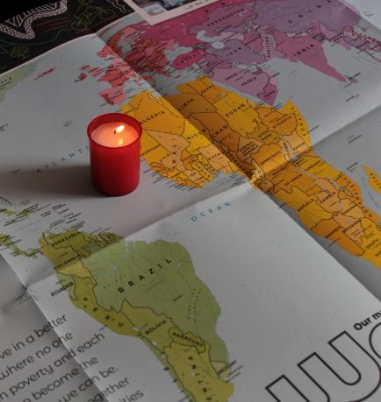
Let us pray
We pray for our global family:
that together we may do all we can to build a better world, free from hunger and poverty and filled with love.
Lord in your mercy…
We pray for our parish, families and friends:
that we may love God with all our hearts and be inspired to share our love with others.
Lord in your mercy...

Slide 14
Let us pray
We pray for the church throughout the world:
that it may be a living example of God's love for all people, especially those who are in need.
Lord in your mercy…
Christ Jesus: you came into the world to show us how to live. May we follow your commandment of love for one another in all that we do and all that we say. Amen.

Slide 15
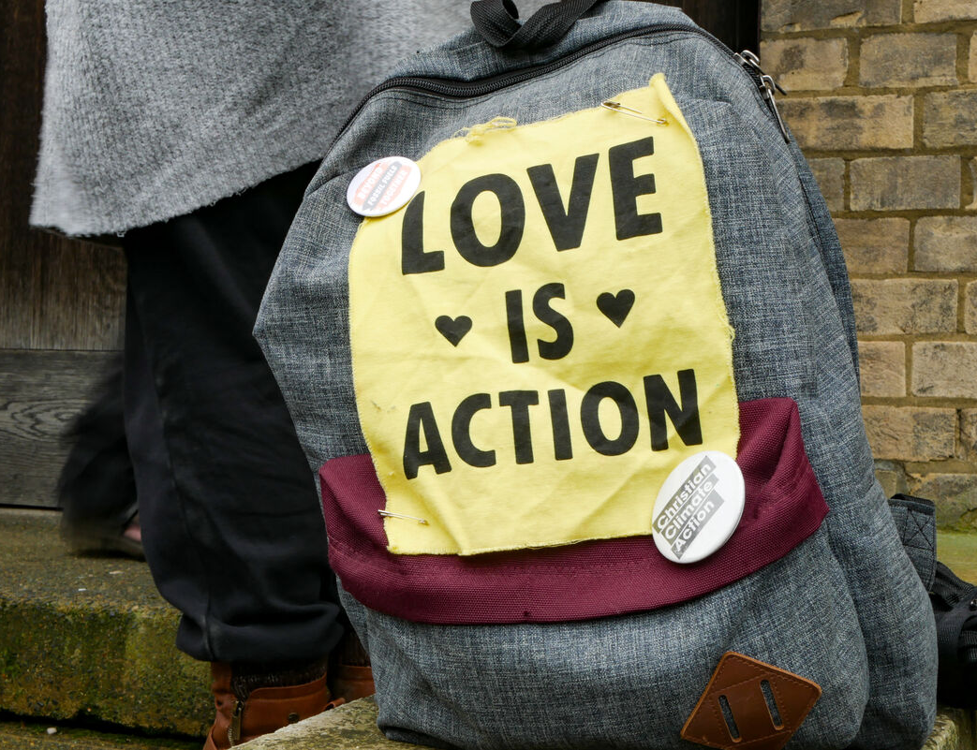
How will you show your love for others, both here and around the world, in the coming week?
Send
Notes:
Campaigning for CAFOD, London
Photo credit: Sophia White

Slide 16
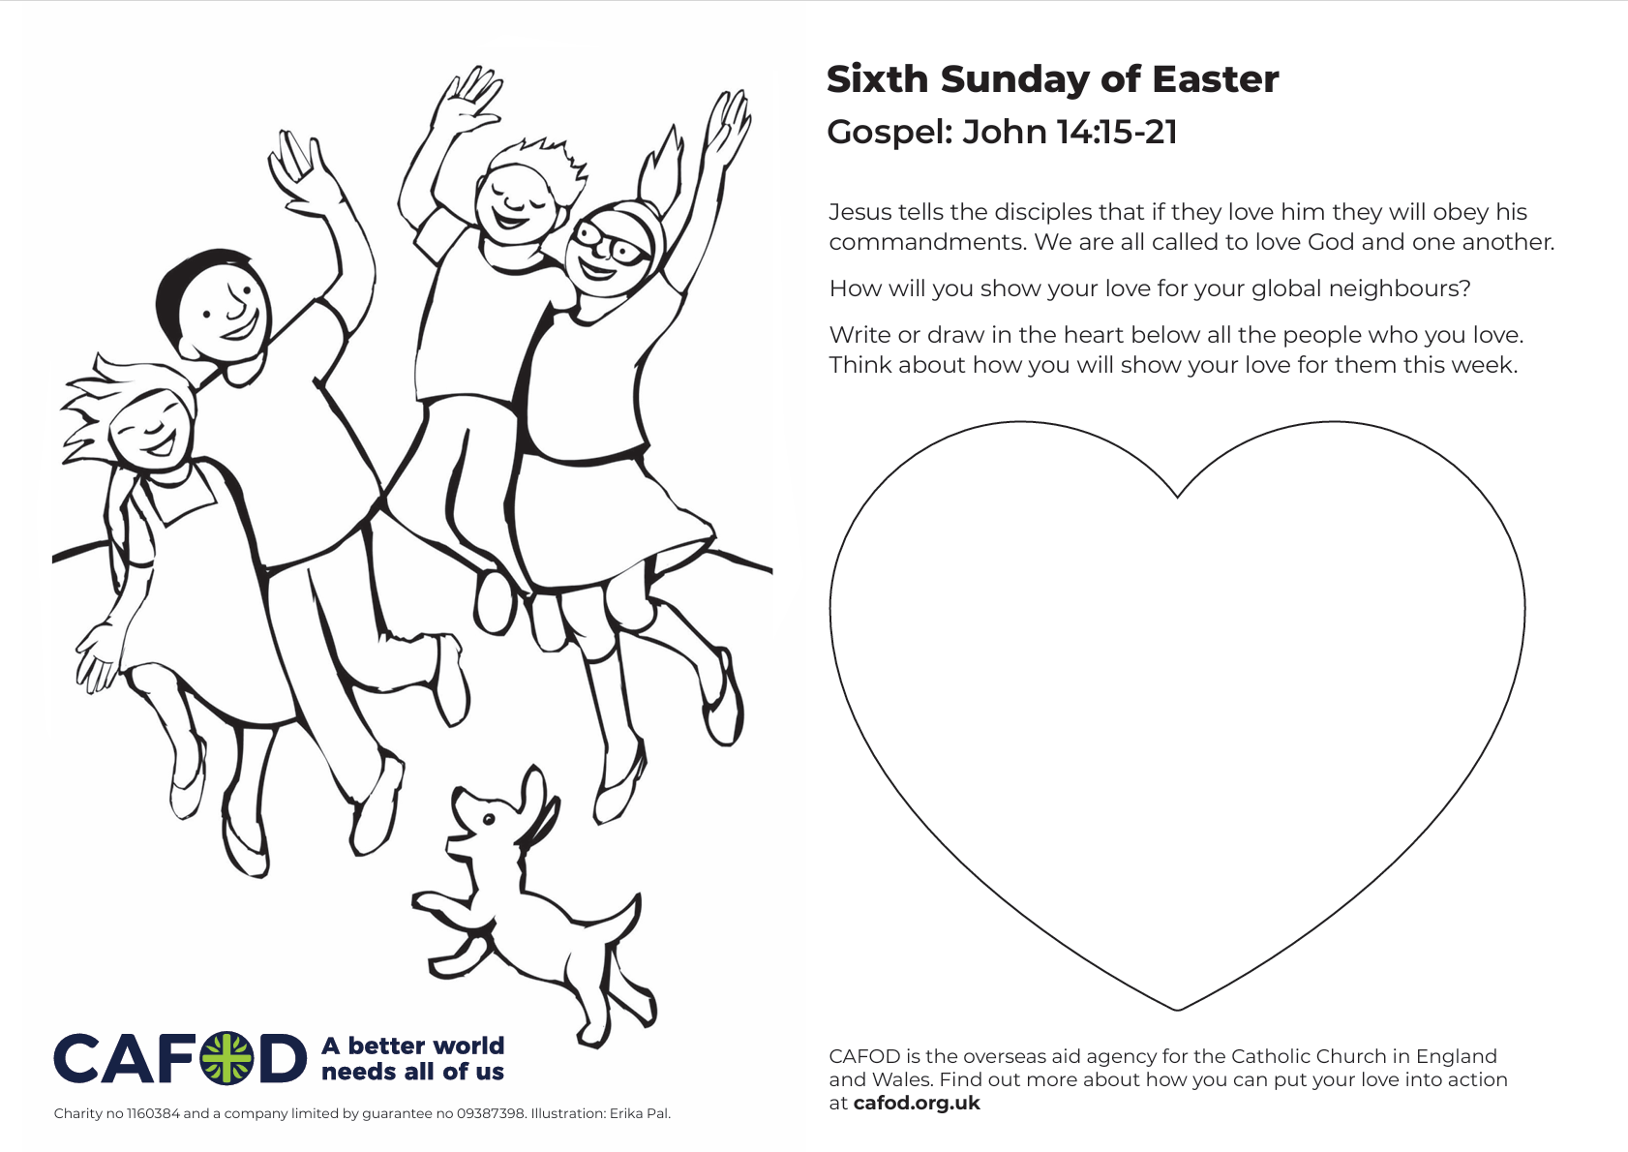
Activity suggestions
Download the illustration
Share the accompanying activity sheet with the children and encourage them to complete it, either in the liturgy or at home. Ask them on the back to write or draw how they will show their love for others in the coming week.
Give the children heart shapes cut out of paper or card. Encourage them to write the name of someone they love on one side and someone who loves them on the other. Then under each name ask them to write or draw what they will do to show their love for these people in the coming week.
Notes:
Illustration: Erika Pal

Slide 17
Encourage the children to write a prayer thanking God for all the people in the world that they love and who are important to them, asking God to bless and watch over them. Remind the children to think about the people they know and also all the members of our global family in this prayer.
Remind the children to share all that they have heard and thought about today with the people at home. If they have written a prayer encourage them to say this together at home during the week. Invite them to do at least one thing that shows their love for others in the coming week.
Find out more about how you can put your love into action with CAFOD at CAFOD
Notes:
Illustration: Erika Pal

Slide 18
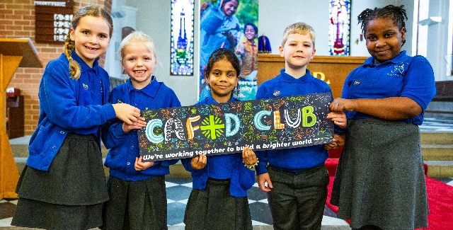
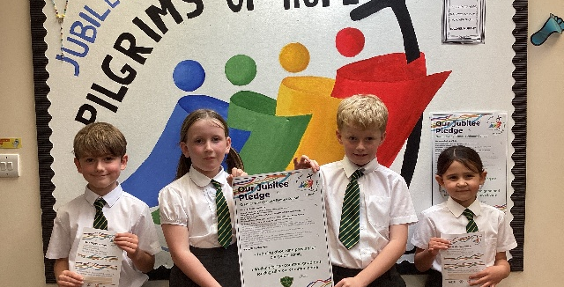

Get involved with CAFOD this term
Explore our summer term resources
Ways to live out your Jubilee Pledge
Fundraise for a World Gift

Slide 19


