Slide 1
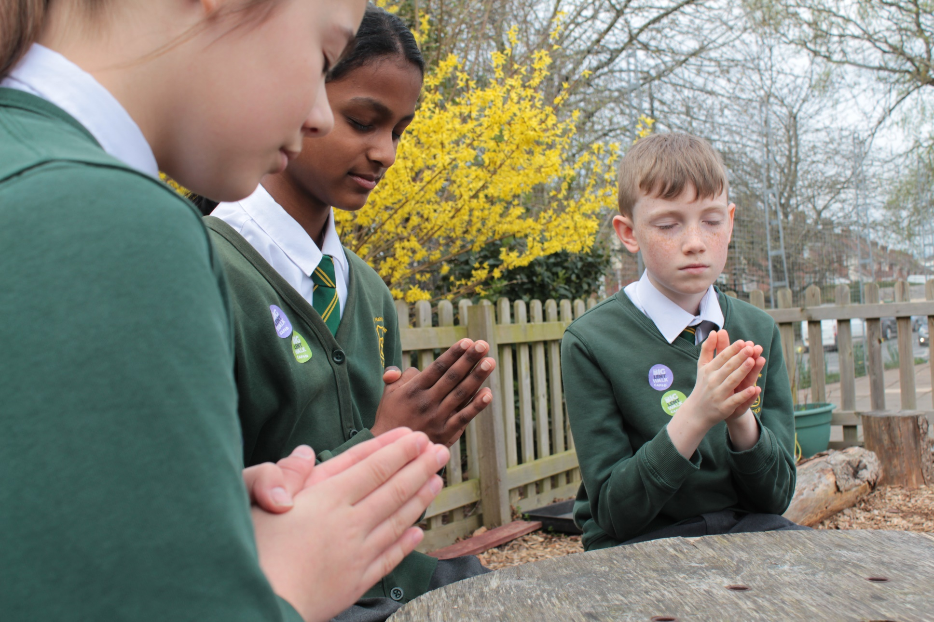
How will we try and live as God asks us to this week?
Gather
Notes:
Preparation of the worship space
Colour: white
Props: Display a picture of the Trinity to remind everyone of this special relationship. Coloured pens and pencils. Card, glue and string.
Song suggestions
Father we adore you (718, Laudate)
Welcome
Today is Trinity Sunday when we think about how God is made up of three persons: God the Father, Jesus Christ the Son and the Holy Spirit. Let’s find out some more...

Slide 2
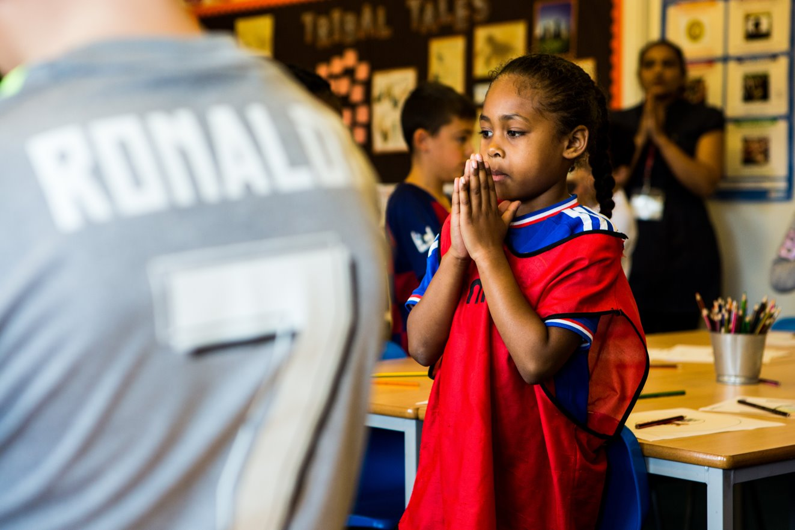
God of love,
You gave us your Son, you gave us your Spirit, may we always follow you in all that we do and say.
Amen.
Notes:
Children at Our Lady Queen of Heaven Primary School
Photo credit: Thom Flint

Slide 3
Gospel: John 16: 12-15
Jesus said to his disciples:
“I have much more to tell you, but now it would be too much for you to bear. When, however, the Spirit comes, who reveals the truth about God, he will lead you into all the truth. He will not speak on his own authority, but he will speak of what he hears and will tell you of things to come. He will give me glory, because he will take what I say and tell it to you.
"All that my Father has is mine; that is why I said that the Spirit will take what I give him and tell it to you.”
Word

Slide 4
What do you remember from the Gospel reading?
This story is part of Jesus’ farewell conversation to the disciples before he dies on the cross.
Jesus says to the disciples that after he has gone, the Holy Spirit will guide them. The Holy Spirit will be their teacher and will speak to them just as Jesus did when he was alive and with them. The Holy Spirit will show the disciples what they must do and what they must say in Jesus’ name.
Respond
Notes:
Signs
Photo credit: Javier Allegue Barros on Unsplash

Slide 5
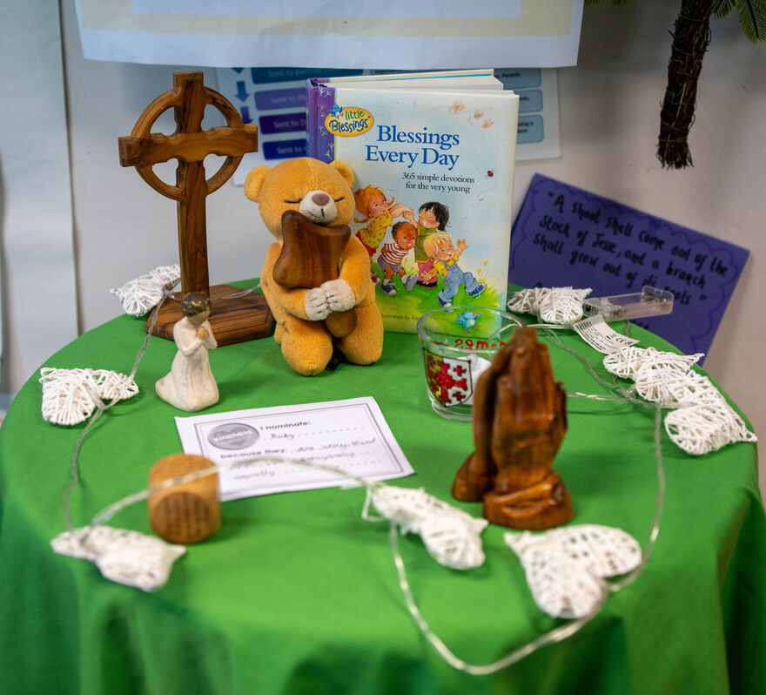
Who teaches you and guides you? Teachers, parents, friends and family all teach us and guide us. And the Holy Spirit is there to guide us too.
There is only one God. But God is made up of three persons: the Father, the Son and the Holy Spirit. This is what we call the Trinity. Trinity means three.
Can you think of a way that we are reminded of the Trinity every time we pray? (Through the Sign of the Cross.)
Notes:
St Chad's Primary School
Photo credit: Joe Newman

Slide 6
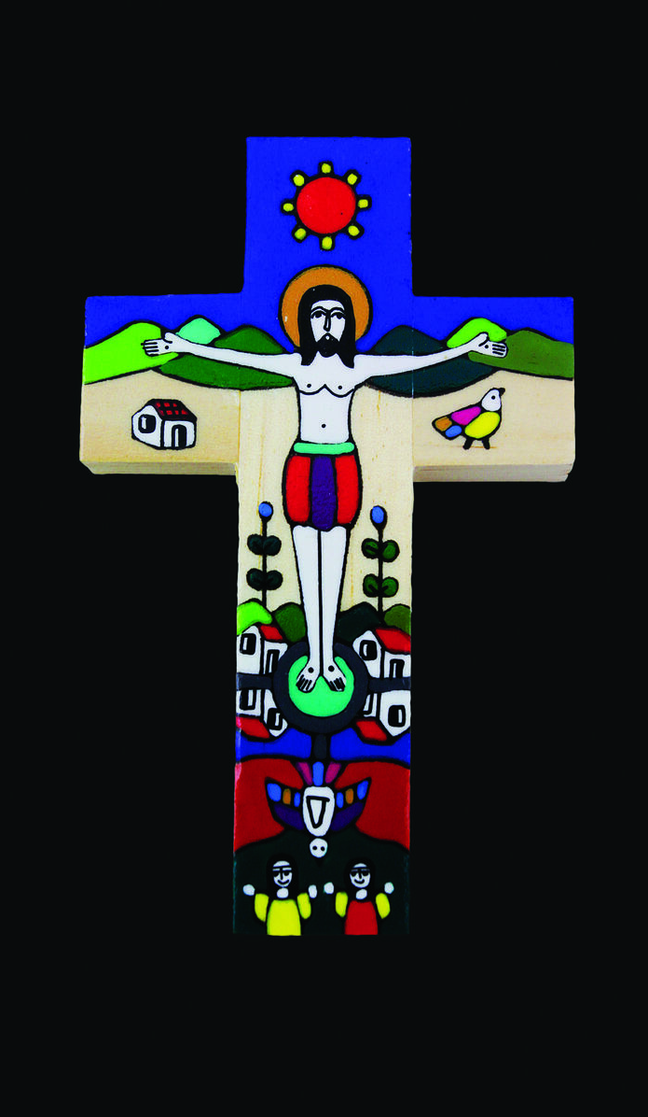
This relationship of the Father, Son and Spirit is a relationship where all are together but each person is also different.
The Father created the world and everything in it and sent his only Son Jesus to live among us here on earth.
Jesus came to help us to know the Father, to teach us how to live and to forgive our sins.
When he returned to heaven, he sent the Holy Spirit to give us courage, to guide us in the right path and to bring us faith, hope, joy and peace.
Notes:
Romero cross
Photo credit: CAFOD

Slide 7
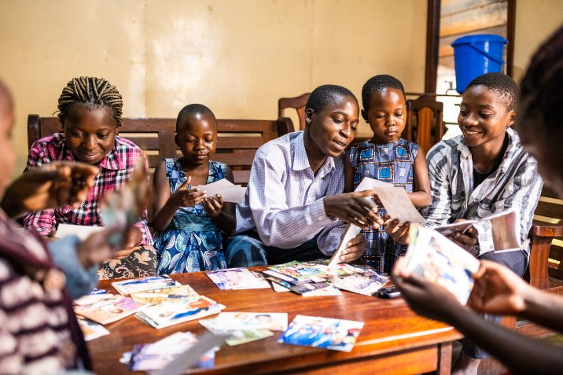
This is a bit like our families – we might have parents, sisters and brothers, aunts and uncles, nieces and nephews, cousins and grandparents.
Whatever the size of our family, we know there are different people in our family who have different relationships and jobs, but we are still only one family with them. We are all connected through our family bond.
Notes:
Francoise Kanyere looking at old photos with her family
Photo credit: Arlette Bashizi

Slide 8
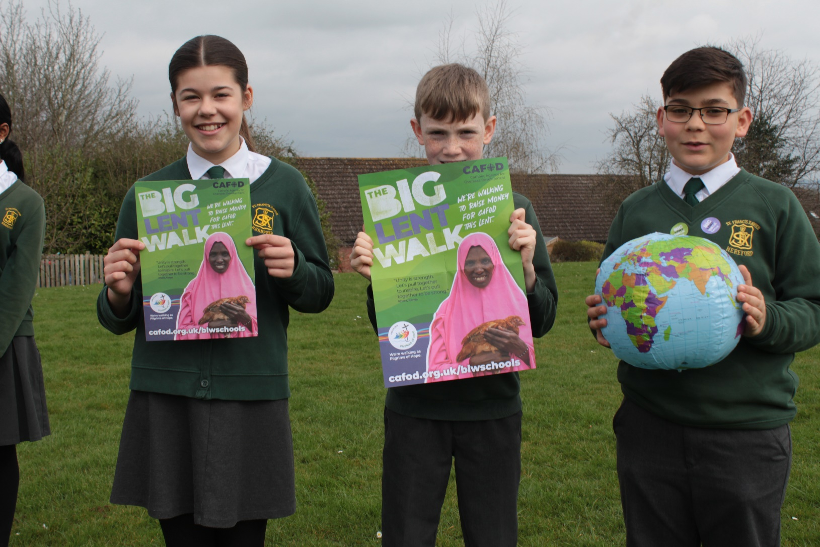
Who do you live with? Do you live with lots of people or just a few? Do all your family live close by or are they spread far apart?
We are also part of one big global family that includes everyone in the world. We are all God’s children. We are all special, and even though we are all different, we are all equally important.
Notes:
Hello across the miles
Photo credit: Stock image

Slide 9
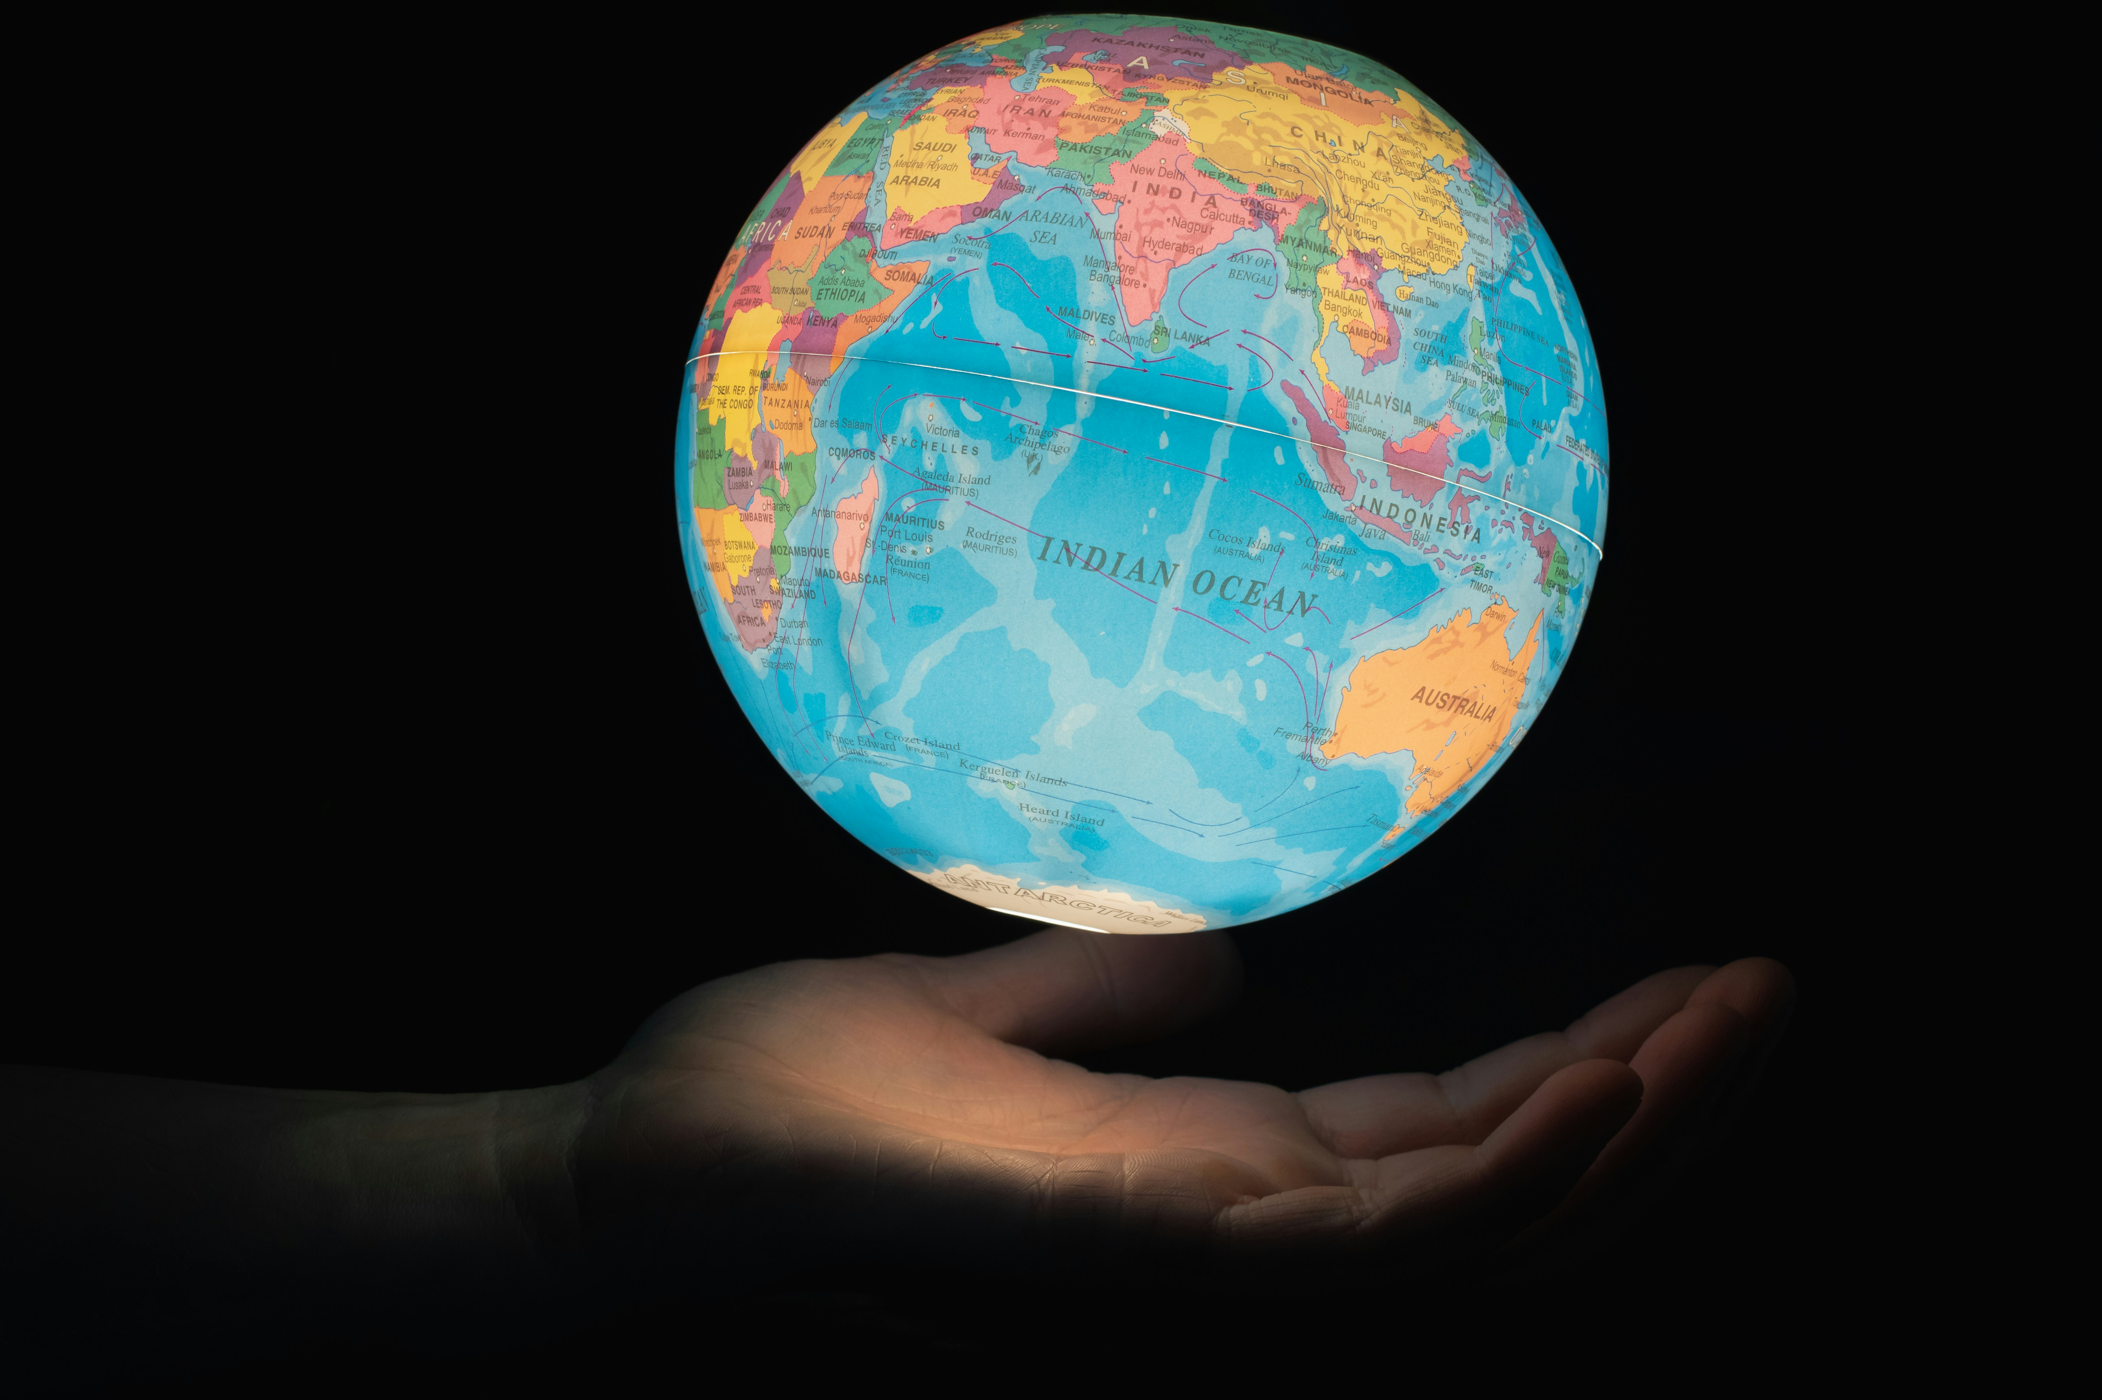
We are all called to care for one another and for the earth that we live in. But how we do this depends on who we are and our own gifts.
We believe that Jesus’ promise to the disciples – that the Holy Spirit would be with them and guide them – is still true for all of us today and for all people after us. The Holy Spirit can guide us to do what is right and to use our talents in the best way to help others.
Notes:
Our world
Photo credit: Greg Rosenke

Slide 10
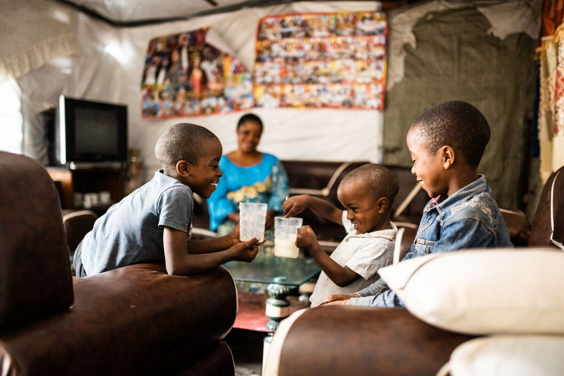
Can you listen to the Holy Spirit in the coming week, and see how the Spirit guides you, especially in the way you treat those you live with and the members of our global family throughout the world?
Notes:
Anuarite Kahindo sharing milk with her children
Photo credit: Arlette Bashizi

Slide 11
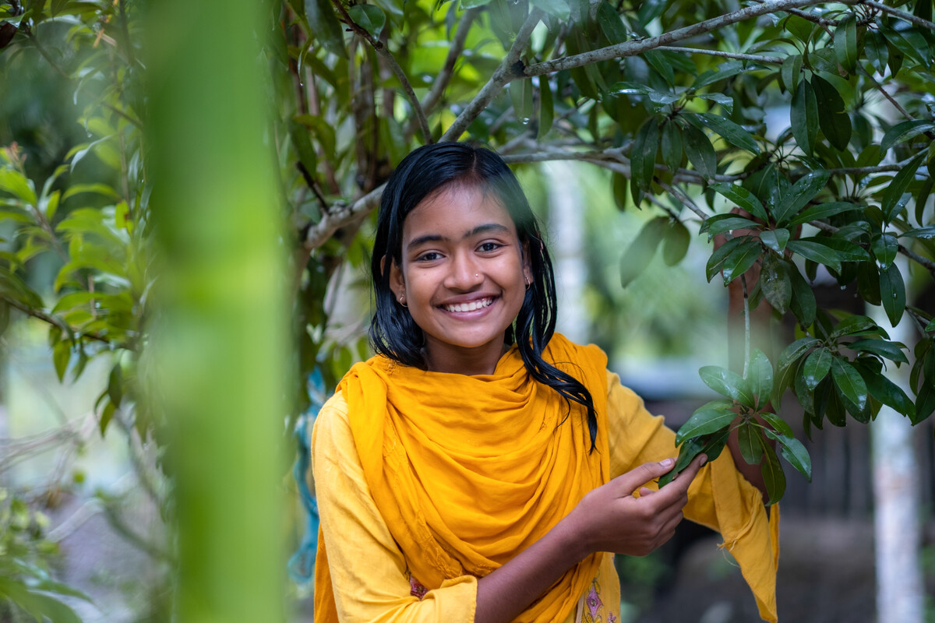
This is Dristy. She lives in Bangladesh.
Dristy loves spending time outside and has a talent for gardening.
"My favourite thing is lychee fruit. I like bananas too. I am used to eating food from my garden. I love it because it is so fresh!"
Notes:
Dristy, Bangladesh
Photo credit: Amit Rudro

Slide 12
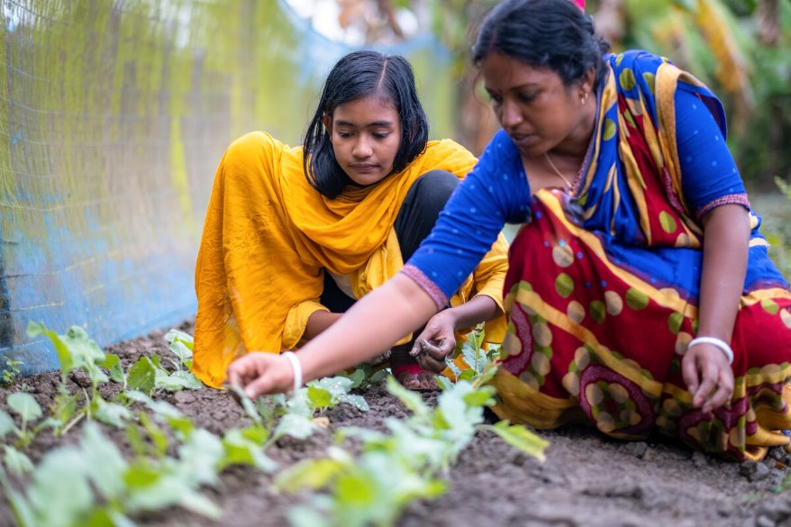
With CAFOD's help, Dristy and her mum, Rupali, have learnt to look after crops to protect them from cyclones caused by climate change.
Dristy and Rupali are using their talents to care for the environment, to look after the world for our global family.
Notes:
Dristy and her mum, Rupali, Bangladesh
Photo credit: Amit Rudro

Slide 13
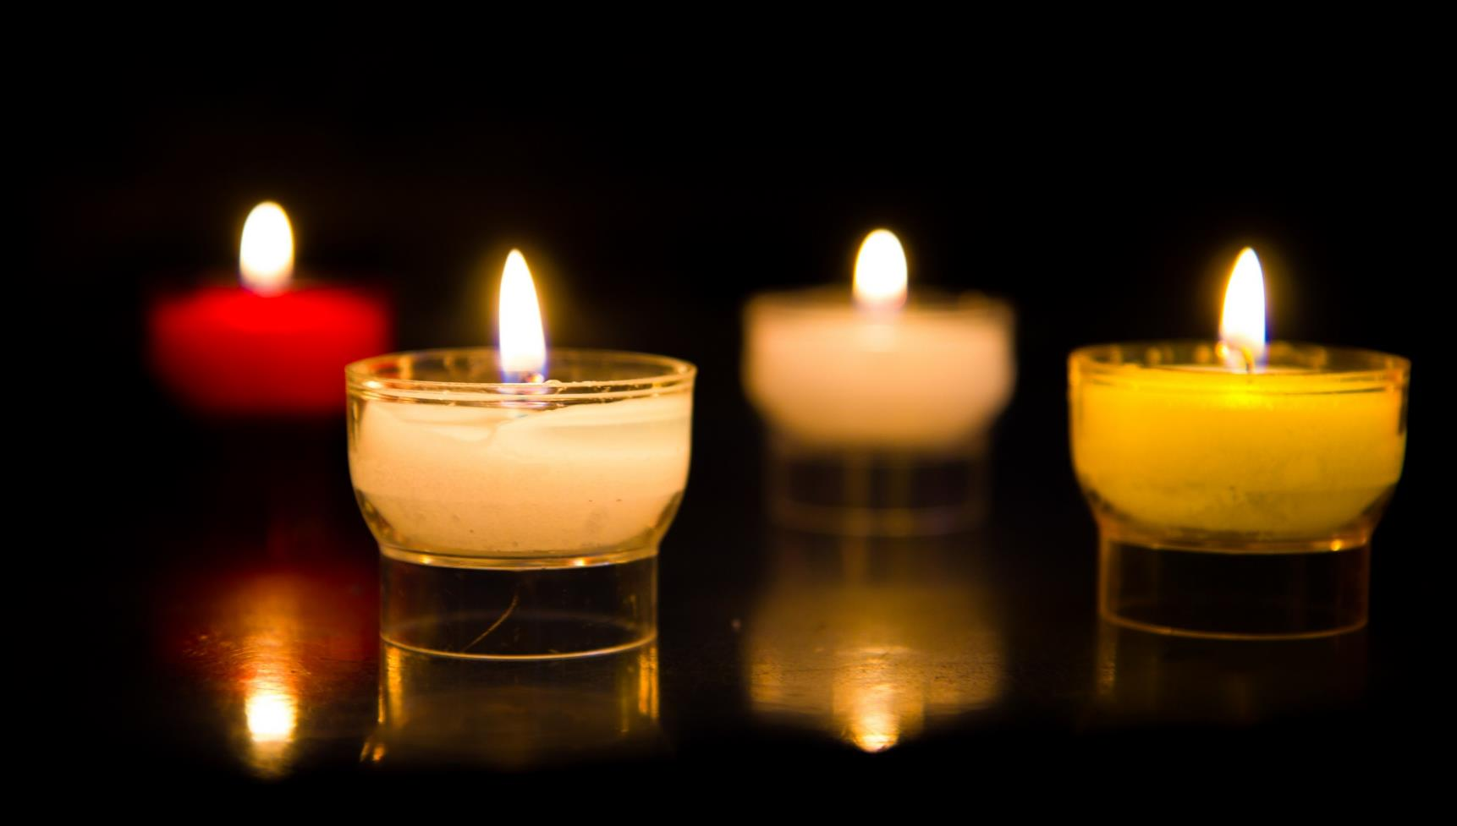
Let us pray…

Slide 14
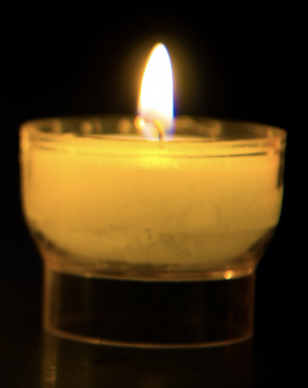
We pray for leaders in our communities: that they may work together despite their differences so that all people may live in peace. Lord in your mercy…
We pray for our parish, family and friends: that we may be guided by the Holy Spirit to be kind, respectful and loving to all people and to use our talents to make the world a better place. Lord, in your mercy…

Slide 15
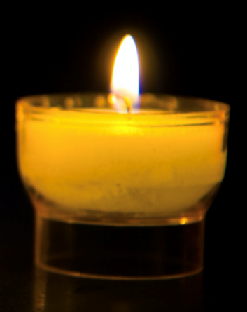
In this Jubilee Year, we pray that we may be signs of hope in our world through all that we do and how we treat one another. Lord, in your mercy…
Loving God, you are with us always. Send us your Spirit to teach and guide us to live in peace with each other every day. Amen.

Slide 16
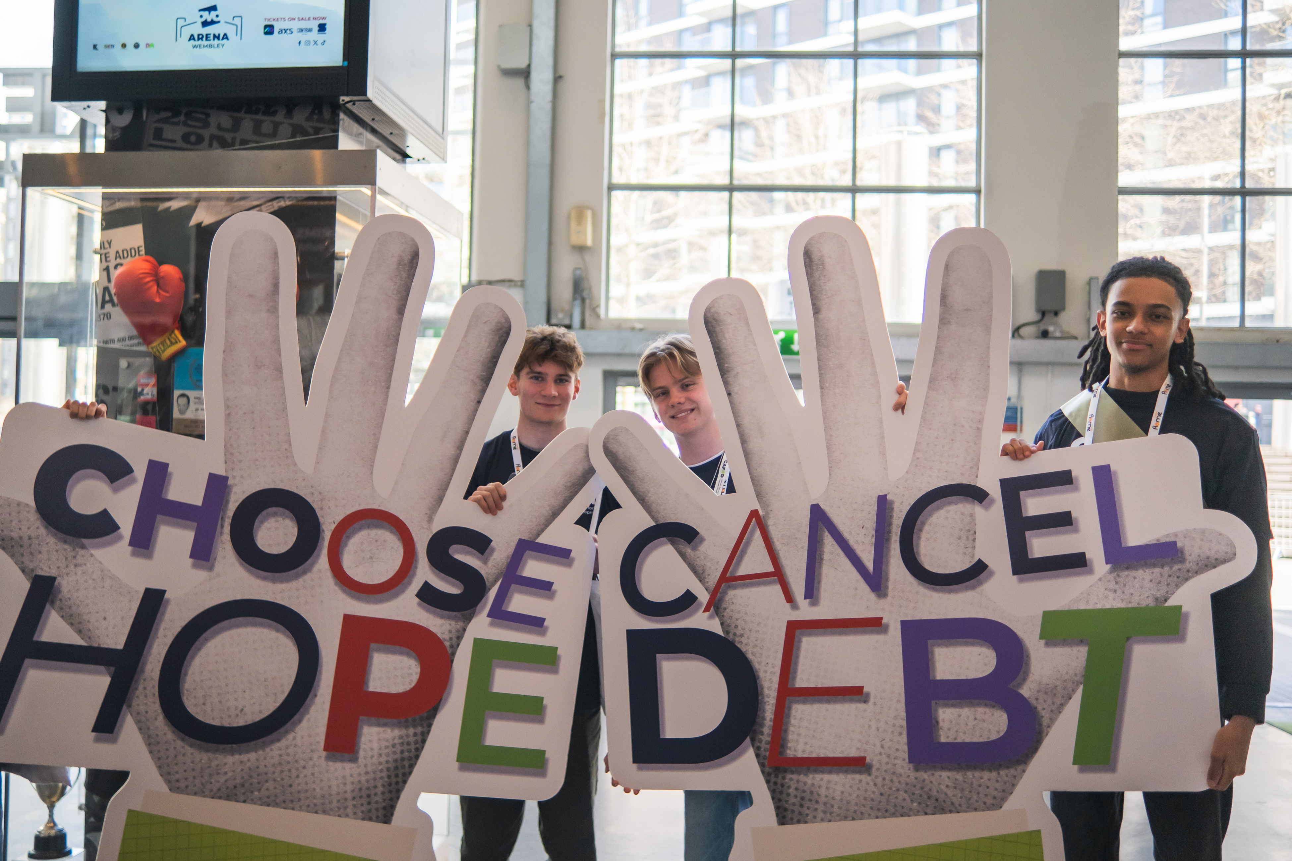
How will you do your best to listen and show your love for God the Father, Son and Holy Spirit this week?
How will you try and live as God asks us to?
Send
Notes:
CAFOD's 'Cancel Debt, Choose Hope' campaign at Flame 25
Photo credit: Amit Rudro

Slide 17
Activity suggestions
Invite the children to colour in the accompanying illustration of all the different members of a family doing their different jobs around the home. On the back get the children to draw a picture of their own family and/or our global family.
Ask the children to sit in silence for a moment and to reflect on a problem that they can see in our world (hunger, homelessness, war, something else). Is there anything that they can do about it? Perhaps the Holy Spirit is prompting them to do something?
Notes:
Illustration: Jane Smith

Slide 18
Spend more time helping the children to understand the idea of the Trinity. You could use the example of a tricycle to help:
Today is a special day called Trinity Sunday. The Holy Trinity has three persons – God the Father, Jesus the Son, and the Holy Spirit.
Let’s think today about a tricycle because they have three wheels. Each wheel can spin without spinning the others. But also, all can spin the same way when needed to go forwards and can turn at different speeds to turn corners.
The three tricycle wheels can work on their own and together but are always included when you say the word ‘tricycle’. God the Father, the Son and the Holy Spirit can work on their own or together but are always included when you say ‘Holy Trinity’.
Create a Trinity image with the children. Stick three pieces of string to the card to create a triangle and label the three corners, Father, Son and Holy Spirit. Write the word God in the middle of the triangle to remind the children that we have one God, with three persons in the Trinity. They could also decorate the card with symbols that remind them of the three persons of the Trinity.
Remind the children to tell the people that they live with all that they have heard and thought about in the liturgy today. Encourage them to listen to how the Holy Spirit is guiding them in the coming week and to use their special talents to do what they can to make the world a better place.

Slide 19
Notes:
Illustration: Jane Smith

Slide 20
Planning your Jubilee Pledge?
It's time to make your Jubilee Pledge!
In June or July, all Catholic schools are invited to make a Jubilee Pledge to live out Catholic Social Teaching.
A better world needs all of us, and the Pledge will be a whole school, long-term commitment to building a fairer world.
Watch our films and download our resources to help you write your Pledge and plan your Pledge Day:
Jubilee pledge for schools
The Jubilee Year is a landmark moment in the life of the global church. School communities are invited to join together as pilgrims of hope, pledging to work together for God’s kingdom of justice, peace and love. Find resources at:
Jubilee for schools 2025 – Pilgrims of Hope

