Slide 1
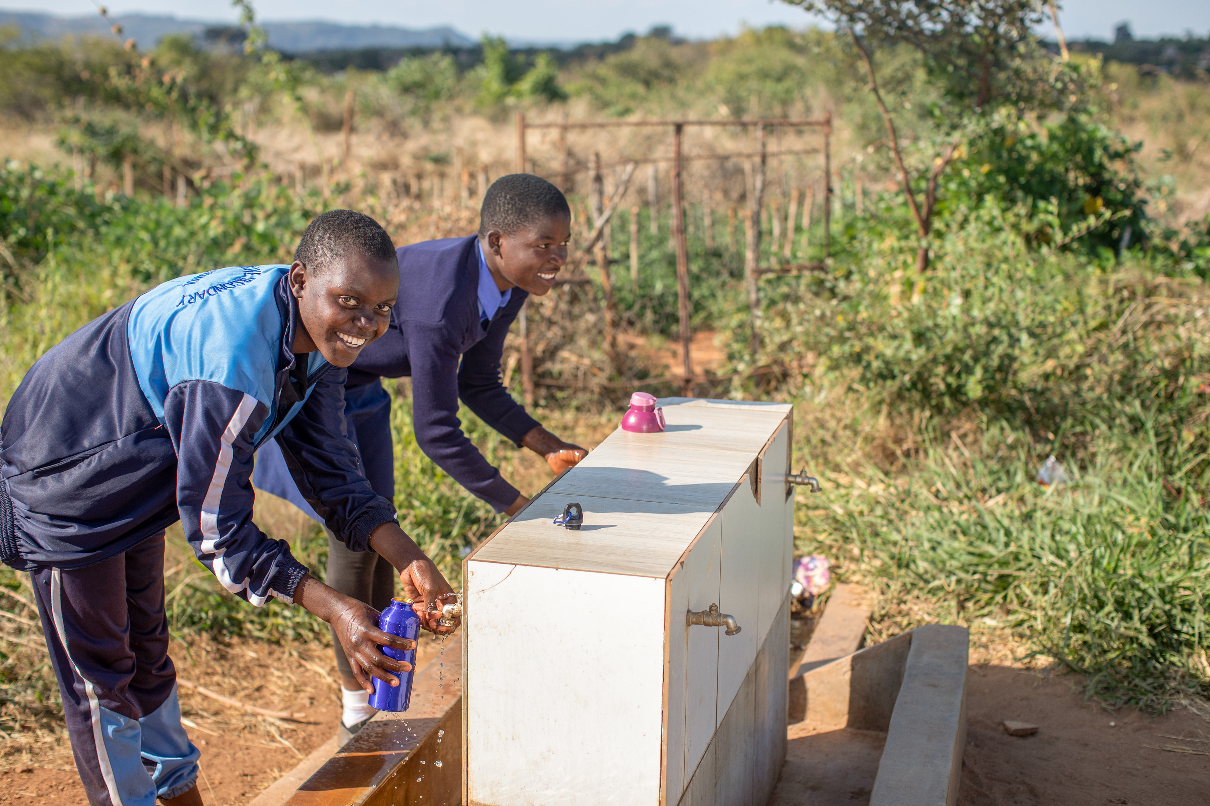
Zimbabwe photopack
For primary schools

Slide 2

How to use this photopack
This photopack accompanies the Zimbabwe film and is designed to help children learn about how access to water is keeping children at school.
Watch the film for primary schools about Maggie in Zimbabwe.
Each card includes photos, quotes and prompt questions. You could also include more general questions when sharing the images:
      What do you notice in this picture? What does that tell you?
      What’s the same? What’s different?
      How does it make you feel?
Join CAFOD’s primary national assembly to help children understand how Maggie’s story links to Pope Leo’s message about caring for our sisters and brothers in need.
Order a fundraising pack and think about ways your school could raise money to help more communities have access to water.

Slide 3
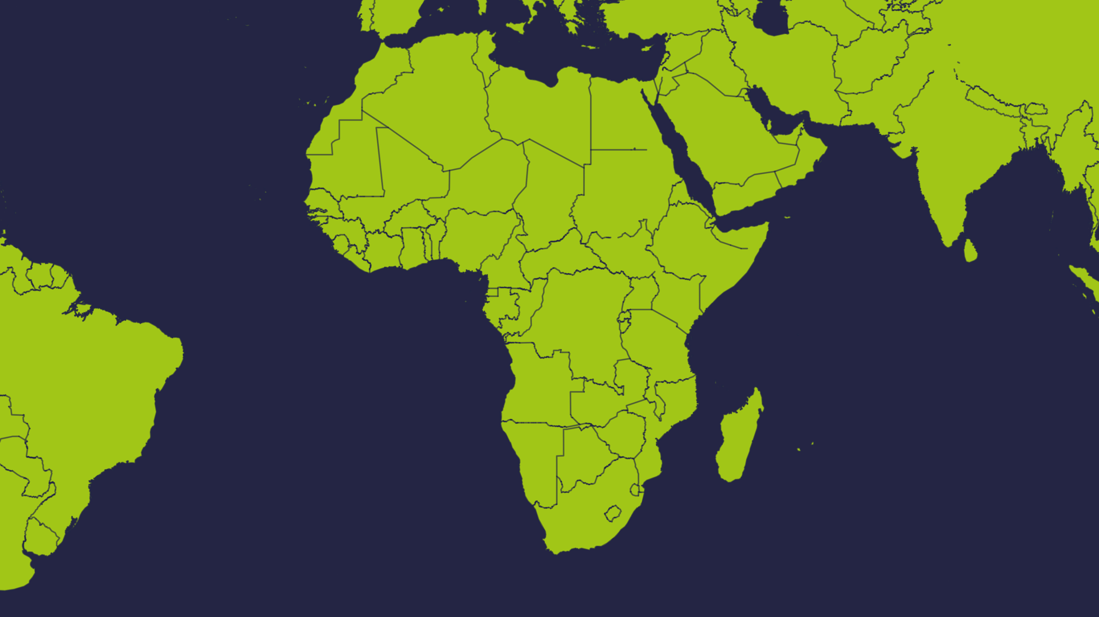
Zimbabwe

Slide 4
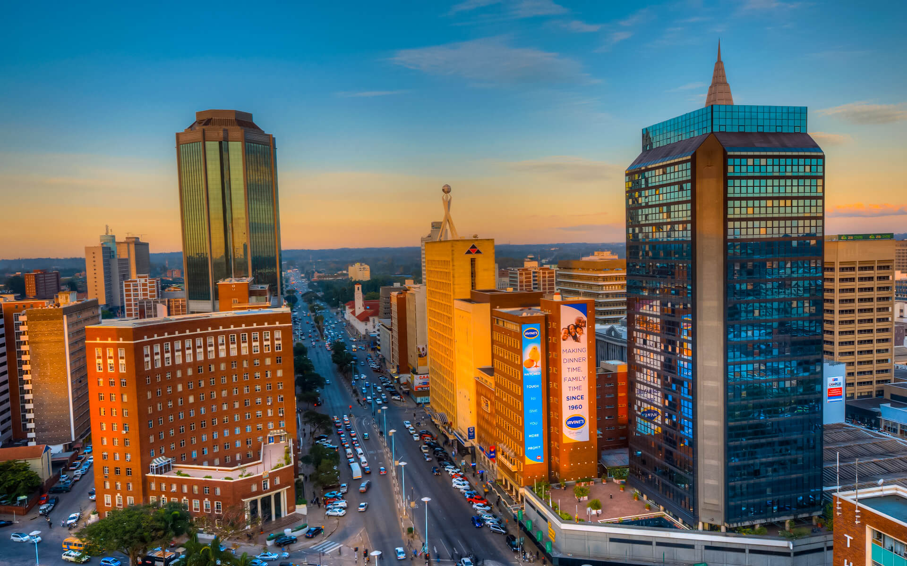
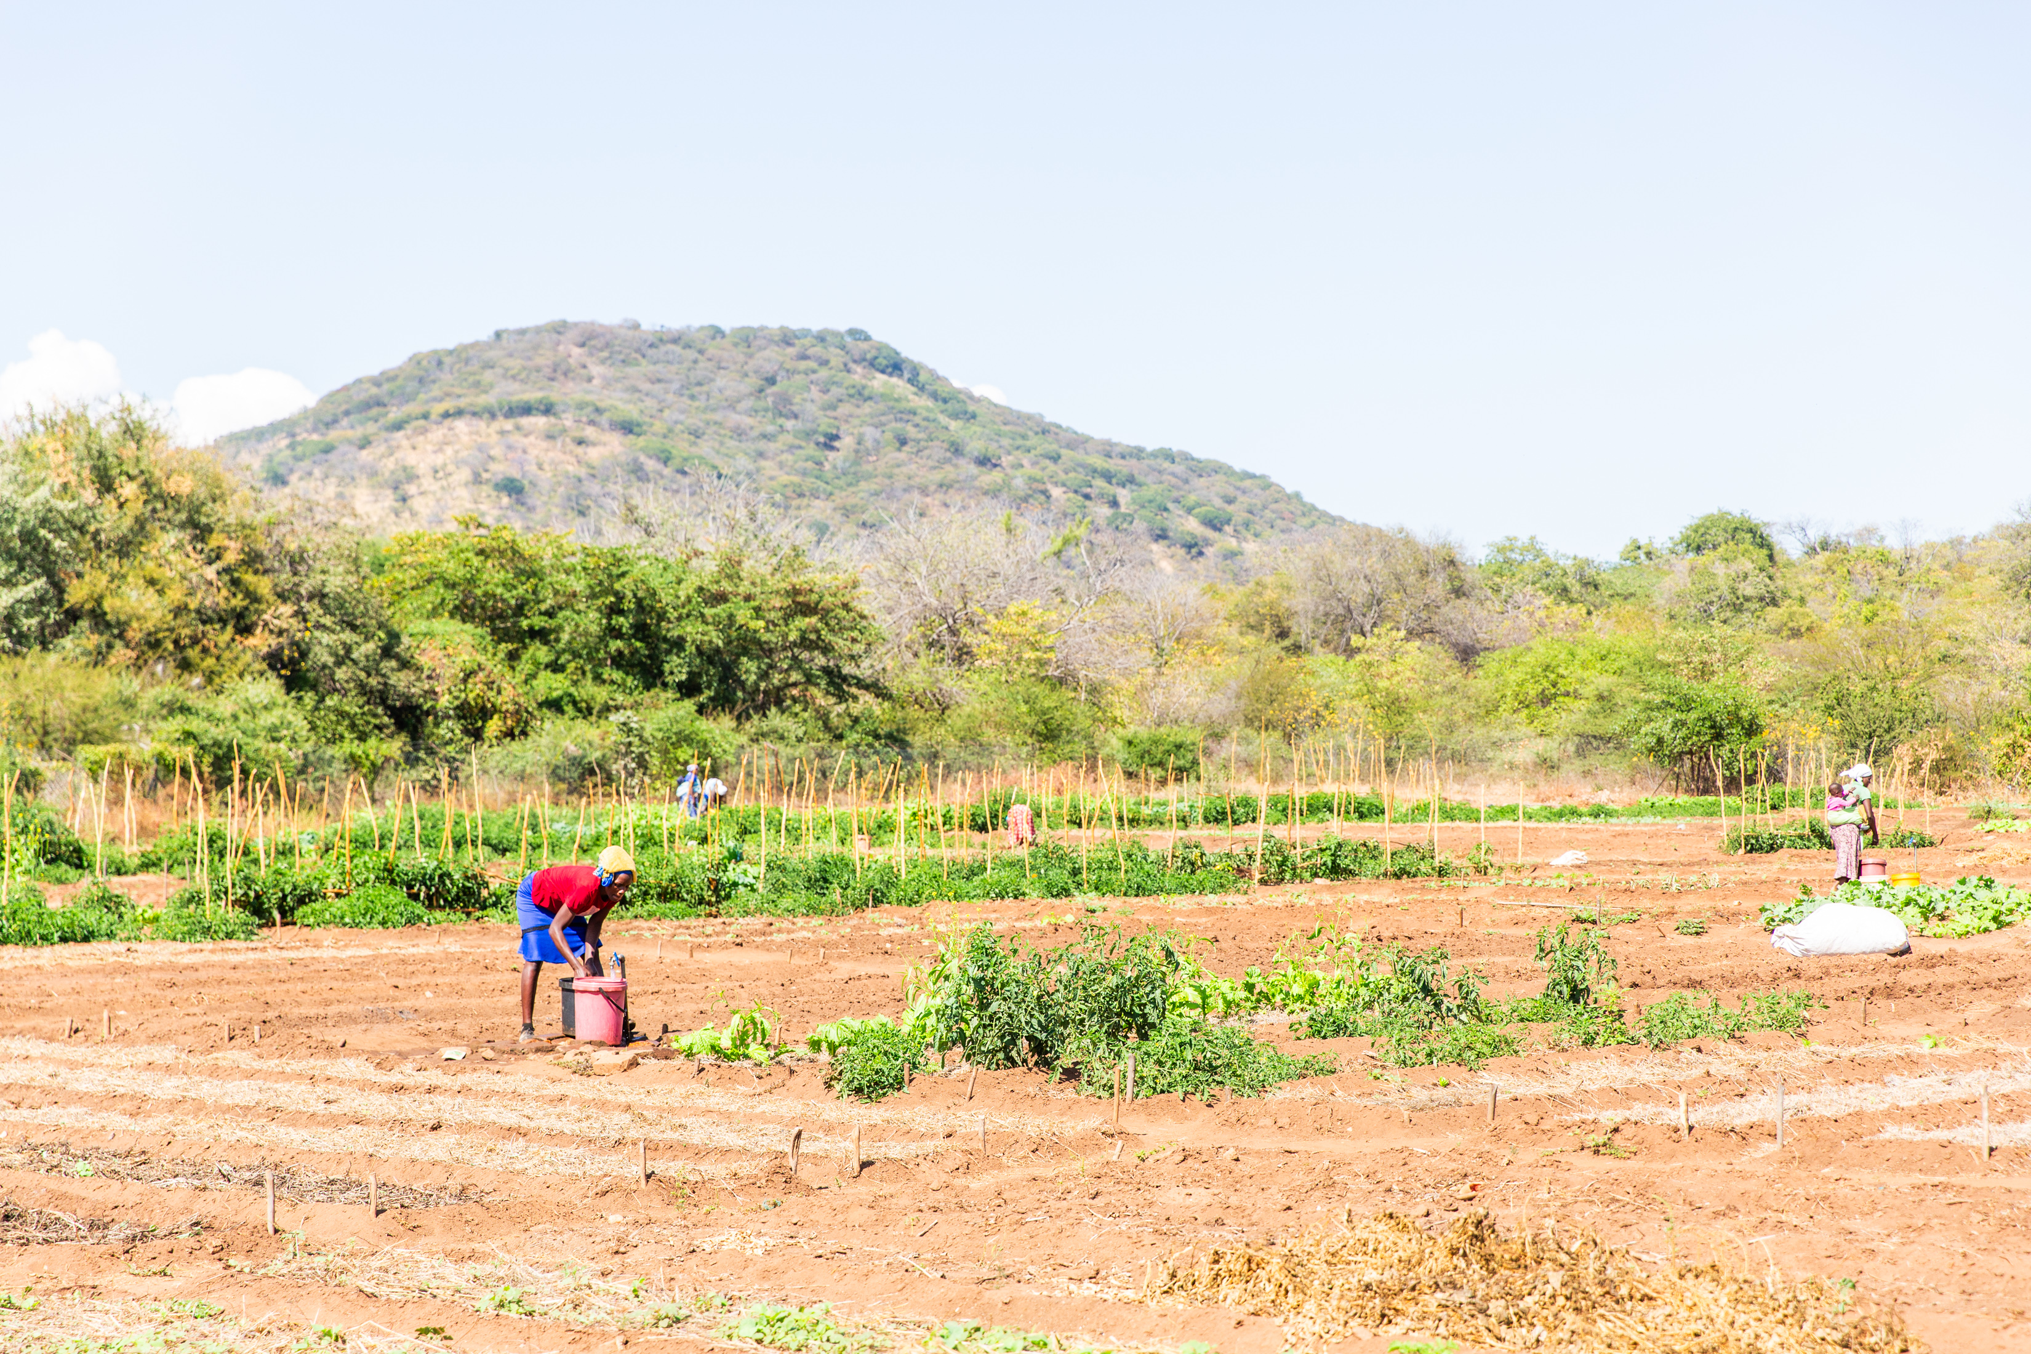
Zimbabwe fact file
Zimbabwe is a country in the south of Africa. Its capital city is Harare.
Zimbabwe is a country with amazing animals and beautiful natural wonders.
Climate change has made Zimbabwe's weather hard to predict for many years.
Capital city: Harare
Poor rainfall leads to drought. This can mean it’s hard to grow crops.
In places with too little water, some children miss school because they need to collect water.
Rushinga, in northern Zimbabwe

Slide 5
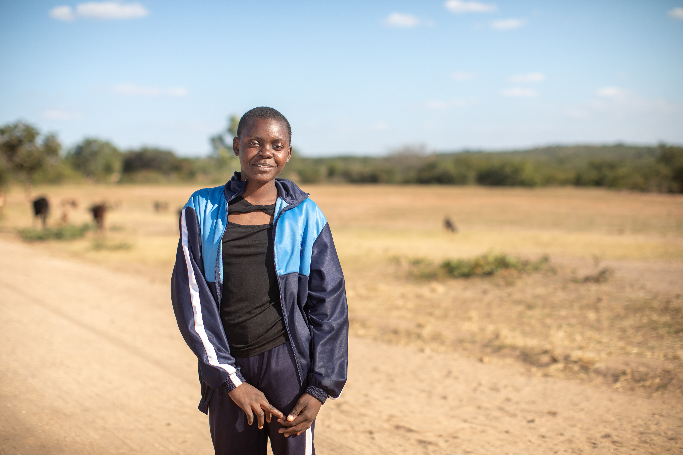
Notes:
Photo Credit: Thom Flint

Slide 6
Photo
1
“When we win a game, we go around the playground singing songs!”
Maggie
Sixteen-year-old Maggie lives in Zimbabwe with her family. She loves school and playing sport. Maggie and her friends love to sing, especially when they win netball games! In Zimbabwe where Maggie lives, the weather is very hard to predict because of climate change. Lack of rain has brought drought in many areas. Because of this, many people, including schoolgirls like Maggie, walk long distances to collect water. ​ How is Maggie’s life like yours? How is it different? What do you think it would be like to walk a long way every day to collect water?

Slide 7
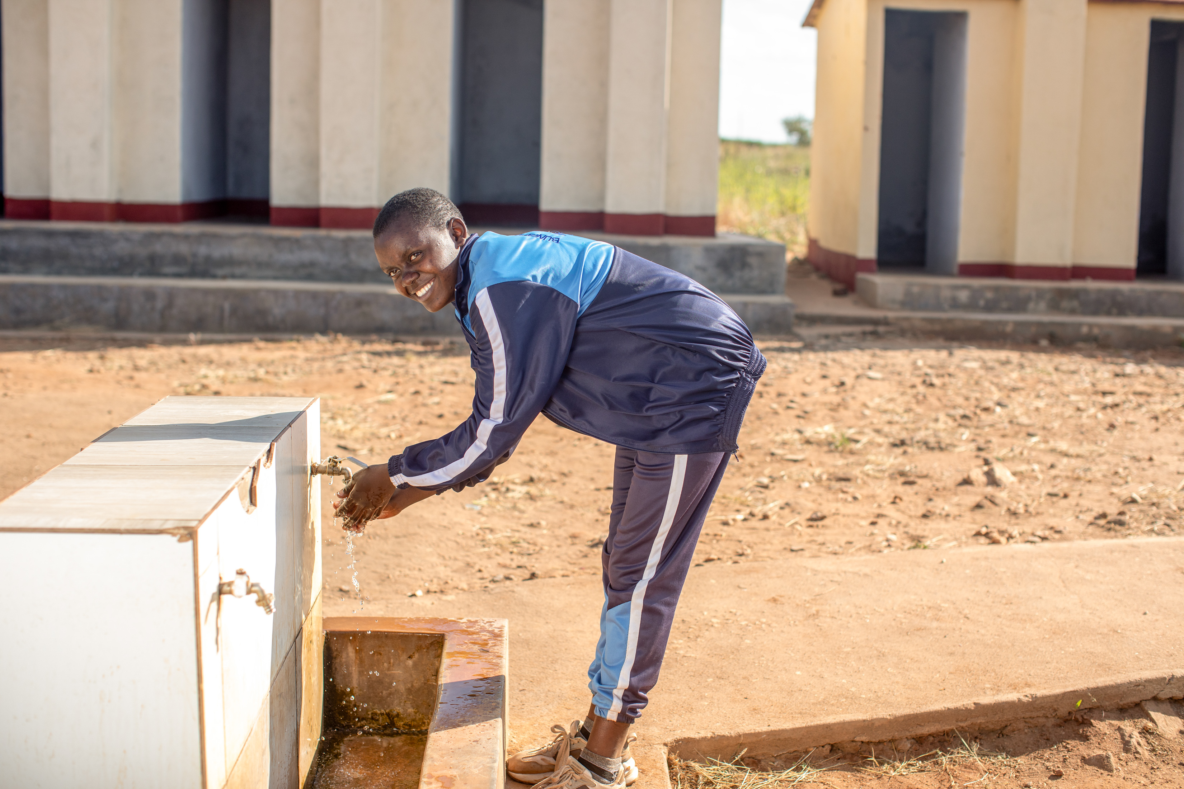
Notes:
Photo Credit: Thom Flint

Slide 8
Photo
2
“We would wake up very early in the morning, and my mother would get a bucket, and I would get my tin. We’d fetch water and then come back home.
Maggie
Maggie said carrying water was difficult because it was heavy. She would carry five litres of water – that’s about the weight of ten water bottles. With CAFOD’s help, taps and showers were installed at Maggie’s school, powered by solar panels. Pupils now have water at school, pumped from the ground, and they do not need to fetch water to take to school for drinking and washing. Think of all the different ways you have used water today. What would happen if you didn’t have water available at school?

Slide 9
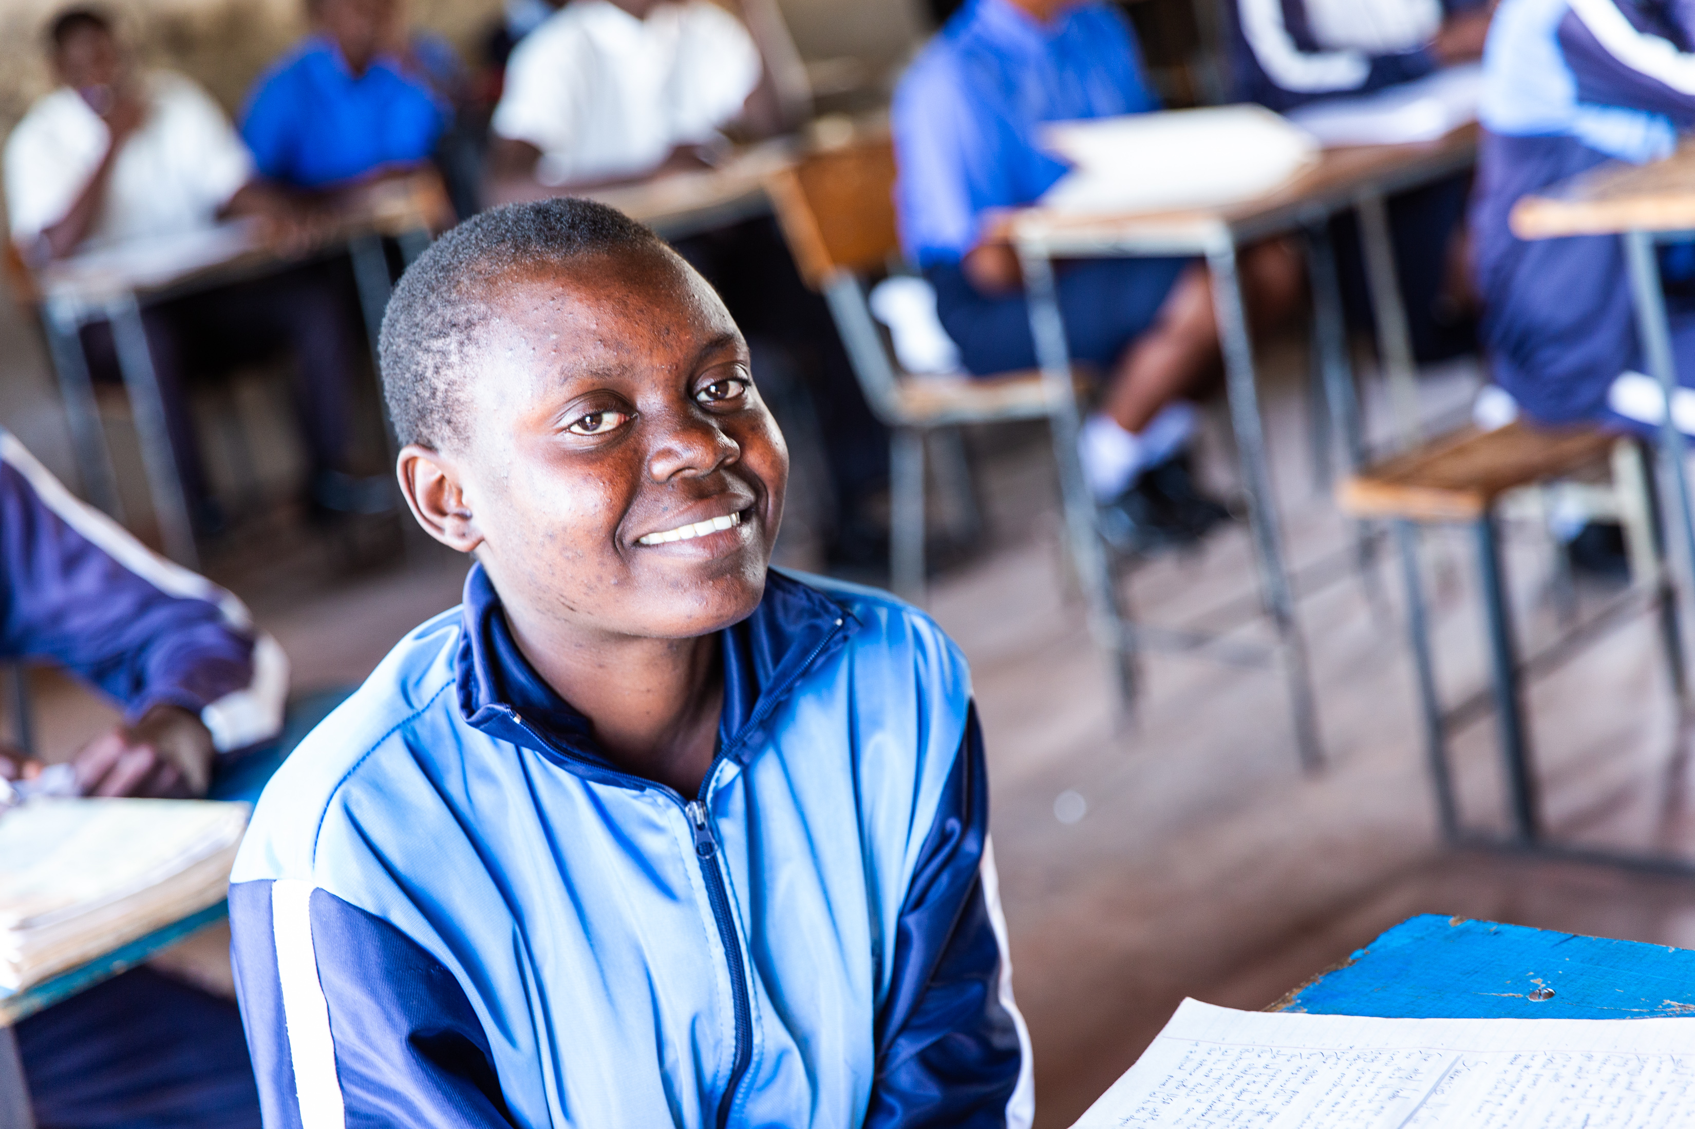
Notes:
Photo Credit: Thom Flint

Slide 10
Photo
3
“I love coming to school. We have water. We no longer carry it to school.”
Maggie
Many girls at Maggie’s school, such as Mary, Maggie’s friend, would fetch water before school. Mary lived far from the water source and would often miss lessons because she had so far to walk. Now that there are taps at school, pupils can focus on learning. This picture shows Maggie in her classroom. Maggie wants to be a doctor when she is older.
Say a prayer today for people around the world who walk for water:
Loving God, ​
We think of all the people around the world who walk to collect water every day.​
​Together, may we build a better world where everyone has water, goes to school and follows their dreams.​
Amen​

Slide 11
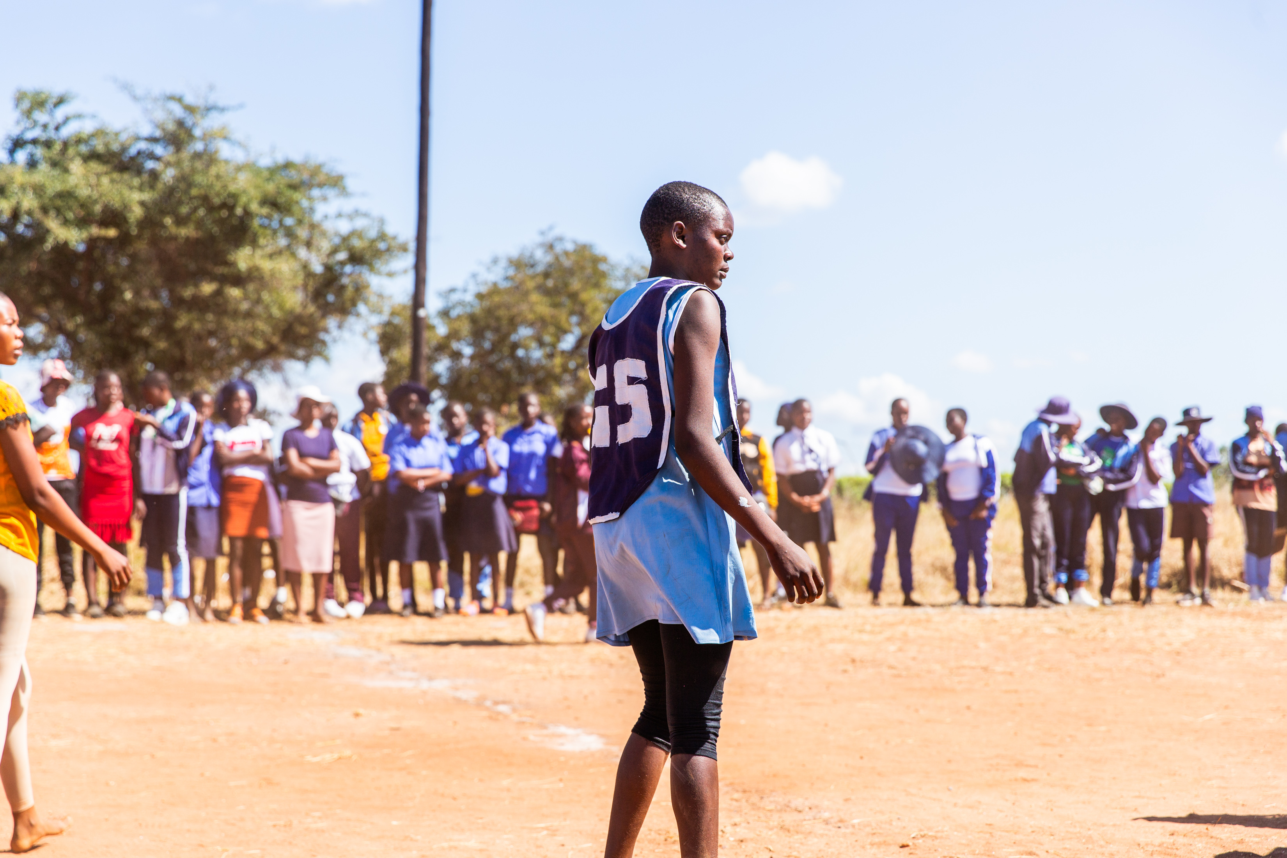
Notes:
Photo Credit: Thom Flint

Slide 12
Photo
4
“It just felt good to have water. After I finished showering, I just stood in the shower and just let water flow on my body. And it was just a good feeling.”
Maggie
What game do you think Maggie is playing here? How do you know that? What sport do you like to play? Maggie loves playing netball. Her position is Goal Shooter and she is happy that her school now has showers so she can wash after playing netball. As she says, it feels good to have water! Having water at school has made such a difference to Maggie and her friends. Why do you need to have water to drink at school? What Catholic Social Teaching principle can we link this to? Why?

Slide 13
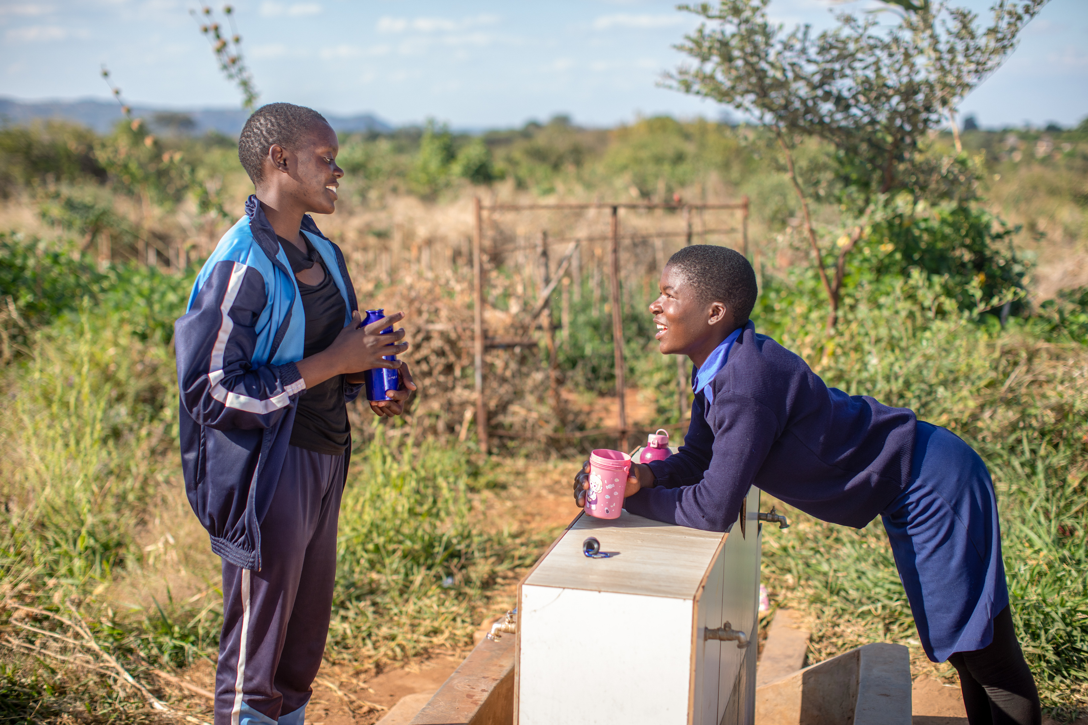
Notes:
Photo Credit: Thom Flint

Slide 14
Photo
5
“Learning about hygiene is important. Someone from the community comes and talks to girls in the clubs…We're keeping ourselves healthy. ”
Maggie
With CAFOD’s help, clubs have been set up at Maggie’s school to help pupils learn about staying healthy. How do you keep healthy at school? Do you have any handwashing posters at school? Is it fair that some people don’t have water? What can we do about it? Together we can build a better world. We can fundraise for CAFOD to help communities like Maggie’s have taps, toilets and showers.

