Slide 1
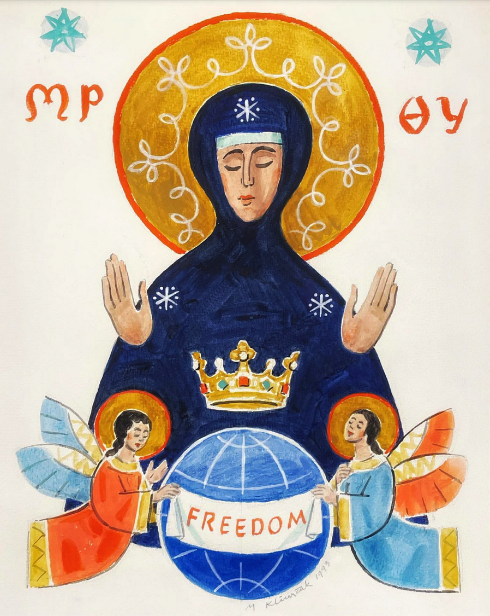
Immaculate Heart of Mary
A prayer for peace in Ukraine
Notes:
In response to the war in Ukraine, Pope Francis has consecrated Ukraine and Russia to the Immaculate Heart of Mary.
This adaptation uses some of the beautiful words used during the consecration and homily in St Peter’s Basilica, accompanied by images and music.
The act of consecration was read simultaneously at St Peter’s in Rome by Pope Francis and at the Sanctuary of Our Lady of Fátima in Portugal.
The ceremony was in answer to one of the visions of the Virgin Mary at Fatima in 1917, which included the instruction to consecrate Russia to her Immaculate Heart. In light of the war in Ukraine, the Ukrainian Catholic bishops formally requested that the Pope renew this consecration in full for the people of Russia and Ukraine.
In his homily, the Pope said that the consecration “is no magic formula but a spiritual act… an act of complete trust on the part of children who, amid the tribulation of this cruel and senseless war that threatens our world, turn to their Mother, reposing all their fears and pain in her heart and abandoning themselves to her.”
TEXT IN FULL:
Immaculate Heart of Mary
A prayer for peace in Ukraine, based on the words of Pope Francis
O Mary, Mother of God and our Mother,
as scenes of war enter our homes, filling us with grief and helplessness,
we turn to you and knock at the door of your heart.
We are your beloved children.
At this dark hour,
when we stand with you beneath the cross,
you remind us that God never abandons us.
Through you, he began a new story of salvation and peace.
To your Immaculate Heart we consecrate ourselves and all humanity,
especially Ukraine and Russia, whose people venerate you with great love.
Your heart beats with compassion for them
and for all peoples decimated by war, hunger, and injustice.
May your embrace comfort those forced to leave their homes,
do not let us be shipwrecked in the tempest of war.
May your Sorrowful Heart move us to compassion
and inspire us to care for our sisters and brothers who are cast aside.
Loving Mother, you are ever with us,
in you we place our trust.
Queen of Heaven, enfold us in your pure and spotless heart,
and lead us now along the path of peace.
Amen.

Slide 2
In response to the war in Ukraine, Pope Francis has consecrated Ukraine and Russia to the Immaculate Heart of Mary.
Using some of his beautiful words, we pray:

Slide 3
O Mary, Mother of God and our Mother,

Slide 4
as scenes of war enter our homes,

Slide 5
filling us with grief and helplessness,

Slide 6
we turn to you and knock at the door of your heart.

Slide 7
We are your beloved children.

Slide 8
At this dark hour, when we stand with you beneath the cross,

Slide 9
you remind us that God never abandons us.

Slide 10
Through you, he began a new story of salvation and peace.

Slide 11
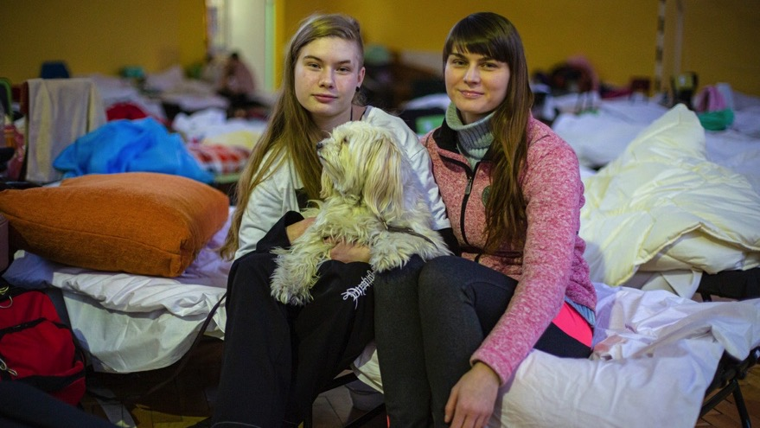
To your Immaculate Heart we entrust ourselves and all humanity,

Slide 12
especially Ukraine and Russia,
whose people venerate you with great love.

Slide 13
Your heart beats with compassion for them,

Slide 14
and for all peoples decimated by war, hunger, and injustice.

Slide 15
May your embrace comfort those forced to leave their homes,

Slide 16
do not let us be shipwrecked in the tempest of war.

Slide 17
May your Sorrowful Heart move us to compassion

Slide 18
and inspire us to care for our sisters and brothers who are cast aside.

Slide 19
Loving Mother, you are ever with us,

Slide 20
in you we place our trust.

Slide 21
Queen of Heaven, enfold us in your pure and spotless heart,

Slide 22
and lead us now along the paths of peace.
Amen.

Slide 23
Notes:
Photo credits:
Slides 1+2: Mary the Woman of Freedom II, by Mikuláš Klimčák, 1993.
Ukrainian Marian Collection, Marian Library, University of Dayton, CC BY-ND
3: Caritas Poland
4, 6, 7, 9, 11, 19, 20: Phillip Spalek, Caritas Germany
5: Julia Rekami / Unsplash
8, 21, 22: Caritas Poland
10: Ukrainian icon / Amudena Rutkowska / CC
12: The Oranta of Kyiv / Saint Sophia Cathedral / Wikimedia Commons
13: Caritas Ukraine
14, 18: Caritas Spes
16: Marijn Fidder, Caritas Germany
17: Gayatri Malhotra / Unsplash

