Slide 1
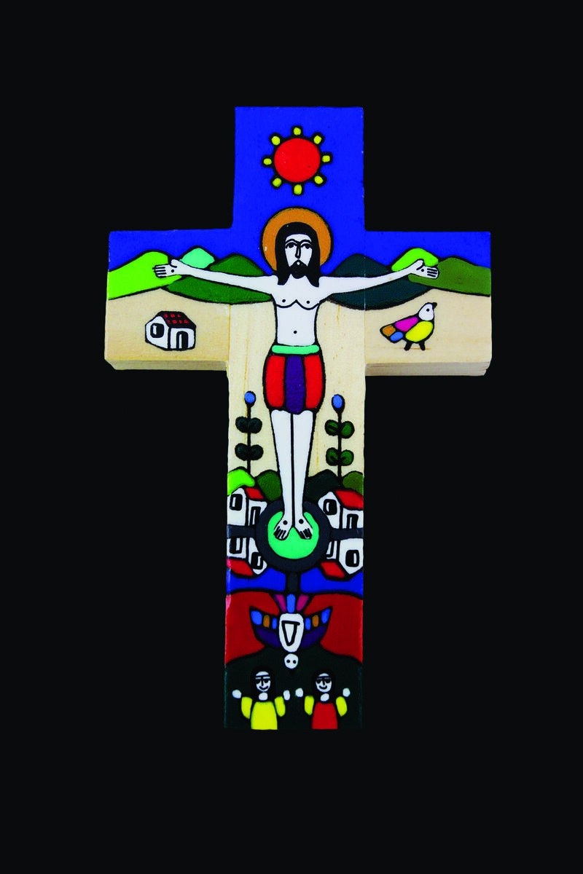

How can I listen to Jesus this week?
Gather
Notes:
Photo credit: CAFOD

Slide 2
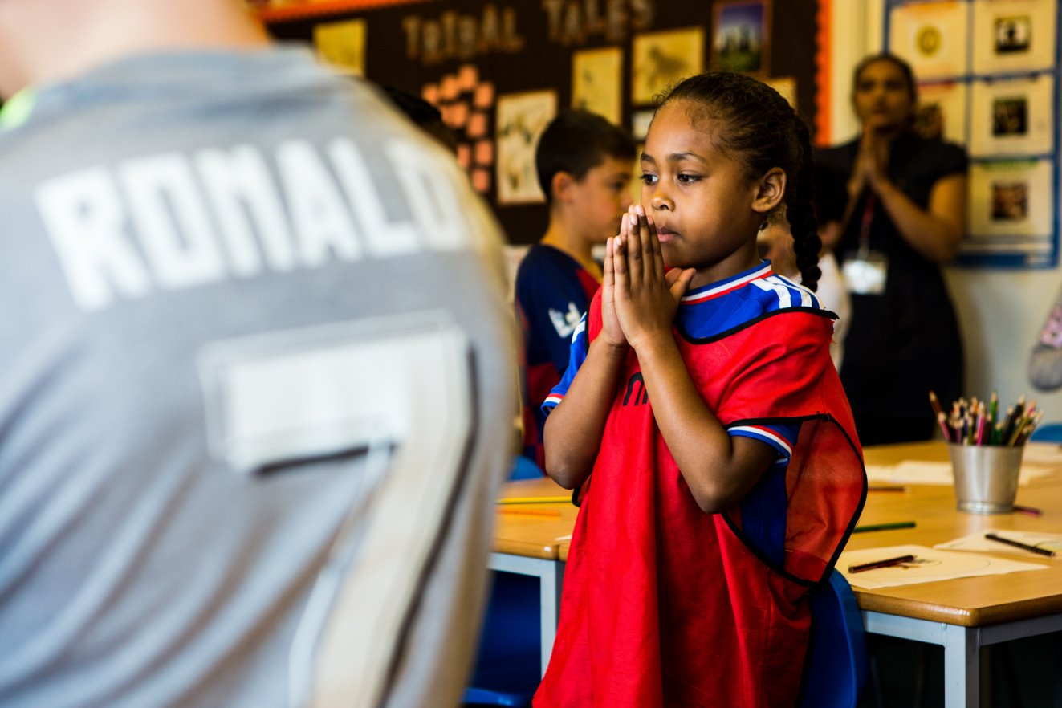
God of all, you sent your Son to show us how to live. Help us to listen to the truth and to follow Jesus’ example in our lives.
Amen.
Notes:
Children at Our Lady Queen of Heaven Primary School
Photo credit: Thom Flint

Slide 3

John 18:33-37
Pilate went back into the palace and called Jesus. “Are you the King of the Jews?” he asked him.
Jesus answered, “Does this question come from you or have others told you about me?”
Pilate replied, “Do you think I am a Jew? It was your own people and the chief priests who handed you over to me. What have you done?”
Jesus said, “My kingdom does not belong to this world; if my kingdom belonged to this world, my followers would fight to keep me from being handed over to the Jewish authorities. No, my kingdom does not belong here!”
So Pilate asked him, “Are you a king, then?”
Jesus answered, “You say that I am a king. I was born and came into the world for this one purpose, to speak about the truth. Whoever belongs to the truth listens to me.”
Word

Slide 4
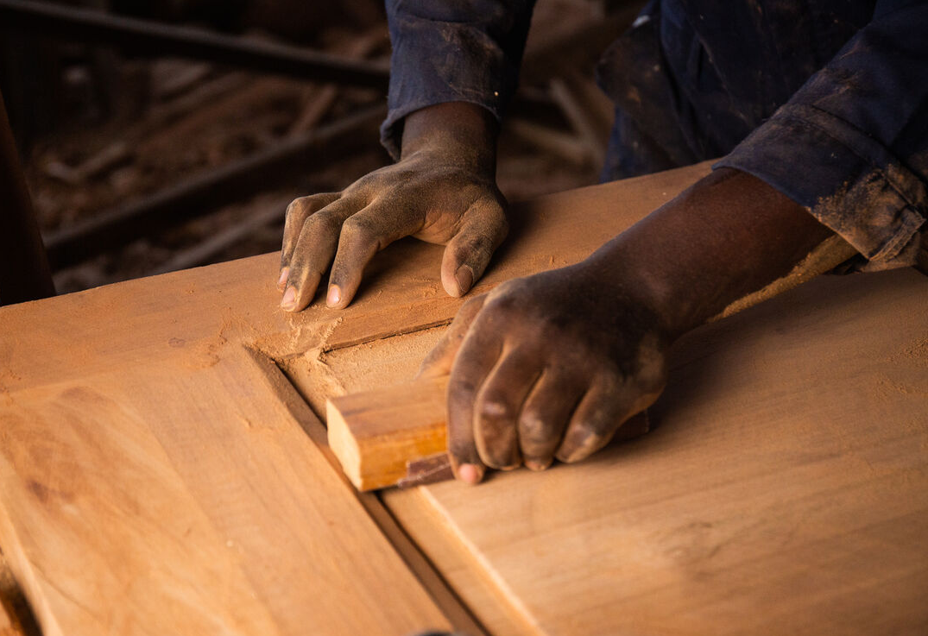

What do you remember from the Gospel reading?
Pilate asks Jesus if he is king of the Jews. Jesus answers that his kingdom is not of this world. What do you think he means?
Jesus’ kingdom isn’t on earth. We can’t see it. Jesus doesn’t wear a crown or have lots of riches. He doesn’t live in a palace with lots of servants. Jesus was born in a stable and mostly lived a normal life in a carpenter’s family.
Respond
Notes:
Daniel, DRC
Photo credit: Thom Flint

Slide 5

We cannot see his kingdom and he doesn’t behave like a normal king. And yet, Jesus is a very special king, because he is the Son of God.
Jesus shows us that you do not have to be rich or powerful to be important. He shows us that what is more important is how you treat others.
What we do and say is much more important than whether we are rich or poor, or where we come from.
Notes:
Photo credit: Louis Hansel on Unsplash

Slide 6

Jesus shows us how to welcome strangers and to be kind to people that others don’t like. He shows us how to stand up for what is right and to love one another.
Pilate is confused. He couldn’t understand what Jesus was saying. So he asks Jesus again if he is a king.
Jesus replies that he was born to come into the world and share the truth with all people.
Notes:
Photo credit: Stock image

Slide 7
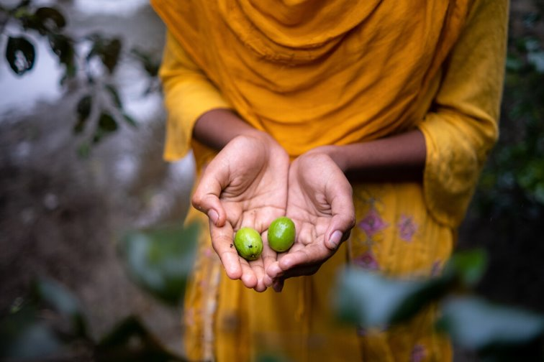
What do you think the truth that Jesus came to share is?
Jesus is the Son of God. He came to share the truth of God’s love for all people with us. He came to show us how to live, to teach us to help others, to love our neighbours and to share with them.
And to pay more attention to what people do and say, than where they come from or what they look like.
Notes:
Photo credit: Dristy, Bangladesh
Amit Rudro

Slide 8

Jesus says that all those who are on the side of truth will listen to him. Can you think of all the different people you listen to in a week? And what else do you listen to?
We listen to our teachers in school. We listen to our parents and carers. We listen to our friends. We listen to music and to the sound of the wind or the rain.
Notes:
Photo credit: Stock image

Slide 9
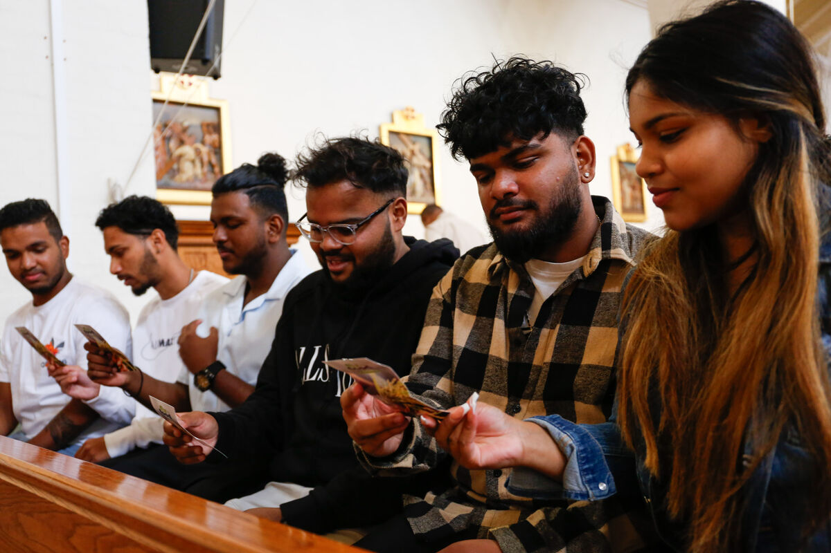
But how do we listen to Jesus and what he wants to tell us about?
We can listen to Jesus by hearing the Gospel and thinking about what Jesus is showing us in these stories. Also we can listen to Jesus when we take time to sit still and be quiet and when we pray.
Notes:
Photo credit: Hounslow parish event
Ben White

Slide 10

Sometimes it is easy to listen. Sometimes it is hard. We might not want to hear what the person is saying to us and so we do not listen properly.
This week, let’s try really hard to listen carefully to everyone. And most importantly, let’s try really hard to listen to Jesus, a very different kind of king, and to the truth that God loves us all.
Notes:
Photo credit: Stock image

Slide 11

Let us pray…

Slide 12

We pray for world leaders: that they may really listen to their people and follow Jesus’ example of love and help for all who are in need. Lord, in your mercy…
We pray for all people around the world, especially those who are poor: that everyone may have the chance to speak up about what is important to them and be listened to.
Lord, in your mercy…

Slide 13

We pray for our parish, family and friends: that we may listen to others and to Jesus and do all that we can to change our lives for the better.
Lord, in your mercy…
Christ our King, help us to be like you, to listen to your truth and to see that all people are important, no matter who they are or where they come from. Amen.

Slide 14
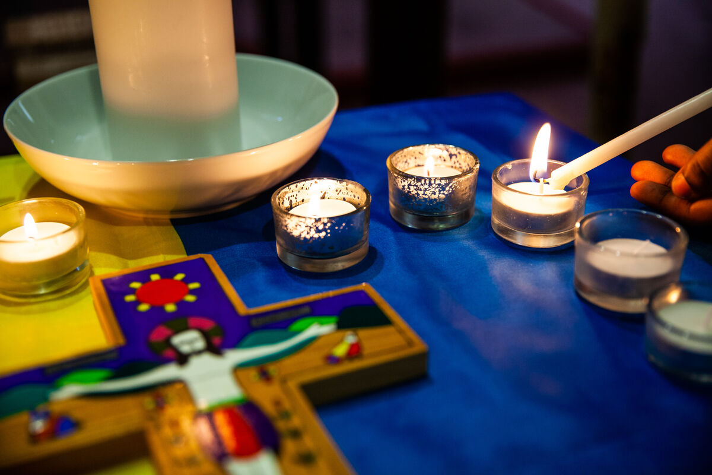

How will you show that you are listening to Jesus this week?
Send
Notes:
Photo credit: All Saints School, Sheffield
Thom Flint

Slide 15
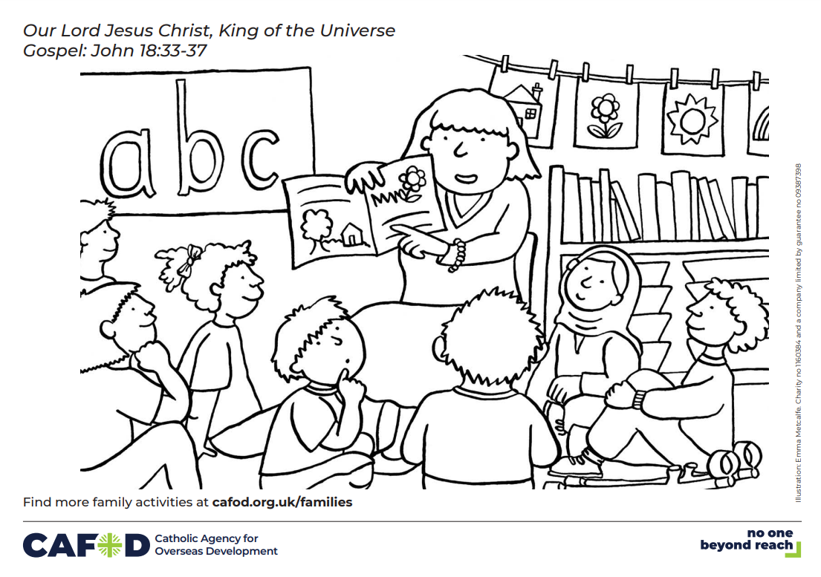
Activity suggestions
Encourage the children to colour in the accompanying illustration of some children listening to their teacher and to draw or write on the back how they will listen to Jesus and to others in the coming week.
Invite the children to sit quietly for a few minutes. When the time is up ask them to share all the things that they heard during that time. Or you could play the children different sounds and ask them to identify them.
Remind the children to share all that they have heard and thought about today with the people at home and to listen carefully to others all week. Remind them to try to listen to Jesus every day.
Encourage the children to think about how they can show kindness and generosity to their brothers and sisters around the world, and show that they are listening to what Jesus taught.
Putting CST into practice (cafod.org.uk)

Slide 16


Advent is coming!
Join our next national assembly! Come together with schools across England and Wales to mark the start of Advent.
Watch live on Thursday 28 November at 9.30am or at any time during Advent.
CAFOD's Advent calendar will help us prepare together to be the best people we can be to celebrate the birth of Jesus – reflections, activities, prayers and actions for each day of Advent. Download it here
This Advent, we are asking schools across England and Wales to consider fundraising for a £100 CAFOD Christmas stocking, full of life-changing gifts. Find out more about the stocking and a poster to support your fundraising. Explore World Gifts
Why not use CAFOD Advent prayers cards as part of your Advent preparation? Order them for free here

Slide 17
Notes:
Illustration: Emma Metcalfe

Slide 18


