Slide 1
General election
workshop for KS2

Slide 3
Clean water
Enough food
Safe home
School
Doctor or nurse
Live in peace

Slide 4
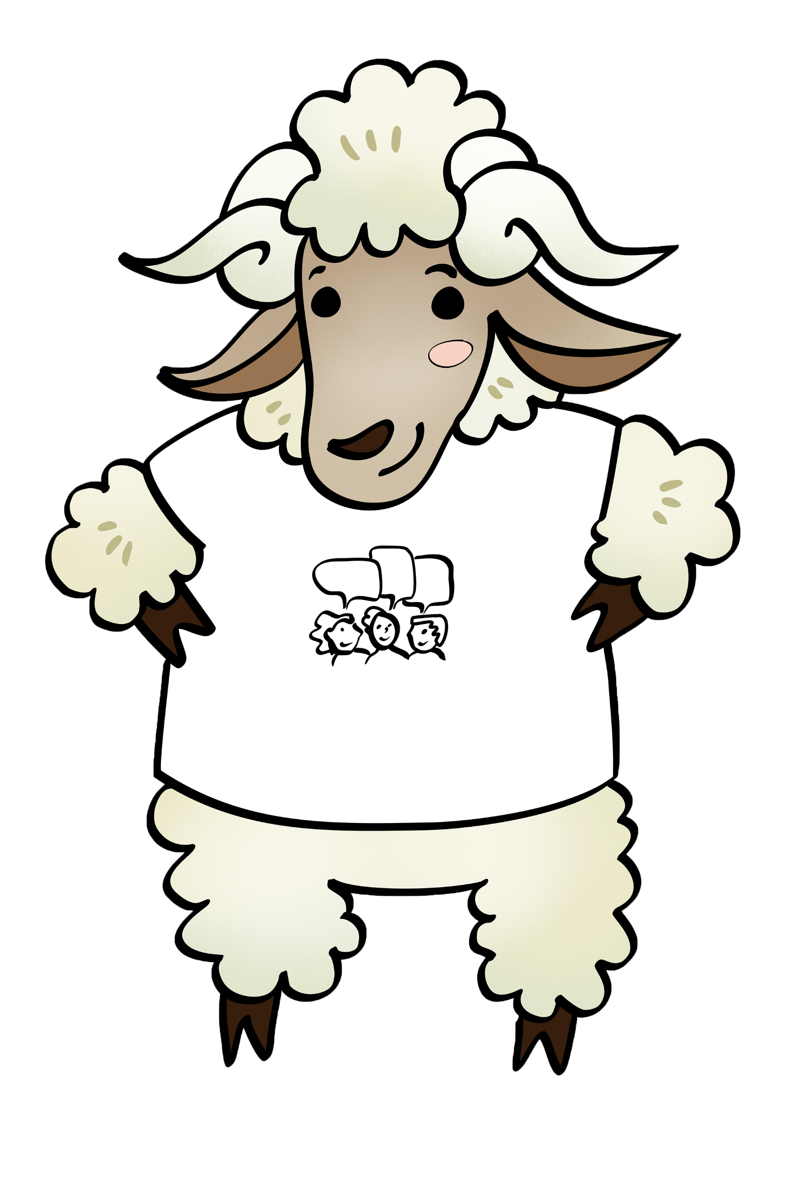
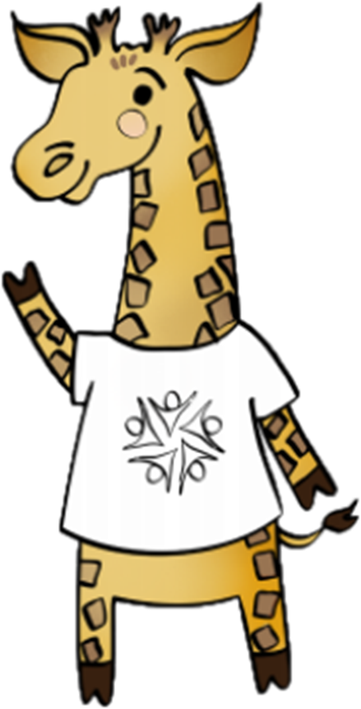
The Common Good
Subsidiarity
Thinking of everyone
Everyone should have a say

Slide 5
Is this fair?

Slide 6
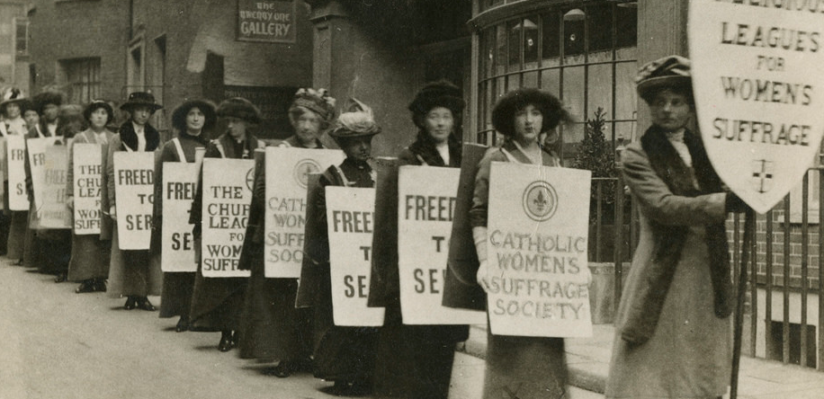
Notes:
Story 1 (Shristi/Luc):
150 years ago in the UK, whether you were a man or woman decided whether you got to have a say or not. But groups of people worked together to make that change. Does anyone know what any of these groups of people were called? Suffragettes, suffragists, Emmeline Pankhurst etc. They spoke out for what they believed in and made change happen.

Slide 7
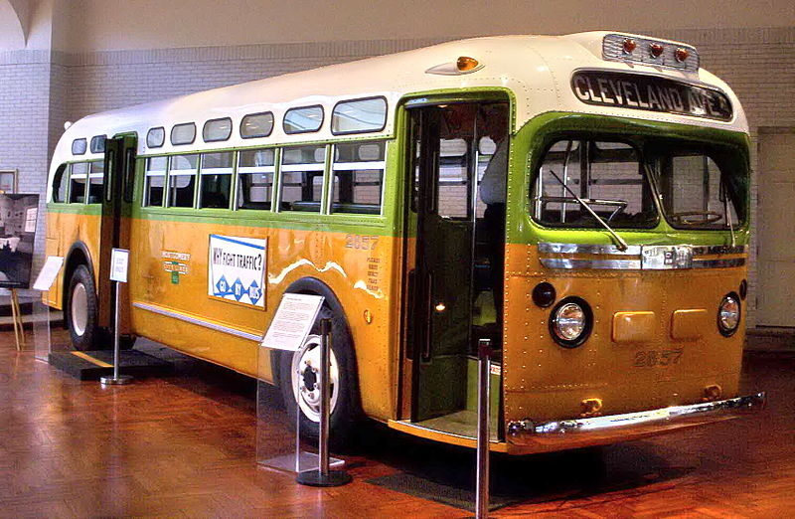
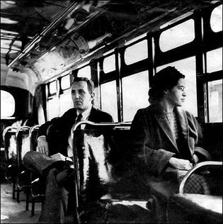
Notes:
Story 2 (Sid/Luc)
In parts of the USA 80 years ago, where you sat on a bus depended on the colour of your skin. Does anyone know this woman’s name? She was called Rosa Parks and she spoke out for what she believed in and made change happen.

Slide 8
What is a general election?

Slide 9
Democracy
Demos Kratia
Power of the people

Slide 10
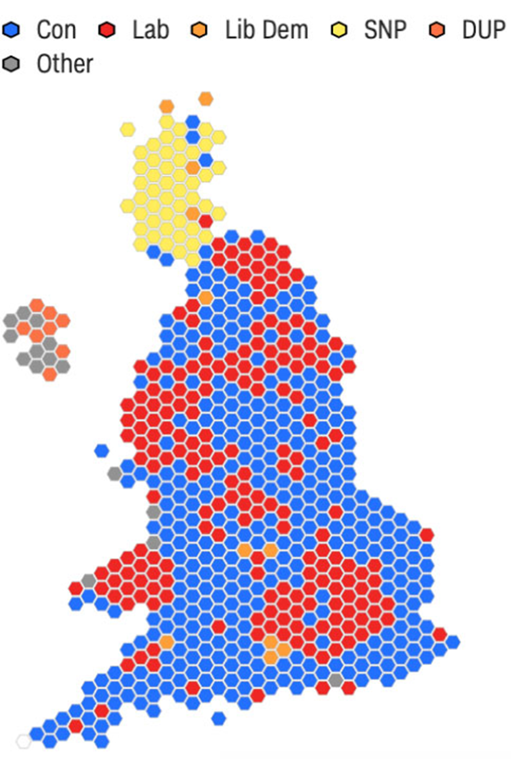
Constituencies

Slide 11
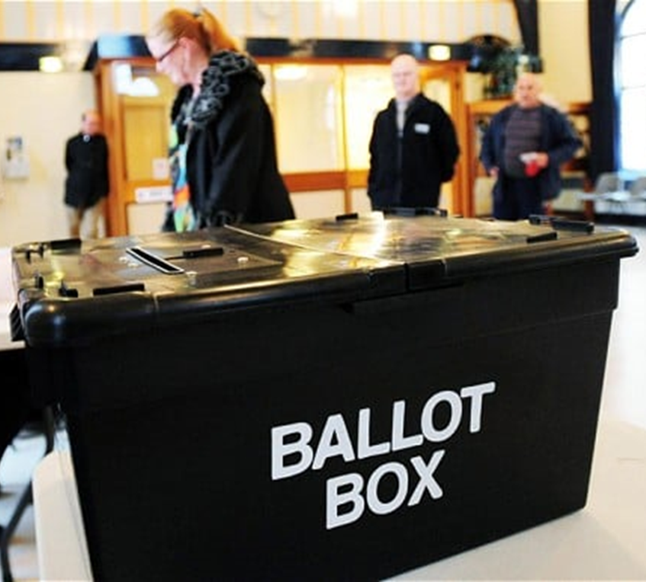
Election day

Slide 12
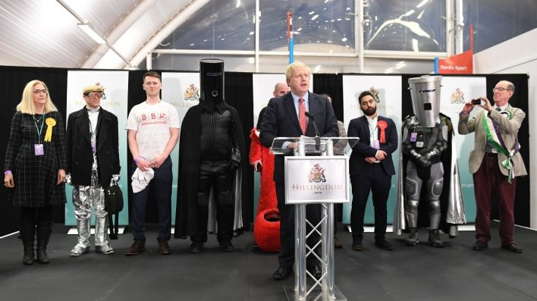
Political parties

Slide 13
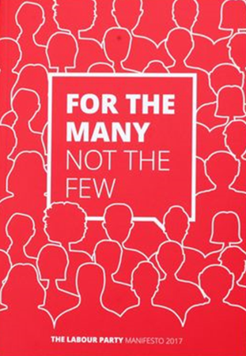
Party manifestoes

Slide 14
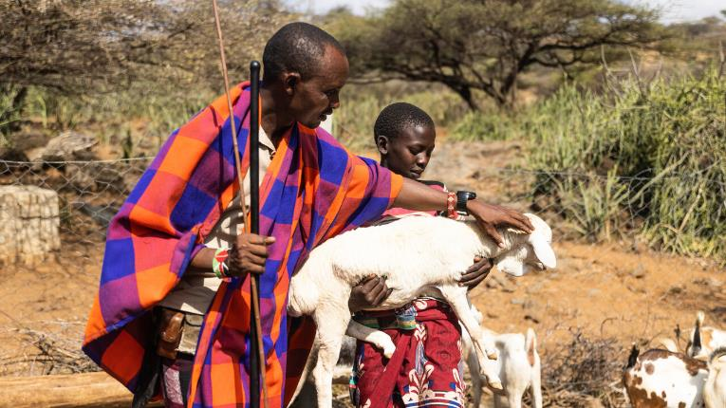
CAFOD ‘manifesto’
1. Tackle poverty
Ochuroi and his family face problems with drought and people claiming their land.

Slide 15
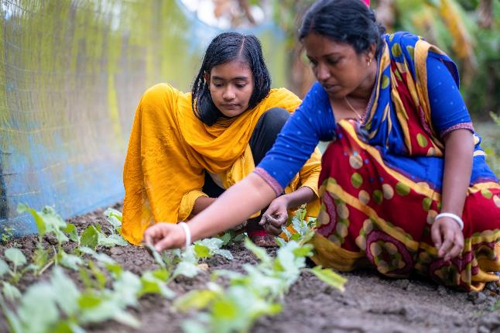
CAFOD ‘manifesto’
2. Stop climate change
Dristy and Rupali have had to change their garden to combat climate change.

Slide 16
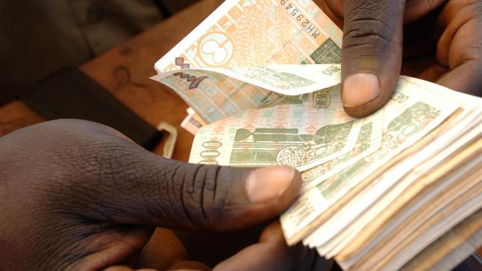
CAFOD ‘manifesto’
3. Cancel debt
Countries around the world are struggling to give people important things like schools and hospitals.

Slide 17
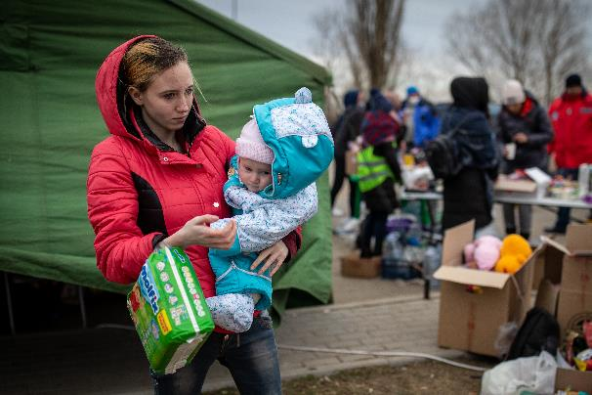
CAFOD ‘manifesto’
4. Help refugees
The Caritas family have supported families who have had to leave their homes in Ukraine because of the conflict.

Slide 19
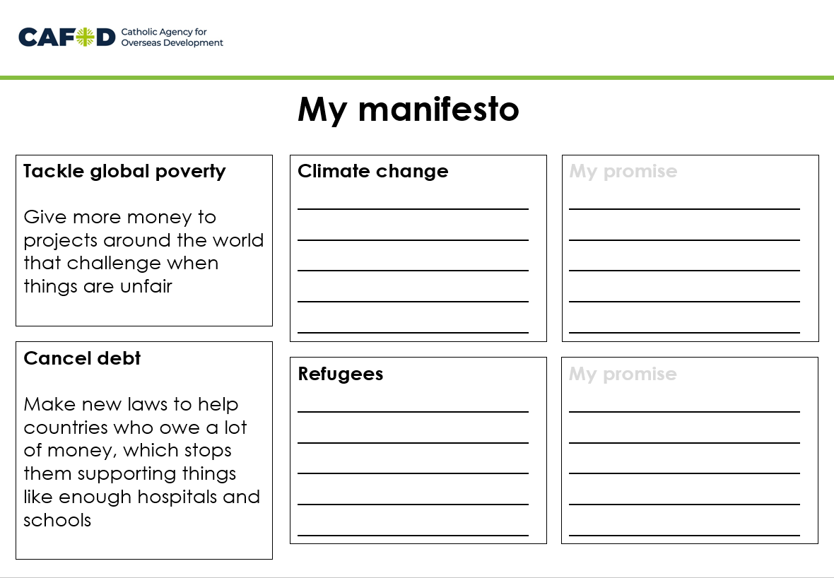
Write your own manifesto!
What do you want to change?
How would you do it?

Slide 20
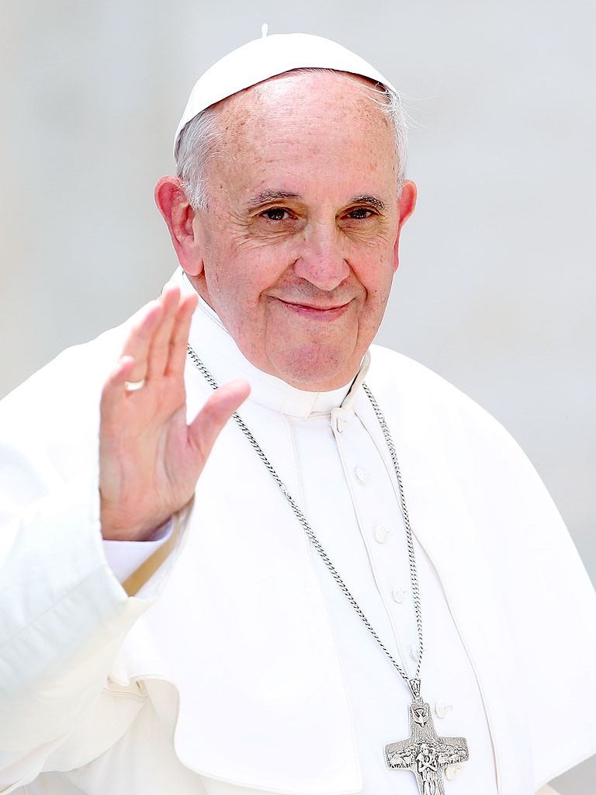
“We all need each other, none of us is an island. And we can only build the future by everyone standing together”
Pope Francis: A message for our earth
Notes:
Pope Francis
Quote from ‘The Future You’ TED talk

Slide 21
Loving God,
Make us wise to know when things aren’t right,
Make us brave to speak out when things are unfair,
Make us open to our whole global family,
so we can work together for everyone to have what they need
to live life to the full.
Amen

