Slide 1
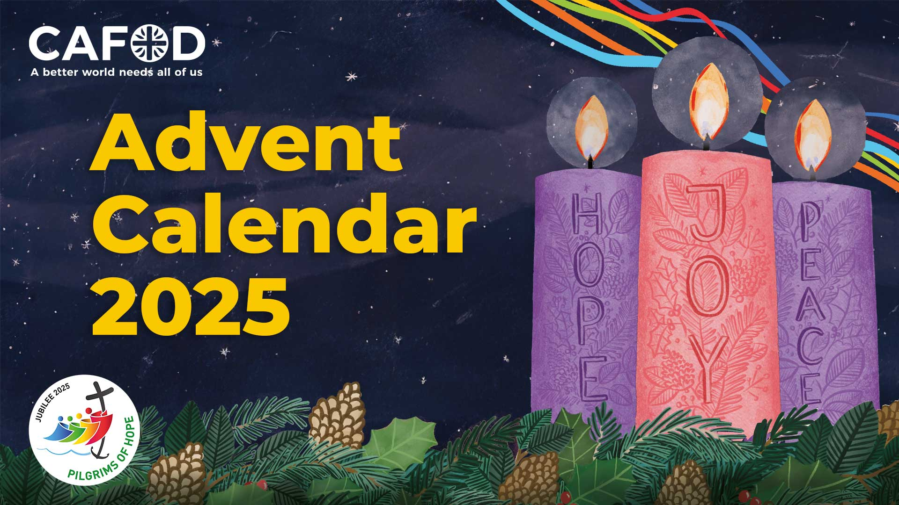


Slide 2

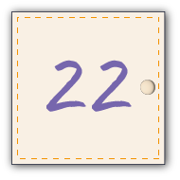
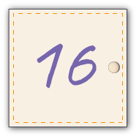
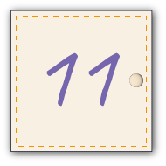

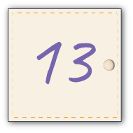


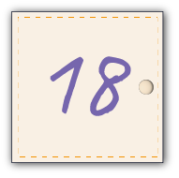

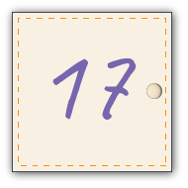


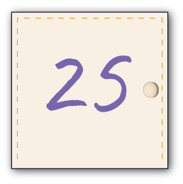


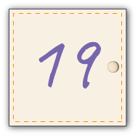

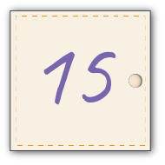
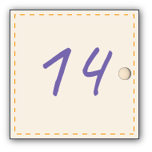
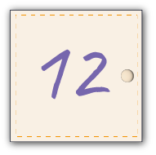
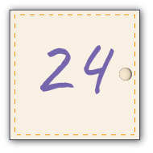

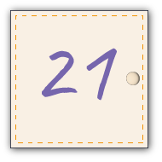




Slide 3


Using the CAFOD Advent calendar
Advent means 'coming'. It is a special time when we get ready for the coming of Jesus at Christmas.
We'll hear a lot about 'preparing' in the next few weeks. CAFOD's Advent calendar will help us prepare together to be the best people we can be to celebrate the birth of Jesus.
There are two slides for each day of Advent which include:
a reflection on the day's scripture – how does it apply to our own lives at home and at school?
an activity – watch a film, play a game, get creative– all inspired by our global family!
a prayer – for those in need, for our world and for ourselves
an action – why not fundraise for a World Gift to help our brothers and sisters experiencing poverty around the world?
More resources
The Jubilee for Schools Celebration Day on 21 November was a vibrant celebration of a year full of faith, learning and transformative action. Show the film this Advent to celebrate and look ahead with renewed hope as you live out your Jubilee Pledge to build a better world.
This Advent we are asking schools in England and Wales to consider fundraising for a £100 CAFOD Christmas stocking full of life-changing gifts. Find out more about the stocking and order a free fundraising pack
    Why not use CAFOD's Advent prayer cards as part of your preparation? Download and print the cards
    As we look forward to welcoming Jesus at Christmas, let's start our Advent journey...

Slide 4





“May there be peace inside your walls and safety in your palaces.” Psalm 122: 7
What inspiring words to start our Advent journey with – emphasising how important peace is in our lives. Home is where we should feel safe, where we play, eat, are with loved ones. Sadly, for many children, it isn't like this. Wouldn’t it be wonderful to live in a world without war?
How can we do our best to live in peace with others at home and at school?
This Advent, join schools around England and Wales in fundraising for a World Gifts Christmas stocking as a way of living out your Jubilee Pledge.
Can your school raise £100 to support refugee families?
Find out what gifts are in the World Gifts Christmas Stocking!

Slide 5




    As we prepare for the birth of Jesus at Advent, we ask that you bring comfort and hope to our brothers and sisters around the world who long to live in peace.
    Lord, in your mercy,
    RESPOND: Hear our Prayer
    World Gifts: Order a World Gifts totaliser poster to help you fundraise for a World Gifts Christmas stocking!

Slide 6

At that time Jesus was filled with joy by the Holy Spirit and said, “Father, Lord of heaven and earth! I thank you because you have shown to the unlearned what you have hidden from the wise and learned. Yes, Father, this was how you were pleased to have it happen. Luke 10:21
Sometimes as children, it can feel difficult to know how to help with the problems facing the world. But in this reading, Jesus emphasises how important children are and the difference they can make.
How can we try and make a difference in our world today?
Join with hundreds of school children across England and Wales to take part in Jubilee Celebration Day. Watch the film to celebrate all you have achieved, and to look ahead with hope.

Slide 7
    In this year of Jubilee, help us remember that children can bring hope to the world by being kind, praying for our global family and by raising money for CAFOD.
    Lord, in your mercy,
    RESPOND: Hear our Prayer
    World Gifts: Remembering that a better world needs all of us, could you raise money as a class or as a school for a Christmas stocking or other CAFOD World Gift to help children living in poverty?
    Discover all the CAFOD World Gifts for schools!

Slide 8

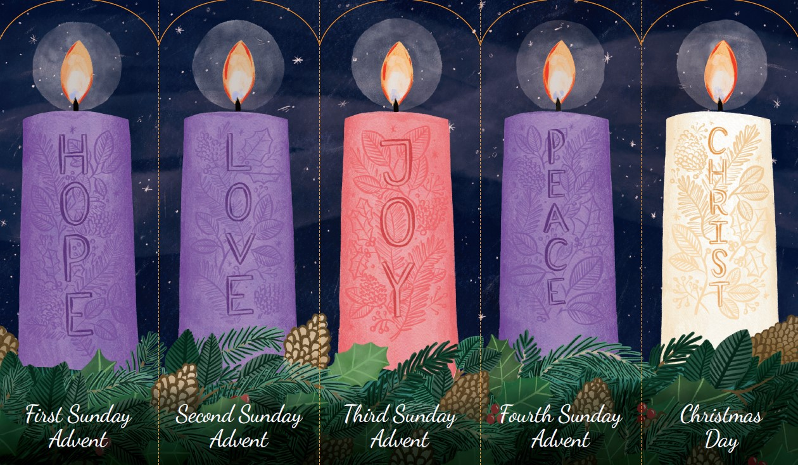
Jesus called his disciples to him and said, “I feel sorry for these people, because they have been with me for three days and now have nothing to eat. I don't want to send them away without feeding them, for they might faint on their way home." Matthew 15:32
Jesus takes pity on the crowd, worrying that they are hungry. The rest of the reading tells how a young boy brings five loaves and two fishes to Jesus which he shares out among 5,000 people.
How can we best share what we have with others?
    Share our popular Advent prayer cards to help prepare for the coming of Jesus at Christmas. There's a prayer for each week of Advent.
    Download and print your Advent prayer cards

Slide 9
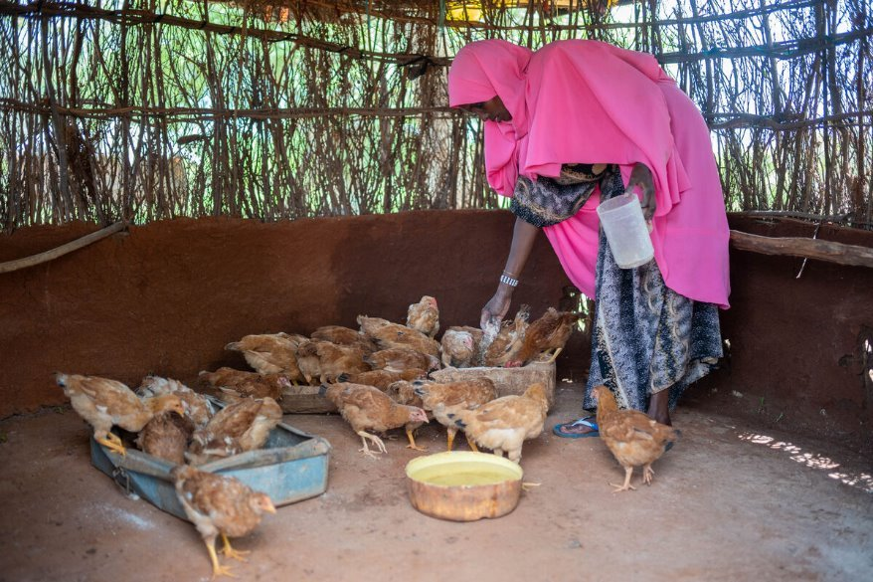
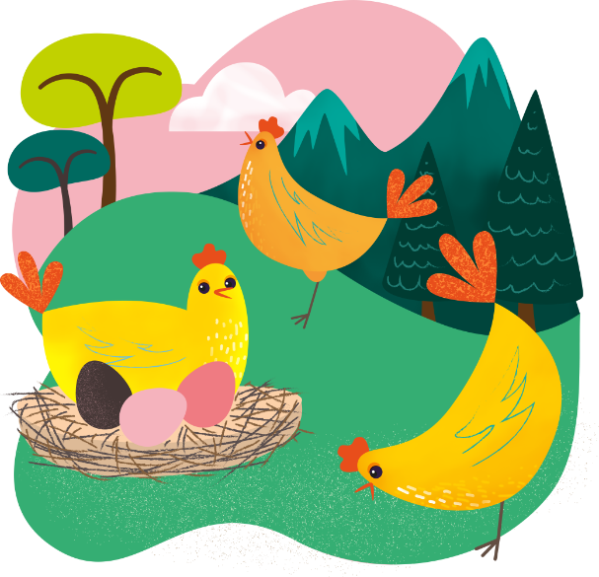
    We pray for those around the world who do not have enough to eat. Just as the young boy helped Jesus to share the loaves and fishes, let us do what we can to help those who are hungry.
    Lord, in your mercy,
    RESPOND: Hear our Prayer
    World Gifts: Severe drought meant Chirri's family struggled to make a living. Now they eat the eggs chirpy chickens lay! They can sell the extras to buy food and things they need for a happy life.
    Find out about the Chirpy chickens CAFOD World Gift
Notes:
Khera and her chickens, Northern Kenya
Photo credit: Louise Norton

Slide 10

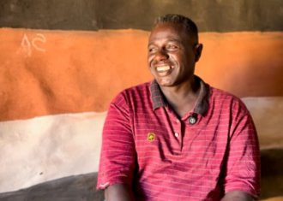
“Not everyone who calls me ‘Lord, Lord’ will enter the Kingdom of heaven, but only those who do what my Father in heaven wants them to do.” Matthew 7:21
Have you heard of the phrase: 'actions speak louder than words'? What do you think it means? It means that what we actually do is more important than just saying we are going to do something.
In this year of Jubilee, how can we be signs of hope in our world, particularly during Advent as we prepare for the birth of Jesus?
Abbiott is a climate change officer where he grew up in Ethiopia. Changing weather has affected his people. Not enough rain meant crops and cattle died and there was not enough clean water to drink. Abbiott wanted to make a difference. He studied climate change to help his community; to build a better world.
Watch this film about Abbiott
Notes:
Abbiott, Southern Ethiopia
Photo credit: Louise Norton

Slide 11
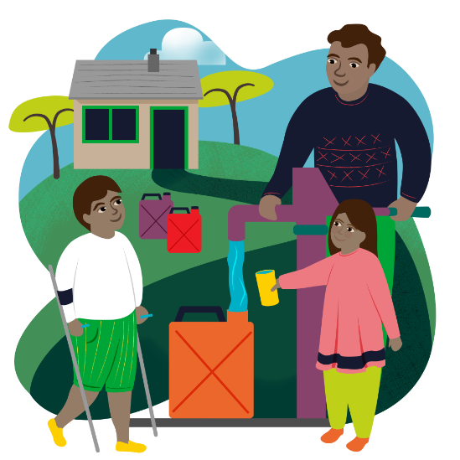
    As we prepare for the birth of Jesus, we pray to be kind, helpful and that our actions show others that a better world needs all of us.
    Lord, in your mercy,
    RESPOND: Hear our Prayer
    World Gifts: Just as Abbiott has helped families in his community to have clean water to drink, so can we!
    Find out about the Water for a family CAFOD World Gift

Slide 12


“Trust in the Lord. Have faith, do not despair. Trust in the Lord.” Psalm 27:14
‘Faith’ and 'Hope’ are important words in this year of Jubilee, where we have been called to be Pilgrims of Hope in the world by putting our faith into action.
As we prepare this Advent for the birth of Jesus, how can we continue to be signs of hope in this world?
    Write a message of hope to someone using CAFOD's Postcards of Hope set. What might your special message be? How can we encourage others to be hopeful?

Slide 13
    As we prepare for Advent during this Jubilee Year, help us to be Pilgrims of Hope by being kind and thoughtful, always remembering that a better world needs all of us. Lord, in your mercy,
    RESPOND: Hear our Prayer
    World Gifts: How about fundraising for a special Christmas stocking full of life-changing gifts this Advent? For £100 your class or school could provide gifts which bring hope!
    Find out more about the Christmas Stocking World Gift

Slide 14

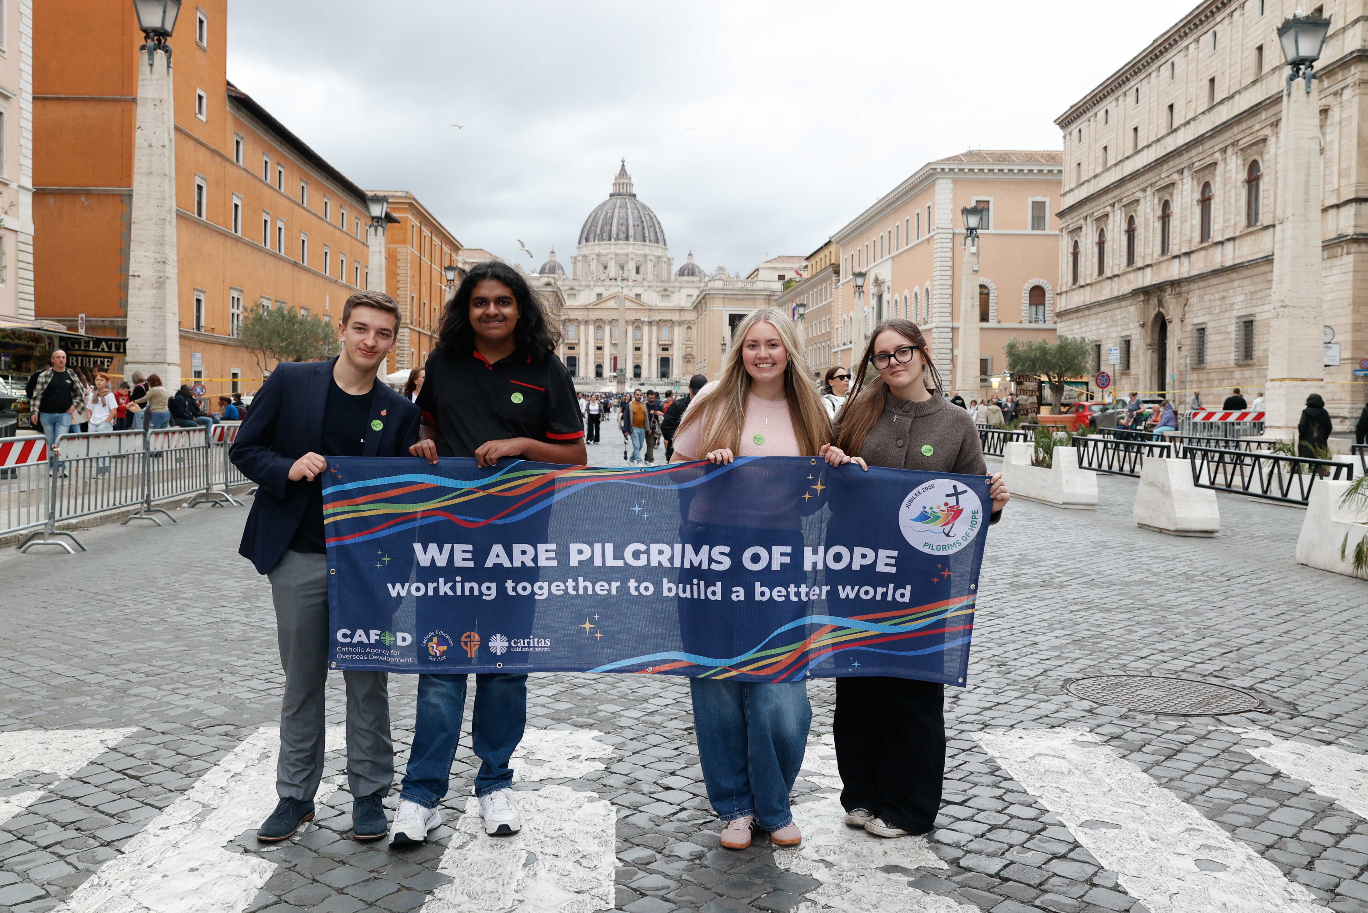
“I am the Lord's servant,” said Mary; “may it happen to me as you have said.” And the angel left her. Luke 1:38
Today is the Feast of the Immaculate Conception. Let's imagine what it must have been like for Mary when the angel asked her to be the mother of Jesus – perhaps frightening, confusing, overwhelming? Yet Mary said ‘yes’ because she trusted in God.
What are the difficulties we sometimes face that God can help us with?
Tell us about your Jubilee Pledge!
At the Jubilee for Education event at the Vatican at the end of October, schools like yours in England and Wales were recognised for their extraordinary response to the Jubilee Year! Have you added your school to the Jubilee Pledge map?
Notes:
Young people in Rome at the Jubilee of Education
Photo credit: Giuseppe Chiantera

Slide 15
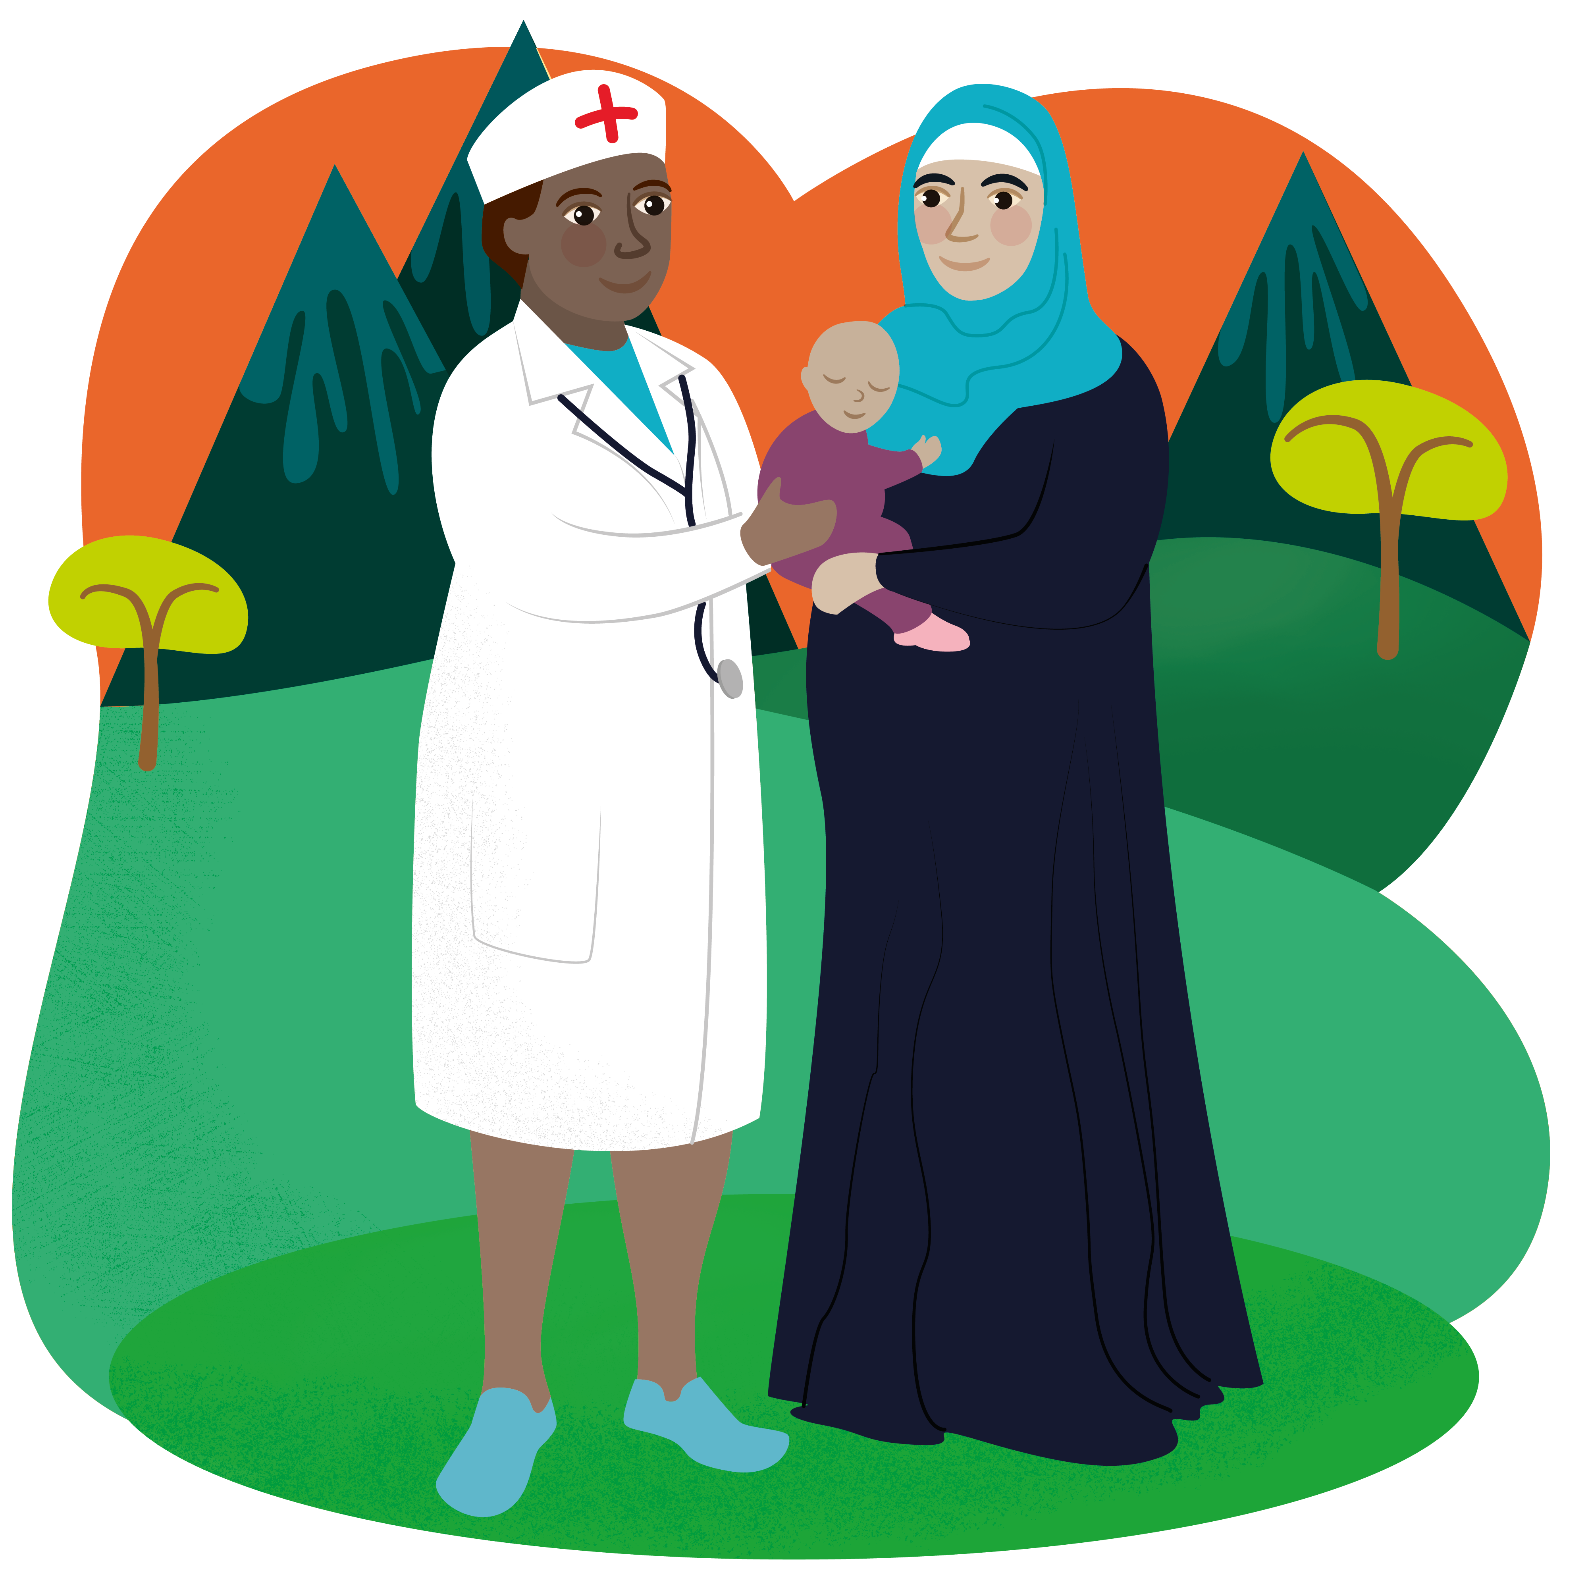
    As we prepare for the coming of Jesus at Christmas, we think of all women around the world preparing to give birth; we pray they will have their babies safely.
    Lord, in your mercy,
    RESPOND: Hear our Prayer
    World Gifts: Help pregnant mothers and newborn babies with urgent medical treatment and nutritious food to enable families to thrive!
    Find out about the Healthy Mum and Baby World Gift

Slide 16

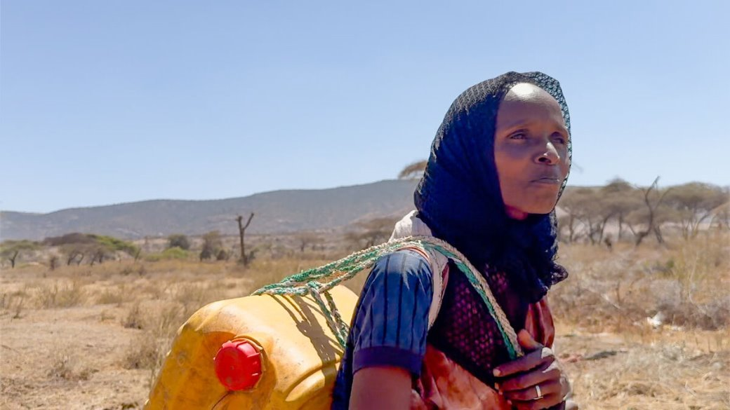
“Comfort my people” says our God. “Comfort them!” Isaiah 40:1
This reading tells us that God wants us to comfort one another when we are sad. We could be sad for all kinds of reasons – an argument with a friend, not understanding some school work, someone sick at home.
What are the ways we can comfort someone if they are feeling upset?
Adi had to leave her children alone for hours to fetch water. With CAFOD's help, a water tank was built in the community. She knows a better world needs all of us and helped with the project. It's a great comfort. "This tank is a blessing," says Adi. "We now have time with our children."
How does a better world need all of us? Play our game! Building a Brighter World
Notes:
Adi, Southern Ethiopia
Photo credit: Louise Norton

Slide 17
    We pray that people struggling around the world because of lack of food, clean water or war will find comfort in knowing that God is always with them.
    Lord, in your mercy,
    RESPOND: Hear our Prayer
    World Gifts: Wiggly worms help turn poor soil into compost! This helps farmers in remote landscapes to grow enough food to feed their families, bringing peace of mind.
    Learn more about the Wonderful worms World Gift!

Slide 18

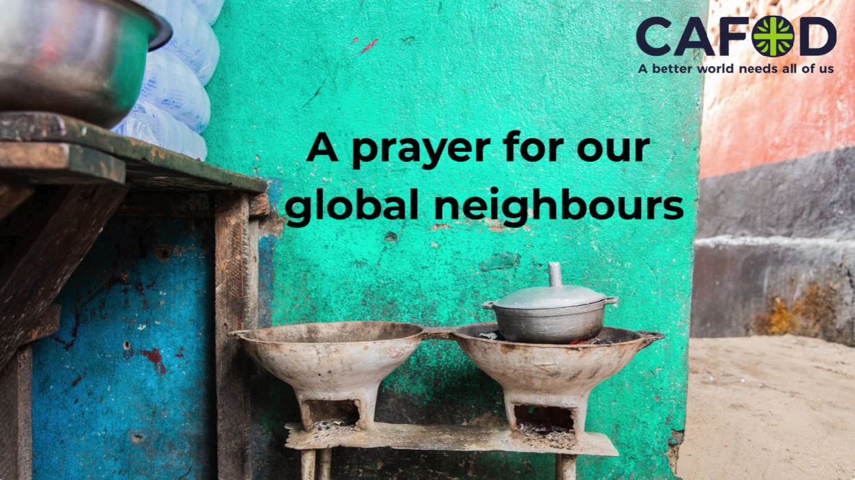
“Come to me, all of you who are tired from carrying heavy loads, and I will give you rest.” Matthew 11:28
Let's think about all those people who are working hard around the world to look after their families, but conflict, drought and not enough food makes this difficult. Today is Human Rights Day, reminding us that everyone in the world is important.
How can we show our family, friends and our global brothers and sisters that they are important?
    In this year of Jubilee, we can bring hope to others by showing that everyone is special; that everyone deserves all the things they need for a happy, healthy and fulfilled life.
    Share this prayer for our global neighbours

Slide 19
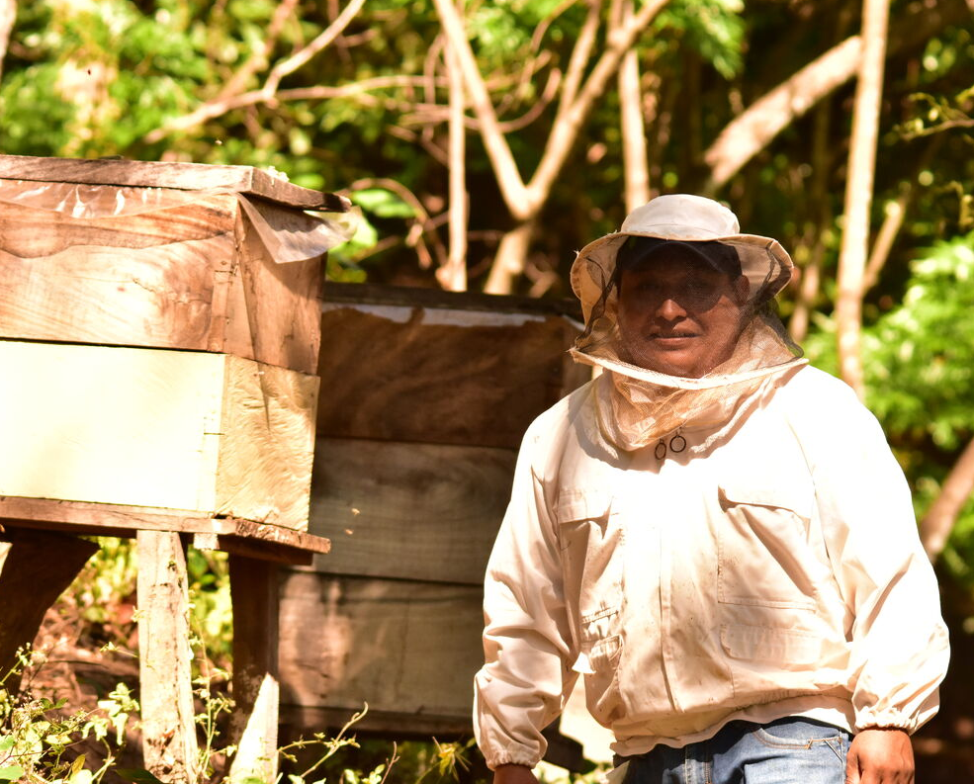

    Remembering that Jesus came to save us all, we pray the human rights of all people, whoever they are, and wherever they live, are respected.
    Lord, in your mercy,
    RESPOND: Hear our Prayer
    World Gifts: With CAFOD’s help, Manuel in El Salvador learned how to keep bees. His hard work is paying off. “We benefit from bees in many ways: their pollination, the food they provide, the health benefits. With all this, your love for bees grows even greater!”
    Learn more about the Happy queen bee World Gift
Notes:
Manuel Aguilar Ramirez, El Salvador
Photo credit: Guillermo Aleman

Slide 20

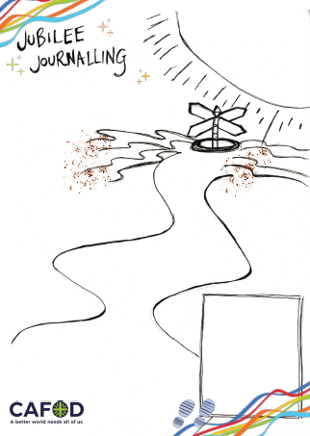
“When the poor in their need look for water, when their throats are dry with thirst, then I, the Lord, will answer their prayer; I the God of Israel, will never abandon them.” Isaiah 41:17
There are so many places in our world today where people struggle to get the safe water they need to drink, wash and keep crops and animals alive. We are used to water flowing from our taps.
How do you think we would feel if we couldn't have a glass of clean, cold water when we felt thirsty? Or have a bath or shower when we wanted one?
Use our Jubilee Journalling resource and template to reflect on your journey as a Pilgrim of Hope in this Jubilee Year. You may wish to include what you learnt about families in Ethiopia and the water tank project.
Start your Jubilee journal

Slide 21
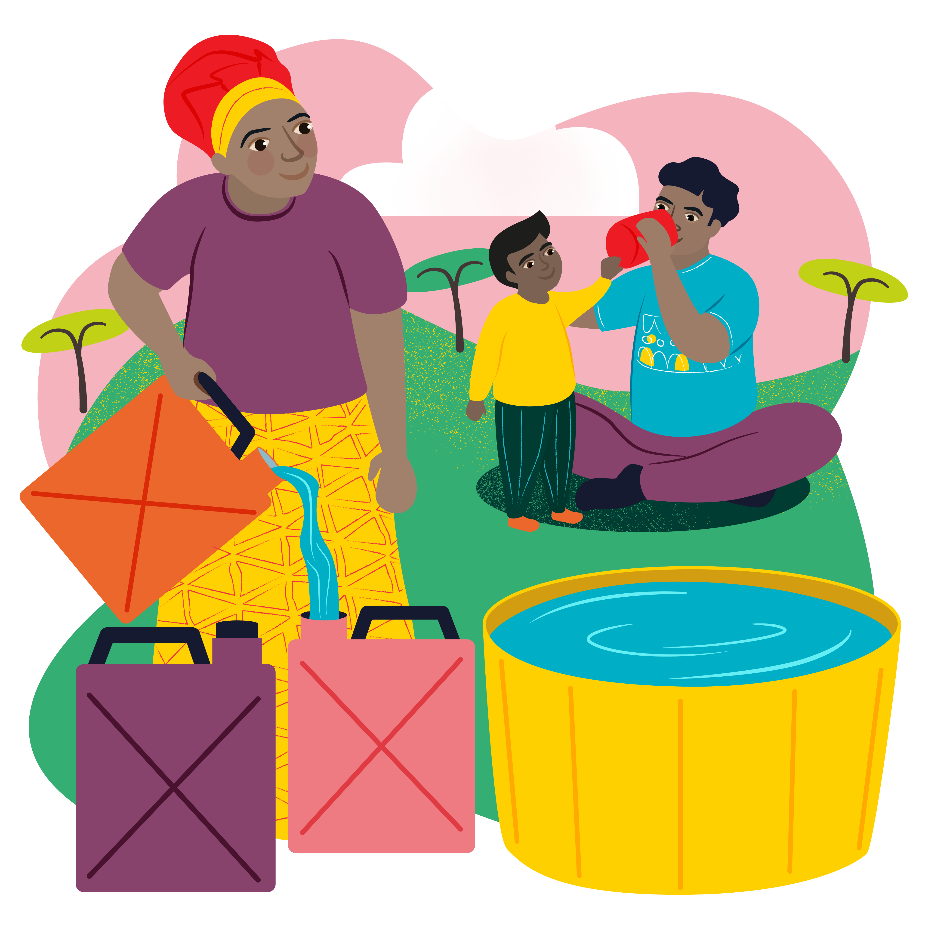
    We are thankful for our supply of water to drink, to cook and to wash and we pray for all those around the world who struggle to find clean water.
    Lord, in your mercy,
    RESPOND: Hear our Prayer
    World Gifts: Find out about community water tanks that mean that women and girls don't have to walk for hours to fetch clean water for their families.
    Find out about the Water for a family World Gift

Slide 22


When the Son of Man came, he ate and drank, and everyone said, ‘Look at this man! He is a glutton and wine drinker, a friend of tax collectors and other outcasts!’ God's wisdom, however, is shown to be true by its results.” Matthew 11:19
Jesus wonders why people are struggling to believe his message of hope because he ate, drank and spent time with ordinary, not powerful, people and those others were wary of.
What would the world think if Jesus came back today and befriended the homeless and refugees, instead of prime ministers and presidents?
Pope Francis wrote a letter to everyone, asking us to reach out to our sisters and brothers in need, whoever they are, wherever they may come from. Watch CAFOD's Fratelli Tutti film to see how we can be good global neighbours.
Watch the animation

Slide 23

    We pray for people on the margins of our communities. Let us be signs of hope in this Jubilee Year and do our best to help those who are struggling.
    Lord, in your mercy,
    RESPOND: Hear our Prayer
    World Gifts: People can struggle for all kinds of reasons, including not being well because of where they live or how they live. Let's ensure our global family get the right help.
    Find out about the life-changing health clinic World Gift

Slide 24

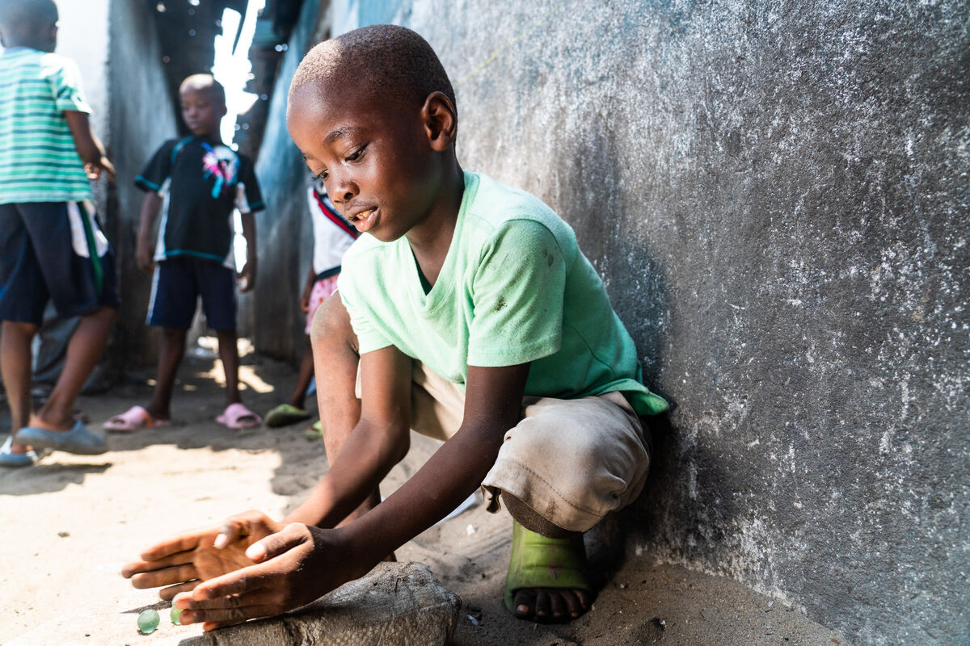
“Teach me your ways, O Lord; make them known to me.” Psalm 25:4
We all have times when we need some guidance, to know which way to go. It could be anything – having trouble with homework, not knowing how to get somewhere, worrying about a quarrel with a friend.
Isn't it wonderful to know we can always turn to God for guidance? And because a better world needs all of us, how can we be a good guide for others when they need help?
Aaron lives in Liberia. His grandfather is a fisherman. “I'd like to be a fisherman too”, says Aaron, but the fish are more difficult to find these days. With CAFOD’s help, fisherman use fishfinders which show where to go to safely catch fish to eat and sell.
Find out more about Aaron in Liberia

Slide 25
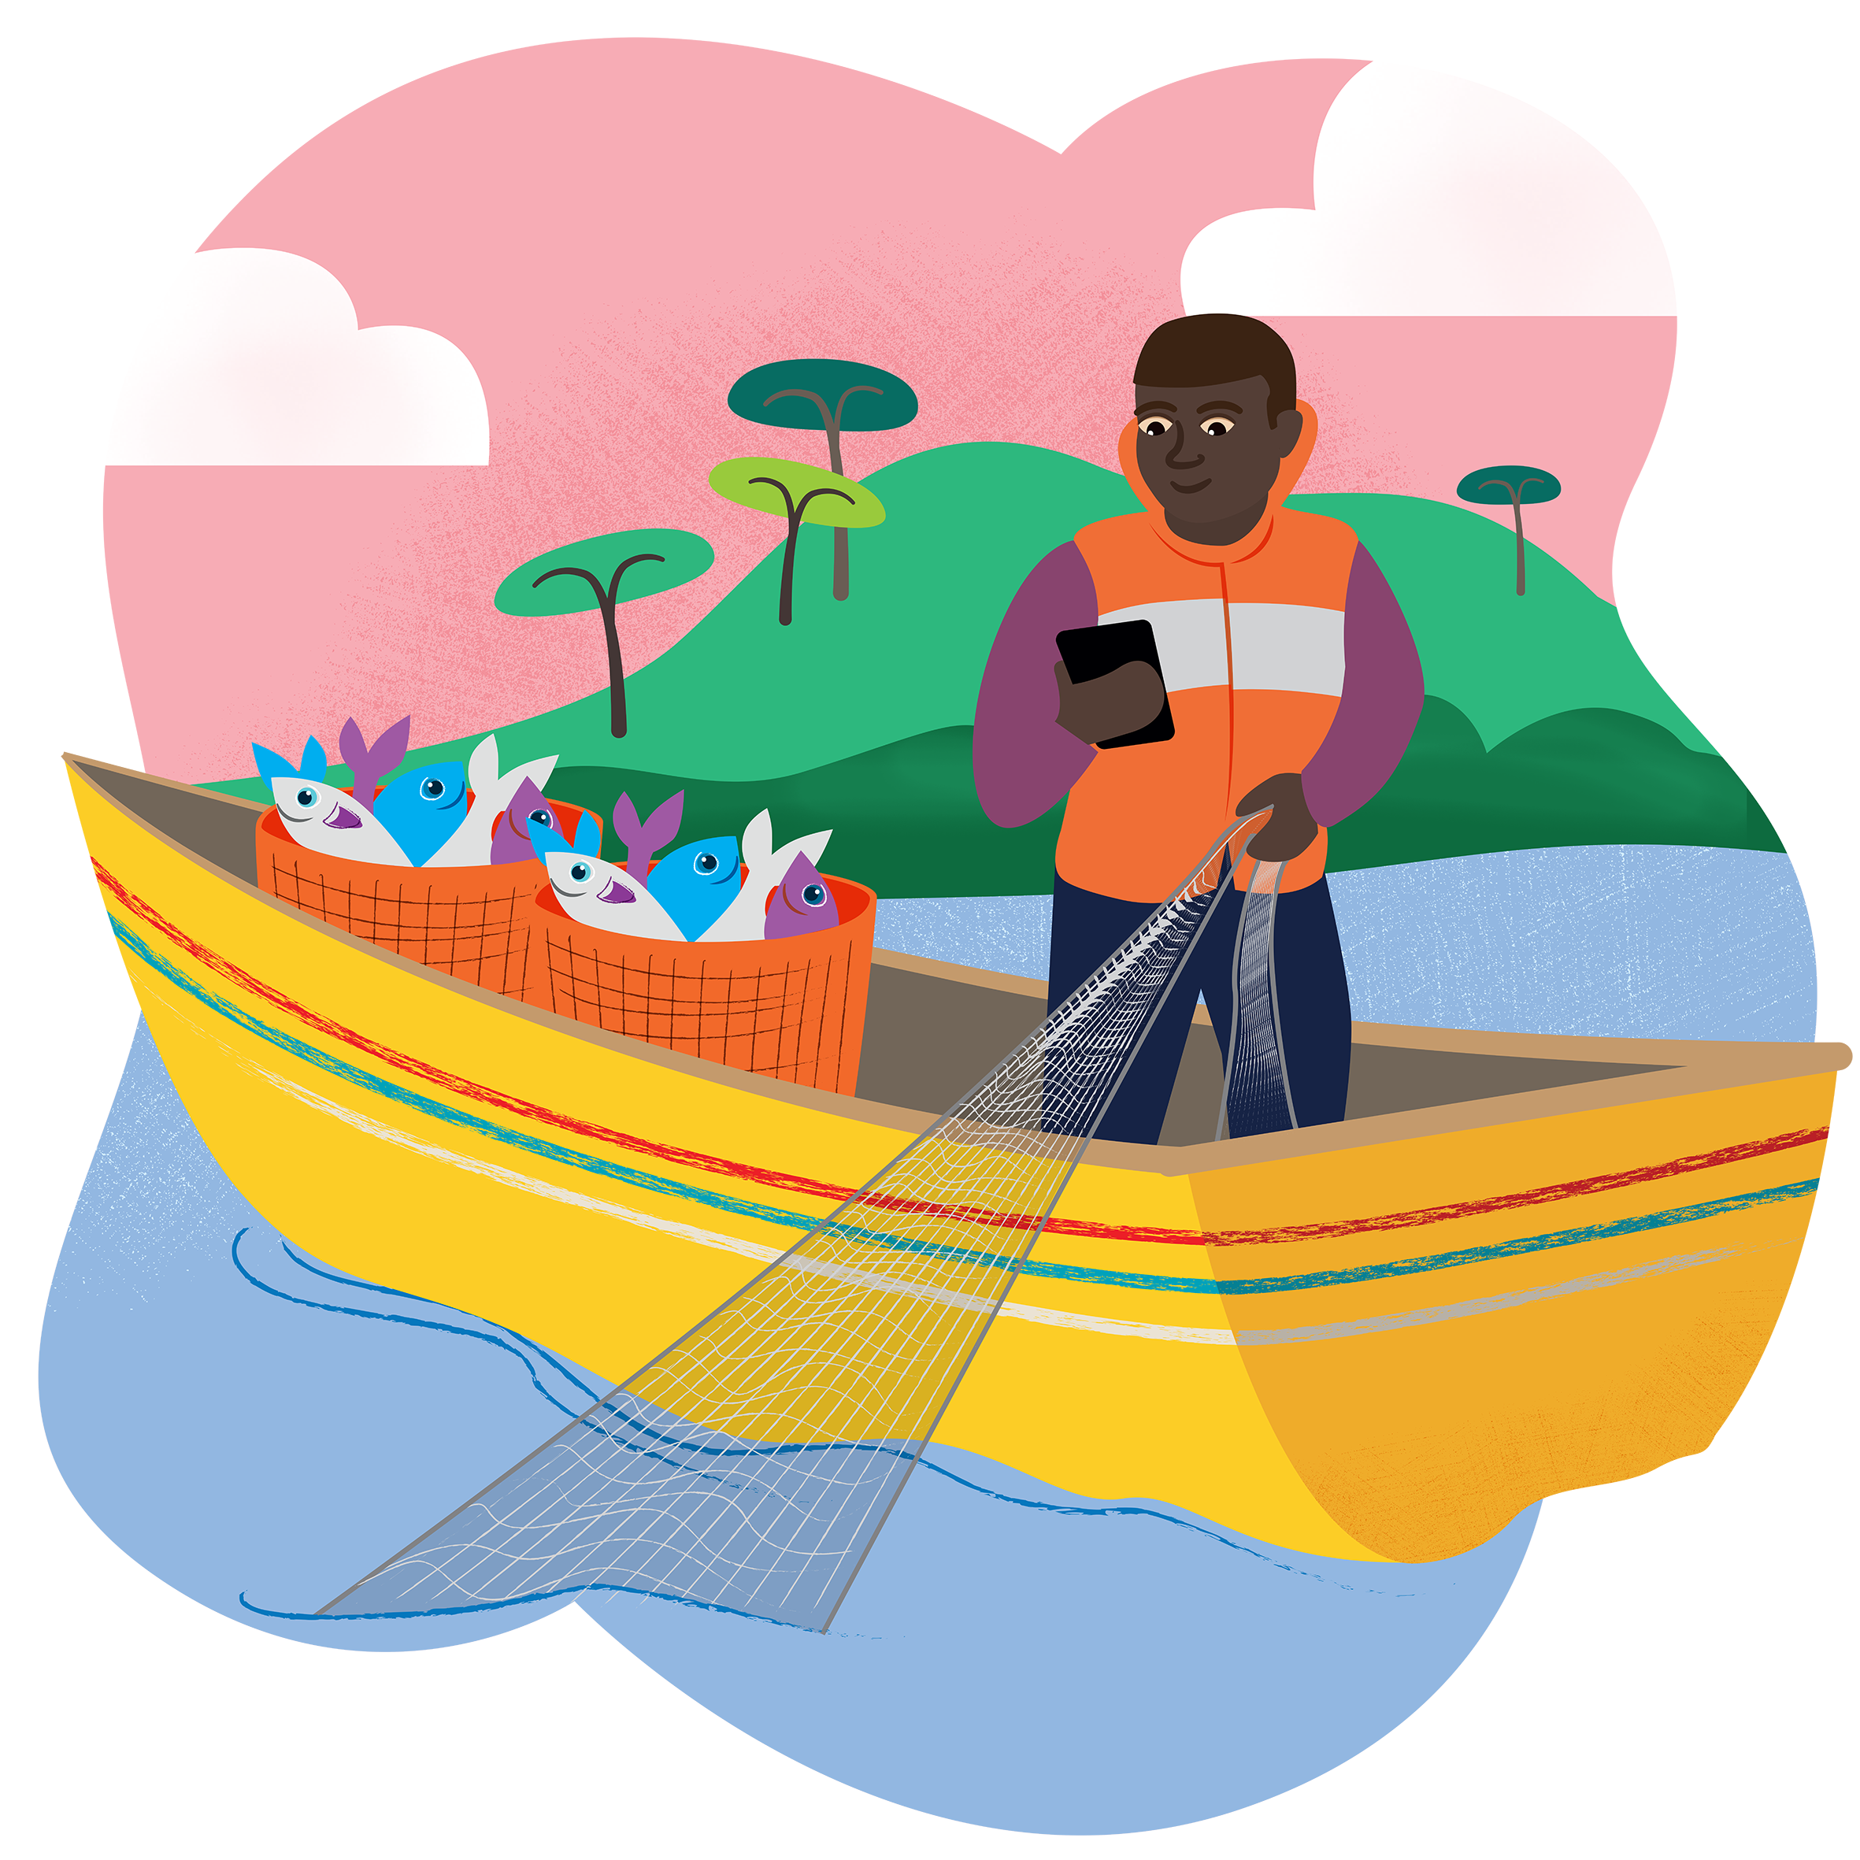
    We pray for those people around the world who do dangerous jobs just to put food on the table for their families. Please guide them and keep them safe.
    Lord, in your mercy,
    RESPOND: Hear our prayer
    World Gifts: "Our fishfinders and safety at sea training have helped us safe lives," says Liberian fisherman Tekon. The technology also guides them to the best places to catch fish so they can make a good living.
    Learn more about the Safe at sea World Gift

Slide 26

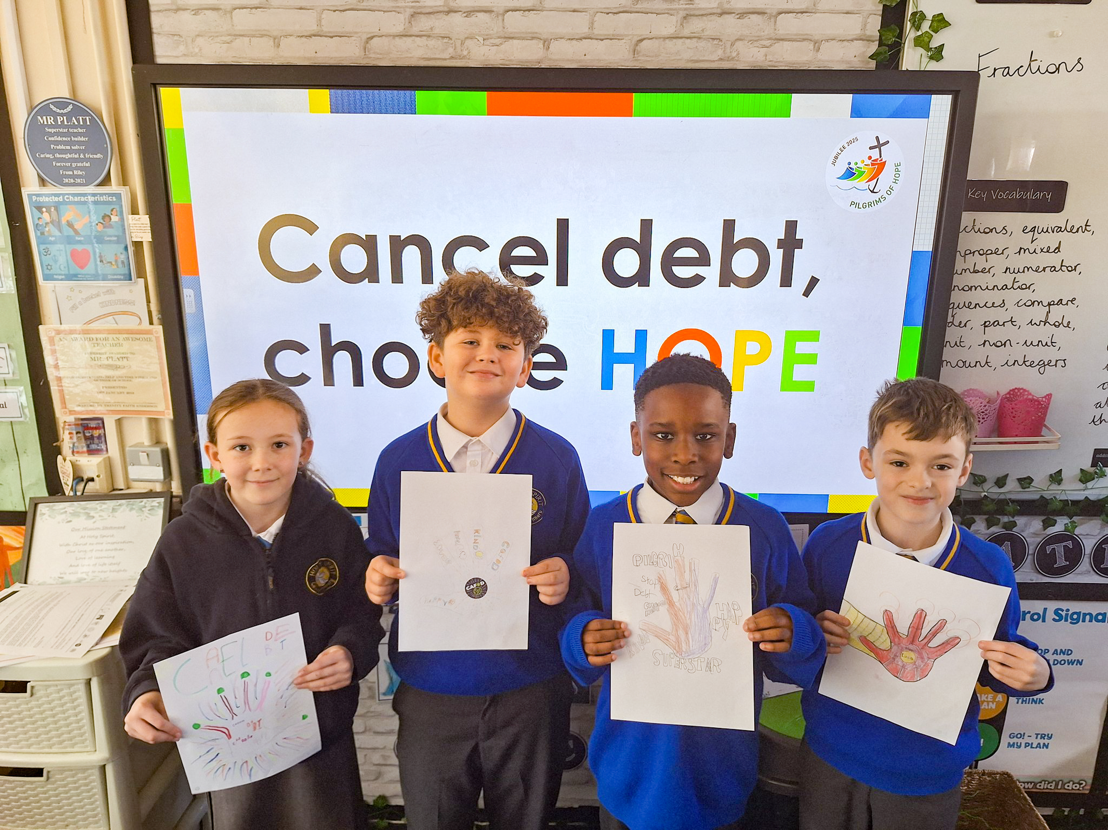
“Which of the two did what his father wanted?” Matthew 21:31
Two sons are asked to help their father. One says yes, the other no, but they both change their minds. This reading shows how important it is not just to say things that we know sound good. Words are empty if they are not backed up by action.
Like the sons in the gospel, we can also choose. Will we simply say we believe, but carry on doing just what we want? Or will we listen to God in our lives, and try to do our best to do what he asks us every day?
Children across England and Wales have joined together as part of the Jubilee Global Debt campaign Cancel Debt, Choose Hope!
Tell us you’ve taken action in the Jubilee Year!
Notes:
Children at St Ralph Sherwin Catholic Primary School taking part in the debt campaign.

Slide 27
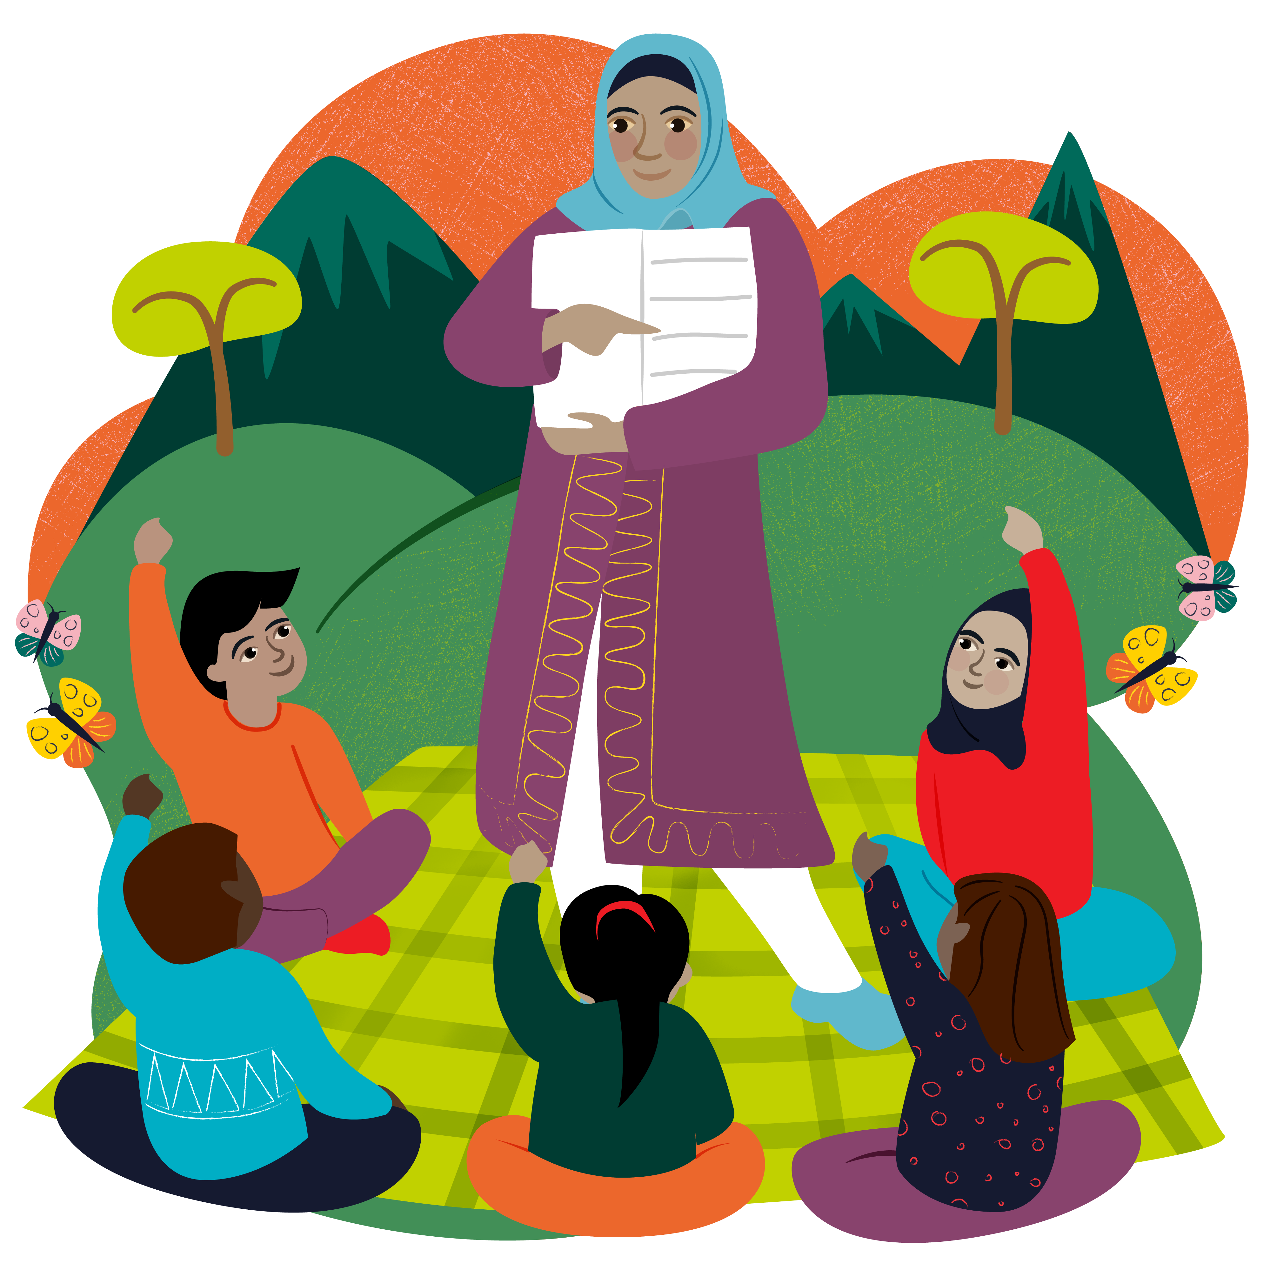
    Lord, give us the enthusiasm and energy to do things that make your love known to everyone, so we can be signs of hope during Advent and in this Jubilee Year.
    Lord, in your mercy,
    RESPOND: Hear our Prayer
    World Gifts: We say 'actions speak louder than words', but we all know how important words are too - teach someone how to read!
    Learn about the Teach a class to read World Gift

Slide 28

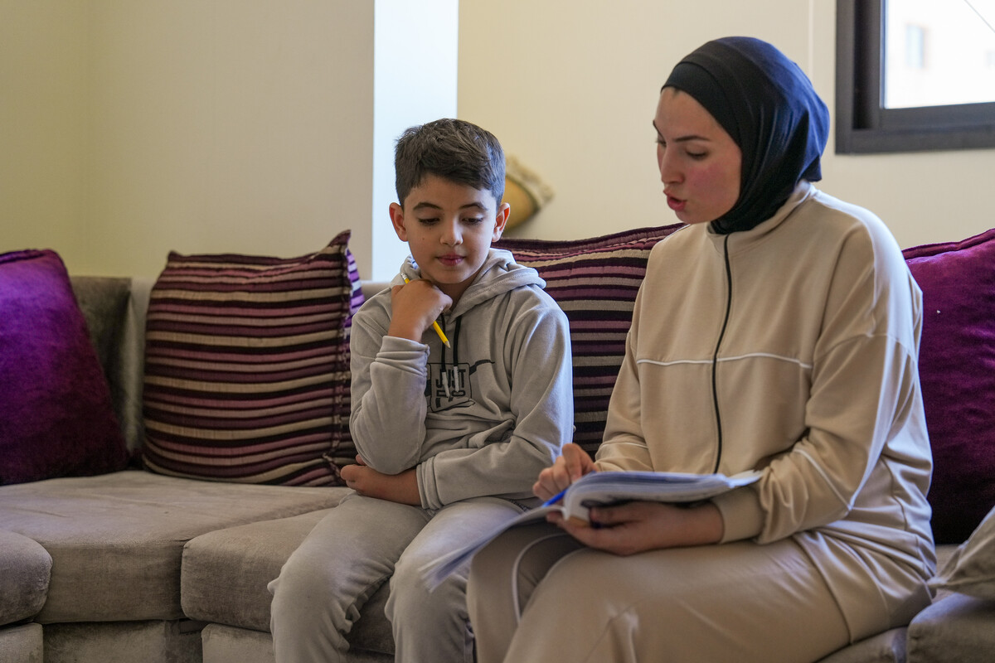
“May righteousness flourish in his lifetime and may prosperity last as long as the moon gives light.” Psalm 72:7
This reading tells us that in a world where we live as Jesus teaches us, peace and justice will flourish. But we know that many of our global family live lives without justice and peace. Yet, this reading gives us hope. Let us try to be Pilgrims of Hope in this Jubilee Year.
How can we best live lives of justice and peace and be signs of hope?
    Zein is eight years old and had to leave his home in Lebanon because of war. He is staying at a camp for displaced people.
    "What I want most is to go back home," says Zein. Find out about this little boy who wants to live peacefully.
Watch this film about Zein's story

Slide 29
    We pray for all people throughout the world who do not live with justice or in peace and we ask that you send them comfort at this time of Advent.
    Lord, in your mercy,
    RESPOND: Hear our Prayer
    World Gifts: If we lived in a just world, everyone would have enough to eat, but that's not the case. A Super Goat gives a family enough milk to drink and some to sell to buy all the things they need.
    Find out about The goat that gives more World Gift

Slide 30

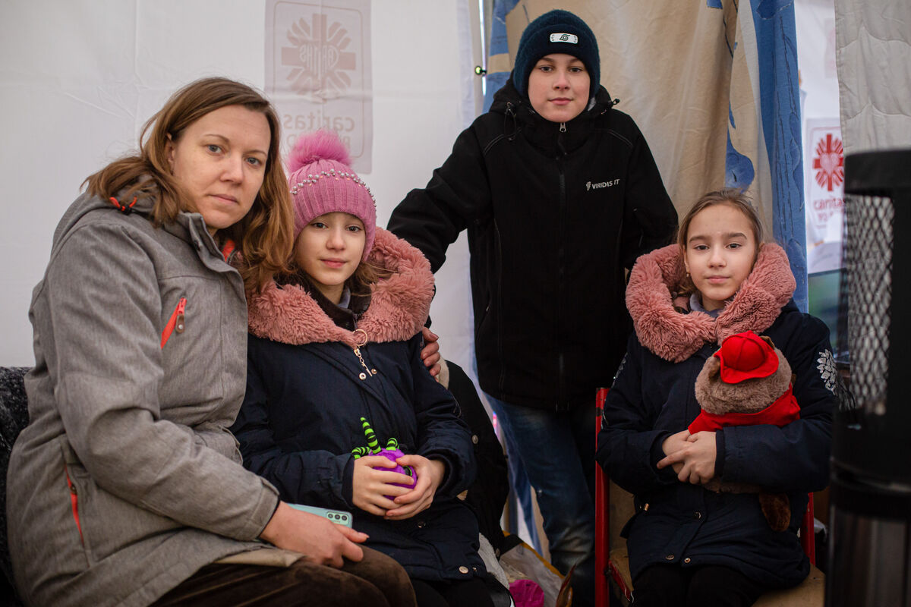
“Joseph, son of David, do not be afraid to take Mary home as your wife.” Matthew 1:20
Mary and Joseph travel a long way to Bethlehem. Today, people journey around the world for many reasons – work, holidays, to see family. But some are forced to travel because of poverty or war. Migrants do not always receive a warm welcome. Too often they are sent on their way.
On Migrants Day, how do we show compassion for others and welcome them into our communities?
Maria and her children are refugees, fleeing to Poland from war in Ukraine. CAFOD is part of Caritas, a charity helping people in times of crisis.
Find out how CAFOD helps families affected by war in Ukraine and explore the Catholic Social Teaching principle of The Common Good.
Notes:
Photo credit: Philipp Spalek / Caritas Germany

Slide 31
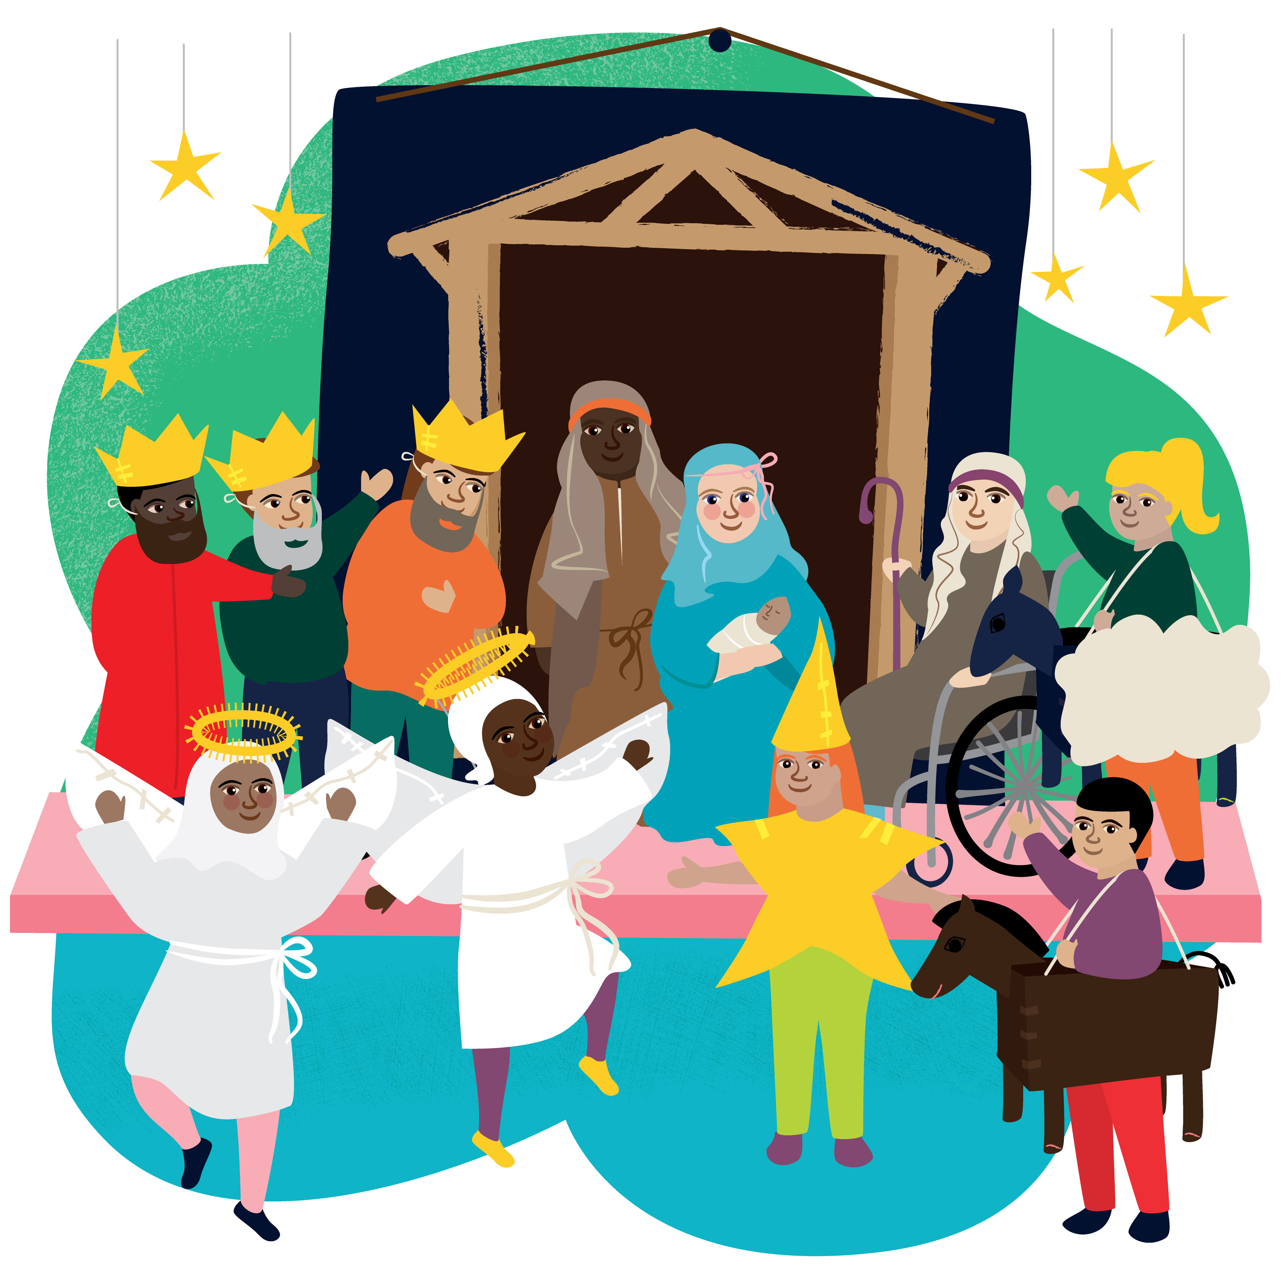
    Let us pray for an end to war all around the world, so that everyone can live in peace in the way that God wants us to.
    Lord, in your mercy,
    RESPOND: Hear our prayer
World Gifts: Did you raise any money during Advent by singing carols or taking collections at your nativity play? Perhaps you could use some of the money to buy a World Gift Christmas stocking for £100?

Slide 32

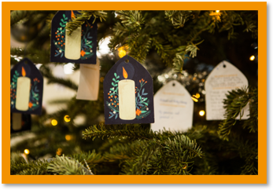
“From his very birth, he will be filled with the Holy Spirit.”
Luke 1:15
We are all filled with the Holy Spirit - we are all special.
Who are the special people in our lives? Because a better world needs all of us, how can we make sure we don’t take special people for granted? What can we do to make sure they feel special?
    Write joyful Christmas messages to your friends on our class Christmas card and make sure that everyone feels special. And the money you save by not buying individual cards could be used to buy a CAFOD World Gift!

Slide 33
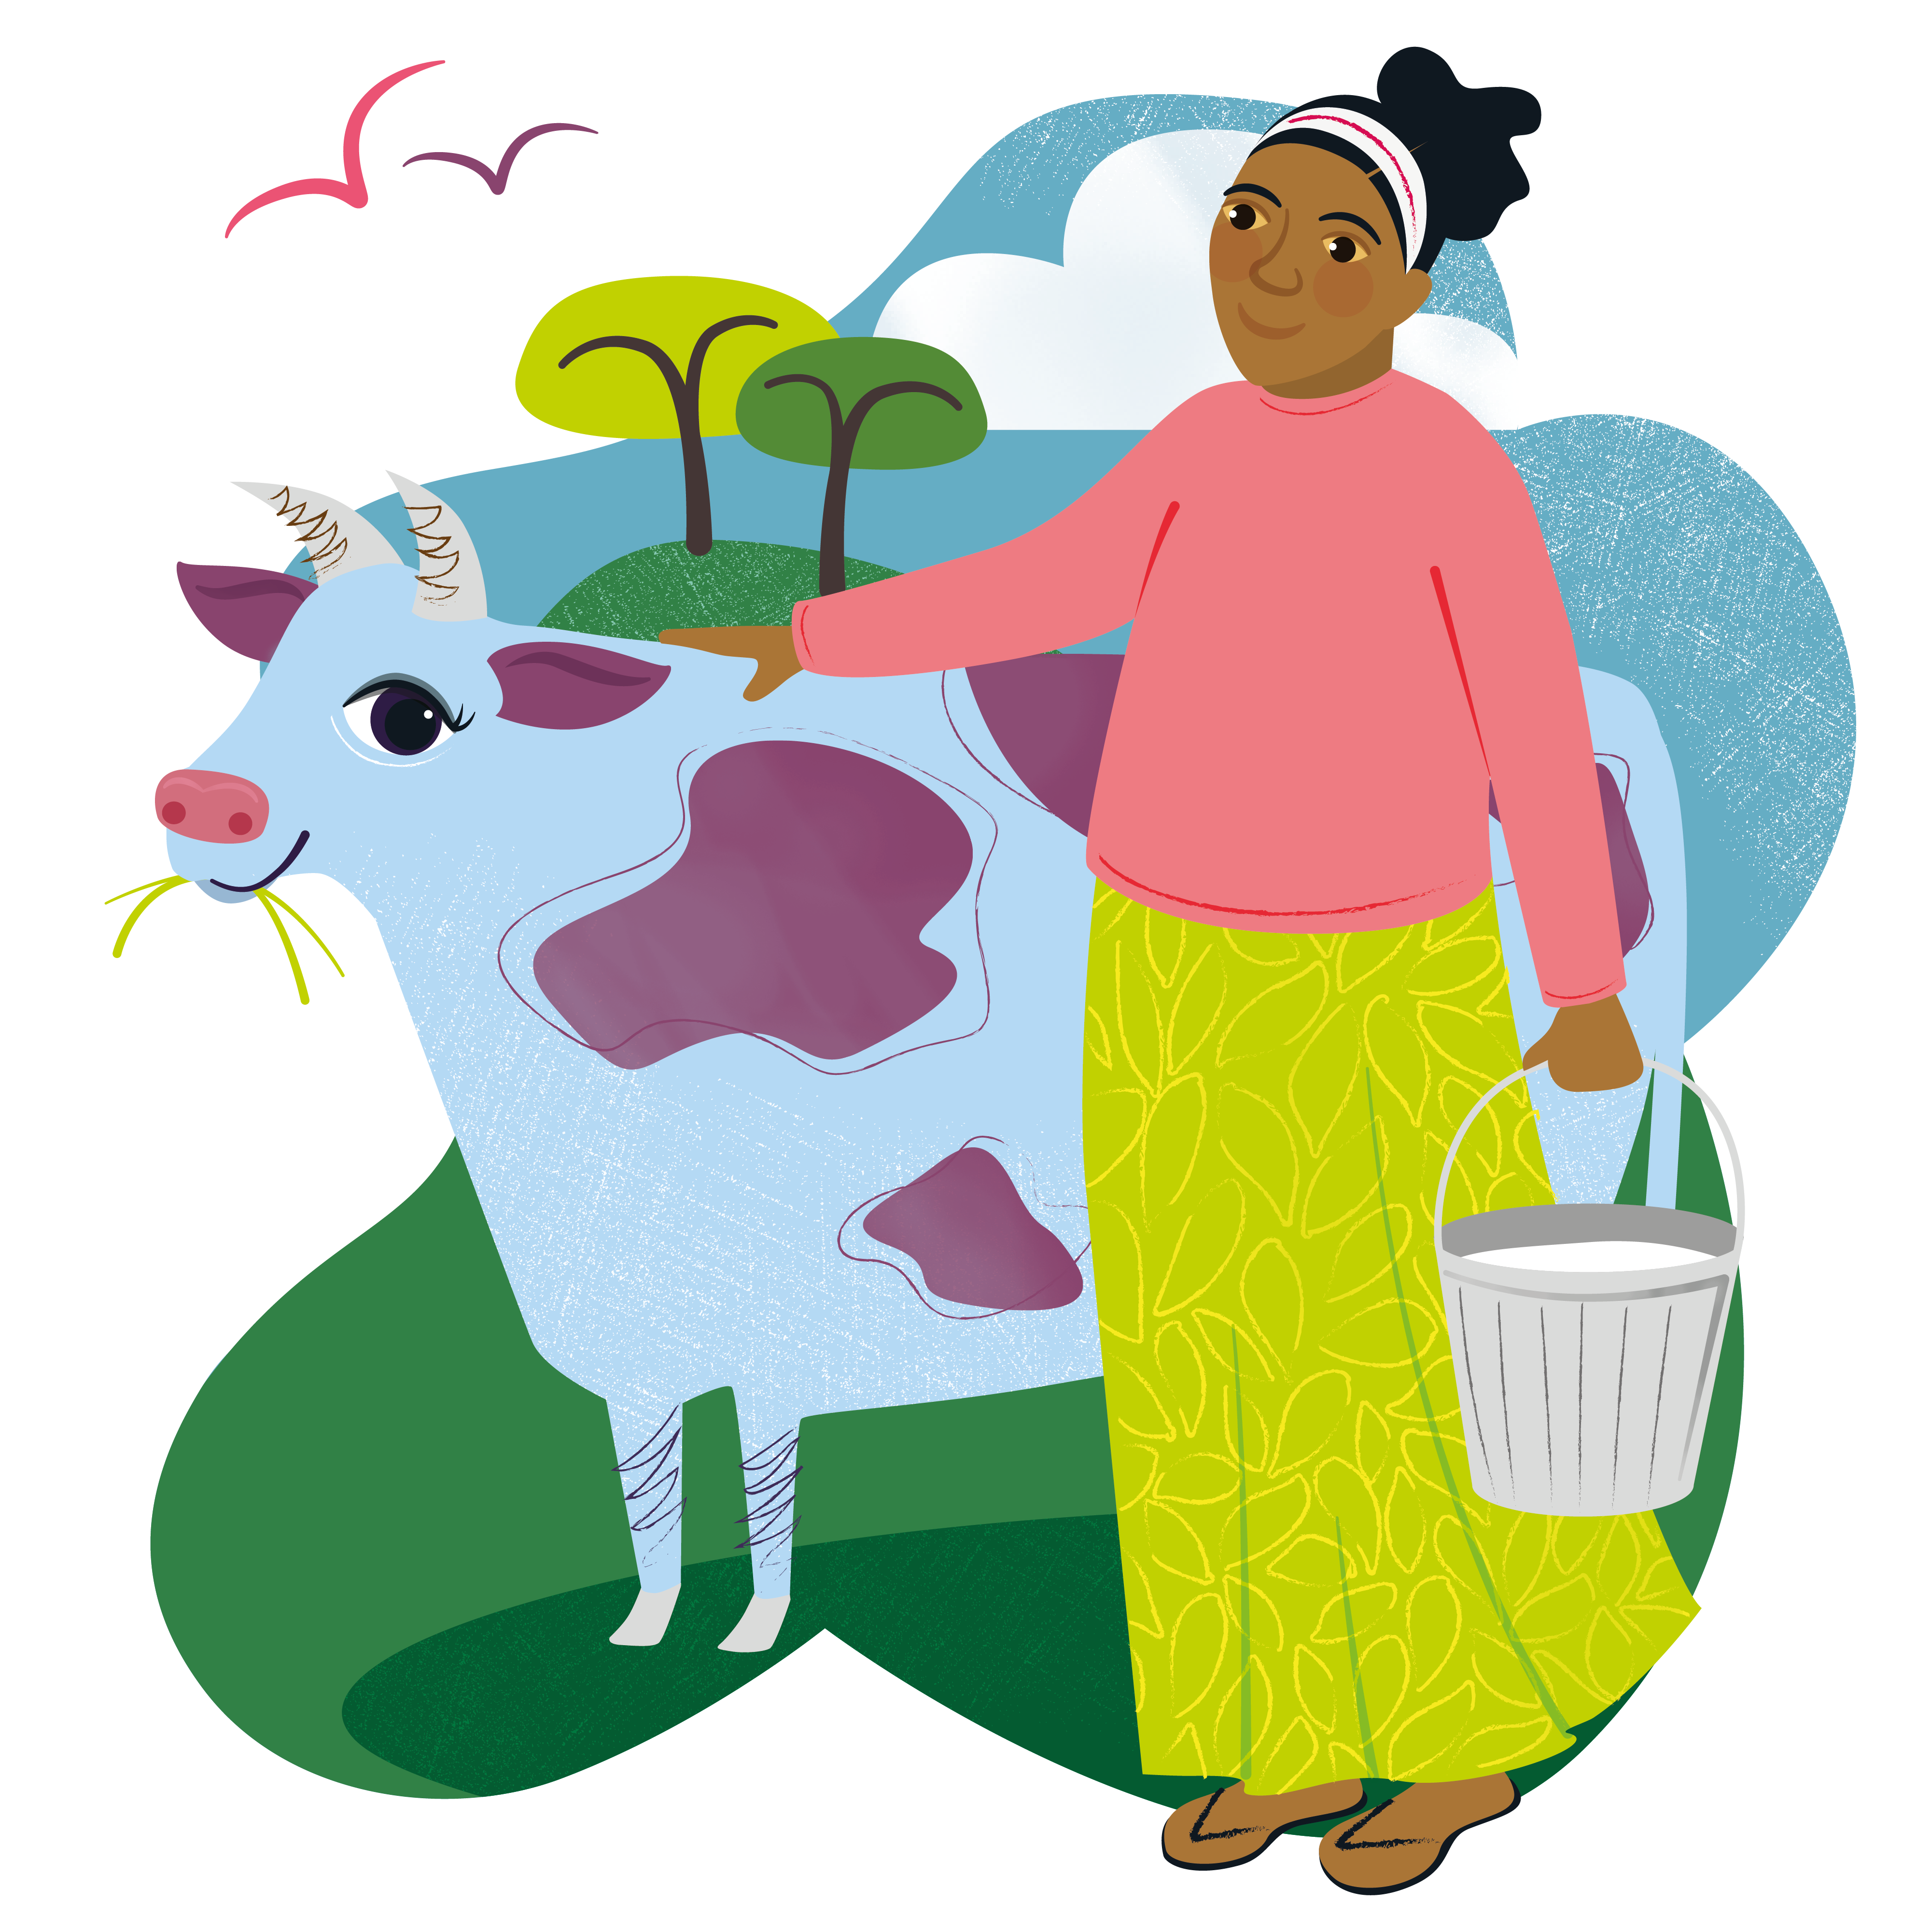
    As we prepare at Advent for the special gift of Jesus at Christmas, let us be thankful for all the special people in our lives.
    Lord, in your mercy,
    RESPOND: Hear our prayer
    World Gifts: And do you know what else is special? This Marvellous Moo Cow which produces milk for families to drink and sell, and their poo can be used as manure to help boost crops!
    Learn more about the Marvellous moo cow World Gift

Slide 34

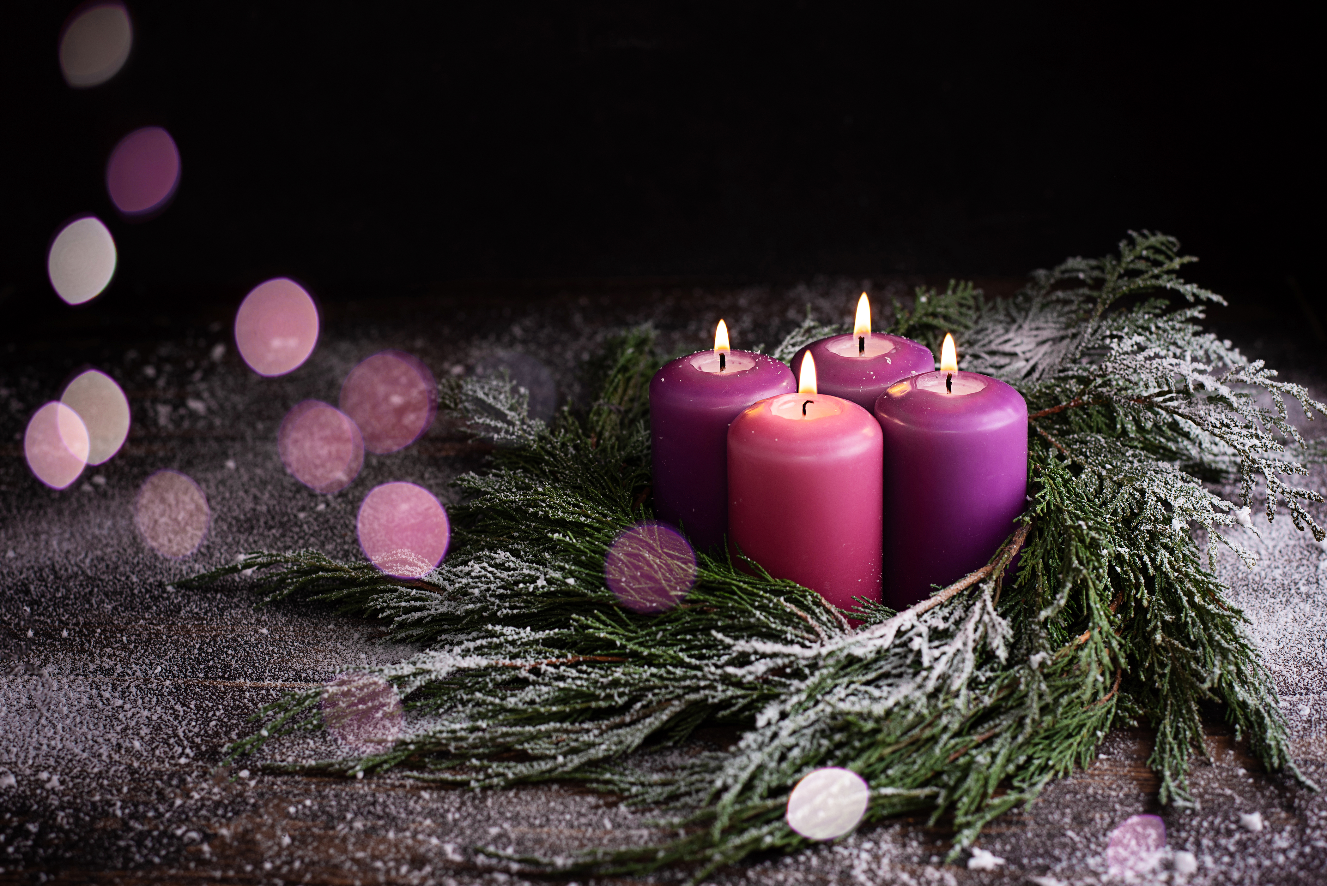
“He has filled the hungry with good things and sent the rich away with empty hands.” Luke 1:53
Mary has gone to visit her sister Elizabeth to tell her about the news from the angel Gabriel. She praises God and describes a world where God's kingdom reigns, where the hungry have food and are raised up.
In this year of Jubilee, how can we be Pilgrims of Hope and make sure we do our best to feed the hungry?
    Write an acrostic poem which reminds us of all the good things around Advent and the coming of Jesus at Christmas.
    You could use A-D-V-E-N-t, or as it’s very nearly C-H-R-I-S-T-M-A-S…

Slide 35
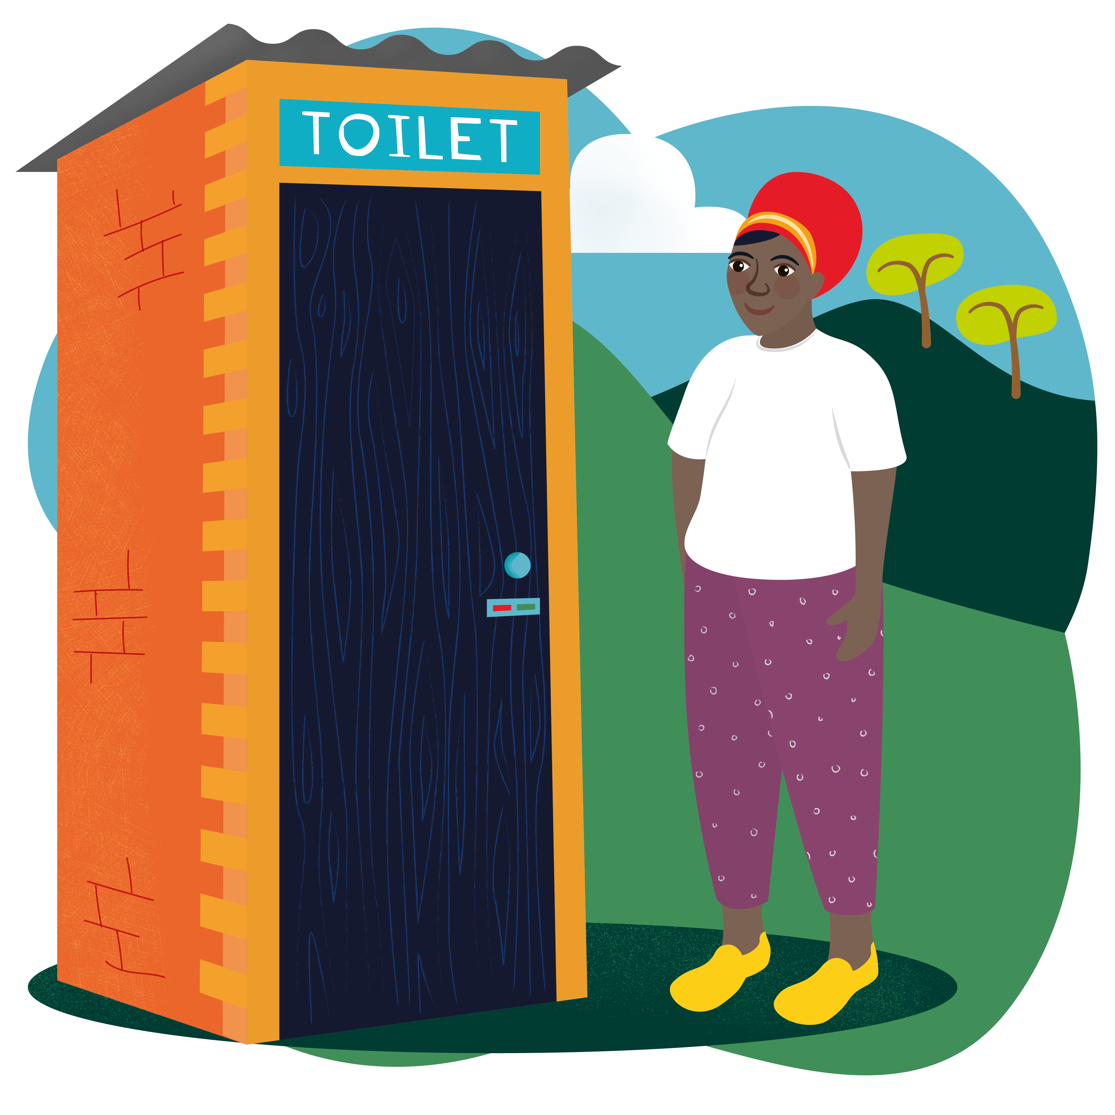
    For all those throughout the world who are hungry, we pray that they may too be filled with the good things you promise.
    Lord, in your mercy,
    RESPOND: Hear our Prayer
    World Gifts: You might not think it, but toilets are good things! Lovely loos are the best way to stop the spread of serious diseases, keeping whole communities healthy and safe.
    Learn more about the Terrific toilet World Gift

Slide 36

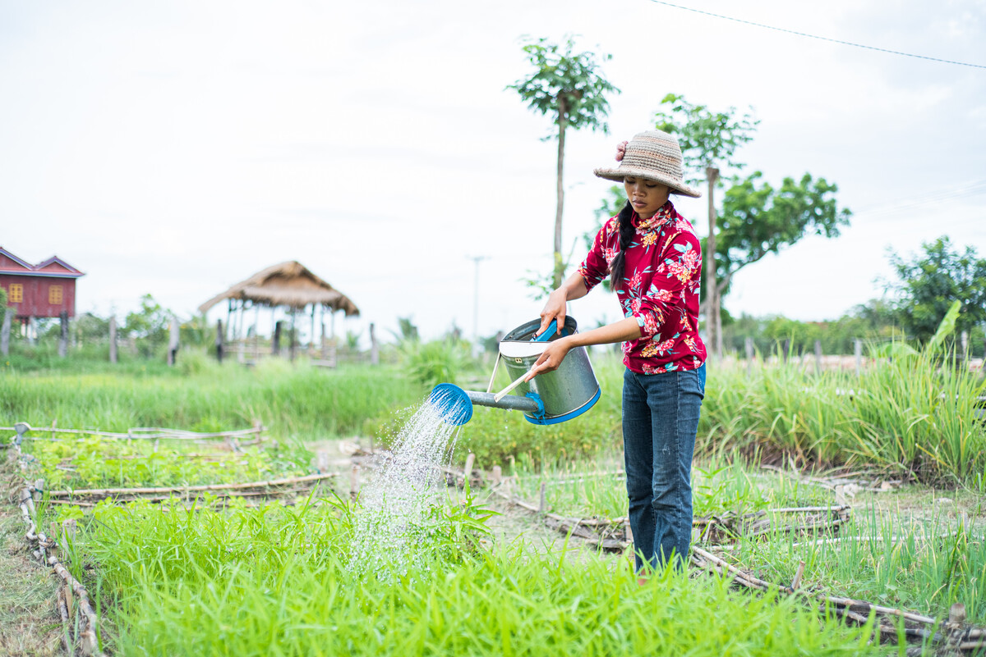
“What is this child going to be?” Luke 1:66
This is not about Jesus, but about John the Baptist who prepared the way for the Lord. It is a question families often ask. What will this baby be when they grow up? A bus driver? A judge? A teacher? An artist? Every child has the ability to surprise us, to grow and to flourish. Yet, as we know from looking around at our world, not all children have the same opportunities.
With God's help, what might we be when we grow up?
    Long's family have farmed in Cambodia for generations, but climate change makes farming difficult now. With CAFOD's help, Long is learning to grow crops even in bad weather, to eat and sell. Long also works in the village café. "In the future, I wish to start a small café to support my family and train others to do the same."
    Learn about Long's ambition and the Catholic Social Teaching principle of Sharing Fairly.

Slide 37
    We pray for all children throughout the world that they may grow up knowing they can be who and what they want to be.
    Lord, in your mercy,
    RESPOND: Hear our Prayer
    World Gifts: For all people to achieve their potential they need to have enough to eat and clean water to drink. Look what a World Gift can do!
    Find out about the Water for a family World Gift

Slide 38

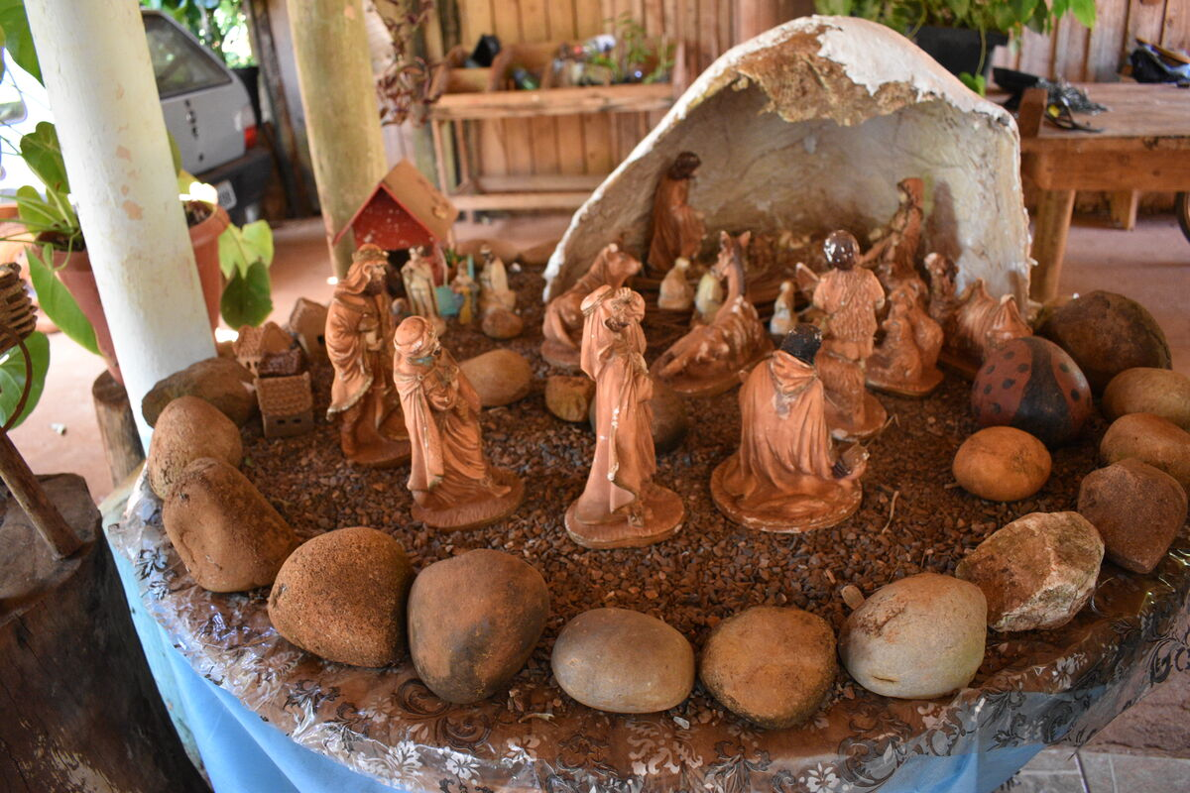
“Our God is merciful and tender. He will cause the bright dawn of salvation to rise on us.” Luke 1:78-19
This reading's words - 'merciful', 'tender', 'bright dawn' are full of hope. As we look forward to Christmas day tomorrow, let's look at what those words mean to us.
How can we be 'merciful', 'tender' and bring a 'bright dawn' to our family and friends around us and to our brothers and sisters around the world? How can we continue to be Pilgrims of Hope?
    There'll be lots of excitement in houses everywhere today! It's Christmas day tomorrow! In amongst all the excitement, let's just take a few moments to remember why we're celebrating. Here are some prayers you can say together as a family. Maybe say one around the Christmas tree or in front of your crib?
Christmas family prayer ideas
Notes:
A Nativity set from São Paulo, Brazil.

Slide 39
    We pray that, inspired by the gift of Jesus at Christmas time, we continue to be Pilgrims of Hope, showing God's love to those around us in all that we say and do.
    Lord, in your mercy,
    RESPOND: Hear our Prayer
    World Gifts: It's not too late to order a World Gift for a Christmas present! It's a special gift that reflects the true meaning of Christmas. Buying one makes a huge difference to our brothers and sisters living in poverty. CAFOD World Gifts

Slide 40
