Slide 1
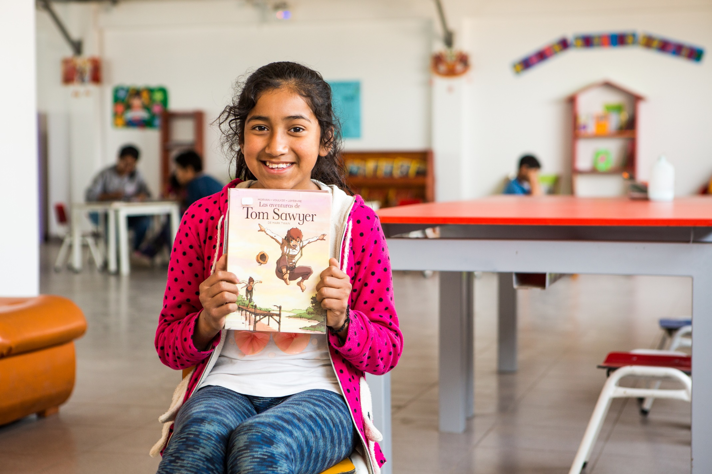
How can I share with others this week?
Gather
Notes:
Photo credit: Juliana, Peru
Gemma Salter

Slide 2
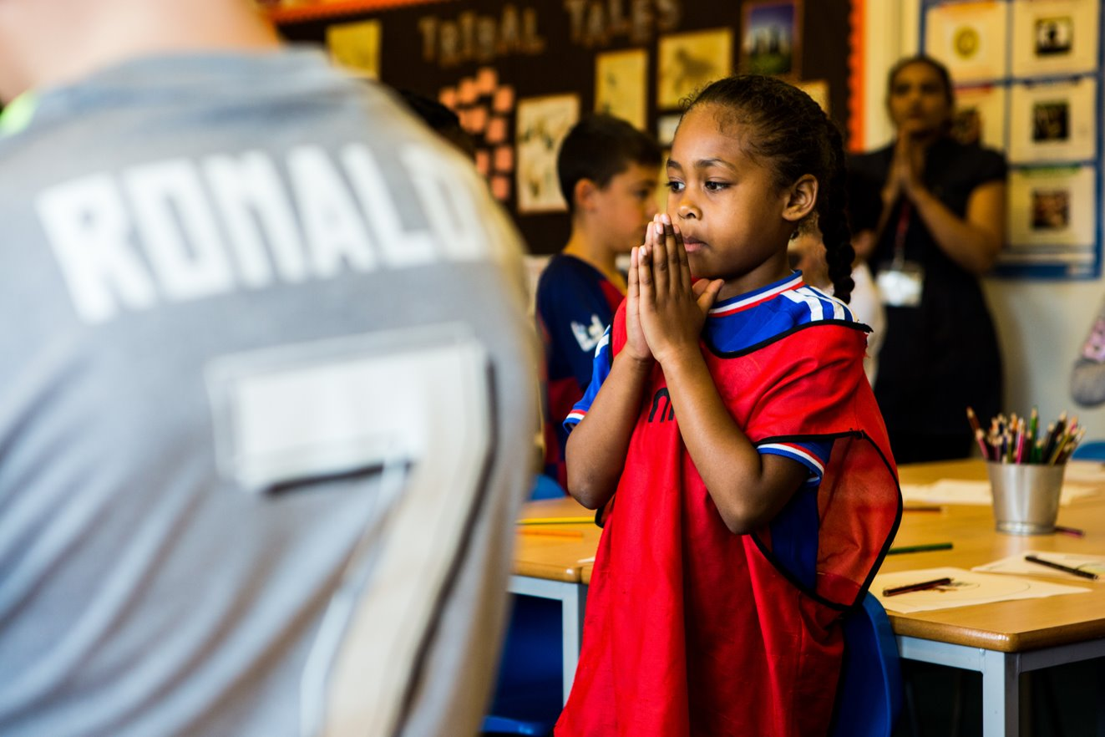
Generous God,
help us to share what we have, so that all people may have enough.
Amen.
Notes:
Children at Our Lady Queen of Heaven Primary School
Photo credit: Thom Flint

Slide 3
Gospel: Mark 12:38-44
As he taught them, [Jesus] said, “Watch out for the teachers of the Law, who like to walk around in their long robes and be greeted with respect in the marketplace, who choose the reserved seats in the synagogues and the best places at feasts. They take advantage of widows and rob them of their homes, and then make a show of saying long prayers. Their punishment will be all the worse!”
As Jesus sat near the temple treasury, he watched the people as they dropped in their money. Many rich men dropped in a lot of money; then a poor widow came along and dropped in two little copper coins, worth about a penny. He called his disciples together and said to them, “I tell you that this poor widow put more in the offering box than all the others. For the others put in what they had to spare of their riches; but she, poor as she is, put in all she had—she gave all she had to live on.”
Word

Slide 4
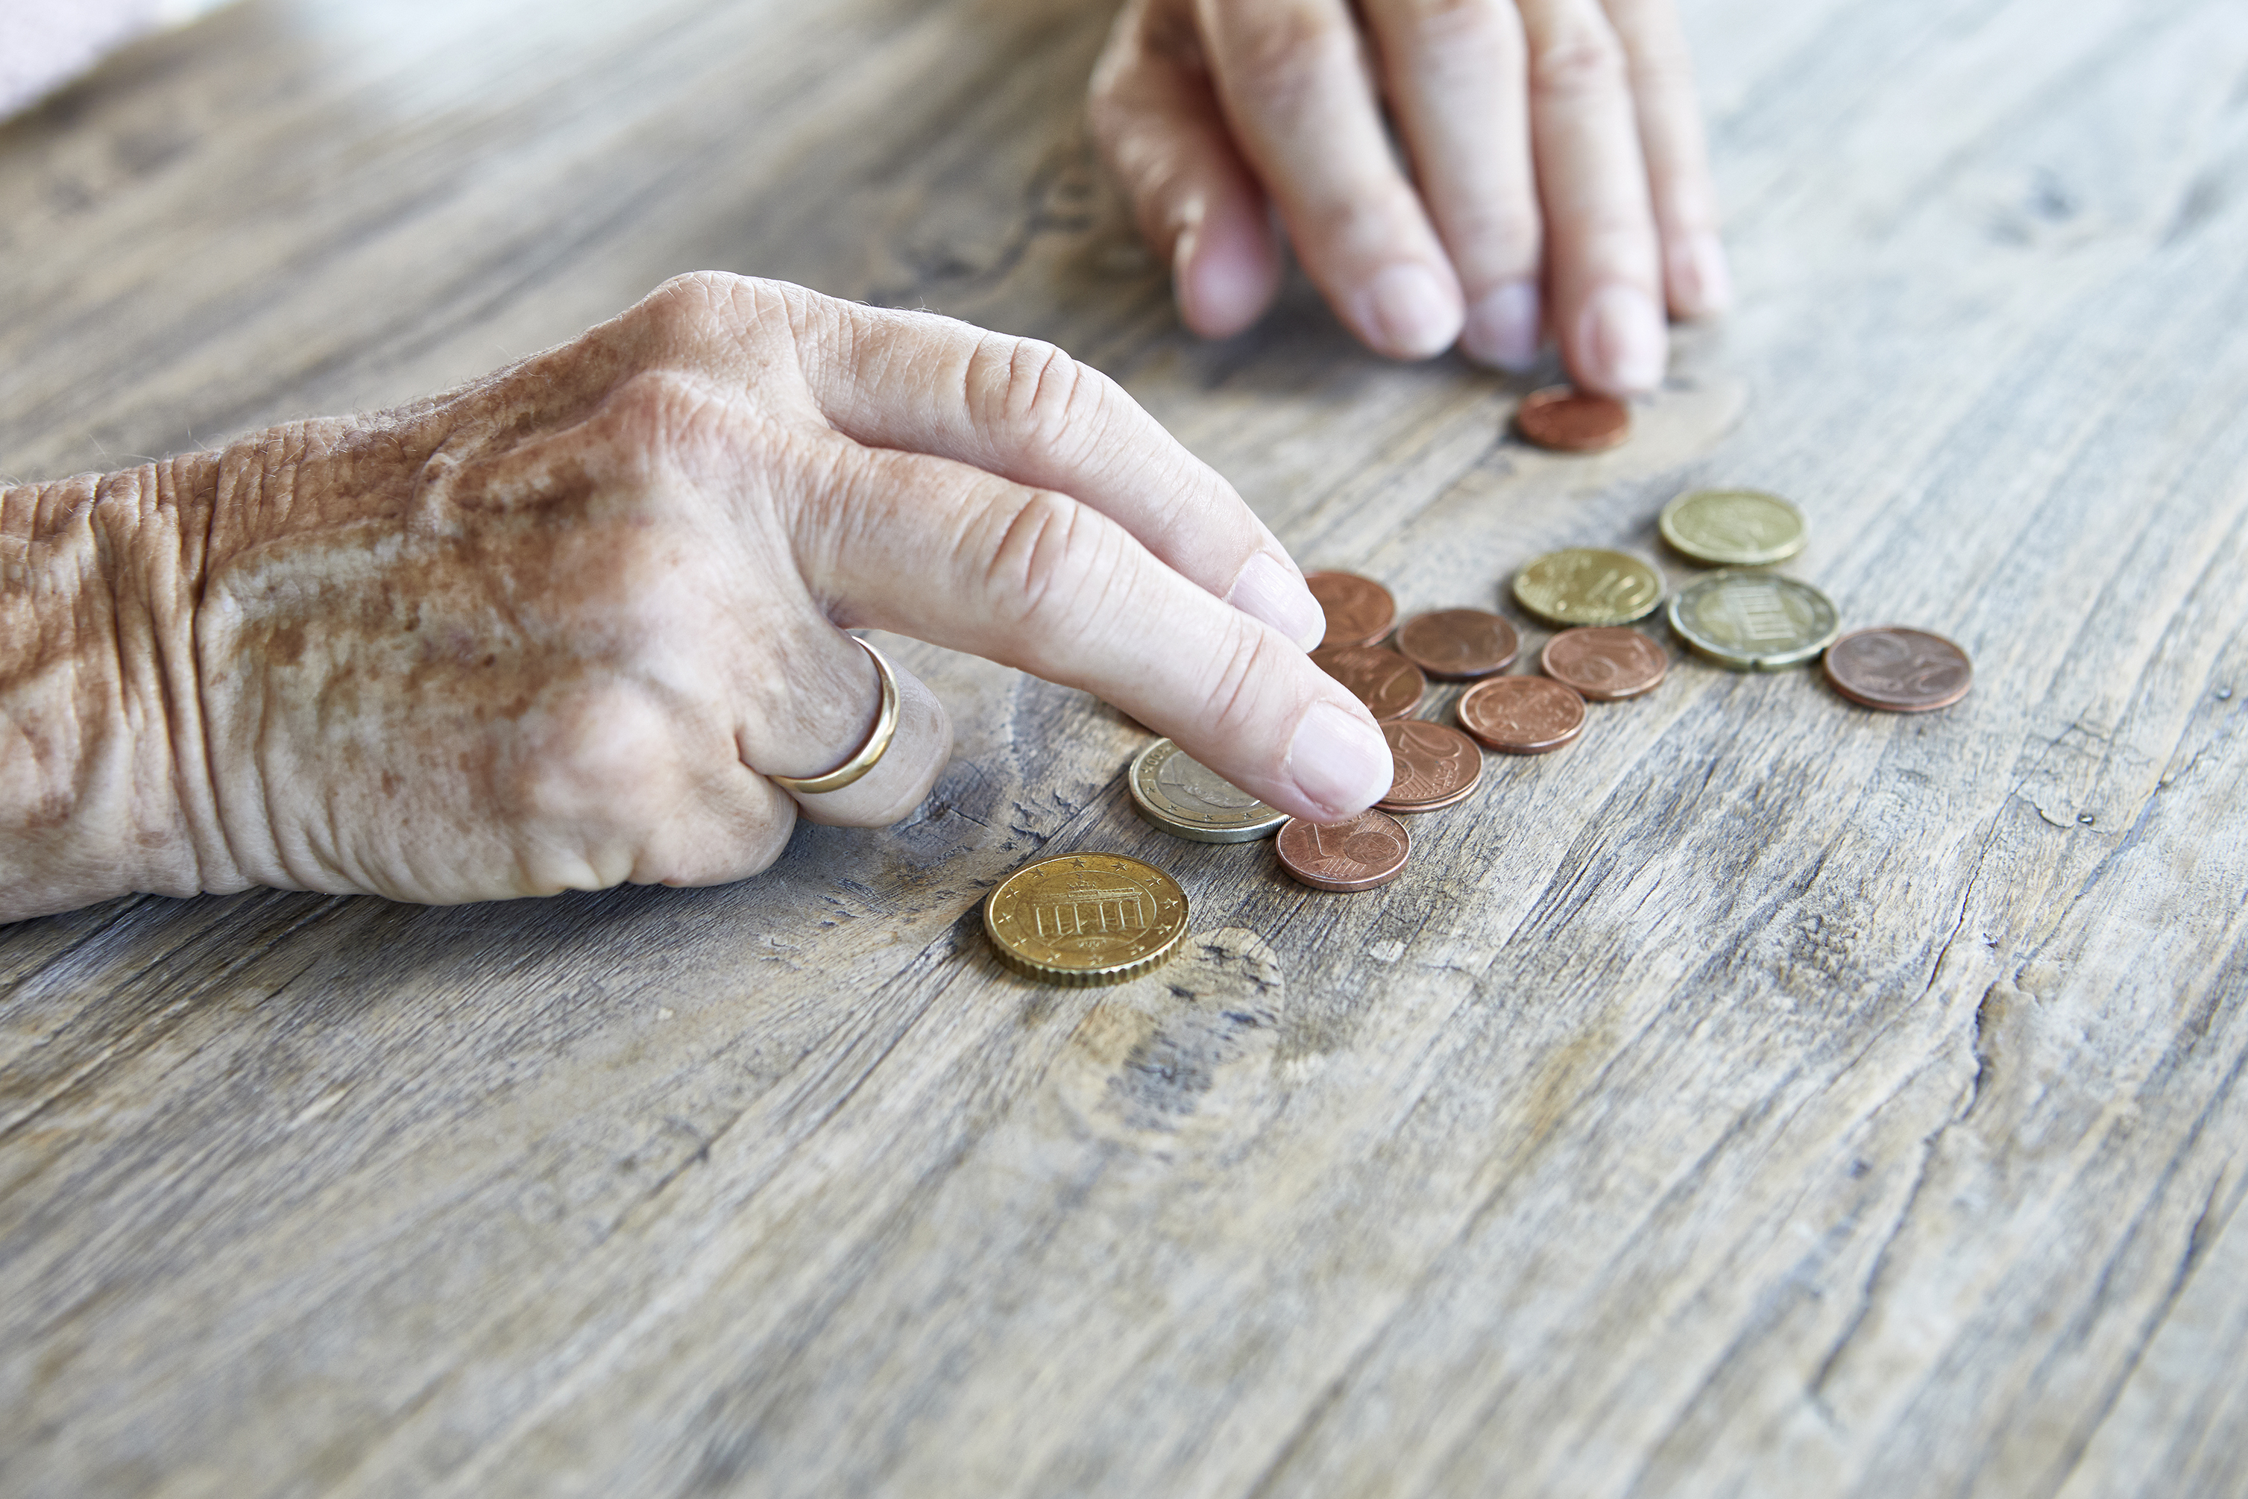
What do you remember from the Gospel reading?
Jesus was watching people putting money in the collection box at the synagogue. He saw some rich people putting in lots of money. Then a widow, who was poor, put in two small coins, the same as a penny.
What did Jesus say to the disciples about the woman?
Jesus said she'd put in more money than all the other people put together. The woman gave only two small coins, and the others had given lots, so what do you think Jesus meant?
Respond
Notes:
Photo credit: Stock image

Slide 5
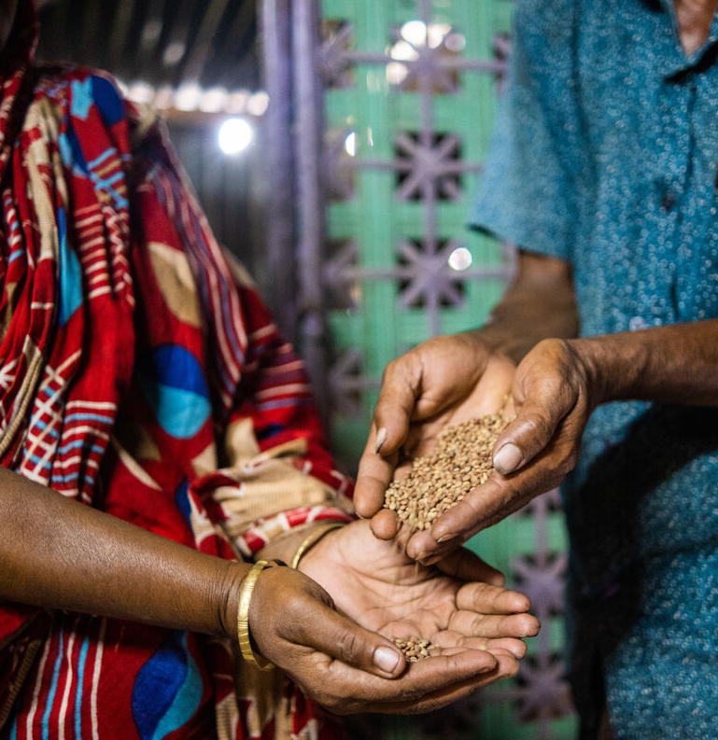
The woman gave everything that she had. The people who had lots of money just gave a little bit of what they had left over. ​
Which do you think Jesus would like us to be more like, the poor widow or the rich people? Why?
Jesus wants us to be generous and to share what we have with others. This is hard but we need to think – are we holding on to more than we need, like the rich people in Jesus’ story? Could we give a bit more or have we shared all that we can?
Notes:
Photo credit: Salina and Mogibor, Bangladesh
Amit Rudro

Slide 6
Jesus also shows us in this reading that everyone has something that they can give, even if at first it does not look like much.
We can give money, but we can also give other things too. Can you think what else we can give and share with others? We can give our time – by listening to others, by being there for them when they are sad or worried. And we can give our talents – for example you could sing a song, or paint a picture, or make someone laugh.
Can you think of something that you can give and share with others?
Notes:
Photo credit: Stock image

Slide 7
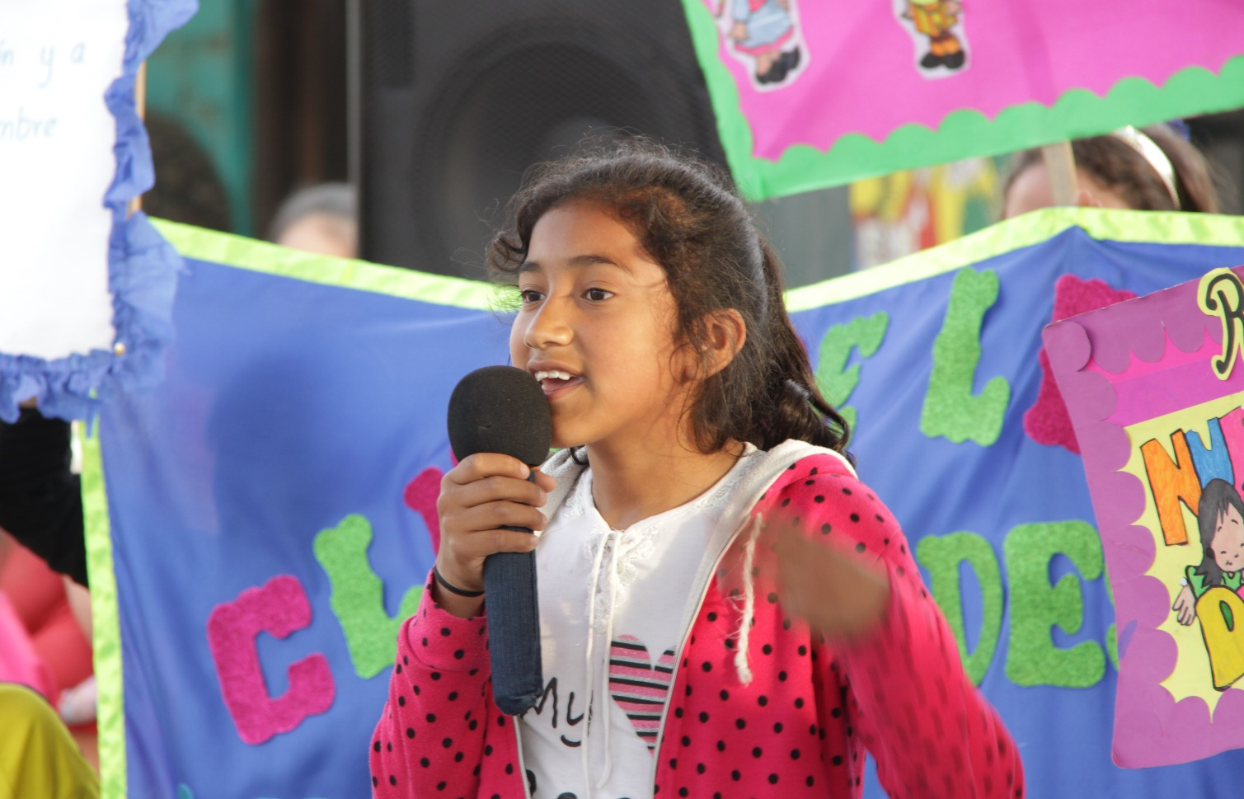
Juliana lives in Peru in an area where there is a lot of poverty and pollution.
There are not many safe places or parks for children to play in.
Notes:
Photo credit: Juliana, Peru
Gemma Salter

Slide 8
Juliana is a member of a reading club. It has been set up by a local organisation that CAFOD supports so that the children in her area have somewhere safe to go.
Juliana loves reading, and she was the first girl in the reading club to read 100 books in a year! Wow!
Notes:
Photo credit: Juliana, Peru
Gemma Salter

Slide 9
Juliana has become a leader of the reading club and she encourages others to keep reading too.
She even got her elder brother to stay at school and finish his education. He started a job to help earn money for his family, but Juliana argued that it would be better to keep on learning. He stayed on and finished his final year of school.
Notes:
Photo credit: Stock image

Slide 10
The gift of books and somewhere safe to read in peace, have made a huge difference to Juliana over the years, and have meant that she can share her passion for books and for learning with others.
What do you think the world would be like if everyone shared what they are able to?
Notes:
Photo credit: Juliana, Peru
Gemma Salter

Slide 11
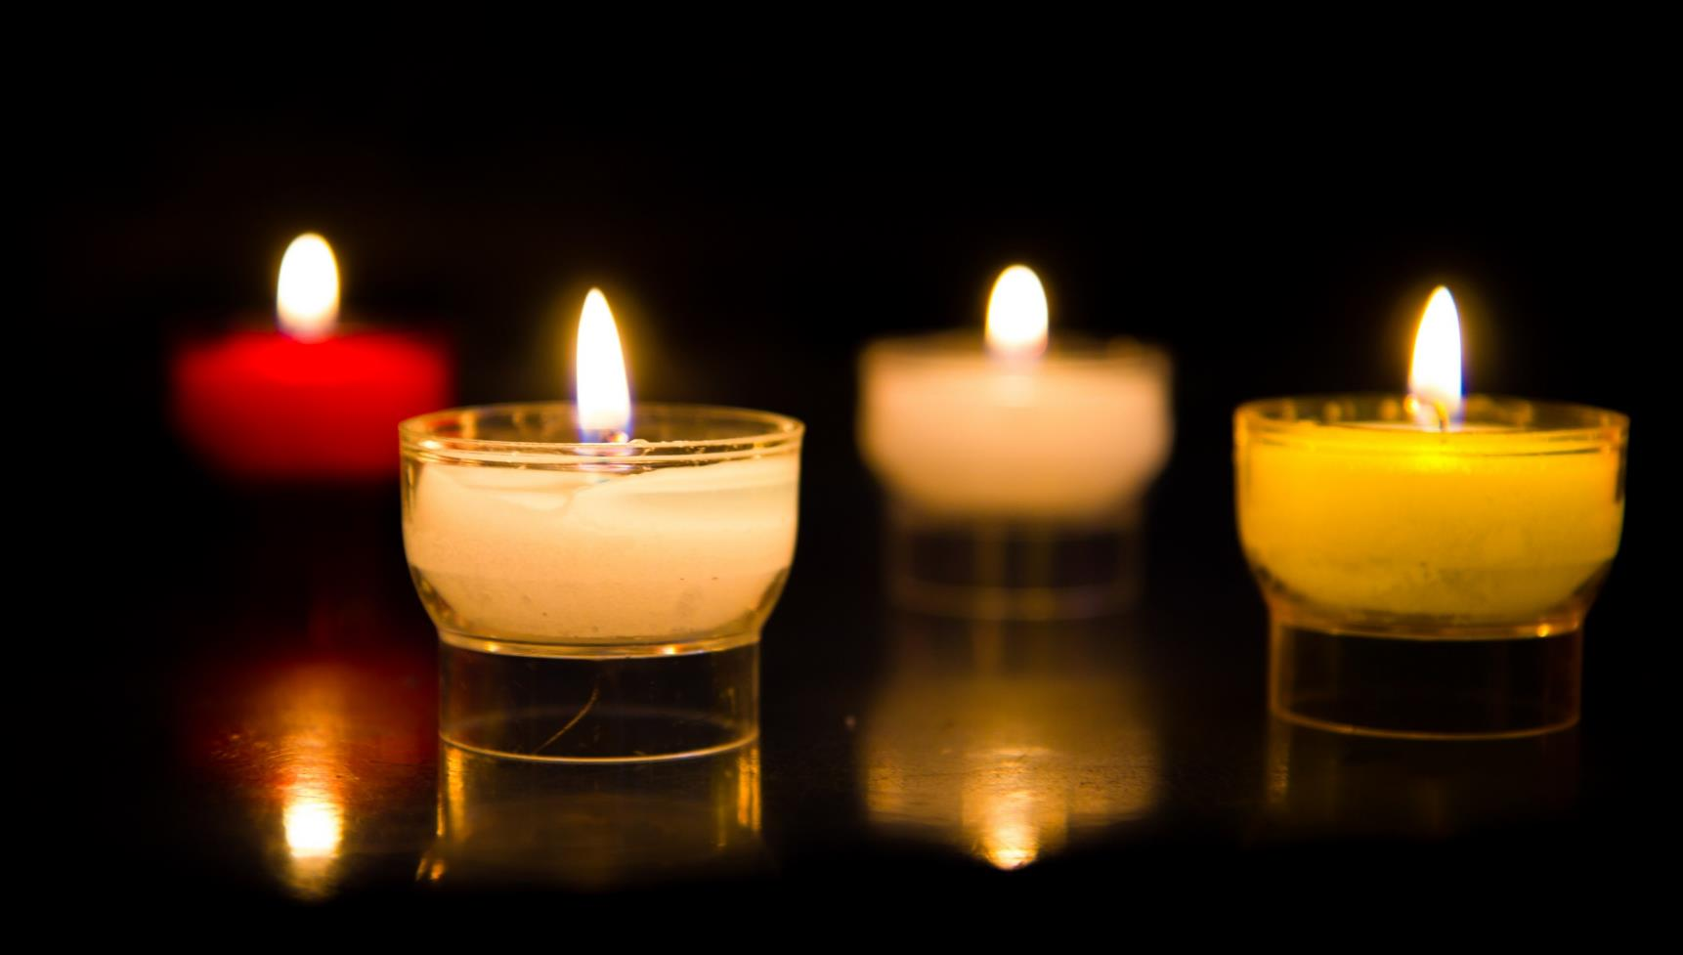
Let us pray…

Slide 12
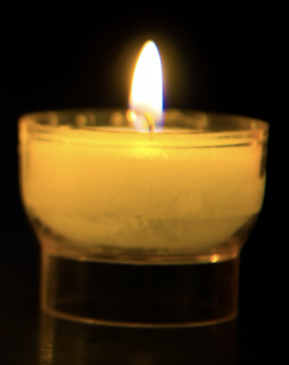
We pray for world leaders: that they may be generous and fair, so that all their people have enough to live free from poverty. Lord, in your mercy…
We pray for all members of our global family: that we may see that all people have something important to share, no matter how small or unimportant it seems at first.
Lord, in your mercy…

Slide 13
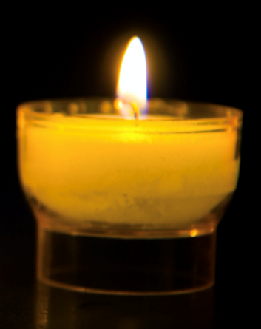
We pray for our parish, family and friends: that we may be as generous as possible, not keeping more of anything than we need, so that everyone may have enough. Lord, in your mercy…
God of light, help us to share generously and to see how important and special each person’s gifts are. Amen.

Slide 14
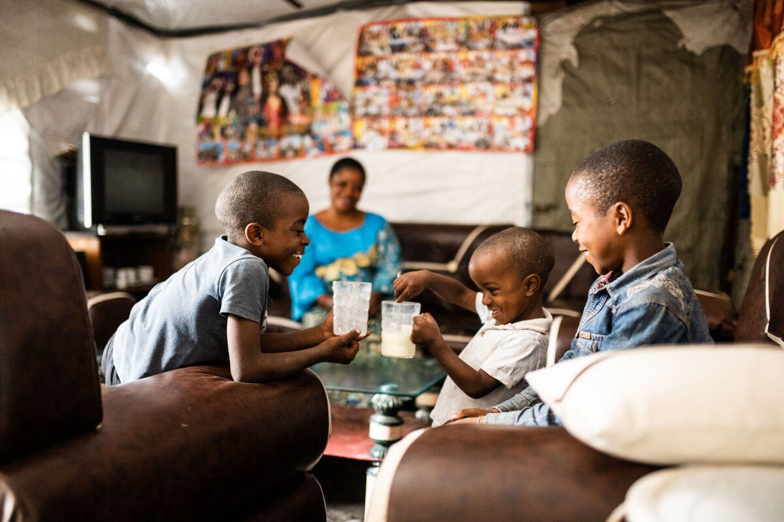
What will you give to, and share with, others in the coming week?
Send
Notes:
Photo credit: Anuarite and her family, DRC
Arlette Bashizi

Slide 15
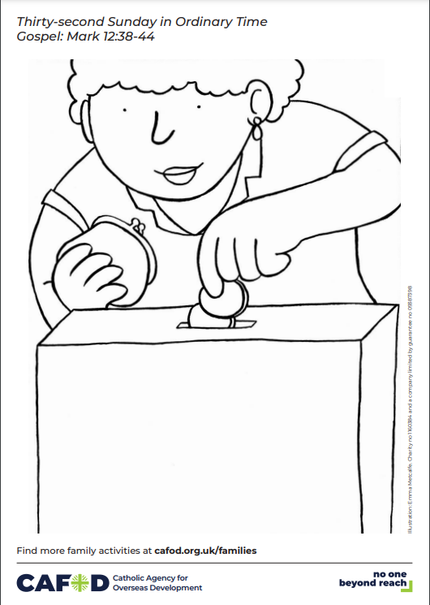
Activity suggestions
Invite children to colour in the accompanying illustration and to draw on the collection box what they will give to share in the coming week.
Make a collection box out of a shoebox with a slit in the lid. Give the children coin-shaped pieces of paper and invite them to write or draw what they will share with others in the coming week – it could be time or a talent or skill. When they have done this encourage them to come forward and put their “coins” in the collection box like the widow in the gospel story.
As Juliana loves to read so much, find out about the World Gift ‘Teach someone to read’. https://worldgifts.cafod.org.uk/collections/frontpage/products/teach-someone-to-read
Meet Long from Cambodia and find out about sharing fairly.
CST_Distributive_Justice.pptx
Encourage the children to think about how they can show kindness and generosity to their brothers and sisters around the world as Jesus taught. Putting CST into practice (cafod.org.uk)
Remind the children to discuss all they've heard and thought about with the people at home, to be as generous as possible and to share with others in the coming week.

Slide 16
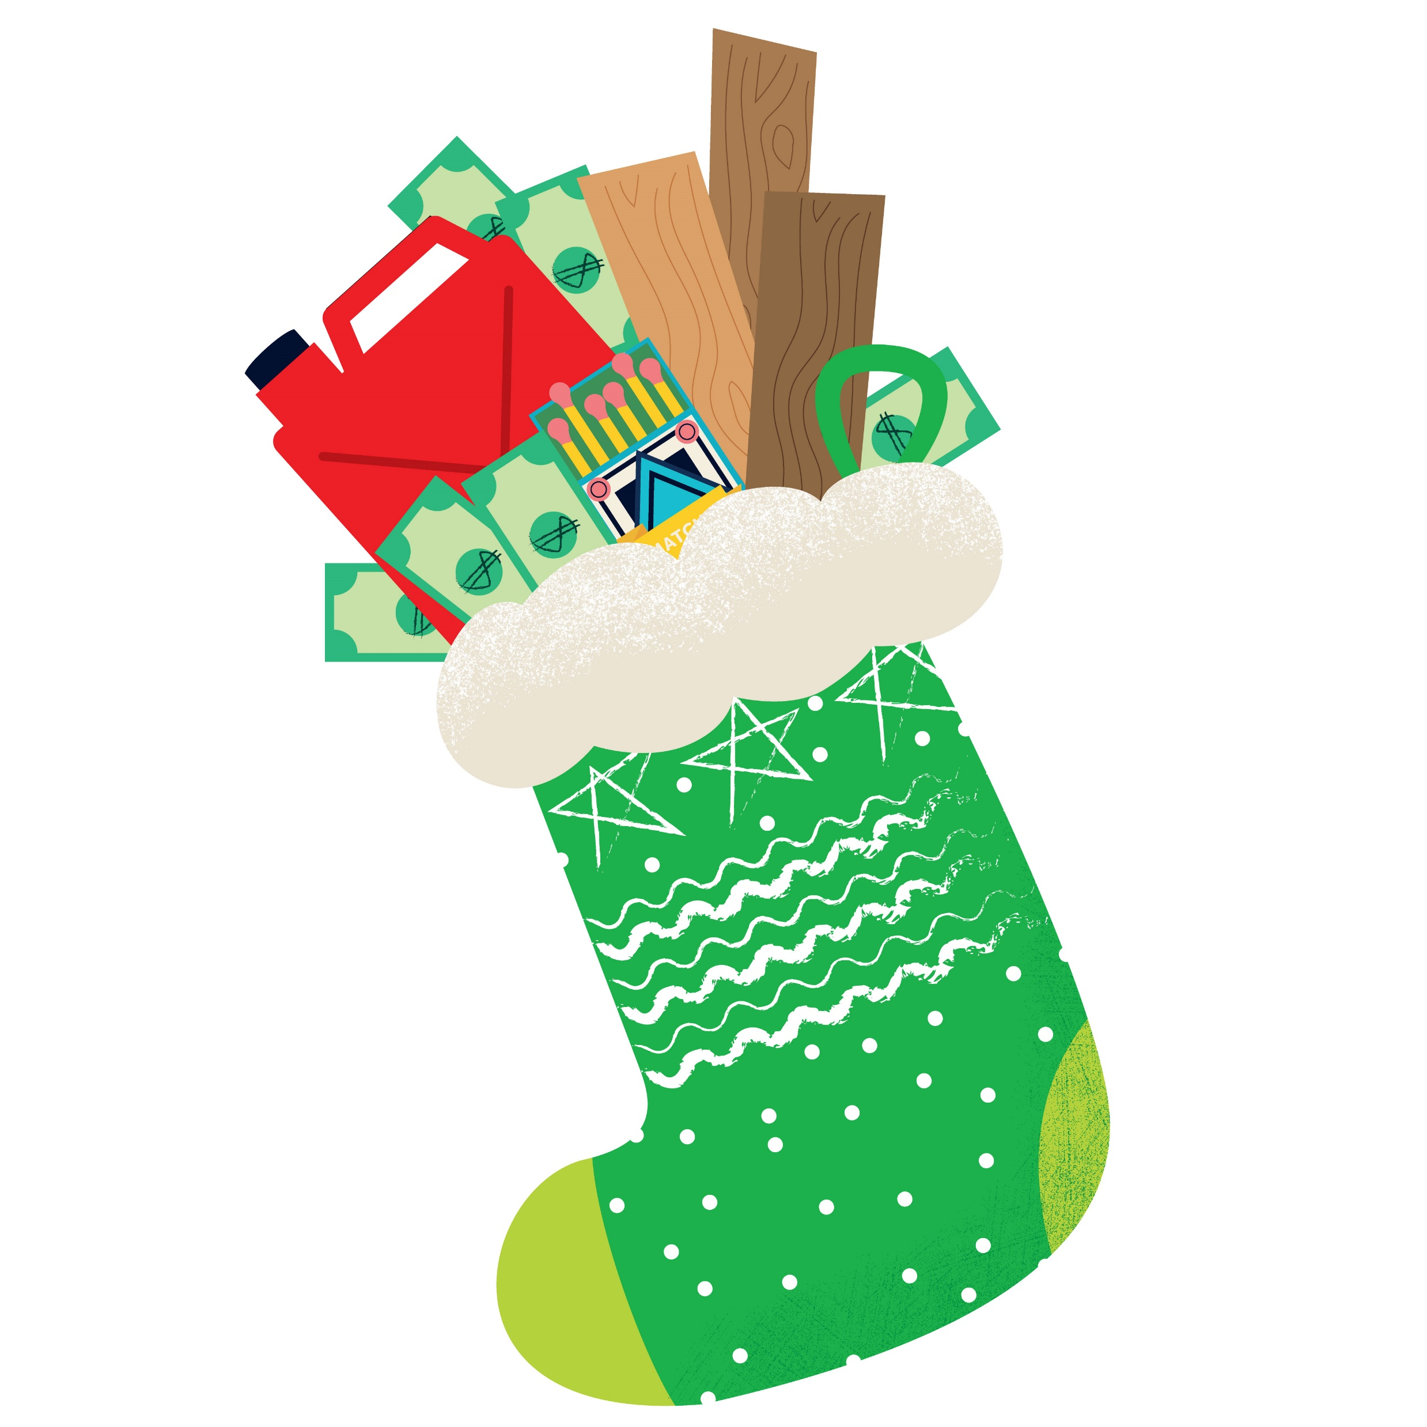
Advent save the date!
Join our next national assembly! Come together with schools across England and Wales to mark the start of Advent.
Watch live on Tuesday 28 November at 9.30am or at any time during Advent.
CAFOD's Advent Calendar will help us prepare together to be the best people we can be to celebrate the birth of Jesus – reflections, activities, prayers and actions for each day of Advent.
This Advent, we are asking schools across England and Wales to consider fundraising for a £100 CAFOD Christmas stocking, full of life-changing gifts. Find out more about the stocking and a poster to support your fundraising.
Why not use CAFOD Advent prayers cards as part of your Advent preparation? Order them for free at Advent Prayer card – CAFOD Shop

Slide 17
Notes:
Illustration: Emma Metcalfe

