Slide 1
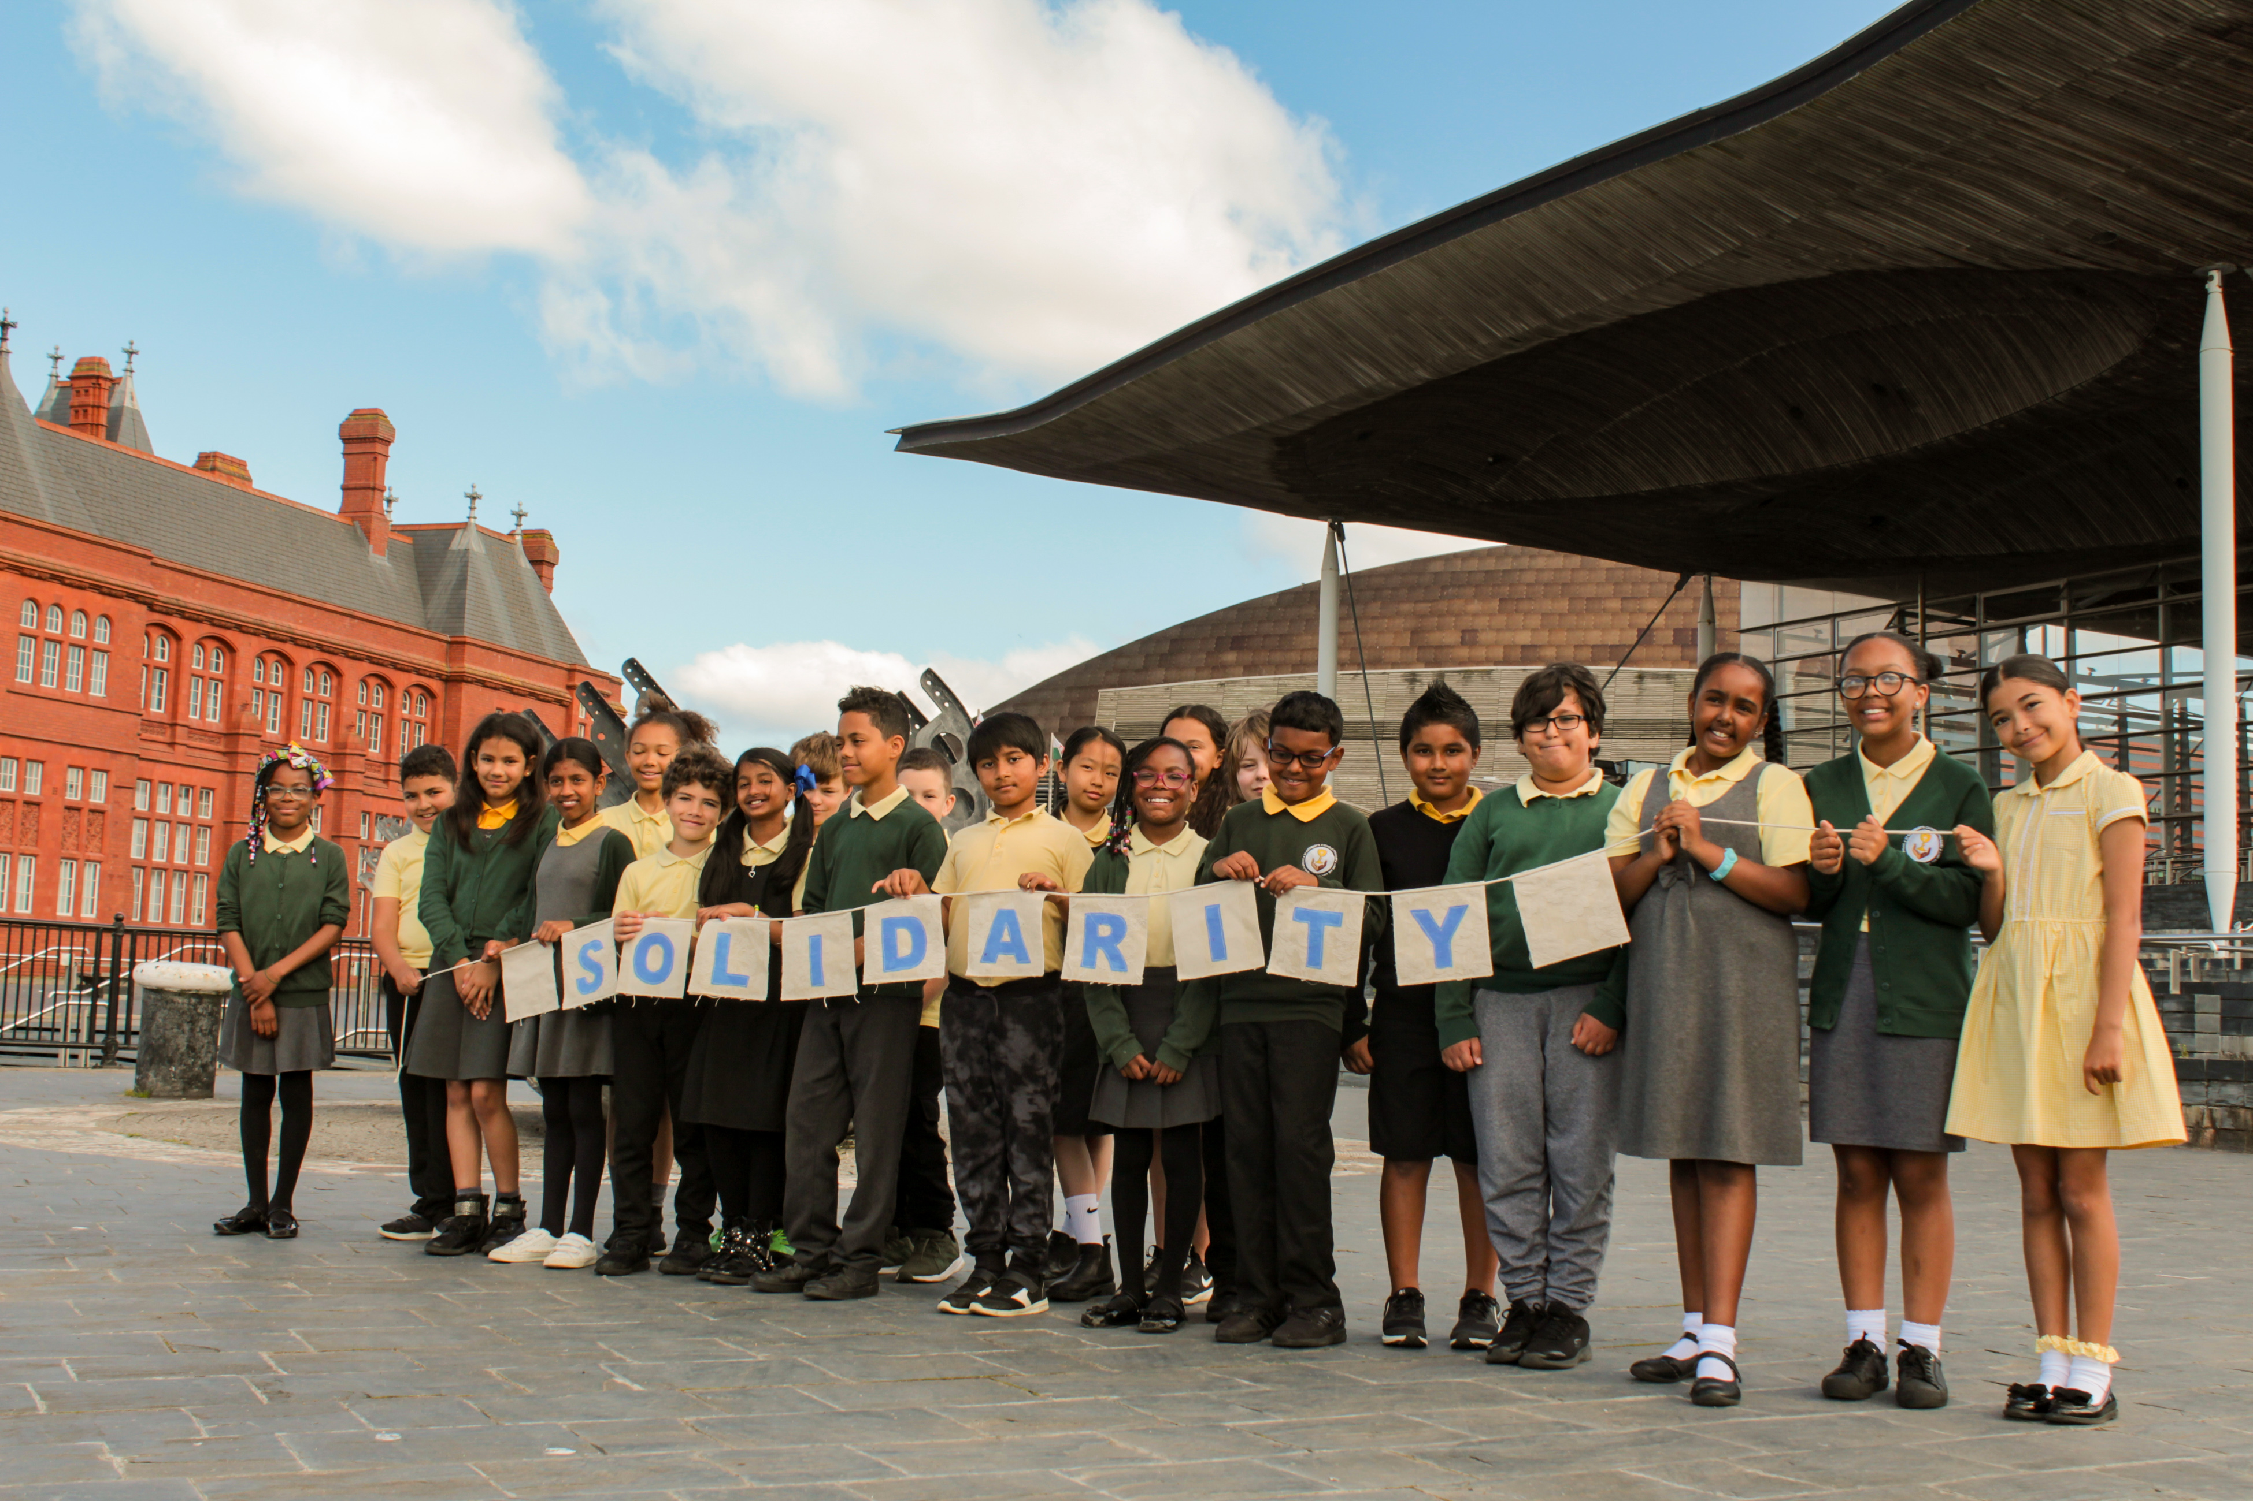
Solidarity
Exploring CST principles in CAFOD’s work
Notes:
Children from St Cuthbert’s primary school, Cardiff.
Photo credit: Victoria Ahmed

Slide 2
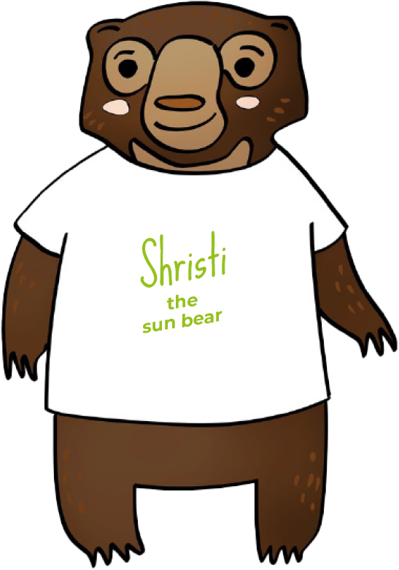
Solidarity means we believe in
showing we care.

Slide 3
“... all of you are one in Christ Jesus.”
Galatians 3:28

Slide 4
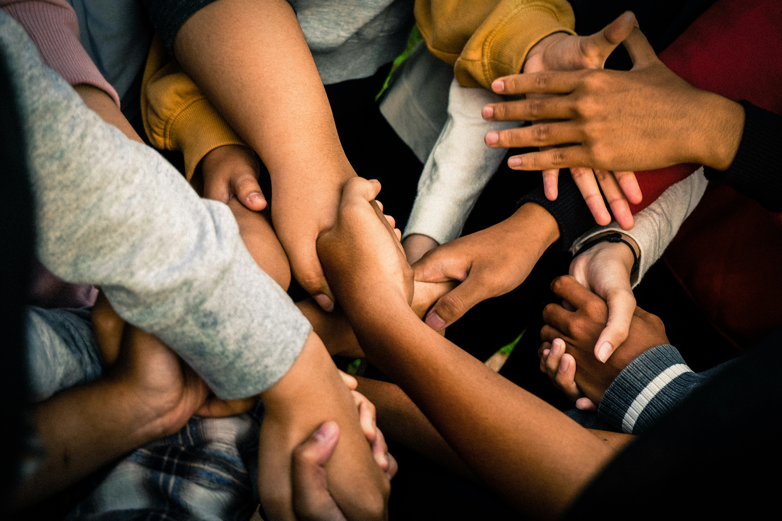
Solidarity
God created us as one global family. It is important we show our brothers and sisters in need around the world that that we care.
Notes:
Photo by Marlis Trio Akbar on Unsplash

Slide 5
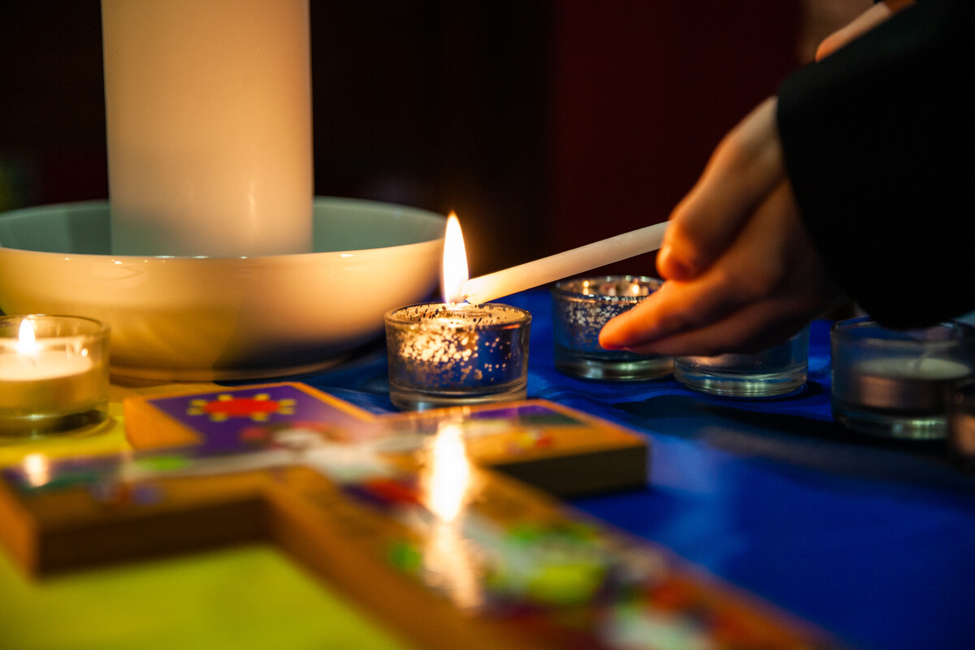
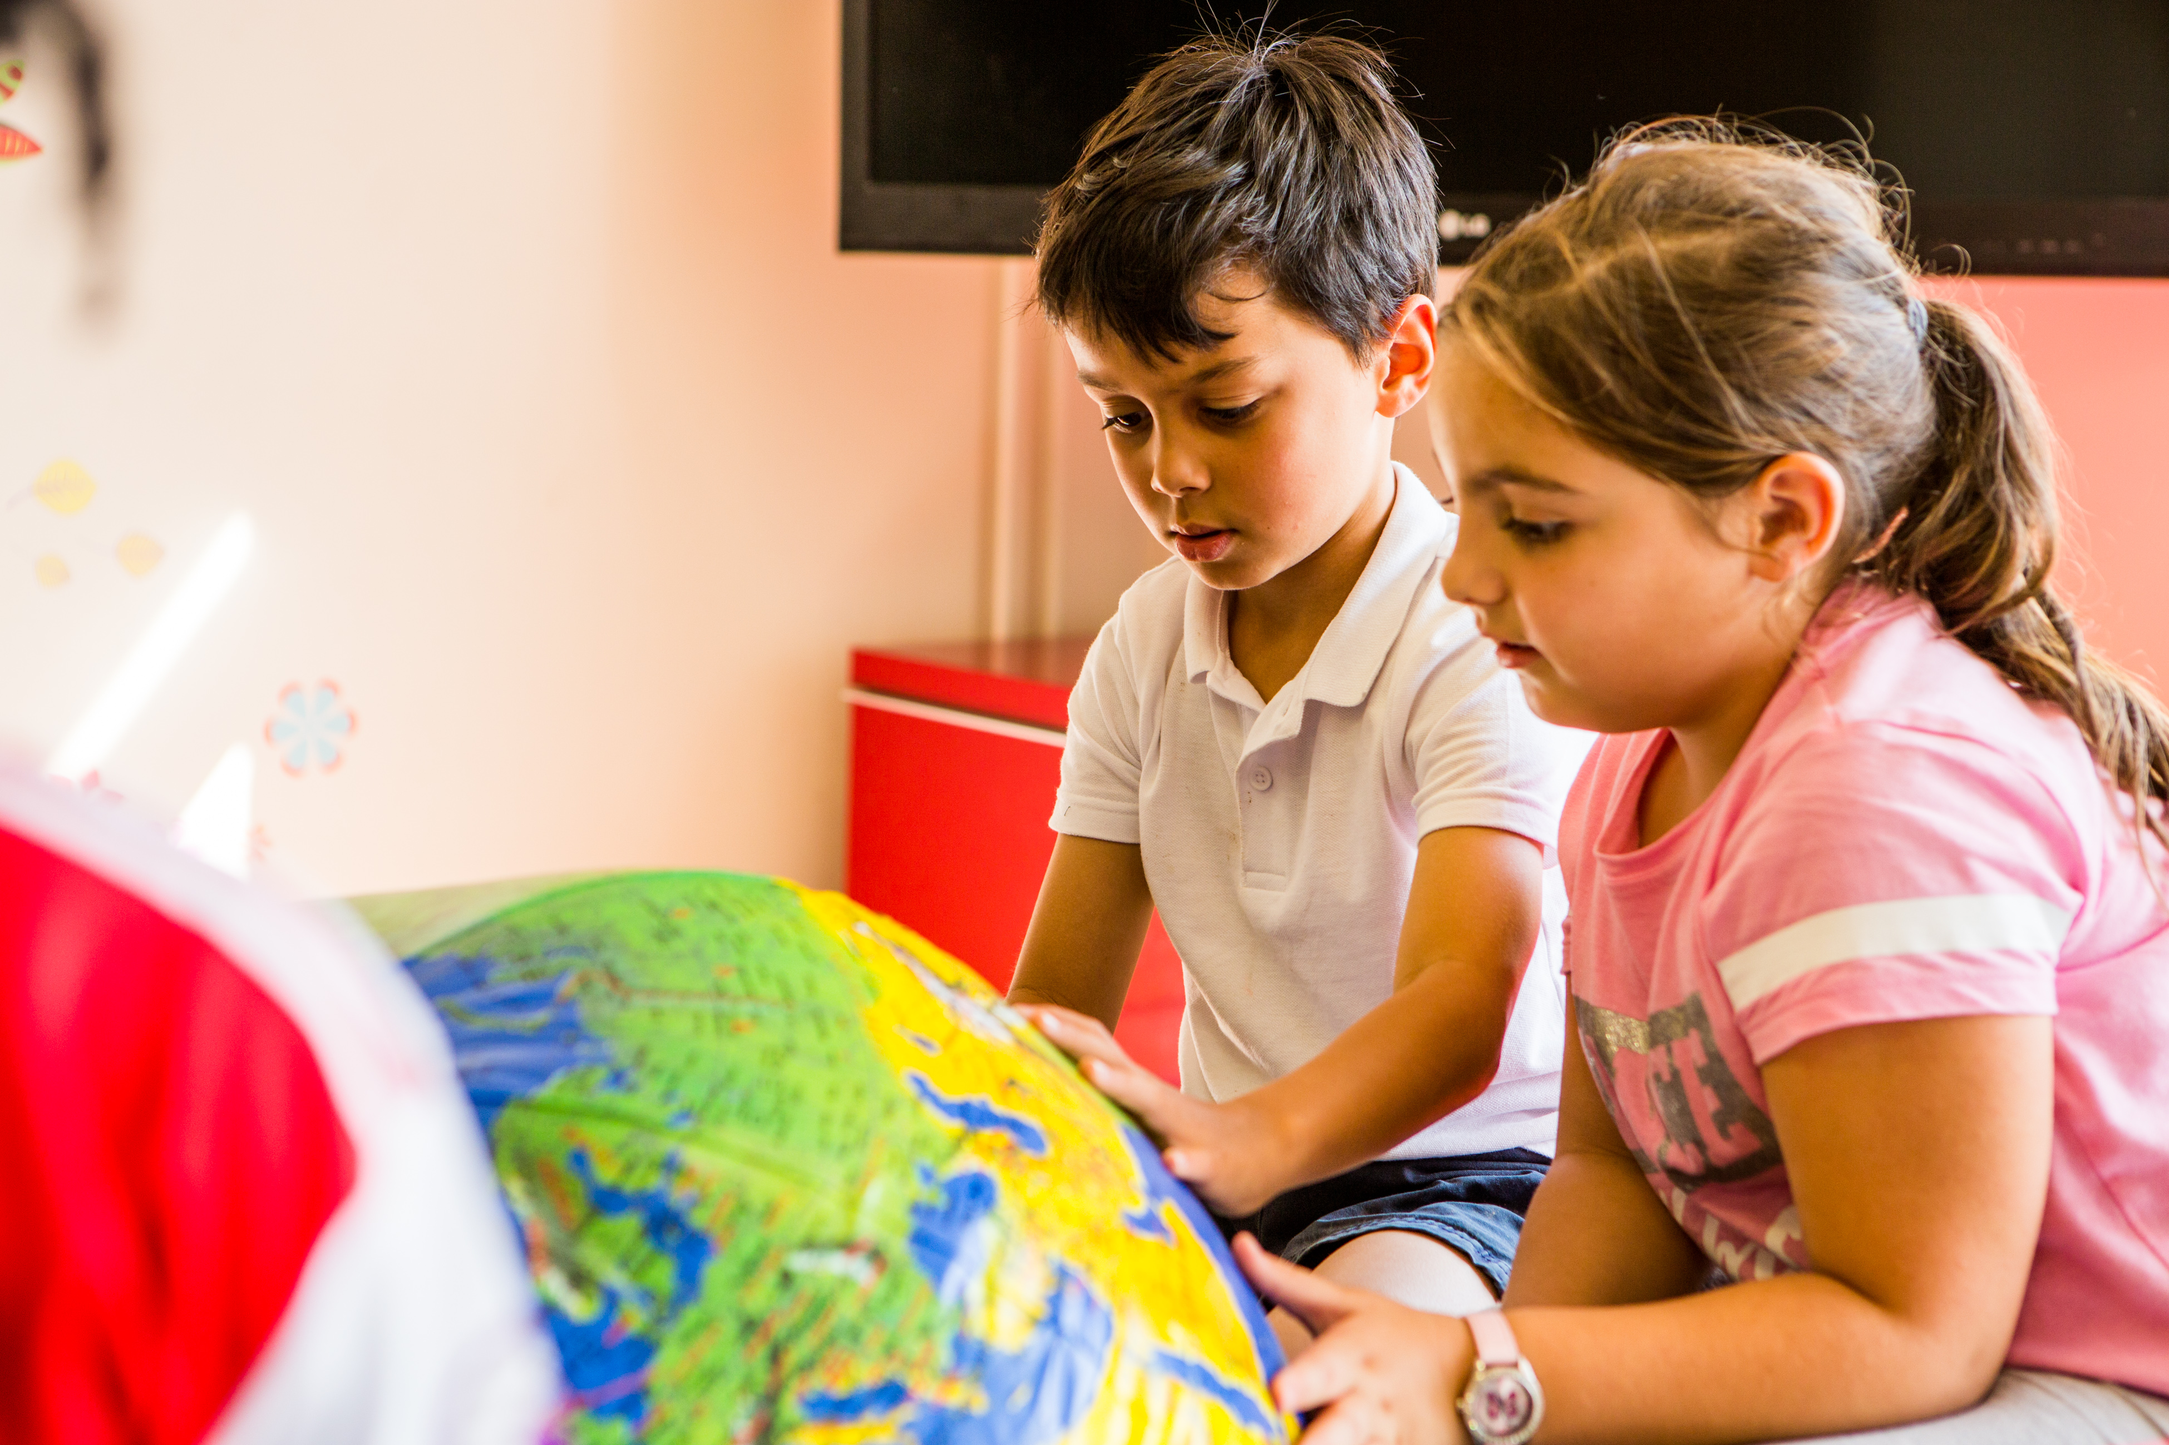
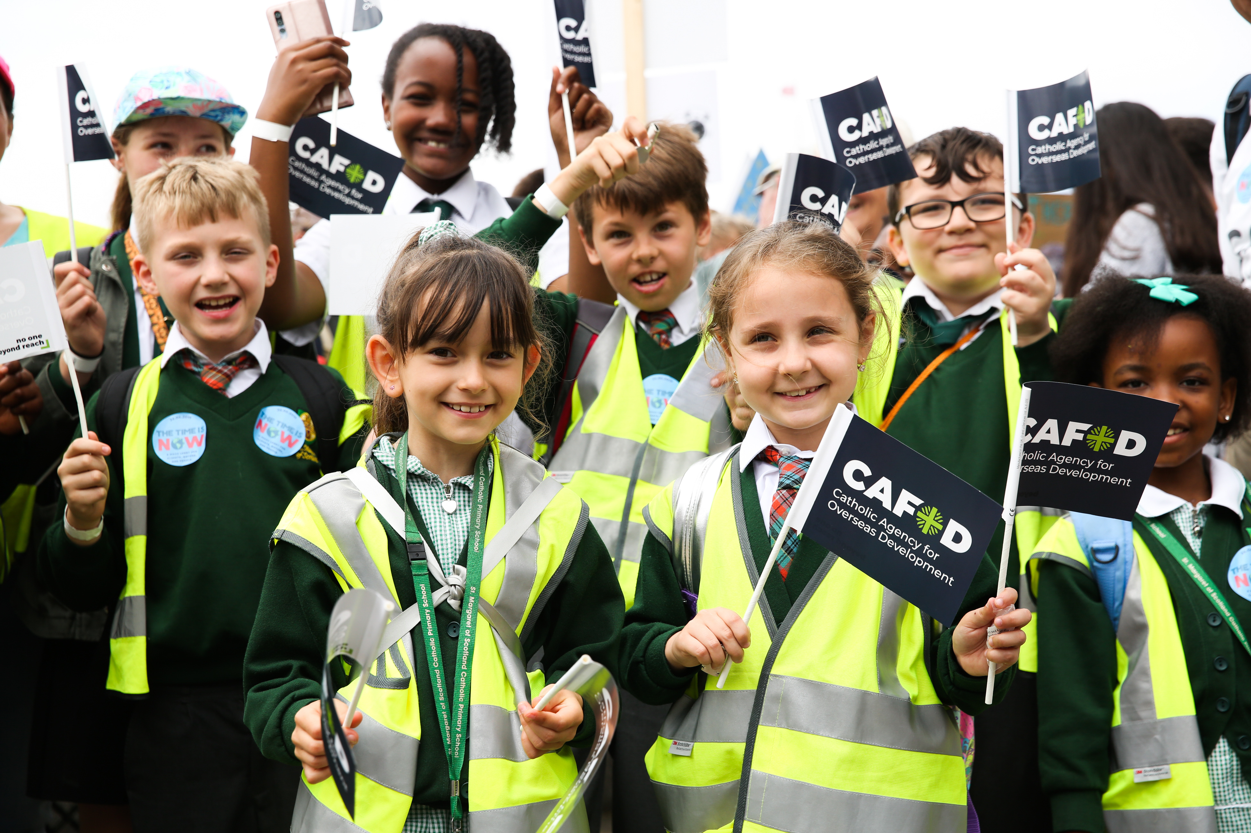
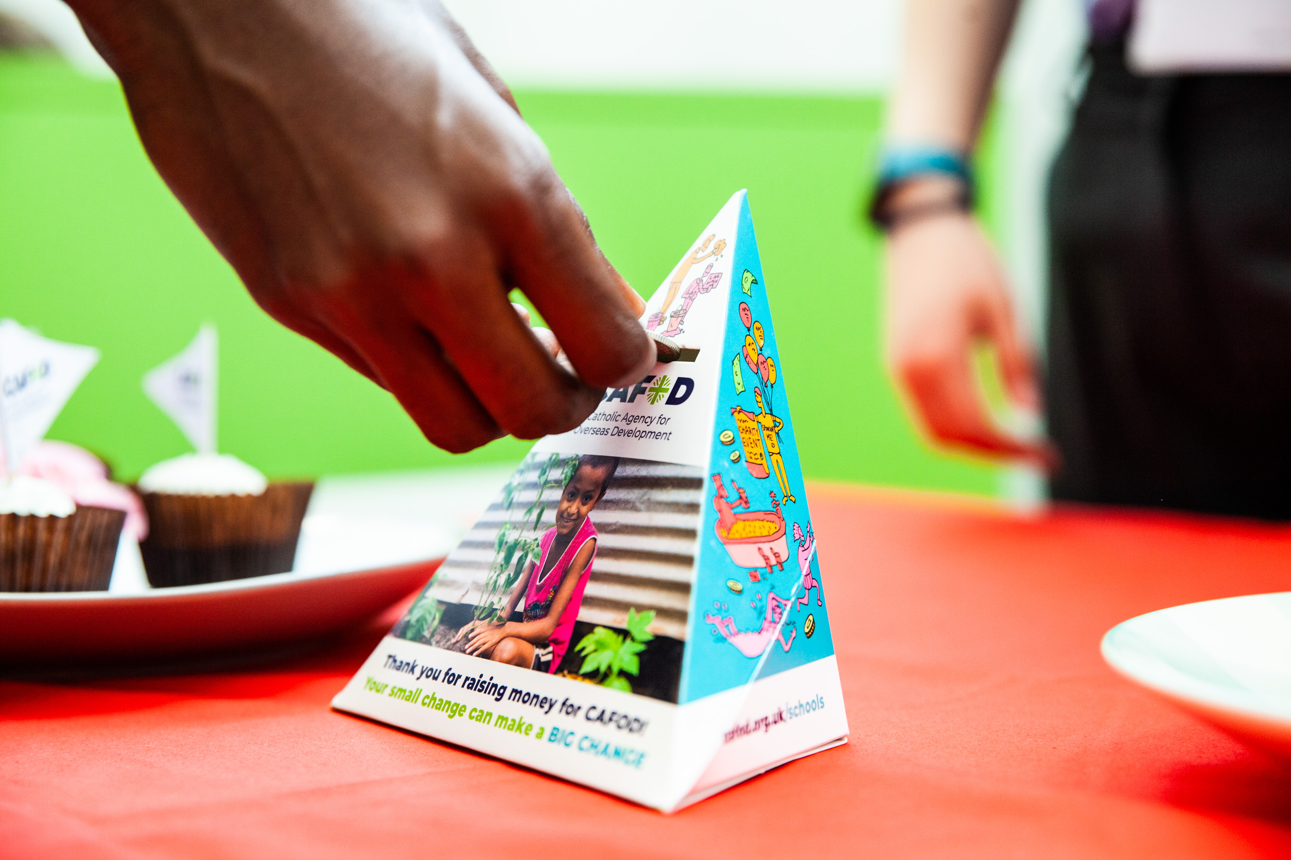
We can show we care in many ways...
We can pray
We can learn and tell others
We can take action
We can fundraise
Notes:
Photo credit: Thom Flint

Slide 6
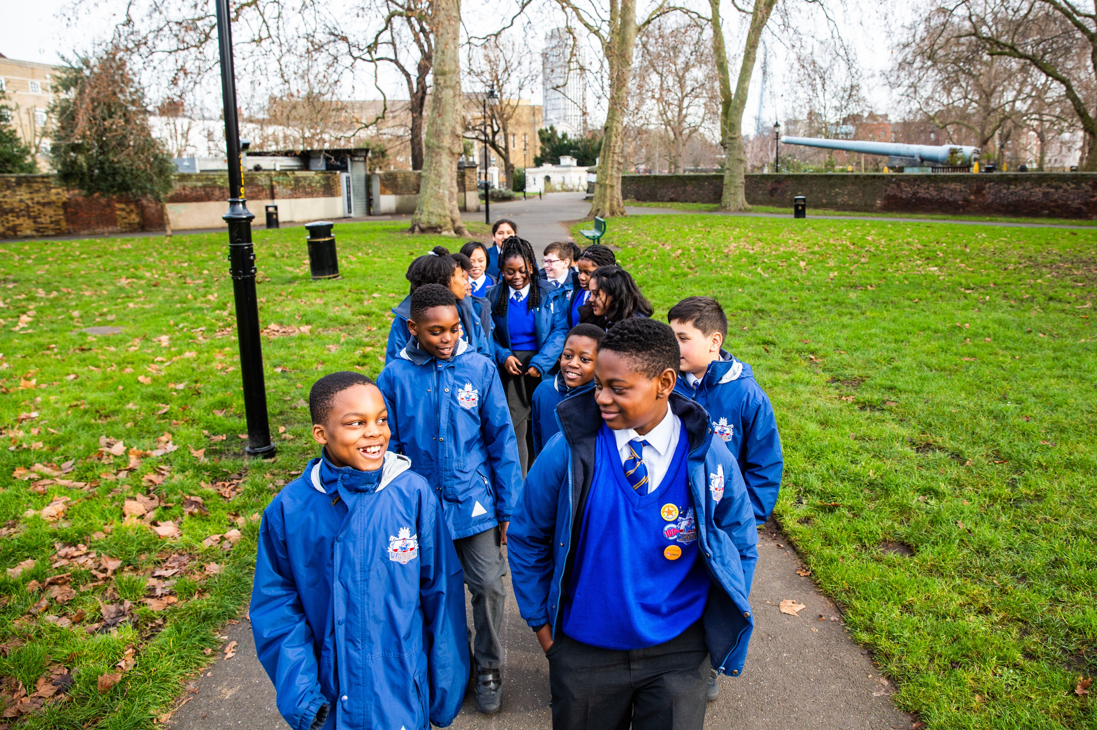
We can show solidarity for our brothers and sisters around the world by taking part in events like CAFOD's Big Lent Walk to raise money to help fight global poverty.
Notes:
Photo credit: Thom Flint

Slide 7
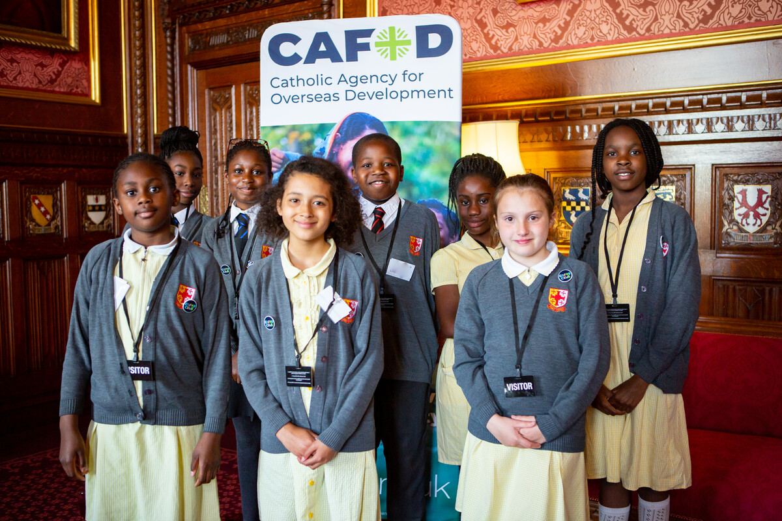
Children in St Chad’s Primary School are speaking out for justice in Parliament, showing solidarity with our global family.
Notes:
Photo credit: Joe Newman

Slide 8
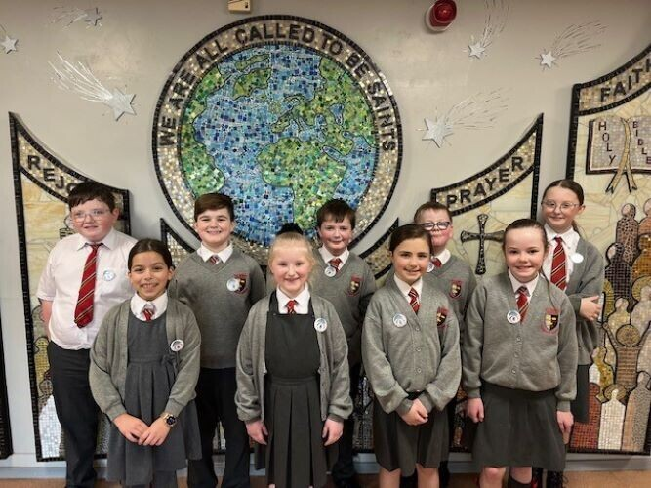
Children from All Saints Primary School have formed a group called Poverty Busters.
They act in solidarity by tackling poverty in the UK and around the world!
Notes:
Photo credit: Joe Newman

Slide 9
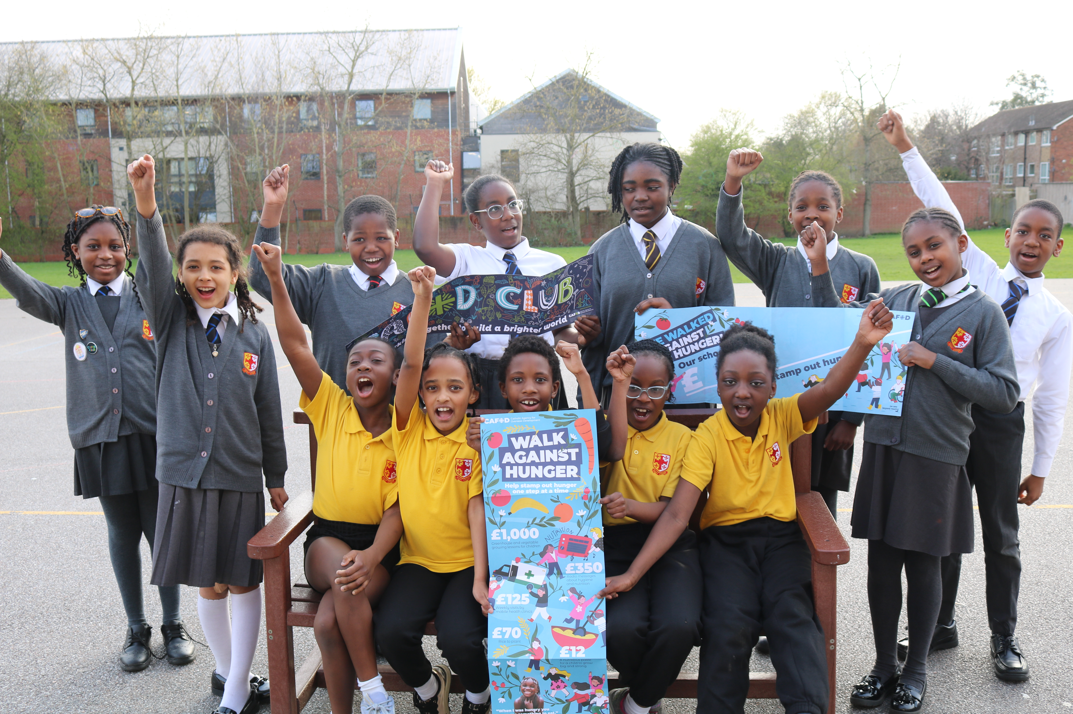
CAFOD clubs like this one at St Chad’s Primary School are acting in solidarity.
They are learning about global poverty around the world, raising awareness at school and taking action by fundraising and campaigning with CAFOD!
Notes:
Photo credit: Joe Newman

Slide 10
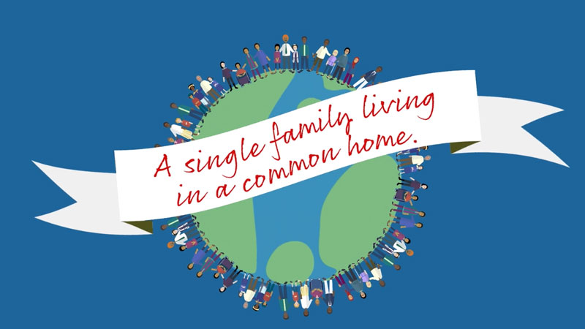
“We are a single family living in a common home.”
Pope Francis, Fratelli Tutti, 17

Slide 11
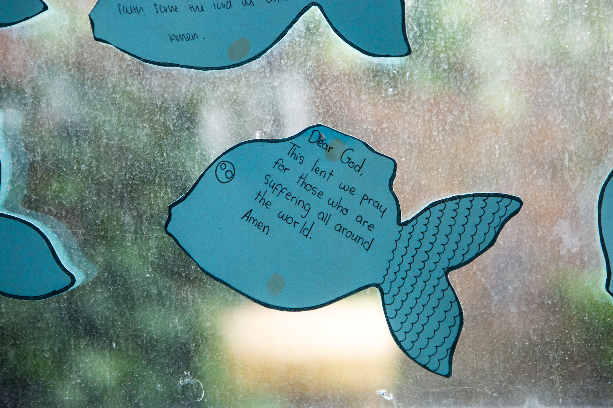
Let us pray.
Loving God,
We believe that we are one big human family.
Help us to reach out to people who are suffering or sad, showing them the love you have shown
to us.
Lord in your mercy
Hear our prayer

Slide 12
Showing we care
Shristi the Sun Bear reminds us that Solidarity is showing we care.
How can we show solidarity with our brothers and sisters around the world?
Notes:
Let us pray..

