Slide 1
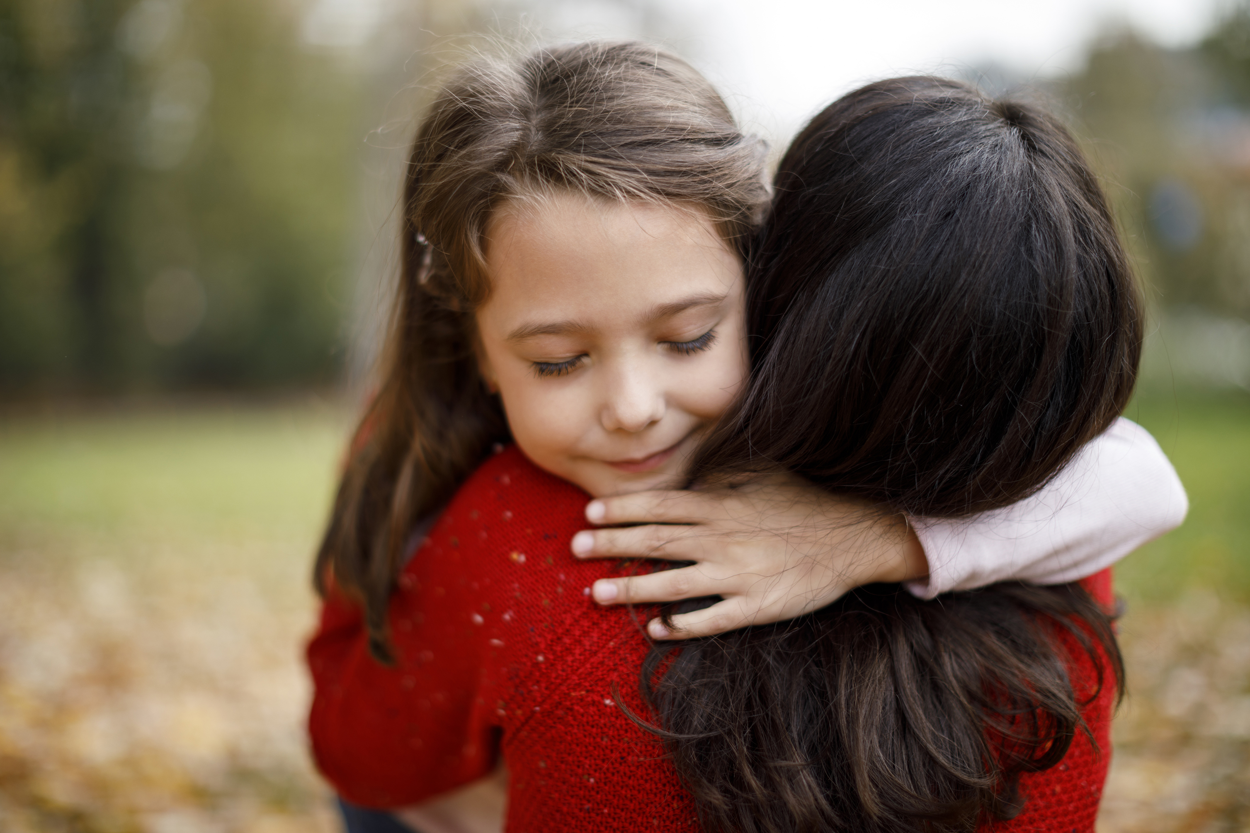
How can we show that we love one another as Jesus loves us?
Gather
Notes:
Children’s liturgy: Fifth Sunday of Easter (Year C)
Preparation of the worship space
Colour: white
Props: paper hearts, colouring pens and pencils
Song suggestions:
A new commandment I give unto you (920, Laudate)
Welcome
Today Jesus has a very important message for his disciples, and for all who believe in him. Jesus asks us to love one another as he loves us. Let’s think about how we can do that today.
Hugs
Photo credit: Stock image

Slide 2
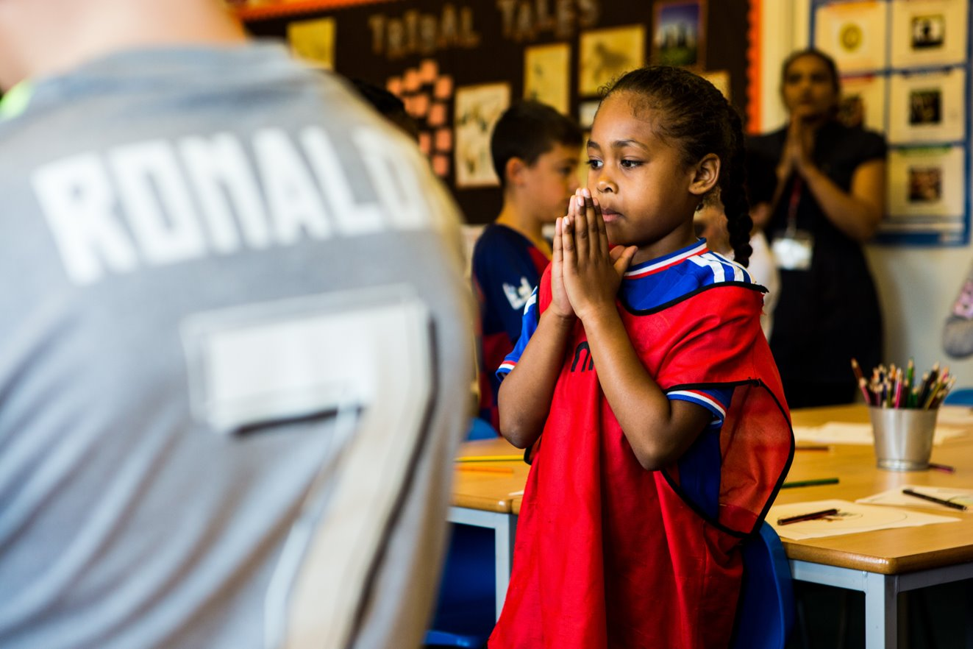
God of hope,
You sent your Son Jesus to teach us how to love one another. Help us to follow his example and to love all our brothers and sisters around the world.
Amen.
Notes:
Children at Our Lady Queen of Heaven Primary School
Photo credit: Thom Flint

Slide 3
Gospel: John 13: 31-35
After Judas had left, Jesus said, “Now the Son of Man’s glory is revealed; now God’s glory is revealed through him. And if God’s glory is revealed through him, then God will reveal the glory of the Son of Man in himself, and he will do so at once.
"My children, I shall not be with you very much longer. You will look for me; but I tell you now what I told the Jewish authorities, ‘You cannot go where I am going.’
"And now I give you a new commandment: love one another. As I have loved you, so you must love one another. If you have love for one another, then everyone will know that you are my disciples.”
Word

Slide 4
What do you remember from the Gospel reading?
Jesus tells his disciples that he will not be with them much longer and he tells them how he’d like them to behave.
Can you remember what he told them to do?
Jesus told the disciples to love one another, just as he had loved them.
What do you think this means? How did Jesus show his love for people?
Respond
Notes:
Heart
Photo credit: Stock image

Slide 5
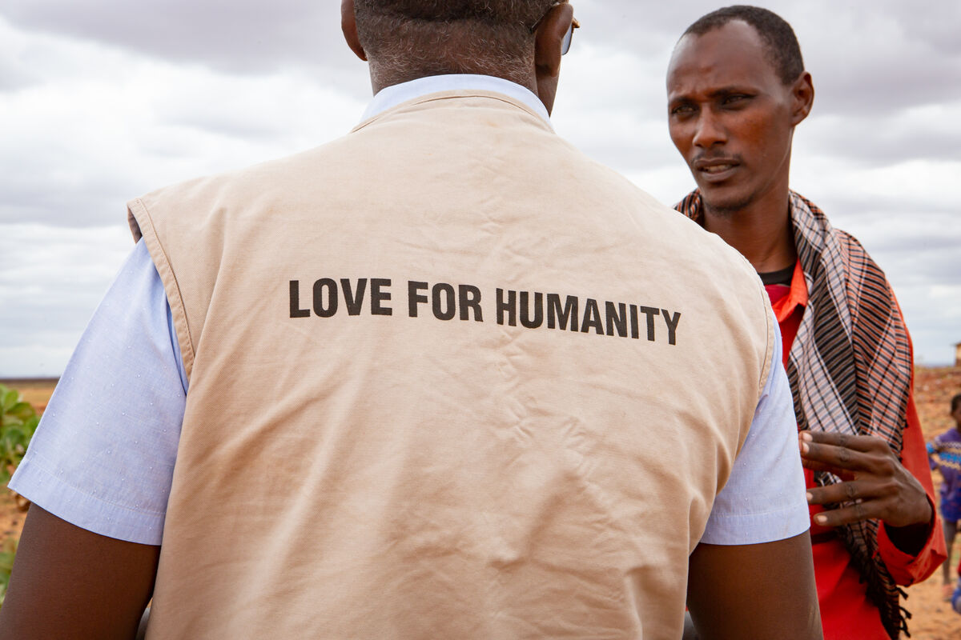
Jesus spent time with people, especially those who were sick, lonely, frightened or poor.
He listened to them and ate with them. He healed them and he helped them to change their
lives for the better.
Do you think this message to love other people was just for the disciples? What do you think
Jesus wants us to do?
Notes:
Food distribution, Kenya
Photo credit: Louise Norton

Slide 6
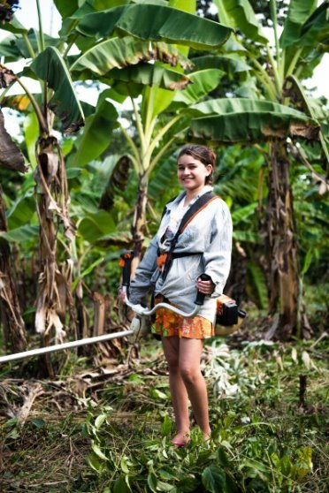
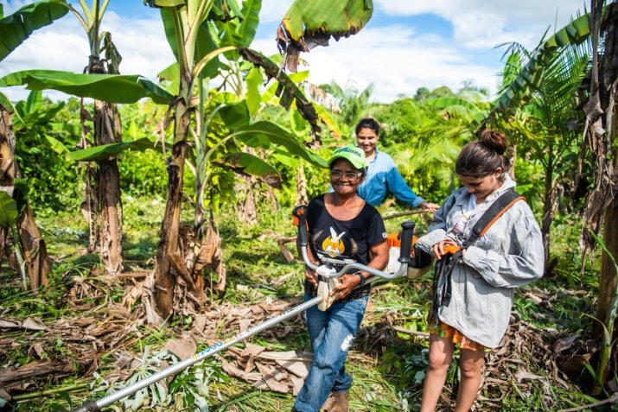
Luana lives with her grandmother in a village in Brazil. "It’s quiet and peaceful and I am near to nature here," says Luana.
With CAFOD's help, the community has learned how to grow bananas, lemons, coconuts and Brazil nuts on the land.
Luana likes helping her grandmother to look after the crops which help to feed the village.
Notes:
Luana and her grandmother, Brazil
Photo credit: Ana Caroline De Lima

Slide 7
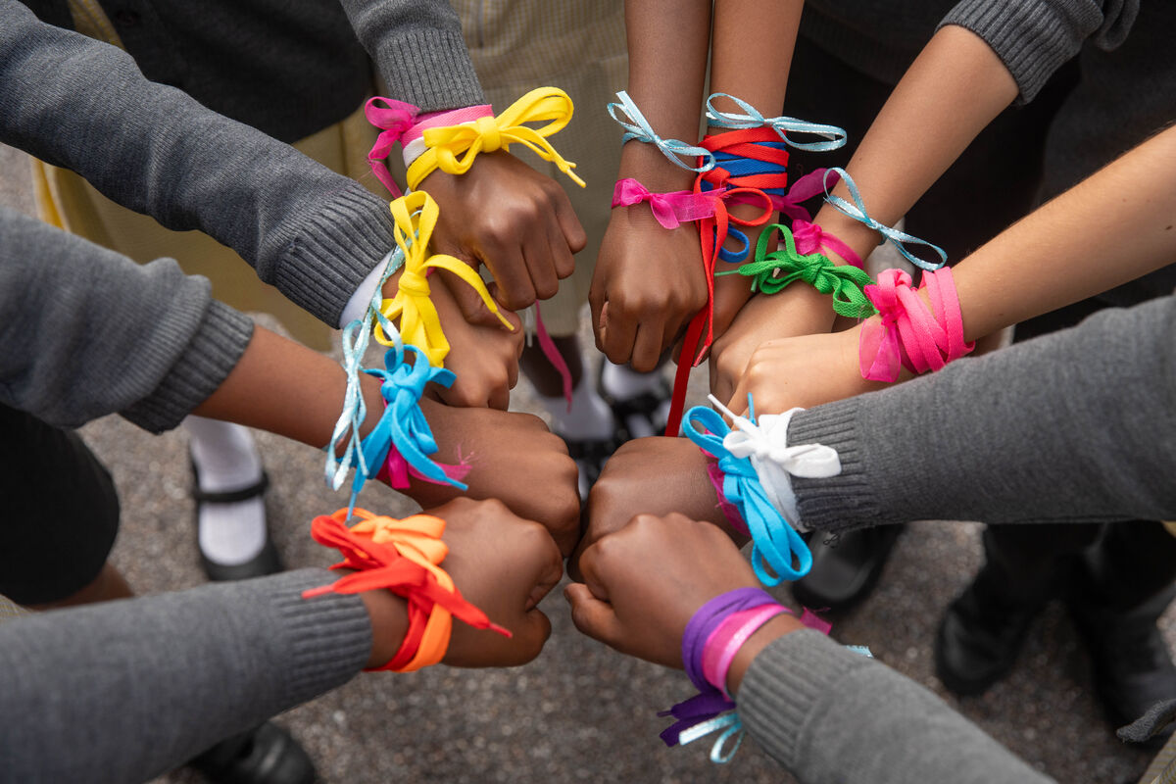
The children at St Chad’s primary school in Croydon made colourful friendship bracelets to sell to raise money and awareness for CAFOD.
Their aim was to support people living in poverty as they try to build a better world.
As Faith explained: “We wanted to help our global neighbours. We are all part of God’s family, and all families take care of each other.”
Notes:
Children at St Chad's
Photo credit: Joe Newman

Slide 8
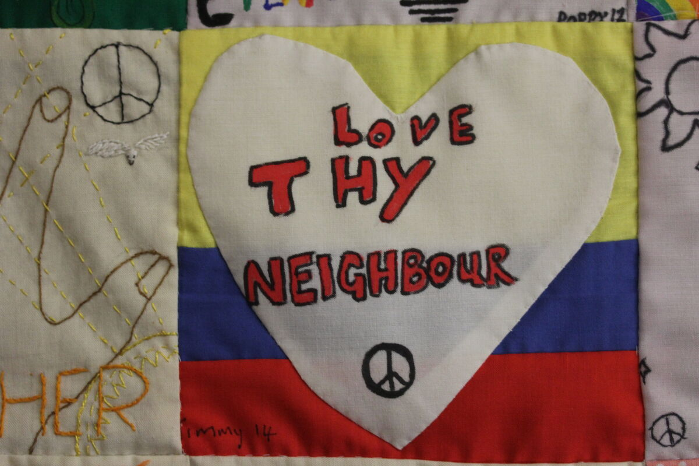
How do you think Luana and the children at St Chad’s school are showing their love for others?
Their stories show us that we can all make a difference and find our own way to love one another.
Jesus asks us all to love one another as he loves us.
Notes:
Hands On Magdalena Medio Norwich wall hanging
Photo credit: Joe Savage

Slide 9
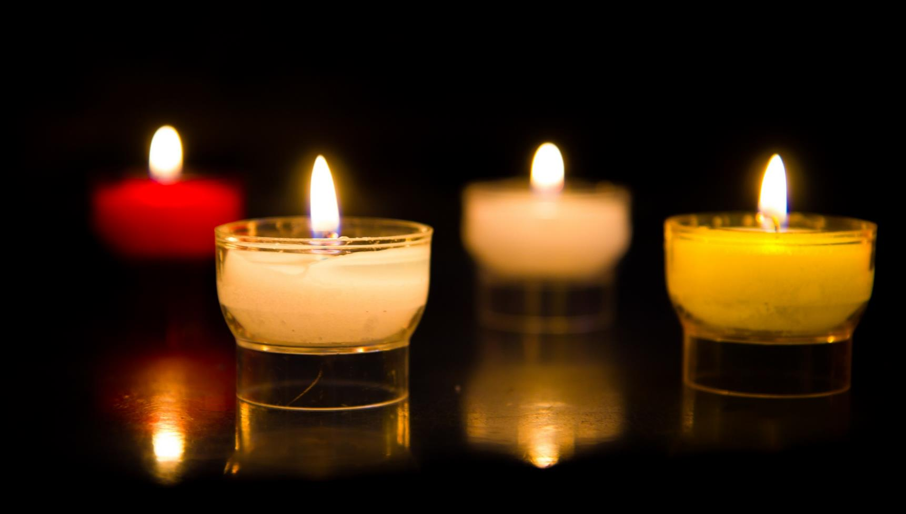
Let us pray…

Slide 10
We pray for world leaders: that they may follow Jesus’ example and show special care for people who are poor, sick, alone or afraid. Lord, in your mercy…
We pray for all children around the world: that they may be loved, cared for and have hope for the future. We pray for our parish, family and friends: that we may love one another as Jesus loves us. Lord, in your mercy…

Slide 11
In this Jubilee Year, we pray that we may be signs of hope in our world through all that we do and how we treat one another. Lord, in your mercy…
Generous God,
Fill our hearts with your love and help us to share this love with all our brothers and sisters throughout the world. Amen.

Slide 12
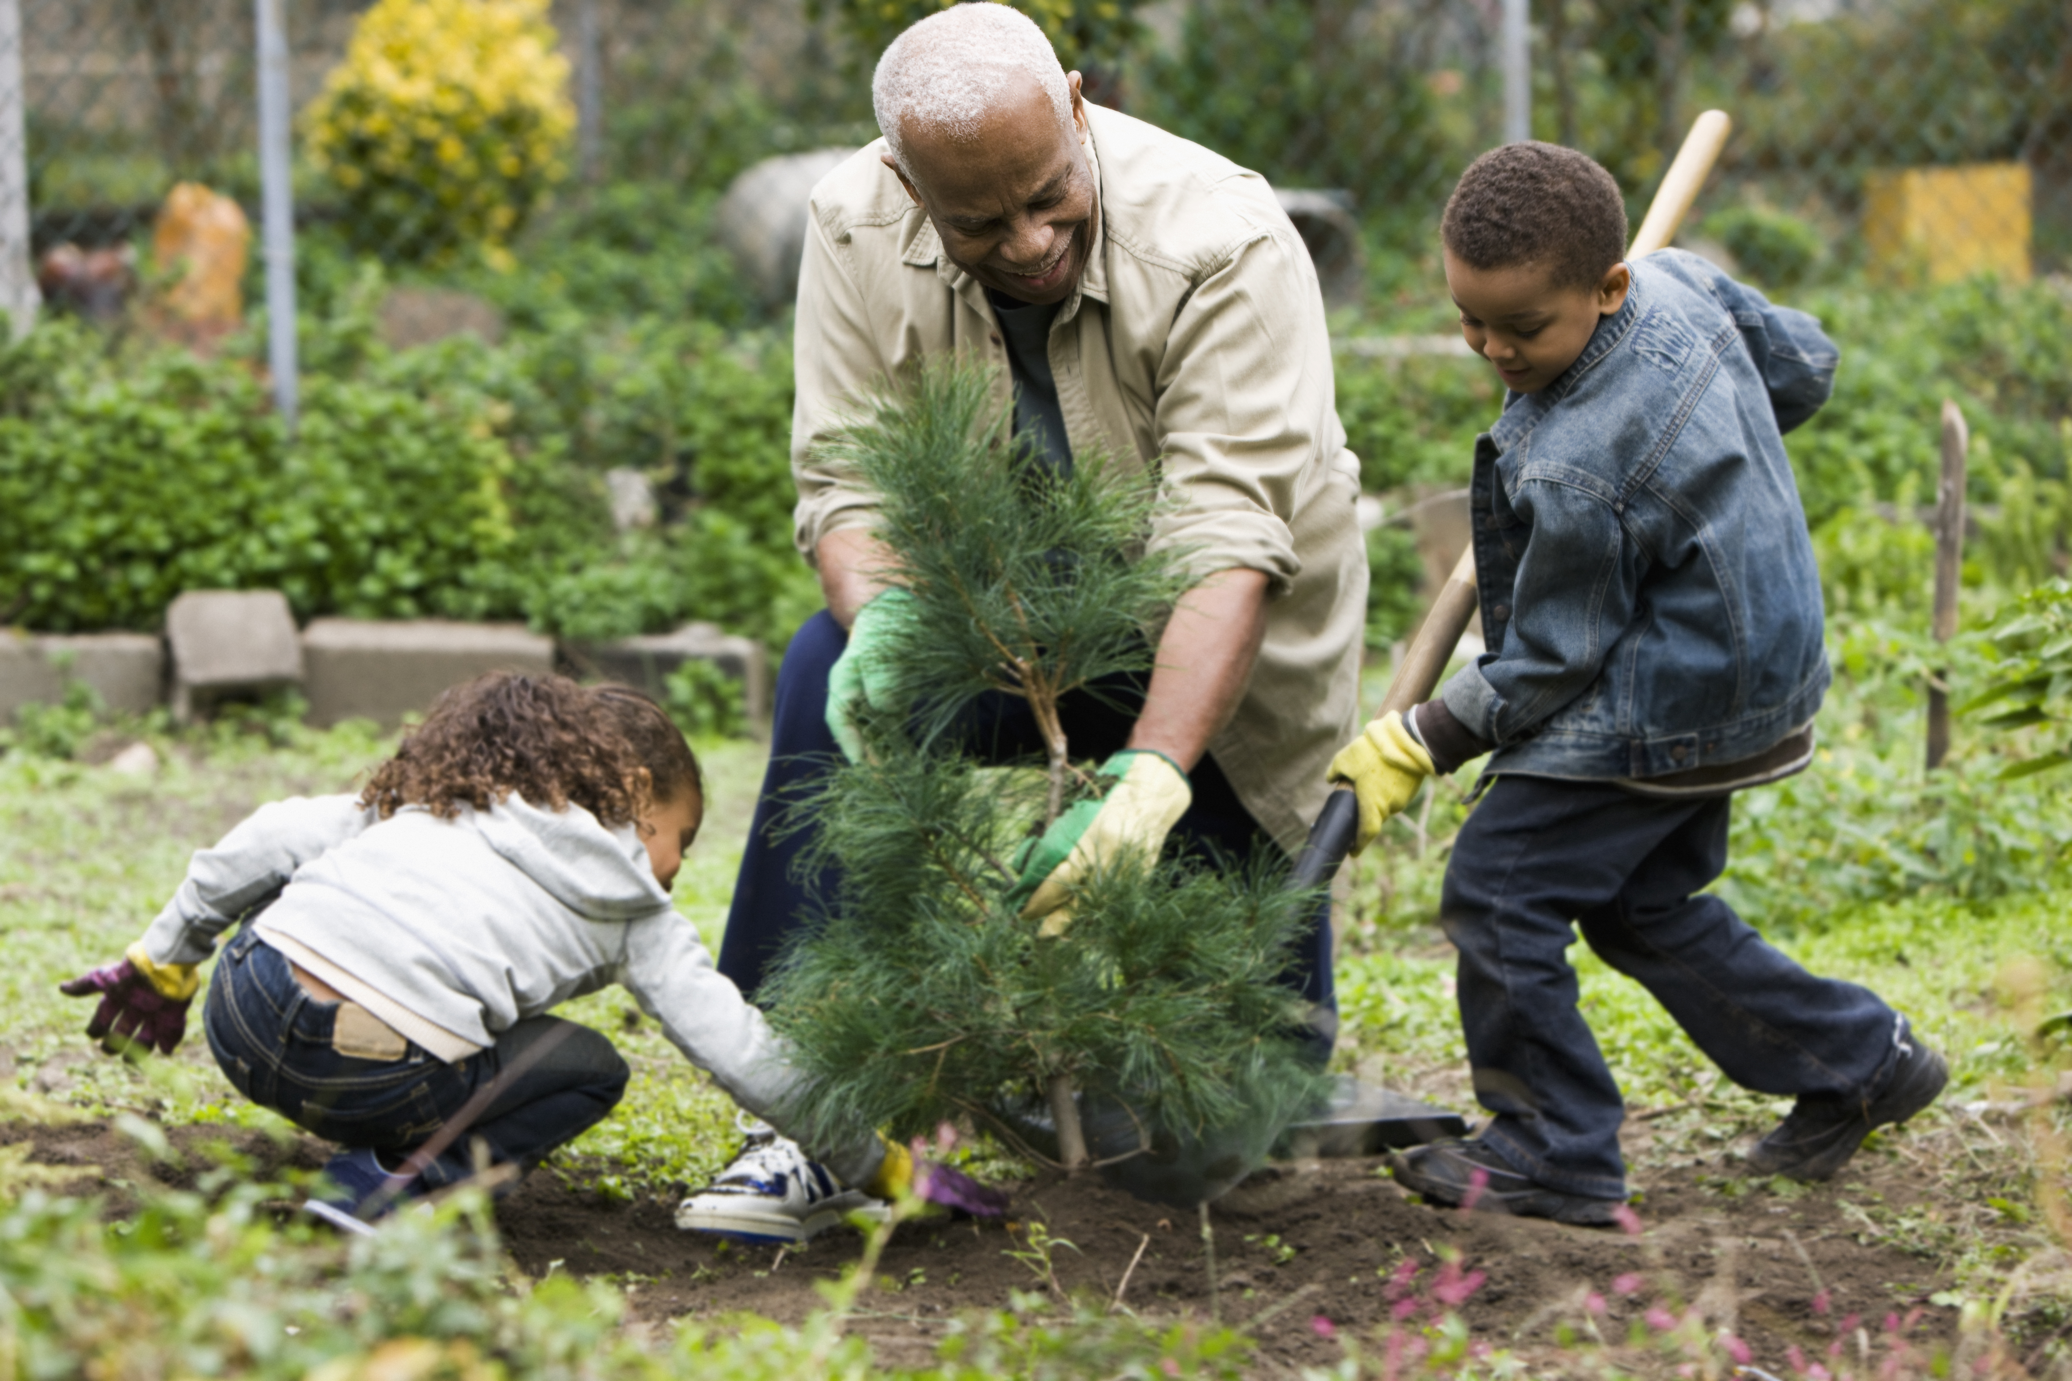
This week, how can we show that we love one another as Jesus loves us?
Send
Notes:
Children helping in the garden
Photo credit: Stock image

Slide 13
Activity suggestions
Invite the children to colour in the accompanying illustration and to write or draw how they will love one another in the coming week.
Give the children a heart-shaped piece of paper. Encourage them to write a prayer on it for all their brothers and sisters throughout the world, or to write or draw how they will love one another in the coming week.
Remind the children to tell the people that they live with all that they have heard and thought about in the liturgy today. If they have written a prayer encourage them to say it together during the week.
Invite the children to do at least one thing in the next week to show their love for others.
Notes:
Illustration: Jane Smith

Slide 14
Notes:
Illustration: Jane Smith

Slide 15
Jubilee activities!
It will soon be time to make your Jubilee Pledge!
In June or July, all Catholic schools are invited to make a Jubilee Pledge to live out Catholic Social Teaching.
A better world needs all of us, and the Pledge will be a whole school, long-term commitment to building a fairer world.
Watch our film and download our resources to help you write your Pledge and plan your Pledge Day:
Jubilee pledge for schools
The Jubilee Year is a landmark moment in the life of the global church. School communities are invited to join together as pilgrims of hope, pledging to work together for God’s kingdom of justice, peace and love. Find resources at:
Jubilee for schools 2025 – Pilgrims of Hope

