Slide 1
What happened at COP26?

Slide 2
THANK YOU to everyone who
joined our Eyes of the world
campaign for COP26.
58,000 of you called on our government to keep the world’s poorest people at the heart of the talks.

Slide 3
Your voices
were heard.

Slide 4
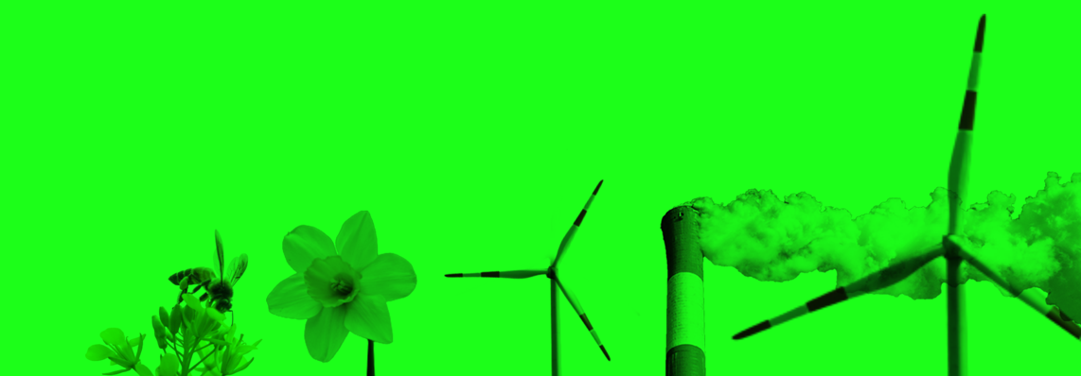
You asked for countries to stop funding fossil fuels overseas…
…The Glasgow Climate Pact is the first COP agreement to mention fossil fuels, with an agreement to phase-down coal.

Slide 5
You called for countries to keep global temperature rises below 1.5 degrees….
…Countries at COP26 agreed to come to COP27 in 2022 with their plans for cutting emissions.

Slide 6
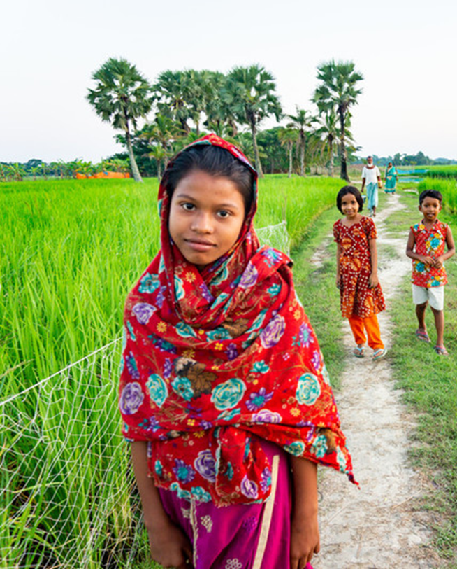
The tide is turning.
But COP26 was just the start. And it didn’t go far enough.
It hasn't delivered the action that’s urgently needed.

Slide 7
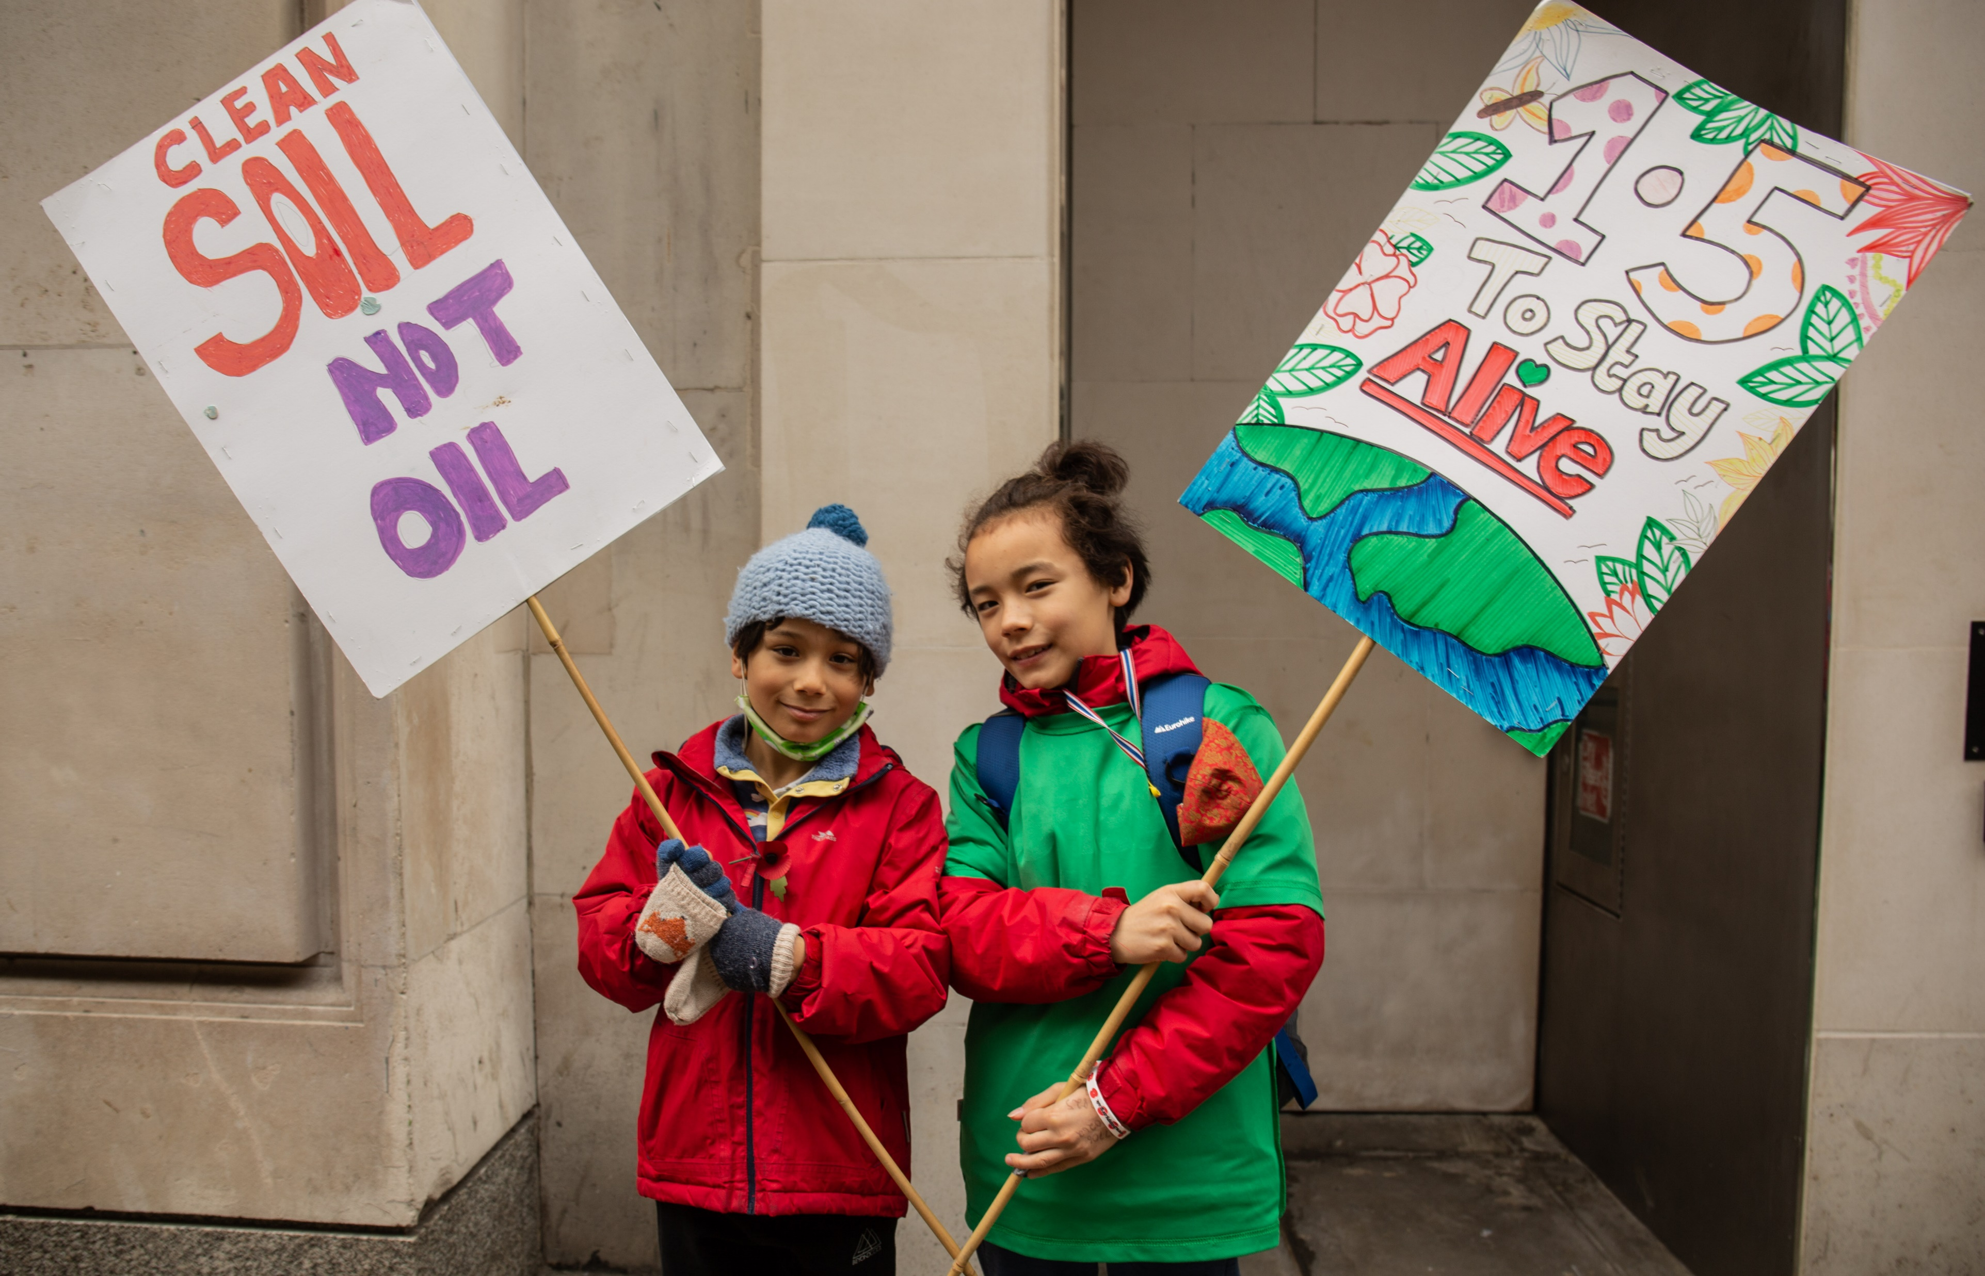
The hotter our climate gets, the more we will see extreme weather, flooding and droughts.
It’s the world’s poorest communities who have done the least to cause the climate crisis, that are suffering the most right now.

Slide 8
We are on a road with no turning back now. The question is are we travelling 'far enough, fast enough and fairly enough' – to which the answer is no. Climate justice is not just a concept for some, it is what must be delivered.
Christine Allen, CAFOD Director

Slide 9
"Now is the time to act, urgently, courageously and responsibly."
Message to COP26. - Pope Francis

Slide 10
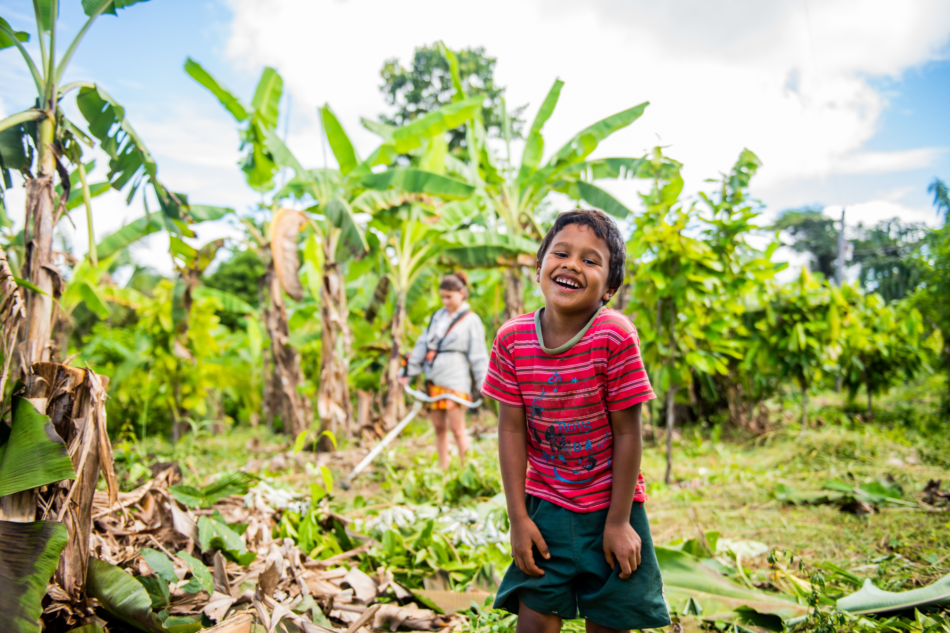
Let’s keep going!
By speaking up for our earth,
and keeping our global brothers and sisters in our prayers,
we can build a better world.

