Slide 1

What will you do to share love?
Gospel Celebration of the Word
Notes:
Children’s liturgy: Thirty-third Sunday in Ordinary Time (Year C)
Preparation of the worship space
Colour: green
Props: coloured pens and pencils
Song suggestions
Be not afraid (964, Laudate)
Welcome
Today Jesus warns us that life will be difficult. The world will face wars and disasters, but we mustn’t lose hope. We must trust in God who will guide us and save us.
Anuarite Kahindo sharing milk with her children
Photo credit: Arlette Bashizi

Slide 2
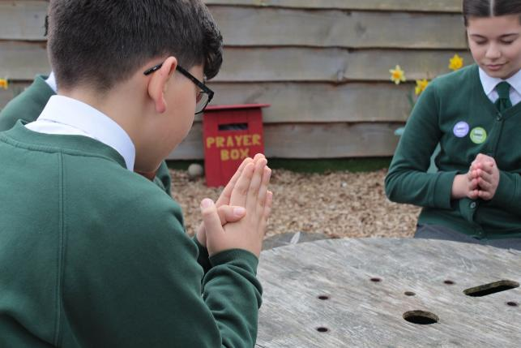

All-powerful God, Nothing is greater than your love, so may we trust in you, no matter what difficulties and challenges we face. Amen.
  Gather
Notes:
St Francis Xavier's RC Primary School, Herefordshire
Photo credit: Vicky Ahmed

Slide 3

Gospel: Luke 23: 35-43
The people stood there watching while the Jewish leaders jeered at Jesus: “He saved others; let him save himself if he is the Messiah whom God has chosen!”
The soldiers also mocked him: they came up to him and offered him cheap wine, and said, “Save yourself if you are the king of the Jews!”
Above him were written these words: “This is the King of the Jews.” One of the criminals hanging there hurled insults at him: “Aren’t you the Messiah? Save yourself and us!”
Word

Slide 4
The other one, however, rebuked him, saying, “Don’t you fear God? You received the same sentence he did. Ours, however, is only right because we are getting what we deserve for what we did; but he has done no wrong.”
And he said to Jesus, “Remember me, Jesus, when you come as King!”
Jesus said to him, “I promise you that today you will be in Paradise with me.”

Slide 5
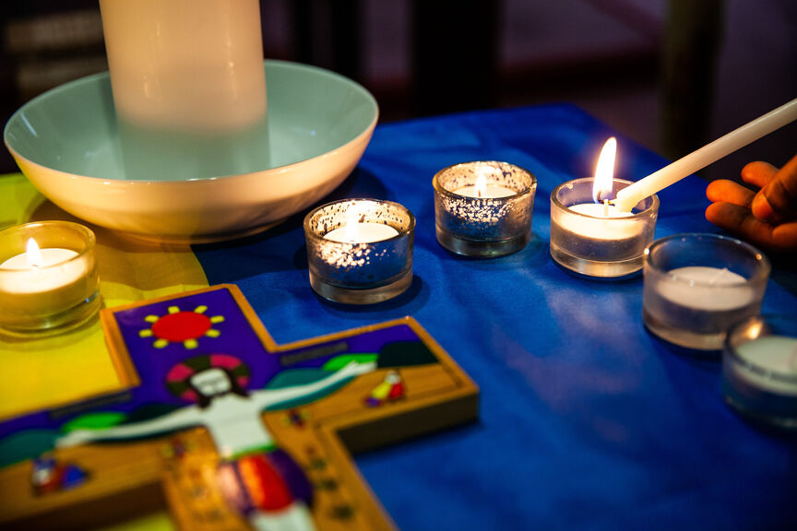

What do you remember from the Gospel reading?
In today’s gospel we hear how Jesus is put to death on a cross and how he is laughed at and made fun of by the people watching.
Can you imagine what it must have been like for Jesus in front of all those people, to be in pain and to be laughed at?
How do you think Jesus felt?
Respond

Slide 6
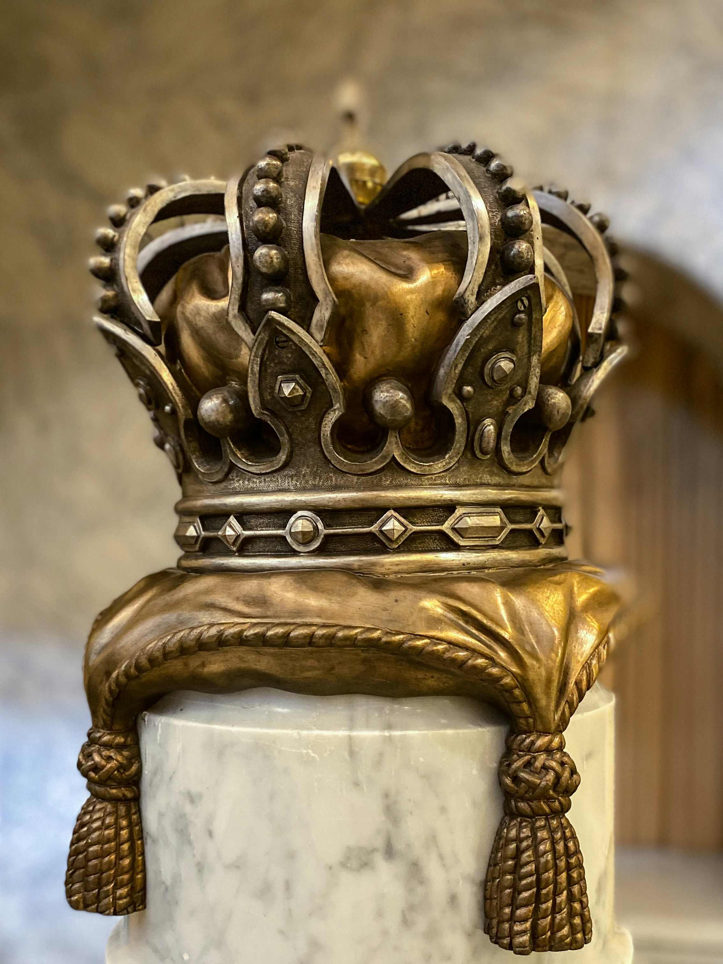
The label above Jesus’ cross said 'king of the Jews'. How do we imagine a king? What do kings wear? Where do they live?
The crowds can’t understand why Jesus, the Son of God, can’t save himself. To them a king is someone who has power, money, land, expensive clothes – not someone on a cross with a crown of thorns on his head.
Kings are powerful, but on the cross Jesus seems helpless. He is going to die and the people can’t understand it.
Notes:
Gold crown
Photo credit: Linda Gerbec on Unsplash

Slide 7

We know now that this was all a part of God’s plan. Jesus had to die so that we are saved.
Jesus is a very different kind of king to one who lives in a palace. He is the king of love. He gives us all a chance of new life with him in heaven.
There were two thieves, one on either side of Jesus, on crosses as well. Can you remember what the first thief said to Jesus?
Notes:
Heart
Photo credit: Stock image

Slide 8

The first thief wants Jesus to prove he is the Son of God by coming off the cross. He insults him.
The second thief tells the first off for being so rude. He knows Jesus has done nothing wrong and he asks Jesus to remember him.
Jesus can see the second thief is sorry for what he has done. Jesus promises to remember him and that that he'll be welcomed into Jesus’ kingdom.
What does this show us about Jesus?
Notes:
A helping hand
Photo credit: Billy Pasco on Unsplash

Slide 9

Even when things are bad, when we are frightened, or hurting, upset or lonely, Jesus is right there with us.
He knows how it feels to be laughed at, to be sad, to be in pain. And just like he did with the second thief, he is always willing to love us and welcome us.
Jesus, the king of love, showed his love for all people by dying on the cross for us.
How do you think we can show our love for others as Jesus asks us to?
Notes:
Holding hands
Photo credit: Tabitha Turner on Unsplash

Slide 10
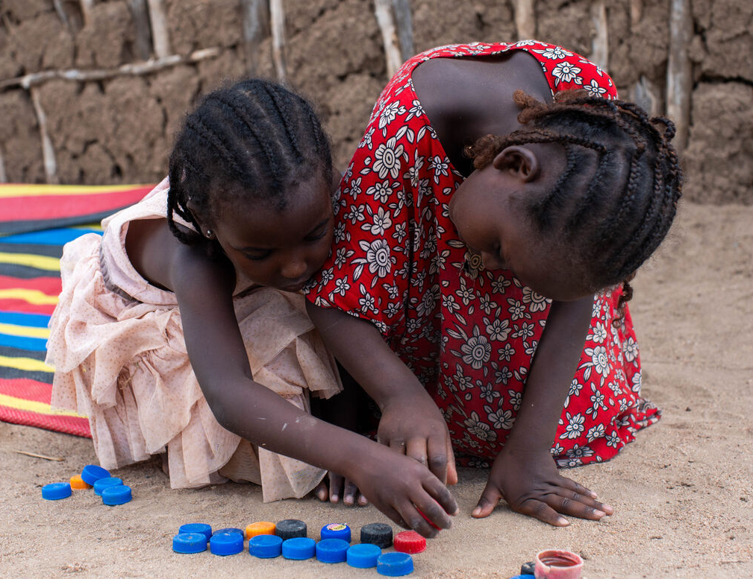
We can be kind, welcoming, generous.
We can make sure that when we have power, we use it as Jesus did – for the good of all people – not just to make ourselves rich and important.
We can make sure we include others in our friendships and in our games.
We can join with others to raise money or to change a situation we think is unfair.
Notes:
Fatu and Worqui play together, Marsabit, Kenya
Photo credit: Joe Newman

Slide 11
This week, when things are difficult, remember that Jesus is always with you.
This week we are celebrating the end of the Jubilee Year, and remembering all of the ways we have been a sign of hope this year.
But the end of the year is really just the beginning. Let us keep Jesus in our hearts as we continue to build a better world.
Notes:
Together
Photo credit: Janko Ferlic on Unsplash

Slide 12
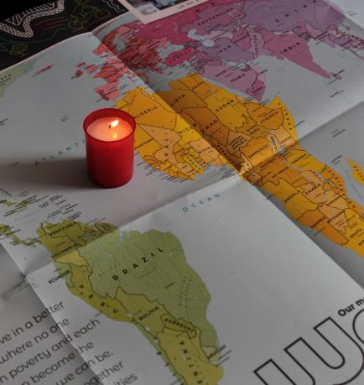
Let us pray
We pray for the church:
that it may follow the example of Christ, loving and serving others at all times.
Lord in your mercy…
We pray for our brothers and sisters in every country: that together with them, we may work for change so all people may live free from poverty.
Lord in your mercy…

Slide 13
Let us pray
In this Jubilee Year:
we pray that we may be signs of hope in our world, in all that we do and how we treat one another.
Lord in your mercy…
O King of Kings, you died so that we may have new life. Help us to share your love with each other and to be there for each other in the most difficult times. Amen.

Slide 14
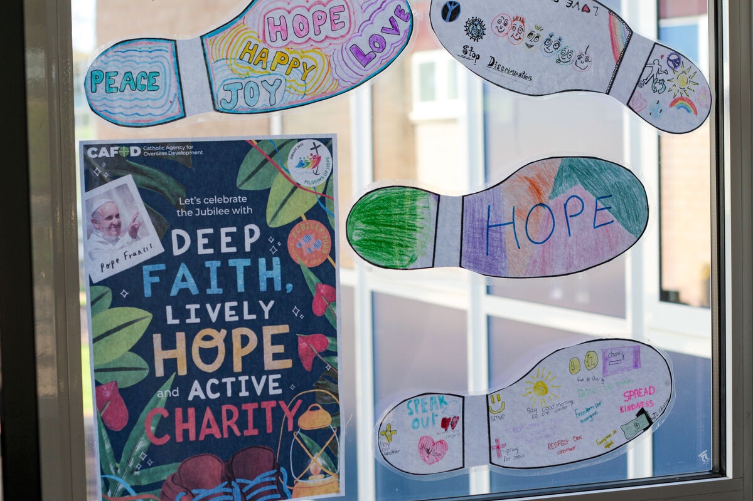

What will you do this week to share love?
Send
Notes:
St Francis Xavier's RC Primary School, Herefordshire
Photo credit: Vicky Ahmed

Slide 15

Activity suggestions
Download the illustration
Invite the children to colour in the accompanying illustration of a crown and to write words around it that describe the type of king that Jesus is (e.g. loving, fair, just, wise, forgiving, serving etc)
Make cardboard crowns with the children. Encourage them to write words on sticky notes that describe what they normally think of when they think of a king or queen (e.g. power, wealth, riches, palaces etc.) How many of these describe the type of king Jesus is? Stick the ones that apply to Jesus on their crowns. Then encourage them to write any more words that describe the type of king that Jesus is on sticky notes and add them to their crowns.
Notes:
Illustration: Jane Smith

Slide 16
Share pictures of different leaders with the children. These could be political leaders, or leaders in sport, the community or other areas. Discuss with the children who these people are and what type of leader they are. Encourage the children to make a collage or artwork about the type of leader they would like to be in their own communities or in the world.
Create a paper chain of people with the children and encourage them to write on it how they will share love with others in the coming week, both as individuals and within the community.
Remind the children to share all that they have heard and thought about in the liturgy today with the people at home . Encourage them to do at least one thing in the coming week to share Christ’s love with others.

Slide 17



Get involved with CAFOD this term
Watch our film
Fundraise this term
Advent resources
Explore our Jubilee Celebration Day resources
Fundraise for a £100 World Gifts Christmas stocking
Download the Advent calendar

Slide 18


