Slide 1

Venezuela Earthquake Appeal

Slide 2
Learn about the what’s happened from a trusted organisation. CAFOD listens carefully to our partners in Venezuela
Pray for all the people involved.
Look out for people in our communities who might have family or friends in Venezuela.
Venezuela

Slide 3
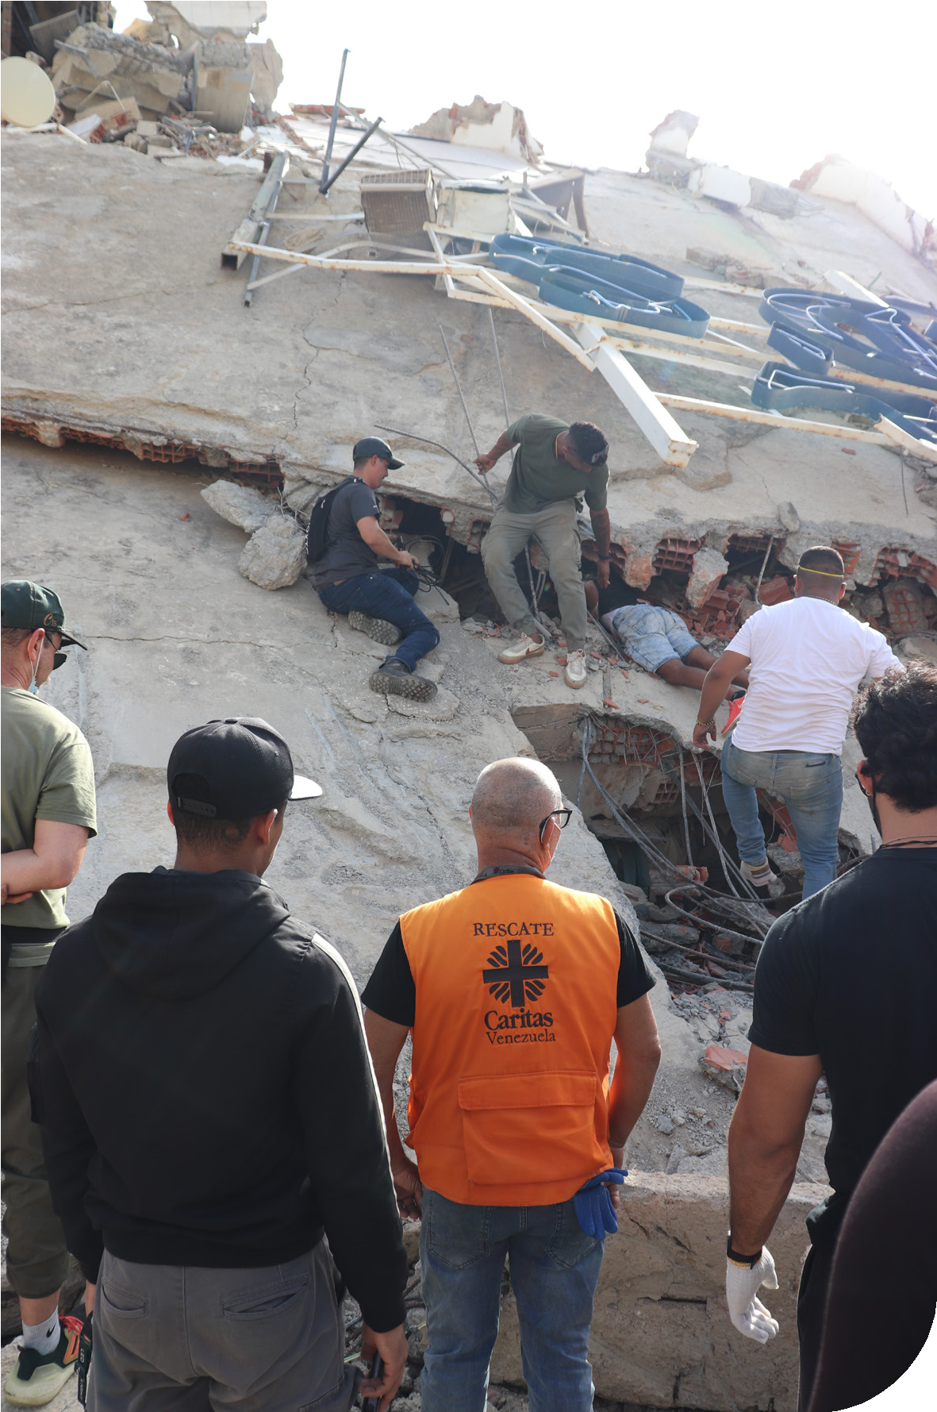
What has happened?
On Thursday 25 June two powerful earthquakes struck northern Venezuela within minutes of each other.
Many people have died, many others are still missing, and homes have been destroyed.
Venezuela

Slide 4
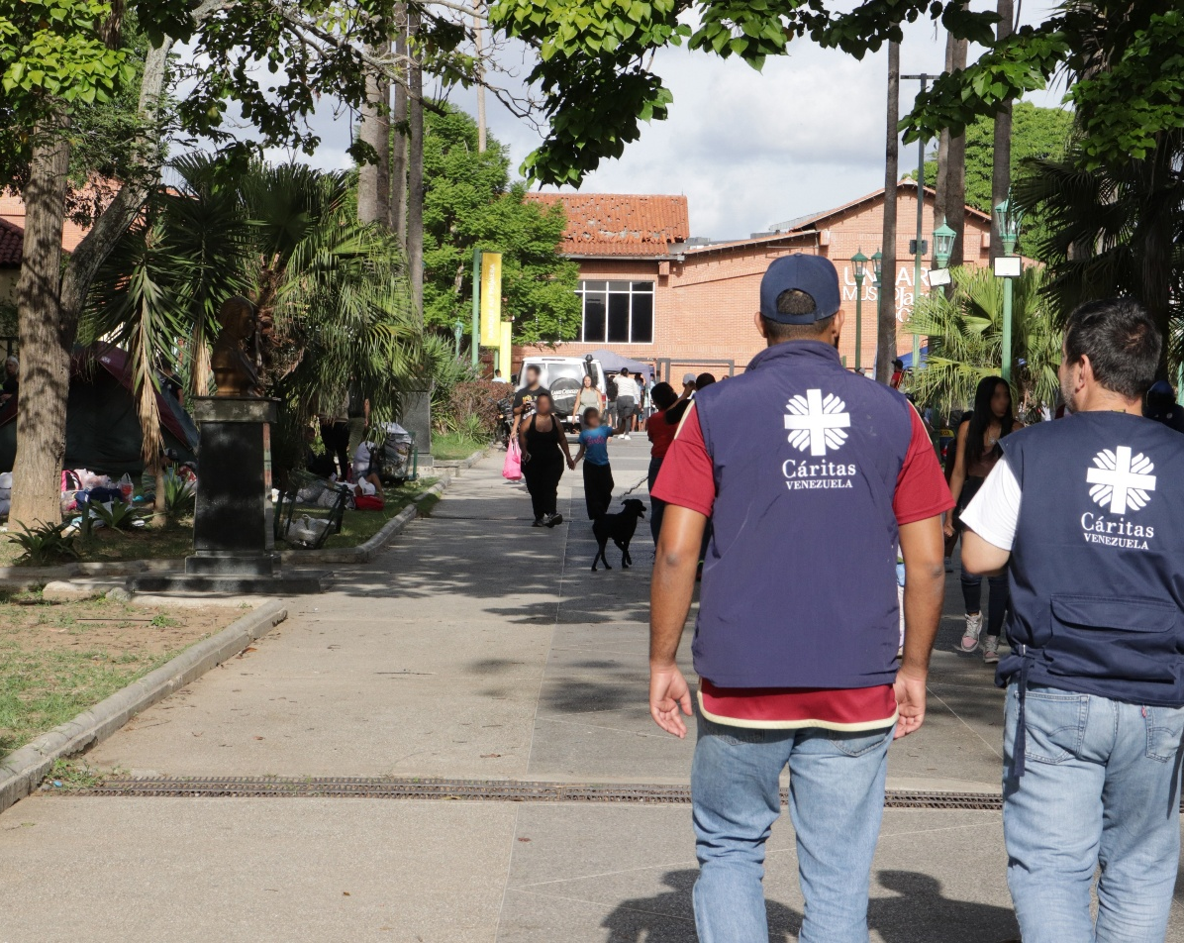

Who are CAFOD working with?
CAFOD are part of Caritas Internationalis, a global Church network. This means we work with church partners to make sure that help can get to where it’s needed very quickly.
Our partner in Venezuela is called Caritas Venezuela.
Venezuela

Slide 5
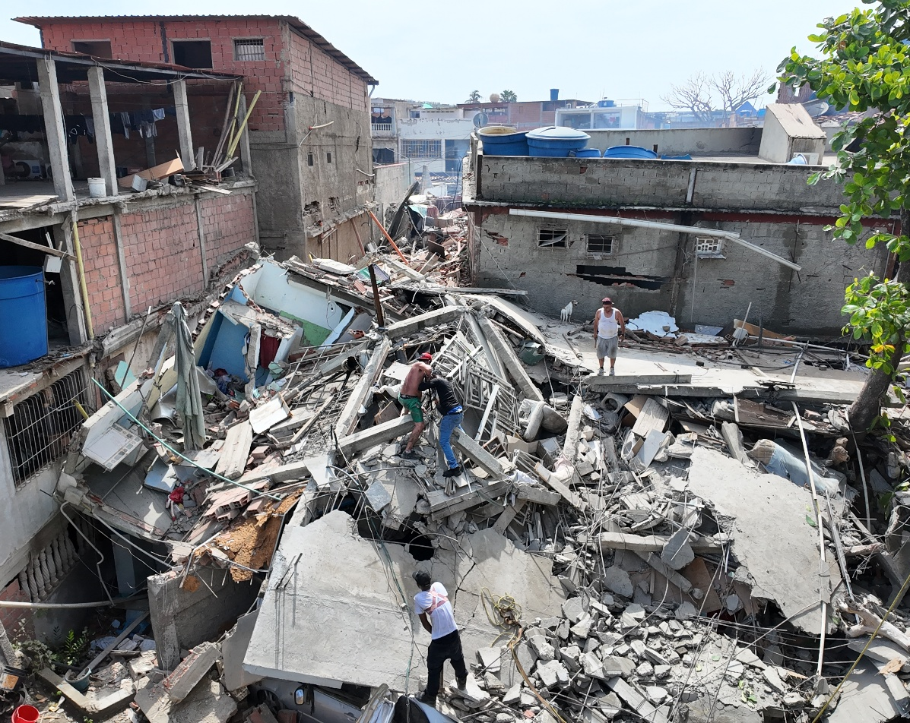
What has CAFOD done so far?
CAFOD have given £100,000 to our trusted Church partners who are already providing emergency food, water and shelter.
We are working together with the government, and 15 other charities, to collect emergency money for Venezuela. This is called a DEC appeal.
Your fundraising will help this very important work.
Venezuela

Slide 6


What is Pope Leo saying?
Pope Leo is praying for those who have died. He says:
“I express my thanks and support to those who are generously carrying out search and rescue efforts.”
Notes:
Image credit: Caritas Jerusalem

Slide 7

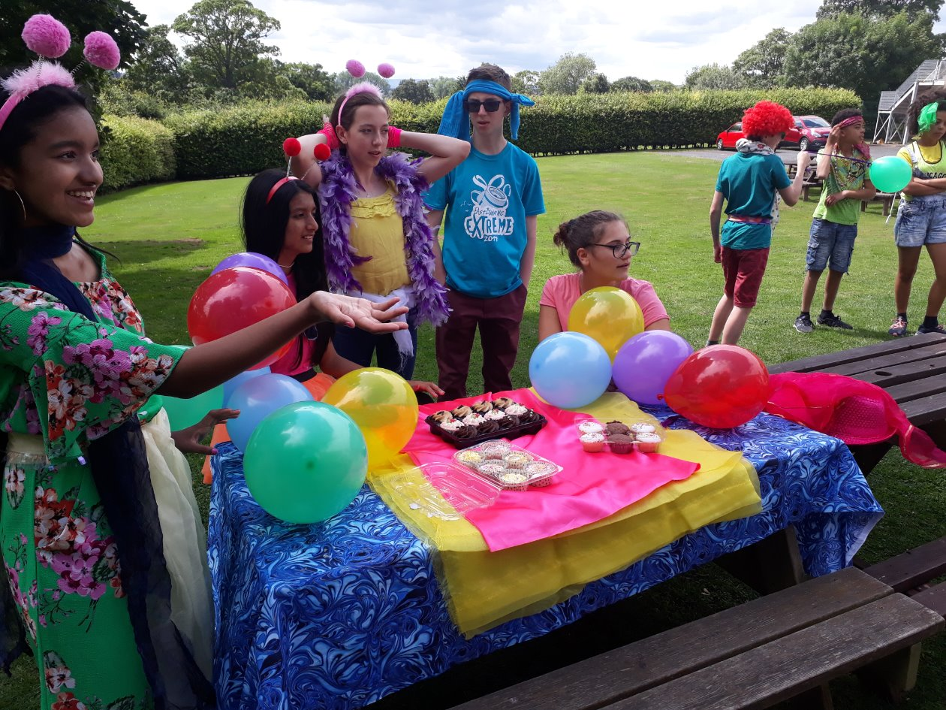
What can you do?
Pray for people in Venezuela
Fundraise!
You could…
Sell drinks at your Sports Day or hold an end of term bake sale?
Venezuela

Slide 8
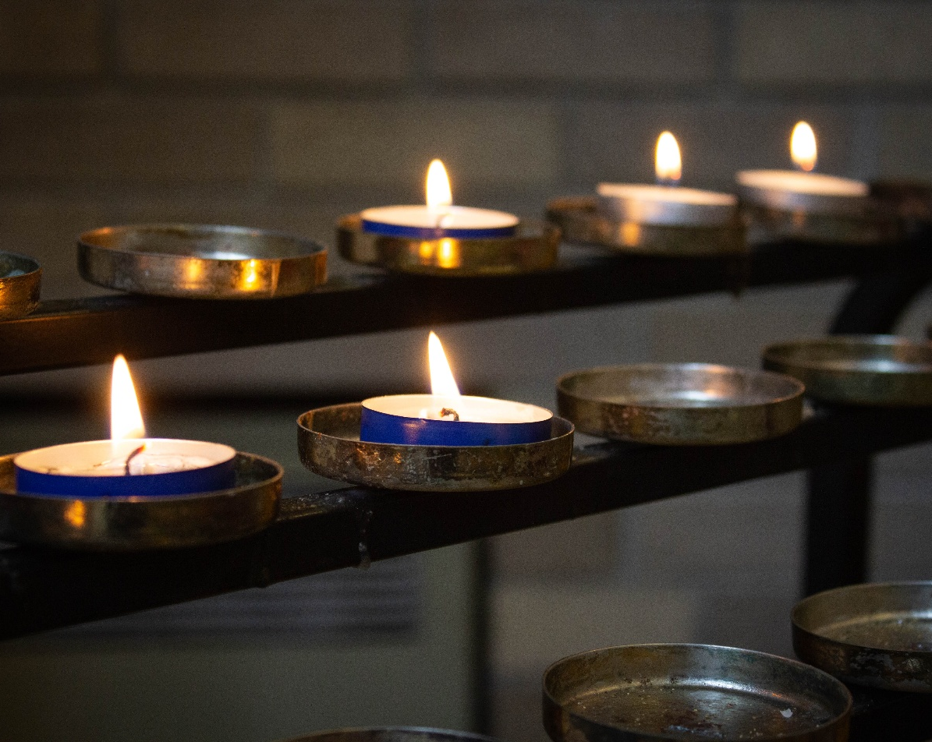
Let us pray
Faithful God,
even when the earth shakes,
your love remains firm.
You are our shelter and help.
Be near the people of Venezuela,
in this time of sadness and fear.
Venezuela

Slide 9
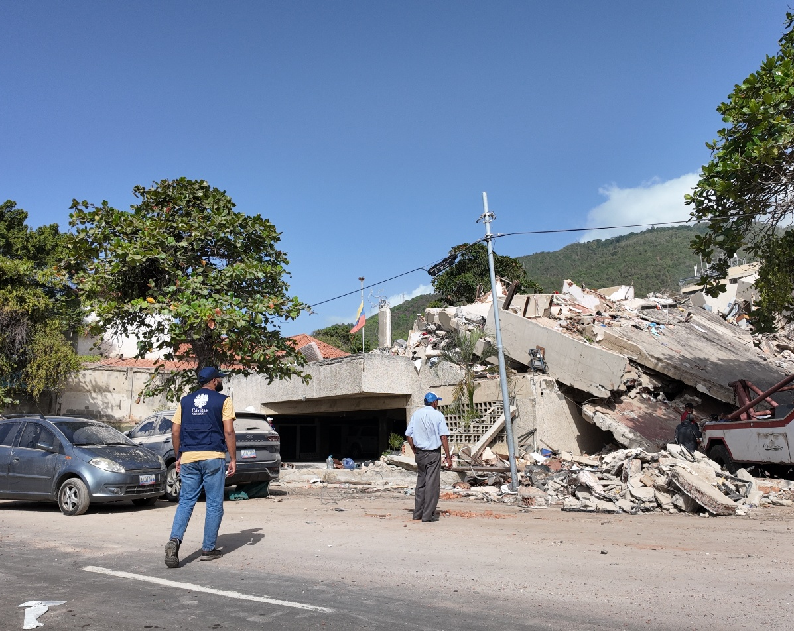
Welcome into your light
those who have died,
comfort those who mourn,
be close to those who are hurt
and bring hope
to those who have lost all that they built.
Amen
Venezuela

Slide 10
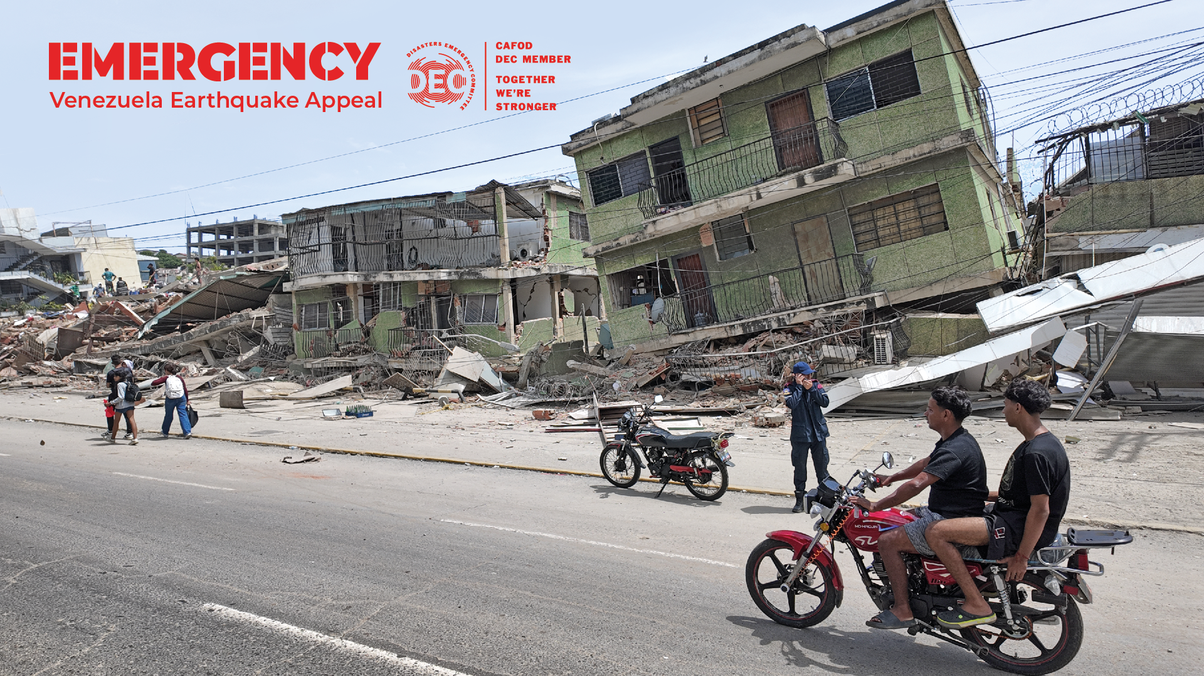

Please fundraise today

