Slide 1
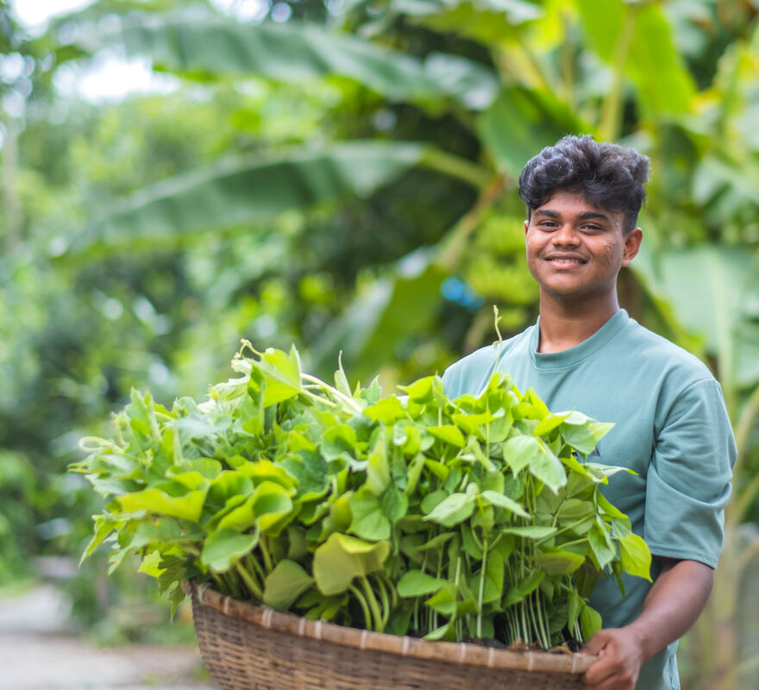
How will you try to welcome all people as we would welcome Jesus?
Gospel Celebration of the Word
Notes:
Children’s liturgy: Palm Sunday (Year A)
Preparation of the worship space
Colour: red
Song suggestions:
Give me joy in my heart (722, Laudate)
Welcome
Today we hear how crowds of people welcomed Jesus into Jerusalem shortly before he was crucified. We have palms to remind us of how the people cut branches and laid them in the road before him as they shouted with joy.
Bayezid, Bangladesh
Photo credit: Amit Rudro

Slide 2
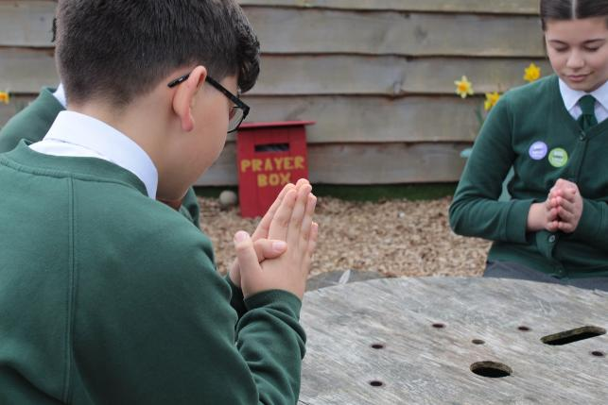

God of joy,
We welcome you into our lives as the people of Jerusalem welcomed Jesus, with respect, love and happiness. Help us to remember that you are in all people and try to make them feel welcome.
Amen.
  Gather
Notes:
St Francis Xavier's RC Primary School, Herefordshire
Photo credit: Vicky Ahmed

Slide 3

Gospel: Matthew 21:1-11
As Jesus and his disciples approached Jerusalem, they came to Bethphage at the Mount of Olives.
There Jesus sent two of the disciples on ahead with these instructions: “Go to the village there ahead of you, and at once you will find a donkey tied up with a colt beside her. Untie them and bring them to me. And if anyone says anything, tell him, ‘The Master needs them’; and then he will let them go at once.”
This happened in order to make what the prophet had said come true:
“Tell the city of Zion, look your king is coming to you! He is humble and rides on a donkey and on a colt, the foal of a donkey.”
Word
Notes:
On Palm Sunday there is often a blessing of the palms and a procession at the start of Mass. The children may be encouraged to take part in this before going off to children’s liturgy, so it may be that this first gospel reading is heard in church.
Gospel: Matthew 26:14-27:66
Due to space restrictions, we have not reproduced the reading of the Passion here. The reflection in this Powerpoint focuses mainly on the first gospel reading.

Slide 4
So the disciples went and did what Jesus had told them to do: they brought the donkey and the colt, threw their cloaks over them, and Jesus got on.
A large crowd of people spread their cloaks on the road while others cut branches from the trees and spread them on the road. The crowds walking in front of Jesus and those walking behind began to shout, “Praise to David’s Son! God bless him who comes in the name of the Lord! Praise be to God!”
When Jesus entered Jerusalem, the whole city was thrown into uproar. “Who is he?” the people asked.
“This is the prophet Jesus, from Nazareth in Galilee,” the crowds answered.

Slide 5
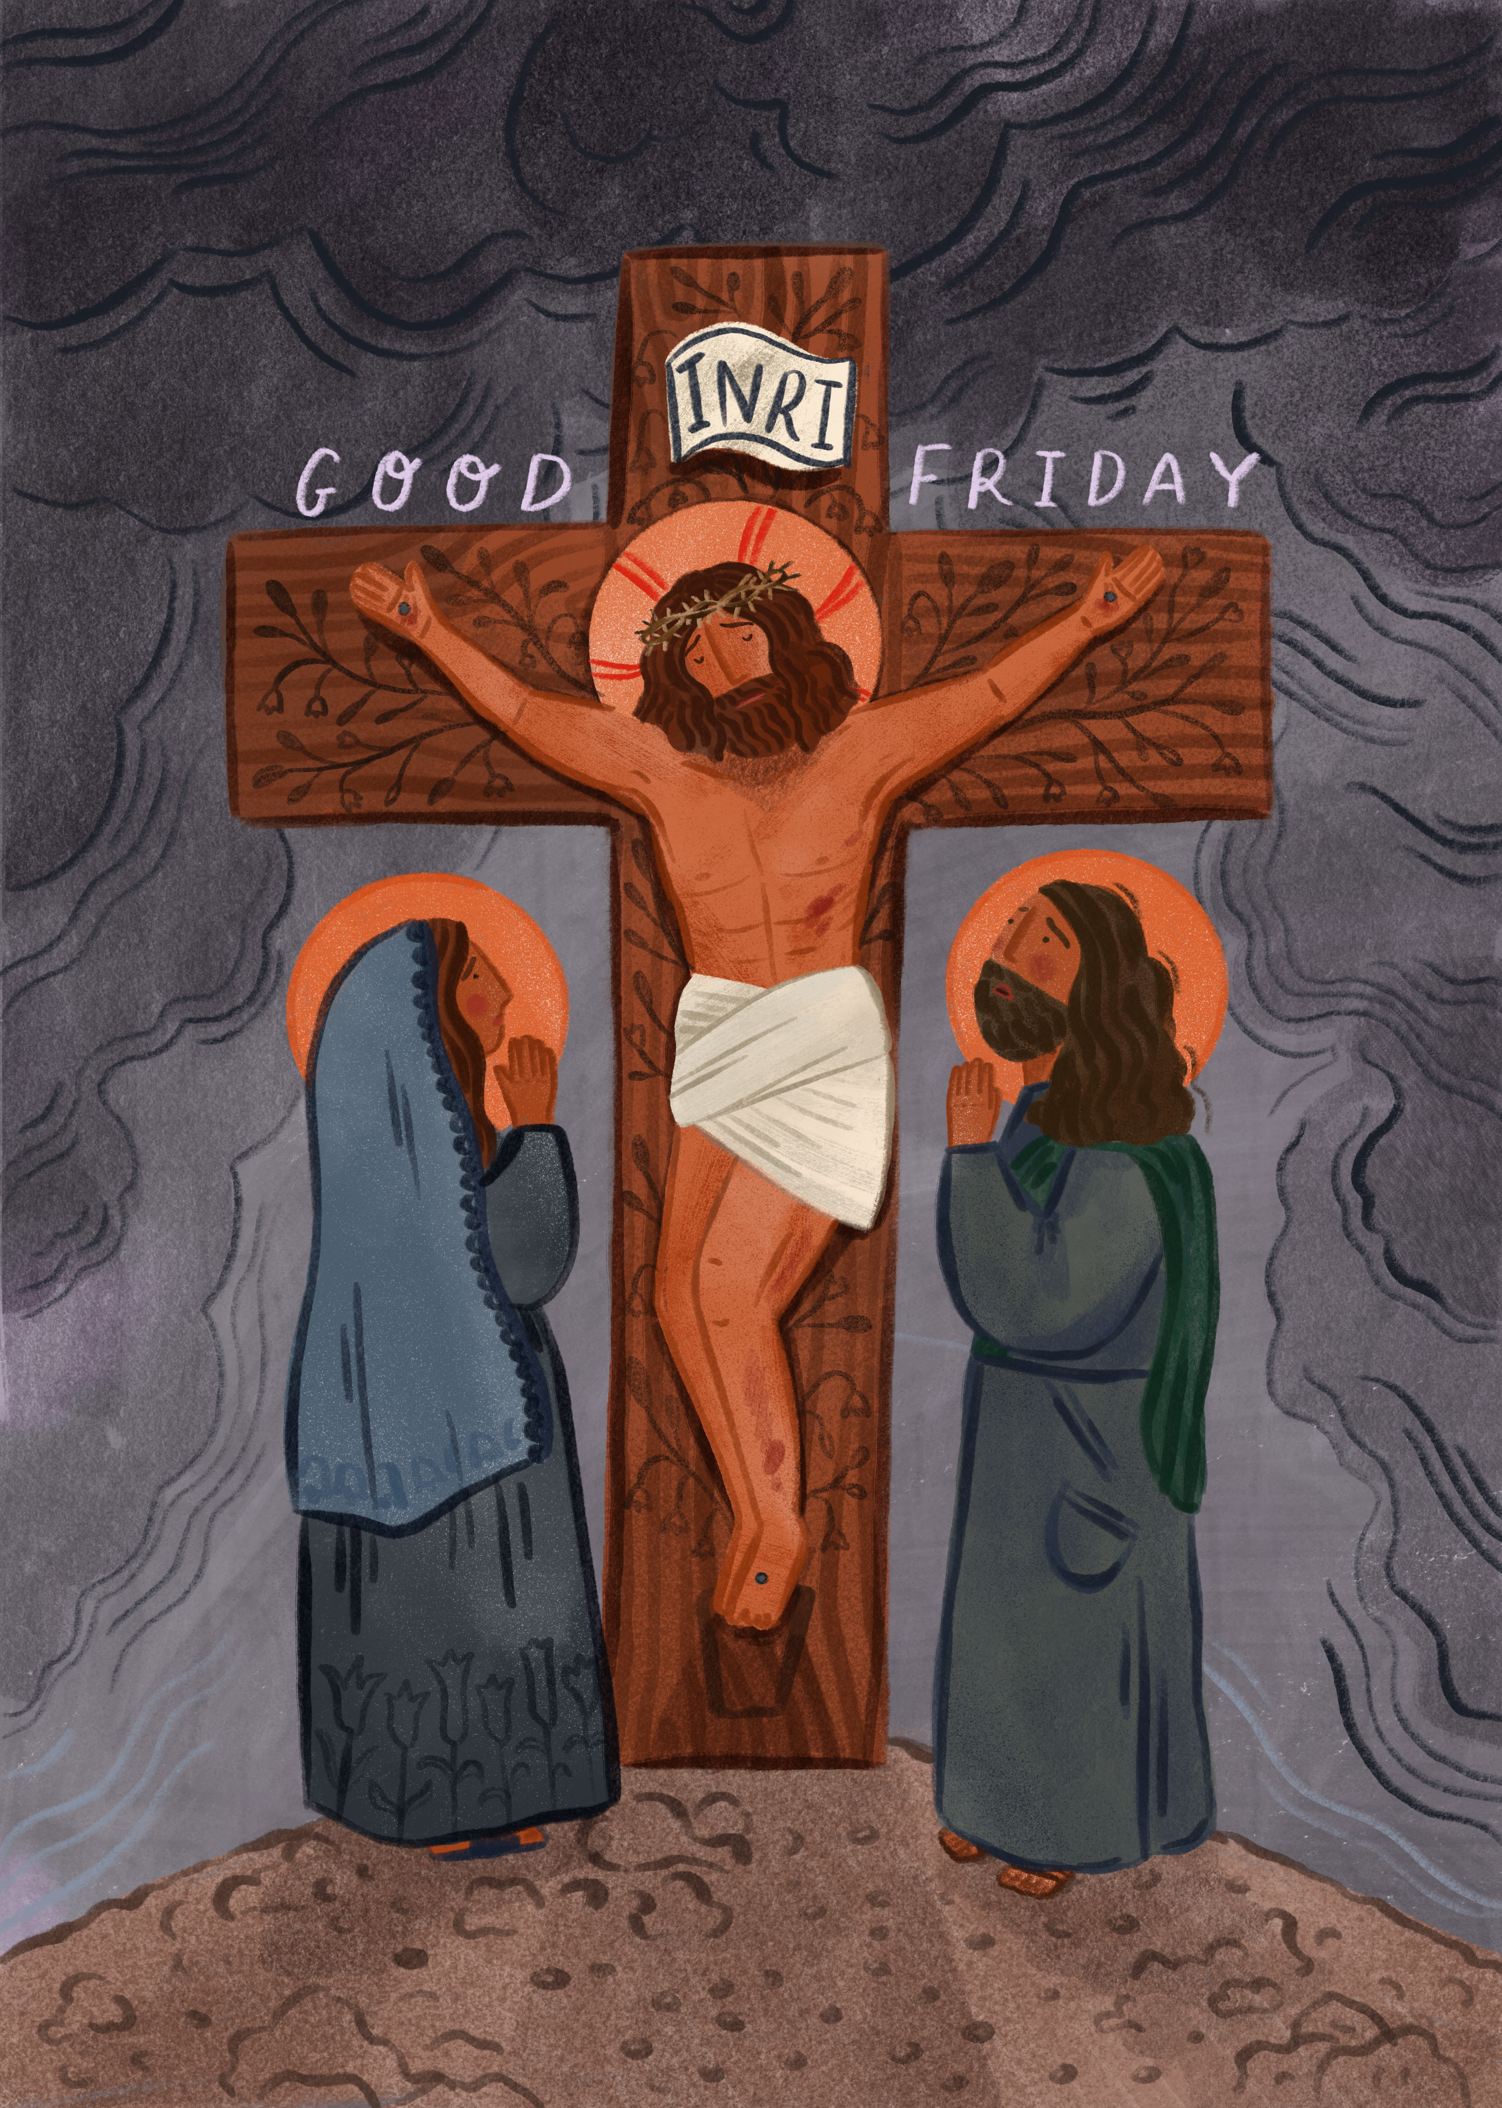

What do you remember from the Gospel reading?
Today is a special day, called Palm Sunday. Today we hear two gospel readings.
The second gospel reading is called the Passion and tells the story of how Jesus was arrested, tried, crucified and buried.
What do you remember from the first gospel reading today?
Respond
Notes:
Illustration: Emma Walton

Slide 6
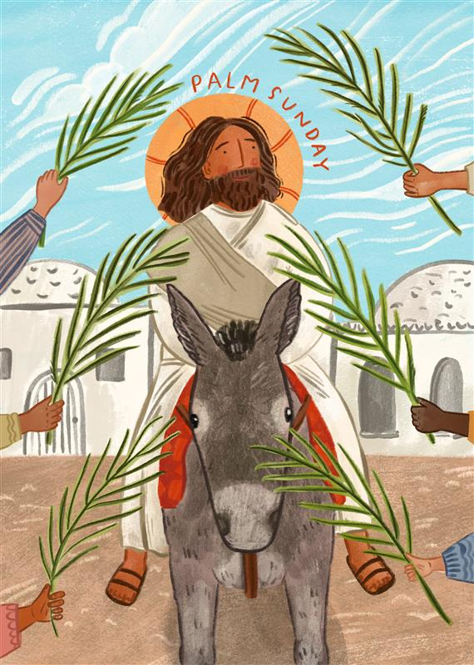
We heard how Jesus entered Jerusalem riding on a donkey.
The donkey was a very humble animal – not very special for such a special person like Jesus. Why do you think he chose a donkey?
Jesus rode on a donkey to show people that he was the Son of God. Despite how important he was, he chose a humble animal – to show that his power comes from God and not from riches.
Notes:
Illustration: Emma Walton

Slide 7

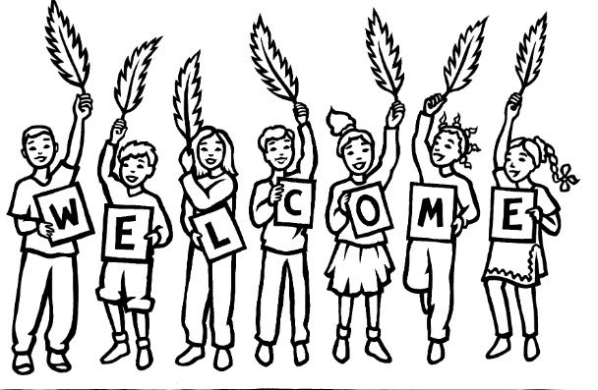
If Jesus were to arrive here today, do you think he would ride on a donkey? What else might he ride or drive?
All of the people were so happy to see Jesus that they laid their cloaks on the floor and cut branches from palm trees to lay before him to show their respect.
This is why today is called Palm Sunday and why we have palms. People shouted to show their joy and praise for God.
Notes:
Palms
Photo credit: Stock image
Illustration credit: CAFOD

Slide 8
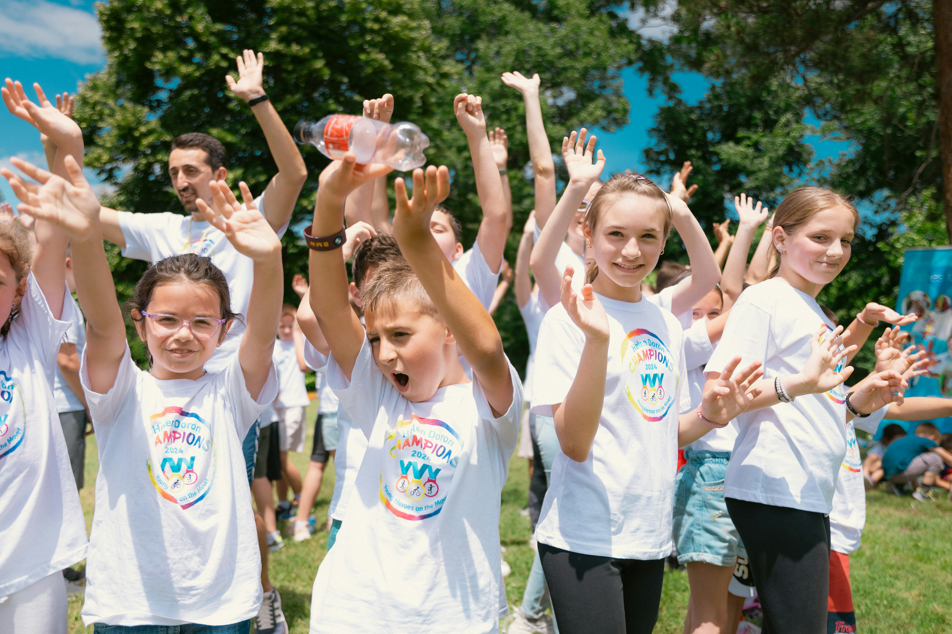
Why do you think that the crowds were so full of happiness and praise for Jesus?
What would you have done if you were in that crowd?
Think again about what it would be like if Jesus arrived here today.
What do you think you would do
to welcome Jesus?
Notes:
Children cheering
Photo credit: Aleksander Andreev on Unsplash

Slide 9
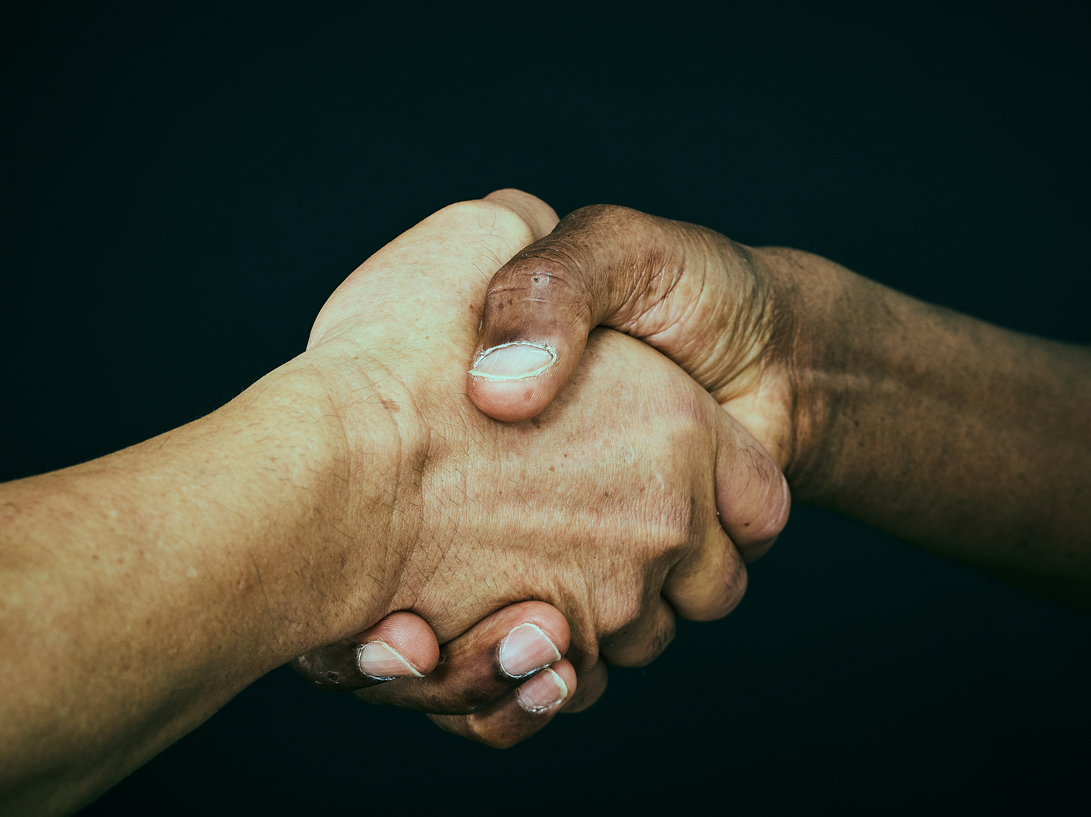
God made all of us, no matter where in the world that we come from.
Jesus is in all of us. So every time we meet someone, and welcome them, we are welcoming Jesus.
Jesus is in all people, so we should treat all people with the respect, love and kindness we would show to Jesus.
We should try to welcome people into our lives and treat them as we would like to be treated.
Notes:
Welcome
Photo credit: Stock images

Slide 10
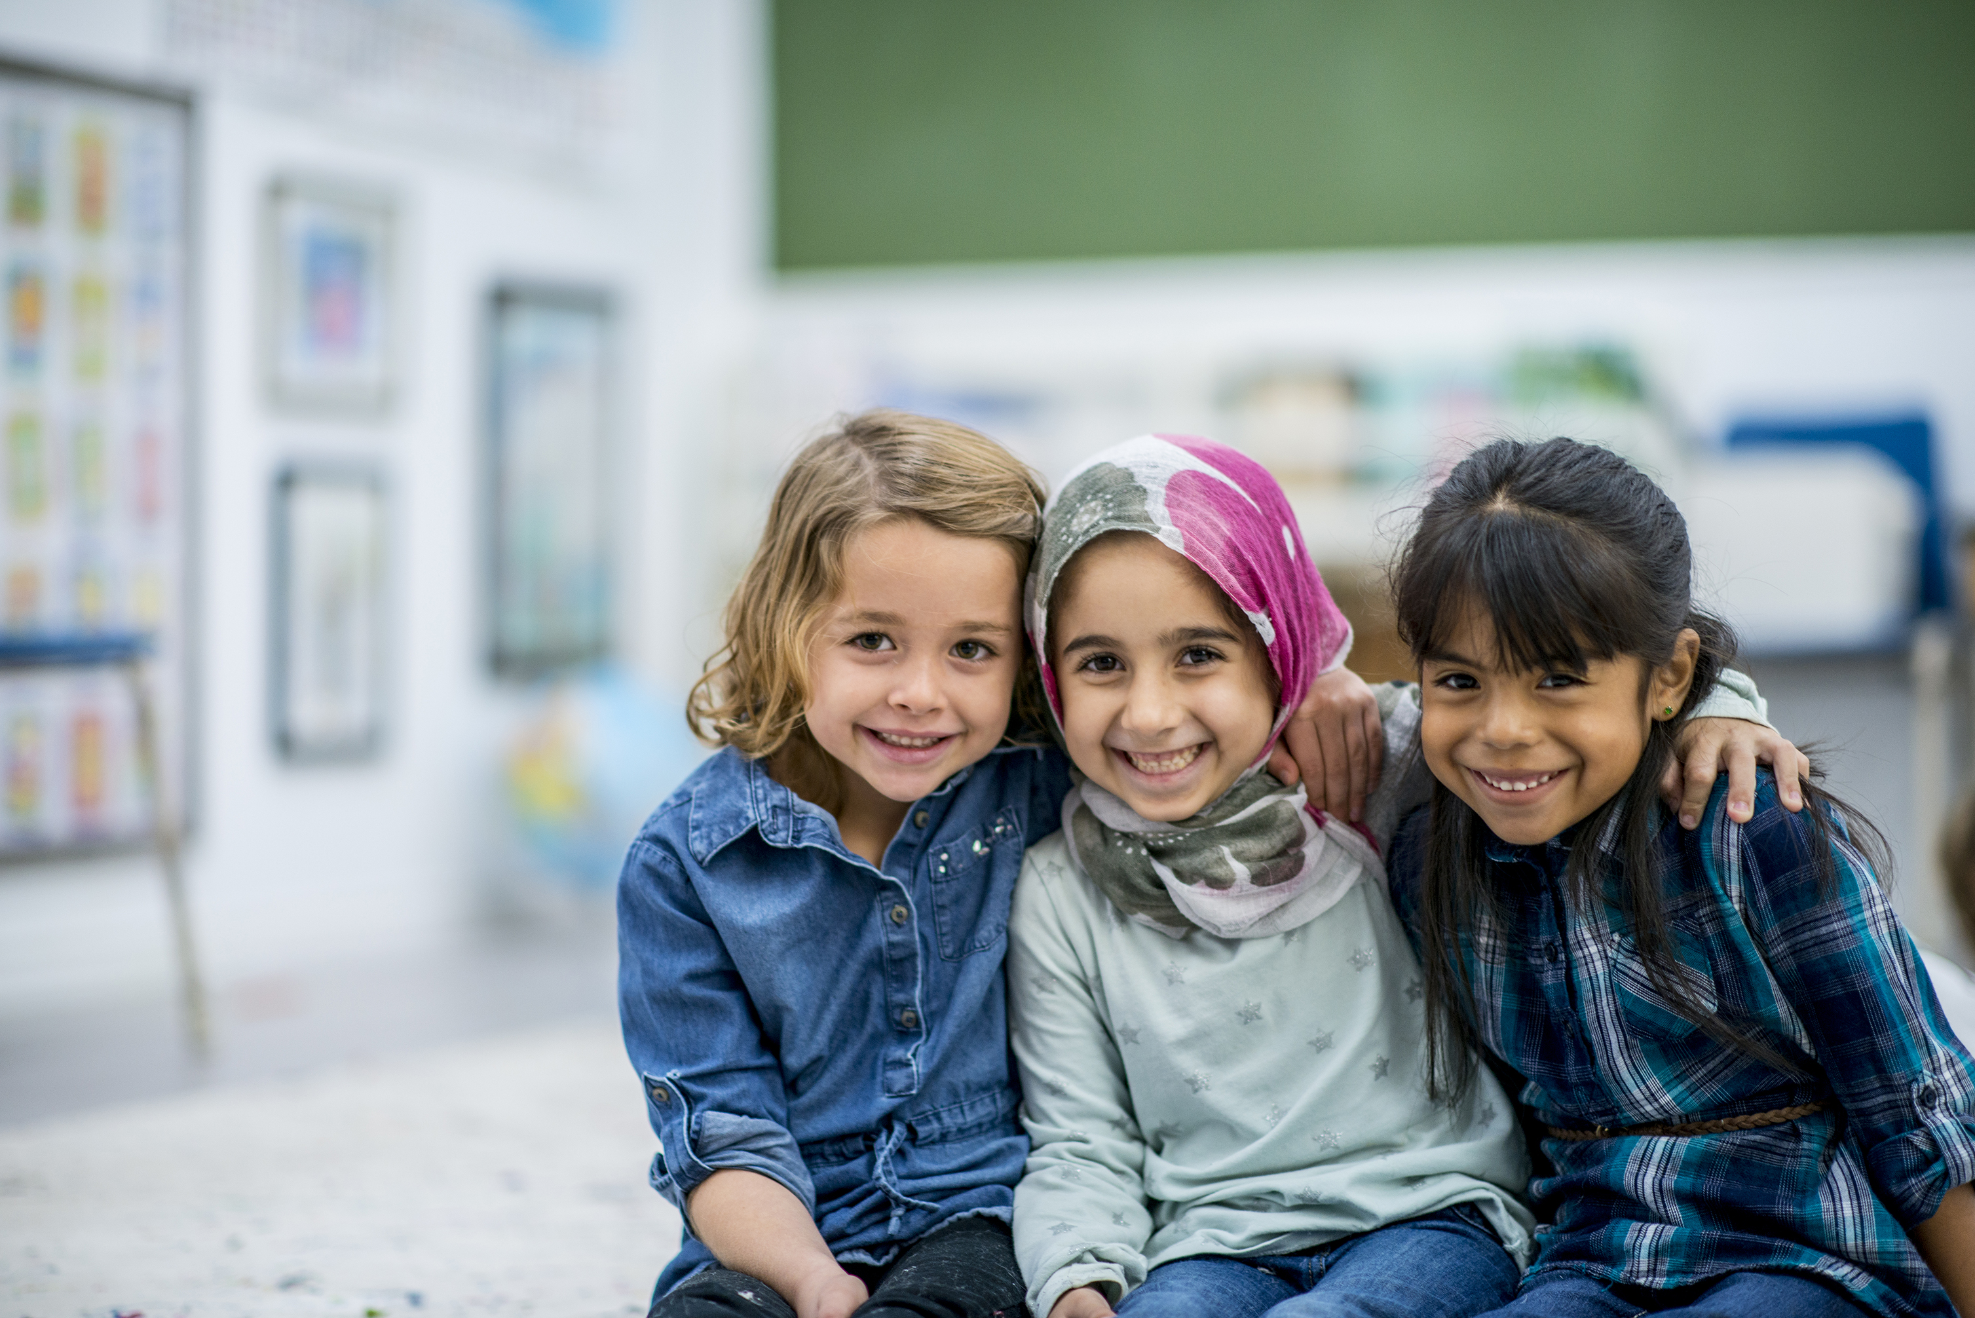
Can you think of a time when you welcomed someone else into your home, your class, your game? What did you do?
Or have you ever been welcomed by others? What did they do to make you feel special and welcome?
This week, let’s try to welcome all people as we would welcome Jesus.
Notes:
Together
Photo credit: Stock images

Slide 11
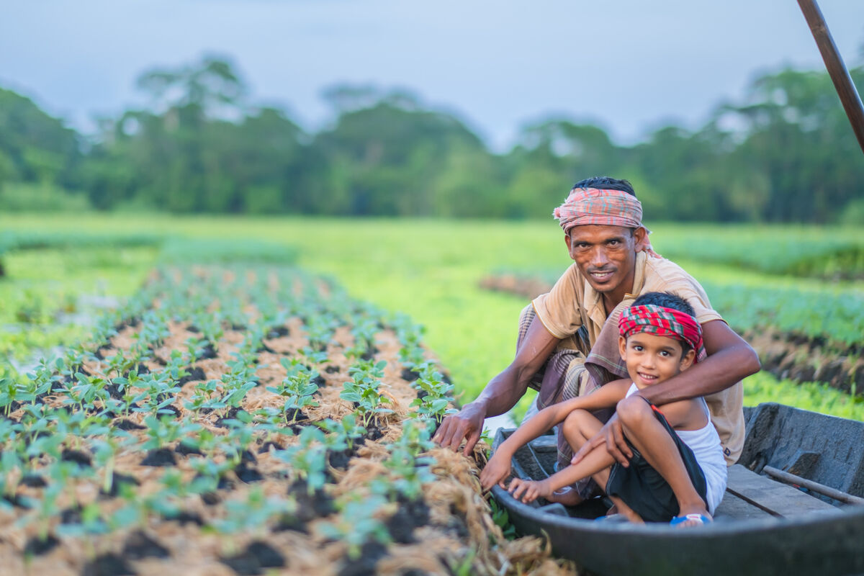
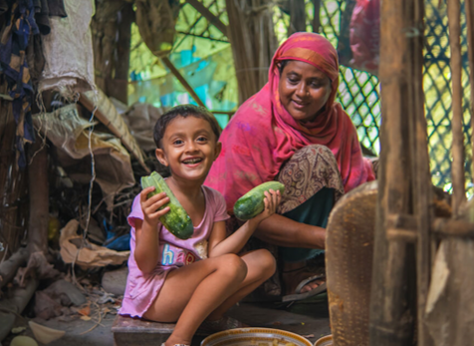
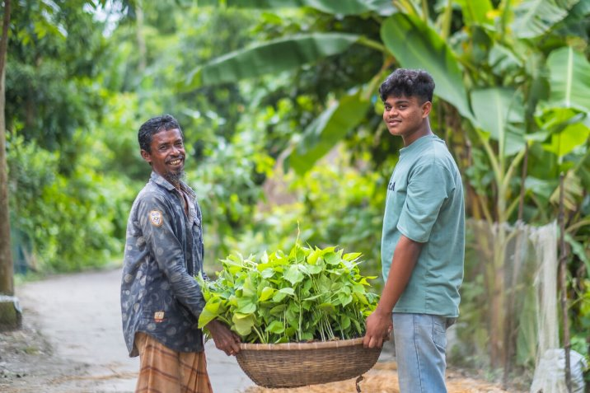

Here we see smiles of welcome from the Choto Bashail community!
This Lent, we've seen how these families learn to cultivate floating gardens. They eat the crops they grow, selling what is left over to buy the things they need for a happy life.
With the money you raise by doing the Big Lent Walk and cake sales and all kinds of brilliant things, CAFOD can help our global family help themselves.
What do you think of that?!
The Choto Bashail community in Bangladesh
Notes:
The Choto Bashail community in Bangladesh
Photo credit: Amit Rudro

Slide 12
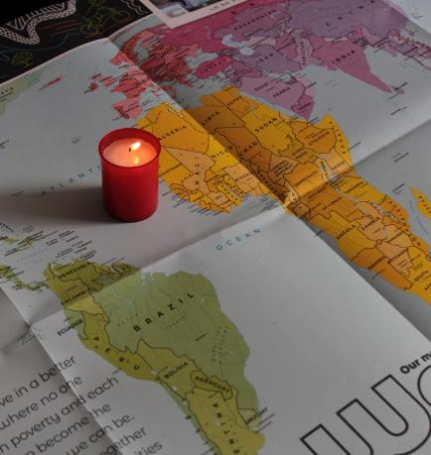
Let us pray
We pray for world leaders:
that they may be inspired by Jesus' example to care for all people, especially those who are poor.
Lord in your mercy…
We pray for our parish, families and friends:
that we may welcome all people with respect and love as Jesus was welcomed into Jerusalem.
Lord in your mercy...

Slide 13
Let us pray
We pray for our brothers and sisters throughout the world:
that we may look for Jesus within them and treat each other as we would wish to be treated.
Lord in your mercy…
God of truth: we thank you for sending your Son, Jesus. Open our hearts so that we may welcome him in others and bring us together to make the world a fairer place. Amen.

Slide 14
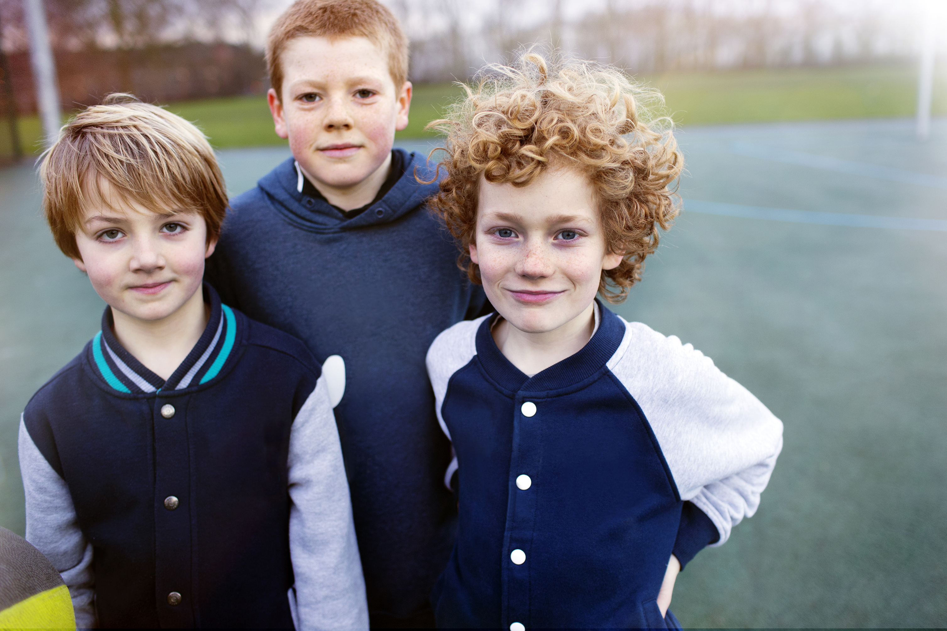

This week, how will you try to welcome all people as
we would welcome Jesus?
Send
Notes:
Children
Photo credit: Stock image

Slide 15
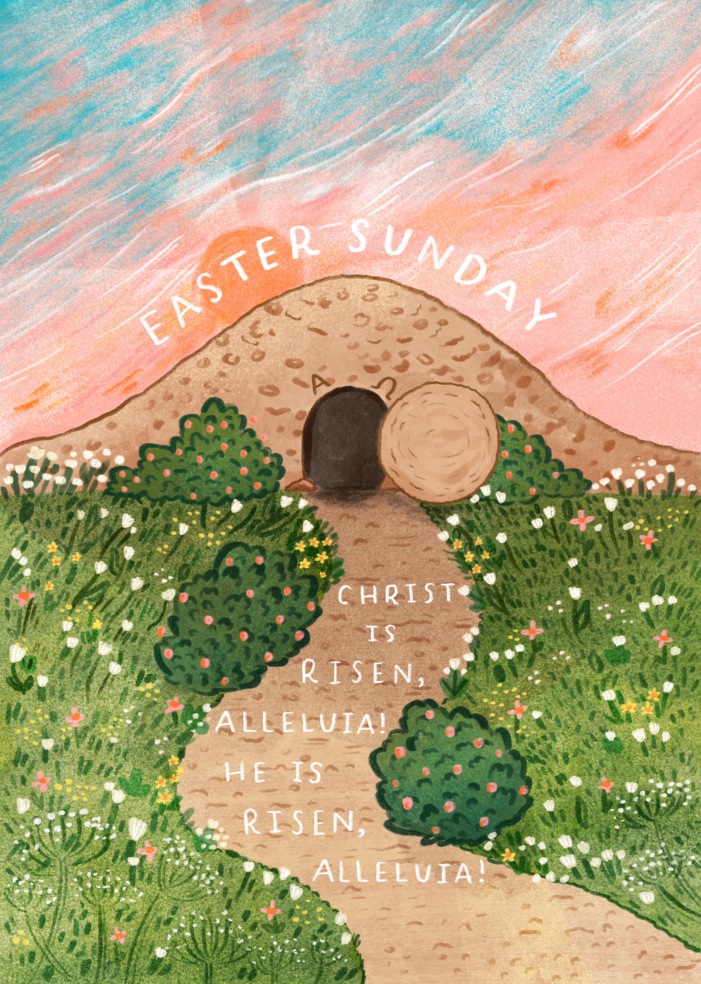
Happy Easter!
Notes:
Illustration: Emma Walton

Slide 16
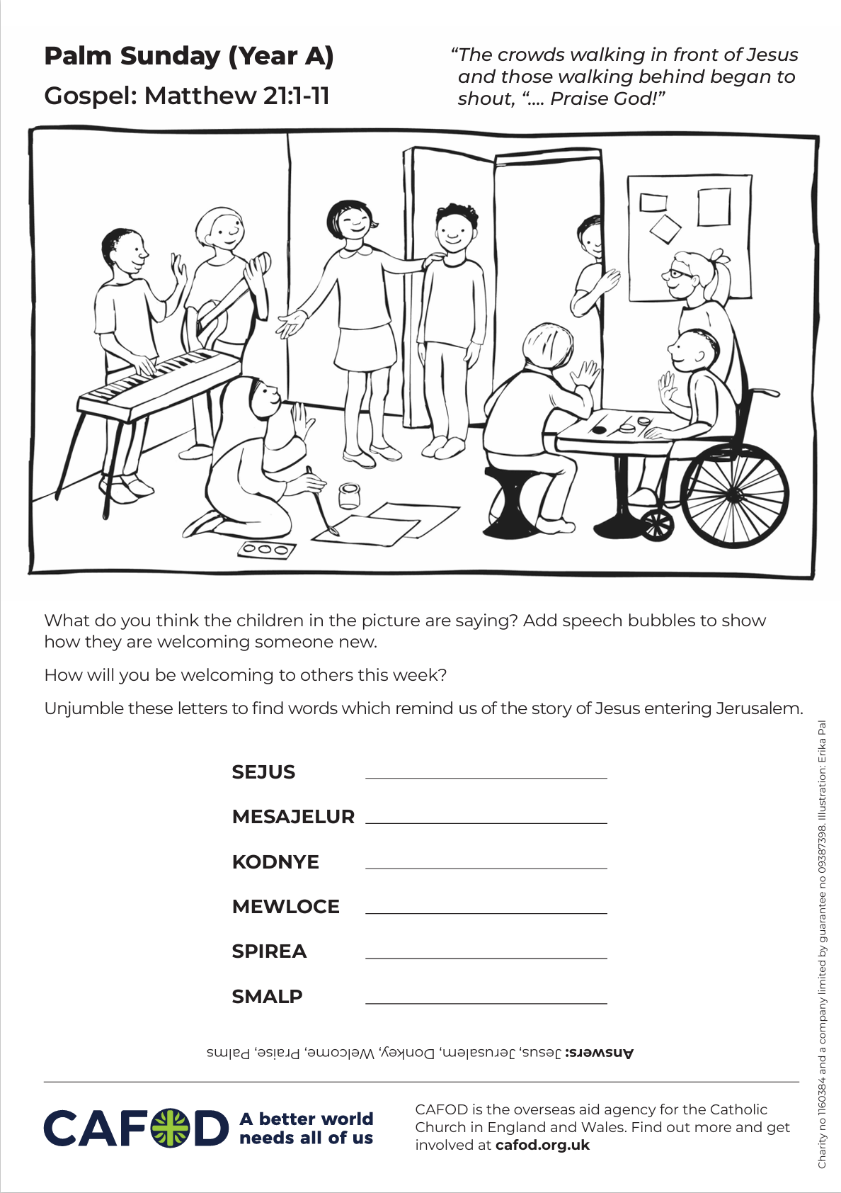
Activity suggestions
Download the illustration
Share the accompanying activity sheet with the children and encourage them to complete it, either in the liturgy or at home. Invite them to colour in the illustration and to add in speech bubbles what they think the children are saying to welcome the newcomer.
Invite the children to act out Jesus’ triumphant arrival into Jerusalem (if they haven’t already processed at the beginning of Mass) or the Passion story.
Remind the children to share all that they have heard and thought about today with the people at home. Encourage them to look for Jesus in others this week and to treat all people as they would treat Jesus, no matter who they are or where they come from.
See Lent 2026 resources for primary schools for child-friendly fundraising and other activities this Lent.
Reflect on the Easter story with our Stations of the Cross Powerpoint
Notes:
Illustration: Erika Pal

Slide 17
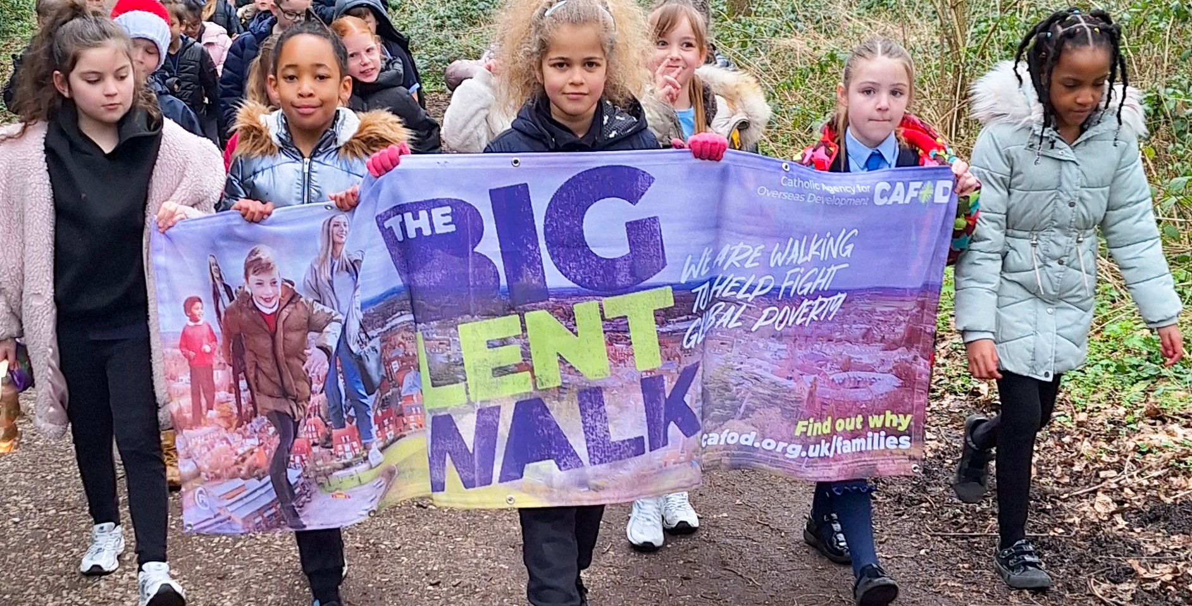
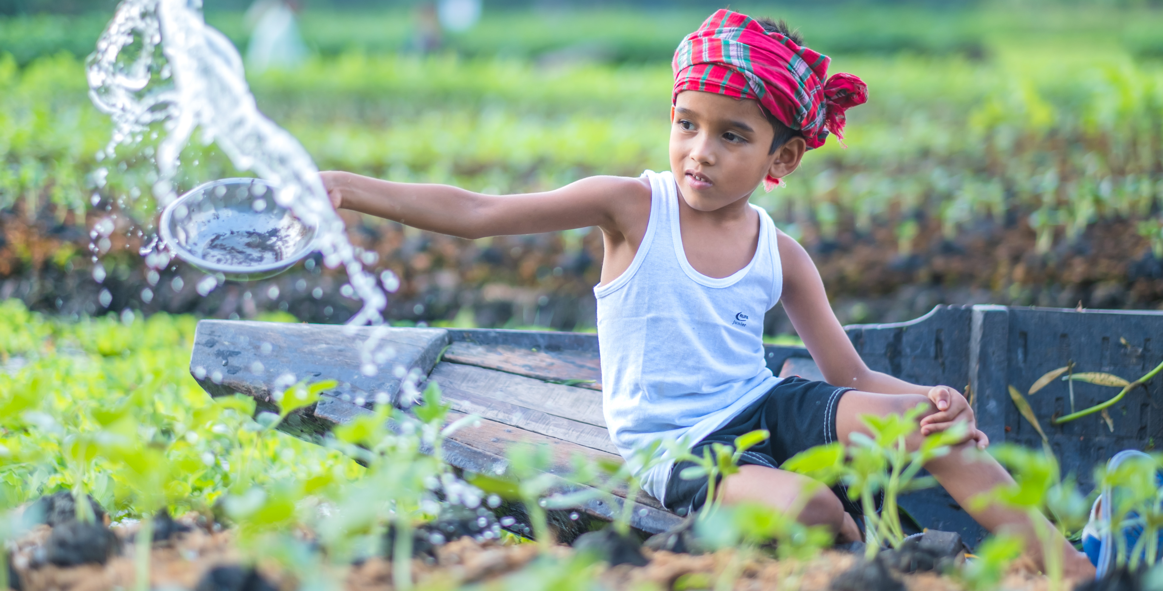
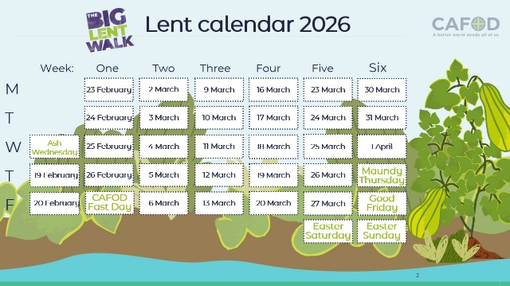
Get involved with CAFOD this term
Big Lent Walk resources
Lent national assembly
Lent resources
Join us on the Big Lent Walk!
Join our national assembly
Explore our Lent 2026 resources

Slide 18
