Slide 1
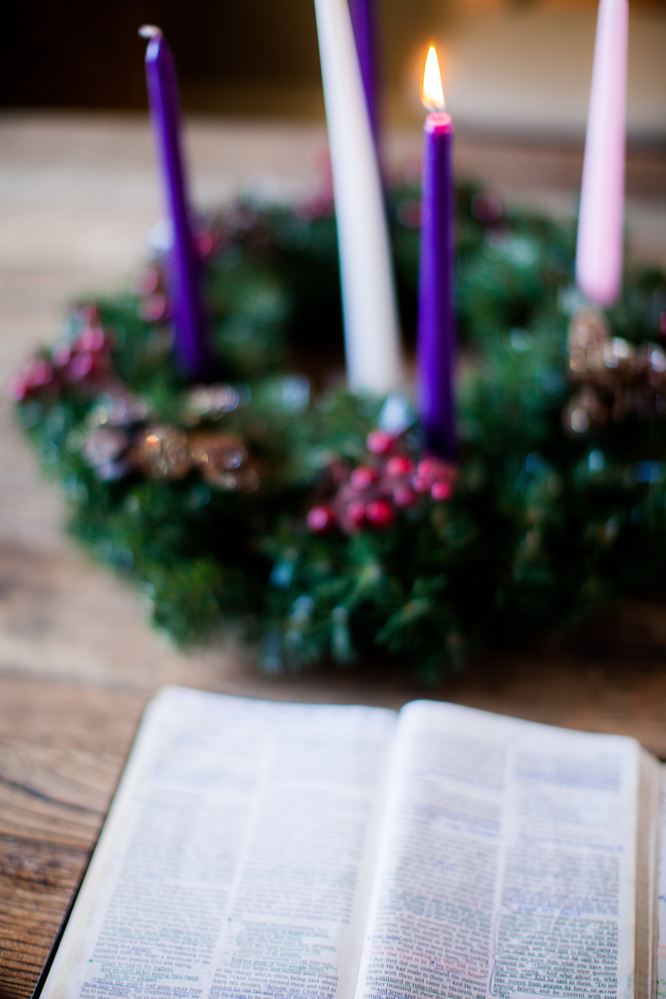
The Liturgical Season of Advent
Hope
Peace
Joy
Love
Welcome
Advent Assembly 2026
“The light shines in the darkness,
and the darkness has not overcome it.”
John 1:5
Notes:
Good morning/afternoon everyone.
My name is __________ and I am here today from CAFOD, the Catholic Agency for Overseas Development.
CAFOD is a charity that works with communities around the world to overcome poverty, respond to emergencies and build a better world for everyone.
Soon, we will begin a new liturgical year in the Church with the season of Advent.
OR
Recently, we began a new liturgical year in the Church with the season of Advent.
Advent gives us an opportunity to pause, reflect and prepare for the celebration of Jesus' birth at Christmas and to wait in hope for His coming again.
Today, we'll think about how your school can prepare for Christmas by helping to share Christ's light with communities around the world.
Photo: Pearl, from Lightstock.
Advent candle graphics: M. Wallflower, Trendify, via Canva.
Green foliage: Sketchify from sketchify, via Canva.
Star graphic: WC Studio from WC Studio, via Canva.

Slide 2
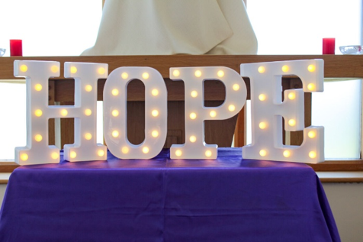
The Liturgical Season of Advent
Hope
Peace
Joy
Love
Advent is a season of:
waiting
hope
preparation
Advent is an opportunity to share Christ’s light and hope with people who might be facing darkness such as poverty, injustice, conflict and hardship.
Notes:
At this time of year, Christmas lights begin appearing everywhere. Streets become brighter, homes are decorated and preparations are underway for Christmas.
But Advent invites Christians to do something slightly different.
Before we celebrate Christmas, the Church asks us to slow down and prepare our hearts for the coming of Christ.
Just as when Jesus came to this earth, there are still people living in darkness today. Many people face poverty, conflict, loneliness and uncertainty.
Yet Christians believe that Jesus is the light who shines in the darkness, bringing hope, love and new life.
Advent reminds us that Christ's light is not something we keep to ourselves. It is something we are called to share.
Photo: Vicky Ahmed, CAFOD.
Advent candle graphics: M. Wallflower, Trendify, via Canva.
Green foliage: Sketchify from sketchify, via Canva.
Star graphic: WC Studio from WC Studio, via Canva.

Slide 3
CAFOD’s Advent Assembly 2026
Hope
Peace
Joy
Love
The Word
A reading from the Holy Gospel according to John,
Response: Glory to You O Lord
In him was life, and the life was the light of men.
The light shines in the darkness,
and the darkness has not overcome it.
The Gospel of the Lord
Response: Praise to You Lord Jesus Christ
John 1:4-5
Notes:
Let's begin with a short reading from John's Gospel.
[Read scripture]
In this scripture, the light that John is describing is Jesus Himself.
John reminds us that Jesus is the source of all life and that His light shines in the darkness. No darkness can overcome it.
At Christmas, we celebrate God coming into the world through Jesus, bringing hope, salvation and new life.
This is why light is such an important symbol during Advent.
As we draw closer to Christmas, the Advent wreath grows brighter as another candle is lit each week.
The growing light reminds us that God kept His promise to send His Son into the world.
It also reminds us that Christ's light continues to shine through ordinary people who live out His love and bring hope to others.
Photo: Pearl from Lightstock.
Advent candle graphics: M. Wallflower, Trendify, via Canva.
Green foliage: Sketchify from sketchify, via Canva.
Star graphic: WC Studio from WC Studio, via Canva.

Slide 4
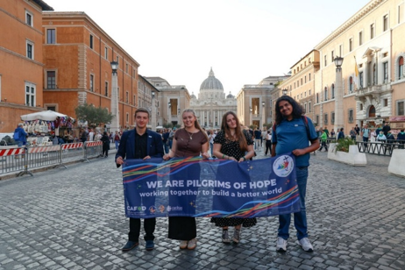

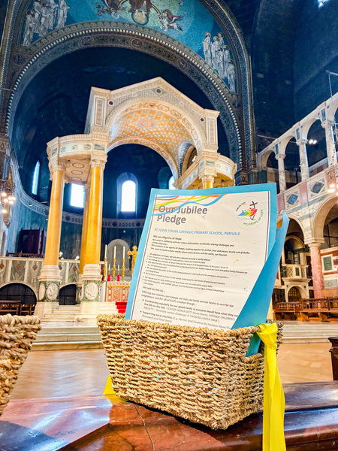
CAFOD’s Advent Assembly 2026
Hope
Peace
Joy
Love
During the Jubilee Year in 2025 “Pilgrims of Hope”, hundreds of schools across England and Wales made pledges to help build a better world.
Many schools committed themselves to:
  acts of service,
  fundraising,
  campaigning
  caring for creation
Every time we put those pledges into action, we share Christ's light with the world.
Notes:
During the Jubilee Year in 2025, hundreds of schools across England and Wales made pledges to help build a better world.
Many schools committed themselves to acts of service, fundraising, campaigning and caring for creation.
[Opportunity to pause and share examples of the school's own achievements, fundraising or campaigning]
Every time we put those pledges into action, we share Christ's light with the world.
As a new Church year begins, this is a good opportunity to revisit your school's Jubilee pledge and think about how you can continue living as Pilgrims of Hope.
Photo: Giuseppe Chiantera, CAFOD.
Photo: CAFOD Westminster. Jubilee Year 2025: Pilgrims of Hope - Schools make the Jubilee Pledge
Advent candle graphics: M. Wallflower, Trendify, via Canva.
Green foliage: Sketchify from sketchify, via Canva.
Star graphic: WC Studio from WC Studio, via Canva.

Slide 5
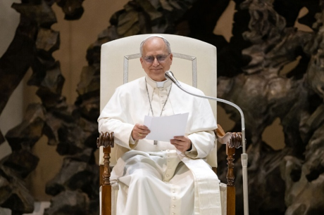
CAFOD’s Advent Assembly 2026
Hope
Peace
Joy
Love
“Indeed, caring for the poor is part of the Church’s great Tradition, a beacon as it were
of evangelical light to illumine the hearts and guide the decisions of Christians in every age. That is why we must feel bound to invite everyone to share in the light and life born of recognizing Christ in the faces of the suffering and those in need.“
Pope Leo XIV: Dilexi te
Notes:
Last year, Pope Leo XIV shared his first Apostolic Exhortation, Dilexi te, which means "I have loved you".
Pope Leo said this:
“Indeed, caring for the poor is part of the Church’s great Tradition, a beacon as it were of evangelical light to illumine the hearts and guide the decisions of Christians in every age. That is why we must feel bound to invite everyone to share in the light and life born of recognizing Christ in the faces of the suffering and those in need.“
In this document, Pope Leo reflects on God's love for those who are poor, vulnerable and excluded.
He reminds us that caring for people in need is not simply something Christians are encouraged to do. It is central to our faith.
Pope Leo describes this care as a beacon of light.
A beacon shines out into the darkness, helping others find direction and hope.
He goes on to say that we should recognise Christ in the faces of people who are suffering and in need.
This is an important message for Advent.
As we prepare to celebrate the birth of Jesus, we are reminded that Christ is present not only in the Christmas story, but also in our sisters and brothers around the world today.
Photo: © Mazur/cbcew.org.uk
Pope Leo XIV - Audience for Journalists
Advent candle graphics: M. Wallflower, Trendify, via Canva.
Green foliage: Sketchify from sketchify, via Canva.
Star graphic: WC Studio from WC Studio, via Canva.

Slide 6
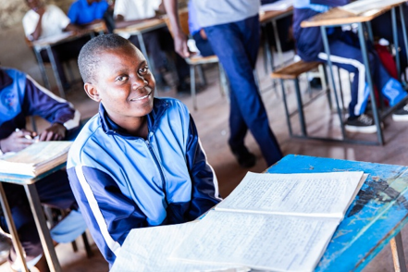
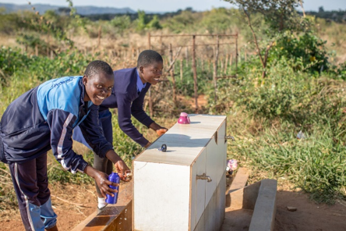
CAFOD’s Advent Assembly 2026
Hope
Peace
Joy
Love
Sharing light in Zimbabwe
This Harvest, we learnt about Maggie in Zimbabwe and how greater access to safe water is helping young people stay in school.
CAFOD's local partners have supported communities by:
  Installing solar-powered taps and showers to provide safe water
  Supporting gender clubs, where young people can learn about personal boundaries, dignity and respect
These projects are helping young people spend less time collecting water, stay in education and look to the future with hope.
Notes:
This Harvest, we learnt about Maggie in Zimbabwe.
Maggie's community has faced increasing challenges because of climate change. Long periods without rainfall have made it difficult to access water and grow food.
CAFOD's local partners have supported communities by:
Installing solar-powered taps and showers to provide safe water
Supporting gender clubs, where young people can learn about personal boundaries, dignity and respect
These projects are helping young people like Maggie spend less time collecting water, stay in education and look to the future with greater hope.
Photo: Cynthia Matonhodze, CAFOD.
Maggie in Zimbabwe 2025 - Solar-powered water and community gardens
Advent candle graphics: M. Wallflower, Trendify, via Canva.
Green foliage: Sketchify from sketchify, via Canva.
Star graphic: WC Studio from WC Studio, via Canva.

Slide 7
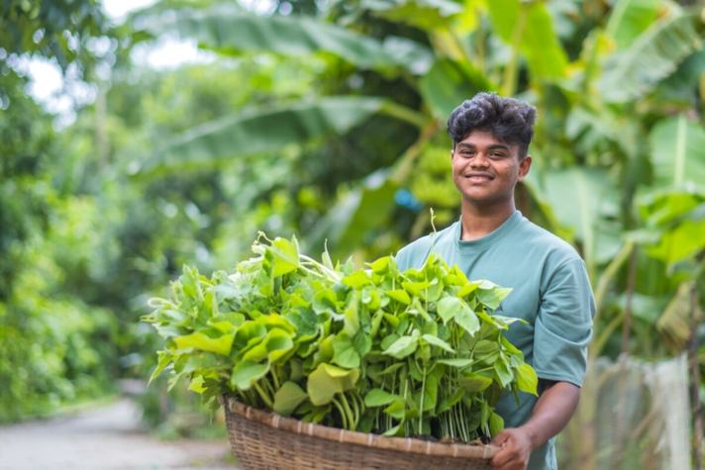
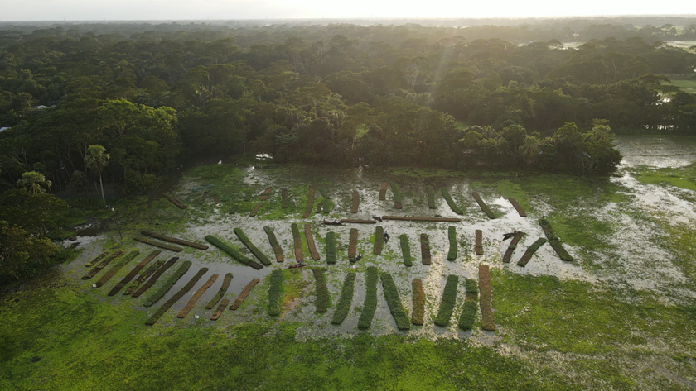
CAFOD’s Advent Assembly 2026
Hope
Peace
Joy
Love
Sharing light in Bangladesh
During Lent this year, we learnt about Bayezid from Bangladesh and how severe flooding is affecting the livelihoods of families.
Working alongside local experts, CAFOD has supported communities with innovative solutions such as floating gardens.
These gardens allow crops to grow even when fields are underwater.
Together, local communities are becoming beacons of hope, helping families build brighter futures.
Notes:
During Lent, we learnt about Bayezid from Bangladesh.
His community faces severe flooding caused by the effects of climate change.
Working alongside local experts, CAFOD has supported communities with innovative solutions such as floating gardens.
These gardens allow crops to grow even when fields are underwater.
Together, local communities are becoming beacons of hope, helping families build brighter futures.
Photo:
Amit Rudro, CAFOD. Bayezid, Floating gardens in Bangladesh.
Sadiqul Islam, CAFOD, Floating gardens in Bangladesh.
Advent candle graphics: M. Wallflower, Trendify, via Canva.
Green foliage: Sketchify from sketchify, via Canva.
Star graphic: WC Studio from WC Studio, via Canva.

Slide 8
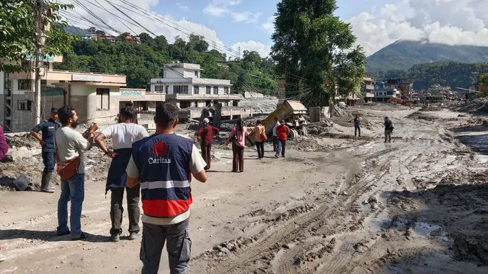

CAFOD’s Advent Assembly 2026
Hope
Peace
Joy
Love
Sharing light in times of crisis
Throughout this year, CAFOD and our partners have responded to emergencies around the world affected by: conflict, displacement, flooding and earthquakes.
In times of crisis, partners have provided:
  Safe water
  Shelter
  Food
  Healthcare
In some of the world's darkest situations, these acts of solidarity become small but powerful beacons of light.
Caritas Nepal responding to the flash floods in Nepal - August 2026
A member of Caritas Jerusalem staff overlooking the Al Masri (Egyptian) camp, Gaza, May 2026.
Notes:
Throughout this year, CAFOD and our partners have responded to emergencies around the world.
Whether supporting people affected by conflict, displacement, flooding or earthquakes, local partners have provided safe water, shelter, food and healthcare.
In some of the world's darkest situations, these acts of solidarity become small but powerful beacons of light.
They remind people that they are not forgotten, and that no one should face hardship alone.
Photo: Trocaire | Raw Media, CAFOD.
Displaced families in Gaza.
Advent candle graphics: M. Wallflower, Trendify, via Canva.
Green foliage: Sketchify from sketchify, via Canva.
Star graphic: WC Studio from WC Studio, via Canva.

Slide 9

CAFOD’s Advent Assembly 2026
Hope
Peace
Joy
Love
Looking Ahead to 2027...
In 2027, we will learn about communities in
El Salvador who are facing longer droughts and increasingly unpredictable weather.
CAFOD's local partners are helping families adapt through:
  Training and workshops
  Drought-resistant seeds
  Water-saving technology
Together, communities are finding innovative ways to care for their families and plan for the future.
Notes:
And in 2027, schools will learn about communities in El Salvador facing longer droughts and increasingly unpredictable weather.
CAFOD's local partners are helping families adapt through training, drought-resistant seeds and water-saving technology.
The beacon of Christ's light continues to shine through communities that refuse to give up hope and work together for a better future.
Photo: Charlotte Nicholls, CAFOD. Food and the climate crisis in rural El Salvador.
Advent candle graphics: M. Wallflower, Trendify, via Canva.
Green foliage: Sketchify from sketchify, via Canva.
Star graphic: WC Studio from WC Studio, via Canva.

Slide 10
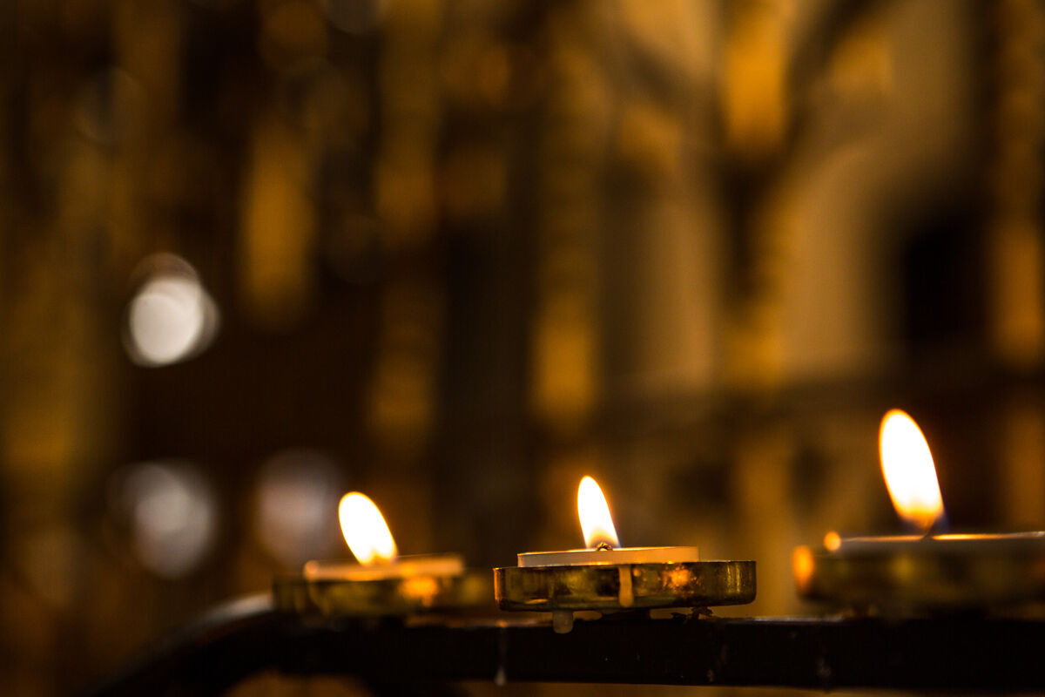
CAFOD’s Advent Assembly 2026
Hope
Peace
Joy
Love
Pause to reflect
  Where have you seen signs of hope this year?
  Where do you recognise Christ in the lives of others?
  How can you share Christ's light this Advent?
Notes:
With all of this in mind, let's take a few moments to reflect quietly.
Where have you seen signs of hope this year?
Pope Leo reminds us to recognise Christ in the faces of those who are suffering and in need.
Where do you recognise Christ in the lives of others?
And how might God be calling you to become a beacon of light for someone else this Advent?
Pause.
Photo: Thom Flint, CAFOD. Candles in St George's Cathedral, Southwark.
Advent candle graphics: M. Wallflower, Trendify, via Canva.
Green foliage: Sketchify from sketchify, via Canva.
Star graphic: WC Studio from WC Studio, via Canva.

Slide 11


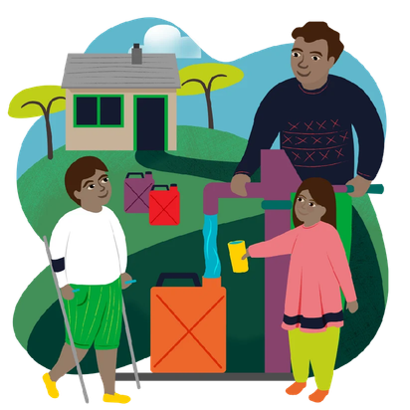
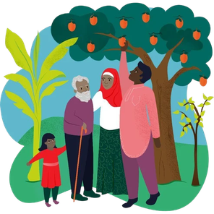


CAFOD’s Advent Assembly 2026
Hope
Peace
Joy
Love
£100 Stocking
Be a beacon of light this Advent with CAFOD’s World Gifts!
Through safe water, education, food, livelihoods and opportunities, these gifts help Christ's light shine where it is needed most.
Could your school work together to fund one or more CAFOD Christmas Stockings this Advent?
Every gift helps bring hope to communities around the world.
Notes:
At this time of year many people like to give each other gifts. You might be thinking of gifts which you might like to give to friends and family or maybe you are thinking about what gifts you might like to receive yourself.
One way you can be a beacon of light this Advent is through CAFOD World Gifts.
CAFOD World Gifts make a huge difference to the lives of our sisters and brothers around the world.
Through safe water, education, food, livelihoods and opportunities, each gift becomes a beacon of hope for a family or community and helps Christ's light shine where it is needed most.
Could your school work together to raise enough money to buy one or more CAFOD Christmas Stockings this Advent?
This year's new World Gift stocking includes gifts such as a Happy Queen Bee, a Sewing Kit, The Goat that Gives, Water for a family and Trees for Life!
Whether it's a Christmas jumper day, a cake sale, a sponsored challenge or a whole-school fundraising event, every contribution can help bring hope to communities around the world.
World Gift Illustrations: Sam Obsorne, CAFOD.
Advent candle graphics: M. Wallflower, Trendify, via Canva.
Green foliage: Sketchify from sketchify, via Canva.
Star graphic: WC Studio from WC Studio, via Canva.

Slide 12
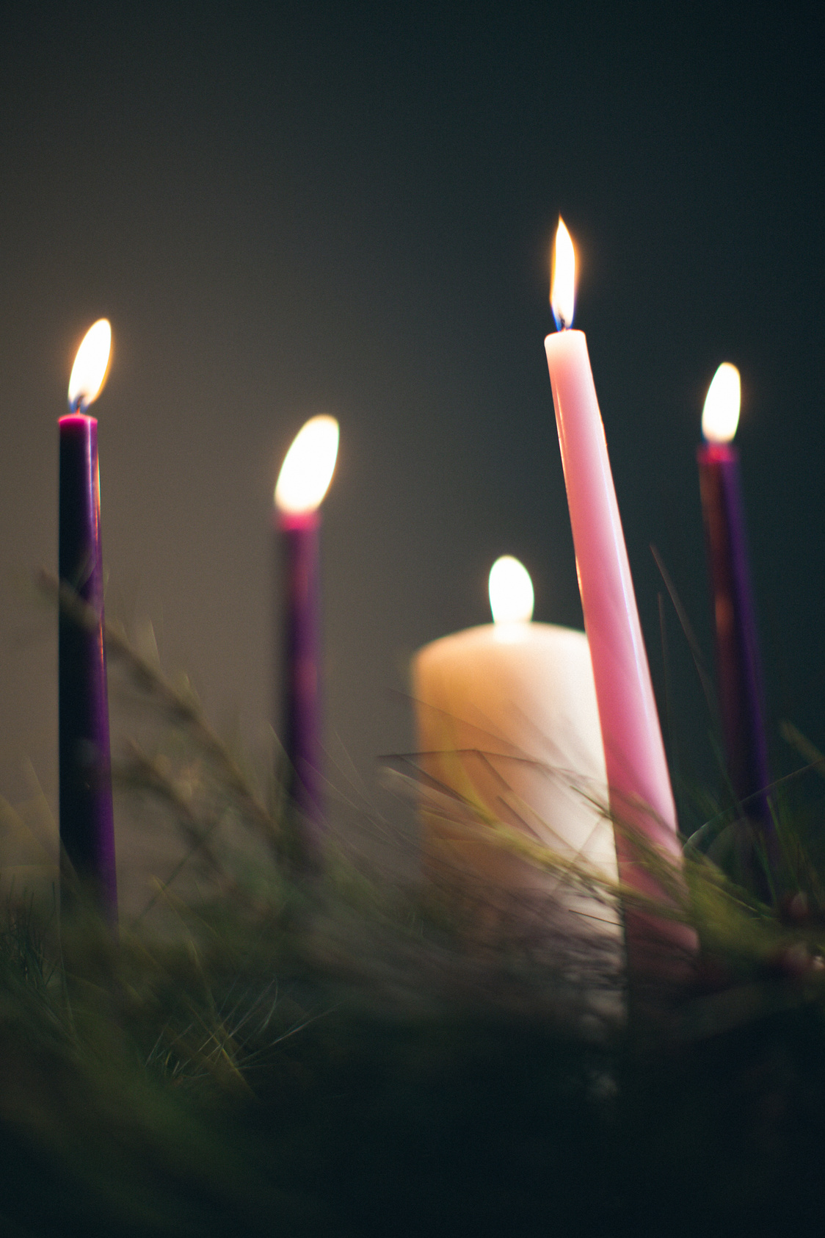
CAFOD’s Advent Assembly 2026
Hope
Peace
Joy
Love
God of light,
As we begin our Advent journey, help us to recognise Your presence in our world.
Open our eyes to see Christ in our sisters and brothers, especially those who are struggling and facing darkness.
Inspire us to share hope, work for justice and shine Your light wherever we go.
We ask this prayer through Christ our Lord.
Amen.
Notes:
Let us now pause for a moment of prayer as we ask for God’s help to be a beacon of light this Advent...
(You could invite the young people and staff to join in with the prayer if the text is visible for them)
We pray:
God of light,
As we begin our Advent journey, help us to recognise Your presence in our world.
Open our eyes to see Christ in our sisters and brothers, especially those who are struggling and facing darkness.
Inspire us to share hope, work for justice and shine Your light wherever we go.
We ask this prayer through Christ our Lord.
Amen.
Photo: Pearl from Lightstock.
Advent candle graphics: M. Wallflower, Trendify, via Canva.
Green foliage: Sketchify from sketchify, via Canva.
Star graphic: WC Studio from WC Studio, via Canva.

Slide 13

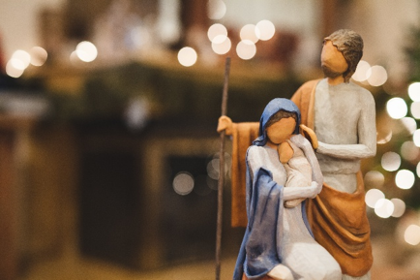
CAFOD’s Advent Assembly 2026
Hope
Peace
Joy
Love
Happy Christmas
from everyone at CAFOD!
“The light shines in the darkness,
and the darkness has not overcome it.”
John 1:5
Notes:
Thank you for welcoming me into your school today.
From everyone at CAFOD, we wish you a very happy Christmas!
And we look forward to hearing about your fundraising and all the ways you are helping to be a beacon of light for those in need.
Photo: Pearl from Lightstock.
Photo: Blue Wave Creative, Lightstock.
Advent candle graphics: M. Wallflower, Trendify, via Canva.
Green foliage: Sketchify from sketchify, via Canva.
Star graphic: WC Studio from WC Studio, via Canva.

