Slide 1
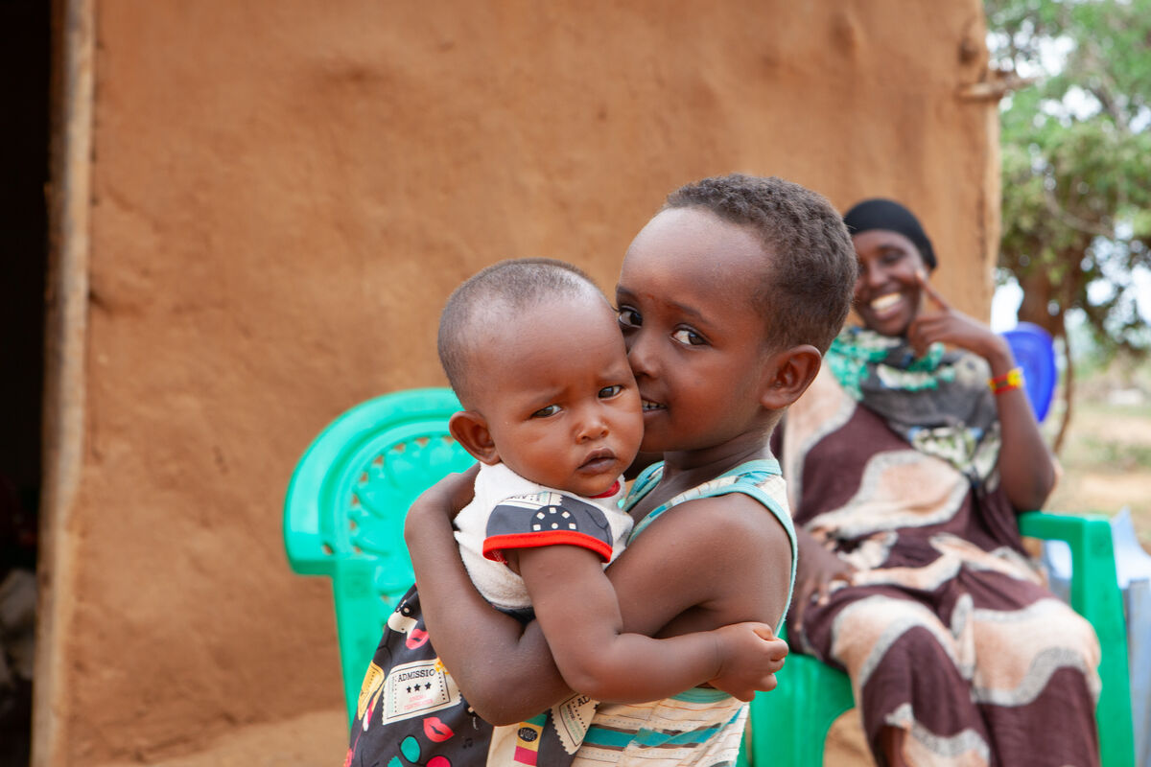
How will you show your love for your neighbours both here and around the world?
Gather
Notes:
Children’s liturgy: Fifteenth Sunday in Ordinary Time (Year C)
Preparation of the worship space
Colour: green
Props: coloured pens and pencils
Song suggestions
When I needed a neighbour (888, Laudate)
Welcome
Today we hear how a Good Samaritan helped a man who was hurt when a Priest and a Levite had both ignored him. Let’s think about who our neighbour is and how Jesus shows us that we should help anyone in need.
Tume and her family, Marsabit, Kenya
Photo credit: Louise Norton

Slide 2
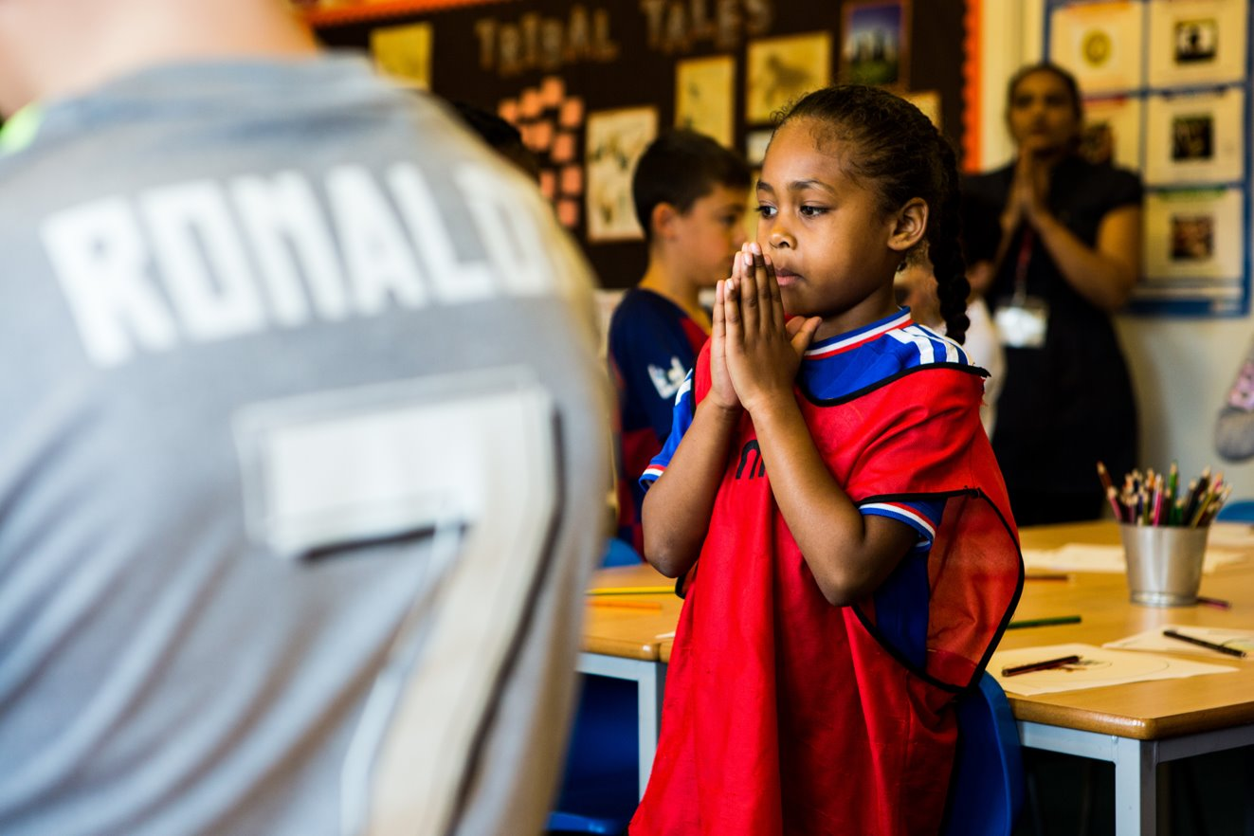
Loving God,
Help us to see that all people throughout the world are our neighbours. Grant that we may be ready to help anyone in need, whether they live near or far from us. Amen.
Notes:
Children at Our Lady Queen of Heaven Primary School
Photo credit: Thom Flint

Slide 3
Gospel: Luke 10: 25-37
A teacher of the Law came up and tried to trap Jesus. “Teacher,” he asked, “what must I do to receive eternal life?”
Jesus answered him, “What do the Scriptures say? How do you interpret them?” The man answered, “’Love the Lord your God with all your heart, with all your soul, with all your strength, and with all your mind’; and ‘Love your neighbour as you love yourself.’”
“You are right,” Jesus replied; “do this and you will live.” But the teacher of the Law wanted to justify himself, so he asked Jesus, “Who is my neighbour?”
Jesus answered, “There was once a man who was going down from Jerusalem to Jericho when robbers attacked him, stripped him, and beat him up, leaving him half dead.
"It so happened that a priest was going down that road; but when he saw the man, he walked on by, on the other side. In the same way a Levite also came there, went over and looked at the man, and then walked on by, on the other side.
Word

Slide 4
"But a Samaritan who was travelling that way came upon the man, and when he saw him, his heart was filled with pity. He went over to him, poured oil and wine on his wounds and bandaged them; then he put the man on his own animal and took him to an inn, where he took care of him.
"The next day he took out two silver coins and gave them to the innkeeper. ‘Take care of him,’ he told the innkeeper, ‘And when I come back this way, I will pay you whatever else you spend on him.’”
And Jesus concluded, "In your opinion, which of these three acted like a neighbour towards the man attacked by the robbers?"
The teacher of the Law answered, “The one who was kind to him.”
Jesus replied, “You go, then, and do the same.”
Word

Slide 5
What do you remember from
the Gospel reading?
A man asks Jesus who his neighbour is. Who should he be loving and caring for? So Jesus tells a parable – a special story – to explain.
A man is travelling to Jericho when he meets some robbers who beat him up, take all his money and then leave him injured on the side of the road. A priest and a Levite (the Levites helped the priests in the Temple) see the wounded man, deliberately cross over the road and walk on by.
Respond
Notes:
Winding road
Photo credit: Stock image

Slide 6
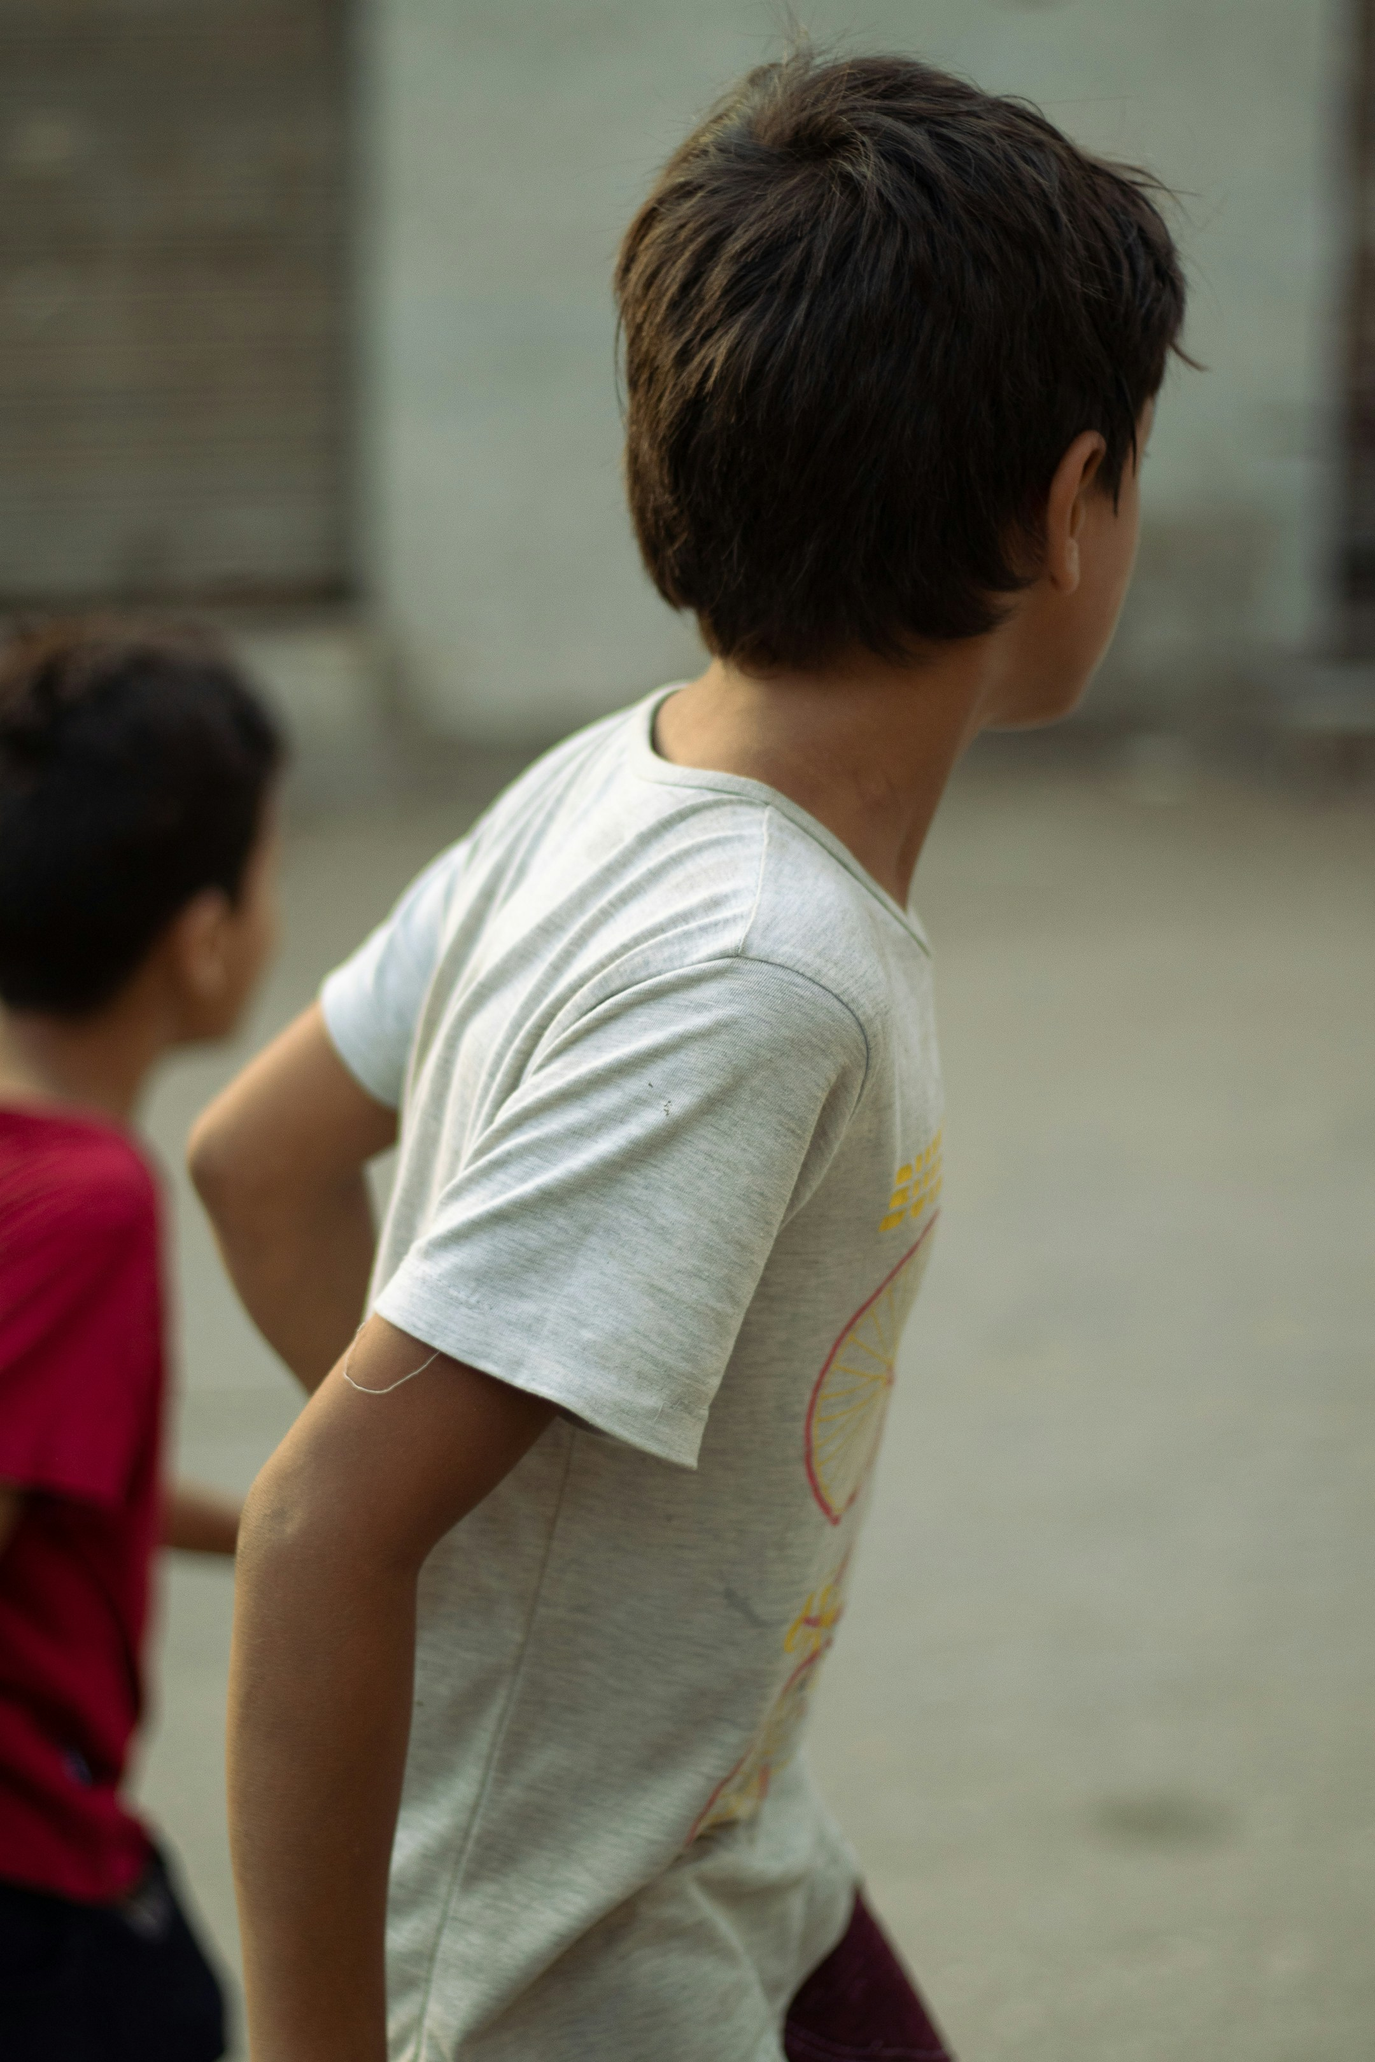
Do you think this is the right choice for these important people to make? Why/why not?
What would you do if you came across someone who was hurt, unwell or sad?
Then Jesus says that a Samaritan (the Jewish people and the Samaritans didn’t get along) saw the man on the ground. He felt sorry for the injured man and went to help him.
Notes:
Going to help
Photo credit: Mohamed Youssry on Unsplash

Slide 7
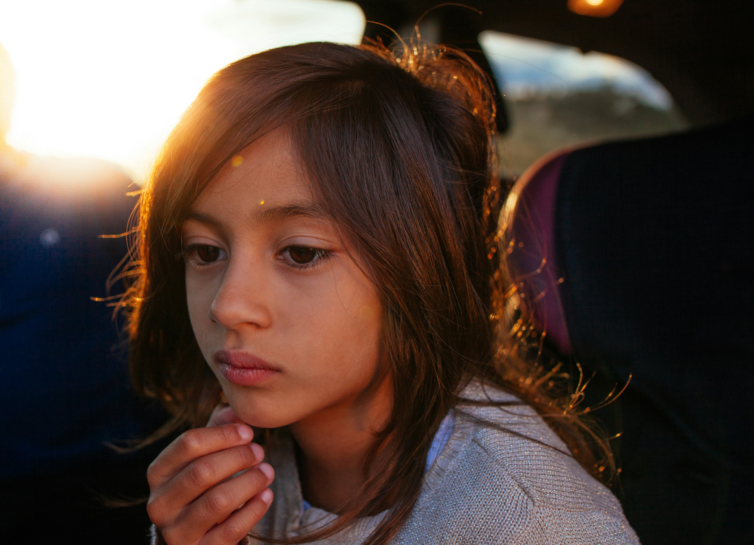
What did the Samaritan do for the man on the ground? Why do you think the Samaritan wanted to help the injured man?
Imagine you are the man who is hurt and lying on the ground and the Samaritan is helping you. What would you think and feel?
You might be very surprised because Samaritans and Jews didn’t usually talk to each other or help each other.
Notes:
Thinking
Photo credit: Joseph Gonzalez on Unsplash

Slide 8
Next, the Samaritan takes the man to an inn to rest, he pays the innkeeper and promises to return to pay any more expenses.
When he has finished the story, Jesus asks who the better neighbour is. The priest, the Levite or the Samaritan? What do you think the answer is and why?
What does this story tell us about how we should treat people?
Notes:
A helping hand
Photo credit: Annie Spratt on Unsplash

Slide 9
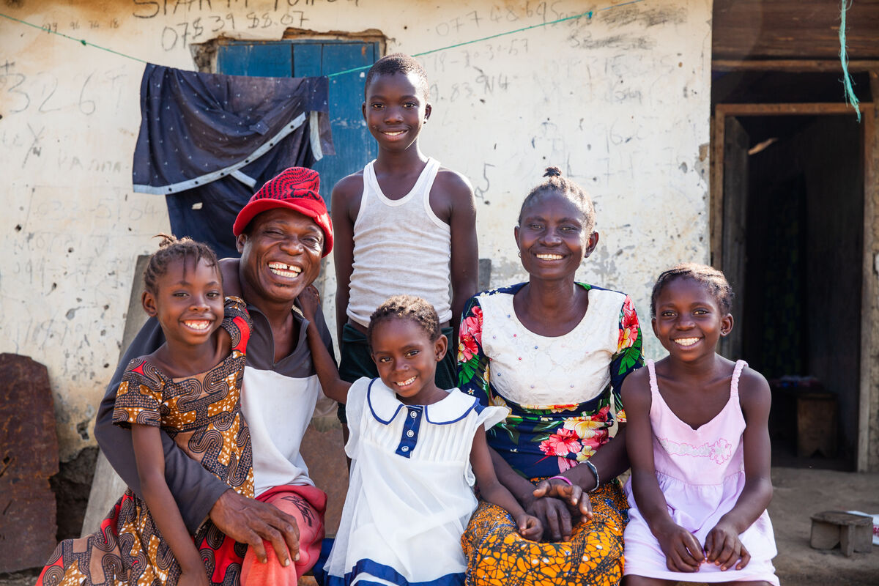
Jesus is saying that everyone is our neighbour, no matter where they come from, or where in the world they live.
At the end of the story, Jesus tells the man who asked the question about who our neighbour is to go and do the same as the Samaritan. This what we are all called to do – to try and help one another.
Notes:
Ishmael and Lucia Sesay and their family, Sierra Leone
Photo credit: Thom Flint

Slide 10
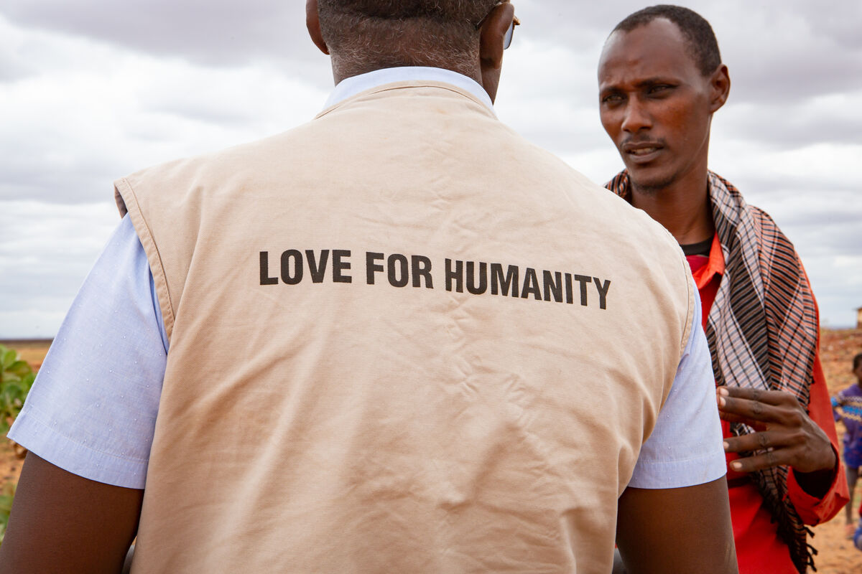
CAFOD works with many people around the world who are poor, helping them to build a better, fairer future for themselves and their families.
We are all God's children. We are all neighbours to each other and no one should be without the support they need in difficult times.
It doesn’t matter where they live, what colour they are or what religion they belong to, the gospel today shows us that everyone is our neighbour in Christ.
Notes:
CAFOD in northern Kenya
Photo credit: Louise Norton

Slide 11
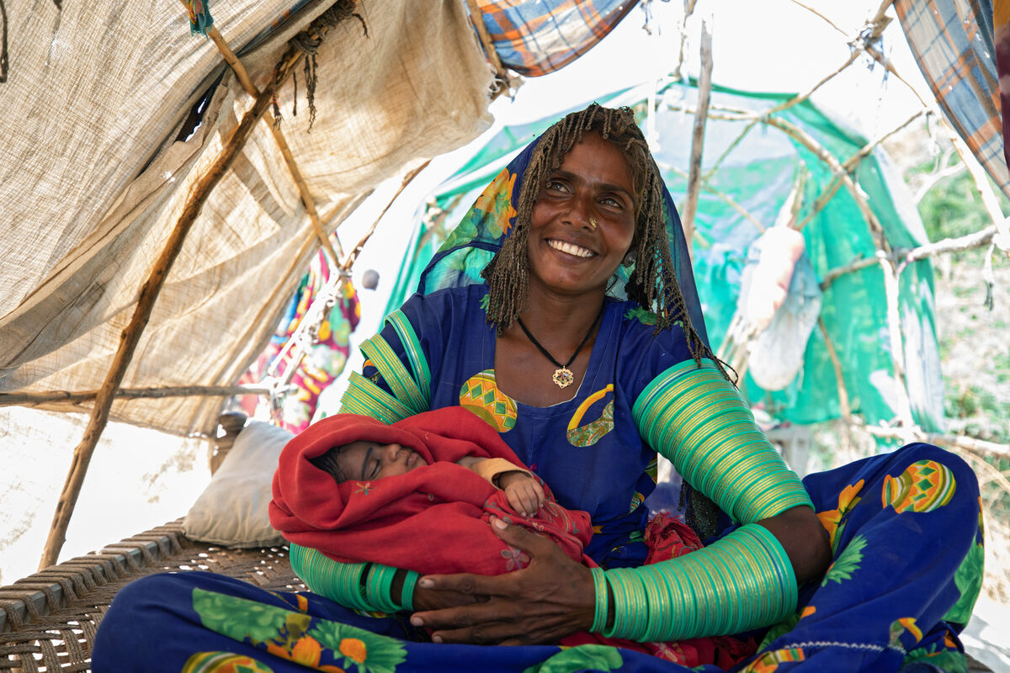
CAFOD raises money with parishes and schools – like yours! - to help our neighbours in need all around the world.
Meera gave birth to Marwi during floods in Bangladesh. "Our home was surrounded by water and Marwi was very sick,” says Meera.
A medical camp funded by CAFOD gave Marwi the medicine to make her better.
Notes:
Meera and her baby, Pakistan
Photo credit: Community World Service Asia (CWSA)

Slide 12
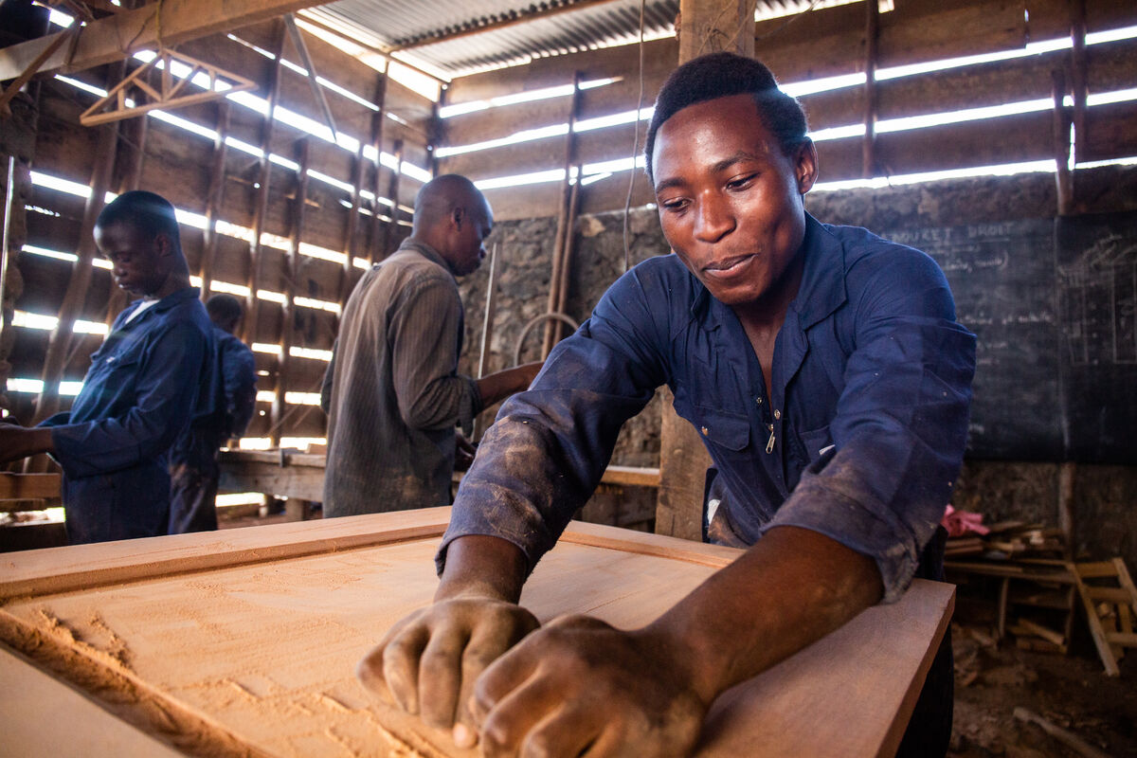
In the Democratic Republic of Congo, young people may be forced to fight in the war.
Many of Daniel's friends became child soldiers, but with CAFOD's help, he learns to make furniture at a carpentry class instead.
“We make tables, beds and chairs,” he says. “This will help me in the future and I am proud of my work."
Notes:
Daniel in the workshop, DRC
Photo credit: Thom Flint

Slide 13
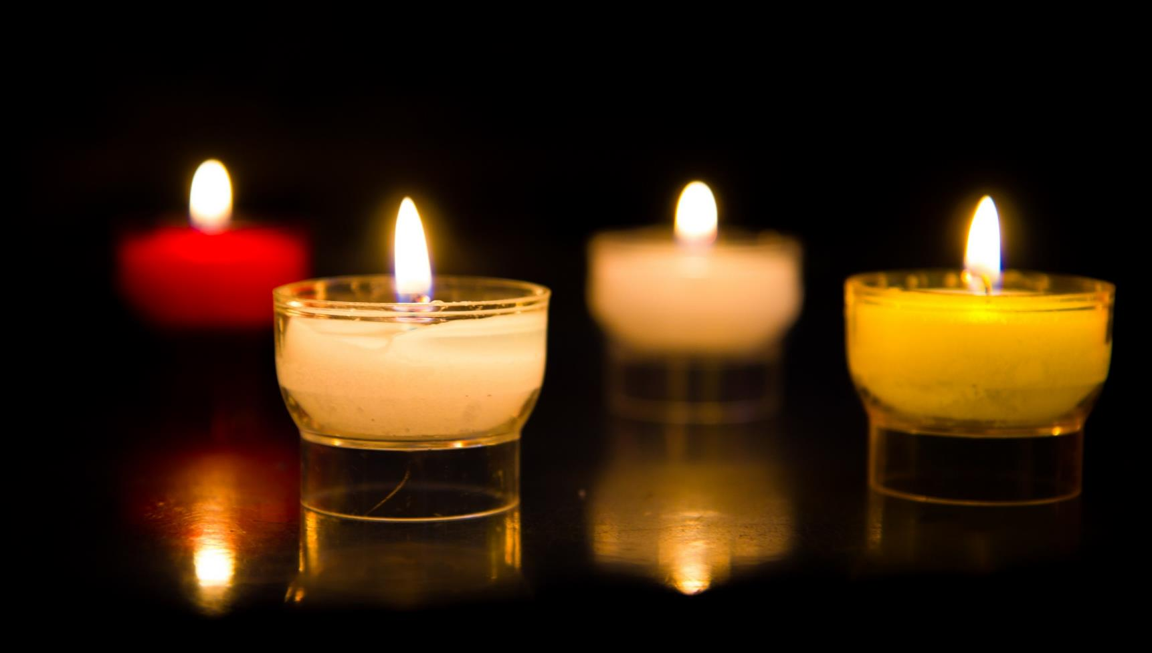
Let us pray…

Slide 14
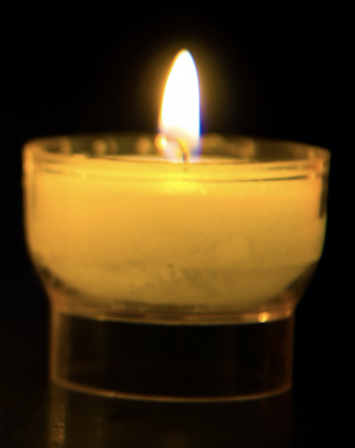
We pray for the Church: that we may all be Good Samaritans to those in need whether at home, in our local community or around the world. Lord in your mercy…
We pray for world leaders: that they may make fair decisions so that no one is ignored when they need help. Lord in your mercy…
We pray for our parish, family and friends: that we may always be ready to help our neighbours, no matter where in the world they may be.
Lord in your mercy…

Slide 15
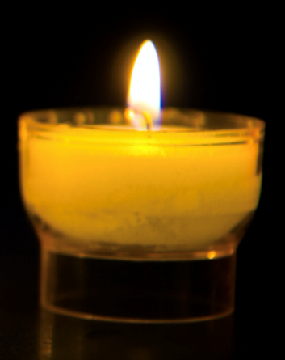
In this Jubilee Year, we pray that we may be signs of hope in our world through all that we do and how we treat one another.
Lord, in your mercy…
Healing God,
Unite us in love for our neighbours, no matter who they are. Let us be like you and offer compassion and help to everyone in need. Amen.

Slide 16
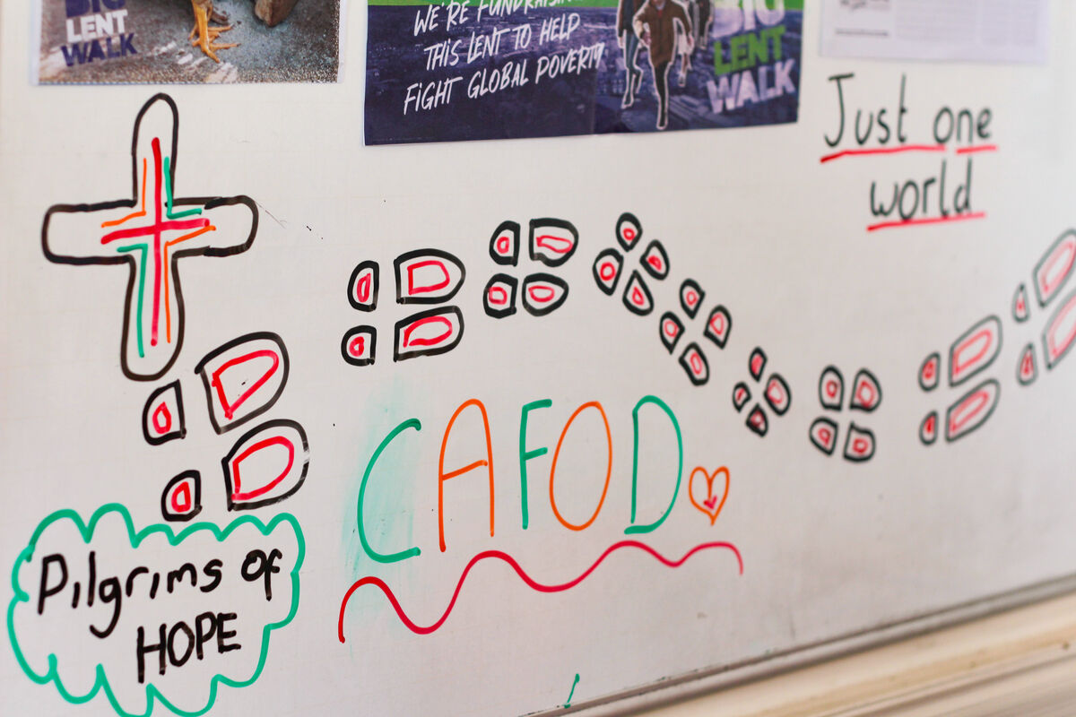
How will you show your love for your neighbours both here and around
the world this week? What will you do?
Send
Notes:
St Mary's RC High School, Herefordshire
Photo credit: Vicky Ahmed

Slide 17
Activity suggestions
Invite the children to colour in the accompanying illustration of the gospel story and to write or draw on the back how they will be good neighbours to others.
Remind the children to go and share with their grown ups all that they have heard and thought about in the liturgy today.
Encourage the children to think about how they can be Good Samaritans – good neighbours – in the coming week. They could think about who might be ignored or neglected in their parish, their school, their neighbourhood etc and what they could do about this.
Remind them to do at least one thing in the coming week to show that they are good neighbours to others.
Notes:
Illustration: Jane Smith

Slide 18
Notes:
Illustration: Jane Smith

Slide 19
Have you made your Jubilee Pledge?
There's still time to make your Jubilee Pledge!
All Catholic schools have been invited to make a Jubilee Pledge, this June or July, to live out Catholic Social Teaching.
A better world needs all of us, and the Pledge will be a whole school, long-term commitment to building a fairer world.
Watch our films and download our resources to help you write your Pledge and plan your Pledge Day:
Jubilee pledge for schools
The Jubilee Year is a landmark moment in the life of the global church. School communities are invited to join together as pilgrims of hope, pledging to work together for God’s kingdom of justice, peace and love. Find resources at:
Jubilee for schools 2025 – Pilgrims of Hope

