Slide 1
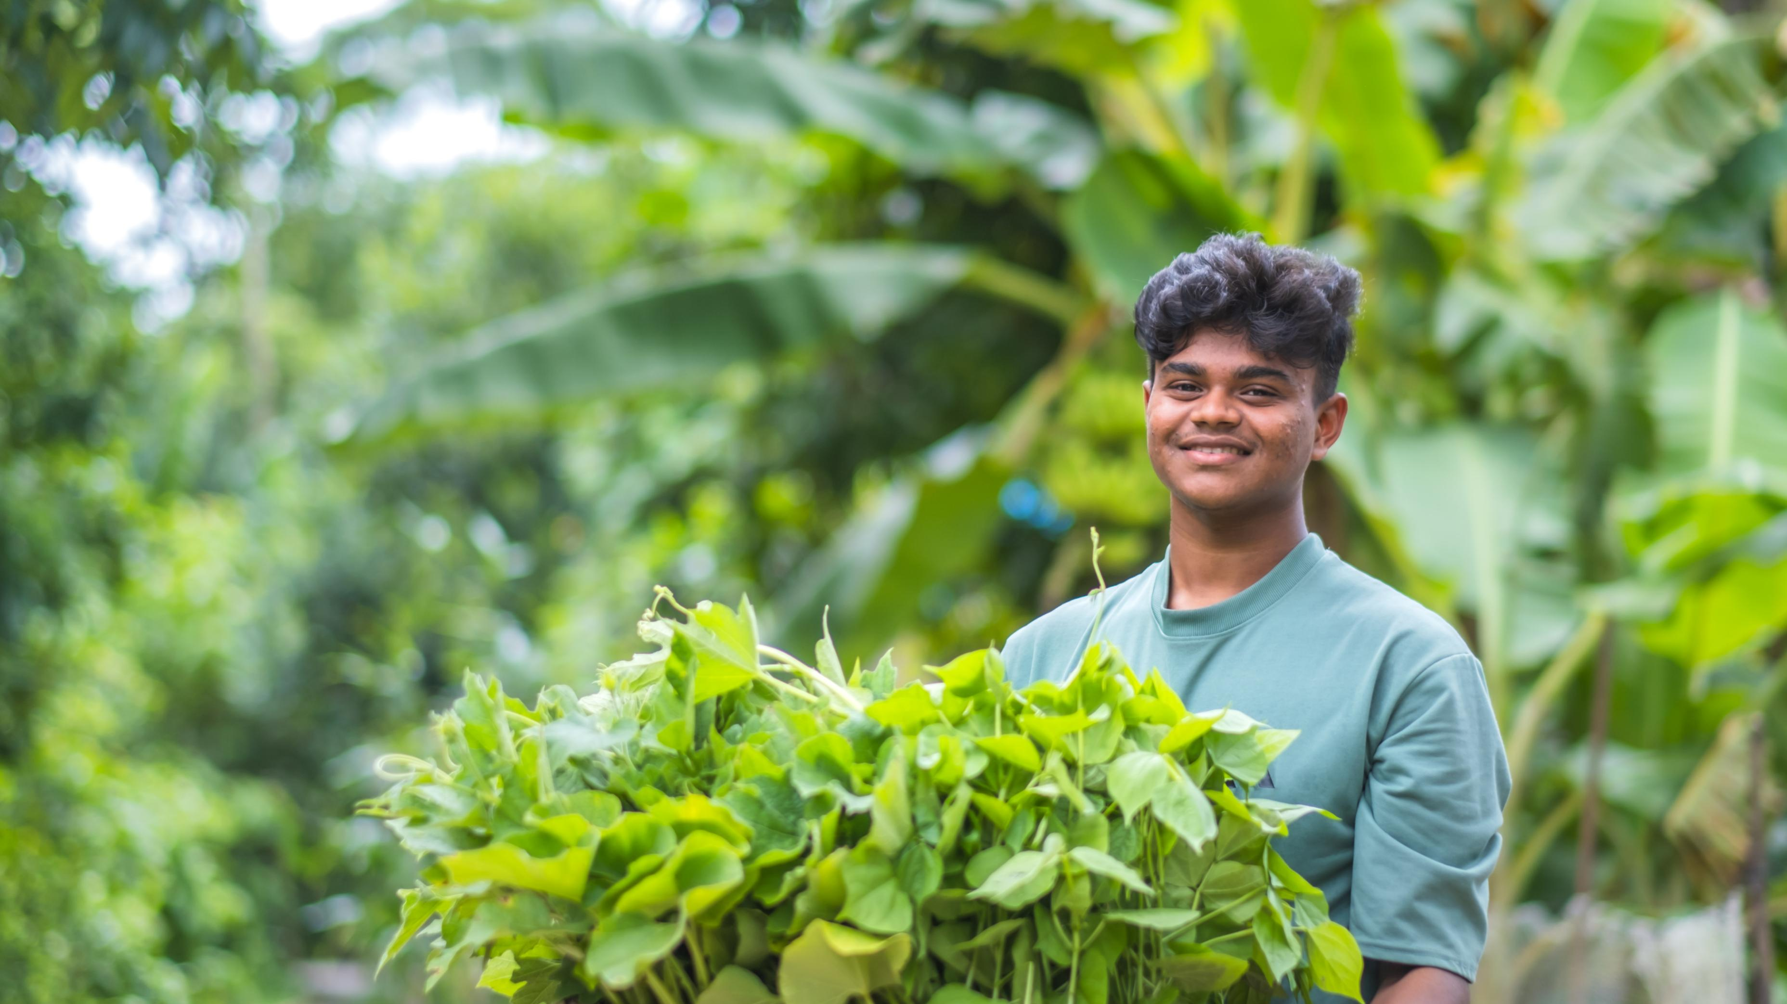

Slide 2

Photo
1
Sixteen-year-old Bayezid lives with his family in a village called Choto Bashail in Bangladesh. Since he was little, Bayezid has helped his family grow vegetables on a floating garden vegetable plot. “By coming with my father and watching, I slowly started helping out on the floating garden,” he says. “In the beginning, we cultivated bottle gourd here. That was the first thing I ate. It tasted really good!”
Discussion questions: Have you ever tasted bottle gourd? It’s similar to a courgette or a squash. Have you ever helped to grow a plant in a garden? What did that process involve?
Photo credit: Amit Rudro, CAFOD

Slide 3
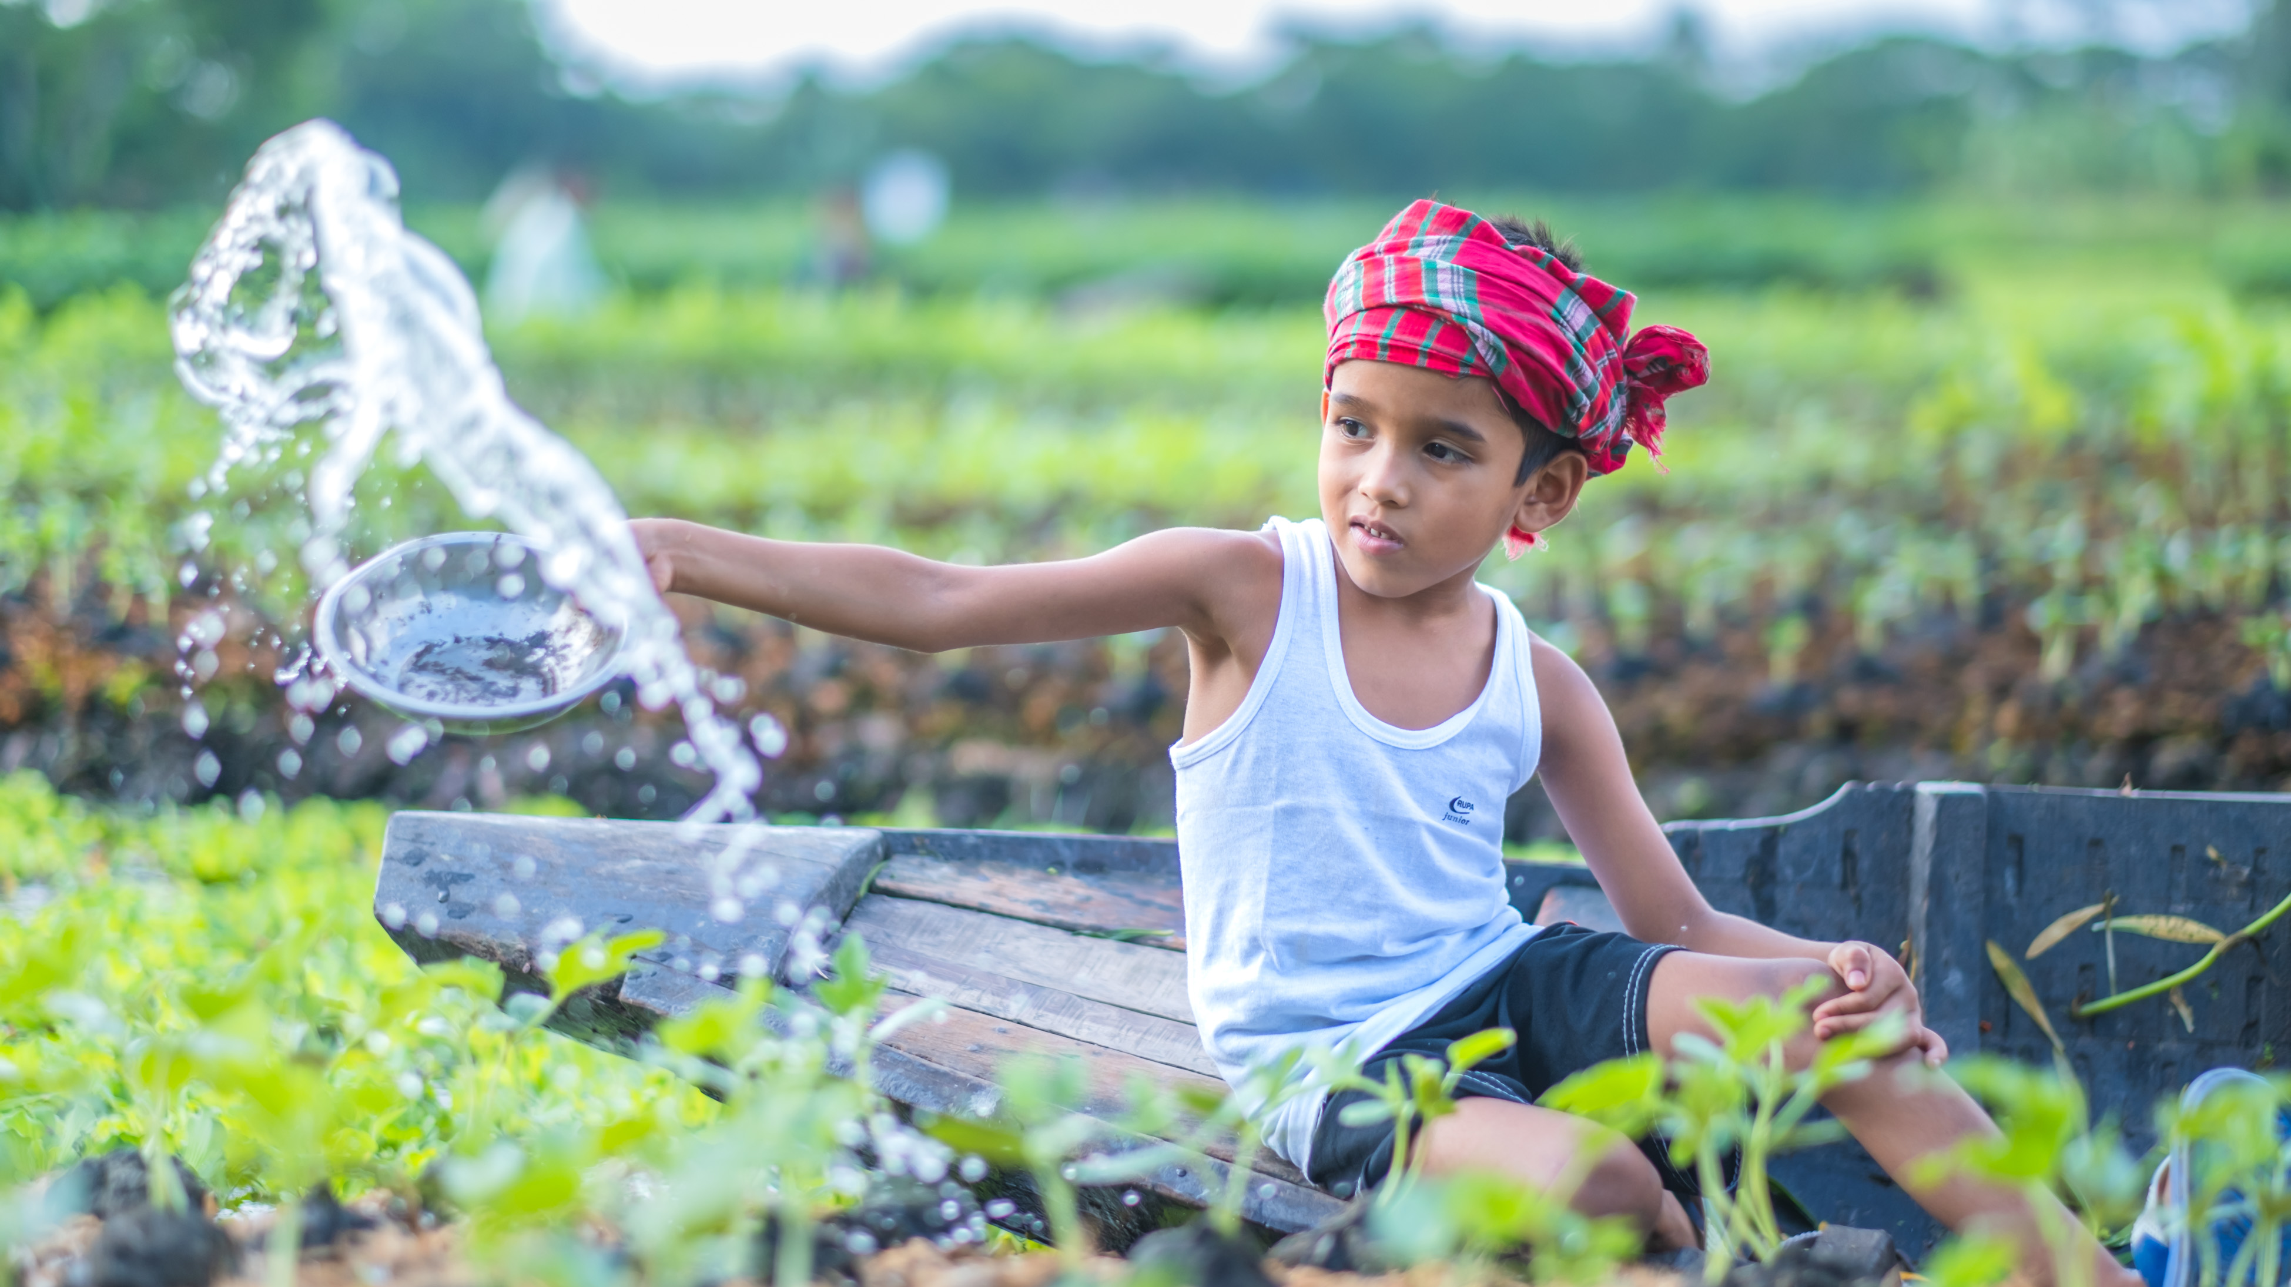

Slide 4
Photo
2
Zunayed is six and lives close to Bayezid. Zunayed’s father watched his neighbours plant floating gardens and became curious. He visited the training sessions on how to construct a bed and asked questions.
Zunayed likes visiting the floating gardens with his father who wants to pass on what he has learnt to his son. Zunayed is keen to keep an eye on things – checking the plants to make sure they are growing.
Discussion questions: Have you ever learnt a skill from a parent, carer or grandparent? Why is it important to pass down skills to different generations? Is there a community project near you that involves lots of families? What benefit do community projects bring to a village/town or city?
Photo credit: Amit Rudro, CAFOD

Slide 5
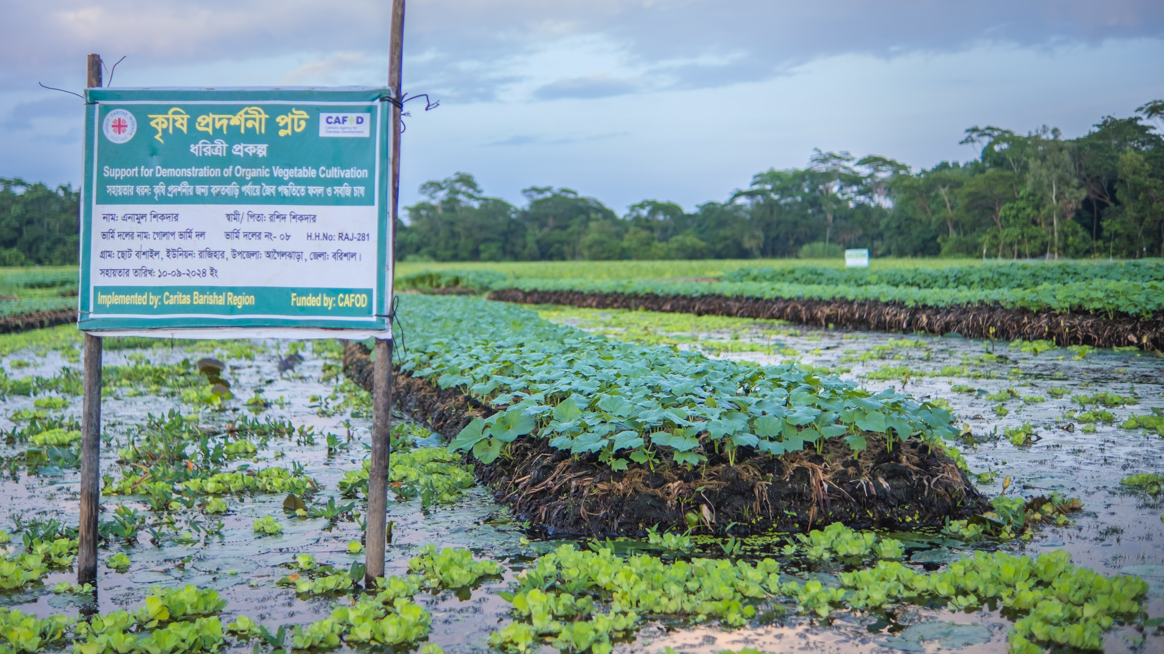

Slide 6
Photo
3
The floating bed is how the family earn their living. They have enough food to eat and sell, with money left over for the things they need to live a happy life. “The floating garden is very important for us,” says Bayezid.
Discussion questions: Where do you buy your food? Do you depend on growing your own crops for your food needs? What would happen to Bayezid’s community if the weather suddenly changed? What impact would this have on healthcare and education?
Photo credit: Amit Rudro, CAFOD

Slide 7
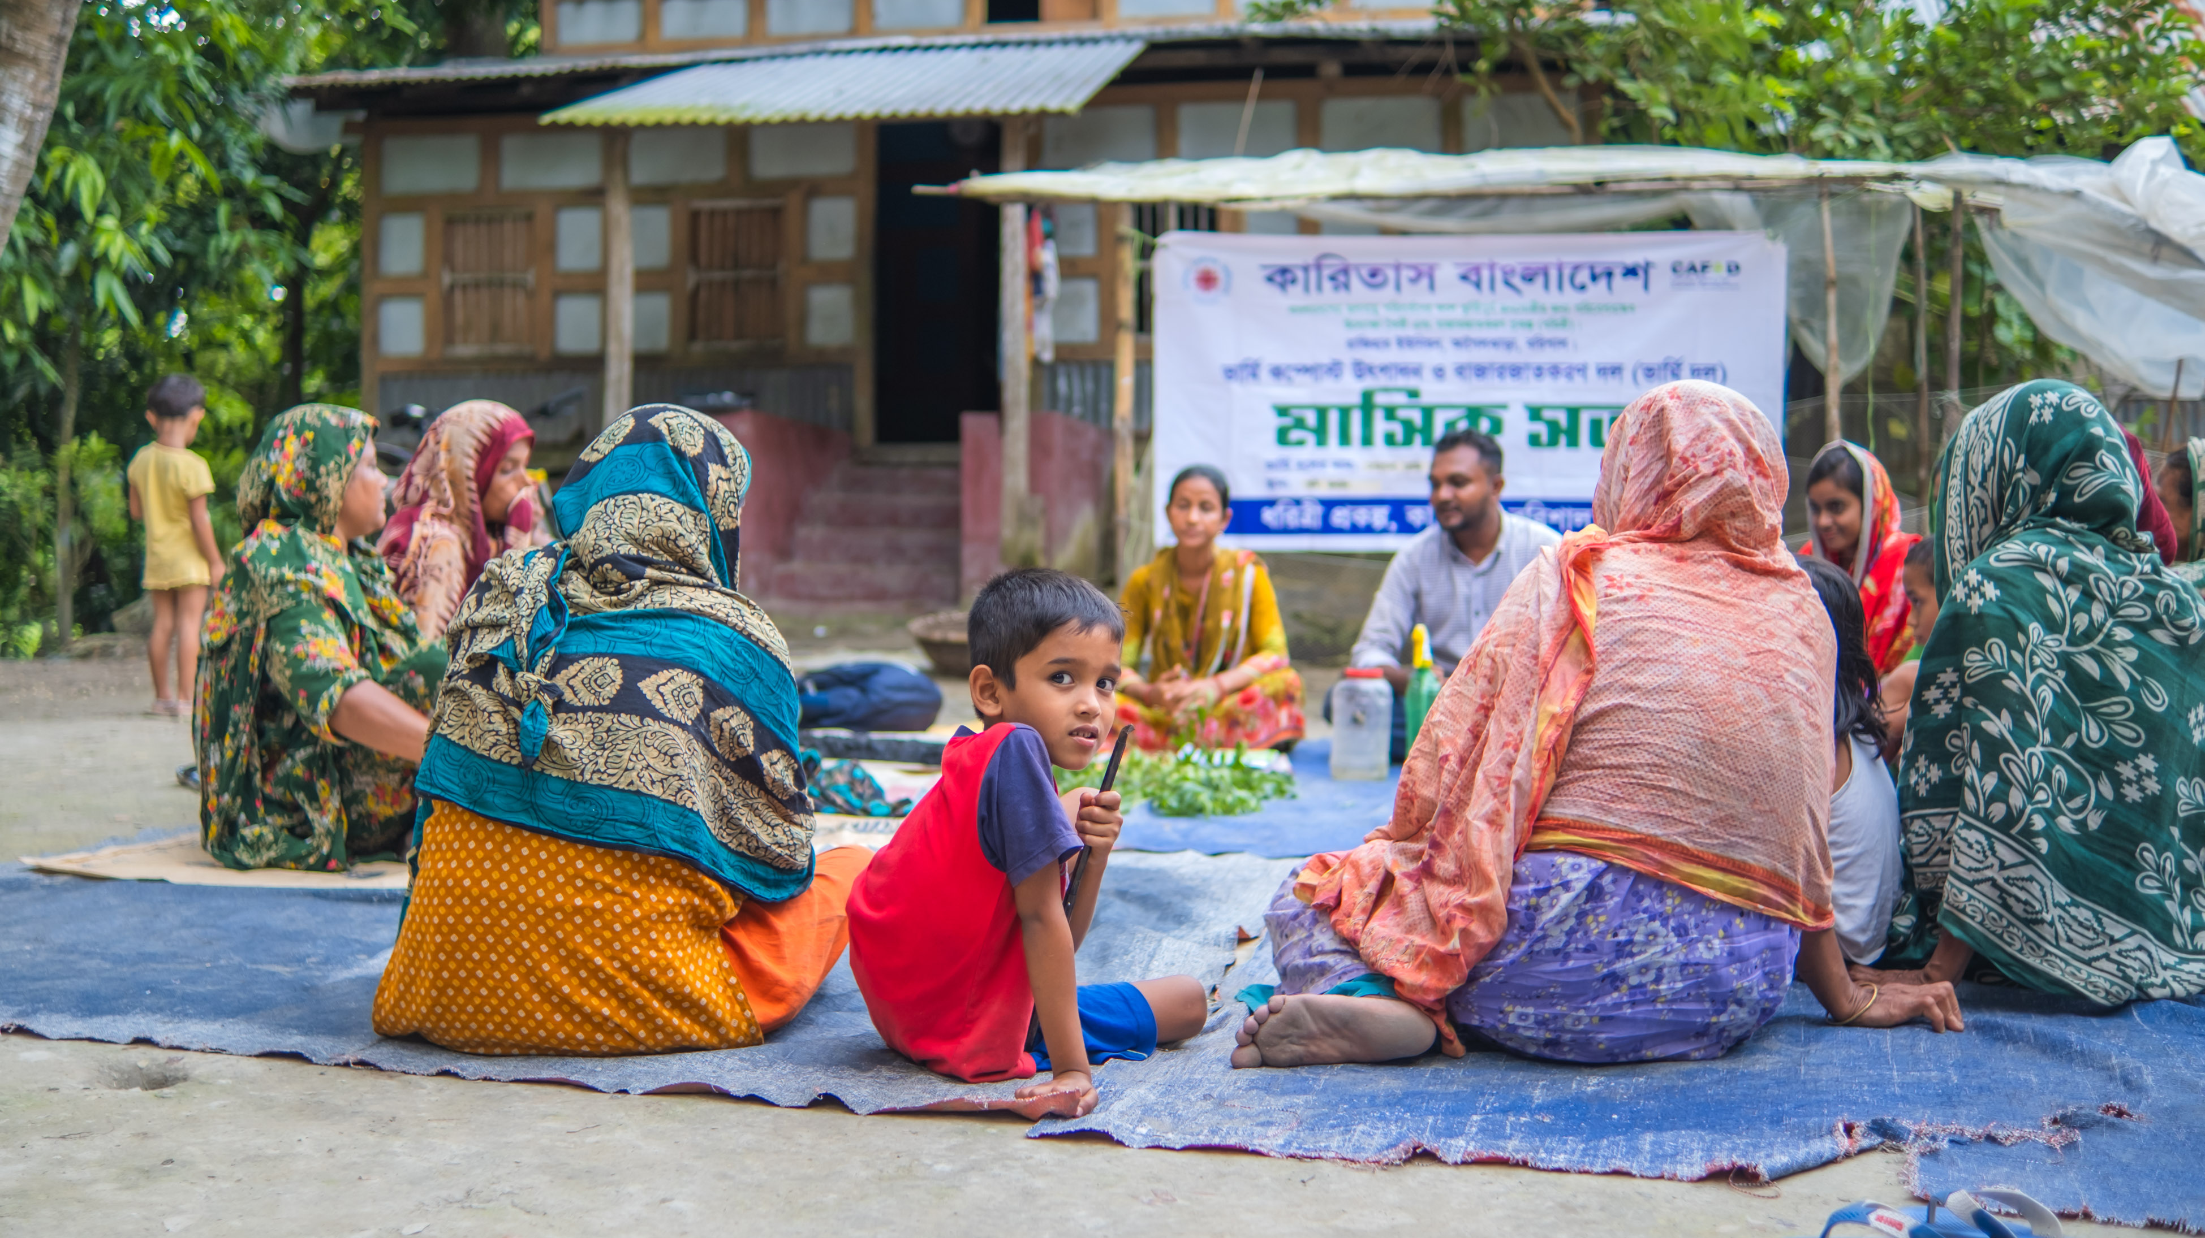

Slide 8
Photo
4
Obaidul lives in the same village as Bayezid. He said, ‘‘Our village has lots of benefits. There is a lot of noise, busyness, and trouble in the city but in our village, there is a freedom. For example, maybe I'm not feeling well, so I'll just go out for a walk around the area, or do a little vegetable farming, or bring grass for the cow. Because of these freedoms, I like the village.’’
Discussion questions: Do you enjoy the area you live in? What are the strength and benefits of your local area? How do you connect to nature? How does nature improve your mental wellbeing?
Photo credit: Amit Rudro, CAFOD

Slide 9
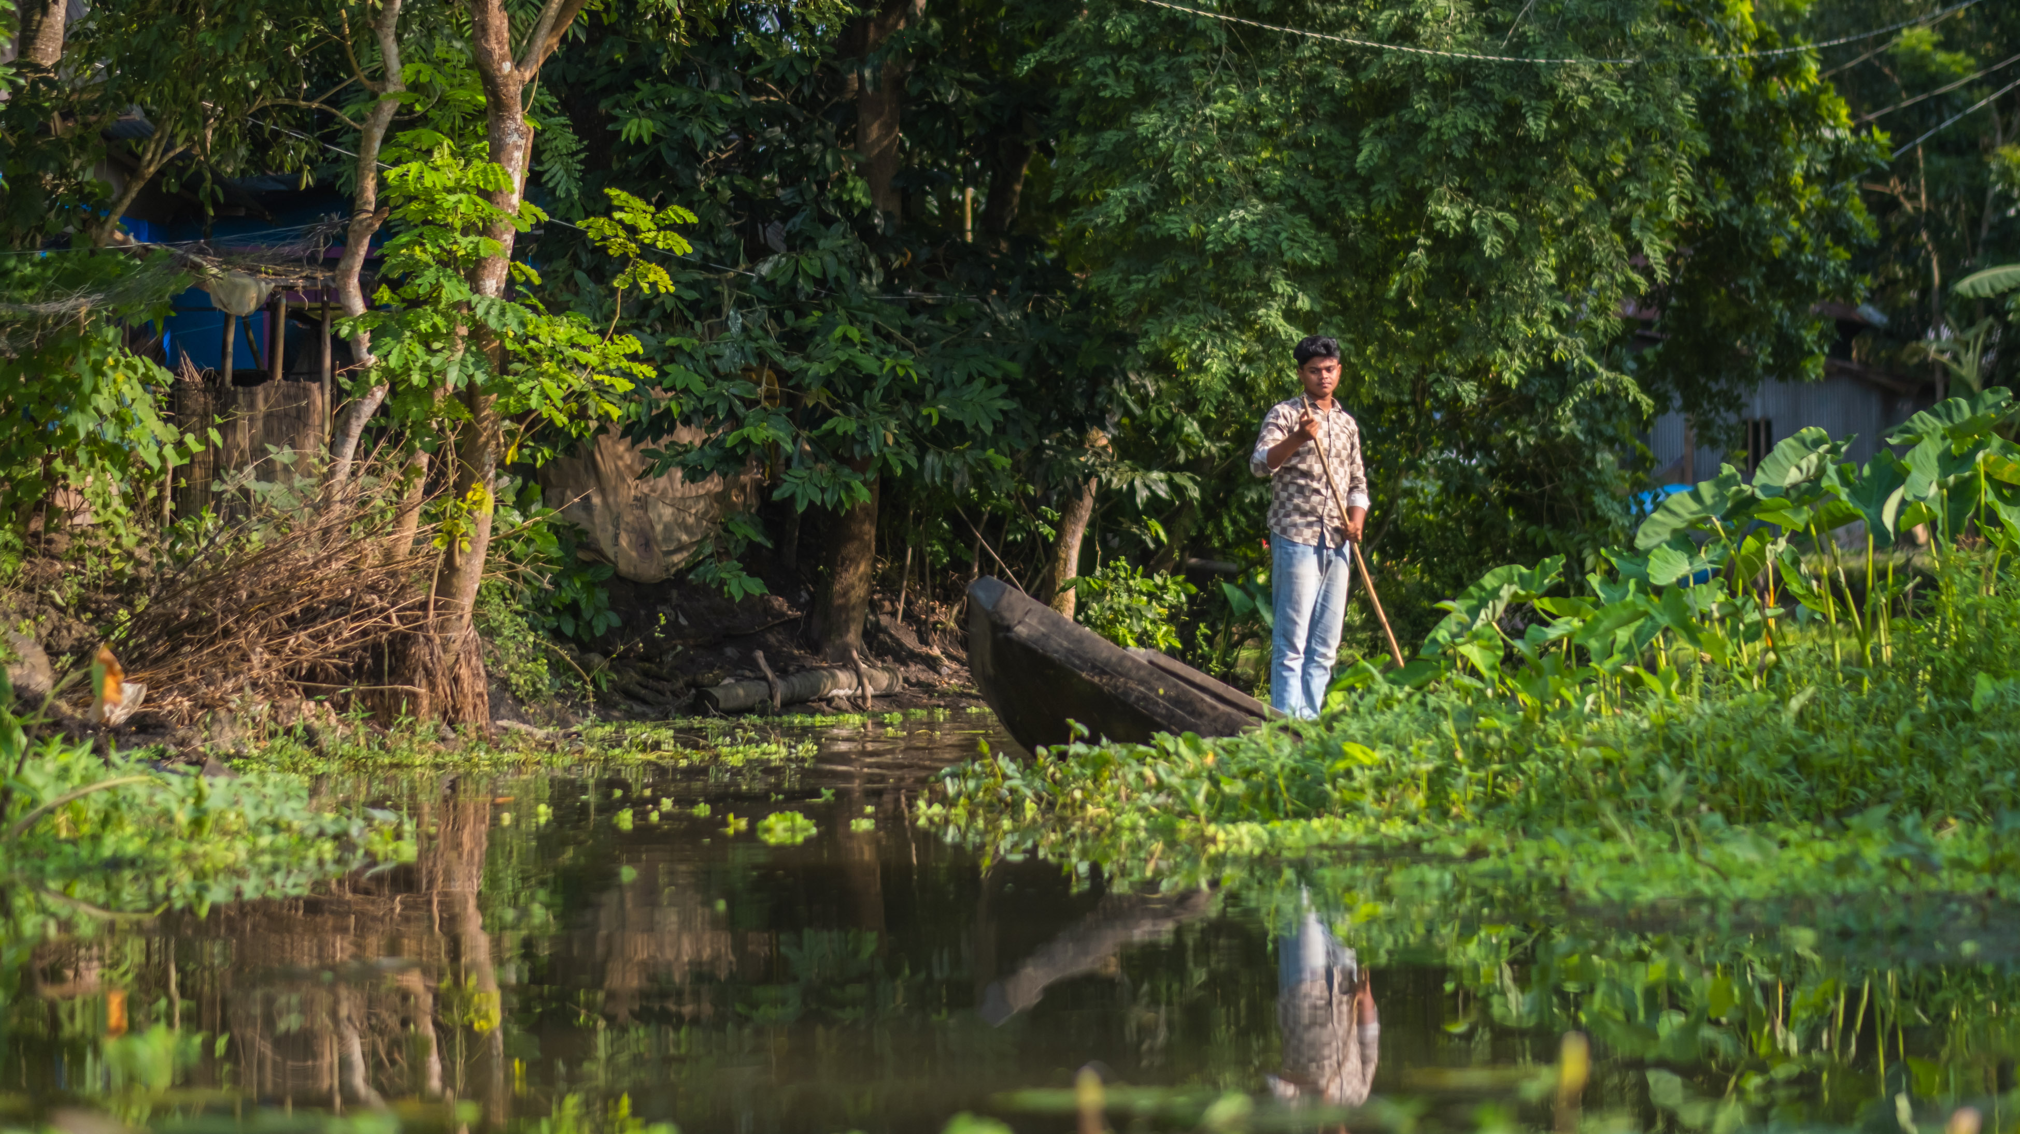

Slide 10
Photo
5
With CAFOD’s help, local experts are working with more families in Bangladesh to build floating gardens. Immune to floods, the buoyancy of the garden allows it to rise with growing water levels. The gardens are created by the community using layers of water hyacinth plants that grow locally.
Discussion questions: How have the community demonstrated creative thinking in the floating garden project? Remember: normal gardens would become waterlogged with too much rain. Why is it important to listen to local experts? What CST principle would this link to? Clue: It begins with an S!
Photo credit: Amit Rudro, CAFOD

Slide 11
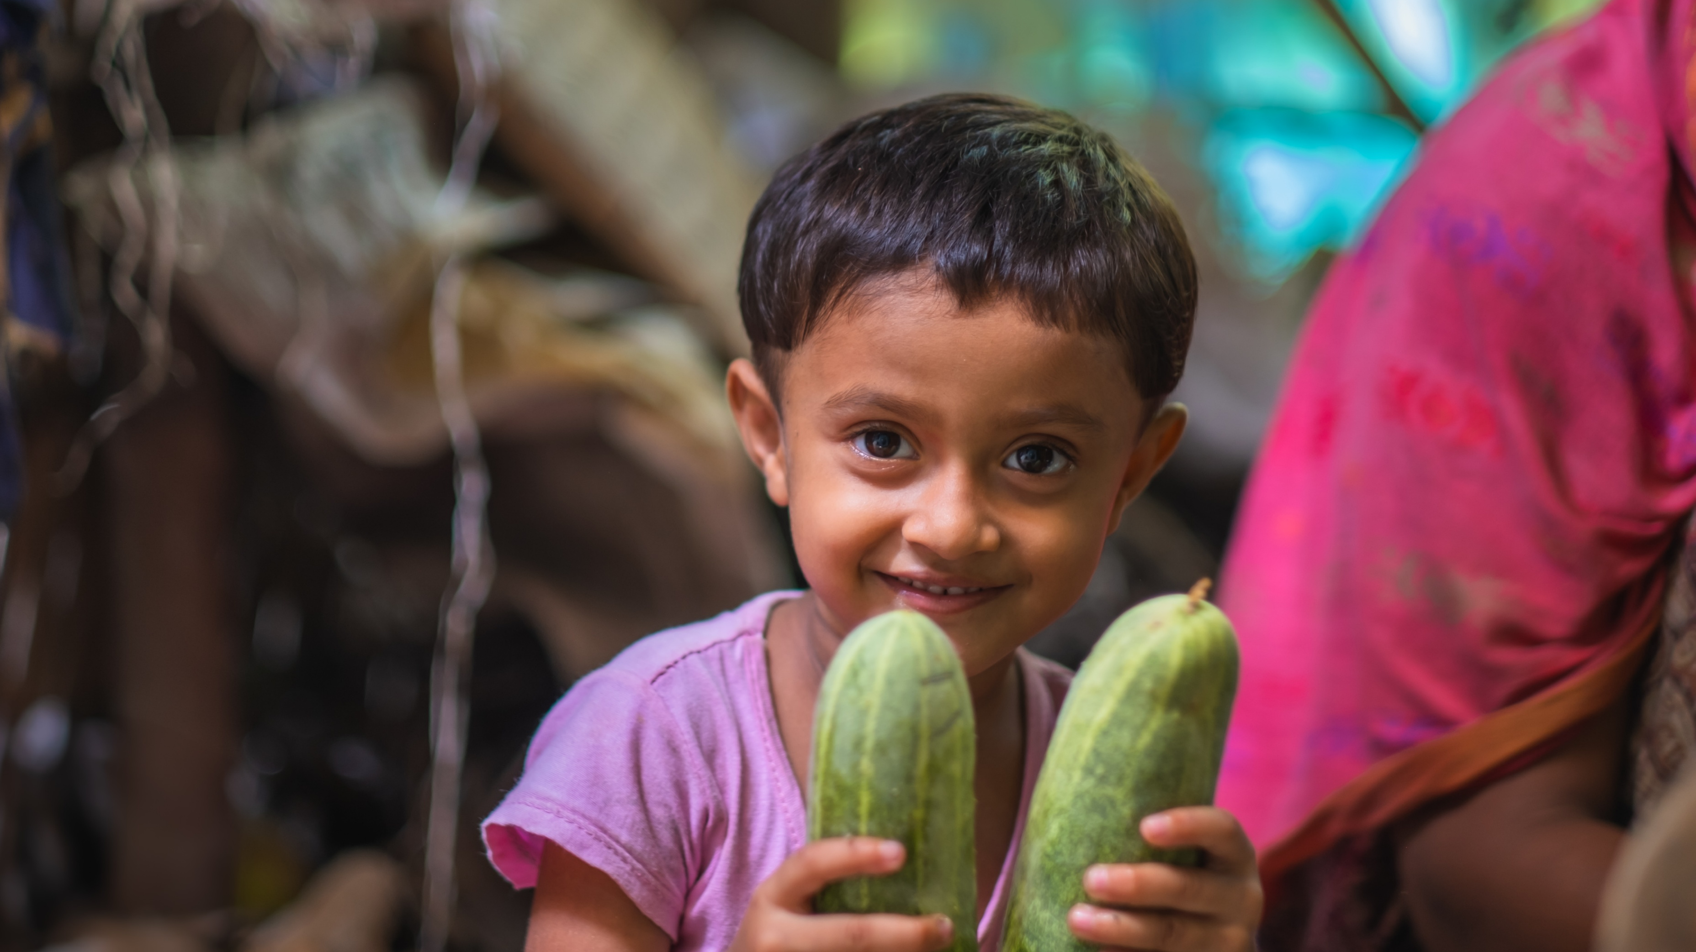

Slide 12
Photo
6
Muslima is five and is Bayezid’s niece. Her family also makes a good living from cultivating floating gardens. Her grandfather was even able to buy ducks and cows from the money he made from selling the vegetables he had grown on the floating beds.
Muslima enjoys being in the kitchen with her grandmother, watching her prepare the vegetables that have been harvested from the floating gardens.
Discussion questions: Why is it helpful for the family to have different ways of earning a living? Think about what would happen if the harvest were to fail one year.
Photo credit: Amit Rudro, CAFOD

Slide 13
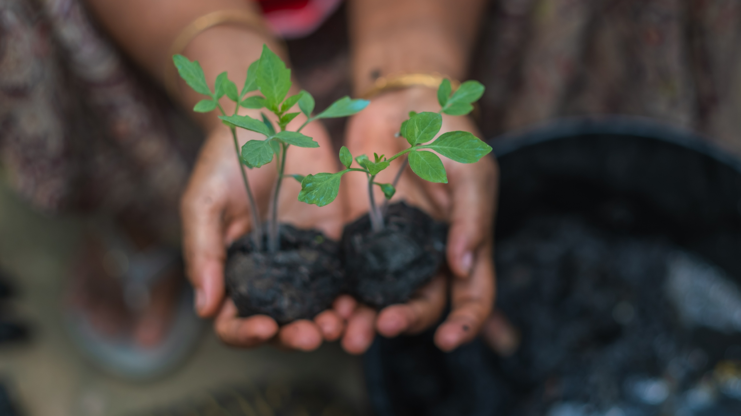

Slide 14
Photo
7
Obaidul said that ‘‘Twenty days after putting them on the beds, the seedlings are suitable for sale. So they are ready for sale in a total of 28 days. I plant 600 seedlings in one bed. Then after 28 days, if the demand is high, every hundred seedlings are sold for 600 takas.’’
*takas are the currency in Bangladesh
Discussion questions: Do you know anyone who owns a business? What do they sell? Demand changes when there are fewer plants. Why would the prices change in areas where there is a flooding risk? What must the community do to guarantee an income even if there is heavy rain that year?
Photo credit: Amit Rudro, CAFOD

Slide 15
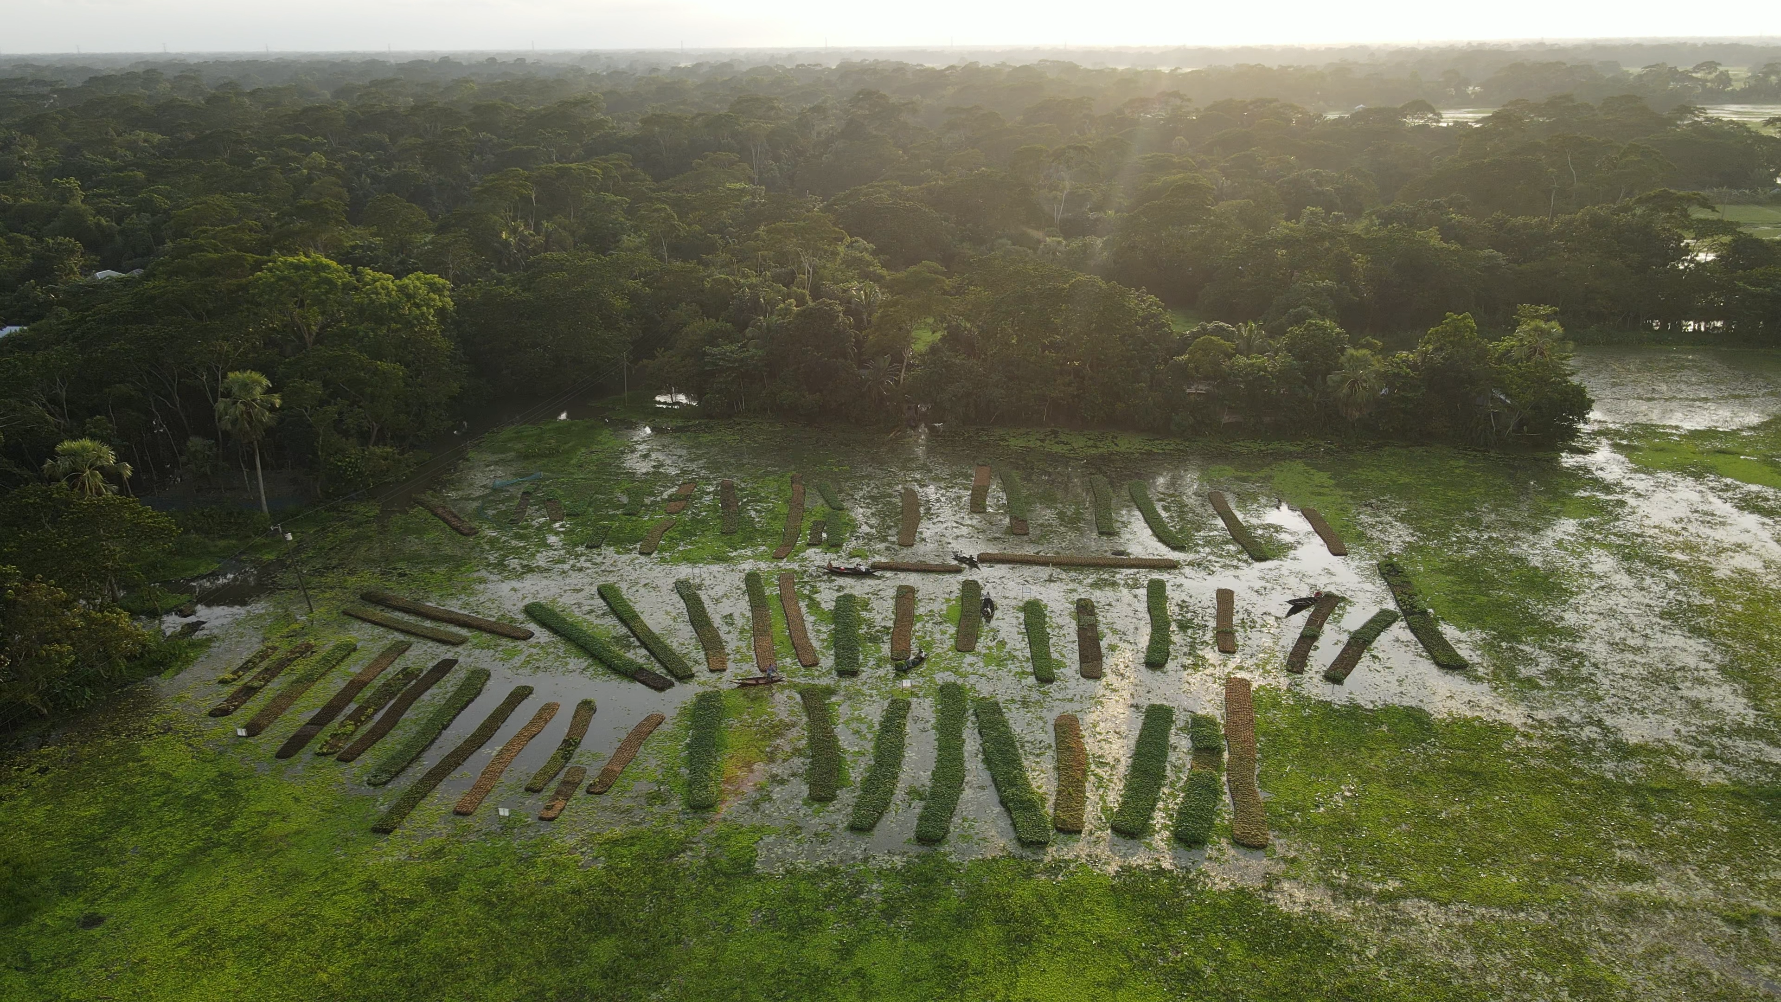

Slide 16
Photo
8
The floating beds are made from water hyancinth. These create a net for soil to be placed on top. They are made new every year because otherwise they will rot. The seedlings are then planted into the bed when they are strong enough. The floating beds are floated down a canal into this area of wetland.
Discussion questions: When you look at this picture of the floating beds, what is your immediate reaction? What do you see, feel and think about this image? Pope Leo has asked to us to care for creation. How do you do that in your school? Does your school take part in the LiveSimply Award?
Photo credit: Amit Rudro, CAFOD

Slide 17
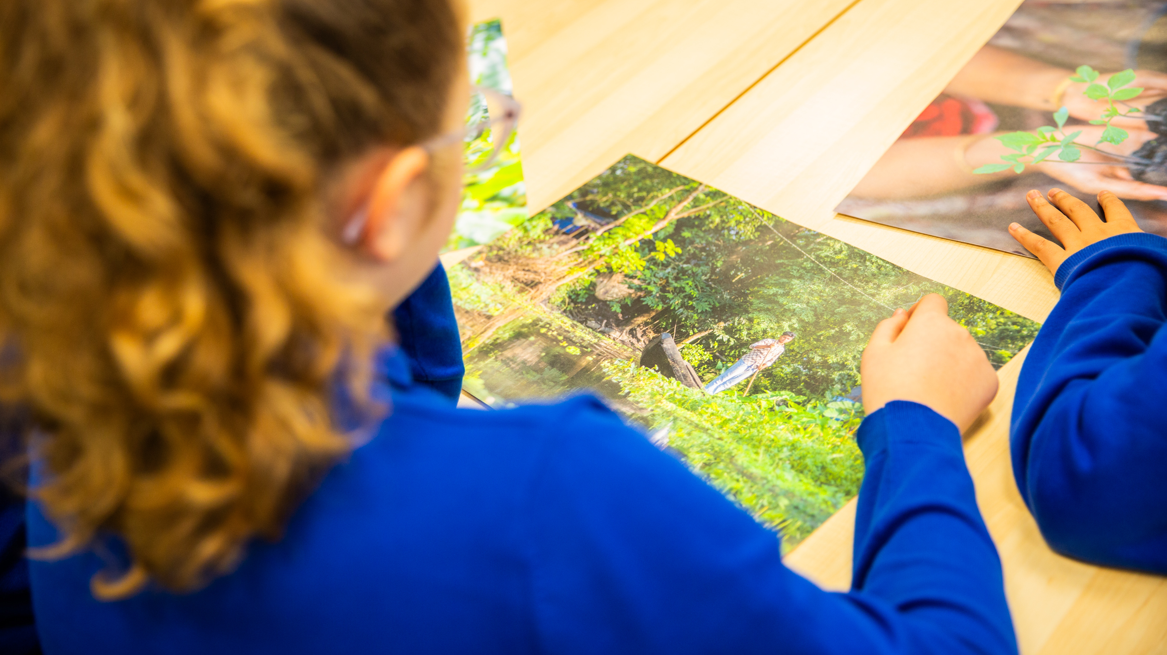

Slide 18
Photo
9
The community received two training sessions from CAFOD’s partner, Caritas Bangladesh. They were taught new farming methods for the floating beds which led to more food and income for the community. Your fundraising helps to finance the training sessions.
Obaidul would like to pass a message on to you, ‘‘I hope that you will train and make many more people self-reliant this way so that poverty is eradicated. Thank you too. I hope you can encourage and help many more people.’’
Discussion questions: Why is it important to learn about our brothers and sisters around the world? What do we learn about ourselves during this process? How can we support more projects like the floating gardens project? What does your school do to fundraise for a better world?
Photo credit: Amit Rudro, CAFOD

