Slide 1
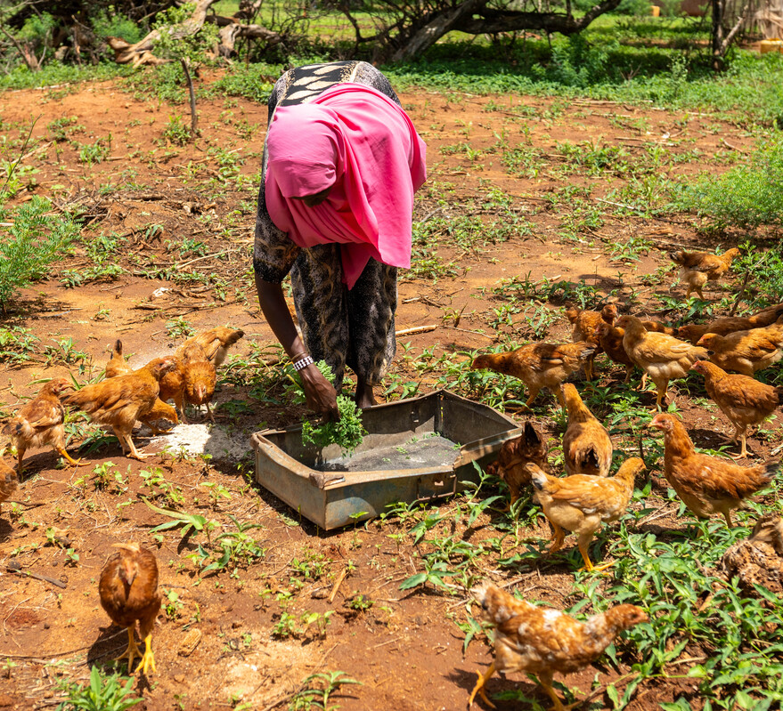
How will you show your trust in God and what will you do for the people who trust in you?
Gospel Celebration of the Word
Notes:
Children’s liturgy: Fifth Sunday of Easter (Year A)
Preparation of the worship space
Colour: white
Song suggestions
Trust is in the eyes of a tiny babe (789, Laudate)
Welcome
Today Jesus tells us that through him we will come to know God and that we should trust him as we trust in God.
Kerra and the chickens, Kenya
Photo credit: Joe Newman

Slide 2
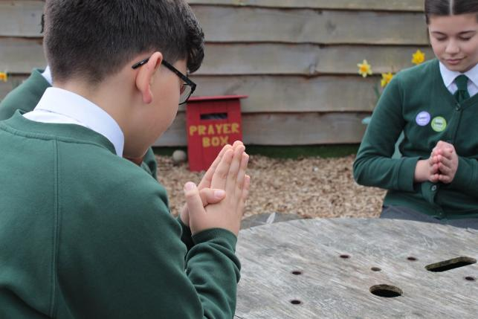
Christ Jesus, Open our hearts to trust in you, so that we may never be afraid to answer your call to love one another, and so that through you we may come closer to God. Amen.
Gather
Notes:
St Francis Xavier's RC Primary School, Herefordshire
Photo credit: Vicky Ahmed

Slide 3
Gospel: John 14: 1-12
“Do not be worried and upset,” Jesus told them. “Believe in God and believe also in me. There are many rooms in my Father’s house, and I am going to prepare a place for you. I would not tell you this if it were not so. And after I go and prepare a place for you, I will come back and take you to myself, so that you will be where I am. You know the way that leads to the place where I am going.”
Thomas said to him, “Lord, we do not know where you are going; so how can we know the way to get there?”
Jesus answered him, “I am the way, the truth, and the life; no one goes to the Father except by me. Now that you have known me,” he said to them, “you will know my Father also, and from now on you do know him and you have seen him.”
Word

Slide 4
Philip said to him, “Lord, show us the Father; that is all we need.”
Jesus answered, “For a long time I have been with you all; yet you do not know me, Philip? Whoever has seen me has seen the Father. Why, then, do you say, ‘Show us the Father’? Do you not believe, Philip, that I am in the Father and the Father is in me?
"The words that I have spoken to you,” Jesus said to his disciples, “do not come from me. The Father, who remains in me, does his own work. Believe me when I say that I am in the Father and the Father is in me.
"If not, believe because of the things I do. I am telling you the truth: those who believe in me will do what I do – yes, they will do even greater things, because I am going to the Father.”

Slide 5
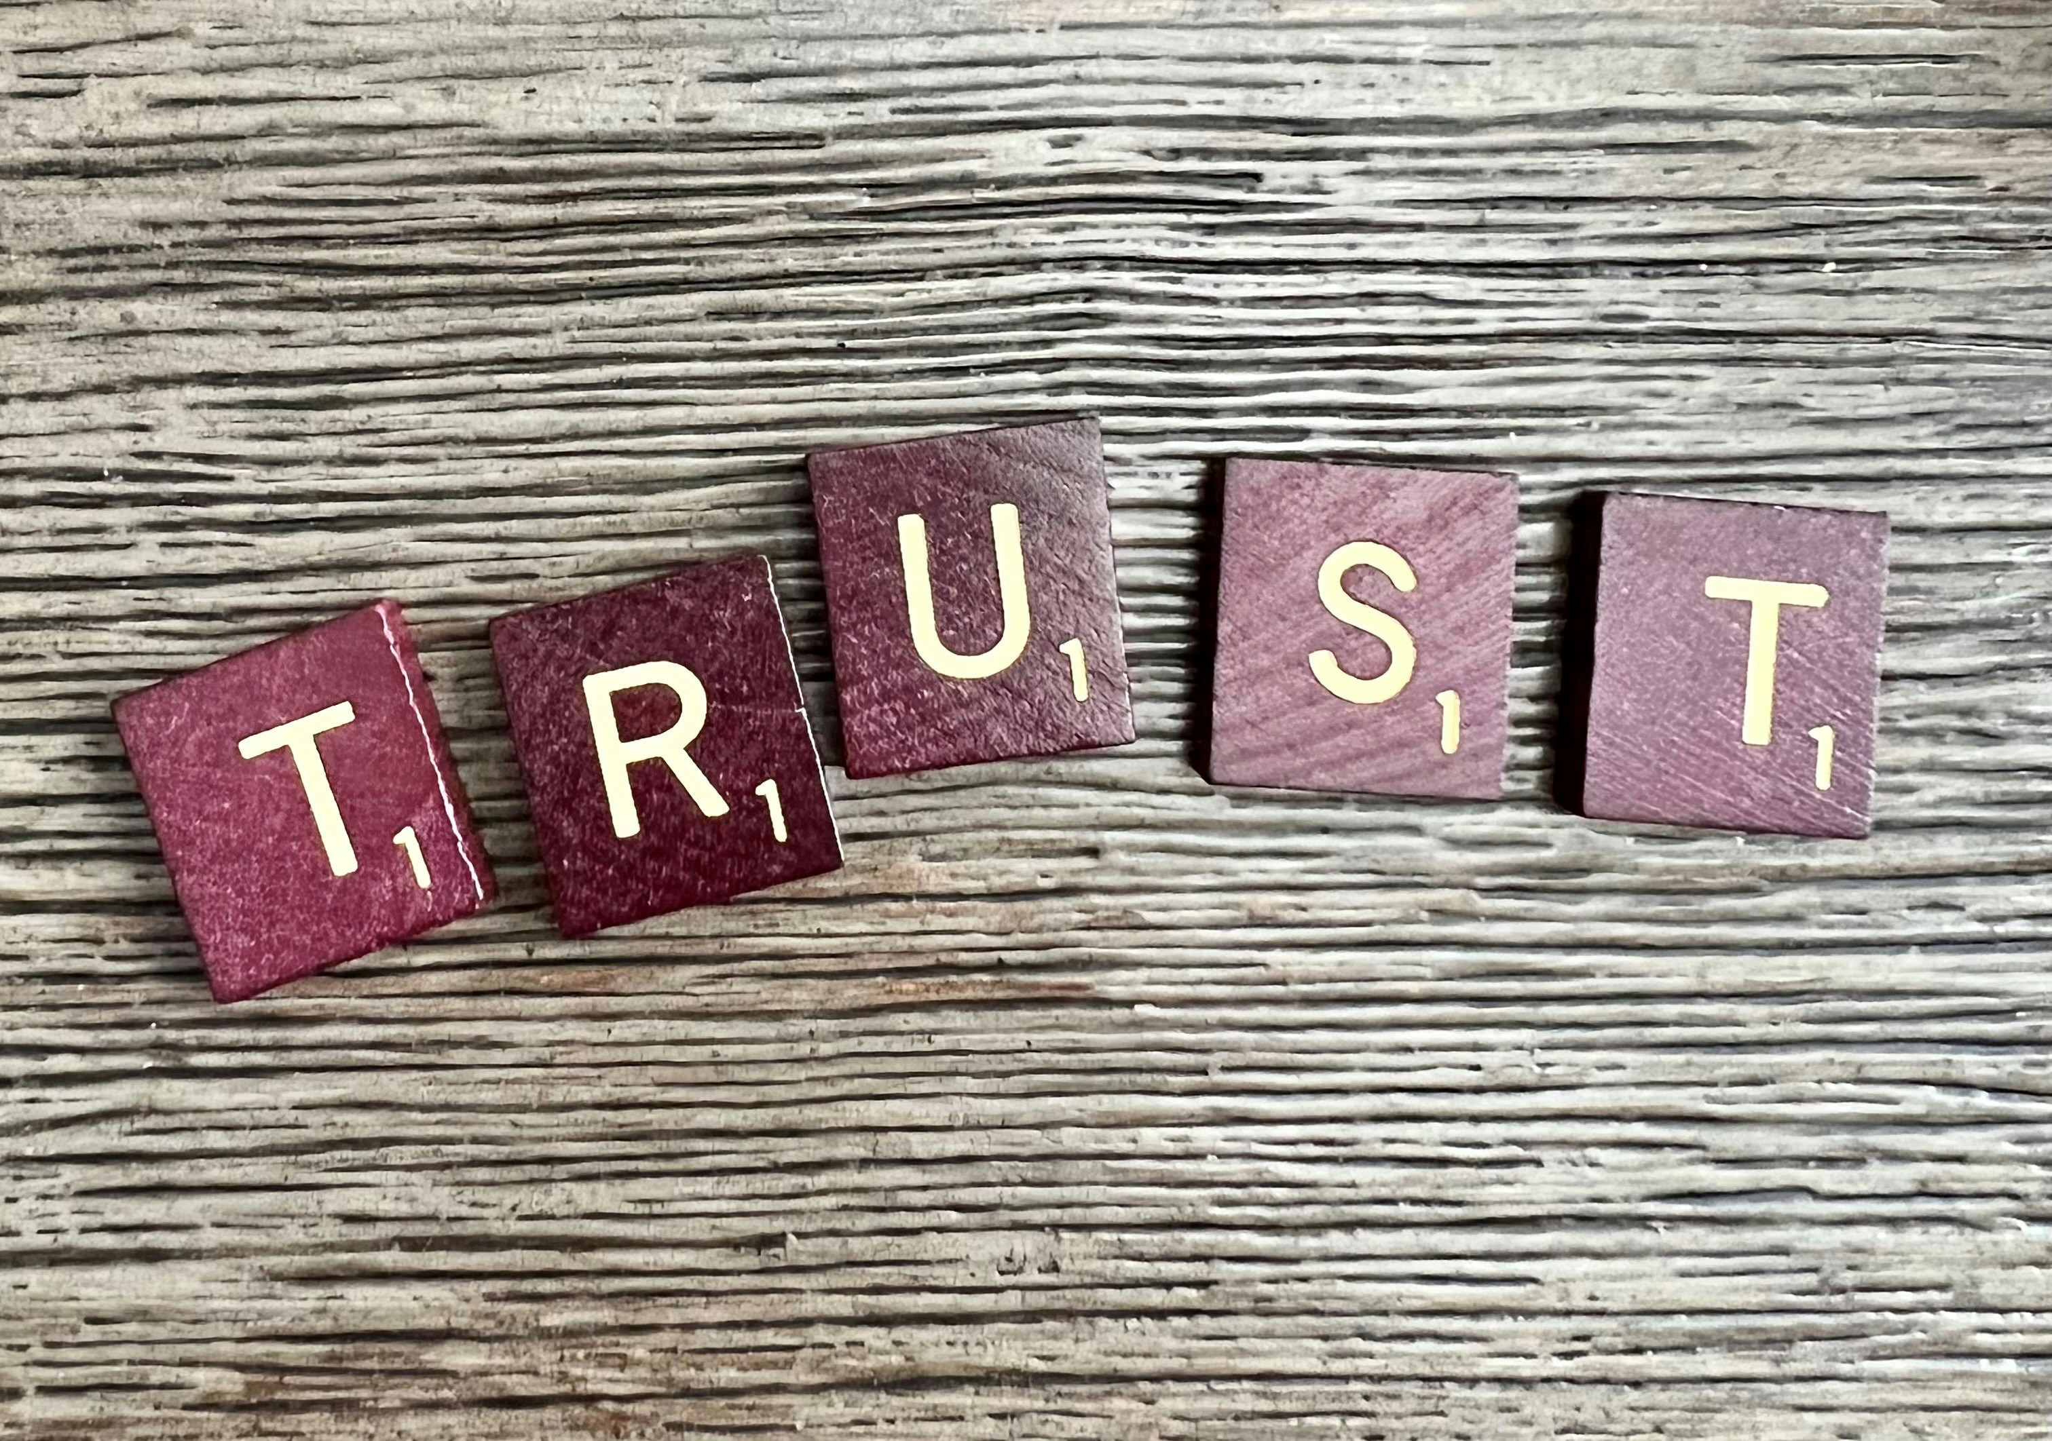
What do you remember from the Gospel reading?
In today’s reading, Jesus is telling the disciples that he is the Son of God. But the disciples find it difficult to understand.
Right at the beginning of today’s gospel, Jesus tells the disciples not to be worried and to believe in him. He is asking them to trust him. What does it mean to trust someone?
Respond
Notes:
Trust
Photo credit: Ronda Dorsey on Unsplash

Slide 6
Trusting someone means believing that they are always there for us, that they are always willing to help us, that they will comfort us when we are upset or frightened.
When it comes to trusting someone, what they do is often more important than what they say.
Notes:
Helping
Photo credit: Annie Spratt on Unsplash

Slide 7
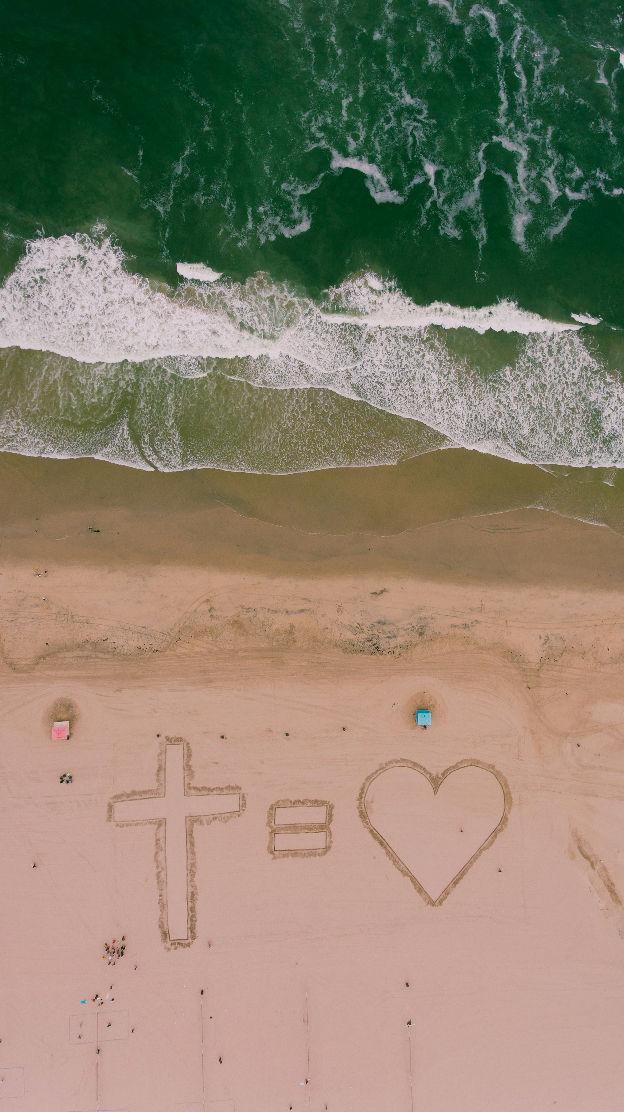
Jesus also tells the disciples in this reading that if they find it hard to believe in his words, to believe in the things that he does.
Jesus did not only teach his disciples with words. Throughout his life he showed them (and us) how to love one another, to serve others and to care for and support people who were poor, sick or sad.
Notes:
Jesus equals love
Photo credit: Neal E Johnson on Unsplash

Slide 8
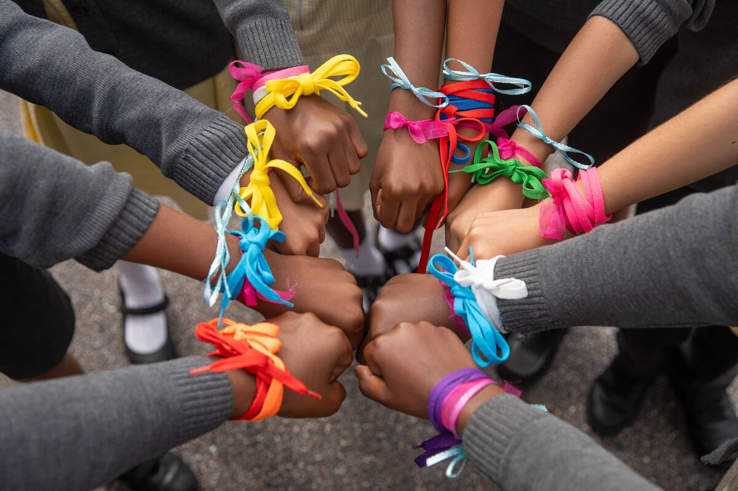
He showed us how to make sure
that we treated all people well, even those who are usually ignored, or who are not well-liked.
We all need people in our lives that we trust. Who do you trust?
Do other people trust you? How can we help other people to trust in us?
Notes:
St Chad's primary school children, UK
Photo credit: Joe Newman

Slide 9
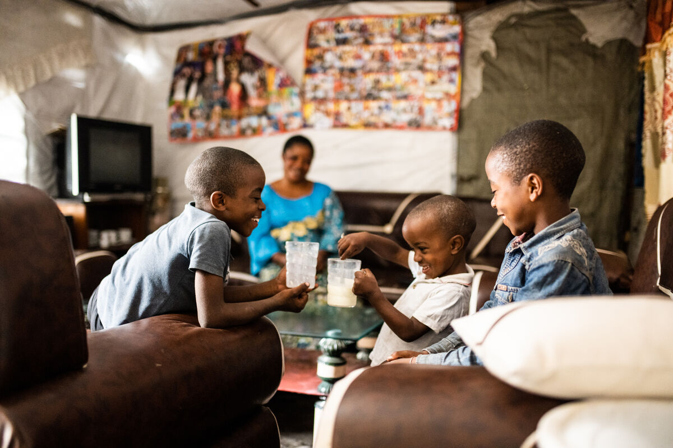
People are more likely to trust us if we are kind, if we listen to what they are saying, if we are willing to help and if we tell the truth.
We can also trust in God. We know God is always there for us and wants what's best for us. God is always ready to listen.
How can we share our worries with God? How can we show our trust in God?
Anuarite Kahindo's children sharing milk, DRC
Notes:
Anuarite Kahindo's children sharing milk, DRC
Illustration: Arlette Bashizi

Slide 10
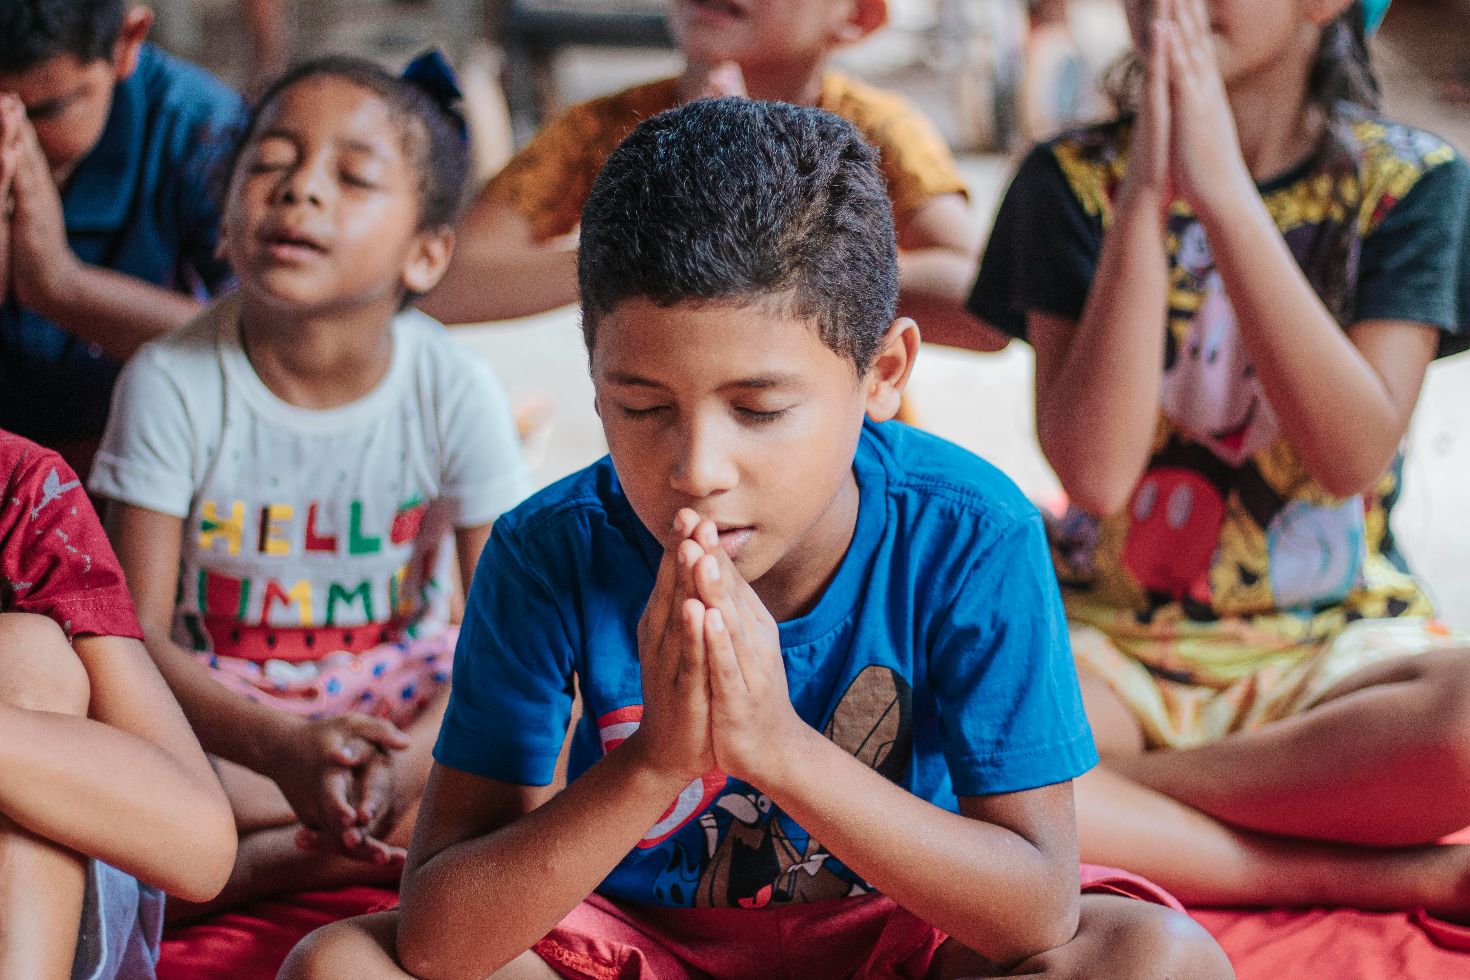
We can talk to God through prayer. When we pray, we can share all our worries and fears, and also all our joys and hopes, with God.
We can show our trust in God by listening to what Jesus asks of us and trying to follow him.
By loving one another and by doing what is right, we are doing what God wants us to do.
Notes:
Praying
Photo credit: Carlos Magno on Unsplash

Slide 11
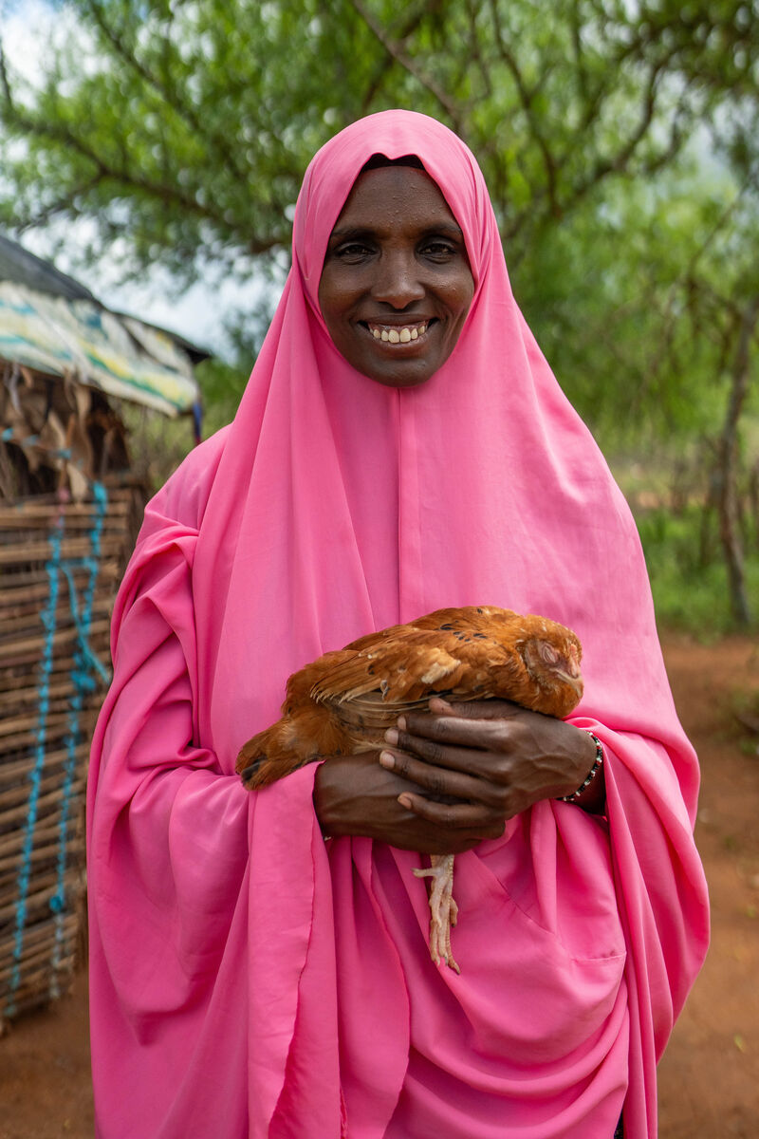
Kerra lives in northern Kenya with her family. Severe drought has meant water is scarce, with not enough for people, crops or livestock. It has been very hard to make a living.
Although life has been difficult for Kerra and her community, she never stopped trusting in God.
"I prayed for hope to God, that one day there would be a change," says Kerra.
Notes:
Kerra, Kenya
Photo credit: Joe Newman

Slide 12
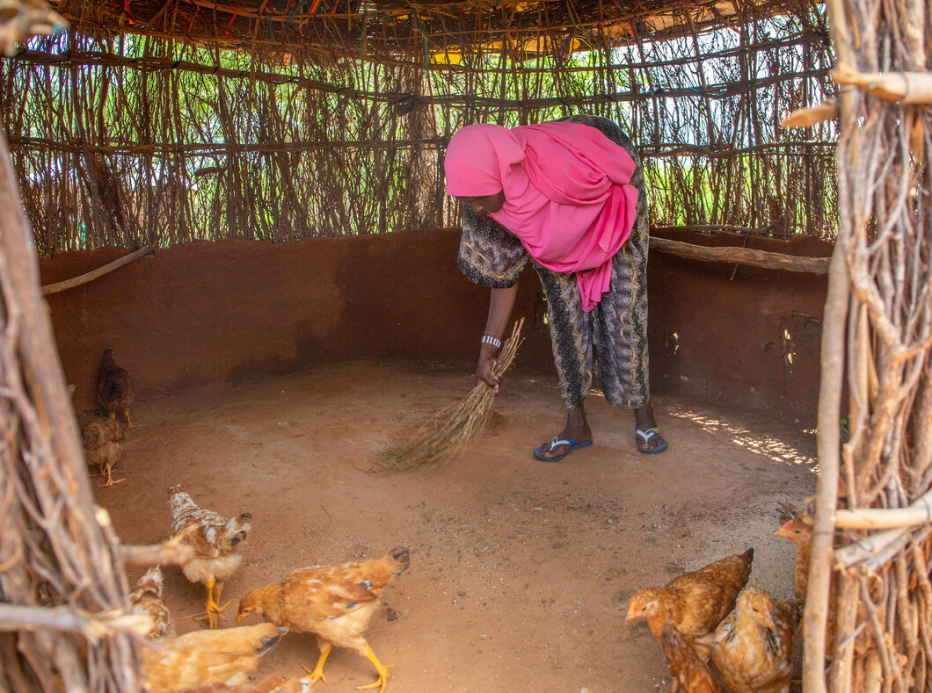
With CAFOD’s help, Kerra and her community were given chickens to help them make a living.
“Chickens don’t depend on water and pasture in the same way cows do,” Kerra explains.
The women learned how to look after the chickens. Now, they have eggs to eat. Or they sell them so they have money for food, clothes and things for school.
Notes:
Kerra and the chickens, Kenya
Photo credit: Joe Newman

Slide 13
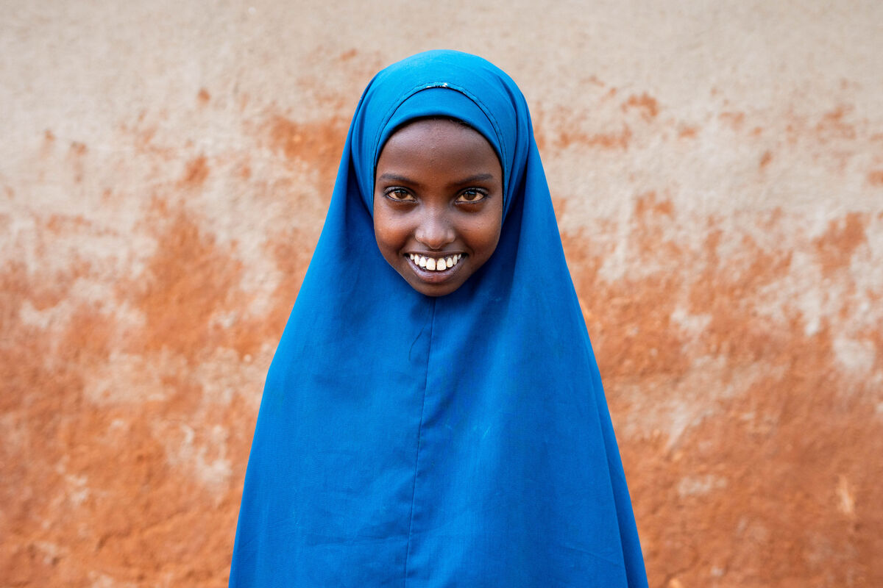
Chirri, Kerra's daughter, helps with the chickens too.
"“My mum taught me how to take care of the chickens, and when she is away, I look after them and feed them," she says.
"I like to see them jumping about and laying eggs. I like eating the eggs too – I want to have them fried for breakfast!"
Notes:
Chirri, Kenya
Photo credit: Joe Newman

Slide 14
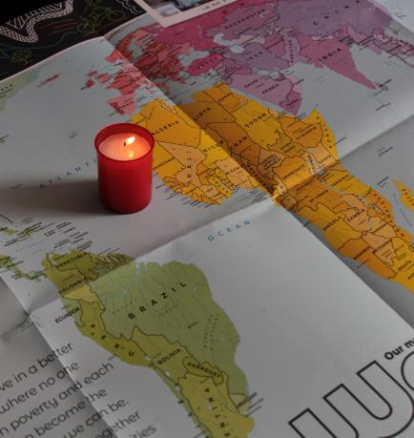
Let us pray
We pray for world leaders:
that they may do what is right and best for all people, especially those who are poor so that their people may trust in them.
Lord in your mercy…
We pray for our parish, families and friends:
that through our actions we may show that we trust and believe in God.
Lord in your mercy...

Slide 15
Let us pray
We pray for the church throughout the world:
that it may be a place of safety and welcome, where all people can come to know the love of God for us all.
Lord in your mercy…
God of life: we thank you for being there for us always. Help us to do all that you ask of us and to love one another so that all people may have someone to trust. Amen.

Slide 16
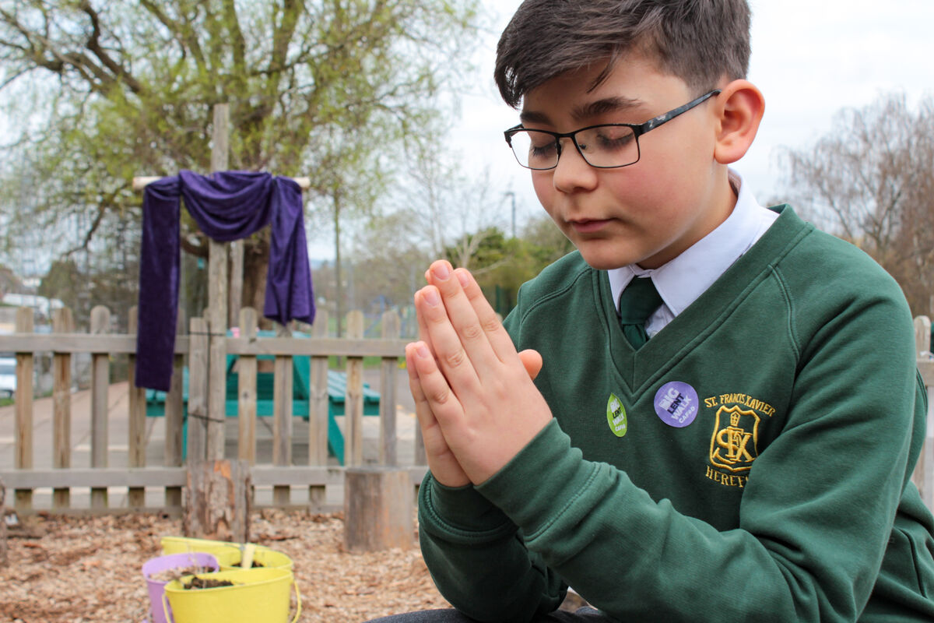
How will you show your trust in God this week and what will you do for the people who trust in you?
Send
Notes:
St Francis Xavier's RC Primary School, Herefordshire
Photo credit: Vicky Ahmed

Slide 17
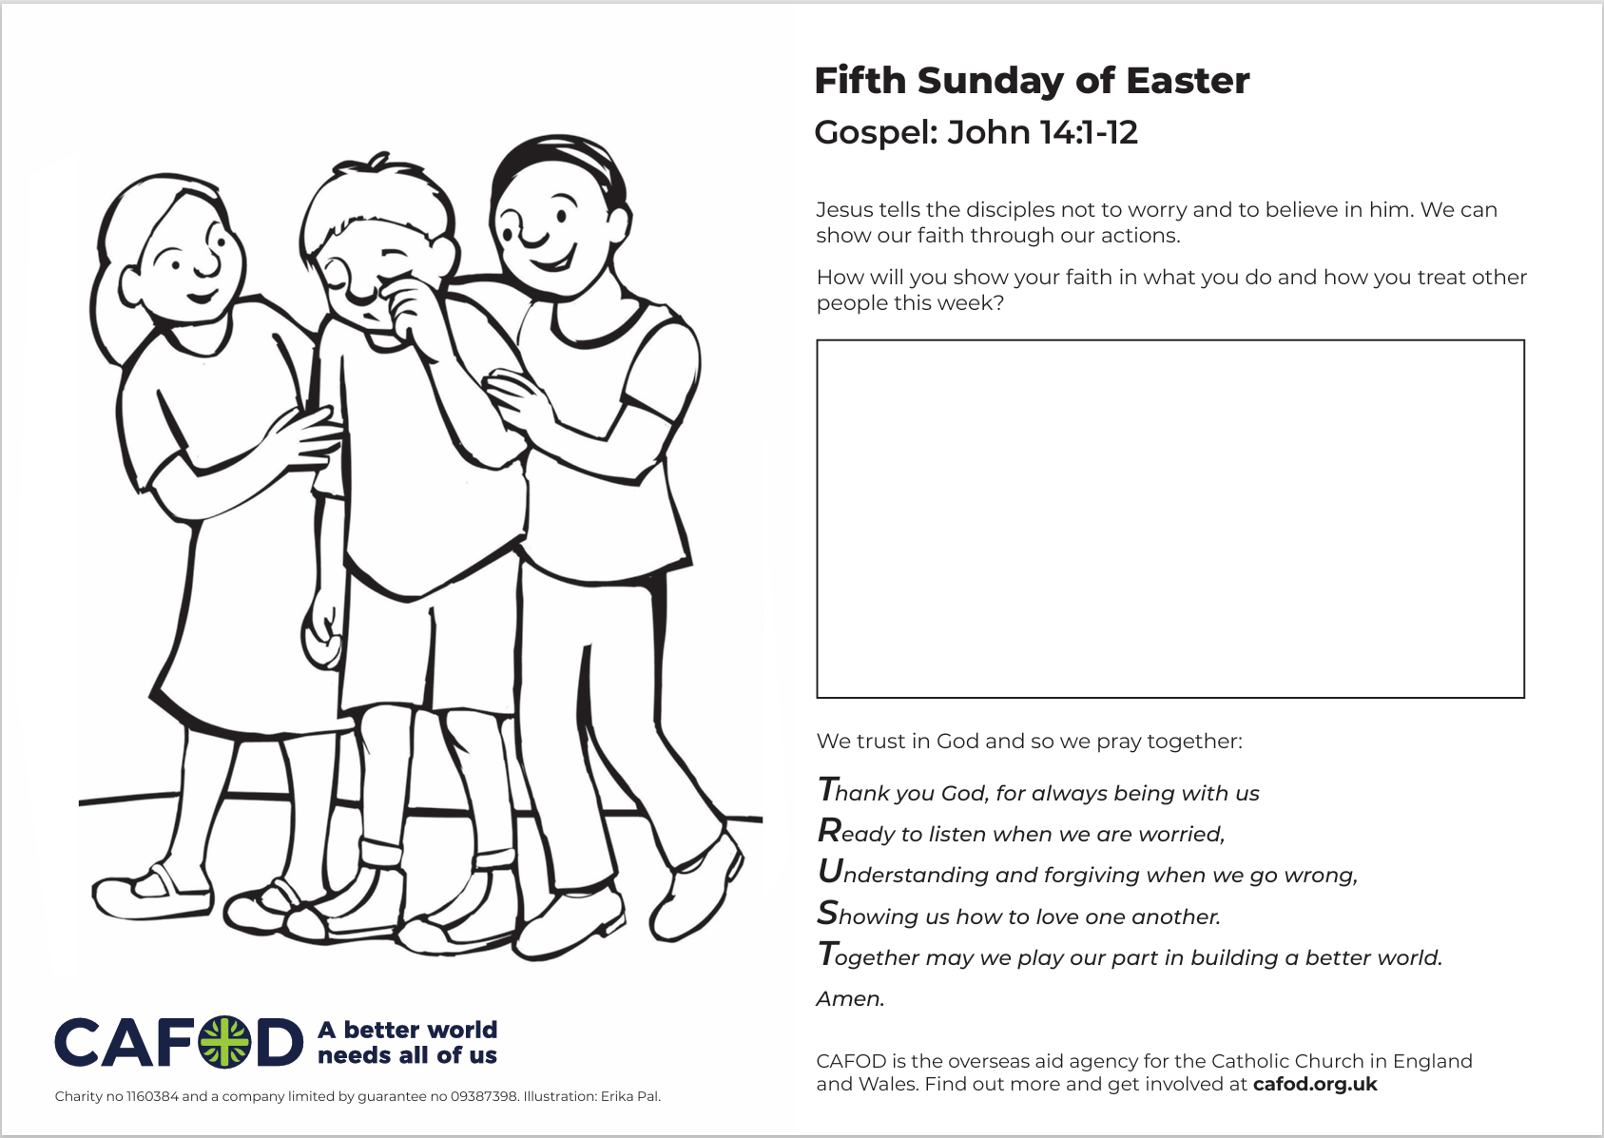
Activity suggestions
Download the illustration
Share the accompanying activity sheet with the children and encourage them to complete it, either in the liturgy or at home.
Encourage the children to play some trust games, either during the liturgy or when they get home. Will your partner catch you as you fall? Could you safely guide a partner round an obstacle course while they are blindfolded?
Remind the children to share all that they have heard and thought about today with the people at home. Encourage the children to place their trust in God in the coming week, through sharing in prayer, and to show their faith in their actions.
Notes:
Illustration: Erika Pal

Slide 18
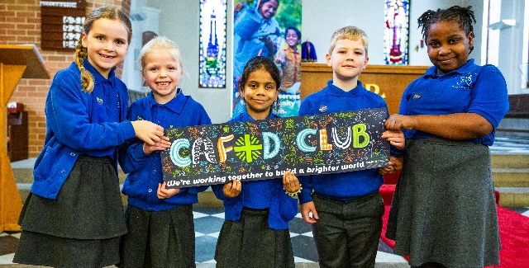
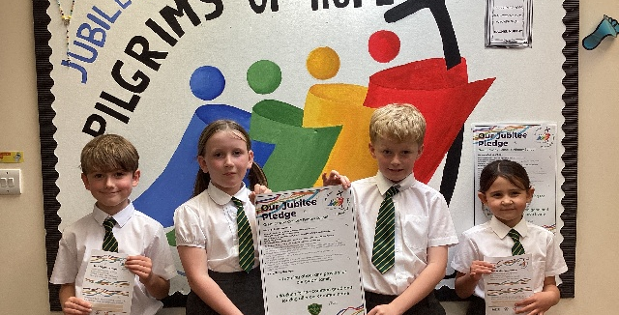

Get involved with CAFOD this term
Explore our summer term resources
Ways to live out your Jubilee Pledge
Fundraise for a World Gift

Slide 19
