Slide 1
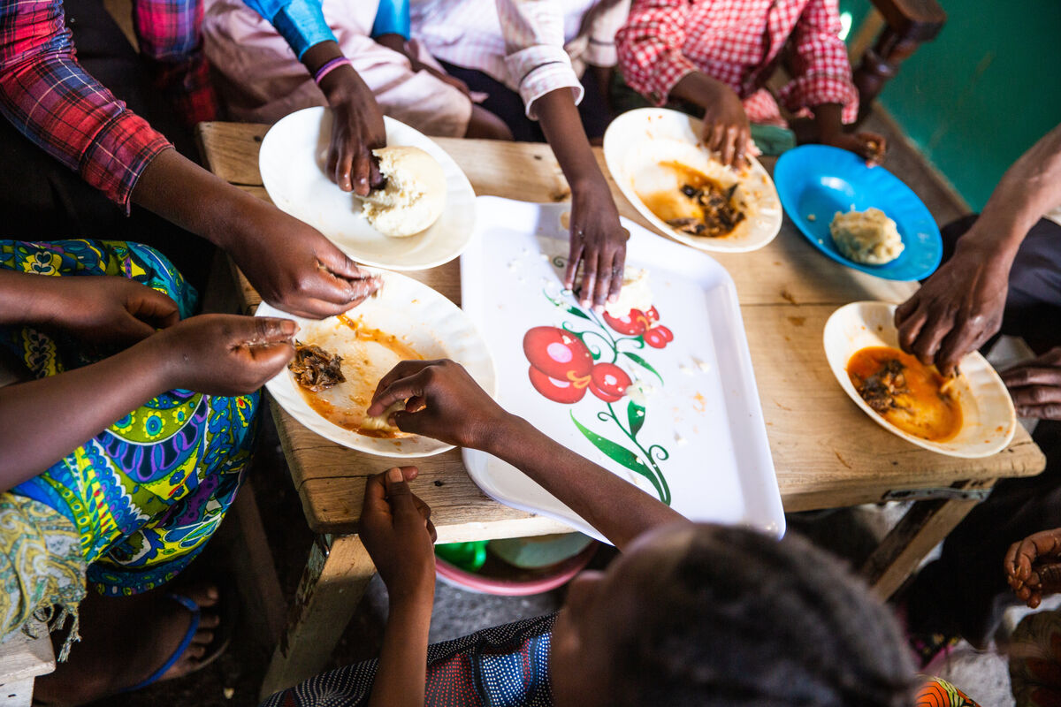
What can we do to help make the world a fairer place, so everyone has enough to eat?
Gather
Notes:
Children’s liturgy: The Most Holy Body and Blood of Christ (Year C)
Preparation of the worship space
Colour: white
Props: Coloured pens and pencils. Paper fish and bread of different designs, baskets to put them in.
Song suggestions
Bread for the world (625, Laudate)
Welcome
Today we hear how Jesus performed a great miracle with bread for five thousand people. Let’s find out why this miracle is so important to us as well.
Marie-Claire Nsimire-Rutale and her family share a meal, Goma, DRC
Photo credit: Thom Flint

Slide 2
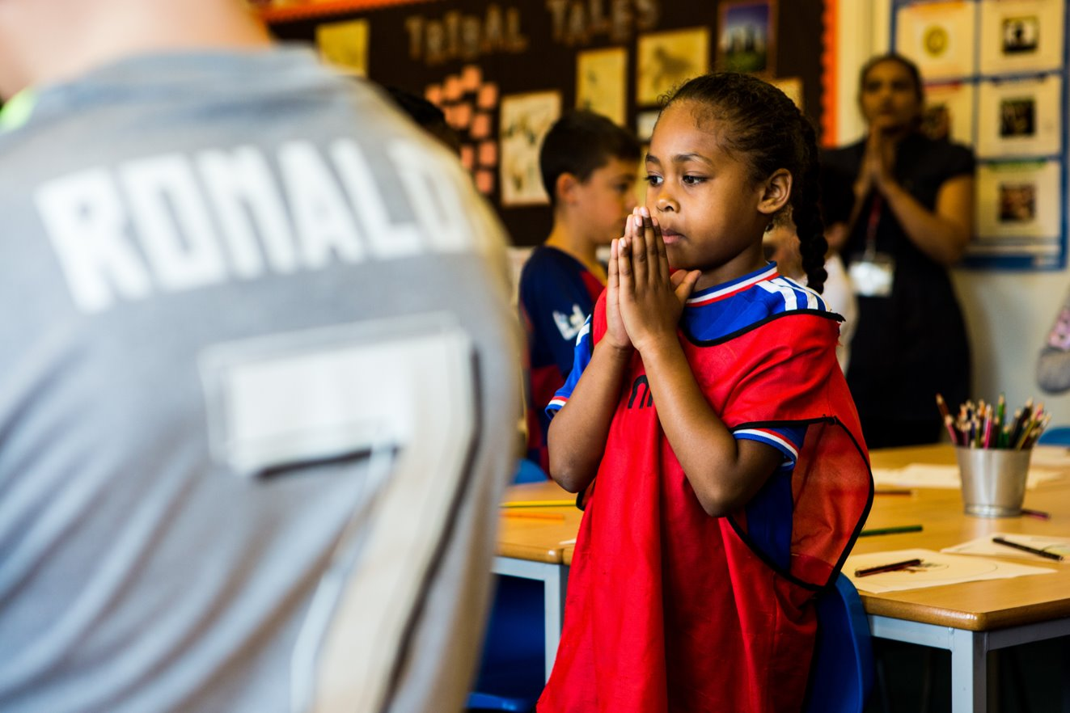
Jesus,
You come to us as bread and wine. Fill us with your kindness and give us the strength to change the world for the better.
Amen.
Notes:
Children at Our Lady Queen of Heaven Primary School
Photo credit: Thom Flint

Slide 3
Gospel: Luke 9: 11-17
Jesus welcomed the crowds, spoke to them about the Kingdom of God, and healed those who needed it.
When the sun was beginning to set, the twelve disciples came to him and said, “Send the people away so that they can go to the villages and farms around here and find food and lodging, because this is a lonely place.”
But Jesus said to them, “You yourselves give them something to eat.” They answered, “All we have are five loaves and two fish. Do you want us to go and buy food for this whole crowd?” (There were about 5,000 men there.)
Jesus said to his disciples, “Make the people sit down in groups of about fifty each.”
After the disciples had done so, Jesus took the five loaves and two fish, looked up to heaven, thanked God for them, broke them and gave them to the disciples to distribute to the people. They all ate and had enough, and the disciples took up twelve baskets of what was left over.
Word

Slide 4
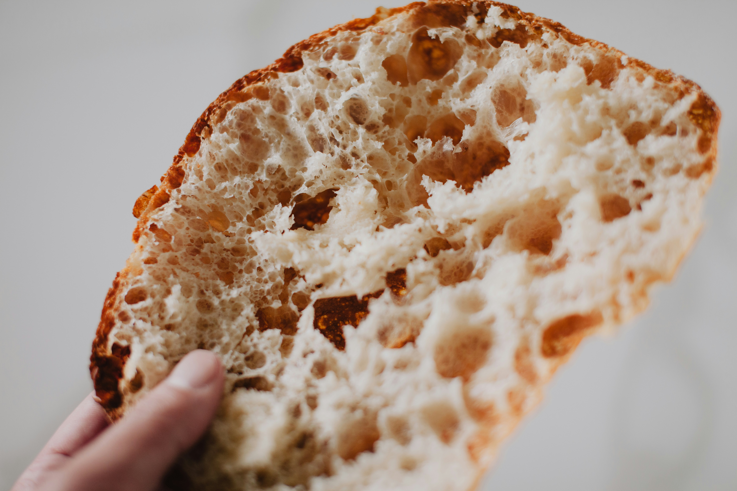
What do you remember from the Gospel reading?
After a long day listening to Jesus, the disciples want to send the crowd away to find food and shelter. But Jesus says that
the disciples have to feed the people themselves.
Why does Jesus want the disciples to feed the people?
Jesus wants the disciples to care about the people they meet and whether they are hungry or not. He wants God’s love to be shown through the disciples.
So, what happens next? What does Jesus say and do?
Respond
Notes:
Giving bread
Photo credit: Jeremy Yap on Unsplash

Slide 5
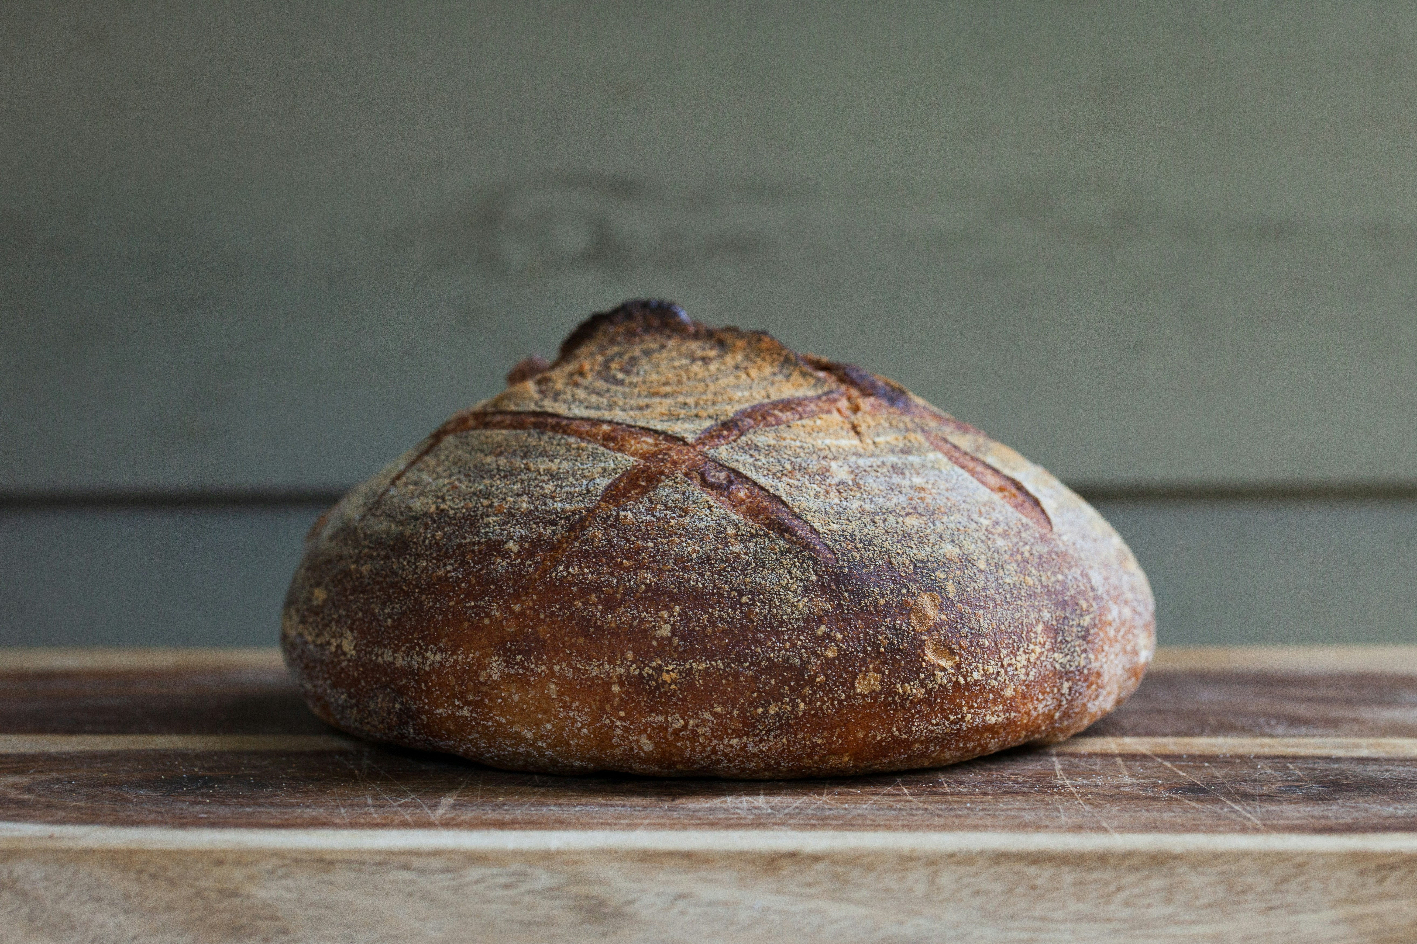
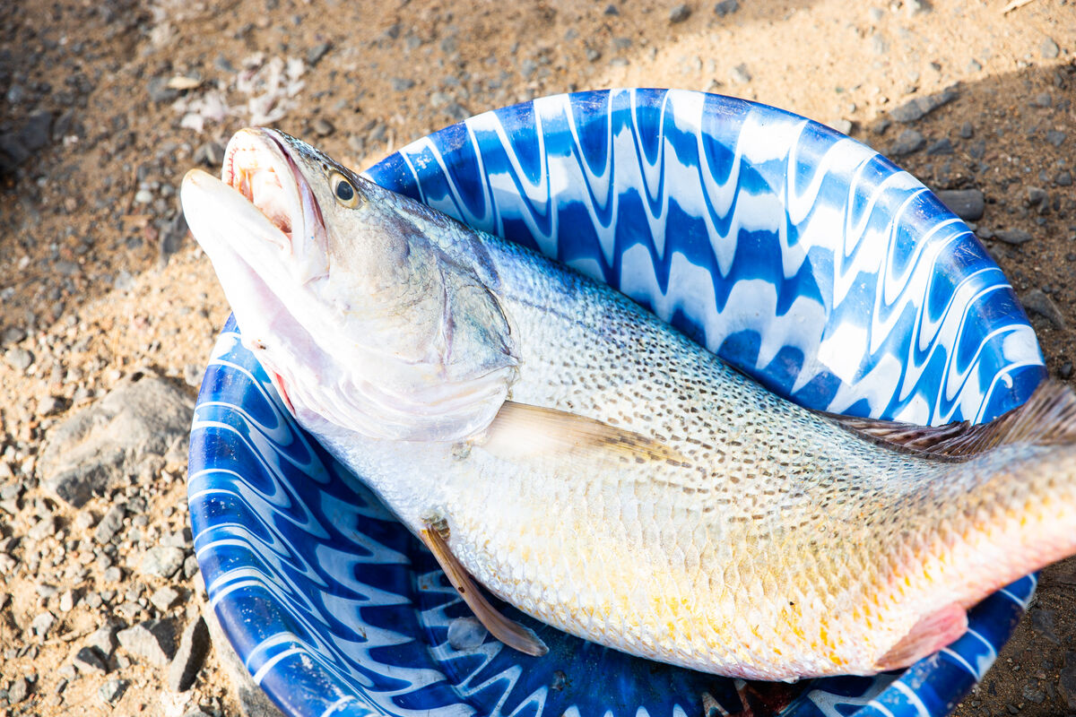
Jesus took the five loaves and two fish, blessed them, broke them up and asked the disciples to share them around.
In the gospel, through God’s grace, everyone, all 5,000 people, eat the bread and the fish, and there is plenty left over. Twelve baskets full!
What do you think the disciples and the other people said to each other when this happened?
Notes:
Bread
Photo credit: Spring Fed on Unsplash
Fish, Liberia
Photo credit: Thom Flint

Slide 6
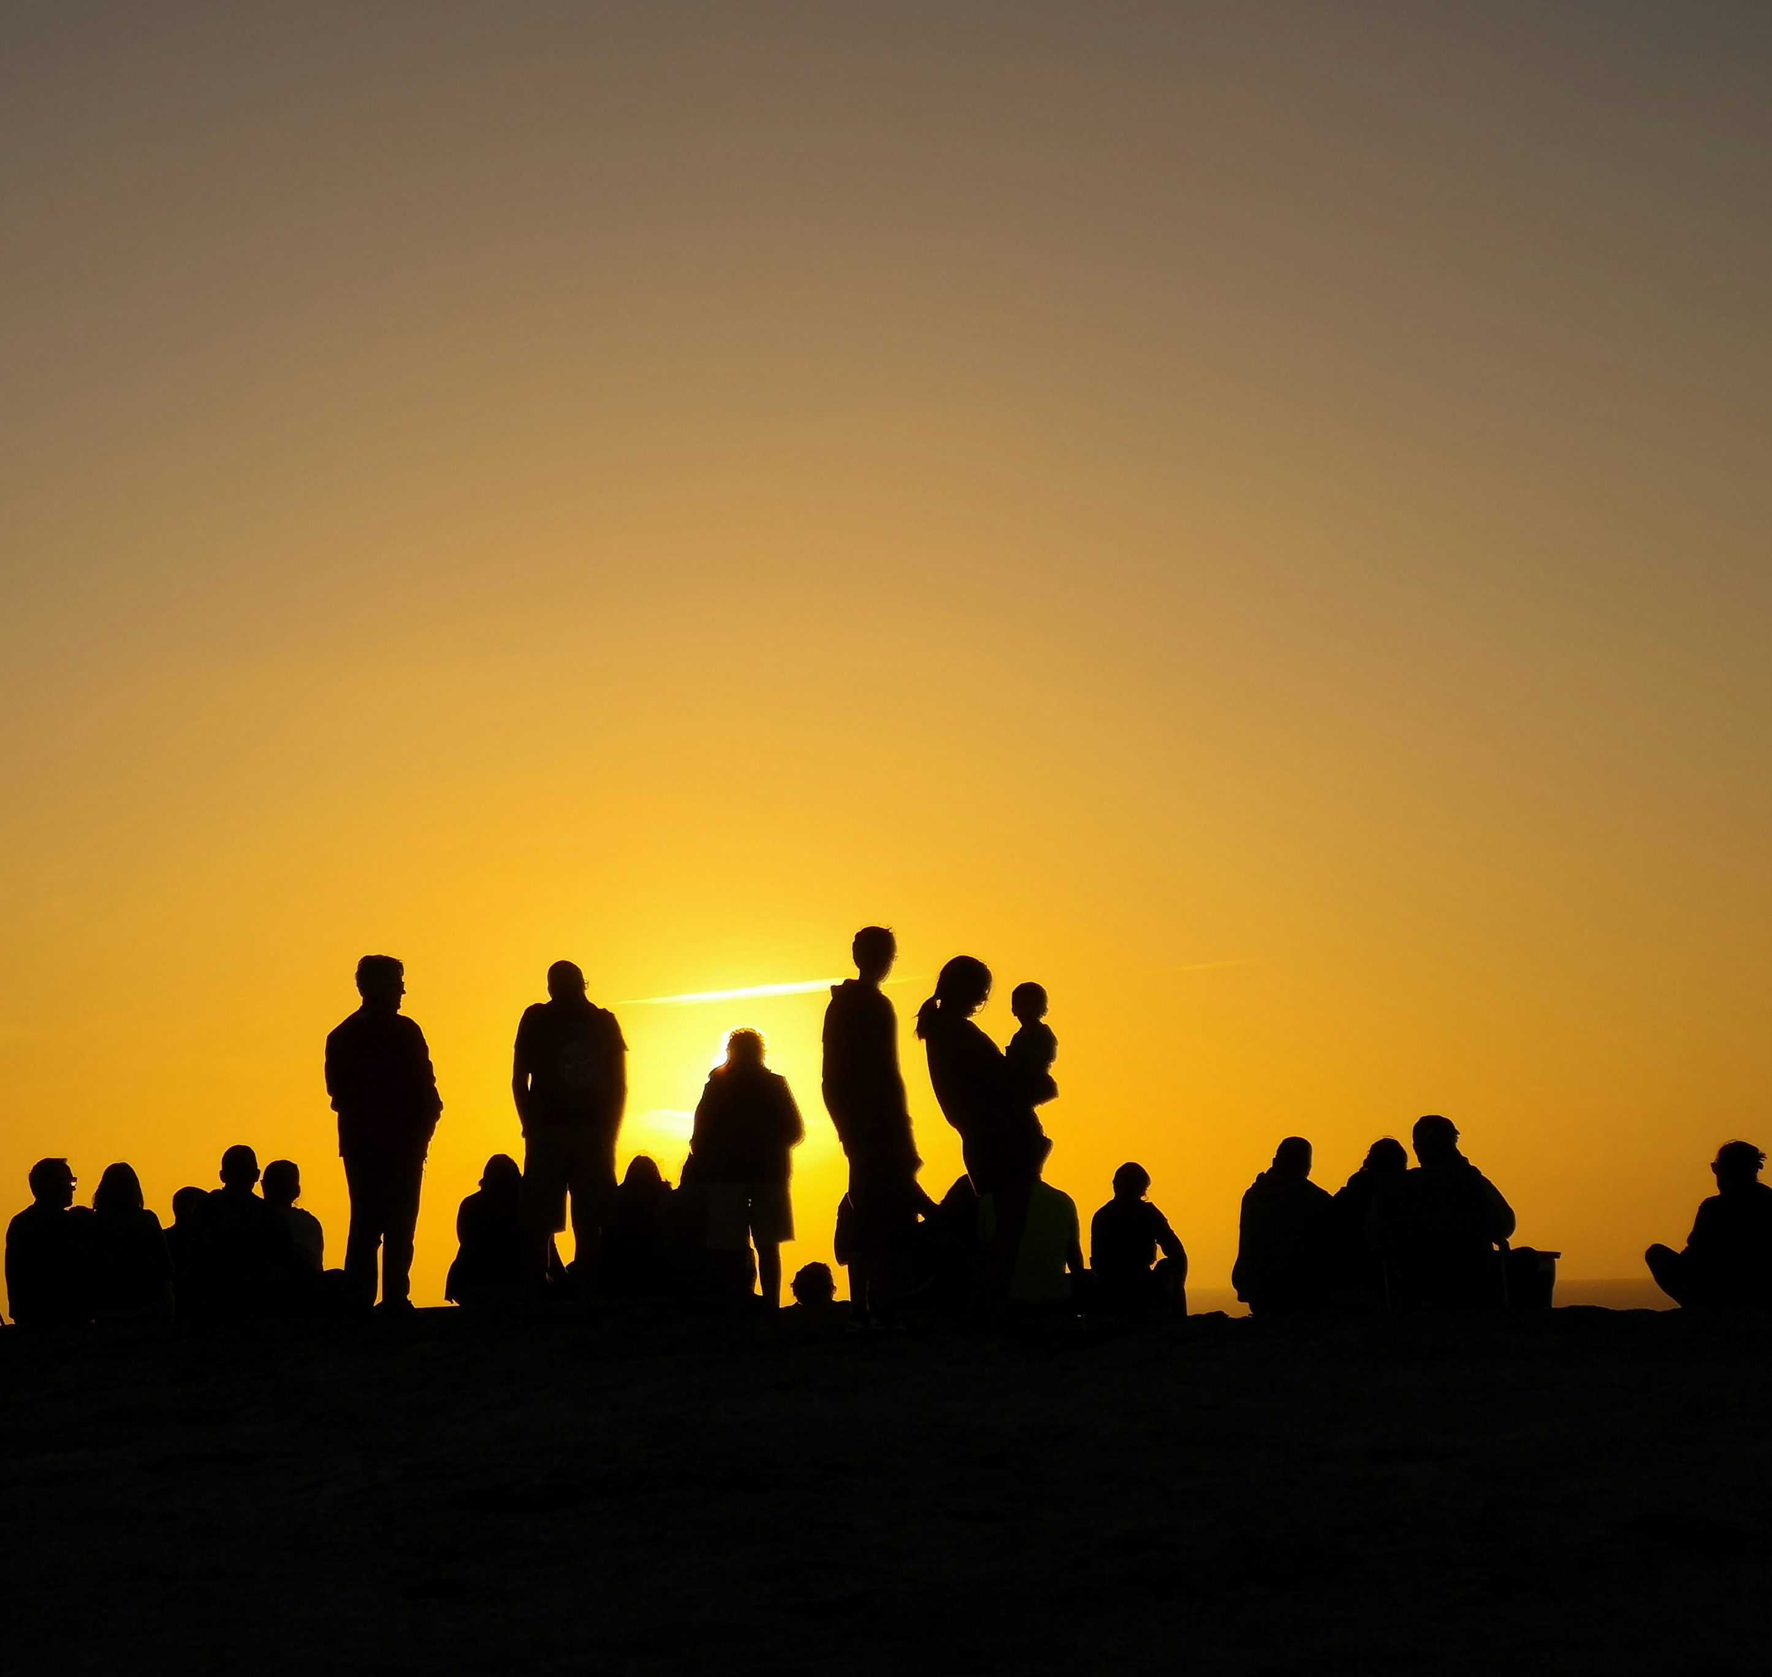
Imagine you are in the crowd of people who have come to Jesus. You were hungry and had no idea where you would find food. But then because of Jesus’ miracle you get given something to eat by the disciples.
How do you feel? What would you like to say to Jesus after you’ve eaten some bread and fish?
Notes:
Crowd at sunset
Photo credit: Fernando Marques on Unsplash

Slide 7
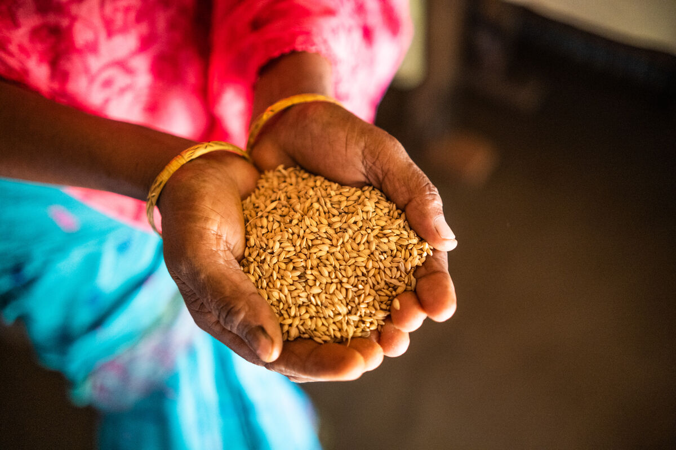
Do you remember to thank God for the food that you eat every day?
And what about the people who grow, harvest, prepare, sell and cook your food? Do you thank them?
Even though there is enough food produced in the world to feed everyone, there are many people who go without food every day – both here in the UK and in other countries.
How does it make you feel to hear that? Do you think it is fair?
Notes:
Anowera Begum with her seeds, Bangladesh
Photo credit: Amit Rudro

Slide 8
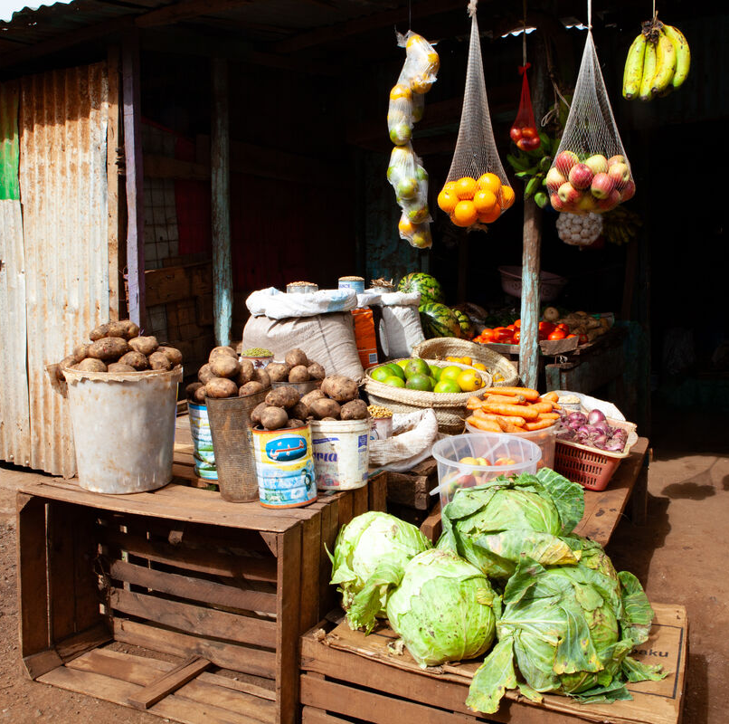
We are all members of one global family. We are all parts of one body – the body of Christ. So if one person is hungry, it is like we are all hungry.
Just like Jesus asks the disciples to feed the crowd in today’s reading, we are also asked to do whatever we can to make sure that everyone has enough
to eat.
What do you think we can do to help make sure everyone gets enough food?
Notes:
Local market, Marsabit, Kenya
Photo credit: Louise Norton

Slide 9
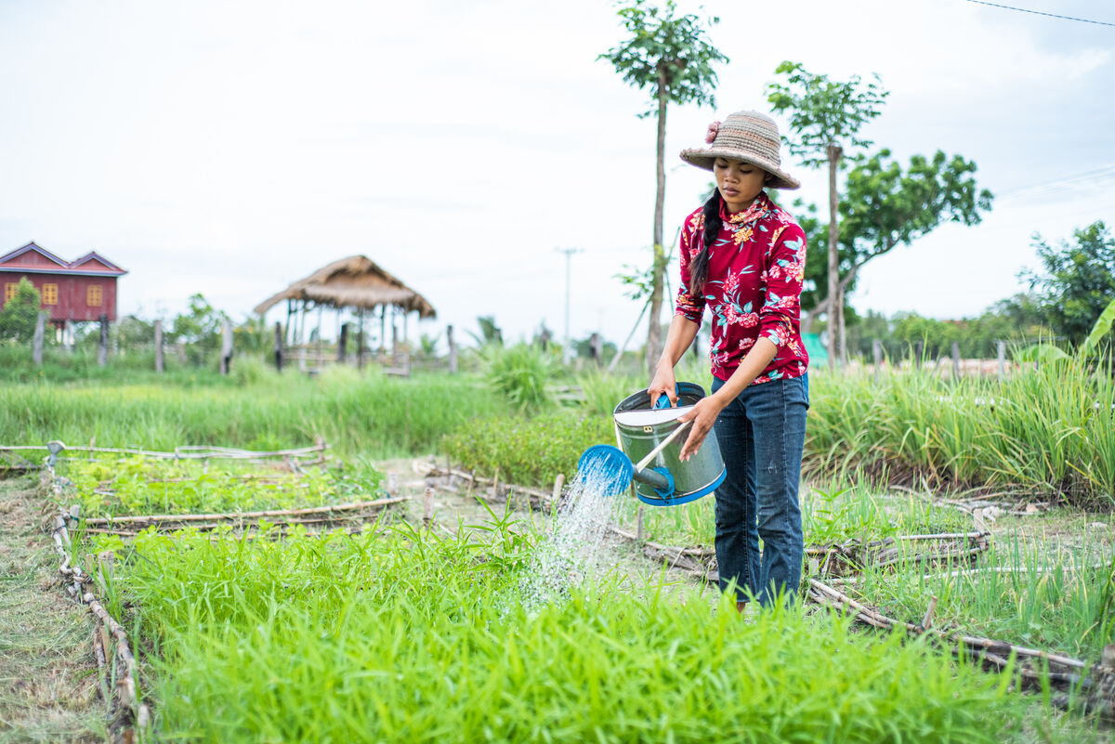
One of the things we can do is to ask the government to support the people around the world who grow food, not the big companies.
Another thing we can do is to share whatever we can with one another.
This week, let’s give thanks for the food that we have. Let us remember to thank God for all that we have been given, as well as thanking and praying for all the people who are involved in getting the food we eat from the farm to our table.
Notes:
Long Sreyneang on her farm, Cambodia
Photo credit: Tom Chheat

Slide 10
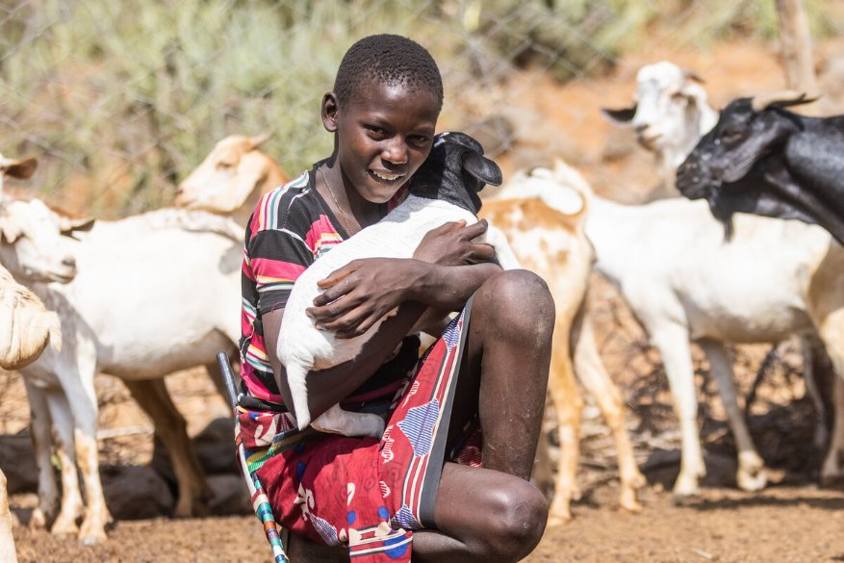
This is Saidimu. He lives in a village in Kenya.
He loves helping his dad, Ochuroi, grow crops on their farm.
"It is how we eat. I like growing vegetables. I also cook them when we harvest them," says Saidimu.
"Without the farm, we would be hungry."
Notes:
Saidimu on his farm, Kenya
Photo credit: Mwangi Kirubi

Slide 11
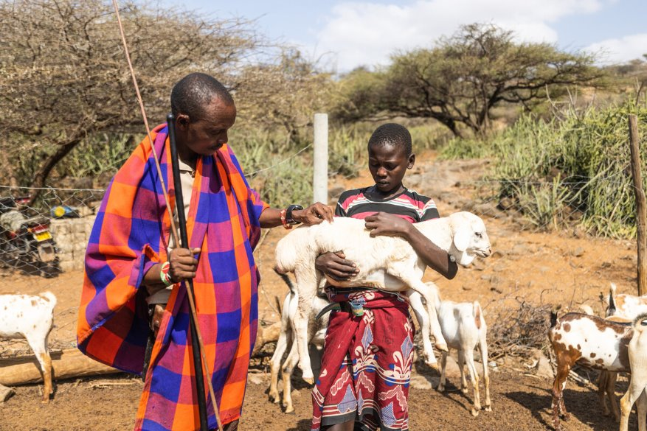
With CAFOD's help, families in Saidimu's village are learning how to grow weather-resistant crops, keep honey bees and run a business selling their produce.
This means Saidimu's community will have enough food to feed their families and money for the things they need to live a happy life.
Notes:
Saidimu and his dad, Ochuroi, on their farm, Kenya
Photo credit: Mwangi Kirubi

Slide 12
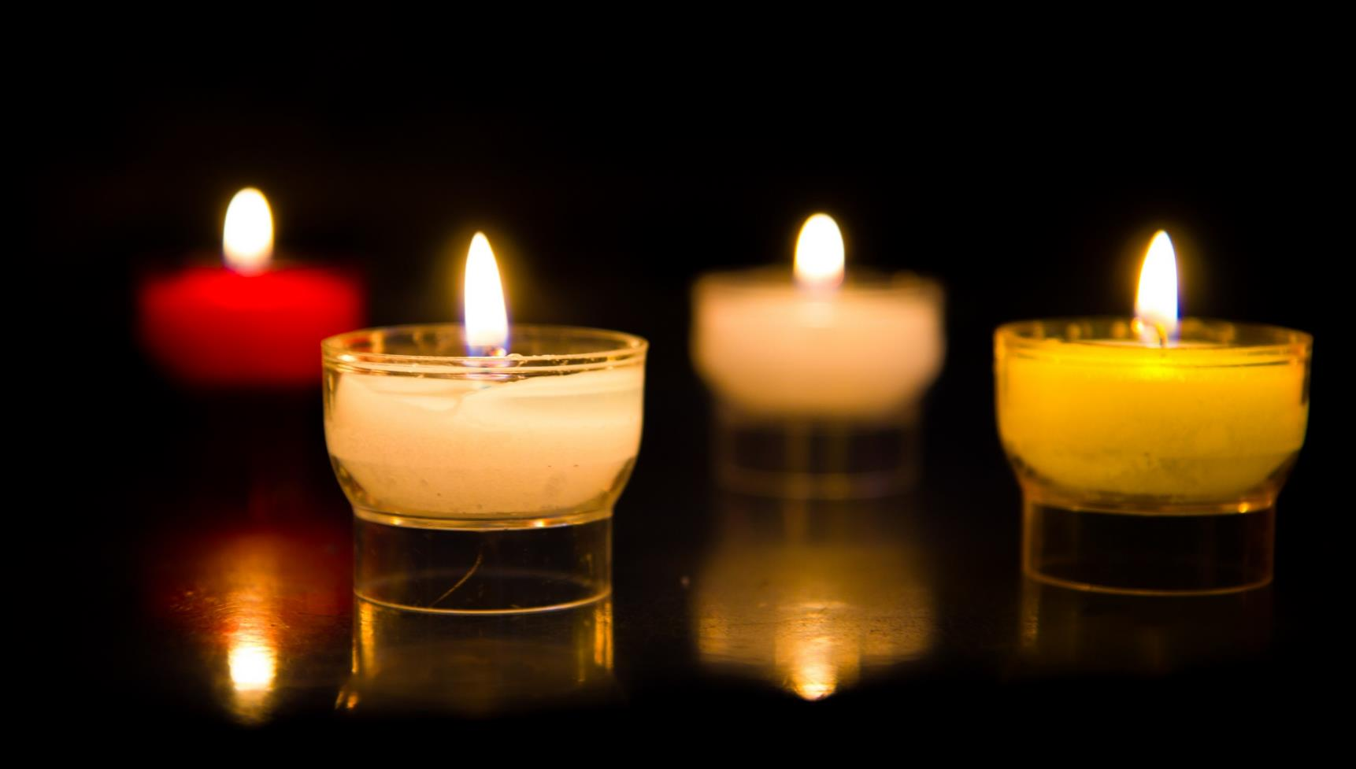
Let us pray…

Slide 13
We pray for world leaders: that they may work to make sure that all people can have what they need to live life to the full.
We pray for all people who do not have enough food today and for an end to world hunger. Lord in your mercy…
We pray for our parish, family and friends: that we may be willing to share what we have with others. May we work to build a brighter world together for all our global family.
Lord, in your mercy…

Slide 14
In this Jubilee Year, we pray that we may be signs of hope in our world through all that we do and how we treat one another. Lord, in your mercy…
Christ Jesus, you fed the hungry crowds. Open our eyes to the needs of others and help us to follow your example of love and service. Amen.

Slide 15
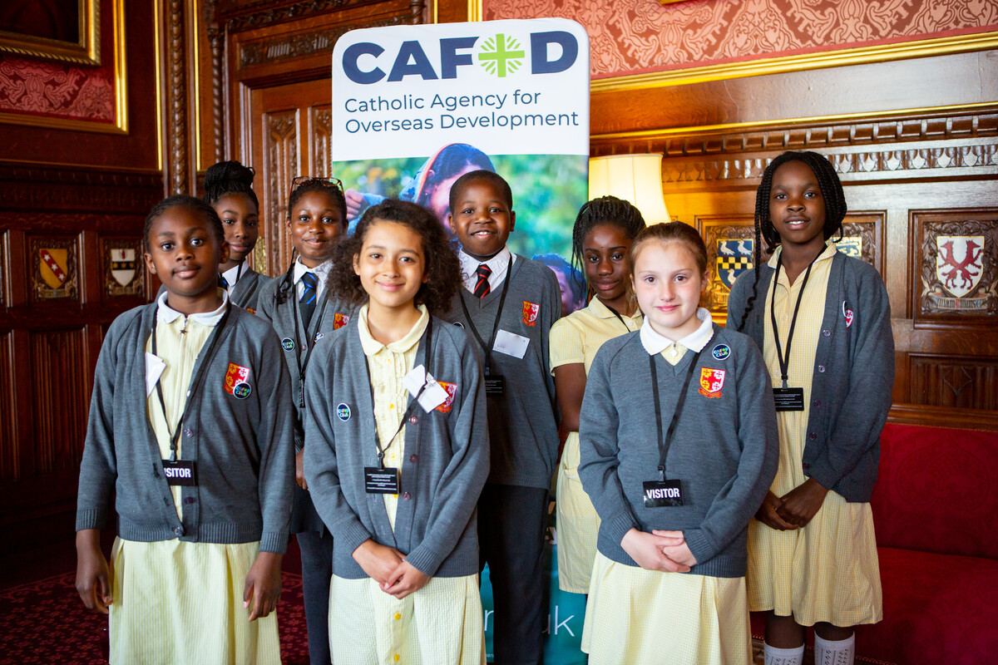
What will you do this week to help make the world a fairer place, so everyone has enough to eat?
Send
Notes:
St Chad's Primary School children at the House of Commons with CAFOD
Photo credit: Louise Norton

Slide 16
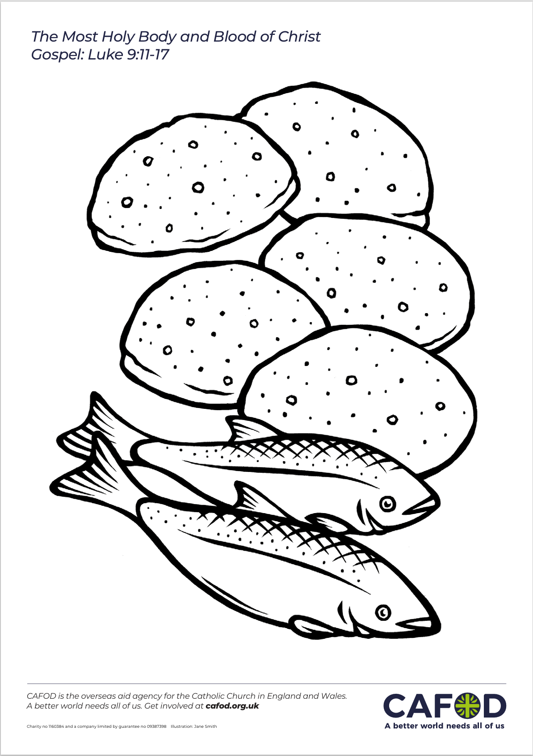
Activity suggestions
Invite the children to colour in the accompanying illustrations of bread and fish and to put them in the baskets to be offered up during the Mass. On the back, encourage them to write or draw what they will do to make sure that all people locally and around the world have enough food to eat.
Share some of the global recipes available at cafod.org.uk/kidzzone with the children and encourage them to think about making one of them at home during the next week.
Invite the children to write their own prayers of thanksgiving to God for the food that they eat and to say this prayer at home during the week. Can they also give thanks for all the people who are involved in growing and making their food?
Remind the children to tell the people that they live with all that they have heard and thought about in the liturgy today.
Notes:
Illustration: Jane Smith

Slide 17
Notes:
Illustration: Jane Smith

Slide 18
Planning your Jubilee Pledge?
It's time to make your Jubilee Pledge!
In June or July, all Catholic schools are invited to make a Jubilee Pledge to live out Catholic Social Teaching.
A better world needs all of us, and the Pledge will be a whole school, long-term commitment to building a fairer world.
Watch our films and download our resources to help you write your Pledge and plan your Pledge Day:
Jubilee pledge for schools
The Jubilee Year is a landmark moment in the life of the global church. School communities are invited to join together as pilgrims of hope, pledging to work together for God’s kingdom of justice, peace and love. Find resources at:
Jubilee for schools 2025 – Pilgrims of Hope

