Slide 1
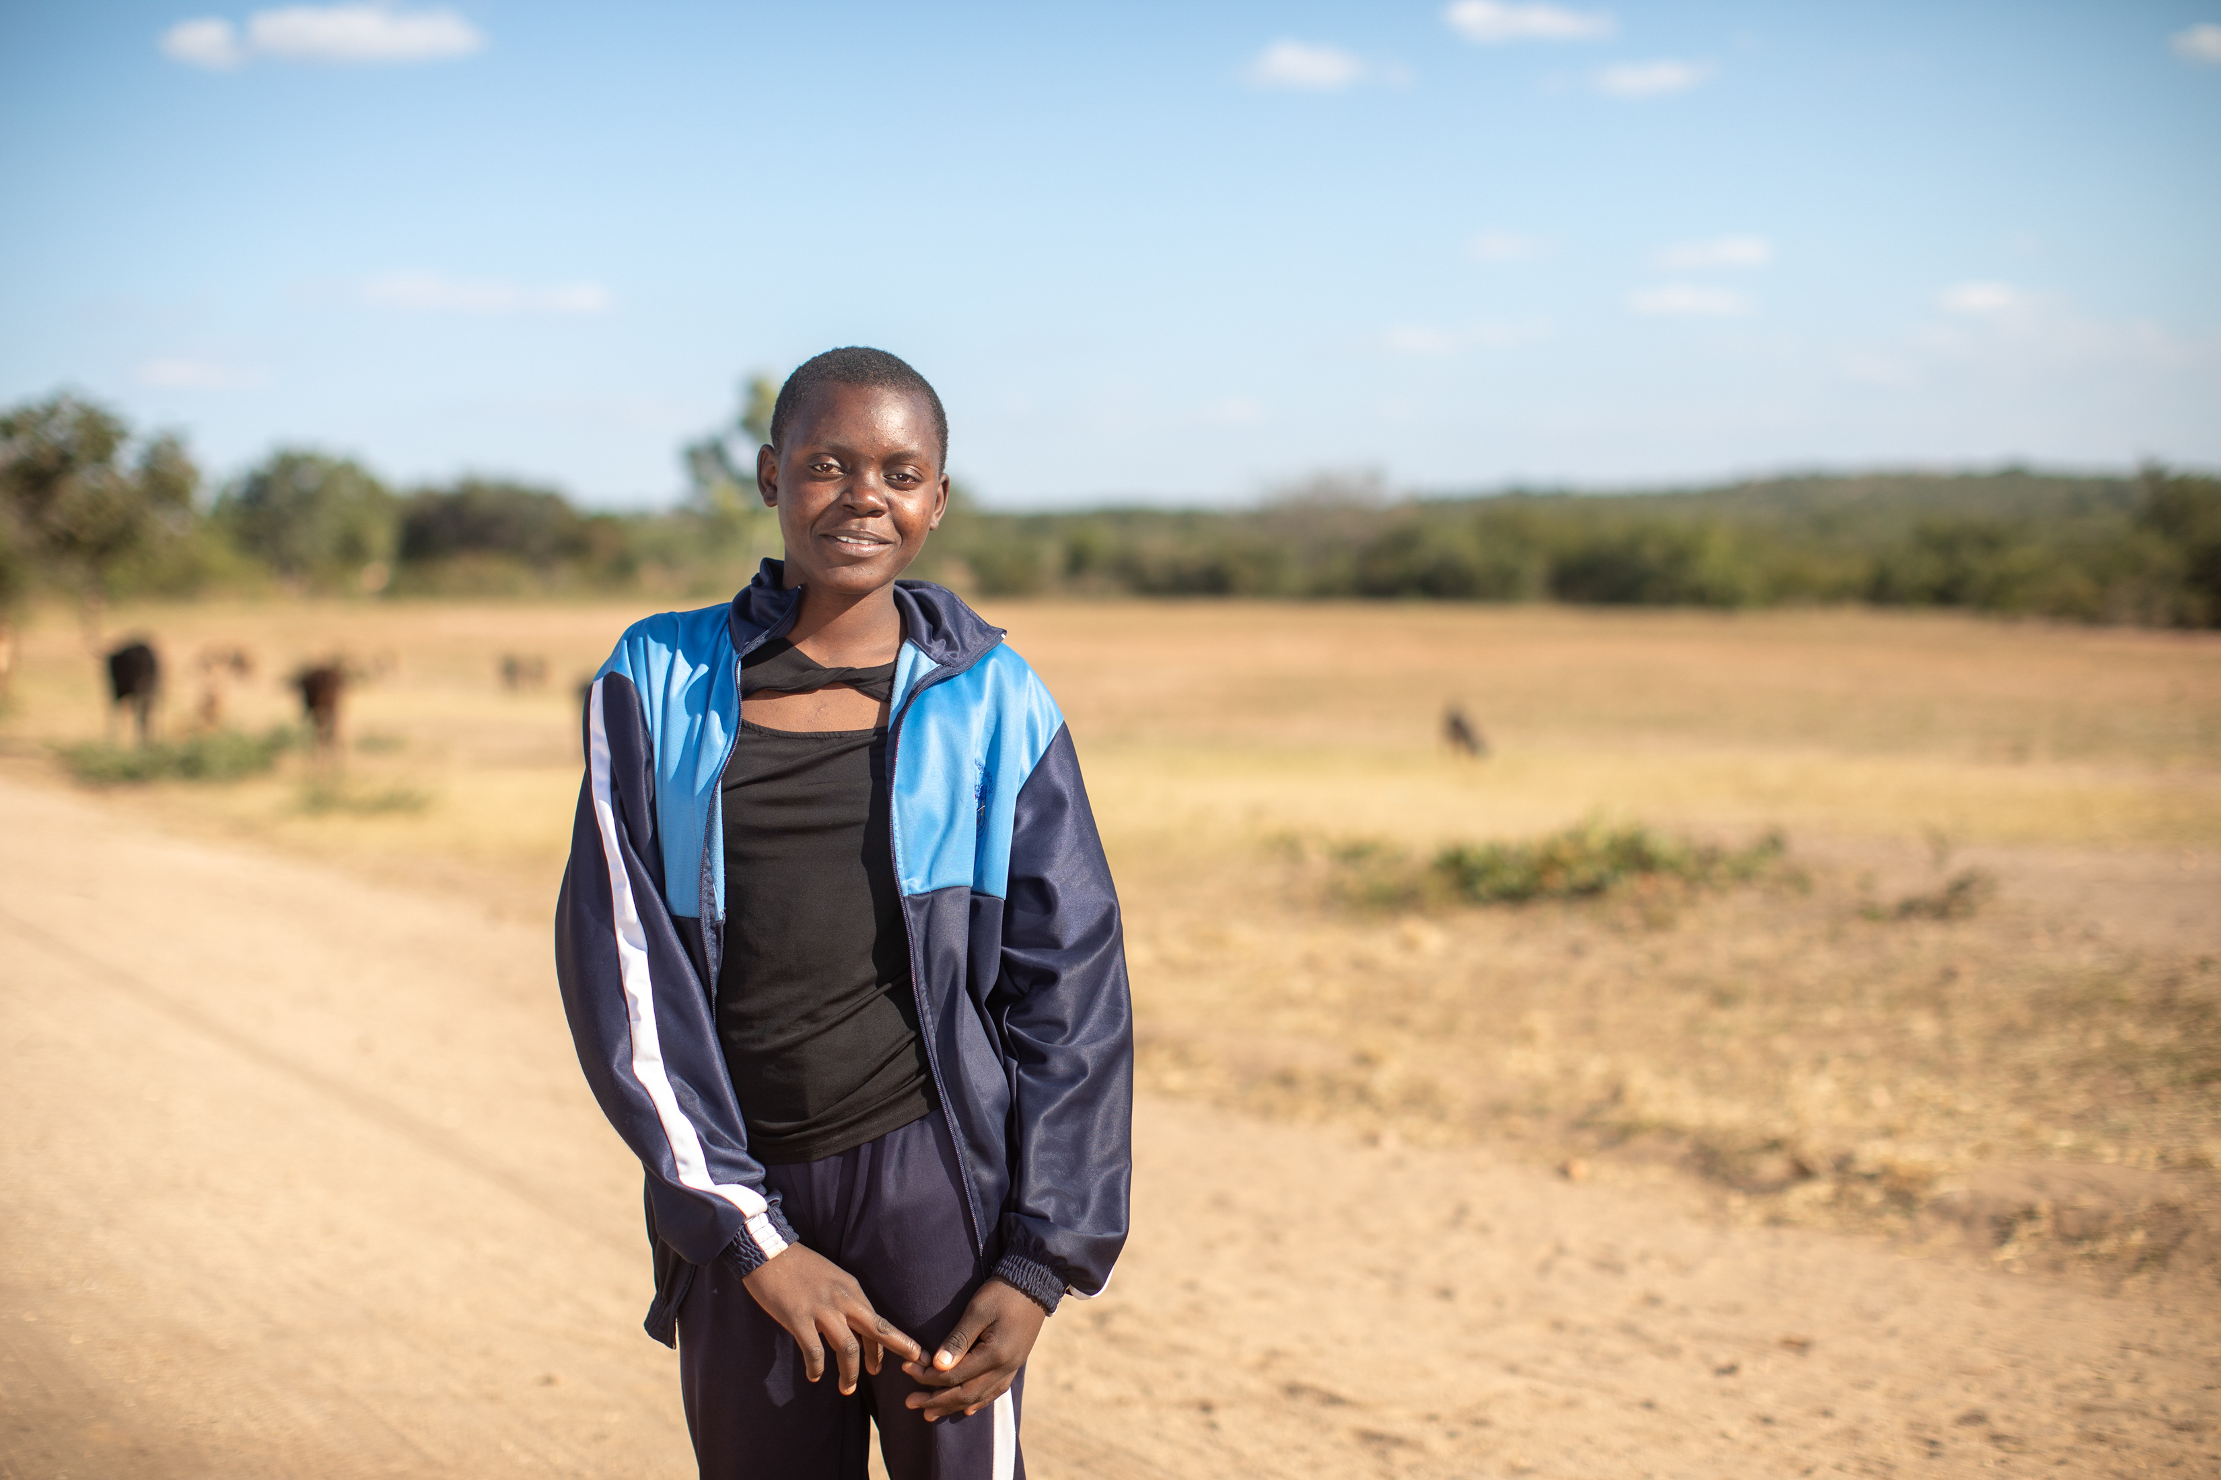
How will you help other people in the coming week?
Gospel Celebration of the Word
Notes:
Photo: Maggie in Zimbabwe
Thom Flint
Children’s liturgy: Twenty-sixth Sunday in Ordinary Time (Year A)
Preparation of the worship space
Colour: green
Song suggestions
Here I am Lord (865, Laudate)
Welcome
Today we hear about two sons who are both asked to help their father. Let’s think a bit about how we listen to what God is asking us to do and how we can help other people at home and around the world.

Slide 2
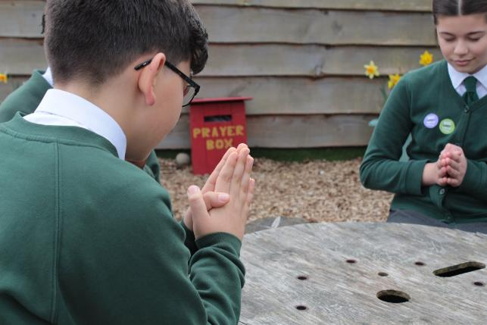
God of love, open our ears to listen to your word. Lead us to help one another and to live our lives as you ask us to. We ask this through Christ our Lord, Amen.
  Gather
Notes:
St Francis Xavier's RC Primary School, Herefordshire
Photo credit: Vicky Ahmed

Slide 3
Gospel: Matthew 21:28-32
Jesus said, “Now, what do you think? There was once a man who had two sons. He went to the elder one and said, ‘Son, go and work in the vineyard today.’ ‘I don't want to,’ he answered, but later he changed his mind and went. Then the father went to the other son and said the same thing. ‘Yes, sir,’ he answered, but he did not go. Which one of the two did what his father wanted?”
“The elder one,” they answered.
So Jesus said to them, “I tell you: the tax collectors and the prostitutes are going into the Kingdom of God ahead of you. For John the Baptist came to you showing you the right path to take, and you would not believe him; but the tax collectors and the prostitutes
believed him. Even when you saw this, you did not later change your minds and believe him.
Word

Slide 4
Can you think of a time when someone asked you to do something? Did you do it? Or did you just say you would do it?
Respond
Notes:
What do you remember from the Gospel reading?
A man had two sons and he asked them both to go out and work in the vineyard. What did the sons say?
The first son said he would not go. But what happened next? He changed his mind and went as his father had asked him.
The second son said he would go. But what happened next? He did not go out to the vineyard.
Jesus asks a question about this story. Which one of the two sons did what his father asked him to do? The first son or the second son? What do you think?
The first son went and did what his father asked, even though at first he did not want to.
Can you think of a time when someone asked you to do something? Did you do it? Or did you just say you would do it?

Slide 5
Why do you think Jesus tells this story?
What is he trying to teach us?
Notes:
How did you feel afterwards? And how do you think the person who asked for your help felt?
What will you do the next time someone asks you for help? How will you help other people in the coming week?
Why do you think Jesus tells this story? What is he trying to teach us?
The man in the story is God. And we are all God’s children. So Jesus is trying to tell us that we should listen to what God asks of us and then go and do what is asked.
It is not enough just to say that we will follow God in our lives. We actually have to go and do what is asked. We are called to live our lives as God wants us to and put our faith into action.
How do you think we can do that today?
God asks us to take care of the world and the people in it and it is up to us how we answer.

Slide 6
Sixteen-year-old Maggie lives in Zimbabwe with her family. She loves playing netball with her mum and her best friend, Mary.
Maggie would like to be a doctor. She is inspired by her mum, who volunteers at a healthcare centre, testing for malaria.
Notes:
Photo credit: Thom Flint

Slide 7
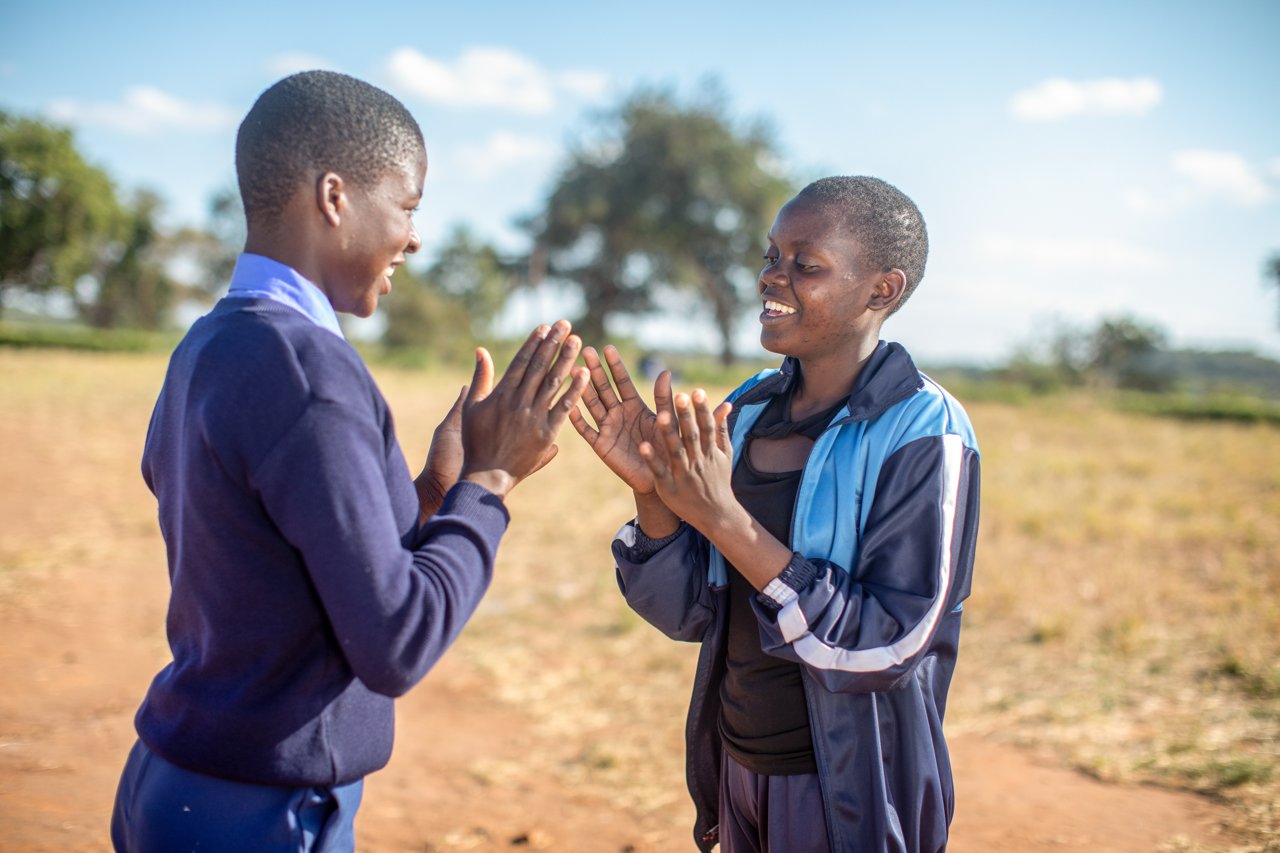
Maggie used to have to collect a big five litre bottle of water to take to school every day.
“The water was not clean. But it’s all we had,” she explained, as the school had no taps or washing facilities. Girls, including Maggie and her friend Mary, sometimes missed school to fetch water.
Notes:
Photo credit: Thom Flint

Slide 8
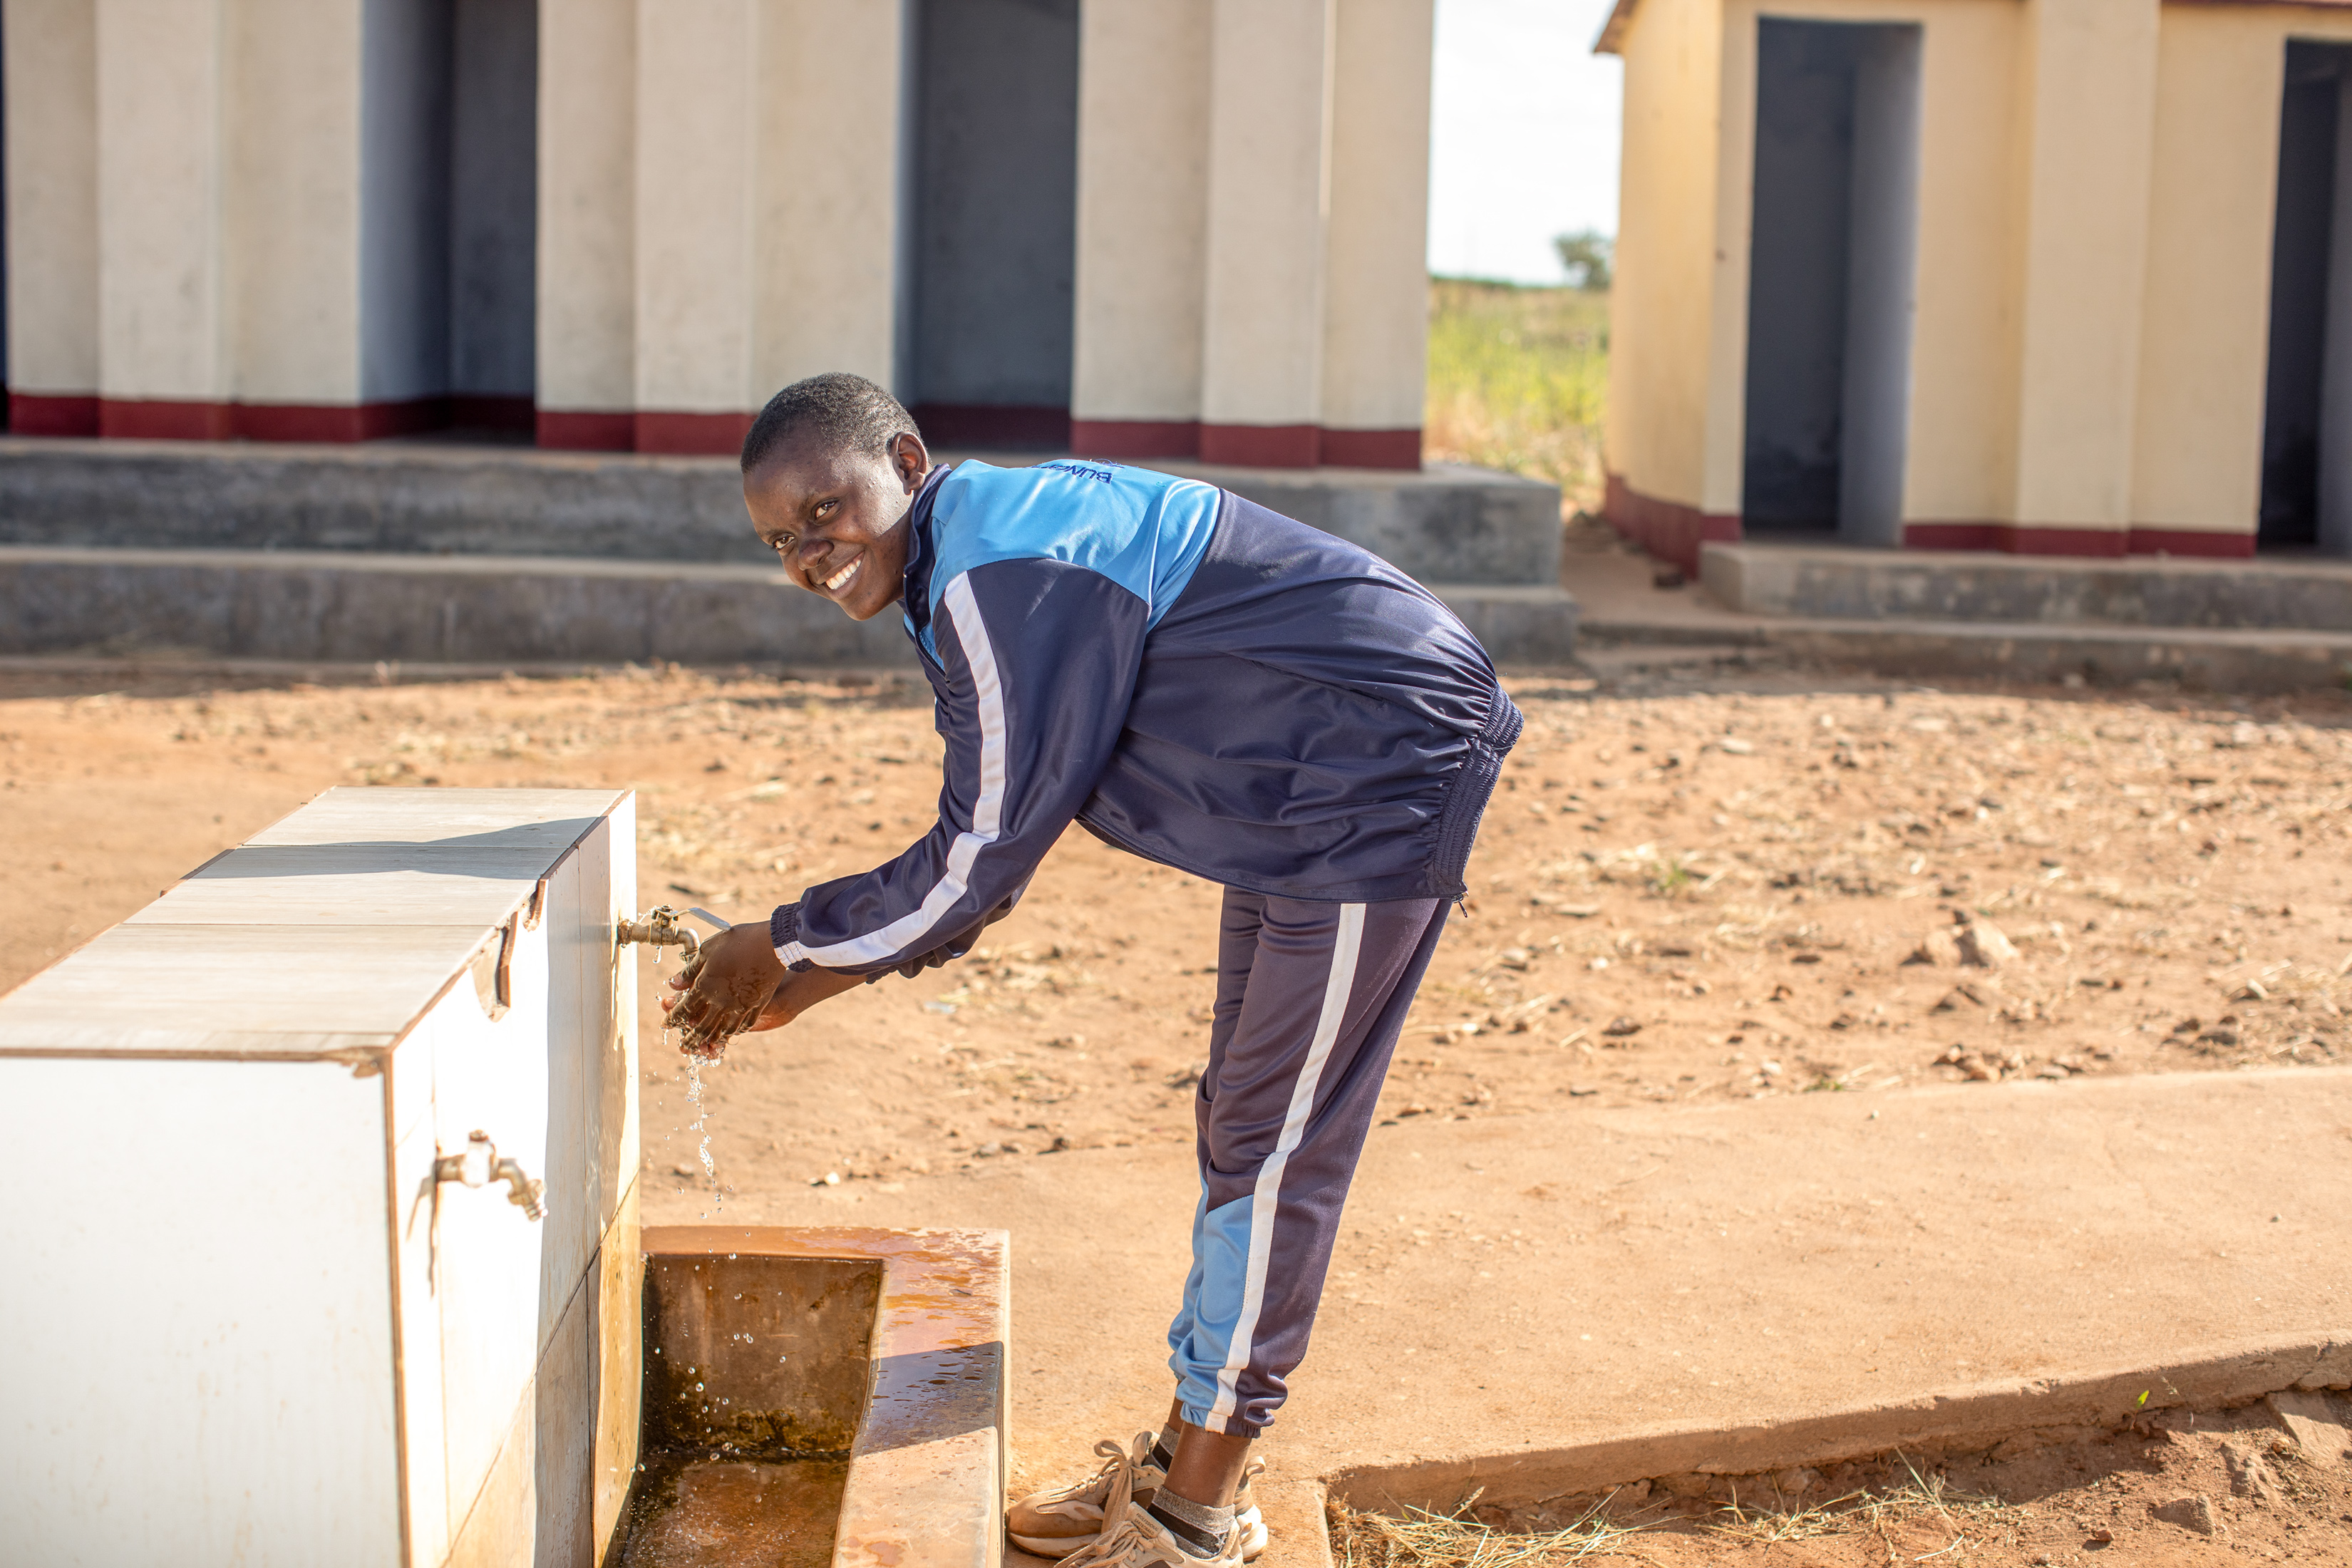
With CAFOD’s help, Maggie’s school installed taps and showers to run clean water.
Now students can focus on learning.
“I’m loving coming to school. We have water. We no longer carry water to school, she says.”
Notes:
Photo credit: Thom Flint

Slide 9
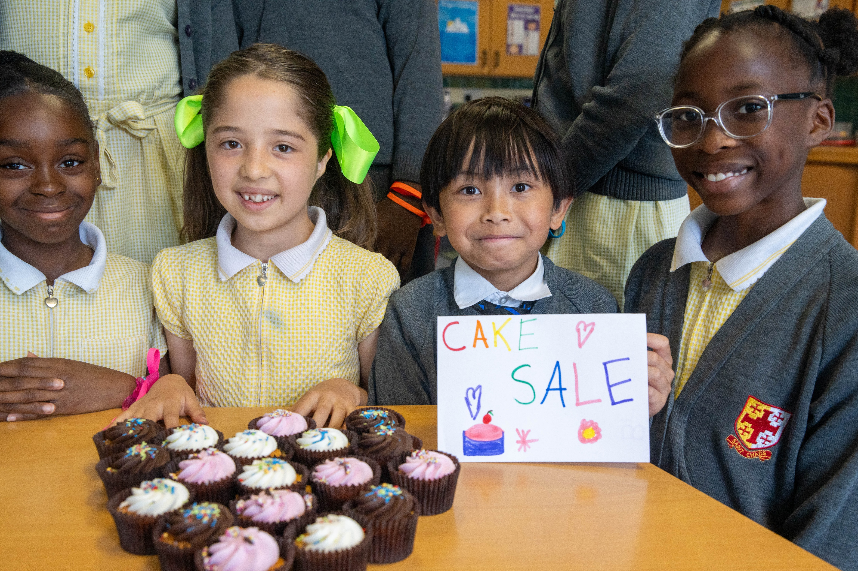
Next Friday is CAFOD’s Family Fast Day, a day when we can pray, fundraise, and eat simply to stand alongside our global family – people like Maggie and her school friends.
Notes:
Photo credit: Joe Newman

Slide 10
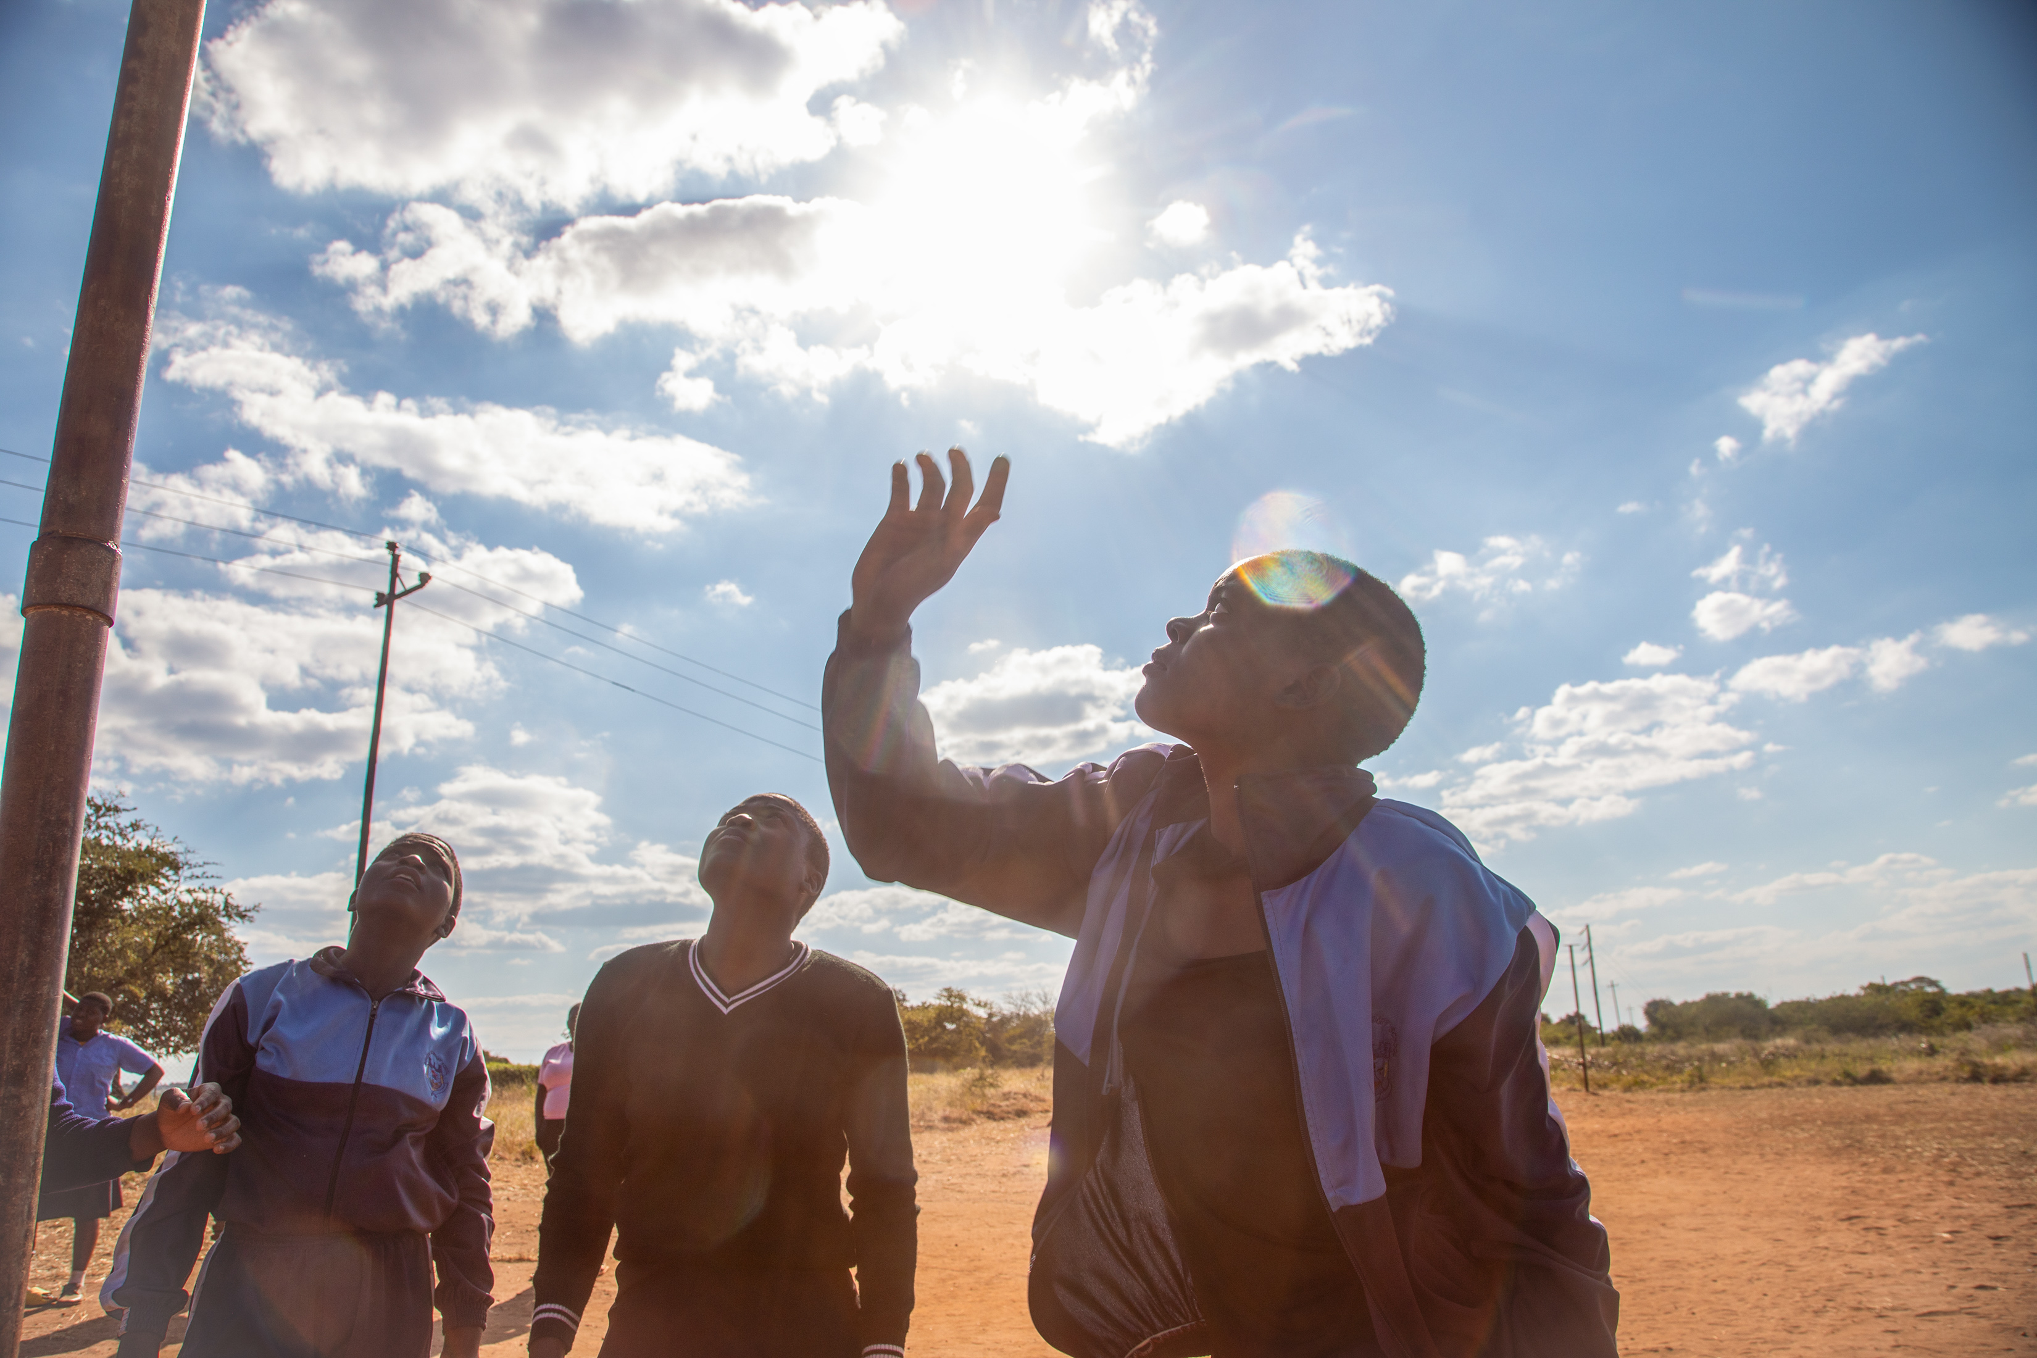
There are lots of different ways that we can answer God’s call, help other people and care for our world.
Notes:
Photo credit: Thom Flint

Slide 11
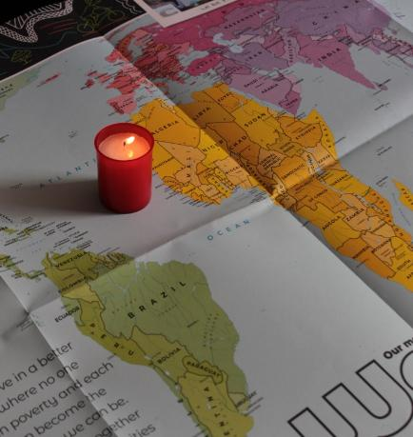
Let us pray
We pray for world leaders: that they may make decisions for the good of all our brothers and sisters. Lord in your mercy…
We pray for all our brothers and sisters throughout the world: that together we may learn and grow in God’s love, fulfilling our potential. Lord in your mercy...

Slide 12
Let us pray
We pray for our parish, our families and our friends: that we may be moved to share what we have with others, especially those who are poor or in need. Lord in your mercy…
Generous God, we thank you for all you have given us. Help us to live as you ask us to and to work together with others to build a better world. Amen.

Slide 13
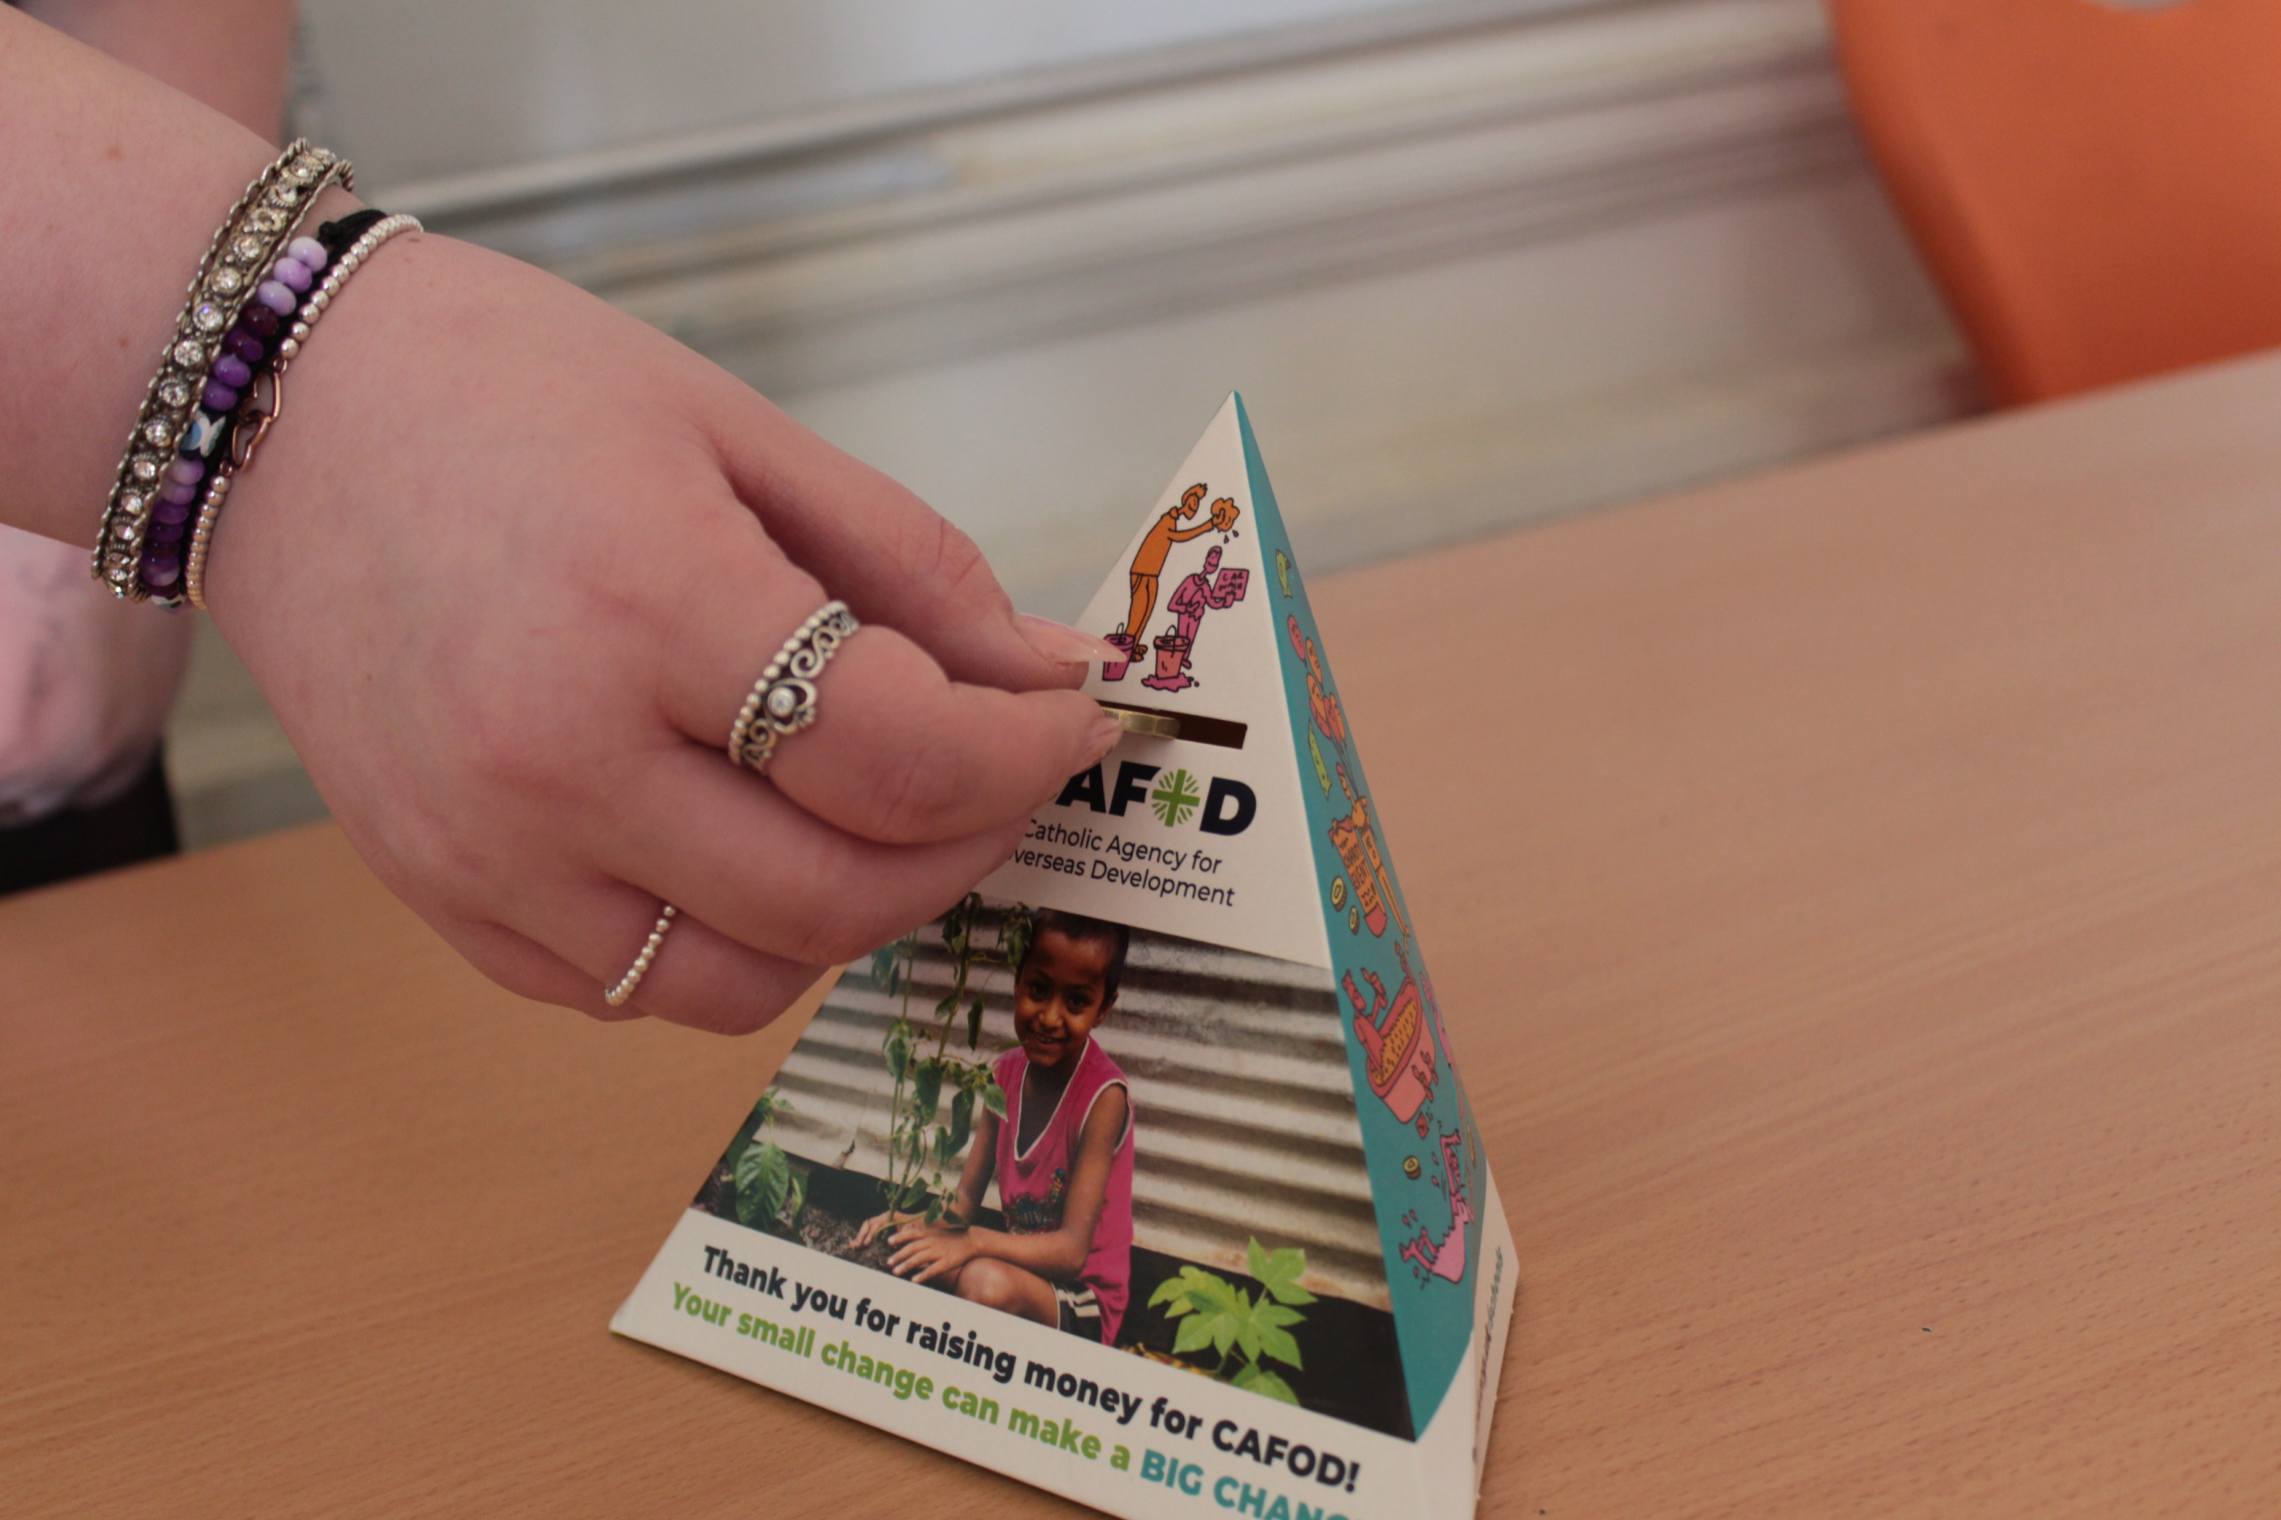
What will you do this week to help others at home? At school? In your local community? And around the world?
Send

Slide 14
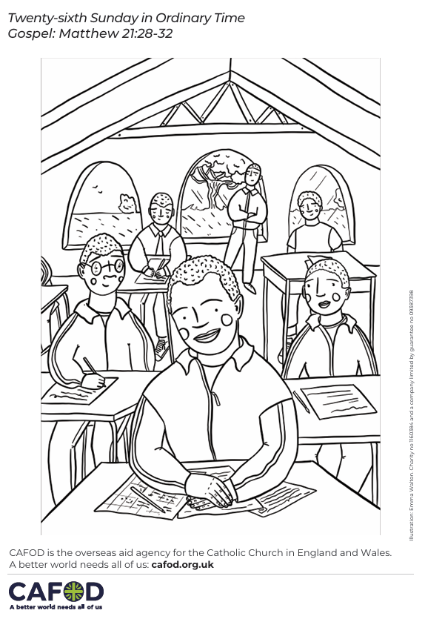
Activity suggestions
Download the illustration
Invite the children to colour in the accompanying illustration of Maggie and her classmates at school and on the back to write or draw what they will do this week to help others either at home or school, locally or globally.
Encourage the children to listen carefully to all that they are asked to do in the next week and to think about how they can help others at home, school, locally and globally.
Organise a fundraiser for CAFOD to support more people like Maggie. Explore our Brighten Up resources
Watch Maggie’s film in Zimbabwe
Notes:
Illustration: Erika Pal

Slide 15
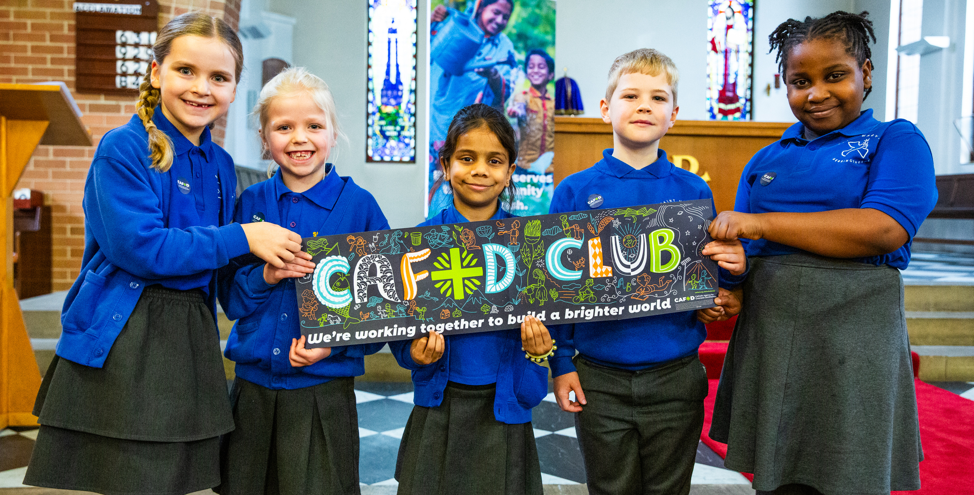
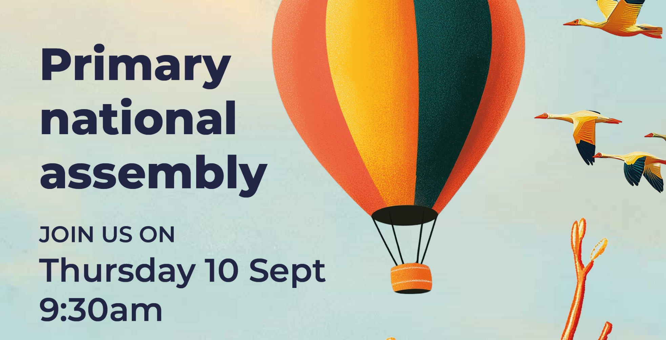
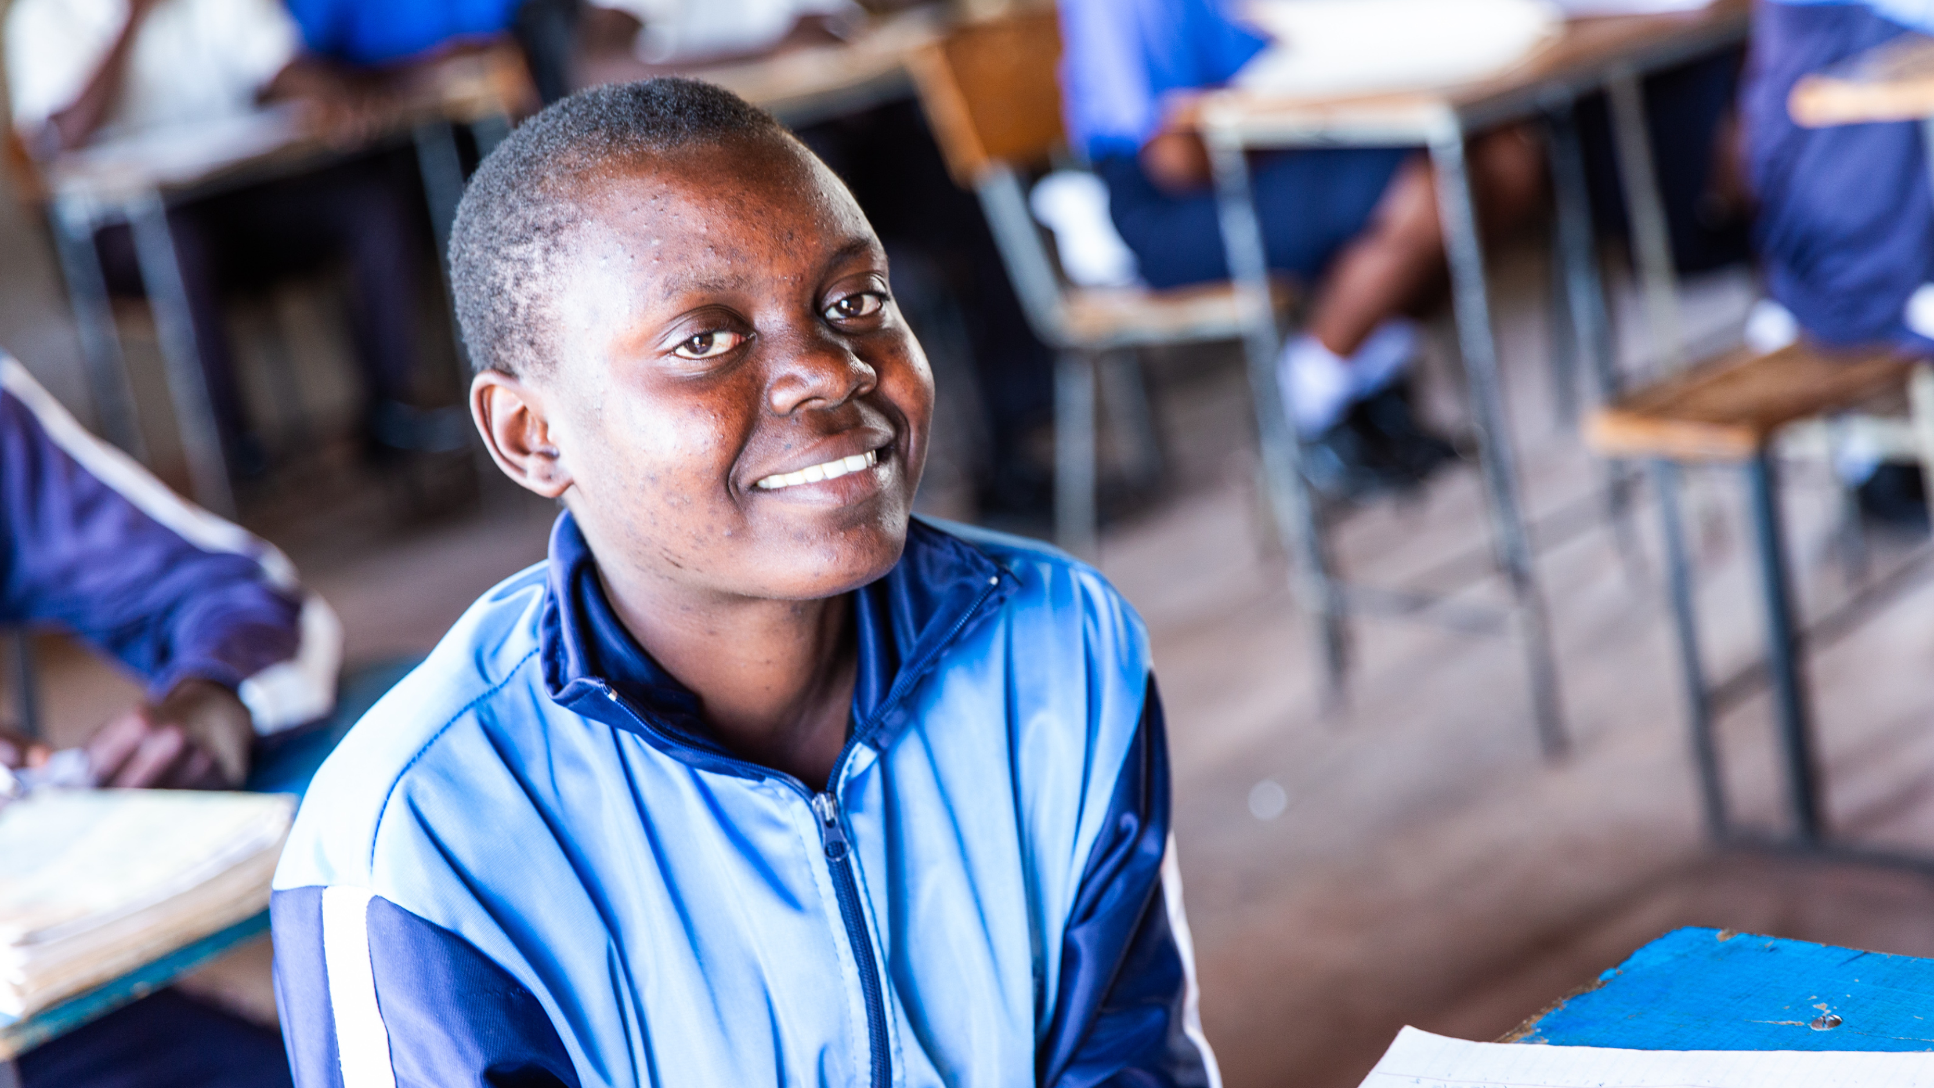
Get involved with CAFOD this term
Explore our resources for the new school term
Watch our national assembly
Fundraise for Harvest Fast Day

Slide 16
