Slide 1
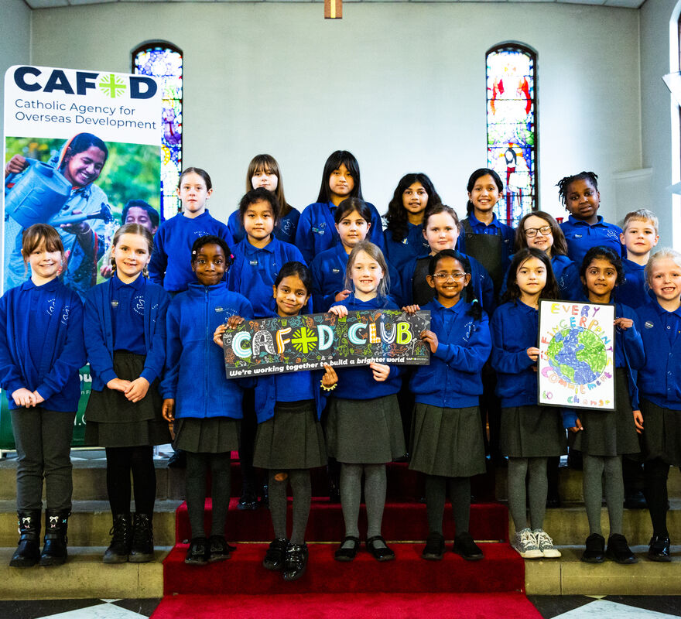
What will you do to help make sure all people around the world get their fair share of the things God has given us all?
Gospel Celebration of the Word
Notes:
Children’s liturgy: Twenty-Fifth Sunday in Ordinary Time (Year A)
Preparation of the worship space
Colour: Green
Props: Paper and coloured pens or pencils
Song suggestions:
Sing of the Lord’s goodness (713, Laudate)
Tell out my soul (880, Laudate)
Welcome
Today Jesus tells us a story about some workers who all receive the same wages, even though some worked all day and some just worked for an hour. Does that sound right to you? Let’s think some more about this today...
St Mary's school at the Immaculate Conception church, Rotherham
Photo credit: Thom Flint

Slide 2
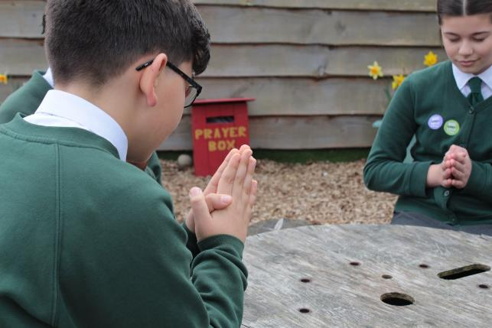
Generous and giving God, You created the world with enough for everyone. Help us to share what we have been given and make sure all your people have enough. Amen.
  Gather
Notes:
St Francis Xavier's RC Primary School, Herefordshire
Photo credit: Vicky Ahmed

Slide 3
Gospel: Matthew 20:1-16
“The Kingdom of heaven is like this. Once a man went out early in the morning to hire some men to work in his vineyard. He agreed to pay them the regular wage, a silver coin a day, and sent them to work in his vineyard.
"He went out again to the market place at nine o'clock and saw some men standing there doing nothing, so he told them, ‘You also go and work in the vineyard, and I will pay you a fair wage.’ So they went.
"Then at twelve o'clock and at three o'clock he did the same. It was nearly five o'clock when he went to the market place and saw other men still standing there. ‘Why are you wasting the whole day here doing nothing?’ he asked. ‘No one hired us,’ they said. ‘Well, you also go and work in the vineyard,’ he said.
“When evening came, the owner told his foreman, ‘Call the workers and pay them their wages, starting with those who were hired last and ending with those who were hired first.’
Word

Slide 4
Gospel: Matthew 18:15-20
"The men who had begun to work at five o'clock were paid a silver coin each. So when the men who were the first to be hired came to be paid, they thought they would get more; but they too were given a silver coin each. They took their money and started grumbling against the employer.
‘These men hired last worked only one hour,’ they said, ‘while we put up with a whole day's work in the hot sun – yet you paid them the same as you paid us!’
‘Listen, friend,’ the owner answered one of them, ‘I have not cheated you. After all, you agreed to do a day's work for one silver coin. Now take your pay and go home. I want to give this man who was hired last as much as I have given you. Don't I have the right to do as I wish with my own money? Or are you jealous because I am generous?’”
And Jesus concluded, “So those who are last will be first, and those who are first will be last.”
Word

Slide 5
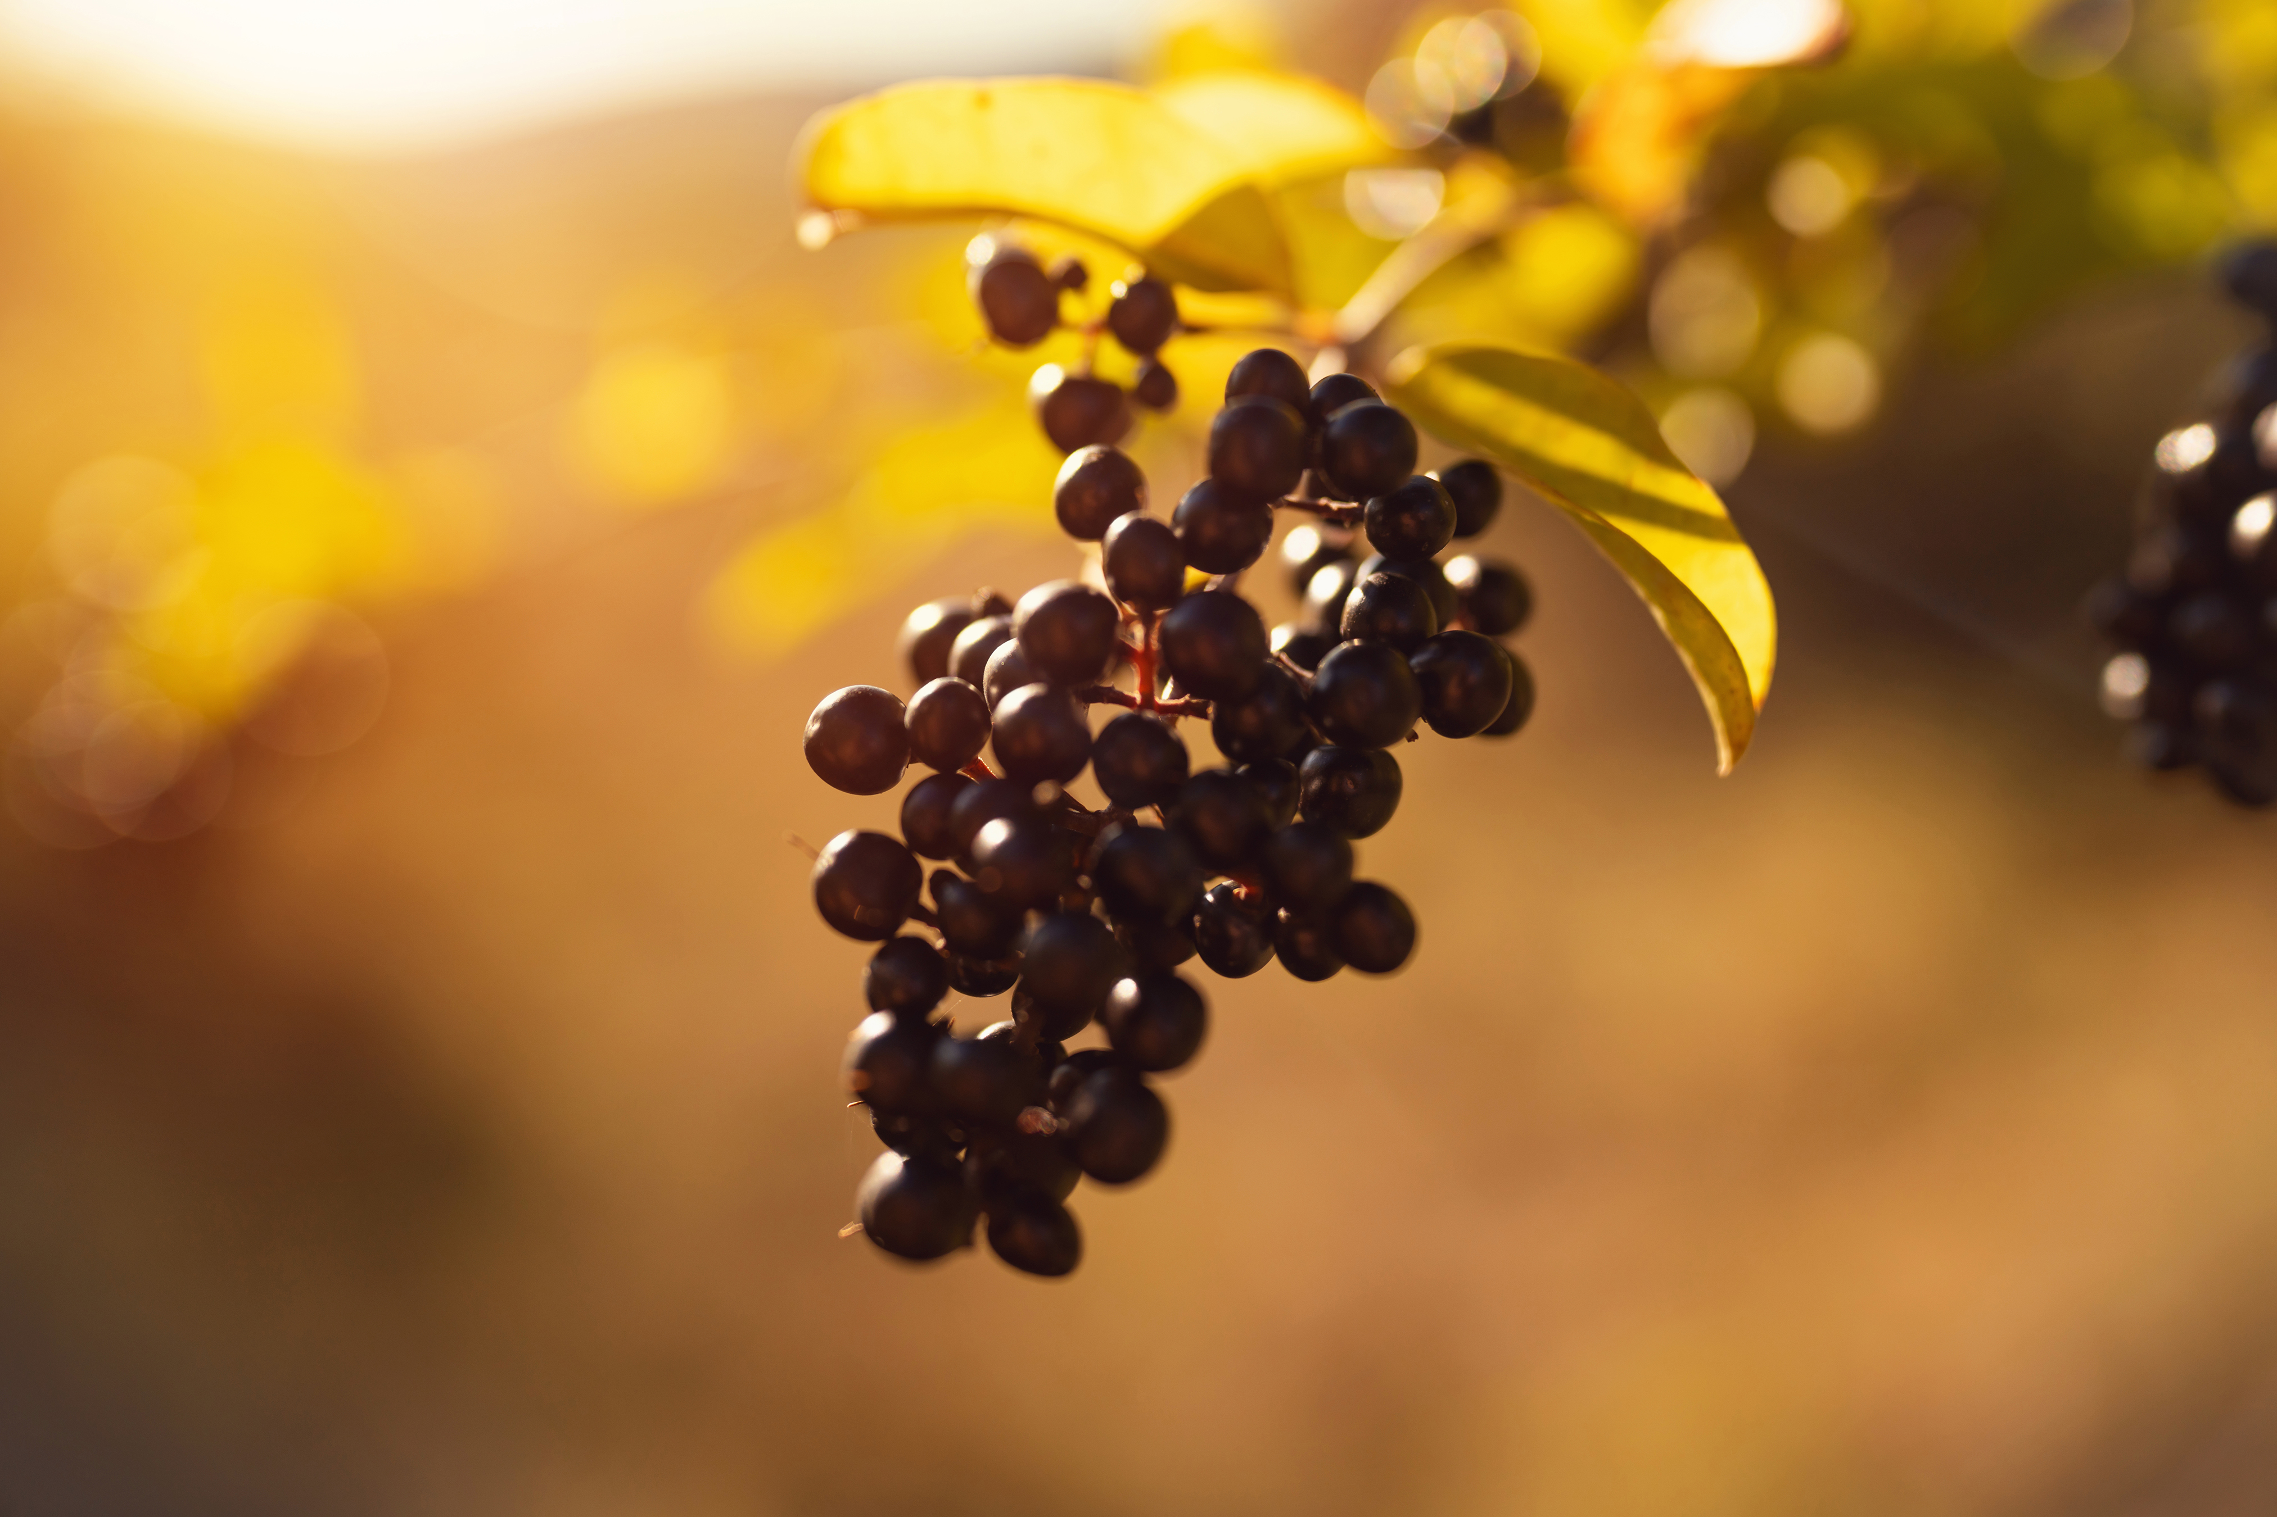
What do you remember from the Gospel reading?
A landowner went out to hire some workers for his vineyard. He took on new workers at the start of the day and three more times later in the day. He promised them all a fair wage.
The workers who arrived first expected to be paid more than the workers who arrived near to the end of the day. After all, they were hot and tired and had worked very hard all day, while some of the others had only worked for one hour.
Respond
Notes:
Grapevine
Photo credit: Stock image

Slide 6
How did the workers who had been hired first feel when they saw that everyone was being paid the same wage?
They thought it was unfair. They were angry and complained.
Do you agree with them? Why? Or why not?
Notes:
Working hands
Photo credit: Stock image

Slide 7

The landowner says he paid the first workers exactly what they agreed was fair at the start of the day.
He says they have no reason to be cross that he is generous to the other workers, that he can do what he likes with his own money.
Can you think of a time when you felt something was unfair?
How did it make you feel? What did you do about it?
Notes:
Coins
Photo credit: Stock image

Slide 8
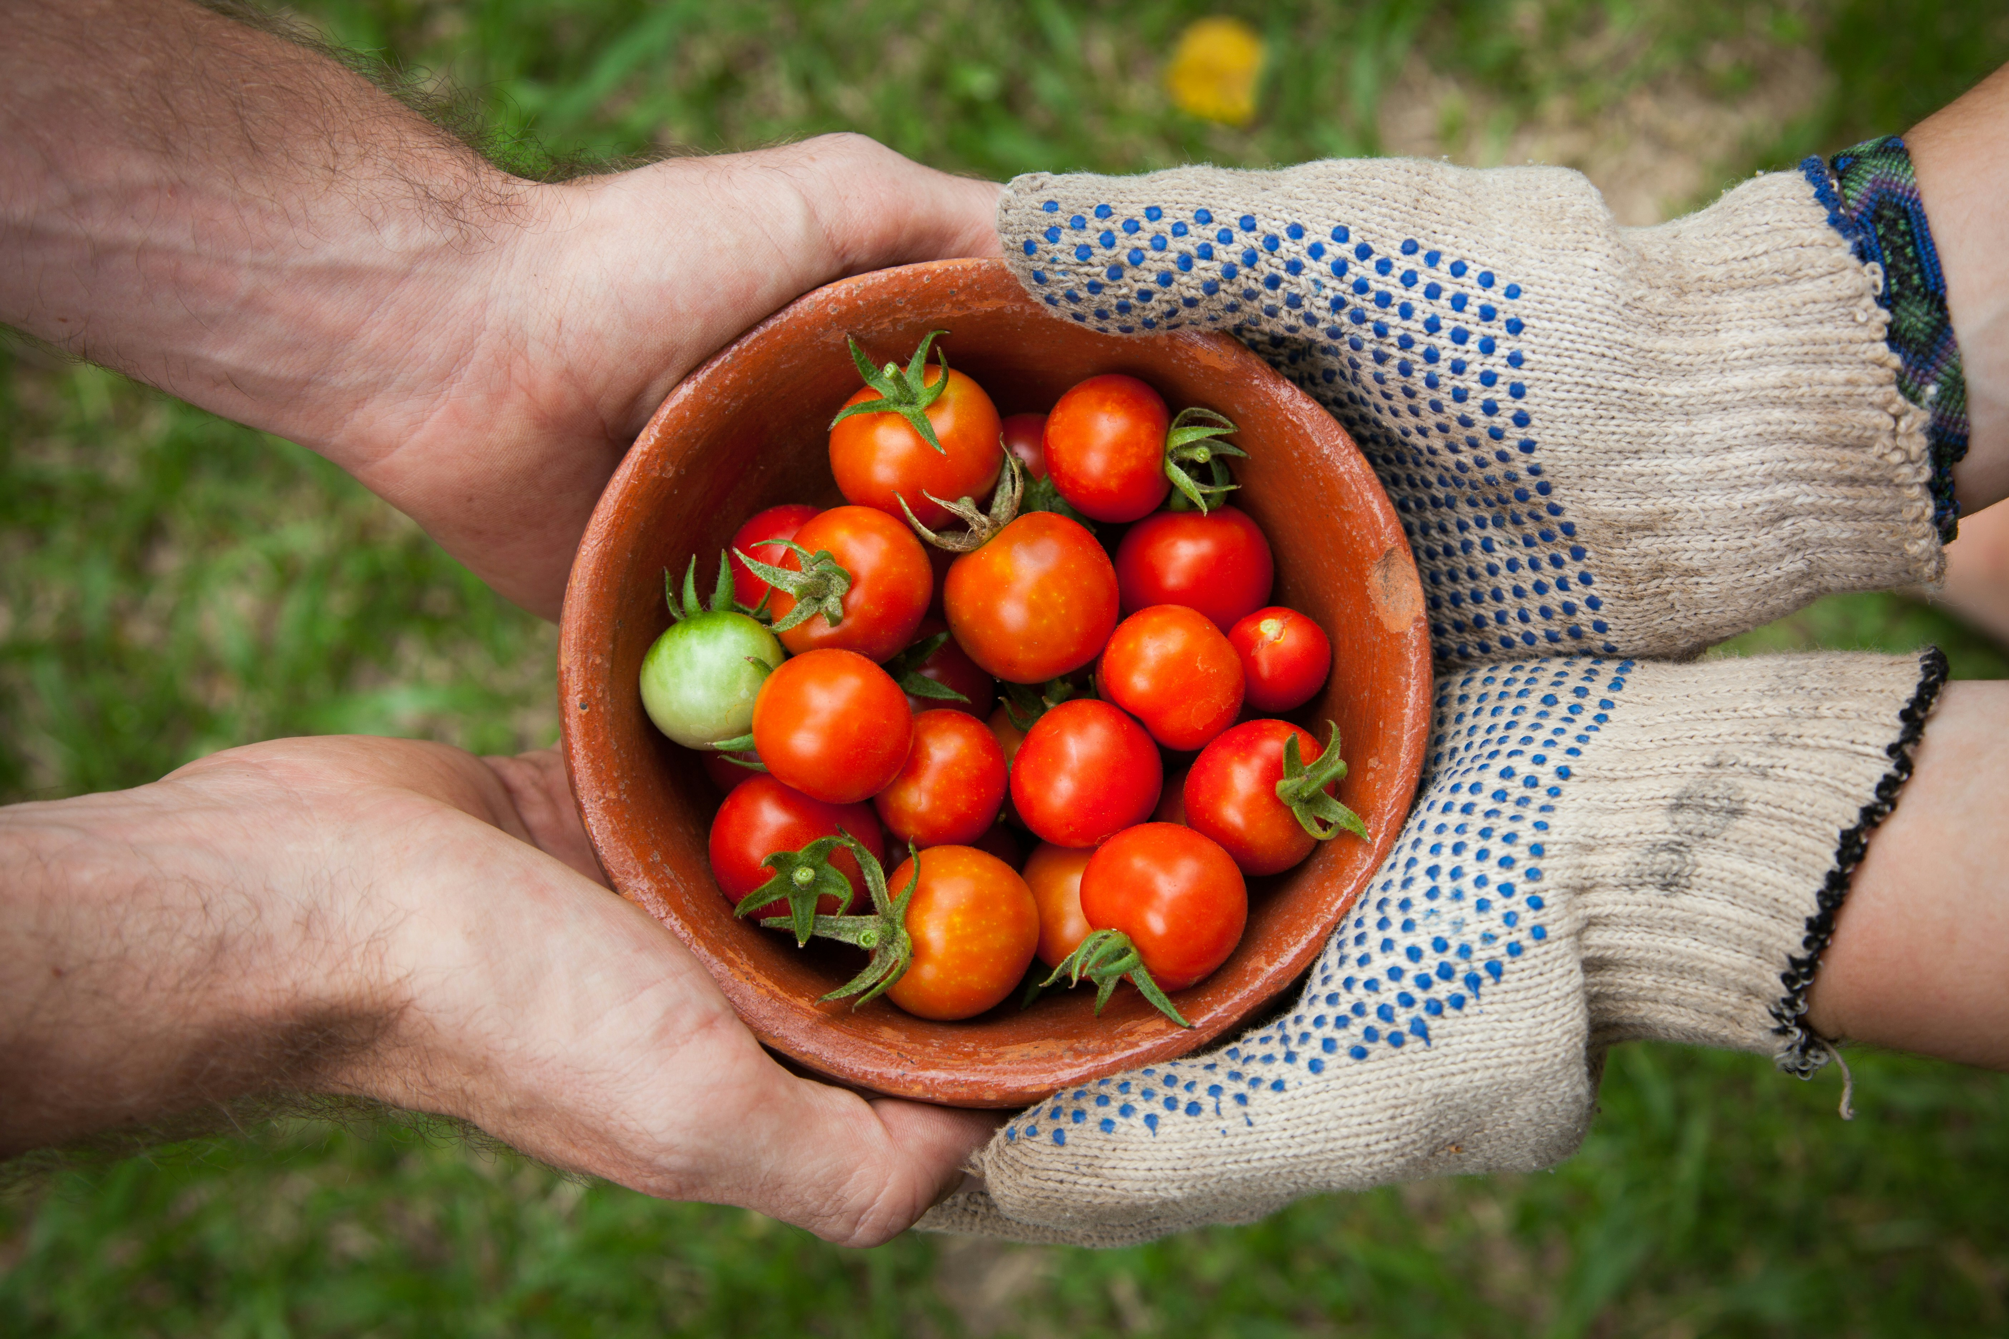
Who do you think the landowner in the story is supposed to be? What is Jesus trying to tell us?
Jesus is showing us that God’s idea of fairness (sometimes we use the word 'justice'), is different from ours.
God’s fairness is about making sure every single person gets what they need, no matter what their situation.
Notes:
Sharing
Photo credit: Elaine Casap on Unsplash

Slide 9
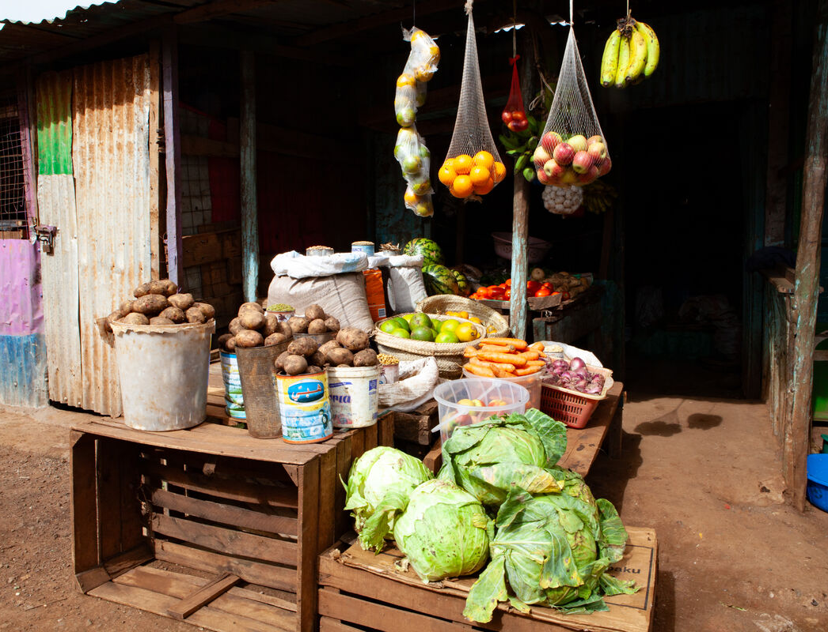
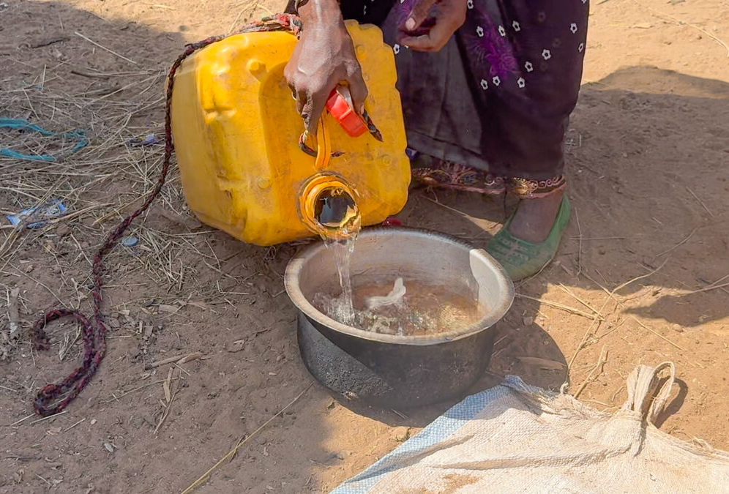
God gives us what we need and not just what others think we deserve. God is generous and created a world with enough for absolutely everyone.
But do you think everyone in our world does have enough money? Or even enough food and water?
Why/why not? Do you think this is fair? Do you think this is what God wants for us?
Notes:
Local market, Kenya
Water, Ethiopia
Photo credit: Louise Norton

Slide 10
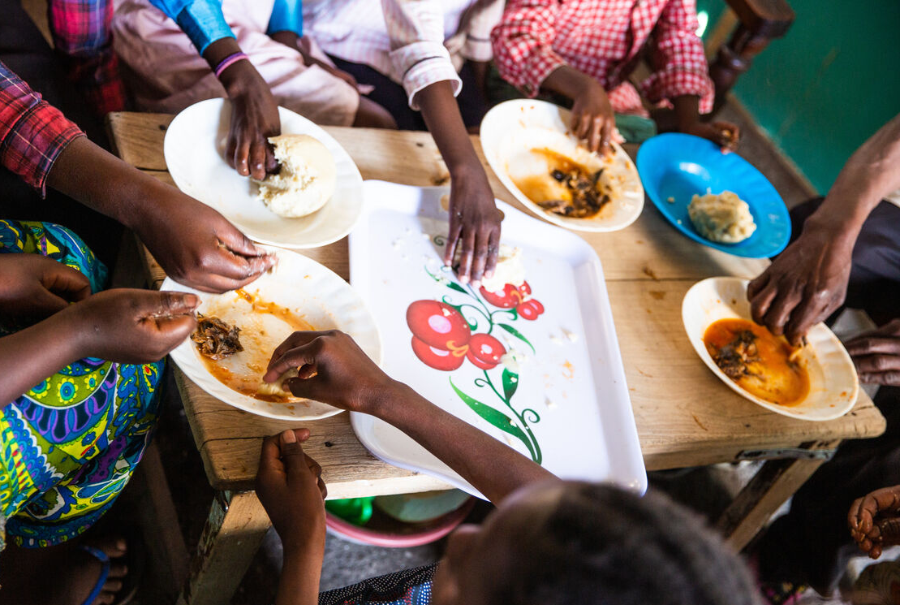
How can we help make sure that all people get their fair share of the good things that God has given us?
We can try hard not to take more than we need and make sure we don’t waste food, water or energy.
We can be generous with what we have, like the landowner in the story, sharing what we have with other people.
Notes:
Sharing a meal, DRC
Photo credit: Thom Flint

Slide 11
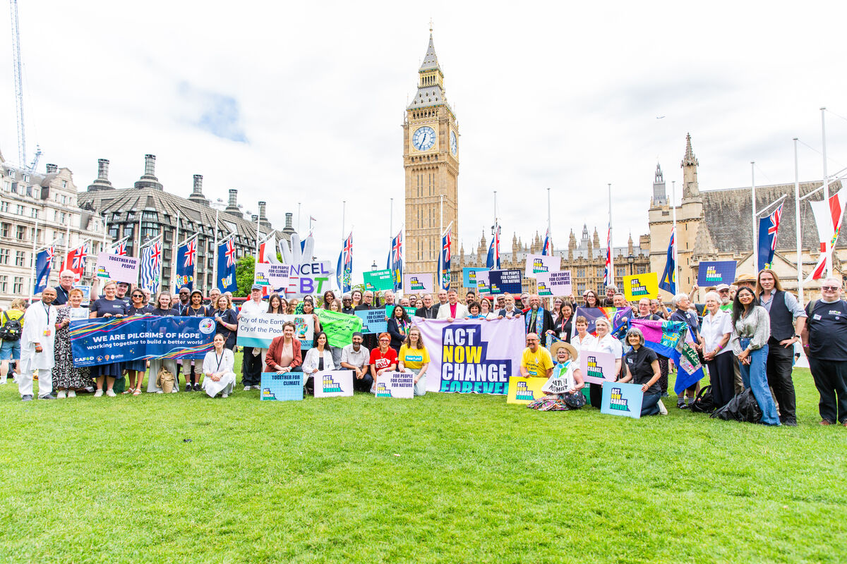
And we can try to make a change to our world so that it
is a fairer place for all people
to live.
Sometimes we can make a difference by ourselves.
And sometimes we do this by writing to the Prime Minister or other people in power asking them to make the changes.
Notes:
Mass lobby, London
Photo credit: Thom Flint

Slide 12
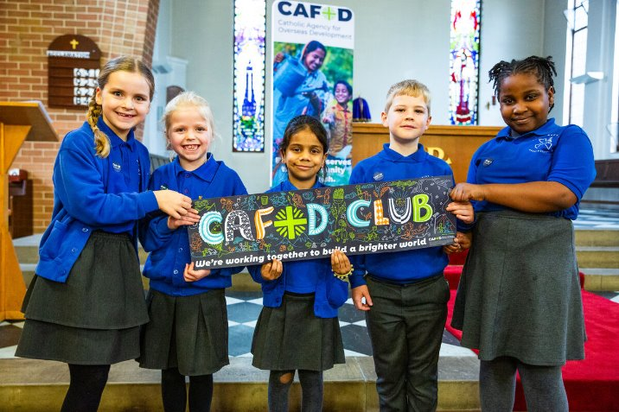
Sometimes it can feel very hard to know how we can make a change in our world.
We might wonder how anything we can do can really make a difference.
Why not set up a CAFOD Club to help support your brothers and sisters in need around the world?
Notes:
St Mary's school at the Immaculate Conception church, Rotherham
Photo credit: Thom Flint

Slide 13
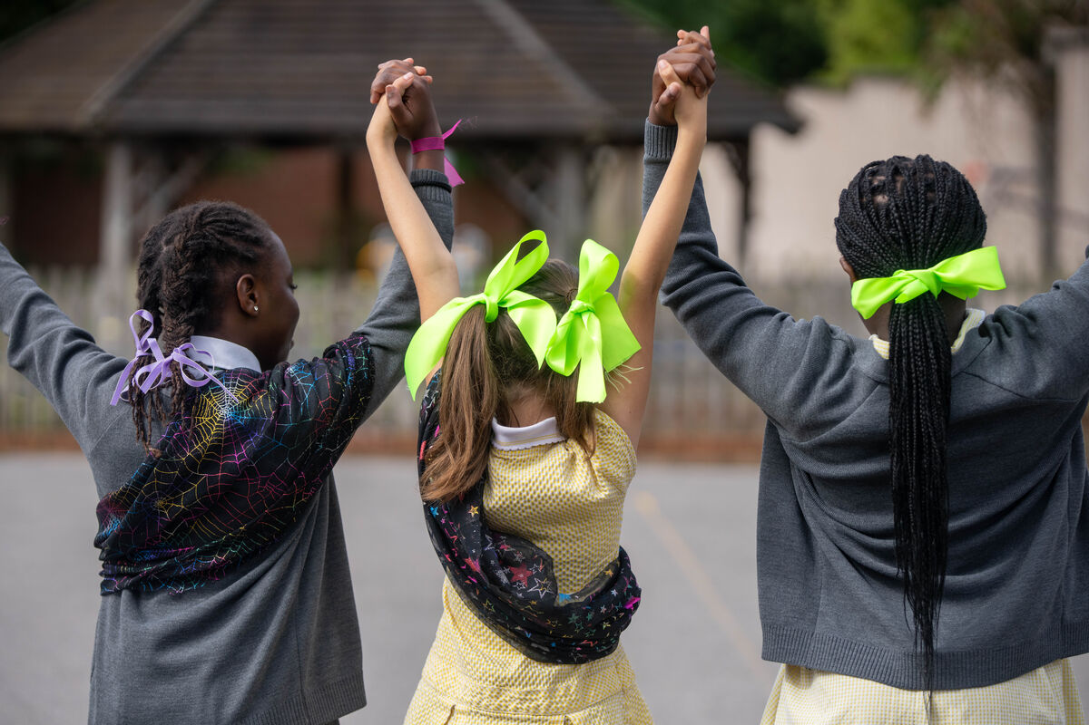
With activities, games and mini-projects, a CAFOD Club will help you explore ways to brighten up the world and reach people who urgently need our help.
They might be communities who do not have clean water to drink, or enough food to eat; they might be communities who need support in standing up for their rights.
Notes:
St Chad's Primary School, UK
Photo credit: Joe Newman

Slide 14
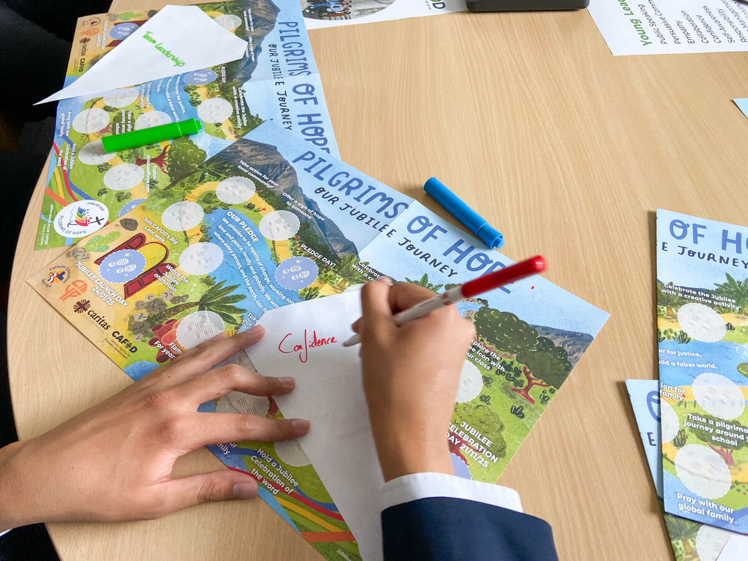
"I like being part of the CAFOD Club because I learn a lot about my brothers and sisters in other places," says Sophie.
"They teach me a lot about their lives and we find out how we can support them. We even wrote to the Prime Minister so he knows how he can help."
Notes:
CAFOD young leaders day
Photo credit: Victoria Ahmed

Slide 15
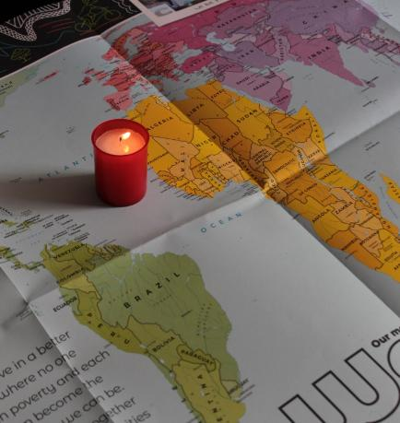
Let us pray
We pray for world leaders: that they may do all they can to make the world a better place where all people have their fair share of God's gifts.
Lord in your mercy…
We pray for our parish, families and friends:
that we may be generous and fair to all people in our one global family.
Lord in your mercy...

Slide 16
Let us pray
We pray for our brothers and sisters around the world, especially those who are poor:
that every single person may have what they need to live.
Lord in your mercy…
Living God: we give thanks for your generosity and love. Help us to take no more than we need, to share all we have and to work together for change so the world becomes a fairer place for us all to live. Amen.

Slide 17
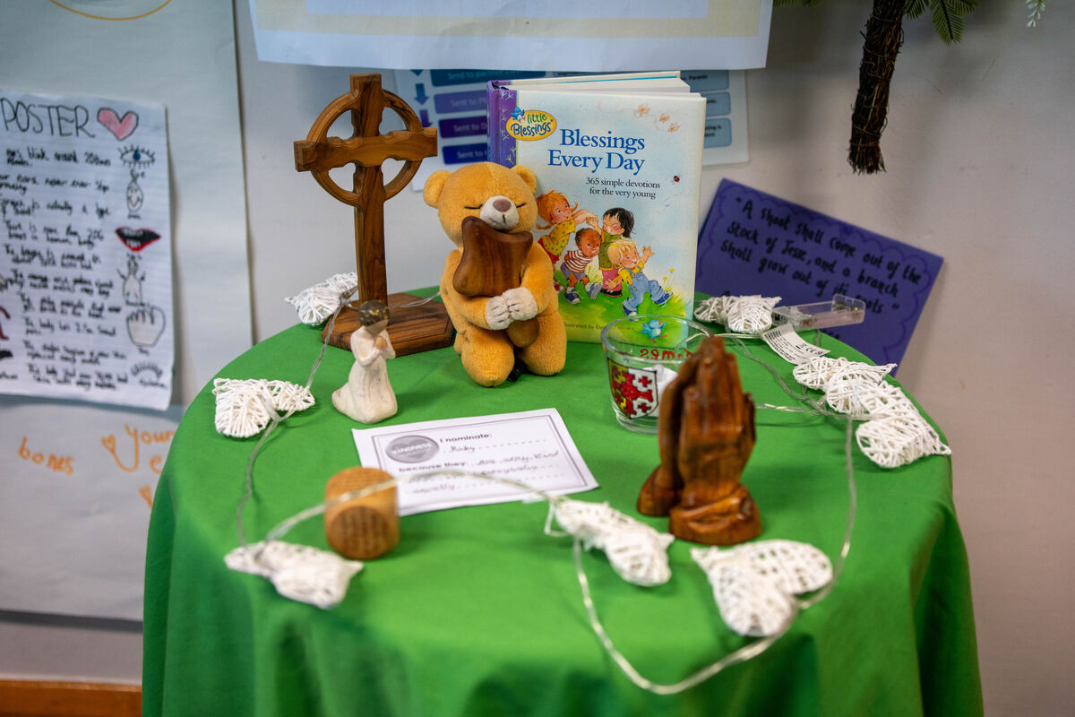
What will you do this week to help make sure all people around the world get their fair share of the things God has given us all?
Send
Notes:
St Chad's Primary School, London
Photo credit: Joe Newman

Slide 18
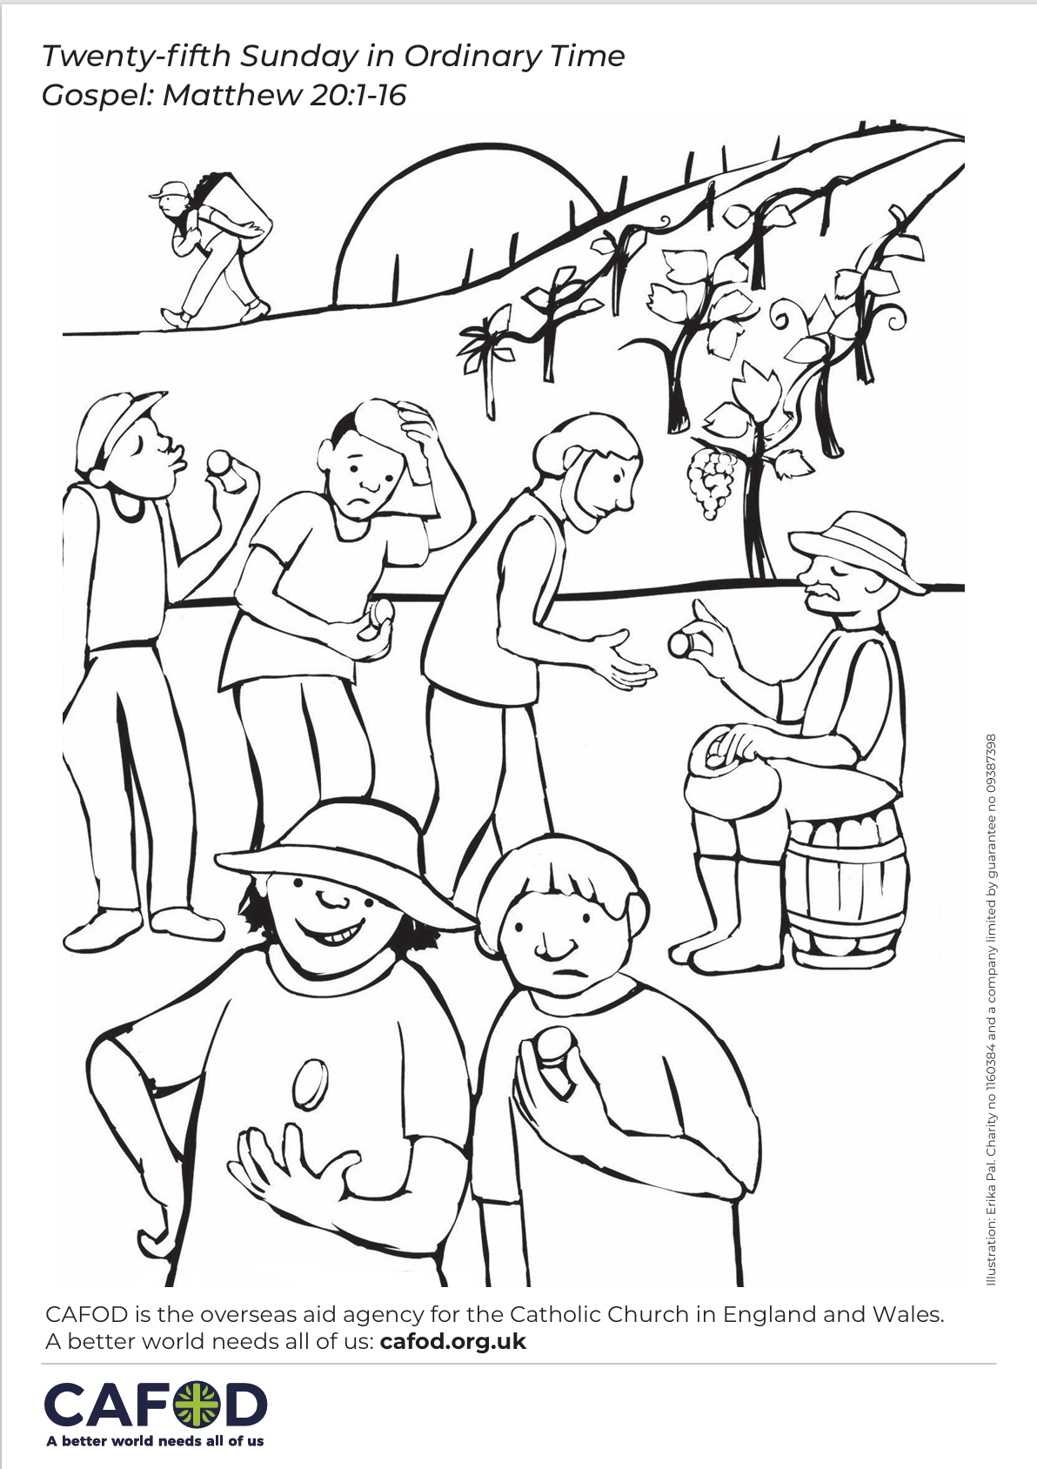
Activity suggestions
Download the illustration
Invite the children to colour in the accompanying illustration and on the back to write or draw how they will help make sure that everyone gets their fair share of the things that God has given us in the coming week.
Take a sheet of paper and divide it into two columns. In one column encourage the children to write or draw all the things that they think are unfair in the world. In the other column ask them to write or draw how they can help change these things to make the world a fairer place.
Invite the children to discuss all that they have heard and thought about today with their grown ups at home. Encourage them to try to be generous and fair in the coming week and to do at least one thing to try to make the world a fairer place for other people.
See Family prayer ideas for more child-friendly activities.
Notes:
Illustration: Erika Pal

Slide 19

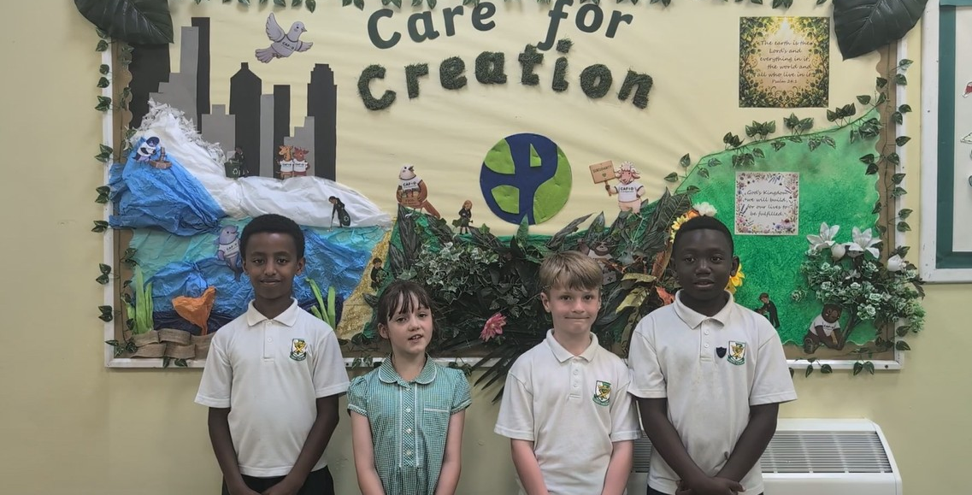
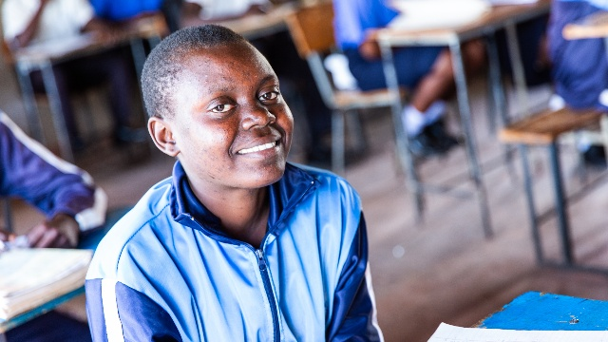
Get involved with CAFOD this term
Watch our national assembly
Autumn fundraising resources
Set up a CAFOD club

Slide 20
