Slide 1
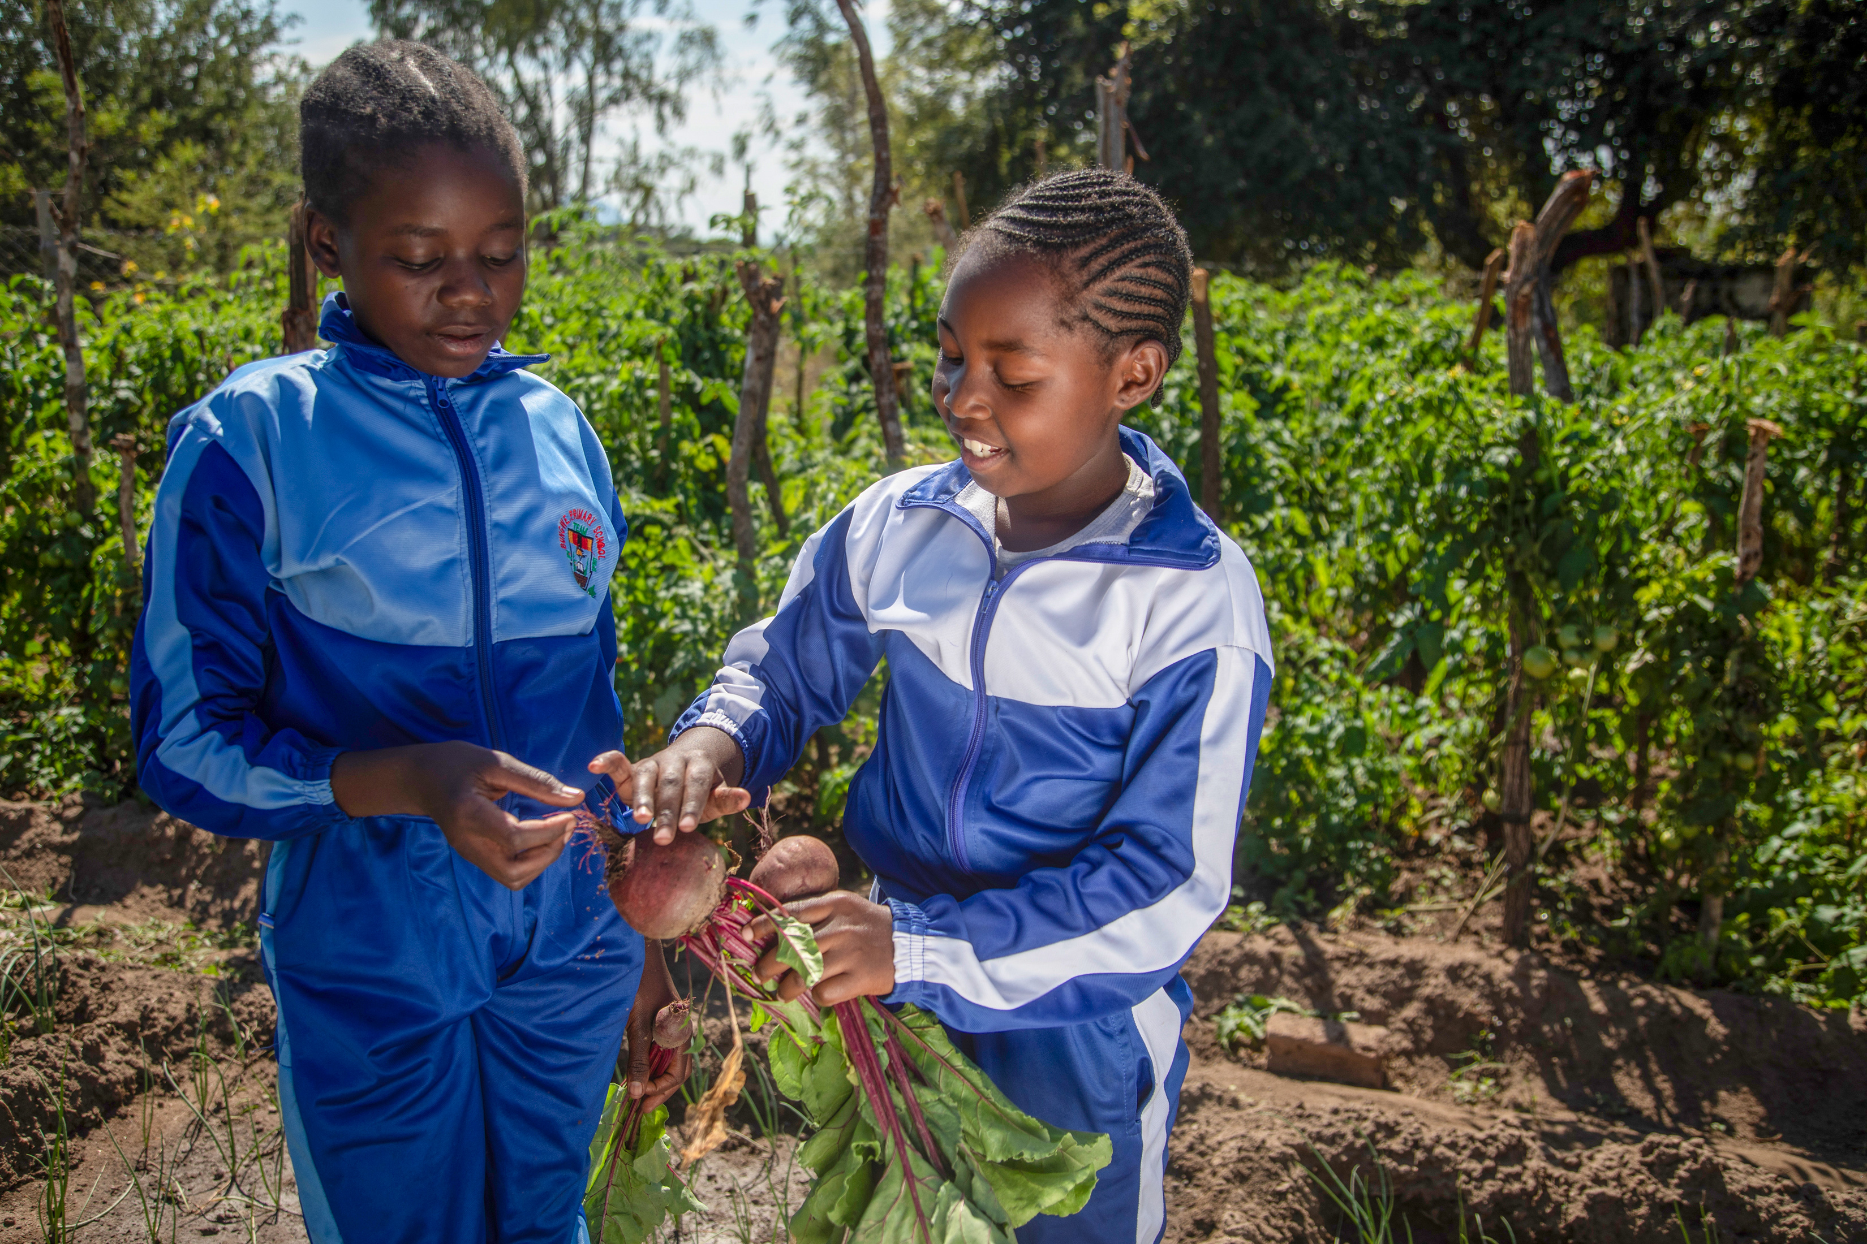
What will you do to take care of the earth now and in the future?
Gospel Celebration of the Word
Notes:
Tayla and Kiki in Zimbabwe
Photo credit: Cynthia Matonhodze
Children’s liturgy: Twenty-seventh Sunday in Ordinary Time (Year A)
Preparation of the worship space
Colour: green Props: a parachute and inflatable globe or a balloon, some old newspapers, toilet roll tubes and scissors.
Song suggestions
He’s got the whole world in his hands (973, Laudate) O Lord, all the world belongs to you (847, Laudate)
Welcome
In today’s gospel Jesus talks to us about a man who has real trouble with the people who are looking after his vineyard. These people are called tenants. Let’s find out some more about this.

Slide 2
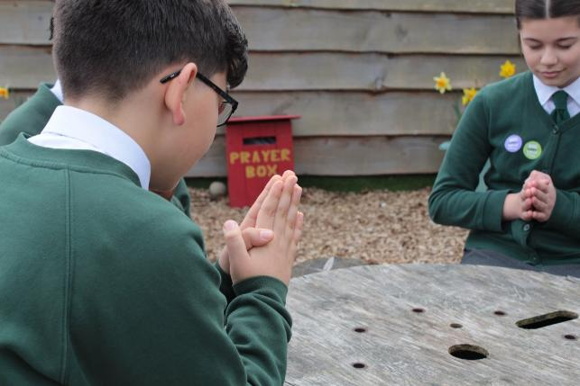
Loving God, you sent your son Jesus to show us how to live. Help us to listen to your word and care for the world that you have given us. Amen..
  Gather
Notes:
St Francis Xavier's RC Primary School, Herefordshire
Photo credit: Vicky Ahmed

Slide 3
Gospel: Matthew 21:33-43
“Listen to another parable,” Jesus said. “There was once a landowner who planted a vineyard, put a fence around it, dug a hole for the winepress, and built a watchtower. Then he let out the vineyard to tenants and went on a journey. When the time came to gather the grapes, he sent his slaves to the tenants to receive his share of the harvest. The tenants seized his slaves, beat one, killed another, and stoned another. Again the man sent other slaves, more than the first time, and the tenants treated them the same way. Last of all he sent his son to them. ‘Surely they will respect my son,’ he said. But when the tenants saw the son, they said to themselves, ‘This is the owner's son. Come on, let's kill him, and we will get his property!’ So they seized him, threw him out of the vineyard, and killed him.
Word

Slide 4
Gospel: Matthew 21:33-43
“Now, when the owner of the vineyard comes, what will he do to those tenants?” Jesus asked.
“He will certainly kill those evil men,” they answered, “and let the vineyard out to other tenants, who will give him his share of the harvest at the right time.”
Jesus said to them, “Haven't you ever read what the Scriptures say?
‘The stone which the builders rejected as worthless turned out to be the most important of all.
This was done by the Lord; what a wonderful sight it is!’
“And so I tell you,” added Jesus, “the Kingdom of God will be taken away from you and given to a people who will produce the proper fruits.”
Word

Slide 5
The tenants were greedy and wanted to keep all the wine for themselves. They didn’t want to share it with anyone, not even the man who owned the vineyard.
Do you think this is what Jesus wants us to be like? No? What does Jesus want us to do?
Respond
Notes:
What do you remember from the Gospel reading?
A man takes good care of his vineyard. He plants grapes in it, builds a fence and a tower and a press for making wine from the grapes. Then, when he goes away, he asks some other people to look after it for him. These people are his tenants.
When the time comes for the wine to be ready, the man sends his people to collect it. But the tenants do not want to share and they hurt those who have been sent.
Eventually the man sends his son because he thinks the tenants will respect and listen to him. But the tenants treat the son no better than they treated the others. How do you think the man felt when he heard what the tenants had done?
The tenants were greedy and wanted to keep all the wine for themselves. They didn’t want to share it with anyone, not even the man who owned the vineyard.
Do you think this is what Jesus wants us to be like? No? What does Jesus want us to do?

Slide 6
Who do you think the man who owned the vineyard is?
Who do you think the people are who the man sends to deliver a message to the tenants?
Who do you think the son in the story is?
Notes:
Jesus told this story so that people could understand more about God and what Jesus had come to do on earth. The different characters in the story represent God, the prophets – who were God’s messengers to the people – and Jesus.
Who do you think the man who owned the vineyard is? (God)
Who do you think the people are who the man sends to deliver a message to the tenants? (the prophets)
Who do you think the son in the story is? (Jesus)

Slide 7
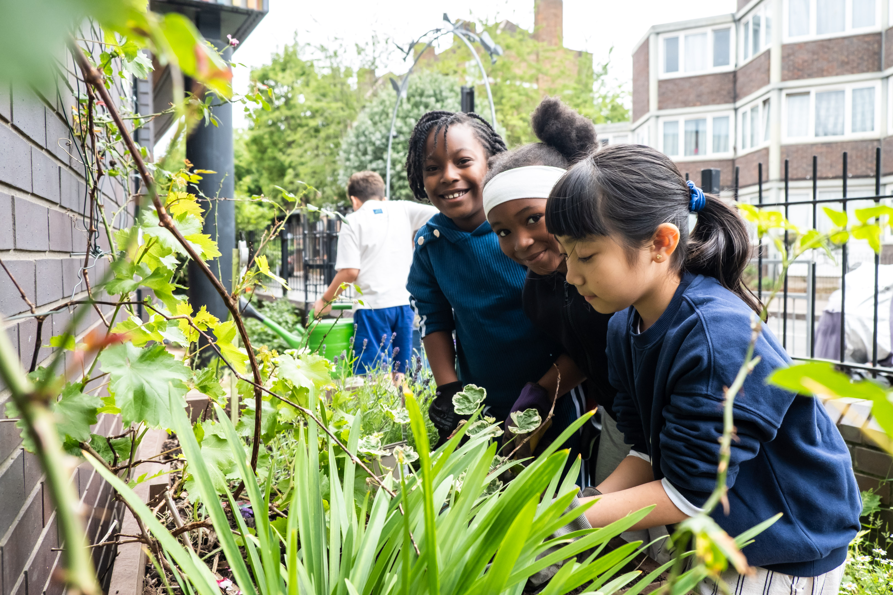
Notes:
Photo credit: Amit Rudro
Children in a LiveSimply group in London
Like the man who gave the vineyard to his tenants to look after, God has given us the earth and all that is in it. God also sent his son Jesus to show us how to live.
We are responsible for looking after the earth and all the animals, people and plants that are in it. Can you think of ways that we sometimes don’t take as good care of the earth as we should?
What happens when we don’t look after the earth?
When we don’t look after the earth, it becomes damaged. We have seen how there are more floods, droughts, storms and heatwaves in our world. This extreme weather often affects people who are poorest the most.

Slide 8
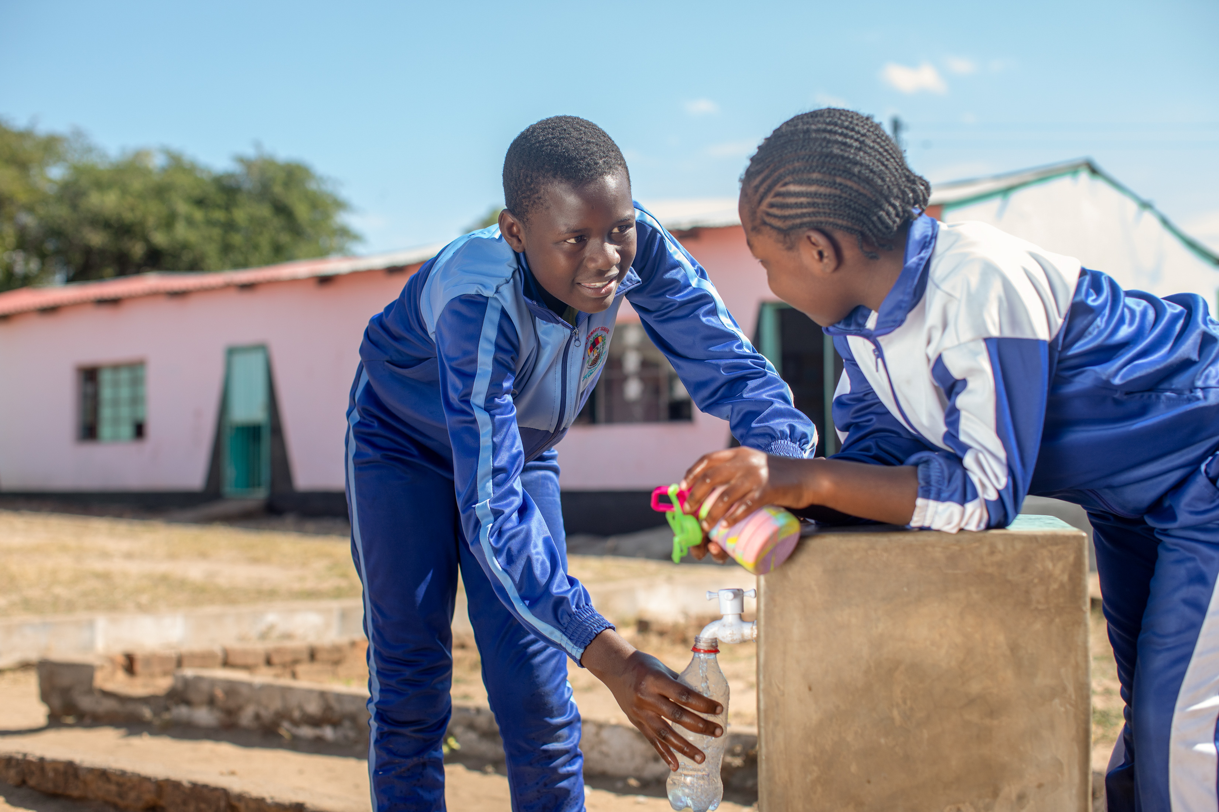
Notes:
Photo credit: Cynthia Matonhodze
Tayla is 12 years old and lives in Zimbabwe, a country in Africa. There has not been enough rain, and drought has left people there struggling with food and water shortages.

Slide 9
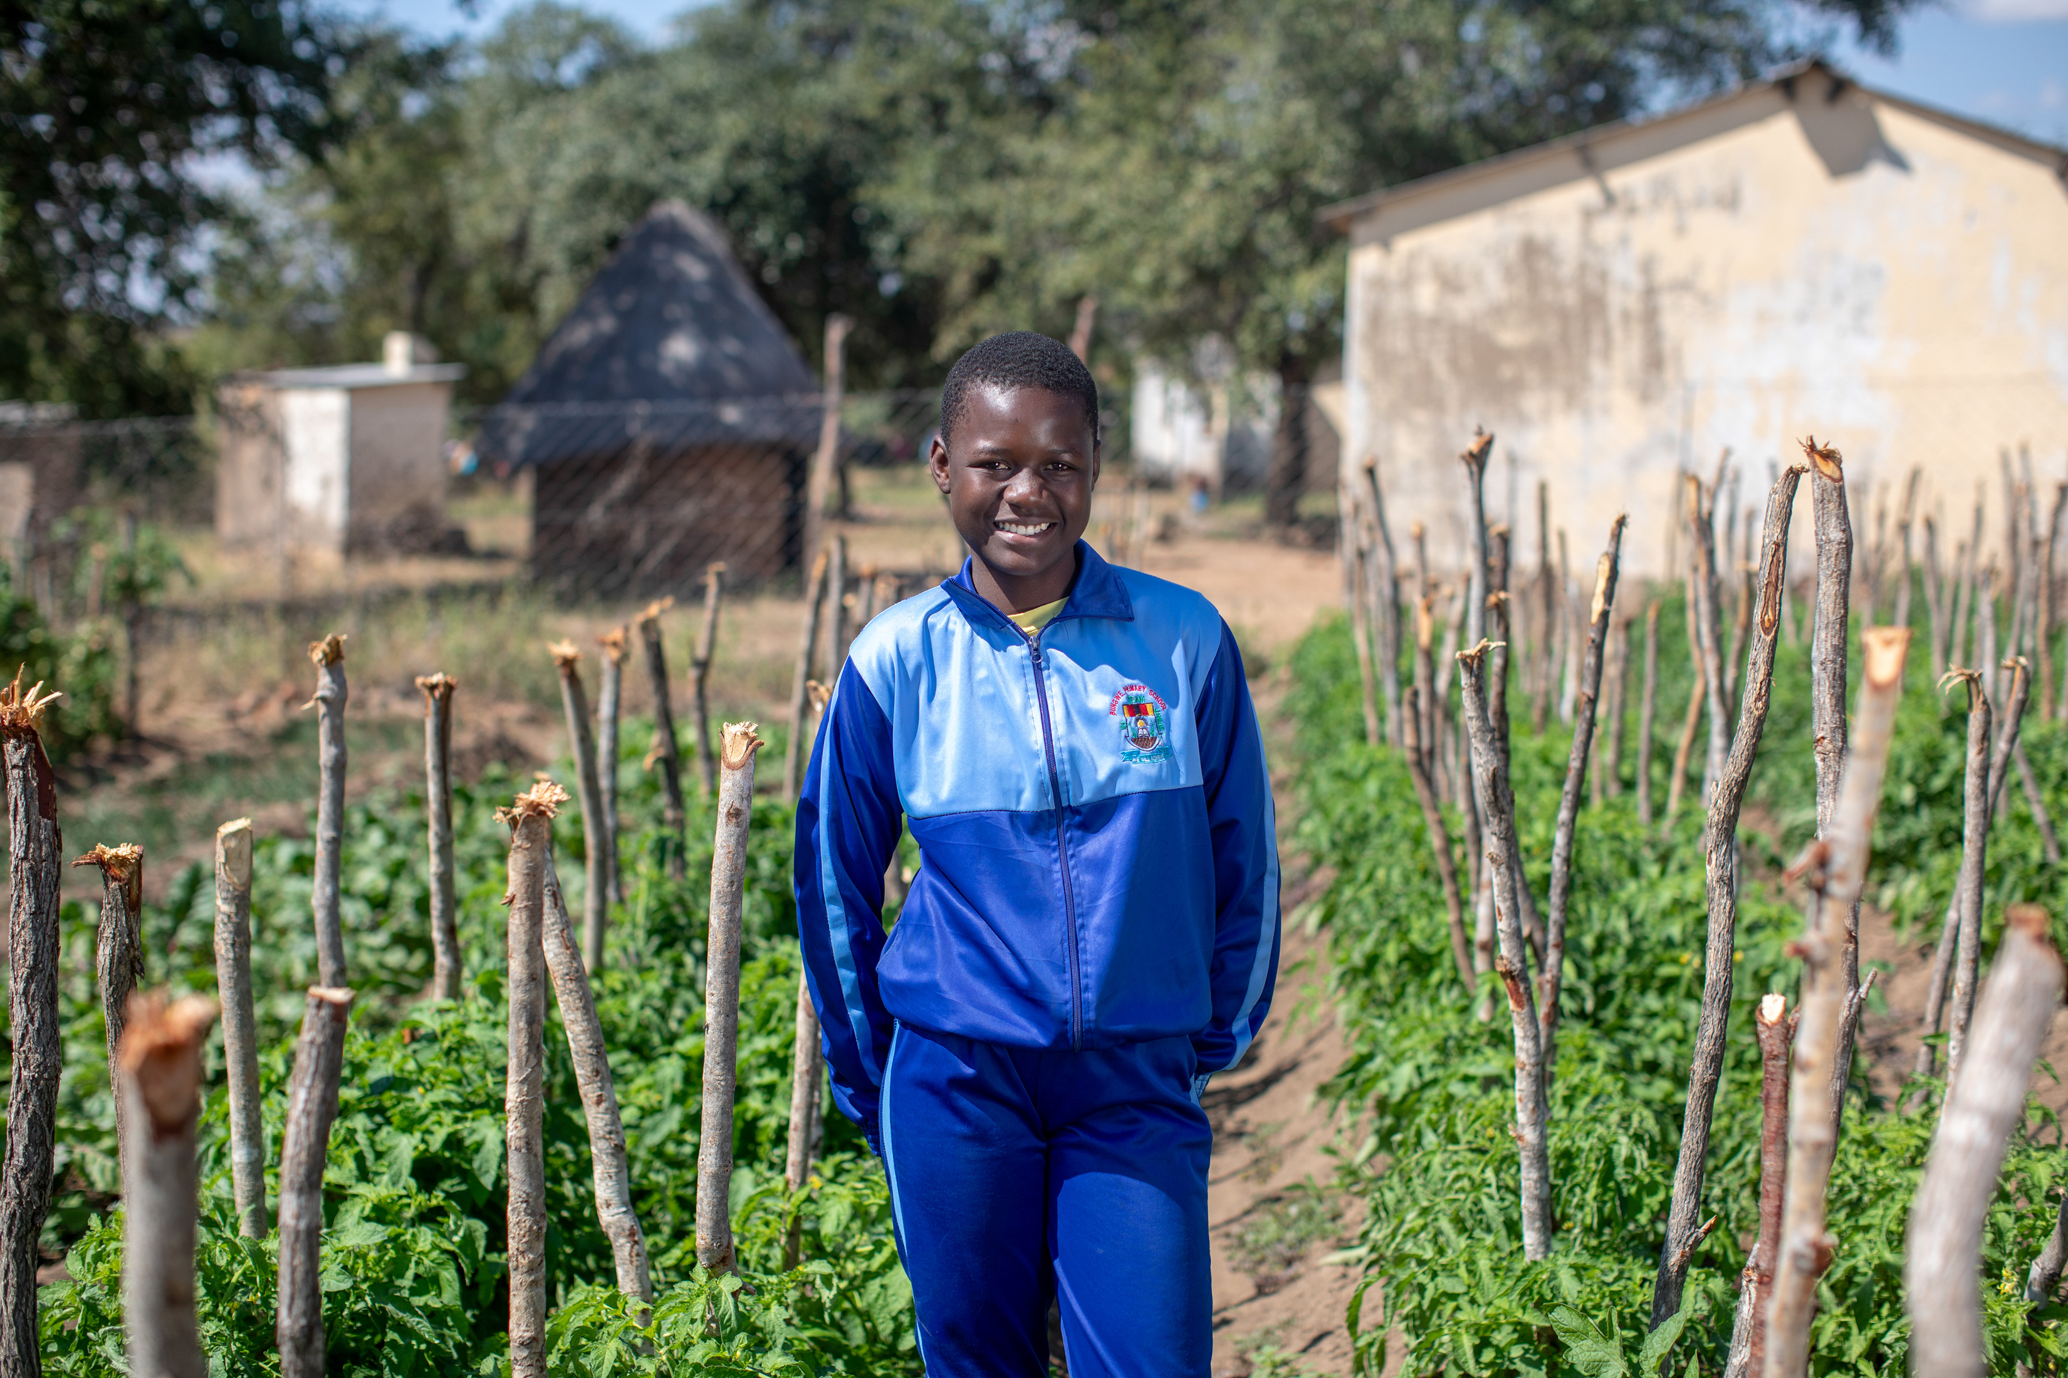
It affected me because I would feel tired and not be good at working. Some of the mathematics would be hard.”
Tayla
Notes:
Photo credit: Cynthia Matonhodze
Fetching water before school each morning meant that Tayla was often hungry and tired. Without enough food or water, she found it hard to concentrate at school and she worried about not doing very well in her schoolwork.
Tayla said, “It affected me because I would feel tired and not be good at working. Some of the mathematics would be hard.”

Slide 10
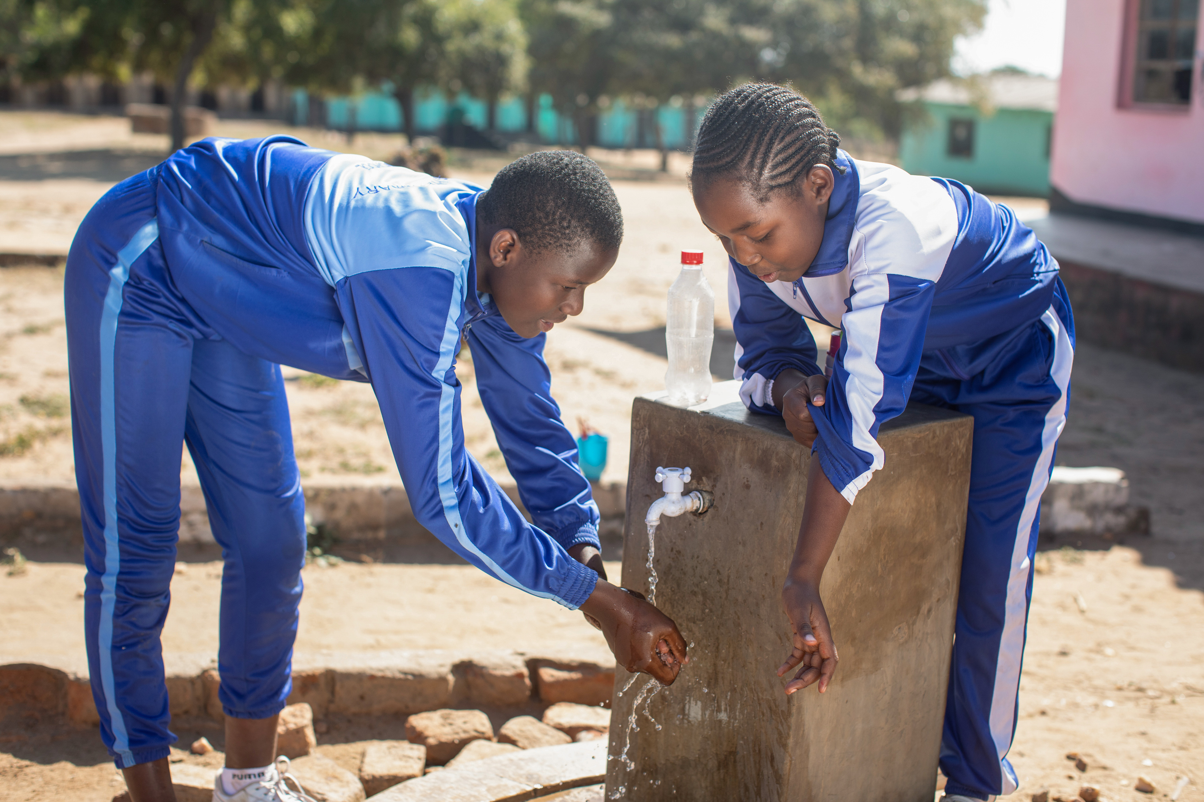
With CAFOD’s help, Maggie’s school installed taps and showers to run clean water.
Now students can focus on learning.
“I’m loving coming to school. We have water. We no longer carry water to school, she says.”
Notes:
But by giving money to CAFOD, schools like ours worked together with Tayla’s community and a local organisation in Zimbabwe to begin to change things.
First, the children got free school meals so that they could keep learning. At the same time, the school, community and local experts worked together to build a solar-powered water pump, so that the children have safe water for drinking and handwashing throughout the day at school, without having to collect it first. The children also use the water to grow vegetables so that they have enough food in the long term.

Slide 11
Notes:
Now Tayla and her classmates are better able to learn and play. She’s happy she can concentrate in her maths lessons and she hopes to become a doctor.
The bad tenants in the gospel story thought only about themselves. Jesus asks us to think about other people too, to use the resources of the earth wisely so that everyone can have their fair share. We are called to care for and protect the earth and enjoy the wonders of God’s creation now and in the future.

Slide 12
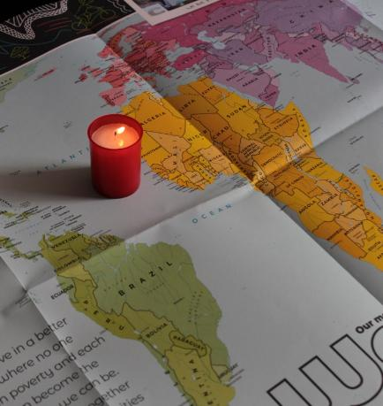
Let us pray
We pray for world leaders: that they may work to protect the earth so that all people now and in the future can enjoy the wonders of God’s creation. Lord, in your mercy…
We pray for our brothers and sisters who are struggling to get enough food or safe water: that together we may make a change so that all God’s children may flourish. Lord, in your mercy…

Slide 13
Let us pray
We pray for our parish, family and friends: that we may treat the earth and all that is in it with respect, never taking more than we need and sharing God’s gifts with one another. Lord, in your mercy…
Creator God, may we listen to your word. Teach us to care for each other and for all creation so that all people may have what they need. Amen.

Slide 14
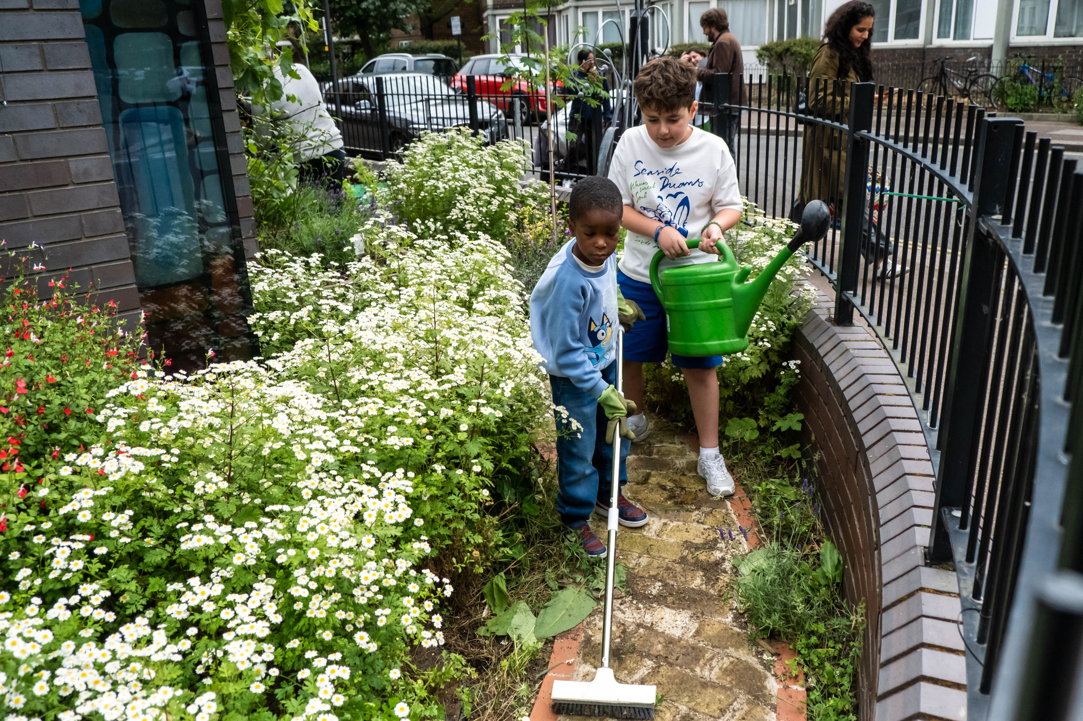
What will you do to take care of the earth now and in the future?
Send

Slide 15
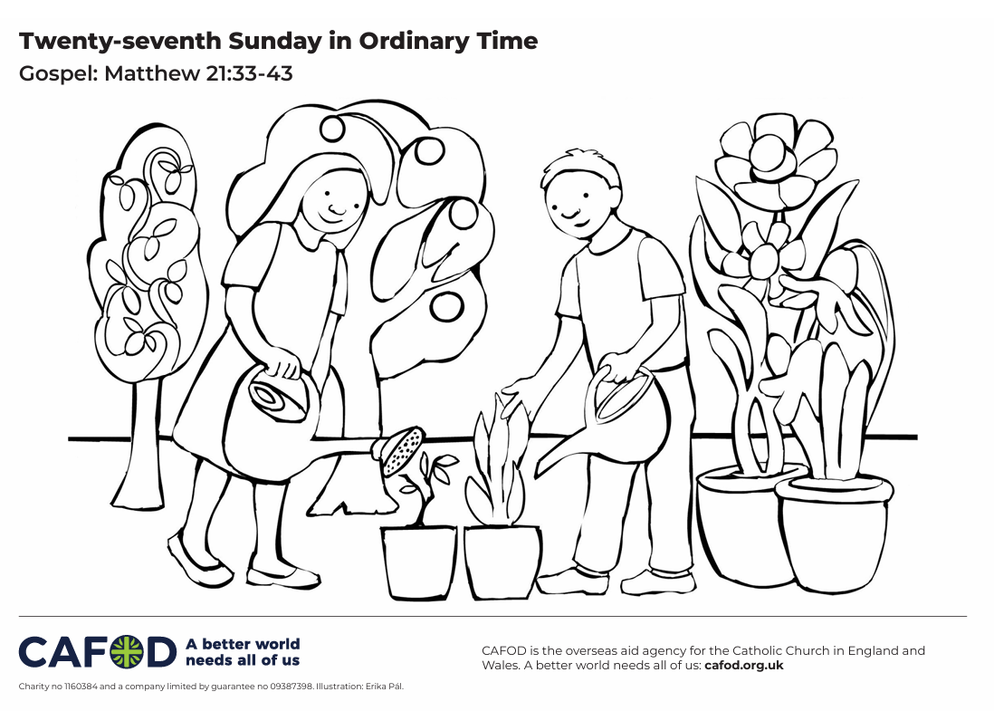
Activity suggestions
Download the illustration
Invite the children to colour in the accompanying illustration and on the back to write or draw how they will take care of the earth so that all people now and in the future can have their fair share and enjoy the wonders of God’s creation.
Organise a fundraiser for CAFOD to support more people like Talya. Explore our Brighten Up resources
Share A prayer for our Earth film with the children.
Notes:
If you have a parachute, you could play this game with the children to encourage them to work together to look after our world. Arrange the children around the parachute so that they are all holding a section. Place a large inflatable globe in the middle of the parachute. As the children pull the material taut, the globe is lifted into the air. As the globe gains momentum, it is lifted higher and higher. The children have to work together to prevent the world from falling off the parachute. Or if you do not have a parachute you could play with one or several balloons – throw the balloon(s) into the air and encourage the children to keep the balloon(s) off the floor by tapping them. Please check any allergies before introducing balloons to the group.
Make plant pots with recycled newspaper with the children so that they can plant some seeds and start growing their own vegetables or plants:
1. Open a newspaper to the middle pages. Cut along the centre fold. Each half sheet will make one plant pot.
2. Take one sheet of newspaper and fold it neatly in half lengthways to create a long strip. The folded edge will be the top of your plant pot.
3. Take a toilet roll tube and roll the paper around it. Leave about two centimetres of toilet roll showing at the folded end of the paper. This will help you to remove the toilet roll when you have finished making the pot.
4. Now crunch the paper at the other end into the toilet roll tube to make the bottom of your plant pot. Give it a little twist as you go to make sure no compost will fall out later on.
5. Finally, remove the toilet roll tube and admire your pot! It’s now ready for soil or compost and a seed!
Remind the children to share all they have heard and thought about in the liturgy today with their grown ups. Encourage the children to think carefully about how they use the earth’s resources in the coming week and to try to do at least one thing to show that they respect and care for the earth and all the people who live in it.
See cafod.org.uk/primary for more ways for children to get involved with Family Fast Day.

Slide 16
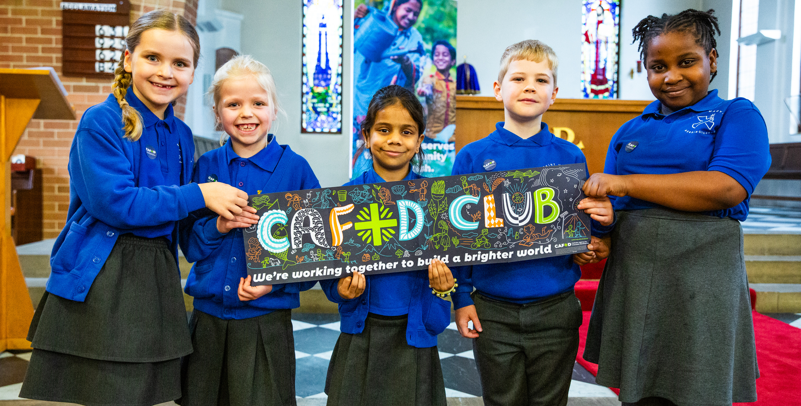
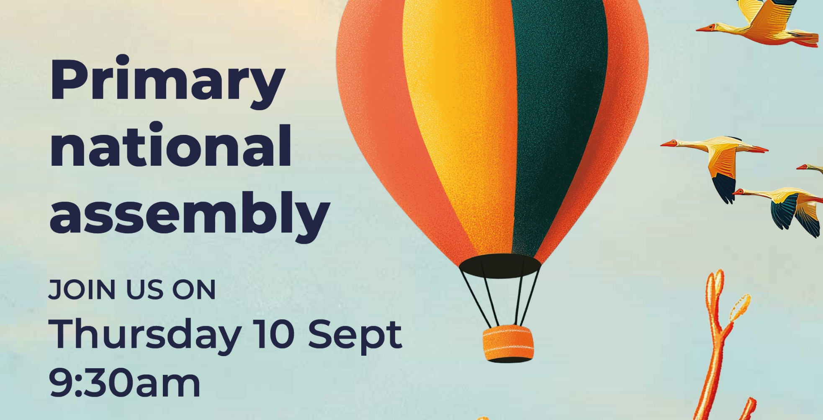
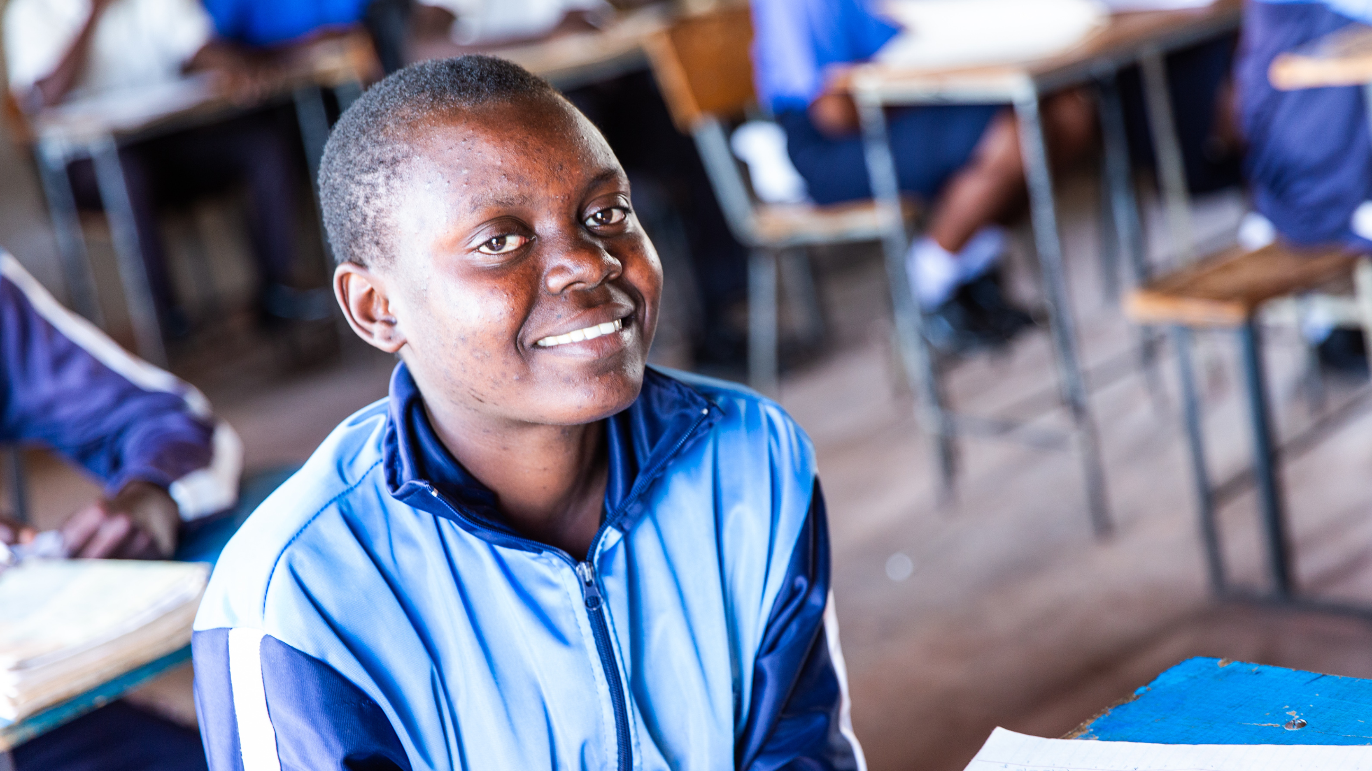
Get involved with CAFOD this term
Explore our resources for the new school term
Watch our national assembly
Fundraise for Harvest Fast Day

Slide 17
