Slide 1
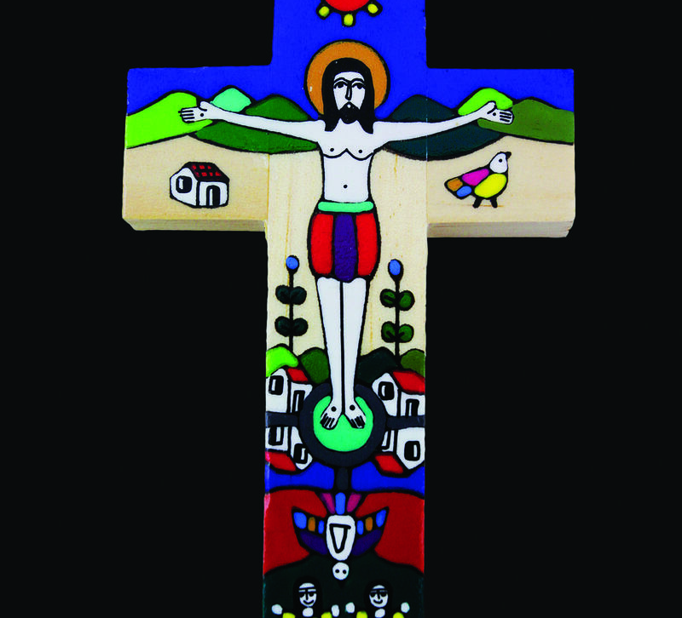
What will you do to show that you believe in Jesus?
Gospel Celebration of the Word
Notes:
Children’s liturgy: Third Sunday of Easter (Year A)
Preparation of the worship space
Colour: white
Song suggestions
One more step along the world I go (901, Celebration Hymnal for Everyone) Christ be beside me (910, Laudate)
Welcome
Today we hear how two of Jesus’ followers went on a journey to a village called Emmaus. Along the way, they met someone really special, although they didn’t recognise him at first. Who do you think it was? Let’s find out if you are right…
Romero cross
Photo credit: CAFOD

Slide 2
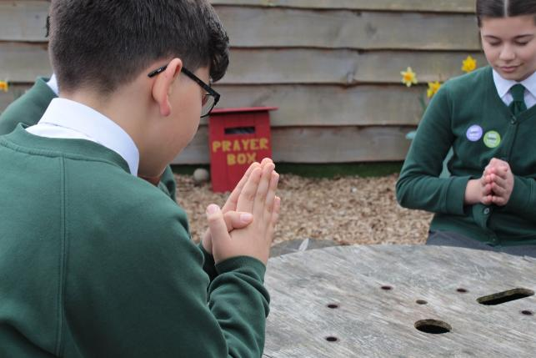
Christ Jesus,
Our light and our guide, as we travel through life, open our eyes to recognise you in everyone we meet.
Open our hearts to share generously with each other. Amen.
  Gather
Notes:
St Francis Xavier's RC Primary School, Herefordshire
Photo credit: Vicky Ahmed

Slide 3
Gospel: Luke 24:13-35
On that same day, two of Jesus’ followers were going to a village named Emmaus, about eleven kilometres from Jerusalem, and they were talking to each other about all the things that had happened.
As they talked and discussed, Jesus himself drew near and walked along with them; they saw him, but somehow did not recognise him. Jesus said to them, “What are you talking about to each other, as you walk along?”
They stood still with sad faces. One of them, named Cleopas, asked him, “Are you the only visitor in Jerusalem who doesn’t know the things that have been happening there these last few days?”
“What things?” he asked.
Word

Slide 4
“The things that happened to Jesus of Nazareth,” they answered. “This man was a prophet and was considered by God and by all the people to be powerful in everything he said and did.
"Our chief priests and rulers handed him over to be sentenced to death, and he was crucified. And we had hoped that he would be the one who was going to set Israel free!
"Besides all that, this is now the third day since it happened. Some of the women of our group surprised us; they went at dawn to the tomb, but could not find his body. They came back saying they had seen a vision of angels who told them that he is alive. Some of our group went to the tomb and found it exactly as the women had said, but they did not see him.”

Slide 5
Then Jesus said to them, “How foolish you are, how slow you are to believe everything the prophets said! Was it not necessary for the Messiah to suffer these things and then to enter his glory?”
And Jesus explained to them what was said about himself in all the Scriptures, beginning with the books of Moses and the writings of all the prophets.
As they came near the village to which they were going, Jesus acted as if he were going farther, but they held him back, saying, “Stay with us; the day is almost over and it is getting dark.” So he went in to stay with them.
He sat down to eat with them, took the bread, and said the blessing; then he broke the bread and gave it to them.

Slide 6
Then their eyes were opened and they recognised him, but he disappeared from their sight. They said to each other, “Wasn’t it like a fire burning within us when he talked to us on the road and explained the Scriptures to us?”
They got up at once and went back to Jerusalem where they found the eleven disciples gathered together with the others and saying, “The Lord is risen indeed! He has appeared to Simon!”
The two then explained to them what happened on the road, and how they had recognised the Lord when he broke the bread.

Slide 7
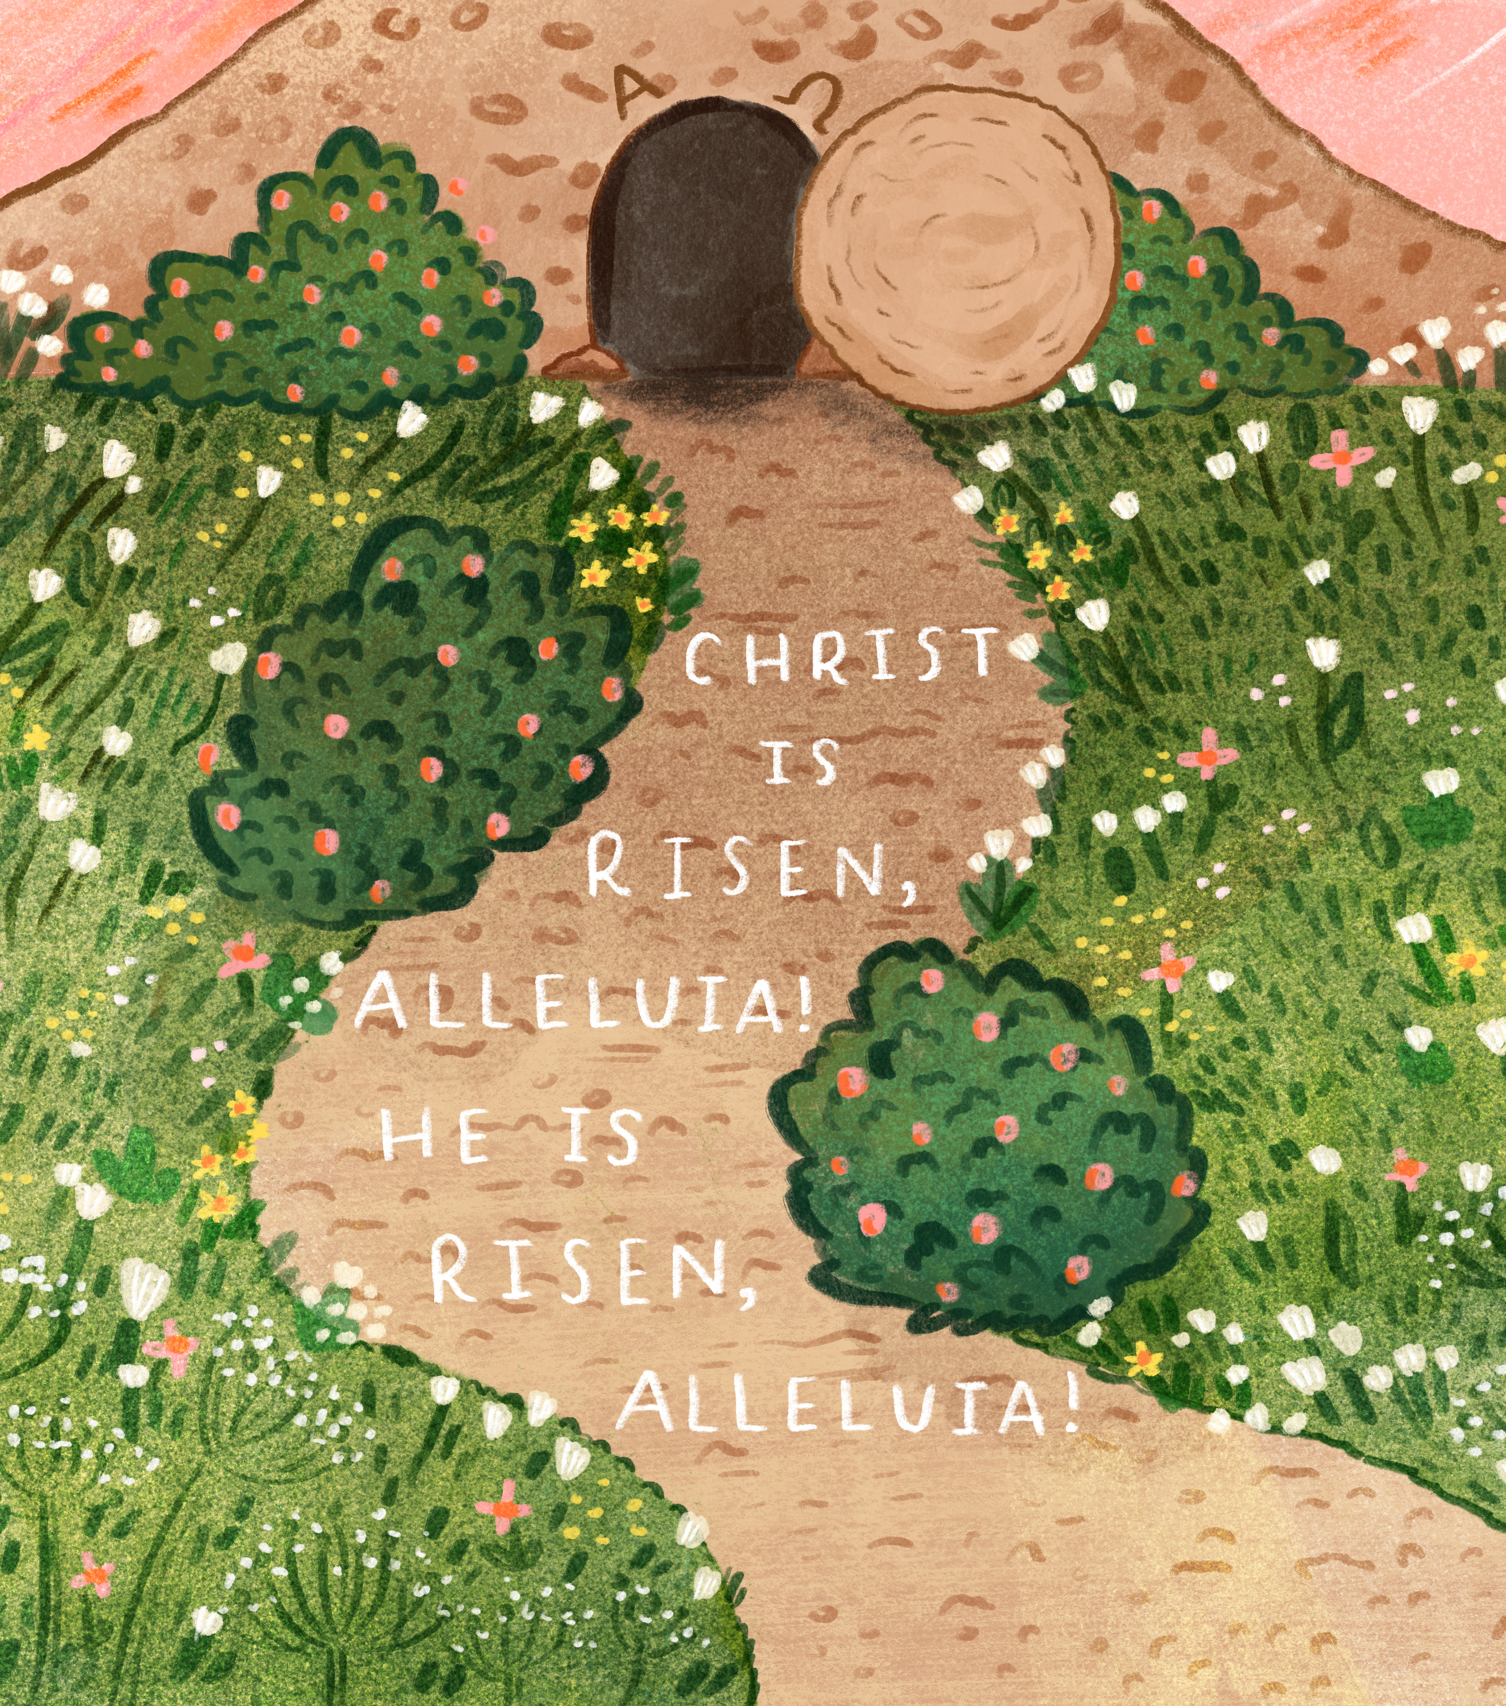
What do you remember from the Gospel reading?
Two followers of Jesus are walking along on their way to a place called Emmaus.
Jesus was crucified two days before and the men are confused because the women have just come back from Jesus’ tomb saying that it is empty.
Why was Jesus’ tomb empty?
The two followers meet another man along the road and they walk with him. Who do you think this man was? Did they recognise him?
Respond
Notes:
Illustration: Emma Walton

Slide 8
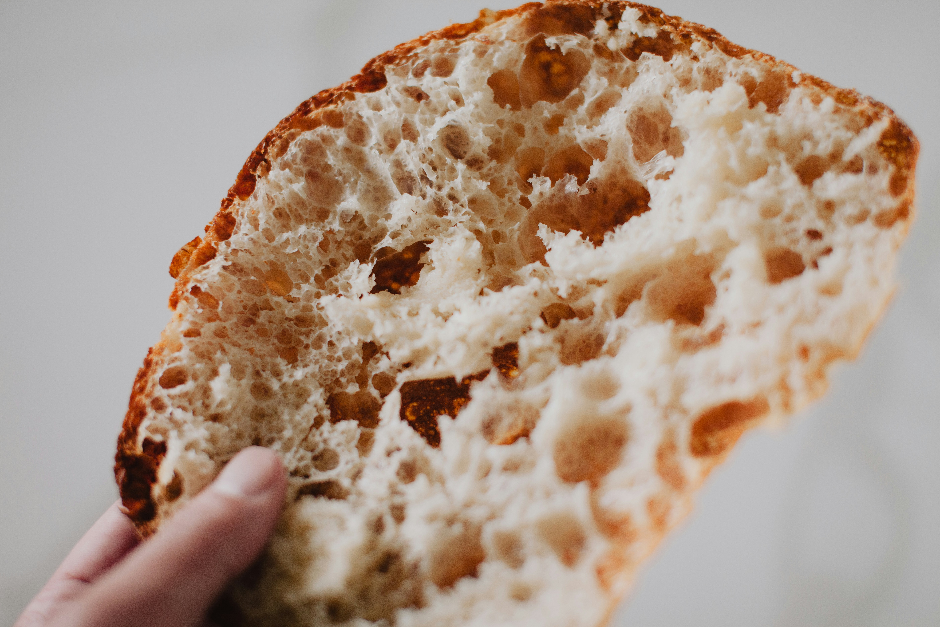
The man explains the Scriptures to them so they can understand that Jesus is risen from the dead. Do the followers recognise him now?
Finally, they persuade the man to come and eat with them. What happens at the meal?
The man takes the bread. He then blesses it, breaks it and shares it with his friends.
Notes:
Bread
Photo credit: Jeremy Yap on Unsplash

Slide 9
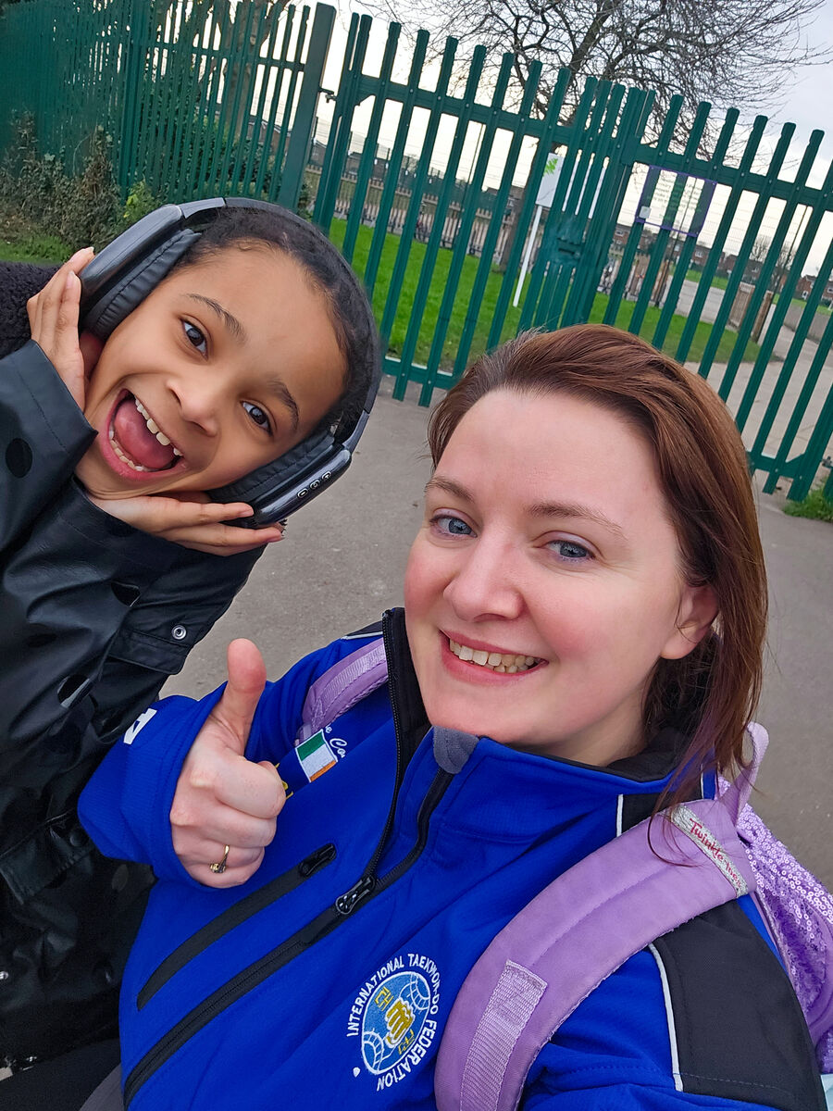
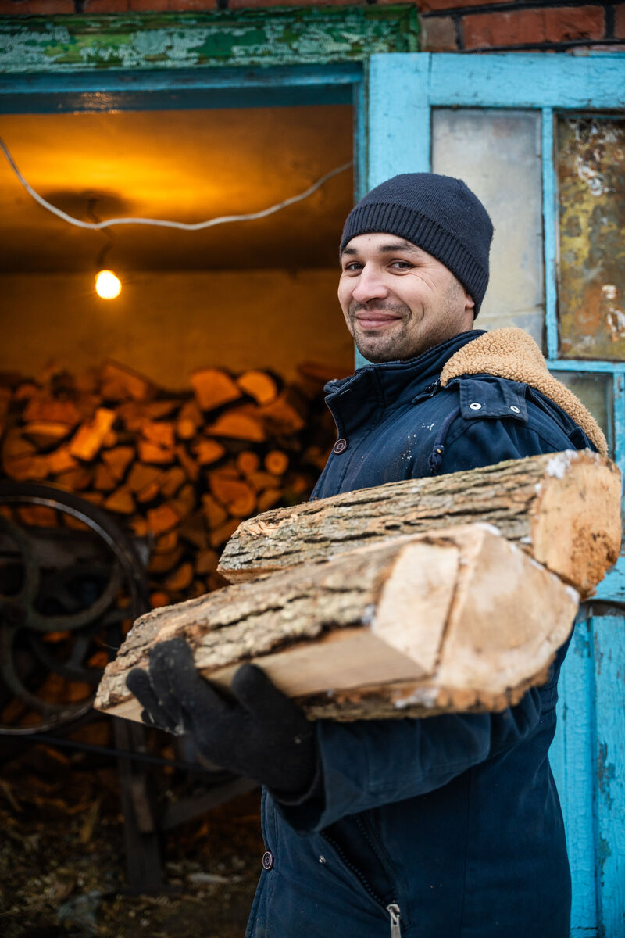
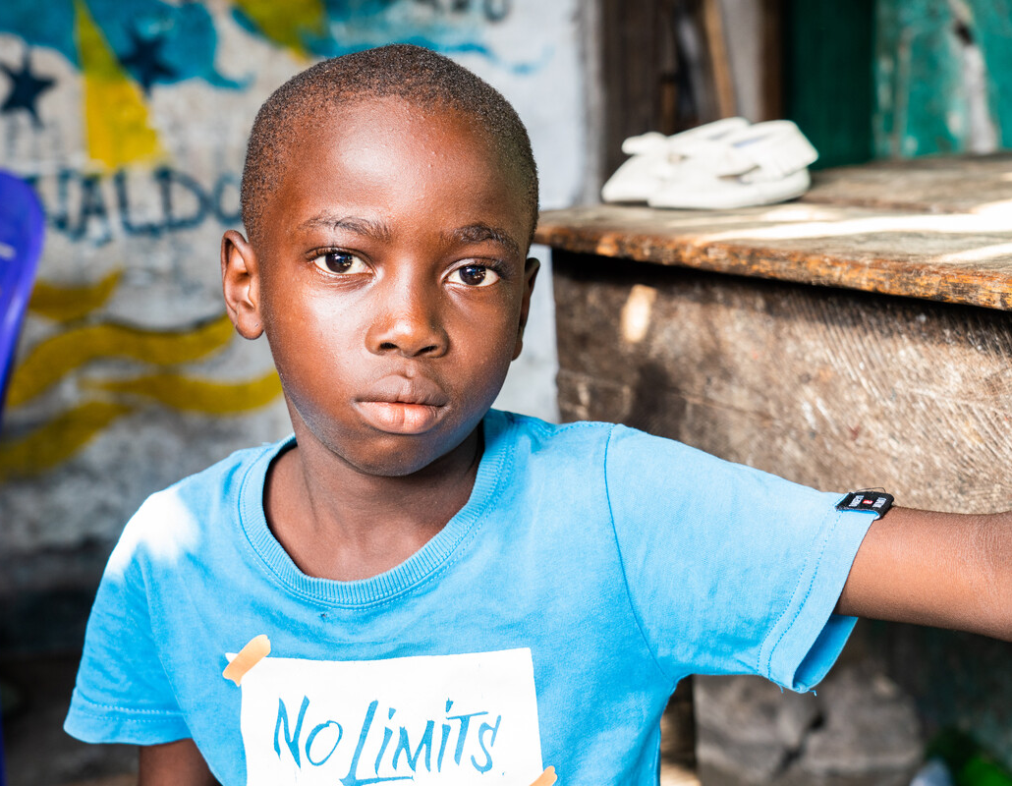
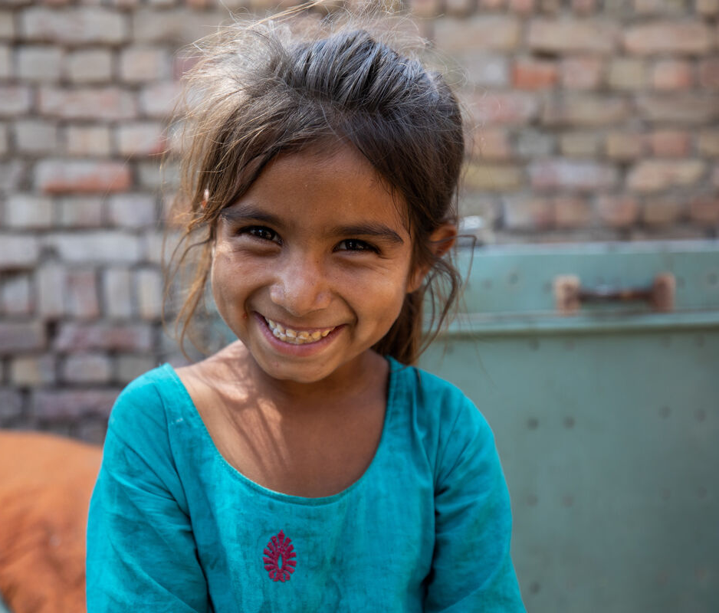
Suddenly they realise who it is. Why do you think they recognise Jesus now?
Can you think of another time that Jesus broke, blessed and shared bread?
We are all made in the image of God and Jesus is in each and every person, but often we forget this.
We do not always take the time to recognise how special and important each person is.
CAFOD supporters, UK; Stephan, Ukraine; Sultana, Pakistan; Aaron, Liberia
Notes:
CAFOD supporters, UK
Photo credit: CAFOD
Stephan, Ukraine
Photo credit: Svitlana Dmytrenko
Sultana, Pakistan
Photo credit: Khaula Jamil/ CWSA
Aaron, Liberia
Photo credit: Carielle Doe

Slide 10
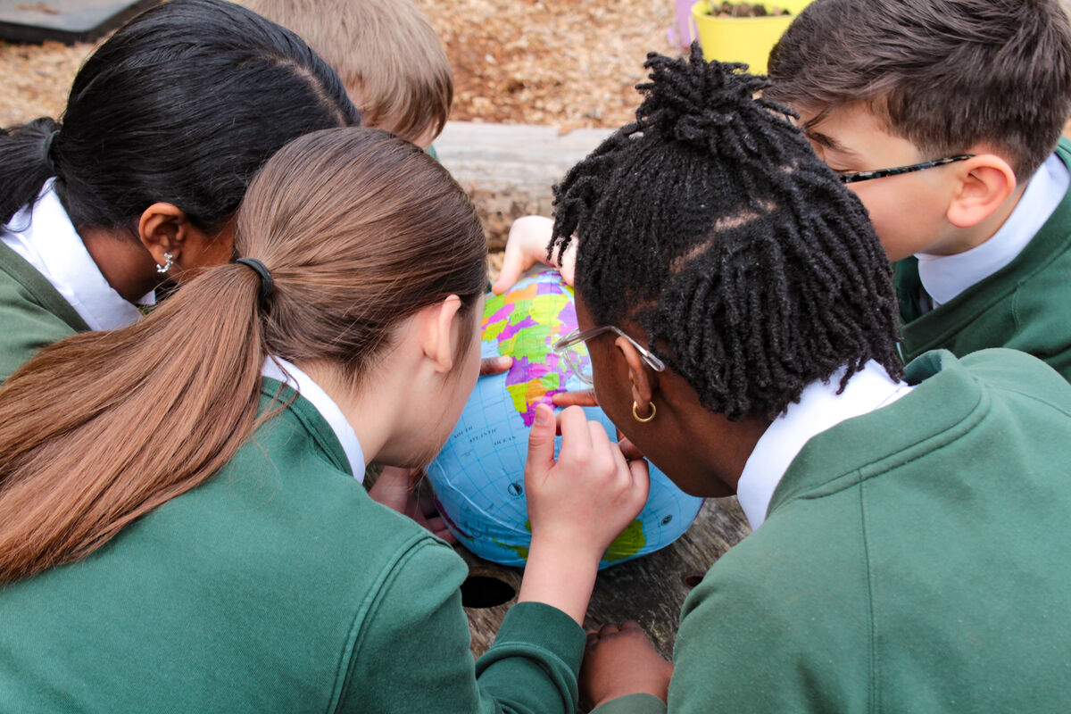
But our eyes can be opened, just like the disciples in this story.
If we take the time to get to know others, to share food with them, perhaps we will come to see Christ in these people.
Perhaps we will come to see that they are our brothers and sisters, who are part of God’s family around the world.
Notes:
St Francis Xavier's RC Primary School, Herefordshire
Photo credit: Vicky Ahmed

Slide 11
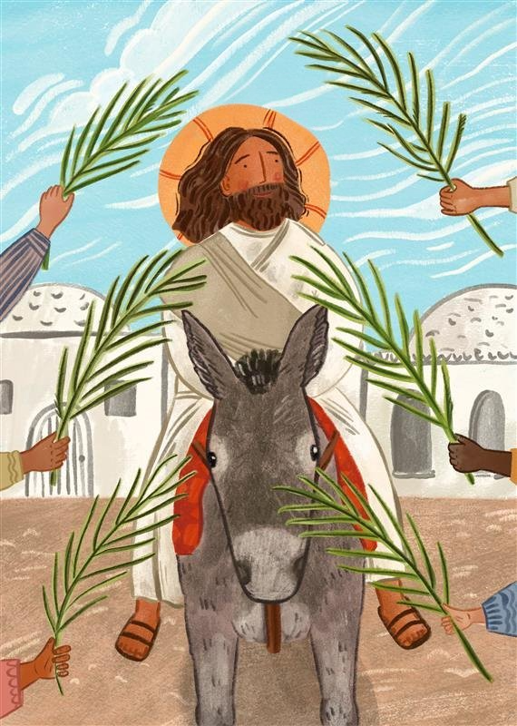
How would you behave if you were eating with Jesus?
What would you say? How would you treat him?
And so, if Christ is in each of us, how do you think we should treat each other?
Would it be the same way as we'd treat Jesus?
Notes:
Jesus
Illustration: Emma Walton

Slide 12
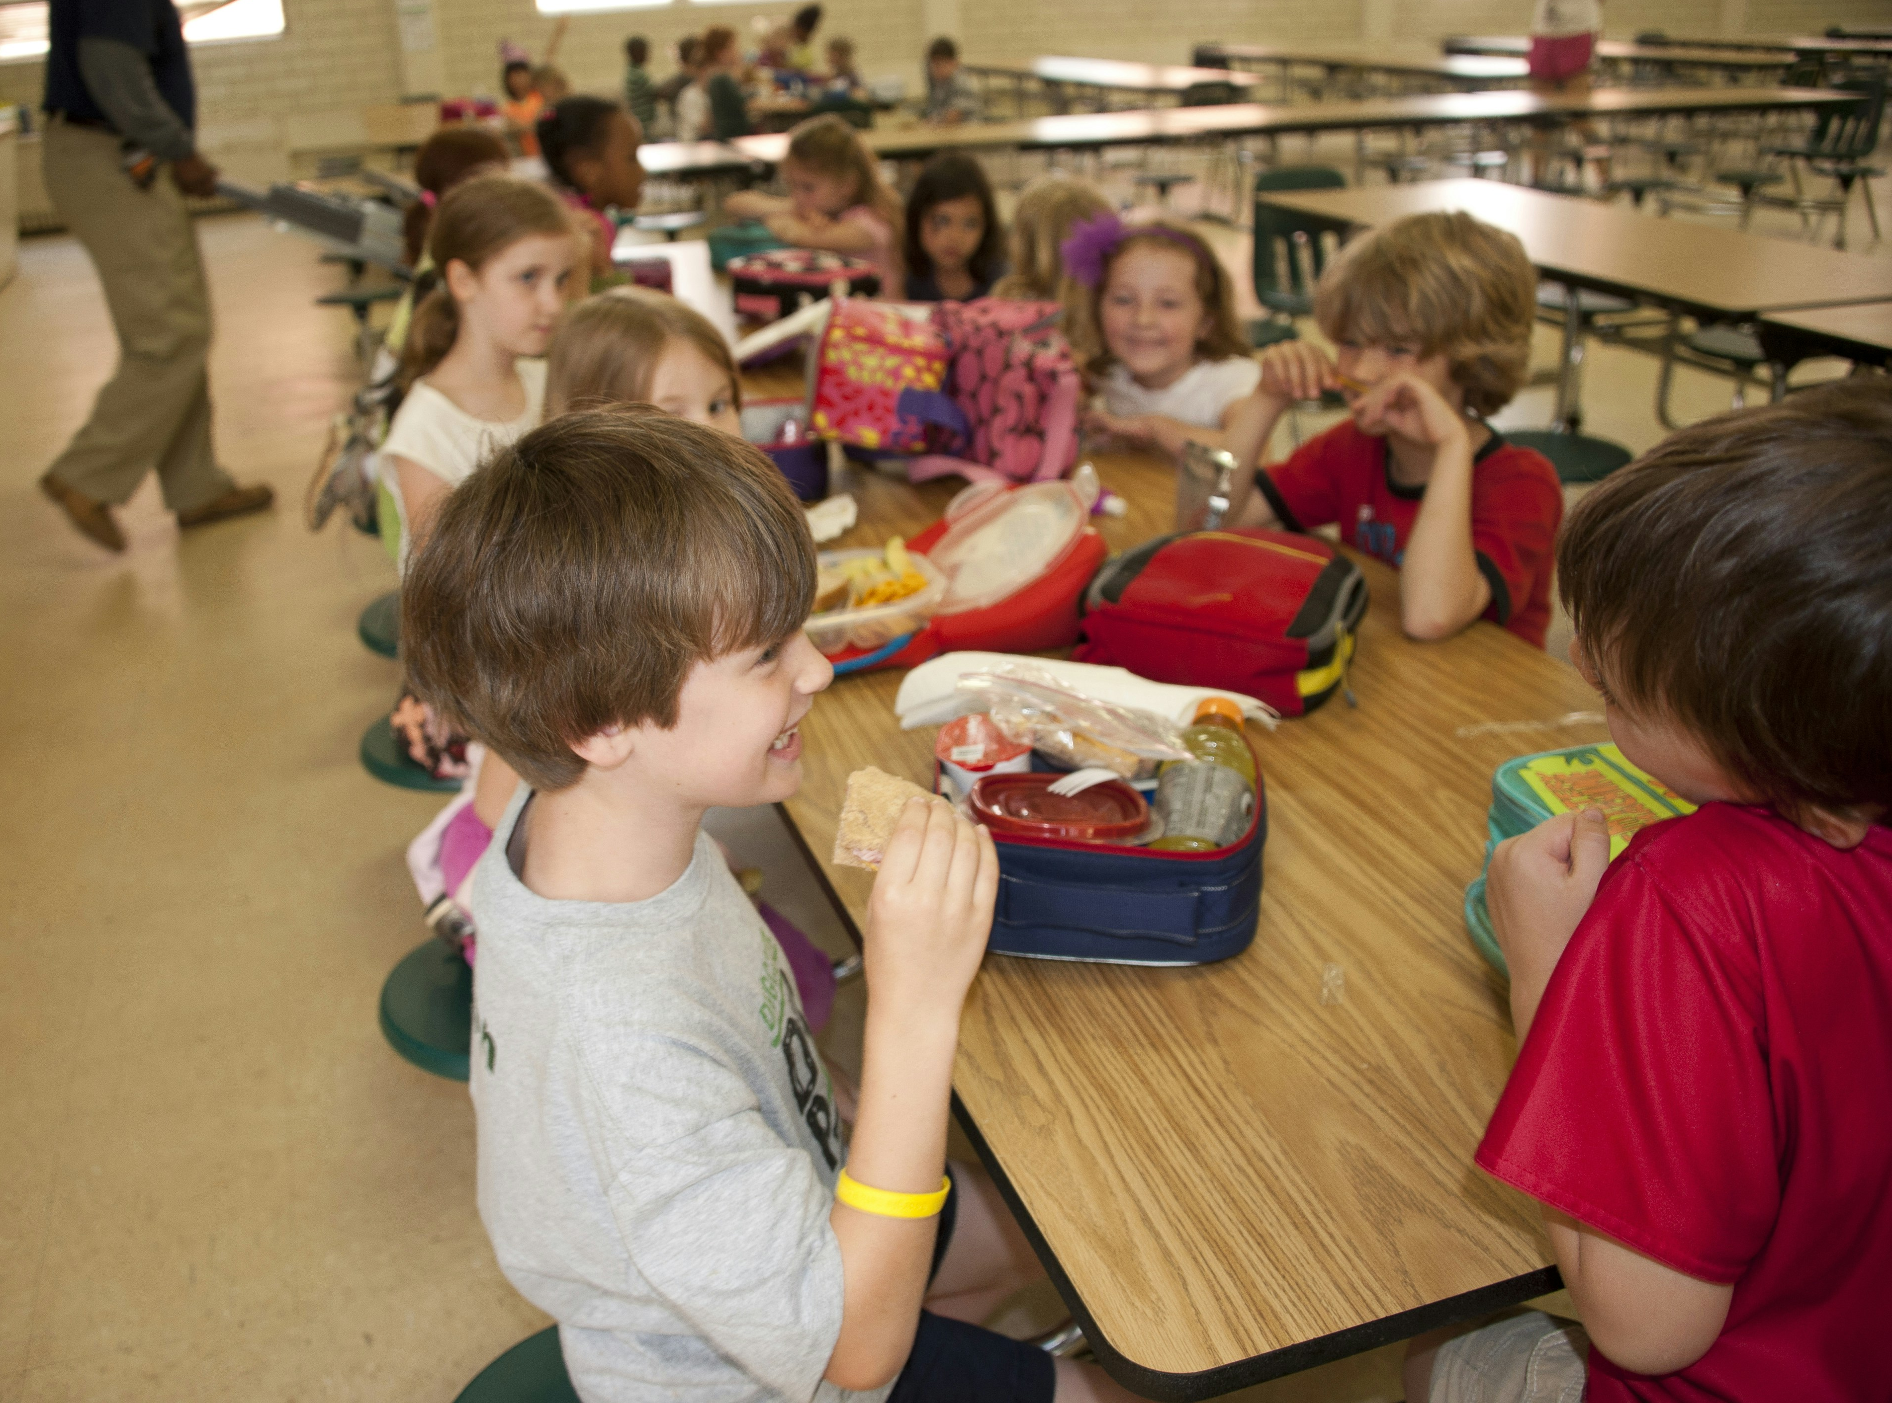
It doesn’t matter how different we are to someone else, whether someone is tall or short, has brown skin or white skin, is rich or poor, quiet or loud, Jesus is in us all.
And we are called to love one another as we love Jesus.
When you are eating this week, take time to talk to the people you are with and to think about how Christ is in each and every one of us.
Notes:
Eating lunch together
Photo credit: CDC on Unsplash

Slide 13
After the meal, the disciples rushed back to Jerusalem to tell other people what had happened.
Let us also by our actions show that we believe Jesus is risen and is always with us. How do you think we could do this?
We can show that we believe in Jesus by treating others as we would wish to be treated, by loving our neighbour as Jesus has asked us and by making the right choices in our lives.
Notes:
Being kind
Annie Spratt on Unsplash

Slide 14
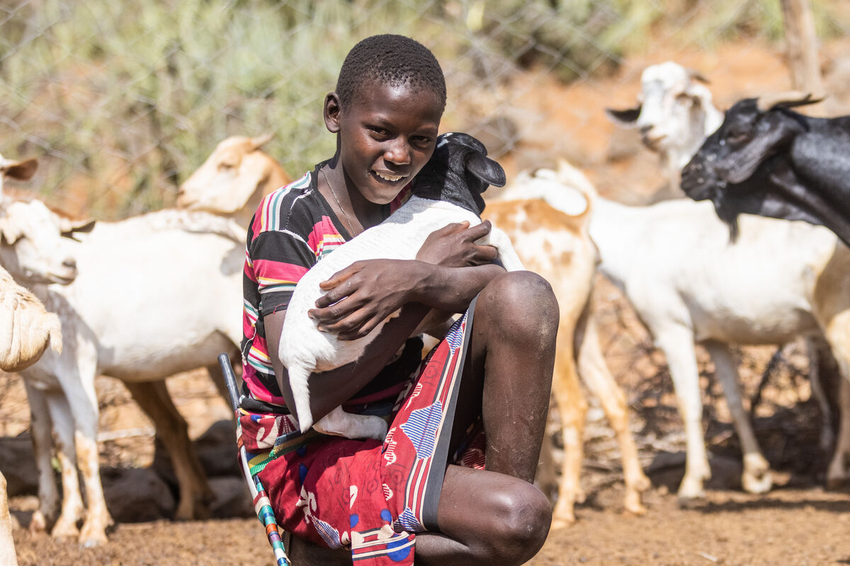
It would be very difficult to literally share our food with our brothers and sisters who are in need around the world.
But we can help CAFOD to support our global family who are living in poverty.
The money you raise by doing the Big Lent Walk or organising cake sales or doing other amazing things, helps people like Saidimu in Kenya.
Notes:
Saidimu, Kenya
Photo credit: Mwangi Kirubi

Slide 15
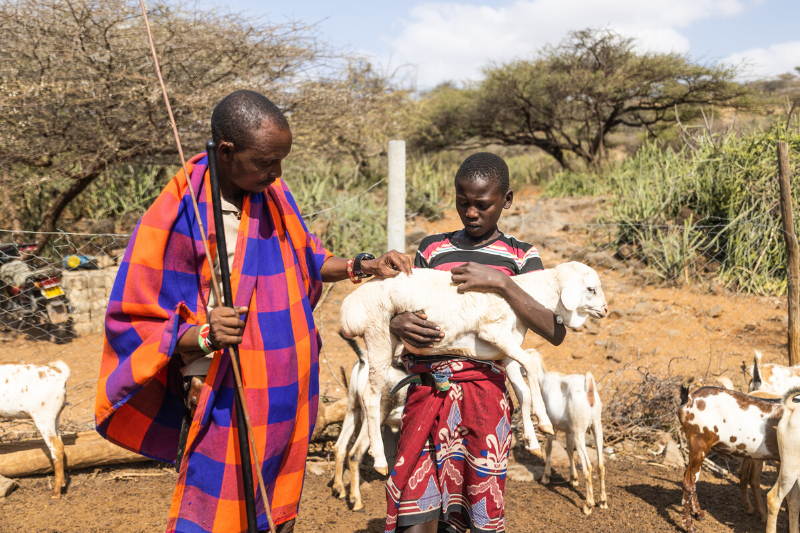
Saidimu loves helping his dad, Ochuroi, on the farm.
"It is how we eat. I like growing vegetables. I cook them when we harvest them," says Saidimu.
"Without the farm, we would be hungry."
Drought has affected how they grow crops and makes it difficult for them to look after their animals.
Notes:
Saidimu and Ochuroi, Kenya
Photo credit: Mwangi Kirubi

Slide 16
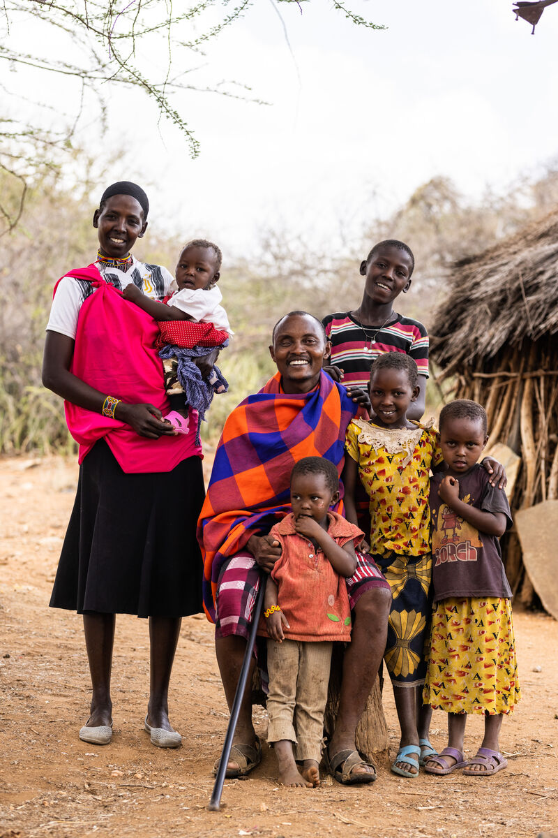
With CAFOD's help, families in Saidimu's village are learning how to grow weather-resistant crops, keep honeybees and run a business selling their produce.
This means they have enough food to eat and sell and enough money for the things they need for a happy life.
Saidimu with his Dad and the rest of the family
Notes:
Saidimu and his family, Kenya
Photo credit: Mwangi Kirubi

Slide 17
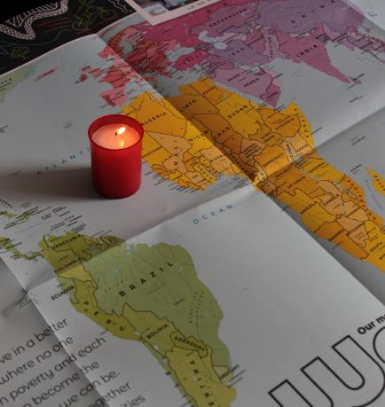
Let us pray
We pray for world leaders:
that they may work together to ensure all people have what they need to live happy, peaceful and healthy lives free from poverty.
Lord in your mercy…
We pray for our parish, families and friends:
that we may see Christ in all people around the world and treat one another as we would wish to be treated.
Lord in your mercy...

Slide 18
Let us pray
We pray for the church throughout the world:
that it may look for Christ in all people and be a welcoming place for all to feel God's love.
Lord in your mercy…
Living God: we look for you in all people. May we be inspired to treat each other with respect, sharing generously from what we have and working together to build a better world. Amen.

Slide 19
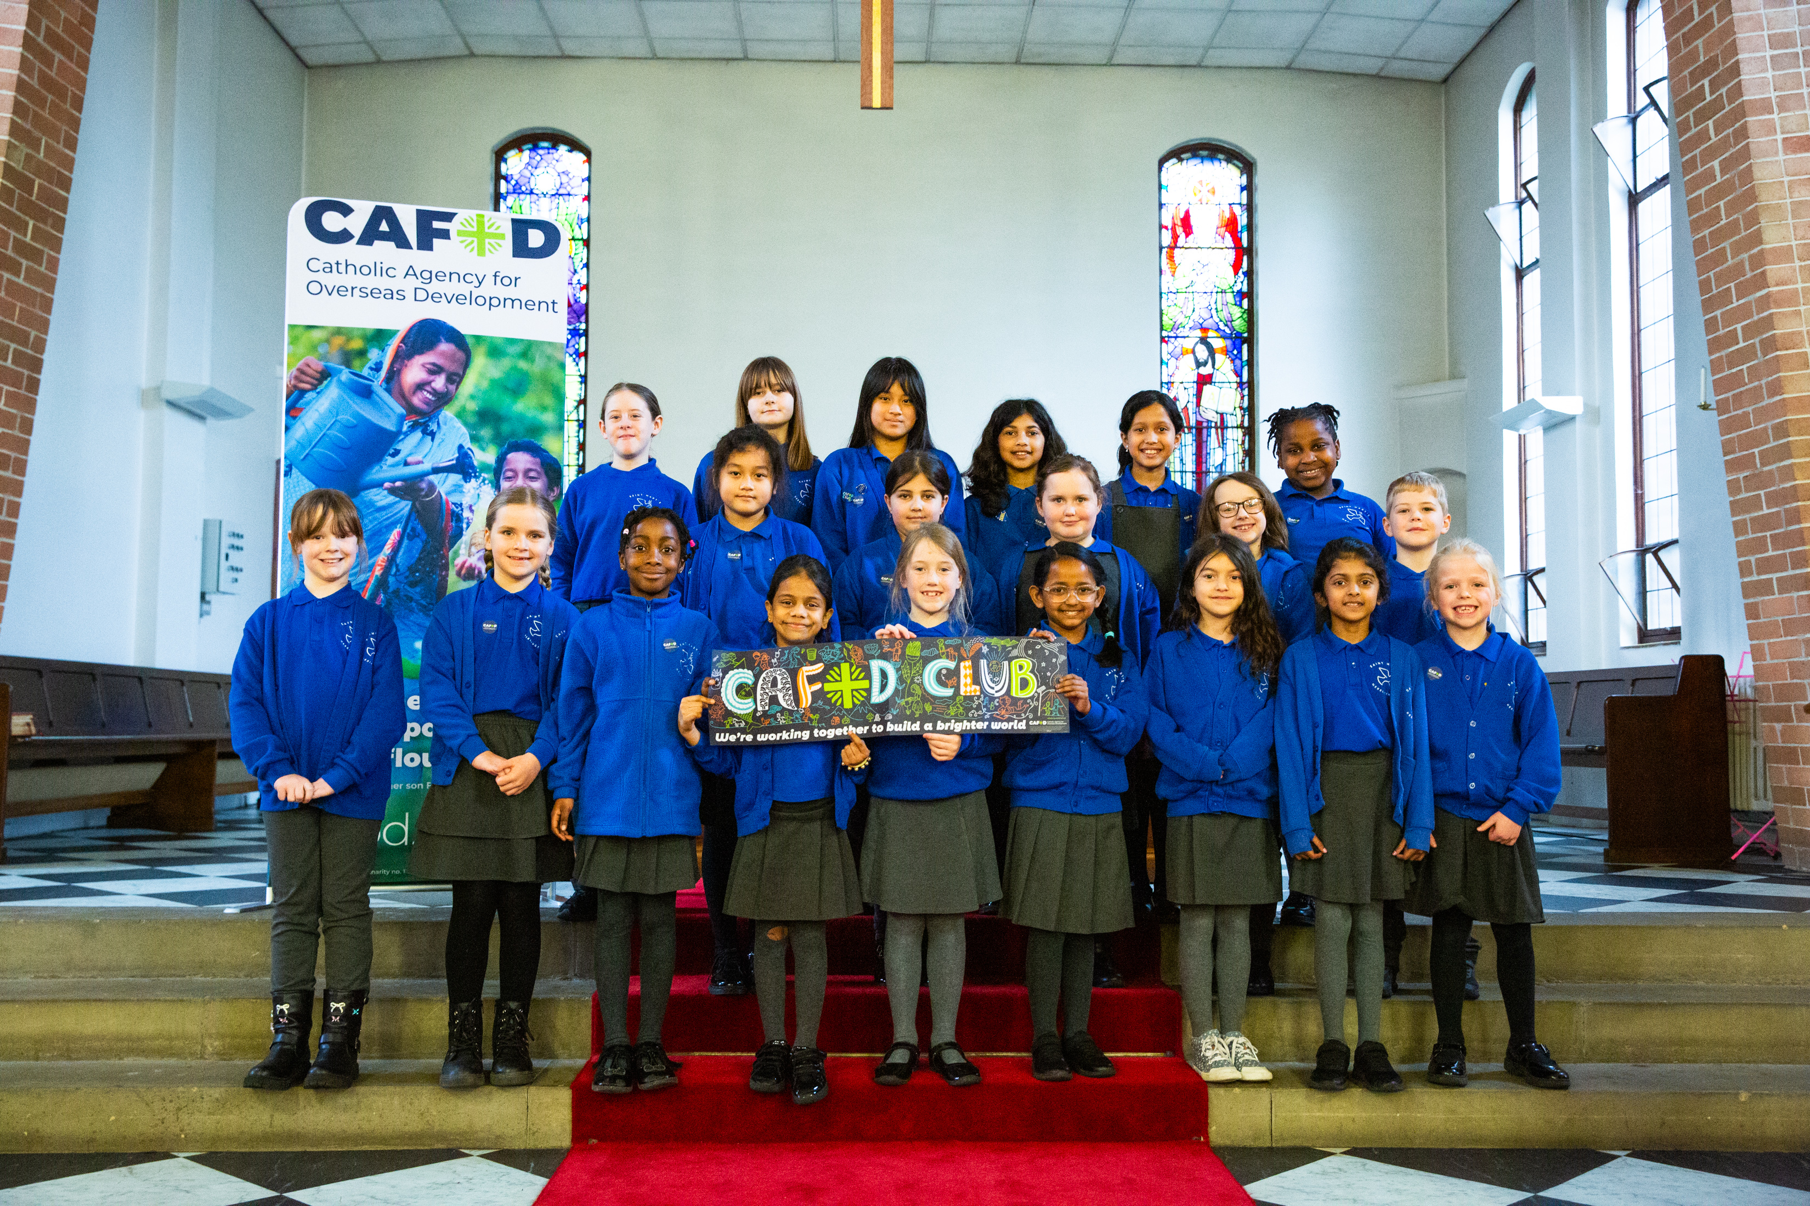
What will you do to show that you believe in Jesus this week?
Send
Notes:
Childre in a CAFOD club
Photo credit: Thom Flint

Slide 20
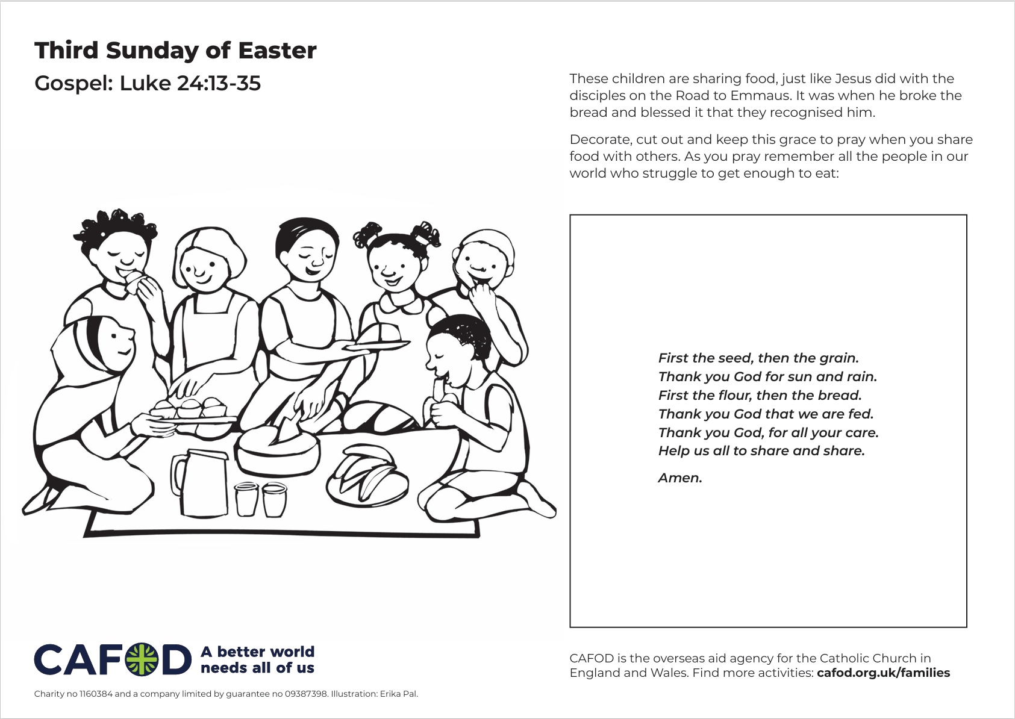
Activity suggestions
Download the illustration
Share the accompanying activity sheet with the children and encourage them to complete it, either in the liturgy or at home.
As well as decorating the grace on the activity sheet, you could encourage the children to write their own grace to be used before meals, so that each time they eat or share food they
remember to look for Jesus in the people around them and in those who prepared, grew and produced the food.
Remind the children to share all that they have heard and thought about today with the people at home. Encourage the children to try to do at least one thing in the coming week to show that they are looking for Jesus in all people.
Notes:
Illustration: Erika Pal

Slide 21
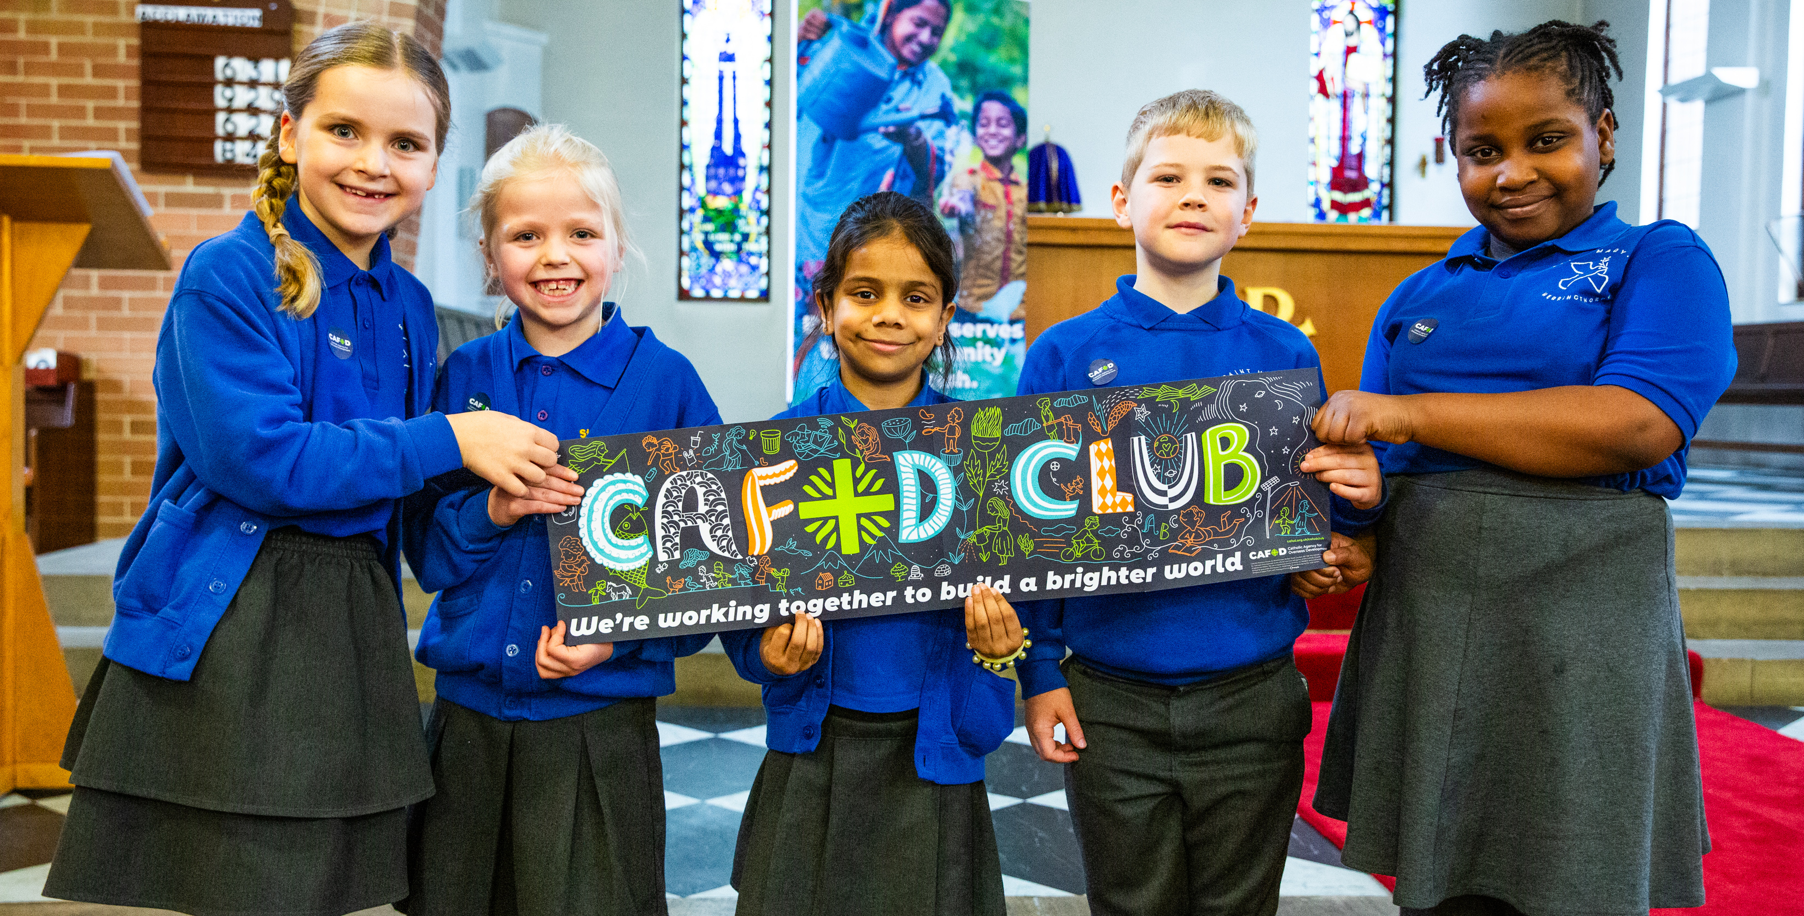
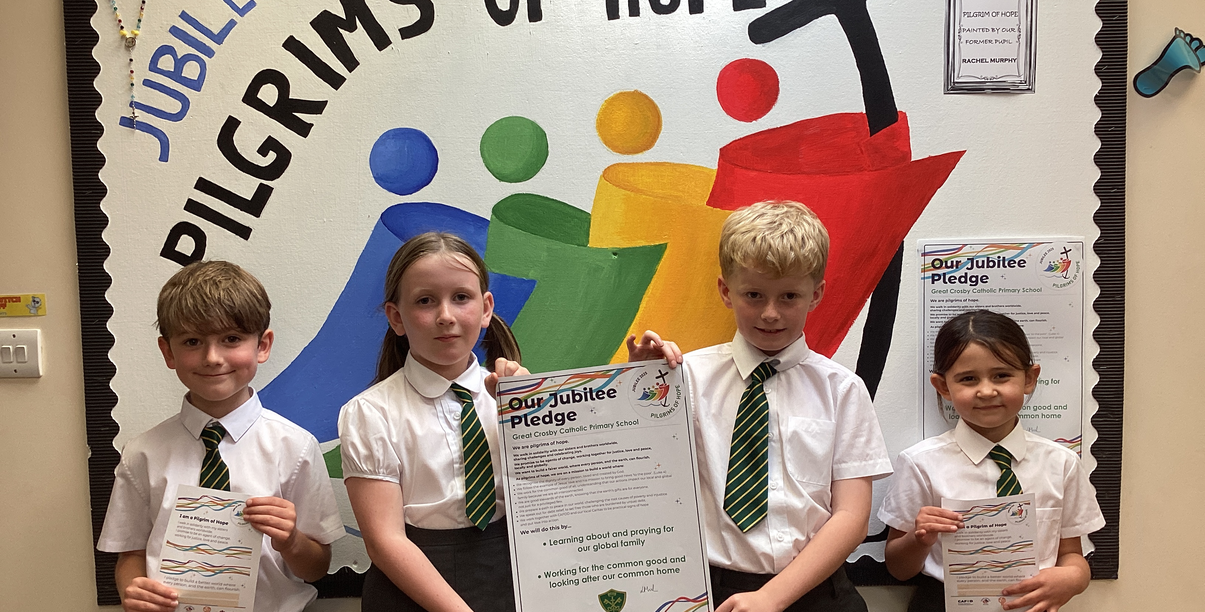

Get involved with CAFOD this term
Explore our summer term resources
Ways to live out your Jubilee Pledge
Fundraise for a World Gift

Slide 22


