Slide 1

What will you do to make sure you are ready when Jesus comes?
Gospel Celebration of the Word
Notes:
Children’s liturgy: First Sunday of Advent (Year A)
Preparation of the worship space
Colour: purple
Props: coloured pens and pencils
Song suggestions
O come, o come Emmanuel (111, Laudate)
Wait for the Lord (88, Laudate)
Welcome
Today is the first Sunday of Advent. Advent is a special time when we get ready for the coming of Jesus. It is very exciting when we know someone is coming to visit us. We make sure that we are ready when they come. Today we are going to think about what it means to be welcoming, and how we get ready to welcome Jesus.
Hands up, ready
Photo credit: Stock image

Slide 2
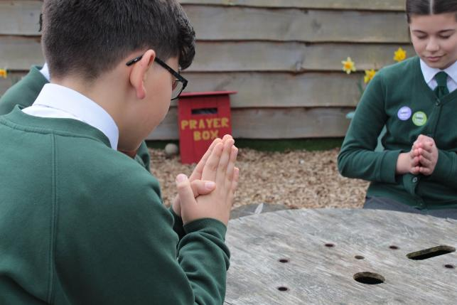

Loving God, You sent your Son Jesus into the world to show us how to live. Help us to be ready when he comes. Help us to make all visitors feel welcome and cared for. Amen.
Gather
Notes:
St Francis Xavier's RC Primary School, Herefordshire
Photo credit: Vicky Ahmed

Slide 3

Gospel: Matthew 24: 37-44
Jesus said to his disciples: “The coming of the Son of Man will be like what happened in the time of Noah.
"In the days before the flood people ate and drank, men and women married, up to the very day Noah went into the boat; yet they did not realise what was happening until the flood came and swept them all away.
"That is how it will be when the Son of Man comes. At that time two men will be working in a field: one will be taken away, the other will be left behind. Two women will be at a mill grinding meal: one will be taken away, the other will be left behind.
Word

Slide 4
"Watch out, then, because you do not know what day your Lord will come.
"If the owner of a house knew the time a thief would come, you can be sure he would stay awake and not let the thief break into his house.
"So then, you also must always be ready, because the Son of Man will come at an hour when you are not expecting him."

Slide 5
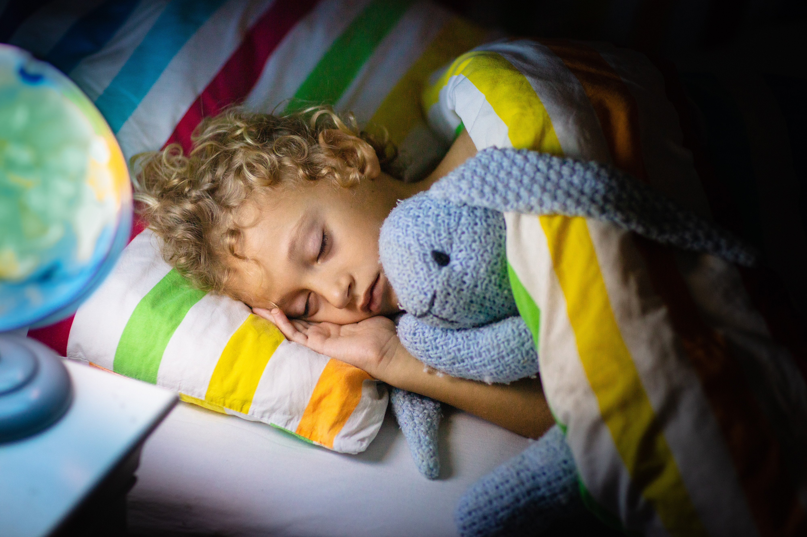

What do you remember from the Gospel reading?
The gospel story is telling us that we must be ready when Jesus comes again, not just as a baby born at Christmas, but at the end of time.
We cannot be exactly sure when that will be, so we must try to be ready all the time.
(We don’t have to stay awake all night, we can go to sleep!)
Respond
Notes:
Sleep
Photo credit: Stock image

Slide 6
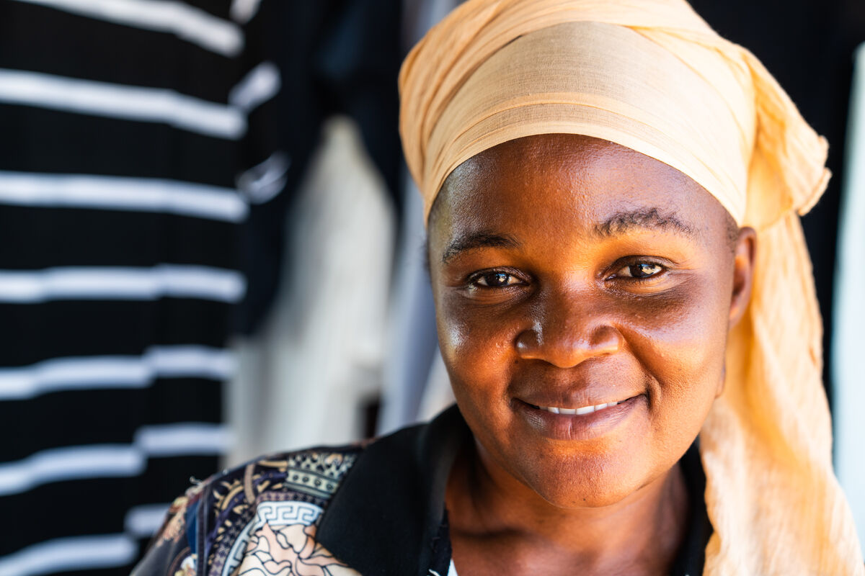
Jesus tells us that we may be surprised when he comes.
Sometimes people surprise us by coming to visit us when we are not expecting them. Or we might go to visit members of our family or friends.
How does it feel to go somewhere for the first time?
What would you like others to do to make you feel welcome if you are going to go somewhere new?
Notes:
Ramatulai Musa, Sierra Leone
Photo credit: Michael Duffy

Slide 7
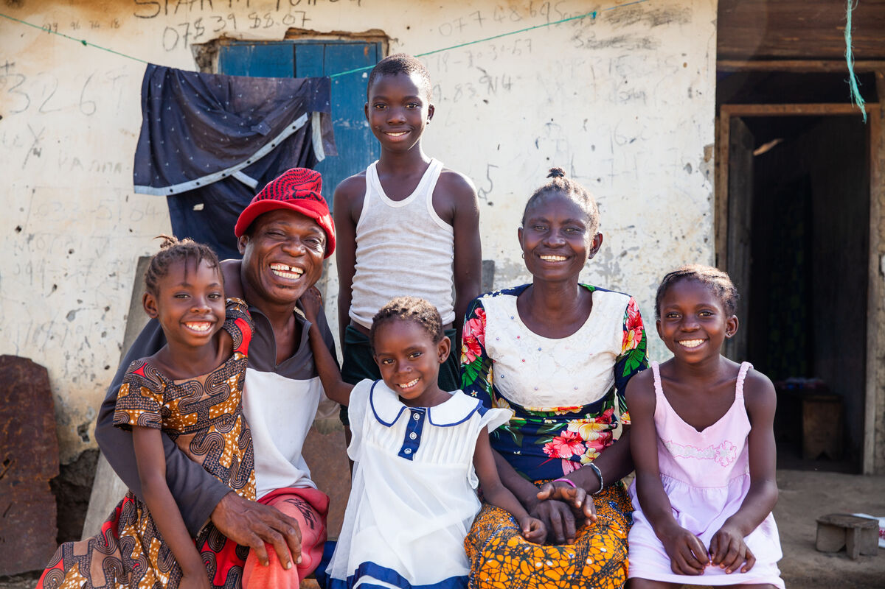
And how can we make other people feel welcome? How can we welcome them in our home? Our school? In our church?
Jesus asks us to be ready when he comes again. How do you think we can get ready to welcome Jesus in our lives?
Is it just about buying presents and putting up Christmas trees?
Notes:
Ishmael and Lucia Sesay and their family, Sierra Leone
Photo credit: Thom Flint

Slide 8
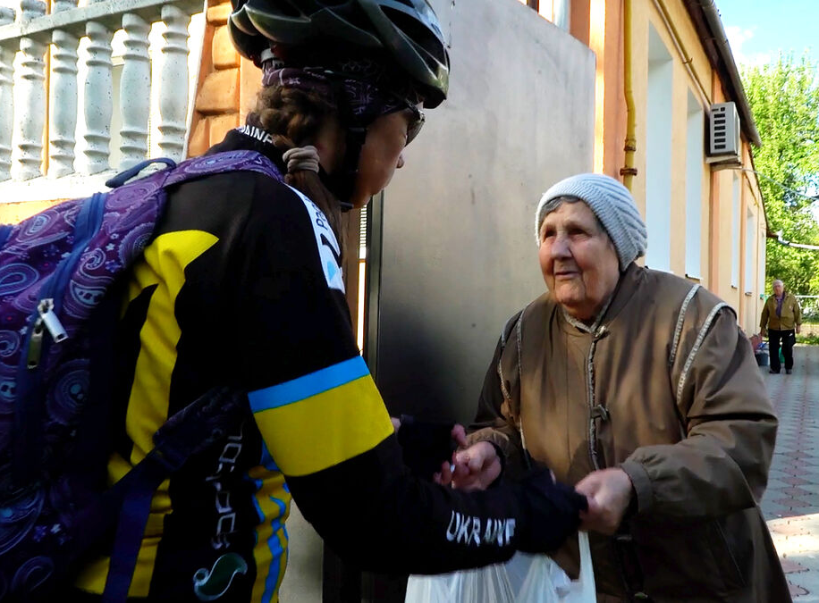
We can make sure we are ready and waiting for Jesus when he comes by living as he asks us to.
We can do this by loving our neighbour, sharing what we have with others, being kind, helping one another etc.
Can you think of any other ways we can be ready for Jesus?
Notes:
Viktoria, a cycle volunteer delivers food to Larysa, an older resident of Kharkiv, Ukraine
Photo credit: Dmytro Minyailo / DEC

Slide 9
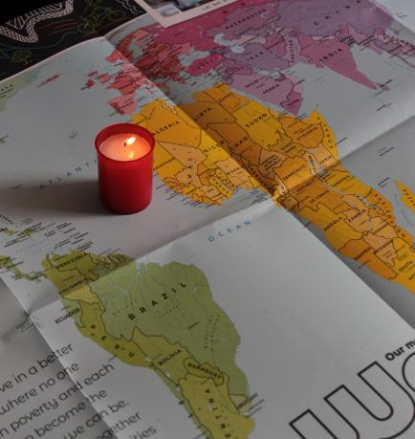
Let us pray
We pray for our parish, our families and friends:
that we may always be welcoming to others and that we may share what we have with those who are in need.
Lord in your mercy…
We pray for people travelling to visit others or who have a long or difficult journey ahead:
that they may arrive safely and receive a warm welcome.
Lord in your mercy…

Slide 10
Let us pray
We pray for all people around the world who are alone, frightened or have had to leave their homes because of war: that they may find safety and welcome in a caring community.
Lord in your mercy…
Generous God, we give thanks for all those people who have visited us, or whom we have visited. Help us to always welcome the people we meet in life, no matter who they are or where they come from. Amen.

Slide 11


What will you do this week to make sure you are ready when Jesus comes?
Send
Notes:
St Francis Xavier's RC Primary School, Herefordshire
Photo credit: Vicky Ahmed

Slide 12
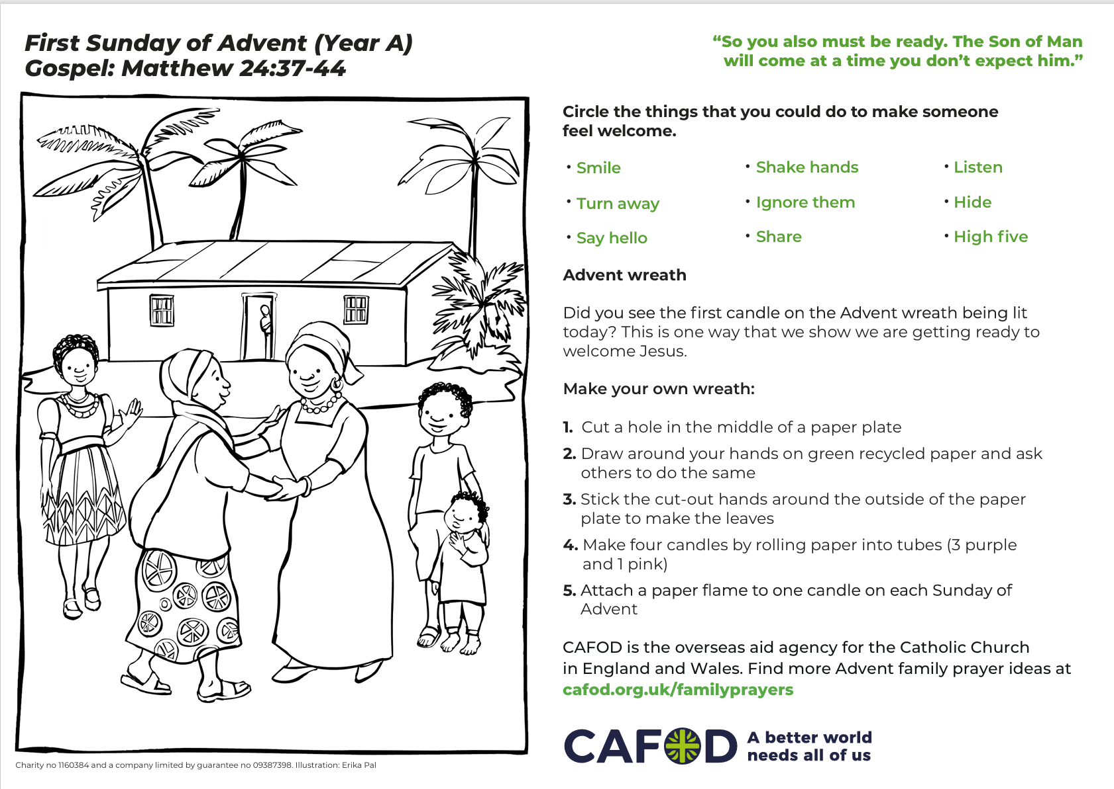
Activity suggestions
Download the illustration
Invite the children to look at the accompanying activity sheet and the picture of people welcoming a visitor. What is different in the picture from their house or family? What is the same? Encourage the children to colour in the picture and do the accompanying activities.
Invite a visitor into children’s liturgy. It could be a parent, member of the choir, or another member of the parish community. Warn the children at the beginning that a visitor is coming and encourage them to think of ways they can make the visitor feel welcome.
Perhaps they could sing them a song or prepare a special place for them to sit. Encourage the children to explain to the visitor what they have been thinking about in this liturgy.
Notes:
Illustration: Jane Smith

Slide 13
Remind them to say thank you and goodbye at the end of the visit. (Also remind them that this a safe environment and their visitor has been invited – and not to approach strangers when unaccompanied by an adult.)
Remind the children to share all that they have heard and thought about in the liturgy today with the people at home. Encourage them to invite a visitor to their house, to prepare for that visitor and make them feel welcome. It could be a relative, neighbour or friend.
While they are doing this, they can think about how they would get ready for the coming of Jesus. (Remind them they must have their parent or guardian’s permission and that they must not approach strangers when unaccompanied by an adult.)

Slide 14


Get involved with CAFOD this term
Join us!
Prepare...
Advent resources
Jubilee Celebration Day!
Join our Advent assembly!
Download the Advent calendar

Slide 15


